Slide 1
ECW- Day 1 Survival Basics for Residents
2020
Dale Coddington

Slide 2
How to log in
Go to Citrix
Click on the icon
Enter your ID & password and change it if prompted

Slide 3
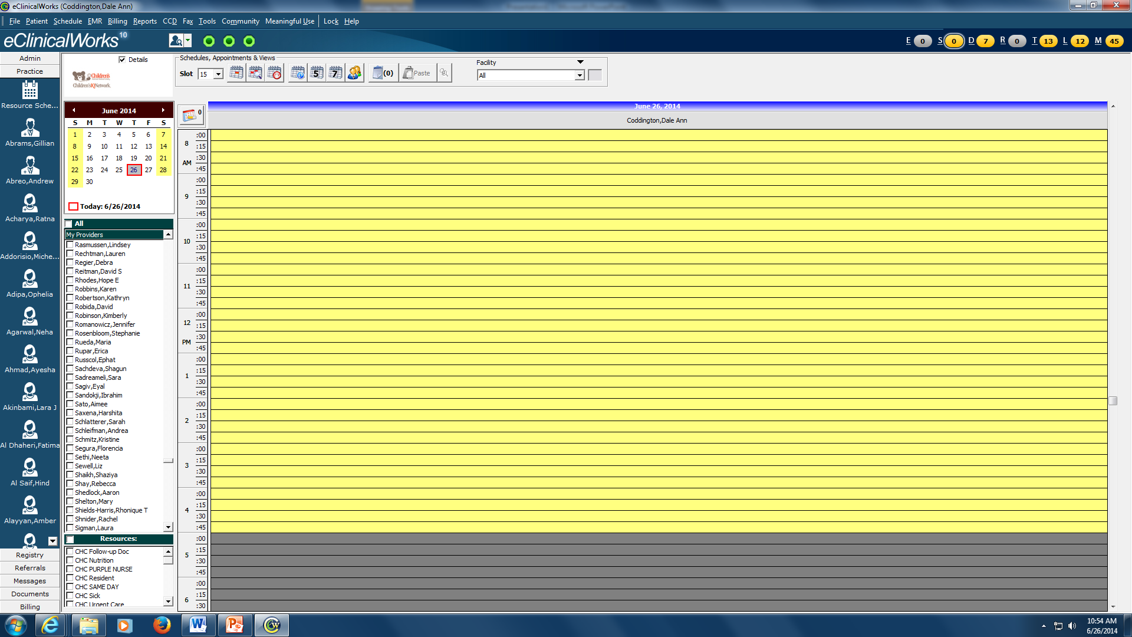
Click on Resource schedule. Now you have to add yourself (only need to do this once). Go to File, go to Settings, go to My Settings

Slide 4
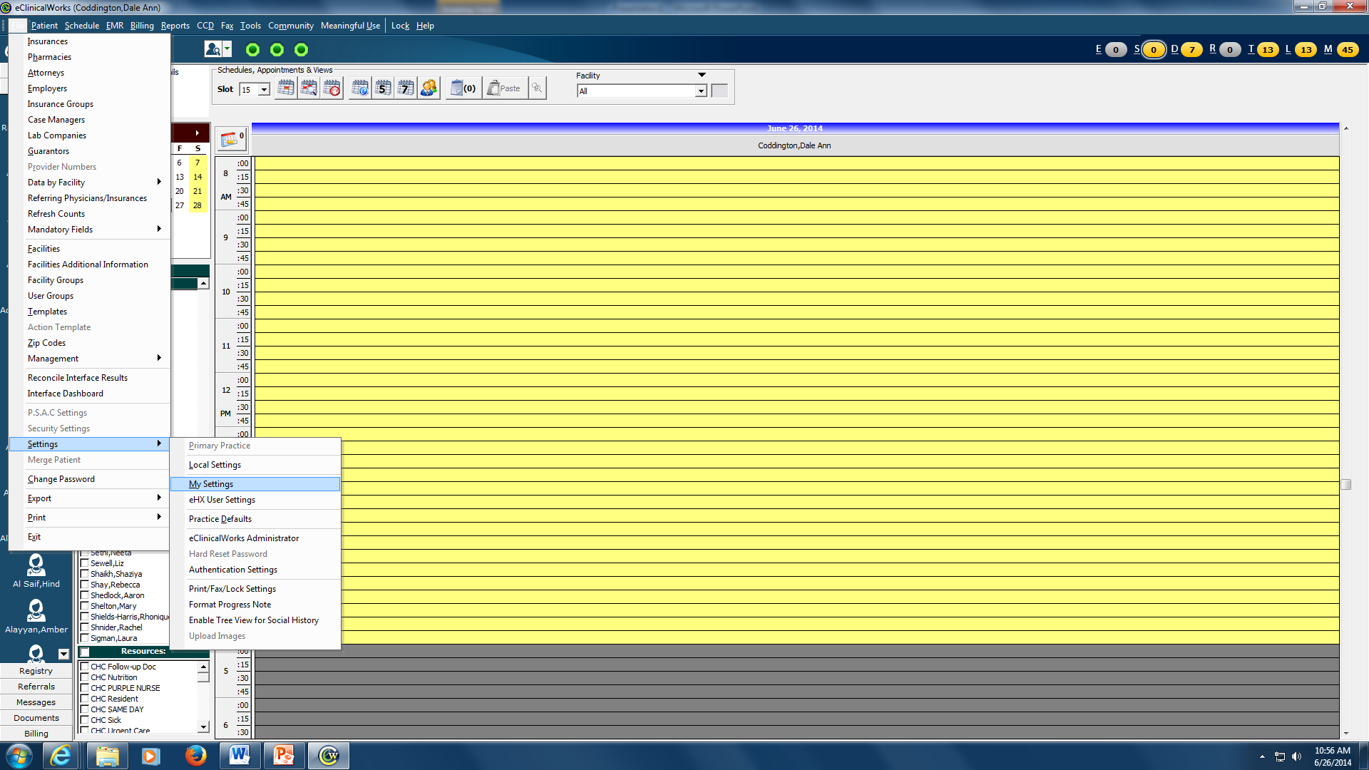
Go to File, then to settings, then to my settings

Slide 5
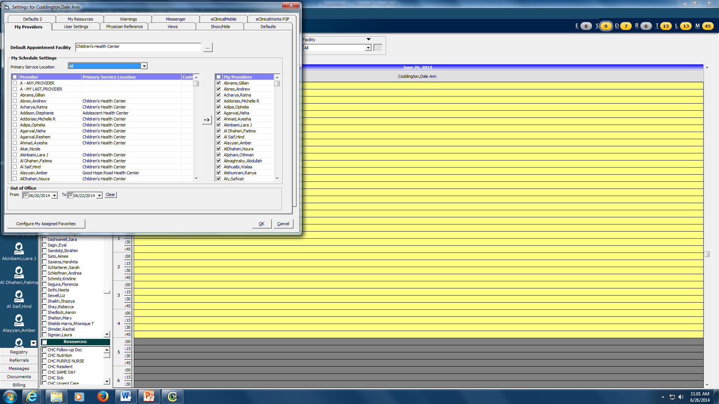
Choose Primary Service Location “All”. Check your name, click on the “Arrow”. Click on My Resources and add the following resource schedules – CHC Same Day, CHC Urgent Care, Video CHC Urgent Care and Video CHC Resident. Click OK. Now close down ECW and log in again.

Slide 6
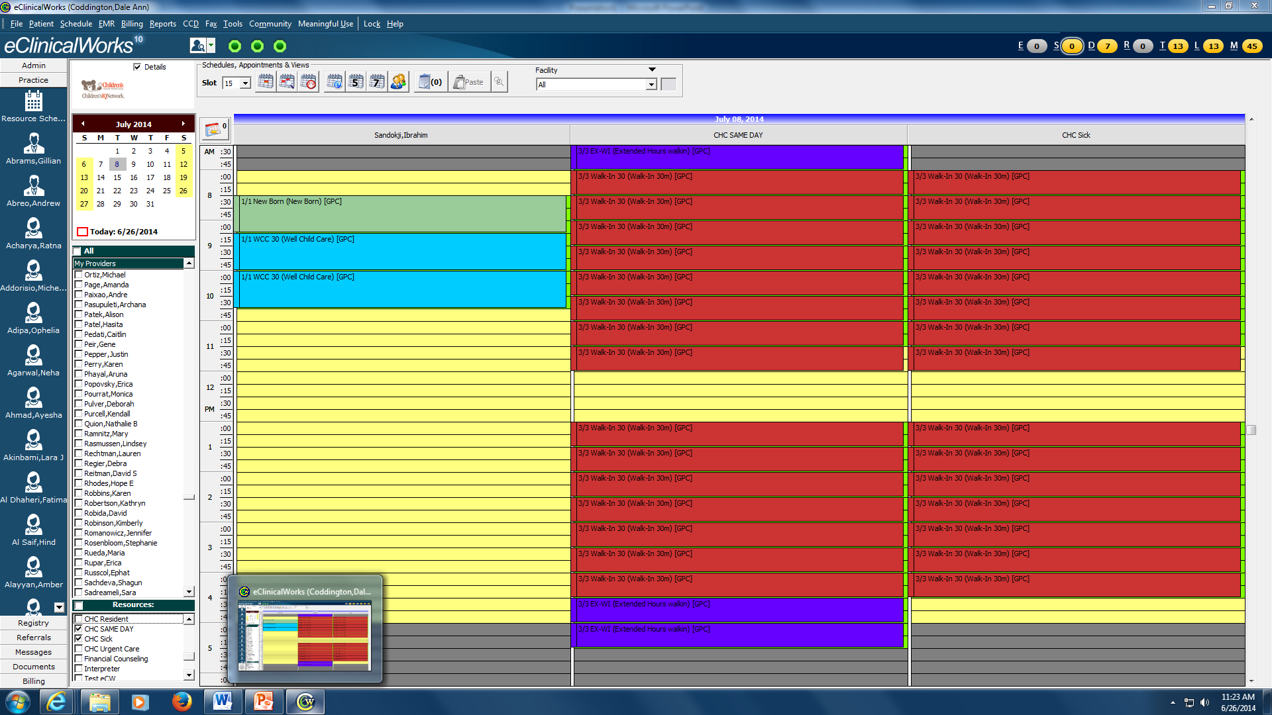
Welcome Back. Go to Resource schedule. Pick your name and then under resources pick CHC Same Day and CHC Urgent Care. This lets you know which patients are here in the clinic

Slide 7
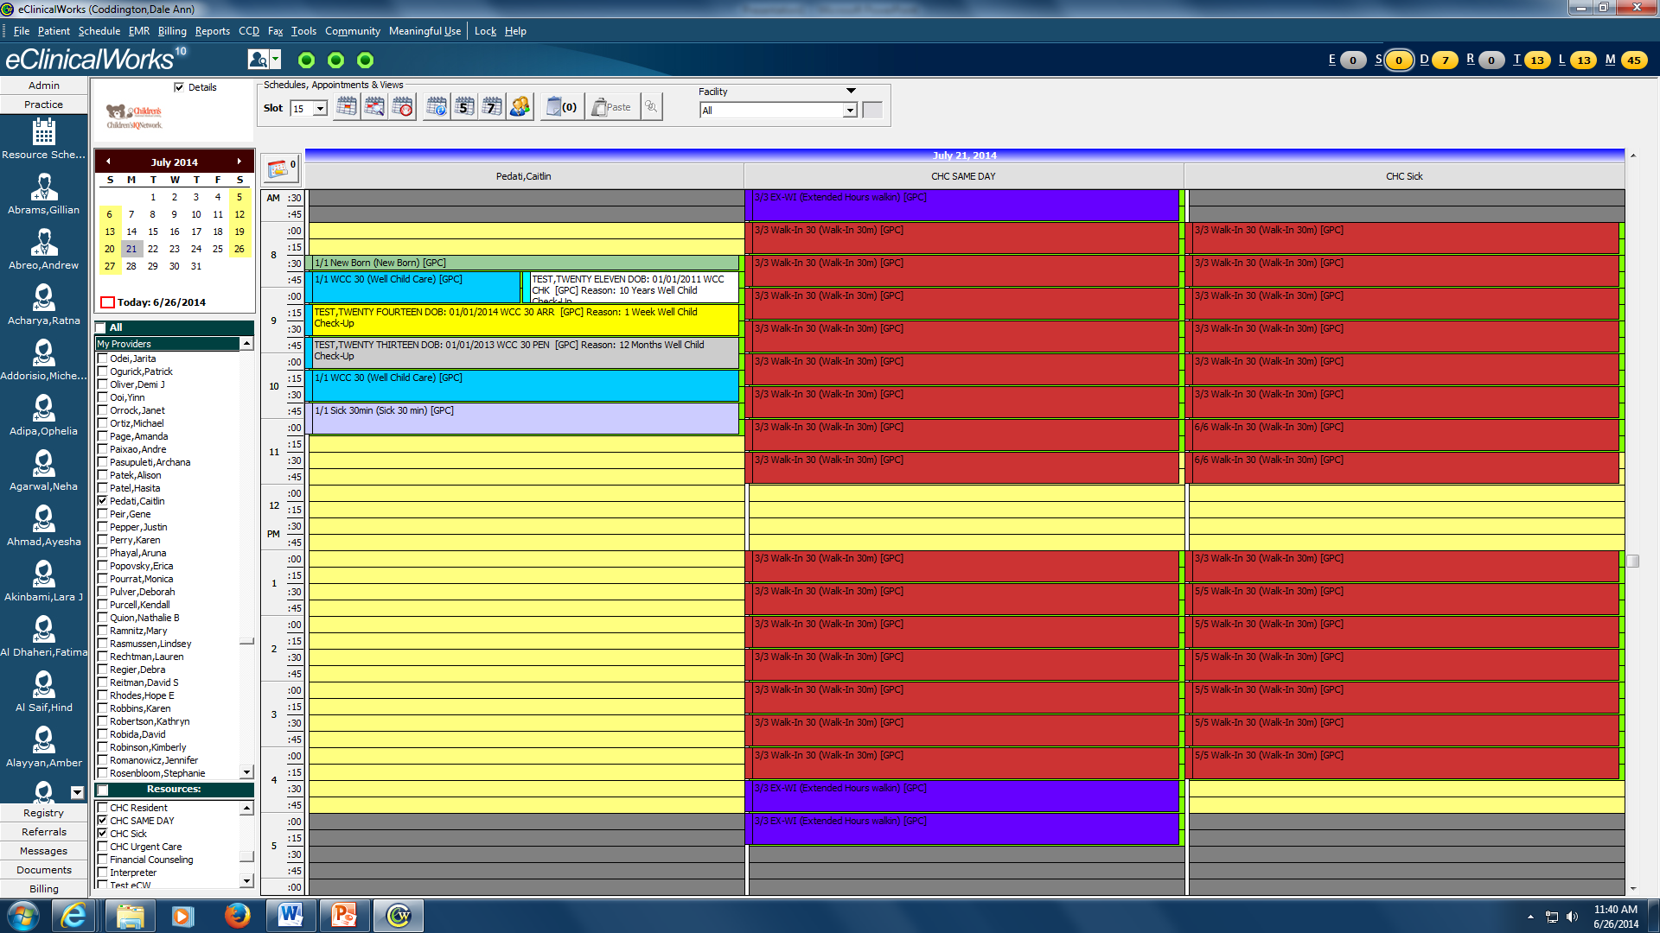
Patient appts. are gray. When the patient checks in, the front staff arrives the patient and the appointment turns yellow. When the patient is checked out, the appointment if changed to white.

Slide 8
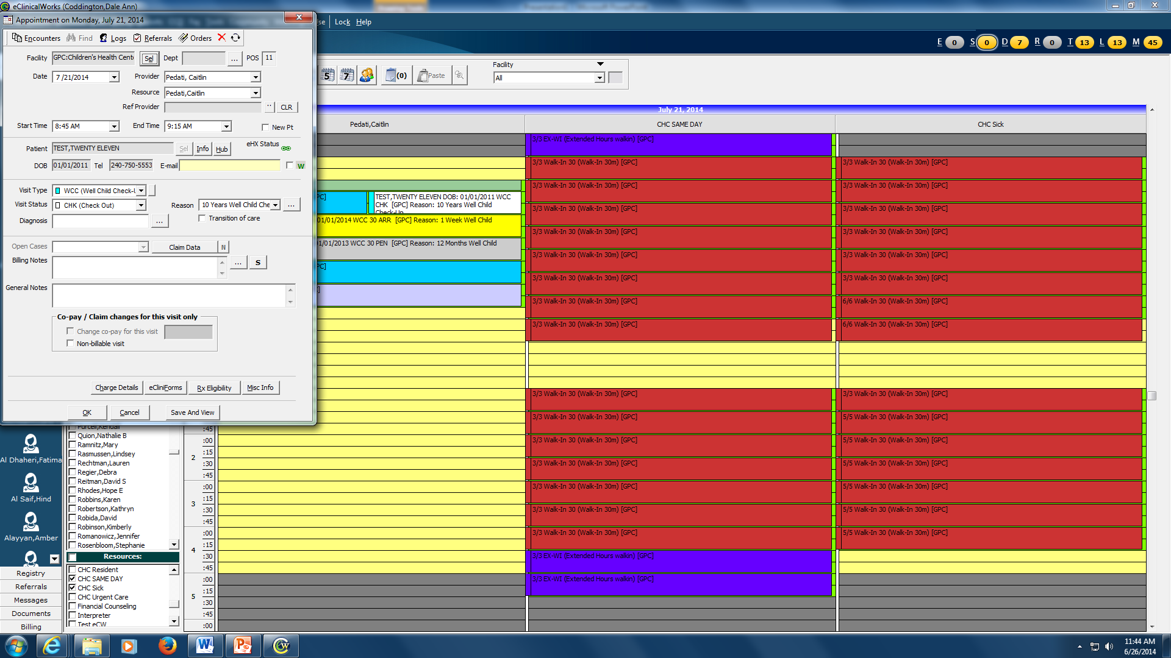
To check out a patient. Double left click on the appt and you can change “Visit Status”

Slide 9
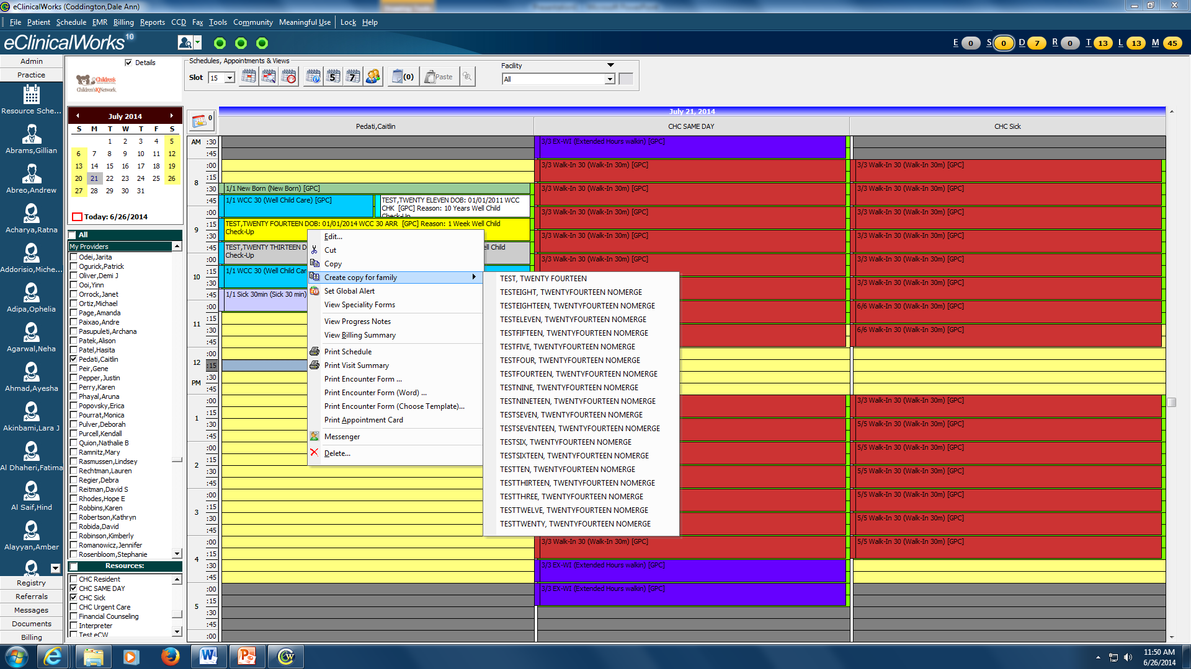
Resource screen allow you to see who is arrived and to cut and paste patients from CHC sick / CHC same day to your schedule. You can also go to the progress note or see who else is in the family by “right click”

Slide 10
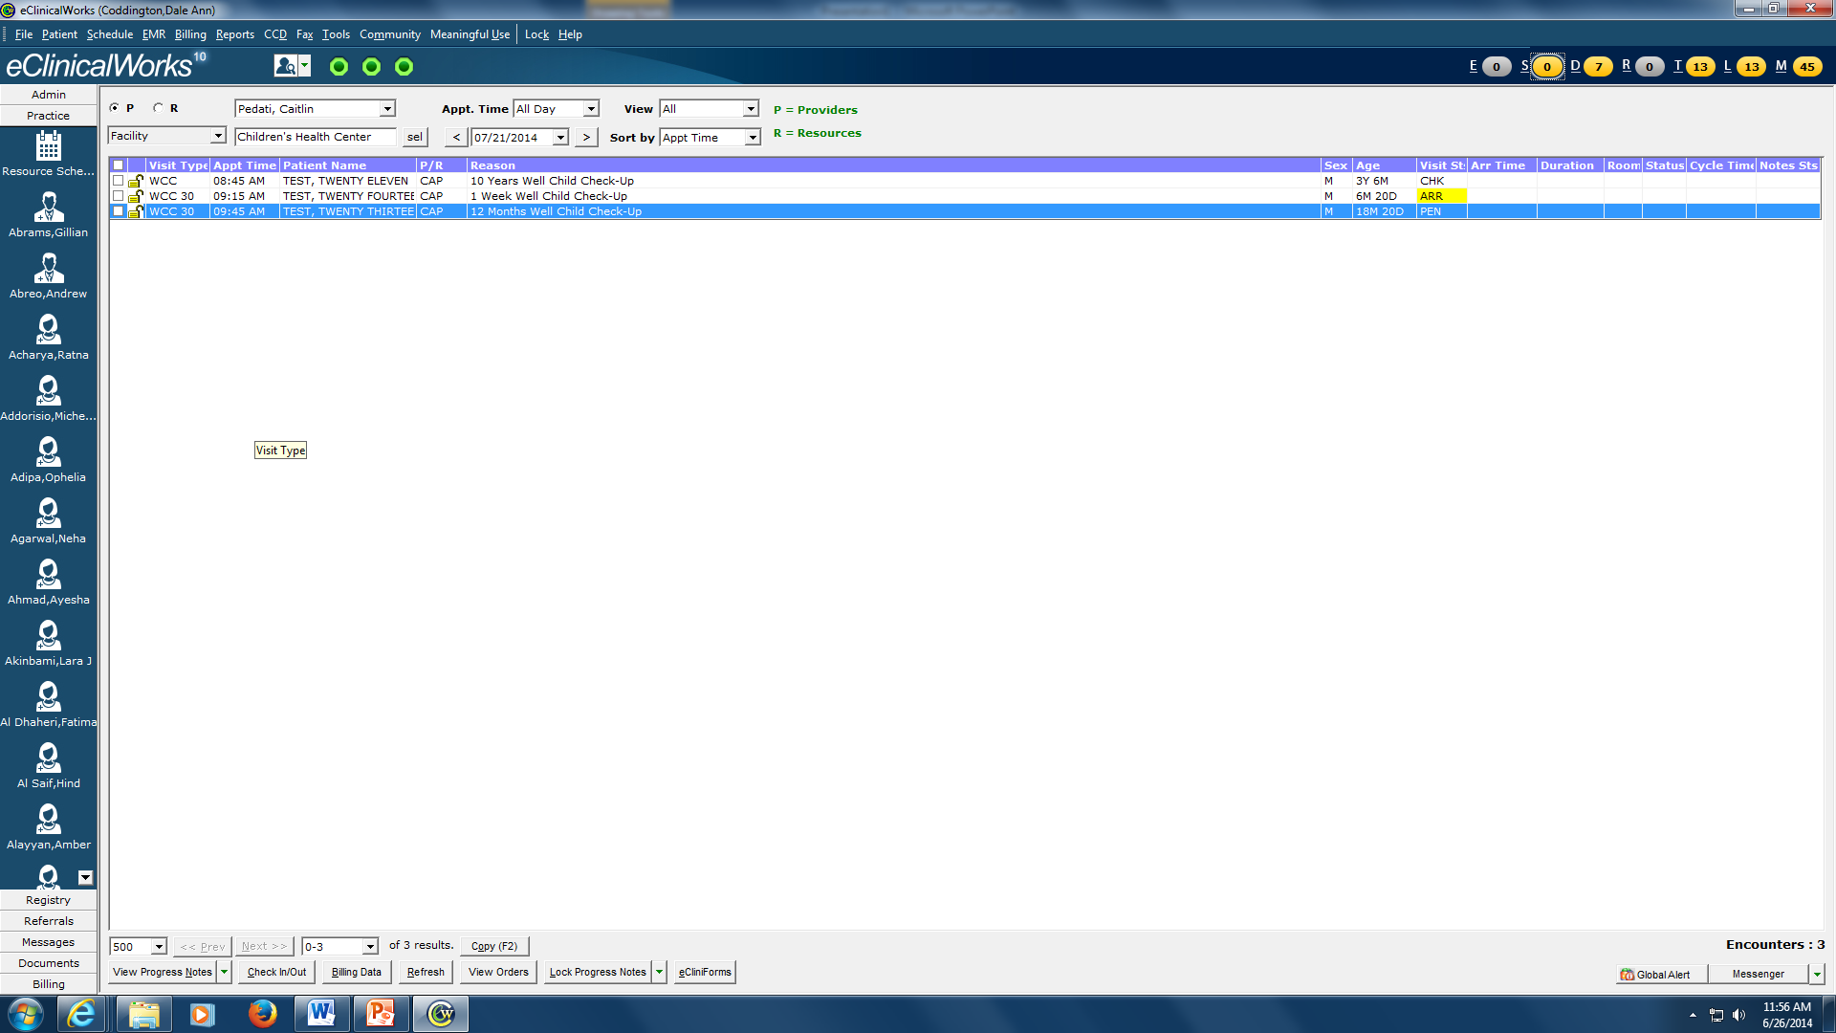
You can also see your schedule by going to the “schedule screen”. Click on the “S” Jellybean and choose your name. This screen shows you if the patient is in “Vitals” or is “Ready” for you to go see them. This screen is how nursing and providers communicate with each other.

Slide 11
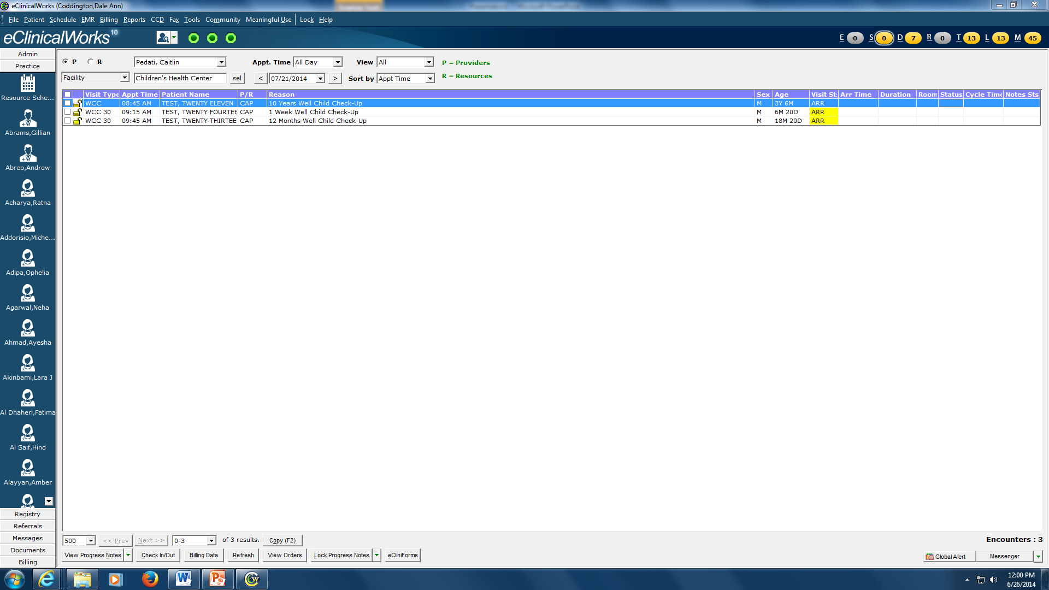
Be sure to always put the room number if you put a patient in a room. You will see if the patient is “ready”. Then you change to Provider and when order such as immunizations are entered, change the status “OrdHold” or “OrdGo”
16
Prov.
17
OrdGo

Slide 12
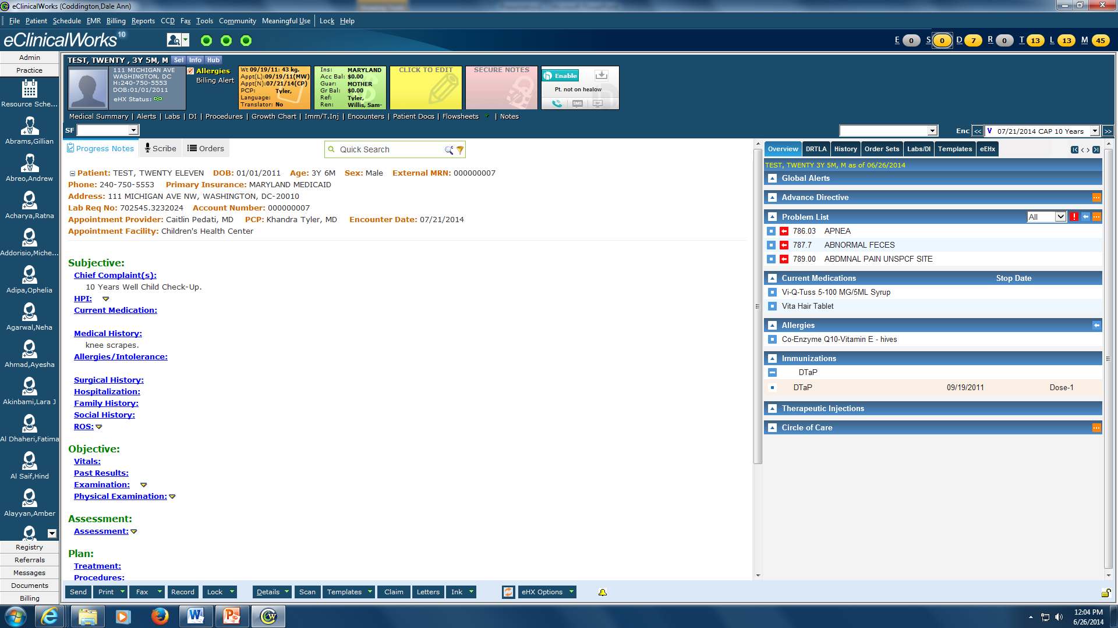
The progress note can be opened from Schedule screen by clicking on the “S” jelly bean or by right clicking on the Resource screen.

Slide 13
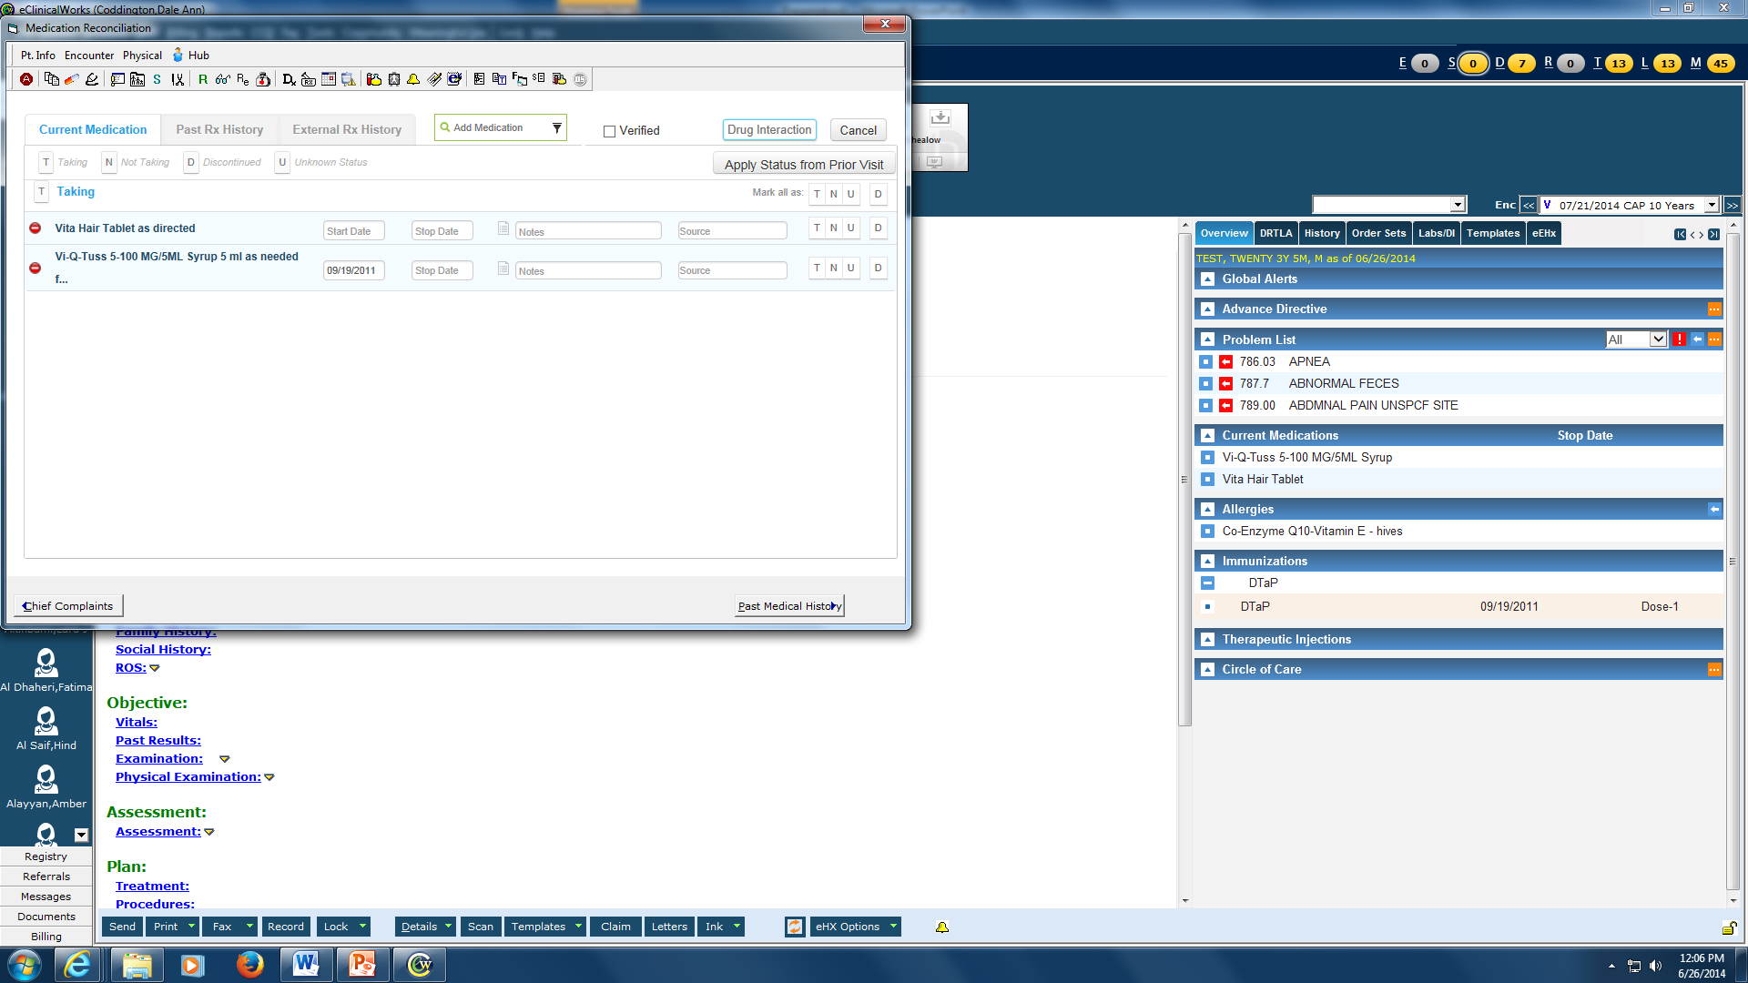
EVERY patient should have medications verified and allergies verified

Slide 14
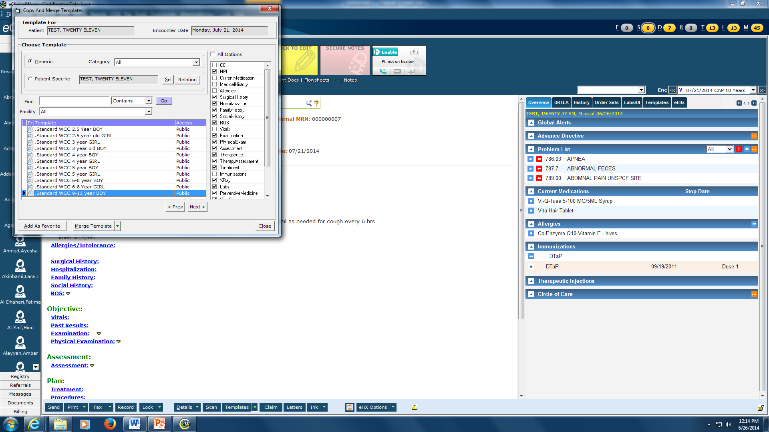
Merging a Template (WCC, asthma, obesity). Click on arrow next to Templates at Bottom, Pick merge a template. Click on Generic and Choose the template and click Merge

Slide 15
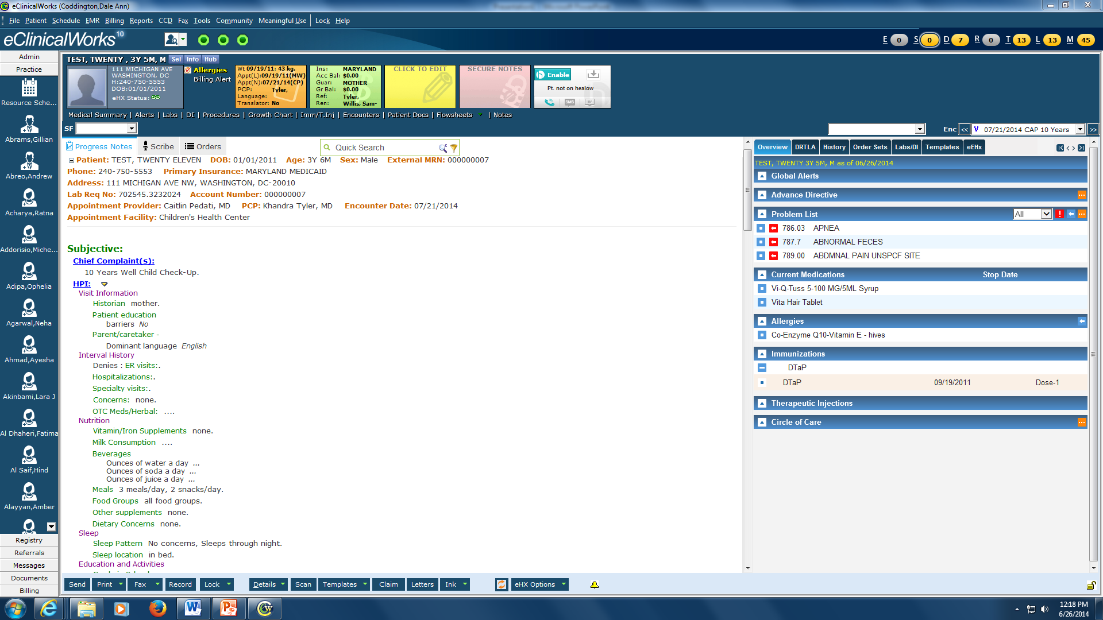
Get to know the templates. There are some fields that are filled out already and may need to be changed. What ever is in your assessment and plan- needs to be consistent with your hx and physical

Slide 16
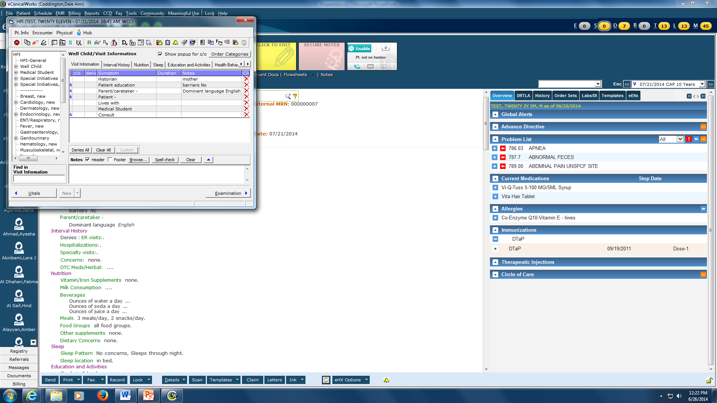
After WCC template is merged: Left Click on “HPI” and you will see this view which is a faster way to go through the templates

Slide 17
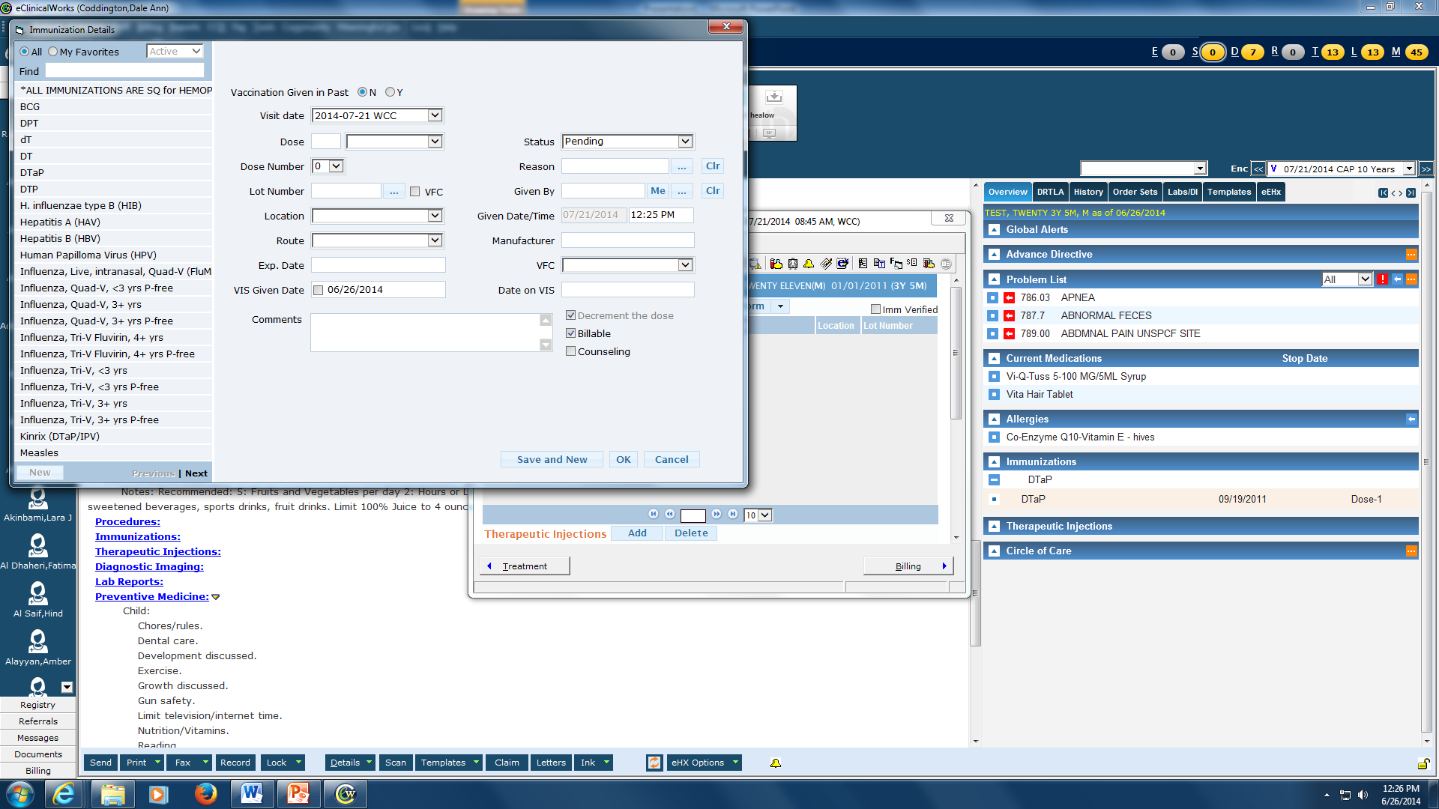
Ordering Immunizations. Click on Immunizations under Treatment, then click on Add. If you have multiple immunizations to add, click on “Save and New” for each one. You can also specify given in past (useful for first Hep B)

Slide 18
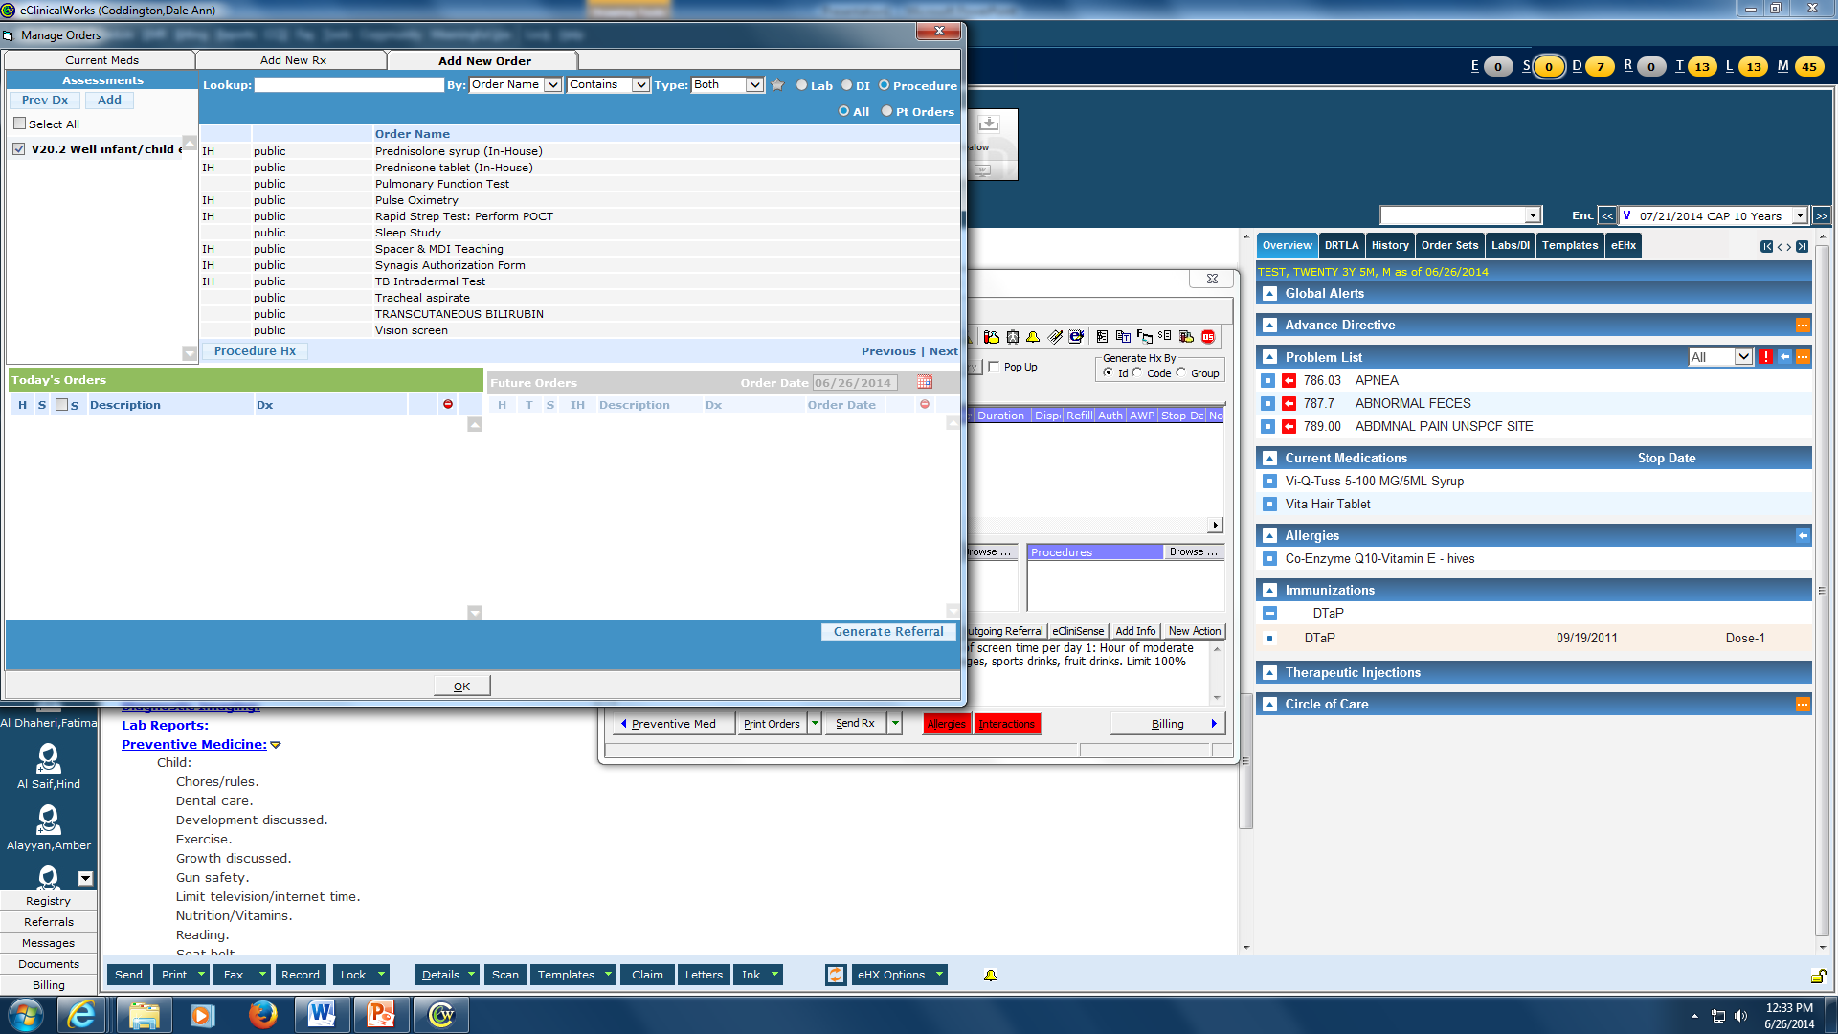
To order Albuterol Nebs, Rapid strep, Urine dip, Health forms, Asthma action plans, MDI teaching etc. Go to Plan and then Treatment and then Procedure. Change to “contains” and enter what you need

Slide 19
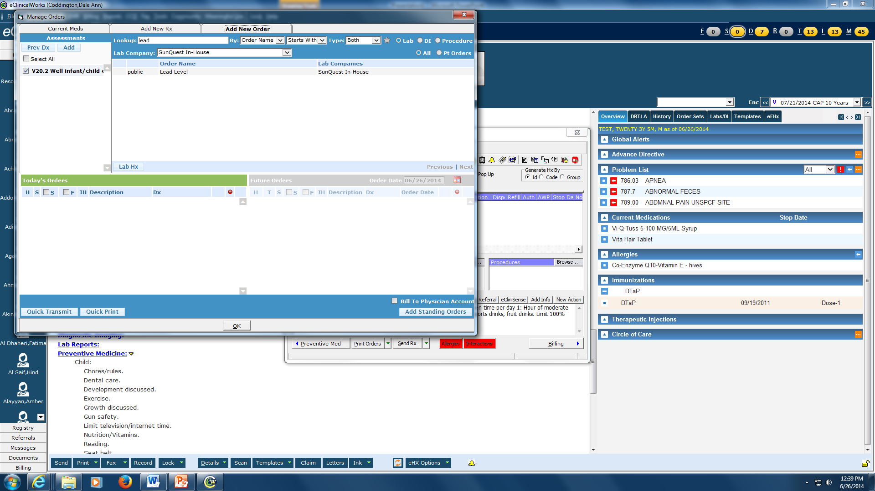
Ordering Labs: Go to Plan , then Treatment, then Lab. Click Browse (don’t change Lab company). Choose your lab. Click ok and fill out the pop-ups. Choose quick Transmit and then Transmit only. The lab will print out in the clinic for the patient. We’ll show you how to do this

Slide 20
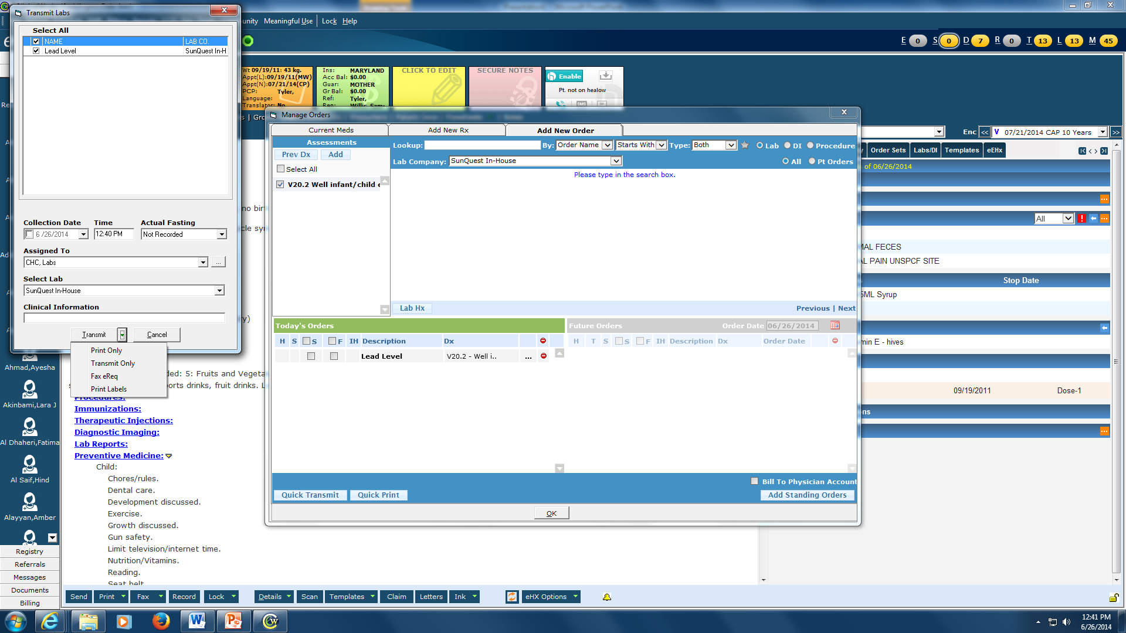

Slide 21
To prescribe a medication, click on treatment and then click on Rx “ + Add”

Slide 22
Be sure to change Type to Medispan Rx. This will list medications that are eligible to be eprescribed

Slide 23
Type in the name of the medication and then choose the strength and formulation you want and click OK

Slide 24
Complete your prescription and click “Apply”

Slide 25
To e-prescribe- click the arrow next to SentRx and choose ePrescribe Rx

Slide 26
To refill a medication that the patient is already on: Click on the green arrow next to Cur Rx, then click “R” next to medication to be refilled.

Slide 27
Always specify follow up for every patient. Every patient over 6 months should be reminded about flu vaccine in the fall and their next Well Child Visit.
We’ll teach you to do the billing but not today.

Slide 28
Every patient gets a visit summary of the visit. Right click print at the bottom left of the encounter and then pick Print Visit Summary.

Slide 29
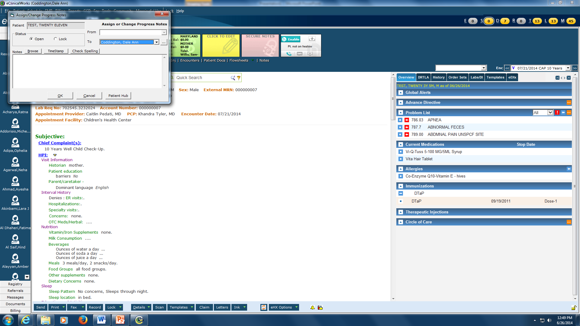
Assign your chart to the attending. Green arrow next to “Details” at the bottom of your screen and choose “change assigned to”. Choose the name from the …. And click OK. You’re done!

Slide 30
There will be lots more to learn:
How to do referrals
Creating a telephone encounter
Finding patient education handouts in ECW
Billing
Ask lots of questions, there is lots to learn

