Slide 1
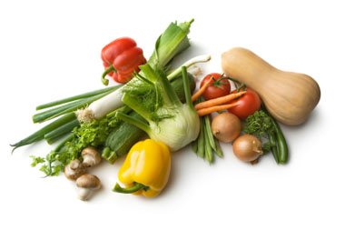
Food Insecurity: A Guide for Pediatric Residents
Kirsten Orloff, MD
Children’s National Medical Center
Pediatric Residency Program 2015
Notes:
Welcome to Food Insecurity: A Guide for Pediatric Residents. Please play in Slideshow Mode.

Slide 2
The Game Plan
This self-directed learning tool will provide you with a base of knowledge about food insecurity and how it pertains to your future career in pediatrics (45 min).
After completing this mini-course, you will embark on a community activity, empowered with new knowledge and perspective (1 hr).
Let’s get started!
Notes:
Here’s the Game Plan. This self-directed learning tool will provide you with a base of knowledge about food insecurity, and how it pertains to your future career in pediatrics. This will take about 45 minutes. In slideshow mode, click your mouse only to advance to the next slide, otherwise the sound and animation will play automatically.
After completing this mini-course, you will embark on a community activity, empowered with new knowledge and perspective. We’ll talk about the activity at the end. The activity will take about 1 hour, but may depend on your transportation needs. You may complete this mini-curriculum with a colleague on your rotation or by yourself.

Slide 3
Learning Objectives
By the end of this session, learners should be able to:
Define what it means to be food insecure for households with children
Describe health consequences of food insecurity in children
Explain the connection between food deserts and poor health outcomes
Effectively and respectfully ask about food insecurity in patient encounters
Offer families resources for addressing food insecurity (be an advocate!)
Notes:
By the end of this session, learners should be able to:
Define what it means to be food insecure for households with children
Describe health consequences of food insecurity in children
Explain the connection between food deserts and poor health outcomes
Effectively and respectfully ask about food insecurity in patient encounters
Offer families resources for addressing food insecurity (be an advocate!)

Slide 4
Facing Hunger in America
Two families tell their stories:
https://www.youtube.com/watch?v=eqKLoapOWpI
Notes:
Take 10 minutes to hear the stories of two American families struggling with food insecurity. Pause the presentation, and click on the link or copy the link into your browser.

Slide 5
What are your thoughts?
Would you have guessed these families were food insecure if you were to see them in clinic?
How do parents try to shield their kids from food insecurity?
What if they can’t?
How does school breakfast and lunch play a role?
Notes:
What are your thoughts? Talk about it with a friend or colleague if you’re watching together. What did you notice? Would you have guessed these families were food insecure if you saw them in the office? People don’t come with labels. The parents are working, they’re not homeless, and the kids have life aspirations. How do parents try to shield their kids from food insecurity? What if they can’t? We saw how Lonetta’s daughter saved part of her lunch for snack. How does school breakfast and lunch play a role?

Slide 6
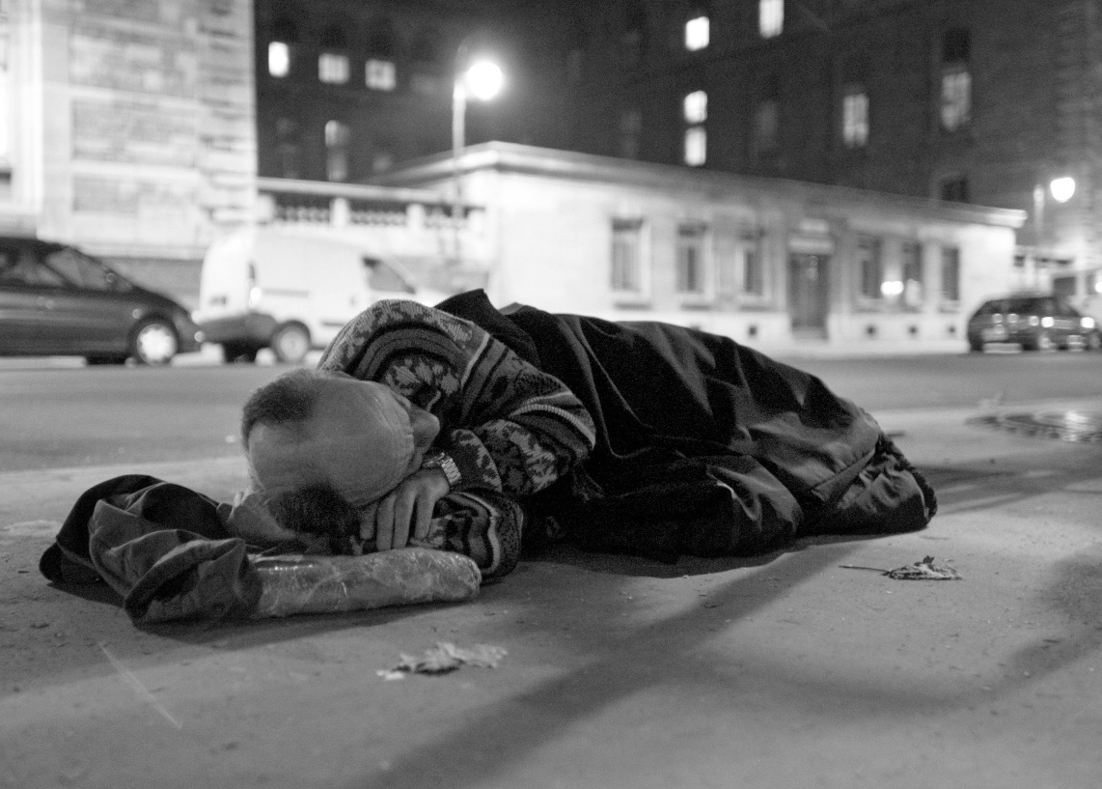
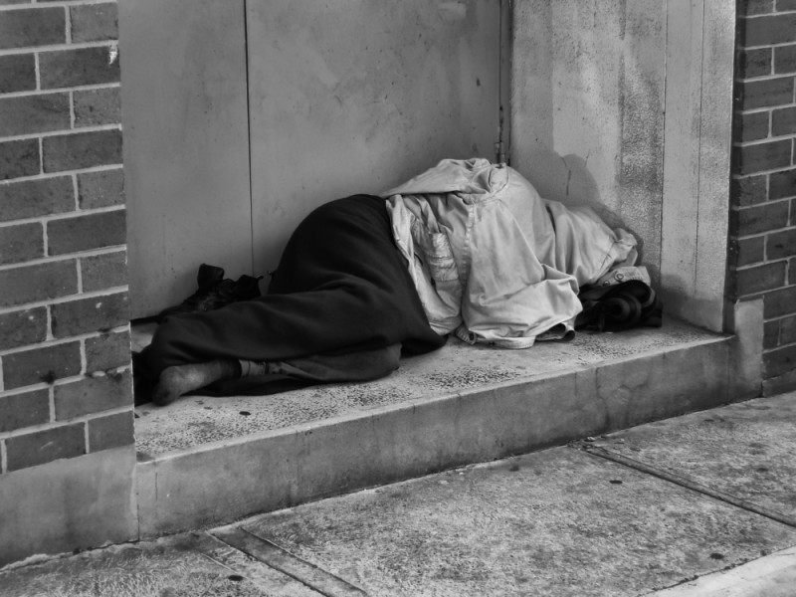
What does food insecurity look like?
Left image from: http://www.nationofchange.org/utah-ending-homelessness-giving-people-homes-1390056183
Right image from: http://www.camelcitydispatch.com/w-s-overflow-homeless-shelter-opens-all-quiet-on-the-night-shift/
Notes:
What do you think about when you hear the term food insecurity? Many think of the homeless, who undoubtedly face food insecurity and need to be included in this conversation. However, food insecurity is definitely not isolated to that population.

Slide 7
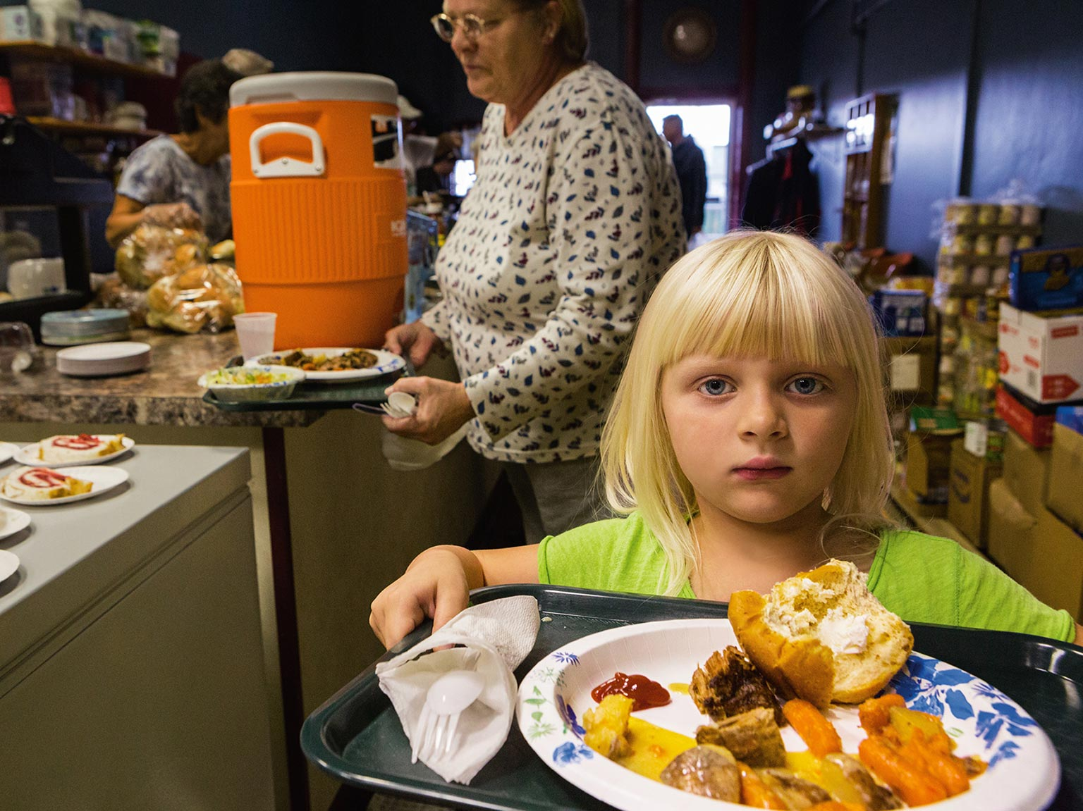
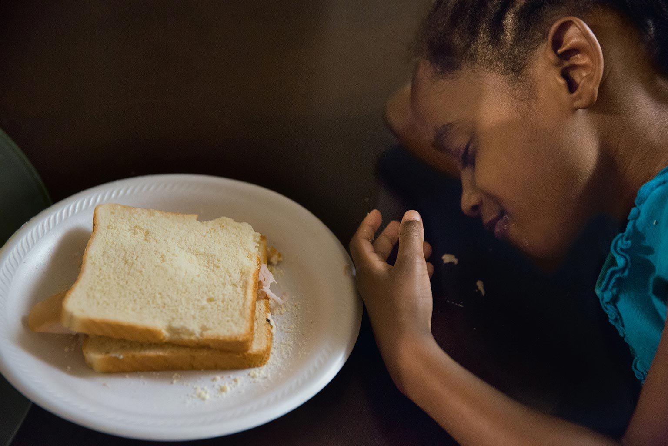
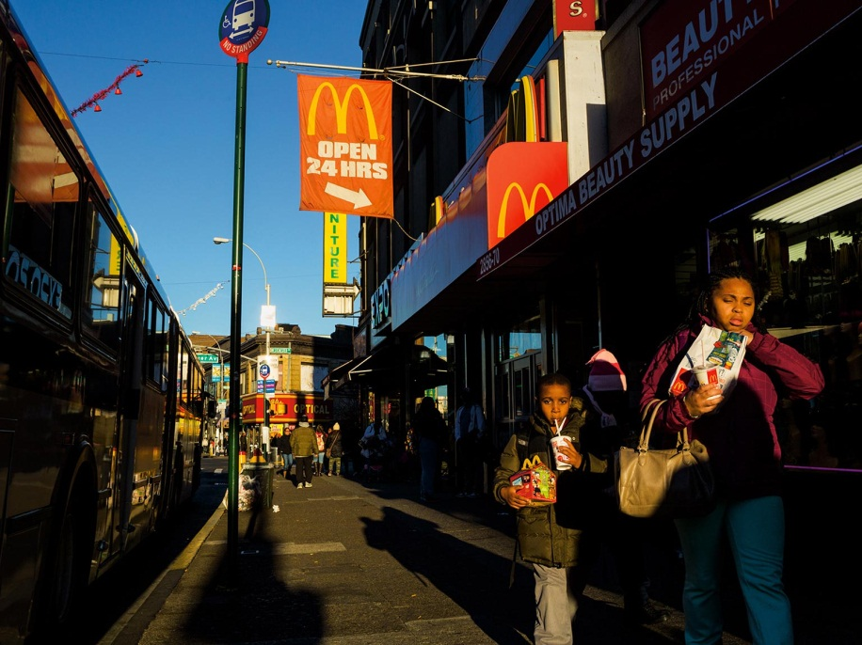
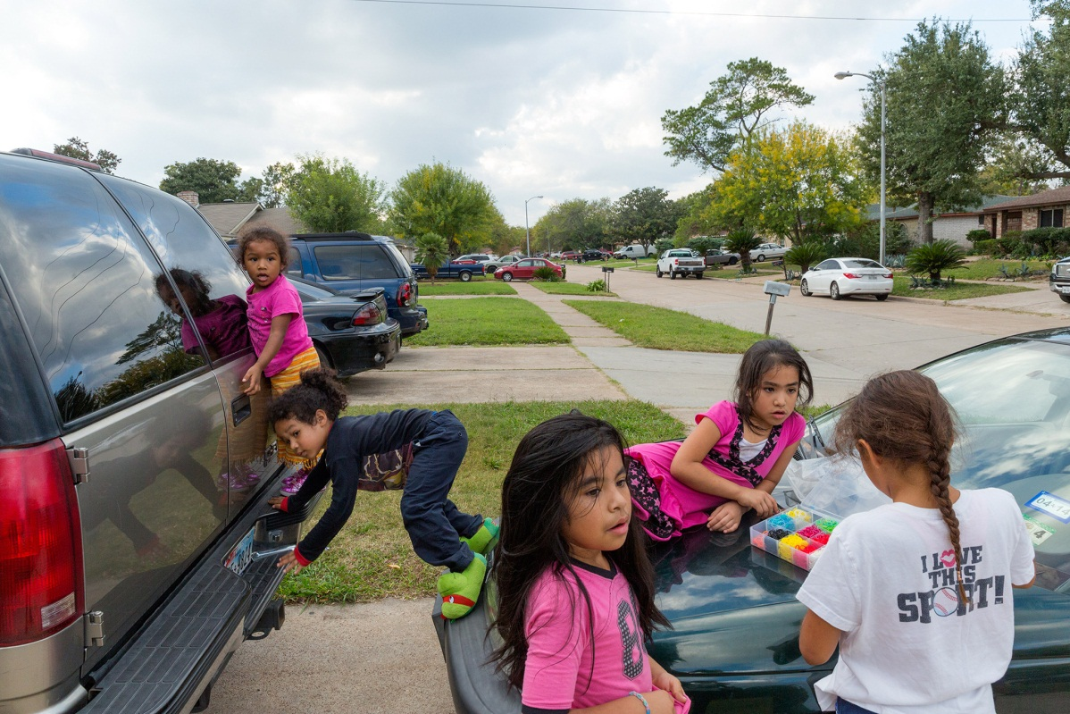
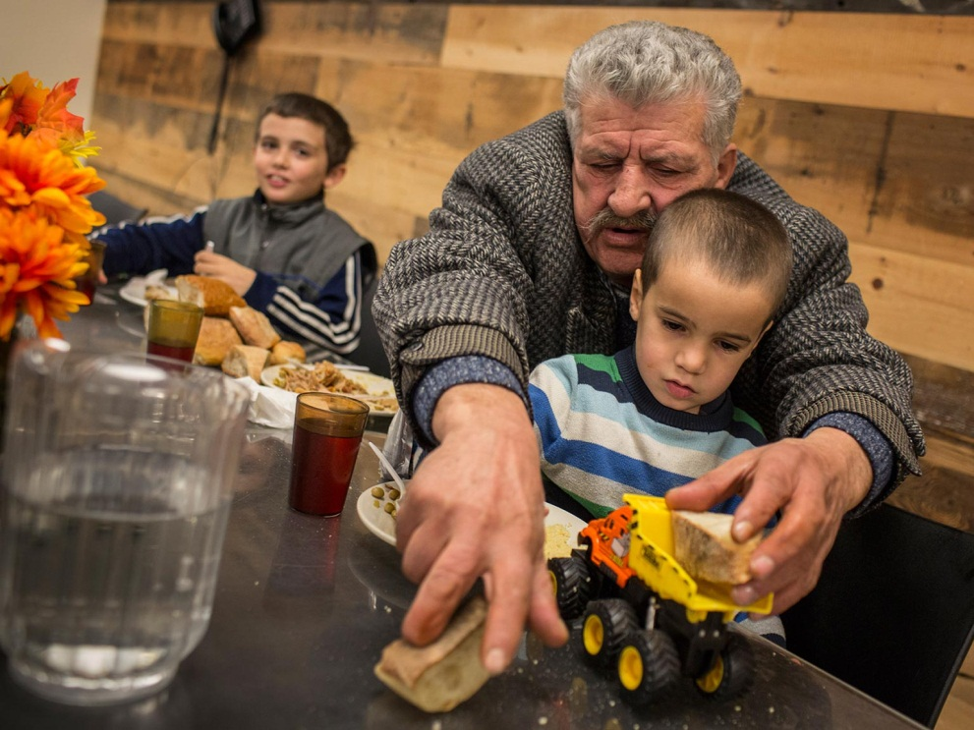
What does food insecurity look like?
McMillan, Tracie (2014). The New Face of Hunger. National Geographic Magazine. Retrieved from: http://www.nationalgeographic.com/foodfeatures/hunger/
Notes:
National Geographic recently photographed families facing food insecurity and showed that it’s everywhere---spanning urban, suburban and rural neighborhoods, races, religions and cultures. Families in very nice neighborhoods in the Houston suburbs, complete with SUVs and nice clothes face food insecurity. Job loss, serious illness or a death in the family can place previously economically stable families in danger. Here is a child from the same area, at dinner eating a sandwich of white bread, a slice of meat and cool whip made after waiting in line for food donations at her church. This little girl in Iowa gets her dinner from a soup kitchen toward the end of every month when food stamps run out. Working parents in the Bronx rotate food pantries and soup kitchens in their neighborhood to feed their kids every night. Other families in the Bronx select from the dollar menu at McDonald’s to make ends meet. There is no single ‘face’ of food insecurity.

Slide 8
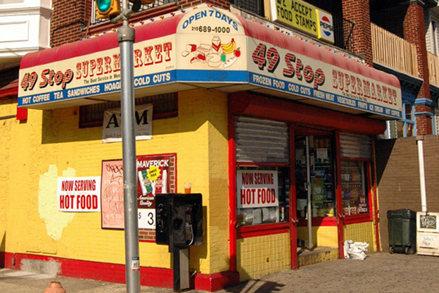
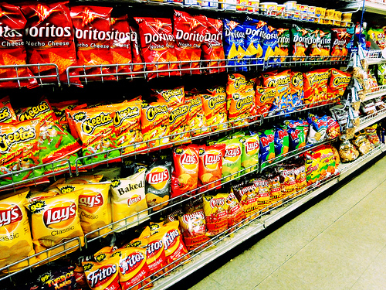
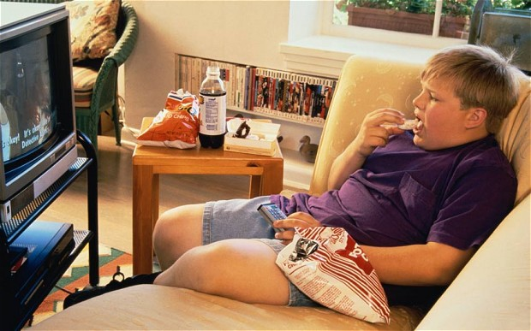
What does food insecurity look like?
Top left: http://indianapublicmedia.org/eartheats/philadelphia-school-battles-childhood-obesity/ Top right: http://earningmylottery.tumblr.com/
Bottom: http://www.telegraph.co.uk/news/health/news/9955236/Childhood-obesity-linked-to-genes.html
Notes:
The last photograph depicted a city street filled with fast-food restaurants.
How does a family’s neighborhood dictate what they eat? Think about your own area. What kind of stores are near you? How far do you travel and how do you get there --- walk, bus, car, subway? What foods are readily available? How can food insecurity and obesity be linked?
We’ll go through all of this together.

Slide 9
A quick distinction…
Food Insecurity: the lack of consistent access to adequate food for an active, healthy lifestyle (USDA)
Low food security: reduced nutritional quality, variety, or desirability of diet.
Very low food security: disrupted eating patterns and reduced food intake.
Hunger: an individual-level physiological condition (symptom) that may result from food insecurity
Food
insecurity
Hunger
Coleman-Jensen, A. & Gregory, C. (2014). ’Definitions of food security.’ United States Department of Agriculture Economic Research Service.
Retreieved from http://www.ers.usda.gov/topics/food-nutrition-assistance/food-security-in-the-us/definitions-of-food-security.aspx
Notes:
Food Insecurity is defined as the lack of consistent access to adequate food for an active, healthy lifestyle. It is an economic and social condition that may result in hunger. Hunger is an individual-level physiological condition (or symptom). Therefore, you can be food and insecure and hungry, or be food insecure without hunger.
Food insecurity is then divided into low and very low food security. Homes with low food security have reduced quality or variety of foods, so they have food but it may be very nutrient-poor. In homes with very low food security, there are disrupted eating patterns or reduced intake.
These terms have been defined by the USDA based on 18-question phone surveys of families across the country. 3 or more positive responses indicate some level of food insecurity. We’ll talk more about that later.

Slide 10
Who’s at risk?
14.3%
Homes with kids
Single parents
Race
Poverty
‘Coleman-Jensen, A. & Gregory, C. (2015). Key Statistics & Graphics’.’ United States Department of Agriculture Economic Research Service.
Retrieved from: http://www.ers.usda.gov/topics/food-nutrition-assistance/food-security-in-the-us/key-statistics-graphics.aspx
Notes:
So who’s at risk for food insecurity? This bar graph breaks down prevalence of food insecurity in the US in 2013 by certain demographics.
Poverty is perhaps the most obvious risk factor (seen here with the longest bars). The graph uses the income-to-poverty ratio, defined by the U.S. Census Bureau as a gauge of “the depth of poverty and shows how close a family’s income is to its poverty threshold’ in percentage form. For example, a family with an income-to-poverty ratio of 125 percent has income that is 25 percent above its poverty threshold.” Clearly those ‘under 1.00’ are below the poverty threshold and have the highest rates of FI.
Can you think of and other risk factors besides poverty? This graph breaks it down to get a clearer picture of specific populations with higher prevalence.
Looking at all household in the US in 2013, just over 14% were food insecure. That number goes up for homes with children, and even higher for single parent homes, which both make sense --- more mouths to feed, on a limited income. Below that there is evidence of a very significant racial disparity.
Interestingly, there is not huge difference if you l live inside or outside a city or in the NE, Midwest, South, or West. Why is that important for you? Wherever you decide to settle down and practice pediatrics, you will face this issue. No place is completely immune.

Slide 11
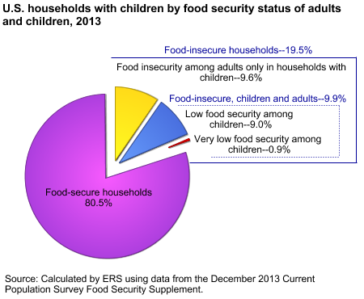
In households with children….
‘Coleman-Jensen, A. & Gregory, C. (2015). Key Statistics & Graphics’.’ United States Department of Agriculture Economic Research Service.
Retrieved from: http://www.ers.usda.gov/topics/food-nutrition-assistance/food-security-in-the-us/key-statistics-graphics.aspx
Notes:
We just learned that having kids is a risk factor for food insecurity, so let’s look more closely at only households with children. In these homes, nearly 20% were food-insecure. That is 1 in 5 homes. In about half of those homes (yellow wedge), only adults were food insecure, and kids were ‘spared,’ meaning adults likely changed their eating habits to ensure their kids had enough to eat. The other half of that group (9.9% of the pie, or 3.8 million homes) had food insecure children & adults.
Now let’s look at the tiny red wedge. It represents kids with VERY low food security, meaning they reduced their food intake at some time during the year. Meaning even their parents’ best efforts to shield them from hunger failed. But at least the red wedge is tiny, right? Wrong. It represents 360,000 households in the U.S. Doesn’t seem that insignificant when we’re talking about such large numbers. Moreover, this is likely underreported –families are worried about stigma of FI, about the consequences of what might happen to their kids if they report this. The graph also doesn’t include homeless people since data was obtained through telephone interviews.

Slide 12
District of Columbia
30.5% of
children are food insecure
= 32,100
children
14% of
people are food insecure
= 86,410 people
$$$$$$
Map the Meal Gap. (2015). Feeding America. Retrieved from http://map.feedingamerica.org
Image from: http://recovery.nih.gov/Stories/ViewStory.aspx?id=13
Notes:
Let’s take a look at the District of Columbia.
A non-profit organization called Feeding America---primarily a national network of food banks---uses USDA, census and Bureau of Labor Statistics data to ‘Map the Meal Gap’ across the Unites States. From 2009-2013, it showed that 14% of people in DC were food insecure, totaling over 86,000 people. That prevalence is consistent with the national average. However, in 2013, DC had the highest rate of any state for child food insecurity at a whopping 30.5% of children under 18.
About ¼ of the food insecure DC residents don’t meet eligibility for SNAP (also known as ‘food stamp’) benefits. With that in mind, we have to think about the cost of food. The average cost of a meal in DC according to Feeding America’s research was the highest in the country at $3.63. The national average is $2.79. Those who barely miss SNAP eligibility clearly will struggle to make ends meet with such high costs.

Slide 13
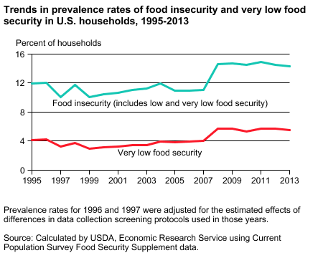
Are things changing?
Recession
‘Coleman-Jensen, A. & Gregory, C. (2015). Key Statistics & Graphics’.’ United States Department of Agriculture Economic Research Service.
Retrieved from: http://www.ers.usda.gov/topics/food-nutrition-assistance/food-security-in-the-us/key-statistics-graphics.aspx
Notes:
Are things changing? The Short answer? No. This graph shows the food insecurity prevalence trend since 1995 in the U.S. We actually saw an abrupt jump in prevalence in 2008, linked to the economic recession. What this highlights is the number of families treading the line between being food security and insecurity at all times, barely making ends meet. When the economy tanks, they can no longer keep their heads above water.
And as you can see, despite improvement in the economic status since 2008, prevalence has barely budged from it’s peak. We have a long way to go.

Slide 14
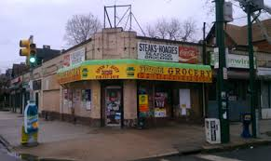
Notes:
References: Desert image: http://images.nationalgeographic.com/wpf/media-live/photos/000/003/cache/simpson-desert-ripples_375_600x450.JPG. Corner store image: http://www.headspacemag.com/greens_foodtrust.html
The link between poverty and food insecurity is not as simple as it may seem. Sure, if you don’t have enough money to buy food, you are hungry. However, poverty goes beyond the money in your pocket. Poorer areas --- both rural and urban --- lack the community resources for basic needs such as full-service grocery stores. We call places like this, food deserts. Even if you had money, there wouldn’t be much nutritious food to buy.
A family may lack their own transportation and rely on a bus, in that case they may have to take 3 to get to a full grocery store like Giant or Safeway seen at a distance here. But parents have to go to work as well, and pick their kids up, so they end up at a corner convenient store at the end of a long day (seen nice and close in the foreground here), specializing in palatable foods that are calorie-dense and nutrient-poor (like chips, soda, cookies).

Slide 15
Food Deserts exist in D.C.
Ashbrook, A., Roberts, K., Social Impact. (2010). When Healthy Food is Out of Reach: An Analysis of the Grocery Gap in the District of Columbia . Retrieved from http://www.dchunger.org/pdf/grocerygap.pdf
Notes:
Food deserts exist here in D.C.
Take a look at this chart developed by researchers and advocates at D.C. Hunger Solutions and Social Impact. The District is broken up in 8 wards geopolitically. Clearly the socioeconomic status of all wards is not equal. Compare Ward 3, located in the most northwestern part of the city, which has the highest average household income at $128,000, to Wards 7 and 8 (located in southeastern DC), which have the lowest average incomes at $29- and $39,000. Though population size does not differ greatly, Ward 3 has 11 full service grocery stores, compared to only 4 and 3 in Wards 7 and 8, respectively. Wards 4 and 5 notably have very few as well. Importantly, Wards 7 and 8 also have much higher percentage of children, placing many more kids in food deserts.

Slide 16
So what does this mean for kids?
Notes:
So what does this mean for kids?

Slide 17
‘I’m starving…..’
Can’t wait for dinner.
Image retrieved 24 Aug 2015 from: https://www.youtube.com/watch?v=kUR_HJT-u0w
Notes:
First think about how you feel at the end of a hard day on the wards, stomach rumbling, hoping sign out will start as soon as possible so you can grab dinner. When was the last time you ate? Probably lunch. But it’s uncomfortable to feel that hunger, right?

Slide 18
But what if you weren’t sure there’d be anything for dinner?
Notes:
But what if you weren’t sure there’d be anything for dinner when you got home? And going out to grab dinner wasn’t an option?
We’ve all gone longer stretches without something to eat, but it’s hard to appreciate the stress that erupts from not knowing when your next meal will be on a daily basis.

Slide 19
‘Sorry if I’m grumpy, but I didn’t eat this weekend’
Child image: http://www.thejournal.ie/kids-going-to-school-hungry-ireland-1636952-Aug2014/
Principal image: http://www.clipartpanda.com/categories/principal-s-office-clipart
Notes:
On Monday, there’s a child in 5th grade being told to stop fidgeting and ‘please read your book quietly’ but all he can think about is his rumbling stomach. So he tries to close his eyes and sleep, but he starts to stress. So he talks back to the teacher or reacts impulsively to a teasing classmate, and gets sent to the office. Sure this is a fictional story, but the point is that kids who experience food insecurity don’t walk around with a sign on their back saying ‘sorry if I’m grumpy, but I didn’t eat this weekend and I’m not sure I will tonight.’
He may appear healthy on the outside, as kids tend to physically grow unless severely restricted on calories. It may only show in his school performance and social interactions.

Slide 20
Impact on Child Health
Development:
Impaired development of non-cognitive abilities (i.e., interpersonal relations, self-control) among school-age children
Insecure attachment and less advanced mental proficiency in toddlers
Higher rates of developmental risk among young children
Mental Health
Higher rates of depressive disorder and suicidal symptoms among adolescents
More anxiety and depression among school-age children
More “internalizing” behavior problems (such as withdrawal or anxiety) among children
Poorer psychosocial function and psychosocial development among school-age children
Physical Health:
Poorer health of children/adolescents, per parents
Lower bone mineral content in adolescent boy
Iron deficiency anemia
More stomach aches, frequent headaches, and colds
Higher hospitalization rates among young kids
Lower physical function among children ages 3-8
Higher numbers of chronic health conditions among children
School:
Kindergarteners:
Lower math achievement & math progress
K-3rd grade:
Lower math and reading gains
Kids ages 6-11:
Lower arithmetic scores
higher likelihood of repeating a grade
Coleman-Jensen, A., McFall, W., Nord, M. (2013). Food Insecurity in Households with Children, EIB-113,
U.S. Department of Agriculture, Economic Research Service. Retrieved from http://www.ers.usda.gov/media/1120651/eib-113.pdf.
Notes:
Food insecurity’s impact on child health is far-reaching, even when controlled for confounding conditions, such as income, employment status, race, and ethnicity.
Its impact on child development is shown through impaired interpersonal relations & self control, insecure attachment in toddlers, and high rates of developmental risk. Food insecurity is linked to mental health problems, such as high rates of depression and suicidal symptoms in adolescents, and anxiety & depression in school age children, including more ‘internalizing’ behaviors.
As far as physical health, food insecure parents reports poorer health overall for their children. Kids who are food insecure also have lower bone mineral content, higher risk of iron deficiency anemia, more common aches, and higher hospitalization rates & chronic health conditions (we’ll get more into that on the next page).
Food insecurity also impacts school performance, seen in lower math & reading progress in young children and a higher likelihood of repeating a grade later on.
Think about how often you deal with these issues in clinic---problems with development, depression or anxiety, chronic health conditions, and poor school performance. Sure, the causes are multifactorial. But perhaps now you’ll stop and consider whether food insecurity could be playing a part.

Slide 21
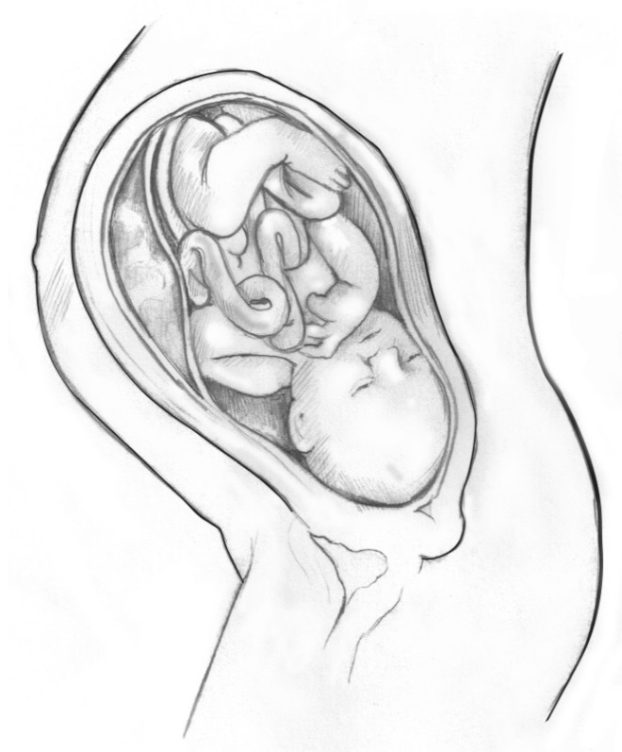
Food Insecurity & Obesity
Barker hypothesis:
Prenatal impact (epigenetics) of
maternal food insecurity leading
to a ‘thrifty phenotype’
Direct consumption of calorie-dense,
nutrient-poor foods; as result of
good taste, low cost, and convenience
Dover GJ. The Barker Hypothesis: How Pediatricians Will Diagnose and Prevent Common Adult-Onset Diseases.
Transactions of the American Clinical and Climatological Association. 2009;120:199-207.
Child image: http://www.telegraph.co.uk/news/health/news/9955236/Childhood-obesity-linked-to-genes.html
Fetus image: https://catalog.niddk.nih.gov/imagelibrary/searchresults.cfm?keyword=499&type=keyword
Notes:
Let’s dive a bit deeper into a major chronic health issue that may be impacted by food insecurity. Obesity.
If we think about the food desert concept, and the cheap, readily available high-fat and high-sugar foods corner stores offer, it’s not hard to imagine a situation in which poverty (& food security) can actually contribute to weight gain. When this child eats, he may not be as concerned with the long term nutritional affect on his health, but rather the short term satisfaction and enjoyment this bag of chips offers.
Moreover, according to the Barker hypothesis: some children may be indirectly affected by food insecurity experienced by their mothers while in utero, which can lead to expression of a ‘thrifty phenotype,’ an epigenetic phenomenon in which the body tends toward an anabolic or fat-storing state to be able to survive possible famine again in the future. This ironically leads to obesity, hypertension, diabetes, and other poor future health outcomes.

Slide 22
District of Columbia
Ashbrook, A., Roberts, K., Social Impact. (2010). When Healthy Food is Out of Reach: An Analysis of the Grocery Gap in the District of Columbia . Retrieved from http://www.dchunger.org/pdf/grocerygap.pdf
Notes:
With this in mind, now let’s take another look at this chart of D.C. We’ve already noted the disparity in full service grocery stores between wards, or the so-called ‘food deserts’ that can create. The next column shows overweight and obesity rates by ward, which are strikingly higher in those wards with lower incomes and fewer full service grocery stores. Of course this doesn’t prove causality---and there are certainly many other contributing factors at play---but the association is not hard grasp with your new knowledge of food access and the Barker Hypothesis.

Slide 23
We as pediatricians must identify patients who are food insecure…
…but how do we ask about it?
Notes:
Hopefully it is now clear that we as pediatricians must identify patients who are food insecure in order to prevent its potential impacts on their health. We have to ask families about it, and we must do so respectfully. Time is also always an issue during patient visits, so we must efficiently screen as well. There are multiple tools providers could use. The USDA uses a standardized 18-question survey called the ‘Household Food Security Survey’ (HFSS), but certainly that would be cumbersome in the office.

Slide 24
The Hunger Vital Sign
“Within the past 12 months we worried whether our food would run out before we got money to buy more.” Was that often, sometimes, or never true for you?
“Within the past 12 months the food that we bought just didn’t last and we didn’t have money to get more.” Was that often, sometimes, or never true for you?
Ettinger de Cuba, S., et al. (2014). ‘The Hunger Vital Sign: A New Standard of Care for Preventive Health.’ Children’s Health Watch Policy Action Brief. Retrieved from http://www.childrenshealthwatch.org/wp-content/uploads/FINAL-Hunger-Vital-Sign-4-pager.pdf
Notes:
So instead of 18 questions, a group from the Children’s Health Watch developed a 2-question screen they called The Hunger Vital Sign. It is literally the first 2 questions from the larger HFSS survey. The questions are as follows:
“Within the past 12 months we worried whether our food would run out before we got money to buy more.” Was that often, sometimes, or never true for you?
“Within the past 12 months the food that we bought just didn’t last and we didn’t have money to get more.” Was that often, sometimes, or never true for you?
It has a sensitivity of 97% and a specificity of 83% using the HFSS as the gold standard. These rates of sensitivity and specificity are considered excellent in scientific publications. When to fit it in? These questions can be used when taking a child’s nutritional history, especially if a child’s diet seems nutrient-poor or restricted. Another option would be during the social history. After asking about the child’s home and parents’ jobs, a logical next question could be whether they receive SNAP, WIC or TANF. Regardless of the answer to this question, the Hunger Vital Sign would be a great follow up question. You’re essentially asking if they feel they have enough for their family in their current situation, using evidence-based questions.

Slide 25
What if they say yes?
Free Summer Meal Program
School Meal Programs
Special Supplemental Nutrition Program for Women Infants & Children (WIC)
Health Leads
Supplemental Nutrition Assistance Program (SNAP)/Food Stamps
Temporary Cash Assistance for Needy Families (TANF)
Food banks/
pantries
Notes:
So what if they say yes, they have worried they’d run out of food, or their food just didn’t last.
There are many different resources for our families that we identify as food insecure. We will spend the next few slides going through some of these resources.

Slide 26
WIC
Special Supplemental Nutrition Program for Women Infants & Children (WIC)
Federally funded grants to states for a preventive nutrition program
For: low-income pregnant women, new mothers, and their infants & kids up to age 5
Nutrition education
Monthly food packages tailored to nutritional needs
Health care referrals
http://wic.fns.usda.gov/wps/pages/start.jsf
Government Food/Nutrition Programs. (2015). D.C. Hunger Solutions: Ending Hunger in the Nation’s Capitol. Retrieved from
http://www.dchunger.org/index.html
Notes:
The Special Supplemental Nutrition Program for Women, Infants, and Children - or WIC – is a federally funded grant program to states. The program provides services for low-income pregnant women, new mothers, infants, and children under 5.
WIC strongly promotes nutrition education. The monthly WIC food package provides foods tailored to nutritional needs, particular for kids at a time of rapid growth and development. WIC increases the number of women receiving prenatal care, reduces the incidence of low birth weight infants and infant mortality, reduces anemia, and enhances the nutritional quality of the diet of participants.
Not sure if they qualify? You can always refer them to a WIC office (many of the clinics have them on site), or to the link here to pre-screen for eligibility based on income.

Slide 27
SNAP
Largest federal nutrition program, operated by USDA and administered by states
For: low-income households
Monthly Electronic Benefit Transfer (EBT) card to use as a debit card at many grocery stores & farmer’s markets
Generates local economic activity
http://www.snap-step1.usda.gov/fns/
Supplemental Nutrition Assistance Program (SNAP)/ Food Stamps
Government Food/Nutrition Programs. (2015). D.C. Hunger Solutions: Ending Hunger in the Nation’s Capitol. Retrieved from
http://www.dchunger.org/index.html
Notes:
The supplemental nutrition Assistance Program, SNAP, formerly known as the Food Stamp Program, is the largest federal nutrition program. It’s operated by the USDA and administered by various state agencies. It provides low-income households with a monthly Electronic Benefit Transfer (EBT) card that can be used, like a debit card, to buy food at most grocery stores and other food retailers, including farmers' markets. USDA research shows that every $1 of SNAP/Food Stamps spent in the community generates $1.79 in local economic activity.
You can have families pre-screen for eligibility at the link here: http://www.snap-step1.usda.gov/fns/

Slide 28
School Meals
For: school-aged children
*Focus on nutritious meals
National School Lunch:
Free or reduced lunch (free in many schools for all)
School Breakfast Program (D.C.)
Free breakfast for all students in DCPS/public charter schools
After School Meals
National School Lunch Program, School Breakfast Program
Healthy Schools Act 2010
Government Food/Nutrition Programs. (2015). D.C. Hunger Solutions: Ending Hunger in the Nation’s Capitol. Retrieved from
http://www.dchunger.org/index.html
Notes:
There are a few school meal program that are essential to know about.
The National School Lunch Program provides free or reduced lunch for low-income kids in school, with a focus on nutritious foods. In D.C., kids also received breakfast through the School Breakfast Program. As of 2010, through the Healthy Schools Act, all kids will be eligible in DC schools. Since all kids get to eat, there is no stigma for those kids who really depend on it.
The program is a critical, proven way to reduce hunger and improve wellness among school-age children. School breakfast helps children learn, improves attendance, and reduces behavior problems and tardiness.
Many schools also offer After School Meals for children staying for after school programs while parents work.

Slide 29
TANF
Temporary Cash Assistance for Needy Families (TANF)
Federal grants to states
For: Families with dependent children who are under- or un-employed, or about to become unemployed
Time-limited cash assistance over a person’s lifetime
Focus on gaining independence through work
Temporary Cash Assistance for Needy Families. Department of Human Services. Retrieved from:
http://dhs.dc.gov/service/temporary-cash-assistance-needy-families-tanf
Notes:
TANF stands for Temporary Cash Assistance for Needy Families. The program is federally funded and administered on the state level to give cash to families who are under- or unemployed, or who are about to become unemployed. This is time-limited and focuses on helping families get back on their feet, gaining independence through employment.

Slide 30
Health Leads
For: D.C. pediatric patients & families (Children’s National clinics)
Connects low-income families to the social resources needed to maintain a healthy household
Examples: job training help, summer camps, child care, paying utility bills, clothing/food drives
Refer by fax, telephone encounter, or email
Health Leads Family Help Desk
Notes:
The Health Leads Family Help Desk is a fantastic resource we can use here at Children’s National and at our satellite clinics. The program is staffed by college-aged students who have compiled databases of community resources to assist families in times of need. Health Leads can help connect families to SNAP , WIC, & TANF, as well as food banks. They can also offer many other helpful resources. Many families are working but perhaps the pay is not sufficient; so you can refer them to Health Leads for job training and child care options. You can refer your patients during a clinic visit by having them fill out a very short referral form (clinics should be stocked) to fax, or sending a telephone encounter or email to the Family Help Desk. Families will be contacted by phone directly with various resources.

Slide 31
Emergency Resources
Hunger Lifeline: 202-644-9807
Capitol Area Food Bank
Martha’s Table
Bread for the City
D.C. Central Kitchen
Food banks/
Pantries
Notes:
Some families may struggle off and on with food insecurity, and there may be a few days or weeks during which they can’t make ends meet. We of course like to focus on longer term solutions, but there are always emergencies and you should be equipped to help your patients!
Be sure to know of local food banks and pantries, such as those listed above. Of course, many only offer non-perishable, packaged goods, so this is not a great long term solution. Martha’s Table in particular has an emphasis on fresh produce. The Hunger Lifeline is also a wonderful tool to know about; families can call and be directed to available food in emergent cases.

Slide 32
Remember, summer is risky…
School breakfast and lunch programs end.
Free Summer Meal Program
Free Summer Meals Program:
Fills summer nutrition gap
Hundreds of sites across city
What else you can do:
Ask about interest in summer camps & school during spring visits (Health Leads can help with this!)
Ensure families are connected to the other assistance programs (WIC, SNAP, TANF) as eligible
Be aware of food banks in the area for emergency cases
Notes:
You just learned how crucial the school meals program can be for families, so when summer rolls around, what happens? You can help!
Fortunately, D.C. has developed The D.C. Free Summer Meals Program, which helps to fill the nutrition gap during the summer at hundreds of sites across the city. Meals are served at schools, community programs, faith-based programs, and recreation centers across the city. The summer food program is paid for by federal funds, which are available for every child who is eligible.
You can also be proactive in the spring with your patients and families, and try to connect them with summer camps and school programs, which serves to keep them active and well-fed during the summer. And again, always make sure families are connected to the assistance programs they are eligible for like SNAP , WIC and TANF, and refer to food banks as needed for emergencies.

Slide 33
Congratulations!
Notes:
Congratulations! You now have learned all about food insecurity, how to screen for it, and resources our families can be connected with to address it.
We have a long way to go to solve the crisis of poverty in the U.S., but you can make a real difference in a child’s life by your willingness to ask about these tough issues and provide resources. Now you can truly be an advocate for your patients and families!

Slide 34
For more information:
Map the Gap:
Interactive U.S. map of food insecurity rates, cost of a meal, and SNAP eligibility, etc
http://map.feedingamerica.org/county/2013/overall
The American Food Disparity: The Story of America's 49 Million Food Insecure
https://www.youtube.com/watch?v=rluCA1VWr7I
Notes:
In case you haven’t had enough, here are a couple websites for you to dive even deeper into the issue of food insecurity in the U.S.

Slide 35
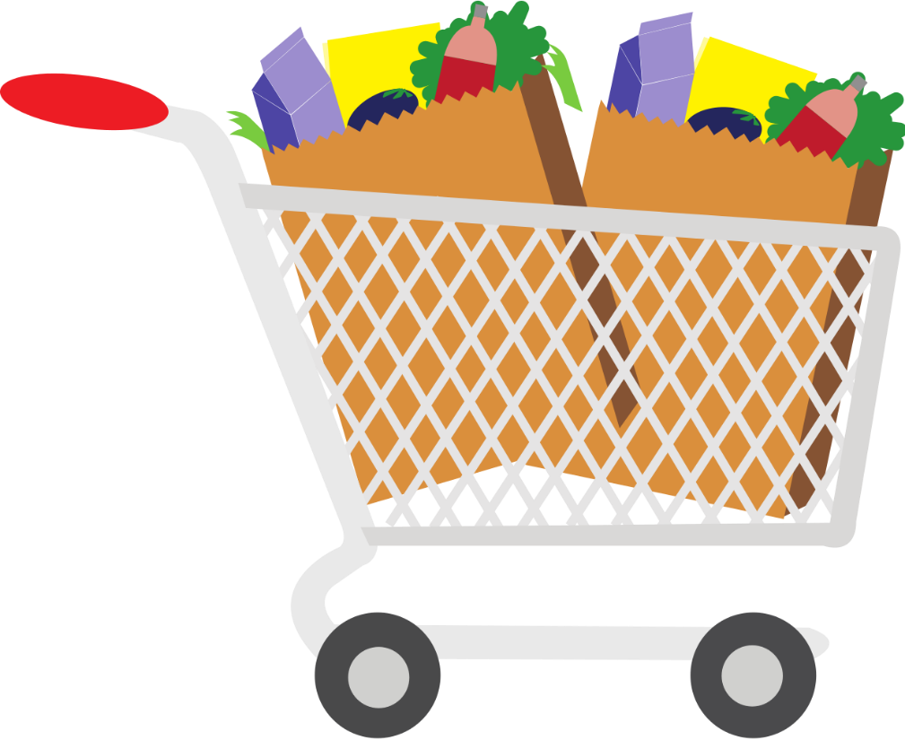
Next step: SNAP (Food Stamp) Challenge
The Situation….
You live in the District of Columbia. You work full-time, but your pay just doesn’t cut it. With rent and other bills to pay, you depend on SNAP benefits (food stamps) to eat.
You really have to plan your weekly food budget to make sure it all lasts.
Notes:
Now it’s time to introduce the community activity ---- the SNAP (or food stamp) Challenge. Here’s the situation: You live in the District of Columbia. You work full-time, but your pay just doesn’t cut it. With rent and other bills to pay, you depend on SNAP benefits (food stamps) to eat.
You really have to plan your weekly food budget to make sure it all lasts.

Slide 36
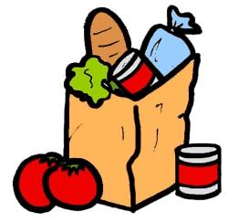
Your SNAP Challenge
Shop for a week’s worth of groceries on a SNAP budget
Budget: $30/week for an individual, or $60/week for two
If possible, shop at one of these grocery stores:
Giant 1535 Alabama Ave SE, Washington, DC 20032
Safeway 2845 Alabama Ave SE, Washington, DC 20020
Place all items in cart, tallying cost on phone/paper (weigh produce as needed, use Giant app if you have it!)
Take a photo of your cart
*You may choose to purchase the cart’s goods and
live this way for a week, but this is not a requirement.
You can leave your un-purchased cart in the store after taking the photo.
Notes:
Your SNAP Challenge will be to shop for a week’s worth of groceries on a SNAP budget. The average D.C. Food Stamp allottment is $1.40 per meal, so about $30/week for one person. If you currently share groceries with another individual, you can double that to $60/week to more directly compare your experience to your current situation.
If possible, shop at one these grocery stores – Giant or Safeway on Alabama Avenue in Southeast D.C.
Place all your items in the cart, tallying cost along the way on paper or your phone. Weigh produce as needed for prices. Use the Giant app if you have it!
Then take a photo of your cart with your week’s allottment.
*You may choose to purchase the cart’s goods and live this way for a week, but this is not a requirement. You can leave your un-purchased cart in the store after taking the photo.

Slide 37
Reflection
Please reflect on your experience afterwards (~half page) and submit it with your cart photo to:
- Dr. Dale Coddington (Categorical Track)
- Dr. Cara Lichtenstein (Community Track)
- Dr. Ed Sepe (Primary Care Track)
Food for thought…
How easy is it to ensure a balanced, nutritious diet for the week?
Will you have enough for the week?
What did you prioritize?
If you were able to get to the recommended stores, did this grocery store differ from your neighborhood store in any way?
How would it feel to know this isn’t just a one-week deal? What if you had to do this again week after week?
Notes:
After leaving the grocery store, take some time to reflect on your experience. Please write about a half-page reflection and submit it to the appropriate advisor as listed here. You can email or print it to hand in. You will not be graded on this exercise.
Some Food for Thought….
How easy is it to ensure a balanced, nutritious diet for the week?
Will you have enough for the week?
What did you prioritize?
If you were able to get to the recommended stores, did this grocery store differ from your neighborhood store in any way?
How would it feel to know this isn’t just a one-week deal? What if you had to do this again week after week?

