Slide 1
Asthma Scripts to School

Slide 2
Updated for 2018
School nurses are back Mon, 8/13
Walgreens will FedEx Asthma Action Plan, spacer and asthma meds directly to DCPS and most DC charter schools at no cost to family
Delivery in 1-3 business days
NEW this year!
Walgreens will also FedEx asthma meds directly to the participating patient’s home at no cost
Trusted will incentive patients $20 to participate
Trusted and AmeriHealth will cover 2 inhaled steroids

Slide 3
What do I do?
E-prescribe inhalers (albuterol ± inhaled steroid) to Walgreens for delivery to school ± home.
Complete and sign/have parent sign Asthma Action Plan
Give parent Walgreens Authorization Form to complete
Staple Asthma Action Plan to Walgreens Authorization Form, and drop in blue “WALGREENS” folder behind the to-be-scanned folder for 3PM daily pick up.

Slide 4
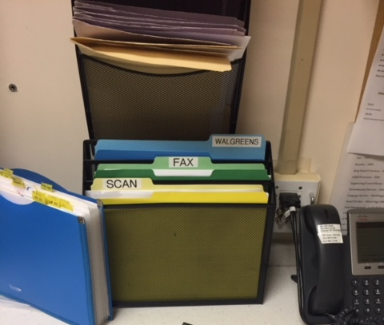
Walgreens folder in Lion pod (under Bright Futures)
Same in Zebra, slightly different in Giraffe
Daily pick up at 3PM. FedEx that evening. Next day if left after 3PM pick up.

Slide 5
Use the browse function when e-prescribing to instruct the pharmacist on whether to send the Rx to home, school or hold for patient pick-up

Slide 6
Use the browse function when e-prescribing to instruct the pharmacist on whether to send the Rx to home, school or hold for patient pick-up

Slide 7
Preview of Rx with comments

Slide 8
Order Set “Walgreens Scripts to School”
Order Set will allow you to:
Order Medications
Select MDI teaching and Asthma Action Plan Procedures
Include language in treatment section for Visit summary to explain next steps of receiving their medications
Print Authorization form if you don’t already have it

Slide 10
Template “Walgreens Scripts to School Template”
Has only standard language in treatment section for visit summary

