Slide 1
Instructions for Logging Duty Hours in MedHub
GME Office
Children’s National Medical Center

Slide 2
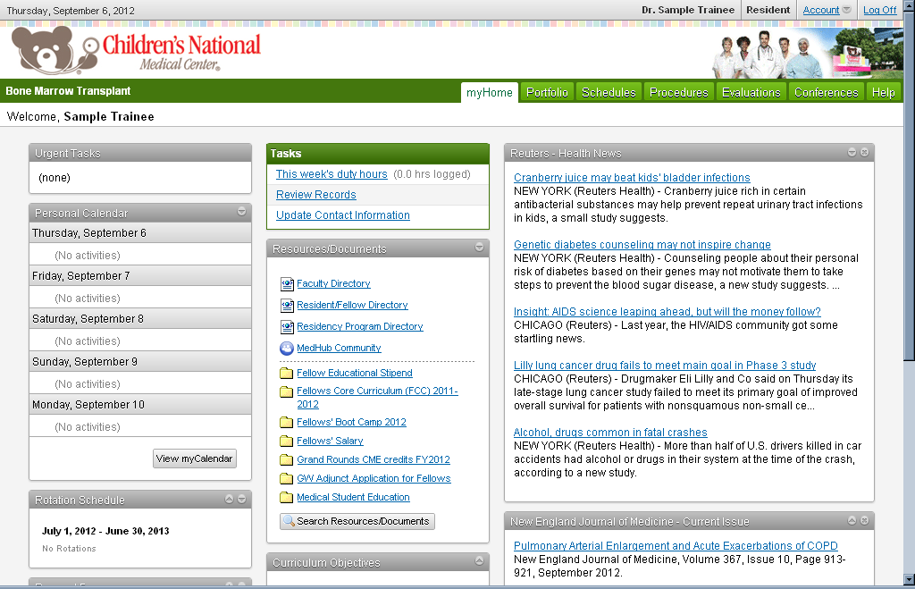
Log into Medhub & Select “This week’s duty hours”

Slide 3
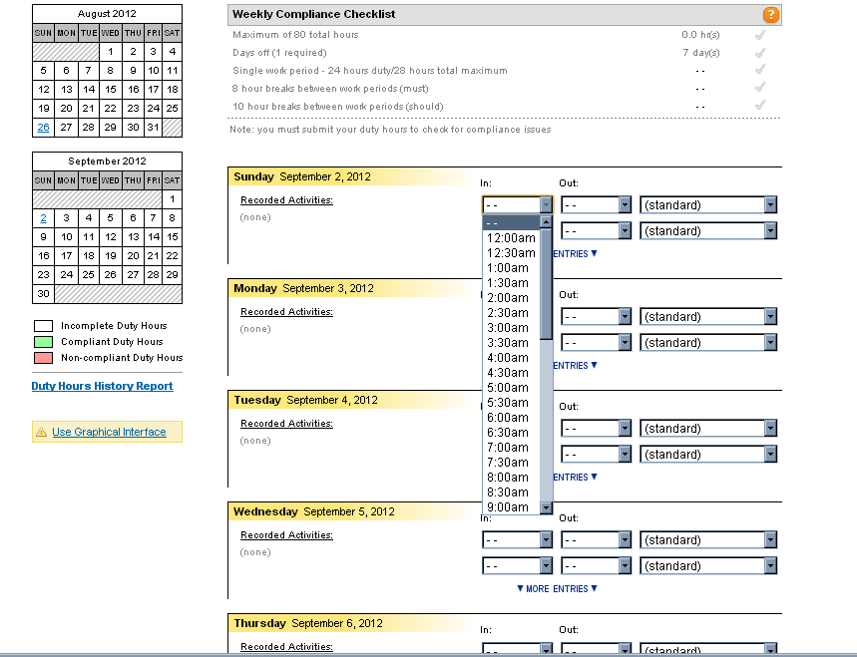
Select Graphical Interface
Change view to Graphical Interface

Slide 4
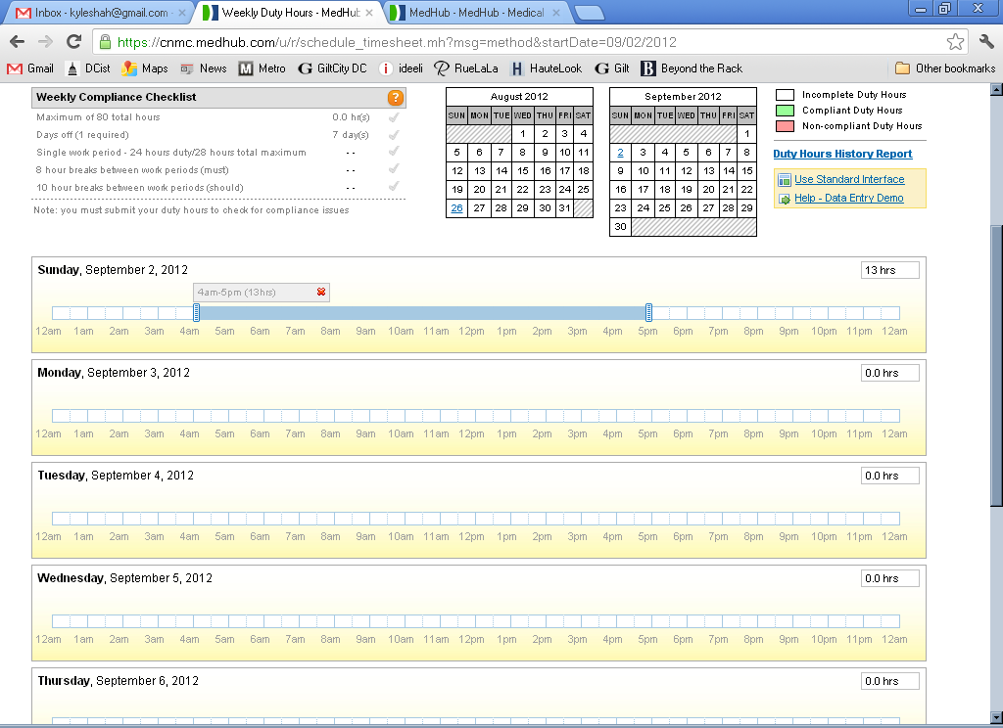
Log Daily Duty Hours. Save daily entries and Submit at end of week – See Save/Submit buttons at bottom of screen.

Slide 5
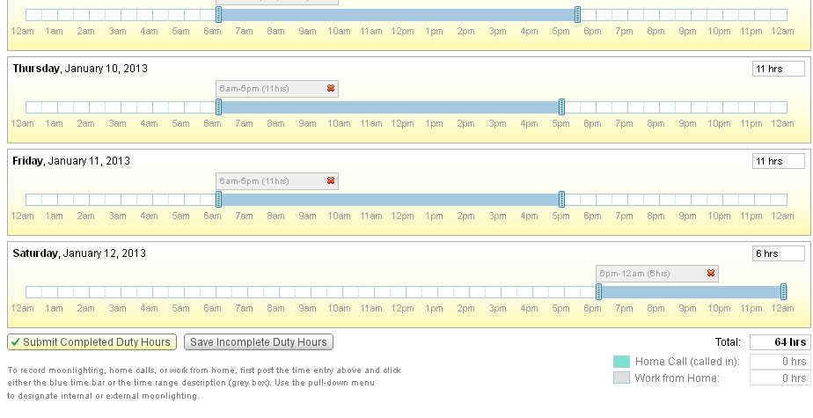
You’re not done until you hit SUBMIT!

