Slide 1
PGY-2 Greatest Hits

Slide 2
HEME
VOC = Vaso-occlusive Crisis with Sickle Cell Disease
Acute pain in patients with sickle cell disease is caused by ischemic tissue injury resulting from the occlusion of microvascular beds by sickled erythrocytes during an acute crisis.
Chronic pain occurs because of the destruction of bones, joints and visceral organs as a result of recurrent crises.

Slide 3
VOC
Include:
Phenotype ( SS vs SB0 )
Baseline Hgb
Blood consent for every patient admitted
Treatment:
PCA: continuous vs demand (run via Pain team)
Can give ATC Morphine/Dialudid + Morphine/Dialudid PRN ( “creating your own PCA”)
Transition to orals🡪
Oxycodone ATC + Morphine/Dialudid PRN
Only prescribe ~ 15-20 Oxycodone pills at discharge!

Slide 4
Oh no..
You admitted a 15 year old with her “typical VOC pain.” She hasn’t left the bed in days. Suddenly, she reports chest pain, has a new fever and her O2 stats drop to 88%.
What is happening?!

Slide 5
Acute Chest Syndrome
Definition:
new pulmonary infiltrate on chest radiograph in addition to one or more of the following: fever, tachypnea, dyspnea, hypoxia, and chest pain
Cause:
most common infectious causes of ACS included Chlamydia pneumoniae (28% of infections), viral infection (22%), and Mycoplasma pneumoniae (20%)
Also thought to be from pulmonary infarct/ fat emolisms
Tx: Start CTX, Azithromycin + supplemental oxygen
Know: have they needed BiPap in the past?
Low threshold for PICU for early initiation of BiPap

Slide 6
Splenic Sequestration
Rapid enlargement of the spleen with resultant trapping of the blood elements.
Occurs in 30% of children with SS by 5 years of age
Findings:
Splenomegaly
Hgb value below baseline
Thrombocytopenia
Management:
Cautious transfusion to Hgb values between 7 and 9 gr/dL. (usually 5ml/kg)
Watch:
Reuction in spleen size frequently occurs 1 to 3 days after initial presentation
Can lead to auto transfusion
Long Term:
50% of patients have recurrence of splenic sequestration
Splenectomy is performed commonly after a second or third sequestration episode

Slide 7
FEVERS
HEME:
Oral or Rectal 🡪 38.5 C
Ax Temp >37.8 confirm with oral/ rectal
Blood cultures q24 hours for fever

Slide 8
ONC
Neutropenia:
Defined as an absolute neutrophil count less than 500/µl, or less than 1000/µl when counts are anticipated to fall based on having recently received myleosuppressive chemotherapy administration within the last 2 weeks.
FEVERS:
NO RECTAL TEMPS!!
Low grade fever 38.0-38.2 RECHECK IN 1 hour
FEVER= 38.3 C
**IF < 12 months or down syndrome: Fever= 38.0 C
Blood cultures q 24 hours for fever (always aerobic--consider anaerobic or fungal
Antibiotics
Cefepime (started if neutropenic + fever)
-/+ Vanc if:
s/p high dose cytarabine
AML
Growing GPCs
Mucositis
http://stemcell/ho_index.html
Notes:
Anaerobic blood cultures are indicated ONLY if significant gastrointestinal symptoms and/or mucositis are present. o Fungal cultures are indicated only for those patients who have prolonged neutropenia (greater than 5 days) or who are to be started on empiric antifungal therapy. Fungal cultures should generally not be sent more than twice a week (unless repeating a previously positive one)

Slide 9
RENAL
Elevated Blood Pressure
SBP and/or DBP between 90-95th percentile
Stage 1 Hypertension:
SBP and/or DBP ≥ 95th %ile but ≤ 95 %ile+ 12 mmHg
Stage 2 Hypertension:
SBP and/or DBP > 95th %ile + 12 mmHg
Inpatient Cutoffs:
95% + 12 mmHg (when giving PRN medications)
All based on gender, height, and age!
Notes:
Peds BP app

Slide 10
Hypertensive urgency: Severe elevation (Stage 2) without end-organ damage
Hypertensive emergency: Severe elevation (Stage 2) with any sign of end-organ damage
Signs/symptoms of end-organ damage include:
CNS 🡪 headache, seizures, lethargy, irritability
Eyes 🡪 papilledema, visual changes
Cardiac 🡪 cough, SOB, signs of heart failure, gallop
Renal 🡪 hematuria, proteinuria

Slide 11
What do I do!?!
See the patient!
Confirm the blood pressure
Manual reading with auscultation
Appropriate size cuff
Assess blood pressure trends
Assess for other secondary causes
Pain
Drugs
Increased ICP
Look for signs/symptoms of end-organ damage
Decide whether emergency, urgency, or just hypertension

Slide 12
Medication Management
Hypertensive Urgency:
Obtain IV access
Oral could be used if tolerating PO (e.g. clonidine)
If acute, treat medically:
Hydralazine 0.1- 0.2 mg/kg/dose IV (max dose 20 mg/dose)
Labetalol 0.2-1 mg/kg/dose IV (max dose 20 mg/dose)
If chronic (e.g. long-standing renal dx, etc.)
Consult with nephrology
Consider oral medications
Notes:
Hydralazine- direct vasodilator of arterial smooth muscle, onset of action is slower than labetalol/nicardipine and duration of treatment is longer
Labetalol- alpha and beta adrenergic blocker
Can also use isradipine as second line, as it increases then labetalol, then nicardipine DRIP!
Want to lower BP in controlled fashion by no more than 25% of the overall planned BP reduction over the 1st 8 hours of treatment (95-99th percentile)

Slide 13
Remember…
Always recheck BP manually with an appropriate-sized cuff
Treat underlying causes if any exist
Hypertensive urgency and emergency require treatment
Any sign of end-organ involvement = hypertensive emergency 🡪 TRANSFER TO ICU

Slide 14
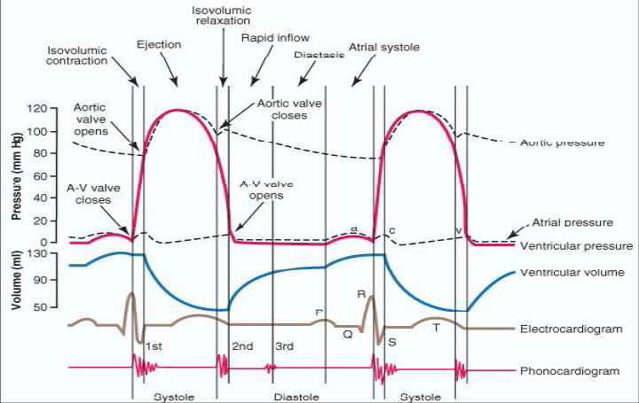
CARDS

Slide 15
EKG Basics
We define normal sinus rhythm as:
a rate that is within the normal limits for age
with a P wave preceding every QRS complex (by a normal PR interval for age) and a QRS complex after every P wave
upright P waves in leads I and AVF.
Remember:
Rhythm (normal R-R intervals)
Rate
P wave Morphology (P-R interval 3-5 small boxes or 0.12-.2 s)
QRS interval ( 3 boxes or 0.12 s)
Electrical Axis (Leads I and aVF )

Slide 16
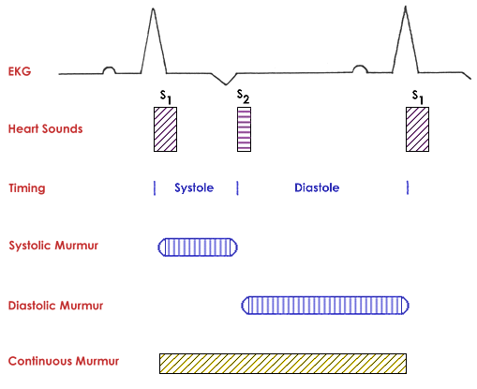
Heart Sounds
S1: closure of mitral/tricuspid valves
S2: closure of aortic/pulmonary valves

Slide 17
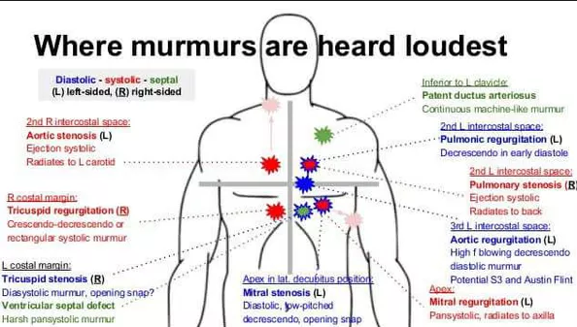
Heart Murmurs
Notes:
Listening to their back and if radiate to the back
How to look at the tracing

