Slide 1
Electrolyte Abnormalites: Sodium, Potassium, & Calcium
National Pediatric Nighttime Curriculum

Slide 2
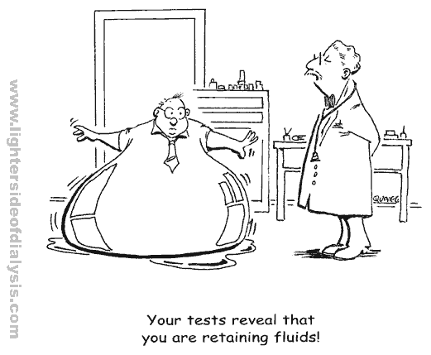
SODIUM: Hyper/hyponatremia

Slide 3
HYPONATREMIA: Sodium level < 135mmol/l
Impaired renal ability to excrete free water in the setting of excess, it is RARELY an issue with salt intake or loss alone!
Pathogenesis?
Effective circulating volume depletion:
GI losses, skin losses (cystic fibrosis), renal losses (cerebral salt-wasting, hypoaldosteronism, diuretics), edematous states (CHF, cirrhosis, hypoalbuminemia – have overall hypervolemia but ADH release 2/2 low circulating volume)
Thiazide diuretics
Renal Failure: acute or chronic
Non-hypovolemic states of ADH excess: SIADH, cortisol deficiency, hypothyroidism

Slide 4
Use urine sodium to differentiate extrarenal from renal losses, if hypovolemia is present:
Urine sodium >20mEq/L = renal losses or mineralocorticoid deficiency (meaning that the urine is inappropriately concentrated)
Urine sodium <20mEq/L = decreased ECV (ie, edematous states) where kidney wants to retain sodium despite excess total body sodium
Also, urine osmolality can be helpful:
Urine Osm >100mOsm/kg (inappropriately concentrated) = inability to excrete free water renally
Urine Osm <100mOsm/kg may mean excess free water uptake with psychogenic polydipsia or water intoxication in infants

Slide 5
But, wait? It is actually pseudohyponatremia?
Hyperglycemia: hyperosmolality 🡪 shifts fluid from ICF to the ECF (1.6mmol/L decrease in Na for every 100mg/dL increase in glucose above nl)
Extreme hyperproteinemia, hyperlipidemia: displace plasma water, but with maintaining normal osmolality
If it is true hyponatremia, use urine sodium to guide your differential:
Urine sodium <25mEq/L = effective circulating volume depletion

Slide 6
Clinical Manifestations:
Influx of water into ICF 🡪 cellular swelling 🡪 cerebral edema, encephalopathy (in children, at risk for symptomatic hyponatremia given higher brain-skull ratio with less room to expand!)
Most morbidity in patients with respiratory arrest with hyponatremic encephalopathy
Interestingly, hypoxemia lessens the brain’s ability to adapt to hyponatremia, leading to a vicious cycle of worsening encephalopathy

Slide 7
A Few Causes of Hyponatremia:
SIADH: severe (serum sodium <120mmol/L)
Causes: CNS disorders, infection (meningitis, encephalitis), neoplasms, postpituitary surgery, PNA, TB, PPV, PTX, vincristine, IV cyclophosphamide, carbamazepine, SSRI’s, ectasy induced
Treatment: fluid restriction but difficult with infants in particular. If giving fluids, make sure it is isotonic! But, use a loop diuretic with hypertonic fluids if a more rapid correction is needed.
Post-operative hyponatremia - resolves POD#3-5
Water intoxication in infants
Diuretic use, psychogenic polydipsia…..

Slide 8
Treatment:
*Review calculations presented in Harriett Lane*
Symptomatic hyponatremia (ie, encephalopathy) is a medical emergency: treat with hypertonic saline
Correct by 10-12mEq/L in the first 24 hours, with first 3-5mEq/L quite rapidly
Keep in mind that 1mL/kg hypertonic saline will raise plasma sodium by about 1mEq/L
Cerebral demyelination: complication of overcorrection (corrected by greater than 25mmol/L in 24-48hours) that occurs several days later

Slide 9
Hypernatremia serum sodium >145mmol/L
Defenses against hypernatremia: thirst mechanism, producing a concentrated urine 🡪 so rarely develop hypernatremia from excessive sodium intake or renal concentrating defect alone
*Like hyponatremia, it is a problem of total body water deficiency relative to total body solute

Slide 10
Clinical Manifestations:
Hypernatremia causes efflux of fluid from ICF to ECF 🡪 cerebral dehydration, can adapt by increasing cerebral intracellular content of sodium, potassium, amino and organic acids to off set osmotic gradient
BUT, this takes time. Acutely, hypernatremia can lead to physical separation from meninges with shrinkage (rupture bridging veins, intracranial hemorrhage), venous sinus thrombosis 🡪 infarction, central pontine myelinosis
Mortality may be up to 15%!

Slide 11
A few Causes of hypernatremia:
Water losses:
Renal: central or nephrogenic diabetes insipidus, diuretics, hyperglycemia
Insensible: fever, burns, respiratory illness
GI: osmotic diarrhea, colostomy, malabsorption
Decreased fluid intake: hypothalamic disorder, neurologic impairment, ineffective breast feeding
Excessive sodium administration: either oral, parenteral, or mineralocorticoid excess

Slide 12
Treatment of Hypernatremia:
Need to correct serum sodium and circulatory volume deficient BUT hard to assess free water loss on exam because fluid shifts protects intravascular volume
Simple calculation to use instead:
Free water deficit (mL) = 4mL x lean body weight (kg) / [desired change in serum sodium (mmol/L]
Remember to add this to the patients maintenance fluid needs to balance ongoing losses!
Replace ½ of the volume deficient in first 8 hours, with the remainder in the following 16 hours
Again, Harriett Lane outlines more detailed calculations

Slide 13
Other caveats of treatment:
Rules of thumb:
The rate of correction to avoid cerebral edema is not more than 1meQ/hour or 15meQ/24hours.
For severe hypernatremia >170meQ/L, do not correct to below 150meQ/L in the first 24-72hours
Seizures may be a sign of cerebral edema – can slow the rate or give some hypertonic saline to counter sodium adjustment. These seizures are usually self-limited, and have no implications on long-term neurologic outcome

Slide 14
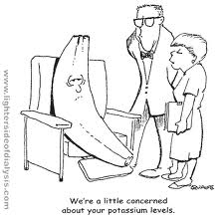
Potassium: Hyper/hypokalemia

Slide 15
Normal Homeostasis:
Largely renally regulated with glomerular filtration, then reabsorption/secretion in the distal nephron
Interference with any part of this leads to imbalance
Adding another layer: keeping ENaC channel in mind (aldosterone driven Na+ absorption for K+/H+ excretion helps you think through clinical scenarios like congenital adrenal hyperplasia)
And…remember that metabolic acidosis (including diabetic ketoacidosis), shifts H+ into cells in exchange for K+, causing hyperkalemia

Slide 16
Causes of Hyperkalemia (>5.5mEq/L):
Pseudohyperkalemia: hemolysis, local ischemia
Hemolysis following massive pRBC transfusion
Acute or chronic renal failure, HUS, or even acute glomerulonephritis or interstital nephritis
Medications: spironolactone, enalapril, NSAIDs
Congenital adrenal hyperplasia
Manifestation of metabolic acidosis, especially in VLBW preterm neonates

Slide 17
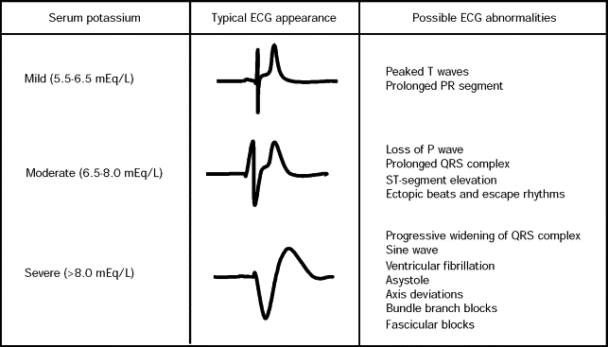
Clincal Manifestations: asymptomatic until level rises quite high!
>7-8.5mEq/L: ascending muscle weakness
>9-10mEq/L: effect on cardiac conduction with fibrillation or asystole

Slide 18
Potential Treatments: Remember underlying pathophysiology
Stabilize myocardium with calcium gluconate
Shift potassium back intracellular with insulin/glucose, albuterol, or increasing serum pH in an acidotic patient (sodium bicarbonate, hyperventilation)
Eliminate potassium from the body with hemodialysis, diuretics, or ion exchange resins like kalexate

Slide 19
Causes of Hypokalemia (<3.5mEq/L)
Intracellular shifting: alkalosis, hyperthyroid, barium poisoning, delirium tremens
Increased loss of potassium
Decreased intake (alcoholism, anorexia)
Gastrointestinal losses
Urinary losses
Osmotic diuresis (mannitol, and interesting DKA can cause both hyper- and hypokalemia)
Mineralocorticoid excess, Cushing syndrome
Antibiotics: amphotericin, cisplatin, aminoglycoside

Slide 20
Hypokalemia: Clinical Manifestations
Membrane hyperpolarization, impaired muscle contraction 🡪 affects muscle, cardiac tissue
Mild (3-3.5mEq/L): asymptomatic
Moderate (2.5-3mEq/L): weakness, myalgia, constipation
Severe: flaccid paralysis, hyporeflexia, respiratory depression if severe enough

Slide 21
Hypokalemia: Treatment
Milder hypokalemia: oral potassium chloride (daily requirement is 1-2mEq/kg/day)
With cardiac arrythmias, muscle weakness or respiratory distress (or in the ICU setting), given 0.5mE/kg KCl bolus over 1-2 hours

Slide 22
Calcium: Hyper/hypocalcemia

Slide 23
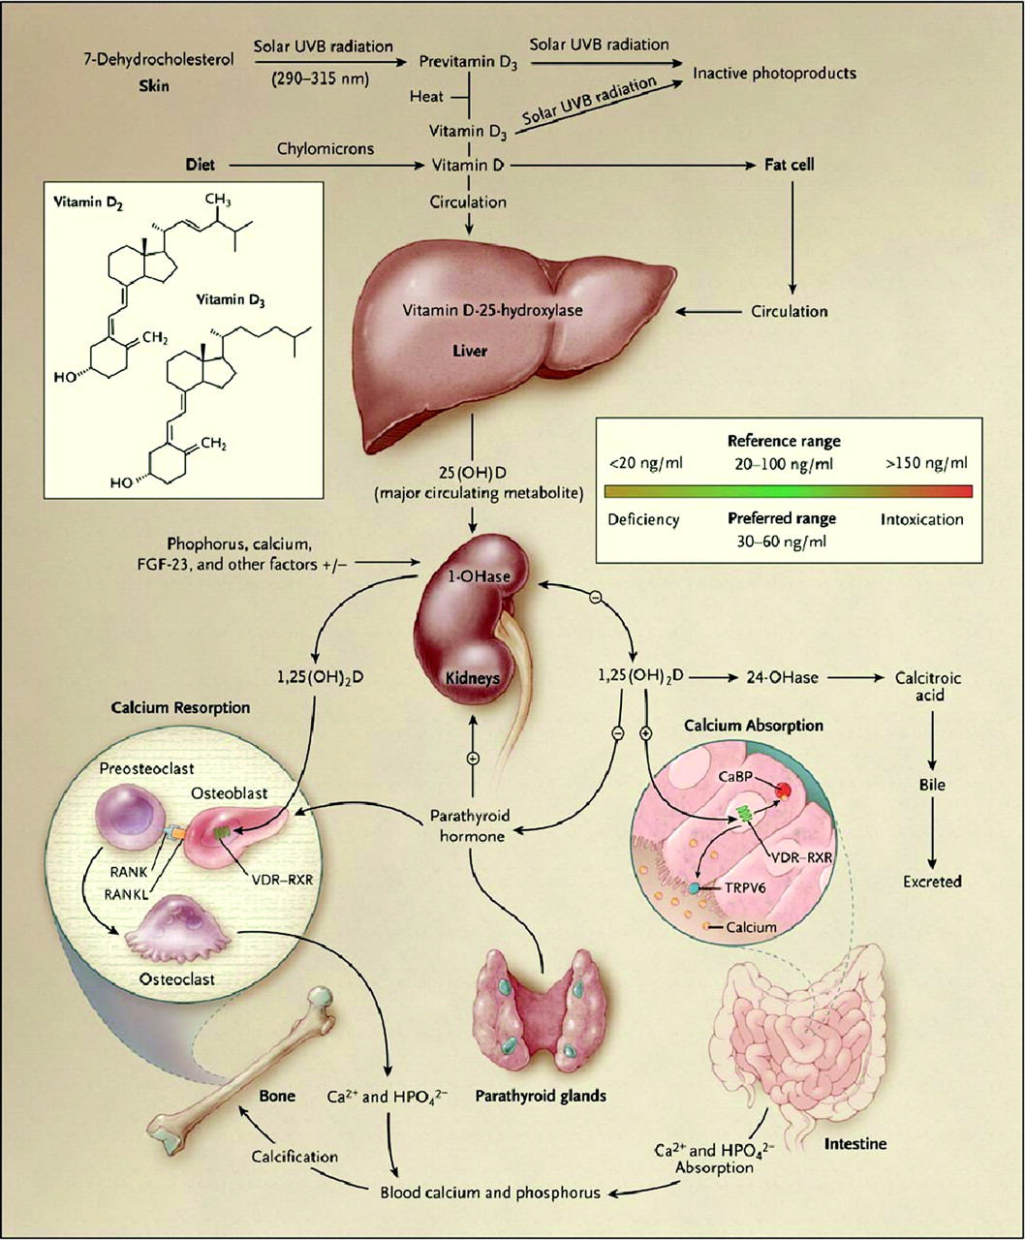

Slide 24
Hypercalcemia
Etiologies:
Hormone imbalance: inappropriate PTH release (adenoma, malignancy), excess vitamin D (exogenous intake, granulomatous diseases)
Metabolic alkalosis – causes increase tubular reabsorption
Glucocorticoid effects on bone formation, intestinal absorption
States of high bone turnover – hyperthryoidism, prolonged immobilization, thiazide use
Renal failure: severe secondary hyperparathyroidism, milk-alkali syndrome

Slide 25
Symptoms of Hypercalcemia:
Stones: renal or biliary
Bones: bone pain
Groans: abdominal pain, nausea, vomiting
Thrones: polyuria
Psychiatric overtones: depression, coma, insomnia
-Other symptoms: pancreatitis, shortened QT interval
- At very high calcium levels (12mg/dL): medical emergency given risk of coma, or cardiac arrest with ventricular arrythmias

Slide 26
Treatment Hypercalcemia:
First line treatment: hydration, furosemide
Other treatments: calcitonin, biphosphonates, glucocorticoids (increases calcium urinary excretion, decreases intestinal absorption), dialysis

Slide 27
Hypocalcemia
Remember to correct for hypoalbuminemia or metabolic alkalosis (increases binding to albumin)!!
Etiologies:
Neonate: early (IDDM) verus late (after the 5th postnatal day from immature parathyroid glands)
Underlying illness: sepsis, cardiac surgery, pancreatitis, tumor lysis syndrome
Chronic causes:
PTH related: hypoparathyroidism, pseudoparathyroidism
Vitamin D deficiency, liver dysfunction, renal failure

Slide 28
Treatment Hypocalcemia
IV Calcium infusions with close cardiac monitoring
Need to correct hypomagnesemia for better PTH activity (needed for its release)

Slide 29
Bibliography
Daly, Kayleen, PharmD, and Elizabeth Farrington, PharmD. "Hypokalemia and Hyperkalemia in Infants and Children: Pathophysiology and Treatment." Journal of Pediatric Health Care 27.6 (2013): 486-95. Web.
Moritz, Michael, and Juan C. Ayus. "Disorders of Water Metabolism in Children: Hyponatremia and Hypernatremia." Pediatrics in Review 23.11 (2002): 371-79. Web.
Zhou, Ping, and Morri Markowitz. "Hypocalcemia in Infants and Children." Pediatrics in Review 30.5 (2009): 191-92. Web.

Slide 30
Symptoms of Hypocalcemia
Muscular excitability, contractions 🡪 tetany, Chvostek and Trousseau’s signs
CNS irritability: anticonvulsant resistant seizures
Cardiac: hypotension, impaired cardiac contractility

