Slide 1
Pediatric Hypertension Night-time Curriculum Talk

Slide 2
Objectives
Describe the initial steps in evaluation of pediatric hypertension in inpatient setting
Identify scenarios where medical therapy is warranted for inpatient hypertension
Select appropriate medications of hypertensive urgency and emergency

Slide 3
Case #1
You are the nighttime intern and are paged at 8:00PM:
“FYI the patient in Room 734 has a BP of 125/82”
-Nurse Sarah
Your sign-out for this patient:
11 yo M here for asthma exacerbation.
Meds: albuterol q2, prednisone
What else do you want to know?
Notes:
Start simple. Always get a repeat blood pressure manually.
Reflect on the past – has this patient been hypertensive before now. In the hospital? In clinic?
Can the medications contribute?

Slide 4
Case #2
You are now the PL-2 on call tonight. An intern calls you with the following question:
“The 8 mo in Room 702 is having BPs as high as 113/62. What should I do?”
- John, intern
The signout:
8 mo ex-26 week preemie admitted w labial abscess.
Weight = 6.4 kg, Length = 64 cm
Notes:
DDx includes renal, cardiovascular, medications, endocrine, neurologic and pain
The initial thought process should include these etiologies, with a focus on things that affect an 8mo (birth hx, current illness, etc).
Patient’s prior hx is important as historically a NICU stay can indicate prior umbilical lines that lead to renal artery stenosis, for example.
Obviously, the labial abscess is quite painful – never assume pain is well controlled.

Slide 5
Hypertension Definitions
Normal BP SBP/DBP <90th percentile
[<120/80]
Elevated BP (Previously Prehypertension)
SBP and/or DBP between 90-95th percentile/
[120-129/<80]
Stage 1 Hypertension:
SBP and/or DBP ≥ 95th %ile but ≤ 95th %ile + 12 mmHg/
[130/80-139/89]
Stage 2 Hypertension:
SBP and/or DBP > 95th %ile + 12 mmHg
>140/90
All based on gender, height, and age!
Must see reference table (check out Harriet Lane)

Slide 6
Hypertension Definitions
Hypertensive urgency: Severe elevation (Stage 2) without end-organ damage
Hypertensive emergency: Severe elevation (Stage 2) with any sign of end-organ damage
Signs/symptoms of end-organ damage include:
CNS → headache, seizures, lethargy, irritability
Eyes → papilledema, visual changes
Cardiac → cough, SOB, signs of heart failure, gallop
Renal → hematuria, proteinuria
Notes:
End organ signs are essential in differentiating urgency from emergency. In pediatrics, we are more likely to see symptoms that can be confused with other illnesses in the acute setting (e.g. seizures, lethargy, SOB)
Any signs of end-organ damage (excluding a clear cause from another etiology) results in the definition of Hypertensive Emergency.

Slide 7
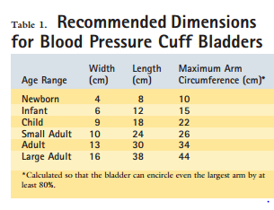
Initial Approach
See the patient!
Confirm the blood pressure
Manual reading with auscultation
Appropriate size cuff
Assess blood pressure trends
Assess for other secondary causes
Pain
Drugs
Increased ICP
Look for signs/symptoms of end-organ damage
Decide whether emergency, urgency, or just hypertension

Slide 8
Differential Diagnosis: MONSTER
M: Medications
O: Obesity
N: Neonatal history
S: Symptoms and signs
T: Trends in the family
E: Endocrine
R: Renal
Notes:
Selected medicines: albuterol, atomoxetine, amphetamines, antidepressants, antipsychotics, caffeine, carbamazepine, cocaine, cyclosporine, ephedrine, epogen, ethanol, fentanyl, gentamicin, ketoconazole, methylphenidate, NSAIDs, OCPs, phenylephrine, pseudoephedrine, steroids, tacrolimus
Neonatal history: umbilical artery catheter, neonatal asphyxia, BPD, anatomical (obstructive uropathy, cystic disease, parenchymal renal disease), renal vein thrombosis, maternal substance abuse, medications
Symptoms/signs: Anything to suggest pheochromocytoma? Hyperaldosteronism? Cushing’s syndrome? Neurofibromatosis?
Trends in family: essential or secondary hypertension, HLD, DM, systemic disease (neurofibromatosis, SLE)
Endocrine: Signs of cortisol excess, steroid use
Renal: Abdominal bruit, growth retardation, family history PKD, renal scars, trauma

Slide 9
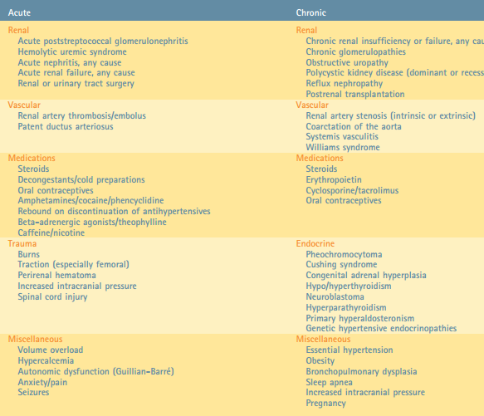
Differential Diagnosis

Slide 10
Management
Hypertensive Urgency:
Obtain IV access
Oral could be used if tolerating PO (e.g. clonidine)
If acute, treat medically:
Hydralazine 0.1- 0.2 mg/kg/dose IV (max dose 20 mg/dose)
Labetalol 0.2-1 mg/kg/dose IV (max dose 20 mg/dose)
If chronic (e.g. long-standing renal dx, etc.)
Consult with nephrology
Consider oral medications
Notes:
Hydralazine- direct vasodilator of arterial smooth muscle, onset of action is slower than labetalol/nicardipine and duration of treatment is longer
Labetalol- alpha and beta adrenergic blocker

Slide 11
Management
Hypertensive emergency:
Obtain IV access
Treat medically:
Hydralazine 0.2 mg/kg/dose
Labetalol 0.2-1 mg/kg/dose
Transfer to ICU for further care
Look for signs of end-organ dysfunction- encephalopathy, vision changes, renal failure, heart failure, etc.
Notes:
— We recommend that children with acute severe hypertension and life-threatening symptoms and/or target-organ involvement should emergently receive intravenous medication that lowers systolic blood pressure (BP) in a controlled fashion by no more than 25 percent of the overall planned BP reduction over the first eight hours of treatment [2-4,9,11]. The ultimate goal for treatment is achievement of a BP value that will cause cessation of life-threatening signs and symptoms and prevent further hypertensive target organ effects. Generally speaking, this is typically a BP between the 95th and 99th percentiles for age, sex, and height (table 5 and table 6), but the goal should be individualized for each patient as determined by response to treatment.

Slide 12
Management
Hypertensive emergency:
May need continuous labetalol/nicardipine gtt
Want to lower BP in controlled fashion by no more than 25% of the overall planned BP reduction over the 1st 8 hours of treatment (95-99th percentile)
Notes:
— We recommend that children with acute severe hypertension and life-threatening symptoms and/or target-organ involvement should emergently receive intravenous medication that lowers systolic blood pressure (BP) in a controlled fashion by no more than 25 percent of the overall planned BP reduction over the first eight hours of treatment [2-4,9,11]. The ultimate goal for treatment is achievement of a BP value that will cause cessation of life-threatening signs and symptoms and prevent further hypertensive target organ effects. Generally speaking, this is typically a BP between the 95th and 99th percentiles for age, sex, and height (table 5 and table 6), but the goal should be individualized for each patient as determined by response to treatment.

Slide 13
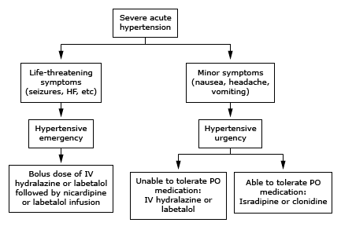
Treatment Algorithm

Slide 14
Big Picture Stuff
Our job on-call is to identify urgencies/emergencies and treat as needed
Always interpret blood pressure by age and height-based norms
Workup can be done less acutely if patient is stable

Slide 15
Take-Home Points
Always recheck BP manually with an appropriate-sized cuff
Treat underlying causes if any exist
Hypertensive urgency and emergency require treatment
Any sign of end-organ involvement = hypertensive emergency → TRANSFER TO ICU
Notes:
=

Slide 16
PREP QUESTION:
You are evaluating a 15 yo M in the ED who complains of a severe headache lasting several days. Pain does not change throughout the day. Has also had some blurry vision. On physical exam, BP = 195/130 and patient has papilledema.
Of the following, the MOST appropriate medication to administer via continuous infusion is:
Diazoxide
Fenoldopam
Hydralazine
Labetalol
Phentolamine
Notes:
Answer: Labetalol
Intravenous antihypertensive medications should be started as soon as the emergency is recognized, with the goal of lowering the blood pressure to a level that will stop or at least mitigate the end organ damage. In general, lowering the blood pressure by approximately 20% to 25% over the first 8 hours will achieve this goal. Further lowering of the blood pressure may produce end organ damage because of lack of adequate perfusion secondary to altered autoregulation. The selection of the appropriate agent will depend on the suspected underlying cause but in general labetalol (a b-blocker) or nicardipine (a calcium channel blocker) are generally used as first-line agents because of their proven efficacy and their ability to be given in continuous infusions after an initial bolus.
Hydralazine, a direct arterial smooth muscle dilator, also has been used as a first-line agent but has a slower onset of action and longer duration, and cannot be used as a continuous infusion. Phentolamine, an a-adrenergic blocker, would be indicated in the setting of excessive catecholamine levels as might occur with a pheochromocytoma or cocaine overdose. Fenoldopam, a peripheral dopamine receptor agonist, is less potent than either labetalol or nicardipine and, therefore, is not generally recommended for initial treatment. Because of its ability to improve renal perfusion, it may be a useful drug in patients with renal insufficiency. Sodium nitroprusside is no longer generally recommended as a first-line agent because of potential cyanide toxicity. Diazoxide also is no longer recommended as a first-line agent because of its unpredictable blood pressure lowering effect.

Slide 17
References:
Constantine E, Linakis J. The assessment and management of hypertensive emergencies and urgencies in children. Pediatr Emerg Care. 2005; 21:391-396.
Fromme. National Nighttime Curriculum. Hypertension ppt. University of Chicago.
Uptodate. Approach to hypertensive emergencies and urgencies in children

