Slide 1
Chest Films 103: Pneumothorax and Pleural Effusions
Night Float Hands On Curriculum
Date: 2/2015

Slide 2
The pleural space is an important area that should be evaluated on all radiographs.
This is a potential space that normally contains only a few cc’s of fluid, which can’t be seen on imaging.
It becomes pathologic when it fills with air (pneumothorax) or fluid (pleural effusion, hemothorax, empyema, etc).
Notes:
There are other things that can go wrong with the pleura and pleural space, but these are rare in kids (tumors, fibrosis, calcification, etc).

Slide 3
Case:
John Smith is a 16 year old healthy boy who plays football. During practice, he had acute onset of chest pain and shortness of breath. He was brought by his friends to the Emergency Department for further evaluation and management?
What is the differential diagnosis of John?

Slide 4
Case continued:
This chest film was obtained. What do you see?

Slide 5
Taking a closer look…
Pneumothorax

Slide 6
Pneumothorax Continued
What are some causes of pneumothorax?
trauma
popped bleb
overventilation (combo volume/pressure)
What are some signs and symptoms of pneumothorax?
Symptoms
Pleuritic chest pain
Dyspnea
Signs
decreased breath sounds
hypoxemia
cardiac arrhythmias or arrest (if severe).

Slide 7
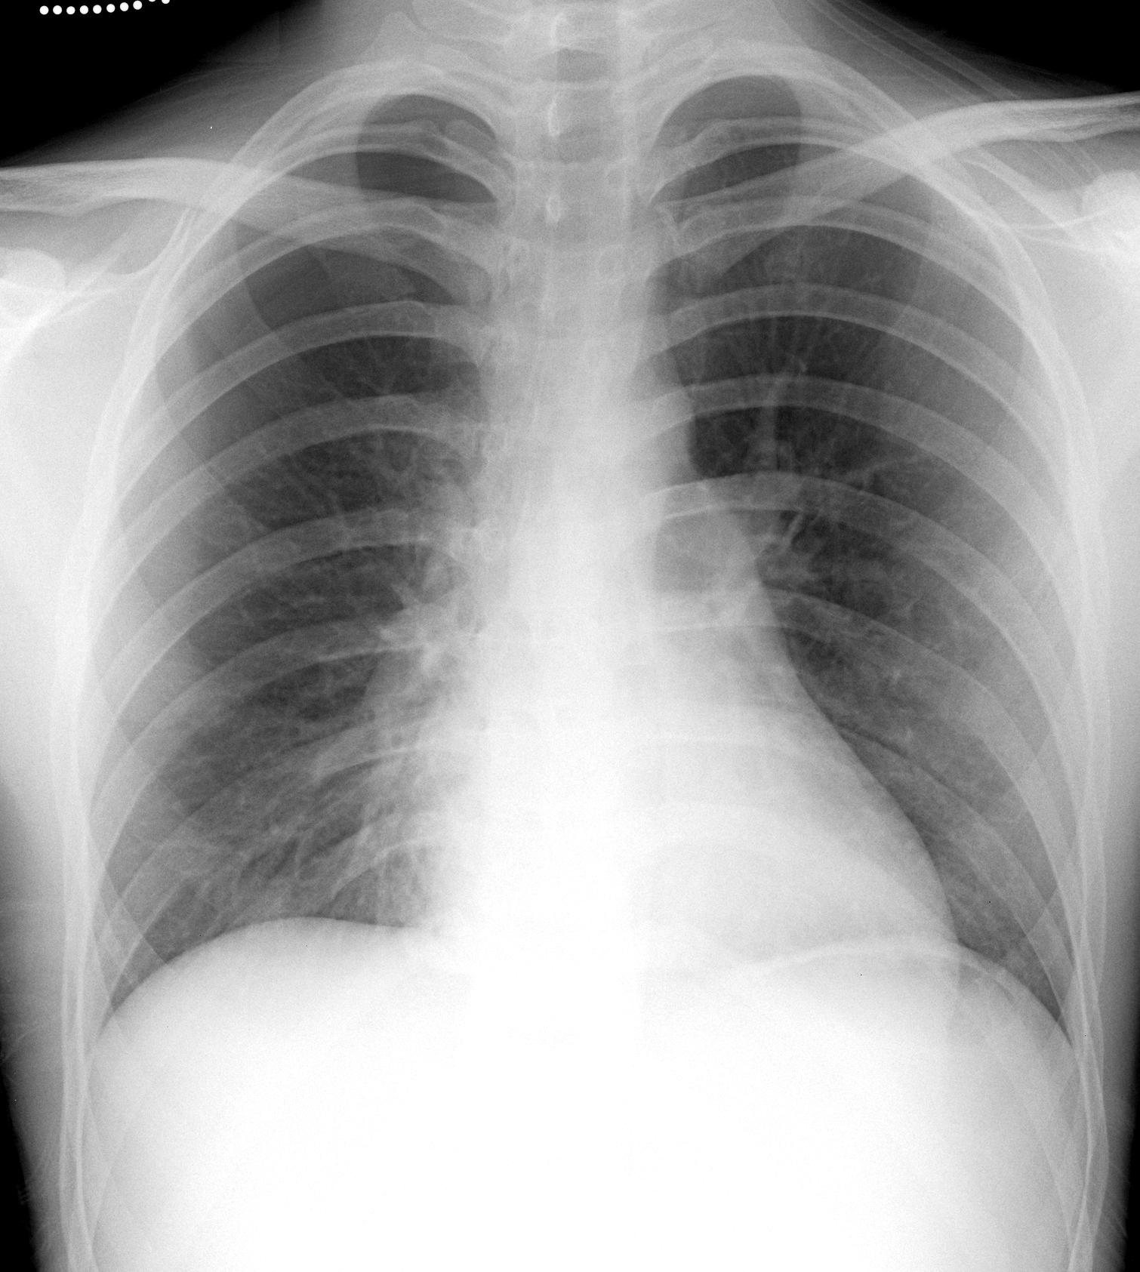
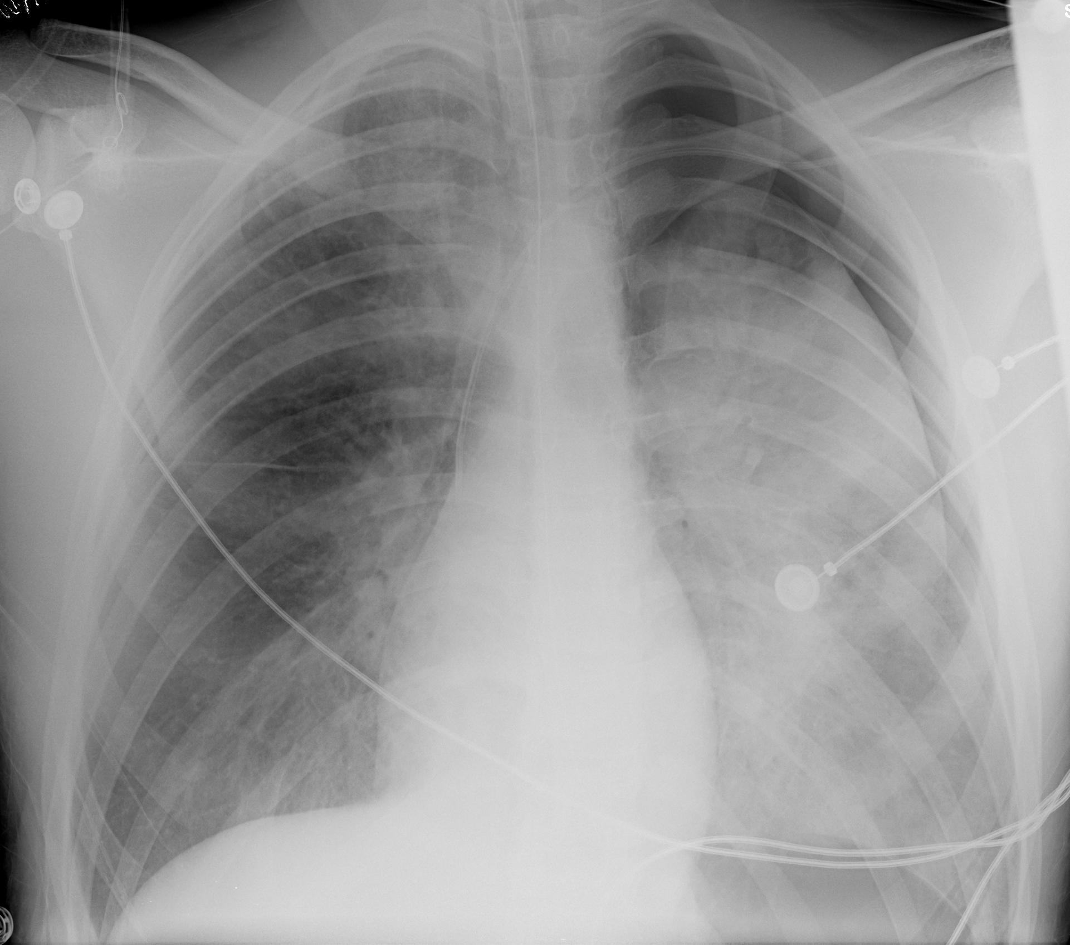
Pneumothoraces.
Which one is easier to see? In a normal lung (left image), the pleural line can be very subtle. If there is lung disease (right image), it can make it easier.
Notes:
The patient on the right was in a car wreck and there is likely pulmonary contusion, hemorrhage, or edema which makes the lung more dense. He is also intubated and has a left subclavian central line. The patient on the left had a spontaneous pneumothorax, and is otherwise normal.

Slide 8
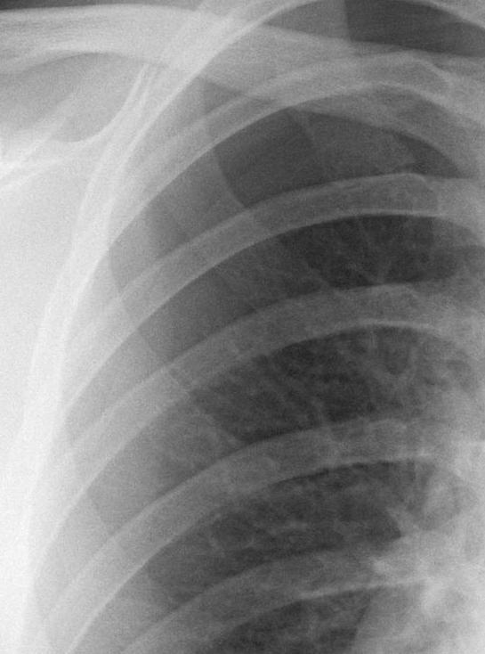
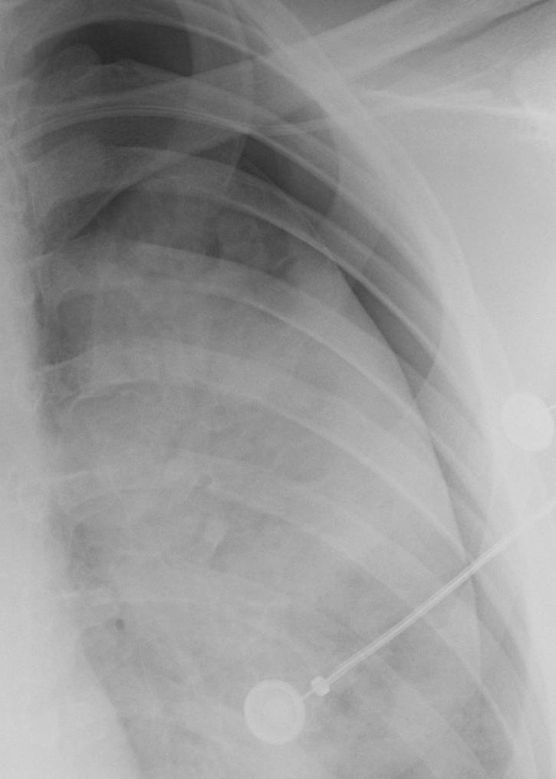
Pneumothoraces.
Which one is easier to see? In a normal lung (left image), the pleural line can be very subtle. If there is lung disease (right image), it can make it easier.

Slide 9
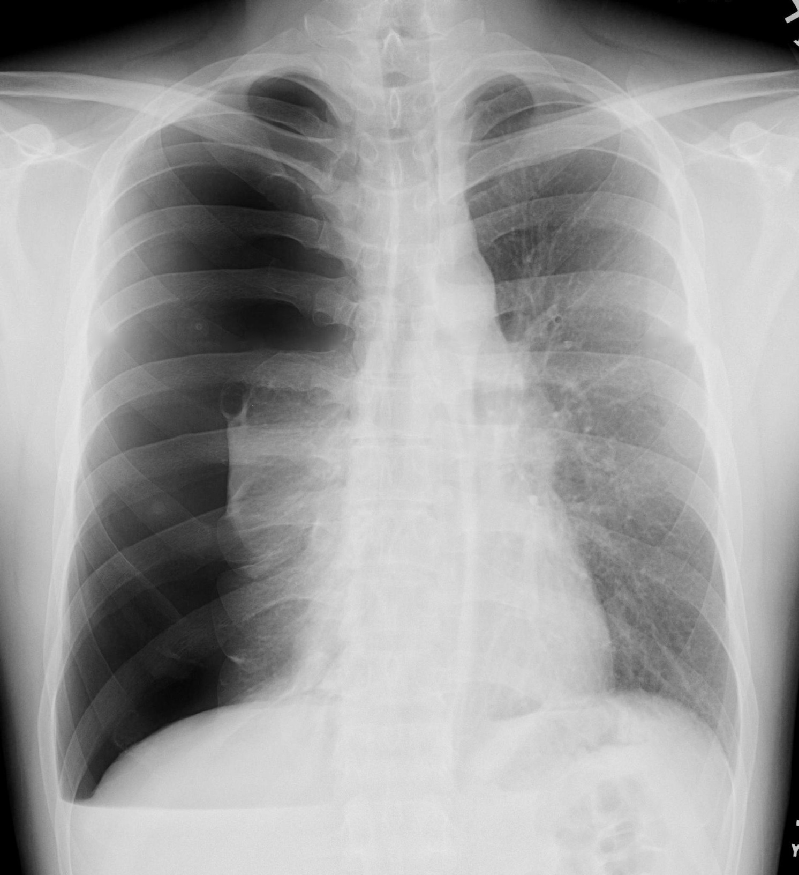
Large pneumothorax
Right lung collapse
Pulmonary bleb is visible
What do you see?
Notes:
The mediastinum is minimally shifted, making tension physiology unlikely. This is because the right lung collapse is allowing room for the air. This happens more often in healthy, elastic lungs. Pulmonary blebs are congenital and can lead to spontaneous pneumothorax, such as in this case.

Slide 10
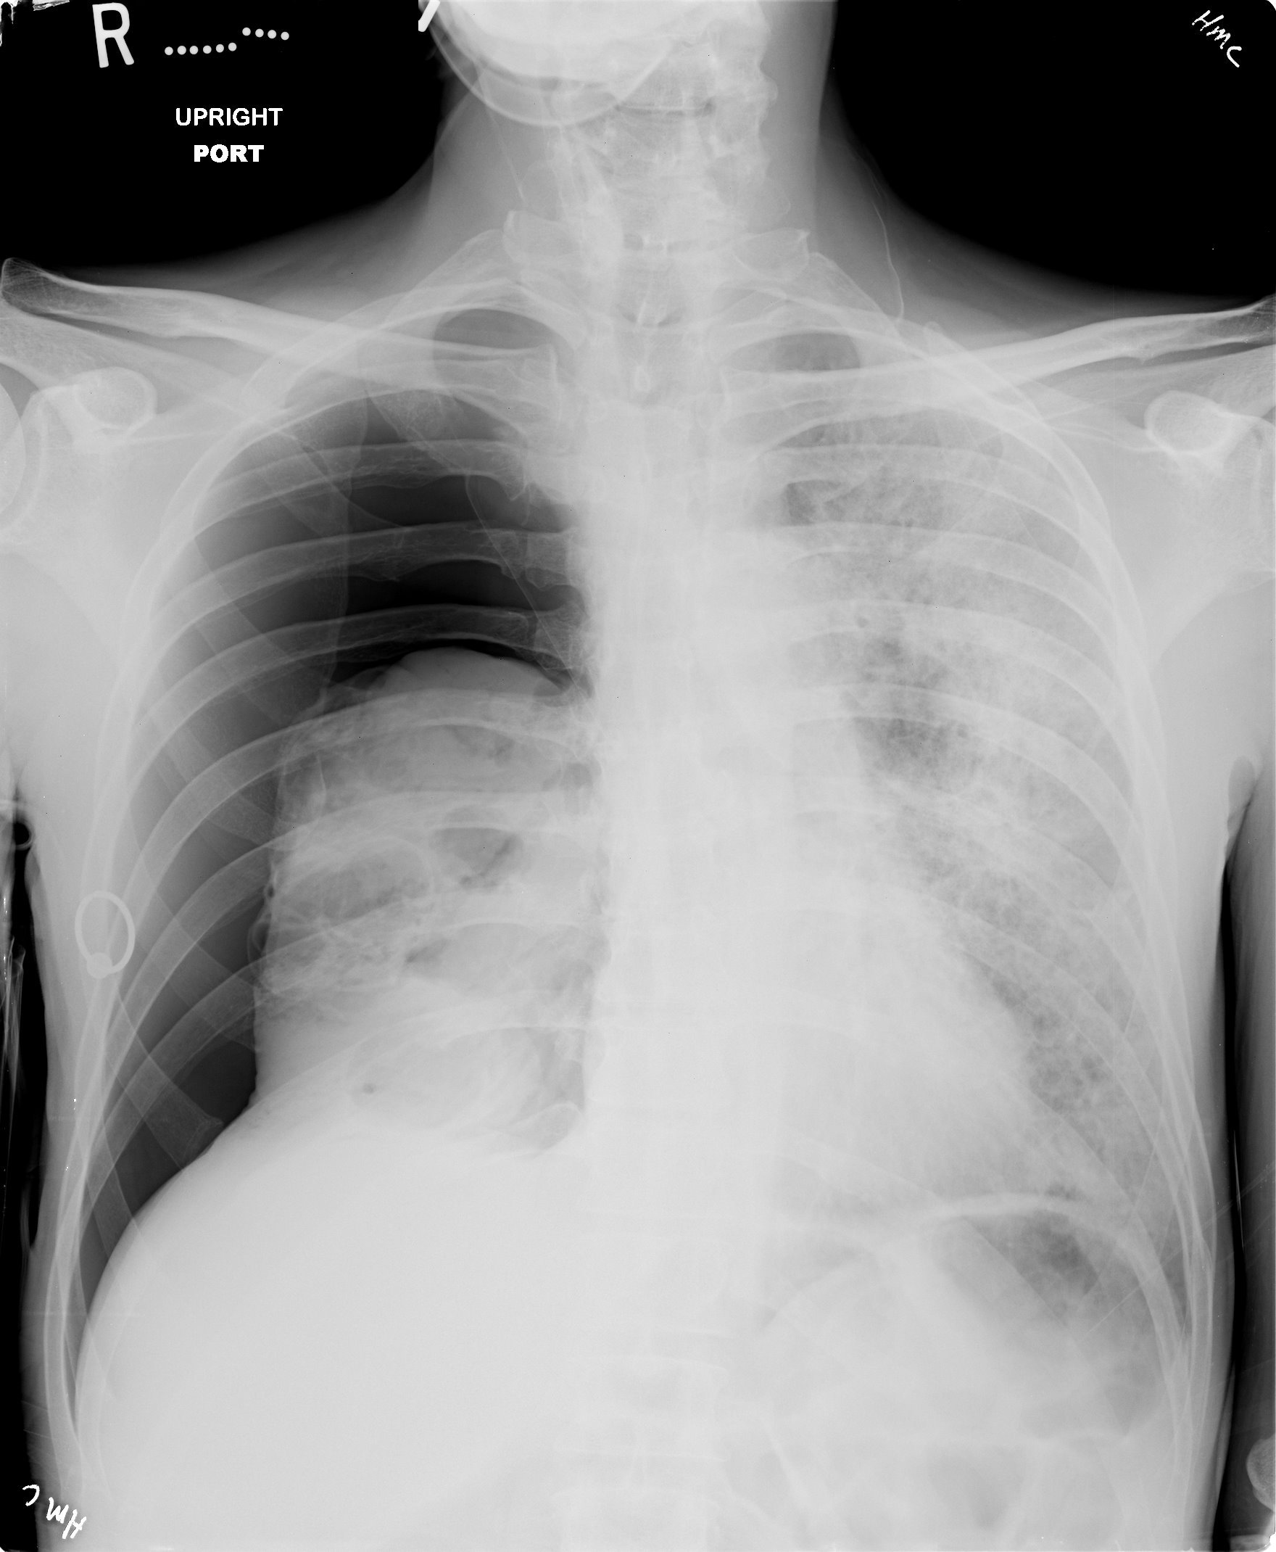
Large pneumothorax
Right lung collapse
Diffuse bilateral lung disease with multiple cysts.
What do you see?
Notes:
This HIV patient has end stage PJP infection, and the pulmonary cysts often rupture spontaneously.

Slide 11
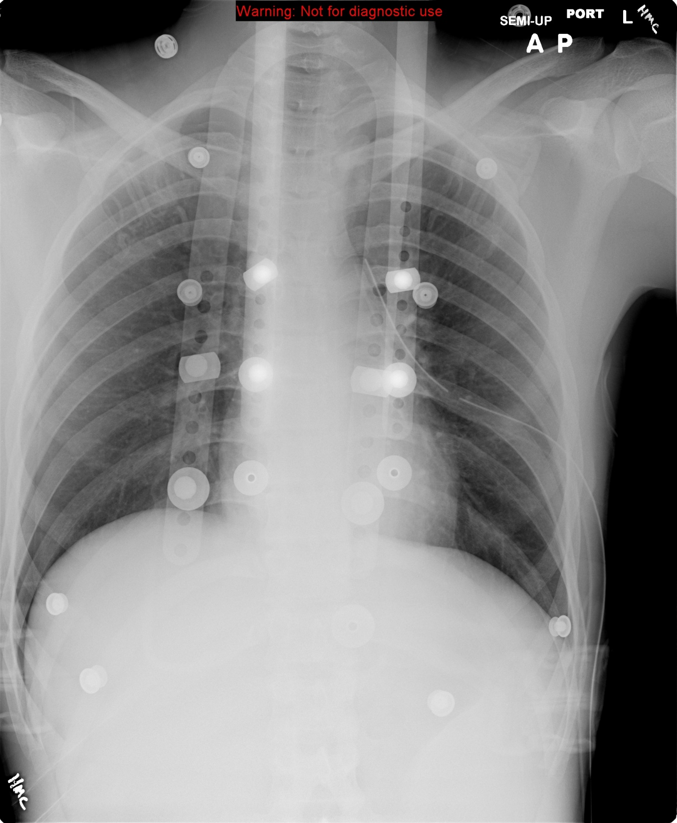
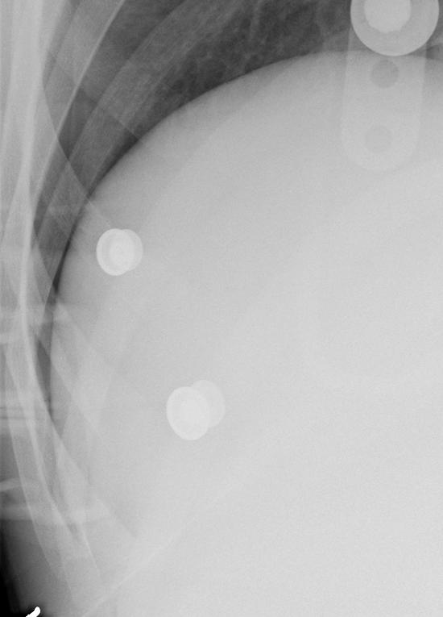
Other Findings with Pneumothorax
Pleural line
Deep sulcus
Notes:
The deep sulcus is formed by air in the pleural space below where the lung normally sits, and is an especially sign useful in supine radiographs.

Slide 12
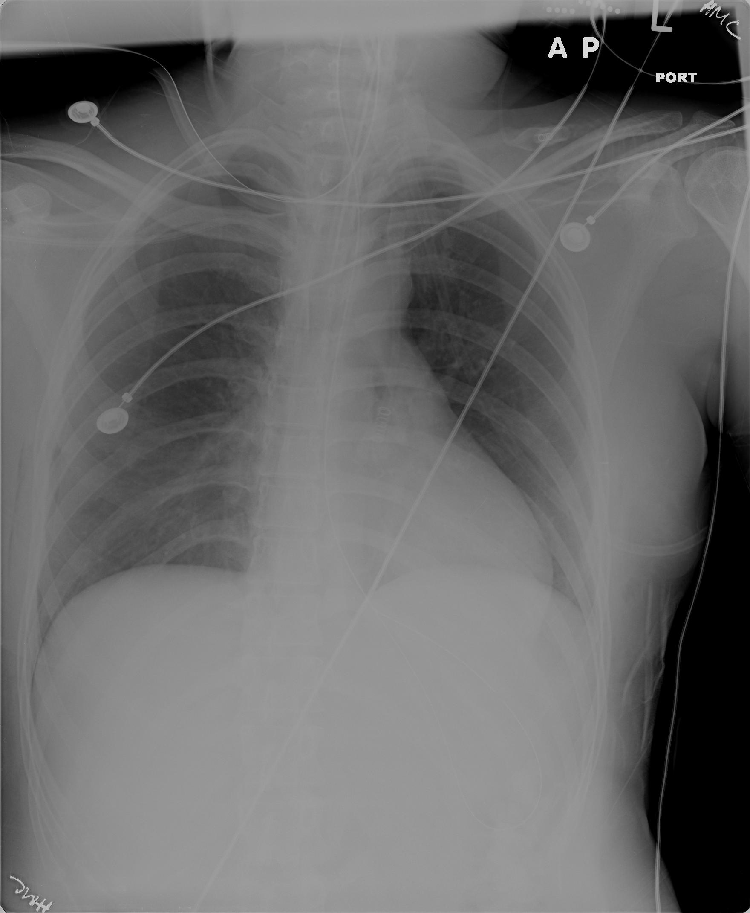
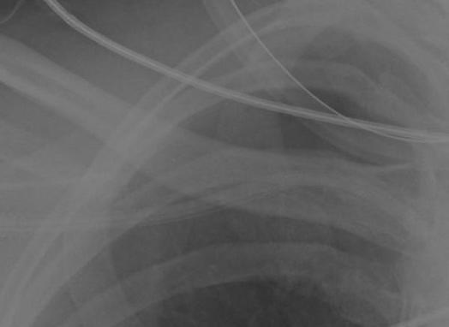
Another example
Deep sulcus
Notes:
This is a subtle pneumothorax made tricky by overlapping wires. But on close inspection you’ll notice one line not accounted for by normal anatomy or by the wires. Also, note the deep sulcus sign on the right. Left lower lobe atelectasis is also present in the retrocardiac area.

Slide 13
Pleural Effusion
What is pleural effusion?

Slide 14
Pleural effusion
Pleural effusion is any fluid in the pleural space. This includes simple fluid (e.g. parapneumonic), blood (hemothorax), pus (empyema), lymph (chylothorax), or any combination.
The simpler the fluid the more likely it is to be mobile, and decubitus views will show it sloshing to the dependent side.
Complex fluid can be thick, loculated, and immobile.

Slide 15
What are some causes of pleural effusion?

Slide 16
Most common causes of pleural effusion in children:
Rank*
Transudate
Heart failure 2
Nephrotic syndrome 4
Exudate
Infection 1 (50-70%)
Cancer (lymphoma) 3
Trauma 5
*
1. Alkrinawi S, Chernick V. Pleural infection in children. Semin Respir Infect. Sep 1996;11(3):148-54.
2. Hardie W, Bokulic R, Garcia VF, et al. Pneumococcal pleural empyemas in children. Clin Infect Dis. Jun 1996;22(6):1057-63.
Notes:
There are many many more rare causes but this list includes more than 95% of cases.

Slide 17
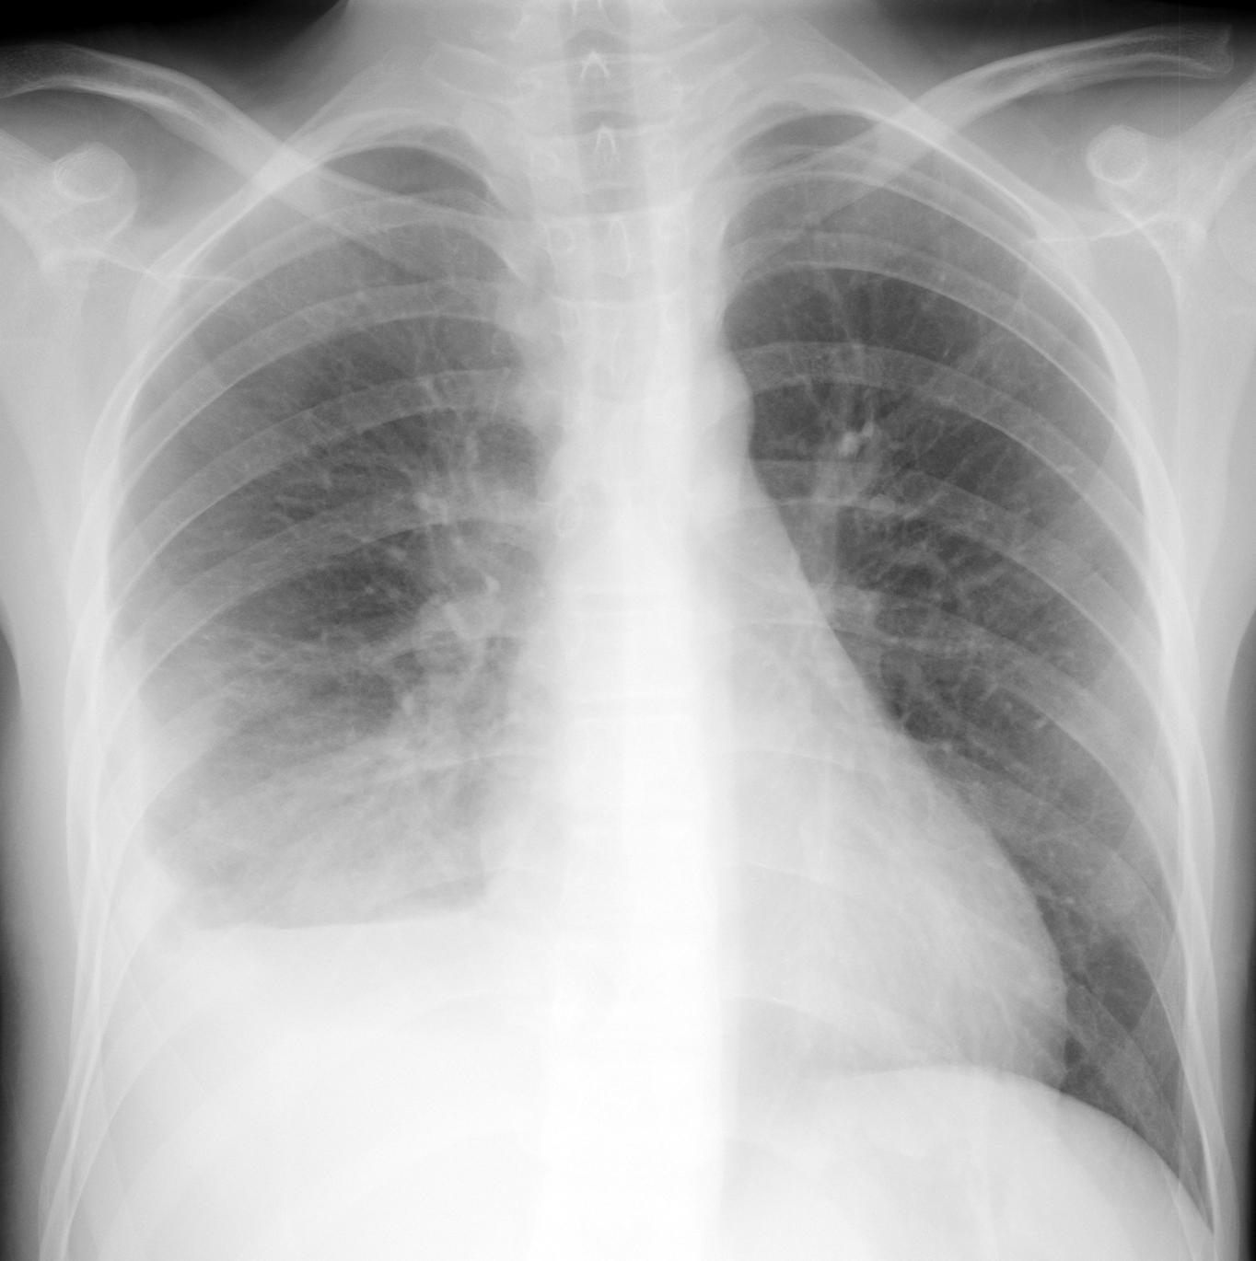
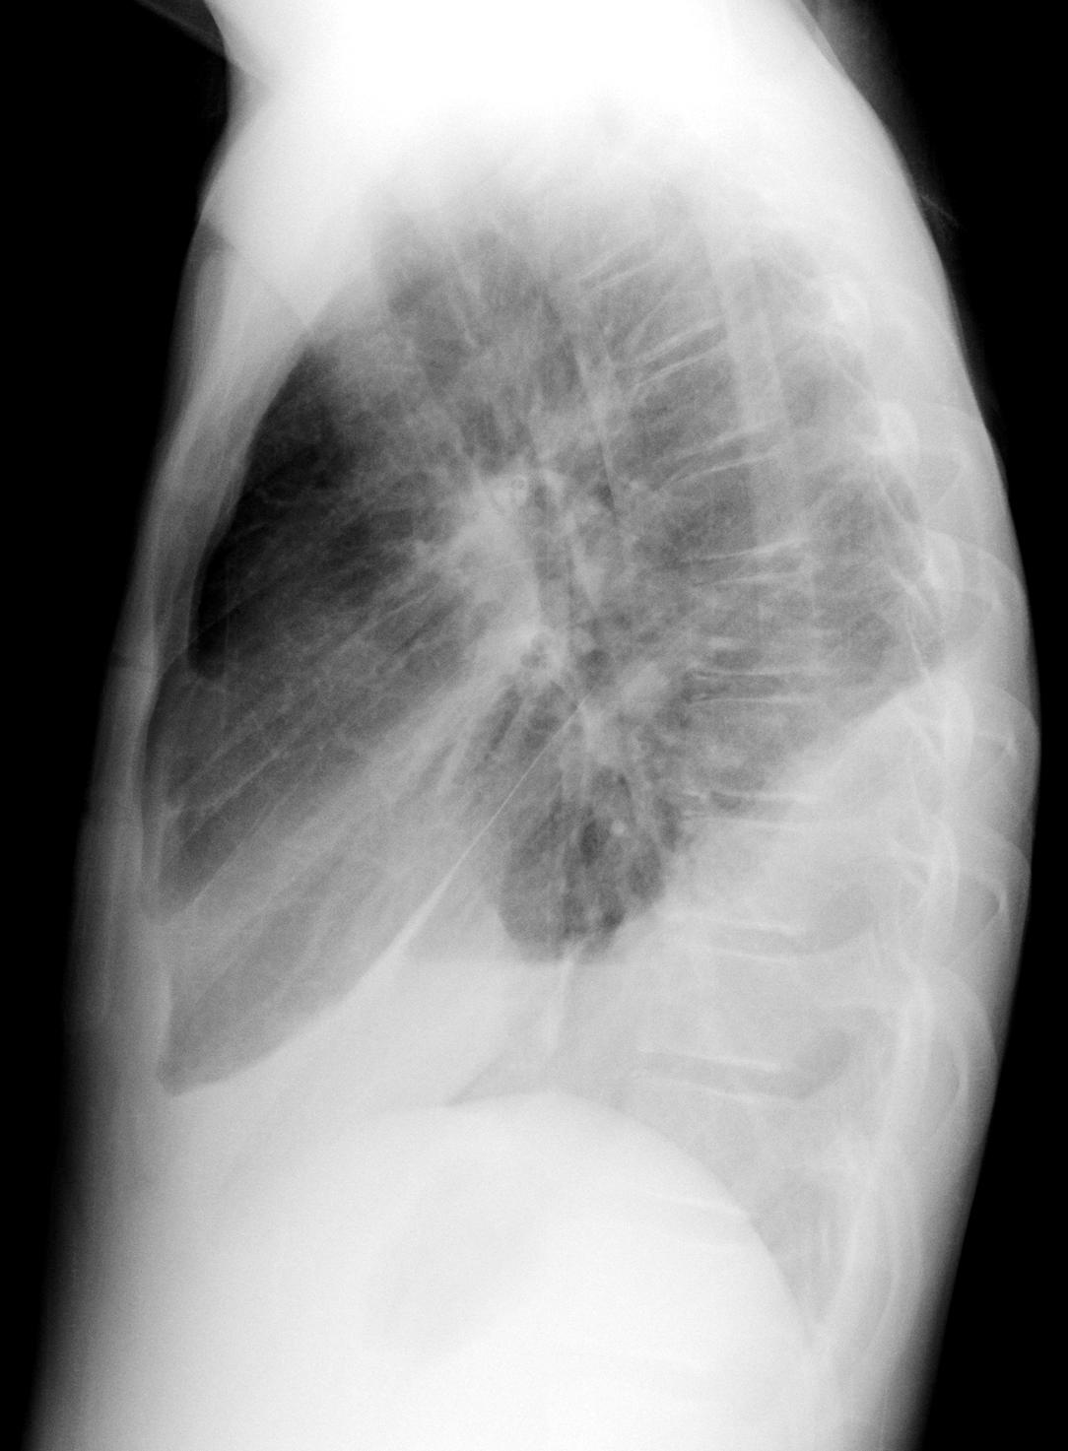
Pleural fluid – Subpulmonic effusion
Meniscus
Veil-like opacity
Fluid in fissure
Obscured right diaphragm

Slide 18
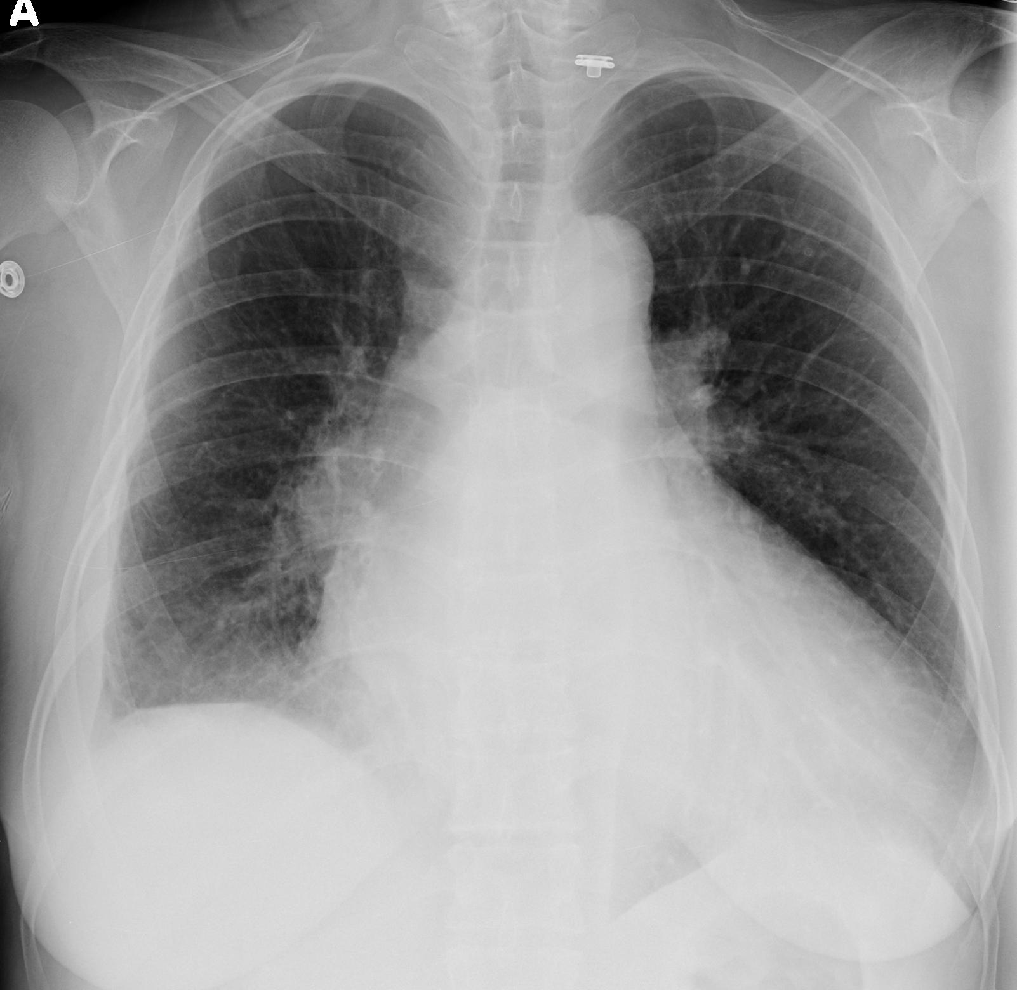
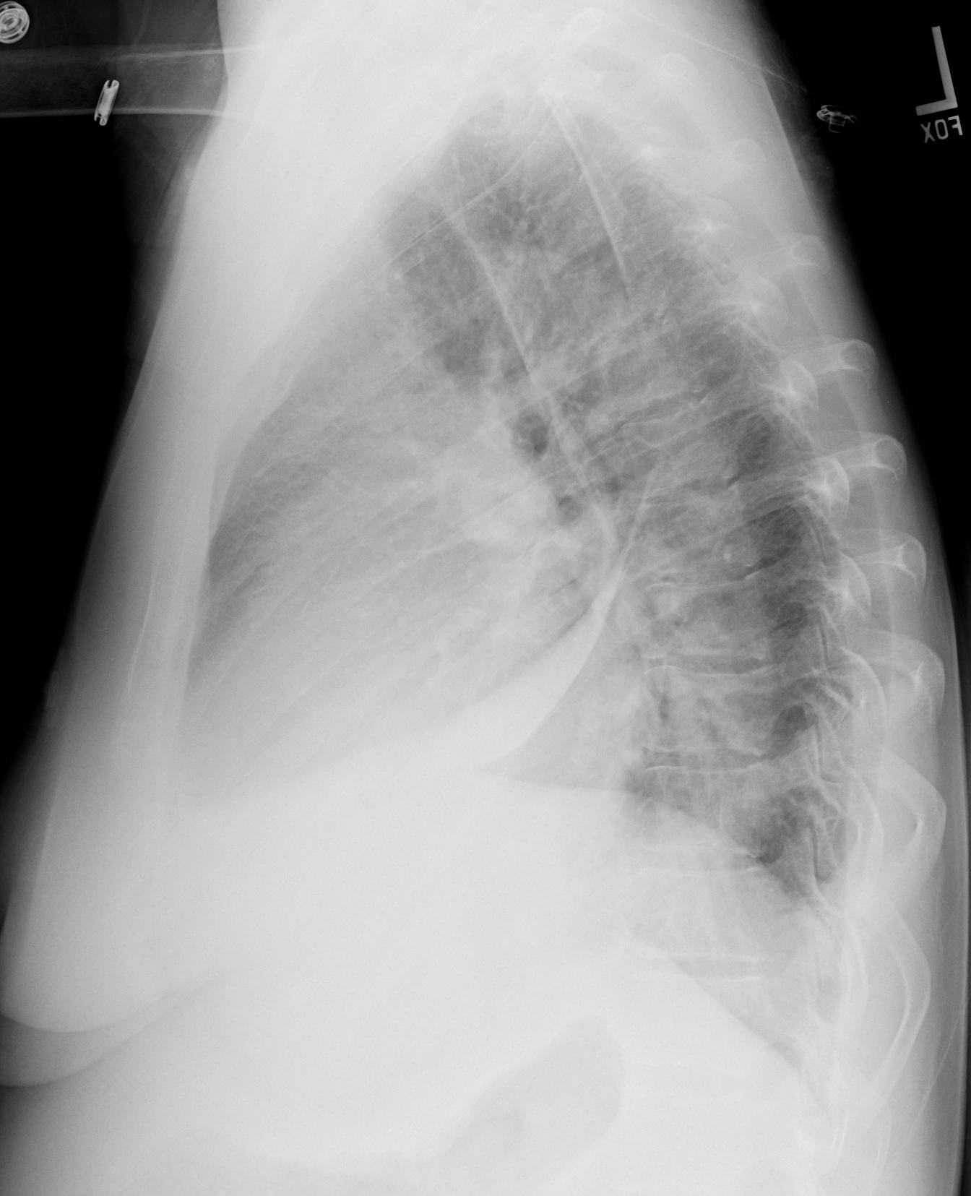
Another right effusion

Slide 19
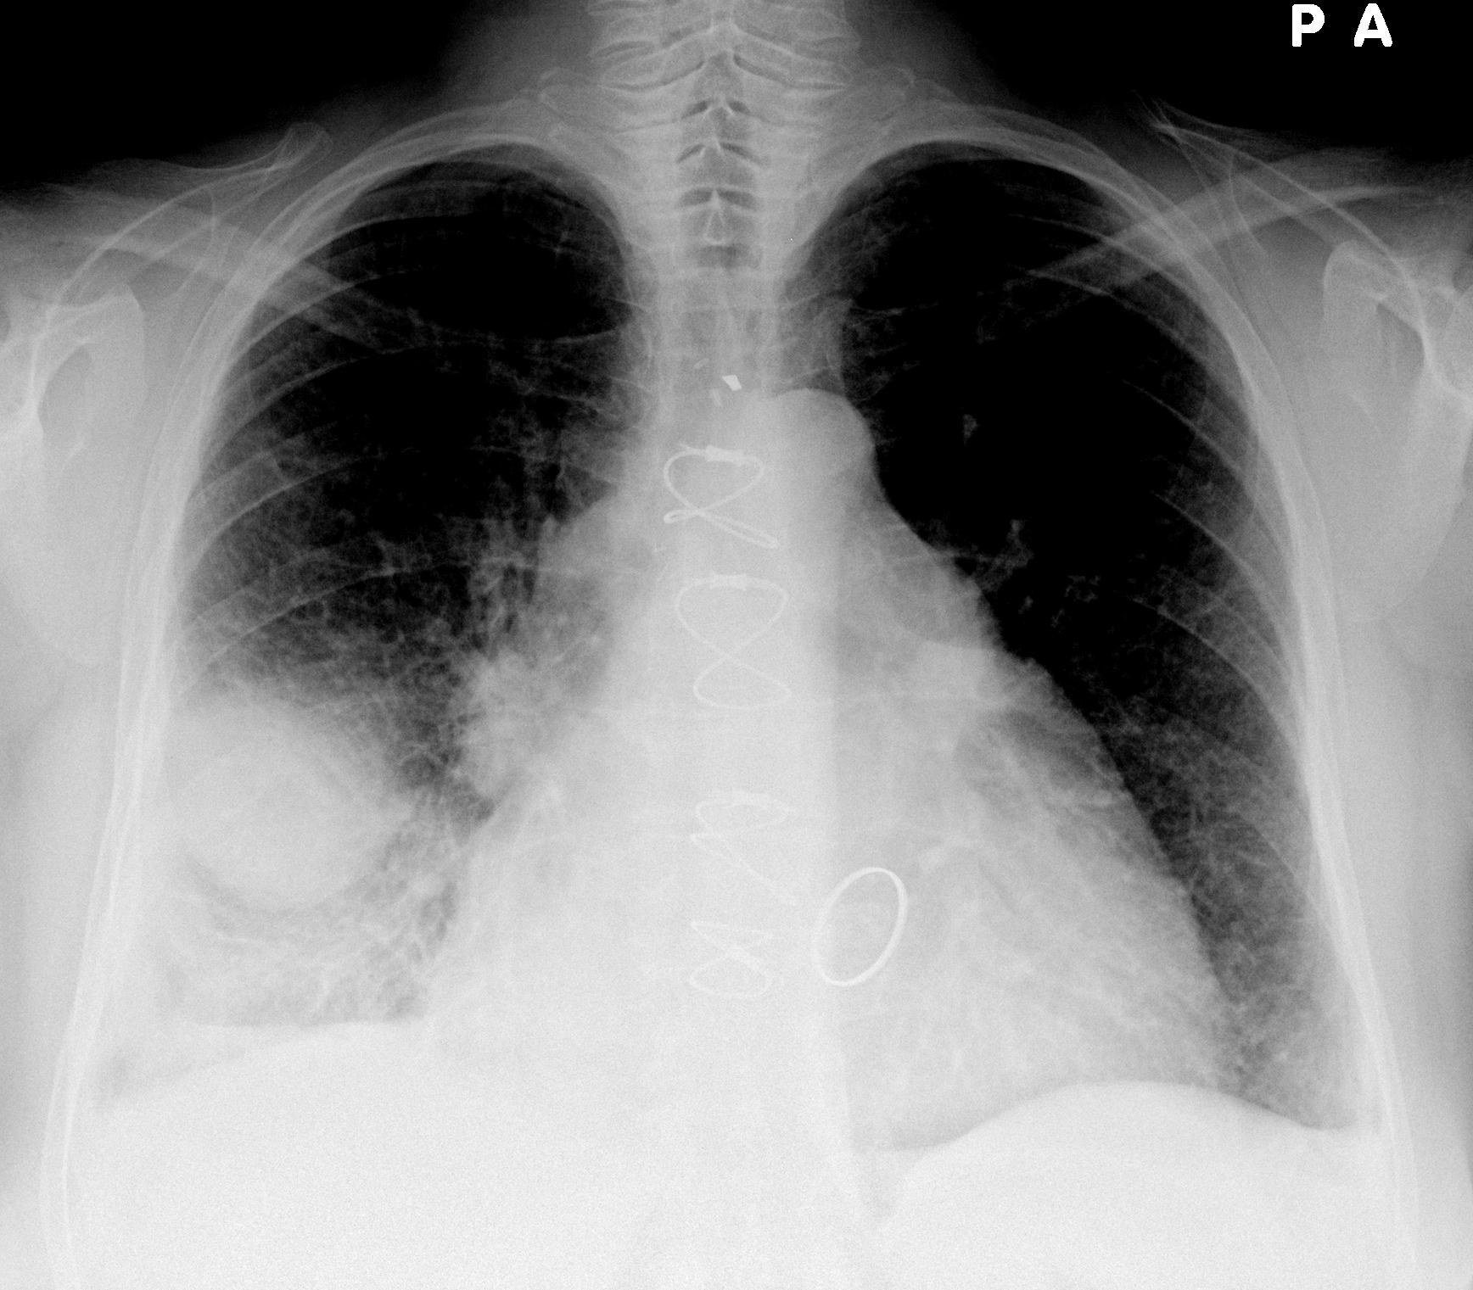
Pleural fluid - Pseudotumor
Fluid in a fissure can be loculated, mimicking a mass.
Notes:
There is also cardiomegaly (or pericardial effusion), CABG clips, sternal wires, a prosthetic mitral valve, and mild pulmonary edema.

Slide 20
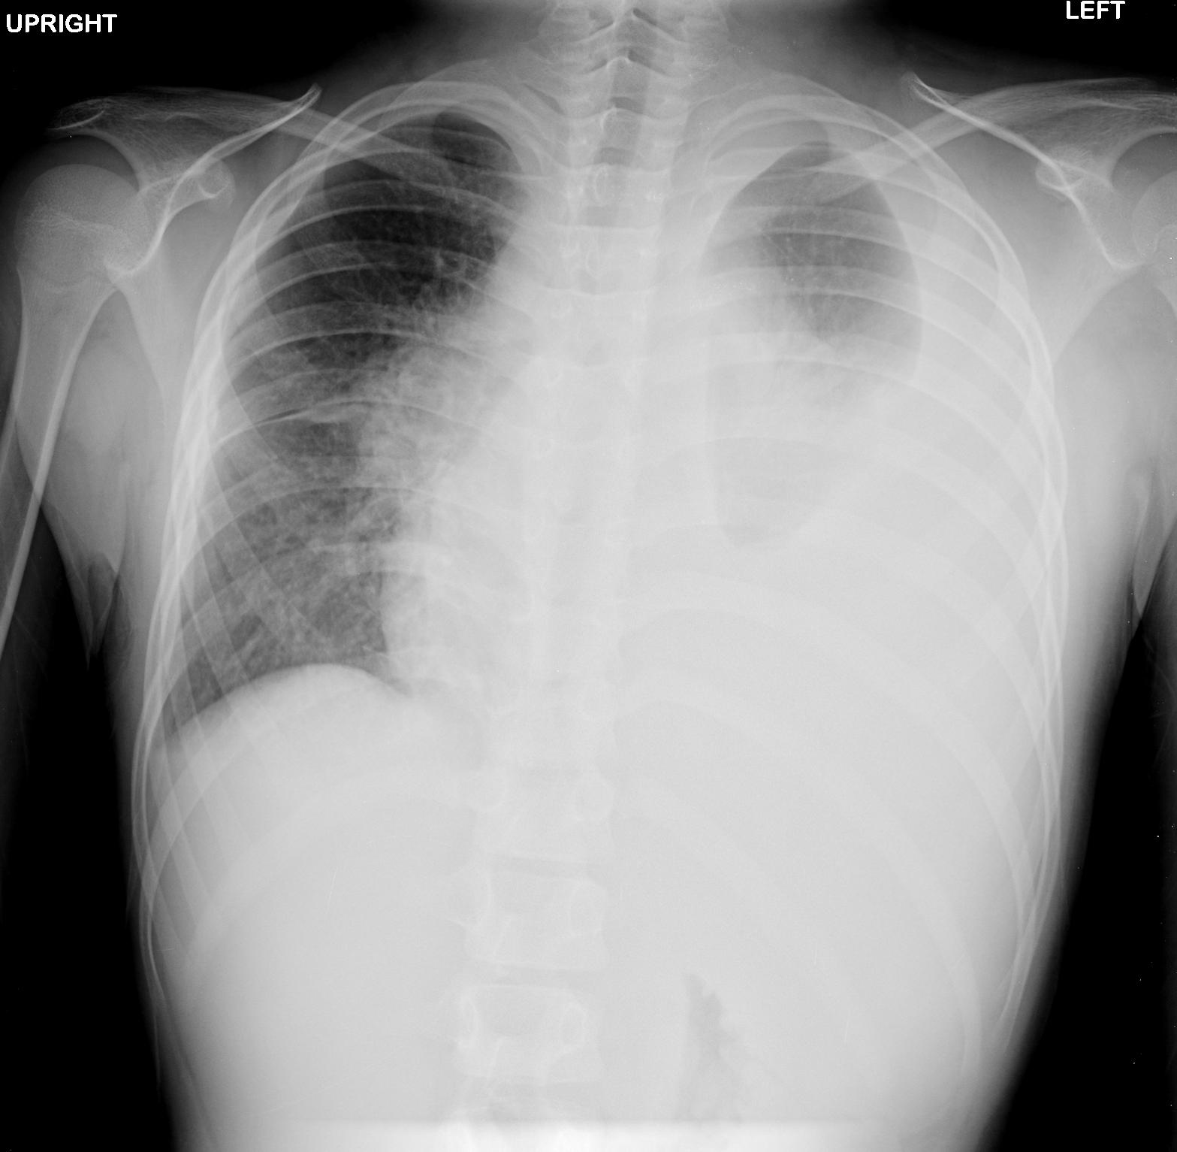
Left effusion
Note the large meniscus tracking up the pleura. There is also mediastinal shift and left lung atelectasis.
Notes:
10 yo with TB

Slide 21
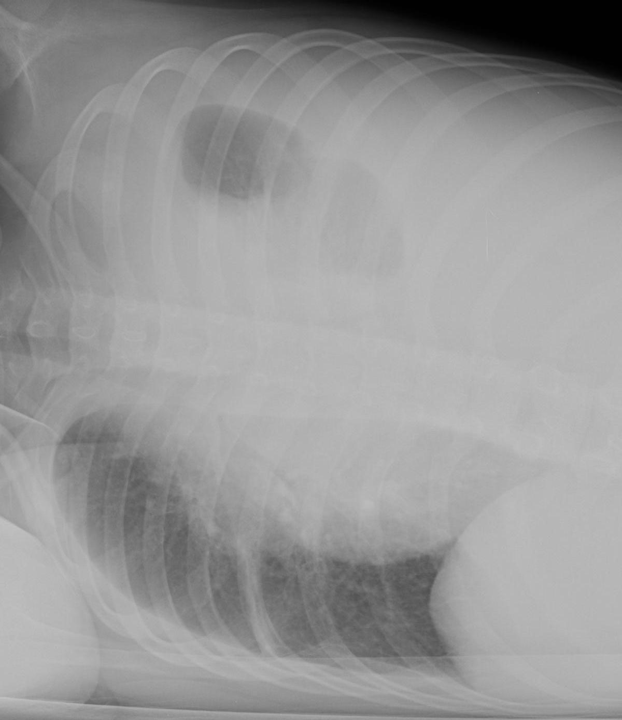
Left (and right) effusion
Laying the same patient decubitus lets us see the small layering right effusion also.
Notes:
10 yo with TB

Slide 22
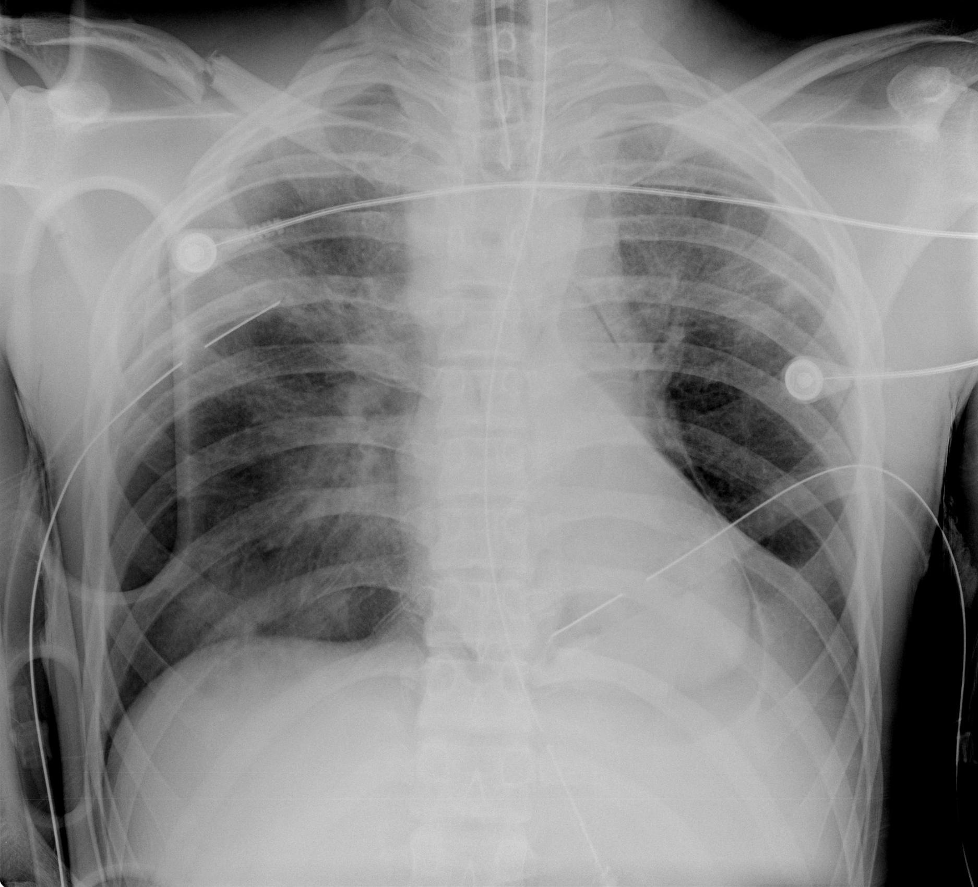
Findings
Left pleural effusion
Right pneumothorax
Right pleural effusion
Patchy lung disease
Pneumopericardium
Chest tubes
Right 1st rib fracture
Clavicle fracture
Intubated
Enteric (NG) tube
Can you find all of these findings?
Notes:
The oval structures are the handles in the backboard the patient was brought in on. The pleural effusions in the case are likely due to blood (hemothorax). This 19 year old was in a high speed boating accident.

Slide 23
Special Thanks:
This module was created by Jeff Otjen, Jan 2011 and modified in 2015

