Slide 1
Chest Films 102: Pneumonia, Atelectasis and Pulmonary Edema Night Float Hands On Curriculum
Date: 2/2015

Slide 2
Only a certain amount of things happen on a chest x-ray:
Stuff in the lungs
Stuff outside the lungs in the pleural space
Stuff in the mediastinum / hilum
Stuff in the chest wall

Slide 3
Stuff in the lungs can be broken down into different things:
Gas
normal air
cavitary lesion
Liquid
pus
hemorrhage
edema
post-obstructive
Solid
collapsed lung
tumor

Slide 4
Case:
Jane Smith is a 16 year old girl who has 2 day history of fever, cough and shortness of breath. She was seen at an outside Urgent Care Clinic and had the following CXR obtained because she had O2 sat of 91-92% on RA.

Slide 5
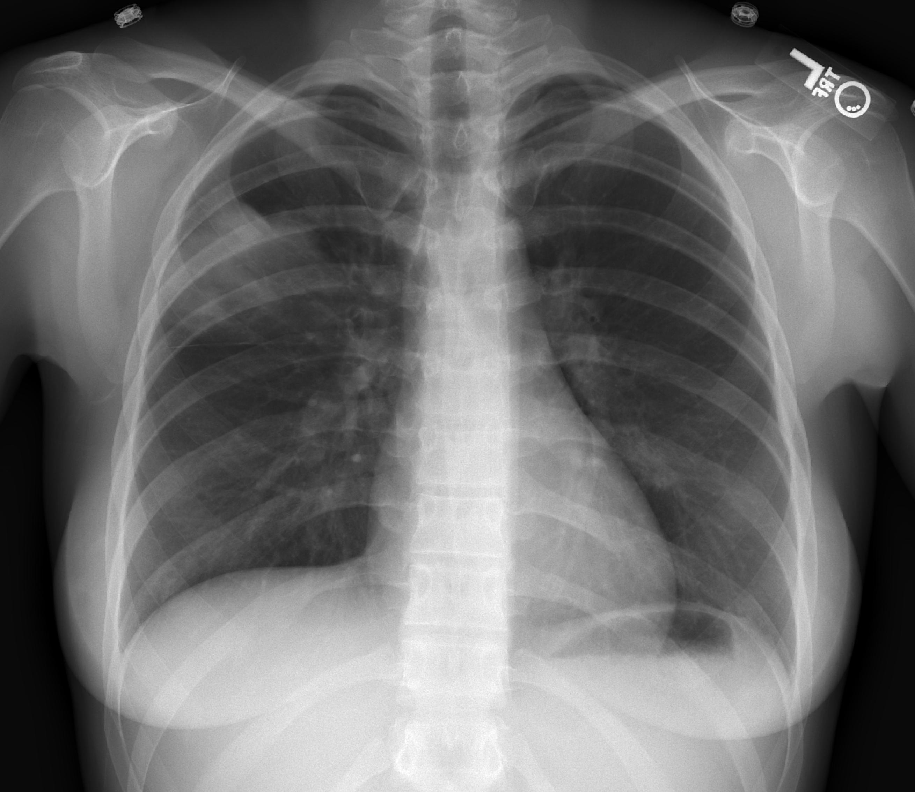
Focal opacity in the right upper lobe
What do you see on this film?
Notes:
Focal opacity in the right upper lung (superior segment of lower lobe or inferior upper lobe). Otherwise normal.

Slide 6
Case:
What do you think is going on?
How would you treat Jane?
What if the history was changed:
Jane had a 10 day history of cough and initially had fever but this resolved, but fever recurred 3 days ago.
What do you think is going on?
How would you treat Jane?

Slide 7
Case Continued
With the initial presentation, Jane likely has a viral pneumonia given the acute onset of symptoms. Treatment would be supportive and may include hospitalization for relative hypoxia or monitoring.
In the second scenario, the likely etiology is bacterial superinfection. Antibiotics are indicated.

Slide 8
Pneumonia
What is the most common cause of this radiographic appearance in the pediatric population?

Slide 9
Virus. But not uncommonly bacterial: S pneumoniae M pneumoniae H influenzae
Radiographically, we cannot tell the etiology. It is based on clinical presentation. If the opacity seen on the radiograph is focal or lobar, it is more likely to be bacterial than if it is diffuse or multifocal, but still less likely (in kids) than virus.

Slide 10
What are we seeing when we say there is pneumonia?

Slide 11
Opacity caused by airspaces filled with fluid, in this case pus

Slide 12
How does pus look different than other fluid?

Slide 13
It doesn’t! We guess it is infectious based on the history and physical, shape, and distribution of the opacity

Slide 14
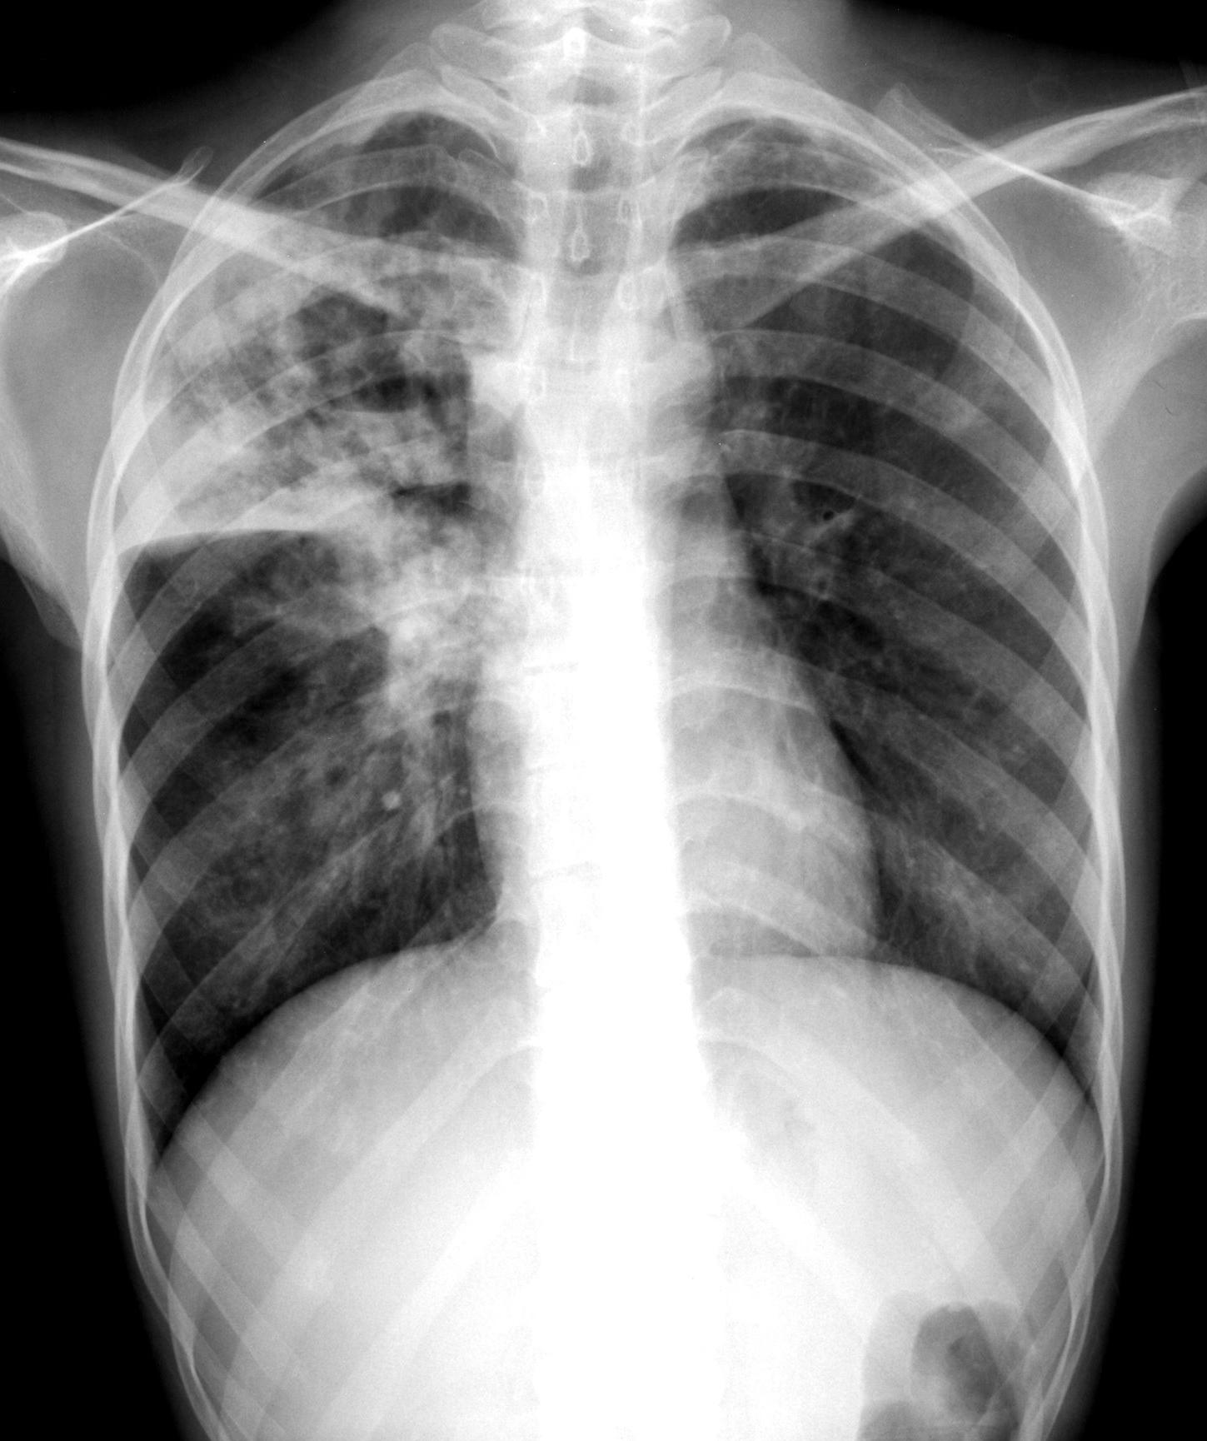
Right upper lobe infection, with a twist.
What do you see on this film?
RUL opacity (pus in the airways), indicates infection.
Air fluid level – confirmed on lateral.
Notes:
This is most often secondary to a bacterial pneumonia in immunocompetent, fungal in immunocompromised.

Slide 15
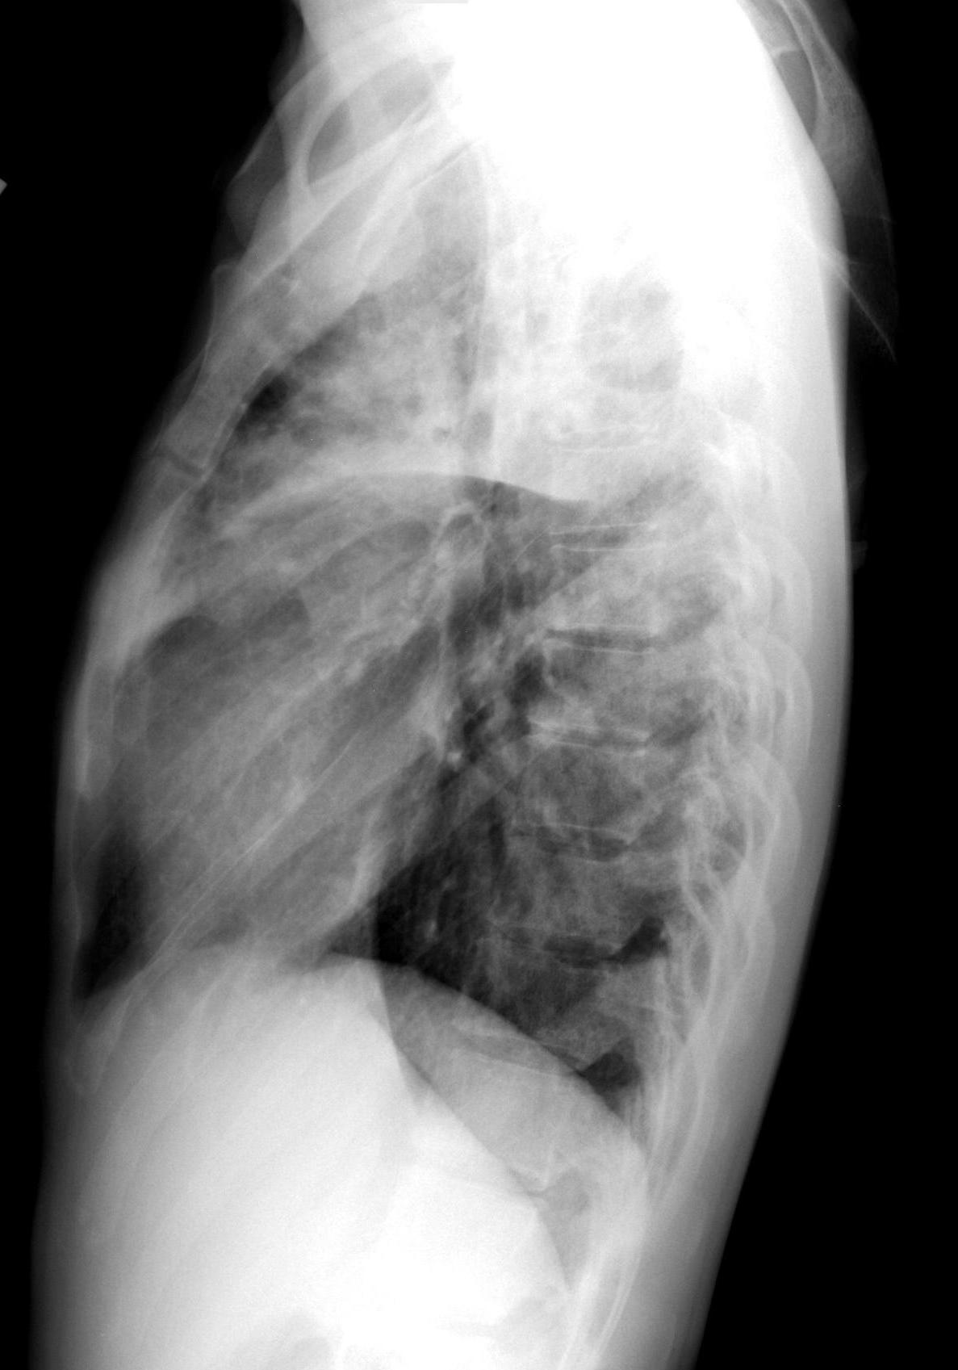
Air fluid level.
Notes:
This is most often secondary to a bacterial pneumonia in immunocompetent, fungal in immunocompromised.

Slide 16
Right upper lobe infection, with a twist.
Air fluid level indicates an abscess with necrotic lung.
Notes:
Lung abscess is often secondary to a bacterial pneumonia in immunocompetent, also consider fungal in immunocompromised.

Slide 17
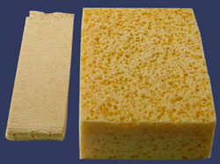
Atelectasis

Slide 18
What is it?
How does it appear on a CXR?
What are some causes?

Slide 19
Atelectasis is compressed or collapsed lung – the hallmarks of which are transience and volume loss.
Other chest contents will be pulled toward the collapsed area.
It can happen in tiny areas or entire lungs.
Blood going through this nonventilated lung is considered a shunt.
Causes include obstruction (mucus, mass, malacia), compression, underventilation, and plain old gravity.

Slide 20
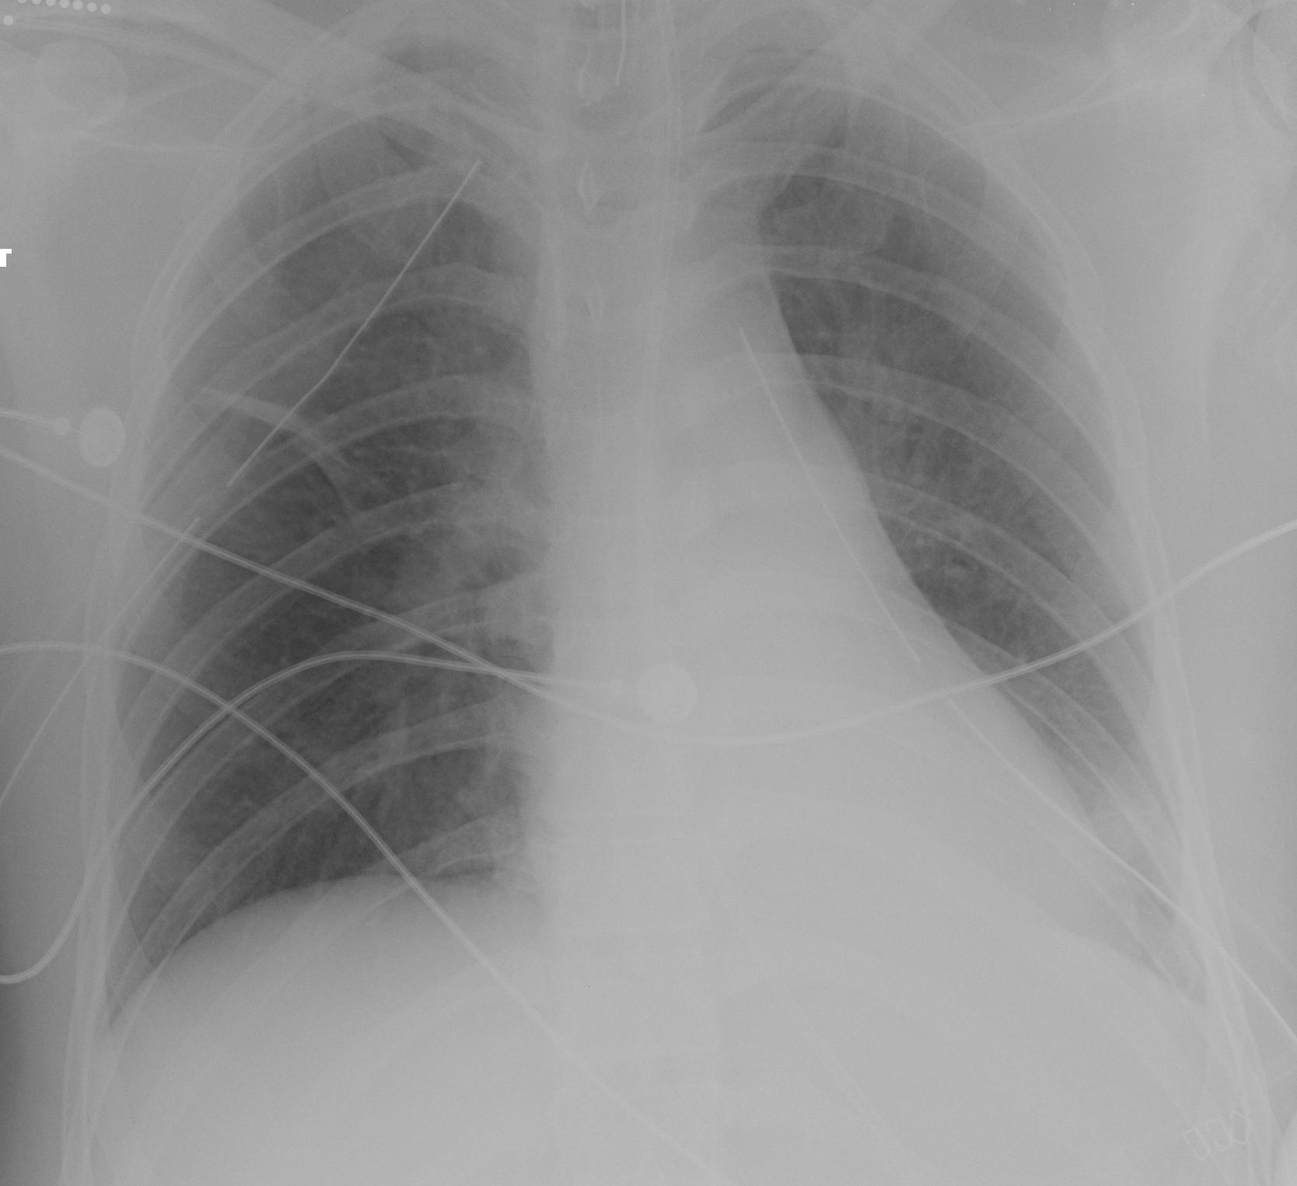
High ETT
Platelike Atelectasis
Chest tubes
Semilobar Atelectasis
What else do you see?
Can you find atelectasis on this film?
Notes:
Also chest tubes and high ETT tube

Slide 21
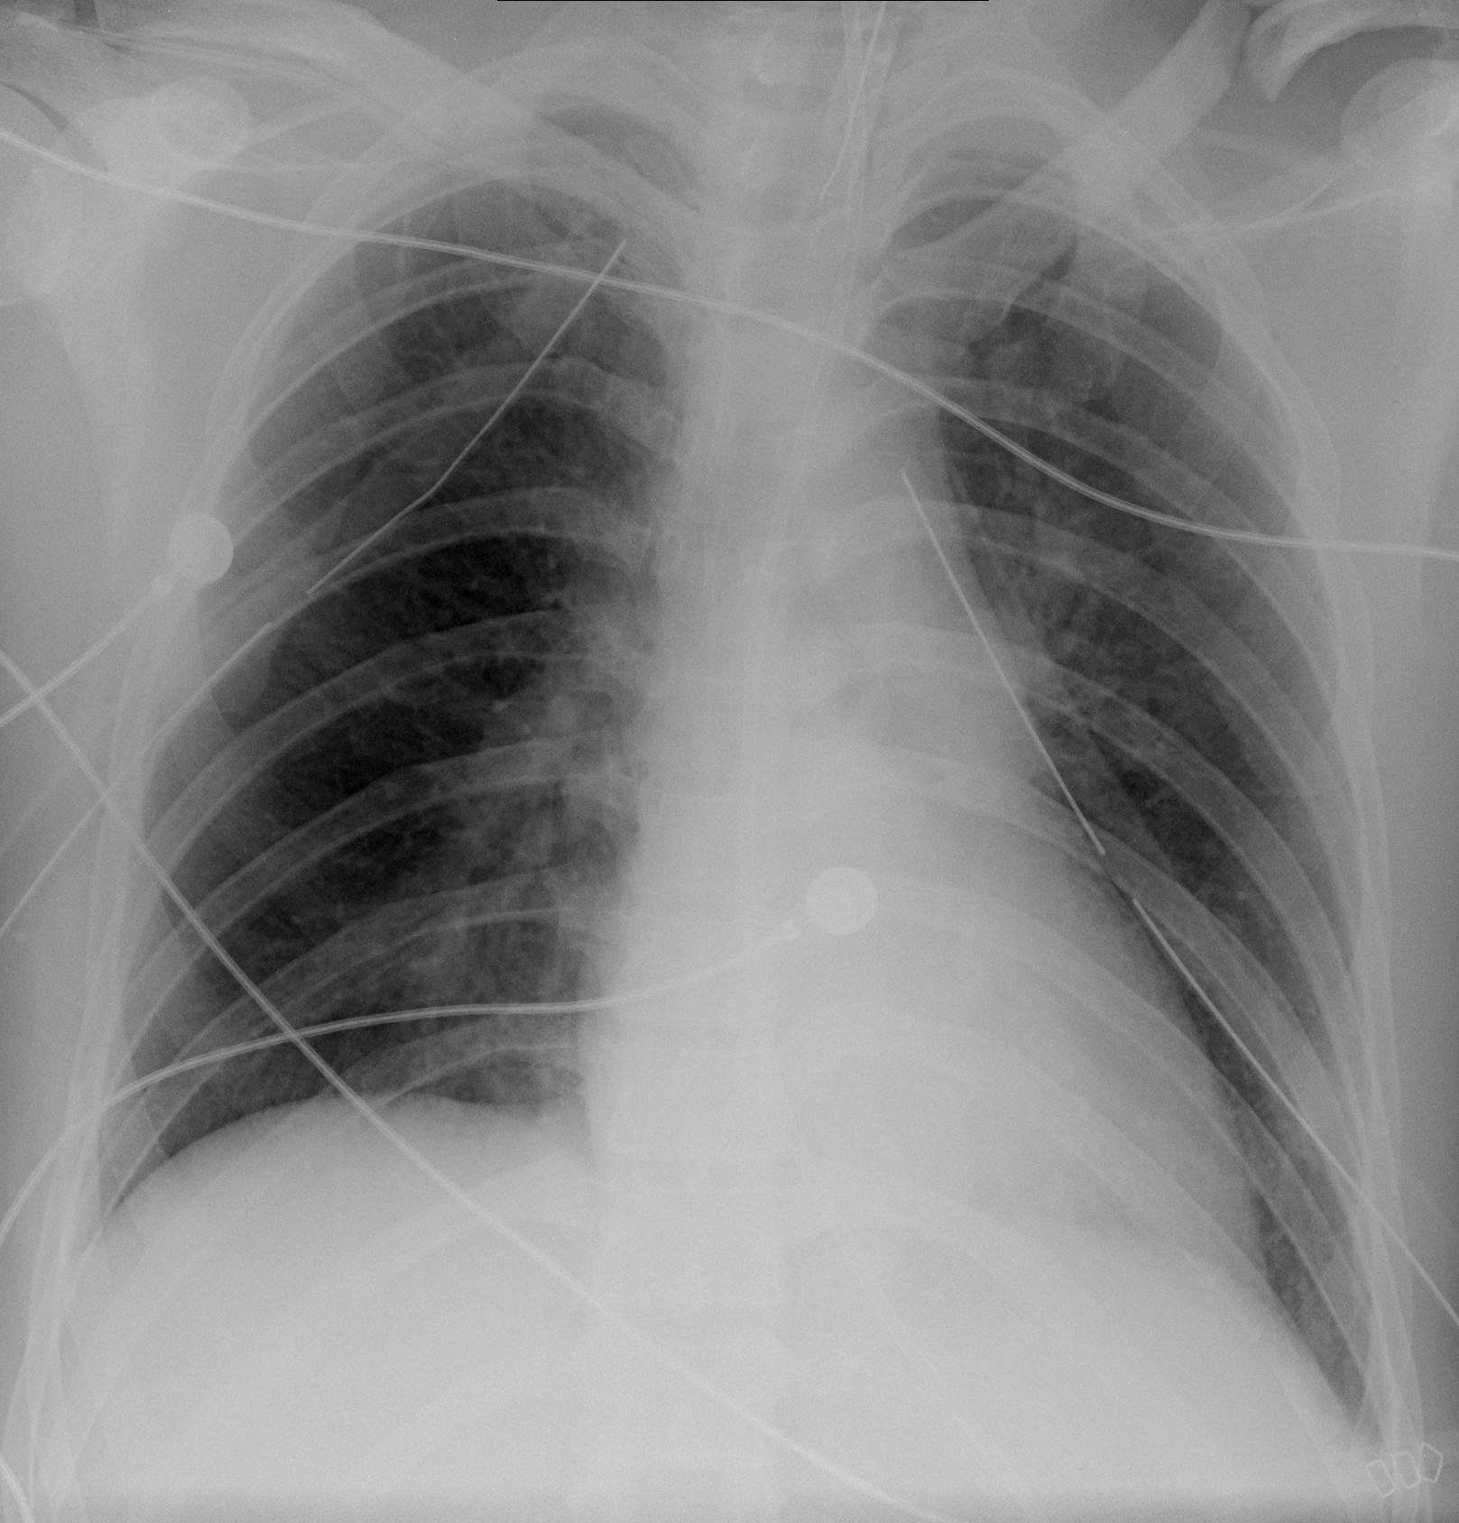
Same patient 12 hours earlier
Notes:
Yes, also a clavicle fx.

Slide 22
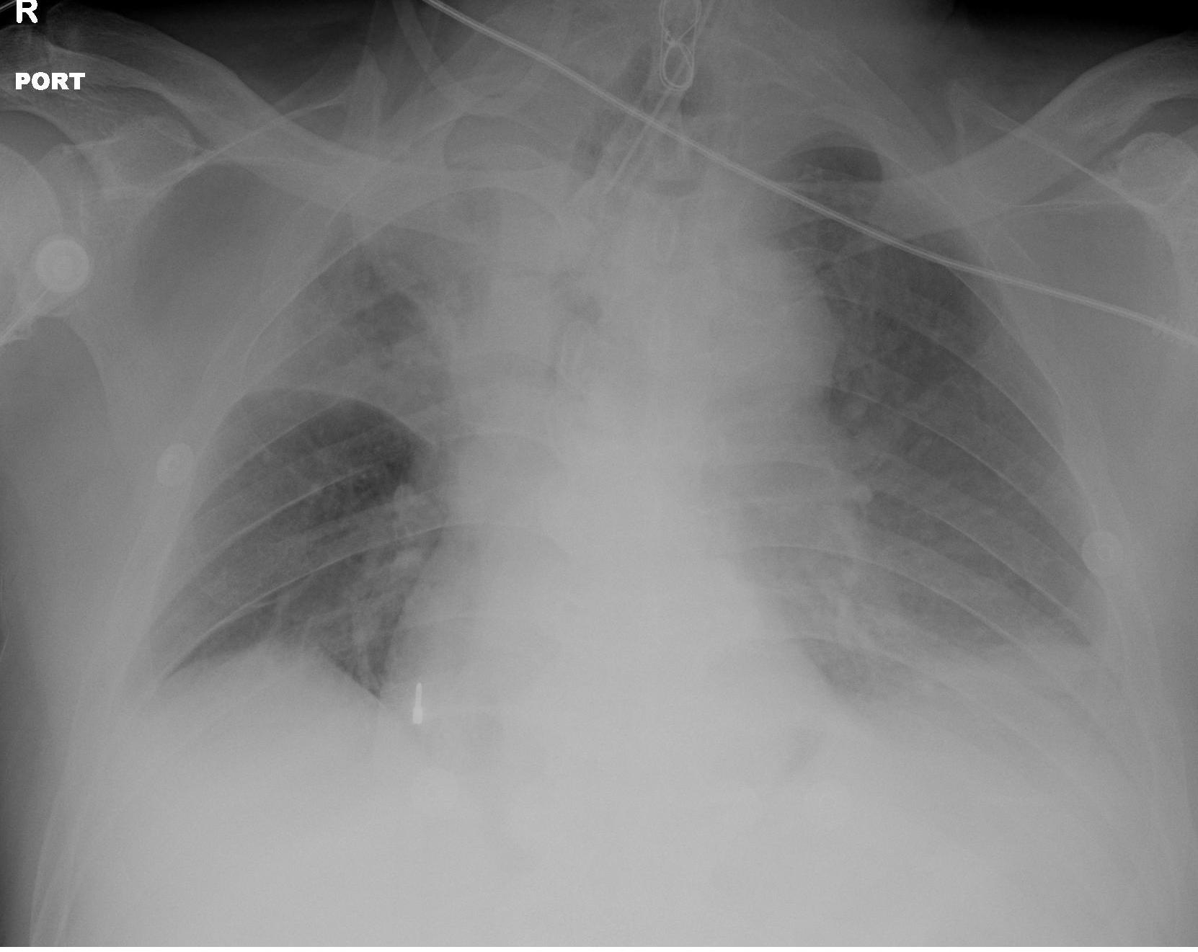
RUL collapse
Tented right diaphragm, minor fissue pulled up, mediastinum shifted to left, all due to volume loss.
Notes:
Patient also has an aortic aneurysm

Slide 23
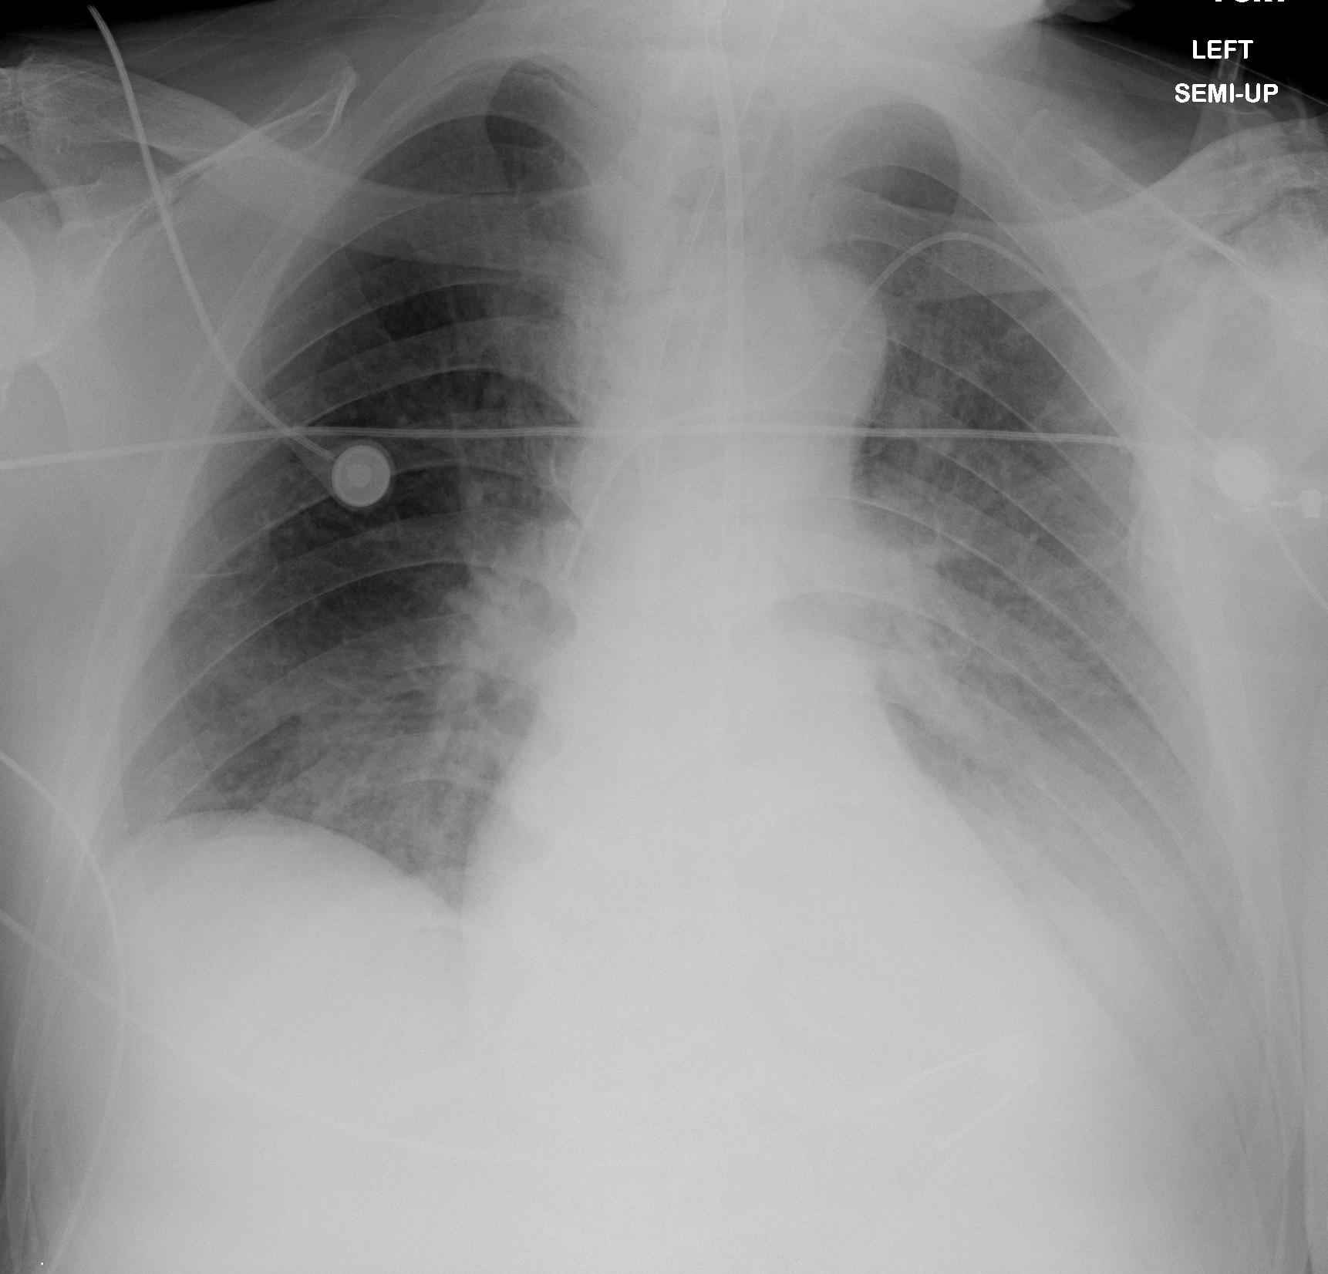
RUL collapse resolved one day later.
New PICC line
Do you see any other new findings?

Slide 24
Pulmonary Edema

Slide 25
Pulmonary edema is caused by a variety of things – all of which lead to leaking pulmonary vessels
Anyone remember some classic CXR features?

Slide 26
Can come and go quickly
Can look like many things, commonly:
Ill defined peri-hilar opacities
Indistinct pulmonary vessels
Kerley B lines
Diffuse opacity

Slide 27
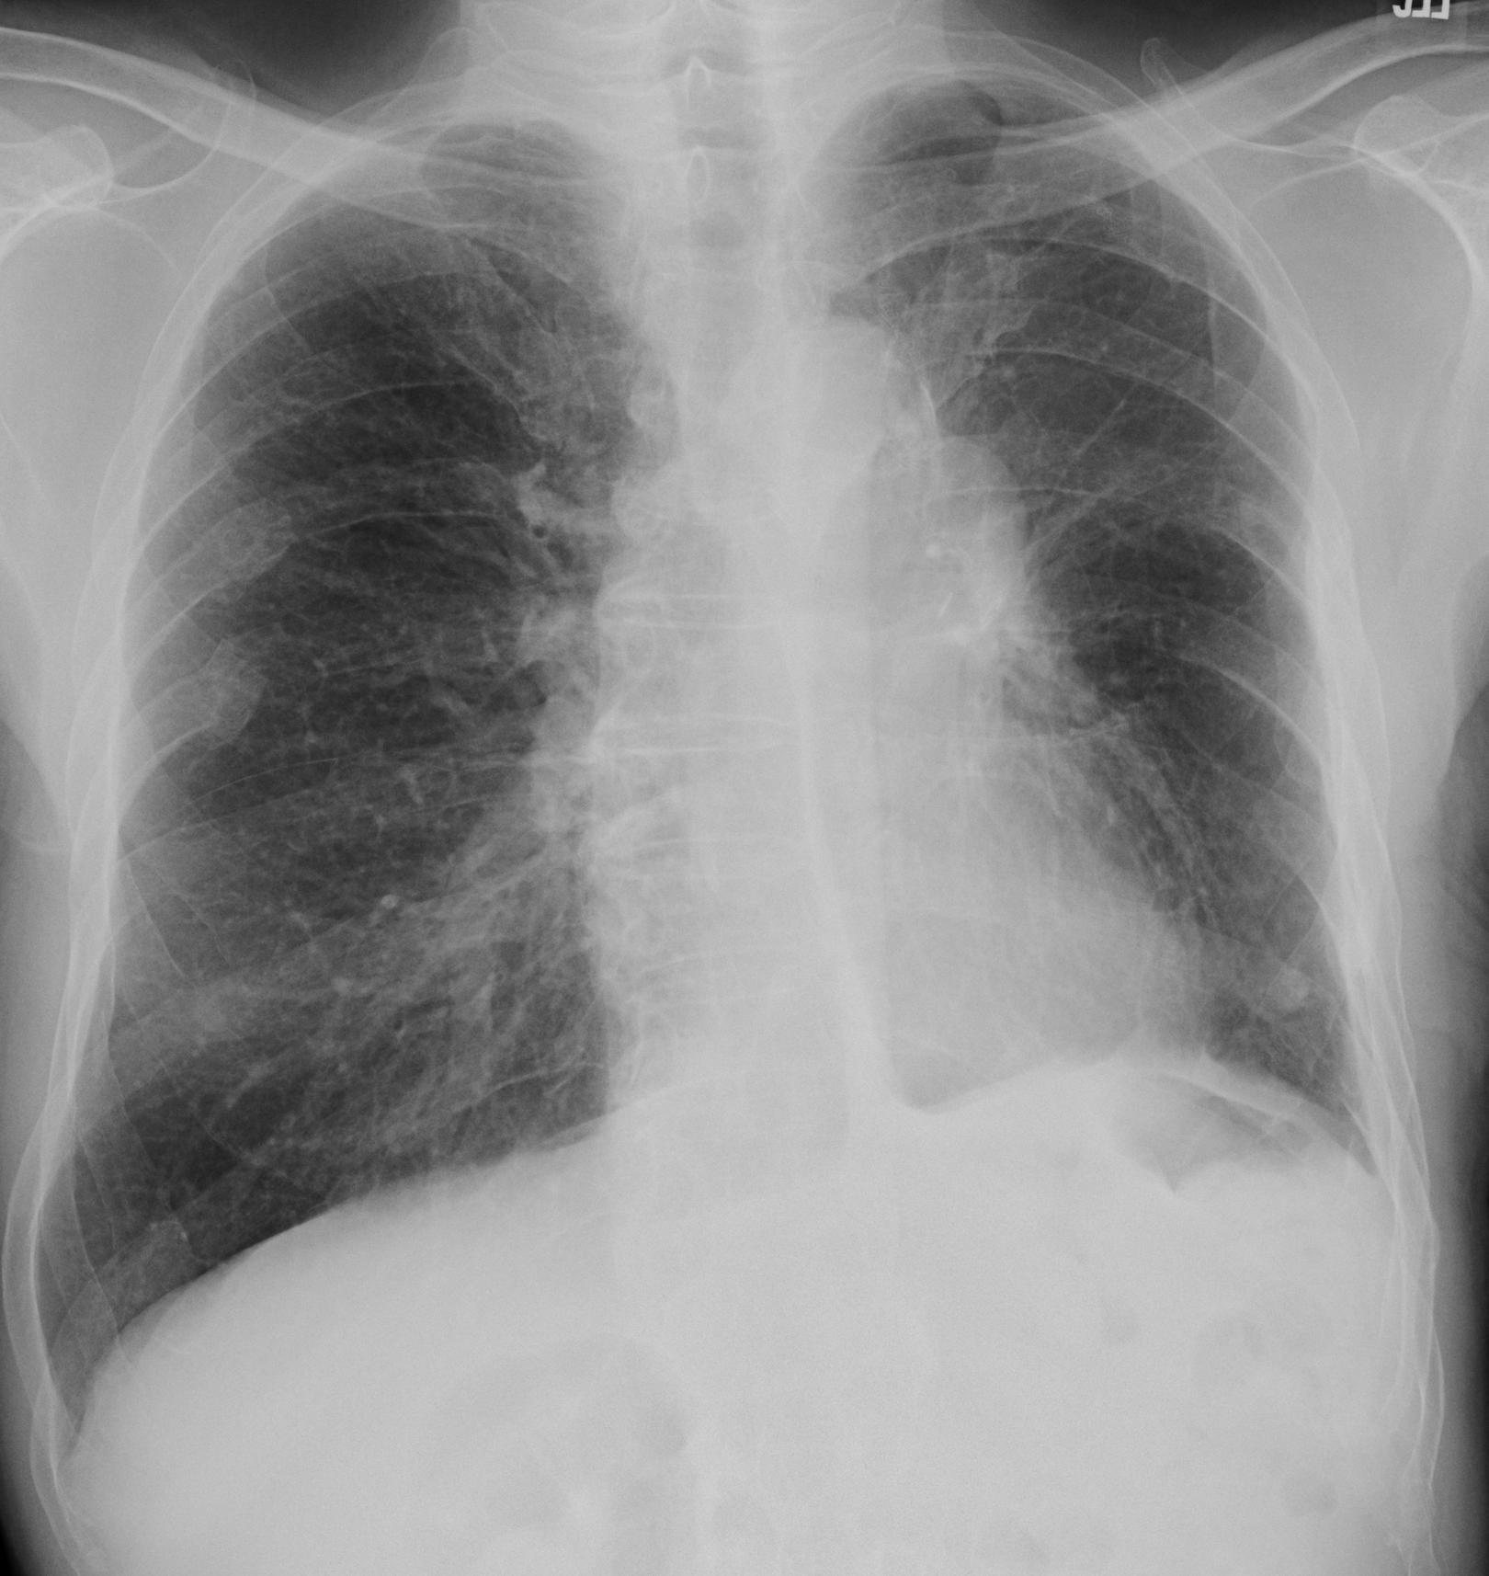
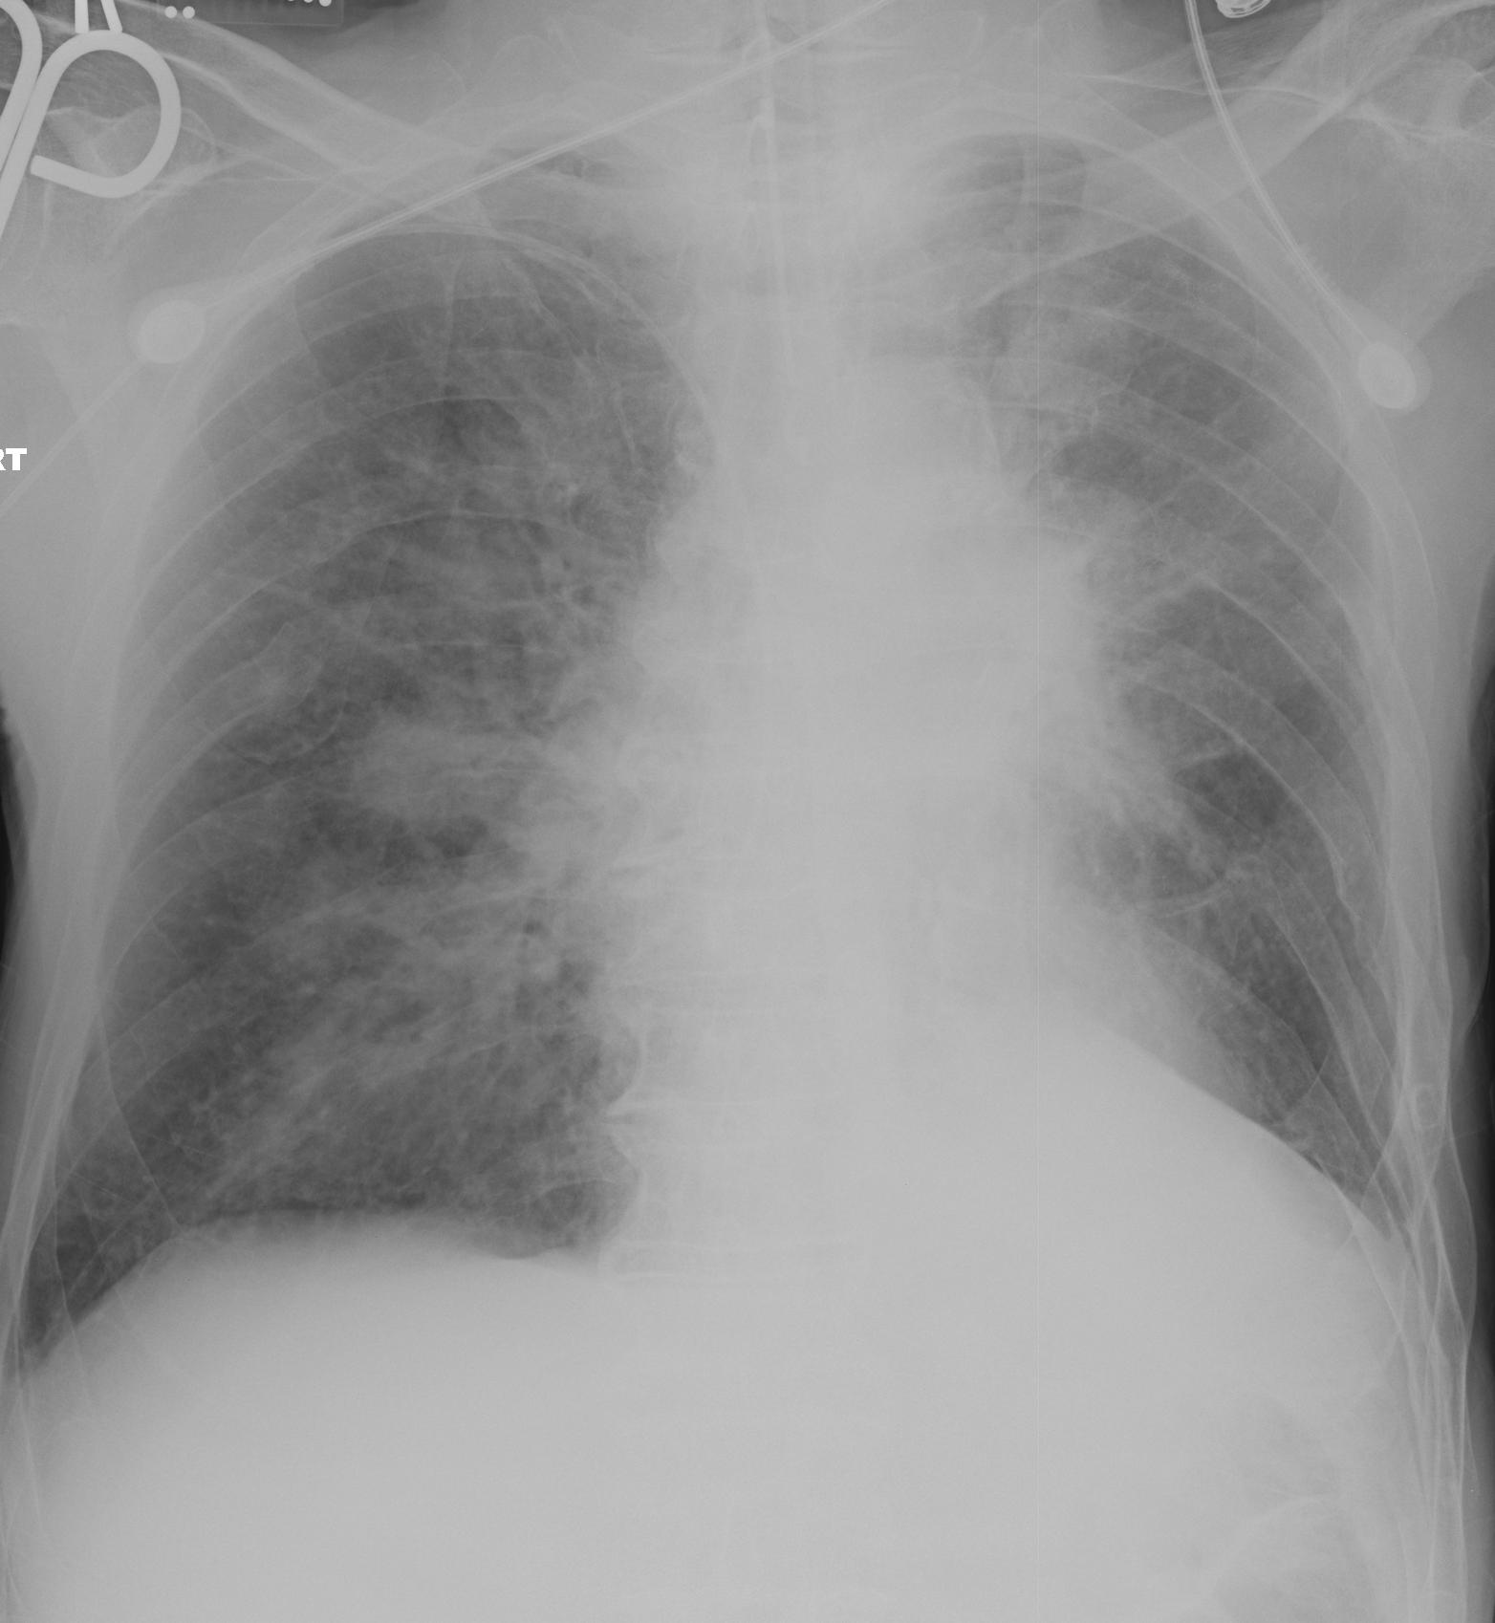
No edema
Moderate edema
Note the hazy, indistinct pulmonary vessels seen on the right image. These are the same patient 1 day apart.
Notes:
Images obtained 1 day apart.

Slide 28
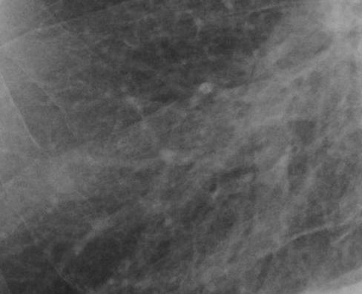
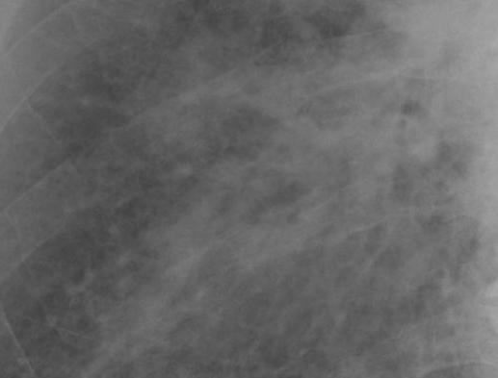
No edema
Moderate edema
Same patient, close up.

Slide 29
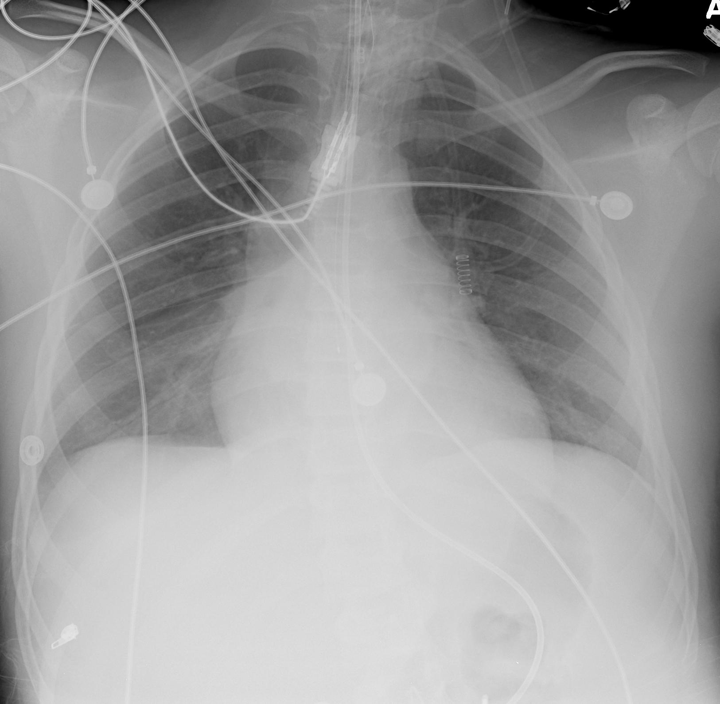
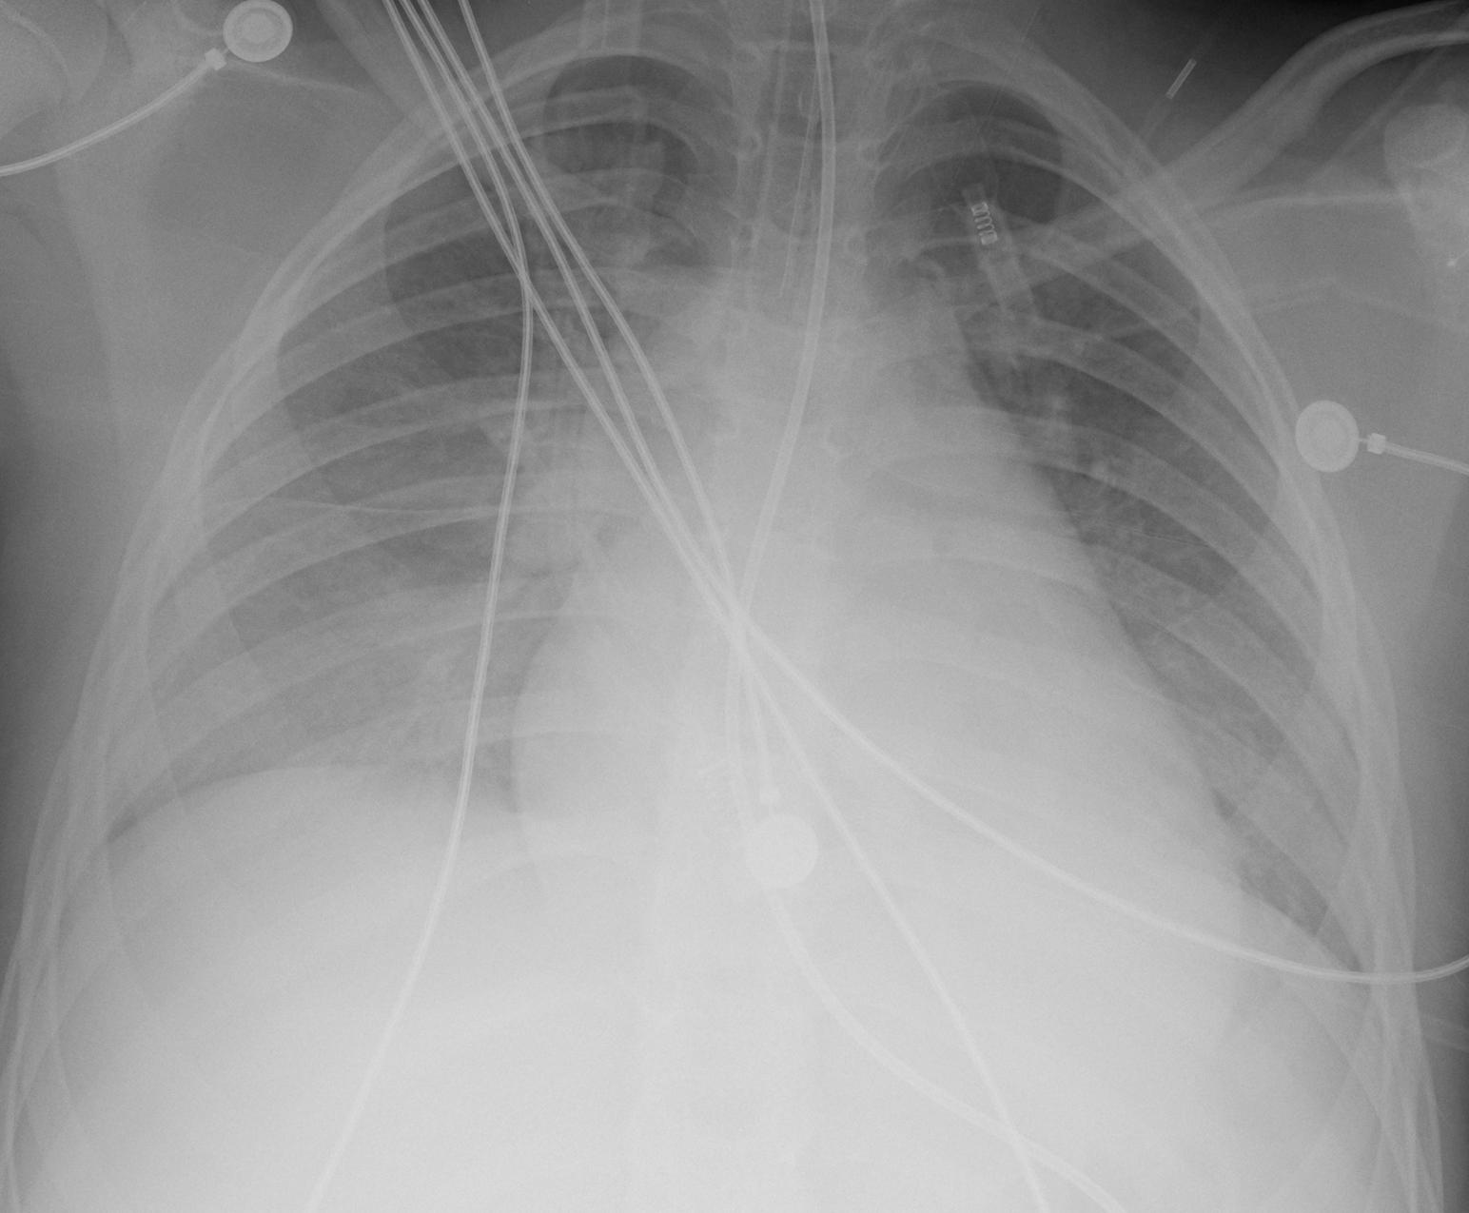
No edema
Moderate edema
Note the thick minor fissure and the plump heart on the right. Also one day apart.

Slide 30
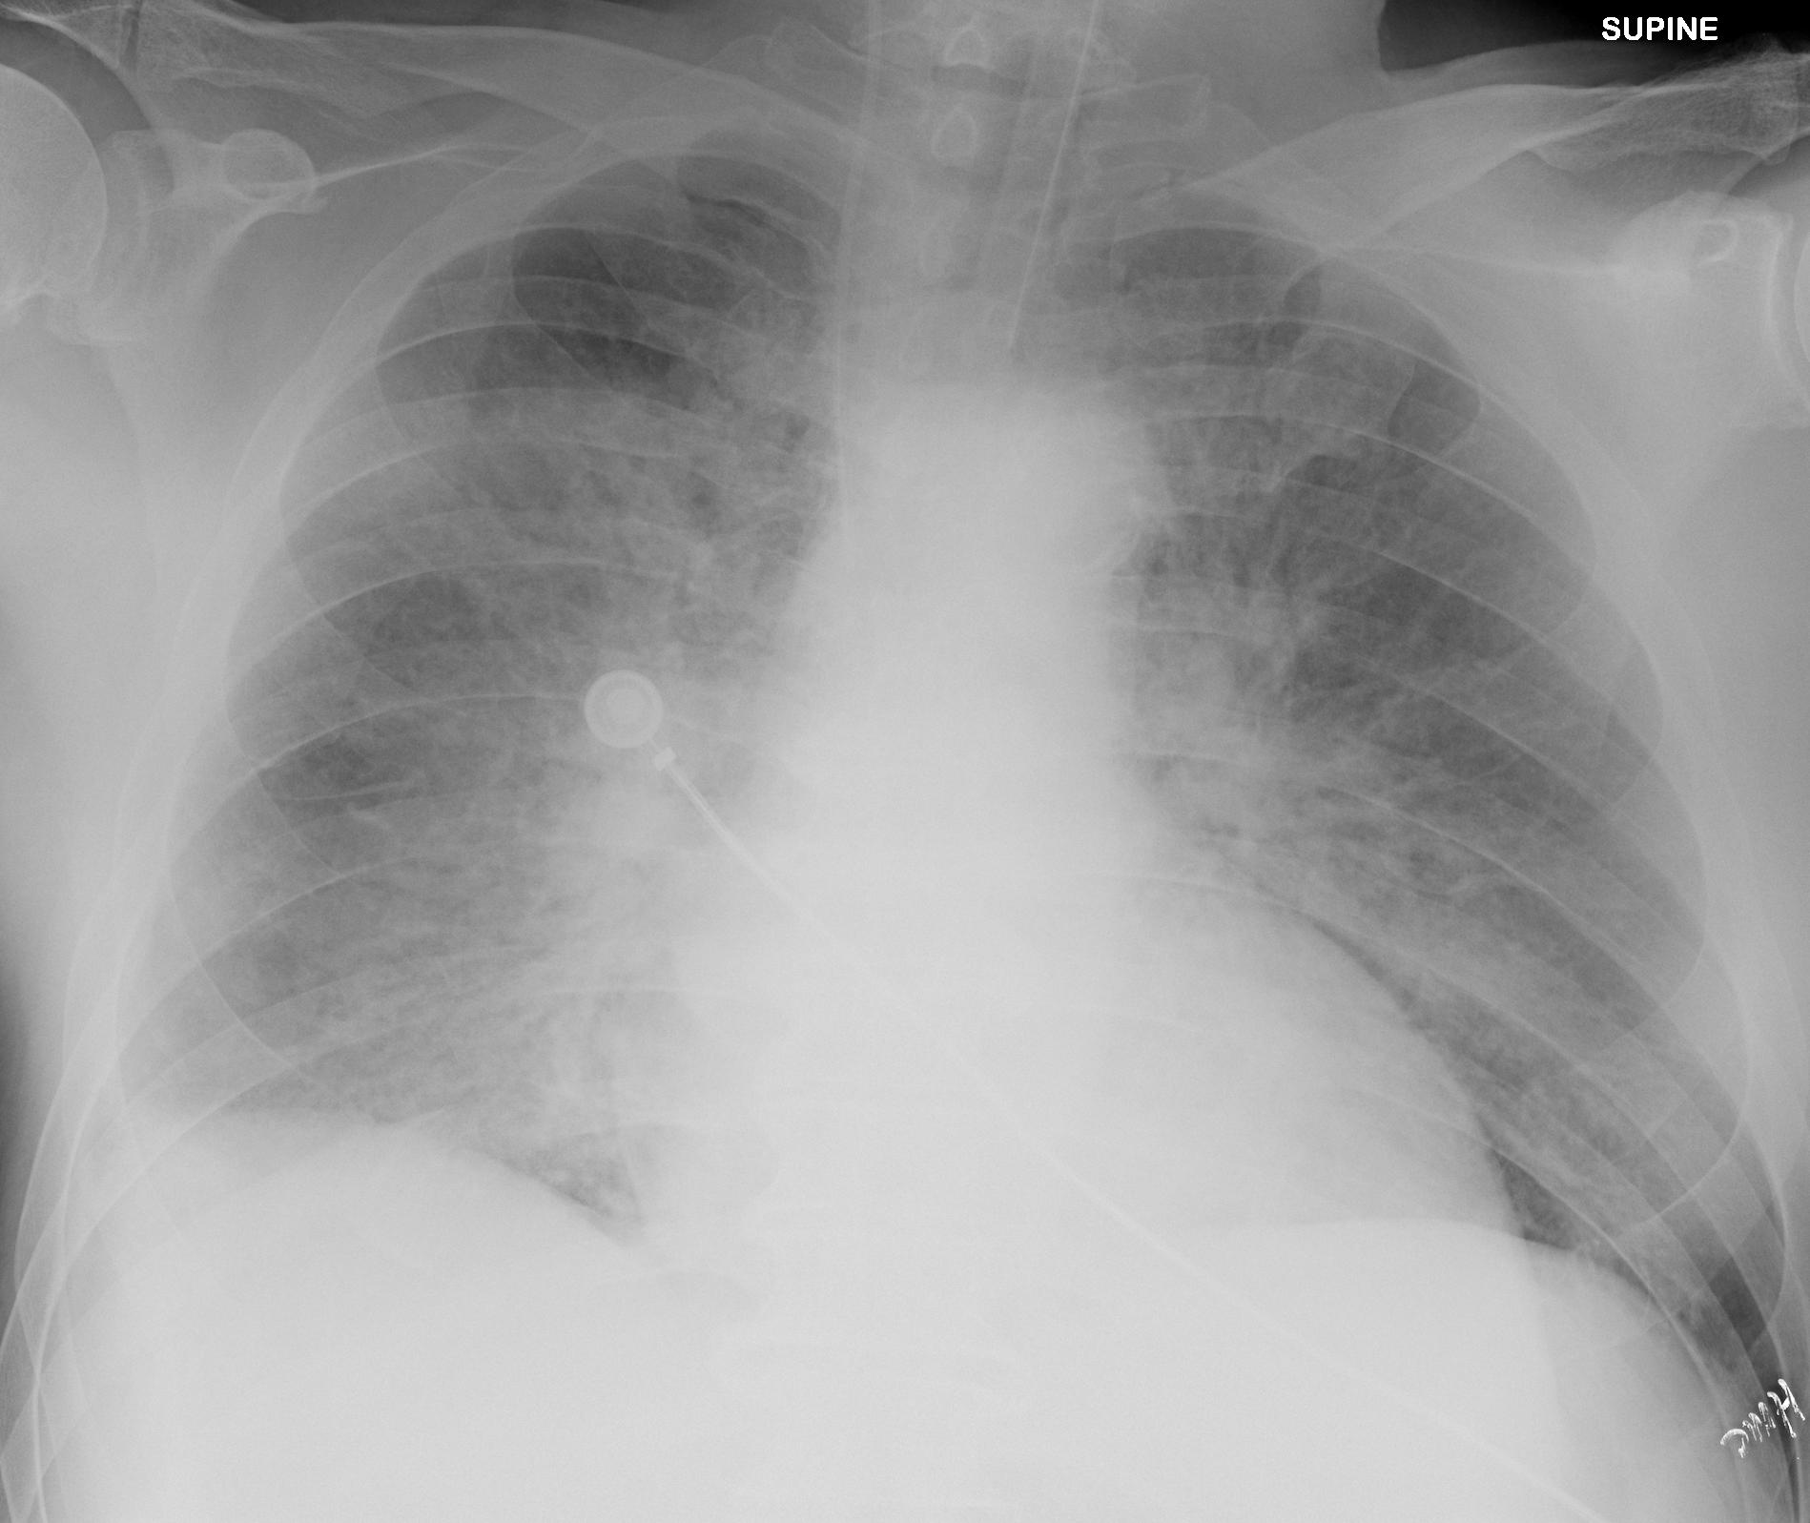
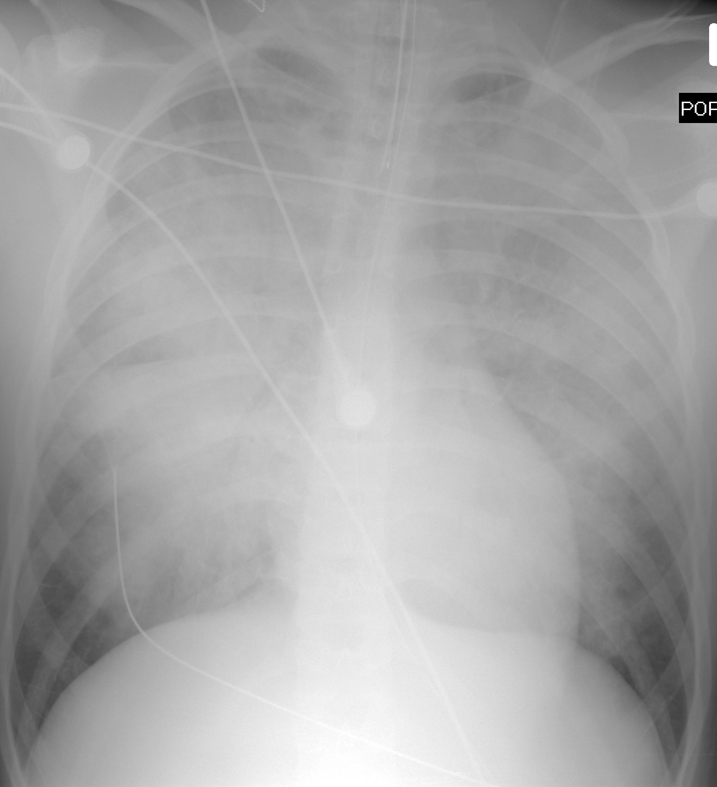
2 cases of severe edema.
Both are more central, very indistinct, and symmetric. Next slide is a close-up of the yellow box

Slide 31
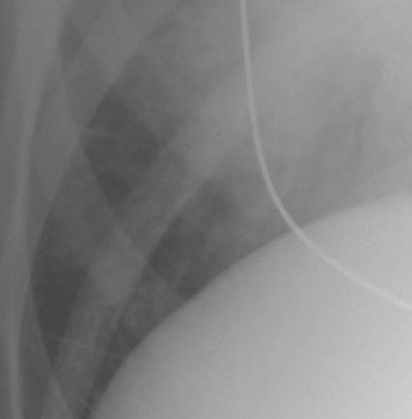
Kerley B lines

Slide 32
Special Thanks:
This module was created by Jeff Otjen, Jan 2011 and modified in 2015

