Slide 1
Cerner tips and tricks
Amelia Noble

Slide 2
Objectives
Clipboards
Autotexts
Order Favorites
Order tips
IView reordering
MAR Summary defaults
Graphing results
Note filters

Slide 3
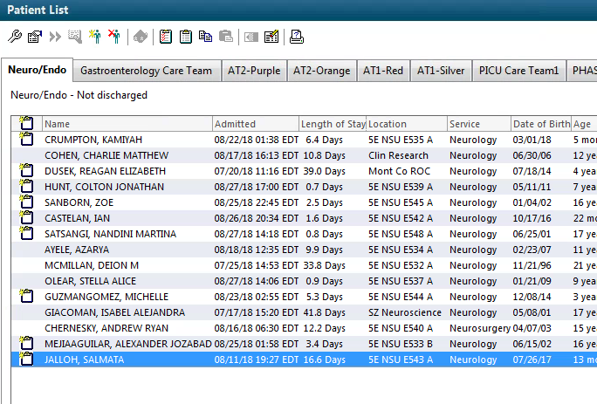
Clipboards, what are they?

Slide 4
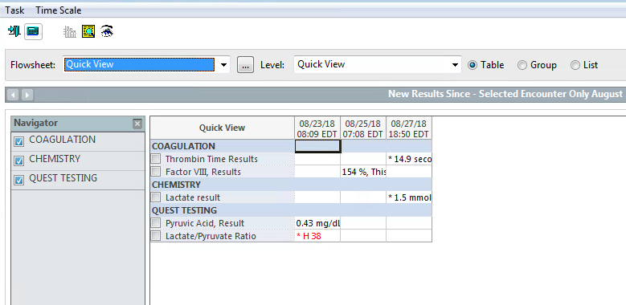

Slide 5
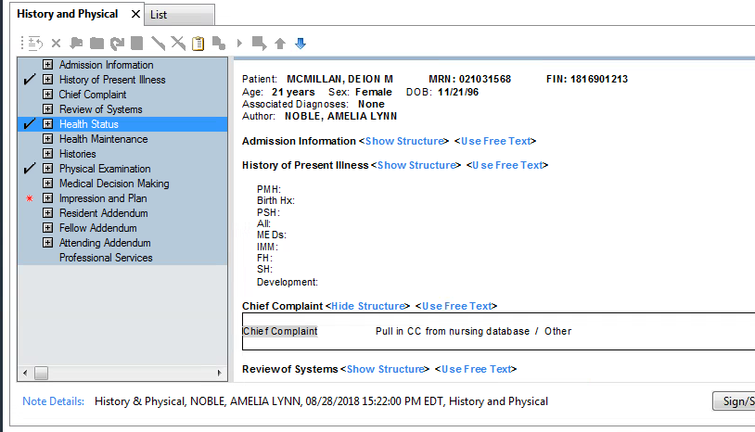
Autotexts/ Macros
Highlight text, right click on it, and click “Save as Autotext”

Slide 6
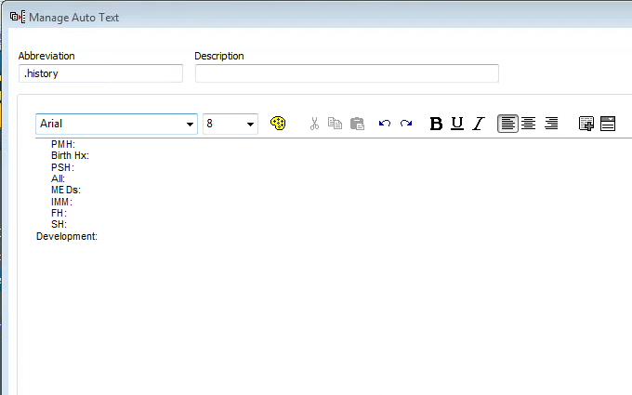
Click Save in lower right corner. Close the following screen. You will be able to use this autotext immediately.

Slide 7
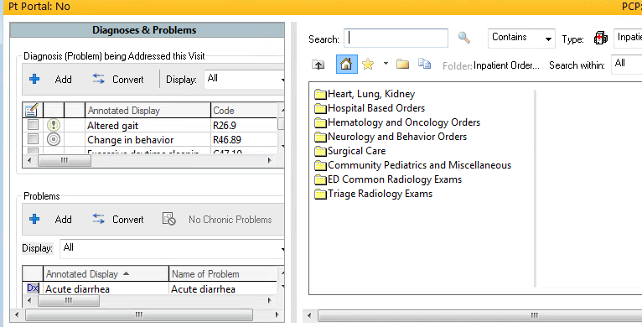
Order Favorites

Slide 8
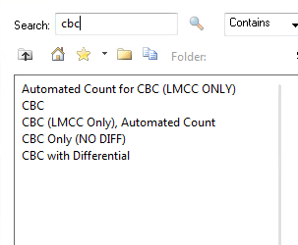
Order Favorites
Right Click on the Order you want added to your list
Click “Add to Favorites”
Click “Ok”
Then it will show up on a list of favorites found by clicking the star

Slide 9
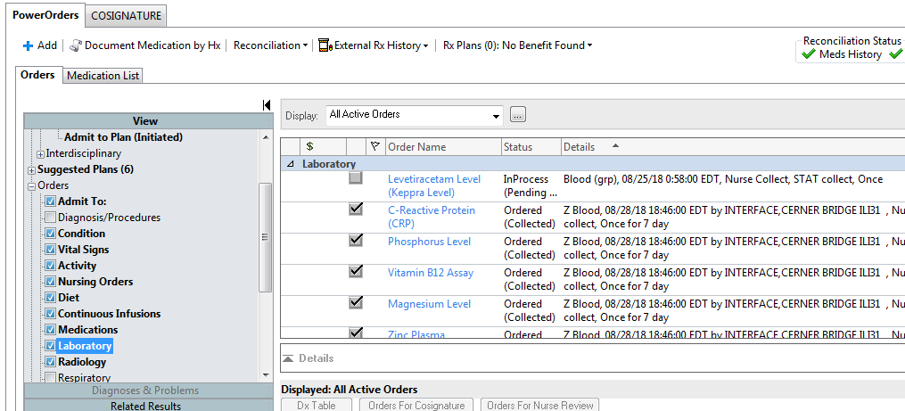
General Orders Tips
To get info on who placed the order, etc. Right click, choose Order information, and go to History tab
Means sample is in lab, getting done!
Uncheck box to cancel the order
Means Lab label was printed! Sample not necessarily in lab

Slide 10
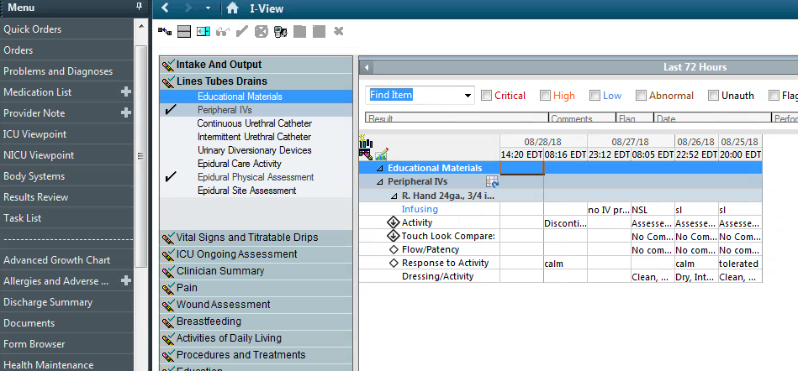
IView, why are you the way that you are

Slide 11
To change order:
While looking at iView
View🡪 Layout 🡪 Navigator bands🡪 Reorder sections 🡪 restart BearTracks

Slide 12
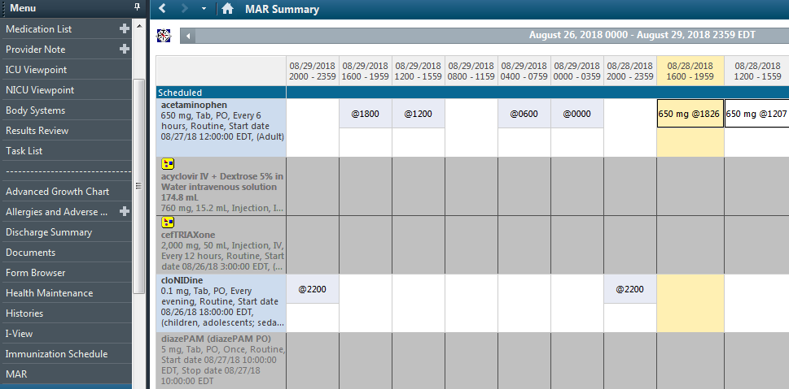
MAR Summary defaults
Right click on Grey bar, choose “Change Defaults”

Slide 13
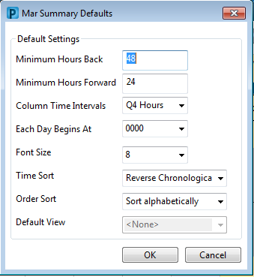
Choose Q24h intervals, then click OK

Slide 14
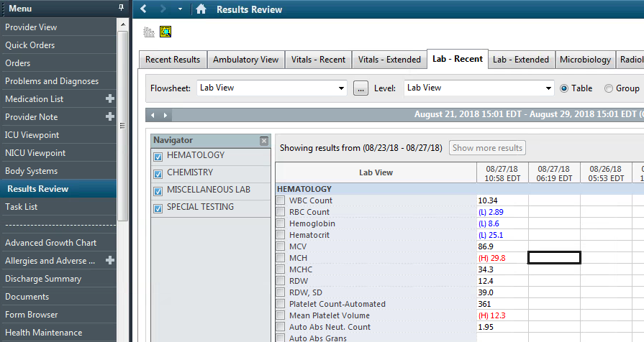
Graphing labs/vitals

Slide 15
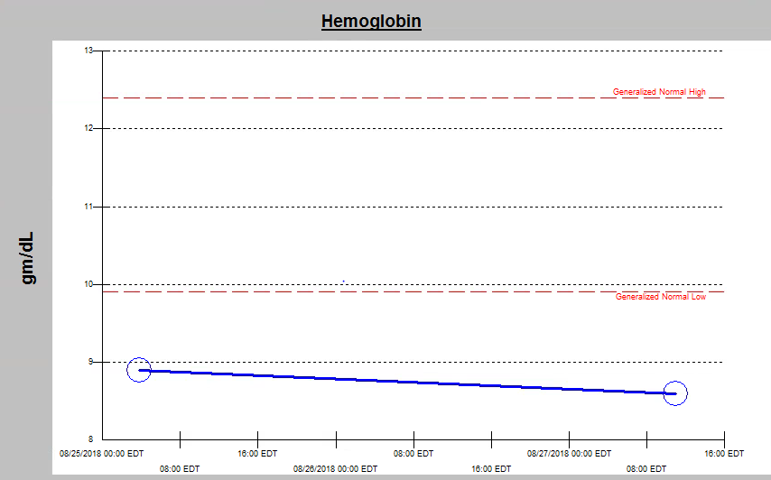

Slide 16
Right click on this grey bar, click Change Search criteria, then select time frame

Slide 17
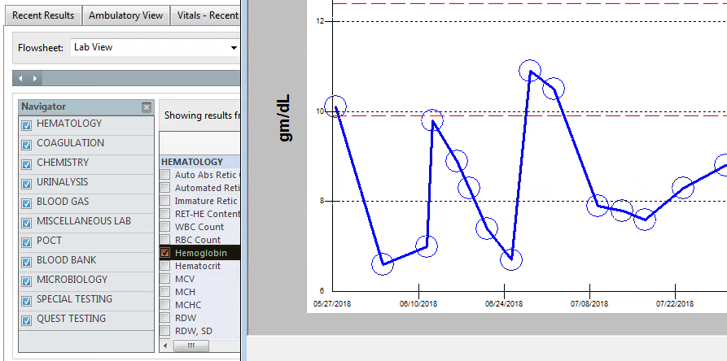

Slide 18
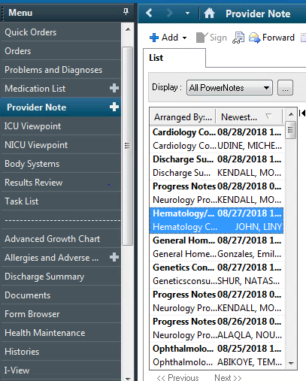
Filters (this will change your life)
Once completed, filters will appear under this dropdown

Slide 19
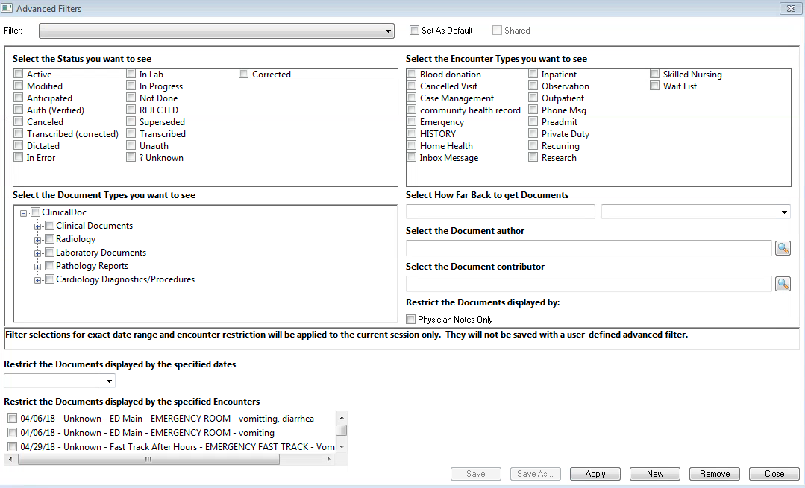
Click plus signs to expand out sections, check boxes of what you want included
Then click “Save as” at bottom to name it
Click Apply

Slide 20
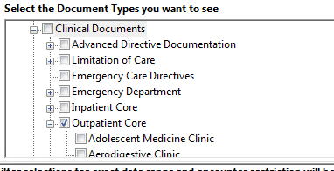
Filters
Example filters:
Outpatient clinic notes:
--Clinical documents 🡪 Click outpatient core box (all items within this tab included)
Operative report:
--Clinical documents 🡪 Peri-operative documents 🡪 Click Operative report
These will apply to current patient immediately, and other patients as well, if you close out their charts and reopen them
I recommend PT/OT, case management, social work, speech, pharmacy, wound notes (these do not appear under the All PowerNotes filter)

Slide 21
Questions?
Any other Cerner concerns?

