Slide 1
Acutely Depressed Mental Status in Children
National Pediatric Nighttime Curriculum
Written by Terry Platchek, MD
Lucile Packard Children’s Hospital, Stanford University

Slide 2
Objectives
Be able to recognize children with acutely depressed mental status
Know the major causes of acutely depressed mental status in children
Initiate the workup for depressed mental status in children
Initiate management of depressed mental status in children

Slide 3
Definitions
Coma:
Unarousable unresponsiveness
The most profound state of depressed mental status
Stupor, Lethargy, Difficult to Arouse, Obtunded:
All of these terms are imprecise and describe a decreased level of consciousness
May be marked by absence of spontaneous movement and diminished responsiveness to stimulation
Awareness is generally impaired before arousal
Brain Death (1-18 y.o.):
Criteria include coma, apnea, and absent brainstem reflexes
Brain death specifically implies no opportunity for recovery

Slide 4
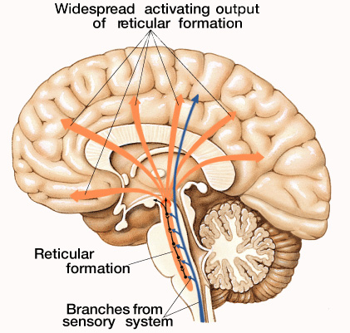
Physiology
Arousal: The physiology of arousal is
dependent on the reticular activating
system (RAS). The RAS is a poorly
localized network of cells in the
brainstem with projections to the
thalamus, hypothalamus and cortex.
Awareness: Awareness is mediated
by the cerebral cortex in widely distributed neuronal networks. Awareness is the product of cortical function that resides within both hemispheres and then projects down to the thalamus and then out, for either motor or sensory functions.
From C.J. Long, Visual Slide Presentation
Notes:
Consciousness is depressed by dysfunction within the brainstem, the bilateral cerebral hemispheres, or global neuronal dysfunction. Generally awareness is impaired before arousal because of it’s more widely distributed cortical network.

Slide 5
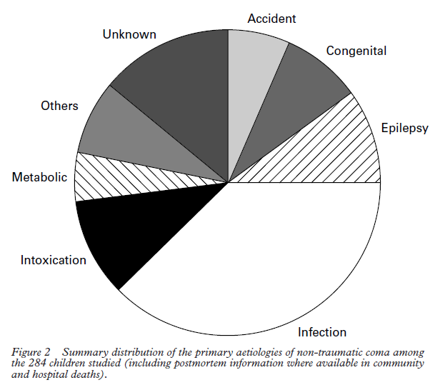
Etiology of Non-Traumatic Pediatric Coma from UK Prospective Study
From: C P Wong, R J Forsyth, T P Kelly, J A Eyre. Incidence, aetiology, and outcome of
non-traumatic coma: a population based study. Arch Dis Child 2001;84:193–199
Notes:
Traumatic and nontraumatic causes have roughly equal annual incidences ~ 30/100,000 children.
In nontraumatic cases:
Infection is the overall leading cause.
Intoxication is a markedly increased cause during adolescence.
Epilepsy has it’s highest incidence during the preschool and school age years.

Slide 6
Workup
Depressed mental status is a medical emergency with a broad differential
Determination of etiology is essential for optimal treatment
Workup requires a systematic approach

Slide 7
Etiology of Depressed Mental Status (from Berger et al)
Nonstructural, Symmetrical
Toxins
Lead,Thallium, Mushrooms, Cyanide, Methanol, Ethylene glycol, Carbon Monoxide
Drugs
Sedatives, Barbiturates*, Hypnotics, Tranquilizers, Bromides, Alcohol, Opiates, Paraldehyde, Salicylate, Psychotropics, Anticholinergics, Amphetamines, Lithium, Phencylidine, MAOi’s
Metabolic
Hypoxia, Hypercapnia, Hypernatremia*, Hypoglycemia*,Hypergylcemic nonketotic coma, Diabetic ketoacidosis, Lactic acidosis, Hypercalcemia, Hypocalcemia, Hypermagnesemia, Hyperthermia, Hypothermia, Reye's encephalopathy, Aminoacidemia, Wernicke's encephalopathy, Porphyria, Hepatic encephalopathy*, Uremia, Dialysis encephalopathy, Addisonian crisis, Hypothyroidism
Infections
Sepsis, Bacterial meningitis, Viral encephalitis, Postinfectious encephalomyelitis, Syphilis, Typhoid fever, Malaria, Waterhouse-Friderichsen syndrome
Other
Postictal* , Diffuse ischemia (MI, heart failure, arrhythmia), Hypotension, Fat embolism*, Hypertensive encephalopathy, Hypothyroidism, Nonconvulsive status epilepticus, Heat stroke
Structural, Symmetrical
Supratentorial
Bilateral internal carotid occlusion, Bilateral anterior cerebral artery occlusion, Sagittal sinus thrombosis, Subarachnoid hemorrhage ,Thalamic hemorrhage*, Trauma-contusion, concussion*, Hydrocephalus
Infratentorial
Basilar occlusion*, Midline brainstem tumor , Pontine hemorrhage*, Central pontine myelinolysis
Structural, Asymetrical
Supratentorial
TTP•, DIC, Nonbacterial thrombotic endocarditis, Subacute bacterial endocarditis, Fat emboli, Unilateral hemispheric mass (tumor, abscess, bleed) with herniation, Subdural hemorrhage, bilateral Intracerebral bleed, Pituitary apoplexy•, Massive or bilateral supratentorial infarction, Multifocal leukoencephalopathy, Creutzfeldt-Jakob disease Adrenal leukodystrophy, Cerebral vasculitis, Subdural empyema, Thrombophlebitis•, Multiple sclerosis, Leukoencephalopathy from chemotherapy, Acute disseminated encephalomyelitis (ADEM)
Infratentorial
Brainstem infarction, Brainstem hemorrhage, Brainstem thrombencephalitis
* Relatively common asymmetrical presentation.
• Relatively symmetrical presentation
Broad Differential!
Manageable in Categories
Notes:
It is impossible to memorize all the causes of depressed mental status. It is best to consider the differential in categories.
Determine if the clinical presentation has symmetric or asymmetric findings.
Asymmetric findings favor a structural cause.
If findings on exam do not localize go through the categories of Toxins, Drugs, Metabolic, Infections, Primary Neuro/Epilepsy and other.

Slide 8
Focused History
AMPLE History
A: Allergy/Airway
M: Medications
P: Past medical history
L: Last meal
E: Event - What happened?
Rapid or Gradual Onset?
Preceding Headache or Neurologic Symptoms?
Ingestions?
Vague or inconsistent history from caregiver is suspicious for non-accidental trauma.
Notes:
A focused history is a vital component in the rapid workup of acutely depressed mental status. By necessity, it should focus on what precipitated the acute event.
In the hospital, always remember that iatrogenic intoxication is a major cause and that recently administered medications must be reviewed.

Slide 9
Focused Physical Exam (suggested by Michelson et al.)
ABC’s (including cardio-respiratory exam)
Vitals
Neurologic examination
Brief and to the point
Differentiate structural from non structural causes
Assess: Level of consciousness/responsiveness, Motor responses, Brainstem reflexes
Meningismus / Nuchal Rigidity
Brudzinski’s sign - Involuntary hip & knee flexion with forced neck flexion
Kernig’s sign - involuntary knee flexion with forced flexion of the hip
Fundoscopy
Papilledema suggests increased ICP of more than several hours duration.
Retinal hemorrhages in an infant are a sign of non-accidental trauma
Skin
Bruising may suggest trauma, rashes may suggest infection
Notes:
Physical exam is aimed at narrowing the differential in a rapid but systematic manner. Additionally, acutely unstable physical exam should prompt the PALS algorithm.

Slide 10
Pediatric Glasgow Coma Scale
 | Infant < 1 yr | Child 1-4 yrs | > 4 years
EYES
4 | Open | Open | Open
3 | To voice | To voice | To voice
2 | To pain | To pain | To pain
1 | No response | No response | No response
VERBAL
5 | Coos, babbles | Oriented, speaks, interacts, social | Oriented and Alert
4 | Irritable cry, consolable | Confused speech, disoriented, consolable | Disoriented
3 | Cries persistently to pain | Inappropriate words, inconsolable | Nonsensical speech
2 | Moans to pain | Incomprehensible, agitated | Moans, unintelligible
1 | No response | No response | No response
MOTOR
6 | Normal spontaneous movement | Normal spontaneous movement | Follows commands
5 | Withdraws to touch | Localizes pain | Localizes pain
4 | Withdraws to pain | Withdraws to pain | Withdraws to pain
3 | Decorticate flexion | Decorticate flexion | Decorticate flexion
2 | Decerebrate extension | Decerebrate extension | Decerebrate extension
1 | No response | No response | No response
Notes:
Total of 15 points which is considered normal. The minimum score is 3.
In patients with a glascow coma score of ≤ 8 intubation is recommended as these patients are at high risk for not protecting their airway.

Slide 11
Management (adapted from Thompson and Williams)
ABCs / PALS
Stabilize C-Spine if indicated
Intubate for GCS ≤ 8
D10% - 2.5 mL/kg IV
Lorazepam (0.1 mg/kg) for clinical seizures
Antidote or reversal agent if known/suspected ingestion
For Infection
Ceftriaxone, Vancomycin
Acyclovir
For increased ICP
Mannitol 0.5-1g/kg
For non-convulsive status epilepticus
Lorazepam or Fosphenytoin
Treat Underlying Cause
Notes:
Treat all patients with ABCs/PALS support. It is important to remember that patients with a GCS of 8 or less cannot adequately protect their airway.
Without a readily identifiable cause for acutely depressed mental status, give all patients IV D10 unless a blood glucose can be immediately checked.
Empiric antibiotics vary by location but ceftriaxone, vancomycin and acyclovir are popular choices.
Lorazepam is a reasonable initial treatment for all cases of definite seizure

Slide 12
Labs (adapted from Michelson et al.)
If cause for depressed mental status is not readily apparent send:
Bedside blood glucose Urine drug screen
Electrolytes with Ca, Mg Complete blood count
BUN, creatinine Blood culture
Transaminases ABG/VBG, ammonia
If suspected metabolic abnormality send:
UA, urine ketones, plasma amino acids, urine organic acids, plasma free fatty acids, carnitine profile, lactate, pyruvate
Notes:
History should always guide your workup.
When etiology remains elusive consider sending thyroid studies, cortisol levels, carboxyhemoglobin, coagulation studies, CK, urine porphyrins and additional infection workup is clinically appropriate

Slide 13
Diagnostic Studies
CT is the initial neuro-imaging test of choice.
MRI with DWI can be considered as an adjunct.
LP after increased ICP has been ruled out
EEG to rule out nonconvulsive status epilepticus should be performed in children with depressed mental status where etiology remains elusive.
Notes:
CT scan is useful to detect intracranial bleeding, trauma, mass and evidence of increased ICP.
LP is an extremely useful diagnostic study and should be performed when working up acutely depressed mental status without clear etiology. Much debate exists on the need for imaging before LP to rule out increased ICP. Exam for a bulging fontanelle in an infant, and for papilledema are often suggested by experts.

Slide 14
Case 1
A 16 year old girl is brought in unconscious by friends from a party. Physical exam notes the smell of alcohol, tachycardia to 178, fever to 39.8, diaphoresis and BP 185/107. You are called to consult in the ED. What is the most likely etiology of her altered mental status?
MDMA (ecstasy)/Amphetamine intoxication
What if the same patient has absent sweating and dilated pupils?
Anticholenergic Intoxication
Notes:
MDMA intoxication (a modified designer amphetamine) and Anticholenergic intoxication can be very similar. One key difference is MDMA intoxication usually presents with diaphoresis whereas anticholenergic intoxication often presents with absent sweating.
While most patients with MDMA overdose improve with supportive care, life-threatening complications may result from severe toxicity. Complications include severe hyperthermia, DIC, rhabdomyolysis, acute renal failure, hyponaremia, seizures, cerebral edema, arrhythmia.
For Anticolenergic intoxication initial assessment and stabilization are required. Check ABCs. Obtain an ECG soon after arrival. Give sodium bicarbonate to patients with QRS prolongation (>100 milliseconds). Following initial stabilization, GI decontamination usually is needed. The antidote for anticholinergic toxicity is physostigmine salicylate.

Slide 15
Case 2
A 3 year old boy with a past medical history of OTC deficiency is admitted with cellulitis. He is found unresponsive in the child life room. As the pediatrics resident, you are called for urgent evaluation.
Please provide a DDx and workup.
DDx includes hyperammonemia, hypoglycemia, sepsis, ingestion, trauma, or sub-clinical seizures.
Workup should include a focused physical exam, chemistries, free flowing ammonia, glucose, CBC, cultures and possible ABG. Evidence of trauma should prompt an immediate head CT.
Notes:
A reasonable DDx includes depressed mental status due to hyperammonemia, hypoglycemia, sepsis, ingestion, trauma, or seizures as a result of any of the preceding. Workup would include focused physical exam, chemistries, free flowing ammonia level, glucose, CBC, routine cultures and possible ABG. Any evidence of trauma should prompt an immediate Head CT.

Slide 16
References
Berger, Joseph R. Clinical Approach to Stupor and Coma. In: Neurology in Clinical Practice: Principles of diagnosis and Management, 4th ed, Bradley, WG, Daroff, RB, Fenichel, GM, Jankovic, J (Eds), Butterworth Heinmann, Philadelphia, PA 2004. p.46.
C P Wong, R J Forsyth, T P Kelly, J A Eyre. Incidence, aetiology, and outcome of non-traumatic coma: a population based study. Arch Dis Child 2001;84:193–199
Michelson D, Thompson L, Williams E. Evaluation of stupor and coma in children. UpToDate. 2006.
Simpson D, Reilly P. Pediatric coma scale. Lancet 1982; 2:450.
Teasdale G, Jennett B. Assessment of coma and impaired consciousness. A practical scale. Lancet 1974,2:81-84 [Glasgow Coma Scale]
Thompson L, Williams E. Treatment and Prognosis of Coma in Children. UpToDate. 2010.
Notes:
I hope you enjoyed the module. For additional information on the topic consider these sources which were used in the creation of this presentation.

