Slide 1
Altered Mental Status Night Time Curriculum

Slide 2
Learning Objectives:
Describe the elements of a rapid clinical assessment for change in mental status
Appraise when you need backup (i.e. specific roles, specific resources available)
Describe the differential diagnosis for changes in mental status and how to assess for these
Discuss initial management strategies and prioritize appropriate testing

Slide 3
Focused Physical Exam:
ABC’s (including cardiorespiratory exam)
Vitals
Neurologic examination:
Assess: Level of consciousness/responsiveness, motor responses, brainstem reflexes
A: Alert
V: Responds to voice
P: Responds to pain
U: Unresponsive
Meningismus/nuchal rigidity:
Brudzinski’s sign: involuntary hip and knee flexion with forced neck flexion
Kernig’s sign: involuntary knee flexion with forced hip flexion
Fundoscopy:
Papilledema suggests increased ICP (for at least several hours)
Retinal hemorrhages may be a sign of NAT
Skin:
Bruising may suggest trauma, rash may suggest infection

Slide 4
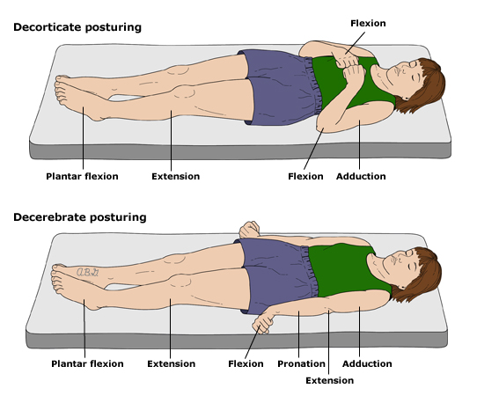
Glasgow Coma Scale
Sign | Pediatric Glasgow Coma Scale | Infant Glasgow Coma Scale | Score
Eye opening | Spontaneous | Spontaneous | 4
 | To sound | To sound | 3
 | To pain | To pain | 2
 | None | None | 1
Verbal Response | Oriented, appropriate | Coos and babbles | 5
 | Confused | Irritable, cries | 4
 | Inappropriate words | Cries in response to pain | 3
 | Incomprehensible sounds | Moans in response to pain | 2
 | None | None | 1
Motor | Obeys commands | Moves spontaneously and purposely | 6
 | Localizes painful stimulus | Withdraws in response to touch | 5
 | Withdraws in response to pain | Withdraws in response to pain | 4
 | Flexion in response to pain | Abnormal flexion posture to pain | 3
 | Extension in response to pain | Abnormal extension posture to pain | 2
 | None | None | 1

Slide 5
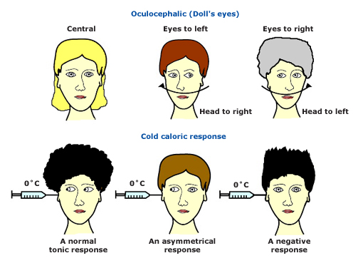
Eye movements:
Oculocephalic (doll's eyes) response: This test should not be performed if a cervical spine injury is suspected. Observe the motion of the eyes while passively moving the head. In a comatose patient, conjugate movement of the eyes in the direction opposite to the head movement is expected. An absent or asymmetric response in an unconscious patient implies brain stem dysfunction. Caloric response: After visually checking that the tympanic membrane is intact, ice cold water is used to irrigate the ear canal and should produce a slow conjugate deviation toward the irrigated side. An absent or asymmetric response indicates brain stem dysfunction.

Slide 6
Forming the Differential: AEIOU-TIPS
A: Alcohol, abuse of substances
E: Electrolyte abnormality, encephalopathy, epilepsy
I: Infection
O: Overdose/ingestion, oxygen deficiency
U: Uremia
T: Trauma, temperature abnormality, tumor
I: Insulin, intussusception, inborn errors of metabolism
P: Psychogenic, poisoning
S: Shock, stroke, seizure, shunt, space-occupying lesion
Notes:
A Alcohol, Abuse of Substances
E Epilepsy, Encephalopathy, Electrolyte Abnormalities,
Endocrine Disorders
I Insulin, Intussusception
O Overdose, Oxygen Deficiency
U Uremia
T Trauma, Temperature Abnormality, Tumor
I Infection
P Poisoning, Psychiatric Conditions
S Shock, Stroke, Space-occupying Lesion (intracranial)

Slide 7
Case #1:
2 month old baby boy is brought to the Emergency Department by his mother after she found him in his crib “limp and blue,” with gagging respirations
HR: 180 RR: 44 BP: 95/70 Temp: 38°C (rectal)
General: pale, limp, difficult to arouse
Respiratory: labored respirations with subcostal and suprasternal retractions
Circulatory: mottled, cap refill 4 seconds centrally, 1+ femoral and brachial pulses
Neurologic: eyes closed, do not open with painful stimulation, PERRL (5 → 3 mm)
Initial assessment?
Differential Diagnosis?
Additional history and physical exam findings?

Slide 8
Case #1:
Additional History:
The patient has been afebrile. He had been home alone with the babysitter for 4 hours when his mother came home and found him “limp and blue” in the crib.
PMHx: Premature birth at 32 weeks, gastroesphageal reflux disease, colic
Medications: Simethicone, ranitidine
Physical exam: Anterior fontanelle bulging, retinal hemorrhages present bilaterally. Tachycardic with regular heart rhythm, no murmur. Abdomen soft and nondistended.
Initial interventions?
Who ya gonna call?
Notes:
Recommended interventions:
Administer 100% oO2 via face mask. Suction oropharynx. Place in cervical spine collar. Put on CR monitor with pulse ox. Attempt IV access and start fluid resuscitation with 20 ml/kg NS bolus. Order labs: rapid glucose, ABG/VBG, CBC, chemistry panel, urinalysis with culture.
Consider giving IV antibiotics for possible infectious etiology of altered mental status

Slide 9
Case #1:
Progression: The patient became bradypneic with agonal respirations and signs of impending respiratory failure. He is intubated using RSI. He later becomes unresponsive to painful stimuli. Right pupil is now 7 mm and fixed, left pupil is 5 mm and reactive to light.
Decerebrate posturing is noted on the (rigid extension of upper and lower extremities) is noted on the left.
HR: 60 RR: 40 (ventilated) BP: 125/85
How would you classify this patient?
Who ya gonna call?
What interventions could you perform at bedside in the meantime?
CUSHING’S TRIAD:
Hypertension
Bradycardia
Irregular respirations
Notes:
RSI:
Atropine 0.01-0.02 mg/kg IV (minimum dose 0.1 mg)
Lidocaine 1 mg/kg IV (use to blunt increased ICP response to intubation)
Etomidate 0.3 mg/kg IV (has the benefit of lowering ICP without significantly decreasing blood pressure)
Rocuronium 0.6-1 mg/kg IV (succinylcholine has the potential to raise ICP but is not contraindicated and may be used in head-injured patients)
Rapid treatment of hypoxia, hypercarbia, and hypotension, since even brief derangements in these parameters can adversely affect outcome [23,24]. Isotonic fluids (eg, 0.9 percent [normal] saline) should be administered to patients to maintain adequate MAP; if this fails, infusions of dopamine or norepinephrine can be initiated [24,30,32].
●Elevation of the head of the bed from 15 to 30 degrees; mild head elevation can lower ICP without adversely affecting MAP or CPP [24,30,33]; elevation greater than 40 degrees may decrease CPP.
●Aggressively treating fever with antipyretics and cooling blankets, since hyperpyrexia increases cerebral metabolism and increases CBF, further elevating ICP [24].
●Controlling shivering in intubated patients with muscle relaxants (eg, vecuronium, rocuronium).
●Administering prophylactic anticonvulsants (eg, levetiracetam, phenytoin, or phenobarbital) to patients who are at high risk of developing seizures (eg, those who have parenchymal abnormalities, depressed skull fractures, or severe traumatic brain injuries). Seizures are associated with increases in ICP [34]. Breakthrough seizures are best treated with benzodiazepines (see "Management of convulsive status epilepticus in children").
●Maintaining adequate analgesia to blunt the response to noxious stimuli [5].
Additional measures can be taken in patients who require endotracheal intubation. These include:
●Maintaining the head in a midline position and taping, rather than tying endotracheal tubes to the face (to prevent obstruction of venous outflow)
●Avoiding high positive pressures and end expiratory pressures; such pressures may increase intrathoracic pressure and impede venous drainage as long as oxygenation remains adequate
●Maintaining adequate sedation to permit controlled ventilation; neuromuscular blockade may be required if ICP remains elevated despite adequate sedation; muscle relaxation also can prevent fighting against the ventilator and permit hyperventilation if it is required; short-acting agents are preferred, and can be withheld periodically to permit neurologic evaluation [24]
●Administration of lidocaine (1 mg/kg IV) before endotracheal tube suctioning to blunt the gag and cough responses; careful attention must be paid to the cumulative dose to avoid lidocaine toxicity, particularly in young children.

Slide 10
What’s the deal with hyperventilation?
Hypercapnia → cerebral vasodilatation → ↑ cerebral blood flow
Hypocapnia → cerebral vasoconstriction → ↓ cerebral blood flow
Take-home point:
In the setting of acute herniation, aggressive hyperventilation may help in relieving the pressure differential in the intracranial compartments. HOWEVER, it may also cause cerebral ischemia (PaCO2 < 35 mmHg) due to decreased cerebral blood flow.
Notes:
Where CAP is carotid arterial pressure, JVP is jugular venous pressure, and CVR is cerebrovascular resistance.
Arterial PaO2 and PaCO2 have well-defined effects on CBF. Arterial PaO2 has its most significant effects at levels below 50 mmHg, when it causes vasodilatation in an attempt to maintain the oxygen supply to the brain [5,8]. PaCO2 has an effect on CBF over a much broader range. Hypercapnia causes cerebral vasodilatation and increased CBF , whereas hypocapnia reduces CBF. Because the response to changes in PaCO2 is rapid, hyperventilation can be a useful tool in the acute management of increased ICP complicated by transtentorial and tonsillar herniation of brain tissue. (See'Hyperventilation' below.)
Hyperventilation (PaCO2 <35 mmHg) may cause cerebral ischemia as the result of decreased cerebral blood flow. Consequently, PaCO2 should be maintained between 35 and 38 mmHg unless there are signs of impending herniation. Aggressive hyperventilation with PaCO2 below 30 is indicated only if there are clinical signs of acute herniation. Aggressive hyperventilation may prevent herniation by relieving the pressure differential in the intracranial compartments. However, the associated risk of cerebral ischemia with excessive lowering of CBF can be justified only in patients who have signs of ongoing herniation

Slide 11
Case #2:
4 year old boy is brought to ED by his dad. He has been cranky, tired, and increasingly pale over the past 1-2 days. 6 days ago the patient developed abdominal pain and diarrhea. Dad is unsure when the patient last voided.
HR: 115 RR: 28 BP: 129/88 Temp: 37.8°C
General: crying but consolable by father, difficult to engage with examiner
Respiratory: normal work of breathing, no retractions
Circulatory: skin slightly cool and pale, cap refill = 2 seconds, strong peripheral pulse
GI: mild abdominal tenderness, no HSM, stools positive for blood
Skin: mild petechiae
Initial assessment?
Differential Diagnosis?
What interventions are needed at this time? What are you worried about?

Slide 12
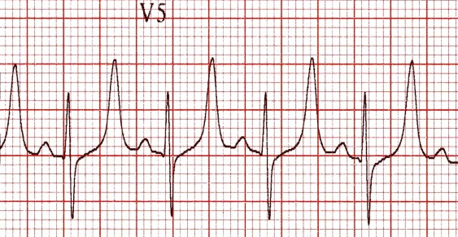
Case #2:
You administer supplemental oxygen and obtain IV access. You send a CBC with diff, reticulocyte count, PT/PTT, blood culture, chemistry, and type and screen.
HR: 200 RR: 32 BP: 132/90 O2 sat: 99%
The patient becomes unresponsive. You notice that
The monitor looks like this:
What are you worried
about?
What are your first steps for treatment?

