Slide 1
Immunizations in the NICU
Samantha Engdahl, PharmD
PGY-1 Pharmacy Practice Resident

Slide 2
Objectives
Explain contraindications and common adverse reactions to vaccinations.
Appropriately determine which vaccinations are needed for a specific patient.

Slide 3
CDC Immunization Schedule
http://www.cdc.gov/vaccines/parents/downloads/parent-ver-sch-0-6yrs.pdf

Slide 4
Common Vaccine Adverse Reactions
Redness, swelling, and pain at injection site
Fever
Irritability
Lethargy

Slide 5
HBV (Hepatitis B)
Dose
Engerix®: 10 mcg (5 mL)
Recombivax®: 5 mcg (5 mL)
Timing (babies normally get 3 doses)
1st Dose: Birth
2nd Dose: 1-2 months
3rd Dose: 6-18 months
Contraindications
Past life-threatening allergic reaction to Hep B
Life-threatening allergy to any component, including yeast
Adverse Reactions
Diminished appetite
Diarrhea
http://www.cdc.gov/vaccines/hcp/vis/vis-statements/hep-b.pdf
Engerix-B [package insert]. Research Triangle Park, NC. GlaxoSmithKline, Inc.; 2013.
Recombivax HB [package insert]. Whitehouse Station, NJ. Merck & Co., Inc.; 2013.

Slide 6
HBV (Hepatitis B) in Infants < 2 kg
HBsAg-Negative Mother
Vaccination deferred until chronological age 1 month or hospital discharge
HBsAg-Positive Mother or HBsAG Status Unknown
Vaccine and hepatitis B immune globulin (HGIB) within 12 hours
Birth dose should not be counted as the first dose in the vaccine series
Follow with full 3-dose standard regimen
Total of 4 doses
http://www.cdc.gov/vaccines/hcp/vis/vis-statements/hep-b.pdf
Engerix-B [package insert]. Research Triangle Park, NC. GlaxoSmithKline, Inc.; 2013.
Recombivax HB [package insert]. Whitehouse Station, NJ. Merck & Co., Inc.; 2013.

Slide 7
DTaP (Diptheria, Tetanus, Pertussis)
Daptacel®, Pentacel®, Pediarix®, Kinrix®, Infanrix®
Dose
0.5 mL
Timing
5 dose series
2, 4, 6, and 15-18 months of age; 4-6 years of age
Contraindications
Previous life-threatening allergic reaction to DTaP
Moderate or severe illness
Brain or nervous system disease within 7 days after dose of DTaP
http://www.cdc.gov/vaccines/hcp/vis/vis-statements/dtap.pdf

Slide 8
Hib (Haemophilus Influenzae type b)
PedvaxHIB®, ActHIB®, Hiberix®, Comvax®, Pentacel®
Timing
2, 4, 6 (if needed), and 12-15 months of age
Contraindications
Infants < 6 weeks old
Past life-threatening allergic reaction after dose of Hib vaccine
http://www.cdc.gov/vaccines/hcp/vis/vis-statements/hib.pdf

Slide 9
IPV (Inactivated Polio Vaccine)
Kinrix®, Pediarix®, Pentacel®, Ipol®
Timing
4 doses
2, 4, 6-18 months; 4-6 years
Contraindications
Life-threatening allergy to component of IPV
Including neomycin, streptomycin, or polymyxin B
Severe allergic reaction to a previous polio shot
http://www.cdc.gov/vaccines/hcp/vis/vis-statements/ipv.pdf

Slide 10
PCV (Pneumococcal Vaccine)
PCV13®
Timing
2, 4, 6, and 12-15 months of age
Contraindications
Life-threatening allergy to component of vaccine
Severe allergic reaction to a previous dose
Adverse Reactions
Drowsiness
Temporary loss of appetite
http://www.cdc.gov/vaccines/hcp/vis/vis-statements/pcv13.pdf

Slide 11
MMR (Measles/Mumps/Rubella)
Timing
First dose: 12-15 months of age
Second dose: 4-6 years of age
Contraindications
Life-threatening allergy to component of vaccine
Severe allergic reaction to a previous dose
Immunocompromised
Adverse Reactions
Rash
Swelling of glands in neck or cheeks
Seizures
Temporary low platelet count
http://www.cdc.gov/vaccines/hcp/vis/vis-statements/mmr.pdf

Slide 12
Varicella
Timing
First dose: 12-15 months of age
Second dose: 4-6 years of age
Contraindications
Life-threatening allergy to gelatin or neomycin
Severe allergic reaction to a previous dose
Immunocompromised
Adverse Reactions
Mild rash (up to 1 month after vaccination)
Varivax®, ProQuad® (combination vaccine with MMR)
http://www.cdc.gov/vaccines/hcp/vis/vis-statements/varicella.pdf

Slide 13
Hepatitis A
Vaqta® and Havrix®
Timing
First dose given between 12 and 23 months of age
Contraindications
Life-threatening allergy to component of vaccine, including latex
Severe allergic reaction to a previous dose
Adverse Reactions
Headache
Loss of appetite
Fatigue
http://www.cdc.gov/vaccines/hcp/vis/vis-statements/hep-a.pdf

Slide 14
Influenza
Timing
First dose given between 12 and 23 months of age
Dose
6 – 35 months: 0.25 mL
≥ 35 months: 0.5 mL
Contraindications
Previous severe allergy to dose of flu vaccine
Previous case of Guillain-Barre Syndrome
Egg allergy
http://www.cdc.gov/vaccines/hcp/vis/vis-statements/hep-a.pdf

Slide 15
Influenza
Clinical pearls
Increased risk of seizures when given at the same time at PCV13
Children 6 months to 8 years should get two doses the first year they are vaccinated
Adverse Reactions
Cough
Aches
Headache
Fatigue
Sore, red, or itchy eyes
http://www.cdc.gov/vaccines/hcp/vis/vis-statements/hep-a.pdf

Slide 16
Rotavirus
NOT given in CNHS NICU
Dose and timing
RotaTeq®
2 mL given at 2,4 and 6 months of age
Rotarix®
1 mL given at 2 and 4 months of age
Contraindications
Life-threatening allergic reaction to previous dose of rotavirus
Immunocompromised
History of intussusception
Adverse reactions
Diarrhea/vomiting
http://www.cdc.gov/vaccines/hcp/vis/vis-statements/rotavirus.pdf
RotaTeq [package insert]. Whitehouse Station, NJ. Merck & Co., Inc.; 2013.
Rotarix [package insert]. Research Triangle Park, NC. GlaxoSmithKline, Inc.; 2013.

Slide 17
Vaccine Combinations

Slide 18
Combination Vaccine Formulary Agents
Formulary
Pentacel®
Daptacel®
Comvax®
Prevnar 13®
Vaqta®
IPOL®
RotaTEQ®
Recombivax®
Non-formulary, usually in stock
Pediarix®
Engerix®

Slide 19
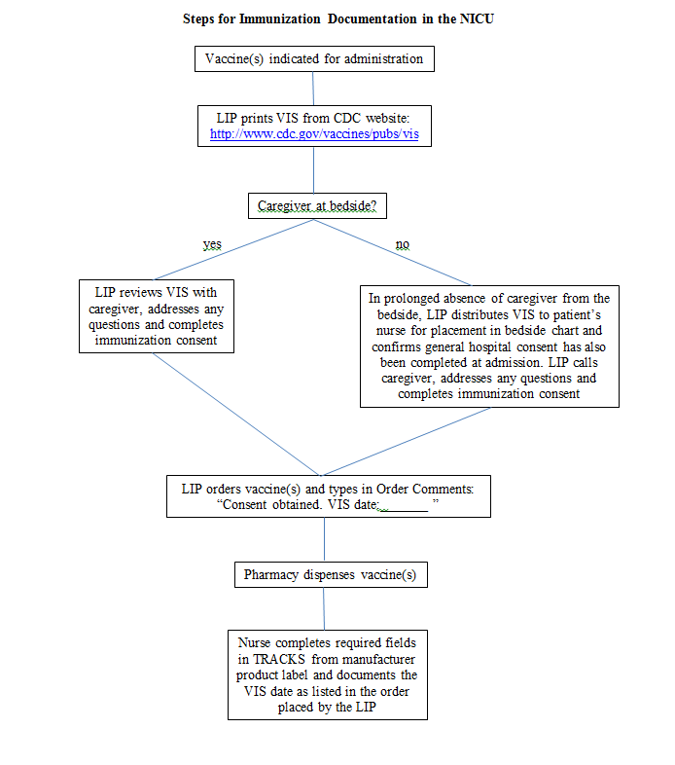
Steps for Immunization Documentation

Slide 20
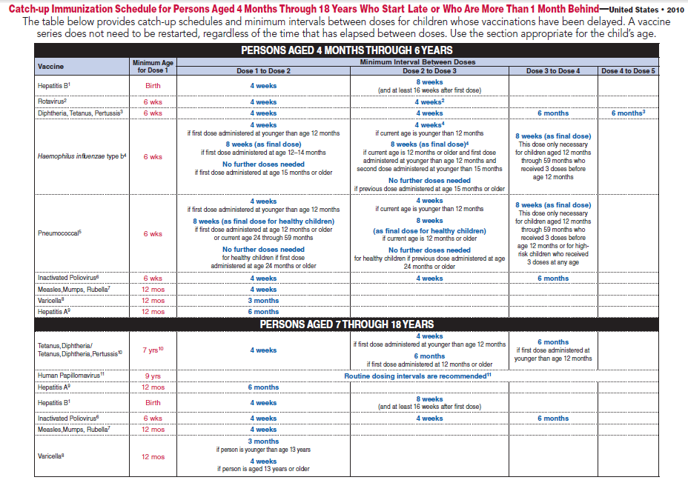
Catch-up Schedule
http://www.cdc.gov/vaccines/schedules/downloads/child/catchup-schedule-pr.pdf

Slide 21
Case #1
WE is a 2 month old clinically stable infant in the NICU who was born at 31 weeks. What immunizations, if any, should he get at this time?
Hepatitis B
DTaP
Hib
PCV
IPV
RV (not at CNHS)

Slide 22
Case #1 Continued
Based on the list of vaccinations which you want to prescribe for this patient, which vaccines (including any combinations) would you order?
Pentacel®
Engerix®
Prevnar 13®

Slide 23
Case #1 Continued
After putting in your vaccine orders, a pharmacist calls to inform you that due to a shortage, we don’t have any Pentacel®. How would you adjust your vaccine orders?
Pediarix®
ActHIB®
Prevnar 13®

Slide 24
Case #2
FL is a 4-month-old (GA 27 weeks) who is currently in the NICU with feeding intolerance and s/p 14 days of antibiotics for treatment of NEC. She hasn’t received any immunizations. What, if any, immunizations should she get at this time? How long should she wait to get the next dose of each vaccinations?
Hepatitis B – 4 weeks
DTaP – 4 weeks
Hib – 6 weeks
PCV – 6 weeks
IPV – 6 weeks
RV (not at CNHS)

Slide 25
Parent Education
CDC website
http://www.cdc.gov/vaccines/parents/index.html
Schedule cards
May request from CDC (free)
Vaccine information sheets
http://www.cdc.gov/vaccines/hcp/vis/index.html
AAP
http://patiented.aap.org/categoryBrowse.aspx?catID=29

Slide 26
Frequently Asked Questions
Should I give vaccines on different days?
Strongly encouraged to do all in same administration
In shortage, combination vaccines given first but always better to give in one administration
Can I use the multiple vaccine VIS sheet?
Yes, but this has been unavailable in the past due to revisions being made
Can I pre-print the VIS sheet?
No, you will need the most recent VIS sheet to give to the caregiver

Slide 27
References
Centers for Disease Control and Prevention. Recommended Immunizations for Children. http://www.cdc.gov/vaccines/parents/downloads/parent-ver-sch-0-6yrs.pdf. Accessed May 9, 2014.
Centers for Disease Control and Prevention. Hepatitis B Vaccine 2012. http://www.cdc.gov/vaccines/hcp/vis/vis-statements/hep-b.pdf. Accessed May 9, 2014.
Engerix-B [package insert]. Research Triangle Park, NC. GlaxoSmithKline, Inc.; 2013.
Recombivax HB [package insert]. Whitehouse Station, NJ. Merck & Co., Inc.; 2013.
Centers for Disease Control and Prevention. DTaP Vaccine 2007. http://www.cdc.gov/vaccines/hcp/vis/vis-statements/dtap.pdf. Accessed May 9, 2014.
Centers for Disease Control and Prevention. Hib Vaccine 2014. http://www.cdc.gov/vaccines/hcp/vis/vis-statements/hib.pdf. Accessed May 12, 2014.
Centers for Disease Control and Prevention. Polio Vaccine 2011. http://www.cdc.gov/vaccines/hcp/vis/vis-statements/ipv.pdf. Accessed May 12, 2014.
Centers for Disease Control and Prevention. Pneuomococcal Conjugate Vaccine 2013. http://www.cdc.gov/vaccines/hcp/vis/vis-statements/pcv13.pdf. Accessed May 12, 2014.
Centers for Disease Control and Prevention. MMR Vaccine 2012. http://www.cdc.gov/vaccines/hcp/vis/vis-statements/mmr.pdf. Accessed May 15, 2014.
Centers for Disease Control and Prevention. Chickenpox Vaccine 2008. http://www.cdc.gov/vaccines/hcp/vis/vis-statements/varicella.pdf. Accessed May 15, 2014.
Centers for Disease Control and Prevention. Hepatitis A Vaccine 2011. http://www.cdc.gov/vaccines/hcp/vis/vis-statements/hep-a.pdf. Accessed May 15, 2014.
Centers for Disease Control and Prevention. Influenza Vaccine 2013. http://www.cdc.gov/vaccines/hcp/vis/vis-statements/flu.pdf. Accessed May 20, 2014.
Centers for Disease Control and Prevention. Rotavirus Vaccine 2013. http://www.cdc.gov/vaccines/hcp/vis/vis-statements/rotavirus.pdf. Accessed May 20, 2014.
RotaTeq [package insert]. Whitehouse Station, NJ. Merck & Co., Inc.; 2013.
Rotarix [package insert]. Research Triangle Park, NC. GlaxoSmithKline, Inc.; 2013.
Centers for Disease Control and Prevention. U.S. Vaccine Names. http://www.cdc.gov/vaccines/about/terms/USVaccines.html. Accessed May 21, 2014.
Centers for Disease Control and Prevention. 2014 Vaccination Catch Up Schedule. http://www.cdc.gov/vaccines/schedules/downloads/child/catchup-schedule-pr.pdf. Accessed May 21, 2014.

