Slide 1
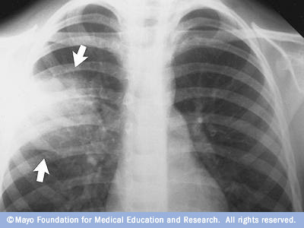
Pneumonia
Rosemary Megalaa, DO
Pediatric Pulmonology Fellow
Noon Board Review
Wednesday December 23, 2015
Notes:
Pneumonia is commonly encountered by ED and primary care physicians.

Slide 2
Definition: Pneumonia
An inflammation of the lung parenchyma

Slide 3
Background
More than 2 million children die annually of pneumonia worldwide
Mortality rare in the developed world – 1 in 1,000 per year
In U.S., 35-40 episodes of community-acquired pneumonia /1,000 children per year
Respiratory viruses most common cause of pneumonia during the first years of life

Slide 4
Pathophysiology
Most common event disturbing lung defense mechanisms is a viral infection
Alters properties of normal lung secretions
Inhibits phagocytosis
Modifies normal bacterial flora
Often precedes development of a bacterial pneumonia by a few days

Slide 5
Case Presentation #1
Six year old female presents to the ER after a one week history of nasal congestion and mild cough. Two days ago, she abruptly developed high fevers, chills, and increased cough.
Upon arrival in the ER, she is ill-appearing, tachypneic, and febrile.
ROS: shaking chills, high fever, cough, right sided chest pain, rhinorrhea, decreased appetite

Slide 6
Case Presentation #1
PMHx: No prior pneumonia or wheezing
FHx: +Asthma (brother)
ALL: NKDA
IMM: Missing part of primary series; no recent PPD done.
SHx: No recent travel out of the country.

Slide 7
Case Presentation #1
Focused PE:
Subcostal and suprasternal retractions with nasal flaring present.
Dullness to percussion on the right superior posterior.
Rales are appreciated on exam over right posterior lung fields.
Tubular breath sounds right superior with decreased breath sounds

Slide 8
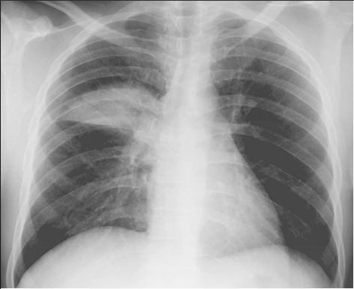
Radiographic Findings

Slide 9
Laboratory
WBC 35,000 N: 87%
Leukocytosis with left shift
WBC <5,000/mm³ poor prognosis
ABG: +/- hypoxemia
Bacteremia on blood culture
Notes:
Put in the context of the case

Slide 10
Which is the MOST likely causative organism in this patient?
Group B strep
Streptococcus pneumoniae
Tuberculosis
Mycoplasma
Legionella

Slide 11
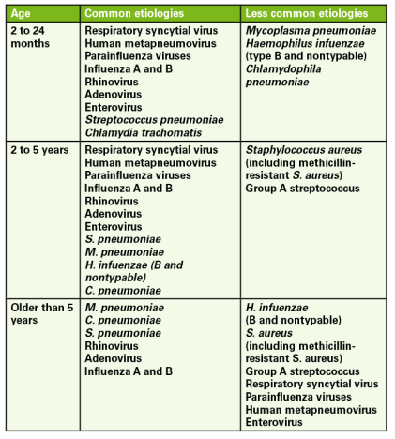

Slide 12
Outpatient Setting | Presumed Bacterial PNA | Presumed Atypical PNA | Presumed Influenza PNA
< 5 years old | Oral HD Amoxicillin or Augmentin | Azithromycin; alt: clarithromycin, erythromycin | Oseltamivir
>or= 5 years old | Oral HD Amoxicillin or Augmentin | Azithromycin; alt: clarithromycin, erythromycin, doxycycline (> 7yo) | Oseltamivir
IDSA Guidelines 2011

Slide 13
Inpatient Setting – all ages | Presumed Bacterial PNA | Presumed Atypical PNA | Presumed Influenza PNA
Fully Immunized for HiB b and S. pneumo | IV Ampicillin; ceftriaxone or cefotax; add vanco if suspect CA-MRSA | Azithromycin; alt: clarithromycin, erythromycin, doxycycline (> 7yo) | Oseltamivir
Not fully immunized for HiB b and S. pneumo | IV Ceftriaxone or cefotax; add vanco or clinda (CA-MRSA) | Azithromycin; alt: clarithromycin, erythromycin, doxycycline (> 7yo) | Oseltamivir
IDSA Guidelines 2011

Slide 14


Vaccines which changed PNA
Haemophilus influenzae type B –created in 1990
Pneumococcal conjugated 7-valent (PCV 7) – 2000
  Decreased rate of invasive disease from 98.7 to 23.4 per 10,000 in just 5 years!
  Also, decreased incidence of PNA requiring hospitalization in children < 2 yo
Pneumococcal conjugated 13-valent (PCV 13) – 2010
  Increased coverage to include
  serotypes 1, 3, 4, 6A, 7F, 19A
PPSV 23 – indicated for those with chronic cardiopulmonary disease, sickle cell, immunodeficiency, long term steroid use

Slide 15
Case Presentation #2
13 year old female presents to the clinic with 9 day history of fatigue, non-productive cough and sore throat. She reports going to school, however, she is not “feeling like herself.” Denies vomiting or diarrhea.
Med Hx: non-contributory
Family Hx: none
PE: no acute distress, clear rhinorrhea, audible coarse cough, no tachypnea, no retractions, crackles auscultated throughout

Slide 16
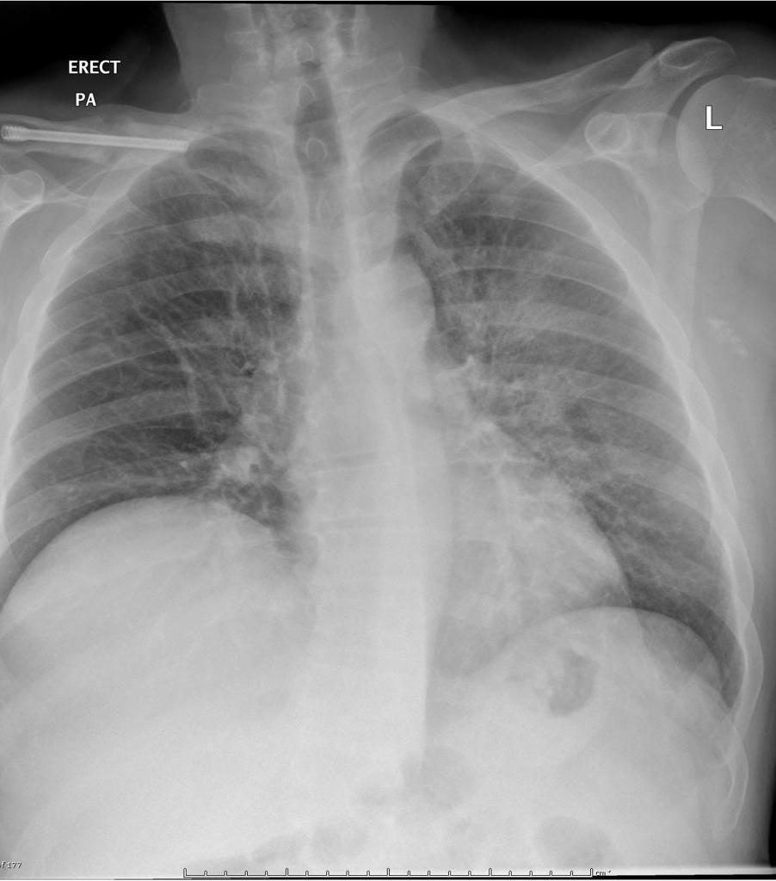
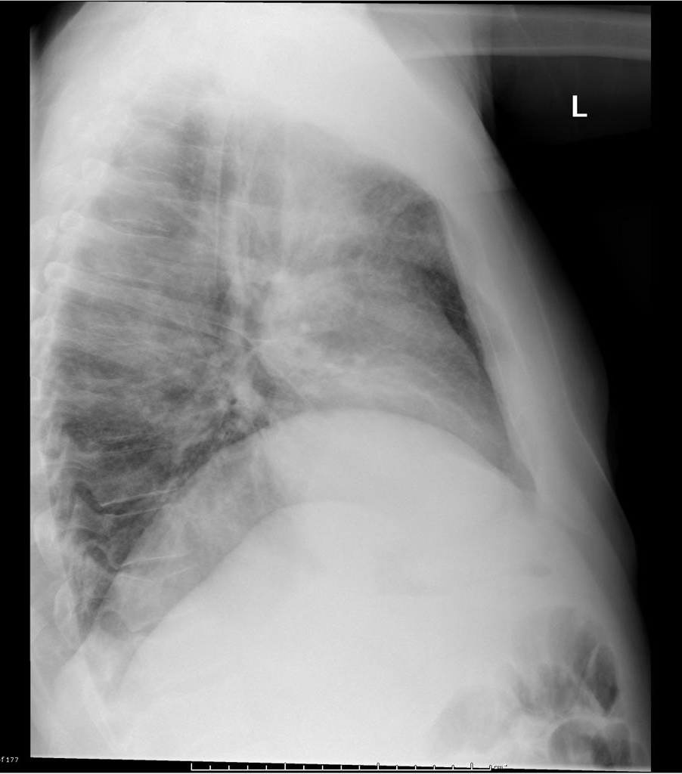
Case courtesy of Royal Melbourne Hospital Respiratory, Radiopaedia.org, rID: 21993

Slide 17
Which is the MOST likely causative organism in this patient?
Group B strep
Streptococcus pneumoniae
Tuberculosis
Mycoplasma
Legionella

Slide 18
Clinical Manifestations of Mycoplasma pneumoniae
Respiratory tract disease
Intractable nonproductive to mild cough (75-100%)
Pneumonia (3-10%)
Chills
With or without wheezing and dyspnea
Pharyngitis (6-59%)
Rhinorrhea (2-40%)
Ear pain (2-35%)
Sinusitis
Extrapulmonary disease
Hemolytic anemia
Rash
Polyarthritis
GI – pancreatitis, hepatitis
CNS
Cardiac – pericarditis, myocarditis

Slide 19
When to Hospitalize
Infants | Older Children
Apnea or Grunting | Grunting
Oxygen Sat <92% | Oxygen Sat < 92%
Poor PO | Poor PO
RR > 70 | RR > 50
All Age Groups
Chronic Lung Disease Asthma Unrepaired or incompletely repaired congenital heart disease Diabetes Mellitus Neuromuscular disease Complicatations such as Empyema and Parapneumonic effusions Family is not able to provide appropriate observation

Slide 20
Laboratory Testing
Not indicated to diagnose pneumonia if patient is stable and will be treated outpatient
Consider for those admitted for PNA who have hypoxemia, severe respiratory distress, possible complicated peumonia, or associated comorbid conditions.

Slide 21
Laboratory Testing
CBC with differential
Blood Culture
Sputum culture for those in ICU and those who do not respond to empiric therapy or have worsening disease – may need to obtain BAL

Slide 22
Case Presentation #3
A nurse calls for you to examine a 2 day old male in the nursery for increased work in breathing
Birth History: Full term, NSVD, ROM x 10 hours
PE: Temp is 35.1 C, tachypneic, nasal flaring, subcostal retractions, diffuse crackles

Slide 23
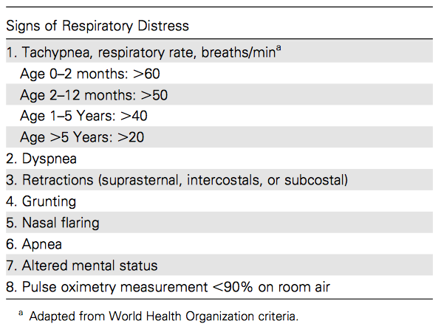
Respiratory Distress

Slide 24
What to do next?
Get a CXR!
Who should get Chest X rays?
  Severe disease, hypoxemia of respiratory distress that requires hospitalization
  Inconclusive clinical findings
  r/o foreign body, heart disease, underlying cardiopulmonary conditions
  Prolonged fever and worsening Sxs despite adequate ABX and consider complications
    Effusions, PTX
  Young infant with fever without source and high or low WBC

Slide 25
Limitations of CXR
Absence of findings does not rule out pneumonia if there is high clinical suspicion
Radiographic findings may lag behind
Dehydrated children may not have an initial infiltrate
Impossible to differentiate atelectasis from pneumonia
  If resolves in 48-72 hours – more likely atelectasis

Slide 26
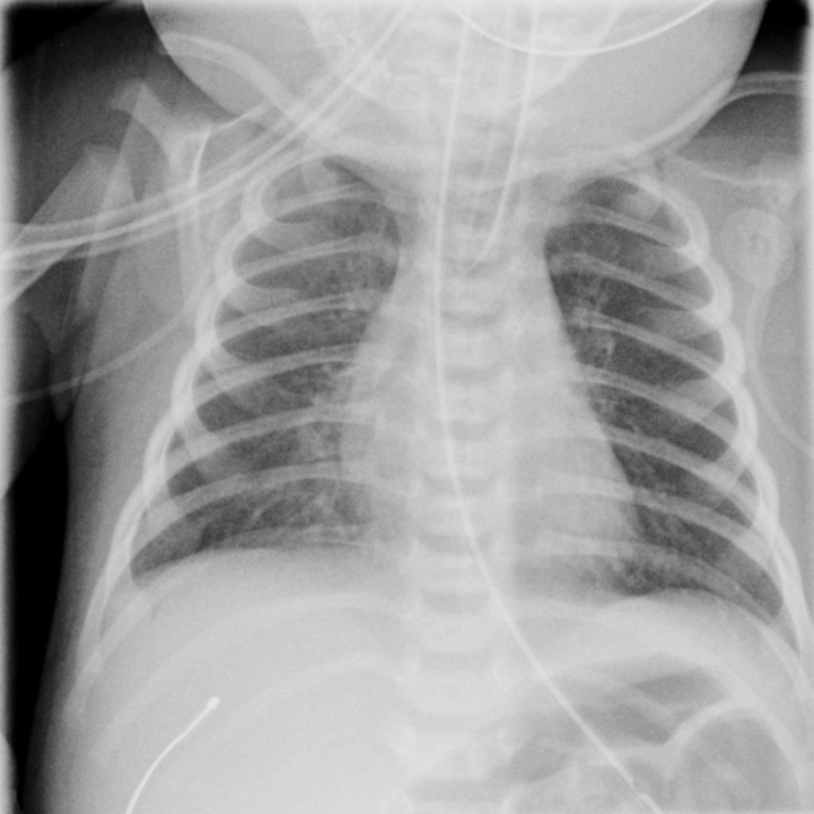
Case courtesy of Dr Jeremy Jones, Radiopaedia.org, rID: 23898

Slide 27
Neonatal Pneumonia
Early Onset
< 72 hours
Vertical maternal transmission
PROM > 18 hours
Maternal amnionitis
Premature delivery
Fetal tachycardia
Maternal intrapartum fever
Late Onset
> 72 hours
Assisted ventilation (4x greater risk with intubation)
Airway anomalies
Severe underlying disease
Prolonged hospitalization
Neurological impairment
Nosocomial infection due to poor hand washing or crowding
Non-specific symptoms – apnea, tachypnea, poor feeding, abdominal distension, emesis, respiratory distress

Slide 28
Differentials to Consider
Neonates with Respiratory Distress
Tracheoesophageal fistula
Congenital heart disease
Sepsis
Infants and Young Children
Foreign body aspiration
Bronchiolitis
Heart failure
Sepsis
Metabolic acidosis

Slide 29
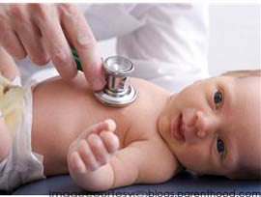
Empiric Therapy
Neonates
  Rule out sepsis
  Parenteral antibiotics
  Ampicillin
  Cefotaxime
  or
  Gentamicin
  Consider viral causes (HSV, CMV)

Slide 30
Clinical Presentation #4
5.5 yr old girl hospitalized with wet-sounding cough, intermittent fever to 38 C, dysphagia for past 5 days.
Severe, sharp, left upper abdominal pain with increasing respiratory distress
ROS: negative for rigors, emesis, diarrhea, constipation, history of pneumonia, wheezing, or bronchitis.
PMHx: otherwise healthy child

Slide 31
Clinical Presentation #4
Exam: Temp 39 C, HR 165, RR 40, BP 98/42, O2 97% r.a.
No grunting or nasal flaring, speaking in full sentences comfortably.
Decreased breath sounds, egophany, pectoriloquy in left lung, right lung is clear to auscultation, abdomen soft and non-tender

Slide 32
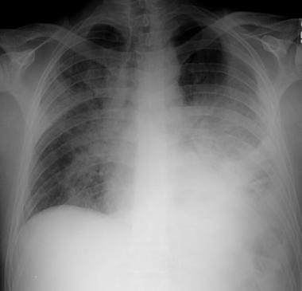

Slide 33
Clinical Presentation #4
Labs: WBC 18K 85% neutrophils, Normal chemistry, PPD negative 48 hrs
US Chest: loculated fluid collection consistent with complicated pleural effusion
Pleural fluid: cloudy, yellow color, glucose 9, protein 5.3, LDH 1936, RBC 10K, WBC 770 99% neutrophils
Gram stain: rare neutrophils, no bacteria
Blood and pleural fluid cultures: negative

Slide 34
Complications
Empyema
Pleural effusion
Pericarditis
Meningitis
Osteomyelitis
Metastatic abscesses

Slide 35
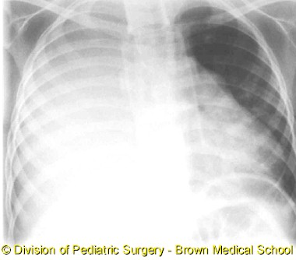
Pleural Effusion

Slide 36
Pleural Effusion
Size | Lateral XR | PA XR | Treatment
Small, uncomplicated | < 10 mm | <25% hemithorax | Conservative management
Moderate | >10mm | <50% hemithorax | Chest tube drainage and fibrinolytics or VATS
Large | >>10mm | >50% hemithorax | Chest tube drainage and fibrinolytics or VATS +/- decortication
Chest tube drainage by IR or VATS procedure by Surgery depends on institutional preference and expertise.
At times, if CT drainage unsuccessful, may need to move to VATS.

Slide 37
Empyema
Collection of purulent material in the pleural space
Often results from bacterial PNA, also:
  mediastinal and subdiaphragmatic infections esophageal rupture
  bronchopulmonary fistula
  penetrating chest wall trauma
  thoracotomy
  foreign body

Slide 38
Pleural Effusion Development
Three Overlapping Stages
Simple Parapneumonic PE within first 2-3 days
  Mobile, thin, and sterile
  pH >7.3, glucose > 60, LDH < 500
Complicated Parapneumonic PE after 4-14 days
  Fibropurulent fluid, elevated PMN, formation of fibrin
  pH < 7.1, glucose < 40, LDH > 500
Empyema is the final stage > 14 days, if Tx uninitiated or unsuccessful
  Thick, purulent secretions
  Pleural peel (or rind) forms – prevents lung expansion, impair fluid drainage through lymphatics → can get as thick as 1cm
  Thoracoscopy or thoracotomy and dibridement is necessary

Slide 39
Clinical Pearls
Majority of empyemas are unilateral
  Are bilateral when involves the mediastinum or there is hematogenous dissemination
Untreated or unresolved empyema can cause sepsis, metastatic abscess formation, bronchopleural fistula, restrictive lung disease, death
S. aureus, S. pneumoniae, and gram negative aerobic bacteria MCC and have multiple loculations
Single loculations with S. aureus
Streptococcal empyemas are frquently left-sided

Slide 40
Follow-Up
Most children have normal xrays by 2-3 months after acute infection*
20% with residual changes 3-4 weeks after infection
Children with persistent symptoms should have follow-up xrays to rule out such things as foreign body, congenital malformations, or TB
Recovering children may have moderate dyspnea for 2-3 months
*Grossman et al. Roentgenographic follow-up of acute pneumonia in children. Pediatrics 1979; 63:30-31

Slide 41
Factors Predisposing to Recurrent Pneumonia
Immunodeficiency
  Neutropenia
  Agammaglobulinemia
  T – Cell deficiency
Bronchiectasis
  Cystic Fibrosis
  Idiopathic
  Primary ciliary dyskinesia
Neuromuscular Weakness
  Aspiration
  Deficient gag reflex
  CP MR
Anatomical
  TEF
  Cleft palate
  Tracheostomy

Slide 42


