Slide 1
Inpatient Asthma Pathway and Order Set Gabrina L. Dixon, MD Claudia Arrieta, RT and Asthma Educator Jahmeilia Paul, Impact DC July 7, 2015

Slide 2
Learning Objectives
Recognize the value of using a pathway for asthma in the hospital
Describe the evidence behind the asthma pathway
Apply the inpatient asthma pathway and order set to a pediatric patient

Slide 3
WHAT DO YOU KNOW ABOUT ASTHMA?

Slide 4
Pathophysiology
Notes:
Bronchoconstriction, mucous production, airway inflammation

Slide 5
HOW MANY PEDIATRIC PATIENTS HAVE YOU TREATED WITH ASTHMA?

Slide 6
ASTHMA
Asthma is the #1 inpatient diagnosis for pediatric patients at Children’s National Health System

Slide 7
Clinical Assessment
History:
Cough
Wheeze
Shortness of breath
Chest pain
Fatigue
Physical Exam:
General Assessment
Use of accessory muscles
Breathless – able to speak/eat
Respiratory Rate
Pulse oximetry
Auscultation
Wheezing (inspiratory/expiratory)
Aeration
Crackles
Exclude alternative diagnoses – - Foreign Body - Bronchiolitis
- CHF - GERD
- Vocal cord dysfunction
- Cystic Fibrosis - Mediastinal mass

Slide 8
Inpatient Management
Cornerstones of Inpatient Management
Frequent clinical assessments
Short-acting inhaled beta-agonists
Systemic corticosteroids
Oxygen when needed
Nutrition – IV hydration if needed
Initiate or resume controller medications
Asthma education

Slide 9
Before coming to Children’s Hospital, did you use a pathway?
Notes:
What are some benefits of using a pathway

Slide 10
Why use a pathway
Decrease length of stay
Decrease use of beta-agonists
Decrease cost of hospitalization
Improve patient education and use of appropriate devices
Increase initiation of controller medications
No increased rate of readmission or adverse events
Johnson, et al, Pediatrics, 2000; Kelly, et al., Ann All Asth Imm 2000; Wazeka, Ped Pulm 2001.

Slide 11
History of Asthma Pathway
CNHS ADMT Committee revises and updates the inpatient asthma pathway and order set approximately every 5 years
The Asthma Order Set was first done in 1997 with the first revision in 2000, most recent revision in 2013
Used a multidisciplinary approach
Goals for updating pathway and order set:
Ensure pathway correlates with order set
Improve efficiency of inpatient asthma care
Remove non-evidence based interventions
Guarantee Pathway aligned with hospital policy and clinical practice

Slide 12
How well do you know the current Asthma Pathway and Order Set ?

Slide 13
Question 1
What age can patients on continuous albuterol nebs be admitted to the floor?

Slide 14
Answer 1
Greater than or equal to 3. Policy 205.1 was changed in early 2012.

Slide 15
Question 2
What are the components to the asthma scoring system?

Slide 16
Answer 2
Characteristic 0 1 2
Respiratory Rate¹
1 -3 years ≤ 34 35 – 39 ≥ 40
4 – 5 years ≤ 30 31 – 35 ≥ 36
6 – 12 years ≤ 26 27 – 30 ≥ 31
> 12 years ≤ 23 24 – 27 ≥ 28
O₂ Saturation² > 93% on RA 89 – 93% on RA ≤ 88% on RA
Auscultation Normal BS Expiratory Wheezes Insp&Exp/Dim BS
Retractions³ ≤ 1 accessory muscle 2 accessory muscles ≥ 3 accessory muscles
Dyspnea 0= Speaks full sentences, playful, and good oral intake 1= Speaks partial sentences, short cry, or poor oral intake 2=Speaks short phrases, grunting, or unable to PO

Slide 17
Question 3
Why do we use a MDI with spacer vs. a neb in the order set?

Slide 18
Answer 3
Some benefits of MDI with spacer vs nebulizer:
Nebulizers:
Require child to sit for 10 minutes
Delivering at best 10% prescribed drug to lungs
Require maintenance, and some do not deliver good respirable output
MDI with spacer:
More efficient means of drug delivery
Less total dose required for same degree of bronchodilation
Time to complete dose is shorter
Costs and effectiveness of spacer versus nebulizer in young children with moderate and severe acute asthma. J Pediatr 136(4), April 2000, pp 497-502
JOSE´ A. CASTRO-RODRIGUEZ, et al. b-AGONISTS THROUGH METERED-DOSE INHALER WITH VALVED HOLDING CHAMBER VERSUS NEBULIZER FOR ACUTE EXACERBATION OF WHEEZING OR ASTHMA IN CHILDREN UNDER 5 YEARS OF AGE: A SYSTEMATIC REVIEW WITH META-ANALYSIS.
J Pediatr 2004;145:172-7)

Slide 19
Question 4
Why do we use daily dosing of corticosteroids in the order set?

Slide 20
Answer 4
The Cochrane Database of Systematic Reviews: Corticosteroids for hospitalized children with acute asthma Issue 4 (2008):
Decrease length of stay for asthmatics
Systemic steroids are for acute exacerbation
No consensus on type of steroids, dose and duration
Initiate steroids early → reduces admissions & decreases recurrence of exacerbations
Multiple studies use a range of steroid dosing:
1mg/kg – 2mg/kg/day
daily to BID to QID dosing

Slide 21
Answer 4
Most common side effects with short burst of corticosteroids:
Sleep disturbance
Behavior changes; mood swings
Several studies comparing Inhaled steroids as a replacement to Oral steroids:
Varying results with budesonide
Similar outcomes if budesonide dosed at 1600mcg per day
Effective as an adjunct with systemic steroids
Sometimes used in ED or outpatient settings, but not recommended for hospitalized asthmatics
S. L. Hewer, et al. Prednisolone in acute childhood asthma: clinical responses to three dosages. Respiratory Medicine (1998) 92, 541-546.
The Cochrane Database of Systematic Reviews: Corticosteroids for hospitalized children with acute asthma. Issue 4 (2008)
G. Rachelefsky. Treating Exacerbations of Asthma in Children: The Role of Systemic Corticosteroids. Pediatrics 2003;112;382

Slide 22
Question 5
What are the different phases of care and what score correlates to each phase?

Slide 23
Answer 5
Continuous Nebs-Asthma Score >4
Frequent MDI-Asthma Score 2-4
Transition to D/C- Asthma Score < or = 1

Slide 24
Question 6
Based on what asthma score do you wean the albuterol from continuous to q2 and from q2 to q 4 hours?

Slide 25
Answer 6
Wean from cont. nebs → q2 MDI if score ≤ 4
Wean from q2 MDI→ q4 MDI if score ≤1
Discharge if score on q4 MDI ≤ 1

Slide 26
Question 7
Based on what asthma score do you increase albuterol from q 4 hours to q 2 hours and q 2 hours to continuous?

Slide 27
Answer 7
If asthma score ≥5 and patient is on q2 MDI, increase to continuous nebs
If asthma score ≥2 and patient is on q4 MDI, increase to q2 MDI

Slide 28
Bonus Question
Which copy of the asthma action plan is given to the family?

Slide 29
Bonus Answer
Original (top) copy → Family
Yellow copy → School
Bottom White Copy→ Chart

Slide 30
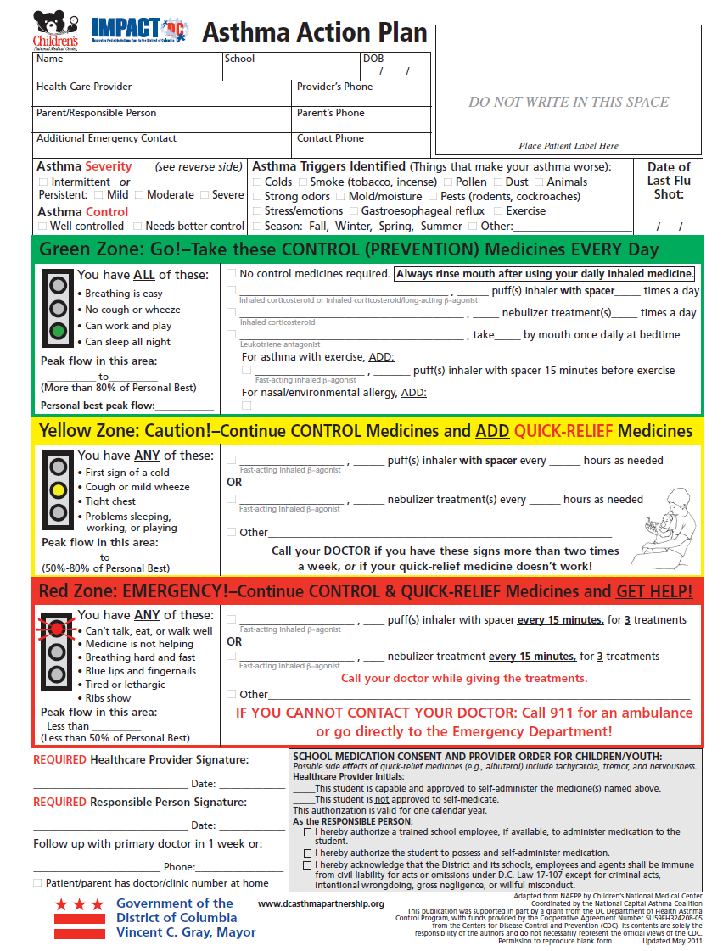

Slide 32
Patient Dr. Bear
2-3 days of URI symptoms
Afebrile
Tachypnea to the 40s
I/E wheezing
O2 saturation 88% on room air
Using 3 accessory muscles
Able to PO, speak in full sentences and PO’s well

Slide 33
What is Dr. Bear’s Asthma Score?

Slide 34
Dr. Bear’s Asthma Score
RR-2
O2-2
Auscultation-2
Retractions-2
Dyspnea-0

Slide 35
Any patient with asthma score 8 or above should go to the PICU

Slide 36
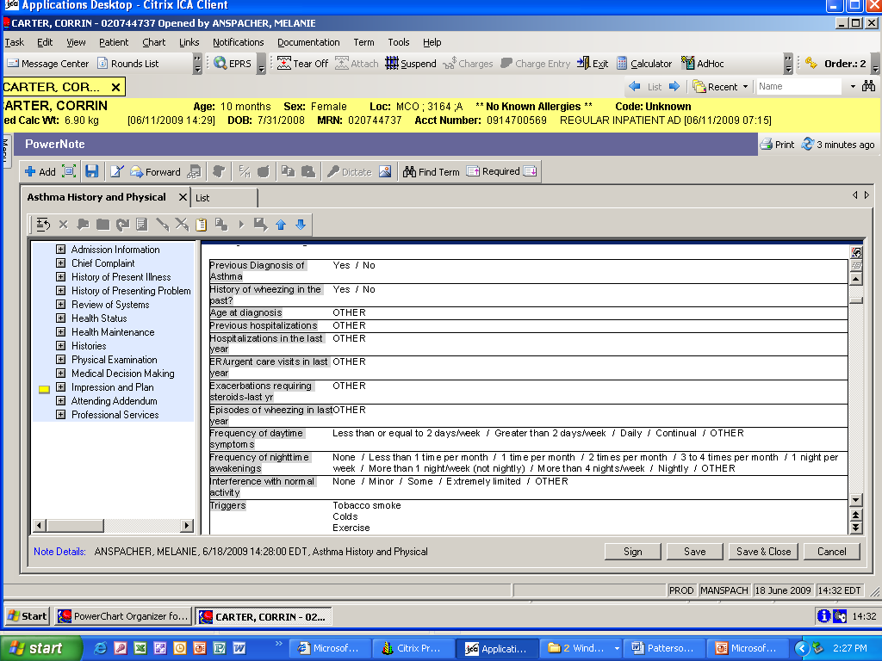

Slide 37
Asthma Education Resources
www.impact-dc.org
Intranet: Home > Departments > Patient and Family Services > Patient Education > Asthma
Get Well Network (coming to 4Main soon!)
CHEX: Search courses → MDI → Metered Dose Inhaler (MDI) Instruction

Slide 38
IMPACT DC: Nuts & Bolts
Focus on kids with a history of poorly controlled asthma
Visits occur within 2-4 weeks of ED visit
We accept referrals from PCPs, families, school nurses, insurance case managers, and more!
Most referrals come from the Emergency Department
Usually a single visit (some families return for follow up)

Slide 39
IMPACT DC: Nuts & Bolts
Based on NIH Guidelines for Asthma Care
1 ½ hour visit
Components of visit
Intake
Education: pathophysiology of asthma, trigger control, and medication technique
Clinical Care: medications and written plan
Care Coordination: linkages to primary care, school nurses, and community resources

Slide 40
IMPACT DC: How We Help
We provide in-depth asthma education for families.
Families can have all of their questions answered and concerns addressed about their child’s asthma.
We practice to make sure kids are getting the right amount of their medicine.
Families will work together with an asthma educator and doctor to come up with an Asthma Action Plan.

Slide 41
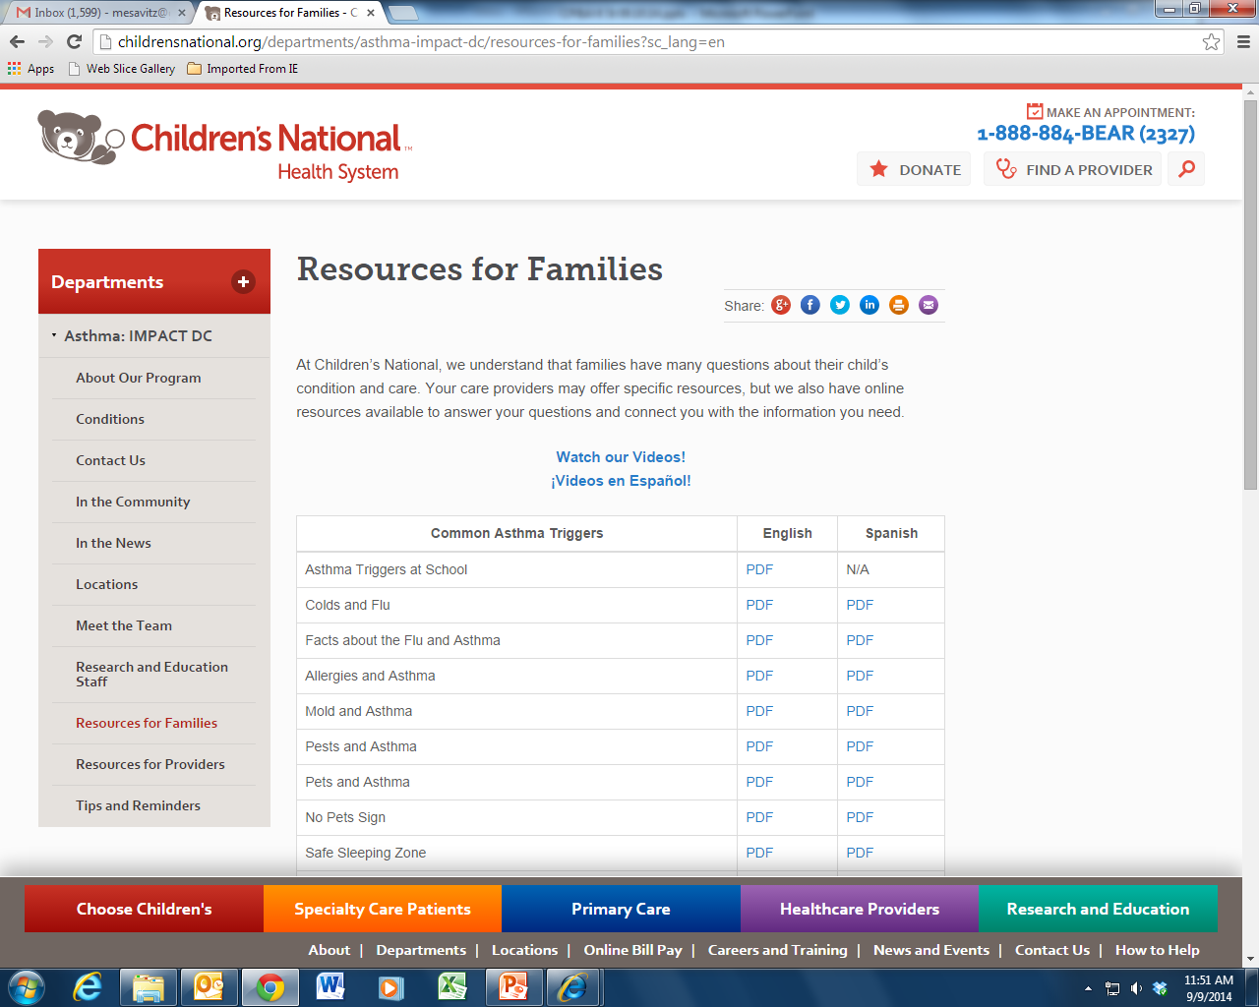
Website: www.impact-dc.org
Notes:
Materials can be downloaded

Slide 42
Educational Videos

Slide 44
ROLE OF THE ASTHMA EDUCATOR
Deliver quality and consistent asthma education to patients and families
Current one on one session
Group classes ( during busy season)
Provides interprofessional asthma education
The goal is to provide consistent education
Make referrals to Impact DC and Severe Asthma Clinic (SAC)
Who gets referred
Who does NOT get referred (PULMONARY) (Kaiser ?) only if….
Asthma Action Plan Compliance Tracking

Slide 45
ASTHMA ACTION PLAN
A Joint Commission mandated requirement
What is the AAP
Who qualifies for the AAP
Who is responsible for reviewing the AAP with patients and families
Asthma Educator ( work Mon-Fri 8-4pm ) early disposition decision
Resident ( daily to include weekends, holidays and Asthma educator off shift
What information should be reviewed during education session with patients and families
All aspects of the AAP to INCLUDE
What is asthma
Triggers ( what they are and how to avoid them)
Signs and symptoms of a flare-up
Review of medications ( when to use them and how much to use)

Slide 46
ASTHMA ACTION PLAN (Joint commission requirement)
Patient Name
Triggers
Controller med(s) or ”no controller”
Rescue meds + (correct) dose(s) are filled out?
Follow up visit or “Follow up with primary doctor in 1 week” filled out?
LIP phone number or “Patient/Parent has doctor/clinic number at home” checked?
Did you AND the parent/guardian SIGN the AAP?
Please give the family the top 2 copies, and put 3 copy in the front of the chart

Slide 47
Controllers/Inhaled Steroids

Slide 48
RESCUE INHALERS
Each one of these 3 inhaler is
Albuterol

Slide 49
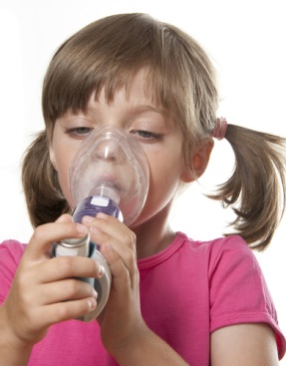
MDI SPACER TECHNIQUE

Slide 50
QUESTIONS?

