Slide 1
Asthma and Advocacy
Children’s National Medical Center
Advocacy Month Resident Noon Conference
Abby Nerlinger, Pediatric Hospital Medicine Fellow
Molly Savitz, IMPACT DC Outreach Director
August 5, 2015

Slide 2
Learning Objectives
Understand changes in policy that are leading to transitions from individual to population health
Discuss the evidence base for population-level pediatric asthma management
Understand how to translate this evidence into advocacy opportunities
Identify community-based resources available for asthmatic patient referral

Slide 3


National Childhood Asthma Cost
7.1 million children <18y living with asthma in the US in 2009*
  3.4 million ambulatory visits (2% of total)
  640,000 ED visits***
  157,000 hospital admissions***
Annual direct and indirect cost associated with asthma: $56 billion****
*National Health Interview Survey
**National Ambulatory Medical Care Survey
***National Hospital Medical Care Survey
****CDC. May 2011. Asthma in the US Vital Signs. http://www.cdc.gov/vitalsigns/asthma
Notes:
Direct cost (hospitalization), indirect cost (lost school and work)

Slide 4
National Childhood Asthma Epidemiology
Number one cause of school absenteeism
  14 million missed school days per year
Millions of hours of lost work per year for parents
10% prevalence of asthma among children (2008)
  Some communities up to 25%
Higher prevalence among families with income below federal poverty level
Nicholas et al. 2005. Am J Public Health. 95:245–249
Akinbami L et al. Trends in Asthma Prevalence, Health Care Use, and Mortality in the US, 2001-2010. http://www.cdc.gov/nchs/data/databriefs/db94.pdf
Notes:
Up to 25% - Central Harlem

Slide 5
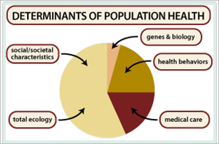
Healthy Patients AND Healthy Communities
Factors that cause patients to repeatedly seek medical care
  Social determinants of health
  Health disparities
  Environmental justice
The pediatric patient is more than just an acute presentation
Source: CDC Determinants of Population Health. Available: http://www.cdc.gov/socialdeterminants/FAQ.html
Notes:
Very little of population health is actually determined by healthcare practices
Product of home, school, and play environments

Slide 6
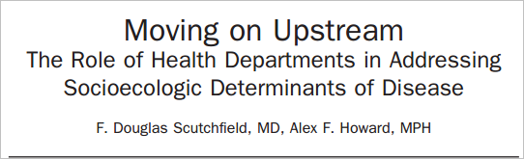
Moving Healthcare Upstream
Notes:
Joe Wright – former director of CHAI
How can we move healthcare upstream for pediatric asthma
Recognition that other things can be done to promote treatment (ie, color coding inhalers) but this talk is about prevention
Outcomes we’re really measuring are clinical outcomes through acute resource utiliztation

Slide 7
Moving Healthcare Upstream
Notes:
Joe Wright – former director of CHAI
How can we move healthcare upstream for pediatric asthma
Recognition that other things can be done to promote treatment (ie, color coding inhalers) but this talk is about prevention
Outcomes we’re really measuring are clinical outcomes through acute resource utiliztation

Slide 8
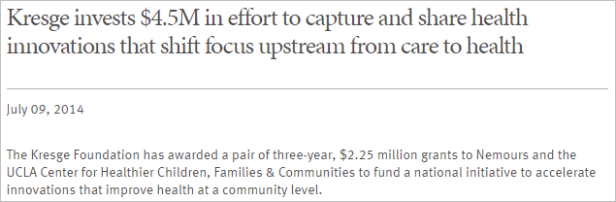
Moving Healthcare Upstream
Notes:
Nemours – housing initiatives
Advisory board for population health initiatives

Slide 9
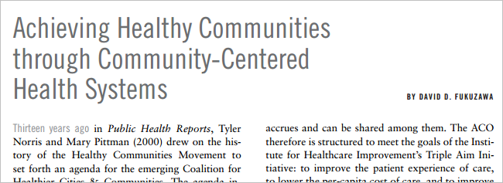

Moving Healthcare Upstream
Notes:
Nemours – housing initiatives
Advisory board for population health initiatives

Slide 10
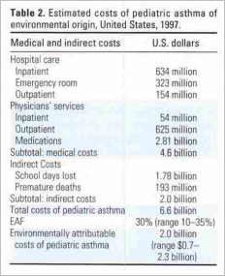
Contribution of Environmental Factors to Preventable Burden of Disease
Environmentally attributable fraction of asthma: 30% in children in the United States¹
Total annual cost of $54.9 billion or 2.8% of the total US healthcare cost.¹
Environmentally mediated disease in US children cost an estimated $76.6 billion in 2008.²
Sources: 1. Based on 1997 updates to the 1990 census. Source: Landrigan PJ, Schechter CB, Lipton JM, Fahs MC, Schwartz J. Environmental pollutants and disease in American children: estimates of morbidity, mortality, and costs for lead poisoning, asthma, cancer, and developmental disabilities. Environ Health Perspect. 2002 July;110(7):721-8.
2. Based on Centers for Medicare and Medicaid Services data, with total spent in 2008 on environmentally mediated diseases including: poisoning, prenatal methylmercury exposure, childhood cancer, asthma, intellectual disability, autism, and attention deficit hyperactivity disorder. Source: Trasande L, Liu Y. Reducing the staggering costs of environmental disease in children, estimated at $76.6 billion in 2008. Health Affairs. 2011;30(5):1-8.
Notes:
Turn into graphic representation?
What does moving healthcare upstream mean for asthma?
Population health causes of disease require population health solutions
Novel population health solutions are required to affect disease outcomes
Concern: environmental exposures are multifactorial – how to contribute to one source?
But we have evidence for environmental exposures and asthma
Staggering population healt hnumbers

Slide 11
Affordable Care Act Summary
Individual mandate
Medicaid expansion
Federal exchanges
Essential health benefits
No exclusion based on pre-existing conditions

Slide 12
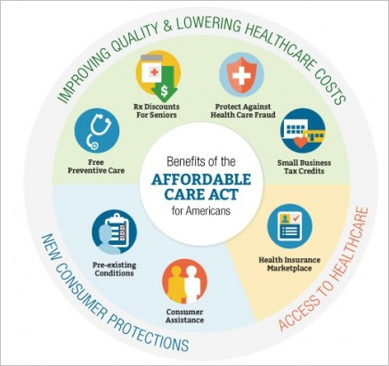
Affordable Care Act and Restructuring Preventive Care
Title IV: Prevention of Chronic Disease and Improving Public Health
  Modernizing Disease Prevention and Public Health Systems
  Increasing Access to Clinical Preventive Services
  Creating Healthier Communities
  Support for Prevention and Public Health Innovation
Source: US Department of Health and Human Services. Read the Law. Available: http://www.hhs.gov/healthcare/rights/law/index.html
Source: US Department of Health and Human Services. Available: http://www.acf.hhs.gov/programs/ecd/child-health-development/affordable-care-act
Notes:
Moderninzing disease prevention: Clinical and community preventive services, school based health centers
Support: health disparities data collection, service delivery, funding for childhood obesity

Slide 13
The Message:
A policy window is open for furthering population-level preventive solutions for pediatric asthma
Notes:
What interventions can be done that are non-medical for asthma??
Good investment for healthy adults – PICU level
So why not focus a discussion of health care savings around pediatric asthma?
AAP graph with cost of taking care of children

Slide 14
Opportunities for Intervention
PATIENT
CLINIC/HOSPITAL
INSURANCE
COMMUNITY
STATE
FEDERALL
Notes:
Policy at each of these levels – microcosm to macrocosm – sometimes when taking care of the individual patient it’s hard to take step back and think about what we can do in terms of the bigger picture
Patient – standards of care, clinical practice guidelines
Hospital level – pathways, QI, pharmacy
Insurance – reimbursement practices
Community – NGOs and referral practices
State – state reimbursement
Federal – funding
Going to go through each of these and how ACA changes affect asthma

Slide 15
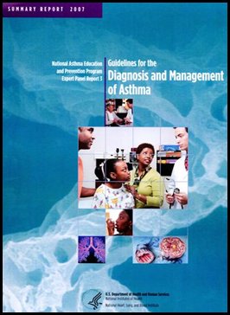
NHLBI Asthma Management Guidelines
6 Priority Messages
Use inhaled corticosteroids
Use a written asthma action plan
Assess asthma severity
Assess and monitor asthma control
Schedule periodic asthma visits
Control environmental exposures
Notes:
Highlight part that has environmental factors
Barriers faced in implementation of practice care guidelines
National Heart, Lung, and Blood Institute, national asthma education an dprvention program, expert panel report 3, guildelines for the DX and management of asthma
The guidelines tell us that we should be doing this but how to most effectively do it if you’re not physically in the home?

Slide 16
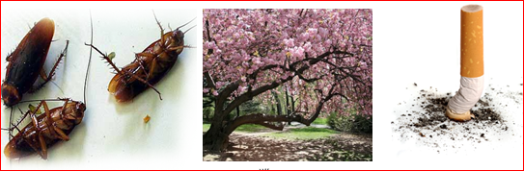
Control of Environmental Measures
Patients who have asthma at any level of severity should be asked about allergen and irritant exposure and counseled appropriately
Children with indoor allergen sensitization have worse outcomes
Notes:
Children with sensitization and exposure to indoor allergens (dust mite, rodents, cockroach, and pet) – worse asthma control, worse lung function, greater airway inflammation, greater morbidity

Slide 17
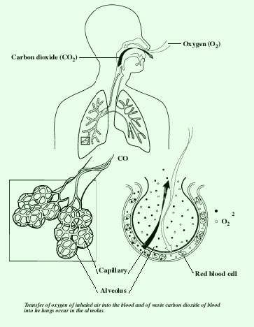
Children Are Not Little Adults
Lungs not completely formed at birth
Continued development until adolescence
  The bronchial tree
  The alveoli (air sacs)
More lung surface area per unit body weight
Different respiratory pattern
Different activity pattern
Have a longer “shelf life”
Notes:
Extrapolate down from info we have about adults but difference between kids and adults can make extrapolations in appropriate
How to think about children in context of environmental issues
The developing bodies of children are uniquely susceptible to environmental hazards. Environmental exposures during critical periods of development can create adverse health outcomes.
Period neuronal connection/formation early in childhood – brain and development
Basically a higher minute ventilation, breather greater volume of air per kilogram body weight than adults
Longer shelf life – longer time of exposure and more time to see development of disease
Children also experience their environments differently than adults in the same environment. – more floor time, more hand mouth behavior

Slide 18
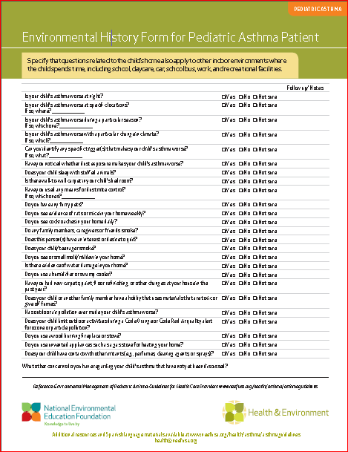
Taking a Pediatric Environmental Exposure History
National Environmental Education Foundation
Environmental History Form for Pediatric Asthma Patients
Applies to all childhood environments
Administered by health care provider
Available in English and Spanish
www.neefusa.org/health/asthma/asthmahistoryform
Notes:
Administered by health care provider
Consider all environments where child spends time

Slide 19
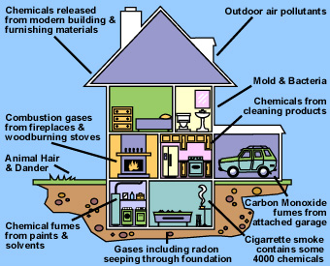
Importance of Protecting Children from Indoor Air Allergens
Home and school environment
Children spend about 90% of their time indoors
School age children spend 30-50 hours a week in and around school buildings
Source: http://www.cdc.gov/nceh/publications/books/housing/cha05.htm
Notes:
Increased exposure to begin with based on risk factors, combined with spending more time in schools

Slide 20
Allergens in the Indoor Air
Indoor air pollutants that can trigger asthma exacerbations:
Causal Relationship:*
Cat
Cockroach
Environmental tobacco smoke (preschooler)
House dust mite
Association:*
Dog
Molds
Rhinovirus
NO2/NOx
  Other triggers:
  Animals: pets, rodents
  Chemicals and pollutants in the air
    cleaning agents
    perfume, cosmetics
    Pesticides
Clearing the Air. Committee on the Assessment of Asthma and Indoor Air; Division of Health. Promotion and Disease Prevention; Institute of Medicine, 2000.
*Roberts JR. Environmental Management of Pediatric Asthma: Guidelines for Health Care Providers Training PowerPoint. National Environmental Education Foundation.
Notes:
Evidence for each –Sufficient evidence of causal relationshiop
Sufficient evidence of association
Limited evidence of association – chemicals including formaledhyde and fragrances, and ETS in school age and older children
Cockroach and dust mite dust settle quickly into furniture/carpets whereas pet danders will stay aerosolized longer – difference in how they are handled

Slide 21

Indoor Air Quality
No federal governmental agency regulates indoor air pollutants with the exception of laws pertaining to smoking in public places
EPA recommendations for voluntary programs
Report by the U.S. Government Accounting Office, the Condition of America's Schools
  over half schools surveyed reported at least one environmental problem which affects indoor air quality
Notes:
No fed, state, local or gov agency regulates
But munical

Slide 22
Home Indoor Air Pollution
Sources:
Particulates
  Environmental tobacco smoke
  Wood burning fireplace/stove
VOCs
Chemicals/cleaners
NO2 secondary to combustion
  gas heat and appliances
Remediation:
Install exhaust fans close to source
HEPA filters for particulates but source removal is ideal
Ventilate room if fuel burning appliance used
Tight-fitting wood stove doors
Venting of fireplaces and gas stoves
Consider replacement of gas stove with electric
Never use gas-cooking appliances as heat sources
Avoid use of products that act as irritants
Roberts JR. Environmental Management of Pediatric Asthma: Guidelines for Health Care Providers Training PowerPoint. National Environmental Education Foundation.
**Matsui et al. AAP Clinical Report: Environmental Control Practices and Asthma Management. Publication Pending.
Notes:
Particulates associated with poorer lung function in children with asthma
VOCs release from carpets, paints, industrial, aerosols
HEPA filter: non-ionizing filters appropriate for size of room
Will be more relevant when we talk about goals of west virginia asthma care

Slide 23
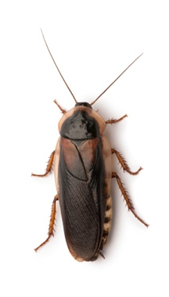
Cockroach Allergen
Favorable environment: warmth, moisture, food
Questions for Family:
How many cockroaches do you see every day?
Do you see cockroach droppings?
Environmental Management of Pediatric Asthma: Guidelines for Health Care Providers. National Environmental Education Foundation.
Notes:
Body parts or droppings of pest can act as allergens

Slide 24
Cockroach Environmental Control
Reduction in cockroach allergen correlates with asthma symptom improvement*
Environmental remediation strategies**
Integrated Pest Management
  Baits, traps, and gels before sprays
Limit access to food
  Keep food and trash in closed containers
  Clean up all spilled food
  No food in bedrooms
  Clean counters daily
Eliminate water - leaky plumbing, leaky roof
Boric acid
Store spacer in plastic bag
DO NOT
  Spray liquids in the house
  Use industrial strength pesticide sprays that require dilution
*Morgan et al. Results of a home-based environmental intervention among urban children with asthma. N Engl J Med. 2004;351(11):1068-80.
**Roberts JR. Environmental Management of Pediatric Asthma: Guidelines for Health Care Providers Training PowerPoint. National Environmental Education Foundation.
Notes:
Spacer storage – plastic bag
Eliminate water – leakly plumbing, leaky roof
Roach bate – roach eats bait then carries to other sources

Slide 25
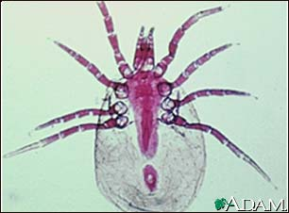
Dust Mite Allergen
Favorable environment: warmth, moisture, food
Live in mattresses, upholstered furniture and carpet
Difficult to see so take climate into account or home dust testing
Children who are sensitized to dust mites have more severe asthma
Notes:
Favorable environment similar to cockroach so similar remediation strategies
Humid environments: SE US and coasts, along water
Too small to be seen
Live in mattresses, pillows, carpets, fabric-covered furniture, bedcovers, clothes, stuffed toys

Slide 26
Evidence for Dust Mite Control
1992 randomized controlled trial comparing dust mite interventions for mattresses and carpets*
  Children using bedding casing and carpet treatment showed decreased dust mite allergen on mattresses and decreased airway reactivity
2003 Danish study using mattress covers**
  Decreased dust mite allergen in those children using dust mite covers
  Decreased dose of controller ICS by 9 months
  No effect on airway reactivity
2008 Cochrane Review: meta-analysis 54 RTCs – environmental interventions decrease mite levels but no correlation with asthma clinical outcomes
*Enhert B, et al. Allergy Clin Immunology 1992;90:135-8.
**Halken S, et al. J Allergy Clin Immunol 2003;111.169-176.
Roberts JR. Environmental Management of Pediatric Asthma: Guidelines for Health Care Providers Training PowerPoint. National Environmental Education Foundation.
Notes:
Other studies have shown correlation between decreased dust mite levels and decreased airway reactivity
Removal of allergen correlates with clinical improvement
Completely eliminating mites is difficult

Slide 27
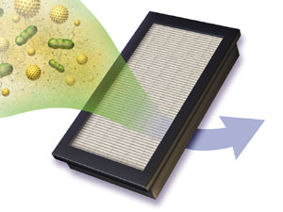
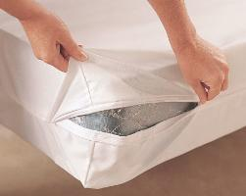
Dust Mite Control
Allergen impermeable pillow and mattress covers
Wash bedding weekly
Wash and dry, or freeze stuffed toys weekly
Wash in HOT water (130°F) to kill mites
Damp mop floor surfaces, dust with wet rag
Remove carpeting or vacuum carpets with HEPA vacuum cleaner
Humidity below 50% - avoid humidifiers
Since dust is larger particle it settles
  Unclear benefit of air filtration
Results usually seen in one month
Roberts JR. Environmental Management of Pediatric Asthma: Guidelines for Health Care Providers Training PowerPoint. National Environmental Education Foundation.
Notes:
Covers for all beds that the child sleeps on
Wash weekly to remove allergen
Freeze for 24 hours but ideally remove
Avoid ionic air cleaners that produce ozone
Humidity – air conditioning in school buidlings even if closed for summer
Remove or wash stuffed toys

Slide 28
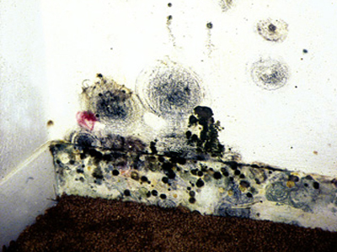
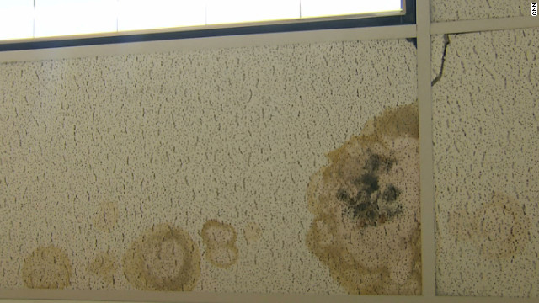
Mold = Fungus = Mildew
Microorganisms that grow in warm and damp environments
Many types of mold often occurring in the same environment
Spore aerosolization
No guideline for acceptable levels
Molds irritate mucous membranes
Produces allergic responses in children who are sensitive to mold
http://www.epa.gov/iedmold1/mold_remediation.html
Institute of Medicine. Damp Indoor Spaces and Health. NAS; 2004.
http://i2.cdn.turner.com/cnn/dam/assets/111222124333-school-mold-cnn-story-top.jpg
Notes:
Symptoms generally related to aerosolization of spores
No guidelines for acceptable levels and spore amount does not correlate with health outcomes
Most common = mucosal irritation
Sinus disease
Asthma exacerbation
Rhinoconjunctivitis in atopic kids
10% of the population has allergic antibodies to fungal antigens, and 5% have clinical illness
However, there is no scientifically valid evidence that mycotoxins or mold present in indoor ambient air can lead to brain damage, cancer, chronic fatigue syndrome, fibromyalgia, neurologic conditions
Generally air noto sampled, but if done should compare indoor and outdoor levels

Slide 29
Questions for Families*
Do you see mold growth in the home?
How large is the area?
Do other locations (school, daycare) have mold growth?
Do you have moisture or leaks in your home?
Do you frequently have condensation on windows?
Have you made attempts to decrease humidity?
*Environmental Management of Pediatric Asthma: Guidelines for Health Care Providers. National Environmental Education Foundation.
Notes:
Ventilation systems (certain number of air filters per minute – ie, hospitals)
May not provide enough air for dilution and/or dehumidification
May contain sources of mold and/or disperse mold spores into the occupants’ breathing zone

Slide 30
Mold Control
Prevention of growth:
Dehumidifier ideally below 50%
Central air conditioner
Vent bathrooms and clothes driers to outside
Use exhaust fan in bathroom or other damp areas
Keep drip pans for fridge, air conditioner dry
Fix leaks of faucets and pipes
Prevent condensation on windows
No raking, mowing if allergy
Home remediation of mold:
Discard items too moldy to clean
Hard surfaces: Clean small areas with detergent and water
Dilute chlorine bleach improves appearance but does not remove allergen
Fix sources of water
If area larger than 3x3 ft: professional remediation
Porous materials usually require replacement
Roberts JR. Environmental Management of Pediatric Asthma: Guidelines for Health Care Providers Training PowerPoint. National Environmental Education Foundation.
Notes:
Hygrometers to measure humidity
Most important: must address moisture source
Licensed contractor/professional cleaning if area larger than 3x3
Air conditioner must be nonevaporative or waterf-filled
Sources of water: outdoor pipes/drains
Moisture control helps for mold, cockroach, dustmite
Porous materials – tiles, carpet

Slide 31
Evidence for Mold Remediation
2006 randomized controlled trial examining mold remediation and asthma symptoms*
  Mold remediation group:
    Significant decrease in mold levels
    Significant decrease in asthma symptoms days
    Significant decrease in rate of asthma exacerbations
*Kercmar CM, et al. Env Health Persp 2006;114:1574-80.
Roberts JR. Environmental Management of Pediatric Asthma: Guidelines for Health Care Providers PowerPoint Training. National Environmental Education Foundation.

Slide 32
Animal Allergens: Pets and Nonpets
Cats
Dogs
Rodents
Birds
Notes:
Birds – likely from dust mites in feathers

Slide 33
Prevalence of Animal Allergens
Cats:
  Smaller particles so remain suspended and easily transferred
  Cat dander and schools
Mice:
Mouse allergen in inner cities
  Found in most inner city homes**
    Allergen concentration higher in cities than suburbs
  Boston: 42% of population tested had mouse allergen detectable in house*
    Risk factors: African American race, visible mice, cockroach allergen
*Phipatanakul W et al. Allergy 2005;60:697-701.
**Matsui et al. AAP Clinical Report: Environmental Control Practices and Asthma Management. Publication Pending.
Notes:
Especially cats: studies have shown that exposure to allergen after it is tracked into school can cause asthma exacerbation in sensitized child
Smaller particles – suspended as opposed to dust mite and cockroach, and can be easily transferred
Mouse allergen can be found in most inner city homes, especially midwest, with greater concentration
Rat allergen exposure less common than mouse

Slide 34
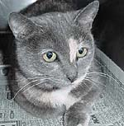
Pet Allergen Control
Find a new home for indoor pets
Keep pet outside
Pillow/mattress encasings
HEPA air filter and vacuum
Keep pet out of bedroom
24-30 weeks of interventions prior to allergen levels normalizing to levels of non-cat household*
Bathing cat may only decrease allergen for 1-2 days**
*Wood RA et al. J Allergy Clin Immunol 1989;83:730-4
**Ownby D et al. J Allergy Clin Immunol 2006:118:521-2
Roberts JR. Environmental Management of Pediatric Asthma: Guidelines for Health Care Providers Training PowerPoint. National Environmental Education Foundation.
Notes:
Pet removal more effective in improving clinical Sx than interventions with keeping pet
If these aren’t possible, similar interventions to dust mites
High-efficiency particulate air filters to help remove pet danders (stay in air) - filters are designed to target much smaller pollutants and particles but studies mixed regarding effectiveness

Slide 35
Environmental Tobacco Smoke
Consists of more than 3800 chemical compounds
Gasses and particulates
Decreasing exposure to ETS over last decade
Children exposed to ETS in utero or infancy are more likely to develop asthma
Children with asthma who are exposed to ETS are more likely to have an asthma attack
Notes:
Smoke free indoor: home and car

Slide 36
Environmental Tobacco Smoke Interventions
Ideally smoke-free all environments
  If not: focus on indoor (house, car)
Support quitting
  Nicotine gum/patch, medications
HEPA filters will help with particulates but not gases
Notes:
Smoke free indoor: home and car

Slide 37
Combined Asthma Trigger Management
Multitrigger management recommended*
Variability in evidence-based outcomes for individual allergen triggers
Sensitivity and exposure to multiple triggers likely
Various outcomes addressed
Frequent and ongoing remediation required
*CDC Task Force Findings and Rationale Statement Interventions for Children and Adolescents with Asthma www.thecommunityguide.org/asthma/rrchildren.html
Roberts JR. Environmental Management of Pediatric Asthma: Guidelines for Health Care Providers PowerPoint Training. National Environmental Education Foundation.
Notes:
variability in evidence based outcomes for many single environmental allergen studies
Most of studies done on single allergens
Outcomes look at allergen level, symptom control, airway reactivity (PFT measurement), medication use
This is why we take a multi trigger approach
Some studies have shown environmental control similar in cost and efficacy to controllers
Not just decrease in allergen level but must show this correlates with Sx
Many studies also show frequent remediation is required – allergens eventually return to environment
Ie, moisture effects dust, cockroach, mold – humidity meter in home

Slide 38
Evidence In Action: Inner City Asthma Study
Management of multiple triggers
7 sites including Washington, DC
937 pediatric asthmatics in inner city
Intervention:
  Environmental questionnaire
  Skin testing
  Home allergen sampling
  Environmental control measures
    Mattress and pillow covers
    HEPA air and vacuum filters
    Professional pest control
Results: 1 year follow up
  Increased number symptom free days
  Decreased allergen levels
  Decreased dust and cockroach levels associated with decreased asthma complications
Morgan WJ et al. New Engl J Med 2004;351:1068-80.
Kattan M et al. J Allergy Clin Immunol 2005;116:1058-63.
Roberts JR. Environmental Management of Pediatric Asthma: Guidelines for Health Care Providers PowerPoint Training. National Environmental Education Foundation.
Notes:
Home allergen sampling: dust, cockroach, cat, dog
1 year of intervention

Slide 39
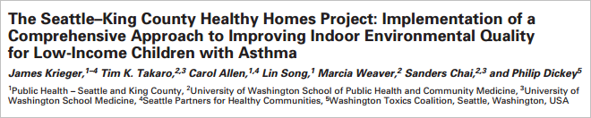
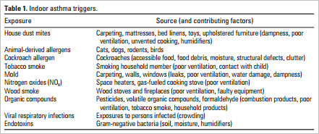
Notes:
Example of care coordination and 1. education and 2. environmental remediation required for prevention of asthma exacerbations
Focus on indoor asthma trigger remediation for individual patient, although in reality much to be done for outdoor air quality

Slide 40
Opportunities for Intervention
PATIENT
CLINIC/HOSPITAL
INSURANCE
COMMUNITY
STATE
FEDERALL
Notes:
Clinics/hospital/hospital systems
How to improve value at a hospital level

Slide 41
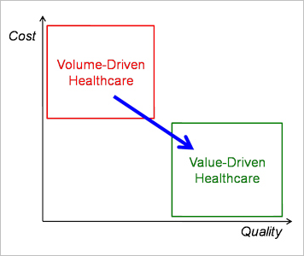
Review of Changes in Health Care Delivery
Title III: Improving the Quality and Efficiency of Health Care
  Transition from volume to value
  Incentives for hospitals to meet quality measures
Source: Center for Healthcare Quality and Payment Reform, Creating a Value-Driven Healthcare System, available: http://www.chqpr.org/goals.html
Source: US Department of Health and Human Services. Read the Law. Available: http://www.hhs.gov/healthcare/rights/law/index.html
Notes:
Transition from volume to value – originated in regional differences in quality and cost for medicare patients
Putting this into context – why these nontraditional changes and solutions are becoming increasingly relevant
VBP – “payment methodology that rewards quality of care through payment incentives and transparency”
Value – quality, cost – new payment strategies to encourage value – payment/reimbursement linked to meeting quality standards (VBP/pay for performance)
Arguing for value in population health
Reimbursement ncentives to hospitals that meet quality outcomes - more for medicare but coming down the line for medicaid -

Slide 42
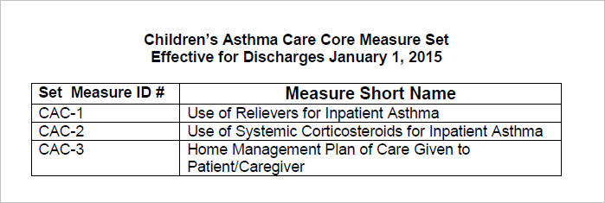
Hospital Level Interventions to Improve Quality of Asthma Care
Pathways to reduce variation in care
Evidence or guideline-based practice
Social worry budget
Meeting Joint Commission standards
Source: Center for Healthcare Quality and Payment Reform, Creating a Value-Driven Healthcare System, available: http://www.chqpr.org/goals.html
Notes:
Other components of value – safety and cost – here going to focus on what hospitals can do to improve quality and reduce cost through pop health interventions
Do patient satisfaction scores improve solely by addressing social needs?
Social worry budget- parents can only worry about so much; improved care by parents if address social needs
What can we do in the hospital to prevent asthma?
Children’s Asthma Performance Measures for accreditation by Joint Commission
Why we fill out AAP – trigger identification as key component
Studies have shown that these steps are not necessarily sufficient to keep kid sout of hospital if same triggers keep brining them back in

Slide 43
Hospital Level Interventions to Improve Cost of Asthma Care
Decrease length of stay
Admission under observation status
Cost and effectiveness of asthma education in the hospital versus home setting
Prevent readmissions through seamless transition to community
Source: Center for Healthcare Quality and Payment Reform, Creating a Value-Driven Healthcare System, available: http://www.chqpr.org/goals.html
Notes:
So what is the solution?
Decrease length of stay especially if receiving bundled payment
This idea of seamless transition
Potentailly not getting paid for readmission if within 30days asa inpatient (unless admit under obs status0

Slide 44
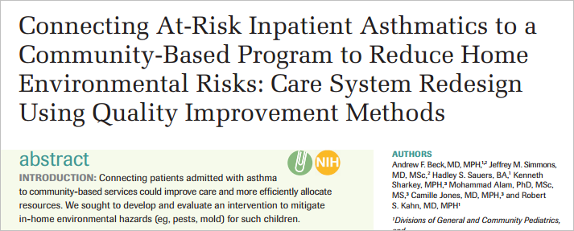
Notes:
Novel idea: hospital level QI with population health outcomes measurements – shifting to measuring outcomes of populations
Direct referral to public health dept and integration into HER
Asthma committee measure pop health outcomes – administration on board
Generally QI happens with small change over a short time period
One question was in what time frame were we expected to show this change
DDOE on board for electronic referall system for providers but how will the hospital communicate with them?

Slide 45
How To Refer to Community Resources From Inpatient Setting

Slide 46
Opportunities for Intervention
PATIENT
CLINIC/HOSPITAL
INSURANCE
COMMUNITY
STATE
FEDERALL
Notes:
Insurance investing in population health interventions
What is being done but what else can we do?

Slide 47
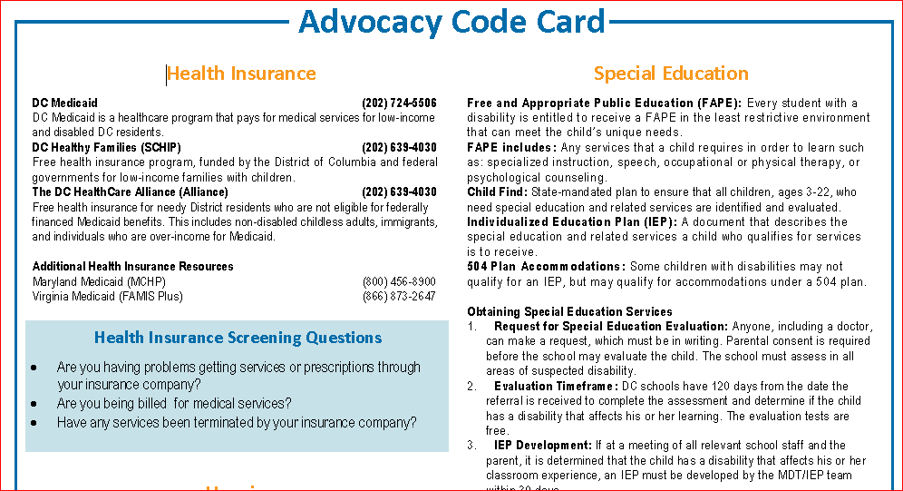
Hospital Awareness of Community Resources
Notes:
Advocacy code card
Slide with community resources available to all patients in hospital
Developing asthma resource card
Social work, case managers, asthma educator, residents, attendings can all refer from the inpatient setting
Why not look at number of community partnerships as a QI measure for hospitals?

Slide 48
What is already being done to prevent asthma within the community?
DC Asthma Coalition
Breathe DC
Children’s Law Center
Health Leads
DC Government
  DC Department of the Environment
    DC Lead-Safe and Healthy Homes Program
  DC Department of Health
  DC Department of Housing and Community Development
Healthy Together
Notes:
Had to ask ourselfs: What is being done within the community to prevent asthma?
How to connect our patients to these resources
HUD – millions of dollars of grant money for home remediation but must be referred from DDOE
DDOE/HUD
HUD – this would be grant funding, not written into federal budget
State must write this into the budget in the first place
Funding through medicaid implies recognition that these environmental factors have health implications
Subject to budget cuts b/c usually relies on federal dollars
CDC budget cuts to healthy homes program and DC had to reinstate funds

Slide 49


District Department of the Environment
Who?
DC residents only
What?
Home environmental and energy assessment
Children with severe or poorly controlled asthma
Home contains health and safety threats/hazards
Environmental health education and energy efficiency tools
Allergen-barrier pillow covers, food storage containers
Assistance in coordinating resources, including CLC
Follow up support from DDOE staff through successful hazard remediation
Technical report to landlord with timeline for remediation
Notes:
For families with extensive, structural housing concerns and/or unresponsive landlords
DDOE completes comprehensive home environmental assessment and energy audit, family education, an asthma management diagnostic and case management coordination.
Once health and safety threats have been identified and systematically documented, DDOE creates a comprehensive Technical Assistance Report that serves as a time-sensitive roadmap for the correction of identified hazards, and that details the potential health issues related to those hazards.

Slide 50
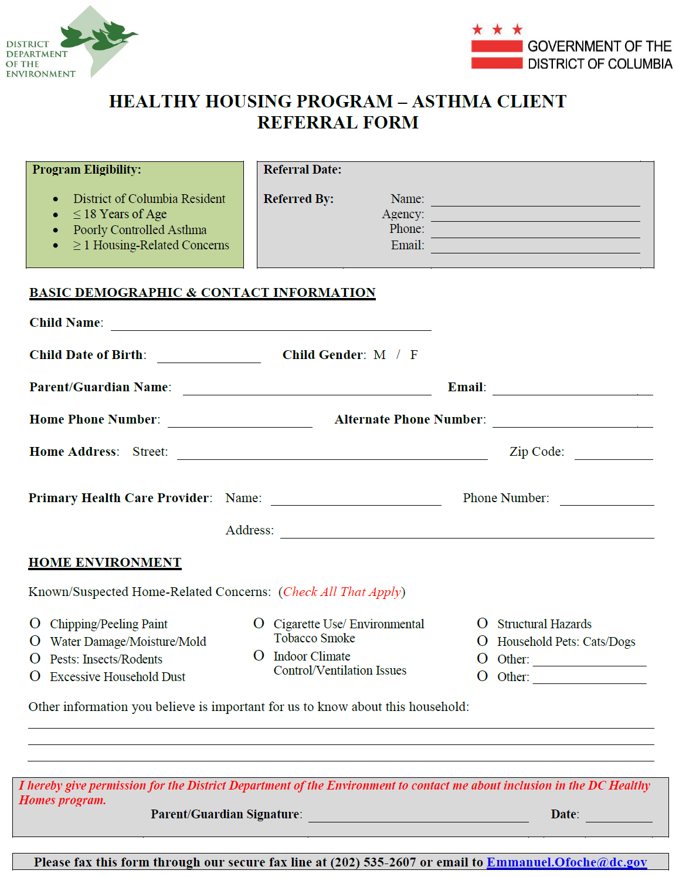

Slide 51
Identified Hazards Summary, 2013-14 IMPACT DC Referrals (n=94)

Slide 52
Remediation Outcome Summary, 2013-14 IMPACT DC Referrals (n=94)

Slide 53

Breathe DC
Who?
Residents of DC and Southern Maryland
What?
1:1 counseling & collaboration w/ local Quitline
Children with moderate to severe asthma
Exposure to tobacco smoke?
Home visit from educator and/or smoking cessation counselor
Educational materials
Allergen-barrier mattress and pillow covers
HEPA vacuum
Pest management
Furnace filters
Notes:
For families that would benefit from an in-home visit for asthma education, exposure assessment, and/or smoking cessation
Breathe Easy Home Improvement Project is a home visiting program. The project staff conducts a walkthrough of the home to identify environmental asthma triggers. A targeted educational intervention is conducted for the child’s primary caregiver and other relatives. Integrated pest management, dust mite reduction measures and other trigger reduction tools and strategies are offered to reduce factors in the home environment that can aggravate asthma attacks in young children. While contributing to the reduction of emergency room visits and hospitalizations, Staff also educate parents on the dangers of smoking and offer assistance to quit smoking.
Pertinent Info
• Grant-based program; currently funded through 2016
• Program Director: Dr. Janet Phoenix
Referral Process
• Accept inpatient and outpatient referrals
• Referral form
• Parental/guardian consent/signature required
• Submit scanned form via email to jphoenix@gwu.edu
• Challenged by large volume of referrals - smaller staff

Slide 54
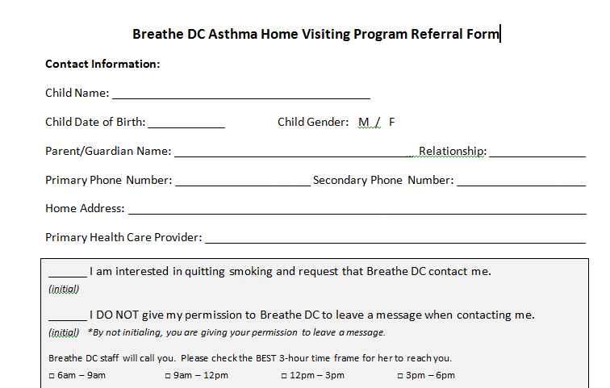
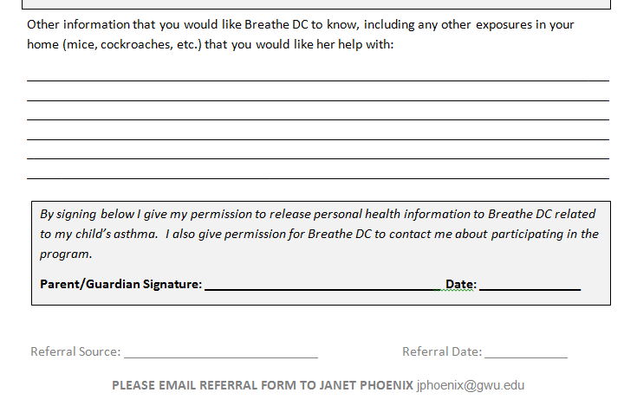

Slide 55

Health Leads Family Help Desk
Who?
Any CN patient who needs help with basic resources (non-medical) – based in CHC
What?
Volunteers assist with obtaining:
Child care, activities
Utilities
Food, household supplies
Insurance or public benefits
Housing
Job training, job placement, GED

Slide 56
Ext
3320

Slide 57
Who can make referrals?
Resident/Attending
Asthma Educator
Nurse/Case Manager/SW
IMPACT DC
Notes:
Also - Primary care provider, School nurse, Parent (self-refer). QI project aim is to INCREASE inpatient referrals.

Slide 58
We can do better…
30 inpatient referrals June 2014-March 2015
  17 to DDOE
  11 to Breathe DC
  (2 to St. Mary’s County)
  0 to Children’s Law Center
  ? to Health Leads
All by asthma educator
No systematic way to track referrals or outcomes

Slide 59
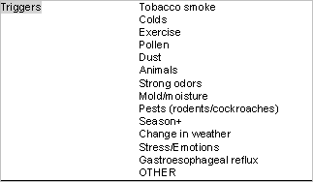
Which patients should you refer?
SMOKE
DUST
MOLD
PESTS

Slide 60
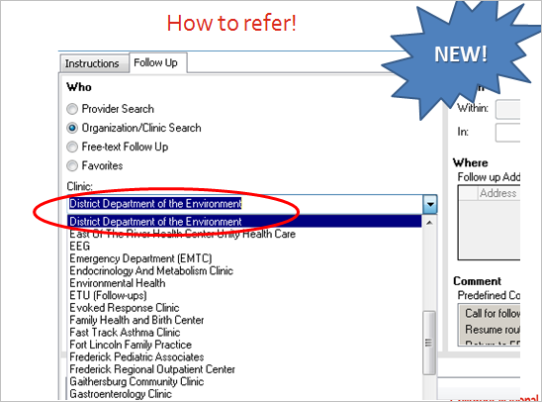

Slide 61

What is already being done to change funding for asthma care?
High-risk Asthma Clinic
  Comprehensive care for high risk pediatric asthmatics
IMPACT DC asthma clinic
  New payment models from DC Medicaid MCOs
DC Chronic Condition Collaborative
  DC Department of Health Care Finance
  Focusing on care coordination for pediatric asthma
Notes:
DC complex care collaborative – asthma was only focus for pediatrics and decided to invest in IMPACT DC
Favorable political climate

Slide 62
Opportunities for Intervention
PATIENT
CLINIC/HOSPITAL
INSURANCE
COMMUNITY
STATE
FEDERALL
Notes:
Insurance investing in population health interventions
What is being done but what else can we do?

Slide 63
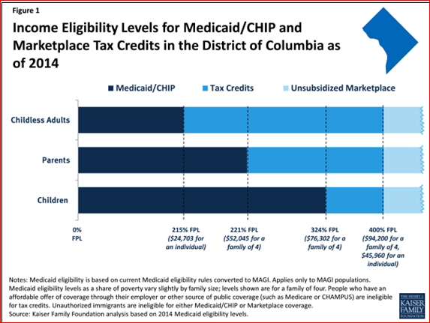
Notes:
DC decision for medicaid expansion

Slide 64
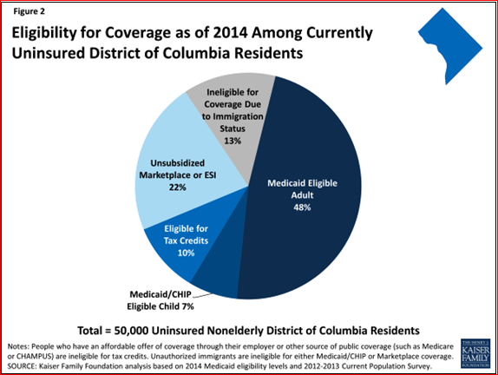
Notes:
Doesn’t mean much for coverage for kids

Slide 65


How to Determine Need?
2013 District of Columbia Community Health Needs Assessment
DC Healthy Communities Collaborative
CNMC, Howard, Providence, Sibley and 2 FQHCs
DC Health Matters Portal
A “collaborative, community-engaged approach for community health improvement”
Data, resources, funding sources, identify community partners
Notes:
Difficultly of showing community benefit – what outcomes to measure – show addressing community needs
6 priority area needs: asthma, obesity, mental health, sexual health, stress related disorders, general access to health services
DC health matters: subjects including; health, economics, education, environment, govenrment and politics, public safety, social environment, transportation

Slide 66
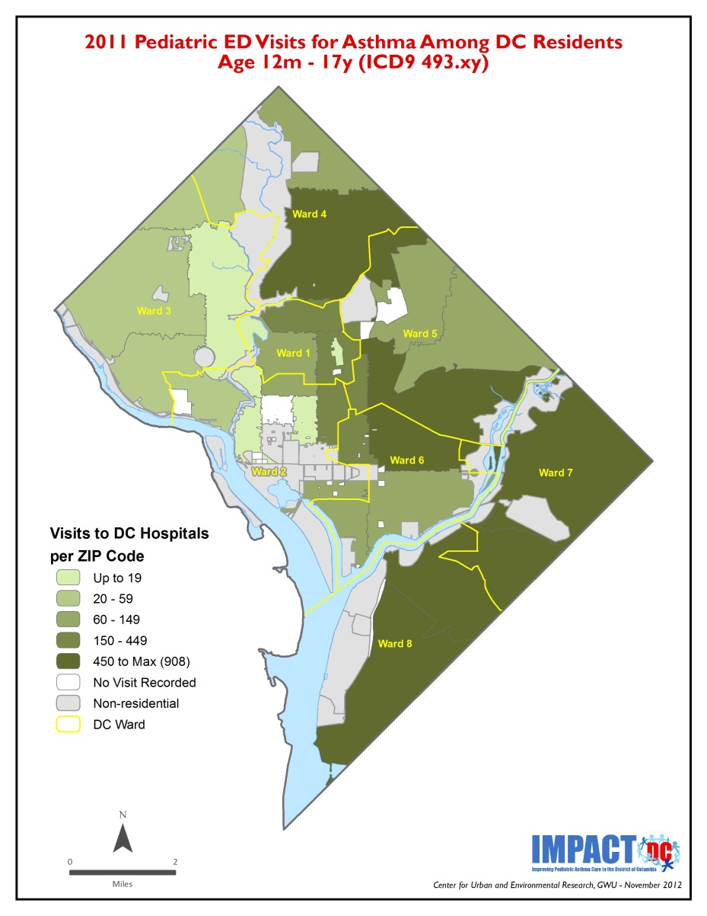
Notes:
Zip code with ward overlaid
are there certain social/envi factors in this zip codes contributing to readmissions?
Overlay with nonattainment areas for criteria air pollutants

Slide 67
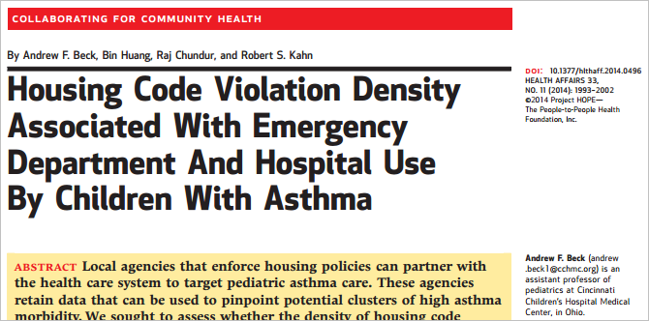
Notes:
How to identify which children will be admitted/where are highest risk
Novel idea – using population health data to predict kids at highest risk for readmission and healthcare spending – how to reduce cost
Highlighting the role of medical legal partnerships

Slide 68
Goals
Asthma education and environmental remediation are both clinically effective and cost-effective, especially for children at high risk of readmission
Education requires repetition outside of the acute care setting
Notes:
How to translate all of this data and evidence into policy?
Deciding on feasible goals and determining what steps are needed to achieve wtihin a given system
Studies showing decreased effectiveness of education in inpatient setting

Slide 69
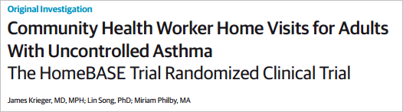

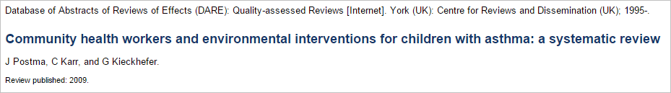
CHWs as in-home educators for pediatric asthmatics and their families
Decrease in asthma symptoms and activity limitations
3/6 RCTs showed decreased asthma-related clinical visits
Cost per child ranged $492 to $2,000
Notes:
Just out in JAMA pediatrics – RCT in adults
How to translate this evidence into policy
2009 RCT review in children found no consistent results
Most based on social cognitive theory
Rang of services 6 weeks to 1 year, 9 home visits on average
How to turn all of this evidence into policy?
How to make the payment systems sustainable?

Slide 70
Medicaid State Plan/Budget Amendments
Amendments for “eligibility, benefits design, financing”
CMS rule for preventive service funding through Medicaid
  Non-licensed health professionals can administer and be reimbursed for preventive services by Medicaid if care is advised/overseen by licensed health professional
    Community Health Worker reimbursed by Medicaid to provide in-home asthma education
    Lawyers reimbursed by Medicaid to enforce housing code violations through MLPs
  Avoids legislative processes
  Works well in fee-for-service payment climate
Notes:
Many budget amendments are for enrollment strategies, bu here talking about benefits design and financing
Enrollment not as much of an issue in pediatrics
Jan 1, 2014: State preventive ruiling – will we be able to convince them to pay for home environmental asthma education
Possible examples that states are attempting – needs to be approved by federal government as budget or state plan amendment
Not aware of any states that have actually been able to implement this
Both budget and plan amendments must go back to fed for approval
State plan amendments
State plan = agreement between a state and fed gov describing how state administers its medicaid and CHIP programs – since receive fed funding
Ie, managed care delivery for medicaid services must be done through a state plan amendment and approved by CMS
Avoids going through trouble of p[assing a bill
Probably not as applicable if bundled payment or ACO
Dental care – using prior model of legislative advocacy

Slide 71
Timeline for Advocacy
CMS ruiling finalized
Independent discussions among stakeholders
Meeting with DC Health Care Finance
Stakeholder meeting
New DC City Council
Spring 2014
Fall 2014
Spring 2015
Summer 2014
Notes:
Realistic timeline
Realized that everyone talking about this independently
Stakeholder meeting to guage interest, define terms; hospitals and asthma coalitions
DC HCF – asthma committee
-

Slide 72
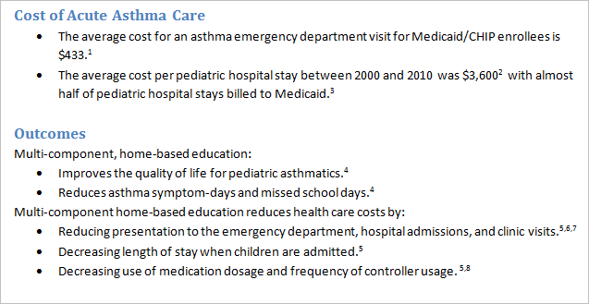
Approaching DC Department of Healthcare Finance
Evidence base behind in-home education and trigger control in a “one pager”
See References for Sources
Notes:
Evidence in a one-pager – medical professional required to summarize evidence

Slide 73
Approaching DC Department of Healthcare Finance
Community education versus environmental remediation
Success of other programs
  To date no successful use of preventive service ruling
  Most have worked through Medicaid MCO
Telling a patient’s story
Will this cost us more money?
  System reorganization
Net cost: CHWs/legal aids versus RNs/physicians
Cost effectiveness of CHWs
  Cost savings data available for city-wide grant-funded programs?
Notes:
Realizing that these were two different things – you could have asthma educator do education anad instruct family on cleaning the home, but need more money and resources for large-scale remediation
Partially feds haven’t clarified what they’re looking for
Patient story – patient you see over and over in the hospital but keeps coming back b/c goes home to the same environment
Inherent success of CHWs as members of community – patients tend to trust their own community members more
Difficulties between state and federal advocacy – although federal advocacy is usually more long-term, state advoaccy requires 1. balanced budget and 2. faster turnover of congressmembers, not as worried about long-term outcomes
Either way medicaid will be paying for it – it’s just whether you want to pay more for inpatient asthma care or pay less for prevention, just may take some time to see effects
Federal medicaid is not supposed to take cost into account when deciding on coverage (just effectiveness) but that doesn’t mean state medicaid MCOs can’t
Cost: is there sufficient evidence on cost savings to justify wide-scale program implementation

Slide 74
Other Innovations in DC Environmental Health Policy
District Department of the Environment
DC Medicaid amendment to use EPSDT funds to pay for home lead remediation
Children’s Law Center
Air Quality Amendment Act of 2014 – requirements for landlords to remediate mold
Legislative + Administrative regulations by DDOE
Landlord must inspect within 7 days of written notice from tenant
Landlord must remediate visible mold within 30 days of inspection

Slide 75
Opportunities for Intervention
Contact federal congresspersons to support policies that promote asthma prevention
Letters
In-person visits
Leave behinds with evidence base
Tell your story!
PATIENT
CLINIC/HOSPITAL
INSURANCE
COMMUNITY
STATE
FEDERALL
Notes:
Federal more of a role in outdoor air control

Slide 76
Learning Objectives
Understand changes in policy that are leading to transitions from individual to population health
Discuss the evidence base for population-level pediatric asthma management
Understand how to translate this evidence into advocacy opportunities
Identify community-based resources available for asthmatic patient referral

Slide 77
Questions?

Slide 78
Opportunities for Intervention
PATIENT
CLINIC/HOSPITAL
INSURANCE
COMMUNITY
STATE
FEDERALL
Notes:
Insurance investing in population health interventions

Slide 79
Medicaid Managed Care Organizations (MCOs)
Use of Medicaid MCOs increasing in most states
Insurance company role in value based purchasing
Notes:
KFF: “More than half of Medicaid beneficiaries now receive all or most of their care from risk-based managed care organizations (MCO), and states are rapidly expanding their reliance on risk contracting”
Usually medicare adopts first, then medicaid, then private insurance; new trend towards private insurance adoption due to pressures on value-based care
Payor mix: “percentage of cases that are medicare, medicaid, commercial insurance, HMO, managed care, self-pay”
Has implication for which approach will be taken when it comes to state policy
Private insurance large, must approach private insurers
Commercial managed care organizations (MCO) versus direct payments to providers via fee for service
Within medicaid category, use of MCOs is increasing

Slide 80
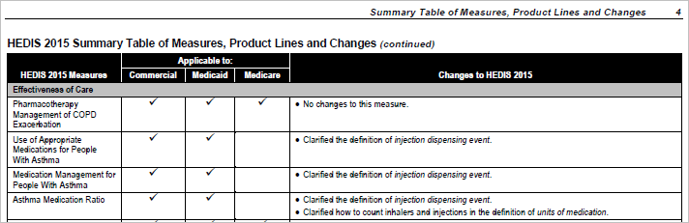
Measuring Quality for Insurance Companies
National Committee for Quality Assurance
  Use of the Healthcare Effectiveness Data and Information Set (HEDIS)
  Sets accreditation standards for Medicaid MCOs
  Help Medicaid to choose MCO provider
Developing performance measures for ACOs
HEDIS and asthma quality measures
Source: HEDIS 2015, Volume 2
Notes:
Private and MCOs
NCQA: independent, nonprofit
Population health outcomes built into ACO measurements
Page 4 in HEIDS – asthma measures for MCOs – given asthma care standards why not envi control as part of these standards?
Convince MCOs that this intervention will help plans meet quality standards

Slide 81
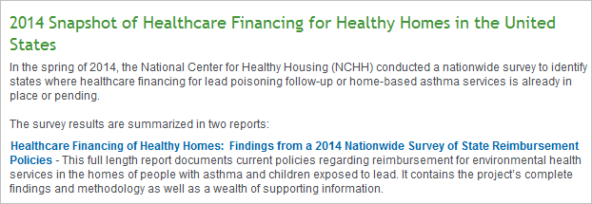

State Strategies For Sustainable Funding of Home Visiting Programs For Pediatric Asthmatics
EPSDT/Title V
Health Homes
Other governmental resources
State Medicaid Plan and Budget Amendments
Negotiate as part of bundled payment from Medicaid MCOs*
Medicaid demonstration application
Notes:
The million dollar (or billion dollar) question – how do we pay for it?
In reality: no one answer that is applicable for all states
Must make decision within constraints of a given system
Ie, reimbursement of legal
Motivation? Interest steps from desire to meet quality benchmarks and continue as MCO operator
MCO: Some interested in reimbursement of population health/community interventions
For more information: AAP state gove affairs, Ntl Center for Healthy Housing, CDC Resource on funding asthma – information on how other states doing this
CDC National Asthma Control Program
EPSDT – lead funding for home remediation through Medicaid EPSDT – recognition of importance of sustainable funding mechanism
Health Homes: ACA created optional Medicaid State Plan benefit for states to est Health Homes for care coordination for ppl with chrornic conditions, care integration and coordination (includes asthma), provides enhanced federal medicaid matching for est health home – none approved for washington, dc or VA

Slide 82
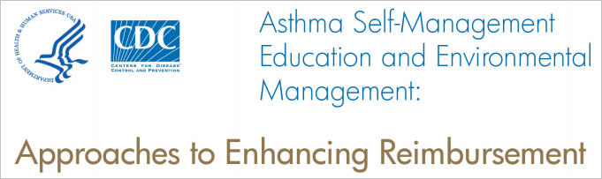
State Strategies For Sustainable Funding of Home Visiting Programs For Pediatric Asthmatics
EPSDT/care coordination/title 5
Health Homes
Dept of the Environment/Dept of Housing and Urban Development
State Medicaid Plan and Budget Amendments
Negotiate as part of capitation or bundled payment from Medicaid MCOs*
Medicaid demonstration application

Slide 83
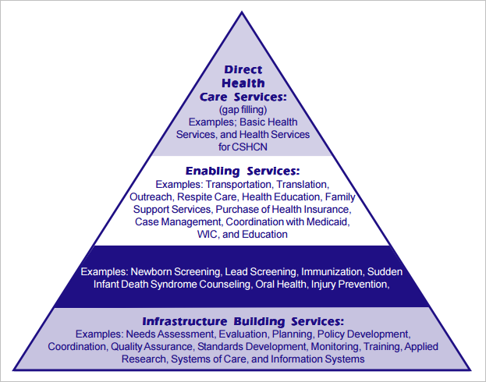
Early and Periodic Screening, Diagnostic, and Treatment
Requirements for services states must provide to children up to age 21
Goal: early recognition, treatment, prevention
Qualify for services excluded under many private insurance, CHIP
Title V Funds
Block grants to states
Women, children, families
Role in providing EPSDT
US Dept HHS. HRSA Maternal and Child Health. EPSDT and Title V Collaboration to Improve Child Health. www.mchb.hrsa.gov
HRSA. Understanding Title V of the Social Security Act. http://www.amchp.org/AboutTitleV/Documents/UnderstandingTitleV.pdf
Notes:
EPSDT and title 5 work in conjunction
PT, OT, ST, respiratory, home nursing, DME
Expansion for home visiting
EPSDT – required by every state; low income children
Existed prior to medicaid but now enhanced
Durable medical equipment
Differences in how DC, VA, MD provides EPSDT services under medicaid
Includes:
Health assessments
Developmental assessments
Vision, dental, hearing
Title 5 funds under the social security act: Address “social, financial, behavioral, structural barriers to health faced by women and children”
In many states used to provide EPSDT

Slide 84
CMS Demonstration/Innovation Grants
Medicaid demonstration in Washington, DC
  Mary’s Center for Maternal Child Care in Washington, DC
    Health Care Innovation Award
    Capital Clinical Integration Network
    $15 million grant
    Super utilizing high cost chronically ill patients
    Telemedicine
    Trained community based care coordinators
    Goal: decrease ED utilization
Notes:
Considering grant funding- then planning grant leads to implementation grant
Mary’s Center – example of asthma state demonstration
Includes asthma
Telemedicine and case managers to transition to patient-centered medical home

