Slide 1
Quality Improvement Methods & Tools
Sonal Kalburgi, DO
Amina Khan, MD, MPH
May 16, 2016

Slide 2
Learning Objectives
Apply healthcare quality concepts
Identify key aspects to building an aim statement and designing quality measures
Discuss process map for QI
Review popular QI tools and their appropriate uses
Notes:
Discuss timeline – Amina and I will both discuss some general concepts. In the middle we’ll have a breakout session for you to put these concepts to work

Slide 3
What is health care quality?
“ Degree to which health care services increase the likelihood of desired health outcomes and are consistent with current professional knowledge”
Wachter, Patient Safety Systems 2012

Slide 4
Institute of Medicine’s “Crossing the Quality Chasm”
Health Care Quality Domains STEEP:
Safe
Timely
Effective
Equitable
Efficient
Patient/Family Centered
…More than Primum non nocere; system prevents harm
…Unintended delays or waiting
…Align with EBM, neither over/underuse
…Social determinants should not impact outcomes
…Reducing waste, decreasing cost
…Role in decision making

Slide 5
Illustrative Case
An 18 month old boy presents with a “head injury” to the local community hospital emergency room.
Toddler was grocery shopping with parents; mom looked away from the grocery cart “for just a second”, when the boy leaned over and fell out of the cart onto the floor…Exam is reassuring, no LOC
How do would we define a high quality experience?
Should we do a head CT on this patient?

Slide 6
In terms of our case…
Health Care Quality Domains:
Safety
Timeliness
Effective
Equitable
Efficient
Patient-Family Centered
Health Care Quality Domains:
Safety
Timeliness
Effective
Equitable
Efficient
Patient-Family Centered
…Minimizing radiation exposure/sedation
…Time to CT, prolongs LOS, ED throughput
…Is CT cost-effective, EBM guidelines
…Access to healthcare providers
…Waste of CT resources, cost, LOS, ED vs PCP care
…Expectation for imaging, LOS

Slide 7
Building your Aim Statement
Content:
SMART
Measurable goals (what)
Timeframe (when)
Target population (who)
Optional:
How (if that is clear)
Why (if it is compelling)
Style:
Succinct: 1-3 sentences only
Clearly answers: “What are we trying to accomplish?”

Slide 8
Developing Problem Statement and AIM
Quality Question:
How do I reduce the rate of unnecessary head CT?
Domains: Effectiveness, Safety, Efficiency
Problem Statement:
Our ED performs too many unnecessary head CTs for minor head trauma
SMART AIM:
Decrease the number of head CT over-utilization(per PECARN algorithm) for pediatric closed head trauma by x% in 6 months

Slide 9
Quality Measures
How will we know that we are making improvements?
Structure Measure:
Measure of the organizational capacity
Process Measure:
Measure of actions carried out by health care professionals to deliver services
Outcome Measure:
Measures the results of health care
Balancing Measure:
Ensures that if changes are made to one part of the system, it doesn’t cause problems in another part of the system

Slide 10
Potential Measures for our case
Structure Measures:
Presence of clinical decision tool for head CT
Training of staff for PECARN algorithm
Process Measures:
Utilization of head CT for minor closed head trauma
# of patients meeting PECARN algorithm
Outcome Measures:
ED LOS
Cost per patient
Patient satisfaction
Balancing Measures:
Readmission rate
Return ED visit rate
Neurologic morbidities

Slide 11
You’ve got a good measure when it is…
Related to the Aim and linked to key changes
Reasonably accurate (bad data worse than no data)
Is easy to collect (already being collected; easy to access data)
Is simple (understandable), yet meaningful
Shows improvement quickly (daily vs quarterly)
Can be displayed graphically over time

Slide 12
Model for Improvement
FOCUS-PDCA
Find a process/problem that needs improvement
Organize a team
Clarify current process
Understand causes and measure performance
Select actions
Plan
Do
Check
Act

Slide 13
Engaging Stakeholders and Team Building
Physicians
PCPs
Trainees
Specialists
Patients
Nursing
Pharmacy
Lab
Admin
Families
IT
RT
Payors
Risk

Slide 14
Breakout Session: Aim Statement & Measures

Slide 15
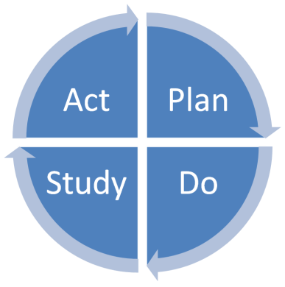
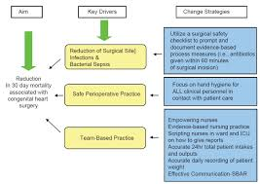
How an idea can be “QI’d”: A Process Map
[ More Proactive]
Error Proofing
STEEEP
Simplify (Lean Design)
Reliable (Six Sigma)
ID Failures & Emergent risks
Adverse Event
Harm Mitigation
Driver Diagram
(Road Map)
PDSA Cycle
(Engine)
Root Cause Analysis
Motivator/AIM
(Key in Ignition)
Tests of Change
(Fuel)
[ More Reactive]
(Brainstorming Tools)
Notes:
Error Proofing – Unique Patient bar codes to minimize pt mix ups with medications, food, equipment, etc
Lean Engineering – Reducing wait time in an ED
Reliable (Six Sigma) – Standardizing a process. CL-BSI classic example – reducing central line related infections by following a standard procedure when inserting a central line or accessing it.
Identify failures & emergent risks – Situational awareness (bedside huddles, 5pm huddles), PEWS scores, alarms
Harm Mitigation – Rapid response teams responding to acutely deteriorating teams
Root Cause analysis – investigating what happened after the adverse event (M&M)

Slide 16
Driver Diagram: Decide how to achieve AIM
INTERVENTIONS
KEY DRIVERS
AIM
GLOBAL GOAL

Slide 17
Key Driver
A Key Driver is a cause or factor that influences the AIM and subsequently helps the team focus on specific interventions or changes
What barriers prevent the team from achieving my aim?
What are the leverage points which contribute directly to the aim?
What determines how we perform on the aim?

Slide 18
Additional Points on Drivers
Do not seek solutions until understand cause(s); find the drivers before the interventions
Limit the number of drivers; 3-6 is best.
Too few – missed important link to outcome
Too many – missed “key” concept
Drivers are nouns; Interventions are verbs
Bad drivers are vague or expansive and don’t inform the interventions (“physicians”, “money”)

Slide 19
Interventions
Intervention - specific test of change likely to support or lead to improvement in one or more key drivers
Use arrows to connect intervention & driver(s)
Single intervention may impact multiple drivers
Good source for interventions -- Multidisciplinary brainstorming after drivers are identified
How to Identify Interventions?
Change Concepts
Best Practice
Expert Consensus
Other

Slide 20
Key Drivers
Interventions
Accountability
-Evaluation of the accuracy of PEWS scores.
-Self audit of PEWS scoring.
Chantel for Nursing
Dr. Khan for subspecialties
accurate PEWs scoring
-Standardize language and documentation of Watcher Activation
increased knowledge of escalation algorithm
SMART AIM
Barb & Javan/Charge Nurses
By June 1,2015 we will increase compliance with the escalation algorithm to 90%
- Improve compliance with completion of redcap survey at time of CAT to get timely feedback from RN, Physician & Family
-Charge RN’s log Watcher Activations and CATs
-Debrief with team members when concerns are not addressed
-Inter-professional simulation scenarios
Collaborative Team
inter-professional team communication
improved situational awareness by leadership
GLOBAL AIM
-identify patients with elevated PEWS scores and f/u on patient’s status
-audit chart for Physician notification of watcher activation
Reduce Late Rescues

Slide 21
QI Tools for Identifying Key Drivers
[ More Proactive]
Error Proofing
Concept Map
Simplify (Lean Design)
Spaghetti Map
Reliable (Six Sigma)
Process Map
Key
Drivers
ID Failures & Emergent risks
5 Whys
Harm Mitigation
Fishbone
Root Cause Analysis
Pareto Chart
Impact Analysis
[ More Reactive]
Notes:
Need to know the variables and determinants before you can identify interventions to try to move them

Slide 22
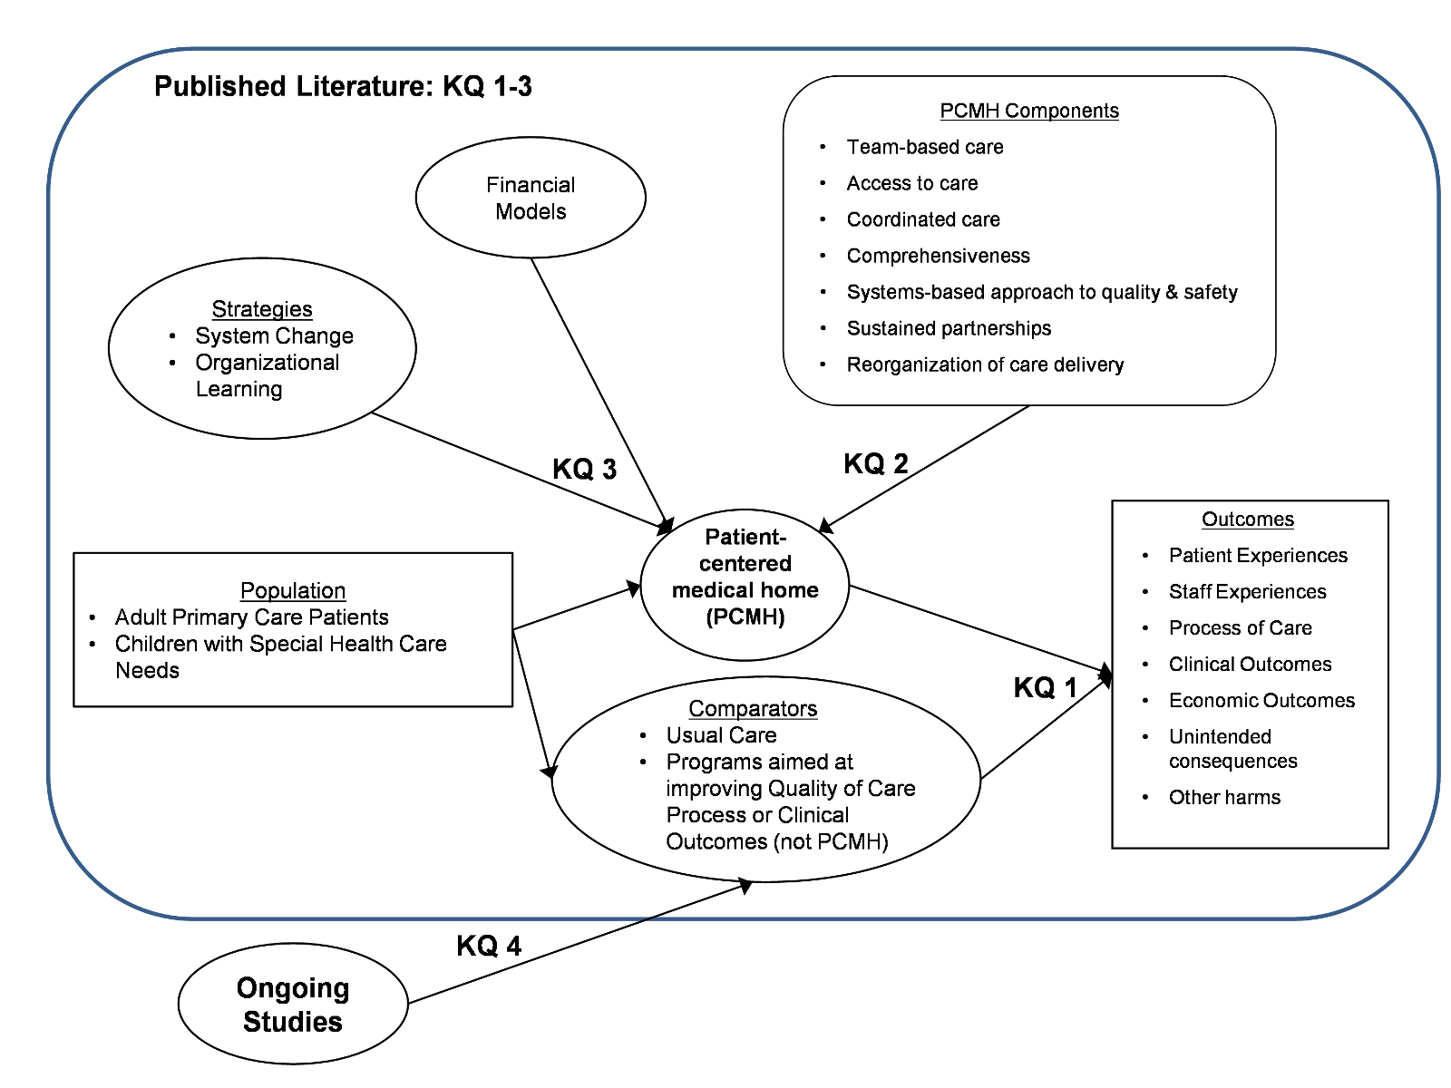
Concept Map: Big picture & illustrates complexities
Notes:
Clinical example:

Slide 23
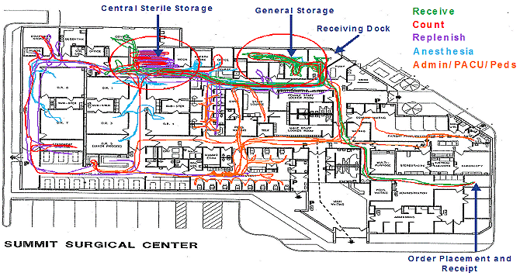
Spaghetti Map: To identify waste within a process
Notes:
Clinical example:

Slide 24
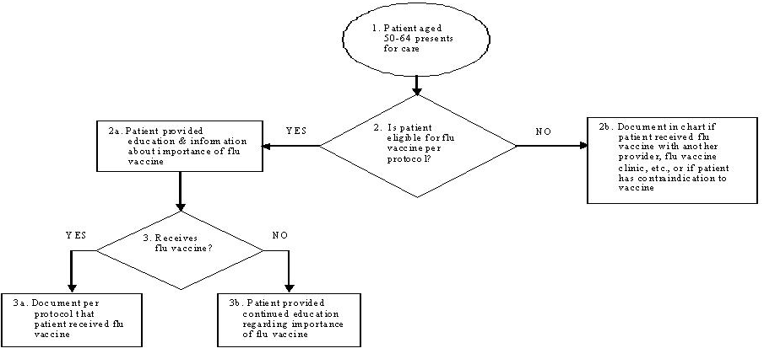
Process Map: Flow chart of a system process with decision points
A clinic’s Flu vaccination process

Slide 25
5 Whys – to identify the root of the problem

Slide 26
Medical Knowledge
Systems
Deferring to nurses
Failure to identify high risk order
Delayed recognition of severe unintended
systemic heparinization
Little training on central lines
Guidelines incomplete
Formulary incomplete
Unclear responsibilities
Deferring to subspecialist, primary MD, pharmacist
Big picture PICU vs details of
each single order
Sticking to the created plan
PICU time constraint
Reluctance to question colleagues
“They must have double-checked“
Inter-reliance
PICU
Fishbone Diagram – To Illustrate “Cause & Effect”
Notes:
Fear of re-thinking
Assumptionthe subspecialist knows best
Silo-ing the responsibilities
Education: deferring to pharmacy – pharmacy deferr to us
Not comfortable with equipment, how its used or ordered
All learners here without training – always deferring to nurces
Systems: conflicting guidelines; ID referring to guidelines as there recommendation
Residents (aka lerners) deferring to nurses in questions of central lines
No official curriculum on central lines:
different levels of individual resident knowledge
Lack of knowledge of the equipment – central line volumes
Rare procedure (3/year)
Residents and consultants referring
to institution guidelines and pharmacists –
pharmacy defers final dose and
administration instructions to ordering physician
Rare order ≠ high risk ≠ team discussion

Slide 27
Pareto Chart: Displays causes to see which is most significant

