Slide 1
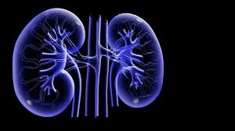
Renal All the Way…
Jingle Bells, Jingle Bells
Paula Magee
December 4, 2015

Slide 2
Question 1
The parents of a 1-month-old infant who was found to have a solitary kidney in utero are asking questions about the status of the infant’s kidney function. The infant is otherwise healthy. Upon the insistence of the family, a serum creatinine and ultrasonography are performed. The serum creatinine is 0.5 mg/dL. Renal ultrasonography demonstrates a 5.5 cm kidney on the right side of the body and absent kidney on the left.
Of the following, the statement that BEST characterizes the renal status of the infant is:
Nephrotoxic agents should be minimized because of decreased nephron mass
This infant is at higher than usual risk for dehydration in the setting of gastroenteritis
This infant is likely to require dialysis by adolescence
This infant will require annual ultrasonography to screen for renal malignancy
Toilet training may be more challenging in the future for this infant

Slide 3
Renal Agenesis
Renal agenesis is the absence of one or both kidneys
Occurs in 1/2900 newborns
Infants with renal agenesis, born with one kidney, have 50% of the expected nephron number.
Each kidney is approximately 1 million nephrons
There is a compensatory increase in the single nephron GFR, thus serum creatinine should fall to normal range for age in the first 1-2 years of life.
Alone for the Holidays

Slide 4
Renal Agenesis
The single kidney should be structurally and functionally normal
Screening for hypertension should be done beginning at age 3 years during health maintenance visits.
Periodic urinalysis also should be considered to screen for the development of proteinuria.
Avoidance of nephrotoxic medications such as nonsteroidal anti-inflammatory drugs, intravenous radiocontrast, and aminoglycoside antibiotics should be considered in children with a single kidney because of the reduced renal reserve in these patients.
Newborns should have a VCUR as there is a 30% risk of vesicoureteral reflux (VUR)
Ohhh Lonely Night!

Slide 5
Renal agenesis
Answer choice B, C, and E:
The single kidney is fully functional and has normal urine concentrating ability and bladder function, so there is no higher risk in the setting of dehydration and there are no issues with toilet training. . The compensatory mechanism to increase GFR rarely leads to nephron mass injury.
Answer choice D: This infant will require annual ultrasonography to screen for renal malignancy
There is no increased risk of malignancy

Slide 6
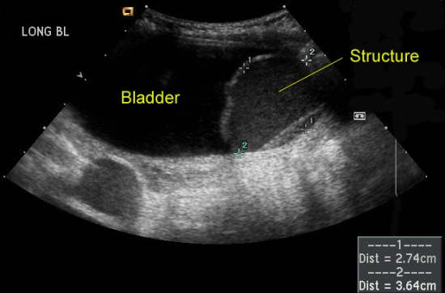
Question 2
A 1-year-old female infant presents with fever and vomiting. You suspect she has acute pyelonephritis and admit her to the hospital for intravenous fluids and antibiotics. Ultrasonographic evaluation showed the following:
- Right kidney, 7.9 cm with marked hydronephrosis of the upper pole and mild caliectasis of the lower pole region
- Left kidney, 6 cm with normal appearance.
- Bladder, apparent cystic structure near the posterior aspect of the bladder on the right side with debris contained within.
Of the following, the MOST likely cause for hydronephrosis in this infant is:
Multicystic dysplastic kidney
Ureterocele
Ureteropelvic junction obstruction
Urolithiasis
Vesicoureteral reflux

Slide 7
Question 2
In 30 to 50% of cases with acute pyelonephritis, there is a urinary tract abnormality.
The most common abnormality is vesicoureteral reflux (VUR).
There are also obstructions of the urinary tract
Upper urinary tract (ureter): ureteropelvic junction, ureterovesical junction, and ureterocele.
Lower urinary tract (bladder and urethra): Posterior urethral valves, neurogenic bladder

Slide 8
Question 2
Ureterocele: cystic dilation of the distal ureter where it inserts into the bladder.

Slide 9
Ureteroceles
Five times more common in females
In males, it is more likely seen with single collecting systems
In females, it is commonly associated with a duplicated collecting system
Presentation:
Ureteral obstruction with a febrile UTI (like our patient)
Incidentally on ultrasound or VCUG (a filling defect is seen in the bladder).
Treatment:
Urology consult
May include incision via cystoscopy
Notes:
Vesicoureteral reflux (VUR) can present with both hydronephrosis and urinary tract infection; however, the filing defect of the bladder is not seen in patients with VUR

Slide 10
Question 3
A 10-year-old boy presents to your office with the complaint of cola-colored urine. He had been well until 2 days ago, when he developed symptoms of rhinorrhea and mild cough. His sister had cold symptoms approximately 1 week ago. His review of systems is notable for a mild sore throat without fever. Family history is notable for an uncle who is on hemodialysis. On physical examination, the boy has a temperature of 37.3°C, a heart rate of 84 beats/min, a respiratory rate of 20 breaths/min, blood pressure of 106/62 mm Hg, and normal growth parameters. Laboratory evaluation reveals the following:
Electrolytes, normal
Blood urea nitrogen, 24 mg/dL (8.6 mmol/L)
Creatinine, 0.9 mg/dL (80 mmol/L)
Albumin, 3.4 gm/dL (34 g/L)
Complement component 3 (C3), 128 mg/dL; normal, 80 to 200 mg/dL
Complement component 4 (C4), 27 mg/dL; normal, 16 to 40 mg/dL
Antinuclear antibody, negative
Urinalysis:
Specific gravity, 1.015
pH, 6.5
3+ blood
2+ protein
Leukocyte esterase, negative
Nitrite, negative
Of the following, the study MOST likely to result in a diagnosis is
Antistreptolysin O titer
Creatine phosphokinase level
Hearing screen
Immunoglobulin A level
Noncontrast computed tomography scan of the abdomen

Slide 11
Question 3
The young boy in the vignette has normocomplementemic nephritis and pharyngitis .
Differential diagnosis:
IgA glomerulonephritis
Membranoproliferative glomerulonephritis (MPGN)
Genetic syndromes:
Alport syndrome
Thin basement membrane syndrome
Given the family history of an uncle on hemodialysis, must consider a genetic syndrome
IgA and MPGH are MORE COMMON.

Slide 12
Glomerulonephritis
Glomerulonephritis :
Cola-colored urine with associated hematuria
Proteinuria
What to do, what to do?
Check for hypertension
Check kidney function
Azotemia is common in glomerulonephritis
Obtain complement 3 (C3) levels
Helps distinguish between self-limiting vs aggressive treatment

Slide 14
Alport Syndrome
Approximately 80% of cases of Alport syndrome are X-linked inherited (XLAS).
Women who are carriers have microscopic hematuria.
The phenotype for Alport syndrome is related to the actual gene defect
In many instances, there is hematuria at disease onset → followed by the development of proteinuria, → later, renal failure and bilateral sensorineural hearing loss.
Approximately 80% of males with XLAS develop bilateral deafness.
Seldomly do they have vision loss, though they have anterior lenticonus, misshapen lenses in the eyes, and abnormal coloration of the retina.

Slide 15
Do You Hear What I Hear?

Slide 16
Question 4
A 2-year-old boy presents with a 3-day history of diarrhea that is now resolving. His mother is concerned because he has developed mild swelling associated with fewer wet diapers per day. His review of systems is negative for fever, gross hematuria, rashes, and apparent pain with urination. Physical examination of the afebrile child reveals a heart rate of 110 beats/min, respiratory rate of 22 breaths/min, blood pressure of 116/82 mm Hg, weight of 14 kg (75th percentile), and length of 90 cm (75th percentile). Mucous membranes are moist and oropharynx is clear. Chest examination reveals no crackles; cardiac examination is negative for a gallop rhythm, and extremities reveal mild pedal swelling with capillary refill of less than 2 seconds and full pulses. A small amount of urine was produced and sent for urinalysis. Laboratory tests reveal the following results:
Sodium, 140 mEq/L (140 mmol/L),
Potassium, 5.9 mEq/L (5.9 mmol/L),
Chloride, 100 mEq/L (100 mmol/L),
Bicarbonate, 14 mEq/L (14 mmol/L),
Blood urea nitrogen, 44 mg/dL (15.7 mmol/L)
Creatinine, 2.3 mg/dL (203 μmol/L))
Calcium, 9.0 mg/dL (2.25 mmol/L)
Phosphorus, 6.5 mg/dL (2.1 mmol/L)
Magnesium, 2.3 mg/dl (1.15 mmol/L)
Albumin, 3.1 g/dL (31 g/L)
Complete blood cell count:
White blood cell count, 18,500/μL (18.5 × 10⁹/L)
Hemoglobin, 8.4 g/dL (84 g/L)
Hematocrit, 26% (0.26)
Platelet count, 82 × 10³/μL(82 × 10⁹/L)
Urinalysis:
Specific gravity, 1.015
pH, 6
3+ blood
3+ protein
Leukocyte esterase, negative
Nitrite, negative
Of the following, the next BEST step in the management of this child is to administer intravenous:
5% albumin at 10 mL/kg over 1 hour
0.9% NaCl at 20 mL/kg over 1 hour
Fluids (5% dextrose) at 12 mL/h + urine replacement (mL for mL)
Fluids (5% dextrose + 0.22% NaCl) at 50 mL/hour
Fluids (5% dextrose + 0.9% NaCl) at 50

Slide 17
Question 4
This child presents with a history of diarrhea and current symptoms of oliguria and swelling. His physical exam shows tachycardia, hypertension, and mild edema.
Laboratory evaluation reveals
Azotemia (elevated blood urea nitrogen and creatinine), mild hyperkalemia, and hyperphosphatemia with an increased anion gap acidosis (AG: (Na+K) – (Cl+Bicarb) ~ 32).
Anemia, thrombocytopenia, and leukocytosis
Hematuria and proteinuria

Slide 18
Acute Renal Failure
Notes:
Prerenal: Sepsis, dehydration

Slide 19
Acute Renal Failure
Management:
Supportive and treating the underlying cause
Establish volemic state
Hypovolemia: Dry, tacky mucous membranes, delayed cap refill, poor pulse
Restore with isolonic fluids to euvolemia → remember to start smaller with patients in renal failure to avoid fluid overload

Slide 20
Acute Renal Failure
After bolus, maintenance fluids:
Insensible water loss (IWL) plus replacement of ongoing losses (urine output, gastrointestinal fluid loss, and others; eg, chest tube drainage). In most patients who lack vomiting or diarrhea, this fluid prescription is a summation of IWL plus urine output (UOP) replacement.
IWL is typically 40 mL/kg for children less than 10 kg in body weight and 500 mL/m2 per day for children heavier than 10 kg.
Unlike a patient with normal renal function and normal urine output, where a “maintenance” fluid prescription of 1200 mL/day for a 14-kg patient would be selected, the clinician must switch to a stricter prescription of 500 mL/m2 (IWL) per day plus UOP replacement.
Sodium supplementation is not needed when replacing IWL and the sodium content of UOP replacement fluid should match that of the patient’s urinary losses.

Slide 21
Question 5
A three-month-old male infant presents with fever, vomiting and fussiness. No one at home is ill. The patient’s medical history is notable for lack of prenatal care. Physical examination reveals that his temperature is 39.1°C, his heart rate is 110 beats/min, his respiratory rate is 30 breaths/min, his blood pressure is 106/62 mm Hg, and his growth parameters are within reference range. Other physical examination findings include bilaterally descended testicles, a uncircumcised penis, and a suprapubic mass. Laboratory and ultrasonographic evaluation reveal the following:
Urine test strip:
Specific gravity, 1.005
pH, 6.5
3+ blood
2+ protein
Leukocyte esterase, positive
Nitrite, negative
Microscopy:
10 to 20 red blood cells/HPF
Greater than 100 white blood cells/HPF
Electrolytes:
Sodium, 144 mEq/L (144 mmol/L)
Potassium, 5.6 mEq/L (5.6 mmol/L)
Chloride, 120 mEq/L (120 mmol/L)
Bicarbonate, 16 mEq/L (16 mmol/L)
Blood urea nitrogen, 24 mg/dL (8.57 mmol/L)
Creatinine, 0.9 mg/dL (79.6 μmol/L)
Ultrasonography:
Bilateral hydronephrosis
Bladder thickening
You review the laboratory and ultrasonographic findings with the boy’s parents.
Of the following, you are MOST likely to advise them that their son’s condition
Can be traced to a problem with the ureteral insertion point into the bladder
Is such that the risk for renal failure is low after corrective surgery, obviating the need for follow-up
Delay of future circumcision
Occurs equally in males and females
Places him at higher risk of dehydration than expected in the setting of gastroenteritis

Slide 22
Question 5
Fever and pyuria indicate pyelonephritis.
The palpable mass with bilateral hydronephrosis with bladder wall thickening in the setting of an elevated creatinine is consistent with an obstructive disorder.
Most likely from posterior urethral valves (PUV)
There is renal tubular damage in PUV, which places them at high risk for dehydration
Notes:
Delayed circumcision: Hypospadias for urethral reconstruction
Renal tubular damage places them at high risk for dehydration (contrast agenesis)

Slide 23
Posterior Urethral Valves
Affects 1 per 5,000 males
Obstructive uropathy: Caused by residual valve tissue in the prostatic urethra.
Patients with PUV also have a high risk for associated vesicoureteral reflux.
Some patients also have a type-4 renal tubular acidosis, which is characterized by a normal anion gap metabolic acidosis with hyperkalemia (we will discuss RTA further).
Prune belly syndrome: rare syndrome
Occurs in 1/50,000
Rriad of bilateral hydroureteronephrosis, bilateral cryptorchidism, and absence of abdominal wall musculature.

Slide 24
Posterior Urethral Valves
Treatment:
DEFINITIVE: Pediatric urology
Transurethral resection
Vesicostomy (in premature infants)
Nephrology follow-up
Bladder continence can be difficult

Slide 25
Question 6
A 10-year-old boy presents with facial swelling and cola-colored urine. Review of systems reveals an episode of pharyngitis approximately 2 weeks ago. On physical examination, vital signs are notable for blood pressure of 134/86 mm Hg. The remainder of the examination is notable for mild facial swelling and nonpitting edema of lower extremities. The following are the results of laboratory tests for the boy:
Urine test strip:
Specific gravity, 1.025
pH, 6.5
3+ blood
3+ protein
1+ leukocyte esterase
Nitrite, negative
Microscopy:
Greater than 100 red blood cells/HPF
5 to 10 white blood cells/HPF
Blood test:
Blood urea nitrogen, 20 mg/dL (7.14 mmol/L)
Creatinine, 0.8 mg/dL (70.72 μmol/L)
Complement component 3 (C3), 25 mg/dL; normal range, 80-200 mg/dL
Complement component 4 (C4), 20 mg/dL; normal range, 16-40 mg/dL
Antinuclear antibody, negative
Of the following, the BEST statement regarding this patient’s prognosis and clinical course is
Complement component 3 (C3) should normalize by 8 weeks in most instances
Microscopic hematuria can persist up to 3 months
Prompt institution of corticosteroids is essential in most instances
Proteinuria is marked in this disorder, resulting in nephrotic syndrome in approximately one-half of cases
Renal biopsy is required to best determine prognosis

Slide 26
Question 6
Hematuria, proteinuria, edema, hypertension, and azotemia = Nephritic Syndrome
Acute glomerulonephritis: sudden onset of the symptoms, including new onset cola-colored urine
Must classify complement components C3 and C4 and characterize as hypo or normocomplementic (in regards to C3).
Post-infectious (PIGN) and post-streptococcal (PSGN) have immune-complex mediated, acute, hypocomplemtemic state after an infectious process.
PSGN exclusively relates to a Group-A, β-hemolytic streptococcal (GABHS) infection
PIGN could be GABHS or another infectious process, such as an infectious process that is secondary to sinusitis or pneumonia.

Slide 27
Acute Glomerulonephritis
Hypocomplementemia from PIGN and PSGN usually resolves by 8 weeks in most cases but remains persistently low in MPGN.
Gross hematuria is present in approximately 40% of patients with PIGN or PSGN.
Microscopic hematuria and proteinuria are universally present at diagnosis but only overt nephrotic syndrome occurs in 10% of cases.
Nephrotic range proteinuria [protein/creatinine (mg/mg) ratio >2.0]
The gross hematuria and edema usually resolve by 2 weeks
Hypertension usually resolves by 2 to 3 weeks
Proteinuria usually resolved by about 4 weeks.
Microscopic hematuria may persist for 1 to 3 years following an episode of PIGN or PSGN
Notes:
1. Lupus has low C3 and C4

Slide 28
Acute Glomerulonephritis
Treatment for PIGN and PSGN: Supportive care
fluid restriction
low-sodium diet
diuretics or vasodilators if patients have edema and hypertension
There is no indication for using corticosteroids in this case. Corticosteroids are rarely used for acute glomerulonephritis and are typically used only in the setting of Rapidly Progressive GN (RPGN), which is rare for PIGN and PSGN.

Slide 29
Question 7
An 18-month-old boy presents with failure to thrive. There is no history of vomiting or diarrhea. He does not eat as well as his older siblings did when they were his age. The boy began walking at 1 year of age. On examination, his weight is 9.0 kg and his length is in less than the 5th percentile. The boy is afebrile with a pulse rate of 80 beats/minute, a respiratory rate of 24 breaths/minute, and blood pressure of 104/60 mm Hg. The boy’s body is small for his age, with bowing of his lower extremities. The results of his eye examination reveal photophobia. The following are the results of his laboratory tests:
Urine test strip:
Specific gravity, 1.003
pH, 6.5
no blood
Trace protein
1+ glucose
Other results are negative
Electrolytes:
Sodium, 134 mEq/L (134 mmol/L)
Potassium, 3.0 mEq/L (3.0 mmol/L)
Chloride, 110 mEq/L (110 mmol/L)
Bicarbonate, 14 mEq/L (14 mmol/L)
Blood urea nitrogen, 24 mg/dL (8.57 mmol/L)
Creatinine, 0.5 mg/dL (44.2 μmol/L)
You suspect the boy has a renal tubular acidosis and decide to order additional studies.
Of the following, the MOST likely additional laboratory finding in this boy is
Hypercalcemia
Hyperglycemia
Hyperuricemia
Hypoalbuminemia
Hypophosphatemia

Slide 30
Question 7
The approach to the metabolic acidotic patient:
First measure anion gap
Electrolytes:
Sodium, 134 mEq/L (134 mmol/L)
Potassium, 3.0 mEq/L (3.0 mmol/L)
Chloride, 110 mEq/L (110 mmol/L)
Bicarbonate, 14 mEq/L (14 mmol/L)
Blood urea nitrogen, 24 mg/dL (8.57 mmol/L)
Creatinine, 0.5 mg/dL (44.2 μmol/L)
The anion gap for our patient is ____??
10 (Normal)
What causes non-anion gap acidosis?

Slide 31
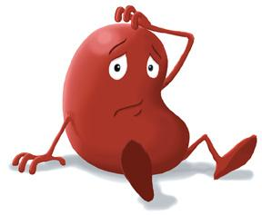

Slide 33
Don’t Freak Out
Notes:
Proximal tubule: Purpose is reabsorption of bicarb
Distal tubule: Purpose is to create new bicarb

Slide 34
Renal Tubular Acidosis
RTA is classified as distal or proximal depending on the site of the renal defect (ie, the distal nephron or proximal convoluted tubule, respectively). Next, urine electrolytes can be measured if looking for a distal RTA.
The classic distal RTA (Type I) is known for hypokalemia and hypocitraturia with an increased risk for urinary stones.
Can be inherited or acquired
Following pyelonephritis or medications (amphotericin B or ifosfamide)
THUS
Notes:
Impairment in H+ ions secretion result in an inability to acidify the pH beyond 5.5 which retards the excretion of titratable acids (H₂PO₄) and NH₄⁺ ions, thus resulting in a reduction in net acid excretion. The plasma bicarbonate is significantly reduced and may fall below 10 meq/L.
Thought to be H/K ATPase

Slide 35
Type II RTA
Type II RTA is a proximal RTA, which means it involves a defect of bicarbonate reabsorption at the proximal convoluted tubule.
This can occur in isolation or as part of a proximal tubulopathy, which is more common.
Fanconi syndrome (global proximal tubule defect) includes losses of sodium, phosphorus, glucose, bicarbonate, and amino acids. → hypophosphatemia, glycosuria, amino aciduria, and hypokalemia (due to distal sodium retention in exchange for potassium).
The most common cause of Fanconi syndrome in pediatrics is nephropathic cystinosis
Notes:
The reduction in HCO3- reabsorption leads to an increase in bicarbonate loss in the urine. Remember that a loss of a single bicarbonate ion is akin to adding one hydrogen ion to the plasma, therefore this bicarbonate loss in the urine leads to increased hydrogen ion concentration and a subsequent reduction in arterial pH.
http://fitsweb.uchc.edu/student/selectives/TimurGraham/RTA2.html

Slide 36
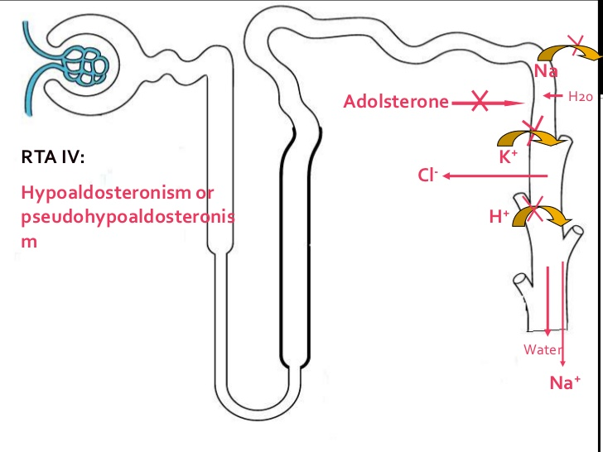
Type IV RTA
Type IV RTA, which is a distal RTA associated with hypoaldosteronism or hyporesponsiveness to aldosterone
Accompanied by hyperkalemia and is often seen in the pediatric patient in the setting of urinary obstruction, such as posterior urethral valves or hydronephrosis, or due to a calcineurin inhibitor (cyclosporine or tacrolimus).
Notes:
Aldosterone deficiency or resistance impairs the secretion of hydrogen and potassium ion resulting in acidosis and hyperkalemia. The hyperkalemia is usually very prominent in this condition and has an important role in metabolic acidosis by impairing ammonium production and acid excretion in the urine. The hyperkalemia in this setting impairs NH4+ production in the proximal tubule by inducing a state of intracellular alkalosis within the tubular cell. This occurs due to the transcellular exchange of potassium for hydrogen resulting in the exit of hydrogen ion from the cell.
The development of intracellular alkalosis reduces NH4+ secretion by the proximal tubular, which in combination with decreased hydrogen secretion distally, result in decreased ammonium excretion and decreased net acid excretion. Reversing this process by correcting the hyperkalemia often leads to increased NH4+ excretion and correction of the metabolic acidosis

Slide 38
Renal Tubular Acidosis
Work-up:
Confirmation of metabolic acidosis with a blood gas
Urine electrolytes
Calculate a urine anion gap (Una+UK) – UCl.
This will be positive in those with distal RTA as the Cl is low in comparison to Na and K when no ammonium is being made to excrete in the urine

Slide 39
Question 8
In the newborn nursery, a 1-day-old male newborn with no history of prenatal care is discovered to have a right-sided flank mass. The infant has voided spontaneously and is otherwise well. His weight is 3.0 kg and his blood pressure is 90/50 mm Hg. His testicles are descended bilaterally and there is no notable hypospadias or phimosis. Ultrasonography reveals an enlarged kidney on the infant’s left side with multiple, noncommunicating cysts that are surrounded by a rim of echogenic parenchyma that is consistent with dysplasia.
Of the following, the best next step in the management of this neonate would be to:
Defer circumcision until 1 year of age
Initiate sodium chloride supplements
Prescribe trimethoprim-sulfamethoxazole prophylaxis
Refer to urology
Schedule a voiding cystourethrogram

Slide 40
Question 8
Renal massess account for 55% of the masses in newborns.
Differential diagnosis includes:
Most common: Multicystic dysplastic kidney and hydronephrosis (most common is secondary to uteropelvic junction obstruction)
Less commonly: renal vein thrombosis and mesoblastic nephroma
Multicystic dysplastic kidney is most likely given noncommunicating renal cysts and minimal parenchyma

Slide 41
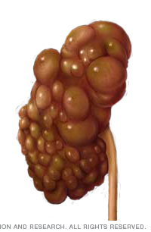
Multicystic Dysplastic Kidney
About thirty percent of kids with MCDK are at risk to develop VUR into the normal, contralateral kidney.
Placed on prophylactic antibiotics in the nursery and then followed up with a voiding cystourethrogram (VCUG).
The standard prophylaxis used in newborns is amoxicillin (10 mg/kg per day).
Trimethoprim sulfamethoxazole is an ideal prophylactic antibiotic, but it should not be used until the infant is at least 2 months of age.
Notes:
Should get circumcision to decrease risk of UTI (15% in those with MCDK)

Slide 42
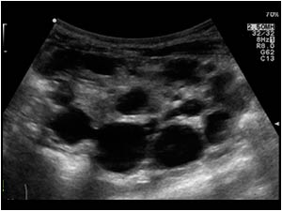
Multicystic Kidney Disease
Require periodic ultrasonographic exams to look for compensatory hypertrophy of the contralateral kidney
These patients should have ultrasonography every 3 to 6 months for the first year and then annually until 5 years old because of increased malignancy risk
Four times as likely as the general population to develop Wilms tumor.

Slide 43
Question 9
An 8-year-old girl presents with cola-colored urine that began this morning. She developed a sore and some associated rhinorrhea 2 days ago. She has been well otherwise. On physical examination, her temperature is 37°C, her pulse rate is 88 beats/minute, her respiratory rate is 20 breaths/min, and her blood pressure is 128/84 mm Hg. Her physical examination also reveals trace edema but is otherwise negative. The following are the results of her urinalysis:
Urine test strip:
Specific gravity, 1.020
pH, 6.5
3+ blood
2+ protein
1+ leukocyte esterase
Microscopy:
100 red blood cells/HPF
5 to 10 white blood cells/HPF
Of the following, the most likely associated laboratory finding in this patient would be
A depressed complement component 3 (C3) level
An elevated anti–double-stranded DNA level
An elevated cholesterol level
An elevated serum creatinine
An increased urinary eosinophils

Slide 44
Question 9
In Post-infectious and post-streptococcal glomerulonephritis, the infectious illness and gross hematuria is separated by 1-3 weeks.
Synpharyngitic syndromes occur in less than 1 week: IgA glomerulonephritis, Alport syndrome, and membranoproliferative glomerulonephritis.
IgA GN is associated with normal complement levels
Urinary eosinophils are typically measured in the diagnostic evaluation of acute interstitial nephritis, which does not present with cola-colored urine.
Cholesterol levels are not usually measured in patients with AGN, although they are often elevated in patients with nephrotic syndrome.

Slide 45
Question 10
A 6-year-old girl presented 2 weeks ago to the emergency department and was noted to have microscopic hematuria during an evaluation for abdominal pain. Results of abdominal ultrasonography at the time were negative, including the renal component, which was negative for renal cysts, stones, and masses. She had a follow-up urinalysis a week ago that showed 2+ blood on a urine test strip, and she is coming to you today for her annual health maintenance visit. Her past medical history is unremarkable. Her growth parameters and vital signs are within reference range. Results of her physical examination are unremarkable. The following are results of her urinalysis:
Urine test strip:
Specific gravity, 1.020
2+ blood
No protein
Otherwise negative
Microscopy:
10 to 20 red blood cells/HPF
Of the following, the BEST next step in the management of this girl is to
Measure a serum creatinine
Measure an antistreptolysin O titer
Recheck urinalysis in 6 months
Refer for renal biopsy
Repeat renal ultrasonography

Slide 46
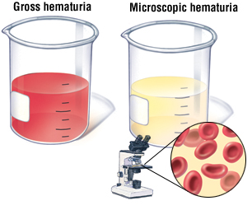
Question 10
Microscopic hematuria is defined as greater than 5 red blood cells per high-power field on urinalysis.
Microscopic hematuria can be either transient or persistent so a more extensive workup to help identify an underlying cause is recommended if it occurs on 3 consecutive urine samples over a few weeks.
Lab work-up: serum creatinine, complement component 3 (C3), complement component 4 (C4), antinuclear antibody (ANA), anti–double-stranded DNA, complete blood cell count (CBC), and erythrocyte sedimentation rate in conjunction with an additional urinalysis with microscopy and a measurement of urine protein-to-creatinine ratio.

Slide 47
Question 10
Renal or bladder ultrasonography is recommended because it will eliminate other potential causes such as renal cysts, stones, or masses.
The American Academy of Pediatrics no longer recommends a screening urinalysis at a health maintenance visit.
Because our patient has already undergone renal imaging within the last 2 weeks, there is no need to repeat renal ultrasonography in this setting
In the event that the above workup is normal, it is usually recommended to recheck a urinalysis every 3 months for the first year to look for evidence of worsening microscopic hematuria and, more importantly, the potential worsening of proteinuria.

Slide 48
Questions??

