Slide 1


Childhood Obesity: Assessment, Prevention, & Treatment
A primer for Pediatric Residents to better identify and manage obesity
Kofi Essel-PGY-5, MD, FAAP
General Academic Pediatrics Fellow
Children’s National Health System
Children's National Pediatric Resident Noon Conference: August 21, 2015
Notes:
Hello Everyone, my name is Kofi Essel a 2nd year Pediatric Fellow in the General Academic Pediatric Fellowship here at Children’s National. I have been doing work in nutrition and obesity over the last decade and I came to give you all a little primer on identification and management of childhood obesity. I will briefly describe some basics of the disease, but I want us to spend some time at the end to discuss a few cases to really solidify the take home points.
Why is this topic so important? Lets focus in on the District of Columbia

Slide 2
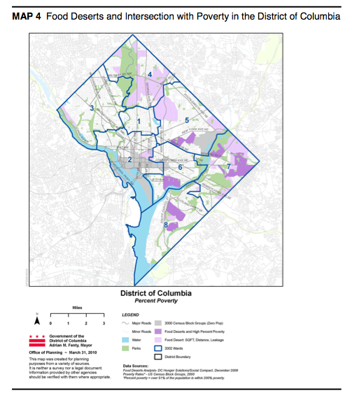
http://www.dchunger.org/pdf/grocerygap.pdf
Notes:
DC is broken up into 4 quadrants and 8 geopolitical regions we call Wards. Now each Ward looks a little different and since we are talking about obesity today I want you to see that there are some distinct classifications that make up each area.

Slide 3
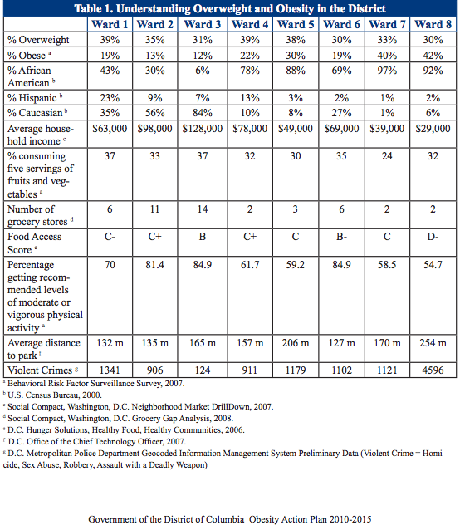
Notes:
So this chart is from the District of Columbia Obesity Action Plan. So as you can see here, this is Wards 1-8 and lets just start with the income level. You can see how they stack up. There are also differences in racial population as well as Overweight/Obesity status. http://doh.dc.gov/sites/default/files/dc/sites/doh/OBESITY%20ACTION%20PLAN.pdf

Slide 4

Notes:
I use this analogy of a polar bear in a dessert that I borrowed from one of my mentors, Dr. David Katz. I start with this slide to emphasize that there is a great environmental influence on obesity. It is very hard to study but there is a lot going on around us that greatly affects everything we do and our lifestyle.

Slide 5

Path of Least Resistance
Notes:
The truth is that we do tend to go down the path of least resistance

Slide 6
Source: Drewnowski A, Darmon N. The economics of obesity: dietary energy density and energy cost. Am J Clin Nutr. 2005 Jul;82(1 Suppl):265S-273S. Review.

Slide 7
The Big 2/3
1. Taste
2. Cost
3. Health
4. Convenience
Glanz K, Basil M, Maibach E, et al. J Am Diet Assoc 1998

Slide 8
Source: Drewnowski A, Darmon N. The economics of obesity: dietary energy density and energy cost. Am J Clin Nutr. 2005 Jul;82(1 Suppl):265S-273S. Review.

Slide 9
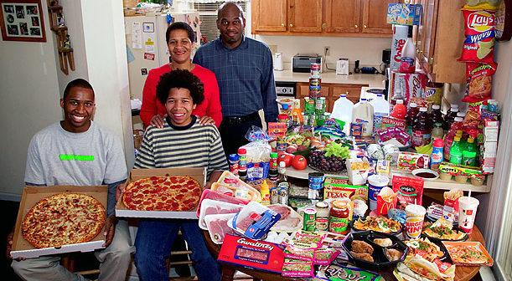
United States: The Revis family of North Carolina Food expenditure for one week $341.98
From the book Hungry Planet: What the World Eats by Peter Menzel and Faith D’Aluisio
Notes:
And our genetics hasn’t changed in the last 30 years in the time of this great obesity epidemic, but our environment has certainly has changed

Slide 10
Quiz Question
How many children are obese in the united states from the age of 2-19yo?
How many Adults are obese in the united states?
16.9%
34.9%
Notes:
Most people will combine the overweight and obese statistics to get a better number.

Slide 11
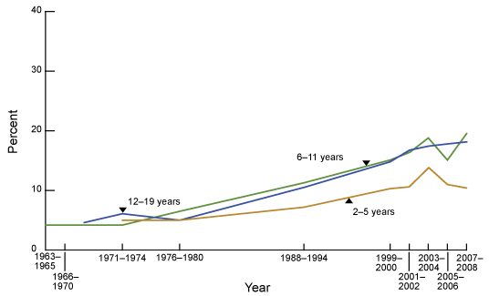
Trends in Obesity Among Children
and Adolescents: United States, 1963–2008
Note: Obesity is defined as body mass index (BMI) greater than or equal to sex- and age-specific 95th percentile from the 2000 CDC Growth Charts.
CDC/NCHS, National Health Examination Surveys II (ages 6–11), III (ages 12–17), and National Health and Nutrition Examination
Surveys (NHANES) 1999–2000, 2001–2003, 2003–2004, 2005–2006, and 2007–2008.

Slide 12
Pediatric Providers Say…
[P]roviders feel they are not qualified for and/or are ineffective at treating childhood overweight and often find treating overweight children frustrating(Silberberg, et. al, NC Med J, 2012)
[F]or most providers, the choice to intervene with a patient is typically based on the provider’s subjective level of concern with the patient’s weight issue(Silberberg, et. al, NC Med J, 2012)
Perceived barriers underlying these perceptions include lack of time, lack of resources (including dietitians), lack of reimbursement, and perceived treatment failures(Silberberg, et. al, NC Med J, 2012)
Notes:
Based on older studies, but pulled them from this paper

Slide 13
Small Cross Sectional Study of 13 Primary Care Pediatric Practices in North Carolina
273 providers(66.9%- response rate)
(Silberberg, et. al, NC Med J, 2012)
Notes:
I pulled a small study from the literature in north carolina. This was a cross sectional study(snap shot in time), basically a survey was taken looking at 13 primary care pediatrics sites in North Carolina delving into the perceptions and knowledge of providers.
So as you can see, things have changed. Providers are now feeling more confident in bringing in up, but not necessarily in managing it.
Look at there ability to recommend nutrition resources and advising parents on healthy foods, but we have known this for a while. And a lot of it dates back to our medical school training. We are behind the times.

Slide 14

Cross Sectional Study of 133 US Medical Schools in 2012-2013
91% Response Rate(121/133 Schools)
Majority failed to provide the minimum of 25hrs(71%, 86/121)
36% provided less than ½ of 25hrs of minimum education
<50% indicated teaching any nutrition in clinical practice
Notes:
Well, I will let you in on a little secret. The field of medicine has done a poor job with training providers on nutrition education. The latest report came out in 2015 and looked at the majority of med schools around the country and noted.
-So providers are not learning practical strategies to approach their patients with nutritional counseling.

Slide 15
Objectives
Define relevance of Childhood Obesity for Residents
Discuss basic national childhood obesity trends
Define Obesity as a disease state
Review case studies to become familiar with basic identification and management techniques
Bonus-Discuss Obesity prevention/management in infants & toddlers
Notes:
Cursory overview of the topic
-Many of you have been asking me about managing infants when there weight gets out of hand, we will talk for a few minutes about some good strategies.

Slide 16
What is Obesity?
A disease state in which excessive fat accumulation poses a risk to health.
Notes:
Lets stop right here and really break this thing down. It is a disease and it is complex. How do you define Obesity? What is Obesity? Why is it important?
-Notice I called it a disease. Do you agree?

Slide 17
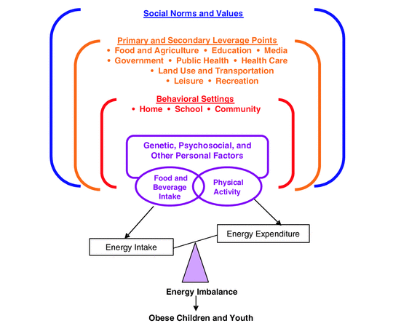
Source: Jeffrey P. Koplan, Catharyn T. Liverman, and Vivica A. Kraak, Editors, Committee on Prevention of Obesity in Children and Youth, “Preventing Childhood Obesity: Health in the Balance,” Institute of Medicine, The National Academies Press, 2005. http://www.nap.edu/catalog.php?record_id=11015
Notes:
Here is a very simplistic beakdown for the causes of obesity. Traditionally we talk about Obesity as purely calories in and calories out. For example: How do you get calories in? Eating. What about out?- BMR, Physical activity, postprandial thermogenesis. With energy in and energy out it puts all the blame on the individual, the old thought is that it took 3500 calories to gain 1 pound of weight. Although there may be some truth to that our bodies are so much more complex than that. Our bodies are not a closed system, but rather very dynamic.
-I will spend some time on this later, but this slide shows how environment and other factors play a big role on what we take in and what we burn.

Slide 18
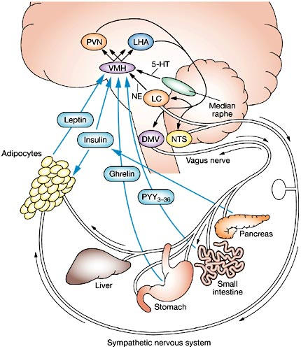

Set Point Theory
More than calories in vs. calories out:
Altered Food Supply
Decreased physical activity
Stress and Distress
Drugs
Figure 1 The homeostatic pathway of energy balance
Reproduced with permission from Lustig RH (2001) The neuroendocrinology of childhood obesity.
Pediatr Clin North Am 48: 909–930. © (2001) Elsevier Inc.
Lustig RH (2006) Childhood obesity: behavioral aberration or biochemical drive? reinterpreting the first law of thermodynamics Nat Clin Pract Endocrino Metabol 2: 447–458 doi:10.1038/ncpendmet0220
Sickness
Notes:
Obesity involves a very complex metabolic pathway and this is a simple breakdown. One of my goals today is to get you all out of the mindset that it is simply calories in calories out.
-The hypothalamus in our brains is our energy balance controller. With increased adiposity there are hormonal changes that occur.
-Altered food supply(poor quality food, worsening insulin resistance), decreased physical activity(effects on muscle and insulin sensitivity), stress and distress and drugs have effects on the brain.

Slide 19
HETEROGENEITY
Obesity Causation is variable
Response to Treatment
Zheng, Berthoud, Physiology, 2008
Notes:
In addition, there is a high degree of heterogeneity. Not only on the cause of Obesity but also the response to treatment
We have different factors that can influence are neural pathways

Slide 20

Original Article
Long-Term Persistence of Hormonal Adaptations to Weight Loss
Priya Sumithran, M.B., B.S., Luke A. Prendergast, Ph.D., Elizabeth Delbridge, Ph.D., Katrina Purcell, B.Sc., Arthur Shulkes, Sc.D., Adamandia Kriketos, Ph.D., and Joseph Proietto, M.B., B.S., Ph.D.
N Engl J Med
Volume 365(17):1597-1604
October 27, 2011
Prospective Cohort
50 Overweight/Obese Adult Patients. Gave Very low energy diet
Measured hormonal levels at Baseline, 10wks, & 62wks
10
Notes:
Here is one more example

Slide 21
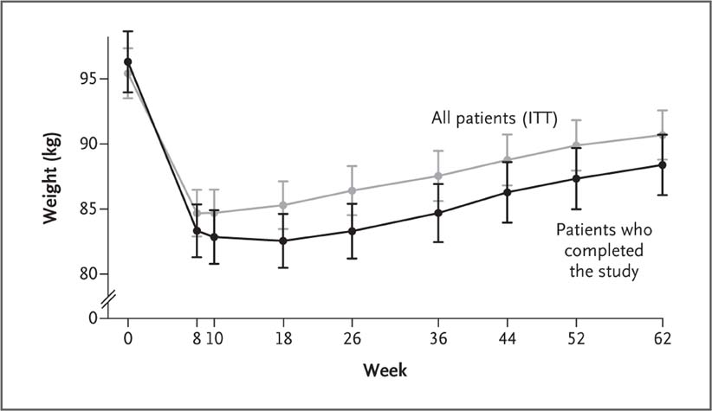
Mean (±SE) Changes in Weight from Baseline to Week 62.
Sumithran P et al. N Engl J Med 2011;365:1597-1604
Most adult weight loss has this “check” pattern.
Why?
Notes:
Figure 1 Mean (±SE) Changes in Weight from Baseline to Week 62. The weight-loss program was started at week 0 and completed at week 10. ITT denotes intention to treat.

Slide 22
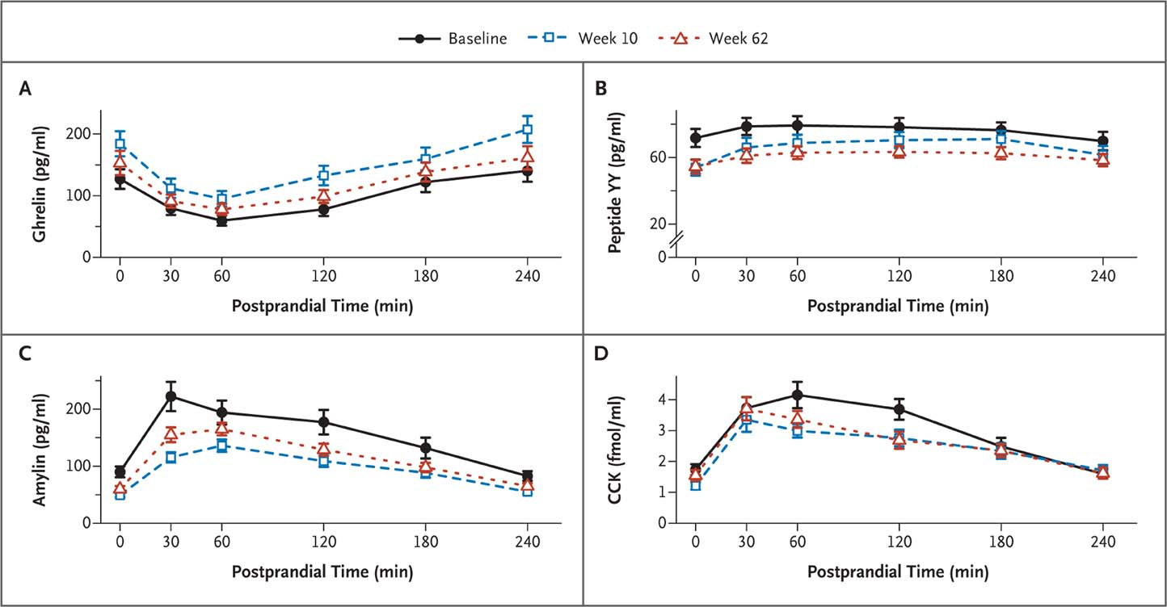
Mean (±SE) Fasting and Postprandial Levels of Ghrelin, Peptide YY, Amylin, and Cholecystokinin (CCK) at Baseline, 10 Weeks, and 62 Weeks.
Sumithran P et al. N Engl J Med 2011;365:1597-1604
Increase in hunger hormones after 10wks
Decrease in Satiety hormones
This will affect physiological mechanisms around Energy Expenditure
Notes:
Figure 2 Mean (±SE) Fasting and Postprandial Levels of Ghrelin, Peptide YY, Amylin, and Cholecystokinin (CCK) at Baseline, 10 Weeks, and 62 Weeks.

Slide 23
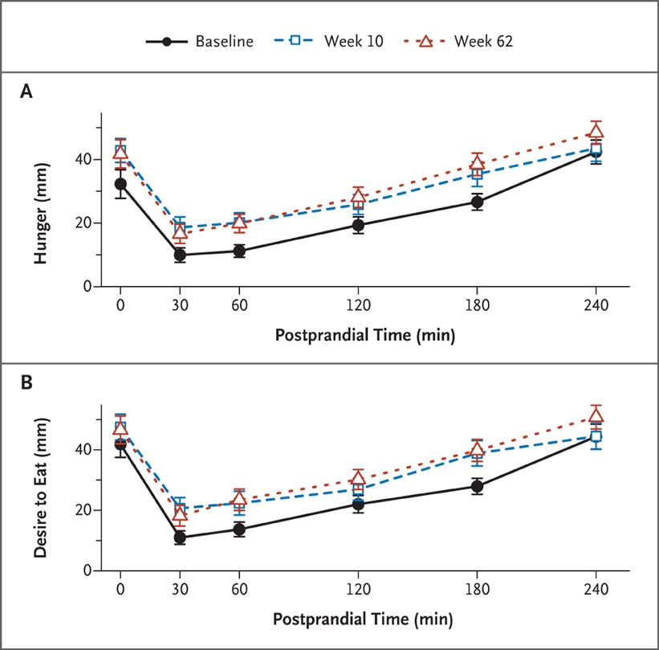
Mean (±SE) Fasting and Postprandial Ratings of Hunger and Desire to Eat at Baseline, 10 Weeks, and 62 Weeks.
Sumithran P et al. N Engl J Med 2011;365:1597-1604
Subjective Increase in appetite
Notes:
Figure 3 Mean (±SE) Fasting and Postprandial Ratings of Hunger and Desire to Eat at Baseline, 10 Weeks, and 62 Weeks. Ratings were based on a visual-analogue scale ranging from 0 to 100 mm. Higher numbers indicate greater hunger or desire.

Slide 24
Take Home Points
Obesity is due to a dysfunction of our physiological regulatory system
The Body defends the fat mass set point
Less about non-compliance and more about a true physiological change
Set point resetting: nutritional quality, exercise, sleep health, stress reduction
Notes:
Set point changes by: diet, exercise, sleep health, stress reduction

Slide 25
What are we measuring when we look at Obesity?
How do you define Obesity?
Notes:
Okay, so we got very heavy there. Lets lighten it up a little and talk about general obesity.

Slide 26
Measuring Adiposity
Goal is to measure Adiposity(Body Fat)
    No set cut off exists
Direct measures of body fat:
  Underwater weighing(Gold Standard)
  Dual X-ray Absorptiometry(DXA)
  Bioelectrical Impedance Analysis(BIA)
Body Fat Proxies:
  BMI, MUAC, WC, W/H ratio

Slide 27
Body Mass Index
Body Mass Index(BMI) = wt(kg)/ ht(m)²
Good proxy of Adiposity as long as we remember it is a measure of body mass and not necessarily body fat
Use BMI purely as a screen to assist you in developing a better assessment of the risk of the patient
BMI = Screening Tool

Slide 28
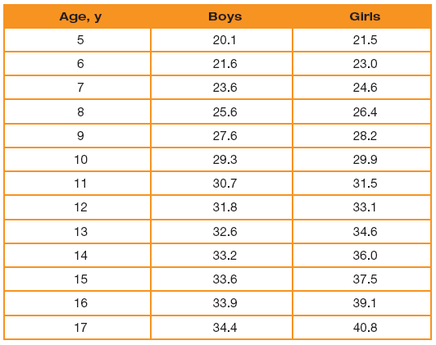
Parameters CDC 2000 Growth Charts
Underweight: BMI for age < 5th%
Normal Weight: 5th% - <85th%
Overweight: 85th% - <95th%
Obesity: ≥95th%
Extreme/Severe Obesity: >99th%
Notes:
BMI’s were derived from a reference population looking at studies from 60s-early 90s. Excluding the increased obesity trend in the late 80s and early 90s.

Slide 29
Slide from Dr. Cynthia Ogden-Obesity Epidemiology- 5/20/15
Notes:
So measures >95th% are more clearly associated with increased adiposity but this is not necessarily the same Overweight status.

Slide 30
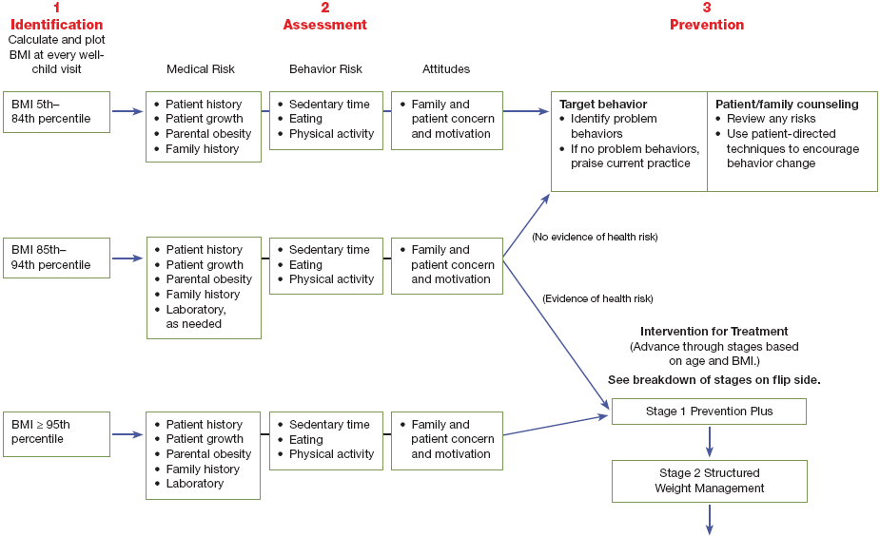
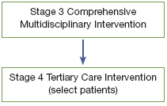
Universal Assessment of Obesity Risk: Steps to Prevention and Treatment
American Academy of Pediatrics. Pediatric Obesity Clinical Decision Support Chart.
Elk Grove Village, IL: American Academy of Pediatrics; 2008.
Notes:
This chart was taken from the 2007 AAP Obesity guidelines. You can see here that the first step is to use your BMI as a screener and based on the medical risk and behavior risk you can determine if they are high risk or low risk and act from there.

Slide 31
Cases

Slide 32

Tool Kit
Prevention Plus-Lifestyle Change
Structured Weight Management & Comprehensive Multidisciplinary Clinic
Tertiary Care- Meds
Tertiary Care- Surgery
Tertiary Care- Post Surgical Combo w/Therapy

Slide 33
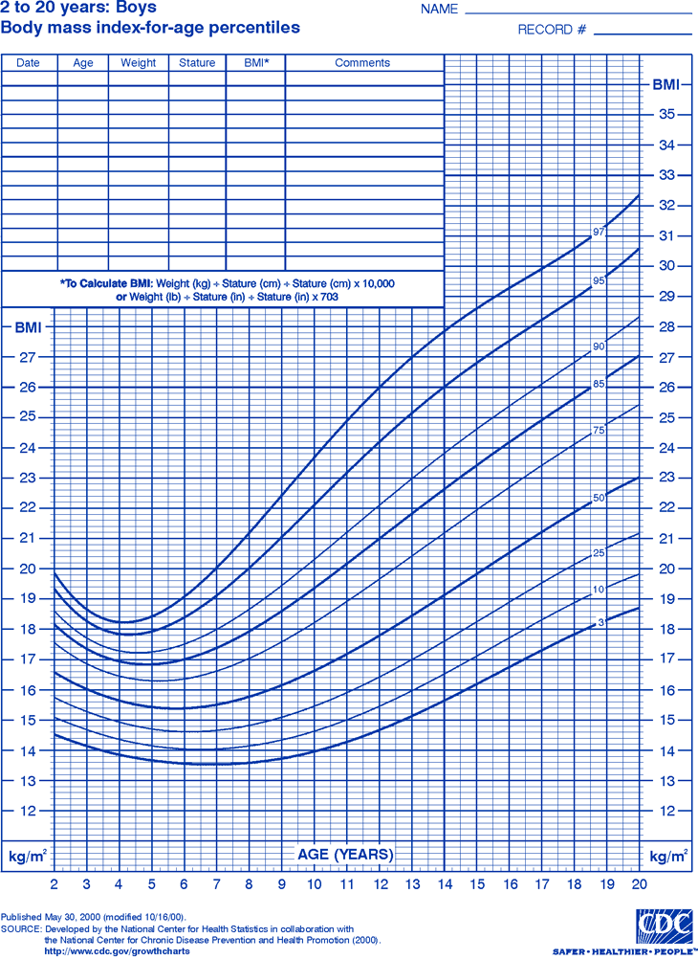
Case #1
13yo black male with obesity
BMI 96%
Physical Exam
  Wt- 80th%
  Ht-90th%(no linear growth delay)
  BP: 121/80
What are you looking for on your exam?
Risk
  Acanthosis
  Parental Obesity
  3hr physical activity per week
Labs?
  Fasting Lipid Panel(Why?)
  AST/ALT(Why?)
  Fasting Glucose/HBA1C?(Why?)
Notes:
BP-90th%
-Steiner MJ, Skinner AC, Perrin EM. Fasting might not be necessary before lipid screening: a nationally representative cross-sectional study. Pediatrics 2011;128:463-70. (Reference)
-”Results of a large, nationally representative study suggest that there are only small and likely clinically insignificant differences in total cholesterol, HDL, LDL and triglycerides between fasting and non-fasting blood samples. (Mean TC, HDL and LDL values for fasting samples were 2-5 mg/dL higher than non-fasting samples. Mean TG value for fasting sample was 7 mg/dL lower than nonfasting sample.) Thus, if obtaining a fasting sample is a barrier to testing, consideration should be given to obtaining non-fasting sample (Steiner, 2011 [Reference]).”
-Start getting your AST/ALT and fasting glucose at 10yo or at start of puberty.

Slide 34
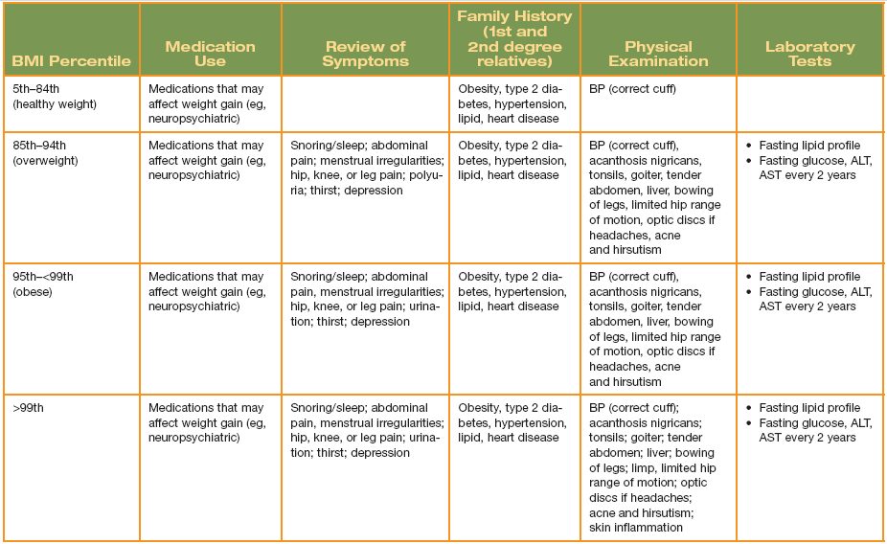
Medical Screening by BMI Category
American Academy of Pediatrics. Pediatric Obesity Clinical Decision Support Chart. Elk Grove Village, IL: American Academy of Pediatrics; 2008.

Slide 35
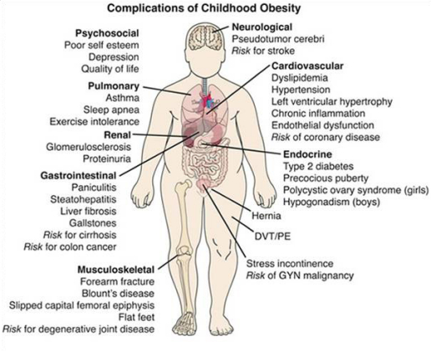
Physical Exam
http://www.sickkids.ca/Research/Obesity-in-Youth-History/Resources/index.html

Slide 36
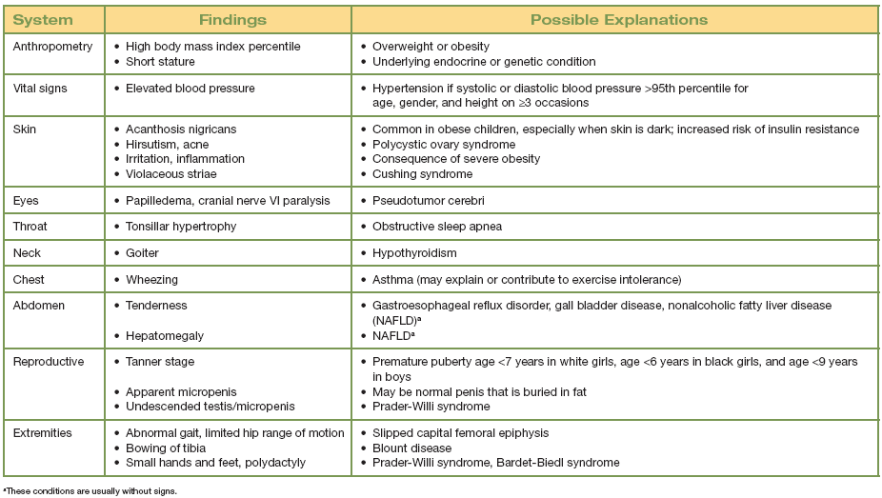
Physical Examination
Obesity Assessment: Physical Examination Findings and Possible Etiologies
American Academy of Pediatrics. Pediatric Obesity Clinical Decision Support Chart. Elk Grove Village, IL: American Academy of Pediatrics; 2008.

Slide 37
What would we like to do for him?

Slide 38
Tool Kit
Prevention Plus-Lifestyle Change
Structured Weight Management & Comprehensive Multidisciplinary Clinic
Motivational Interviewing
Nutrition Counseling
Physical Activity Counseling
Behavior Management
Tertiary Care- Meds
Tertiary Care- Surgery
Tertiary Care- Post Surgical Combo w/Therapy
Notes:
So within your toolkit, the primary care provider will be mainly focused on prevention plus. Within Prevention Plus you have many options. What do you all typically do?
Well, let me introduce you to 5-3-2-1-Almost none. This hits on most of the AAP basic recs.

Slide 39
Change Talk Basics
Identify your own obesity stigma
Avoid/limit Inflammatory language: Bad vs. Good foods, fat person, obese, diet
Allow family to come up with their own goals
  SMART Goals
  Try confidence ruler and importance ruler
Focus on successes and not failures
Ask for permission, reflect, be empathetic

Slide 40
Promote Basic AAP Guidelines (5-3-2-1-Almost None)

Slide 41
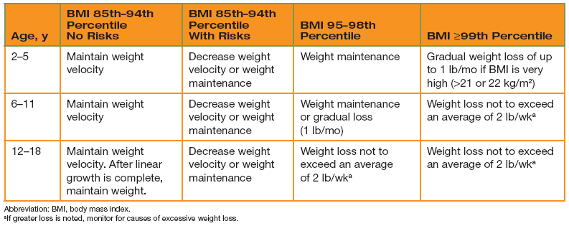
Weight Loss Targets
American Academy of Pediatrics. Pediatric Obesity Clinical Decision Support Chart. Elk Grove Village, IL: American Academy of Pediatrics; 2008.

Slide 42
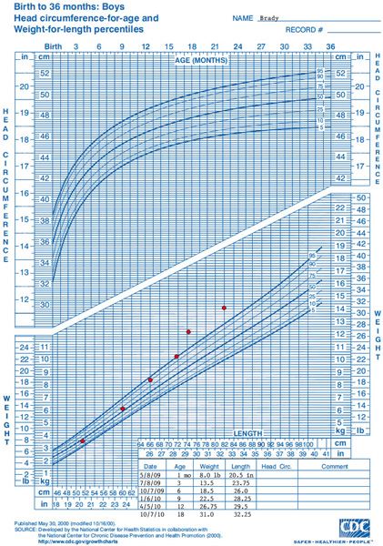
Case #2
George
21mo infant with increased weight gain
Wt/Length= 95%(are you worried?)
>95%(are you worried?)
Notice the chart

Slide 43
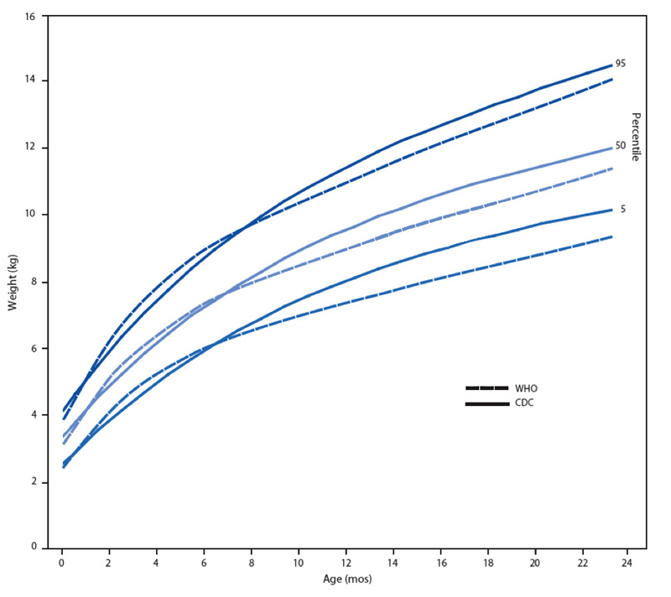
Growth Rate for Breastfed Infant
Breastfed infants
grow faster
in the first 3 months
Breastfed infants grow slower from
3 to 12 months
Girls: Birth to 24 months
Weight-for-age curves
Adapted from Figure 2. Use of World Health Organization and CDC Growth Charts for Children Aged 0--59 Months in the United States. CDC Morbidity and Mortality Weekly Report (MMWR) Recommendations and Reports 2010; 59(rr09):1-15.
Available online at: http://www.cdc.gov/mmwr/preview/mmwrhtml/rr5909a1.htm
Slide taken from WHO Growth chart presentation
Notes:
Reference vs. Standard Population. Standard doesn’t imply optimal growth, while the reference population took breastfeeding children in optimal living conditions and followed them forward. ECW is using this.
Talking Points:
On this chart, the dark blue continuous lines represent the 5th, 50th and 95th percentiles on the CDC growth chart for infants. The dotted lines represent the 5th, 50th and 95th percentiles on the WHO growth chart.
If you take a look at dark blue dotted line, which is the 95th percentile on the WHO growth chart., you can see that the breastfed infant grows faster in the first three months of life as compared to the predominantly formula-fed infants (the continuous top line)
Now if you look at the bottom lines, the 5th percentile, you can see how the breastfed infant’s growth (the dotted line) begins to slow down as the predominantly formula-fed infant’s growth begins to increase.
If a predominantly breastfed infant was plotted on the CDC growth charts, the health care provider may have unnecessarily recommended supplementing with formula or solids, and often recommend that the mother stop breastfeeding altogether.
Because the patterns of growth for exclusively breastfed and formula-fed infants differ, use caution when interpreting growth of exclusively breastfed infants and those who are formula-fed.
The American Academy of Pediatrics (AAP) recommends exclusive breastfeeding for the first 6 months and continuing for at least 12 months. For further support and education for the family, refer to the WIC program.

Slide 44
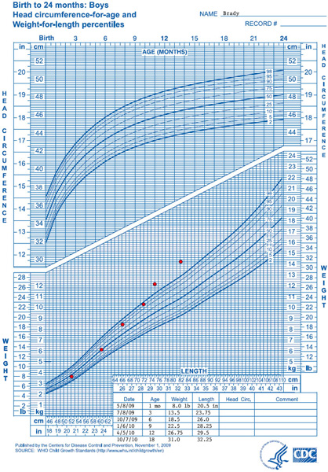
Comparing Weight-for-Length
CDC Weight-for-Length Growth Chart
WHO Weight-for-Length Growth Chart
George
George
Slide taken from WHO Growth chart presentation
Notes:
Talking Points:
Look at the Weight-for-Length sides of the growth charts side by side.
• When George's measurements are plotted on the CDC weight-for-length growth chart, his weight-for-length is around the 50th percentile at one month old and begins an upward trend of crossing centiles at three months of age and continues rising to the 95th percentile at 9 months and above the 95th percentile (high weight-for-length) at 12 months of age.
• When George's weight and length are plotted on the WHO weight-for-length chart, his weight-for-length is below the 50th percentile for the first month of life. The health care provider can assure George's caretakers that he is growing at an appropriate weight and discourage any increase in feeding.
• At 9 months of age, plotting George's weight-for-length on the WHO growth chart indicates that George's weight is high for his length with weight-for-length between the 95th and 98th percentiles. At 12 months of age, George’s weight-for-length is above the 98th percentile (high weight-for-length using the new cutoffs).
Note that both the WHO and CDC weight-for-age and weight-for-length charts show a similar pattern of growth for George, i.e., an upward trend. However, the WHO weight-for-length chart identified high weight at an earlier age than the CDC weight-for-length chart (9 months versus 12 months).

Slide 45
Case #2
George
21mo infant with increased weight gain
Wt/Length= 98%
Physical Exam:
  Vitals wnl
  Denuded skin in intertriginous folds
Labs?
What do you want to do about it?

Slide 46

Responsive Feeding
“…a reciprocal relationship between an infant or child and his or her caregiver that is characterized by the child communicating feelings of hunger and satiety through verbal or nonverbal cues, followed by an immediate response from the caregiver.”
Harbron, et. al, 2013
Notes:
Responsive Feeding reflects responsive parenting
Harbron J, Booley S, Najaar B, Day C. Responsive feeding: establishing healthy eating behaviour early on in life.South African Journal Of Clinical Nutrition [serial online]. September 2, 2013;26(3):S141-9.

Slide 47

Notes:
Infant/Toddler feeding is often seen as a 1 way phenomenon, where the parent just feeds the child. But the pediatric provider must be skilled in understanding that it is a 2 way communication, a sort of dance. Both parties have their individual responsibilities.

Slide 48
Responsibilities
Infant/Toddlers Responsibility
Parents Responsibility
How much
Whether
What to Eat
When
Where
Black, et. al, 2011
Notes:
Each party has their own responsibility with the parent providing the “what” to eat, “when”, and “where;” while the child decides “how much” and “whether” they eat or not (4).
Parent will control the environment and determine what to eat, when to eat, and where to eat.
While the child should determine How much and whether they want to eat. That’s why it is so important for infant to be able to have the skills to turn and reject and show their interests. Ultimately we are encouraging our infants to move towards independence, self feeding, and recognizing and responding to their own hunger and satiety cues.

Slide 49
Parental Feeding Styles
Non-Responsive Feeding
Responsive Feeding
(Authoritative/Democratic)
Demanding +/Responsive +
Indulgent
(Permissive)
Controlling
(Authoritarian)
Neglectful
(Uninvolved)
Demanding -/Responsive +
Demanding +/Responsive -
Demanding -/Responsive -
Harbron, et. al, 2013
Notes:
In order for Pediatric providers to understand how to implement responsive feeding into their practice they must first understand the different types of parental feeding styles.
The 2 main categories are responsive feeding vs. non-responsive feeding. We have introduced the concept of responsive feeding. Responsive feeding is also described as more authoratative or democratic. Basically very demanding on the parents and requires increase responsiveness from the parents to pay attention to the child's signals.
Harbron J, Booley S, Najaar B, Day C. Responsive feeding: establishing healthy eating behaviour early on in life.South African Journal Of Clinical Nutrition [serial online]. September 2, 2013;26(3):S141-9.

Slide 50

Responsive Feeding
Involved
Nurturing
Structured
Consequences: Awareness of Hunger Cues, may curb obesity/overweight, makes mealtimes enjoyable
Savage, et. al, 2007; Harbron, et. al 2013

Slide 51
Parental Feeding Styles
Non-Responsive Feeding
Responsive Feeding
(Authoritative/Democratic)
Demanding +/Responsive +
Indulgent
(Permissive)
Controlling
(Authoritarian)
Neglectful
(Uninvolved)
Demanding -/Responsive +
Demanding +/Responsive -
Demanding -/Responsive -
Harbron, et. al, 2013
Notes:
The Indulgent or Permissive Parenting Feeding Style is described as being less Demanding and Highly responsive to the infants cues.

Slide 52
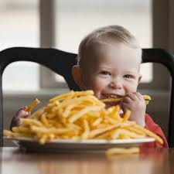
Indulgent Feeding
Involved
Nurturing
Unrestricted
Consequences: High intake of Salt/Sugar, Low Intake of Vegetables, Overweight/Obesity
Savage, et. al, 2007; Harbron, et. al 2013
Notes:
These parents recognize the childs hunger cues but will continue to allow them to dictate the foods that they eat.
As we all remember, we all have a natural predilection for sweet and salt, and even at times higher calorie foods which incorporate Fattier foods. These infants eat high intakes of salt and sugar with very little vegetables.

Slide 53
Parental Feeding Styles
Non-Responsive Feeding
Responsive Feeding
(Authoritative/Democratic)
Demanding +/Responsive +
Indulgent
(Permissive)
Controlling
(Authoritarian)
Neglectful
(Uninvolved)
Demanding -/Responsive +
Demanding +/Responsive -
Demanding -/Responsive -
Harbron, et. al, 2013

Slide 54

Controlling Feeding
Forceful
Restrictive
Structured
Low in Nurturance
Consequences: Overweight/Obesity?, Impulsive and overeating, FTT, distress around feeding
Savage, et. al, 2007; Harbron, et. al 2013
Notes:
Controlling /Authoritarian parental feeding styles are described as demanding and not responsive, forcing children to eat and ignoring hunger and satiety cues (9, 13).
Unfortunately, this is often a very coercive style. Parents will distract children to force food in their mouth or are on time restraints so will rush food to meet their own deadlines. Or may be trying to save money or set the goal for the child to clean their plate.
Parents typically will use punishment or a multitude of rewards to force the child to eat. Studies have shown that approximately half of mothers and most fathers practice this method of feeding (12). This strategy is often used when parents have increased demands on their time; the child is having poor growth, or even when children are recovering from being sick (11-13). As described above, parents will often use this style in response to pediatrician guidance to optimize nutrition and weight (4,11). One subset of controlling intake is through parents practicing restrictive feeding. This can also be very harmful to children and is often associated with parents who have a perception of their child as being overweight/obese (4, 9, 13). In addition, excessive and non-constructive restriction of foods may actually increase the child’s desire for the “forbidden” food, which is counterproductive and may cause future uninhibited intake (9).
Savage J, Fisher J, Birch L. Parental influence on eating behavior: conception to adolescence. Journal Of Law, Medicine & Ethics [serial online]. March 2007;35(1):22-34.

Slide 55
Parental Feeding Styles
Non-Responsive Feeding
Responsive Feeding
(Authoritative/Democratic)
Demanding +/Responsive +
Indulgent
(Permissive)
Controlling
(Authoritarian)
Neglectful
(Uninvolved)
Demanding -/Responsive +
Demanding +/Responsive -
Demanding -/Responsive -
Harbron, et. al, 2013

Slide 56

Neglectful Feeding
Unengaged
Insensitive
Unstructured
Low Nurturance
Consequences: Impulsive Eating, Overweight/Obesity, Poor recognition of hunger and satiety cues
Savage, et. al, 2007; Harbron, et. al 2013
Notes:
Lastly, the neglectful/uninvolved parental feeding style is described as less demanding and less responsive (13). These parents show very little attention to the child, and may avoid eye contact or appear detached during feeding. The typical child or parent may have developmental disabilities, emotional concerns, or even depression. Children may begin to show attention grabbing behavior such as refusing to eat, throwing foods, or having a tantrum in order to attract the parent (11-13).

Slide 57
Main Principles of
Responsive Feeding
Feed infants directly and assist older children when they feed themselves, being sensitive to their hunger and satiety cues.
Feed slowly and patiently, and encourage children to eat, but do not force them.
If children refuse many foods, experiment with different food combinations, tastes, textures and methods of encouragement. Or, offer new foods several times. Children sometimes refuse new food for the first few tries
Minimize distractions during meals if the child loses interest easily
Remember that feeding times are periods of learning and love. Talk to children during feeding, with eye-to-eye contact.
Guiding Principles for Complementary Feeding of the Breastfed Child Recommendations
WHO, 2003
Notes:
So we have discussed most of these, but these are the basic recs from the WHO Recommendations. This is directly from the Guiding Principles for Complementary Feeding of the Breastfed Child Recommendations from the WHO.
Pan American Health Organization, WHO. Guiding principles for complementary feeding of the breastfed child. Washington, DC: Pan American Health Organization/WHO; 2003.
-Avoiding distractions, feeding to encourage appetite, serve age appropriate foods, tolerate age appropriate mess.

Slide 58

Notes:
Improving Diet, Energy and Activity for Life Clinic

