Slide 1
Toxicology 201
When Poison Control and Urine Drug Screens Won’t Help You
David J Mathison, MD MBA
Emergency Medicine

Slide 2
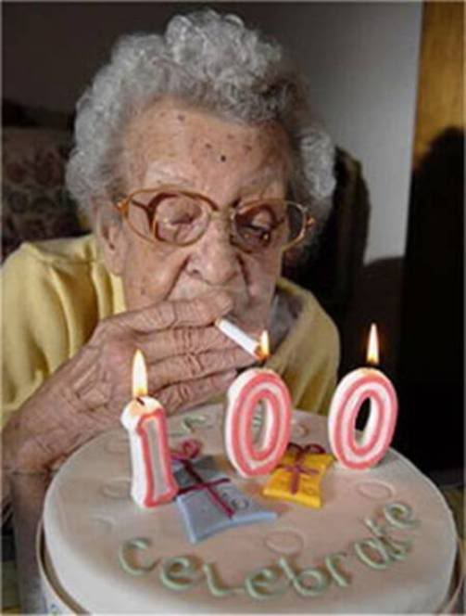
The Caregiver
Mom goes to the grocery store and leaves her three kids with grandma:
“I’ve been baby-sitting kids for 75 years, we’ll be fine…”
Notes:
You are called to evaluate a 3-year-old girl who is brought in by mom for concern of a possible ingestion. Mom had put her down for a nap about an hour earlier. She heard her playing, went to go check on her, and was shocked to find her surrounded by several open pill bottles. Mom brought her in immediately, along with a bag full of pill bottles, but thinks she may have left one or two behind.

Slide 3
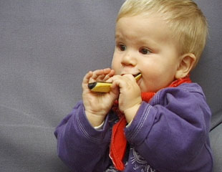

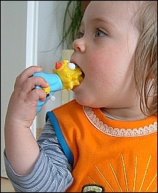
Your Patients
Don’t worry, Grandma is watching them…

Slide 4

Assessment
Vitamins
Acetaminophen
Blood Pressure Meds
Methadone
Grandma’s Meds
Notes:
In assessment, mom hands the nurse a bag of medicines. It contains vitamins, acetaminophen, a diuretic, and a beta blocker.. Mom is frantic, the little girl is complaining of abdominal pain but otherwise looks well.

Slide 5
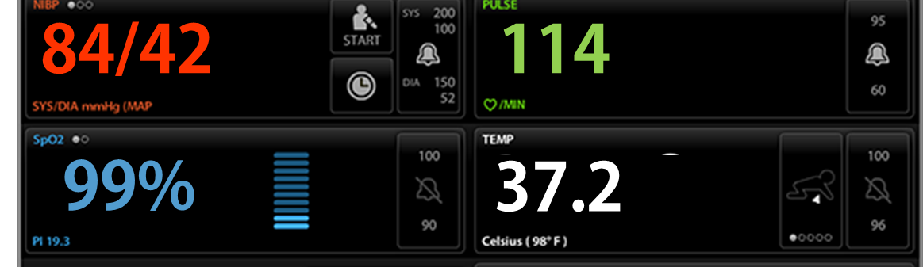
ED Room 18
The nurse has a 24 French orogastric tube in one hand and a bottle of charcoal in the other…….then turns to you and says, “Dr………how should we manage this patient?”

Slide 6

Objectives
Plan initial management for a toxicologic patient
Discuss role of decontamination
Review management strategies for a few common ingestions
Notes:
After viewing this module, you should feel comfortable planning the initial management of this patient, and others like her. We will discuss the epidemiology and general approach to pediatric toxicology, and will focus on the evidence behind gastric decontamination, and will review the indications and contraindications for gastrointestinal decontamination using single-dose activated charcoal, gastric lavage, and whole bowel irrigation in children.

Slide 7
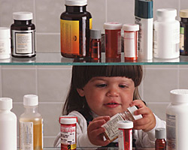
Epidemiology
Children ≤ 6 years old account for 50% of all toxic exposures
Notes:
In the pediatric emergency room, we commonly see children who have been exposed to or ingested something toxic. Half of all human toxic exposures occur in children 6 years old or younger.

Slide 8
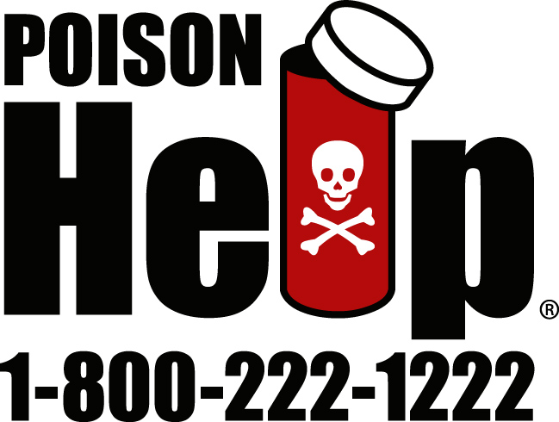
Poison Control
3.9 million calls to Poison Centers in 2010
Notes:
In 2010, poison control centers in the US received almost 4 million calls.
Poison control centers filter calls from the community so emergency departments aren’t over-burdened by low-risk exposures.

Slide 9
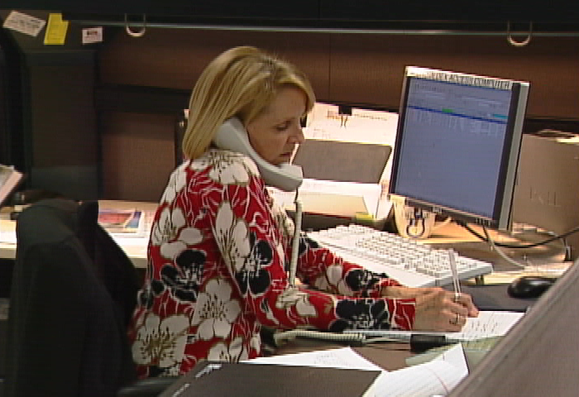
Poison Control
70% of calls are
handled at home
Notes:
Poison control centers filter calls from the community so emergency departments aren’t over-burdened by low-risk exposures. Approximately 70% of call are managed at home

Slide 10
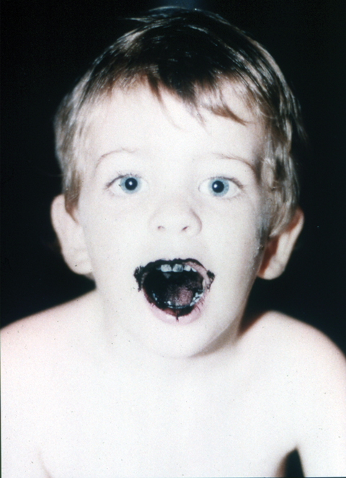
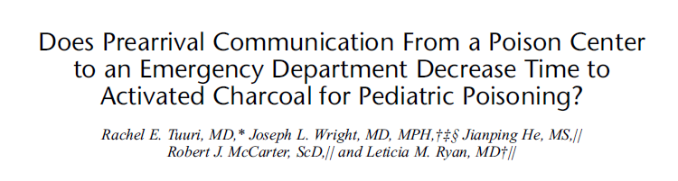
Decontamination
57% of patient ingestions seen at health care facilities receive decontamination
Pre-communication with poison control ↓time to GI decontamination
Pediatr Emerg Care. 2011 Nov;27(11):1045-51.
Does prearrival communication from a poison center to an emergency department decrease time to activated charcoal for pediatric poisoning?
Tuuri RE, Wright JL, He J, McCarter RJ, Ryan LM.
Source
Division of Pediatric Emergency Medicine, Medical University of South Carolina, Charleston, SC, USA. rtuuri@hotmail.com
Abstract
OBJECTIVE:
A poison center plays an important role in directing appropriate care, which is critical in reducing morbidity due to poisoning. Activated charcoal (AC) is one intervention for some poisonings. This study examined whether children with a poisoning who were preannounced by a poison center received AC earlier than patients without a referral.
METHODS:
A retrospective review of AC administration in children aged 0 to 18 years in a pediatric emergency department (ED) from 2000 to 2006 was performed. Abstracted covariates were poison center referral status, age, sex, acuity, disposition, transportation mode, triage time, and time of AC administration. Analysis of variance controlling for covariates tested the equality of mean time intervals between the groups with and without a poison center referral.
RESULTS:
Three hundred fifty-one cases met the inclusion criteria. One hundred thirty-five (39%) were male. Eighty cases (23%) had a poison center referral. Time from triage to charcoal administration for patients with a poison center referral was a mean of 59 (SD, 34) minutes. Time for the group without a referral was a mean of 71 (SD, 43) minutes (P = 0.0036).
CONCLUSIONS:
Advanced communication from a poison center was associated with earlier administration of AC in the ED for this population. Nevertheless, the duration to charcoal administration was frequently suboptimal. Triage and prehospital practices should be reexamined to improve timeliness of AC when indicated and consider exclusion of administration if beyond an appropriate time frame. Advanced notification should be the paradigm for all poison centers, and early response protocols for poison center referrals should be used by EDs.
Notes:
Of all patients who present to a health care facility, 57% receive some form of decontamination; which is annually about 25 thousand children under the age of 5. When families call poison control and are then referred in for emergency care, it decreases the time to GI decontamination. Which is one of many reasons why educating families about the role of poison control is critical !

Slide 11
Approach to the Unknown Ingestion
Notes:
So back to our friend in the ED- there has been no pre-hospital communication with poison control and her mom is anxiously awaiting your plan..

Slide 12

Basic Approach
Airway
Breathing
Circulation
Disability (Neuro)
Exposures
Notes:
In general, the approach to any patient begins with our good old ABCs, but we have a new pneumonic as we approach “D”

Slide 13
Basic Approach
Airway
Breathing
Circulation
Decontamination/DONT
Enhanced elimination
Notes:
After a quick neurologic assessment, think about decontamination and ‘dont’. DON’T stands for dextrose, oxygen, naloxone and thiamine, all of which you should think about in unknown ingestions.

Slide 14
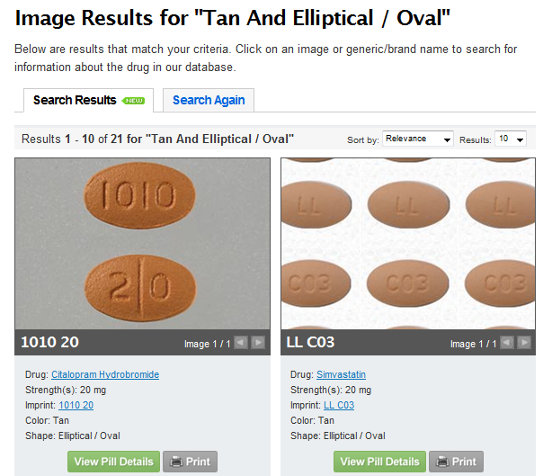
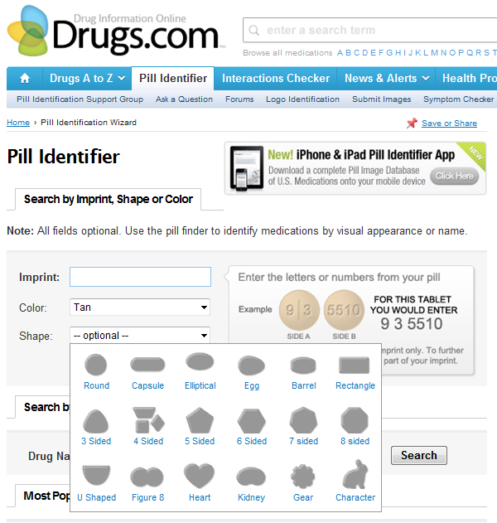
Pill Search
Notes:
DONT stands for dextrose, oxygen, naloxone, thiamine

Slide 15
You Took What?
Marijuana
Acapulco gold
Bhang
Doobie
Ganja
Grass
Joint
Mary Jane
Pot
Rope
Reefer
LSD
Acid
Blotters
Microdots
Paper acid
Pyramids
Window pane
Amphetamines
Black beauties
Crank
Crystals
Cat
Ice
Ecstasy
Meth
Pep pills
Smart drug
(Ritalin)
Speed
Uppers
Ecstasy
Adam
E
Lollies
Love Drug
Smarties
Vitamin E
XTC
Cocaine
Coke
Crack
Girl
Mother of pearl
Nose candy
Peruvian powder
Snow
Toot
White lady
Heroin
Boy
China white
Dust
Harry
Horse
Junk
Monkey
Smack
Speed ball
(w/ cocaine)
Atom bomb
(w/ marijuana)
PCP
Angel dust
Goon
Horse tranquilizer
Hog
Gamma-hydroxybutyrate (GHB)
Bioski
Georgia home boy
Grievous bodily harm
Liquid G
Liquid ecstasy
Somatomax
Cow growth hormone
Notes:
DONT stands for dextrose, oxygen, naloxone, thiamine

Slide 16
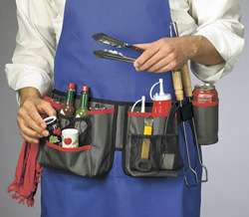
Toxicology Tool Belt
DIAGNOSTICS
ECG, drug screen, ASA, APAP, EtOH, toxin level, osmolality, lytes…
Notes:
16

Slide 17
The Urine Tox Screen
Drug | Caveats
Amphetamines | Decongestants (ephedrine) cross-react
Barbiturates | May be detectable up to 30 days
Benzodiazepenes | May be detectable up to 30 days
Cannaboids (marijuana)
Cocaine | False positives unlikely
Opiates | Quinolones / Dextromethorophan - false (+) Synthetic opiates have little cross-reactivity (fentanyl, tramadol, demerol…)
Methadone
Phenylcyclidine (PCP) | Dextromethorophan and ketamine cross-react
Tricyclics | LOTS of false positives

Slide 18
The Urine Tox Screen
Drug | Caveats
Amphetamines | Decongestants (ephedrine) cross-react
Barbiturates | May be detectable up to 30 days
Benzodiazepenes | May be detectable up to 30 days
Cannaboids (marijuana)
Cocaine | False positives unlikely
Opiates | Quinolones / Dextromethorophan - false (+) Synthetic opiates have little cross-reactivity (fentanyl, tramadol, demerol…)
Methadone
Phenylcyclidine (PCP) | Dextromethorophan and ketamine cross-react
Tricyclics | LOTS of false positives

Slide 19
The Urine Tox Screen
Drug | Caveats
Amphetamines | Decongestants (ephedrine) cross-react
Barbiturates | May be detectable up to 30 days
Benzodiazepenes | May be detectable up to 30 days
Cannaboids (marijuana)
Cocaine | False positives unlikely
Opiates | Quinolones / Dextromethorophan - false (+) Synthetic opiates have little cross-reactivity (fentanyl, tramadol, demerol…)
Methadone
Phenylcyclidine (PCP) | Dextromethorophan and ketamine cross-react
Tricyclics | LOTS of false positives

Slide 20
The Urine Tox Screen
Drug | Caveats
Amphetamines | Decongestants (ephedrine) cross-react
Barbiturates | May be detectable up to 30 days
Benzodiazepenes | May be detectable up to 30 days
Cannaboids (marijuana)
Cocaine | False positives unlikely
Opiates | Quinolones / Dextromethorophan - false (+) Synthetic opiates have little cross-reactivity (fentanyl, tramadol, demerol…)
Methadone
Phenylcyclidine (PCP) | Dextromethorophan and ketamine cross-react
Tricyclics | LOTS of false positives

Slide 21
The Urine Tox Screen
Drug | Caveats
Amphetamines | Decongestants (ephedrine) cross-react
Barbiturates | May be detectable up to 30 days
Benzodiazepenes | May be detectable up to 30 days
Cannaboids (marijuana)
Cocaine | False positives unlikely
Opiates | Quinolones / Dextromethorophan - false (+) Synthetic opiates have little cross-reactivity (fentanyl, tramadol, demerol…)
Methadone
Phenylcyclidine (PCP) | Dextromethorophan and ketamine cross-react
Tricyclics | LOTS of false positives

Slide 22
The Urine Tox Screen
Drug | Caveats
Amphetamines | Decongestants (ephedrine) cross-react
Barbiturates | May be detectable up to 30 days
Benzodiazepenes | May be detectable up to 30 days
Cannaboids (marijuana)
Cocaine | False positives unlikely
Opiates | Quinolones / Dextromethorophan - false (+) Synthetic opiates have little cross-reactivity (fentanyl, tramadol, demerol…)
Methadone
Phenylcyclidine (PCP) | Dextromethorophan and ketamine cross-react
Tricyclics | LOTS of false positives

Slide 23
The Urine Tox Screen
Drug | Caveats
Amphetamines | Decongestants (ephedrine) cross-react
Barbiturates | May be detectable up to 30 days
Benzodiazepenes | May be detectable up to 30 days
Cannaboids (marijuana)
Cocaine | False positives unlikely
Opiates | Quinolones / Dextromethorophan - false (+) Synthetic opiates have little cross-reactivity (fentanyl, tramadol, demerol…)
Methadone
Phenylcyclidine (PCP) | Dextromethorophan and ketamine cross-react
Tricyclics | LOTS of false positives

Slide 24
The Urine Tox Screen
Drug | Caveats
Amphetamines | Decongestants (ephedrine) cross-react
Barbiturates | May be detectable up to 30 days
Benzodiazepenes | May be detectable up to 30 days
Cannaboids (marijuana)
Cocaine | False positives unlikely
Opiates | Quinolones / Dextromethorophan - false (+) Synthetic opiates have little cross-reactivity (fentanyl, tramadol, demerol…)
Methadone
Phenylcyclidine (PCP) | Dextromethorophan and ketamine cross-react
Tricyclics | LOTS of false positives

Slide 25
The Urine Tox Screen
Drug | Caveats
Amphetamines | Decongestants (ephedrine) cross-react
Barbiturates | May be detectable up to 30 days
Benzodiazepenes | May be detectable up to 30 days
Cannaboids (marijuana)
Cocaine | False positives unlikely
Opiates | Quinolones / Dextromethorophan - false (+) Synthetic opiates have little cross-reactivity (fentanyl, tramadol, demerol…)
Methadone
Phenylcyclidine (PCP) | Dextromethorophan and ketamine cross-react
Tricyclics | LOTS of false positives

Slide 26
Further Diagnostics
Consider sending serum tests for….
Acetaminophen
Salicylate
Lead
Digoxin
Iron
Lithium
Co-oximetry
Alcohols (ethanol, methanol, etc)
Seizure meds (depakote, etc)
Notes:
Commercial urine tests for: LSD, ectstasy, oxycodone

Slide 27
GI Decontamination
Goal = prevent absorption of toxic substances
Notes:
The goal of any method of gastrointestinal decontamination is to prevent the absorption of toxic substances from the GI tract. We’ll discuss single-dose activated charcoal, gastric lavage, and whole bowel irrigation.
We won’t talk about syrup of ipecac, as its use is no longer recommended by the American Academy of Pediatrics, the American Association of Clinical Toxicology, or the American Association of Poison Control Centers.

Slide 28
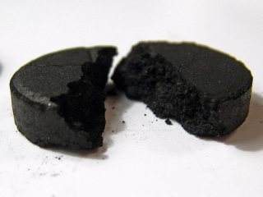
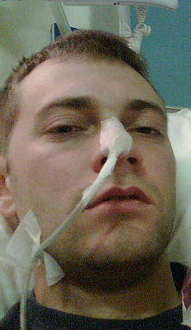
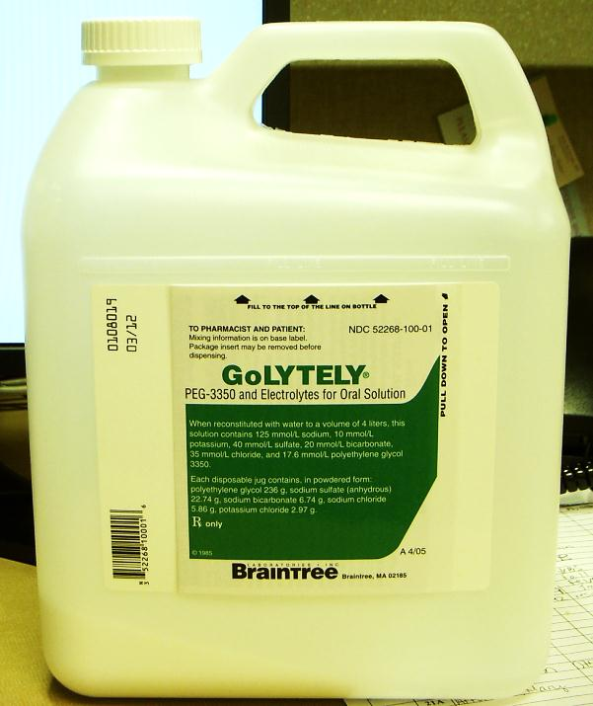
GI Decontamination
Activated Charcoal
Gastric Lavage
Whole Bowel Irrigation
Notes:
We’ll discuss single-dose activated charcoal, gastric lavage, and whole bowel irrigation.
We won’t talk about syrup of ipecac, as its use is no longer recommended by the American Academy of Pediatrics, the American Association of Clinical Toxicology, or the American Association of Poison Control Centers.

Slide 29
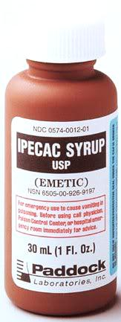
GI Decontamination
Activated Charcoal
Syrup of Ipecac
Whole Bowel Irrigation
Notes:
We’ll discuss single-dose activated charcoal, gastric lavage, and whole bowel irrigation.
We won’t talk about syrup of ipecac, as its use is no longer recommended by the American Academy of Pediatrics, the American Association of Clinical Toxicology, or the American Association of Poison Control Centers.

Slide 30
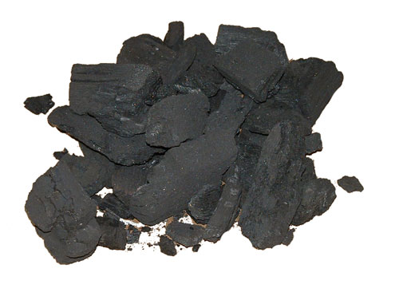
Activated Charcoal (AC)
Notes:
Let’s start with the most common method of GI decontamination: activated charcoal

Slide 31
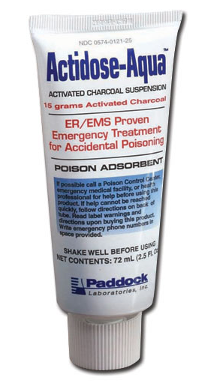
Activated Charcoal
Porous surface for adsorption
Mixed with water, preservatives, sorbitol, flavorings
Notes:
Charcoal becomes ‘activated’ by heating at high temperatures-this creates a large, porous surface area for adsorption of poisons. It’s usually mixed with water, preservatives, sorbitol [I thought they got rid of this?], and/or flavorings and given in liquid form orally or via nasogastric tube.

Slide 32

Activated Charcoal
Adsorb a variety of agents
However, no controlled studies have demonstrated improved clinical outcome
Notes:
Activated charcoal has been demonstrated to adsorb a variety of agents in multiple studies, including in vitro studies, animal studies, in human volunteers, and in actual overdose patients. However, no controlled studies have demonstrated changes with activated charcoal. Despite the lack of evidence demonstrating clinical improvement with activated charcoal, it is still utilized as the previous data is convincing enough to warrant its use in selected cases

Slide 33
AC Indications
“consider in patients who present within 1 hour after ingestion of a potentially toxic amount of a poison that can be adsorbed to charcoal”
Notes:
The American Association of Clinical Toxicology recommends that activated charcoal be considered in patients who present within 1 hour after ingestion of a potentially toxic amount of a poison that can be adsorbed to charcoal.

Slide 34
Feasibility
J Med Toxicol 2007
The feasibility of administration of activated charcoal with respect to current practice guidelines in ED patients
LoVecchio F, Shriki J, Innes K, Bermudez J.
Only 16% of patients present within 60 min
Many are treated despite recommendations.
Role for pre-hospital AC ?
Notes:
Despite these recommendations, this retrospective study of more than 16,000 ingestion patients over 3 years showed that only 16% actually get to an Emergency Department within 60 minutes. And many are treated with charcoal after an hour despite the recommendation. This brings into question the role of activated charcoal in pre-hospital medicine, which is available in some EMS jurisdications.
Study:
OBJECTIVE:
The American Academy of Clinical Toxicology, European Association of Poisons Centres, and Clinical Toxicologists recommend administration of activated charcoal (AC) within one-hour of an acute toxic ingestion [1]. Our poison control center periodically and upon request faxes an abbreviated protocol to hospital emergency departments, reminding physicians of these current AC recommendations. This study was conducted to describe how often patients present within the one-hour time frame and how often the guidelines in the above position statement are being followed.
METHODS:
Following a brief training of systematic chart review, reviewers blinded to the purpose of the study completed a standardized data collection sheet. Three years after publication of these consensus statements, a period of 3 consecutive years of poison center patient encounters were reviewed. Recorded data included age, outcomes, and time to administration of charcoal.
RESULTS:
Approximately 150,000 reported toxic exposures were reviewed, of which 16,914 patients of acute ingestions presented to a health care facility. The mean age of the group that presented was 25 years [range 1 month-87 years]. A total of 2,700 (16%) patients that presented were within 60 minutes of an acute overdose and all were administered AC in accordance with the recommended guidelines. Interestingly, pre-hospital personnel administered AC within 60 minutes to 762 (28% of 2,700) patients. Correspondingly, 14,214 (84%) patients presented more than 60 minutes after an acute overdose. Of this latter group AC was withheld in 341 (2.4% of 14,214) patients, and 13,873 (97.6% of 14,214) patients received charcoal despite having arrived more than 60 minutes after ingestion. The mean time to the first administration of AC in this latter group was 225 minutes [range of 61-2160 minutes] following ingestion.
CONCLUSIONS:
Only a small percentage of patients treated for an acute overdose (16%) present within 60 minutes and are given charcoal according to the current guidelines. A large subset of these patients (28%) is given AC in a pre-hospital setting. Few patients presenting to a health care provider after an acute toxic ingestion are treated in accordance with the current recommendations for activated charcoal.

Slide 35
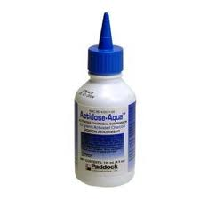
AC Contraindications
High risk of aspiration
Substance not adsorbed by charcoal
Caution in patients at risk for
  GI hemorrhage
  GI perforation
  Sudden onset seizure or AMS
Notes:
There are three main reasons NOT to give activated charcoal First, if the patient is a high risk of aspiration. This may necessitate endotracheal intubation to secure the airway and assure safe passage of activated charcoal into the GI tract. This is especially important in hydrocarbon ingestions where aspiration can have particularly deletrious effects on the lungs. Second, avoid activated charcoal in acid/alkali ingestions as charcoal has not been shown to be of benefit and may be more likely to induce emesis. Lastly, avoid charcoal in patients who ingest substances that don’t adsorb!
And be careful using charcoal in patients at risk for GI hemorrhage, GI perforation, or the sudden onset of seizuers or altered mental status. In short, though activated charcoal should be considered in all patients presenting within one hour of a potentially toxic ingestion, a careful risk-benefit analysis should be taken before deciding to administer charcoal.

Slide 36
“PHAILS”
P | Pesticides, petroleum distillates
H | Hydrocarbons, heavy metals
A | Acids, alkali, alcohols
I | Iron
L | Lithium
S | Solvents
Notes:
As mentioned, though charcoal binds to most agents, it doesn’t bind to all. Here is a helpful pneumonic to remember which poisons are not adsorbed by charcoal, or when activated charcoal ‘phails.’ (can read through letters or just give folks time to look at it)

Slide 37
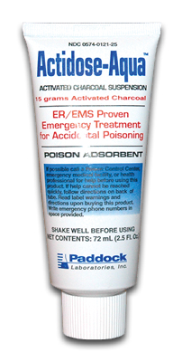
AC Dosing
1 g/kg PO x 1
Max dose = 100 g
Mix with chocolate syrup or juice
Notes:
The recommended dose is 1gm/kg in children 12 and under with a max dose of 100g
In young children, it helps to mix

Slide 38
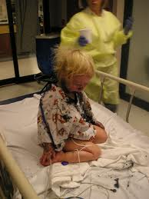
AC Complications
Emesis in 6-26% of patients
Aspiration uncommon
  Increased risk
    GCS <15
    Spontaneous emesis
    Seizures
    Delayed presentation
    Tricyclic ingestion
Notes:
In general, activated charcoal is very well tolerated and has few side effects. The most common complication is emesis, which has been reported in 6-26% of patients. The most serious complication is aspiration. Fortunately, this is very rare, with <1% of patients experiencing clinically significant aspiration. Patients with a GCS less than 15, as well as those with spontaneous emesis, seizures, a delayed presentation, and tricyclic ingestion have been found to be at increased risk for aspiration. This highlights the importance of a secure airway in all patients who receive activated charcoal.

Slide 39

>1 Hour Post-Ingestion ?
Acetaminophen?
Anticholinergics?
“potential benefit after one hour cannot be excluded”
Notes:
It is controversial as to whether there is any benefit to giving activated charcoal more than one hour after ingestion. The literature shows that most patients, both pediatric and adult, do not present for care within one hour of ingestion. However, surveys of emergency physicians show that doctors routinely give activated charcoal to patients 3 or more hours after ingestion.
Researchers have studied the effects of delayed activated charcoal administration after ingestion of several specific toxins. The evidence for delayed AC after acetaminophen ingestion is positive but inconclusive. There is theoretical benefit to the administration of AC more than one hour after ingestion of drugs with anticholinergic properties, as these drugs can delay gastric emptying, but this has not been studied extensively.
The American Association of Clinical Toxicology still recommends that activated charcoal be given within one hour of ingestion, but adds that the potential benefit after one hour cannot be excluded. This, along with the low rate of complications of activated charcoal and the desire to ‘do something’ to help patients after ingestion, likely explains why many patients receive activated charcoal more than one hour after ingestion.

Slide 40
Multiple Dose AC
Interrupts enterohepatic, enteroenteric, enterogastric circulation
Enhances non-renal elimination
D | Dapsone
C | Carbamazepine
P | Phenobarbital
Q | Quinine
T | Theophylline
Notes:
Although multiple-dose activated charcoal is not something that would be performed in the ED, it’s worth mentioning here. Instead of adsorbing toxins that are still in the stomach, multiple-dose activated charcoal works by enhancing the elimination of drugs already absorbed. It does this by interrupting the enterohepatic, enteroenteric, and enterogastric circulation of toxins, thus enhancing their elimination.
There is little evidence for the use of multiple dose activated charcoal. Most studies are in animals, and many of those are inconclusive. However, there is some evidence for its use in large overdoses of the drugs listed here (think “DCPQT”. After the initial activated charcoal dose, adults should receive 12.5 g/hr until their clinical symptoms and/or laboratory parameters improve.
While complications are rare, patients who receive multiple dose activated charcoal are at risk for constipation, fluid and electrolyte imbalance, and bowel obstruction.

Slide 41
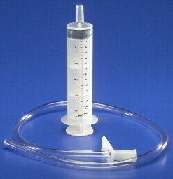
Gastric Lavage
Notes:
Another option for gastrointestinal decontamination in children is gastric lavage. This method directly removes ingested particles of toxin from the stomach by administering and aspirating small volumes of liquid through a large bore orogastric tube.

Slide 42
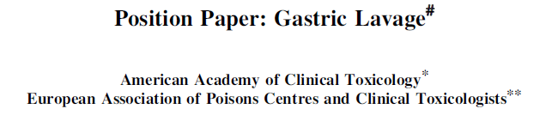
Gastric Lavage Indications
“should not be performed routinely, if ever, in the management of poisoned patients”
  Life-threatening poison
  Presentation shortly after ingestion
  Substances not adsorbed by AC
Notes:
There are very few studies that support the use of gastric lavage for decontamination in patients of any age. Most studies compare activated charcoal alone to activated charcoal plus lavage- none have found any additional benefit when lavage is added. Animal and volunteer studies have shown that lavage recovers scant amounts of toxins, even when performed shortly after ingestion.
As a result, the American Association of Clinical Toxicology does not recommend routine use of gastric lavage for decontamination. It may be considered for potentially life-threatening poisons if the patient presents soon after ingestion or for substances not adsorbed by activated charcoal.

Slide 43
Gastric Lavage Contraindications
Patients unable to protect airway
  Secure with endotracheal intubation
Patients at high risk for
  Aspiration (hydrocarbon ingestion)
  Hemorrhage (anticoagulation, medical condition)
  Perforation (alkaline corrosive ingestion)
Notes:
As with activated charcoal, patients who are unable to protect their airway and those at high risk for aspiration should not undergo gastric lavage. In addition, lavage is contraindicated in patients at risk of hemorrhage, due to anticoagulation or another medical problem, and those at risk of gastrointestinal perforation, such as patients who have ingested an alkaline corrosive.

Slide 44
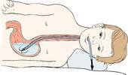
Gastric Lavage Technique
Proper positioning
Large bore tube with side holes (24-28 Fr)
Sequentially administer & aspirate fluid until clear
  Warmed ½ normal or normal saline
  10cc/kg in children, 200-300cc in adolescents
Notes:
For the rare pediatric patient who would benefit from gastric lavage, the following technique is recommended. The patient should be placed in the left lateral decubitus position, with the head of the bed tilted down. The tube should be as large as possible in order to maximize the recovery of pill fragments.
Once the tube is inserted, you administer and aspirate fluid until the fluid is clear of toxins and particles. The American Association of Clinical Toxicology recommends using warmed half normal or normal saline, 10cc/kg for children and 200-300 cc for adolescents.

Slide 45
Gastric Lavage Complications
Aspiration pneumonia
Dysrhythmias
Esophageal & gastric perforation
Laryngospasm
Hypernatremia
Notes:
Complications from gastric lavage are rare but can be serious, and even life-threatening. They include aspiration pneumonia, esophageal and gastric perforation, laryngospasm, and hypernatremia.

Slide 46
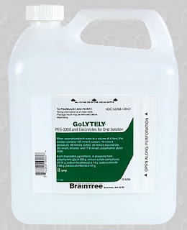
Whole Bowel Irrigation
Notes:
The last method of gastrointestinal decontamination we’ll discuss is whole bowel irrigation. This method aims to eliminate toxins from the GI tract before they can be absorbed. An osmotically balanced solultion is used to physically expel the toxins from the GI tract via a liquid stool.

Slide 47
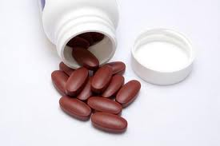
WBI Indications
None (theoretical benefit)
  Ex: iron ingestion
Notes:
There is even less evidence in support of the use of whole bowel irrigation for gastrointestinal decontamination. Several case reports describe the use of whole bowel irrigation in adults and children who have ingested large amounts of iron. As iron is not adsorbed by activated charcoal, other methods of decontamination were tried. All authors reported visualization of pill fragments in the stools and the patients did well clinically. Based on this, the American Association of Clinical Toxicology states NO indications for whole bowel irrigation. They only state that there may be theoretical benefit in patients who have ingested large amounts of iron or other substances not adsorbed by AC.

Slide 48
WBI Contraindications
Patients unable to protect airway
  Secure with endotracheal intubation
Patients at high risk for
  Aspiration (hydrocarbon ingestion)
  Hemorrhage (anticoagulation, medical condition)
  Perforation (alkaline corrosive ingestion)
Patients with
  Ileus
  Bowel obstruction
  Hemodynamically unstable
  Intractable vomiting
Notes:
Whole bowel irrigation has the same contraindications as gastric lavage; but also should not be performed in patients with ileus or bowel obstruction, and in hemodynamically unstable patients or those with intractable vomiting.

Slide 49
WBI Technique
Head of bed elevated 45°
Polyethylene glycol solution via NG tube
  9mos-6 years: 500cc/hr
  6-12 years: 1000cc/hr
  Adolescents: 1500-2000cc/hr
Continue until rectal effluent clear
Notes:
To decontaminate with whole bowel irrigation, the head of the patient’s bed should be elevated at least 45 degrees. The patient should then have an NG tube placed. The polyethylene glycol solution is run through the NG tube at a rate based on the patient’s age. The rate is 500cc/hr for young children, 1000cc/hr for school-aged children, and 1500-2000cc/hr for adolescents & adults. Irrigation should continue until the rectal effluent is clear, which may take several hours.

Slide 50
WBI Complications
Nausea
Vomiting
Abdominal cramping
Notes:
Few complications have been reported from whole bowel irrigation. They include nausea, vomiting, and abdominal cramps.

Slide 51
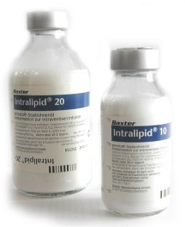
Intralipid Rescue
Lipid sequestration has been observed to reverse cardiac toxicity in:
Phenytoin
Chlorpormazine
Anesthetic agents
Propranolol
Verapamil
Notes:
Straathof D, Driessen O, Meyer W, et al. Influence of Intralipid infusion on elimination of phenytoin. Arch Int Pharmacodyn. 1984;267:180-186.
Krieglstein J, Meffert A, Niemeyer D. Influence of emulsified fat on chlorpromazine availability in rat blood. Experientia. 1974;30: 924-926.

Slide 52
Intralipid Rescue
Why might this work?
Sequestration of lipophilic drugs
in intravascular lipid compartment
FFAs provide myocardial energy
(may reverse ischemia-induced switch from lipid-to-glucose metabolism in injured myocardium)
Notes:
Sequestration of lipophilic drugs into a newly created intravascular lipid compartment has been proposed as the beneficial mechanism of action of lipid infusion.2,3,6-8 In 3
studies, investigators have tested in vitro concentrations of toxic agent in lipid and aqueous phases of blood after addition of lipid emulsion. Substantial lipid sequestration has been observed for bupivacaine,2 phenytoin,19 and chlorpromazine.
increased free fatty acid availability may help reverse the ischemia-induced switch from lipid to glucose metabolism known to occur in the stunned myocardium of animals and humans
52

Slide 53
Approach to the KNOWN Ingestion
Notes:
So back to our friend in the ED- there has been no pre-hospital communication with poison control and her mom is anxiously awaiting your plan..

Slide 54
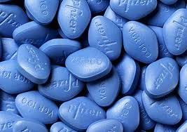
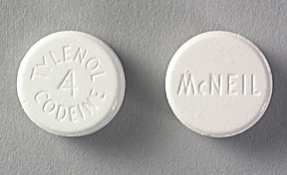
If you know what was ingested
Toxin-Specific
Antidotes
Decontamination
Toxin-Specific Management
Risk Assessment
Notes:
When you know exactly what was taken and when, you’re job is a bit easier. You start again with a patient assessment, followed quickly by initiating decontamination, specific antidotes if applicable, and can guide your management based on the toxin ingested. All of this is done by a risk assessment of how toxic the ingestion is.

Slide 55
Risk Assessment
  Toxicity
Was the dose toxic?
Potential Dose
Time Since Ingestion
Patient Characteristics
Symptoms on Arrival
Notes:
When you are thinking about drug toxicity, your risk assessment will take into account the potential dose the patient had access to, how long ago they took it, patient characteristics such as age and weight, and how the patient appears on physical exam

Slide 56
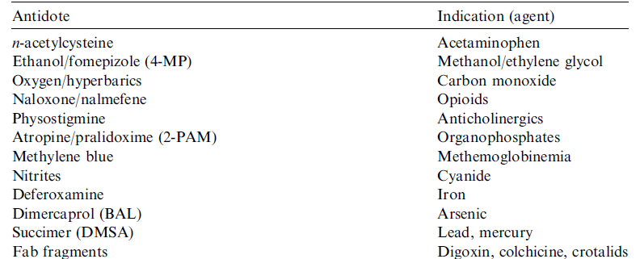
Antidotes

Slide 57
Case 1
iStat (normal lytes, glucose, pH)
ECG shows bradycardia 75 with prolonged PR interval (type I)
Vomits in the room
Grandma takes out a bottle of diltiazem…
HR 80
BP 74/48

Slide 58
Anti-Hypertensives
Grandma’s Medicines
ACE Inhibitors
Diuretics
Calcium Channel Blockers
Beta Blockers
Central Acting Agents
Vasodilators
Notes:
Central = Clonidine (alpha-1 antagonist)
Vasodilators = hydroxazine, minoxidil

Slide 59
A Brady-Arrhythmia?
Beta Blockers
Calcium Channel Blockers (verapamil, diltiazem)
Cardiac Glycosides
(digoxin)
Alpha-1 antagonists
(clonidine)
HR 80
BP 74/48
Notes:
Cholinergics, sedatives, opiates

Slide 60
Ca²⁺ Channel Blockers are BAD
↓SVR
↓Myocardial Contractility
↓AV Nodal Conduction
Brady-arrhyhtmias
Hypotension
Shock
Notes:
may appear warm and well perfused owing to a lack of vasomotor tone. Negative inotropic and chronotropic effects lead to decreased cardiac output contributing to the shock state. Cardiac ejection fractions as low as 10% have been reported in poisoned patients.^{[40,][41]} Depression of myocardial conduction may cause depression

Slide 61
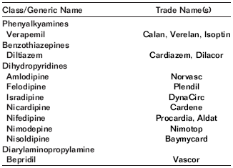
Calcium Channel Blockers 201
Less potent vasodilators
But…added effects:
↓myocardial contractility and
↓AV nodal conduction
Hypotension and Bradycardia

Slide 62
Calcium Channel Blockers 202
Most potent vasodilators
Hypotension with reflex tachycardia
Little effect on myocardial contractility or AV nodal conduction
Notes:
Bepridil – causes some AV block and bradycardia

Slide 63
Peak Effect?
Short Acting = peaks at 2 hours
Long Acting = peaks at 6 hours
(case reports of delay in symptoms for 15-24hrs)

Slide 64
Calcium Channel Mgmt
Fluids
Decontamination
Atropine (for symptomatic bradycardia)
Calcium
Glucagon
Insulin/Glucose
Vasoactives
Intralipid Rescue?
no single agent has consistently demonstrated efficacy
Notes:
Atropine is necessary for symptomatic bradycardia, can be repeated every 2-3 minutes

Slide 65
Review Questions
Which of the following is not a manifestation of salicylate poisoning?
  Hyperventilation
  Wide gap metabolic acidosis
  Hearing Loss
  Seizures
  Vomiting
  Hypothermia
Notes:
Now a few questions to review the important points..

Slide 66
Review Questions
Which of the following substances is NOT adsorbed by activated charcoal?
  Penicillin
  Acetaminophen
  Fluoxetine
  Lithium

Slide 67
Review Questions
The most common reported complication of decontamination with activated charcoal is
  Aspiration
  Emesis
  Hypotension
  Seizures

Slide 68
Review Questions
There is theoretical benefit of delayed (>1 hour after ingestion) decontamination with activated charcoal in patients who have ingested which class of drugs?
  Anticholinergics
  Non-steroidal anti-inflammatory drugs
  Corrosives
  Heavy metals

Slide 69
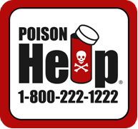
Talk with Poison Control

Slide 70
