Slide 1
Strabismus 101, Conjunctivitis, Glaucoma
November 2015
Marijean Miller, MD

Slide 2
Vision Screening What is your responsibility?
Vision Screening is strongly recommended by the American Academy of Pediatrics (AAP)
Check newborns for red reflex to find congenital cataracts
I
Check for ability to fix and follow
Check for strabismus.
Toddlers: pupillary red reflexes tested with a direct ophthalmoscope (Brückner Test)
As soon as able (by 3-4 years), Acuity of each eye (with the non-tested eye patched) is screened to identify amblyopia.
AAPOS= American Association of Pediatric Ophthalmology and Strabismus

Slide 3
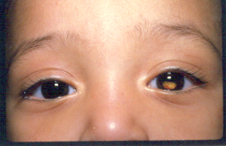
Why should pediatricians care about strabismus?
Retinoblastoma
Amblyopia=
reversible loss of vision
Fusion
School function
Induced head postures
reconstructive

Slide 4
Esotropia= ET
Left Esotropia

Slide 5
Exotropia = XT
Left Exotropia
“Exo” = eye exits the nose

Slide 6
Tests for Strabismus
Light reflex
Cover-uncover test
Alternate Cover Test

Slide 7
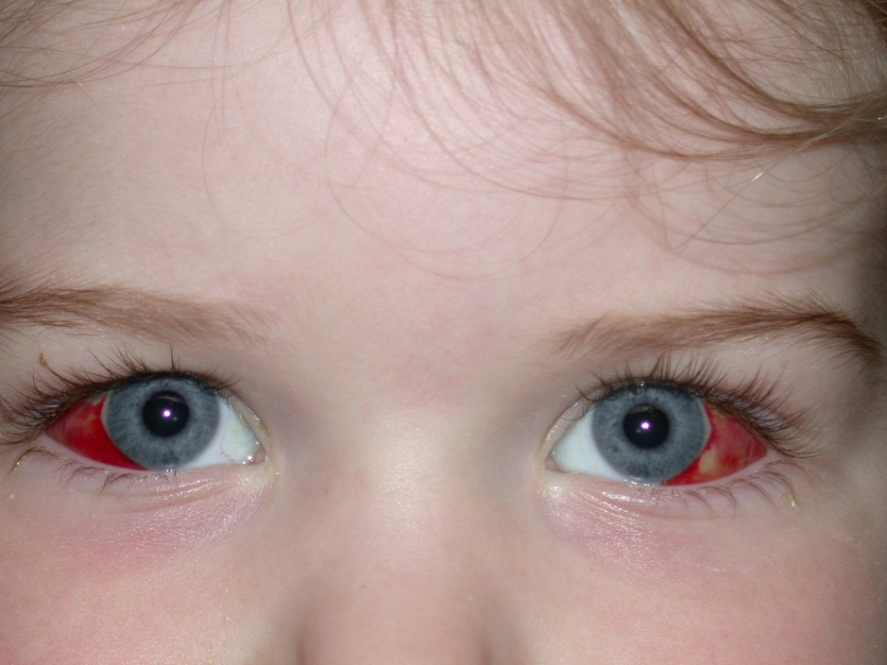
Light Reflex
Normal = Reflex in center of pupil

Slide 8
Light Reflex

Slide 9
Light reflex is first estimate of alignment.

Slide 10
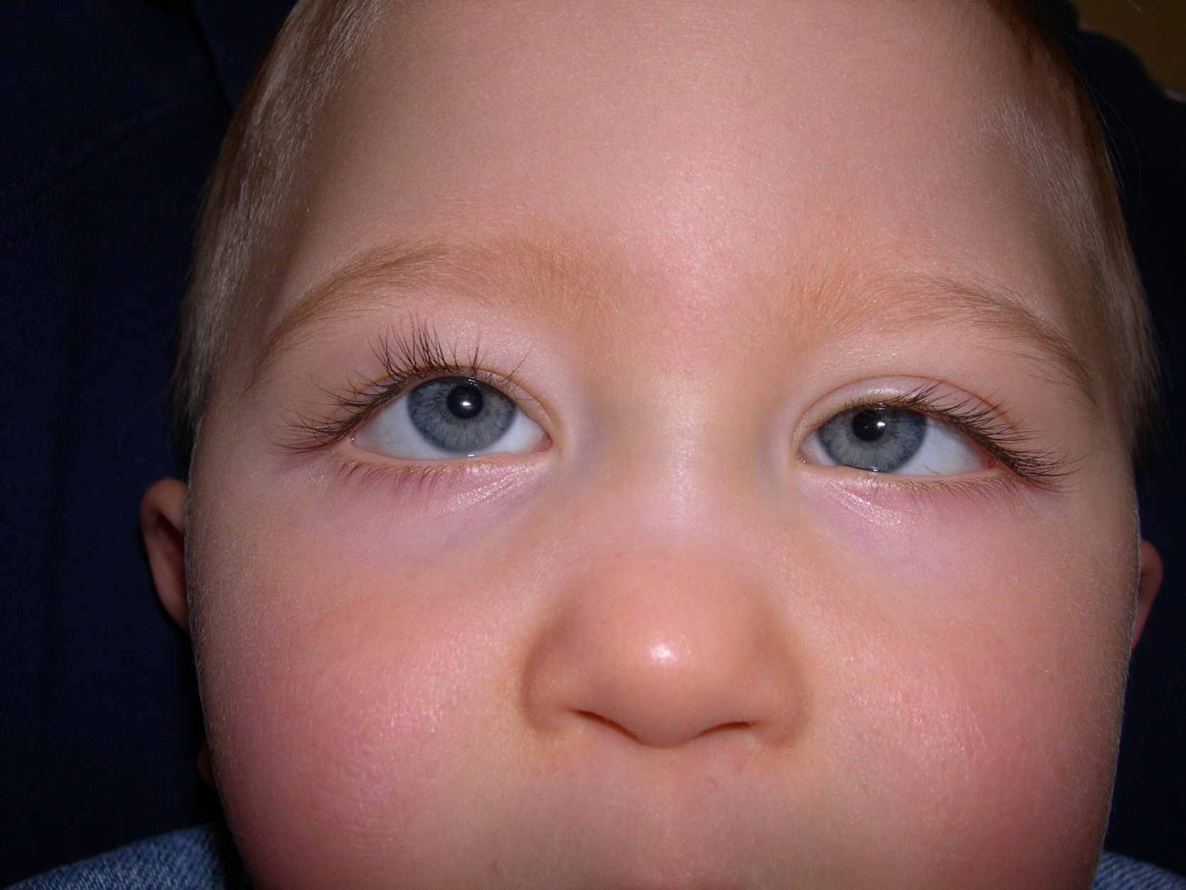

Slide 11
Hypertropia

Slide 12
Cover Uncover Test
Use occluder
Have child look at a target

Slide 13
Right esotropia ???
Cover left eye
Did the right eye move?
If right eye moved to look was not previously straight.

Slide 14
Cover Uncover
Repeat test for second eye

Slide 15
Cover Uncover test
Child fixates on a target (distance or near)
Check covering left
Check covering right
Normal is NO movement of uncovered eye.
Watch the uncovered eye for tropia movement
Figure out type of misaligment
Figure out which eye is preferred

Slide 16
Strabismus graded by control
Tropia = misaligned all the time
Intermittent= sometimes misaligned and can hurt vision and function
Phoria= tendency controlled by fusion. Small amount is normal.

Slide 17
Cover Uncover Test
Allows fusion sometimes so only shows worst strabismus problems.
Tropias (esotropia, exotropia, hypertropia)
Intermittent tropias
Pull the cover away see movement that “recovers to straight”. Eyes are straight at times so tropia is intermittent.

Slide 18
Diagnosis?

Slide 19
Strabismus Tests ….So far
Light reflex
Cover Uncover Test

Slide 20
Alternative Cover Test
Child fixates on target.
Move occluder back and forth between eyes.
This is most “dissociating test”…..no time to fuse.
Reveals TOTAL of all strabismus.
This is strongest test because child cannot fuse.

Slide 21
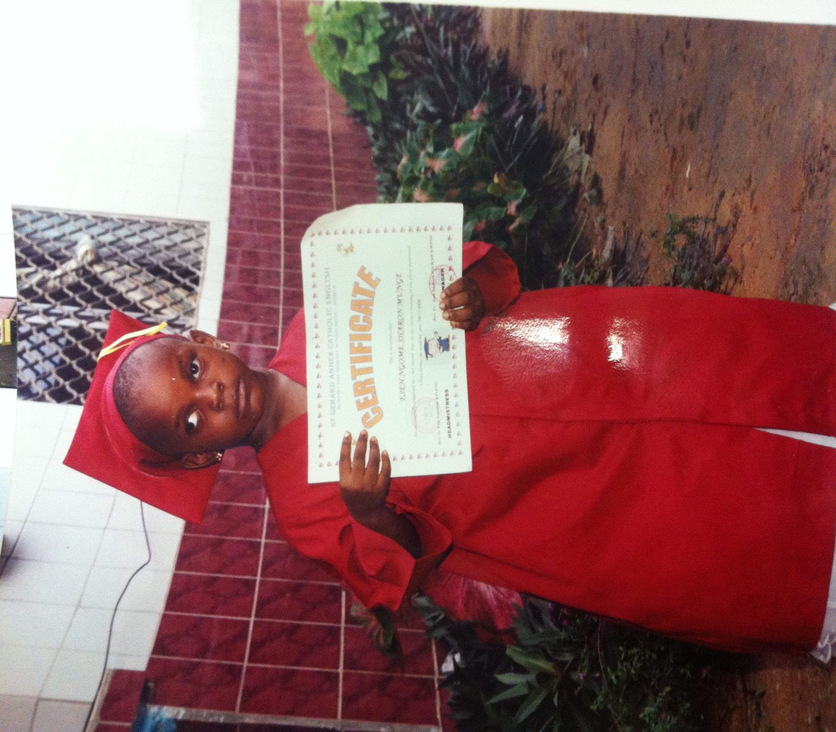

Slide 22
Terms
XT= Exotropia
X(T) = Intermittent exotropia
X‘= Exophoria

Slide 23
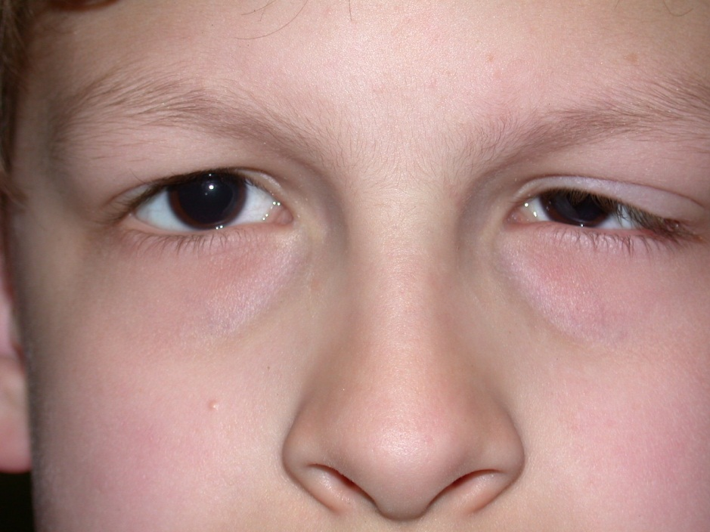

Slide 25
Other
Ocular Torticollis
Superior Oblique Palsy
Nystagmus
Glasses
Muscle restriction
Is head tilt present in sleep?
Reverse tilt do eyes misalign on light reflex?

Slide 26
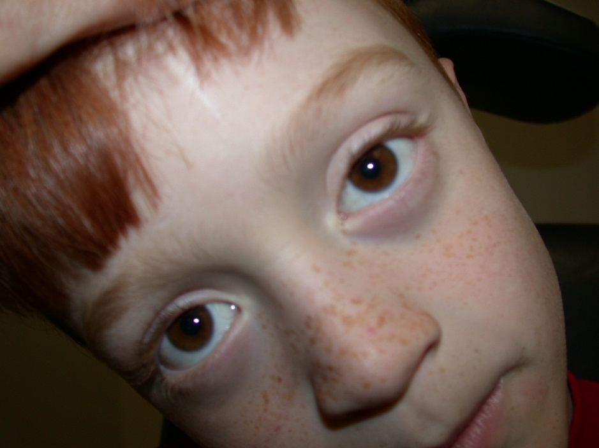
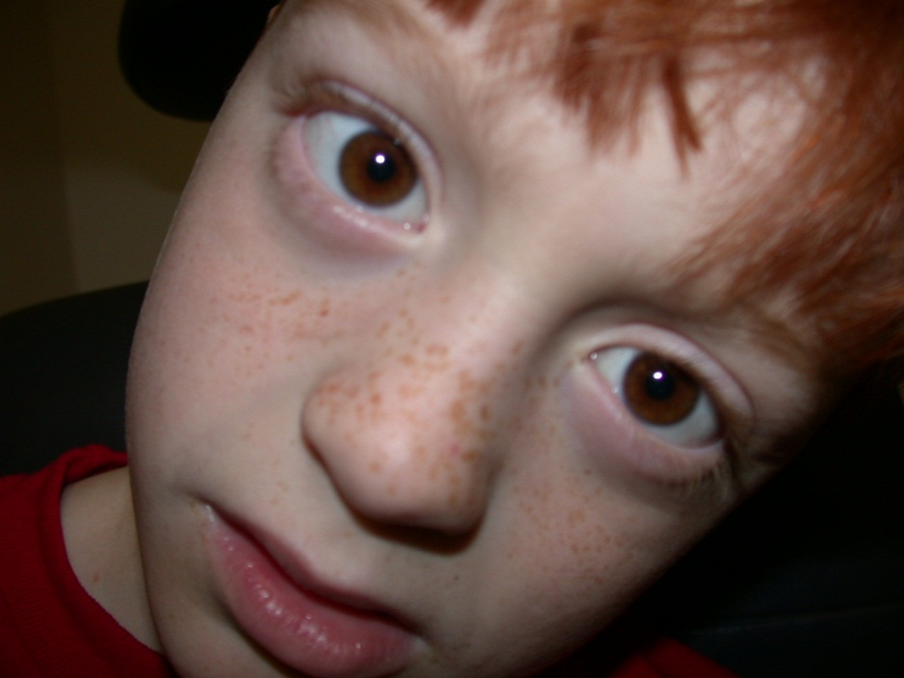

Slide 27
Paralytic vs Restrictive Strabismsus
Versions
New Head posture!
6th = loss of abduction
3rd = down and out eye, maybe large pupil
4th= new tilt or vertical or turn
Lid narrows on adduction

Slide 28
Restrictive Strabismus
Floor fracture
Medial Wall Fracture
Thyroid
Duane’s Type 1

Slide 29
New Topic

Slide 30
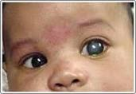
Infants: Watch out Don’t miss Glaucoma!
Early: Clear tears
Photophobia
Irritable
Family hx Glaucoma
Late= Buphthalmia
Pressure before age 3
eye blows up like balloon.
Vs Common:
Nasolacrimal Duct Obstruction
Discharge
Clear Cornea!
Happy kid
Sac pressure more goo

Slide 31
Watch out Don’t miss HSV!!
Minimal discharge
Photophobia
Conjunctiva may be pink
HSV early:
Fluroscene stain =branch pattern
HSV late:
Cornea hazy or white areas
Discharge
Clear Cornea!
Happy kid
Sac pressure expresses material
Don’t miss dacrocyceole newborn as most become dacrocyctitis!

Slide 32
Dacroceole: not just any old NLD Obstruction
Newborn
Make sure no ball at lacrimal sac
Amniotic fluid in high and low block of lacrimal system
Usually gets spontaneously infected during 1st week of life
When infected = Dacrocystitis
Results admission and w/u sepsis
May prevent infection with early probe in office

Slide 33
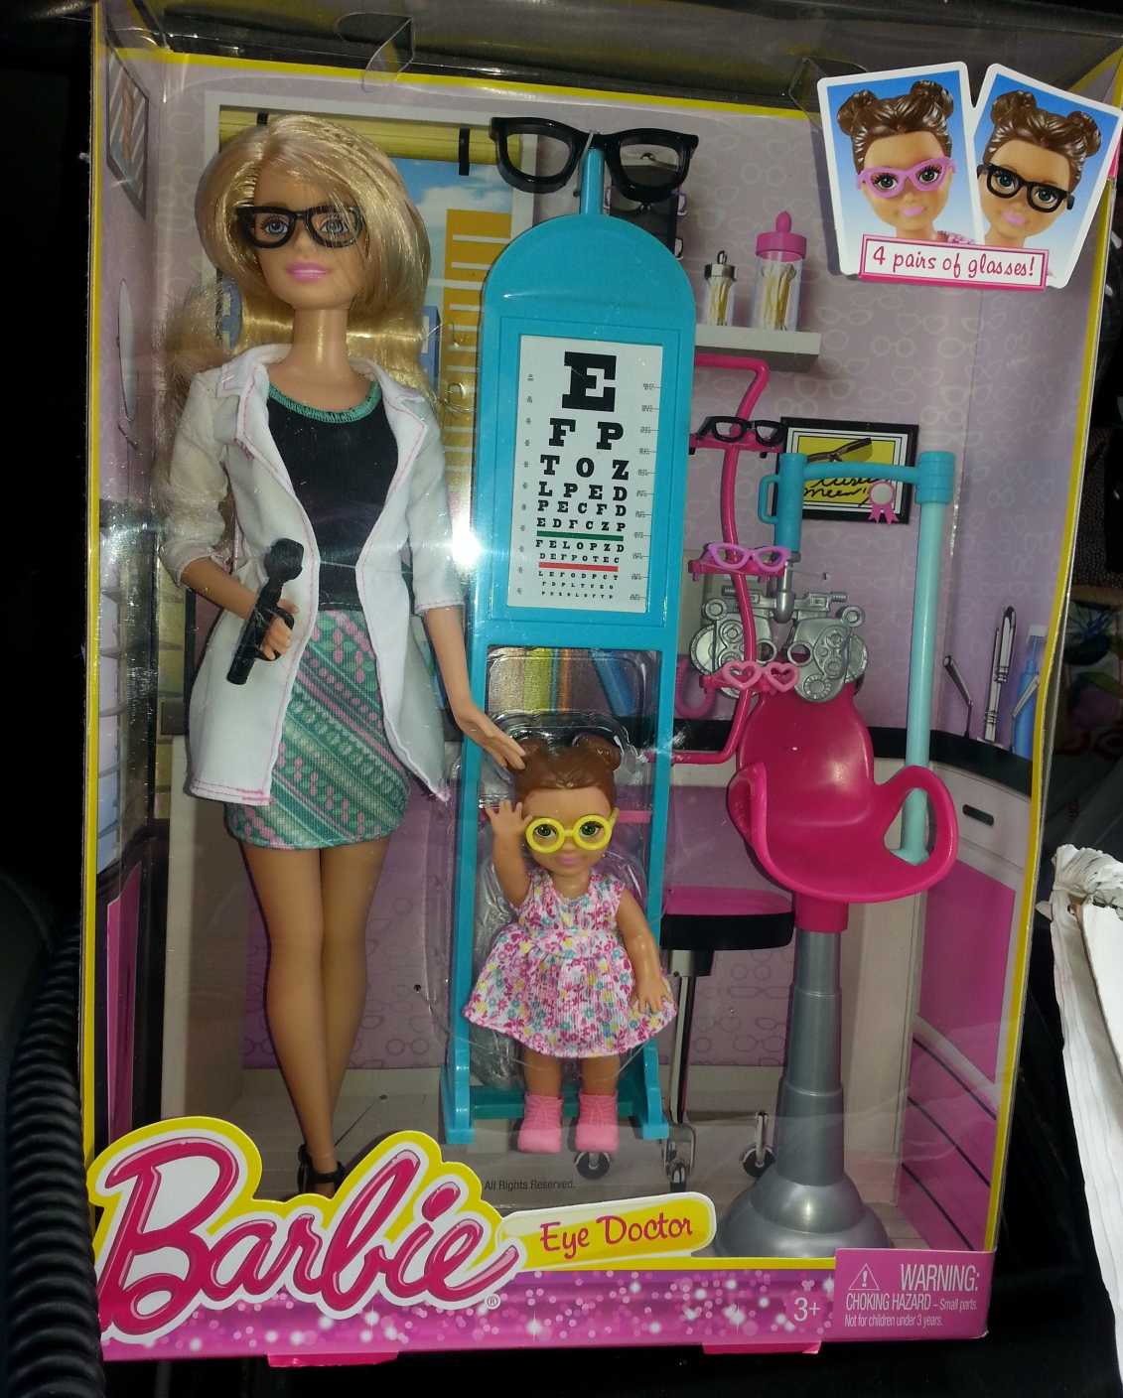

Slide 34
Thank you
Marijean Miller, MD
Rotate through the eye clinic or come to SG satellite
Rotate in the NICU on ROP rounds
AAPOS website

Slide 35
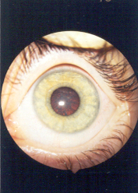

Slide 36
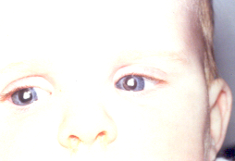

Slide 37
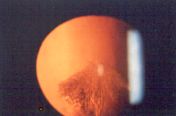
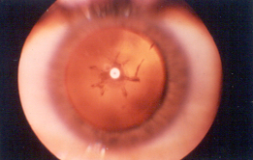

Slide 38
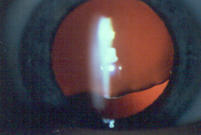

Slide 41
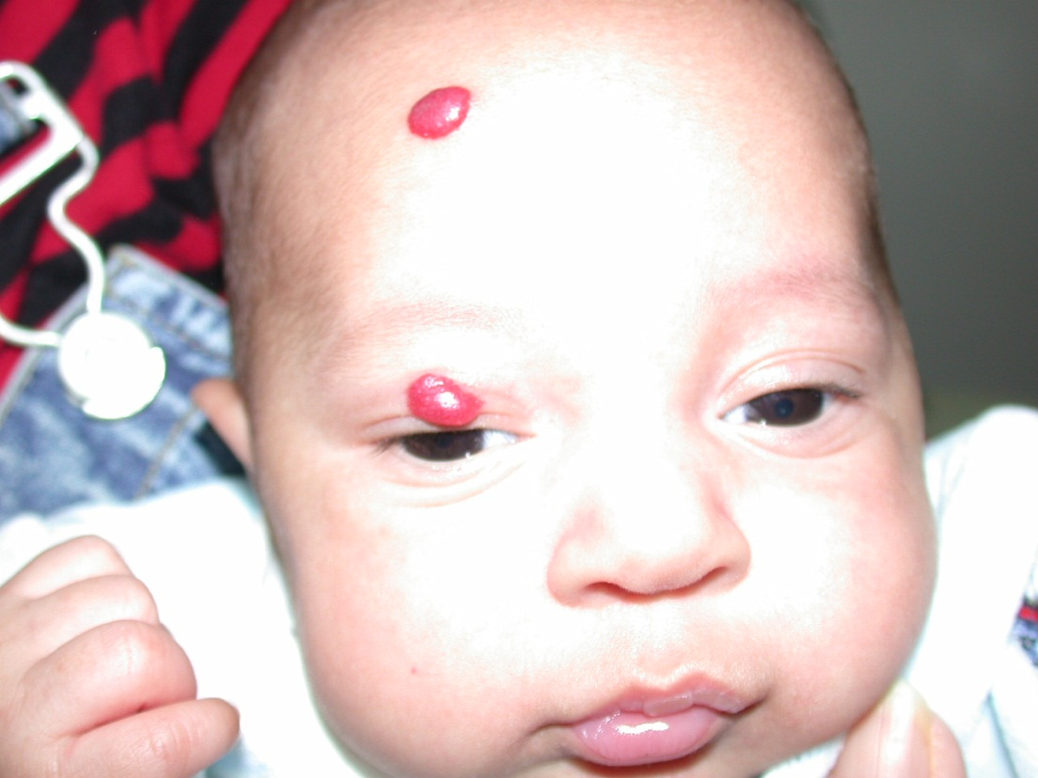

Slide 43
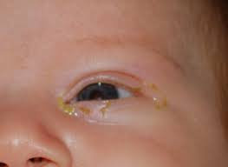

Slide 45
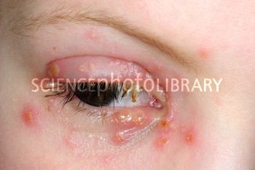

Slide 46
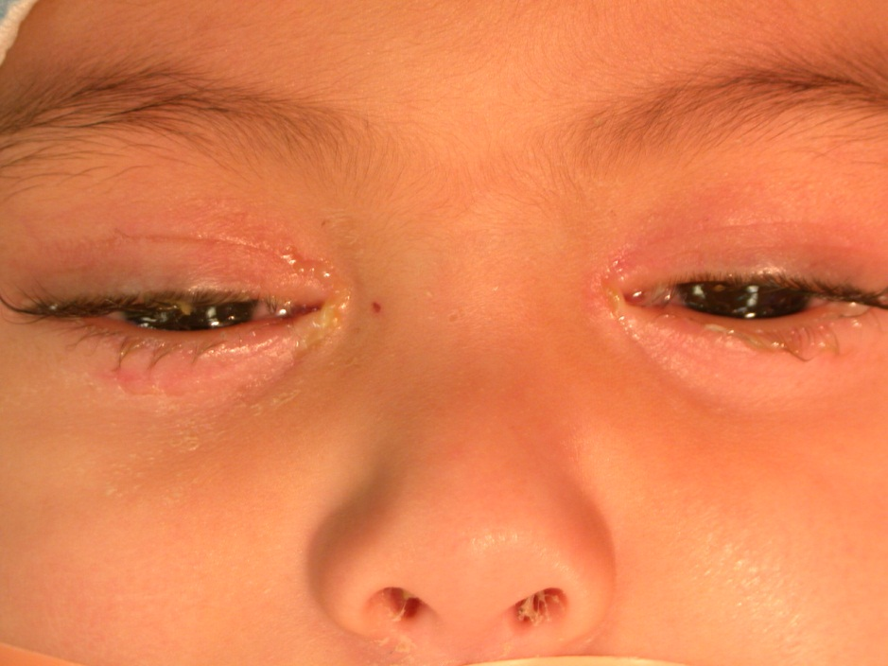
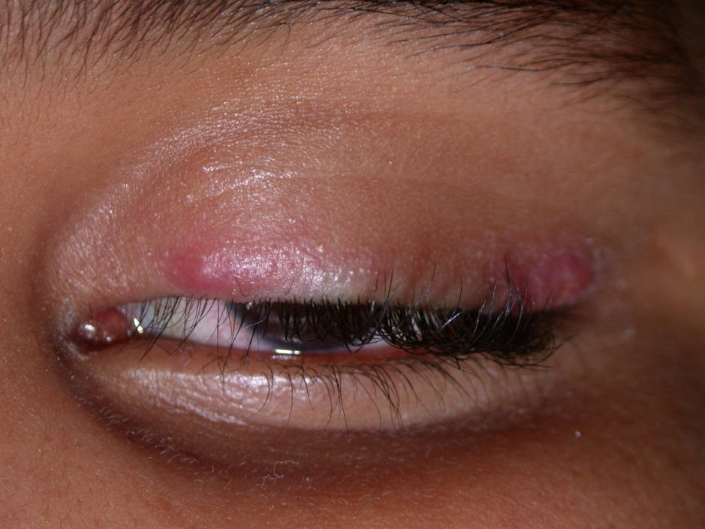

Slide 47
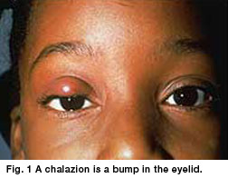

Slide 49
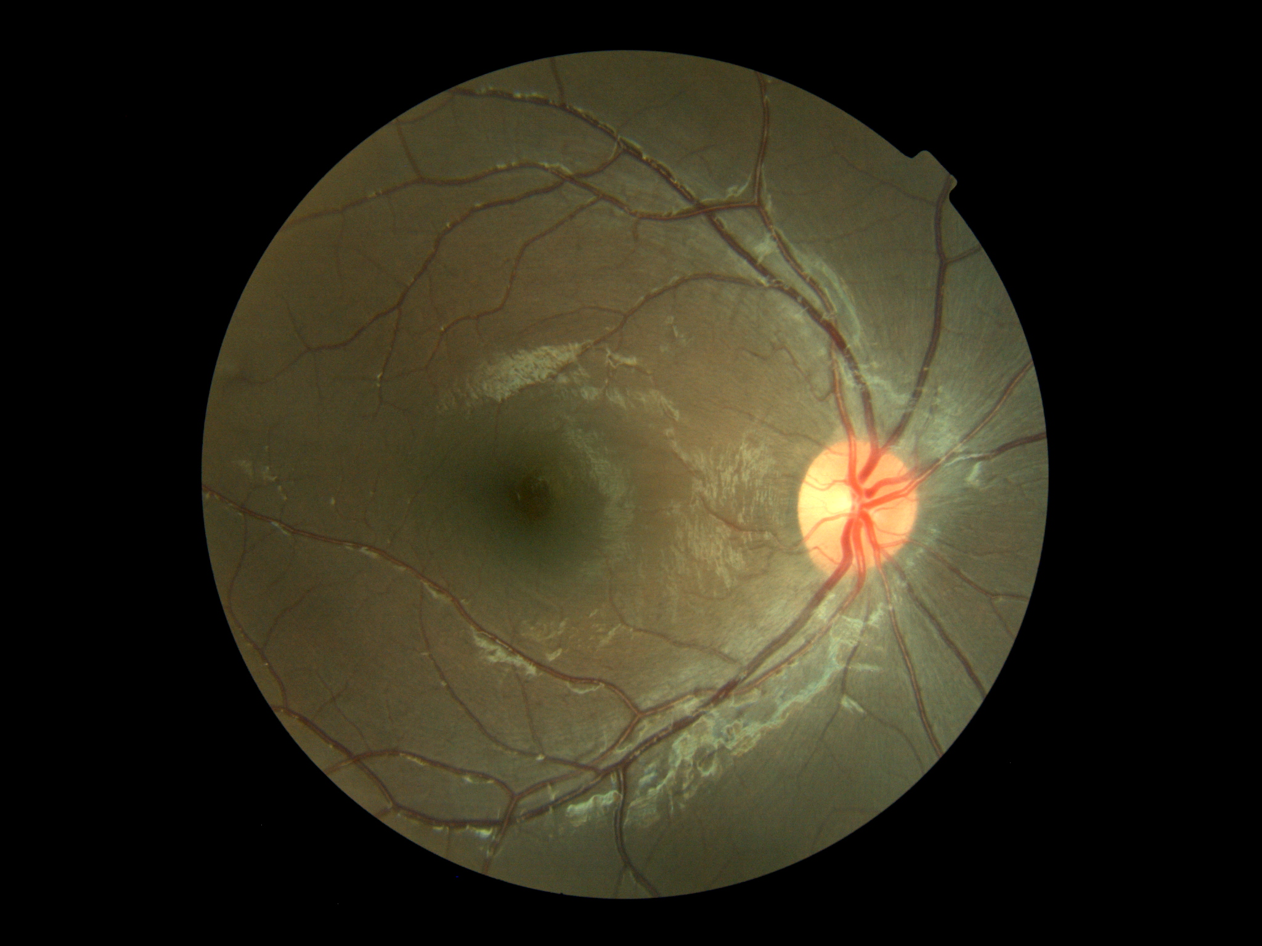

Slide 50
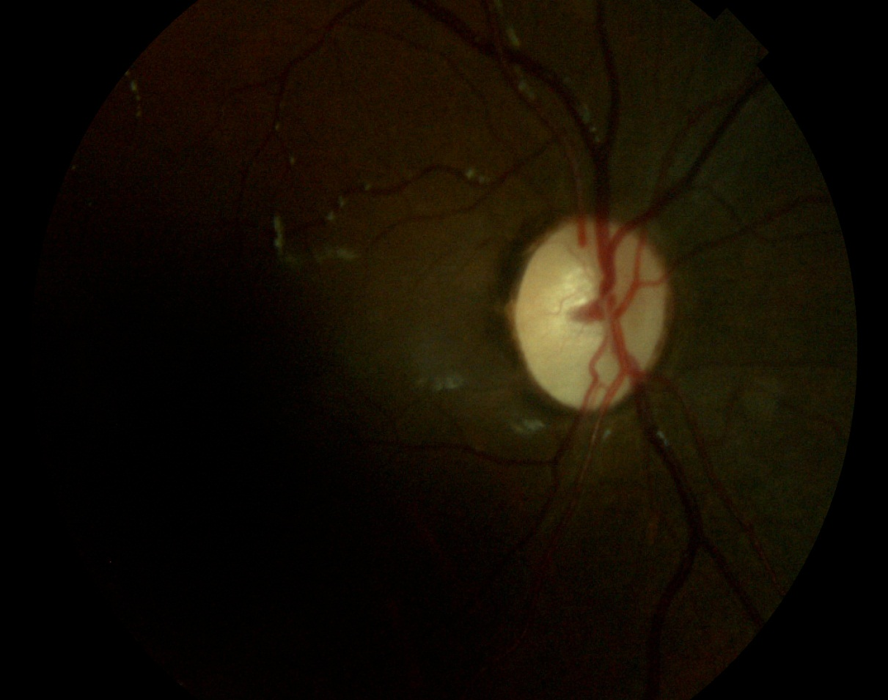

Slide 51
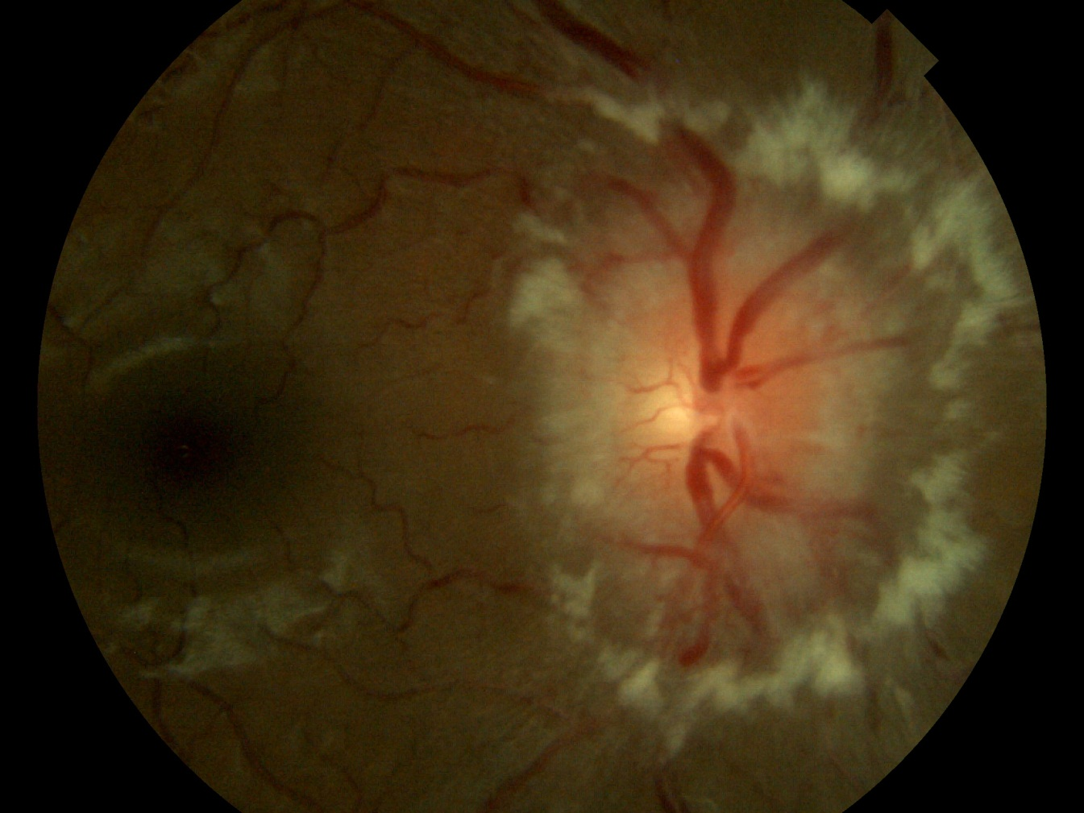

Slide 52
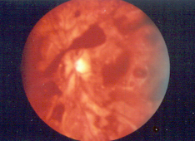

Slide 53
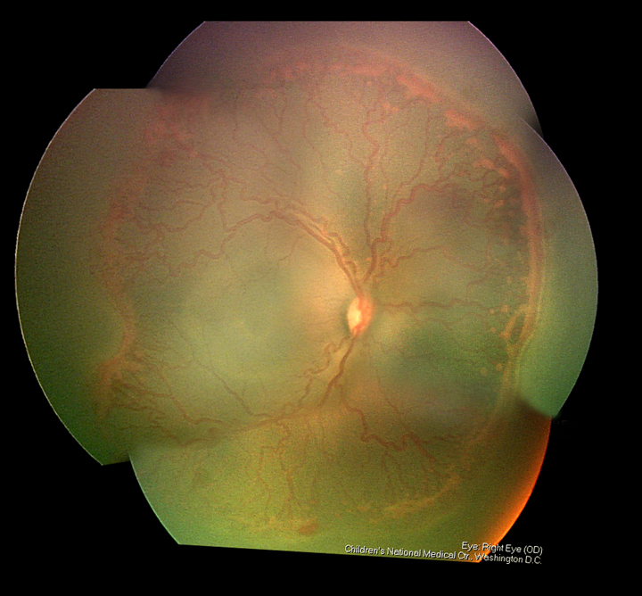

Slide 54
Who is at risk?
Premature infants born :
30 weeks or less
Low Birth Weight Infants (LBWI)
1500 grams or less
Infant that have had an extremely ill medical course
Risk Factors
Twin or multiple gestation
IVH
Hydrocephalus
Cardiovascular Disease
Chronic lung Disease

Slide 55
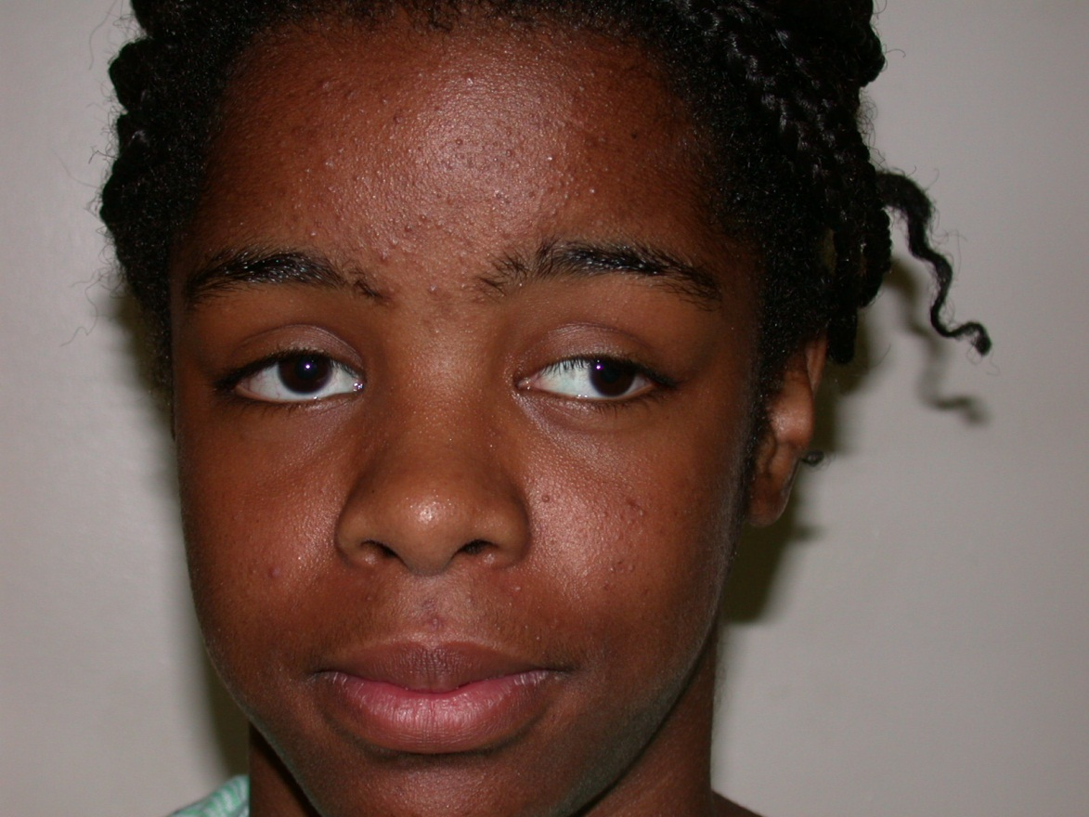

Slide 57
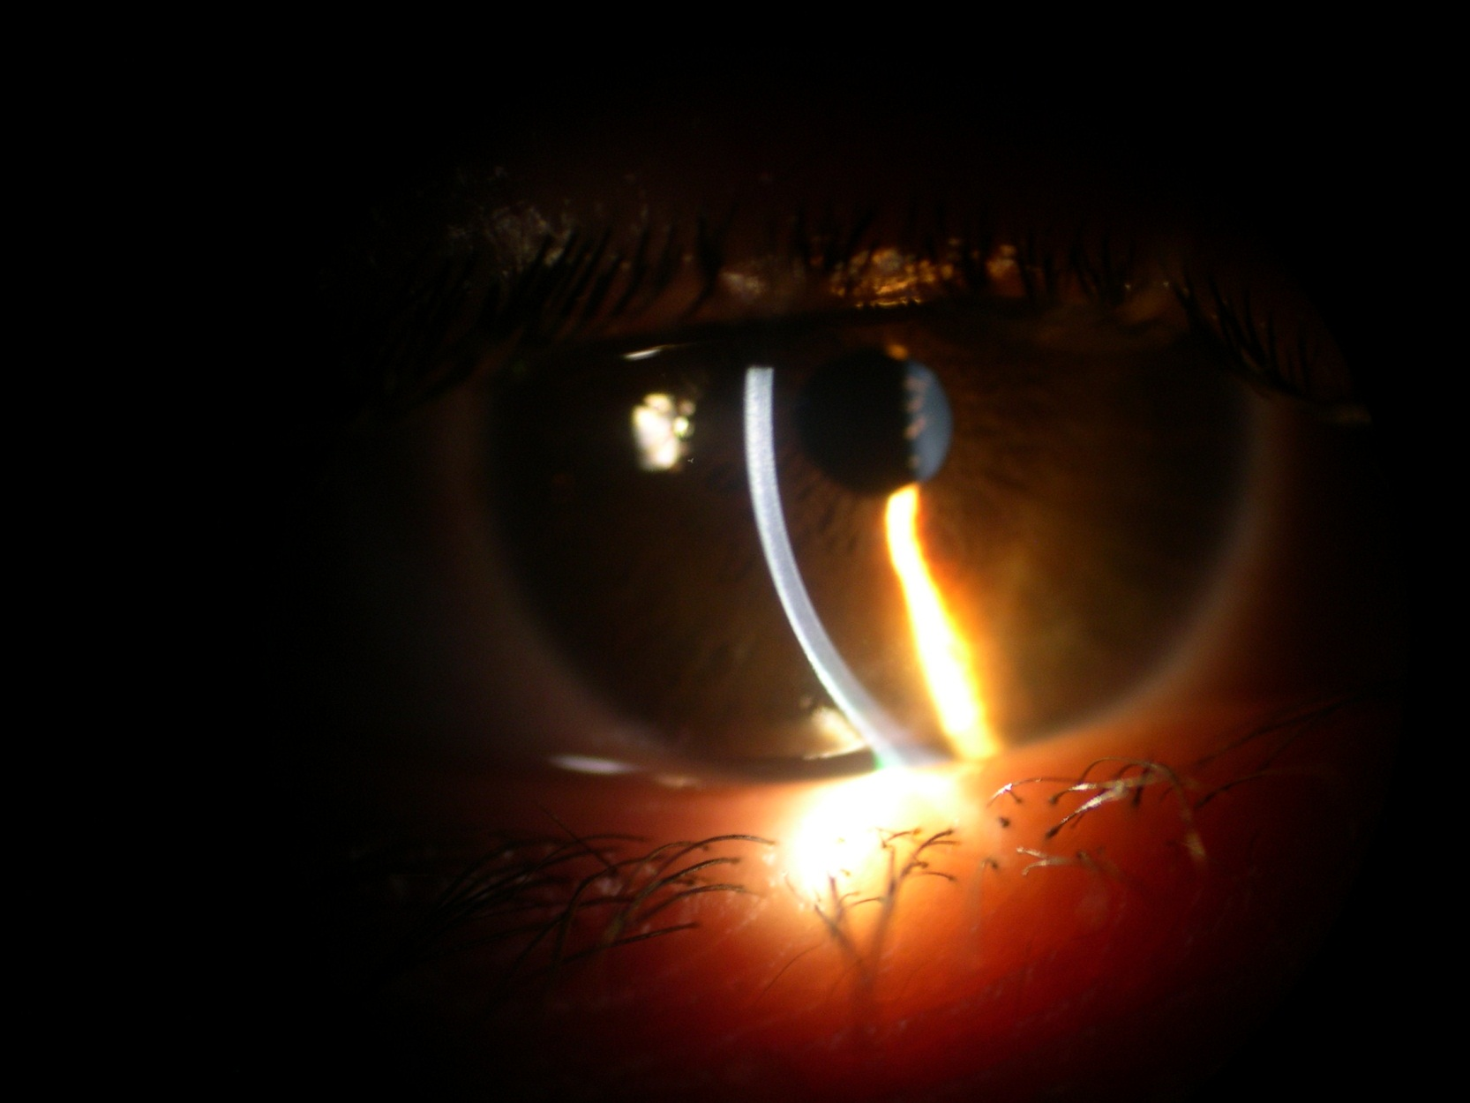

Slide 58
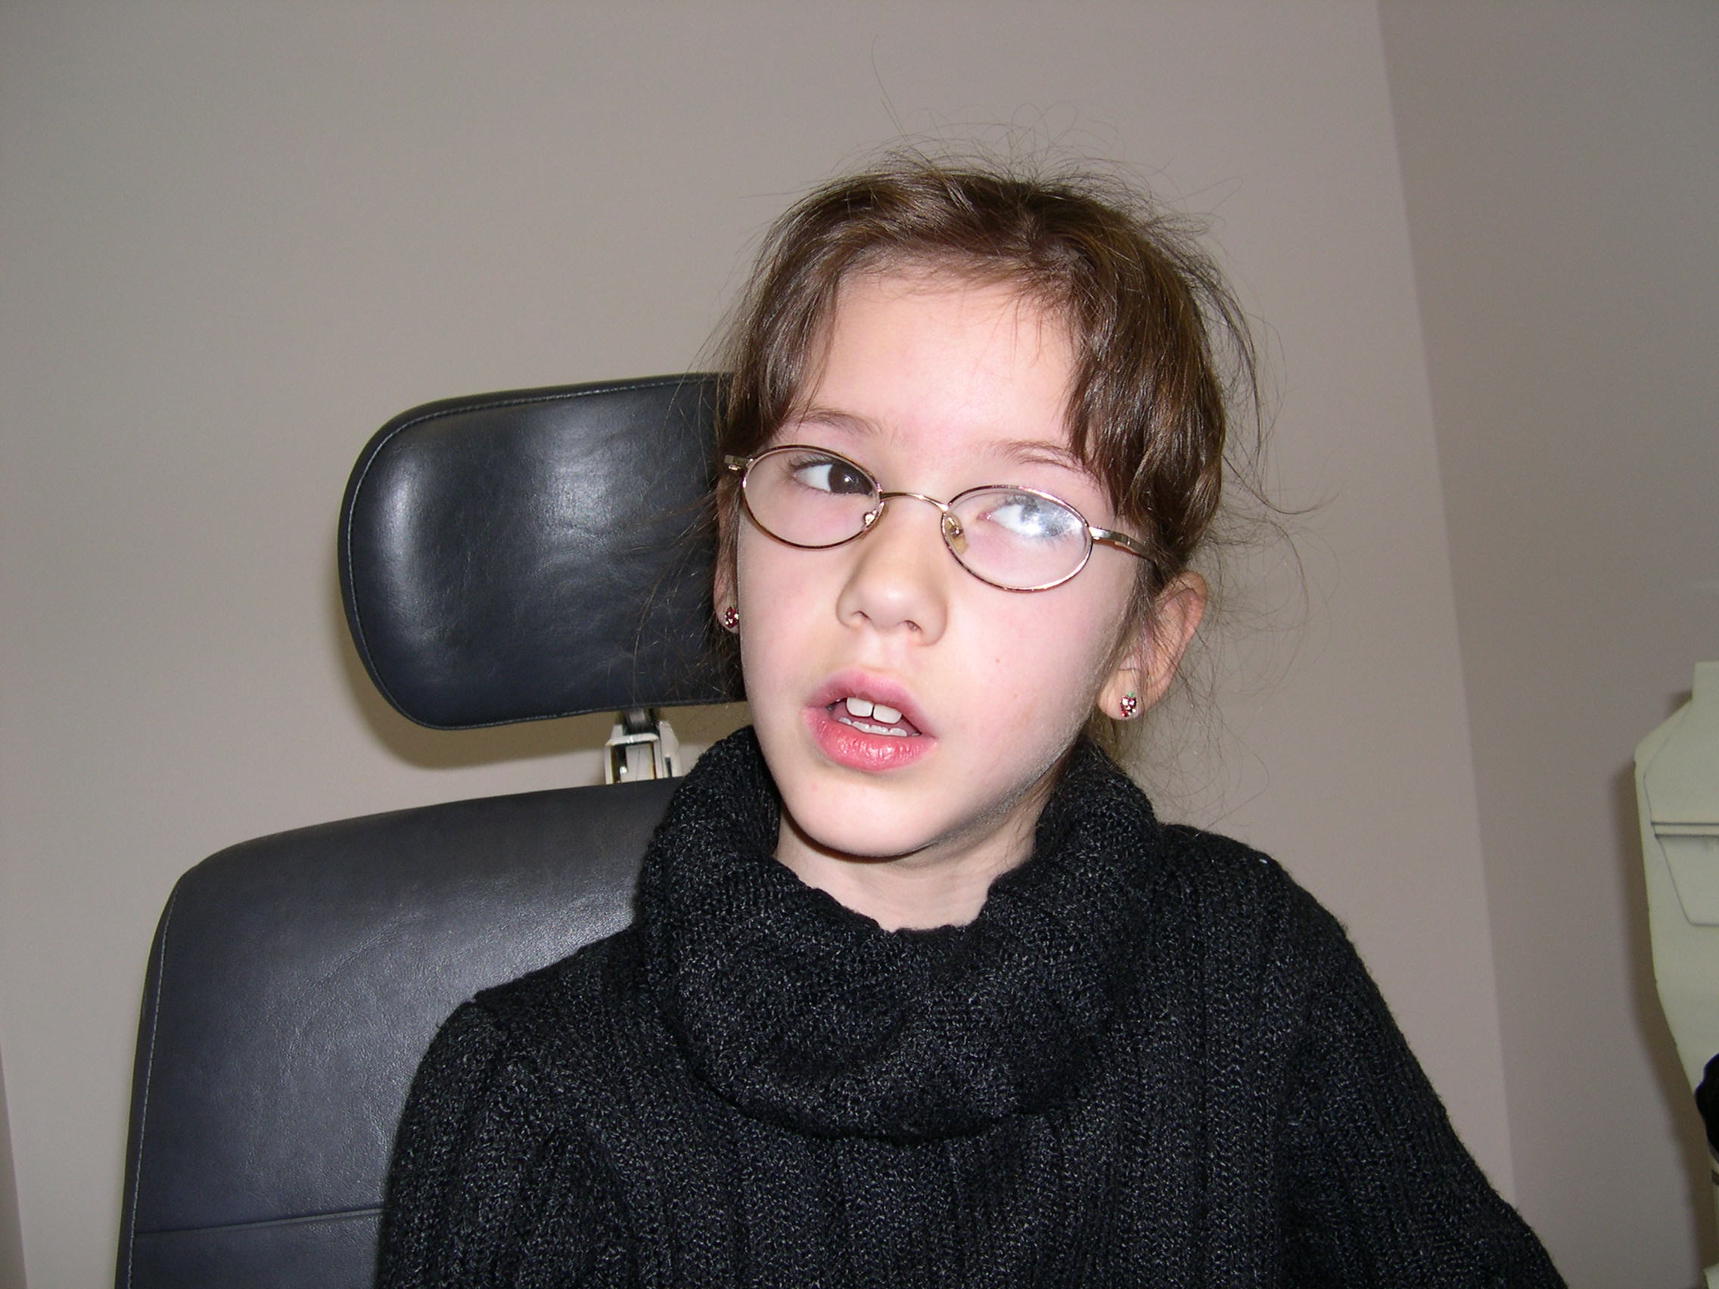

Slide 59
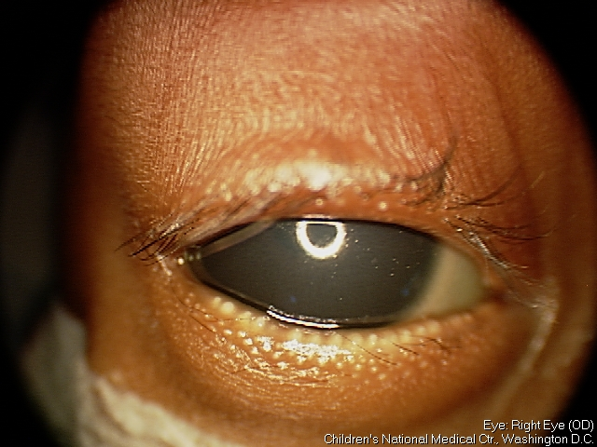
External Photograph
ortho
RHT 8Δ
RHT 10Δ
X 12
RHT 20Δ
RHT 12Δ
RHT 25Δ
E4

Slide 60
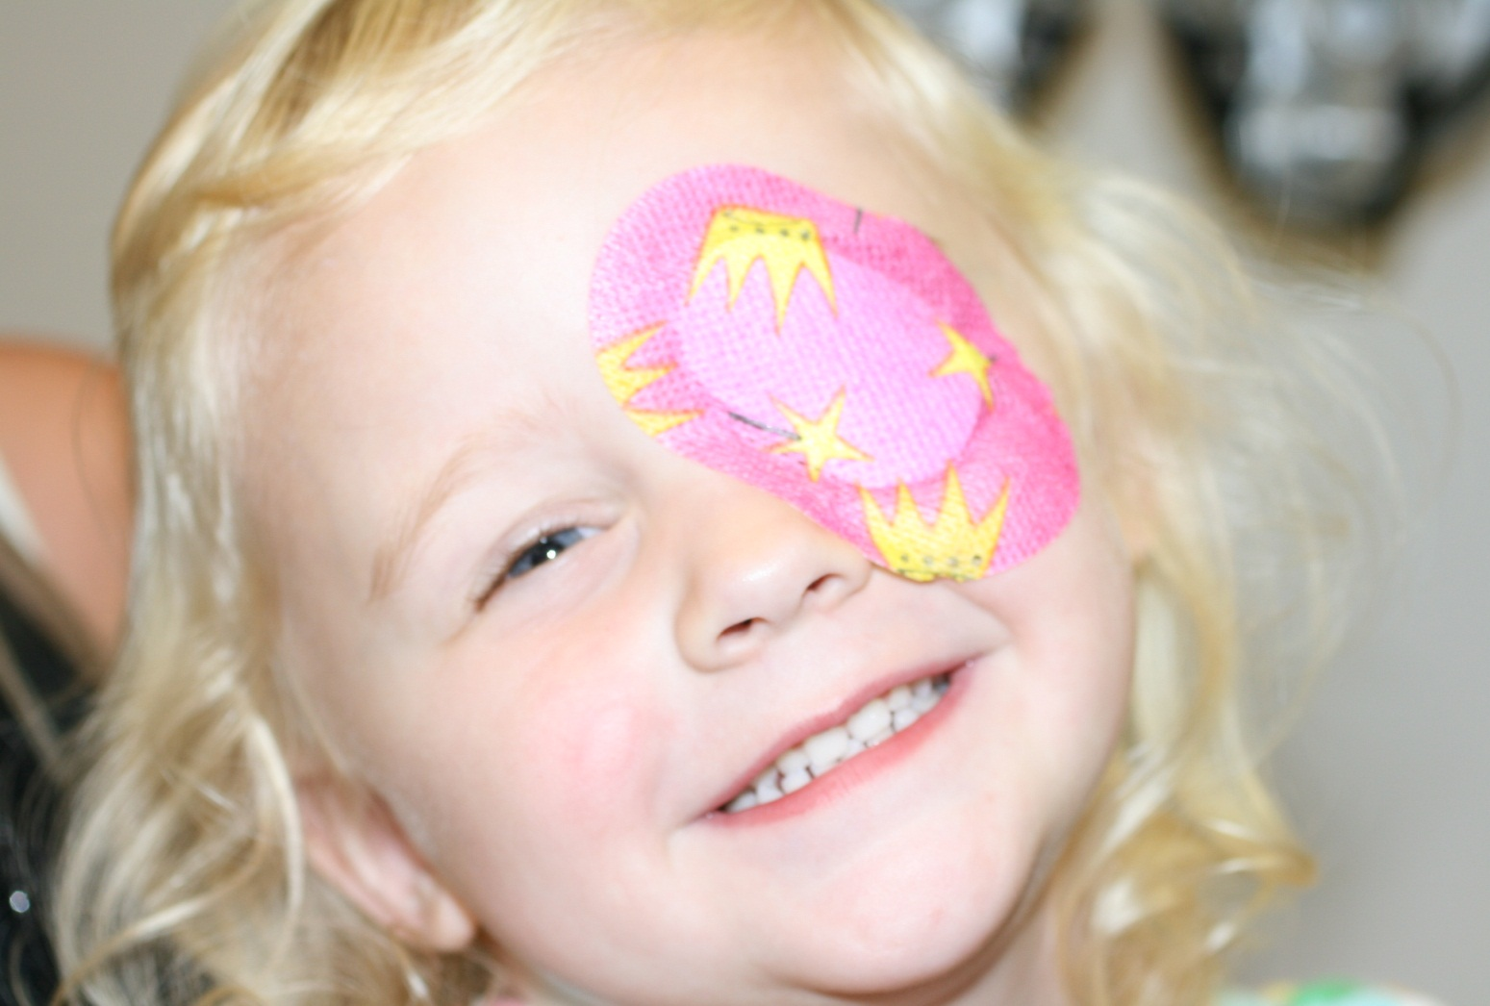

Slide 62
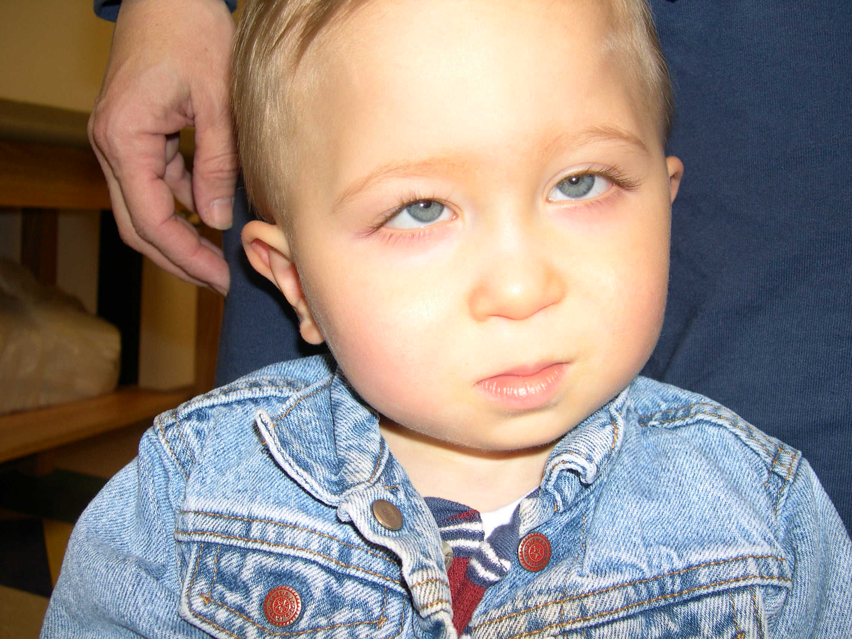

Slide 63
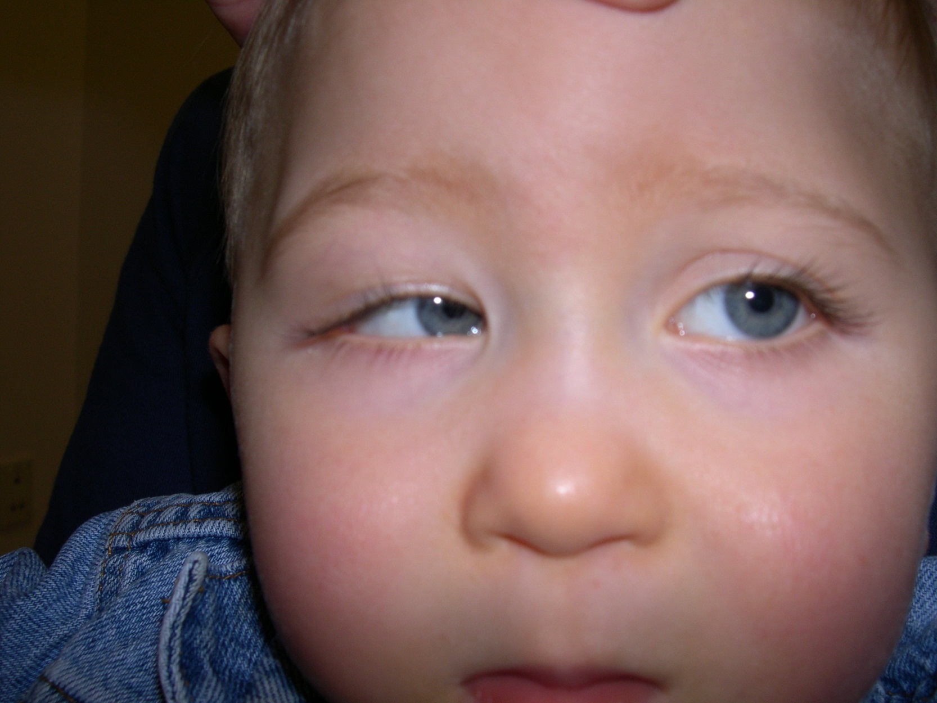

Slide 64
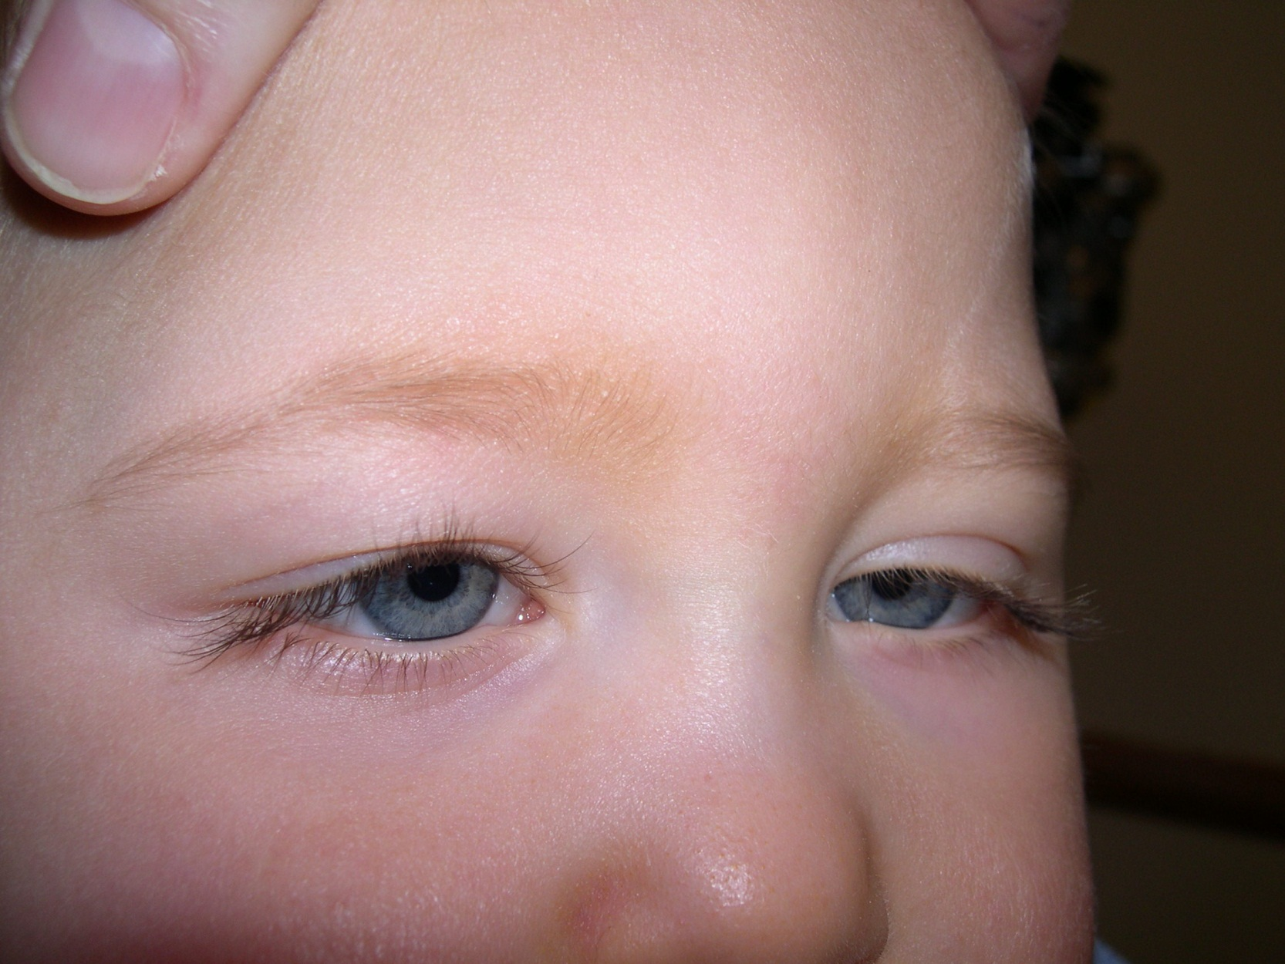

Slide 65
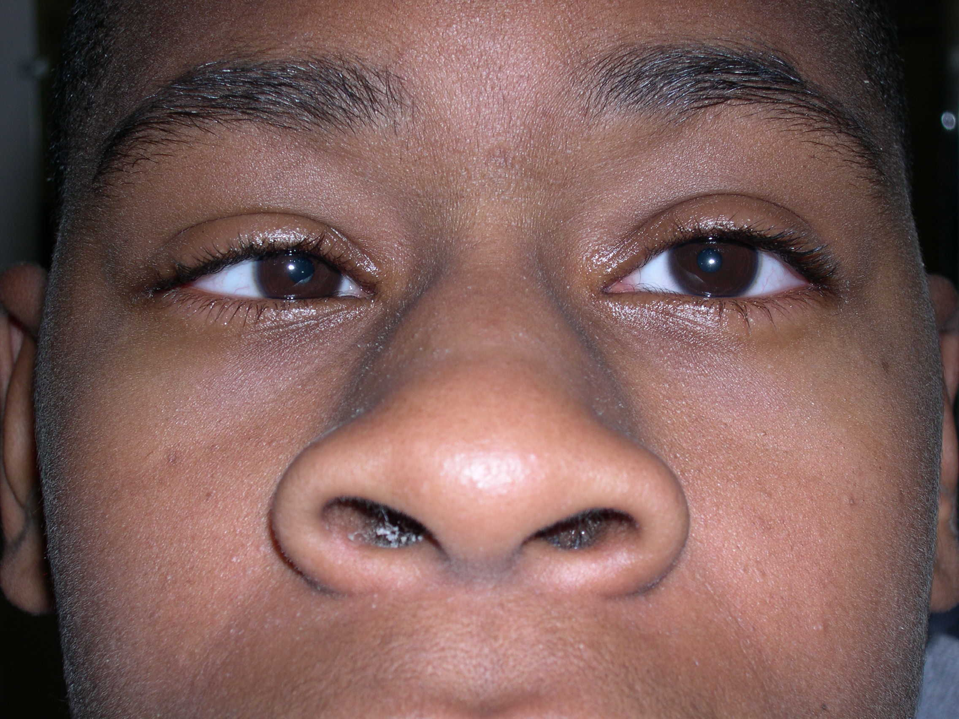

Slide 66
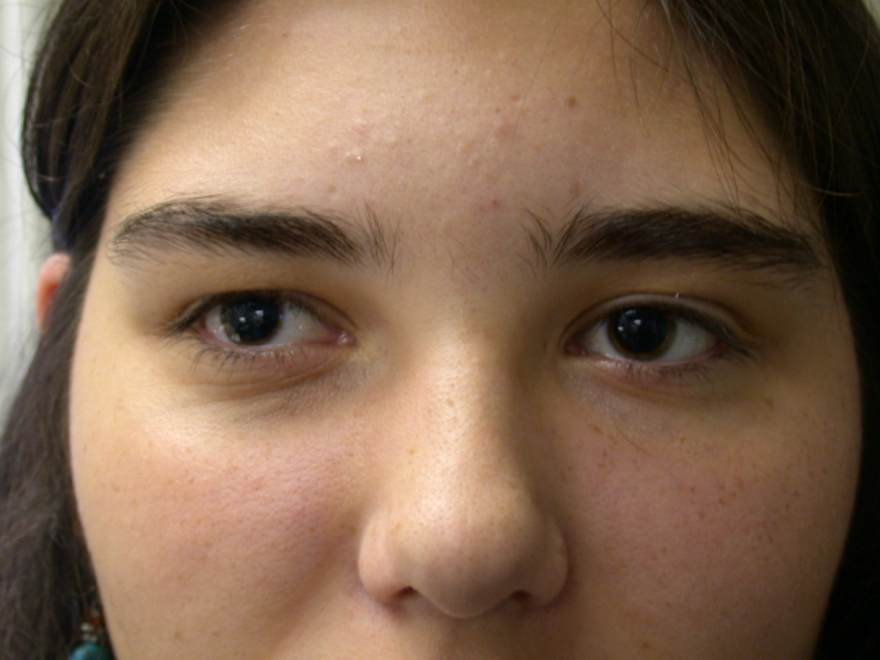

Slide 68
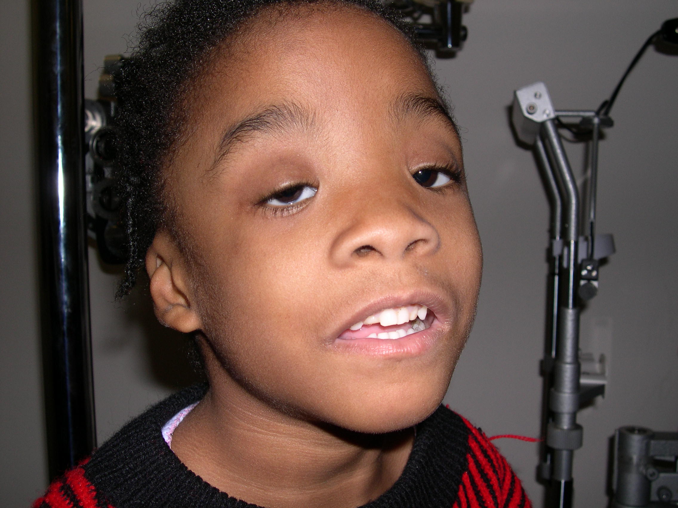

Slide 69
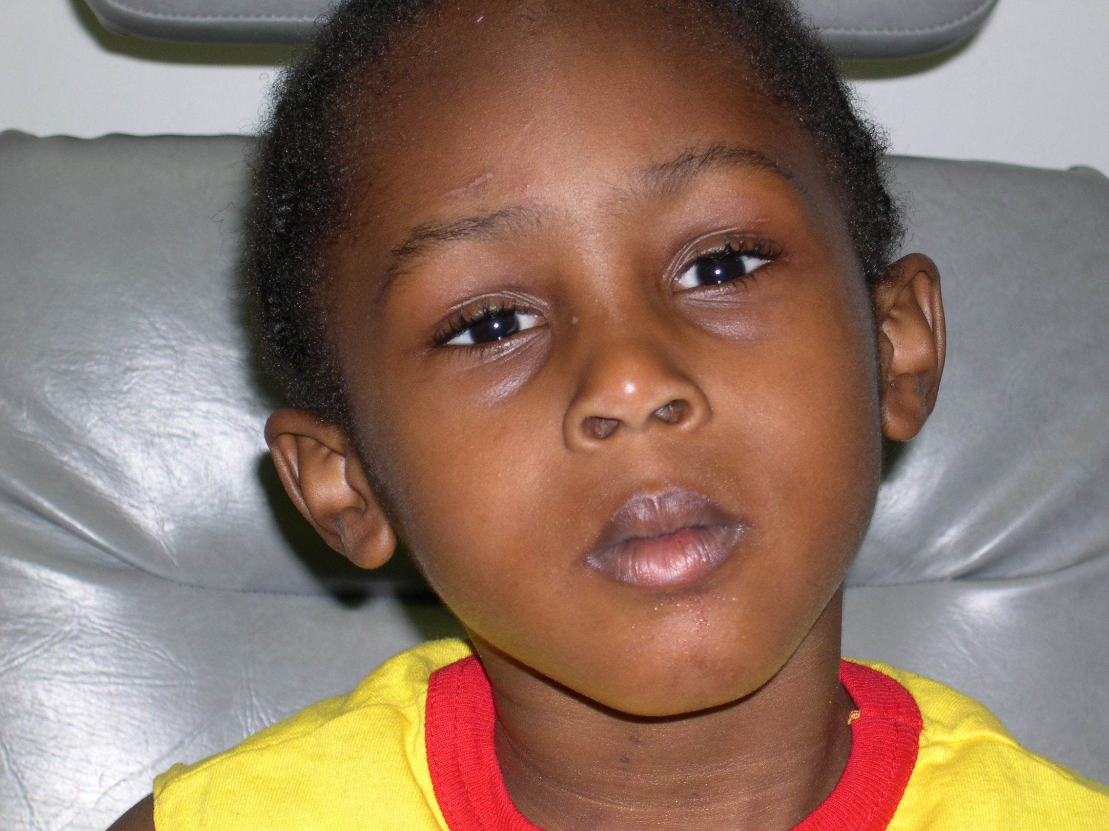

Slide 70
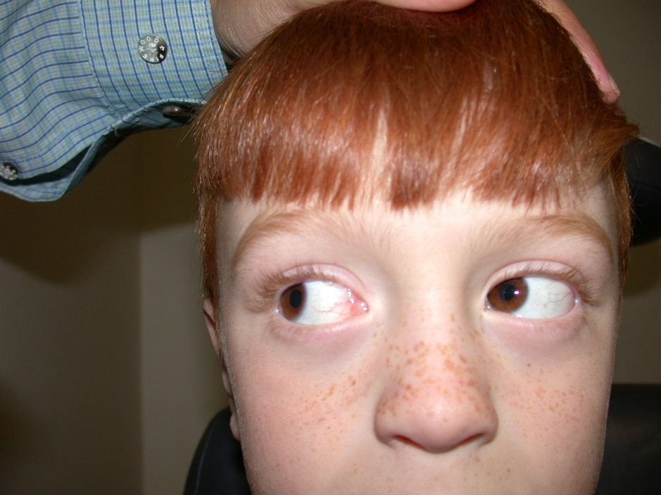
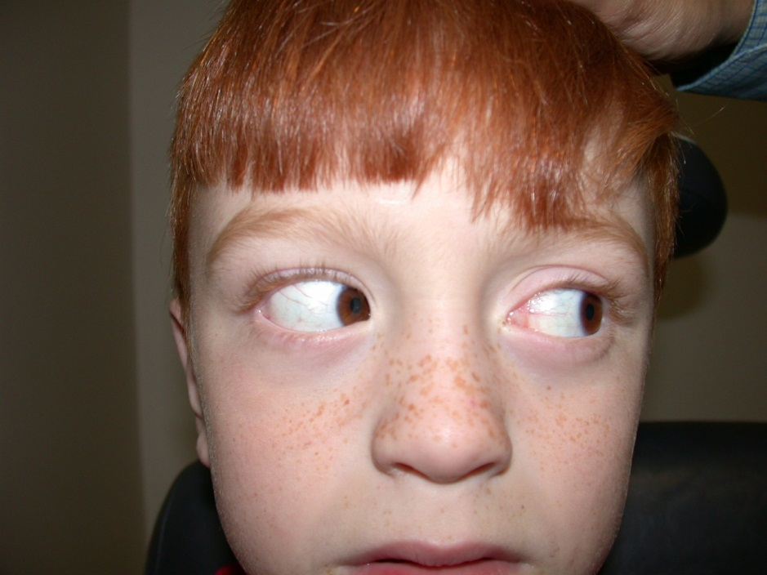
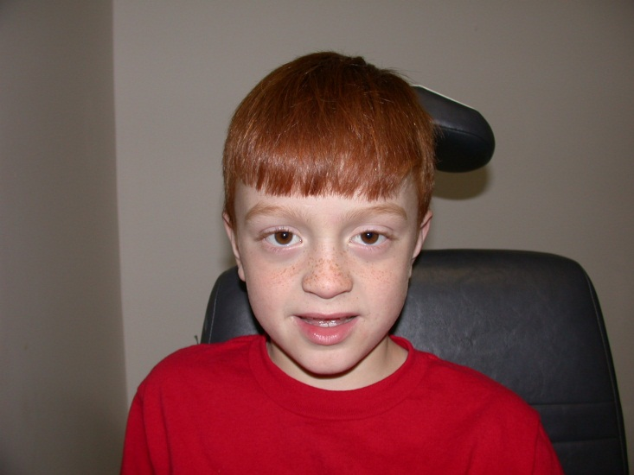

Slide 71
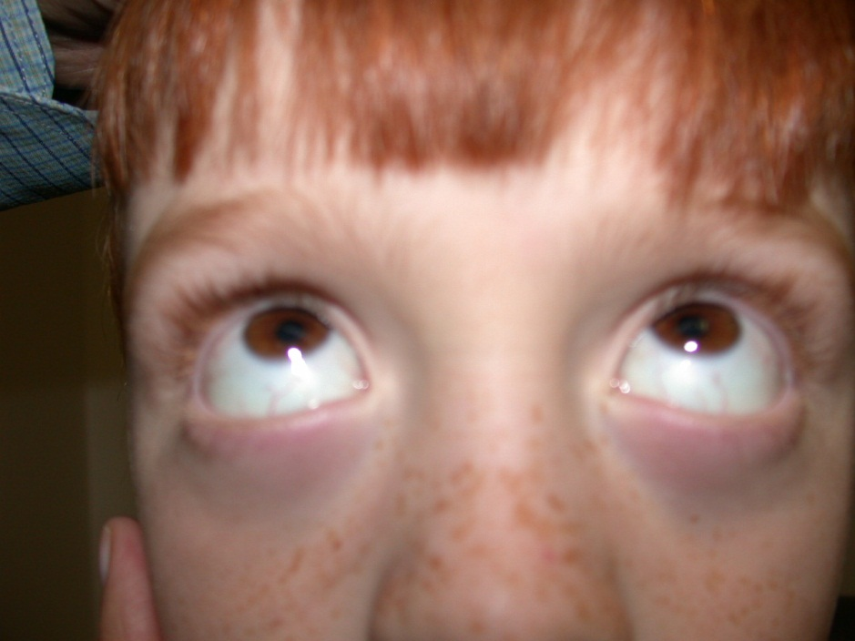
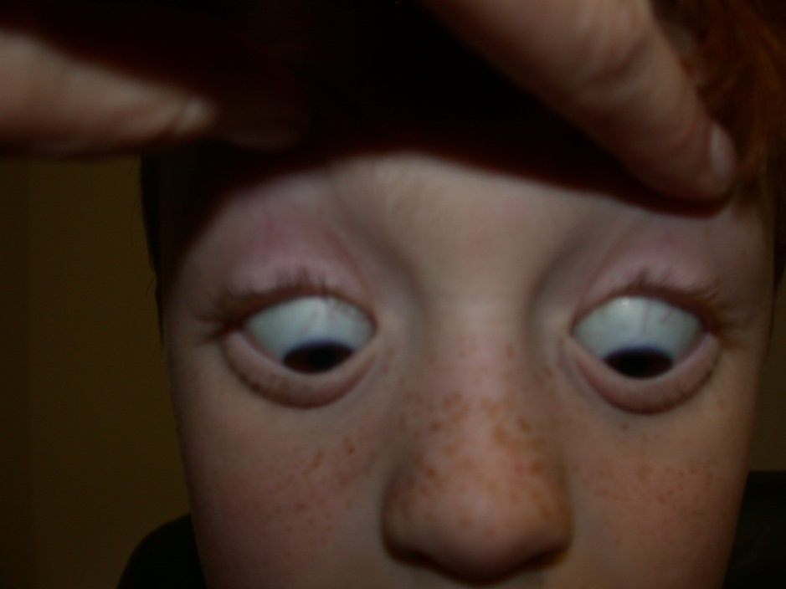

Slide 73
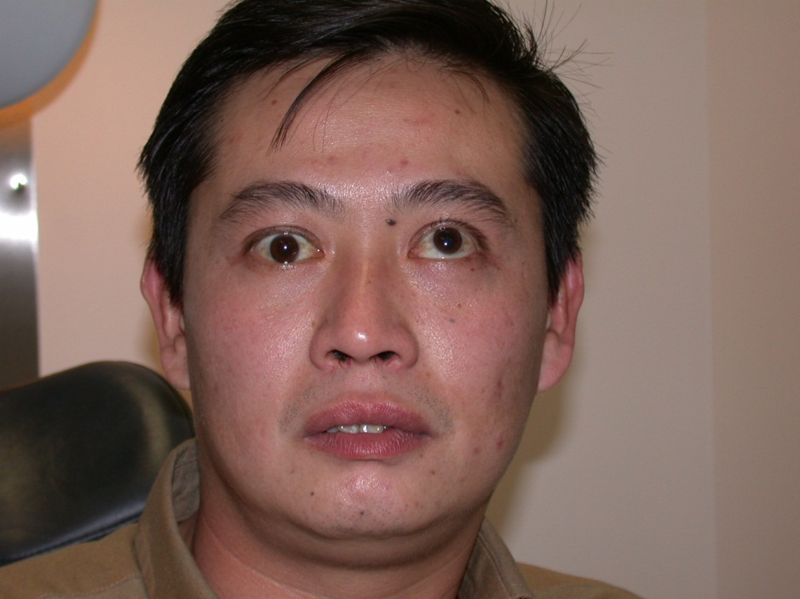

Slide 74
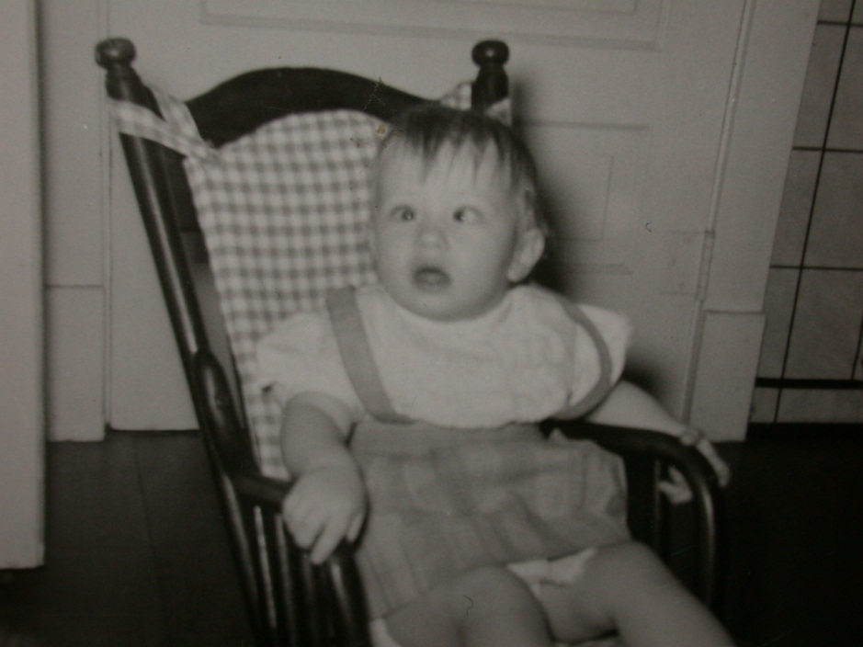
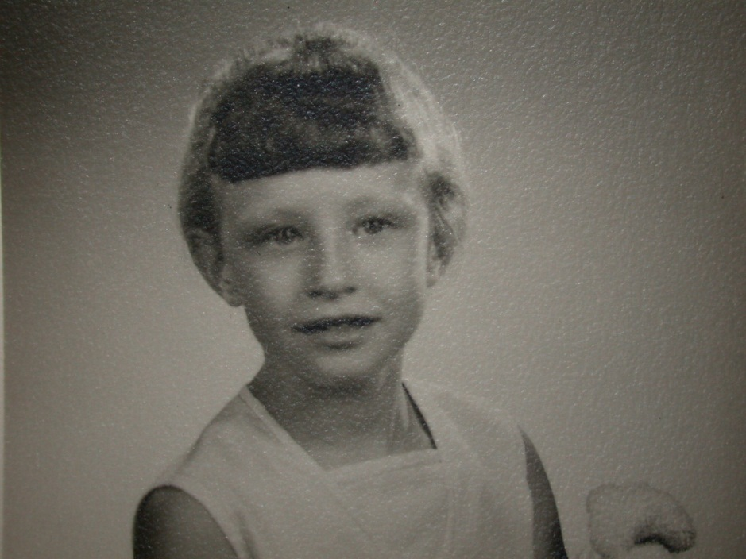
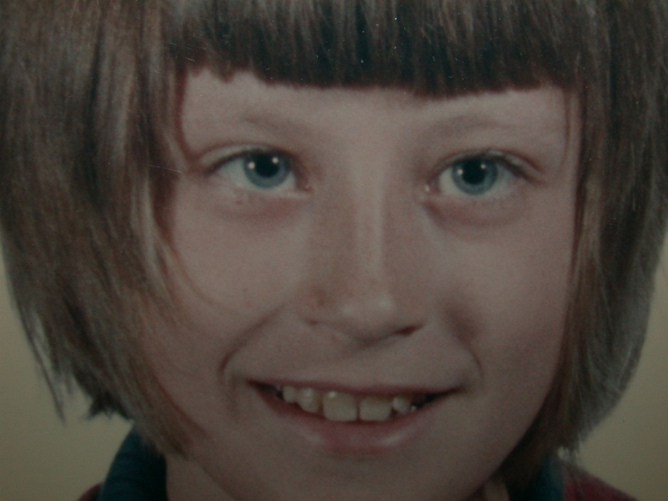
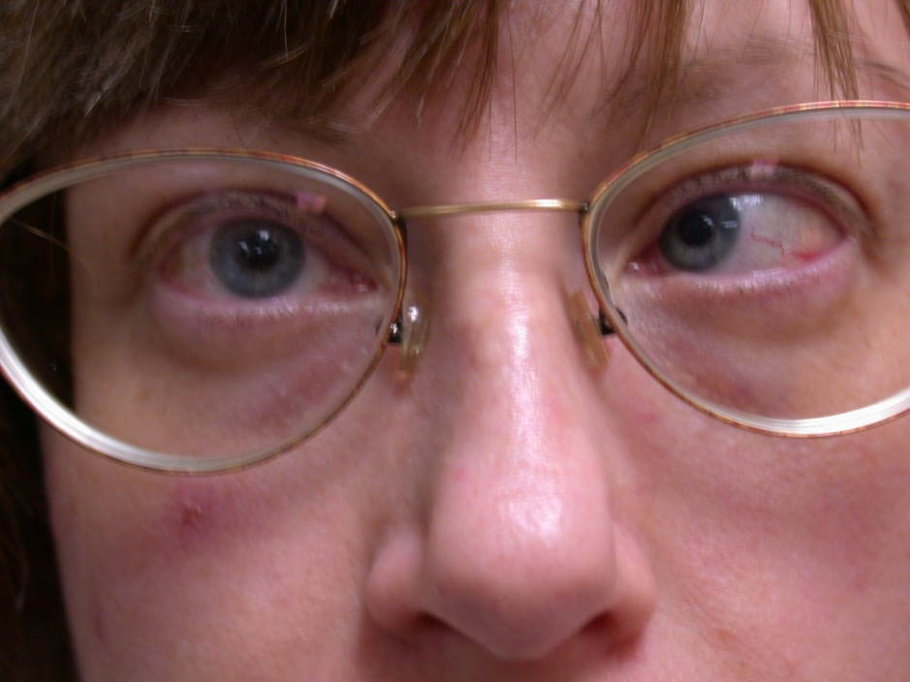

Slide 75
Which eye is looking at you?
Right eye = Fixating Eye

Slide 76
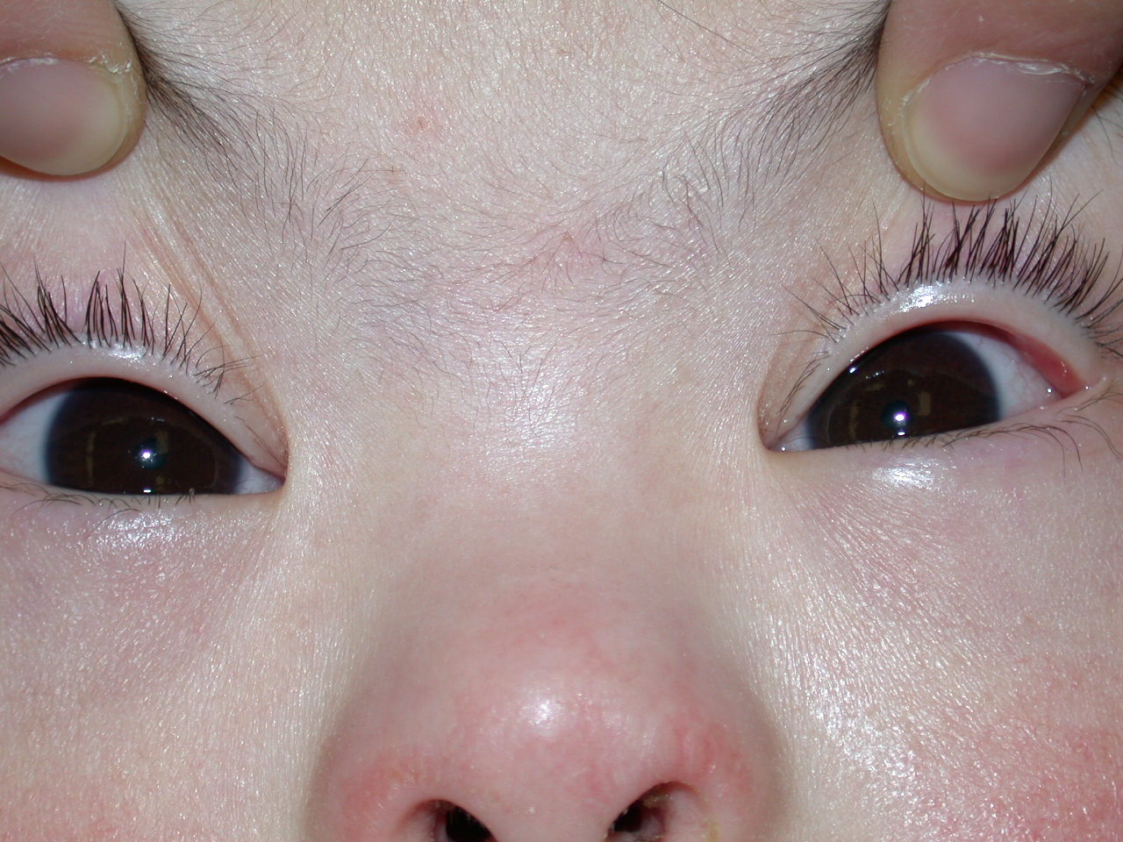
Light Reflex

Slide 77
Topics Covered Today
Pseudostrabismus vs Strabismus
Abnormal Red Reflex
Tearing
Styes
Optic Nerve/Retina
Amblyopia
ROP screening criteria
AAPOS
American Association of
Pediatric Ophthalmology and Strabismus

