Slide 1
Baby Bites: Tidbits on Infant Feeding Rebecca Vander Veer, RD, LD

Slide 2
Breast Milk Essentials

Slide 3
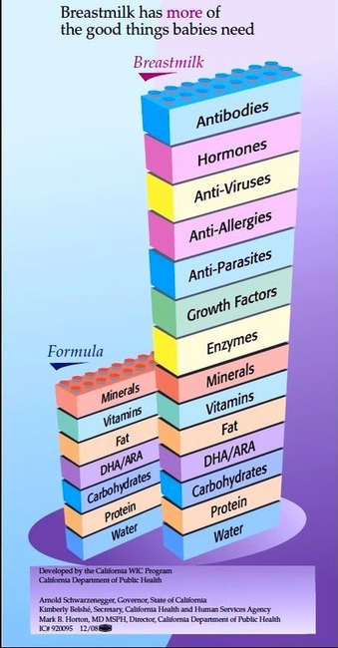
How do breast milk and formula stack up to each other?

Slide 4
Breast Milk Benefits
Easily-digestible protein
60:40 whey-casein ratio
Infant can self-regulate intake
Low renal solute load
Immune-support factors
Protection against illness and chronic disease
decreased otitis media, respiratory tract infections, UTIs, bacteremia, bacterial meningitis, NEC, late-onset sepsis in preterm infants, etc.
Barbas, 2014.

Slide 5
Immune Support
Secretory IgA for passive immunity
Lactoferrin
Prevents Fe-dependent pathogens from binding to Fe
Lysozyme
L. bifidus as probiotic
Leukocytes
Barbas, 2014.

Slide 6
Immune Support
Xanthine oxidase in BM creates hydrogen peroxide
Neonatal saliva vs. adult saliva
High levels of hypoxanthine and xanthine
Nucleosides and nucleobases
BM + saliva → more hydrogen peroxide
Effects
Inhibited growth of Staphylococcus aureus, Salmonella spp.
Promoted growth of commensal Lactobacillus plantarum
Al-Shehri, 2015.

Slide 7
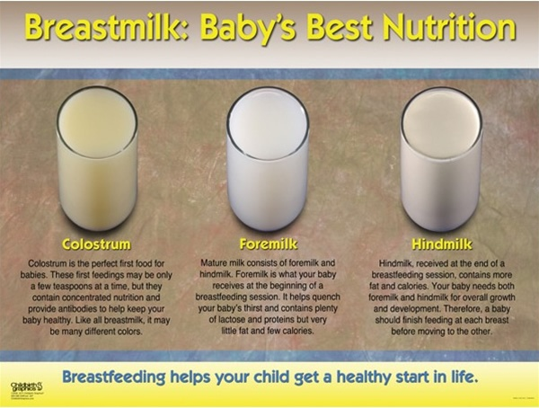
Changing Composition of Breast Milk
During the feed
Foremilk and hindmilk
Hindmilk has up to 2x fat of foremilk
During the day
Higher fat at night
During the lifecycle
Colostrum
Preterm vs. term
Protein decrease
Barbas, 2014.

Slide 8
Contraindications to Breastfeeding
HIV (in developed countries)
Active, untreated tuberculosis
Galactosemia in the infant
Some medications
LactMed app
Drugs of abuse
Barbas, 2014.

Slide 9
Breastfeeding Problems & Roadblocks
Common problems
Lack of social support
Lack of resources
Pain
breastfeeding should not hurt
Perceived low milk supply
Refer moms to an IBCLC for any problems
East of the River Lactation Center – free lactation support

Slide 10
Donor Milk in the Outpatient Setting
Pasteurized donor milk from HMBANA milk banks
Donor and her milk are screened
Limited availability with prescription
Internet, community (e.g., family member)
Use with extreme caution
Non-pasteurized
Risks:
Microbial contamination
Diluted milk
Contamination with other animal milks
Drug/infectious disease exposure (e.g., HIV)

Slide 11
Infant Formula Essentials

Slide 12
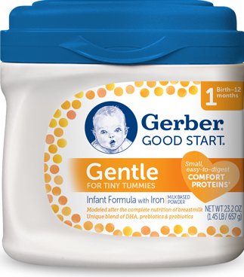
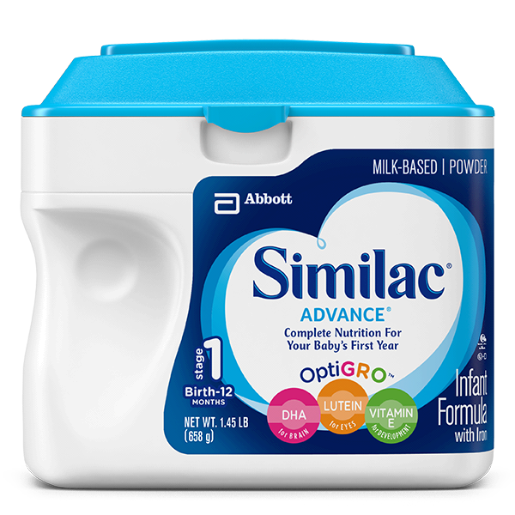
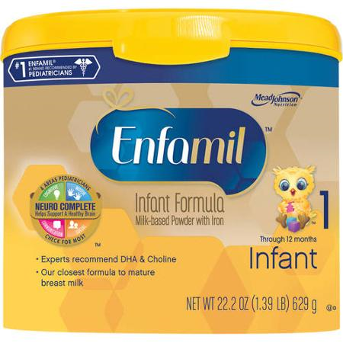
Types of Formula: Standard
Standard Term formula
Enfamil Infant, Similac Advance, Gerber Good Start Gentle
Store brands, organic brands, etc.
New organic/non-GMO versions
For healthy term babies
Cow’s milk based
19 or 20 kcal/oz

Slide 13
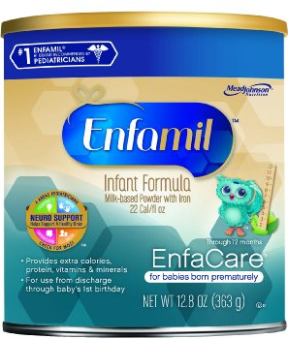
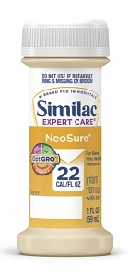
Types of Formula: Standard Preterm
Standard Preterm Formula
Similac Neosure, Enfamil Enfacare
For preterm infants >2.5 kg until ~9 months CGA
Includes late preterm
↑ Protein, Ca, Phos, folate, trace minerals, fat-soluble vitamins, etc.
Cow’s milk based
22 kcal/oz

Slide 14
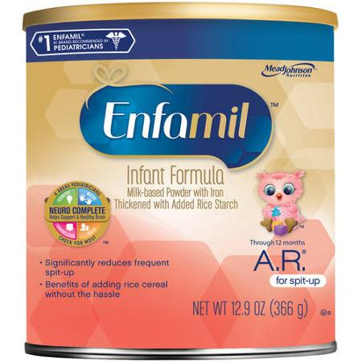
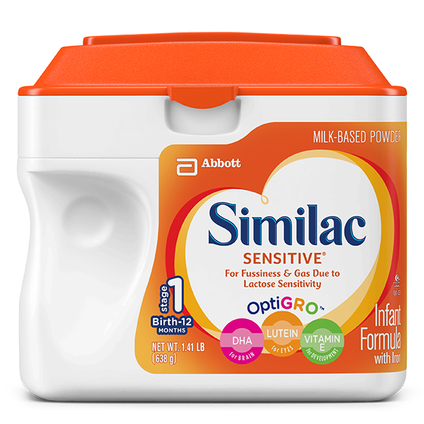
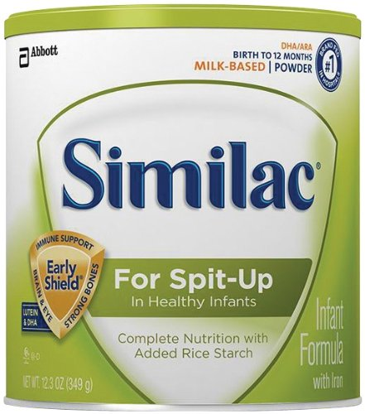
Types of Formula: Specialty Standard
Similac Sensitive, Similac for Spit-Up, Enfamil A.R. (added rice)
For fussiness, gas, spit-up, GER
Cow’s milk based
Lower lactose content
Added rice starch
vs. adding rice cereal
? efficacy
Placebo effect/treats symptoms?
Treats normal infant behavior?
↓ kcal? → effect on growth
Lasekan, 2014; Lightdale, 2013; Vanderhoof, 2003

Slide 15
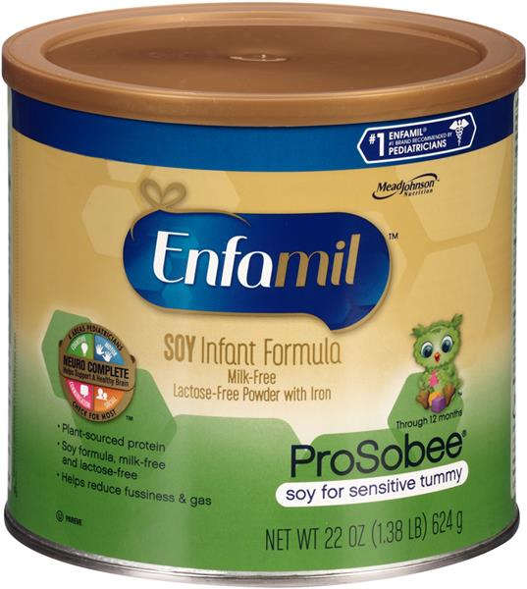
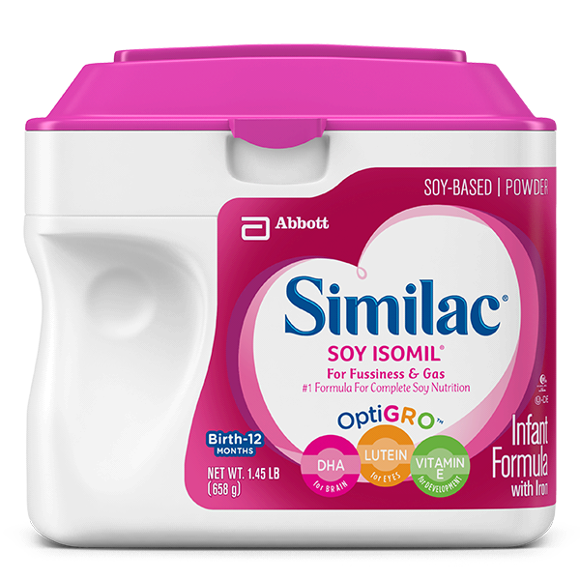
Types of Formula: Soy-Based
ProSobee, Isomil, Gerber Soy
Vegan/vegetarian
Not indicated for preterm infants
phytic acid, high aluminum, low phos
Lactose-free
lactose intolerance rare in infants
May soothe fussiness/gas – placebo?
Not always effective in treating CMP allergy
10-14% may also have soy allergy
Berseth, 2009; Bhatia, 2008.

Slide 16
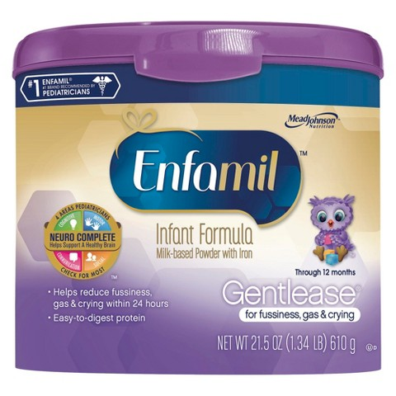
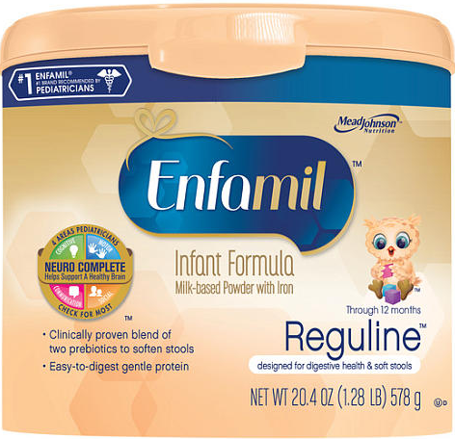
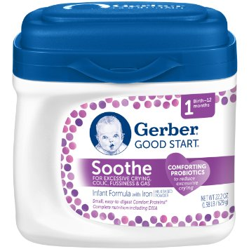
Types of Formula: Partially-Hydrolyzed Protein
Enfamil Gentlease, Enfamil Reguline, Gerber Good Start Soothe
Reguline – prebiotics
Gerber Soothe – probiotics
Partially broken down protein
Cow’s milk based
Reduce fussiness, gas, crying, spit-up
Treat mild to moderate atopic dermatitis
May reduce risk of CMP allergy
Ashley, 2012; Berseth, 2009; Fleischer, 2013; Jin, 2011; Nentwich, 2001; Skajewska, 2010; von Berg, 2007; Ziegler, 2007.

Slide 17
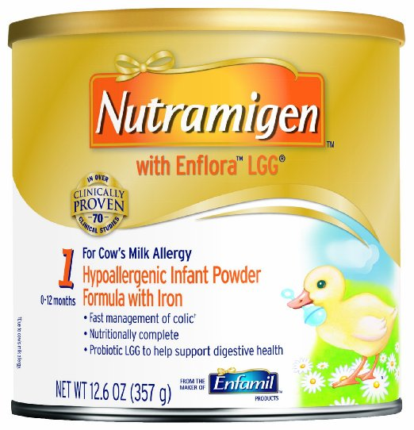
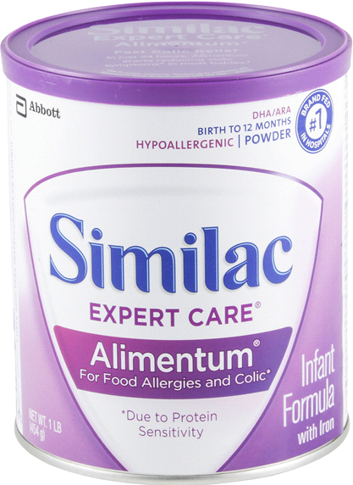
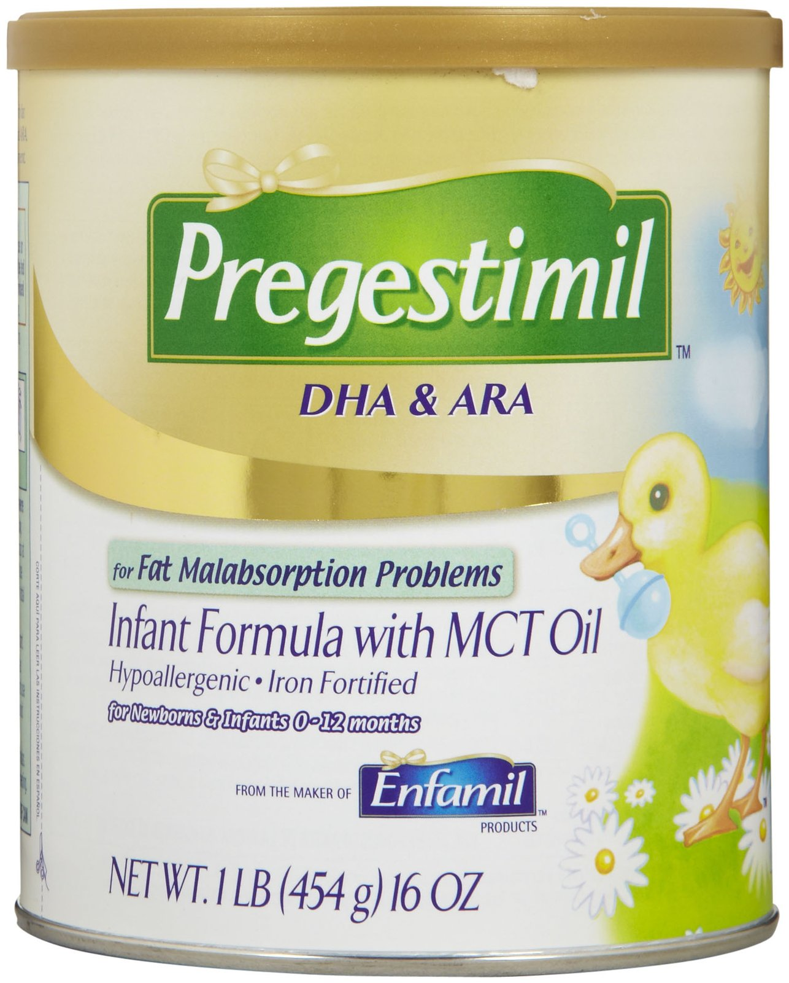
Types of Formula: Extensively-Hydrolyzed Protein
Nutramigen, Pregestimil, Alimentum
Pregestimil & Alimentum – MCTs
Fat malabsorption
Nutramigen (powder) – L. rhamnosus GG
Protein as peptides
CMP allergy
Should be 1st treatment option unless symptoms are life-threatening
~40-80% of infants on EHPF gain tolerance to CMP compared to ~20% of infants on amino acid based formula
higher rate for those on formula + LGG
Berni Canani, 2013, Koletzko, 2012

Slide 18
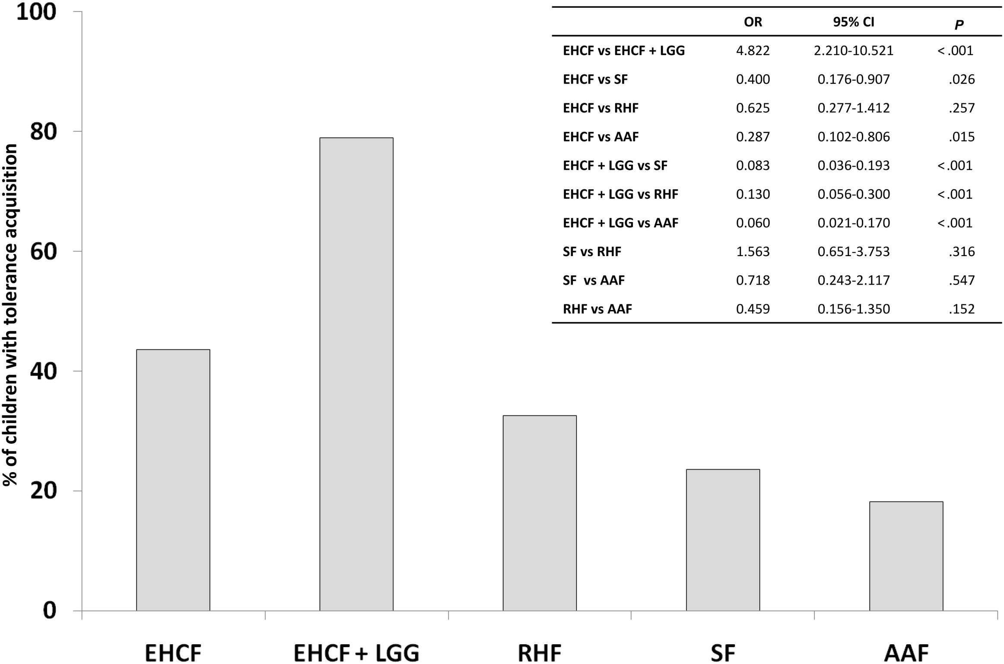
Berni Canani R, Nocerino R, Terrin G, et al. Formula selection for management of children with cow's milk allergy influences the rate of acquisition of tolerance: a prospective multicenter study. J Pediatr. 2013;163(3):771-7.e1.

Slide 19
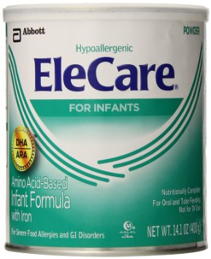
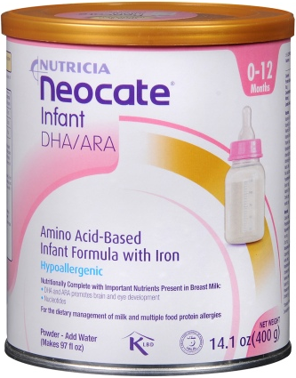
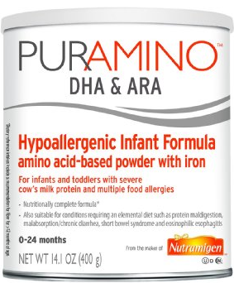
Types of Formula: Amino Acid Based
EleCare, Neocate Infant, PurAmino
Protein is 100% amino acids
Short bowel syndrome (SBS), EoE, severe CMP allergy, other food allergies
SBS
Alleviates chronic diarrhea, improves intestinal function, weight-for-age %ile when used x3 months
May reduce dependence on PN
Bines, 1998; Borschel, 2014

Slide 20
Modifying caloric Content

Slide 21
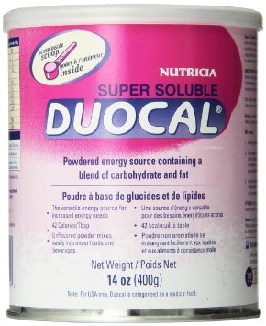
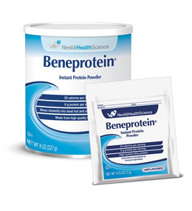
Formula Modulars
Duocal
Fat and carbohydrate
Tasteless
5 g = 25 kcal
Abbott Liquid Protein Fortifier
Extensively-hydrolyzed casein protein
1 g per 6 mL
Beneprotein
Whey protein
6 g protein per 7 g
Can add to food or formula/breast milk

Slide 22
Formula Modulars
Risks
Inappropriate mixing (adds too many kcal)
Imbalanced macronutrient ratio
Alternatives
Adjusting formula recipe: e.g., Enfamil 24 kcal/oz

Slide 23
Vitamin and Mineral Supplements

Slide 24
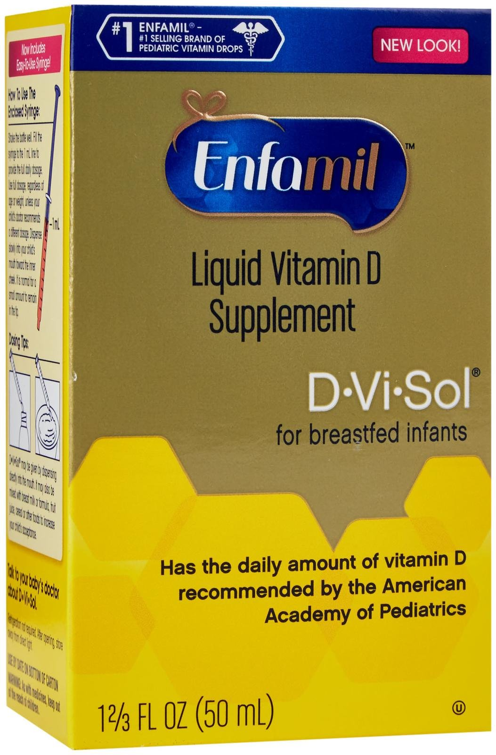
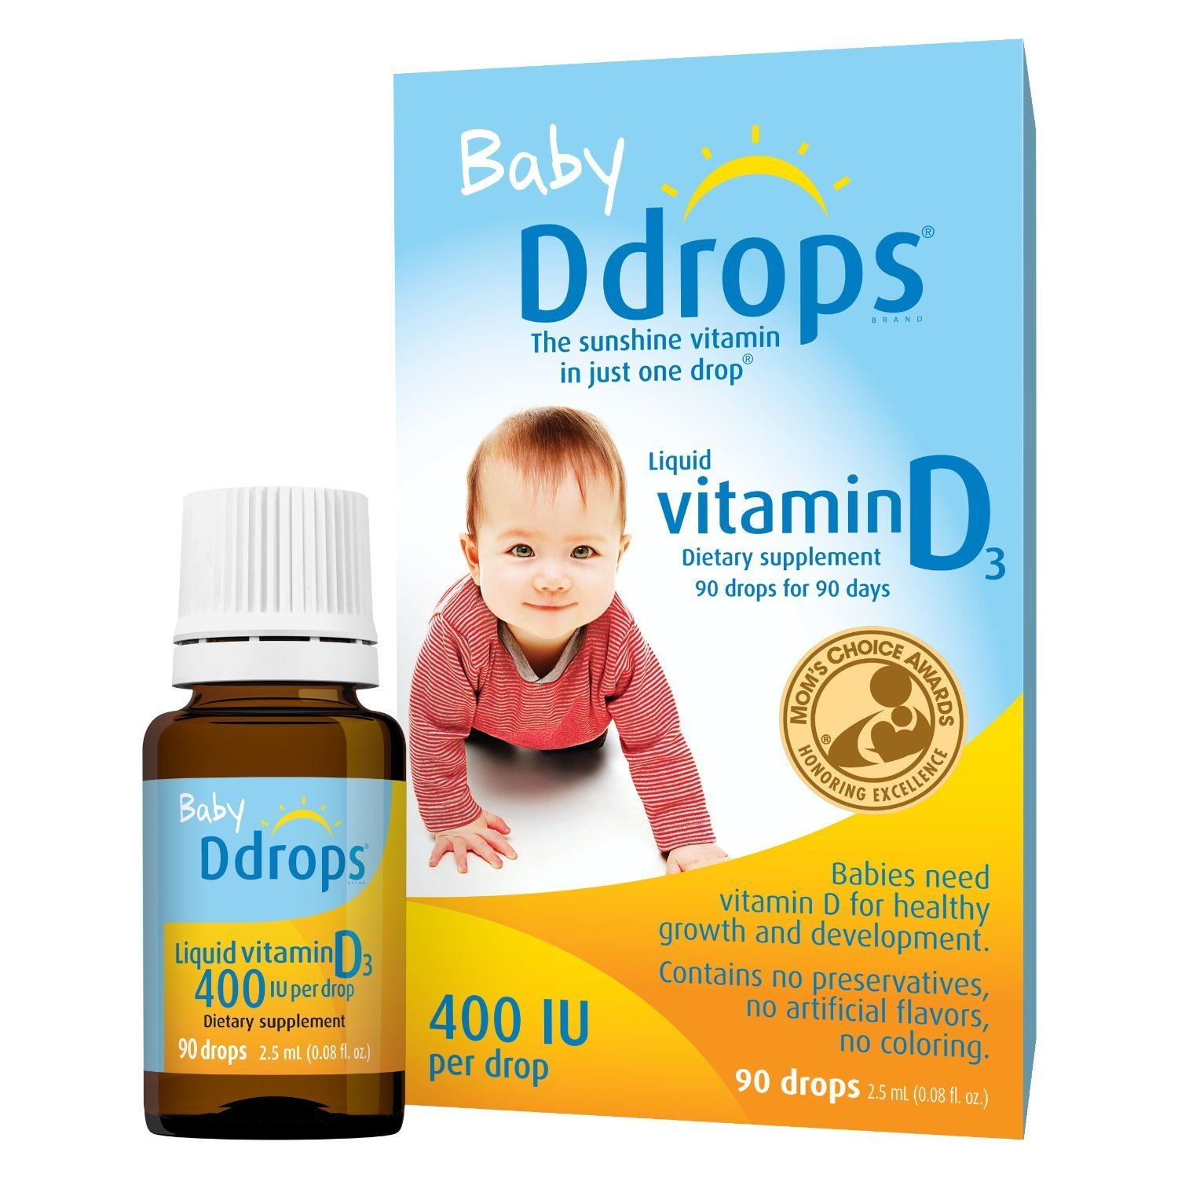
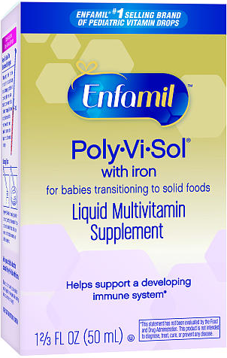
Vitamin/Mineral Supplements
Term babies:
400 IU Vitamin D for breastfed infants and infants consuming <1 L formula
May omit for breastfed infants if Mom takes 6400 IU vitamin D daily
Dose: 1 mL vs. 1 drop
Preterm babies:
1 ml/day Poly-vi-Sol with Iron
Vitamins A, C, D, B₁, B₂, B₃, B₆, iron
Duryea, 2015; Hollis, 2015; Isaacs, 2011

Slide 25
Vitamin/Mineral Supplements
Strict vegetarian moms exclusively breastfeeding
B₁₂ - Adequate intake: 0.4 mcg/day (birth-6 months), 0.5 mcg/day (7-12 months)
Exclusively breastfed >4 months
Consider iron supplementation – 1 mg/kg/day
4 oz iron-fortified dry cereal per day (mixed with breast milk, water, or formula), or ½ to 1 jar of pureed meat
>6 months
Fluoride: Nonfluoridated water at home, exclusive breastfeeding
Duryea, 2015; Hollis, 2015; Isaacs, 2011

Slide 26
Infant Stool Patterns

Slide 27
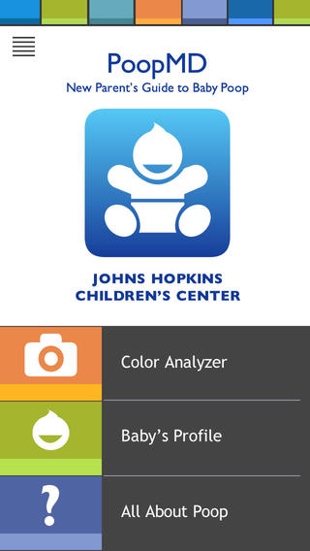
Ultimate Guide to Baby Poop
PoopMD app, infographics
Infants usually stool 5-6x/day…or more, or less
Breastfed
Loose, seedy, mustard-colored
Formula-fed
Tan, thicker (consistency of hummus)
Solid foods
Darker brown
Cleveland Clinic, 2014.

Slide 28
Ultimate Guide to Baby Poop
Other colors
Bright green
Inadequate nutrition, viruses
May only be receiving foremilk
Red
May indicate blood, could be 2/2 eating beets
White
Fat malabsorption
Black (after meconium)
Blood in upper GI tract
Cleveland Clinic, 2014.

Slide 29
Starting Solid Food & Cow’s Milk

Slide 30
Starting Solids
AAP/WHO: start around 6 months
4-6 months may be ok if developmentally ready
Signs of readiness
Showing interest in food
Sitting without support
Putting hands/toys in mouth
Pushing up from prone position with straight elbows
Extrusion reflex eliminated
Duryea, 2015; Isaacs, 2011

Slide 31
Risks Associated with Solid Foods
Early introduction
Aspiration
Inadequate or excessive energy/nutrient intake
Delayed introduction
Inadequate nutrient intake
Iron deficiency
Food aversion
Delayed oral motor function
Increased risk for atopic disease, type 1 diabetes
Duryea, 2015; Isaacs, 2011

Slide 32
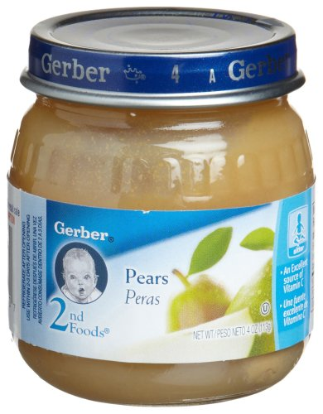
First Foods
Infant cereal
Iron-fortified
Mix with breast milk, formula, or water
Rice – hypoallergenic
Fruit, vegetables
Pureed meats
Introduce single foods
3-5 days between new foods
Duryea, 2015; Isaacs, 2011

Slide 33
Advancing to Other Solids
Combination foods
Introduce when individual ingredients are tolerated
Thick purees, soft mashed foods
Introduce when sitting independently, when infant grasps at foods
Usually able to chew, swallow textured food (small, soft lumps, ground, etc.) by 8 months
Duryea, 2015

Slide 34
Advancing to Other Solids
Finger foods
8-12 months
Hand grasp, pincer grasp
Includes small pieces of soft foods, easily-dissolved foods
e.g. Cheerios, small banana pieces, cheese
Family meals
9-12 months
Can self-feed with assistance
Bite-size pieces of what family eats
Duryea, 2015

Slide 35
Food Safety
Home-prepared food
Avoid spinach, beets, squash, green beans, carrots
High nitrate content
USDA website: Making Homemade Baby Food Safe
No added salt/sugar
General food safety guidelines
Opened baby food jars should be refrigerated and leftovers discarded after 48 hours
Jars → not necessarily the suggested serving size
Serve from bowl and discard food left in bowl
Duryea, 2015; Isaacs, 2011

Slide 36
Inappropriate Foods
Popcorn
Whole grapes, raisins, hard raw fruits and vegetables
Peanuts
Uncut stringy meats, hot dog pieces
Hard candy, gum/gummy candy
Honey (risk of botulism)
Sugar-sweetened beverages
Isaacs, 2011

Slide 37
Cow’s Milk in Infancy
Do not start until 1 year of life.
Risks:
Iron-deficiency anemia
Low iron availability, Ca and P impair absorption, GI blood loss
Dehydration → high renal solute load
Duryea, 2015; Isaacs, 2011

Slide 38
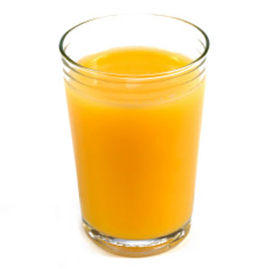
Juice in Infancy
Do not introduce until 6 months
Offer in a cup
100% juice only
Max 4-6 oz/day
Consider diluting with water
Pasteurized juice only
Should not be sipped throughout the day or offered at bedtime
Duryea, 2015; Isaacs, 2011

Slide 39
Questions?

Slide 40
References
Al-Shehri SS, Knox CL, Liley HG, et al. Breastmilk-Saliva Interactions Boost Innate Immunity by Regulating the Oral Microbiome in Early Infancy. PLoS ONE. 2015;10(9):e0135047.
Ashley C, Johnston WH, Harris CL, Stolz SI, Wampler JL, Berseth CL. Growth and tolerance of infants fed formula supplemented with polydextrose (PDX) and/or galactooligosaccharides (GOS): double-blind, randomized, controlled trial. Nutr J. 2012;11:38.
Barbas KH, Fulhan J. Breastfeeding and Human Milk. In: Sonneville K, Duggan C, eds. Manual of Pediatric Nutrition. 5th ed. Shelton, CT: People’s Medical Publishing House-USA; 2014:64-80.
Berni Canani R, Nocerino R, Terrin G, et al. Formula selection for management of children with cow's milk allergy influences the rate of acquisition of tolerance: a prospective multicenter study. J Pediatr. 2013;163(3):771-7.e1.
Berseth CL, Johnston WH, Stolz SI, Harris CL, Mitmesser SH. Clinical response to 2 commonly used switch formulas occurs within 1 day. Clin Pediatr (Phila). 2009;48(1):58-65.
Bhatia J, Greer F. Use of soy protein-based formulas in infant feeding. Pediatrics. 2008;121(5):1062-8.
Bines J, Francis D, Hill D. Reducing parenteral requirement in children with short bowel syndrome: impact of an amino acid-based complete infant formula. J Pediatr Gastroenterol Nutr. 1998;26(2):123-8.
Borschel MW, Antonson DL, Murray ND, et al. Two single group, prospective, baseline-controlled feeding studies in infants and children with chronic diarrhea fed a hypoallergenic free amino acid-based formula. BMC Pediatr. 2014;14:136.
Deciphering the Dreaded Dirty Diaper infographic. Cleveland Clinic. http://2rdnmg1qbg403gumla1v9i2h.wpengine.netdna-cdn.com/wp-content/uploads/sites/3/2014/03/14-HHB-209-Baby-Diaper-Infographic.jpg. Accessed February 4, 2016.
Duryea TK. Introducing solid foods and vitamin and mineral supplementation during infancy. In: UpToDate, Drutz JE, Motil KJ (Ed), UpToDate, Waltham, MA. (Accessed February 3rd, 2016.)
Fleischer DM, Spergel JM, Assa'ad AH, Pongracic JA. Primary prevention of allergic disease through nutritional interventions. J Allergy Clin Immunol Pract. 2013;1(1):29-36.
Hollis BW, Wagner CL, Howard CR, et al. Maternal Versus Infant Vitamin D Supplementation During Lactation: A Randomized Controlled Trial. Pediatrics. 2015;136(4):625-34.
Isaacs JS. Infant Nutrition. In: Brown JE.Nutrition Through the Life Cycle. 4th ed. Wadsworth; 2011:222-245.
Jin YY, Cao RM, Chen J, et al. Partially hydrolyzed cow's milk formula has a therapeutic effect on the infants with mild to moderate atopic dermatitis: a randomized, double-blind study. Pediatr Allergy Immunol. 2011;22(7):688-94.
Koletzko S, Niggemann B, Arato A, et al. Diagnostic approach and management of cow's-milk protein allergy in infants and children: ESPGHAN GI Committee practical guidelines. J Pediatr Gastroenterol Nutr. 2012;55(2):221-9.
Lasekan JB, Linke HK, Oliver JS, et al. Milk protein-based infant formula containing rice starch and low lactose reduces common regurgitation in healthy term infants: a randomized, blinded, and prospective trial. J Am Coll Nutr. 2014;33(2):136-46.
Lightdale JR, Gremse DA. Gastroesophageal reflux: management guidance for the pediatrician. Pediatrics. 2013;131(5):e1684-95.
Lowe AJ, Dharmage SC, Allen KJ, Tang ML, Hill DJ. The role of partially hydrolyzed whey formula for the prevention of allergic disease: evidence and gaps. Expert Rev Clin Immunol. 2013;9(1):31-41.
Nentwich I, Michková E, Nevoral J, Urbanek R, Szépfalusi Z. Cow's milk-specific cellular and humoral immune responses and atopy skin symptoms in infants from atopic families fed a partially (pHF) or extensively (eHF) hydrolyzed infant formula. Allergy. 2001;56(12):1144-56.
Szajewska H, Horvath A. Meta-analysis of the evidence for a partially hydrolyzed 100% whey formula for the prevention of allergic diseases. Curr Med Res Opin. 2010;26(2):423-37.
Vanderhoof JA, Moran JR, Harris CL, Merkel KL, Orenstein SR. Efficacy of a pre-thickened infant formula: a multicenter, double-blind, randomized, placebo-controlled parallel group trial in 104 infants with symptomatic gastroesophageal reflux. Clin Pediatr (Phila). 2003;42(6):483-95.
von Berg A, Koletzko S, Filipiak-Pittroff B, et al. Certain hydrolyzed formulas reduce the incidence of atopic dermatitis but not that of asthma: three-year results of the German Infant Nutritional Intervention Study. J Allergy Clin Immunol. 2007;119(3):718-25.
Ziegler E, Vanderhoof JA, Petschow B, et al. Term infants fed formula supplemented with selected blends of prebiotics grow normally and have soft stools similar to those reported for breast-fed infants. J Pediatr Gastroenterol Nutr. 2007;44(3):359-64.

Slide 41
References
Beneprotein. Nestle Health Science. https://www.nestlehealthscience.us/brands/beneprotein/beneprotein-hcp. Accessed February 4, 2016.
Gerber Infant Formulas & Supplements. Gerber for Medical Professionals. https://medical.gerber.com/products/formulas. Accessed January 15, 2016.
Liquid Protein Fortifier. Abbott Nutrition. http://abbottnutrition.com/brands/products/liquid-protein-fortifier. Accessed February 4, 2016.
Products. Mead Johnson Nutrition. http://www.meadjohnson.com/pediatrics/us-en/product-information/products. Accessed January 15, 2016.
Similac. Abbott Nutrition. http://abbottnutrition.com/brands/similac. Accessed January 15, 2016.

Slide 42
Picture sources
http://www.birthingandbreastfeeding.com/uploads/5/5/3/2/5532100/4565312.jpg?340
http://ciknursing.com/blog/wp-content/uploads/2015/01/foremilk.jpg
http://blog.babeezeinarms.com/wp-content/uploads/2014/01/2013IBCLC_Day.jpg
http://2.bp.blogspot.com/-Iik0HH-o7O0/UvsM5eMvITI/AAAAAAAAAJ0/cPsVoQfnMvw/s1600/Lactmed+1.jpg
https://higherlogicdownload.s3.amazonaws.com/ILCA/e3ee2b6e-c389-43de-83ea-f32482f20da5/UploadedImages/THEME/ILCA_Logo.png
http://i5.walmartimages.com/dfw/dce07b8c-3a72/k2-_5ac66b73-d4c0-45a2-b8f8-a8c4606b42a1.v3.jpg
https://static.abbottnutrition.com/cms-prod/Similac-2015.com/img/SWA1_SimplePac_Front-D.png
http://www.medline.com/media/catalog/sku/R-L/300x300/R-L56177_PRI01.JPG
https://www.gerber.com/images/default-source/products/410x410/050000111787.png?sfvrsn=4
http://ecx.images-amazon.com/images/I/81-aOb2wsdL._SX425_.jpg
http://ll-us-i5.wal.co/dfw/dce07b8c-63f9/k2-_01f9781c-9076-434d-93da-6cec295e941b.v4.jpg-2312fdb12d3ca58e354e49ac2df762ec41b73609-optim-450x450.jpg
http://ecx.images-amazon.com/images/I/51L723YF1IL.jpg
https://static.abbottnutrition.com/cms-prod/Similac-2015.com/img/SSE1-Front-D.png
https://static.abbottnutrition.com/cms-prod/similac-2015.com/img/soy-1.45-front-d.png
https://fa74d61d848a20b729bb-0251b36b713060ab3e0e8321940e01ff.ssl.cf2.rackcdn.com/0000871214420_CF_version_type_large.jpeg
https://www.gerber.com/images/default-source/products/410x410/-050000353569_4108D1ADE86C764.png?sfvrsn=4
http://scene7.targetimg1.com/is/image/Target/12849575?wid=480&hei=480
http://www.toysrus.com/graphics/tru_prod_images/Enfamil-Reguline-Powder---20.4--pTRU1-17998397dt.jpg
http://ecx.images-amazon.com/images/I/81LX2YeWrjL._SY355_.jpg
http://ecx.images-amazon.com/images/I/710hmq91ZAL._SX522_.jpg
https://static.meijer.com/Media/007/00745/0070074576640_a1c1_0600.png
http://c4.q-assets.com/images/products/p/mj/mj-020_1z.jpg
http://ecx.images-amazon.com/images/I/81ToXVqHW1L._SY355_.jpg
http://pics.drugstore.com/prodimg/534172/450.jpg
http://ecx.images-amazon.com/images/I/71N2EjybmhL._SY355_.jpg
http://ecx.images-amazon.com/images/I/91jwxO98EKL._SY355_.jpg
https://www.nestlehealthscience.us/asset-library/PublishingImages/products/us-products/Beneprotein.jpg
http://static.abbottnutrition.com/cms-prod/abbottnutrition.com/img/62317LQP2ozBTLweb.png
http://c1.q-assets.com/images/products/p/mj/mj-061_1z.jpg
http://ecx.images-amazon.com/images/I/71FI9p5UxjL._SL1500_.jpg
http://www.toysrus.com/graphics/tru_prod_images/Enfamil-Poly-Vi-Sol-with--pTRU1-5718280dt.jpg
http://www.imedicalapps.com/wp-content/uploads/2015/07/PoopMD.jpeg
http://ecx.images-amazon.com/images/I/51RZ9T7-mML.jpg
http://www.countrydairy.com/files/products/photos/2per-gal.jpg
http://canigivemybaby.com/wp-content/uploads/2011/12/can-i-give-my-baby-orange-juice.jpg

