Slide 1
Movement Disorders for the Pediatrician
Julie Ziobro
12/22/15

Slide 2
Objectives
Recognize common movement disorders in the pediatric population
Recognize when testing is needed
Know when to refer

Slide 3
Case 1:
A 6 yo boy is brought to his PMD for frequent eye blinking. They also notice that his eyes occasionally move in circles and he will sometimes move his neck to the right. These movements began 3 weeks ago and his parents are now quite concerned that he might have something wrong with his eyes. There is no history of prior infection.
His eye exam and neurologic exam are normal.

Slide 4
Definitions
Tics: intermittent, repeated and stereotyped movements or sounds.
May be rhythmic or non-rhythmic
Tonic postures or brief jerking movements
Singe movement or sequence of movements and sounds
Distinct onset and ending
Repeated at unpredictable intervals

Slide 5
Definitions
Involuntary movement disorder, but can often suppress voluntarily
Often sense of build-up and need to perform the tic and a sudden release when it is over.
Precipitated by anxiety, stress, or boredom

Slide 6
Classifications
simple or complex
Simple: single movement, sound, or muscle contraction
Clonic, tonic, or dystonic
Complex: sequence of movements – difficult to distinguish from a compulsion.
Sensory: repeated stereotyped sensation without movement

Slide 7
Classifications
Classification by time:
Transient – 1 month to 1 year
Chronic – more than 1 year, no more than 3 months tic free
Tourette syndrome – more than 1 year, no more than 3 months tic free. Multiple motor tics, history of at least 1 vocal tic, symptoms started before adulthood.

Slide 8
Prevalence
Up to 2% of school-aged children have chronic motor or vocal tics. Up to 0.5% fulfill criteria for Tourette syndrome.
Male:female – up to 5:1
Genetic etiology – 1st degree relative increases prevalence by 10 times.
Co-morbid conditions: OCD, ADHD
Etiology is not really known: basal ganglia mediated? Imbalance of dopaminergic tone?

Slide 9
Evaluation
clinical features of suppressibility, suggestibility, and predictability.
Can be difficult to get this info from younger children. Prediction and control will allow the child to assume stable body posture, finish swallowing food, etc.

Slide 10
Differential
Medication exacerbating tics: stimulants, tegretol, steroids, neuroleptics.
CO intoxication
Post-streptococcal (PANDAS….)
Huntington’s, Wilson’s, PKAN, Lesch-Nyhan, neuroachanthocytosis
OCD, shuddering spells, repetitive flapping, infant masturbation, restless leg syndrome

Slide 11
Evaluation
With otherwise normal neurologic exam, no further testing is needed.
If other neurologic signs or concern for progressive disorder, refer for further neurologic evaluation.
With recent onset, evaluate for other triggers such as anxiety, stress, mood disorders. Assess for comorbidities (OCD, ADHD, learning disorders and impulsivity)

Slide 12
Treatment
Determine if they are mild or severe: based on the consequences of the tics for the child’s life.
Reassurance and education are most important.
Assess and treat possible co-morbid conditions
CBT can be helpful
Medical treatment: clonidine, guanfacine, clonazepam. Or neuroleptics.

Slide 13
Prognosis
EXCELLENT!
Nature and severity of tics will change frequently over time.
May never resolve completely, but may be reduced a minor annoyance or disappear for several years at a time.

Slide 14
Tics and Tourette
Tourette video

Slide 15
Case 2:
10 yo F with 2 weeks of abnormal involuntary movements that consisted of constant movement of her hands and then progressed into her arms. She was clumsy, frequently dropping things, restless and irritable with slurred speech. She had strep throat 2 mos earlier, but otherwise has been healthy.
On exam, she appeared anxious and fidgety with rapid, purposeless, jerky movements in her arms. She was dysarthric. Had difficulty maintaining a grip or any postures. Normal motor exam, reflexes and sensory exam.

Slide 16
Sydenham chorea
Most common cause of childhood chorea
Autoimmune
Usually begins within 2-6 months after group A B-hemolytic strep pharyngitis
Usually generalized, though 20-30% may have hemichorea.
Distal is more affected than proximal
May include emotional lability and behavior changes
30% will have recurrence of symptoms

Slide 17
Sydenham chorea
Sydenham

Slide 18
Diagnosis
History and exam
Elevated ASO titer, elevated anti-DNA-ase B titer, positive strep

Slide 19
Treatment
Usually self-limited and resolves within 6 months.
VPA or tetrabenazine may be useful in severe or prolonged cases
Prednisone 2mg/kg/day for 4 weeks had a more rapid remission
IVIG has been used for prolonged cases
Must also treat to prevent rheumatic fever.

Slide 20
Case 3:
7 month old girl who presents with episodes of head tilting to the right with her face rotated to the left. First event was 2 months ago and lasted about 30 minutes. It’s happened 3 other times. The most recent event lasted 2 hours. She is awake and alert during the head tilting, but she can’t seem to move her head to the other side.
Birth history is unremarkable
Family history notable for mother with migraines
Neurologic exam is normal

Slide 21
What is it?
Head tilting baby

Slide 22
Benign paroxysmal torticollis
Idiopathic disorder
Periods of an abnormal, sustained posture of the head and neck.
Events begin and end suddenly with duration between minutes to days.
Child is alert and responsive during the attack
May show delays in motor development during attacks, but development improveds
Thought to be related to migraines

Slide 23
Case 4
5 mo boy who is presenting with episodes of shaking of his arms lasting seconds at a time, but occurring 4 times today. Each event happened when he was excited or before eating. He stares during the event, but is back to normal right after.

Slide 24
Video
Infant shaking

Slide 25
Shuddering attacks
Usually begin in infancy, less commonly in childhood.
Brief episodes of altered muscle tone, so appears to be a rapid tremor or the head, shoulder, and trunk.
May lean to one side or even fall
Often with lots of stimulus
Resolve spontaneously by the 2nd decade

Slide 26
Case 5
2 week old baby boy with twitching movements in sleep

Slide 27
Jerking baby
2 week old baby

Slide 28
Benign neonatal sleep myoclonus
Occurs in the first month
Starts in the early stages of sleep and is stimulus sensitive.
Bilateral, synchronous, repetitive, located primarily in distal parts of the upper extremities.
Occur only during sleep, resolve with waking.

Slide 29
Case 6
5 mo boy who is having episodes of head bobbing, associated with strange eye movements. His parents have also noticed that he seems to hold his head to one side.
He’s been otherwise healthy. These events started last week and happen multiple times a day. He is otherwise happy and playful with a normal exam.

Slide 30
What is it?
cute baby video

Slide 31
Spasmus nutans
Occurs between 4 months and 1 year.
Characterized by quick episodes of pendular nystagmus, head nodding, and head tilting.
Nystagmus can be monocular or asymmetric.
Head nodding can suppress the nystagmus through the VOR.

Slide 32
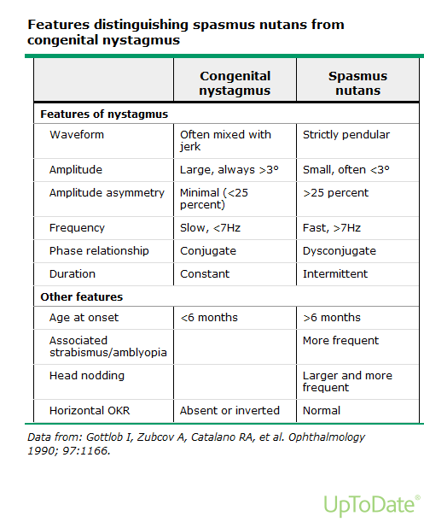
Spasmus nutans

Slide 33
Spasmus nutans
Differential: SN-like nystagums associated with low vision, optic pathway glioma, arachnoid cyst, opsoclonus myoclonus, Leigh syndrome.
Generally resolves by 1 year of age
Children may have strabismus, amblyopia, or refractive errors requiring glasses.

Slide 34
Opsoclonus-Myoclonus
OMS

Slide 35
Opsoclonus-Myoclonus
Opsoclonus, myoclonus, ataxia, aphasia, mutism, lethargy, irritability, drooling, strabismus, vomiting
Half of all cases associated with neuroblastoma
Other cases are presumed autoimmune.
Treatment may include ACTH, steroids, IVIG, cytoxan, rituximab.

Slide 36
Last case!
8 mo with 1 month episodes of head nodding. Tends to happen while playing and exciting.
Are these seizures??????

Slide 37
Head nodding
head nodding

Slide 38
Benign head nodding of infancy
Can be vertical (“yes-yes”), horizontal (“no-no”) or oblique.
Can occur several times a day
Frequency of 1-2hz
Do not occur while lying, but always in sitting or standing.
Some have a history of shuddering spells and occasionally a family history of essential tremor.
With progressive head nodding, consider “bobble head doll syndrome” – 3rd ventricle cyst with obstructive hydrocephalus

Slide 39
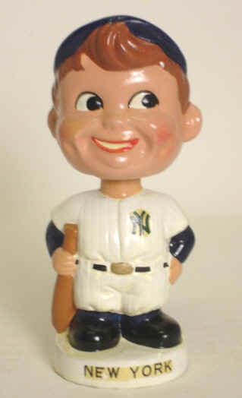
Questions?

