Slide 1
Pediatric Spells: Not All That Moves Is a Seizure
Marc DiSabella, DO
Assistant Professor, Child Neurology
Child Neurology Program Director
Children's National Medical Center

Slide 2
Disclosures
I have no outside funding sources to claim.

Slide 3
Goals for Lecture
Identify the key clinical features that distinguish between common spells in pediatric patients
Discuss the appropriate diagnostic work up for patients presenting with spells
Review the current evidence for management of various types of spells

Slide 4
Spells
ICD-9-CM = 780.39 Other convulsions
  Convulsive disorder NOS
  Fits NOS
  Recurrent convulsions NOS
  Seizure NOS
  Seizures NOS

Slide 5
Spells
Tics
Breath-
holding
Syncope
Shudder
Seizures

Slide 6
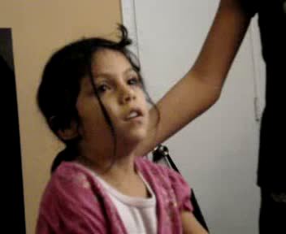
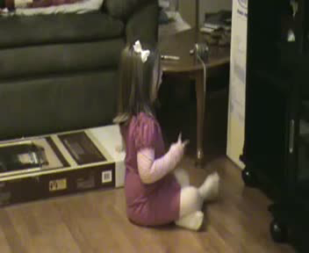
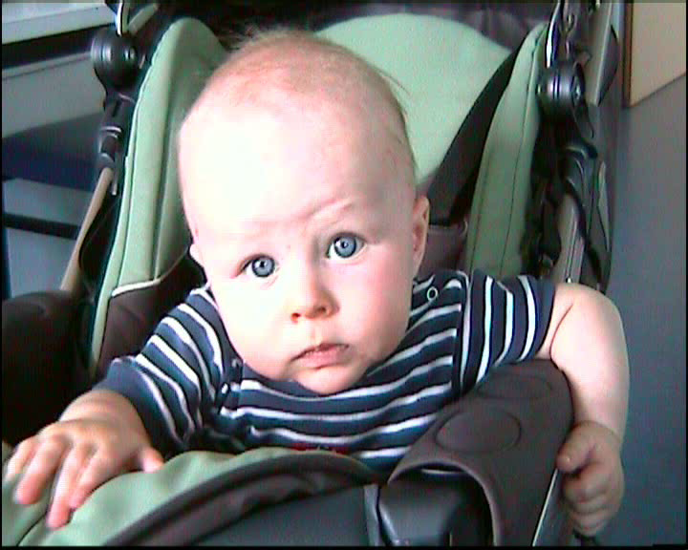
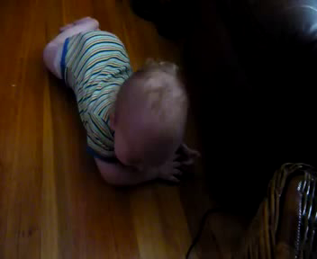
Some Scary Spells

Slide 7
And on to the Spells…

Slide 8
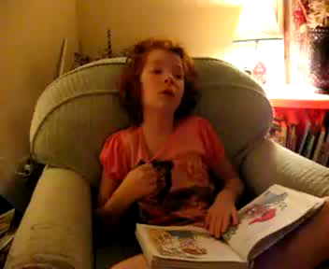
Notes:
Note contralateral head deviation to left suggesting R cortical focus, and ipsilateral hand automatisms

Slide 9
What type of spell was this?

Slide 10
Complex Partial Seizure
Notes:
Note contralateral head deviation to left suggesting R cortical focus, and ipsilateral hand automatisms

Slide 11
So What is the Difference Between Seizure and Epilepsy?

Slide 12
Seizures and Epilepsy
Seizures
  transient
  stereotyped events
  synchronized abnormal electrical discharges occurring in the cortex of the brain
Febrile seizures are seen in 2% to 5% of children.
Epilepsy = two unprovoked seizures separated by a 24 hour period.
Epilepsy is seen in 0.5-1% of the population.

Slide 13
Seizure Classification
Partial Onset
  Simple – no change in level of consciousness
  Complex – associated change in consciousness
    Both may be associated with aura
Generalized Onset
  Absence
  Tonic
  Clonic
  Myoclonic
  Atonic

Slide 14
So Why Call it Epilepsy?

Slide 15
Risk of Epilepsy after First Unprovoked Seizure
S. Shinnar et al. Pediatrics 1996;98;216-225

Slide 16
Predictors of Multiple Seizures in a Cohort of Children Prospectively Followed from the
Time of Their First Unprovoked Seizure
Ann Neurol 2000;48:140–147
Risk of 3rd seizure after a 2nd seizure >70%
= LIKELY

Slide 17

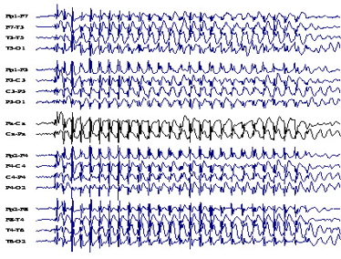
Which is better?
Me or EEG
VS

Slide 18
The accuracy of the diagnosis of paroxysmal events in children
H. Stroink et al. J. Neurol. Neurosurg. Psychiatry 1998;64;595-600
156 children of which 51 (30% of total) had unclear events
5 had epilepsy (3% of total) of which only 3 had abnormal EEG
5 without epilepsy had abnormal EEG (5% of total)
Clinical impression more predictive than EEG
Notes:
156 children 1mos – 16yo with NOS. 51 had event that was not clearly seizure (30%). Of those only 5 had epilepsy (3% of total), and 39 had events clearly not seizure (25% of total). Clinical impression was much more predictive than EEG due to high false positive rate.

Slide 19
What Tests Should Be Performed on Patients with New Onset Seizure?

Slide 20
AAN: Evaluation of
First Unprovoked Seizure
Hirtz et al. 2000;55;616-623 Neurology
Routine EEG recommended
Laboratory tests should be considered
  Vomiting, diarrhea, dehydration, or failure to return to baseline alertness.
  Toxicology screening if drug exposure or substance abuse.
  LP if concern about possible meningitis or encephalitis.
Neuroimaging should be considered
  MRI is the preferred modality
Notes:
Emergent neuroimaging if
Postictal focal deficit (Todd’s paresis) not quickly resolving
Lack of return to baseline within several hours after the seizure
Nonurgent imaging studies
Cognitive or motor impairment of unknown etiology
Unexplained abnormalities on neurologic examination
Partial (focal) onset with or without secondary generalization
EEG that does not represent a benign partial epilepsy of childhood or primary generalized epilepsy
Children under 1 year of age.

Slide 21
AAN: Treatment of
First Nonfebrile Seizure
D. Hirtz et al. Neurology 2003;60;166-175
Treatment with AED is not indicated for the prevention of the development of epilepsy
Treatment with AED may be considered in circumstances benefit outweighs risk
  Severe static encephalopathy
  Swimming or driving “obligation”

Slide 23
What type of spell was this?

Slide 24
Absence Seizure
Two Forms
  Childhood
    4-8yo onset, outgrow in teens
  Juvenile
    9-13yo onset, lifelong
    75% with GTC
Brief stereotyped spells of loss of consciousness
  Last 5-20sec
  20-100 spells per day
  Facial automatisms
  No post ictal period, no loss of tone

Slide 25
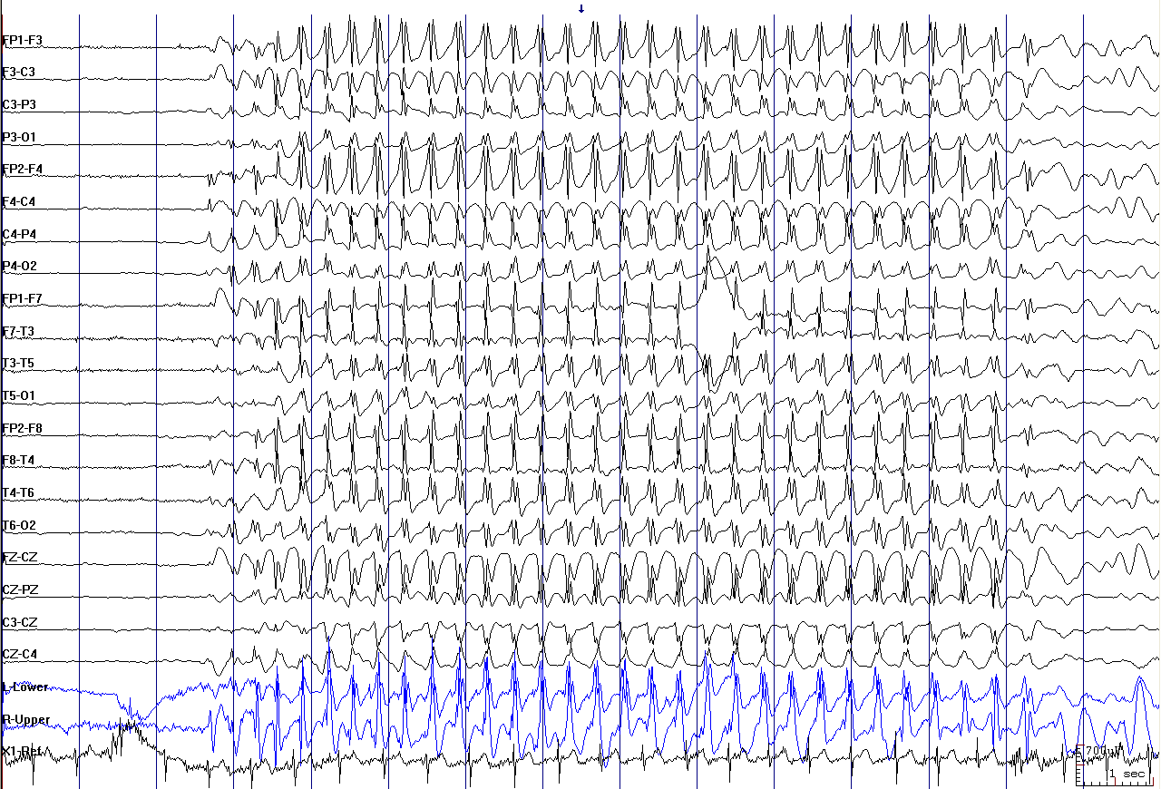
Diagnosis:
Generalized 3-5Hz Spike and Wave

Slide 26
Ethosuximide, Valproic Acid, and
Lamotrigine in Childhood Absence Epilepsy
Glauser et al. N Engl J Med 2010;362:790-9
Notes:
453 children double blind RCT age 2.5-13yo with CAE. ETX max 60mg/kg, VPA 60m/kg, LMT 12mg/kg

Slide 27
Ethosuximide, Valproic Acid, and
Lamotrigine in Childhood Absence Epilepsy
Glauser et al. N Engl J Med 2010;362:790-9
Notes:
ADR were worse in VPA (57%) vs ETX (32%). Psych issues inlcuded hyperactivity, hostility, personality change, decrease concentration, dpression, attention, dizzy, somnolence.

Slide 28
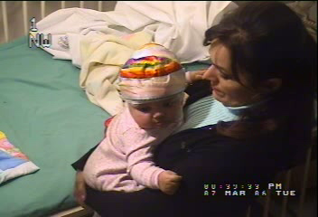

Slide 29
What type of spell was this?

Slide 30
Infantile Spasms
Onset 3mos – 8mos
West Syndrome triad
  1. Infantile spasms
  2. Develop regression/stagnation,
  3. Hypsarhythmia on EEG
    Multifocal spikes >300mV, chaotic background with slowing
2 types:
  1.cyptogenic
    normal birth and develop, unknown etiology
  2.symptomatic
    Abnormal brain and development
      Perinatal and prenatal insults
      Neurocutaneous syndromes - Tuberous sclerosis, NF
      Other - Agenesis of corpus collosum (Aicardi syn), Down’s Syndrome

Slide 31
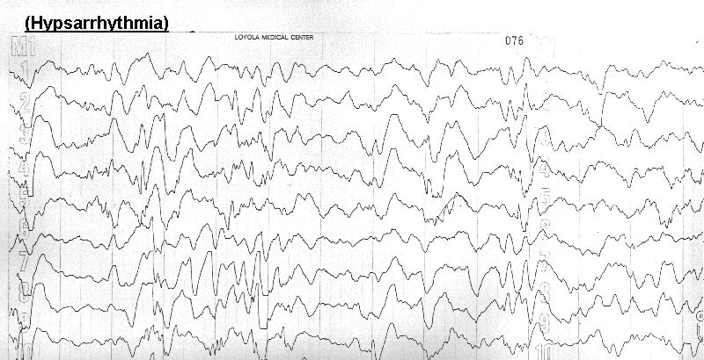
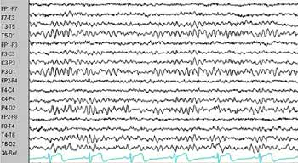
Diagnosis:
Hypsarrhythmia
Hypsarrhythmia
Normal Awake EEG
Notes:
Hypsarrhythmia consists of diffuse giant waves (high voltage, >400 microvolts) with a chaotic background of irregular, multifocal spikes and sharp waves and very little synchrony between the cerebral hemispheres

Slide 32
AAN Practice Parameter
Treatment of Infantile Spasm
M.T. Mackay et al. Neurology 2004;62;1668-1681
Adrenocorticotropic hormone (ACTH) is probably effective for the short-term treatment of infantile spasms
There is insufficient evidence to determine whether oral corticosteroids are effective.
Vigabatrin is possibly effective for the short-term treatment of infantile spasm and is possibly also effective for children with tuberous sclerosis.

Slide 33
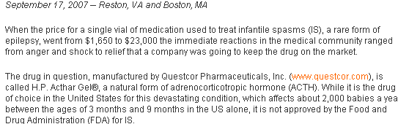
“Money, it’s a crime”
Roger Waters. Dark Side of the Moon 1973

Slide 34
High-dose oral prednisolone for infantile spasms: an effective and less expensive alternative to ACTH
Kossoff EH et al. Epilepsy Behav. 2009 Apr;14(4):674-6. Epub 2009 Feb 4
High-dose oral prednisolone (40-60 mg/day)
Spasm freedom was equivalent to our most recent 15 infants receiving ACTH, with 13 (87%) responding, P=0.16.
Oral prednisolone had fewer adverse effects (53% vs 80%, P=0.10)
Oral prednisolone was less expensive ($200 vs approximately $70,000) than ACTH

Slide 35
Seizure
BEFORE | DURING | AFTER
Inciting event: rare Aura: Partial onset may have abnormal smell, taste, sensory disturbance, motor twitching | Event: Stereotyped involuntary cortical activity with associated movements/sensory disturbance, eye opening Suppressible: No | Confusion, lethargy, weakness (Todd’s), headache None if absence seizure, frontal lobe

Slide 37
What type of spell was this?

Slide 38
Breath-Holding Spells
Onset 6-18mos, resolve by 6yo in 90%
  No increased risk epilepsy, mental retardation
  17% with syncope as adult
  Affects up to 27% of children
3 types
  Cyanotic
    60% of BHS
  Pallid
    Asytole
  Mixed

Slide 39
Breath-Holding Spells
    Emotional response
    Cries or “holds breath”
    LOC and loss of tone
    Possible hypoxic convulsion
    Rapid return to baseline with irritability

Slide 40
Breath-Holding Spells
Diagnosis
  Clinical scenario, video
  EKG to ruled out prolonged QT
  EEG if prolonged LOC, frequent association of convulsion
Treatment
  Reassurance
  Vagolytics (atropine), SSRIs, piracetam
  Iron

Slide 41
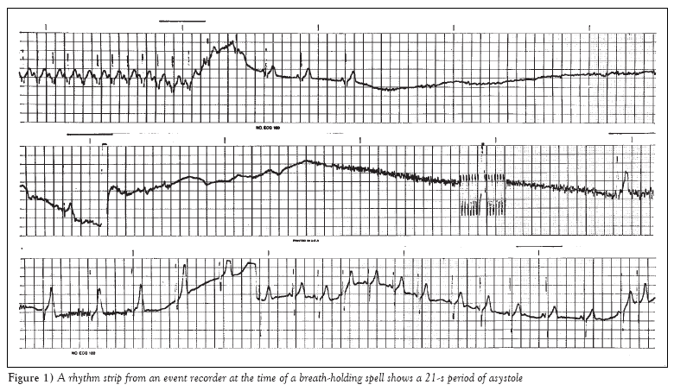
A pacemaker for asystole in breath-holding spells
Paediatr Child Health 2002;7(4):251-254.

Slide 42
Breath-Holding Spell
BEFORE | DURING | AFTER
Inciting event: Stress, excitement Aura: Crying, tantrum, “silent” scream | Event: Loss of tone, cyanotic or pallor, may have brief stiffening or jerking Suppressible: No | Rapid return to baseline No confusion except event itself Irritability

Slide 44
What type of spell was this?

Slide 45
Shuddering Attacks
Onset infancy through childhood
Brief movements of whole body shivering
  Variable frequency
    1 - 100x per day
    Shudder free intervals
  No provocation
    May be seen during excitement, bowel movements, eating
  Immediate return to baseline

Slide 46
Shuddering Attacks
Diagnosis
  Clinical history, video
  EEG if suspect myoclonus, infantile spasm
  Examine family for tremor

Slide 47
Shuddering attacks in children: An early clinical manifestation of essential tremor
Neurology 1976;26;1027
6/6 children with shuddering had tremor
5/6 with familial essential tremor
EMG with characteristics of essential tremor
Reports of severe shuddering treated successfully with propranolol

Slide 48
Shuddering Attack
BEFORE | DURING | AFTER
Inciting event: None Aura: None | Event: Brief trembling of whole body Suppressible: No | No change in level of consciousness

Slide 49
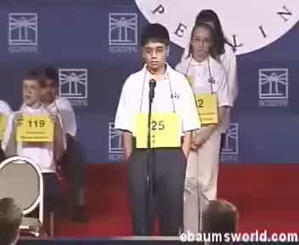

Slide 50
What type of spell was this?

Slide 51
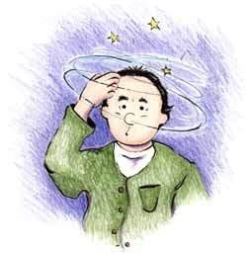
Syncope
Defined as transient loss of consciousness and muscle tone
  Presyncope – dizzy/vertigo, tunnel vision, diaphoresis, tachycardia
15% adolescents, 47% college students
3% of ER visits, 6% of hospital admissions

Slide 52
Syncope
Etiology
Neurocardiogenic – 75%
Noncardiac – 15-20%
  Seizure, migraine, POTS, narcolepsy, toxin
Cardiac – 5-10%
    Outflow obstruction, myocardial dysfunction, arrhythmia

Slide 53
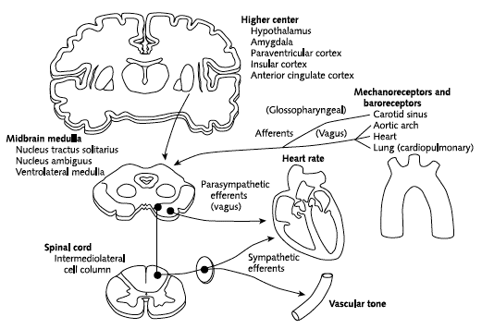
Autonomic Dysregulation in Neurocardiogenic Syncope

Slide 54
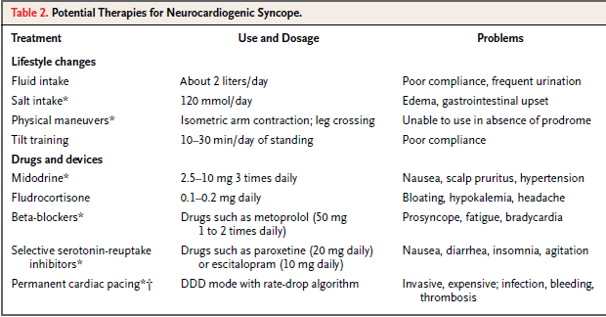
Neurocardiogenic Syncope
Treatment
N Engl J Med 2005;352:1004-10.

Slide 55
Syncope
BEFORE | DURING | AFTER
Inciting event: Stress, heat, emotion, position change Aura: Diaphoresis, dizziness, vertigo, tachycardia, “tunnel vision” | Event: Loss of muscle tone and consciousness, eyes closed during event, may have brief stiffening or jerking Suppressible: No | Rapid return to baseline No confusion except of event itself

Slide 57
What type of spell was this?

Slide 58
Stereotypy
Onset prior to 3yo
Repetitive, involuntary, purposeless activities
  Head banging, hand flapping, rocking, nodding
  Daily, bilateral, and distractible
Situational exacerbation
  Excited, scared, bored

Slide 59
Stereotypy
Diagnosis
  Clinical scenario, video
  Screen for Autistic Spectrum Disorders
  Normal exam
  No testing
Treatment
  Reassurance
  No medication
  Stimulants may worsen

Slide 60
Stereotypy - Prognosis
Singer H. J Pediatr 2004;145:391-5
40 children followed up to 10yrs after initial presentation
  32% improved
    2% outgrew completely
  50% unchanged
  12% worse
Comorbid conditions
  25% ADHD
  5% OCD
  18% chronic motor or vocal tics
  20% learning disabilities
  38% early developmental delay before age 4 years but with subsequent normal overall intellectual and motor function

Slide 61
Stereotypy
BEFORE | DURING | AFTER
Inciting event: Stress, excitement Aura: None | Event: Complex stereotypic movements Suppressible: Rarely as infant/child, more likely as pre-adolescent | No change in level of consciousness

Slide 62
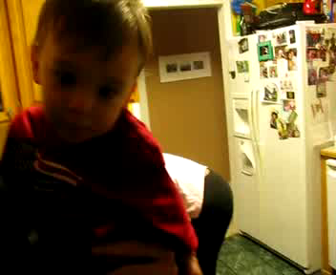

Slide 63
What type of spell was this?

Slide 64
Tics
Characteristics
2 – 15% of school aged children
Age of onset after 3yo, typically school age
  Peak at 11-13yo
  Male > female
2 types
  Motor
    eye blinking, shoulder shrug, head nod
  Vocal
    Sniffing, grunting, barking

Slide 65
Tics
Clinical Characteristics
Tics are defined as being:
  Repetitive
  Stereotyped
  Intermittent
Most tics are:
  Non-rhythmic
  Involve the head and upper body
  Temporarily suppressible
  “Build up” with rebound
  Waxing and waning
  Exacerbated by stress, concentration

Slide 66
Tics
Comorbid Conditions
Tics
ADHD
OCD
Anxiety

Slide 67
Tics
Diagnosis
No testing unless clinical characteristics suggest otherwise
  Atypical clinical course
    Lack of response to treatment
    Cognitive decline not attributed to ADHD
    Nocturnal disruptions
  Rare disorders:
    Dystonia – Wilson’s, PKAN, mitochondrial disorders
    Chorea – Sydenham’s
    Neurobehavioral symptoms and Strep - PANDAS

Slide 68
Tic or Stereotypy
Singer H. J Pediatr 2004;145:391-5

Slide 69
Tics
Treatment
Most do not need any treatment
  Avoid treating parental anxiety
Treatment reserved for interference with life
  Pain
  School decline or absences, disruption
  Social impairment
Treat the most disabling symptom
Medications
  First Line
    alpha-2 agonists - guanfacine and clonidine
  Second line
    Antipsychotics - haldol, aripiprazole, risperidone
    Baclofen
    Antiepileptics

Slide 70
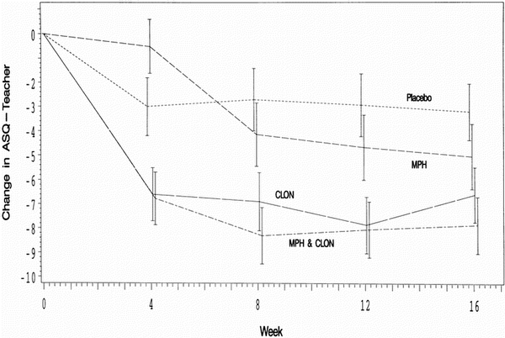
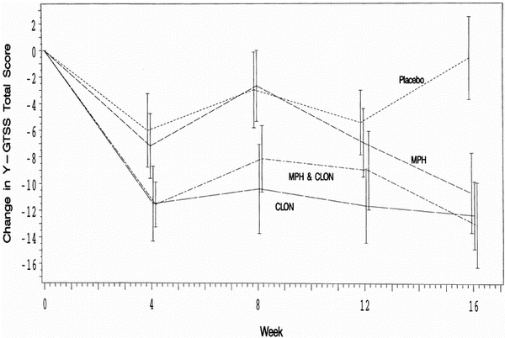
NIH Tourette and ADHD Trial Stimulants Improve Tics
Neurology - Volume 58, Issue 4 (February 2002)
  ADHD Symptoms
Tics
“The proportion of individual subjects reporting a worsening of tics as an adverse effect was no higher in those treated with MPH (20%) than those being administered CLON alone (26%) or placebo (22%). “
Notes:
136 children, RCT double blind to placebo, methylphenidate alone, MP and clonidine, and clonidine alone. Showed improvement in both tics and ADHD in all groups except placebo.

Slide 71
Tics
BEFORE | DURING | AFTER
Inciting event: Stress, concentration Aura: Sensory or premonitory urge | Event: Simple brief patterned movement or noise Suppressible: Temporarily | Brief relaxation No change in level of consciousness

Slide 72
Differentiation of Pediatric
Spells Based on History
 | BEFORE | DURING | AFTER
Tic | Inciting event: Stress, concentration Aura: Sensory or premonitory urge | Event: Simple brief patterned movement or noise Suppressible: Temporarily | Brief relaxation No change in level of consciousness
Stereotypy | Inciting event: Stress, excitement Aura: None | Event: Complex stereotypic movements Suppressible: Rarely as infant/child, more likely as pre-adolescent | No change in level of consciousness
Syncope | Inciting event: Stress, heat, emotion Aura: Diaphoresis, dizzy/vertigo, tachycardia, tunnel vision | Event: Loss of muscle tone and consciousness, eyes closed during event, may have brief stiffening or jerking Suppressible: No | Rapid return to baseline No confusion except event itself
Seizure | Inciting event: rare Aura: Partial onset may have abnormal smell, taste, sensory disturbance, motor twitching | Event: Stereotyped involuntary cortical activity with associated movements/sensory disturbance, eye opening Suppressible: No | Confusion, lethargy, weakness (Todd’s), headache None if absence seizure, frontal lobe
Breath Holding | Inciting event: Stress, excitement Aura: crying, tantrum, “silent” scream | Event: Loss of tone, cyanotic or pallor, may have brief stiffening or jerking Suppressible: No | Rapid return to baseline No confusion except event itself Irritability
Shuddering | Inciting event: None Aura: None | Event: Brief trembling of whole body Suppressible: No | No change in level of consciousness

Slide 73

Conclusion
Spells can be differentiated through careful history of what occurred before, during, and after spells

