Slide 1
CNS Infection I: Meningitis and Intracranial Empyema
Roberta L. DeBiasi, MD, MS
Chief, Division of Pediatric Infectious Diseases
Professor of Pediatrics and Microbiology/Immunology/ Tropical Medicine
The George Washington University School of Medicine

Slide 2
Objectives
Identify clinical features consistent with meningitis
Differential Diagnosis of meningitis
Distinguish CSF profiles of Bacterial, Viral, Fungal, Mycobacterial meningitis
Identify appropriate empiric therapy for bacterial meningitis
Identify appropriate chemoprophylaxis measures for bacterial meningitis
Identify key features of Neonatal HSV and treatment
Identify appropriate management and antimicrobial therapy of subdural and epidural empyema and brain abscess

Slide 3
Definitions:
Meningitis:
Inflammation of meninges (covering of the brain)
Encephalitis
Inflammation of the brain parenchyma itself
Focal Suppurative Infections of the CNS
Brain Abscess
Subdural Empyema
Epidural Empyema

Slide 4
Meningitis: Typical Case Scenarios
3 week old infant (0-1 months = Neonate)
Lethargy
Decreased oral intake
Tactile temperature
2 month old infant (1-3 months of age)
Lethargy
Decreased oral intake
Tactile temperature
15 month old (3 months of age and older)
Fever
Irritable

Slide 5
Meningitis – Clinical Features
Headache – older children and adults
Meningismus
Neck Stiffness
Kernig’s and Brudzinski Signs
Photophobia
Fever (older) or Temperature instability (neonates)
Lethargy or Irritability (infants)
Decreased oral intake (neonates)
Full or bulging fontanelle
Altered Mental Status (Late Sign)
Seizures
Vomiting

Slide 6
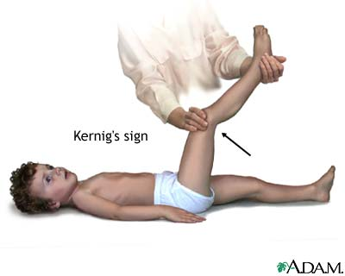
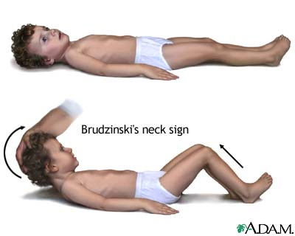
Kernig and Brudzinski Signs
Kernig’s:
Resistance to straightening the leg when hip is flexed to 90 degrees
Brudzinski’s
When examiner flexes neck,
Pt flexes hips and knees

Slide 7
Meningitis: Microbiologic Differential Diagnosis - 1
Bacterial:
0-1 months (Neonate):
Escherichia coli
Group B Streptococcus
Listeria monocytogenes
>1 month of age
Neisseria meningitidis
Streptococcus pneumoniae
Haemophilus influenzae (Non-type B >Type B)
Group B strep, E.coli still possible
Other
Borrelia burgdorferi (Lyme)
Treponema pallidum (Syphilis)

Slide 8
Meningitis: Microbiologic Differential Diagnosis - 2
Viral:
0-3 months:
Herpes Simplex Virus (especially <6 weeks of age)
Enterovirus
>1 month of age
Enterovirus>>>>Others
Others
Arbovirus (West Nile Virus ,SLE>>> WEE, EEE)
Respiratory viruses (including Influenza)
Other Herpesviruses (EBV, HHV-6)

Slide 9
Meningitis: Microbiologic Differential Diagnosis - 3
Mycobacterial:
Mycobacterium tuberculosis
Mycobacterium bovis
Fungal
Cryptococcus > Endemic Fungi
Endemic Fungi:
Histoplasma, Coccidioides, Blastomyces
Candida
Immunocompromised hosts or neonates

Slide 10
Meningitis – Initial management
CT scan for:
Structural mass
Increased ICP which would make LP dangerous
Parameningeal focus
Brain abscess, Epidural/Subdural Empyema
Lumbar Puncture
Opening pressure, Cell counts, Chemistries
Other studies
CSF PCR for (both are very sensitive and specific)
Enterovirus
HSV
CSF Cryptococcal Antigen

Slide 11
Meningitis: Usual CSF Findings
 | WBC (per mm³) | Diff | Glucose (mg/dL) | Protein (mg/dL) | Other
Bacteria | >1000 | >85-90% Neutrophils | Low (0-40) | Elevated (100-150) | Gram Stain positive >80%
Virus | <1000 | Lymphs, Monos (20-40% Neutro) | Normal | Normal | Negative
TB | <500 | Lymphs, Monos (<10-20% Neutro) | Low (<40) | Very elevated (>200-300) | Negative gram stain <30% AFB Stain
Fungus | <500 | Lymphs, Monos (<10-20% Neutro) | Low (<40) | Elevated (>100-200) | May see organisms on gram stain (<40%)
Lyme | <500 | Lymphs, Monos (<10% Neutro) | Normal | <100 | Negative

Slide 12
Meningitis – Initial management (Continued)
Steroids or No Steroids?
Controversial in pediatrics
Immediate Empiric Antimicrobials for Possible Bacterial Meningitis:
Neonate:
Ampicillin 75 mg/kg/dose IV q 6 hours
Cefotaxime 50 mg/kg/dose IV q6 hours
>1 month old
Vancomycin (possible resistant Pneumococcus) PLUS
Ceftriaxone 50 mg/kg/dose IV q12 (meningitic dose) OR Cefotaxime 50 mg/kg/dose IV q6 hours (meningitic dose)

Slide 13
Steroids and Meningitis: RedBook Statements
“Dexamethasone may be beneficial for treatment of infants and children with Hib meningitis to diminish risk of (neurological complications including) hearing loss, if given BEFORE or concurrently with the first dose of antimicrobial agents”
“For infants and children 6 weeks of age and older, adjunctive therapy with dexamethasone may be considered after weighing the potential benefits and possible risks. Some (Many) experts recommend use of corticosteroids in pneumococcal meningitis but this issue is controversial and data are not sufficient to make a routine recommendation for children. If used…should be given before or concurrently with the first dose of antimicrobial agents.”
Extrapolation of time post abx admin and bugs controversial

Slide 14
Meningitis: Definitive Therapy
Bacterial meningitis
Neisseria meningitis: 7 days
Haemophilus: 7- 10 days, longer if complicated
Pneumococcus: 10-14 days
Group B Strep: 14-21 days
Gram negatives: 21 days
Listeria: >21 days
HSV: CNS 21 days intravenous acyclovir
TB: 9-12 months total
2 months of daily 4 drug (INH, Rif, PZA, Ethambutol)
Then 7-10 months of 2 drugs daily/twice weekly (INH + Rifampin)

Slide 15
Meningitis – Other food for thought
Long Term Problems:
Hearing Loss:
Baseline and followup hearing tests
Neurodevelopmental Delay
Follow these children closely
Can you stop antibacterial therapy if cultures are negative?
Other etiology found
Other etiology not found
Was CSF profile reassuring?
Can you interpret a “bloody tap”?

Slide 18
Meningococcal Epidemiology – U.S.
4000 cases per year
1.3/100,000 overall incidence in U.S.
47% of cases in children < 2
2/3 meningitis and 1/3 bacteremia
Case fatality rate 14%
Penicillin resistance now reported from the US (alteration of penicillin binding protein)

Slide 19
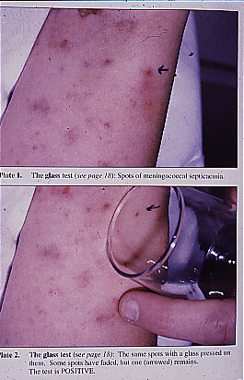

Slide 20
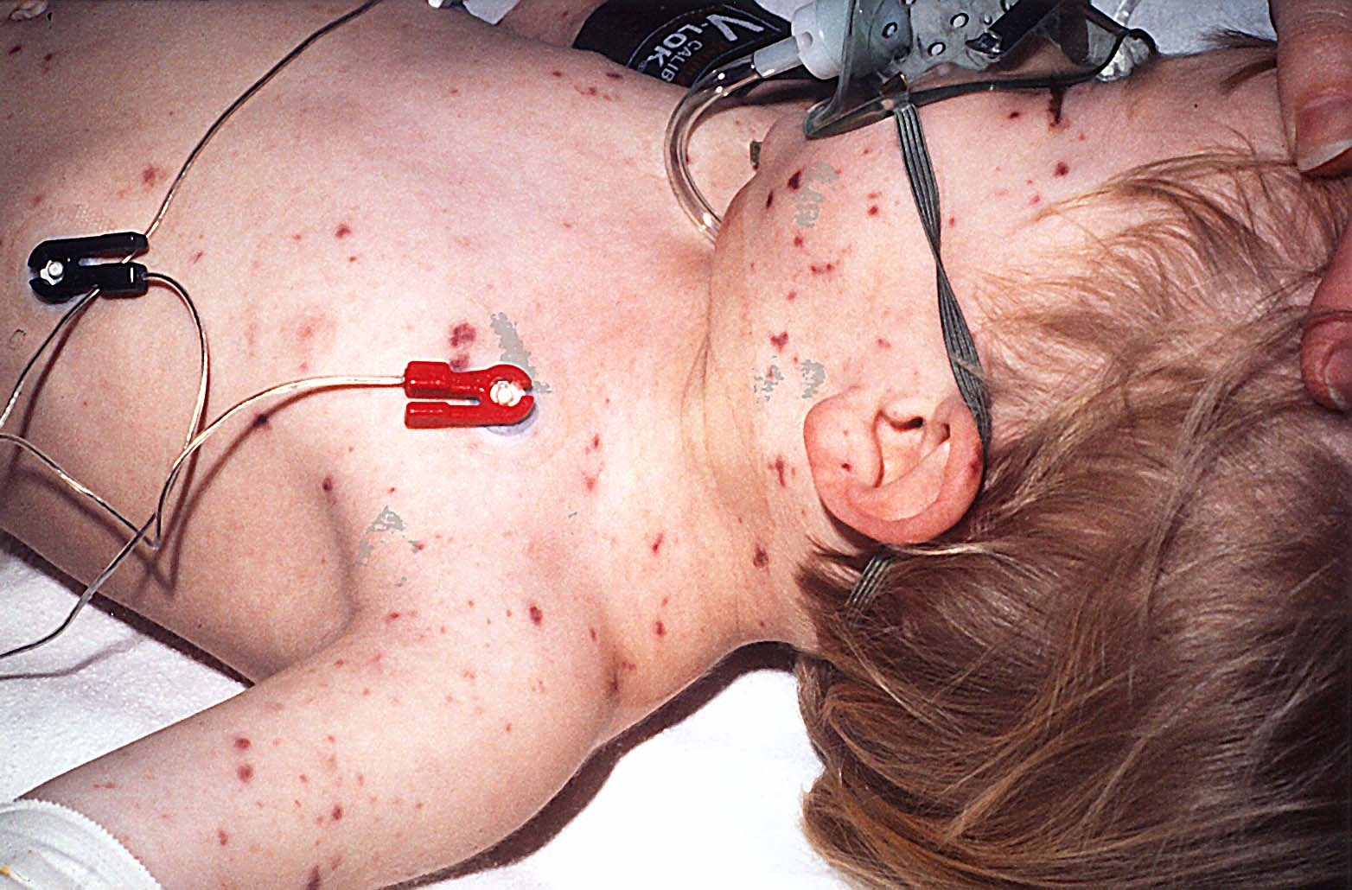

Slide 21
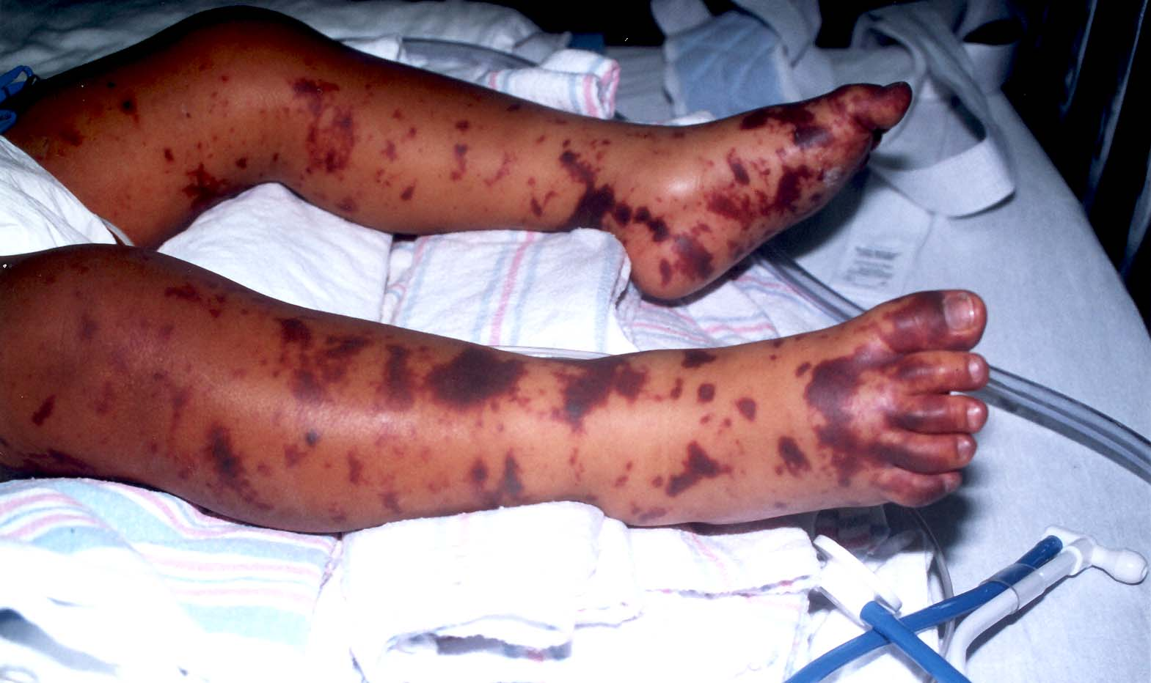

Slide 22
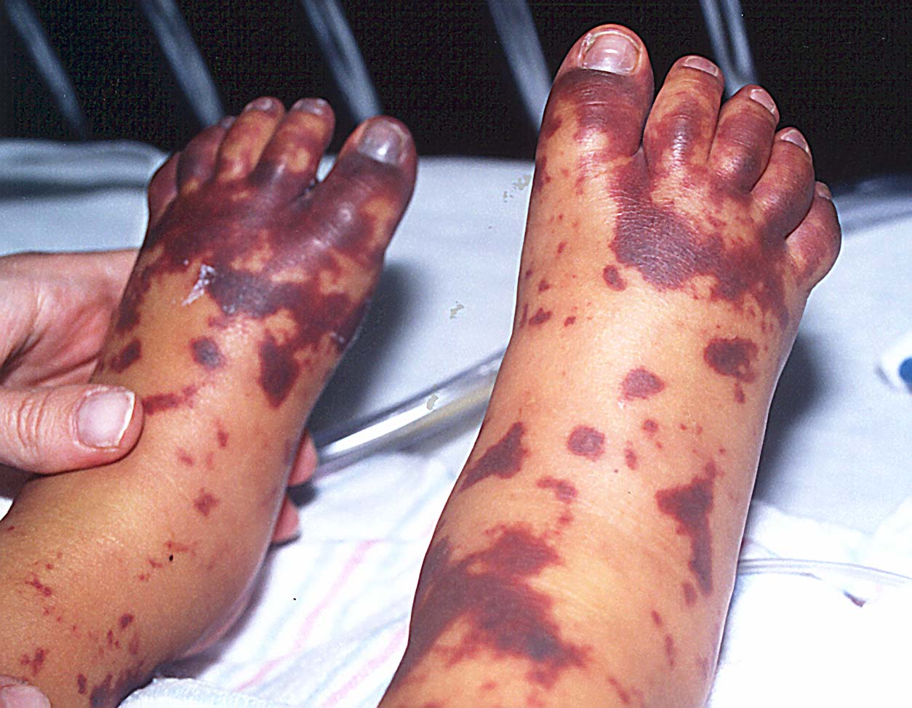

Slide 23
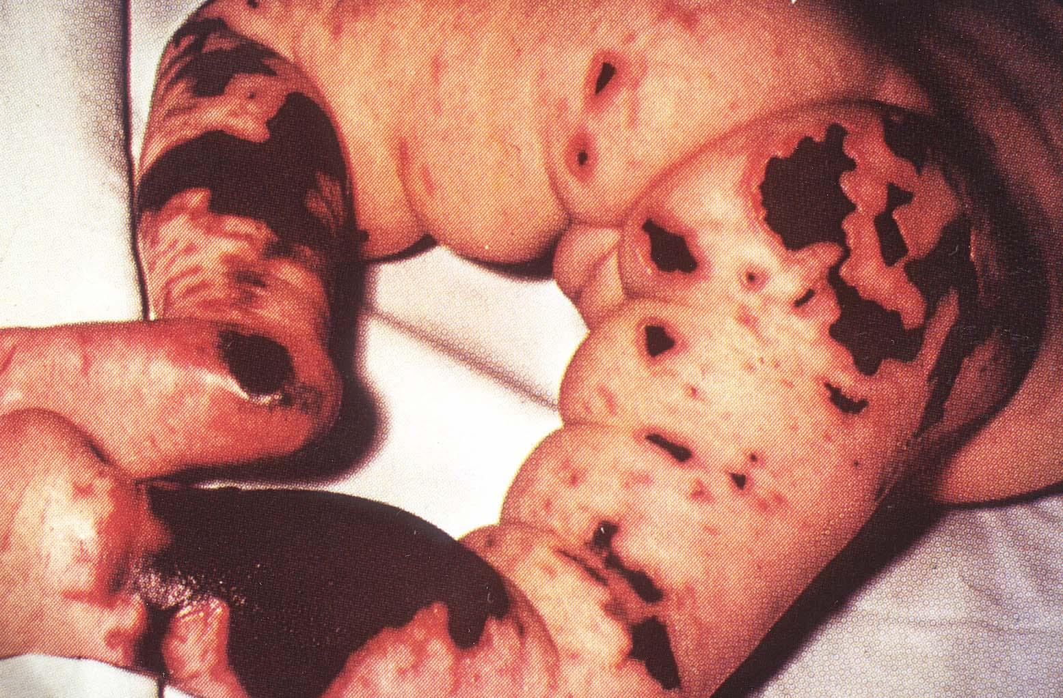

Slide 24
Meningococcus and Complement
Antibody and complement required for killing
Deficiency of terminal complement (C5-C9) or properdin -> increased susceptibility to meningococcal disease.
Prevalence of complement deficiency:
10-20% children with first episode
Check CH50 in patients with meningococcal meningitis

Slide 25
Meningococcal Chemoprophylaxis
High risk – Prophylaxis Recommended
Household contacts (1000 fold increased risk of disease)
Especially if < 2 years of age
Childcare or Preschool contacts any time during 7 days prior to onset of illness
Index patient if treated with Penicillin (Does not eradicate nasopharyngeal carriage)
Persons exposed to oral secretions of the index patient
Regimens
Rifampin - Oral dose bid X 2 days (4 doses)
Ceftriaxone – Single IM dose
Ciprofloxacin – Single oral dose
Azithromycin – Single oral dose

Slide 26
Meningococcal Vaccine
US Vaccines
Contain Serogroups A, C, Y, W135 (not B)
Tetravalent Meningococcal Conjugate Vaccine (MCV4)
Menactra, Menveo, also a
Now part of routine vaccination
Primary vaccine in adolescents at 11-12 years
Booster recommended at age 16-18 years
Also for high risk children 2 months - 18 years age
Anatomic or functional asplenia (including sickle cell)
Complement deficiency
Residing or traveling to endemic area (Meningitis Belt)
During community outbreak (vaccine serotype)

Slide 27
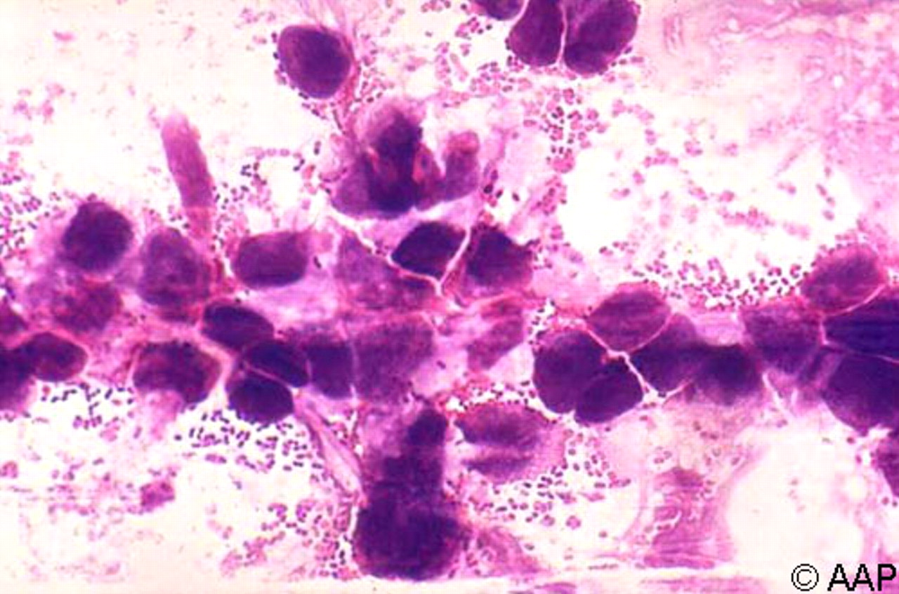
Streptococcus pneumoniae in CSF of a child with meningitis (Gram stain)
Red Book Online Visual Library, 2009. Image 102_02. Available at: http://aapredbook.aappublications.org/visual.
Copyright ©2009 American Academy of Pediatrics

Slide 28
Streptococcus pneumoniae
90 serotypes
Nasopharyngeal carriage rates 20-60%
Pre PCV- vaccine Invasive serotypes (1998-9):
4, 6B, 9V, 14, 18C, 19F, 23F
Post-vaccine Era (2000) –
80% reduction in invasive disease
Replacement of colonizing strains with other invasive serotypes
Newly implemented PCV-14 Vaccine (2011)
Expansion of coverage to 14 serotypes
Ages 2, 4, 6, 15 months

Slide 29
2008-2009
Pre PCV 7 1998-1999
ABC Surveillance Data

Slide 30
High Risk Groups for Invasive Pneumococcal Disease
Definite:
Sickle cell, congenital or acquired asplenia
HIV
<2 years of age Alaska Native or some American Indian
Cochlear implant
Presumed:
Congenital immunodeficiency
Cardiac disease, Pulm disease, Renal disease, Diabetes
CSF Leaks
Immunosuppressive or radiation therapy (cancer, SCT, SOT)

Slide 31
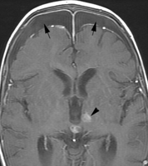
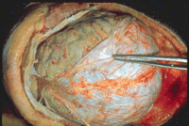
Bacterial Meningitis: Complications
Subdural Effusions
Subdural Empyema
Suppurative Intracranial Thrombophlebitis
Superior Sagittal Venous Sinus
Cavernous Sinus
Hearing Loss

Slide 32
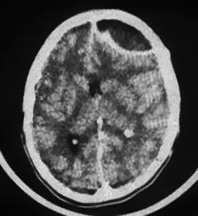
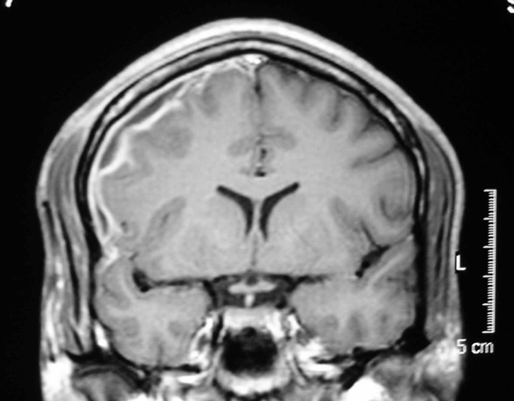
Intracranial Empyema
Subdural Empyema
Epidural Empyema

Slide 33
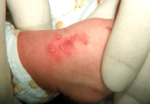
Neonatal Herpes

Slide 34
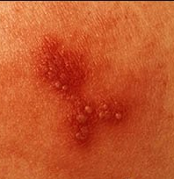
Herpes: Classic grouped vesicular lesions on an erythematous base

Slide 35
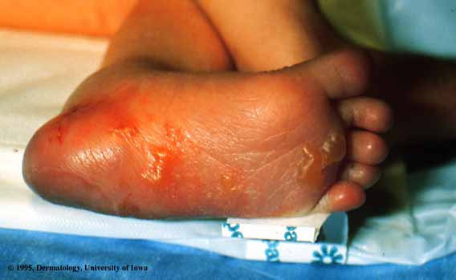
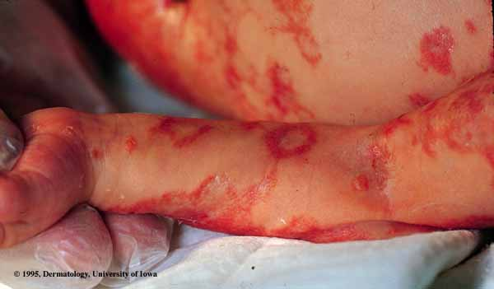
Neonatal Herpes
Check Hidden areas: Wristband, back, scalp electrode

Slide 36
Neonatal HSV CNS disease
Irritability, abnormal movements/ positioning, seizures, bulging fontanelle
Typically presents days 14 to 28 of life
up to 6 weeks of life
2/3 have concomitant skin lesions
1/3 no skin vesicles
CSF:
Lymphocytic/Monocytic
Normal glucose
Normal or slight elevated protein

Slide 37
Neonatal Herpes: 3 Classic Presentations
Disseminated Disease (25%)
Earliest onset, usually first week of life
Sepsis, Multiorgan involvement, esp liver/lungs
Localized Skin, Eye and Mouth Disease (45%)
Usually presents at 5-14 days of life
Recurrent vesicular lesions
Neuro sequelae if recurrences in first 6 mos of life
Localized CNS Disease (30%)
Latest onset, second and third weeks of life

Slide 38
Neonatal HSV: Significance
1 in 3200 deliveries
1,500 cases/year in the US
75% HSV-2
25% HSV-1
Overall Mortality
No Treatment : 50-80%
With Acyclovir: 4-30%
Morbidity
No Treatment: 50-70% impaired neurodevelopment
With Acyclovir: 2-70% impaired
Most commonly presents in the physician’s office or ED during the first 4-6 weeks of life

Slide 39
Neonatal HSV - Transmission
Intrapartum : 90% of cases
Genital: HSV 1 or 2 infection
Postpartum : 5 to 10% of cases
Oral/labial: HSV 1 >> HSV 2
Risk of transmission from maternal herpes:
Primary genital lesions: 50%
Reactivated lesions: 0-5%
Remember: 2/3 of infected individuals are ASYMPTOMATIC
Appropriate to ask maternal history, but negative history does not change management of infant

Slide 40
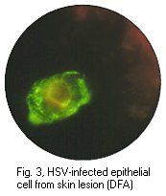
Neonatal Herpes: DX and RX
DX:
CSF: HSV PCR (Culture is poor yield)
Liver Enzymes – often elevated
Vesicle HSV DFA with culture backup
DFA has replaced Tzanck prep
Unroof vesicle and scrape base for cells
Swab conjunctiva, throat and rectum for HSV culture
RX:
Immediate administration of IV acyclovir – do not await confirmation of diagnosis
Neonatal Dosing: 60 mg/kg/day divided q8 hours

Slide 41
Take Home Points - Meningitis
Classic signs may be absent in infants
Etiology is different for different age groups
CSF Profile is very important for Diff Dx
Diff, protein, glucose
Time is of the essence - don’t delay antimicrobial Rx
Bloody taps are not interpretable
Steroid use is still controversial/institution dependent
Don’t forget about HSV in babies 0-6 weeks of age !

Slide 42
Focal Suppurative Infection of CNS: Brain Abscess, Subdural Empyema, Epidural Empyema
Predisposing Conditions for Brain Abscess
Hematogenous Spread
Cyanotic Congenital Heart (TOF, Transposition)
Hypercoaguability, Sickle Cell
Septic Thrombophlebitis (Lemierre’s, Endocarditis)
Contiguous Spread:
Sinusitis (esp Frontal): Potts Puffy Tumor with intracranial extension
Otitis media/mastoiditis with extension
Dental Source
Bacterial Meningitis
Trauma/Surgical

Slide 43
Pyogenic Brain Abscess – Clinical
Symptoms/signs depend on location
Frontal and Parietal Abscesses – often asymptomatic for longer periods of time until compression occurs
Epidural empyema: Insidious clinical presentaton
Most common symptoms:
Headache, Fever, Vomiting each occur in >50% cases
However Classic Triad occurs in <30% cases
MS changes <50% cases
Seizures <50% cases
Focal Neurologic Deficits 40%
Meningeal Signs <25%

Slide 44
Pyogenic Brain Abscess: Microbiology
Polymicrobial infection common (30%)
Aerobic and Anaerobic (Microaerophillic) Streptococci (50-70%)
Streptococcus intermedius Group
Streptococcus anginosis Group
Staphylococcus aureus (MRSA, MSSA) – 10-30%
Gram negative enterics– especialy Citrobacter diversus (neonate) – 10-25%
Respiratory Pathogens: Pneumococcus, Moraxella, Haemophilus
** Anaerobes – Often present, difficult to grow
Immunocompromised host: Nocardia, Actinomyces, Toxoplasma

Slide 45
Pyogenic Brain Abscess – Initial Management
Imaging: CT scan with contrast or MRI
LP generally not indicated
Surgical Evacuation:
Stains: Gram stain, AFB Stain, Fungal Stain
Cultures: Bacterial Aerobic and Anaerobic, Fungal, AFB
Sinus Approach/Fenestration vs. Intracranial
Empiric Therapy:
Vancomycin
Ceftriaxone or Cefotaxime
Flagyl (never use Clinda – no CSF penetration)
OR
Vancomycin PLUS Meropenem

Slide 46
Brain Abscess – Definitive RX
Tailor antimicrobials based on cultures
However, in general, do not stop anaerobic coverage even if no growth
Generally treat all IV for minimum 4-6 weeks
Drainage or no drainage impacts length of course
Re-imaging toward end of therapy (sometimes at 4 weeks into therapy)
Imaging may not be completely normal prior to stopping antimicrobial therapy

Slide 47
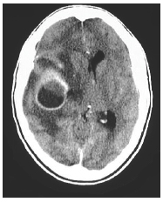
Brain Abscess - Imaging
Ill-defined hypodensity on non-contrasted CT scan
Variable amount of associated edema
Frequently ring-enhance with the addition of intravenous contrast

Slide 48
Intracranial Empyema
Subdural Empyema
Epidural Empyema

Slide 49
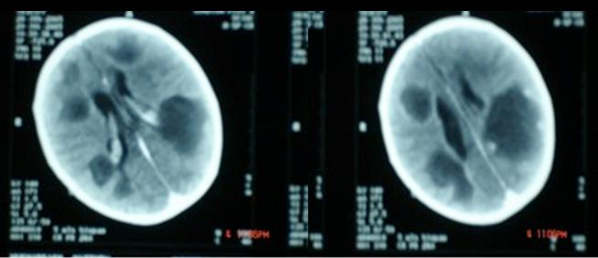
Citrobacter diversus Brain Abscess

Slide 50
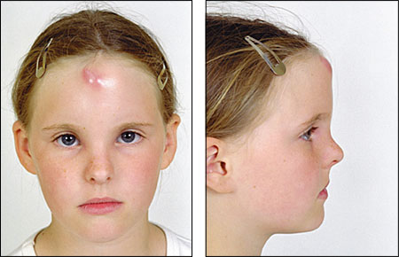
Potts Puffy Tumor
Extension from Frontal Sinusitis
With or without intracranial extension

Slide 51
CNS Shunt Infections
Refer to 2004 IDSA Guidelines Page 1281
No randomized prospective studies
Removal of all components of hardware most effective treatment
Hardware in head, catheter, distal tip in gut
Erosions through peritoneum/polymicrobial
Treat with IV abx with shunt externalized until CSF has sterilized (daily cell counts, chemistries, cultures)
Reinsert shunt when CSF is sterile X days
Coagulase Negative Staphylcocci: 10 days
Staph Aureus: 10 days
Gram Negatives: 10-14 days
Treat additional period post-reinsertion? (48 hours)

