Slide 1
N E U T R O P E N I A FROM THE PICU TO PRIMARY CARE
Alexis Leonard, MD
Pediatric Hematology/Oncology Fellow
Resident Noon Conference
September 14, 2015

Slide 2
O B J E C T I V E S By the end of the lecture, be able to …
Define neutropenia
Have a framework for the differential for neutropenia
Evaluate a patient with suspected/known neutropenia
Know what to do with fever and neutropenia

Slide 3
C A S E S

Slide 4
C A S E 1 : Baby Boy ANC
At the PMD
CC: rash, sleepy
HPI: 3wk FT M, second baby, umbilical rash x 3-4d, now worse & not feeding well
ROS: terrible intake/output, but no f/v/d
PE: pertinents = Tachycardic/Tachypneic, lethargic, +dry mucous membranes, cellulitis to skin surrounding cord
Dispo: ER → Admitted to PICU for hypovolemic/septic shock

Slide 5
C A S E 2 : Toddler ANC
At the PMD
CC: persistent fever
HPI: 3y M with 3-4 days of fever to 103-104. Seen twice in the last 4 days without clear etiology of fever
ROS: fever, URI symptoms
PE: pertinents = +rhinorrhea, erythematous palate, posterior cervical LAD
Dispo: Labs, then home

Slide 6
C A S E 3 : Toddler Twin ANC
At the PMD
CC: rule out ear infection
HPI: 3y M with URI sx, now with new fever & ear tugging
Hx: Starting at 15mo --> Multiple infections
7 episodes AOM
4 episodes sinusitis
1 admission for PNA
1 admission for periorbital cellulitis (treated outpatient for 2 other episodes of cellulitis)
PE: pertinents = +rhinorrhea, +ROM, poor dentition
Dispo: Abx, labs, then home

Slide 7
C A S E S
Case 1: BB Anc | Case 2: Toddler Anc | Case 3: Toddler Twin Anc
17 10 229 47.9 S: 4 Bands: 1 L: 64 M: 14 E: 7 | 9.3 4.1 123 28.6 S: 25 Bands: 0 L: 73 M: 3 E: 1 | 12 3.3 215 37.1 S: 17 Bands: 0 L: 77 M: 5 E: 1

Slide 8
C A S E 1 : Baby Boy ANC
Admitted to the PICU
Septic workup in ED + skin culture
Started on IV ceftaz & vanc
IVF
Serial CBCs
Heme consult
Workup for neutropenia….
Notes:
Safe to say it was clear this child was sick and needed to be sent to ED

Slide 9
C A S E S 2 & 3
Case 2: Toddler Anc
Sick/Not sick?
Worried?
Antibiotics?
Next step?
Case 3: Toddler Twin Anc
Sick/Not sick?
Workup?
Refer?
Antibiotics?
Counsel the parents?

Slide 10
Neutrophils!
Notes:
Phagocyte, first-responder to cytokines (bacteria, inflammation), express & release cytokines to amplify the inflammatory response
Lifespan: 5-90hr, marginate to epithelium (integrin dependent adhesion) & migrate into tissue where live for 1-2d

Slide 11
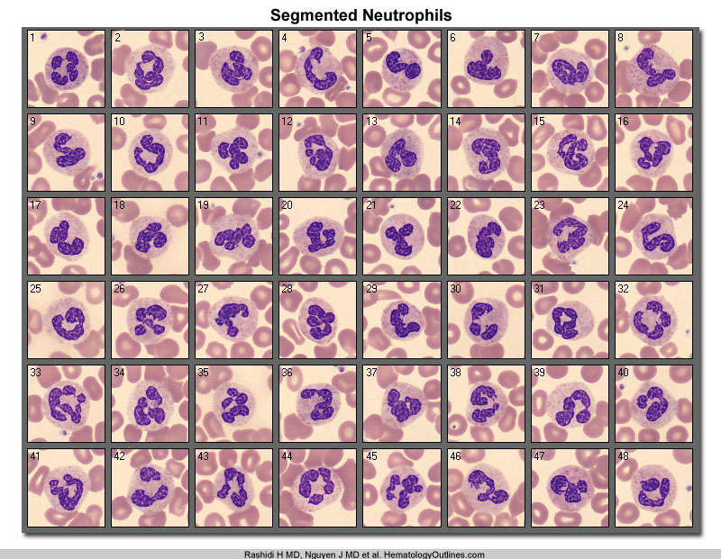

Slide 13
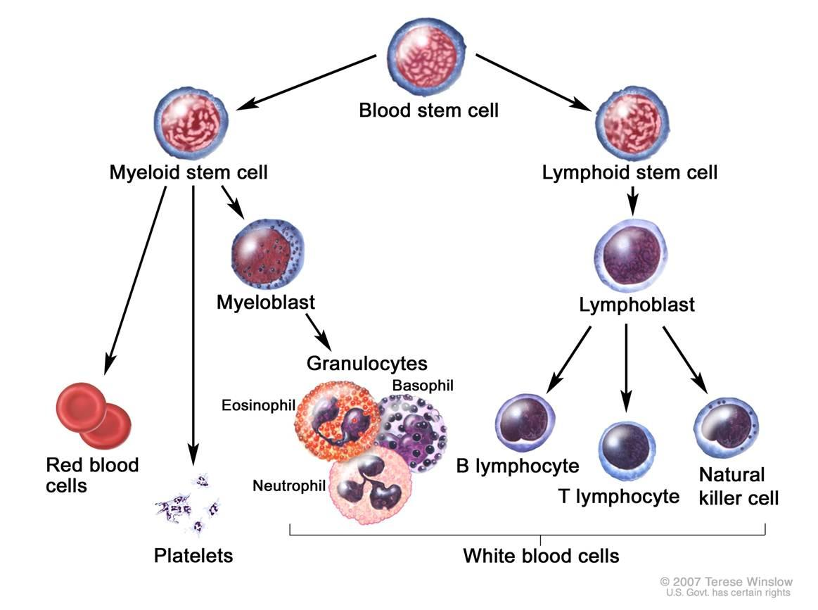

Slide 14
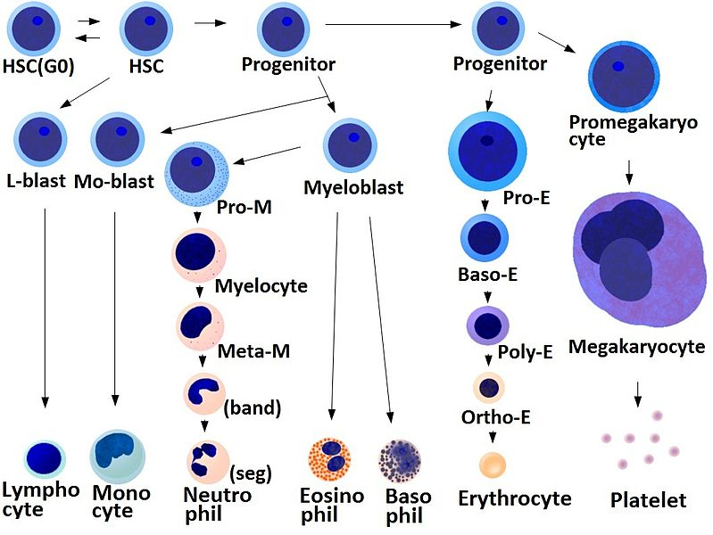

Slide 15
O B J E C T I V E S By the end of the lecture, be able to …
Define Neutropenia

Slide 16
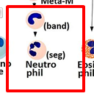
Definition of Neutropenia
Reduction in the absolute number of neutrophils* in the blood
ANC = total WBC * (%segs + %bands)
Cases -- > ANC?
BB Anc: WBC 10.0, 4 segs, 1 band
Normal ANC = 1500-8000**
Neutropenia = ANC <1500
Chronic Neutropenia: lasting longer than 3mo
*Neutrophils = Segmented cells and bands
ANC = 10,000 x (0.04 + 0.01)
Notes:
Talking about your absolute neutrophil count = ANC
Case 1: ANC = 500
Case 2: ANC = 1025
Case 3: ANC = 561
** data based on white children

Slide 17
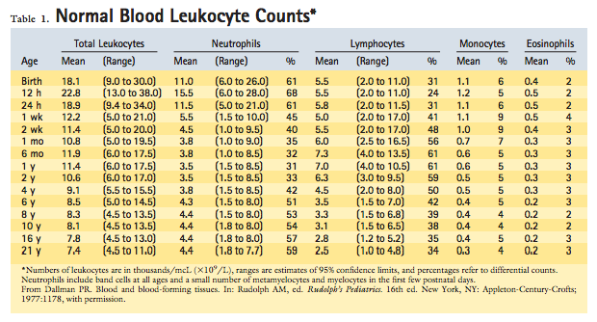
**Neutropenia varies physiologically
Varies by age & ethnicity
Notes:
- Normal total WBC and ANC changes from childhood into adolescence
- ANC increases from 1y until adult range during adolescence
- Neutrophil count is not as stable as other blood measurements & fluctuates physiologically in a nonrandom fashion b/c it’s subject to variation
* vary with activity, exercise, eating, time of day
* vary with serious infection, inflammatory disorders, CCS, extreme anxiety
--> neutropenia should be confirmed on at least 3 sample obtained over several weeks

Slide 18
ANC Lower Limit : varies by age
By Age:
24HOL: 6000
First week: 5000
Second week: 1500
2wk -1y: 1000
1y-10y: 1800
>10y: 1500
Ethnic Variation:
African patients have ANCs 1000-1500
approx 3-5% have levels <1500
Neutropenia Definition:
2-12mo: less than 1000
>12mo: less than 1500
AA: 800 can be normal
Notes:
Believe may be related to Duffy-null ag that protects against invasion from P.Vivax, regulates neutrophil storage in BM?

Slide 19
Risk Stratification
Mild Neutropenia: 1000-1500
little to no heightened risk of infection
Moderate Neutropenia: 500-1000
much less frequent and severe infections
Severe Neutropenia: <500
high susceptibility
Why do you care?
Helps predict risk of pyogenic infections
Other things to think about:
Length of neutropenia
Isolated neutropenia or are other cell lines affected?
Marrow problem?*
Oncology or Immunodeficient patient?*
Notes:
* In general, disorders of neutrophil production and release from bone marrow carry more risk for bacterial infections than peripheral neutropenia associated with normal marrow
- Immune neutropenia has lower risk of infection due to heightened neutrophil production
- Some chronic neutropenia <500 do not get serious infection b/c of working B and T cells
- Neutropenia from malignancies worse b/c compromised function and numbers of lymphocyte and monocytes
- Chemo compromised integrity of the skin and mucous membranes, nutritional status (predisposed to infection)

Slide 20
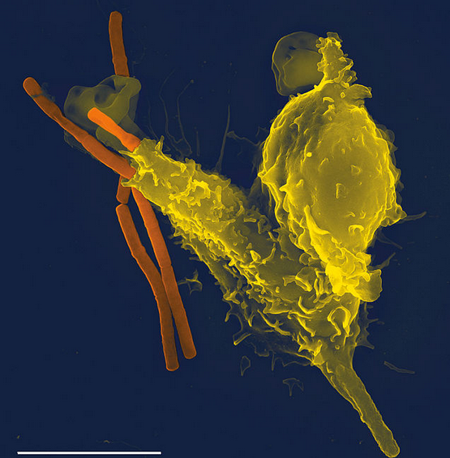
Mechanism of Infection
Neutrophil disorders: Most frequent sites of infection = skin, mucosa of oral cavity and GI tract, head/neck/lungs
Infection from endogenous flora (skin and GI)
Cellulitis
Furunculosis
Stomatitis, gingivitis*
OM
Sinusitis
PNA
Septicemia
Perirectal inflammation
Diffuse intestinal lesions
Notes:
Gingivitis: good indication can’t mobilize neutrophils
* Disorders of the oral cavity are always present by 2 in kids with neutropenia 2/2 impaired production
* Erosive, Hemorrhagic, and painful gingivitis, oral ulcers of the tongue and buccal mucosa
Diffuse GI lesions --> abd pain and diarrhea --> bacterial overgrowth --> more pain

Slide 21
Pathogens
Bacteria: Staph aureus, Staph Epidermidis, Strep, Enterococci, Pseudomonas, Gram negatives
Fungus: Candida, Aspergillus
Symptoms may be atypical because neutropenia means less inflammation and therefore clinical symptoms
Remember! You won’t see…
s/sx of local infections & inflammation (exudate, abscess, regional LAD)
Remember! You will see…
redness, pain, tenderness, warmth, fever

Slide 22
C A S E S
Case 1: BB Anc | Case 2: Toddler Anc | Case 3: Toddler Twin Anc
17 10 229 47.9 S: 4 B: 1 L: 64 M: 14 E: 7 | 9.3 4.1 123 28.6 S: 25 B: 0 L: 73 M: 3 E: 1 | 12 3.3 215 37.1 S: 17 B: 0 L: 77 M: 5 E: 1
Is the ANC normal? What is the risk stratification? What infection are you worried about? What pathogens? Summary Statement . . .
Notes:
Risk stratification? Things to think about
Degree & length of neutropenia
Isolated neutropenia or are other cell lines affected?
Oncology or Immunodeficient patient?
What infection are you worried about?
What will you see? What won’t you see?
Most likely pathogens?

Slide 23
C A S E S : Summary Statements
Case 1: 2wk FT male with Omphilits due to isolated severe neutropenia, admitted to the ICU for concern of hypovolemic vs. septic shock
Case 2: 3y male with prolonged high fever without clear etiology, found to have pancytopenia & mild neutropenia
Case 3: 3y male with hx of recurrent bacterial infections, presenting with ROM and moderate neutropenia

Slide 24
C A S E S : Summary Statements
Case 1: 2wk FT male with Omphilits due to isolated severe neutropenia , admitted to the ICU for concern of hypovolemic vs. septic shock that is most likely secondary to …
Case 2: 2y male with prolonged high fever without clear etiology, found to have pancytopenia with mild neutropenia that is most likely secondary to …
Case 3: 3y male with hx of recurrent bacterial infections, presenting with BOM and moderate neutropenia that is most likely secondary to …

Slide 25
O B J E C T I V E S By the end of the lecture, be able to …
Define Neutropenia
Have a framework for the differential for neutropenia

Slide 26
Big Picture on Neutropenia To help you narrow your differential
Acquired or Inherited?
Extrinsic or Intrinsic?
Acute or Chronic?
Part of a Syndrome?
Immune Related? Part of Immunodeficiency?
Meet age & ethnic requirement for neutropenia?
Notes:
Not totally clear cut, a lot of these overlap

Slide 27
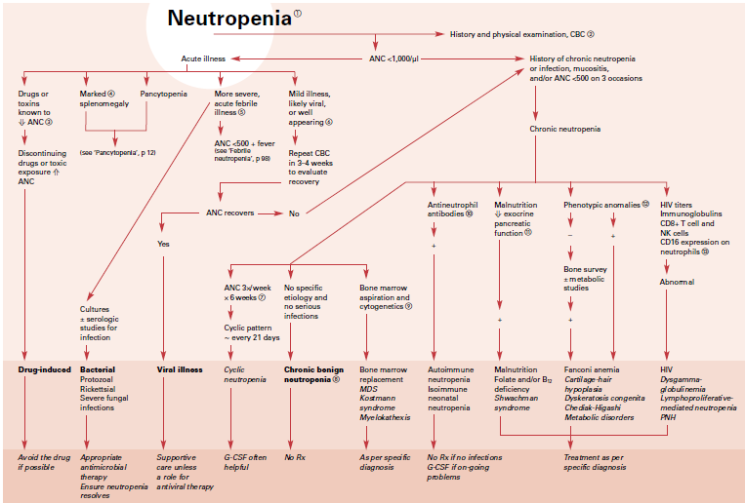
Notes:
Practical Algorithms in Pediatric Hematology and Oncology

Slide 28
For the most part . . .
Acquired/Extrinsic/Acute
vs.
Inherited/Intrinsic/Chronic
Notes:
** exception: immune (both chronic and acute) & nutritional (acquired chronic)
Immunologic neutropenia – acute OR chronic
Nutritional neutropenia – acquired chronic disease

Slide 29
Acquired Neutropenia: Acquired/Extrinsic/Acute
Infection
Autoimmune
Idiopathic
Bone Marrow Replacement
Drug-Induced
Sequestration
Nutritional Deficiency

Slide 30
Acquired Neutropenia: Infection
SHOULD ALWAYS BE YOUR FIRST THOUGHT
VIRUSES MOST COMMON
EBV, RSV, Flu A and B, Hepatitis, HHV6, Varicella, Rubella, Rubeola
Consider bacterial, protozoal, rickettsial, fungal
Occurs over first 1-2d & persists for 3-8d (acute period of viremia)
Redistribute
Move neutrophils to site of infection
Production does not meet demand
Notes:
Severe bacterial infection may cause neutrophilia
Typhoid fever, TB, RMSF
Evolves over a few days when neutrophil use is rapid and production is compromised
Mechanism: Redistribution peripheral blood to marginating pool (adherent to endothelium after release of adhesion molecules)
Premies exhaust marrow easily, succumbing to bacterial sepsis vs. older chidlren and adults that have increased reserves in infection

Slide 31
Acquired Neutropenia: Acquired/Extrinsic/Acute
Infection
Autoimmune
Idiopathic
Bone Marrow Replacement
Drug-Induced
Sequestration
Nutritional Deficiency
Neonatal Alloimmune Neutropenia
Primary Autoimmune Neutropenia
Secondary Autoimmune Neutropenia

Slide 32
Acquired Neutropenia: Autoimmune
Neonatal Alloimmune
Transplacental transfer maternal IgG against fetal neutrophil ag Think RH disease
P/W delayed separation of umbilical cord, mild skin infections, fever, PNA in the first 2 weeks
Half-life of IgG is approximately 5 - 6 wk → alloimmune neutropenia usually disappears after 2 – 3mo (survival of maternal antibody)
Treat with supportive care, abx as needed, G-CSF for severe cases
Notes:
Transfer of fetal cells to the maternal circulation causing mother to produce Ab to fetal antigens not present on her own cells
Neonatal Alloimmune Neutropenia:
2. Passive transfer of maternal antibody
- Pregnant women with primary immune neutropenia or immune neutropenia due to disease such as lupus can transfer IgG anti-neutrophil ab
- Transient

Slide 33
Acquired Neutropenia: Autoimmune
Primary Autoimmune Previously Chronic Benign Neutropenia of Childhood
+ Anti-Neutrophil Antibody : “molecular mimicry”
Typically diagnosed at 5-15mo , 95% spontaneous recovery by 5y, mean duration of neutropenia is approximately 20mo
90% -- no association with increased risk of repeated pyogenic infections even with severe neutropenia
Sometimes need up to 3 attempts to achieve detection
Rx: abx, CCS, G-CSF (heighten neutrophil production to overcome Ab-induced destruction)
Can be immunized with live viral vaccines because cellular immune system is intact
Notes:
Epitope of virus stimulates production of an Ab that cross-reacts with a similar ag on neutrophil
CCS: suppress immune destruction of neutrophils

Slide 34
Acquired Neutropenia: Autoimmune
S E C O N D A R Y A U T O I M M U N E
Systemic autoimmune disease
Rx: treat primary disease, G-CSF if severe
Notes:
Reported in Wilms tumor & Hodgkin disease

Slide 35
Acquired Neutropenia: Acquired/Extrinsic/Acute
Infection
Autoimmune
Idiopathic
Bone Marrow Replacement
Drug-Induced
Sequestration
Nutritional Deficiency

Slide 36
Idiopathic Likely a variety of disorders, not well characterized
Routine CBC w/o hx of recurrent fevers or infection
May actually be immune neutropenia or familial benign neutropenia
Hematologists try to keep eval to a minimum
Marrow Replacement Cancer, Chemo & Radiation Effects, Aplastic Anemia
Acquired BM disorders
hematoligic malignancies
metastatic solid tumors
myelodysplastic syndrome
aplastic anemia
Notes:
D. Chronic Idiopathic Neutropenia: Usually ineffective or decreased production of neutrophils
- Marrow findings are not consistent
When Rx: CCS & G-CSF
Mild, mod, or severe -- if severe, could have recurrent fevers, URIs, skin infections easily treated with abx
Serial CBCs
Uncommon for these patients to have systemic symptoms, or to later progress to develop AI diseases
7. Marrow Replacement/Cancer Chemo & Radiation effects, Aplastic Anemia
- Chemo & radiation damage stem cells
- Aplastic anemia from T-cell mediated damage to stem cells
- Prompt abx to cover SA and Pseudomonas
- Usually only presenting sign is fever

Slide 37
Acquired Neutropenia: Acquired/Extrinsic/Acute
Infection
Autoimmune
Idiopathic
Bone Marrow Replacement
Drug-Induced
Sequestration
Nutritional Deficiency

Slide 38
Drug Induced
Most Common Drugs
ABX – AEDs -- Anti-thyroids-- Anti-psychotics – Others
Excluding chemo, kids only 10% of drug induced neutropenia
Splenic Sequestration
ANC 1000-1500 +/- low Hb & plt
Hemolytic anemia, liver disease, portal hypertension, metabolic disorders (Gaucher)
Nutritional Deficiencies
B12, Folic Acid, Copper, Severe Protein-Calorie Malnutrition
Usually always causes multiple cytopenias
Notes:
Drug:
MC >60 because multiple meds
Sequestration:
- Splenic hyperplasia from inflammation, neoplasia, or hemolytic anemias --> leads to neutrophil trapping
F. Nutritional Deficiency: B12 or folate
- Megaloblastic erythropoiesis and impairment in DNA processing
- Neutrophil nuclear maturation is impaired leading to hypersegmentation of neutrophil nuclei in the blood as well as ineffective marrow proliferation and maturation

Slide 39
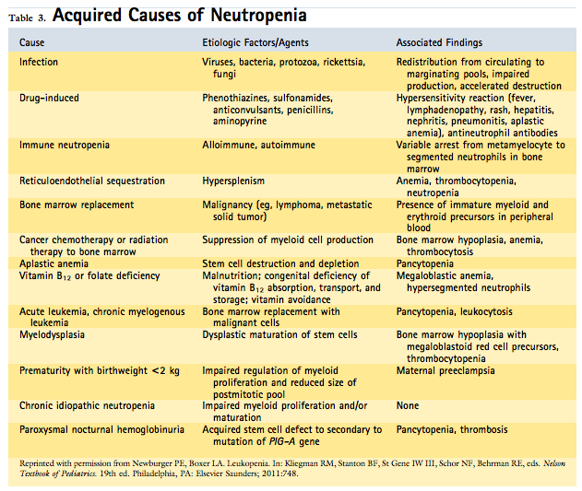

Slide 40
C A S E S
Could this this an acquired neutropenia?
Infection
Drug-Induced
Sequestration
Nutritional Deficiency
Autoimmune
Idiopathic
Bone Marrow Replacement

Slide 41
C A S E 1 : Baby Boy ANC
Summary Statement: 2wk FT male with Omphilits due to isolated severe neutropenia , admitted to the ICU for concern of hypovolemic vs. septic shock that is most likely secondary to …
Could this this an acquired neutropenia?
Infection
Drug-Induced
Sequestration
Nutritional Deficiency
Autoimmune
Idiopathic
Bone Marrow Replacement

Slide 42
C A S E 2 : Toddler ANC
Summary Statement: 3y male with prolonged high fever without clear etiology, found to have pancytopenia with mild neutropenia most likely secondary to …
Could this this an acquired neutropenia?
Infection
Drug-Induced
Sequestration
Nutritional Deficiency
Autoimmune
Idiopathic
Bone Marrow Replacement
Notes:
isolated neutropenia or associated with anemia/thrombocytopenia worry about aplastic anemia or marrow infiltration

Slide 43
C A S E 3 : Toddler Twin ANC
Summary Statement: 3y male with hx of recurrent bacterial infections, presenting with ROM and moderate neutropenia that is most likely secondary to …
Could this this an acquired neutropenia?
Infection
Drug-Induced
Sequestration
Nutritional Deficiency
Autoimmune
Idiopathic
Bone Marrow Replacement

Slide 44
But remember, more than just acquired. . .
Acquired/Extrinsic/Acute*
vs.
Inherited/Intrinsic/Chronic*
Notes:
Genetic or acquired abnormalities in hematopoietic progenitor cells --> failure of marrow to produce mature neutrophils

Slide 45
Intrinsic Neutropenia: Intrinsic/Inherited/Syndromic/Chronic
Severe Congenital Neutropenia
Cyclic Neutropenia
Syndromes associated with Neutropenia
Shwachman-Diamond Syndrome
Fanconi Anemia
Dyskeratosis Congenita
Chediak-Higashi
Glygoen Storage 1b
Immunodeficiency

Slide 46
Inherited/Intrinsic Neutropenia: Severe Congenital Neutropenia
S C N
Mutational arrest in myeloid maturation at the promyelocyte stage
ANC <200 on at least 3 separate occasions over 1 mo
Notes:
ANC is < 500/mcL and often < 200/mcL
- Marrow: arrest at the promyelocyte stage of development
* Few or no myelocytes, metamyelocytes, bands, or mature neutrophils are seen
* Associated monocytosis and eosinophilia in the blood

Slide 47
S C N : 1 in a million!
AD or AR (AR = Kostmann Syndrome)
AD: Mutation in Elastase gene (ELA2)
AR: mutation in HAX1 gene
Predictable pattern of infection & inflammation
Infancy : umbilical infection, pyoderma, oral ulcers, pulmonary infections, or perineal infections of the labia or perirectal area
Differentiated from idiopathic & immune neutropenia by "maturational arrest" in the marrow
Before G-CSF, 2/3 died of fatal infections before adolescents
Now 10-20% develop MDS/AML independent of G-CSF
Why need CBC q3mo + BMBx annually
Notes:
- AD (60% mutation in elastase gene), ELA2 = accelerated apoptosis of myeloid precursors, HAX = signal transduction
- MDS
* onset can be insidious -- thrombocytopenia, anemia, or increased dose of G-CSF
* Cytogenetic changes: monosomy 7, trisomy 21, activating ras oncogene
- More than 95% of SCN respond to G-CSF
* 5% that do not respond --> BMT
- Indication for BMT: do not respond to G-CSF, dose >8ug/kg, cytogenetic change, select gene mutations
- Patients with SCN --> MDS/AML, traditional chemo is ineffective and associated with high mortality
- Many with SCN and SDS who survived infection, died of leukemia
- Therapy:
- Mild to mod neutropenia: PO abx
- ANC <500 and fever >38: IV abx

Slide 48
C A S E : Baby Boy ANC
Labs ED:
17
10 229
47.9
S: 4
B: 1
L: 64
M: 14
E: 7
ANC: 500
Labs HD2:
16.7
12 239
46.4
S: 2
B: 0
L: 71
M: 6
E: 11
ANC: 250
Labs HD3:
16
11 223
44.4
S: 4
B: 1
L: 62
M: 16
E: 11
ANC: 800
Bone Marrow Bx:
????

Slide 49
Intrinsic Neutropenia: Intrinsic/Inherited/Syndromic/Chronic
Severe Congenital Neutropenia
Cyclic Neutropenia
Syndromes associated with Neutropenia
Shwachman-Diamond Syndrome
Fanconi Anemia
Dyskeratosis Congenita
Chediak-Higashi
Glygoen Storage 1b
Immunodeficiency

Slide 50
Inherited/Intrinsic Neutropenia: Cyclic Neutropenia
Cyclic Neutropenia: 0.6 in a million!!
21d cycles of changing neutrophil counts, neutropenia spans 3-6d
CBC 2x/wk x2mo + molecular genetic studies to confirm
AD
Mutation in neutrophil elastase gene (ELA2, different location from SCN)
Fever & oral ulcerations usually are seen during the nadir
more serious infections include PNA, NEC, peritonitis, and E. Coli or Clostridium sepsis
By the time the patient comes to medical attention, the neutrophil count may be recovering --> dx requires mult blood draws over a 6wk pd
Notes:
may develop gingivitis, pharyngitis, and skin infections during NADIR

Slide 51
Inherited/Intrinsic Neutropenia: Cyclic Neutropenia
Cyclic Neutropenia: 0.6 in a million!!
21d cycles of changing neutrophil counts, neutropenia spans 3-6d
CBC 2x/wk x2mo + molecular genetic studies to confirm
Rx: daily G-CSF --> cycle of neutropenia changes from 21d to 9-11d interval with 1d of profound neutropenia
recommended to prevent severe symptoms at the nadir of the cycle
No increased risk of MDS/AML
Notes:
Before G-CSF, 10% of patients died from GN sepsis or Clostridium perfringens
BMBx: marrow reflects the state of neutropenia
- Prior to the ANC nadir, the marrow may resemble that associated with SCN before proceeding to a recovery phase

Slide 52
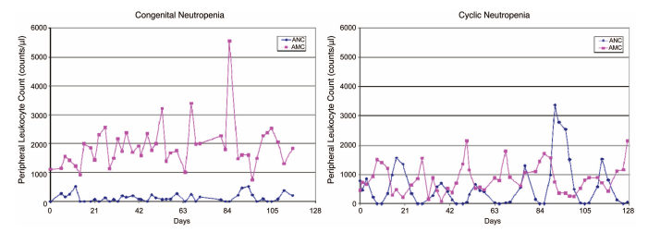
Inherited/Intrinsic Neutropenia: Cyclic Neutropenia
Cyclic Neutropenia
Differentiated from idiopathic neutropenia by nadir of neutropenia accompanied by elevated monocyte in reciprocal relationship

Slide 53
C A S E : Baby Boy ANC
Labs ED:
17
10 229
47.9
S: 4
B: 1
L: 64
M: 14
E: 7
ANC: 500
Labs HD2:
16.7
12 239
46.4
S: 2
B: 0
L: 71
M: 6
E: 11
ANC: 250
Notes:
Mono count should be highest when ANC is lowest (reciprocal relationship)

Slide 54
C A S E : Baby Boy ANC
ANC:
500
250
1200
790
250
550
780
1500
Monos:
14
6
16
16
10
6
5
5

Slide 55
Intrinsic Neutropenia: Intrinsic/Inherited/Syndromic/Chronic
Severe Congenital Neutropenia
Cyclic Neutropenia
Syndromes associated with Neutropenia
Shwachman-Diamond Syndrome
Fanconi Anemia
Dyskeratosis Congenita
Chediak-Higashi
Glygoen Storage 1b
Immunodeficiency

Slide 56
Syndromes
Shwachman-Diamond:
RNA processing defect = failure of neutrophil development
Malabsorption & FTT are common
Exocrine pancreatic insufficiency, short stature, metaphyseal dysplasia, marrow failure, and the risk of MDS/AML
Immunodeficiency Abnormalities in T, B, or natural killer cell function + Neutropenia
Part of a global immunodeficiency syndrome?
If so, more susceptible to infectious complications
Most common, Hyper-IgM syndrome
Notes:
C. Shwachman-Diamond Syndrome
Mild-to-moderate degree of neutropenia
G-CSF has been used when the neutropenia is symptomatic
Pancreatic replacement therapy is required
D. Fanconi Anemia (Marrow Failure Syndrome)
- Marrow is hypoplastic & resembles aplastic anemia
Mutations: FANC genes, primarily in FANC A, C, and G
- Clinically: short stature; dysplastic thumbs; or heart, kidney, or eye abnormalities
- 10% risk of developing MDS/AML
- Rx: androgen (for pancytopenia especially for young women), G-CSF, cytokines, SCT (curative)
F. Syndromes Associated with Neutropenia and Immunodeficiency
- One condition is the hyper-IgM syndrome, in which concentrations of IgG and IgA are diminished and IgM is heightened
* nature of the neutropenia is not known, but may be immune in origin, although antineutrophil antibodies are negative

Slide 57
Immunodeficiency?
Referrals for neutrophil disorders should be initiated for those with at least one of the clinical features listed below in 1 year:
More than two systemic bacterial infections (sepsis, meningitis, osteomyelitis)
More than two serious respiratory infections (ie. pneumonia)
Multiple bacterial infections (cellulitis, draining OM, lymphadenitis)
Unusual infections involving the liver or a brain abscess
Infections caused by unusual pathogens (eg, Aspergillus pneumonia, disseminated candidiasis, infection with Serratia marcescens, Nocardia species, Burkholderia cepacia)
Infections of unusual severity
Chronic gingivitis or recurring aphthous ulcers

Slide 58
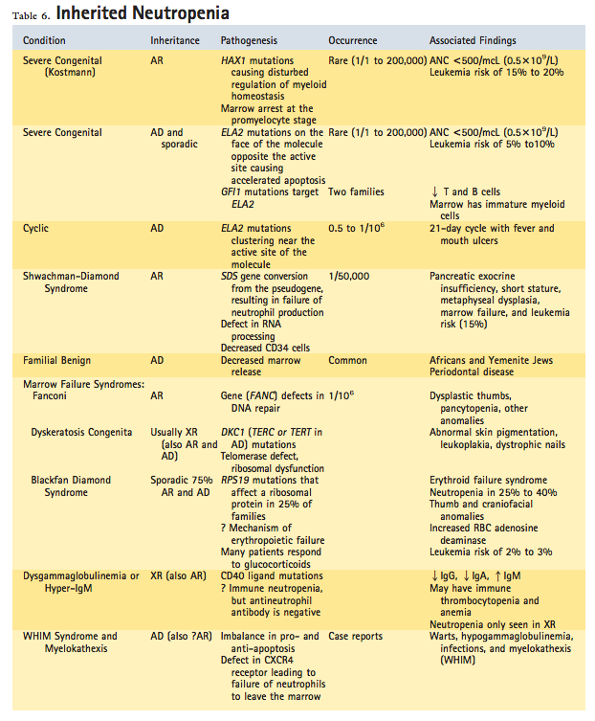

Slide 59
C A S E S
Could this this an intrinsic neutropenia?
Severe Congenital Neutropenia
Cyclic Neutropenia
Syndromes associated with Neutropenia
Immunodeficiency

Slide 60
C A S E 1 : Baby Boy ANC
Summary Statement: 2wk FT male with Omphilits due to isolated severe neutropenia , admitted to the ICU for concern of hypovolemic vs. septic shock that is most likely secondary to …
Could this this an intrinsic neutropenia?
Severe Congenital Neutropenia
Cyclic Neutropenia
Syndromes associated with Neutropenia
Immunodeficiency

Slide 61
C A S E 2 : Toddler ANC
Summary Statement: 3y male with prolonged high fever without clear etiology, found to have pancytopenia with moderate neutropenia most likely secondary to …
Could this this an intrinsic neutropenia?
Severe Congenital Neutropenia
Cyclic Neutropenia
Syndromes associated with Neutropenia
Immunodeficiency

Slide 62
C A S E 3 : Toddler Twin ANC
Summary Statement: 3y male with hx of recurrent bacterial infections, presenting with ROM and moderate neutropenia concerning for …
Could this this an intrinsic neutropenia?
Severe Congenital Neutropenia
Cyclic Neutropenia
Syndromes associated with Neutropenia
Immunodeficiency

Slide 63
O B J E C T I V E S By the end of the lecture, be able to …
Define Neutropenia & provide a risk assessment for the degree of neutropenia
Have a framework for the differential for neutropenia when encountered in primary care
Evaluate a patient with suspected/known neutropenia

Slide 64
Evaluation
History
Type, frequency, severity of infections
Recurrent bacterial infections?
Medications, recent and current
Physical:
Growth & development
Phenotypic abnormalities
Presence of bacterial infection (MM, skin, gingiva, rectum, LAD, HSM, petechiae/purpura)
AVOID rectal temps
Family Hx
Neutropenia or recurrent infection
Unexplained death
Labs
CBC with diff
Notes:
Rectal temps: injury to mucosa and spread of bacteria into the circulation

Slide 65
Evaluation -- Situations
Observe?
if appears viral with mild-mod neutropenia & appears well
consider repeat CBC in 3-4 weeks to look for recovery
Persistent?
after 1-2 weeks, additional eval is necessary
Recurrent?
CBC 2-3x/wk x6wk
Immunodeficiency?
quantitative immunoglobulins, lymphocyte subset panel
Immune?
antineutrophil ab
Asymptomatic?
Nothing
Antineutrophil ab to look for autoimmune neutropenia
Lupus?
ANA, anti-double strand DNA

Slide 66
Evaluation -- Situations
Severe?
refer, concerned for SCN
need HAX and ELA2 gene testing
Clinical hx & worrisome exam?
Refer
CBCs weekly x6wk to establish CycN vs. SCN. Will get BMA&Bx to assess cellular morphology, leukemia risk, myeloid maturation
Pancytopenia?
BMA&Bx to look at cellularity, cytogenetics, special stains
Malabsorption & Neutropenia?
evaluation for Shwachman-Diamond Syndrome (pancreatic enzymes, skeletal eval for metaphyseal chondrodysplasia)
Consider folate, B12 as indicated

Slide 68
When do I order a CBC?
If clinical suggest more severe bacterial infection or course is atypical & prolonged, or complicated
Recurrent infections
Prolonged or extreme fever (103°F [39.5°C])
Spreading of localized bacterial infection
Suspicion of chronic inflammatory disease, immunodeficiency, or malignancy

Slide 69
When do I refer?
ANC <500 3 separate tests
Concern for SCN or cyclic neutropenia
Concern for a syndrome
Multiple cell lines down that is not consistent with simple viral illness
Concern for immunodeficiency
Primary or secondary autoimmune neutropenia
When do I NOT refer?
Healthy & Viral suppression
Healthy & Idiopathic neutropenia
Healthy & Ethnic neutropenia

Slide 70
C A S E S
What evaluation would you do?

Slide 71
C A S E S
What evaluation would you do?
Summary Statement: 2wk FT male with Omphilits due to isolated severe neutropenia , admitted to the ICU for concern of hypovolemic vs. septic shock that is most likely secondary to alloimmune neutropenia vs. SCN
Summary Statement: 3y male with prolonged high fever without clear etiology, found to have pancytopenia with moderate neutropenia most likely secondary to viral suppression vs. BM replacement
Summary Statement: 3y male with hx of recurrent bacterial infections, presenting with ROM and moderate neutropenia concerning for viral suppression vs. drug induced vs. AI vs. cyclic neutropenia vs. immundeficiency
Notes:
Case 1: neutrophil ab and bone marrow bx
Case 2: repeat CBC in 3-4 weeks unless clinical signs change or doesn’t improve
Case 3: neutrophil ab, repeat CBCs weekly x6wk, lymphocyte subset panel & immunoglobulin titers
Case 2: 3rd %tile for height with chronic diarrhea? Schwachman diamond

Slide 72
C A S E S
What evaluation would you do?
Summary Statement: 2wk FT male with Omphilits due to isolated severe neutropenia , admitted to the ICU for concern of hypovolemic vs. septic shock that is most likely secondary to autoimmune neutropenia vs. SCN
neutrophil ab and bone marrow bx
Summary Statement: 3y male with prolonged high fever without clear etiology, found to have pancytopenia with moderate neutropenia most likely secondary to viral suppression vs. BM replacement
repeat CBC in 3-4 weeks unless clinical signs change or doesn’t improve
Summary Statement: 3y male with hx of recurrent bacterial infections, presenting with ROM and moderate neutropenia concerning for viral suppression vs. drug induced vs. AI vs. cyclic neutropenia vs. immundeficiency
lymphocyte subset panel & immunoglobulin titers, neutrophil ab, repeat CBCs weekly x6wk
Notes:
Case 1: neutrophil ab and bone marrow bx
Case 2: repeat CBC in 3-4 weeks unless clinical signs change or doesn’t improve
Case 3: neutrophil ab, repeat CBCs weekly x6wk, lymphocyte subset panel & immunoglobulin titers
Case 2: 3rd %tile for height with chronic diarrhea? Schwachman diamond

Slide 73
O B J E C T I V E S By the end of the lecture, be able to …
Define Neutropenia
Have a framework for the differential for neutropenia when encountered in primary care
Evaluate a patient with suspected/known neutropenia
Know what to do with fever and neutropenia

Slide 74
Fever and Neutropenia
Fever definition:
101°F (38.3°C)
100.4°F (38°C) >1 hour
Neutropenia
ANC <500 or expected to decrease to <500 in 48hr
No data or guidelines on treatment for neutropenia that is not associated with cancer treatment!
Guidelines: Dec 2012, Guidelines for the management of fever and neutorpneia in children with cancer and/or undergoing hematopoietic stem-cell transplant
Notes:
This data is from neutropenia due to chemo, therefore patients with isolated neutropenia would be expected to have lower risks of infection at any ANC

Slide 75
What clinical and laboratory features can be used to classify patients with FN as low or high risk?
Decision for treatment & potential hospitalization depends on RISK STRATIFICATION
severity of the neutropenia
likelihood of bacterial infection
location and severity of the infection
likelihood & timeframe of neutrophil recovery
age of patient
proximity to specialized medical care
reliability of guardians
Notes:
Risk Stratification: Definition: high or low risk of a poor outcome based on a variety of factors
Mortality of an episode of fever and neutropenia varies widely
Recommendations from the guidelines
Pediatric guidelines support the concept of risk stratification
Adults use MASCC scoring guidelines

Slide 76
High risk patients → ER
What do you do with low risk patients?

Slide 77
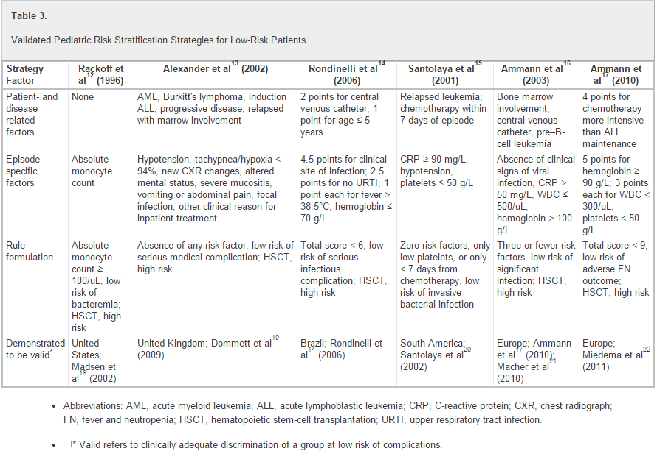

Slide 78
Low vs. High Risk
Patient-specific factors
age, malignancy type, and disease status
Treatment-specific factors
type and timing of chemotherapy
Episode-specific factors
including height of fever, hypotension, mucositis, blood counts, and C-reactive protein
Automatic high risk:
severe myelosuppression and patients with BMT
No single rule is clearly more effective or reliable than the others

Slide 79
What clinical, laboratory, and imaging studies are useful at the initial presentation of FN to assess the etiology of the episode and guide future treatment?
Blood cultures from central line +/- peripheral BCx
Consider urinalysis and urine culture
Routine UA/UCx in children is controversial
Restricting Ucx to those with symptoms or abnormal urinalysis is probably NOT justified in children
Obtain CXR only if symptomatic
Belief that neutropenic child less likely to exhibit s/sx of PNA
Studies show frequency of PNA in an asymptomatic child is <5% & there are no adverse clinical consequences if no CXR if obtained
Notes:
*CXR usefulness may be limited because the lack of neutrophils may not produce a visible infiltrate in patients who have severe neutropenia

Slide 80
What am I expecting to find?
Etiology?
Non-infectious, viral, bacterial?
Supposed to be infectious in origin -- infection is only documented in a minority of cases
FUO 50-60%
Microbiologically documented infection (commonly bacteremia) 10-20%
Clinically documented infection (typhlitis or cellulitis without pathogen identification) 20-30%
Notes:
2/3 of isolated organisms are GP

Slide 81
In children with low-risk FN, is initial or step-down outpatient management as effective and safe as inpatient management? Is oral as effective as parenteral?
1. Yes, if infrastructure is in place to ensure careful monitoring & followup
not associated with significantly higher treatment failure & no difference in mortality
2. Yes, if the child is able to tolerate this route of administration reliably (weak recommendation, moderate-quality evidence)
Issues: drug availability as an oral liquid, palatability, cooperation of young children, mucositis, and impaired gastrointestinal absorption
Notes:
increased quality of life for children and large reduction in costs

Slide 82
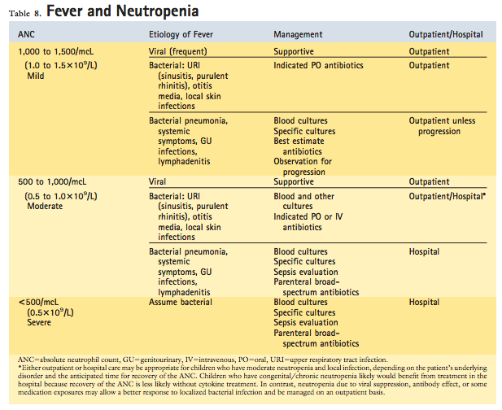
Notes:
Immune neutropenia of infancy often can be treated as outpatient because they can mobilize neutrophils transiently

Slide 83
What therapy do you choose?
Outpatient
3rd generation cephalosporin or Augmentin
Clindamycin?
Inpatient = monotherapy for pseudomonal coverage
Zosyn, Imipenem, Meropenem, Cefepime, Ceftazidime
Addition of vancomycin is controversial*
Notes:
Outpatient: No guidelines, many studies are not homogenous in patient selection criteria, no conclusive comparison
- "Low risk" outpatient = fluoroquinolone (or antipseudomonal) + Augmentin (or clinda for PCN allergic)
All the guidelines recommend NOT including vanc routinely in initial regimen & not adding it empirically for persistent fever, but when to add is variable
IDSA strongly recommends adding vanc when: hemodynamically unstable, PNA, Catheter related infections, skin & soft tissue infections, severe mucositis, known colonization with MRSA
Newest IDSA guidelines took out ceftaz as a preferred single agent based on susceptibility patterns
Oral antibiotics used were fluoroquinolone monotherapy (seven studies; n = 581), fluoroquinolone and amoxicillin-clavulanate (three studies; n = 159), and cefixime (one study, n = 45)

Slide 84
C A S E 1 : Baby Boy ANC
Summary Statement: 2wk FT male with Omphilits due to isolated severe neutropenia , admitted to the ICU for concern of hypovolemic vs. septic shock that is most likely secondary to autoimmune neutropenia vs. SCN
Started on IV ceftaz and vanc
Agree?
BCx, Ucx, CSF Cx final negative
Wound Cx grew MSSA → changed to IV clinda & ceftaz
ID recommended 10d course of IV abx while still neutropenic

Slide 85
C A S E 2 : Toddler ANC
Summary Statement: 3y male with prolonged high fever without clear etiology, found to have pancytopenia with moderate neutropenia most likely secondary to viral suppression vs. BM replacement
ANC 1025
Treat with abx?
Notes:
No!

Slide 86
C A S E 3 : Toddler Twin ANC
Summary Statement: 3y male with hx of recurrent bacterial infections, presenting with ROM and moderate neutropenia concerning for viral suppression vs. drug induced vs. AI vs. cyclic neutropenia vs. immundeficiency
ANC = 561
Expand beyond amoxcillin for his AOM?
Treat at home?

Slide 87
When can empiric antibiotics be discontinued in patients with low- and high-risk FN?
Negative blood cultures x 48 hours, afebrile for at least 24 hours, and evidence of marrow recovery (1C; strong recommendation, low-quality evidence)
Consider discontinuation of empiric antibiotics at 72 hours in low-risk patients who have negative blood cultures and who have been afebrile for at least 24 hours, irrespective of marrow recovery status, as long as careful follow-up is ensured (2B; weak recommendation, moderate-quality evidence)

Slide 88
T H E R A P Y
Antibiotics | BCx | Febrile | Neutropenic
I N P A T I E N T | - | + | + | Finish abx in the hospital, add anti-fungal coverage
 | + | - | + | Finish abx in the hospital*
O U T P A T I E N T | + | - | - | Finish abx at home
D / C | - | - | +** | 48hr rule out

Slide 89
O B J E C T I V E S By the end of the lecture, be able to …
Define Neutropenia & provide a risk assessment for the degree of neutropenia
Have a framework for the differential for neutropenia when encountered in primary care
Evaluate a patient with suspected/known neutropenia
Know what to do with fever and neutropenia
Give anticipatory guidance to families

Slide 90
Anticipatory Guidance
Must contact provider at onset of any febrile illness
Know eval & treatment in case family not near major medical center
Permission to allow carrying of injectable meds
Carry a written summary of child's condition & lab values, contact # of their primary institution & MDs
Good oral hygiene & appropriate preventive dental visits
Good skin care
All immunizations can and should be given according to the routine vaccination schedule
Ok to go to school/daycare unless severe neutropenia
Genetic counseling for the family & siblings of patients who have inherited neutropenias
Notes:
2. evaluation and treatment = history and physical examination, blood counts and ANC, blood and other cultures
3. G-CSF, syringes, hypodermic needles on airplanes
6. prompt cleansing of superficial cuts, abrasions, and bruises where the skin is broken help to prevent local infection
7. Children who have impaired T- or B-lymphocyte function should not receive live or attenuated-live vaccines
contact with obviously ill children should be avoided
8. Families of patients who have neutropenia may experience significant stress due to feeling responsible for the disease if it is an inherited condition Precautions
- Simple soap and water hygiene, hand washing because source of most infections are patients own skin and gut flora
- Neutropenia does not interfere with defense against viruses, avoid crowded areas to avoid admission for febrile neutropenia

Slide 91
O B J E C T I V E S By the end of the lecture, be able to …
Define Neutropenia & provide a risk assessment for the degree of neutropenia
Have a framework for the differential for neutropenia when encountered in primary care
Evaluate a patient with suspected/known neutropenia
Know what to do with fever and neutropenia
Give anticipatory guidance to families
Consider the different treatments for neutropenia with the information learned

Slide 92
A C Q U I R E D
I N T R I N S I C
Infection
Nothing vs. Abx
Drug-Induced
Stop drug
Sequestration
Splenectomy
Nutritional Deficiency
Replace deficiency
Autoimmune
Steroids
Idiopathic
G-CSF
Bone Marrow Replacement
Refer
Severe Congenital Neutropenia
G-CSF
Cyclic Neutropenia
G-CSF
Syndromes associated with Neutropenia
G-CSF
Immunodeficiency
G-CSF

Slide 93
G – C S F = Myeloid Specific Cytokine
Myeloid Growth Factor Therapy: Principal regulator of neutrophil count = Filgrastim, Neupogen
RTCs show pts with congenital, cyclic, or idiopathic neutropenia
less mouth ulcers, febrile events, & infections
Goal is a G-CSF dose sufficient to maintain ANC >1000
Most common adverse event = bone pain and headache
worse bone pain with larger doses spread out less often (treat by giving smaller dose more frequently)
injection site reaction, fever, chills are rare

Slide 94
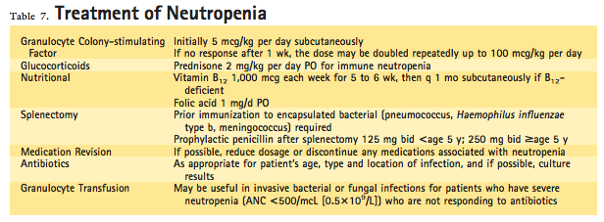

Slide 95
C A S E 1 : Baby Boy ANC
Diagnosis?

Slide 96
C A S E : Baby Boy ANC
Neutrophil Antibody: IgG positive
Bone Marrow Bx: Normal marrow elements
Completed 10d course of IV antibiotics and was discharged home with a rising ANC & heme followup
ANC recovered and his IgG anti-neutrophil ab was negative at 4mo

Slide 97
C A S E : Baby Boy ANC
2wk FT male admitted to the PICU in hypovolemic shock in the setting of Omphilitis due to isolated severe neutropenia, found to be secondary to neonatal alloimmune neutropenia

Slide 98
C A S E 2 : Toddler ANC
Diagnosis?

Slide 99
C A S E : Baby Boy ANC
CBC 4 week later : ANC 4031
Fevers resolved the next day

Slide 100
C A S E : Baby Boy ANC
3y male with prolonged high fever without clear etiology, found to have pancytopenia with moderate neutropenia secondary to viral suppression

Slide 101
C A S E 3 : Toddler Twin ANC
Diagnosis?

Slide 102
C A S E 3 : Toddler Twin ANC (Dr. H’s Patient)
FHx: no hx of recurrent bacterial infections, neutropenia, immunodeficiency, AI disease, early death
Exam: VS wnl, 50th %tile for weight, 75th %tile for height, chronic rhinorrhea
Labs: normal immunoglobulins, lymphocyte subset, vaccine titers, complement levels

Slide 103
C A S E 3 : Toddler Twin ANC (Dr. H’s Patient)

Slide 104
C A S E 3 : Toddler Twin ANC (Dr. H’s Patient)

Slide 105
C A S E 3 : Toddler Twin ANC (Dr. H’s Patient)
Diagnosis: ?
ACQUIRED | INHERITED
Infection Autoimmune Drug-Induced Sequestration Nutritional Deficiency Idiopathic Bone Marrow Replacement | Severe Congenital Neutropenia Cyclic Neutropenia Syndromes associated with Neutropenia Immunodeficiency

Slide 106
C A S E 3 : Toddler Twin ANC (Dr. H’s Patient)
Diagnosis: Cyclic Neutropenia? Autoimmune neutropenia?
Anticipatory guidance: ?

Slide 107
C A S E 1
13mo F seen for followup hospital admission
Admitted for pseudomonas otitis externa and found to have neutropenia
ANCs: 54-896 (at discharge)
ROS: Currently has URI sx & fever Tmax 38.5
Hx: Normal CBC at 10mo, no hx of increased bacterial or fungal infection, not on medications
FHx: no hx of recurrent bacterial infections, neutropenia, immunodeficiency, AI disease, early death
Exam: VS wnl, 75th %tile for height and weight, PE normal (no thrush, LAD, HSM, skin lesions)

Slide 108
C A S E 1
Labs: ANC 40 → admitted & started on ceftaz
Hospital Labs: +Anti-neutrophil antibody, bone marrow shows normal morphology
Diagnosis: Primary Autoimmune Neutropenia (Chronic benign neutropenia of infancy and childhood)
Anticipatory guidance: 95% spontaneous recovery by 5y, mean duration of neutropenia is approximately 20mo, can receive live viral vaccines

Slide 109
B O A R D Q U E S T I O N S
A 2-year-old boy presents to the pediatrician’s office for cough, rhinorrhea, and tactile temperature for 5 days. The mother reports that he was healthy until starting child care this year and now has been treated for an ear infection 3 times in the past 6 months. He has never been hospitalized. He has been in the 50th to 75th percentile for weight and height for the past 2 years. On review of systems, he has a nonproductive cough and clear rhinorrhea, with no vomiting or diarrhea. In the office, his temperature is 37.2°C, his pulse rate is 90 beats/min, his respiratory rate is 20 breaths/min, and his blood pressure is 100/55 mm Hg. On physical examination, his tympanic membranes appear normal, his lungs are clear to auscultation, and there are no oral ulcers, skin lesions, lymphadenopathy, or hepatosplenomegaly. The following are the results of his complete blood cell count:
WBC: 6,000/μL (6.0 × 109/L), with 5% N, 5% B, 74% L, 13% M, and 3% E
Hemoglobin, 11.8 g/dL (118 g/L)
Platelet count, 437 × 103/μL (437 × 109/L)
The pediatric resident asks you about interpretation of the complete blood cell count in this child. Of the following, the MOST appropriate response to the resident would be that the child
A. does not have neutropenia and the frequency of infections is normal for his age
B. does not have neutropenia; therefore, the frequency of infections warrants an evaluation for other immune deficiencies
C. has moderate neutropenia, which is likely related to his current infection
D. has neutropenia and lymphocytosis; therefore, bone marrow studies should be done to rule out acute lymphoblastic leukemia
E. has severe neutropenia and should be referred to a hematologist
Notes:
C. The patient in the vignette has an absolute neutrophil count (ANC) of 600/μL, which is moderate neutropenia for his age. The ANC is calculated by multiplying the total white blood count (WBC) by the percentage of neutrophils and bands. The normal range for ANC varies according to factors such as age and race. For the white population, the lower limit of normal for ANC is 1,000/μL in infants 2 weeks to 1 year of age. After 1 year of age, the lower limit of normal for ANC increases to 1,500/μL. In healthy African Americans, up to 30% have an ANC as low as 1,000/μL, which may reflect a difference in normal range of ANC for certain ethnic populations.
The severity and cause of the neutropenia determines the risk for infection. After infancy, mild neutropenia is defined as an ANC of 1,000 to 1,500/μL, moderate neutropenia as an ANC of 500 to 1,000/μL, and severe neutropenia as an ANC of less than 500/μL. When the ANC is less than 200 cells/μL, it is classified as agranulocytosis. Children with mild or moderate neutropenia generally do not have significant clinical symptoms, but they may require evaluation for the underlying cause of the low ANC. Neutropenic patients can have increased susceptibility to fungal and bacterial infections, which are frequently from endogenous bacteria, Staphylococcus aureus, or gram-negative bacteria. The actual susceptibility to infection can be quite variable depending on the underlying cause of the neutropenia. In chronic autoimmune neutropenia, one of the most common forms of neutropenia in children, children rarely experience serious infections even with an ANC of less than 200 cells/μL. In severe congenital neutropenia, patients can have life-threatening infections when they have an ANC of less than 500 cells/μL and a history of severe invasive infections within the first year after birth.
In children, neutropenia can occur in association with acute infection. The proposed mechanisms by which this occurs include the following: (1) redistribution of neutrophilsfrom the peripheral blood circulating pool to the marginating pool; (2) increased use of neutrophils at the sites of infection; and (3) decreased production of neutrophils.
Another common cause of neutropenia in children is autoimmune neutropenia (AIN). In infants and young children, AIN is usually benign and resolves spontaneously in less than 2 years. It is often diagnosed after an infection. An antineutrophil antibody can be detected, although it is not necessary for the diagnosis. Neutropenia in AIN can be mild to severe, but patients generally do not have serious infections despite the severity of the neutropenia. There can also be a compensatory monocytosis. If an otherwise healthy patient is found to have isolated neutropenia around the time of an infection, the ANC should be repeated when the patient is in baseline state of health before initiating an elaborate evaluation for causes of neutropenia.
The patient in the vignette is unlikely to have a severe congenital form of neutropenia since he has been otherwise healthy through infancy. He has had some minor infections since starting daycare that are not uncommon in healthy children. The relative lymphocytosis is attributable to the neutropenia and, in the absence of other cytopenias (eg, anemia or thrombocytopenia), would make leukemia unlikely

Slide 110
B O A R D Q U E S T I O N S
A 2-year-old boy presents to the pediatrician’s office for cough, rhinorrhea, and tactile temperature for 5 days. The mother reports that he was healthy until starting child care this year and now has been treated for an ear infection 3 times in the past 6 months. He has never been hospitalized. He has been in the 50th to 75th percentile for weight and height for the past 2 years. On review of systems, he has a nonproductive cough and clear rhinorrhea, with no vomiting or diarrhea. In the office, his temperature is 37.2°C, his pulse rate is 90 beats/min, his respiratory rate is 20 breaths/min, and his blood pressure is 100/55 mm Hg. On physical examination, his tympanic membranes appear normal, his lungs are clear to auscultation, and there are no oral ulcers, skin lesions, lymphadenopathy, or hepatosplenomegaly. The following are the results of his complete blood cell count:
WBC: 6,000/μL (6.0 × 109/L), with 5% N, 5% B, 74% L, 13% M, and 3% E
Hemoglobin, 11.8 g/dL (118 g/L)
Platelet count, 437 × 103/μL (437 × 109/L)
The pediatric resident asks you about interpretation of the complete blood cell count in this child. Of the following, the MOST appropriate response to the resident would be that the child
A. does not have neutropenia and the frequency of infections is normal for his age
B. does not have neutropenia; therefore, the frequency of infections warrants an evaluation for other immune deficiencies
C. has moderate neutropenia, which is likely related to his current infection
D. has neutropenia and lymphocytosis; therefore, bone marrow studies should be done to rule out acute lymphoblastic leukemia
E. has severe neutropenia and should be referred to a hematologist
Notes:
C. The patient in the vignette has an absolute neutrophil count (ANC) of 600/μL, which is moderate neutropenia for his age. The ANC is calculated by multiplying the total white blood count (WBC) by the percentage of neutrophils and bands. The normal range for ANC varies according to factors such as age and race. For the white population, the lower limit of normal for ANC is 1,000/μL in infants 2 weeks to 1 year of age. After 1 year of age, the lower limit of normal for ANC increases to 1,500/μL. In healthy African Americans, up to 30% have an ANC as low as 1,000/μL, which may reflect a difference in normal range of ANC for certain ethnic populations.
The severity and cause of the neutropenia determines the risk for infection. After infancy, mild neutropenia is defined as an ANC of 1,000 to 1,500/μL, moderate neutropenia as an ANC of 500 to 1,000/μL, and severe neutropenia as an ANC of less than 500/μL. When the ANC is less than 200 cells/μL, it is classified as agranulocytosis. Children with mild or moderate neutropenia generally do not have significant clinical symptoms, but they may require evaluation for the underlying cause of the low ANC. Neutropenic patients can have increased susceptibility to fungal and bacterial infections, which are frequently from endogenous bacteria, Staphylococcus aureus, or gram-negative bacteria. The actual susceptibility to infection can be quite variable depending on the underlying cause of the neutropenia. In chronic autoimmune neutropenia, one of the most common forms of neutropenia in children, children rarely experience serious infections even with an ANC of less than 200 cells/μL. In severe congenital neutropenia, patients can have life-threatening infections when they have an ANC of less than 500 cells/μL and a history of severe invasive infections within the first year after birth.
In children, neutropenia can occur in association with acute infection. The proposed mechanisms by which this occurs include the following: (1) redistribution of neutrophilsfrom the peripheral blood circulating pool to the marginating pool; (2) increased use of neutrophils at the sites of infection; and (3) decreased production of neutrophils.
Another common cause of neutropenia in children is autoimmune neutropenia (AIN). In infants and young children, AIN is usually benign and resolves spontaneously in less than 2 years. It is often diagnosed after an infection. An antineutrophil antibody can be detected, although it is not necessary for the diagnosis. Neutropenia in AIN can be mild to severe, but patients generally do not have serious infections despite the severity of the neutropenia. There can also be a compensatory monocytosis. If an otherwise healthy patient is found to have isolated neutropenia around the time of an infection, the ANC should be repeated when the patient is in baseline state of health before initiating an elaborate evaluation for causes of neutropenia.
The patient in the vignette is unlikely to have a severe congenital form of neutropenia since he has been otherwise healthy through infancy. He has had some minor infections since starting daycare that are not uncommon in healthy children. The relative lymphocytosis is attributable to the neutropenia and, in the absence of other cytopenias (eg, anemia or thrombocytopenia), would make leukemia unlikely
110

Slide 111
B O A R D Q U E S T I O N S
A 7-year-old boy with acute lymphocytic leukemia has a central venous catheter for ongoing maintenance chemotherapy. He is admitted with a fever of 39.0°C and neutropenia (absolute neutrophil count of 100/µL). Other than the fever, his vital signs are stable and there is no focus of infection on physical examination.
Of the following, the BEST choice for empiric antimicrobial therapy is
A. azithromycin and cefotaxime
B. cefazolin and gentamicin
C. clindamycin and gentamicin
D. piperacillin-tazobactam and gentamicin
E. vancomycin and cefotaxime
Notes:
Correct D
Average Percent Correct:53.26%
Children with cancer who develop fever during chemotherapy-induced neutropenia are routinely treated with broad spectrum antibiotics to cover gram-negative organisms, including Pseudomonas aeruginosa, and an array of gram-positive bacteria. Of the regimens listed in the question, piperacillin-tazobactam and gentamicin provide the required broad-based coverage. The other regimens listed do not provide adequate coverage. Cefotaxime is a third-generation cephalosporin that provides broad gram-negative coverage but does not cover Pseudomonas. Cefazolin is a first-generation cephalosporin with more limited gram-negative coverage. Clindamycin covers gram-positive organisms and anaerobes but not gram-negative bacteria, and it is bacteriostatic, which may be problematic in the face of neutropenia. Gentamicin covers aerobic gram-negative organisms but may not be adequate as a single gram-negative agent because of its relatively narrow toxic-therapeutic range. In the well-appearing child, the empiric use of vancomycin should be avoided in an effort to delay emergence of resistant organisms, such as vancomycin-resistant enterococcus (VRE).
However, central catheter-related infections are a common complication in this setting, with coagulase negative staphylococci (CoNS) being the leading cause of such infections. CoNS produce a biofilm that embeds the bacteria and allows them to adhere to the catheter. If a CoNS catheter-related infection is confirmed or highly probable,vancomycin is the therapeutic agent of choice and is administered alone intravenously or in combination with “antibiotic-lock technique” (where the appropriate antimicrobialagent is instilled into the central venous catheter and left in place for a defined period). Many other organisms, including Staphylococcus aureus, a wide variety of gram-negative rods, enterococci, Candida species, and a number of less pathogenic bacteria (eg, Bacillus species, Propionibacterium, Micrococcus species, and Mycobacterium species) may also be associated with catheter-related blood stream infections. Appropriate antibiotic therapy can be selected according to the isolate and sensitivity testing.Long-term catheters should be removed in the face of severe sepsis, suppurative thrombophlebitis, endocarditis, and persistence of positive cultures for longer than 72 hours after institution of appropriate antimicrobial therapy.

Slide 112
B O A R D Q U E S T I O N S
A 7-year-old boy with acute lymphocytic leukemia has a central venous catheter for ongoing maintenance chemotherapy. He is admitted with a fever of 39.0°C and neutropenia (absolute neutrophil count of 100/µL). Other than the fever, his vital signs are stable and there is no focus of infection on physical examination.
Of the following, the BEST choice for empiric antimicrobial therapy is
A. azithromycin and cefotaxime
B. cefazolin and gentamicin
C. clindamycin and gentamicin
D. piperacillin-tazobactam and gentamicin
E. vancomycin and cefotaxime
Notes:
Correct D
Average Percent Correct:53.26%
Children with cancer who develop fever during chemotherapy-induced neutropenia are routinely treated with broad spectrum antibiotics to cover gram-negative organisms, including Pseudomonas aeruginosa, and an array of gram-positive bacteria. Of the regimens listed in the question, piperacillin-tazobactam and gentamicin provide the required broad-based coverage. The other regimens listed do not provide adequate coverage. Cefotaxime is a third-generation cephalosporin that provides broad gram-negative coverage but does not cover Pseudomonas. Cefazolin is a first-generation cephalosporin with more limited gram-negative coverage. Clindamycin covers gram-positive organisms and anaerobes but not gram-negative bacteria, and it is bacteriostatic, which may be problematic in the face of neutropenia. Gentamicin covers aerobic gram-negative organisms but may not be adequate as a single gram-negative agent because of its relatively narrow toxic-therapeutic range. In the well-appearing child, the empiric use of vancomycin should be avoided in an effort to delay emergence of resistant organisms, such as vancomycin-resistant enterococcus (VRE).
However, central catheter-related infections are a common complication in this setting, with coagulase negative staphylococci (CoNS) being the leading cause of such infections. CoNS produce a biofilm that embeds the bacteria and allows them to adhere to the catheter. If a CoNS catheter-related infection is confirmed or highly probable,vancomycin is the therapeutic agent of choice and is administered alone intravenously or in combination with “antibiotic-lock technique” (where the appropriate antimicrobialagent is instilled into the central venous catheter and left in place for a defined period). Many other organisms, including Staphylococcus aureus, a wide variety of gram-negative rods, enterococci, Candida species, and a number of less pathogenic bacteria (eg, Bacillus species, Propionibacterium, Micrococcus species, and Mycobacterium species) may also be associated with catheter-related blood stream infections. Appropriate antibiotic therapy can be selected according to the isolate and sensitivity testing.Long-term catheters should be removed in the face of severe sepsis, suppurative thrombophlebitis, endocarditis, and persistence of positive cultures for longer than 72 hours after institution of appropriate antimicrobial therapy.
112

Slide 113
Summary
Neutropenia definition:
2-12mo: <1000
>12mo: <1500
AA: 800 can be normal
ANC = total WBC * (%segs + %bands)
ANC <500 → high susceptibility to pyogenic infection from endogenous flora
Symptoms may be atypical because neutropenia means less inflammation
Framework for differential
Acquired/Extrinsic/Acute
Inherited/Intrinsic/Chronic
How old is the patient?
First thought : viral suppression!
Workup: need multiple CBCs over a 1-2mo period
Fever = 101 or 100.4 >1hr + Neutropenia = ANC <500 or expected to <500 in 48hr
No data on non-cancer or BMT children
Hospitalize if febrile and ANC <500
Outpatient management if low risk = Augmentin, 3rd generation cephalosporin, or Clinda

Slide 114
R E F E R E N C E S
Segel, G, Halterman, J. Neutropenia in pediatric practice. Pediatrics in Review. Vol. 29 No. 1January 1, 2008. pp. 12 -24
Walkovich, K, Boxer, L. How to approach neutropenia in childhood. Pediatrics in Review. Vol. 34 No. 4 April 1, 2013. pp. 173 -184
Gea-Banacloche, J. Evidence-based approach to treatment of febrile neutropenia in hematologic malignancies. ASH Education Book December 6, 2013 vol. 2013 no. 1 414-422
Boxer, L. How to approach neutropenia. ASH Education Book December 8, 2012 vol. 2012 no. 1 174-182
Newburger. Evaluation and management of patients with isolated neutropenia. Seminars in Hematology, Vol 50, No 3, July 2013, pp 198–206
Lehrnbecher T, Phillips R, Alexander S, et al. Guideline for the management of fever and neutropenia in children with cancer and/or undergoing hematopoietic stem cell transplantation. Journal of clinical oncology. December 10, 2012 vol 30. no 35. 4427-4438

