Slide 1
Noon conference
May 9, 2016

Slide 2
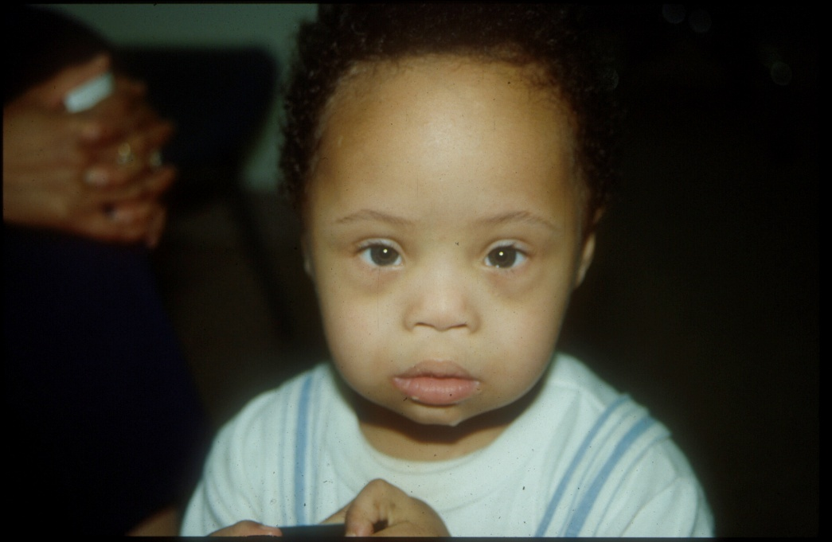
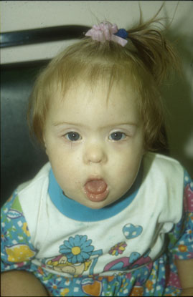
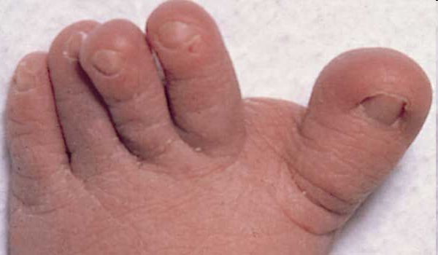
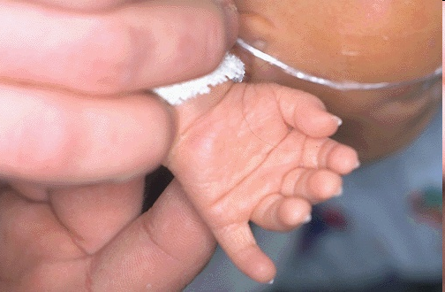
Photos from Brendan Lanpher

Slide 3
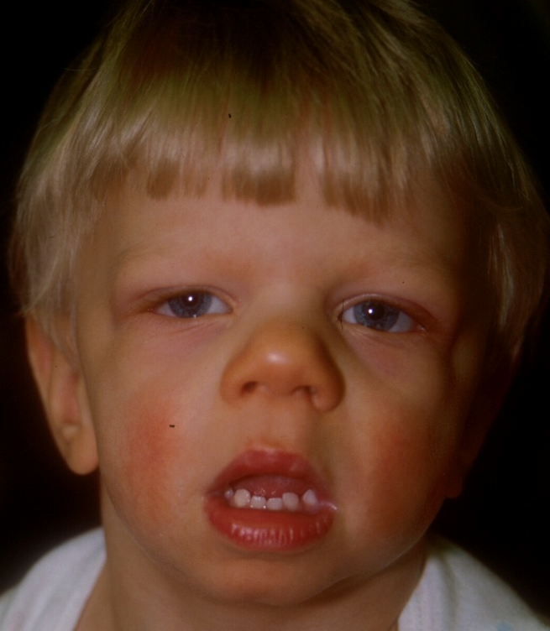

Slide 4
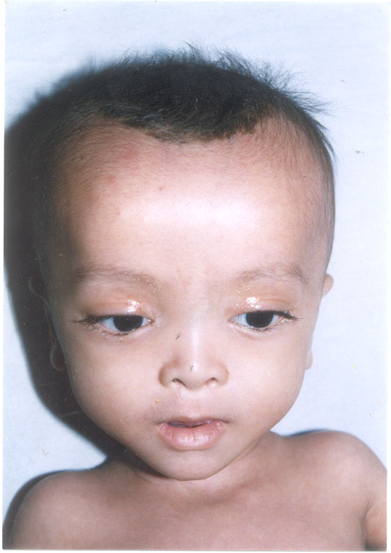
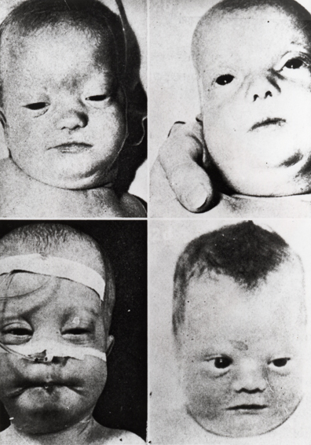

Slide 5
Down syndrome
Common, ~ 1/750
Features:
Hypotonia
Flat face, flat occiput (brachycephaly)
Upslanting palpebral fissures
Epicanthal folds
Prominent tongue
Single palmar creases (~50%)
Short fingers
5th finger clinodactyly (incurving)

Slide 7
Hall’s criteria
Hypotonia 80%
Poor Moro reflex 85%
Hyperflexibility of joints 80%
Excess skin on neck 80%
Flat facial profile 90%
Slanted palpebral fissures 80%
Anomalous auricles 60%
Dysplasia of pelvis 70%
Dysplasia of midphalanx of 5th digit 60%
Simian crease 45%
4 criteria 48%
6 criteria 89%

Slide 8
“Double bubble”
of duodenal stenosis

Slide 9
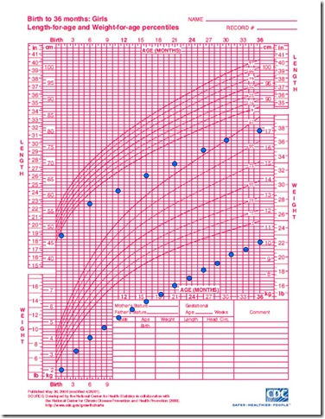
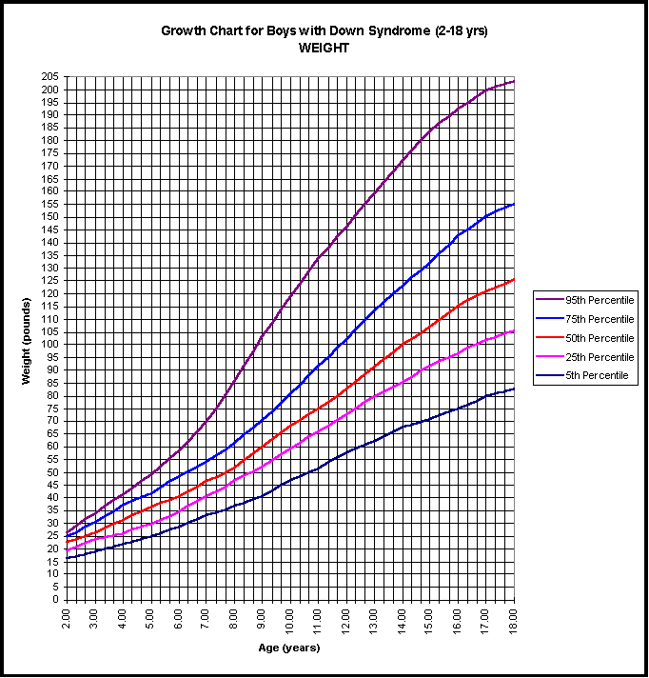
Growth—use the correct growth curve

Slide 12
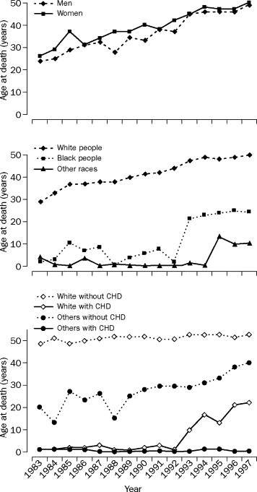
Increased
Life
Expectancy
Lancet, 2002

Slide 13
Williams syndrome
~1/10,000
Features
Short stature, FTT
Long philtrum
Full lips
Puffy eyes
Stellate irides
SVAS, PS
Hypercalcemia
“cocktail party personality”

Slide 14
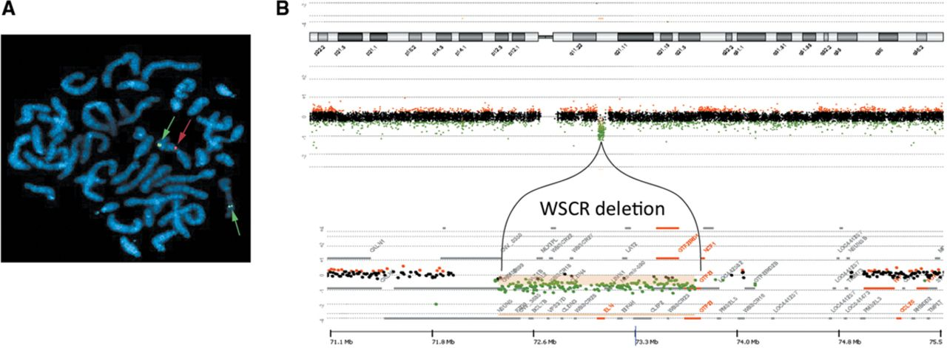
Williams syndrome
Deletion of 7q11.23: 25 genes

Slide 18
Zellweger syndrome
High forehead
Large fontanelle
Epicanthus, Brushfield spots
High arched palate
External ear deformities
Micrognathia
Redundant skin folds of the neck
Cataract/cloudy cornea, Glaucoma, abnormal retinal pigmentation, optic disk pallor
Severe hypotonia
Abnormal Moro response
Hyporeflexia
Poor sucking
Gavage feeding (feeding by a tube)
Epileptic seizures
Psychomotor retardation
Impaired hearing
Hepatomegaly

Slide 19
Peroxisomal Disorders
Peroxisomal biosynthesis (PEX genes)

Slide 20
Diagnosis
VLCFA
Phytanic acid
Pristanic acid
Plasmalogens

