Slide 1
Dysmorphology 101
Seth Berger, MD, PhD
Pediatrics / Medical Genetics Resident
(Slides adapted with permission from Debra Regier)

Slide 2
Approach to dysmorphology
Describe what you see
Choose words carefully
  Accurate use of lay terms better than misuse of medicalese
When in doubt, measure
  Growth charts available for everything

Slide 3
Dysmorphology Terminology
https://elementsofmorphology.nih.gov/

Slide 4
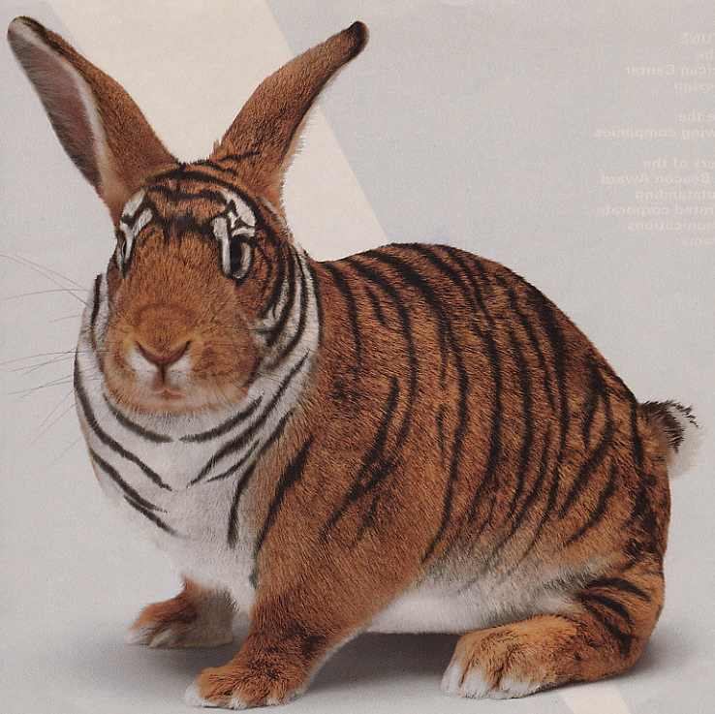
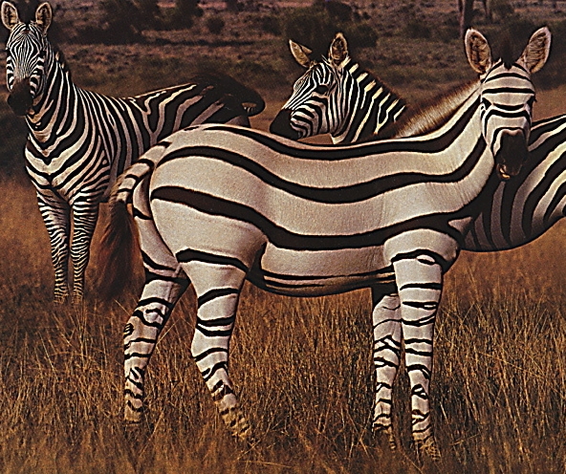
Dysmorphology is pattern recognition!

Slide 5
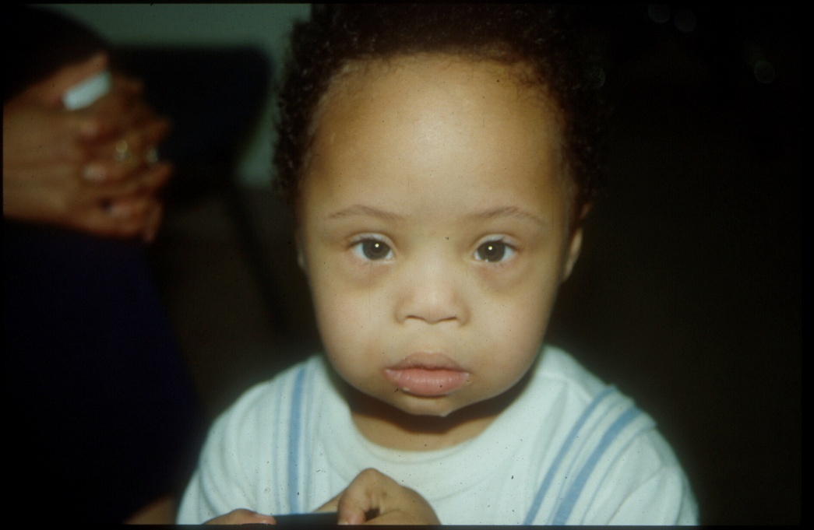
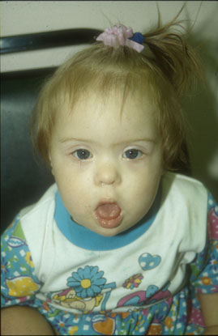
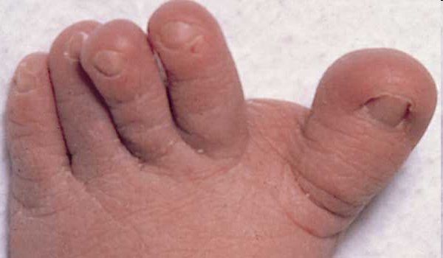
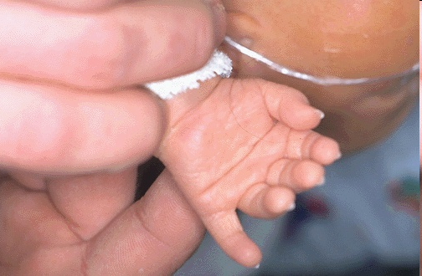

Slide 6
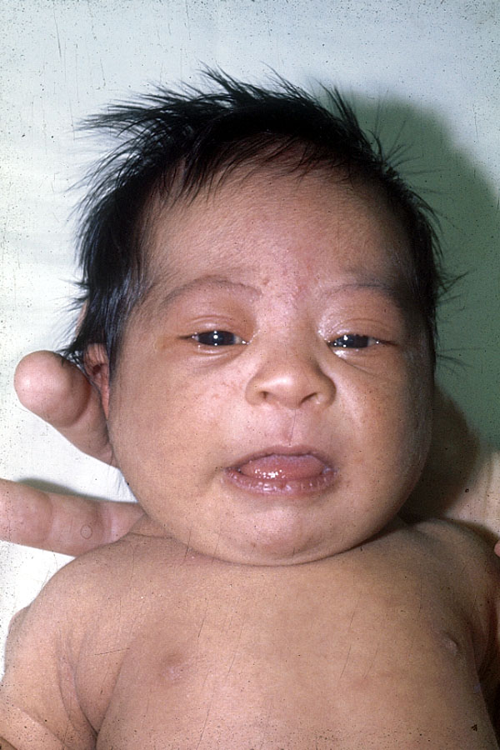
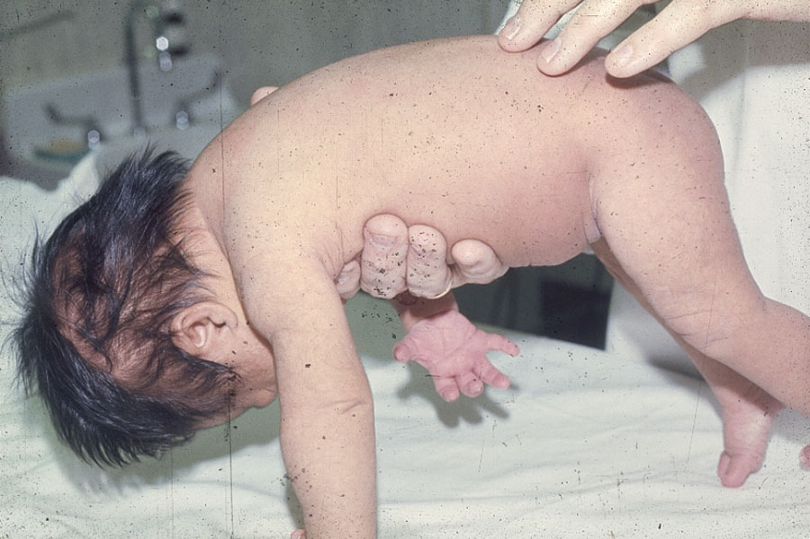
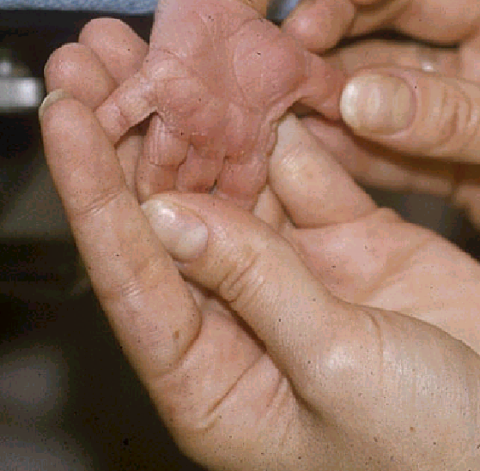

Slide 7
Down syndrome
Common, ~ 1/750
Features:
  Hypotonia
  Flat face, flat occiput (brachycephaly)
  Upslanting palpebral fissures
  Epicanthal folds
  Prominent tongue
  Single palmar creases (~50%)
  Short fingers
  5th finger clinodactyly (incurving)

Slide 8
Epicanthal folds

Slide 9
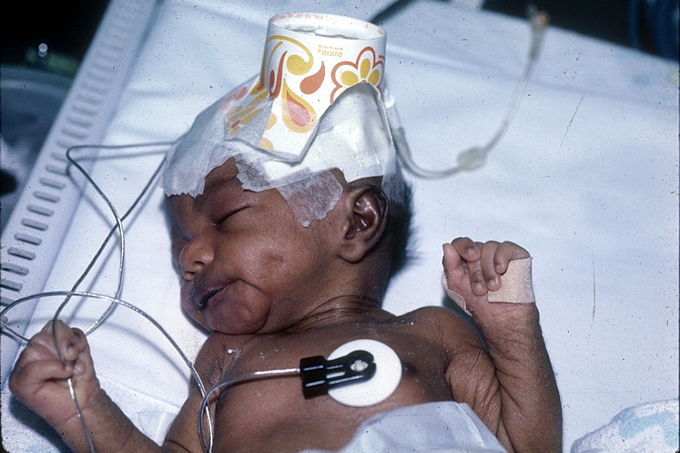
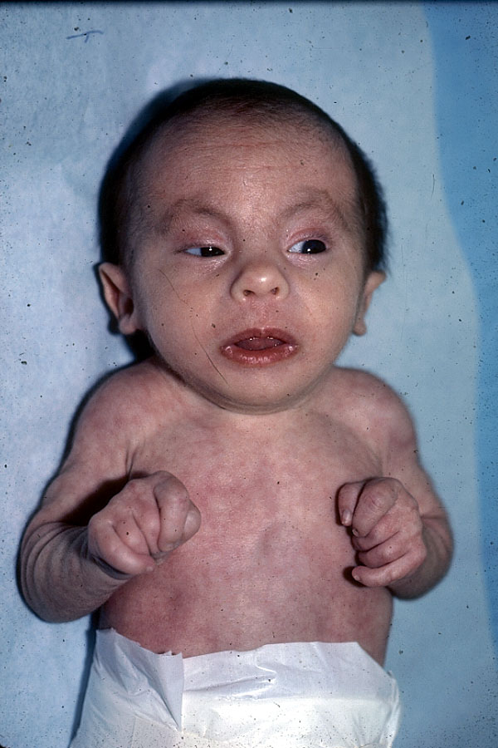
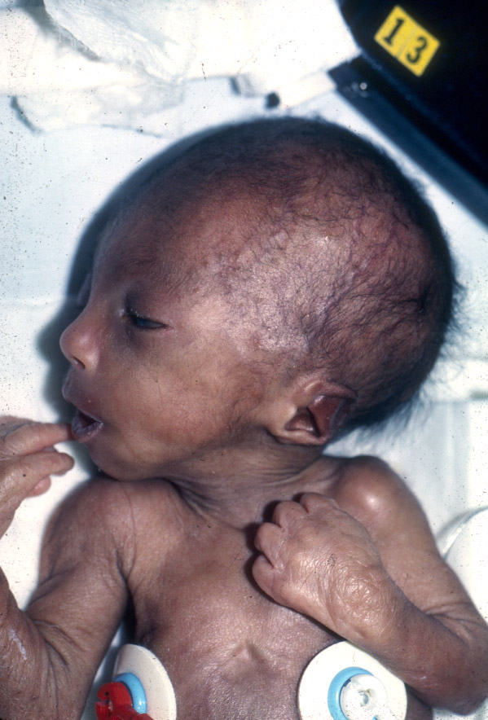

Slide 10
Trisomy 18
Incidence 1/7500 births
High fetal lethality (>90%)
Great “masquerader”
Diagnostic keys
  SGA
  Craniofacial disproportion
  Microophthalmia, auricular dysplasia, clenched hands

Slide 11
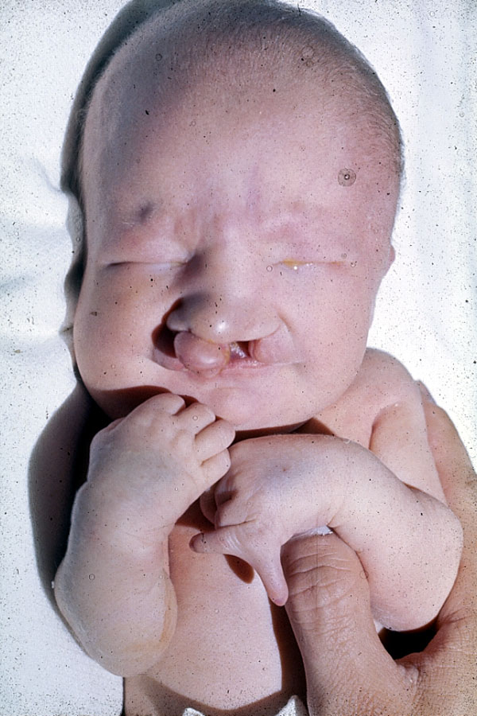
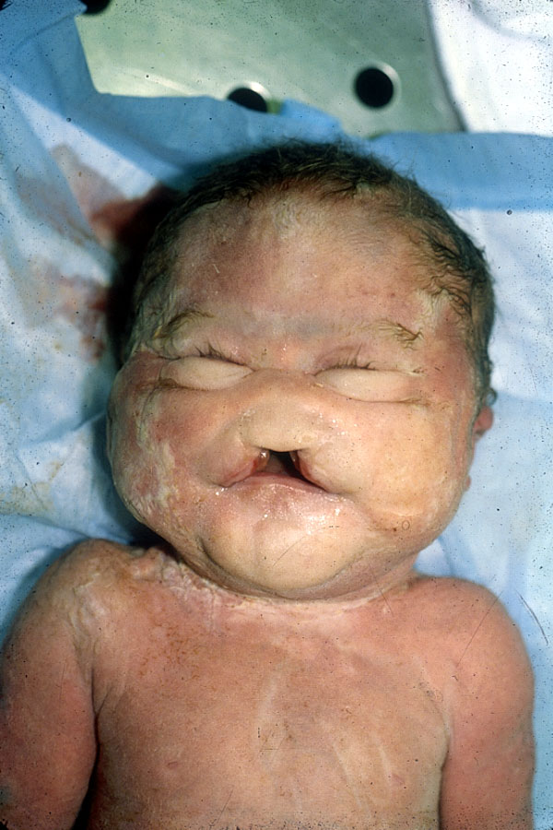
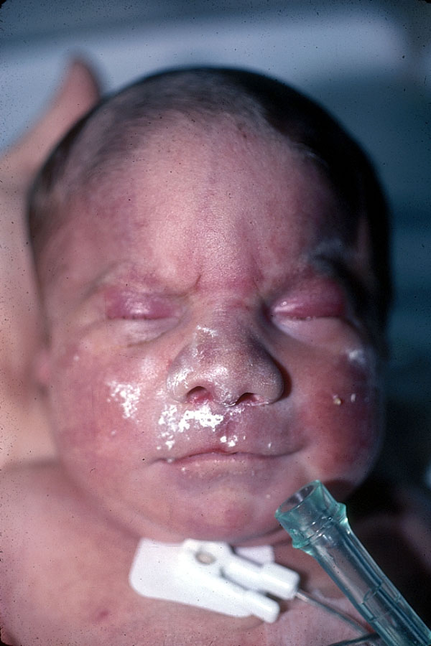
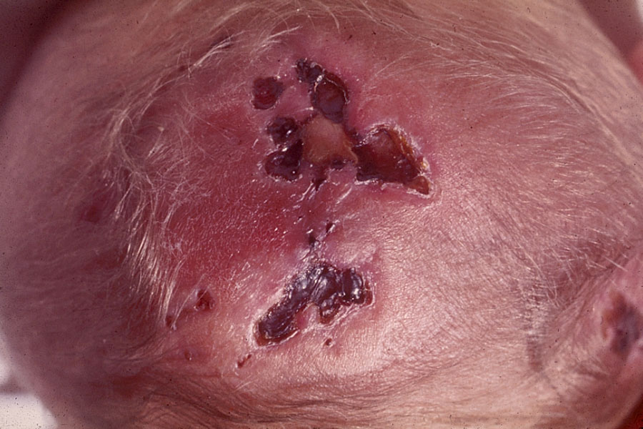

Slide 12
Trisomy 13
Incidence 1/10,000 births
Diagnostic keys
  Aplasia cutis congenita
  Microophthalmia
  Cleft lip and palate
  Post-axial polydactyly
  Bulbous nasal tip
Major malformations common (cardiac, renal, CNS, GI)

Slide 13
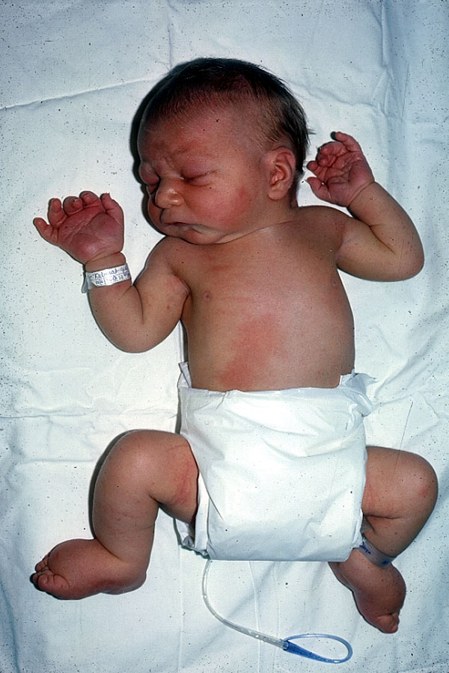
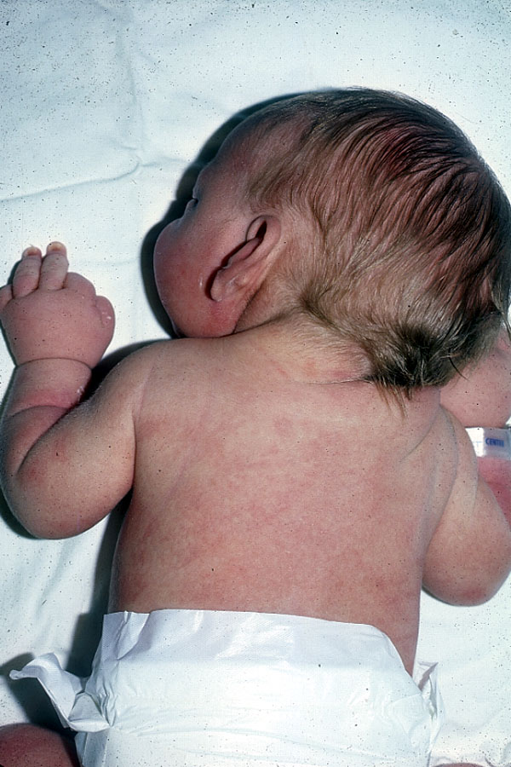
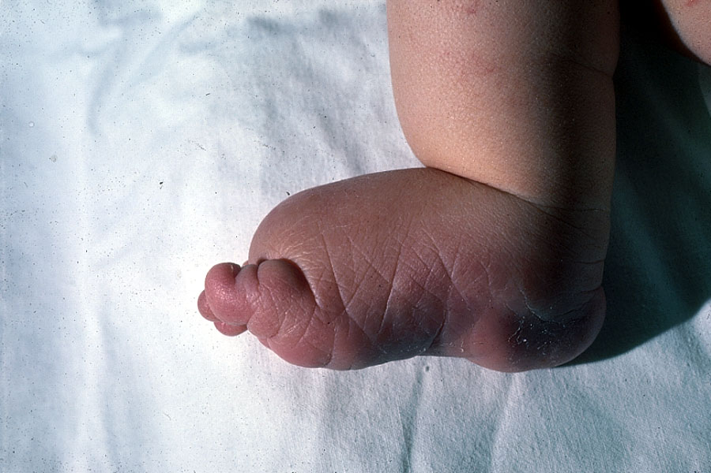

Slide 14
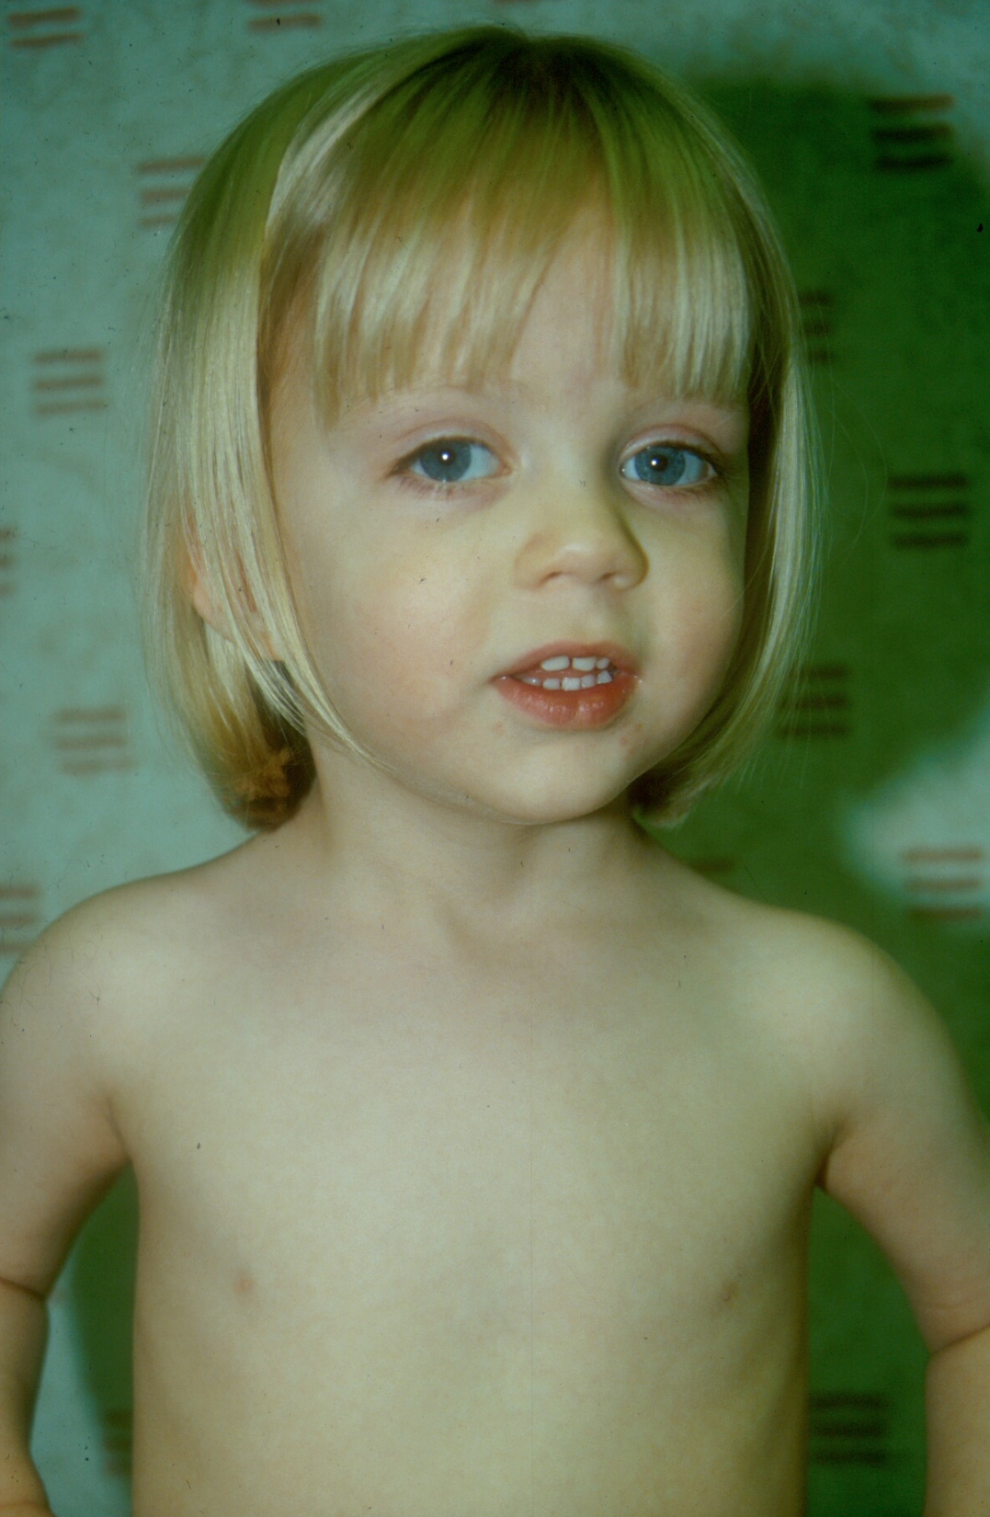
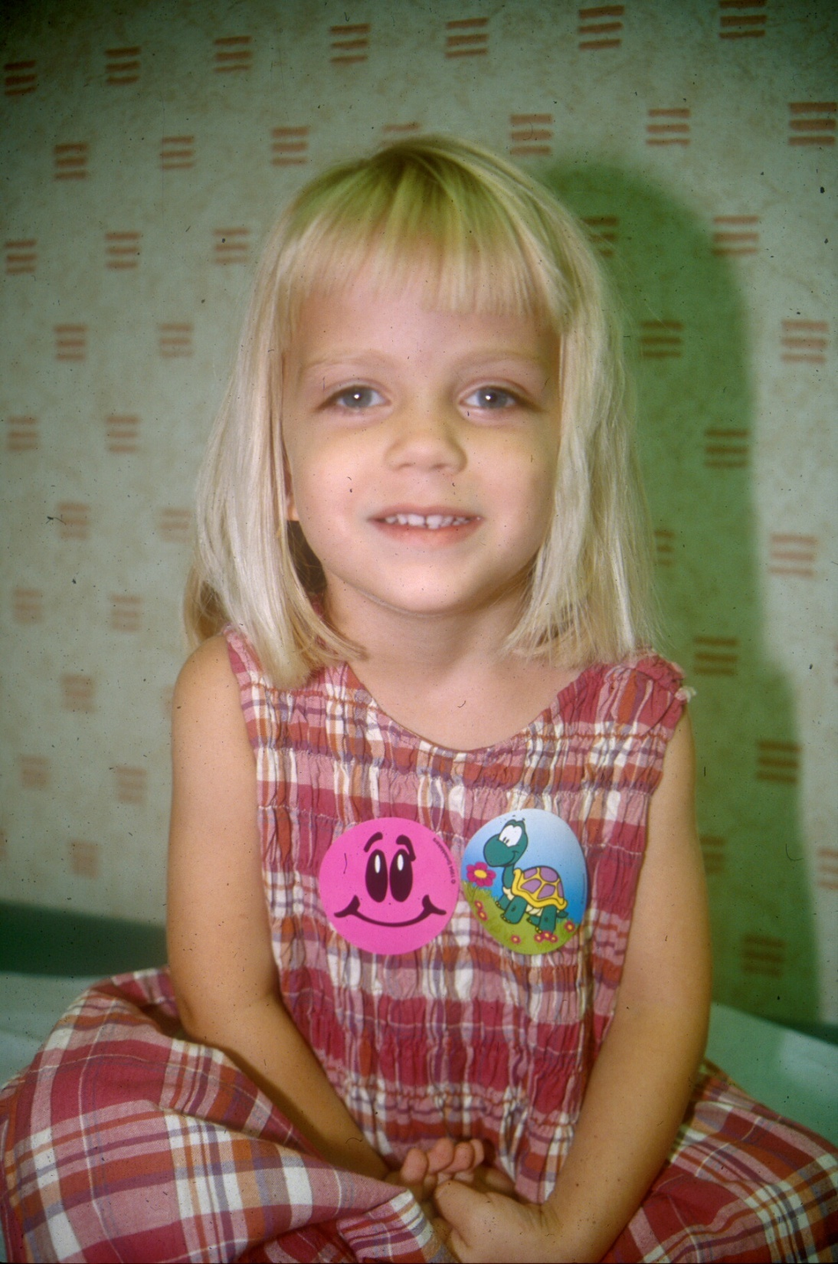

Slide 15
Turner syndrome
~1/2500
Features:
  Short, webbed neck
  Congenital lymphedema
    Swollen hands and feet at birth
  Broad chest, wide spaced nipples
  +/- epicanthic folds, down-slanting palp. Fissures
  Cubitus valgus
  Congenital heart disease (particularly coarctation)

Slide 16
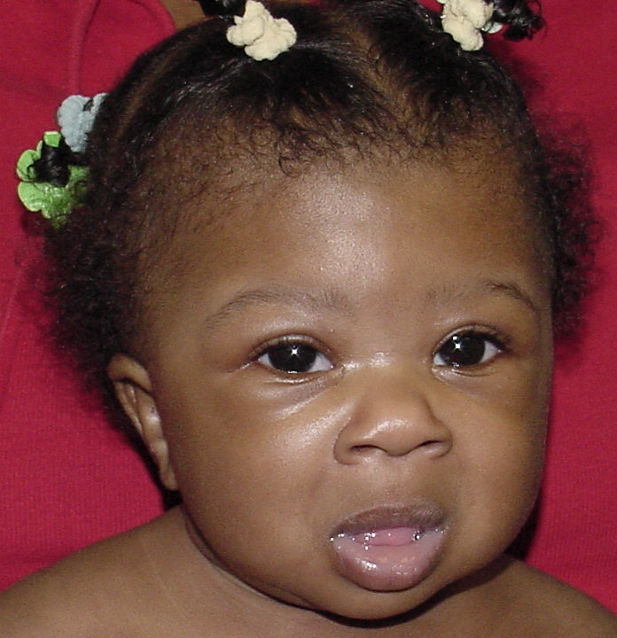
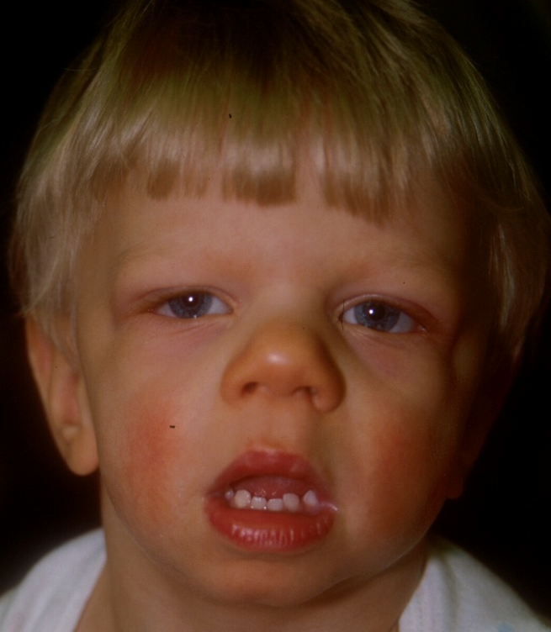
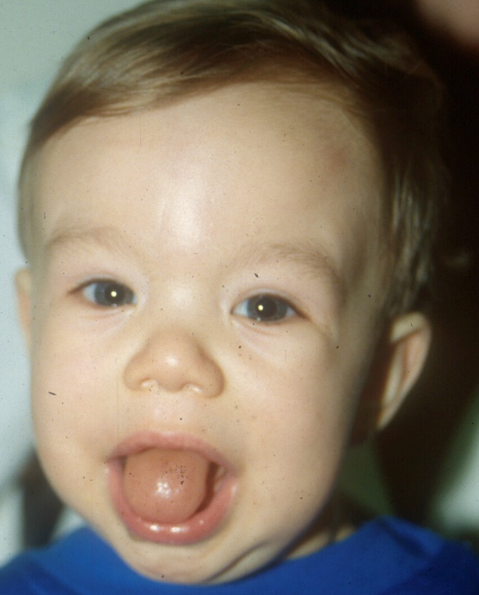
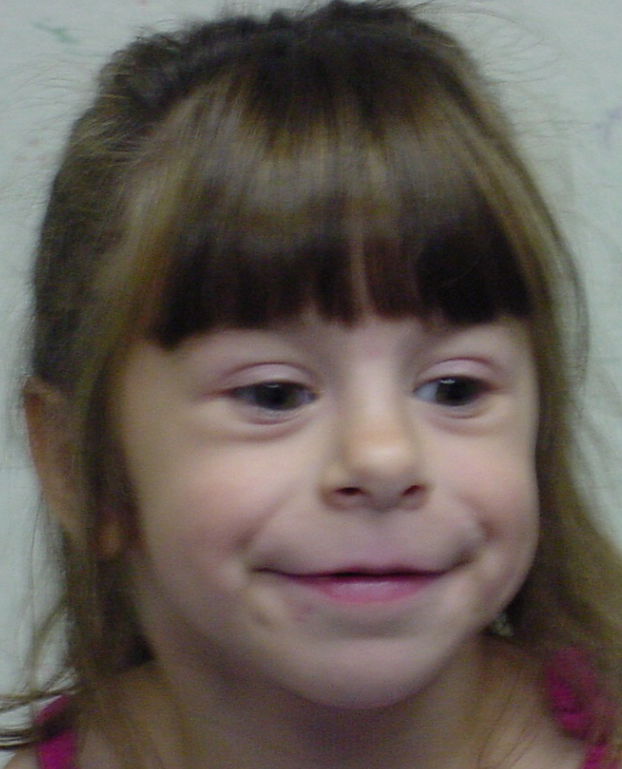
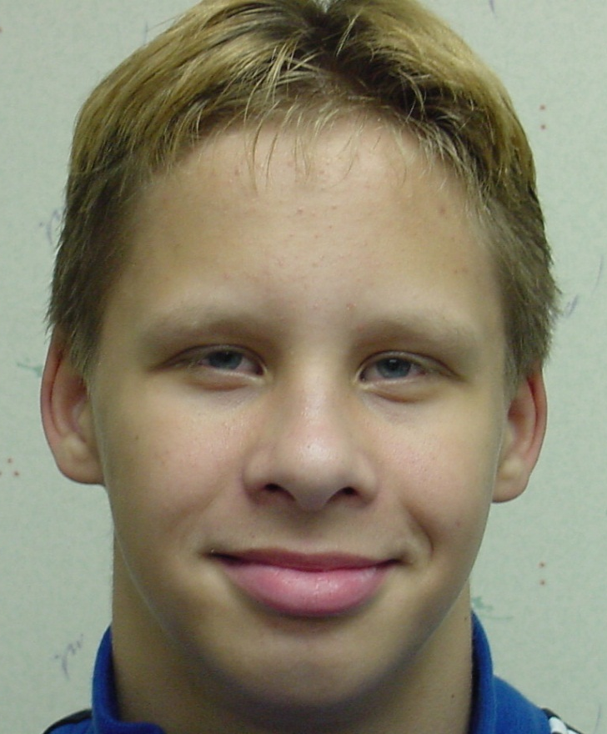
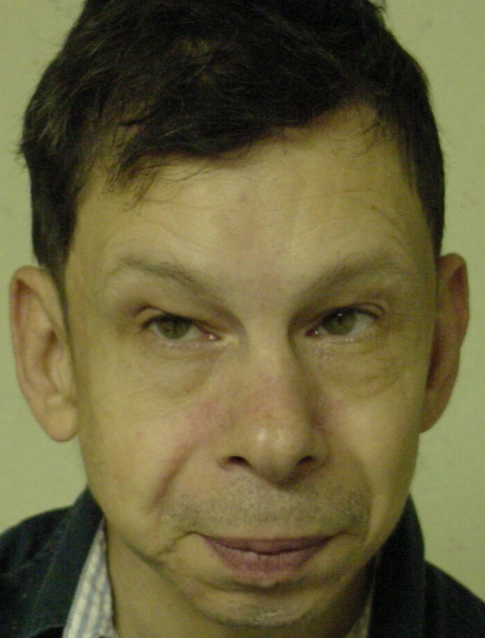

Slide 17
Williams syndrome
~1/10,000
Features
  Short stature, FTT
  Long philtrum
  Full lips
  Puffy eyes
  Stellate irides
  SVAS, PS
  Hypercalcemia
  “cocktail party personality”

Slide 18
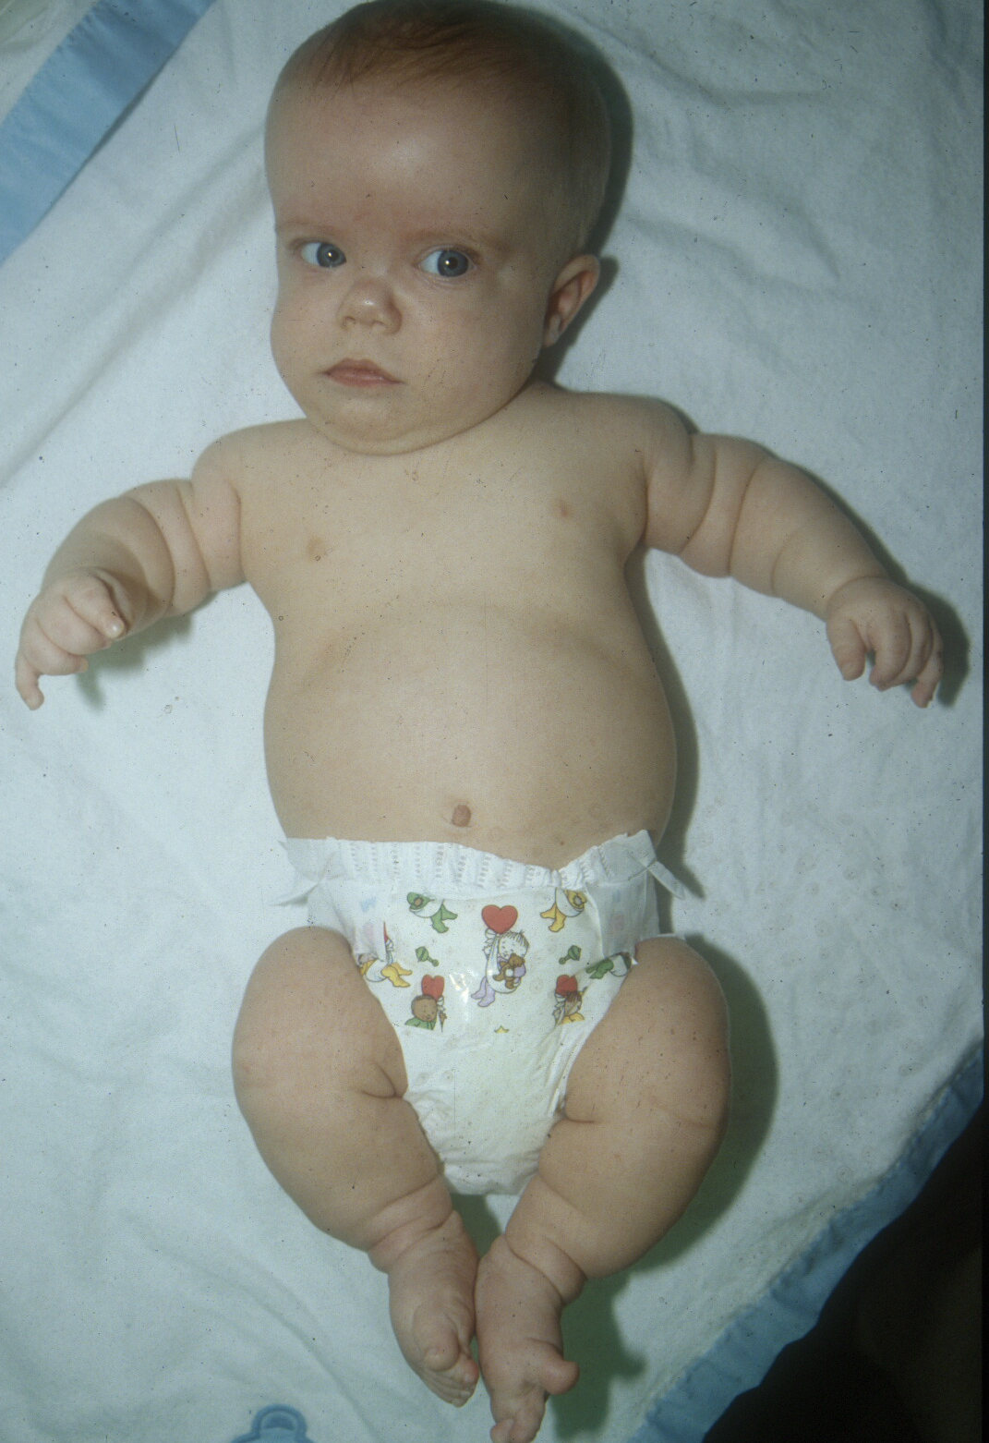
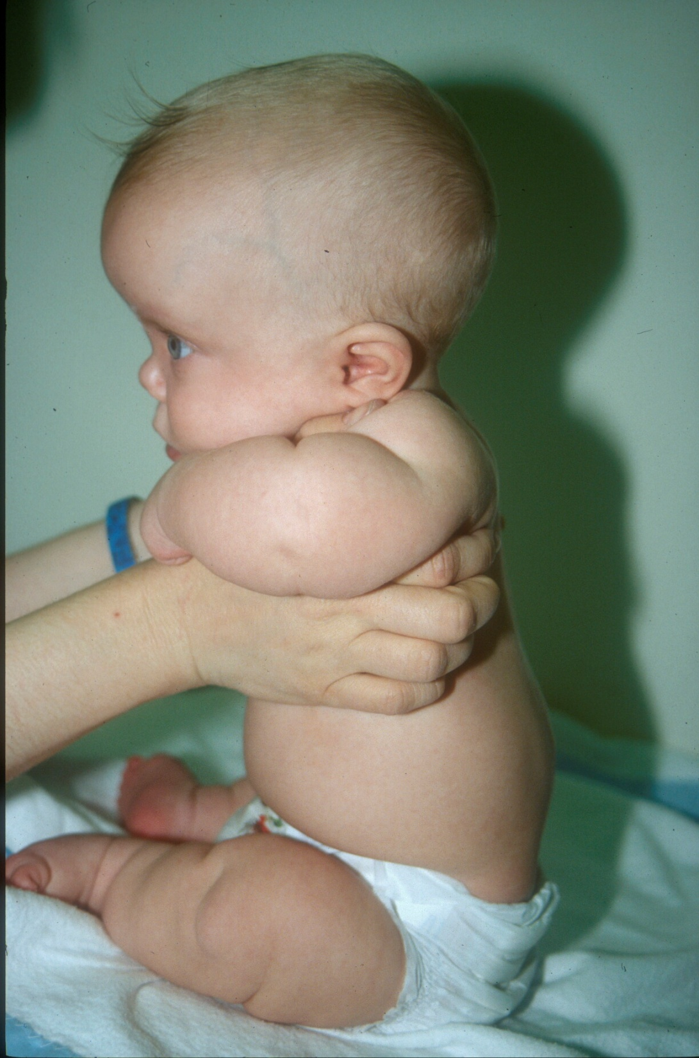

Slide 19
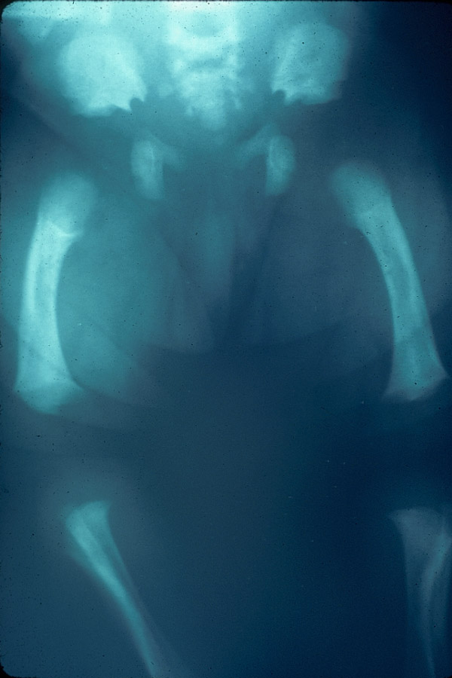
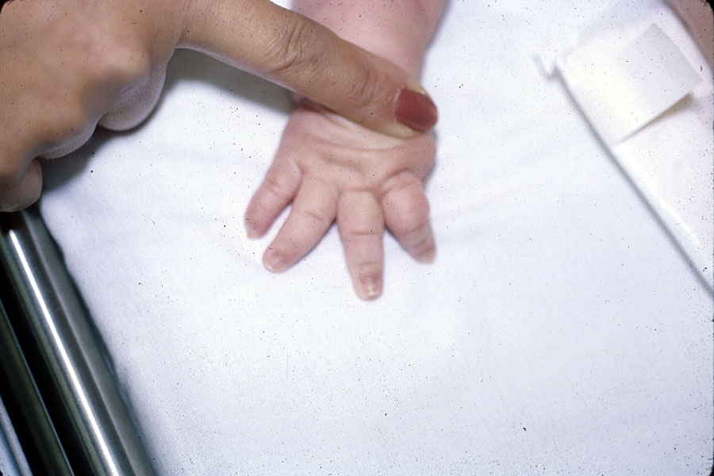
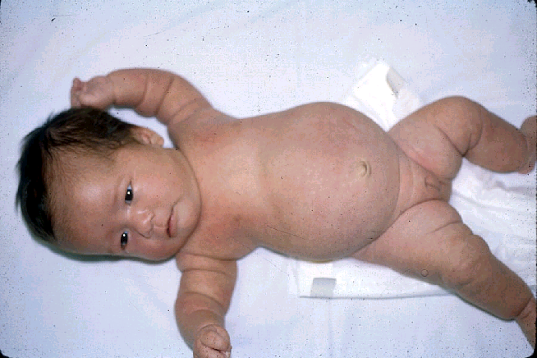

Slide 20
Achondroplasia
~1/25,000
Rhizomelic (proximal segment) dwarfism
Distinctive facies
  Macrocephaly
  Frontal bossing
  Midface hypoplasia

Slide 21
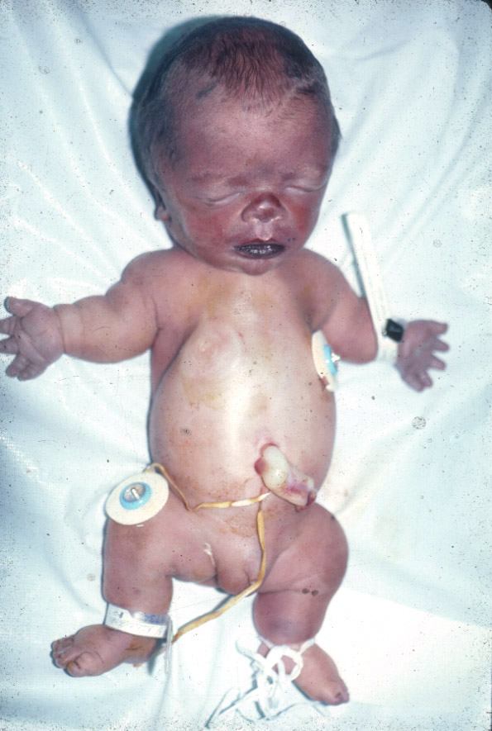
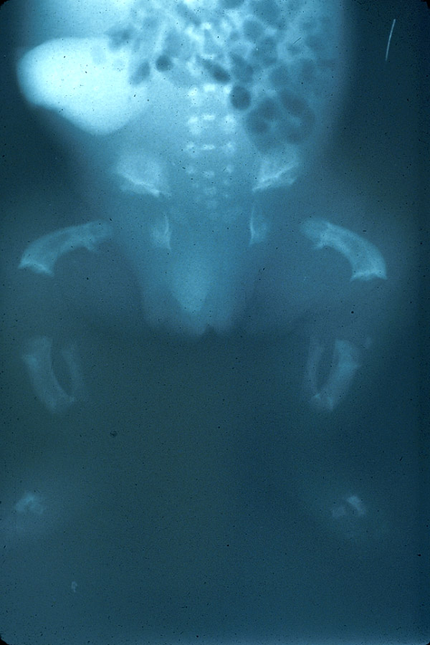

Slide 22
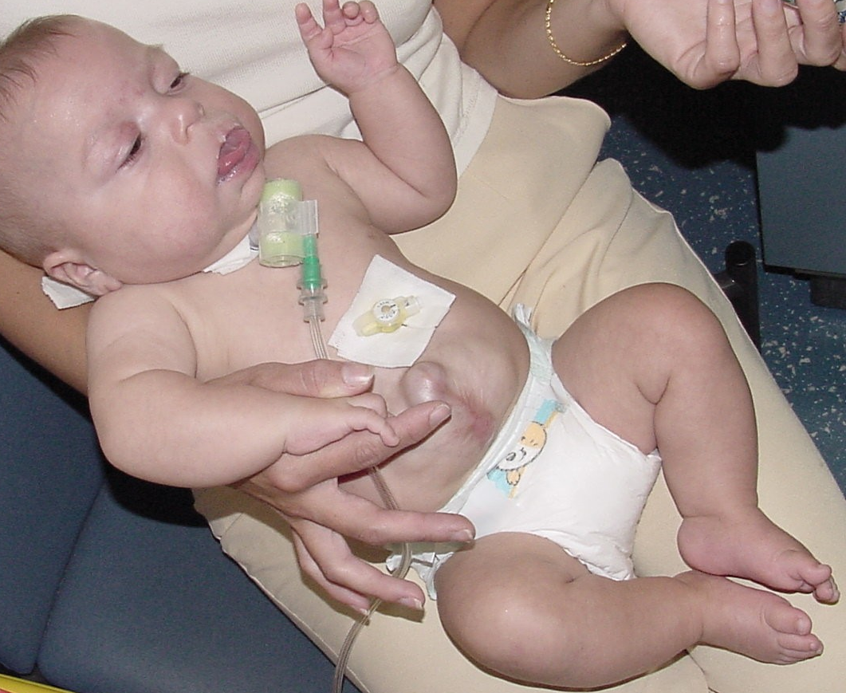
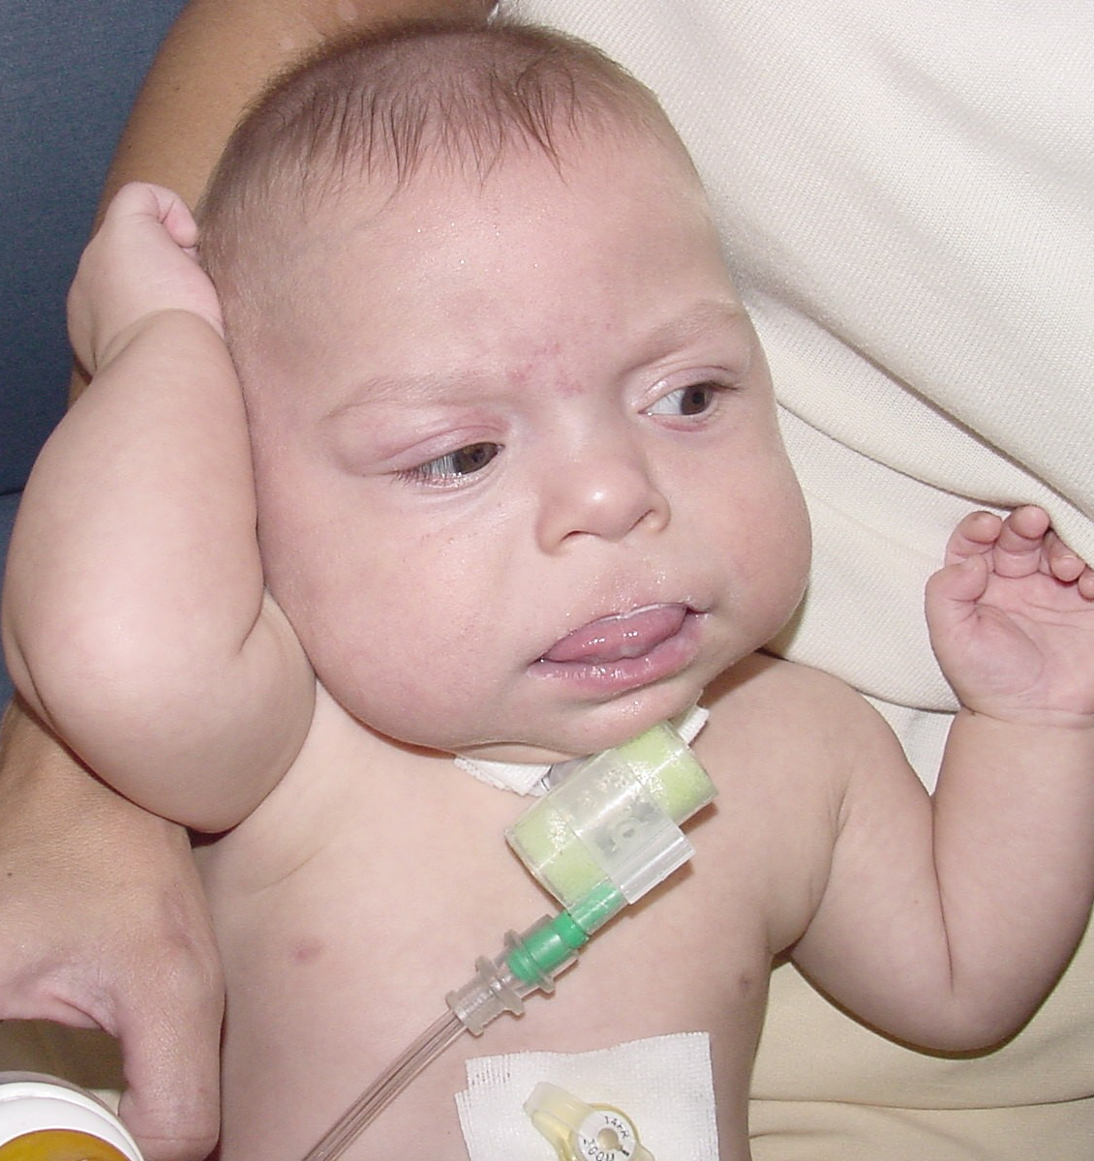
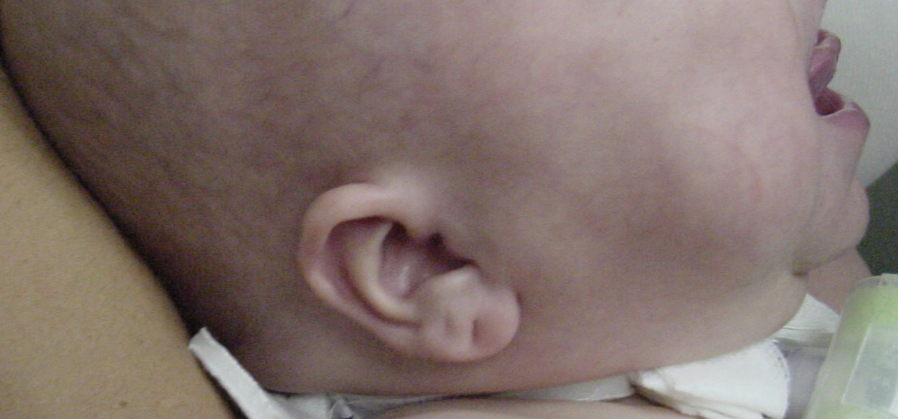

Slide 23
Beckwith Wiedemann Syndrome
LGA
Macroglossia
Ear pits/creases
Omphalocele
Hemihypertrophy
Cancer risk
  Wilms, hepatoblastoma
Neonatal hypoglycemia
Multiple genetic causes

Slide 24
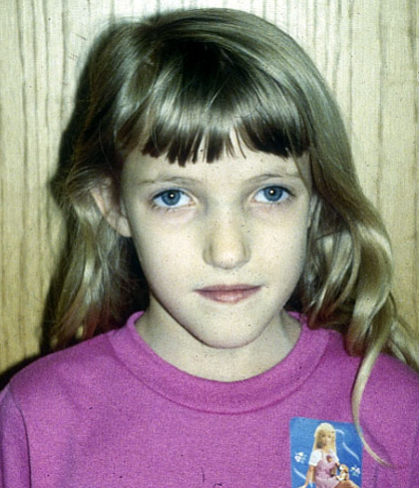
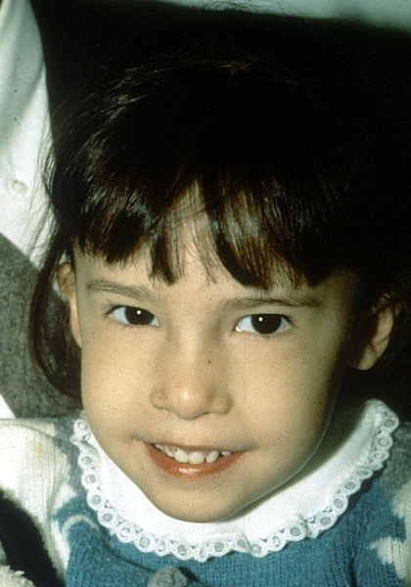
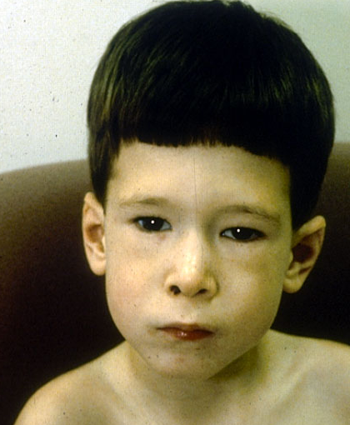
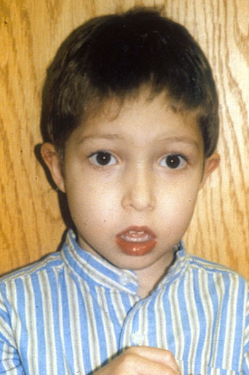

Slide 25
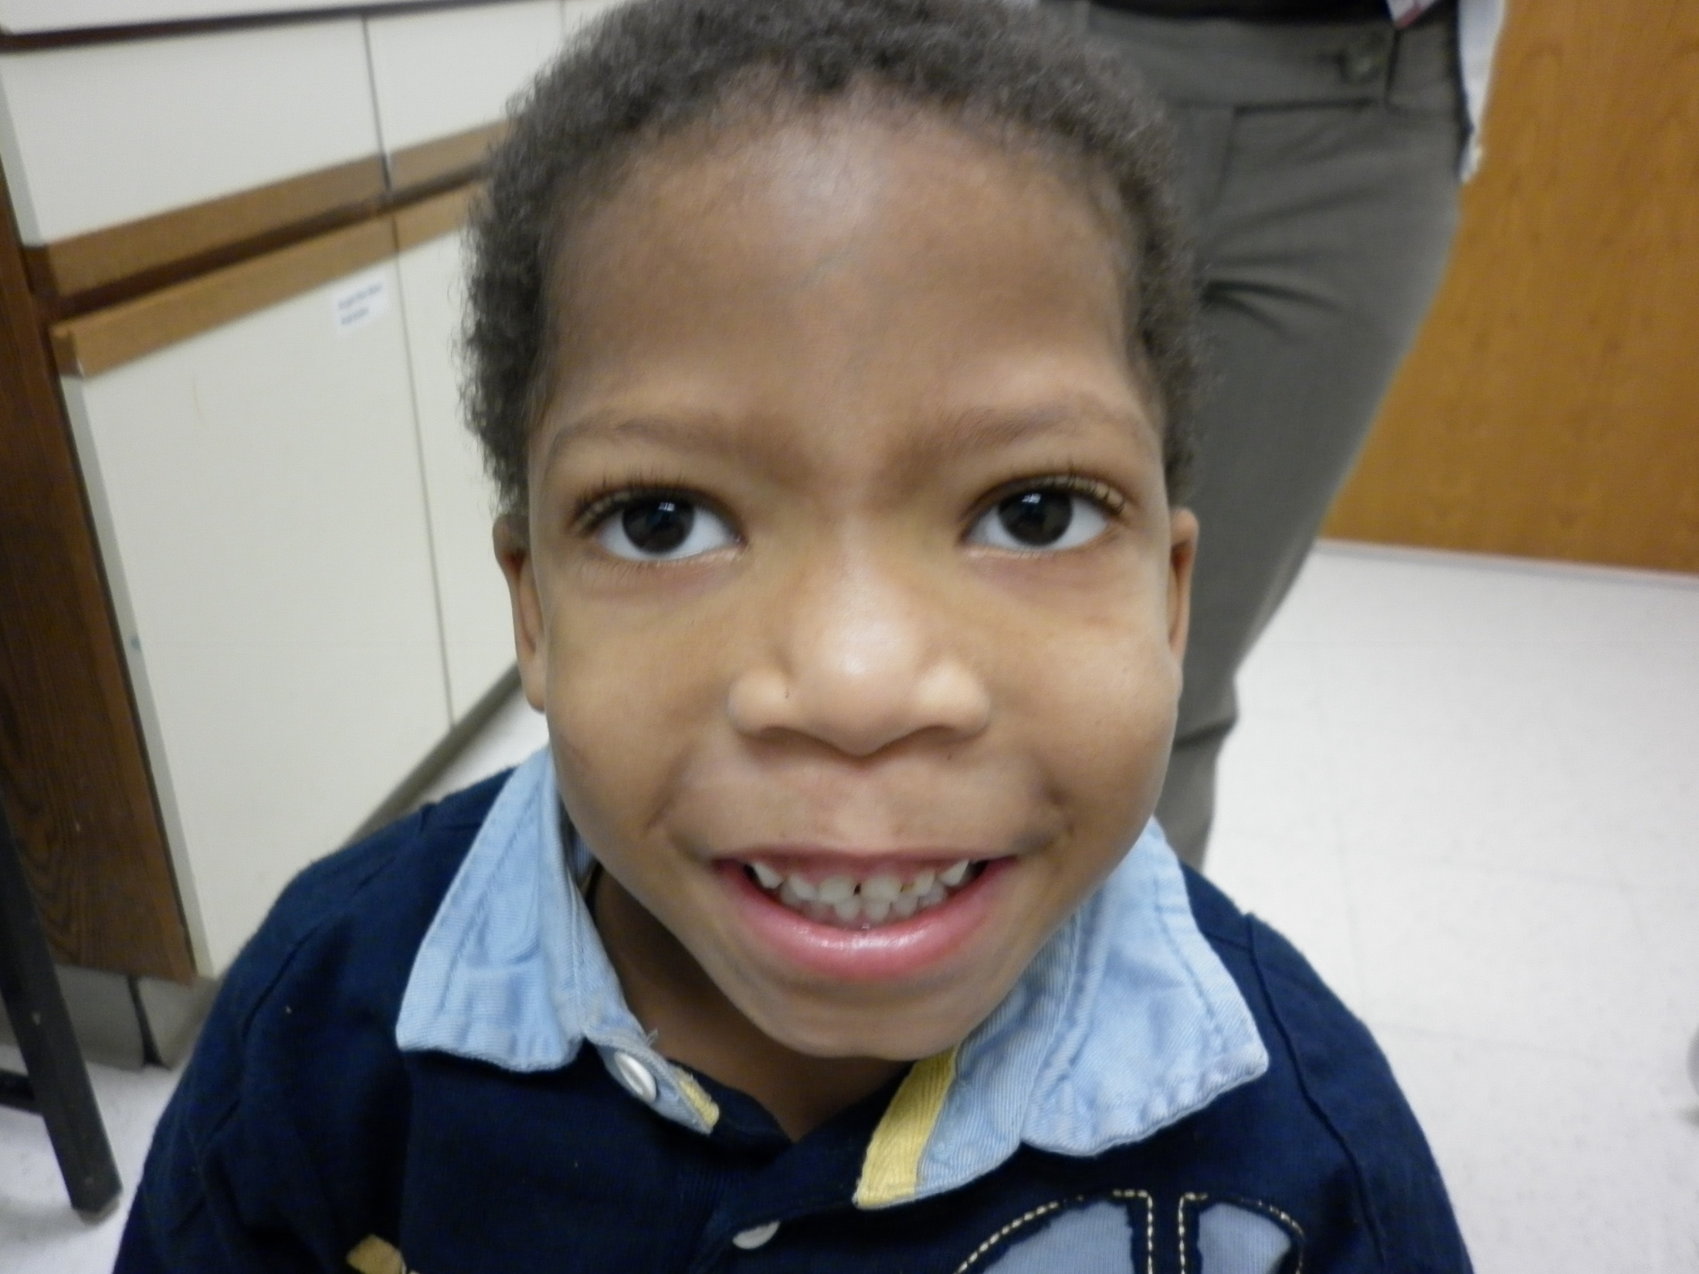

Slide 26
Velocardiofacial Syndrome
(22q11 deletion)
Features
  Tubular nose with hypoplastic alae nasae
  Palate abnormalities
    Cleft, velopharyngeal incompetence, nasal voice
  Long tapering fingers
  Cardiac abnormalities
    Outflow tract
  Neurologic
    MR, psychiatric, etc.

Slide 28
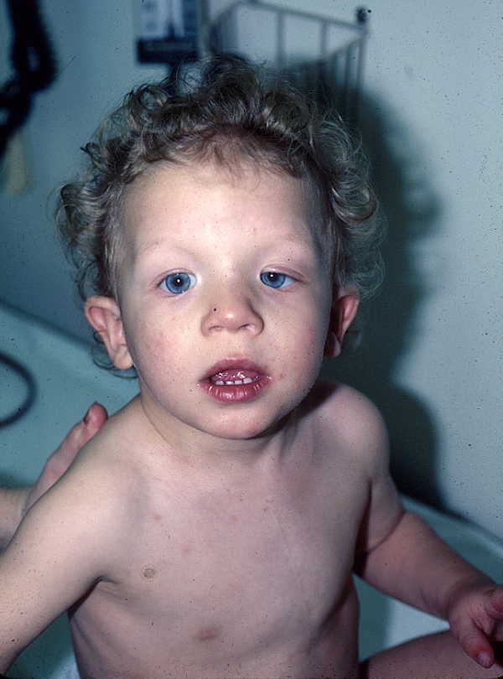
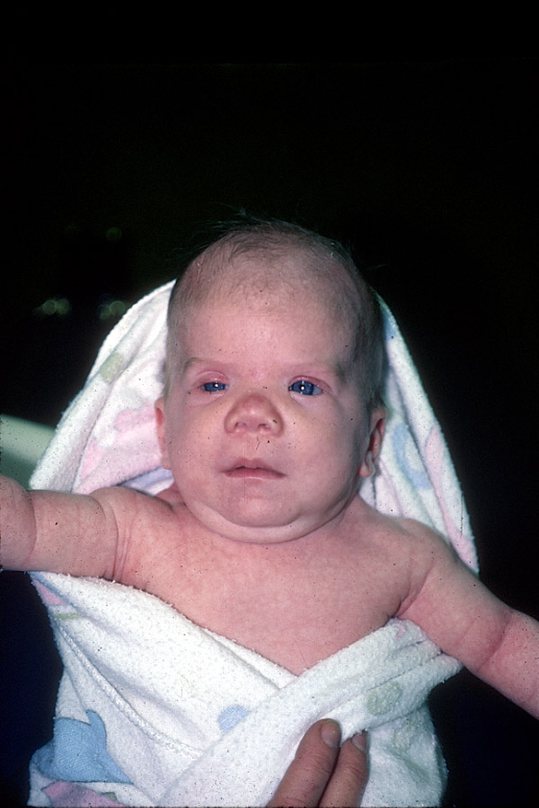

Slide 29
Noonan Syndrome
Features:
  Short stature
  Hypertelorism
  Downslanting palpebral fissures
  Low-set, posteriorly rotated ears
  Short neck
  Broad chest, pectus abnormality
  Cardiac anomalies

Slide 30
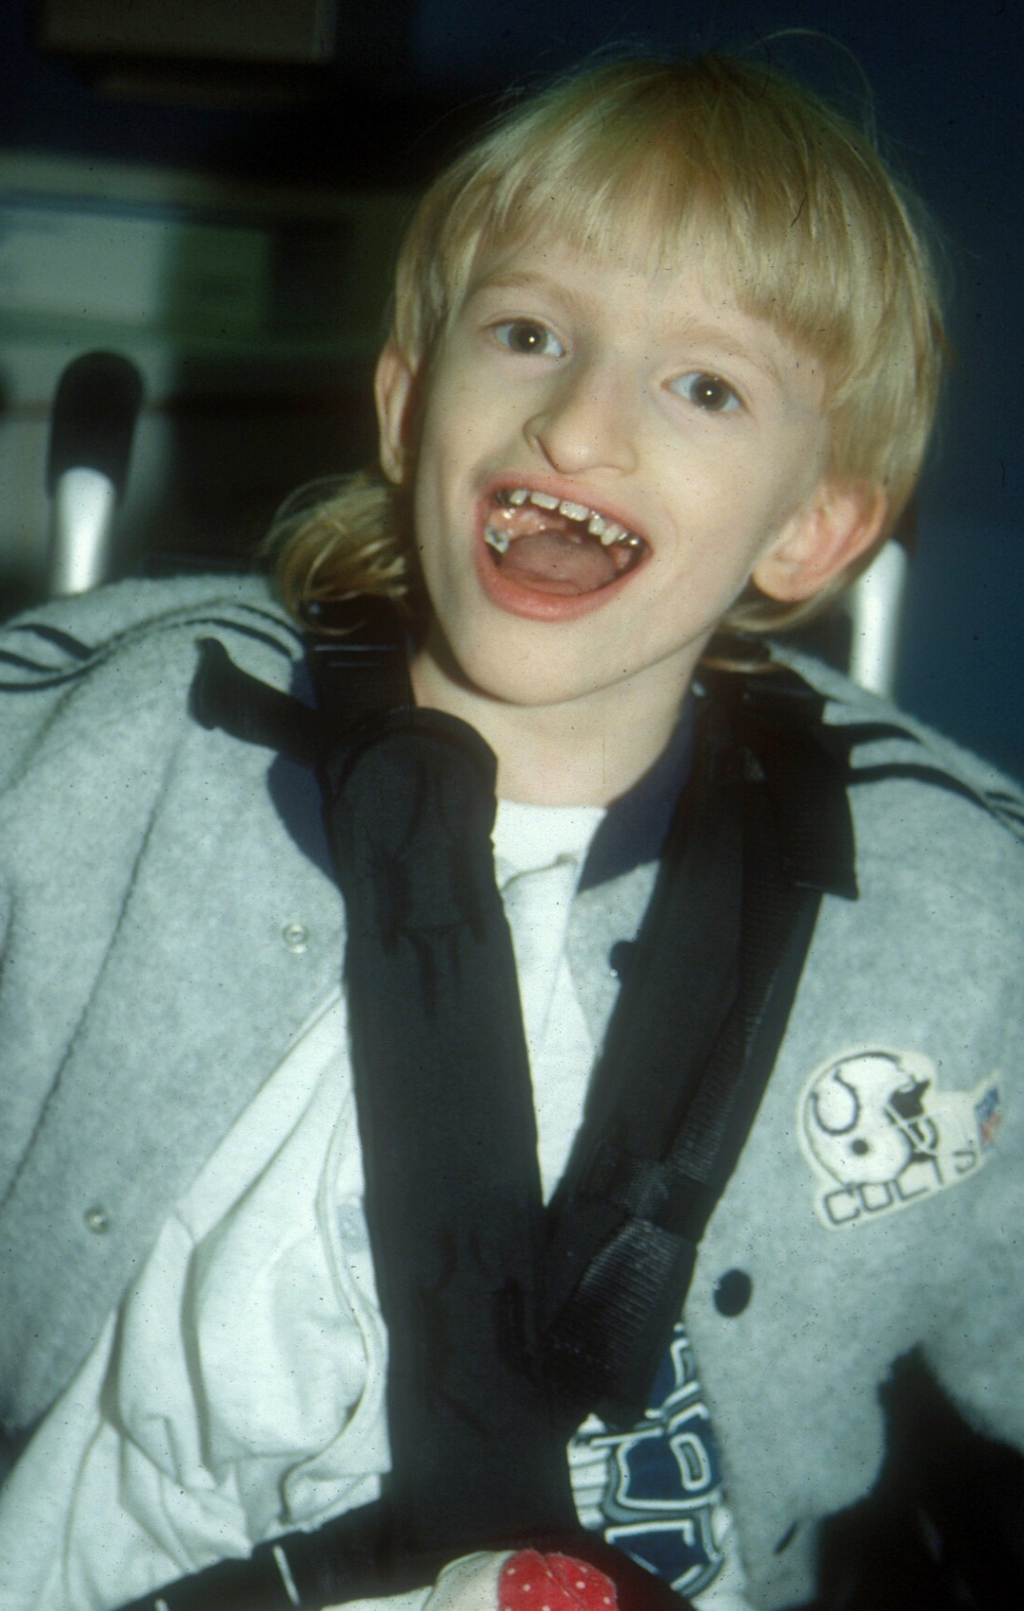
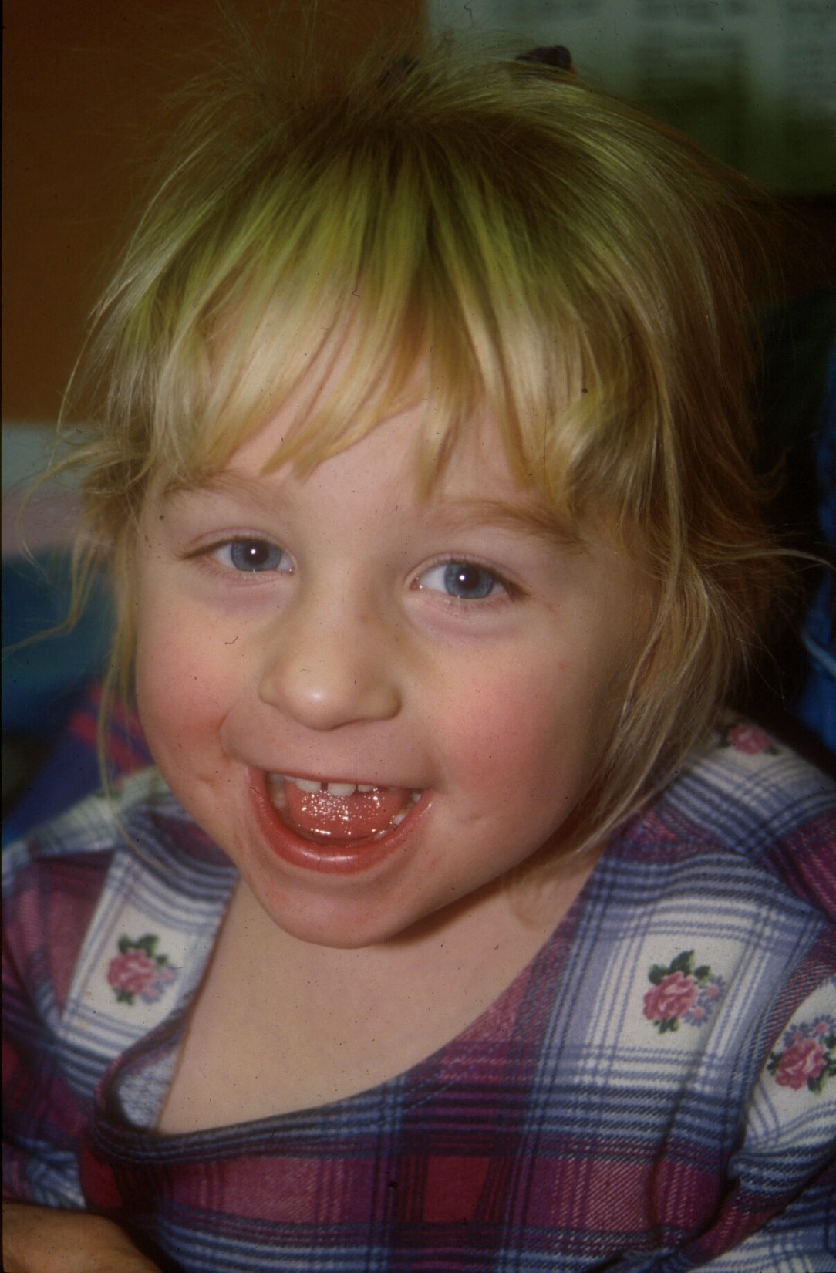

Slide 31
Angelman syndrome
~1/20,000
Features
  Microcephaly
  Broad mouth
  Prominent chin
  Inappropriate laughter
  Severe MR, seizures

Slide 32
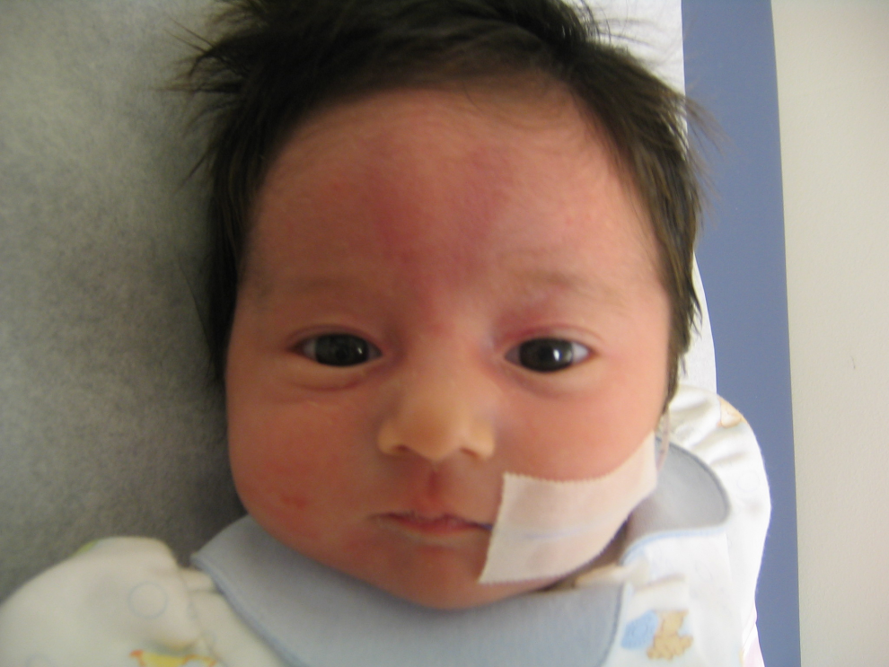
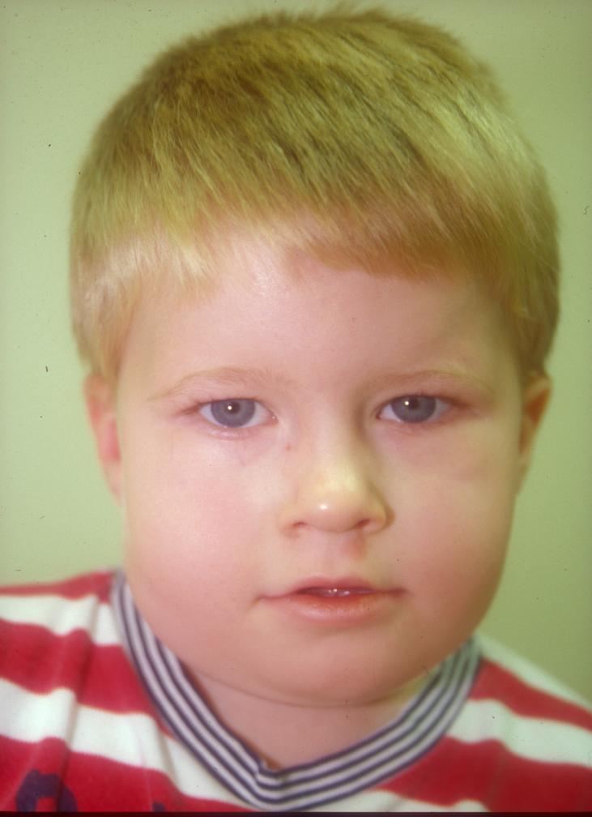
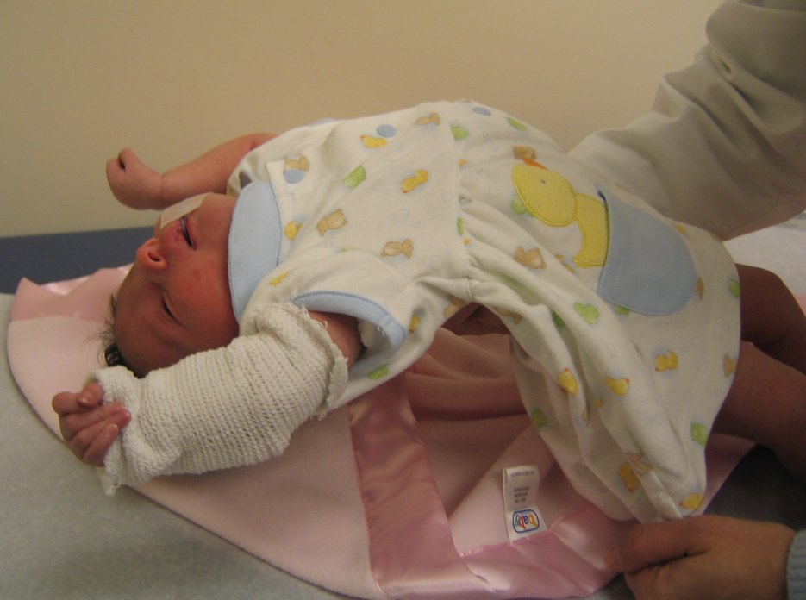

Slide 33
Prader-Willi Syndrome
Infantile hypotonia
“almond-shaped” eyes, epicanthal folds
Small hands/feet
Hypogonadism
Short stature

Slide 34
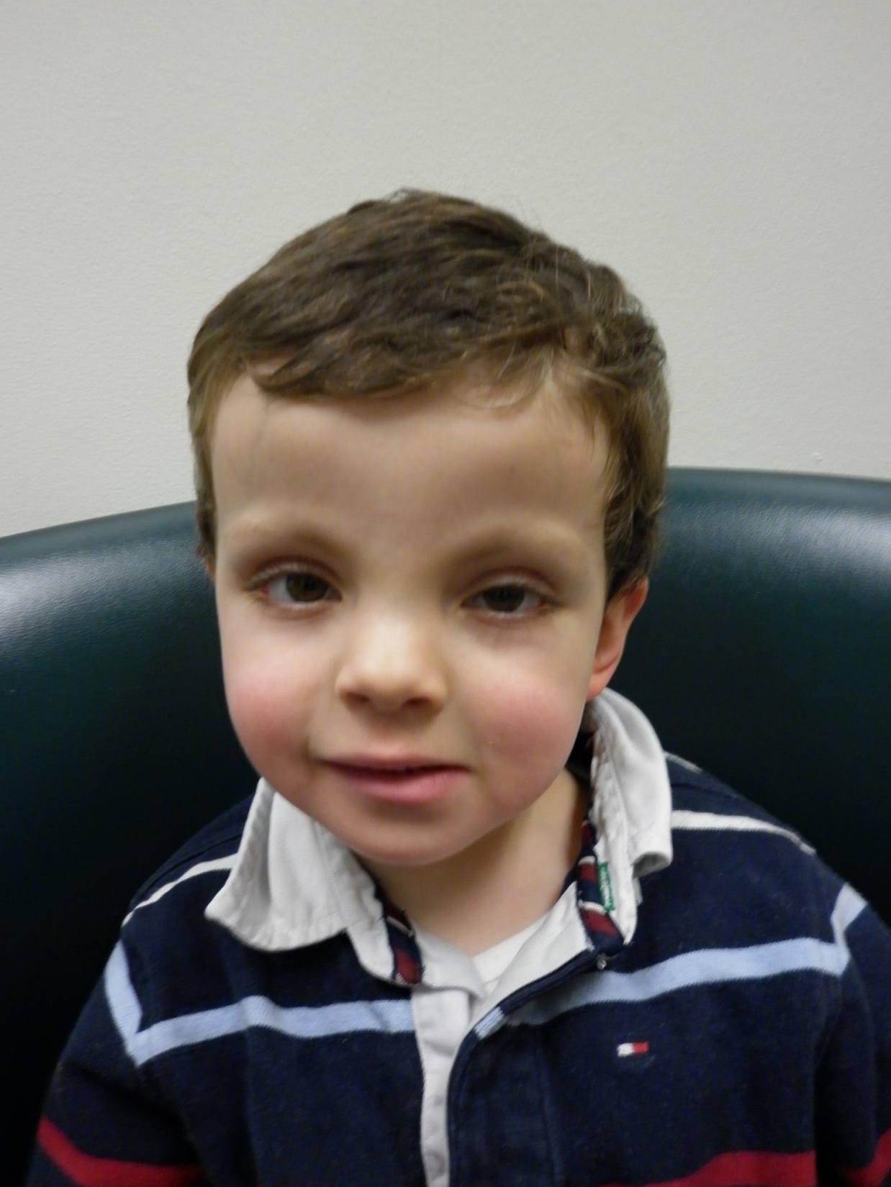

Slide 35
Kabuki Syndrome
Common (1/5000-1/10,000)
Autosomal dominant
  MLL2 mutations
Craniofacial
  Long palpebral fissures with lateral gaping
  Short columella
  Notched, sparse eyebrows
  Ocular colobomas
Cardiac (atrial septal defect, coarctation)
Hip dysplasia
Prominent fetal fingertip pads
Variable cognitive deficits

Slide 36




Slide 37
Holt-Oram syndrome
~1/100,000
Most common heart-hand syndrome
Radial ray defects
  Thenar hypoplasia, carpal bone anomalies, radial aplasia
Heart anomalies
  ASD, VSD most common
  Conotruncal defects rare
Genetic cause: TBX5 mutations
Autosomal dominant, high penetrance, variable expressivity
Normal intellect

Slide 38


Slide 39


Slide 40
Treacher-Collins syndrome
Rare
Features
  Short, downslanting palpebral fissures
  Eyelid colobomas (inferior, lateral)
  Hypertelorism
  Microtia, atretic ear canals
  Hypoplastic zygomatic arch
  Micrognathia, cleft palate

Slide 41


Slide 42
Marfan Syndrome
Multiple system involvement
  Skeletal, ocular, cardiac, others
Ghent criteria
  2 major features
    Skeletal (need 4+ findings)
    Ocular (ectopia lentis)
    Cardiovascular (dilation of aortic root or ascending)
    Lumbosacral dural ectasia
    First-degree relative, or identified mutation
    FBN1 mutation
  Or 1 major and 2 minor
    As above, also pulmonary, skin criteria

Slide 43


Slide 44


Slide 45


Slide 46
Marfan syndrome
Autosomal dominant
  Most with an affected parent (~75%)
Aortic disease (aneurysm, rupture, dissection) is major source of mortality/morbidity
Excess TGFβ signalling is responsible for aortic changes
  Responds well to Losartan (anti- TGFβ effects)
    Surgery, beta-blockade were primary treatment before discovery of TGFβ role

Slide 47




Slide 48


Slide 49
Cornelia De Lange Syndrome
Hirsutism
Synophrys (unibrow)
Long eyelashes
Short, anteverted nares
Long philtrum
Thin lips, down-turned corners of mouth
Wide spaced teeth
Growth failure
Limb reduction defects
Cardiac anomalies

Slide 50



Slide 51
Waardenburg Syndrome
~1/40,000
White forelock
  May be subtle, may include eyebrows/lashes
Iris heterochromia
Cochlear deafness
hyptertelorism

Slide 52



4 months 18 months 3 years

Slide 53
Russell-Silver syndrome
Features
  Growth failure
  Large skull
  Triangular face
  Limb asymmetry
Multifactorial
  10% with maternal UPD chromosome 7

Slide 54
END

Slide 55
Notes:
  IND: 25%
  Ear rotation:20 degree

