Slide 1
Malabsorption
Sona Sehgal
07/27/15

Slide 2

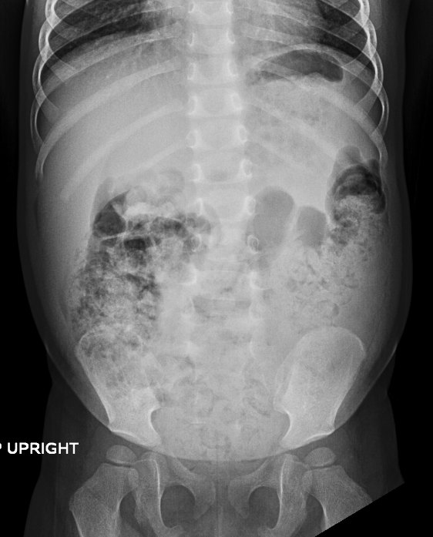
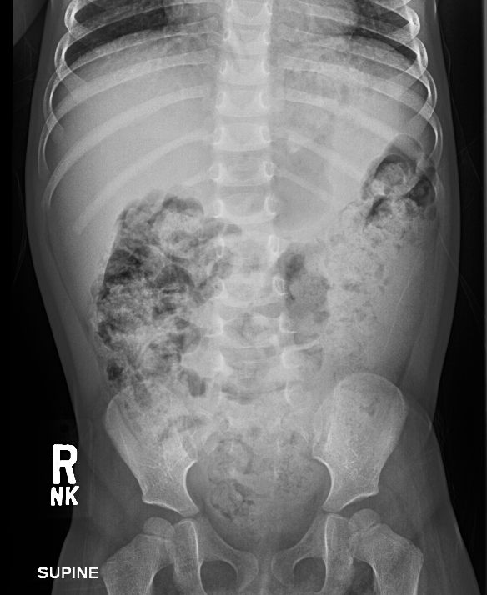
Case 1
2 year old girl with significant abdominal distention & KUB-severe constipation.
Born FT, passed meconium, BM- 2 formed small-moderate, excellent appetite, no emesis
Chronic upper airway congestion

Slide 3
Case 1
PHYSICAL EXAM
BP 86/62, HR=98,
Wt=11.7 Kg (28%), Ht=89cm (61%), BMI=14.8 (11%)
Happy, playful, anxious when approached
Poor subcutaneous fat
Moderately protruberant abdomen
No organomegaly or mass

Slide 4
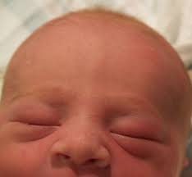
Case 2
2 month old baby girl with history of hydrops on prenatal sono, had persistent edema in periorbital region and extremities.
Prenatal sono at 28weeks showed mild pleural and pericardial effusion. Prenatal echo, karyotype and TORCH/Infectious negative.
Born at 31 weeks via c/s-mild respitory distress; ascites, CXR –butterfly vertebra at T6,Cardiac eval PDA, UA-N, karyotype =n
Feeding well: Brest milk and Neosure; gained 7gm/day in past 2 weeks; 1BM-green, loose, seedy; no emesis

Slide 5
Case 2
Physical Exam:
Wt=4.01Kg (25% ,corrected), Ht=51cm (10-25%, corrected), HC=39.5cm (97%, corrected), Wt/ht=78%
Well nourished, comfortable
HEENT-no icterus, periorbital edema
Chest-CTA, S1S2 no murmur
Abdomen- moderately distended, no mass
Extremities- mild edema of feet bilaterally

Slide 6
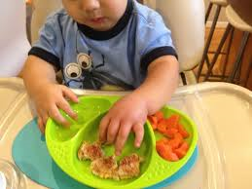
Case 3
12 month old boy who developed acute gastroenteritis. Admitted for dehydration secondary to diarrhea (15 stools/day) , vomiting (5-7 times/day).
Persistent emesis for 4 weeks and subsequent recurrent edema.
Feeding well-soy/lactaid milk, table foods; loose watery stools every 3 days.

Slide 7
Case 3
Physical Exam:
Wt=11.5 kg (52%), Ht=78.2cm (23%), HC=50.5cm (99%), Wt/Ht= 89%
HR=148, RR=28
Active, happy
No periorbital edema
Abdomen moderately protruberant
No pedal or scrotal edema

Slide 8
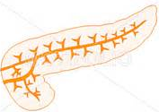
Definition
Impaired absorption of nutrients.
2. Mucosal phase:
a. Dissachridase deficiency
b. Celiac
c. IBD
Luminal phase:
a. Pancreatic enzyme deficiency.
b. Impaired bile
secretion/loss/deconjugation
3. Postabsorptive phase:
a. Lymphangiectasia

Slide 9
Types of Malabsorption
Fat malabsorption
    Pancreatic insufficiency
    Chronic cholestasis
Carbohydrate malabsorption
    Celiac disease
    Enzyme deficiency
    Short bowel
    Anatomic gut lesions
    Postenteritis syndrome
    Bacterial overgrowth
    Protein losing enteropathy
    Lymphangiectasia
    Post Fontan
    Allergic gastroenteropathy
    IBD
    Infections

Slide 10
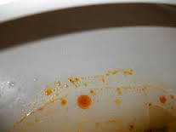
Symptoms and Signs
Poor growth- weight, height
Diarrhea- bulky, greasy, fowl smell
Constipation
Vomiting
Abdominal distention
Edema
Anemia
Symptoms from vitamin deficiency

Slide 11
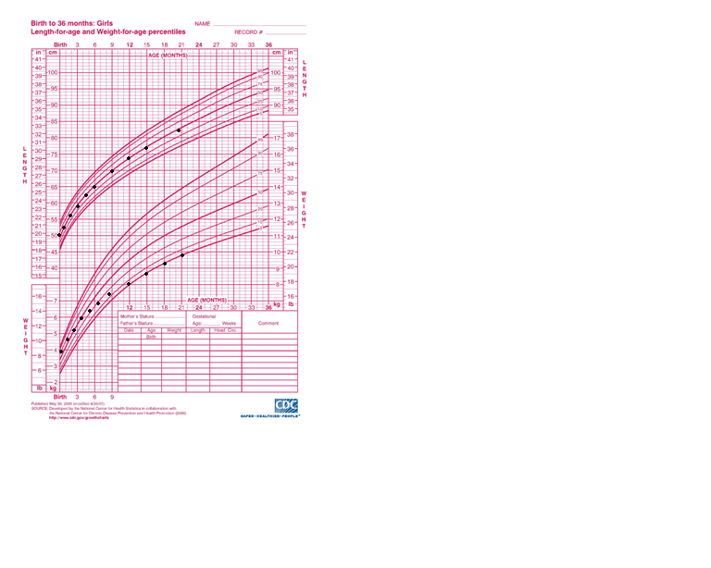
Assessment
Detailed history and physical exam
Diet history

Slide 12
Lab tests
CBC- anemia, lymphopenia
CMP- hypoalbuminemia, hypogammaglobulinemia
Vitamin A, 25 hrdroxy D, Vitamin E, Coags
Iron, RBC folate, Vitamin B12
Celiac serology
Stool tests
Sweat test

Slide 13
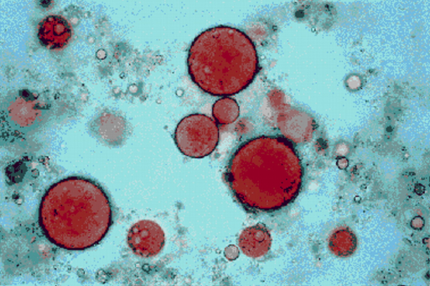
Lab tests
Fat malabsorption
Most sensitive indicator of global malabsorption
Most energy dense therefore most critical nutrient
Spot fecal fat= qualitative (Sudan red stain)
72 hr fecal fat= quantitative
Coefficient of fat excretion= Fat in stool, g x 100
< 6months of age=85%, then 93-95%
(CFA)
Fat intake, g
Notes:
A diet consisting of 100
g of fat per day is recommended for adolescents and adults and 2 g/
kg in infants and younger children. The standardized fat diet is
started 3 days beforehand and then continued for the full 3 days of
stool collection (12).
It is an
acceptable practice to calculate the 72-hour fat intake in children by
primarily keeping a strict dietary record and not requiring a
minimum intake of fat (14).

Slide 14
Indirect tests for pancreatic insufficiency
Stool trypsin/chymotrypsin
Prone to bacterial degradation
Stool Elastase
  Falsely low in large volume diarrhea
  Sensitivity=100% for severe insufficiency
  77-100% for moderate
  0-63% for mild
  Specificity= 93%

Slide 15
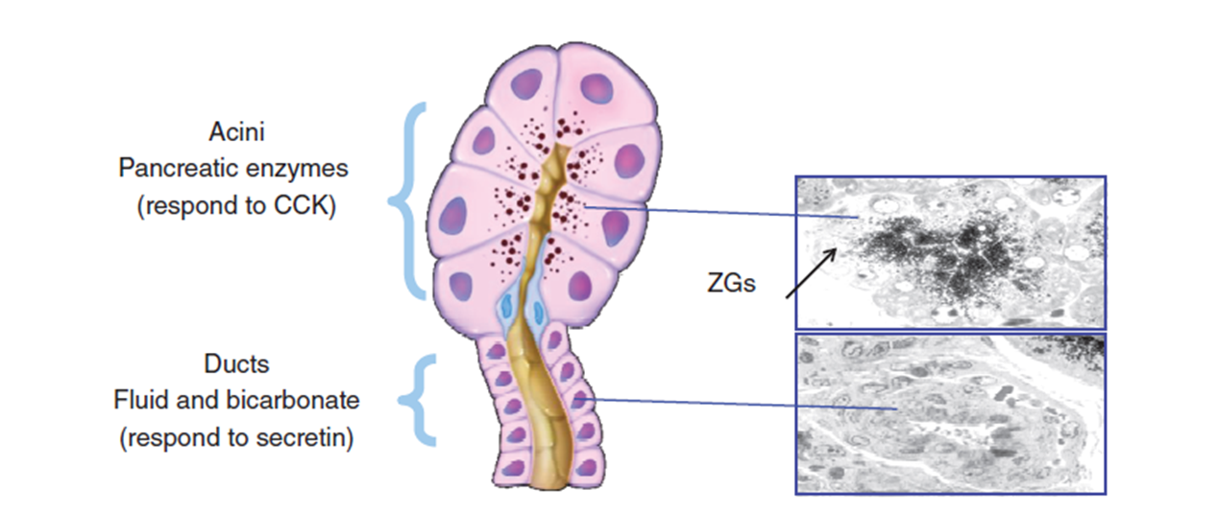
Direct tests for pancreatic insufficiency
Stimulate pancreas with enzymes
Notes:
Animal studies have suggested that the functional mass of pancreatic tissue is closely related to the maximal bicarbonate output, suggesting that the secretin test may better define the functional mass of pancreatic tissue [18]

Slide 16
Pancreatic stimulation test
Notes:
second portion of the duodenum close to the ampulla of Vater are
collected, in many instances, every 15 minutes up to an hour.
Chloride and bicarbonate concentrations are measured, and an
increase in bicarbonate >80 mmol/L indicates normal function
(62). The patient should fast for the endoscopy and should stop
taking PERT for 48 hours before the procedure.
The ePFT has several advantages and some limitations,
particularly in children. A major advantage is that it is a direct
PFT, which can potentially detect mild to moderate EPI

Slide 17
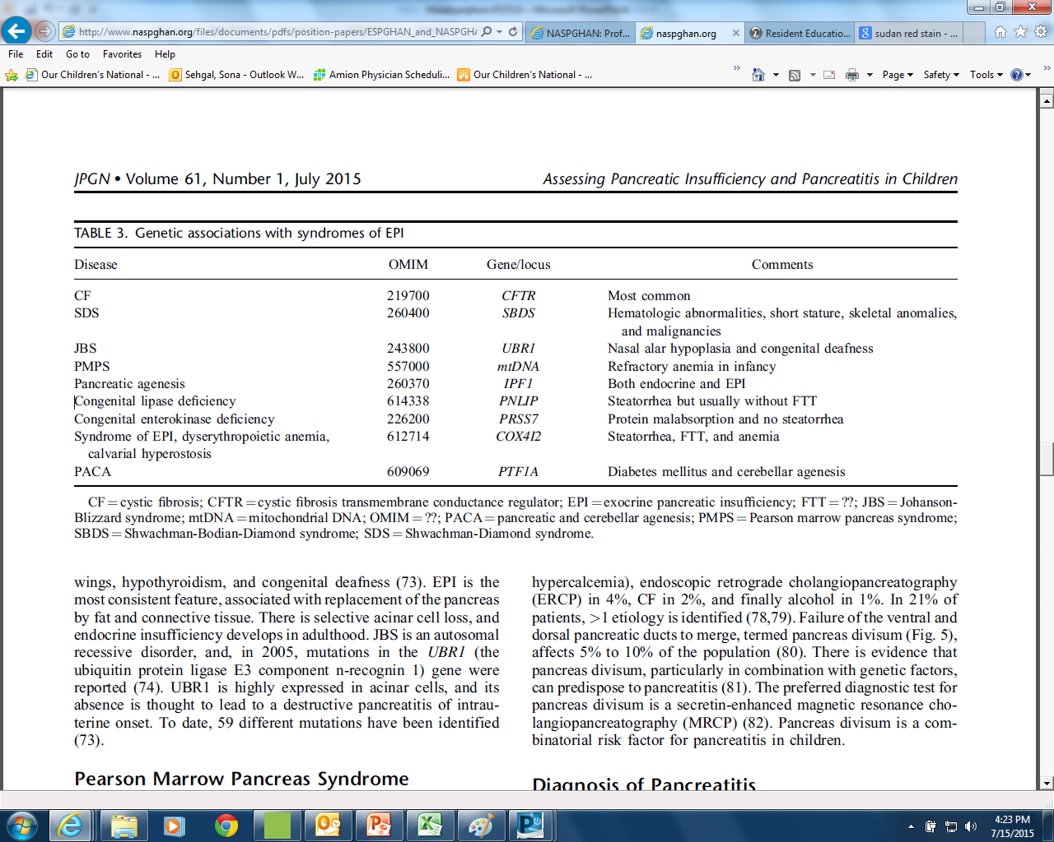
Genetic associations and syndrome causing pancreatic insufficiency

Slide 18
Carbohydrate malabsorption
Absorbed in jejunum and ileum
Fermented by colonic bacteria to SCFA and absorbed
  Complex Carbohydrates-starches
  -Digested by salivary and pancreatic amylases to disaccharides
  Disaccharides-lactose, sucrose, maltose and trehalose
-Brush border enzymes break down to monosacchrides
Monosaccharaides-glucose, galactose and fructose
  -Enter via carrier mediated transporters
  SGLT1- actively transports glucose,& galactose
  GLUT 1-actively transports glucose and galactose
  GLUT5-passive absorption of fructose
Notes:
Sodium glucose linked transporter- 2 Na molecules absorbed for every glucose.

Slide 19
Carbohydrate malabsorption
Inflammation of the small intestine-autoimmune enteropathy, celiac disease, post viral, radiation enteritis
Congenital intestinal transport or enzyme deficiency
Inherited disorders of brush border-microvillus inclusion disease, tufting enteropathy
Pancreatic exocrine insufficiency
Excessive intake of malabsorbed sugars like sorbitol
Short bowel syndrome

Slide 20
Brush border enzyme defects
Disorder | Abnormal Gene/Protein | Symptoms | Diagnosis | Treatment
Sucrase-somaltase deficiency | Sucrase-Isomaltase | Presents at 3-6mths | -Clinical -Duodenal biopsy -Genetic | -Sucrose restriction -Enzyme supplement
Glucose-galactose malabsorption | Na-glucose- Galactose Cotransport (SGLT1) | Severe life threatening diarrhea & Dehydration (DOL 1-14) | -Clinical | -Glucose and galactose restriction (fructose containing formula)
Congenital lactase deficiency | Lactase | Diarrhea and severe malnut at birth Hypercalcemia Nephrocalcinosis | -Clinical -Duodenal biopsy | Lactose restriction
Congenital trehalase deficiency | Trehalase | Diarrhea after ingesting mushrooms | -Duodenal biopsy | Trehalose restriction
Fructose malabsorption | Facilitative Glucose transport | Presents at 3-6 months | -Improved on fructose elim -Fructose breath test | Diet free of fructose
Adult-type hypolactasia | Lactase | Presents at 3-15yrs Worse with age | -Clinical -H2 breath test -Duodenal biopsy | -Avoid lactose -Lactase pills

Slide 21
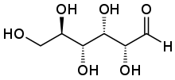
Carbohydrate malabsorption
Fecal pH and reducing substance
-Generated by colonic bacterial fermentation of unabsorbed dietary carbohydrates
-Stool pH <5.5
Breath test- fructose, lactose
Duodenal biopsy- Sucrase-isomaltase, lactase, trehalase
Genetic test-Gluc-Gal malab, Sucrase-isomaltase
Aldehyde group
Notes:
A reducing sugar is any sugar that either has an aldehyde group or is capable of forming one in solution through tautomerization, a form of isomerism. All monosaccharides are reducing sugars, along with some disaccharides, oligosaccharides, and polysaccharides
The common dietary monosaccharides galactose, glucose and fructose are all reducing sugars.
Reducing disaccharides like lactose and maltose
Nonreducing disaccharides like sucrose and trehalose
The aldehyde functional group allows the sugar to act as a reducing agent, for example in the Tollens' test or Benedict's test.

Slide 22
Protein loosing enteropathy
Abnormal loss of protein from the GI tract resulting in decreased serum protein.
Causes:
Metabolic-enterocyte heparin sulfate deficiency, disorders of glycosylation
Mucosal inflammation, erosion, ulceration
Infection-C difficile, CMV, Giardia, H pylori
Non-Infectious-allergic enteropathy, celiac, polyposis
Notes:
Sulfated Glycosaminoglycans in basolateral membrane confine albumin to intravascular compartment.

Slide 23
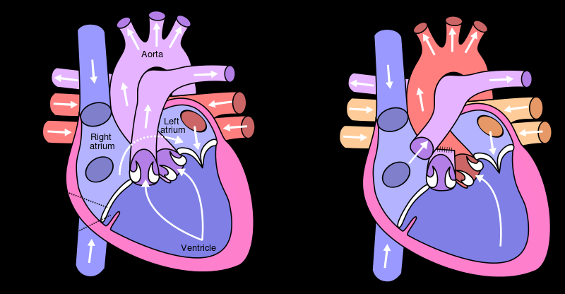
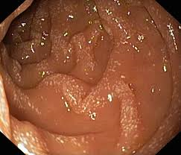
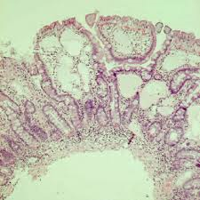
Protein loosing enteropathy
Fontan procedure
right atrium
-leakage of protein across gut
Lymphangiectasia
-poor absorption of fat
-leakage of protein
pulmonary artery
Notes:
The Fontan procedure, or Fontan/Kreutzer procedure, is a palliative surgical procedure used in children with complex congenital heart defects. It involves diverting the venous blood from the right atrium to the pulmonary arteries without passing through the morphologic right ventricle. – abnormality of pumping hypoplastic left/right heart, single ventricle, lack of valve (mitral , tricuspid)

Slide 24
Protein loosing enteropathy
Diagnosis
  elevated fecal alpha-1-antitrypsin
  decreased albumin, gamma-globulin and lymphocytes
  UA
  small bowel contrast study
  endoscopy
Notes:
Alpha-l antitrypsin has a moderately higher molecular weight than albumin (50,000) and is excreted intact in the stool because it is resistant to proteolysis and degradation in the intestinal lumen
Decreased transferrin, ceruloplasmin, fibrinogen, gamma globulin

Slide 25
Management
Treating primary disease
Pancreatic Enzyme Replacement Therapy (PERT), specific enzyme supplementation
Special formulae- RCF formula, MCT oil based
Vitamin supplementation

Slide 26

Case 1
2 year old girl with significant abdominal distention, severe constipation and poor weight gain despite excellent intake.
LABS:
CBC, CMP, TTG IgA, serum IgA=N
Elevated fecal fat, normal elastase
Sweat chloride right arm=17 (0-39)
US= normal pancreas
EGD and rectal suction biopsy=normal
Secretin not available

Slide 27
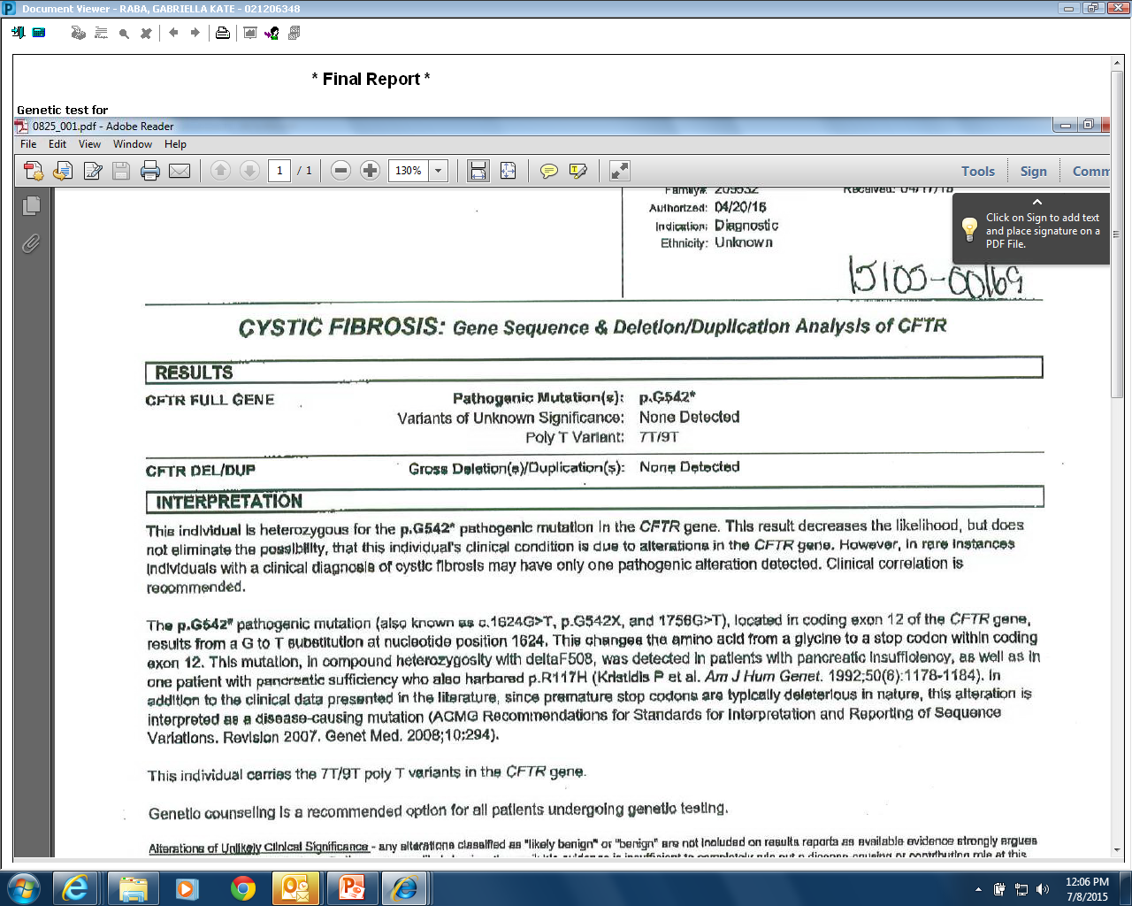
Case 1
Notes:
Nonclassic patients with CF (class IV or V)
can have varying degrees of exocrine pancreatic function. These
patients are usually exocrine PS and are at a higher risk of developing
pancreatitis (71).

Slide 28
Case 1
TREATMENT
  Started on Pancreatic Enzyme Replacement Therapy (PERT)
  Polyethelene glycol
  Genetic evaluation

Slide 29
Case 2
2 month old baby girl with history of hydrops on prenatal US, with persistent edema and poor weight gain.
Labs –wbc=2.9, lymph=830 (>1500), tp=4.7 (6-7.8), alb=2.1 (3.5-4.1),
Fecal elastase >500 ng/dl, fecal fat +, fecal A1AT=95g/dl (<55)
US-mild ascites
SBFT-thickened bowel wall
EGD & Colon-mild lymphangiectasia

Slide 30
Case 2
TREATMENT
  High protein low fat diet
  MCT oil supplementation
  ADEK
  Immunology evaluation

Slide 31
Case 3
12 month old boy who developed acute gastroenteritis then had recurrent emesis and edema for 4 weeks.
Labs: Serum albumen=2.1, fecal alpha-1-antitrypsin = elevated
EGD

Slide 32
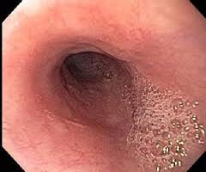
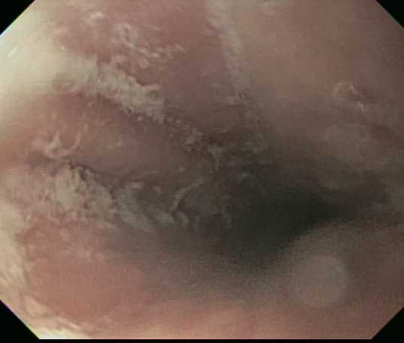
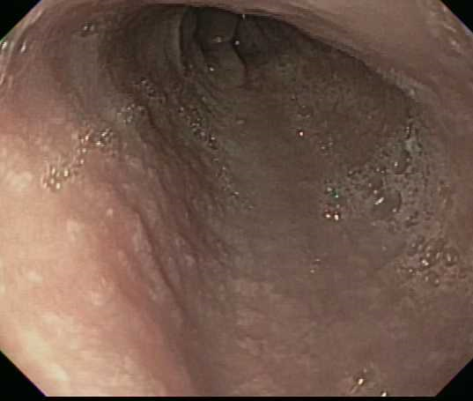
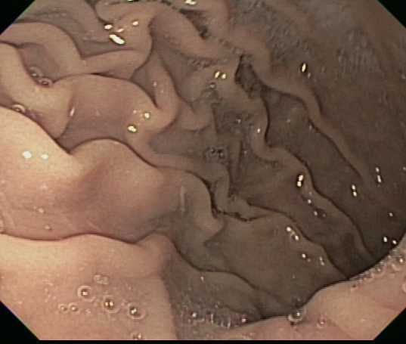
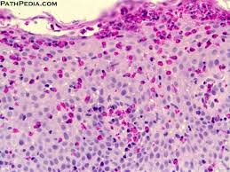
Case 3

Slide 33
Case 3
TREATMENT:
PPI
Referred to allergy- SPT positive to peanuts, cows milk eliminated

Slide 34
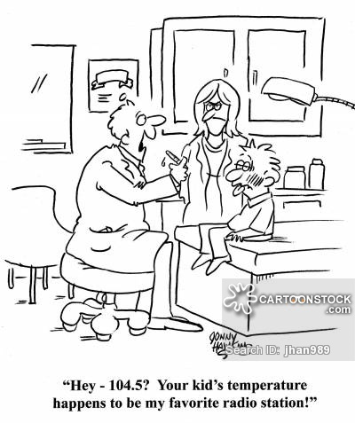
The End

