Slide 1


A practical approach to classifying and managing feeding difficulties
Presented by Benny Kerzner
Notes:
Start with my usual introduction. Thank Abbott – note the name of my introducer Also thank Vandana
Note very-0 pediatrician will be confronted by children experiencing feeding difficulties.
Yet never got a lecture on how to feed a child – And there is no algorithm to guide them.
then how I became involved from the perspective of a specialist in a complex pediatric hospital. But ultimately was seen cases from the general population.
My interest was peaked and be early lectures that I gave him the subject were devoted to Picky eaters
Note that it is not just the severe end of the spectrum that is at risk – emphasize the emotional consequences
Recognized its short comings and moved on to try an understand in broader terms the magnitude of the problem
Both physical and emotional
Now appreciated we needed an approach and for that we needed a workable classification
Go through its evolution: Limitations of existing classifications from the PMDs perspective
Could start presenting Kedesey and Buds book chapter – noting how useless earlier classifications were
Then say well to get something that comports to these issues listed above we needed a working classification
Note here
Modifying Chatoor - Recognize its short comings - Show the classification
Show the ideal and why we fell short of it
Now how to put it to use wind up with the algorithm and the summation slides of the classification

Slide 2
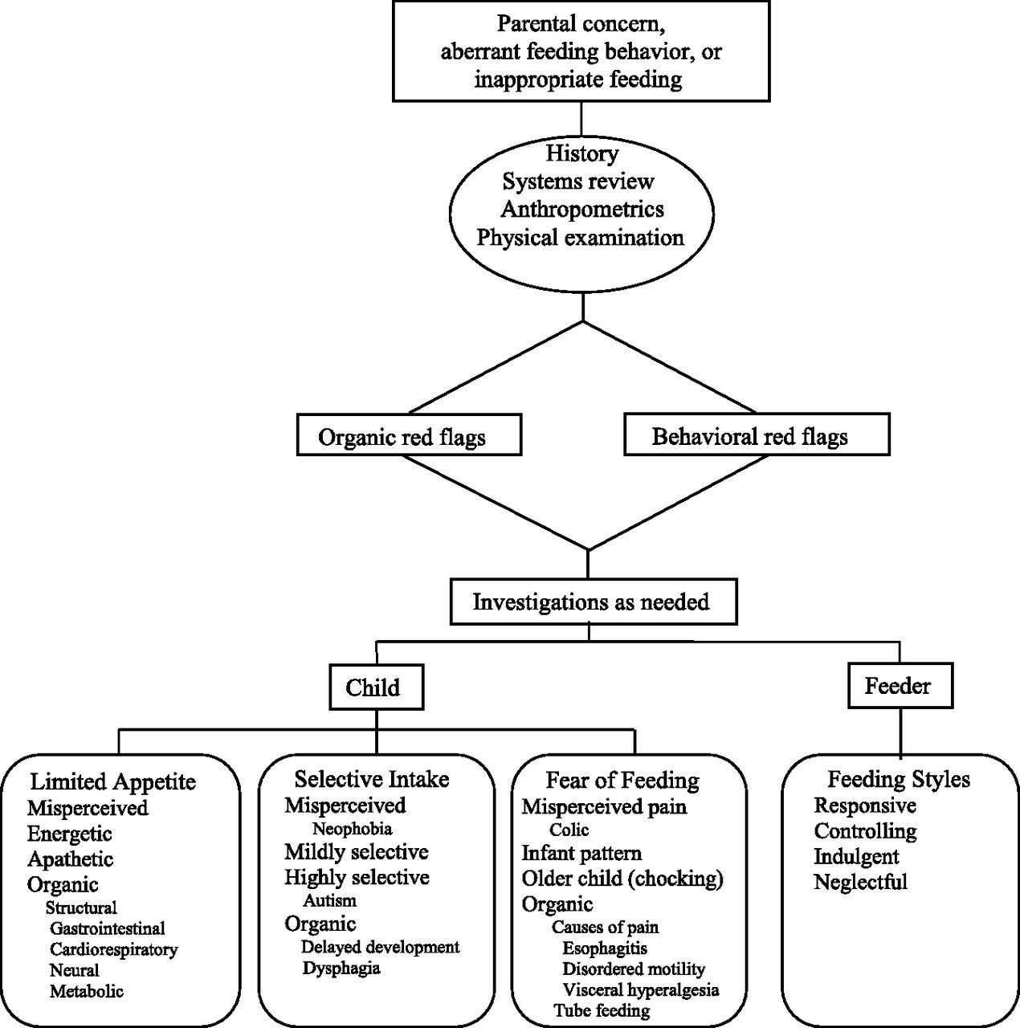

An approach to identifying and managing feeding difficulties
Background
Presentation
Evaluation
Classification and Management
Benny Kerzner et al. Pediatrics 2015;135:344-353
©2015 by American Academy of Pediatrics
Notes:
An approach to identifying and managing feeding difficulties.

Slide 3
An approach to identifying and managing feeding difficulties
Background
  Who is involved
  Why does it occur
  What operational definition should we use to describe it
Presentation
Evaluation
Classification and Management
Benny Kerzner et al. Pediatrics 2015;135:344-353
©2015 by American Academy of Pediatrics
Notes:
An approach to identifying and managing feeding difficulties.

Slide 4

Feeding concerns are a universal problem
Every pediatrician will be confronted by feeding problems
Notes:
So why do we need a classification
First every pediatrician is confronted by feeding issues/difficulties – no matter if they are generalists or specialists
The problem is universal not confined to emotional cultures
Remarkable common uniformly throughout the world
Thanks Abbott for surveys mirrored by the formal literature

Slide 5
Wide variation in the reported prevalence
1992 Reau: 62% of toddlers
2004 Carruth: 19% to 50% from 4-24 mnths
2005 Galloway: 48% of 9 yr olds
1970 Bentovim: 30% - 45%
1982 Beautrais: 24%, 19% and 18% at 2, 4 and 6 yrs
2005 Jacobi: 21% classified as picky eaters
Notes:
And in its broadest sense this issue is enormous. Publications in peer reviewed journals ……ranging from a high of 62 to a low of 21 %
Figures range from you might not be surprised to hear that anywhere between 25 to 60 percent perceive there young children to be eating poorly.

Slide 6
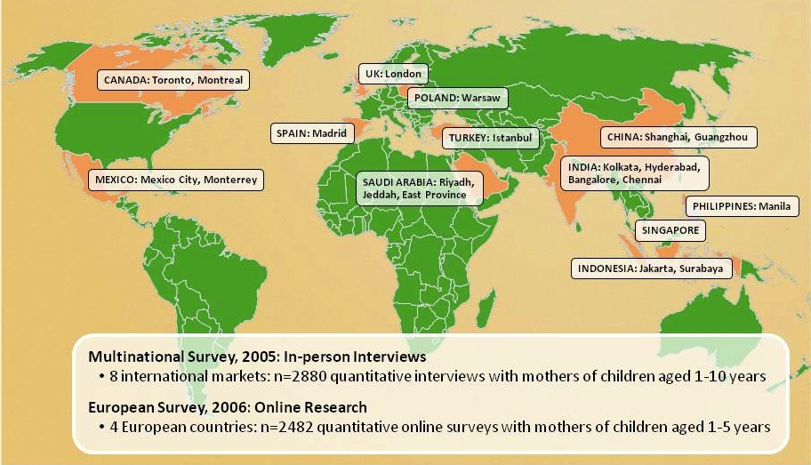
World wide surveys show consistent results
Every pediatrician will be confronted by feeding problems
Notes:
So why do we need a classification
First every pediatrician is confronted by feeding issues/difficulties – no matter if they are generalists or specialists
The problem is universal not confined to emotional cultures
Remarkable common uniformly throughout the world
Thanks Abbott for surveys mirrored by the formal literature

Slide 7



Children implicated by concerned parents
Parents
Children
~50%
~20–30%
Notes:
Here are the fundamental numbers
They are impressive
They hide considerable detail
A wide variety of conditions

Slide 8
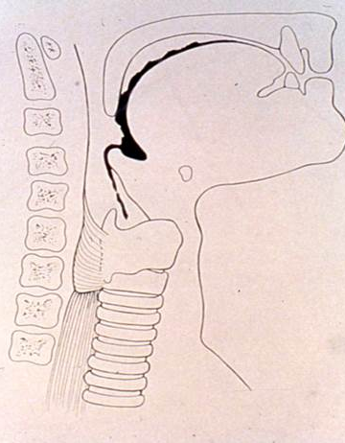


Serious issues that require resolution
‘‘Picky eaters” were :
Selective with strong preferences
Subject to excessive parental anxiety
Years later
Not nutritionally compromised
More likely to have behavioral problems
  withdrawal
  somatic complaints
  anxiety
  depression
  aggressive disorders
  Delinquency
  1. Jacobi C. Is picky eating an eating disorder? International Journal of Eating Disorders 10/2008; 41(7):626 - 634
Touching Behavior
Aspiration
1.2
Feeding disorders
115
Controls
110
1
Celiac disease
105
0.8
*
MDI score
100
*
Frequency per 15 minutes
0.6
95
Social stigmatization
90
0.4
85
0.2
Healthy
Picky
Children
eaters
eaters
with
0
infantile
Chatoor et.al.
anorexia
Affectionate
Negative
Feldman R, et al. J Am Acad Child Adolesc. Psychiatr. 2004;43:1089-1097.
Long term emotional consequences
Notes:
This is an animated slide, showing that among the many mild cases are very severe problems:
1. Aspiration is big deal
2. Some conditions can be overt or more often subtle (celiac disease is an example of an organic cause of feeding difficulty)
3. We need to be more cognizant of the emotional and social consequences of feeding difficulties
4. Excessive parental anxiety can have long-term consequences for the child
5. It is important to pay attention to relieving mealtime tension early on, to avoid emotional consequences

Slide 9
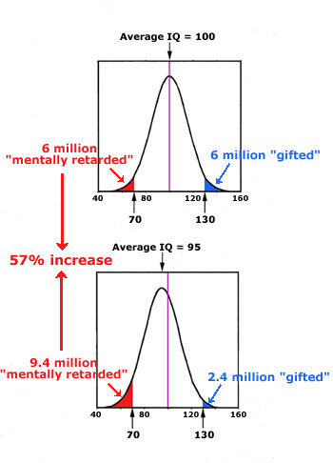
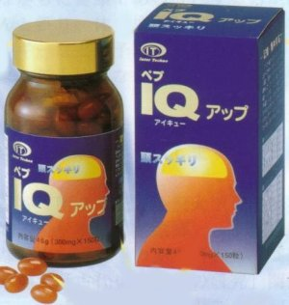
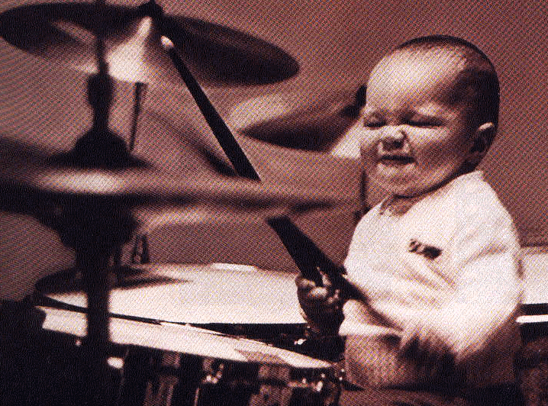
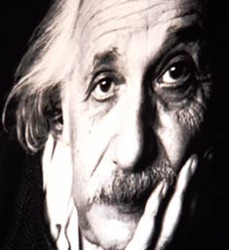
IQ – appropriate vs. destructive concern

Slide 10
Definitions of “picky eaters”
Marqi and Cohen (1990)
  Does not eat enough, often choosing, usually eat slowly, usually not interested
Chatoor (1998)
  Food refusal for more than one month, no growth problem, parents concerned
Carruth (1998)
  Rigorous standardized approach developed dietary variety and diversity scores with reference to the dietary pyramid
Jacobi (2003)
  Accepted the mother’s definition
Alercon (2003)
  Included children failing to thrive

Slide 11
“Picky eating”
Inconsistent definitions
Some include selectivity, fussiness and poor appetite
Others view it as a mild sensory disturbance
Connotes a mild problem but it is exploited for advertising purposes
Not a medical condition - it required systematic classification

Slide 12


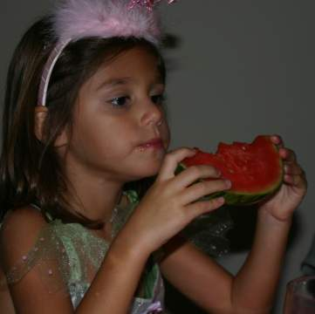
The full spectrum of feeding difficulties confronting pediatricians
/
Increasing severity
Normal
Mild
Severe
eg, picky
Decreasing prevalence
eg, autistic
Significant impairment: Weight loss
Insufficient growth
Developmental defects
These have “Feeding Disorders”
Notes:
12
The triangle incorporates all childrn with feeding difficulties and it depicts This slide conceptually depicts the inverse relationship between the prevalence and the severity of feeding difficulties, that is, the most severe difficulties are less prevalent than mild difficulties. It is common for the pediatrician or other primary care provider to manage less severe feeding difficulties. As severity increases, intervention by one or more specialists may be required for resolution of the feeding difficulty.

Slide 13
Nomenclature
Feeding disorder
  Connotes a severe problem resulting in substantial organic, nutritional or emotional consequences
  Equates to an avoidance/restrictive food intake disorder diagnosis in the DSM 5 and the ICD 10
Feeding difficulty
  Useful umbrella term suggesting any feeding problem
Benny Kerzner et al. Pediatrics 2015;135:344-353

Slide 14

An approach to identifying and managing feeding difficulties
Background
Presentation
Parental concern,
Inappropriate feeding or
Aberrant feeding behaviour
Evaluation
Classification and Management
Benny Kerzner et al. Pediatrics 2015;135:344-353
©2015 by American Academy of Pediatrics
Notes:
An approach to identifying and managing feeding difficulties.

Slide 15
Only 50% of mothers think pediatricians’ suggestions resolved Picky Eating
14.7%
8.7%
Not helpful
11.7%
13.1%
18.3%
17.0%
19.5%
26.2%
30.6%
Partly helpful; not resolved
35.4%
46.1%
34.1%
26.8%
39.3%
65.1%
49.9%
Helpful
57.7%
40.8%
42.4%
48.9%
53.7%
Age (years)
Base: all respondents (n=)
Prof. Jin Xingming and Prof. Shi Rongc
Shanghai 2008

Slide 16
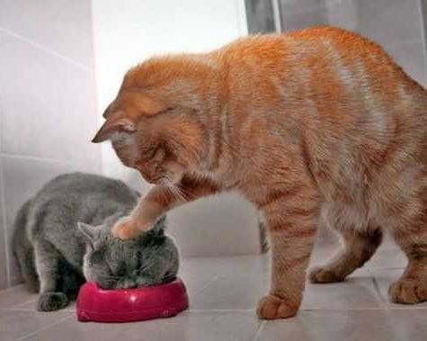
Maternal strategies to counter feeding difficulties
Base: all respondents who induce
the child to eat (n=400)
Prof. Jin Xingming and Prof. Shi Rongc
Shanghai 2008

Slide 17
An approach to identifying and managing feeding difficulties
Background
Presentation
Evaluation
Classification and Management
Benny Kerzner et al. Pediatrics 2015;135:344-353
©2015 by American Academy of Pediatrics
Notes:
An approach to identifying and managing feeding difficulties.

Slide 18
Identification and investigation
Parental concern,
Inappropriate feeding or
aberrant feeding behaviour
History,
Anthropometrics
- Physical exam
Organic red flags
Behavioral red flags
Investigations
Child
Caregiver
Limited Appetite
Misperceived
Behavioral
Organic
Selective Intake
Misperceived Behavioral
Organic
Fear of Feeding
Misperceived
Behavioral
Organic
Feeding style
Responsive
Controlling
Indulgent
Neglectful
Benny Kerzner et al. Pediatrics 2015;135:344-353
Notes:
Anthropometrics
Tp be well done requires a stadiometer
and personal attention
The H and P reqires attention to red flags
The definition of a red flag is
Dysphagia
Aspiration
Apparent pain with feeding
Vomiting and diarrhea
Developmental delay
Chronic cardio-respiratory symptoms
Growth Failure (Failure to thrive)

Slide 19
Identification of feeding difficulties -Presenting features or clues
Food refusal lasting more than 1 month
Failure to advance food items and textures
    (Prolonged breast or bottle feeding)
Aberrant mealtimes
Too long
Disruptive and stressful
Distraction to increase intake
Nocturnal eating in a toddler
Lack of appropriate independent feeding
Benny Kerzner et al. Pediatrics 2015;135:344-353
Notes:
And the list could go on

Slide 20

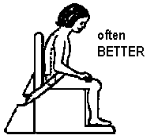
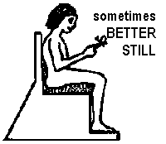


Positioning ‘the hips affect the lips’
Awful
Excellent
Notes:
Oral stability is dependent upon neck and shoulder stability that is in turn dependent on trunk and pelvic stability.
Functional movement of lips, cheeks and tongue is dependent on jaw stability.

Slide 21


Growth Assessment: Anthropometry
ACCURATE ANTHROPOMETRIC MEASUREMENTS
are necessary
to prevent misdiagnosis
And this is not
the way to do it
Rifas-Shiman SL, et al. Med Gen Med. 2005;7(4):56.
21

Slide 22

Identification of feeding difficulties
Red flags
Medical and Behavioral symptoms and signs that require:
- prompt attention - possible referral for intense investigation/specialized Rx
Benny Kerzner et al. Pediatrics 2015;135:344-353

Slide 23
Identification and investigation
Parental concern,
Inappropriate feeding or
aberrant feeding behaviour
History,
Anthropometrics
- Physical exam
Organic red flags
Behavioral red flags
Investigations
Child
Caregiver
Limited Appetite
Misperceived
Behavioral
Organic
Selective Intake
Misperceived Behavioral
Organic
Fear of Feeding
Misperceived
Behavioral
Organic
Feeding style
Responsive
Controlling
Indulgent
Neglectful
Benny Kerzner et al. Pediatrics 2015;135:344-353
Notes:
Anthropometrics
Tp be well done requires a stadiometer
and personal attention
The H and P reqires attention to red flags
The definition of a red flag is
Dysphagia
Aspiration
Apparent pain with feeding
Vomiting and diarrhea
Developmental delay
Chronic cardio-respiratory symptoms
Growth Failure (Failure to thrive)

Slide 24
Identification and investigation
Parental concern,
Inappropriate feeding or
aberrant feeding behaviour
Organic Red Flags
Dysphagia
Aspiration
Apparent pain with feeding
Vomiting and diarrhea
Developmental delay
Chronic cardio-respiratory symptoms
Growth failure (Failure to thrive)
History,
Anthropometrics
- Physical exam
Organic red flags
Behavioral red flags
Investigations
Child
Caregiver
Limited Appetite
Misperceived
Behavioral
Organic
Selective Intake
Misperceived Behavioral
Organic
Fear of Feeding
Misperceived
Behavioral
Organic
Feeding style
Responsive
Controlling
Indulgent
Neglectful
Benny Kerzner et al. Pediatrics 2015;135:344-353
Notes:
Anthropometrics
Tp be well done requires a stadiometer
and personal attention
The H and P reqires attention to red flags
The definition of a red flag is
Dysphagia
Aspiration
Apparent pain with feeding
Vomiting and diarrhea
Developmental delay
Chronic cardio-respiratory symptoms
Growth Failure (Failure to thrive)

Slide 25
Identification and investigation
Parental concern,
Inappropriate feeding or
aberrant feeding behaviour
Behavioral Red Flags
Food fixation (selective and extreme dietary preferences)
Noxious (forceful and /or persecutory) feeding practices
Abrupt cessation of feeding following a trigger event
Anticipatory gagging
Failure to Thrive
History,
Anthropometrics
- Physical exam
Organic red flags
Behavioral red flags
Investigations
Child
Caregiver
Limited Appetite
Misperceived
Behavioral
Organic
Selective Intake
Misperceived Behavioral
Organic
Fear of Feeding
Misperceived
Behavioral
Organic
Feeding style
Responsive
Controlling
Indulgent
Neglectful
Benny Kerzner et al. Pediatrics 2015;135:344-353
Notes:
Anthropometrics
Tp be well done requires a stadiometer
and personal attention
The H and P reqires attention to red flags
The definition of a red flag is
Food fixation (selective, extreme dietary limitations)
Noxious (forceful and/or persecutory) feeding
Abrupt cessation of feeding following a trigger event
Anticipatory gagging
Failure to thrive

Slide 26
Identification and investigation
Parental concern,
Inappropriate feeding or
aberrant feeding behaviour
Basic investigations may include*
Complete blood count
Comprehensive metabolic panel
Sedimentation rate
Complex metabolic panel
Ferritin
Lead level
Total IgA and Antitissue transglutaminase
Urine analyses
Stool for neutral fat and elastase
* Adjusted for history, physical and regional frequency of disease
History,
Anthropometrics
- Physical exam
Organic red flags
Behavioral red flags
Investigations
Child
Caregiver
Limited Appetite
Misperceived
Behavioral
Organic
Selective Intake
Misperceived Behavioral
Organic
Fear of Feeding
Misperceived
Behavioral
Organic
Feeding style
Responsive
Controlling
Indulgent
Neglectful
Benny Kerzner et al. Pediatrics 2015;135:344-353
Notes:
Anthropometrics
Tp be well done requires a stadiometer
and personal attention
The H and P reqires attention to red flags
The definition of a red flag is
Dysphagia
Aspiration
Apparent pain with feeding
Vomiting and diarrhea
Developmental delay
Chronic cardio-respiratory symptoms
Growth Failure (Failure to thrive)

Slide 27
An approach to identifying and managing feeding difficulties
Background
Presentation
Evaluation
Classification and Management
Benny Kerzner et al. Pediatrics 2015;135:344-353
©2015 by American Academy of Pediatrics
Notes:
An approach to identifying and managing feeding difficulties.

Slide 28

Early attempts at classification
O’Brien, Repp, Williams & Christopher (1991)
Food refusal
Food type selectivity
Food texture selectivity
Liquid refusal or selectivity
Grams of calories consumed low
Sucking and swallowing problems
Problems with chewing
Delays in self feeding
Delays in self drinking
Lack of utensil use
Inappropriate utensil use
Problems with lunch box or tray
Leaving table
Spitting
Throwing items
Aggression
Inappropriate verbalizations
Inappropriate noises
Amount of spillage
Rate of intake
Chewing with mouth open
Lack of napkin use

Slide 29
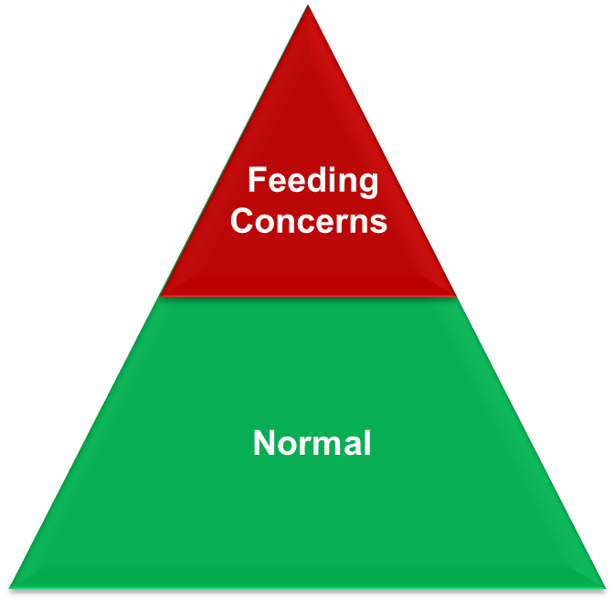
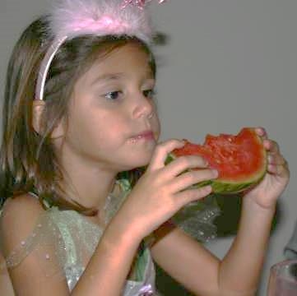
The population of children with feeding difficulties
Mothers implicate ~25% of Children
Feeding Concerns
Normal
The Population of Children

Slide 30
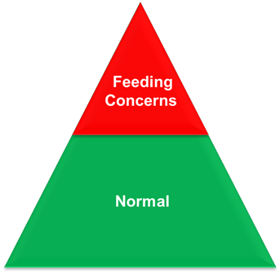
The population of children with feeding difficulties
Only 1 - 4% have
a Feeding Disorder

Slide 31
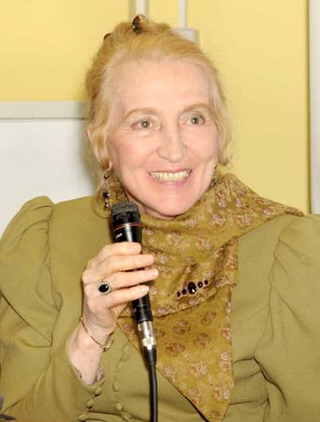
Chatoor classified Feeding Disorders
A system related to child’s development
  Disordered state regulation Newborn
  Disordered reciprocity (neglect) 3 to 8 months
  Infantile anorexia Transition to self- feeding
Plus
  Sensory food aversions Any age
  Concurrent medical condition Any age
  Post traumatic Any age
Chatoor I. Child Adolesc Psychiatric Clin N Am. 2002;11;163-183

Slide 32
Chatoor classified feeding disorders
Mildly involved cases - considered sub-threshold expressions of the same feeding disorders -
Chatoor I. Child Adolesc Psychiatric Clin N Am. 2002;11;163-183

Slide 33
Many considered poor feeders are actually within the normal range
Prospective study of 494 children, 30% characterized as “poor eaters”
Weight-adjusted energy consumption no different to the rest of the population
They are smaller and therefore eat less
Parents misperceived them to be small because they believed they ate too little
Saarilehto S, et al. Pediatr. 2004;144(3): 363-367.
33

Slide 34
My modifications of Chatoor’s classification
Three categories based on behavior not development
Red flags used to address organic causes
Terminology familiar to most clinicians
Includes children misperceived to have a poor appetite
Chatoor I. Child Adolesc Psychiatric Clin N Am. 2002;11;163-183.
Kerzner B et al. 2009 Clinical Pediatrics
Kerzner B et al 2015 Pediatrics

Slide 35



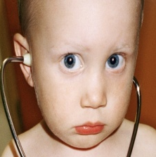
Limited appetite
Misperception
Energetic and playful
Organic disease
Structural
Gastrointestinal
Cardiorespiratory
Neural
Metabolic
Apathetic and
withdrawn
Organic disease
Burklow KA, et al 1998 JPGN127:143-7
Notes:
The following 7 types of feeding difficulties are commonly encountered by
pediatricians:
Poor appetite due to organic disease
Poor appetite that is a misperception on the part of the parents
Poor appetite in a child who is fundamentally vigorous
Poor appetite in a child who is apathetic and withdrawn
Highly selective intake
Colic that interferes with feeding
Fear of feeding
35

Slide 36
Limited appetite
Misperceived
Energetic apparently healthy
Apathetic apparently ill
Organic
- Appropriate appetite is considered limited - Excessive parental concern
Alert active inquisitive - Play and talk instead of eating - Easily distracted - Often FTT
- Withdrawn, limited communication with caregiver - Features of malnutrition and possibly neglect
- Red flags will
identify many
- Be alert for subtle
presentations, eg. celiac disease
Need reassurance and education

Slide 37







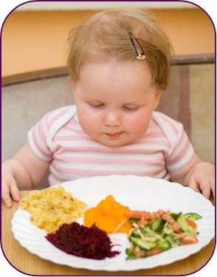
Feeding guidelines for all children
Avoid distraction during mealtimes (television cell phones etc.)
Maintain a pleasant neutral attitude
Feed to encourage appetite
  Limit duration (20 -30 minutes)
  4 -6 snacks a day with only water between
Serve age appropriate foods
Systematically introduce new foods (8 – 15 times)
Encourage self-feeding
Tolerate age appropriate mess
Benny Kerzner et al. Pediatrics 2015;135:344-353

Slide 38
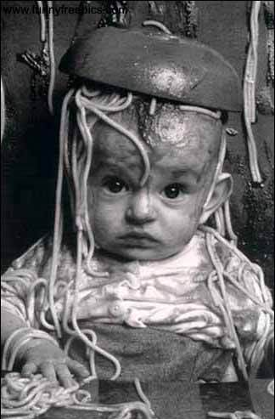
…but there are limits

Slide 39
Limited appetite
Misperceived
Energetic apparently healthy
Apathetic apparently ill
Organic
- Appropriate appetite is considered limited - Excessive parental concern
Alert active inquisitive - Play and talk instead of eating - Easily distracted - Often FTT
- Withdrawn, limited communication with caregiver - Features of malnutrition and possibly neglect
- Red flags will
identify many
- Be alert for subtle
presentations, eg. celiac disease
Need reassurance and education
Promote appetite, resolve conflict, supplement if FTT. Cyproheptadine may have a place
Feeding by an empathetic caregiver
Treat underlying pathology

Slide 40



Selective
Misperceived (Developmental & Neophobia)
Mildly selective
Highly selective
Organic
(e.g. Autistic)
Organic
40
Notes:
The following 7 types of feeding difficulties are commonly encountered by
pediatricians:
Poor appetite due to organic disease
Poor appetite that is a misperception on the part of the parents
Poor appetite in a child who is fundamentally vigorous
Poor appetite in a child who is apathetic and withdrawn
Highly selective intake
Colic that interferes with feeding
Fear of feeding
40

Slide 41
Expanding selectivity
Taking development into account
Birth
6
12
18
24
Highly selective
Liquid
Strained
Junior
Chopped fine
Regular
Texture
Munch,
Bite,
Chewing
Basic rotatory chew,
Mature rotatory chew
Guided,
Grasps,
Assisted feeding,
Messy self feeding
Spoon
Sips
Assists drinking
Self drinking
Cup
Birth
6
12
18
24
41
Notes:
The following 7 types of feeding difficulties are commonly encountered by
pediatricians:
Poor appetite due to organic disease
Poor appetite that is a misperception on the part of the parents
Poor appetite in a child who is fundamentally vigorous
Poor appetite in a child who is apathetic and withdrawn
Highly selective intake
Colic that interferes with feeding
Fear of feeding
41

Slide 42
Limitations in selection are a normal phenomenon between 2 and 8 years of age
Number of foods
Children
Skinner et. al.Journal of the American Dietetic Association Nov 2002
42
Notes:
The following 7 types of feeding difficulties are commonly encountered by
pediatricians:
Poor appetite due to organic disease
Poor appetite that is a misperception on the part of the parents
Poor appetite in a child who is fundamentally vigorous
Poor appetite in a child who is apathetic and withdrawn
Highly selective intake
Colic that interferes with feeding
Fear of feeding
42

Slide 43
Neophobia is a normal phenomenon early in life
First taste of the novel food
First view of novel food
Picky/Fussy Child
Food refusal
After 15 exposures
Food Neophobic Child
Exposure
Dovey, et al. Appetite. 2008;50:181-193
43
Notes:
The following 7 types of feeding difficulties are commonly encountered by
pediatricians:
Poor appetite due to organic disease
Poor appetite that is a misperception on the part of the parents
Poor appetite in a child who is fundamentally vigorous
Poor appetite in a child who is apathetic and withdrawn
Highly selective intake
Colic that interferes with feeding
Fear of feeding
43

Slide 44

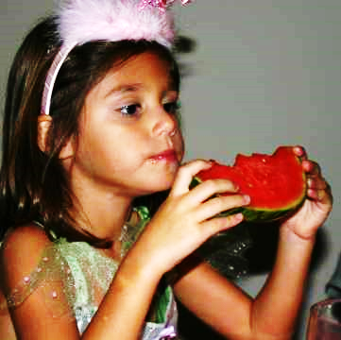

Selectivity
Misperceived
Mild
Severe
Organic
- Normal developmental limitation - oral-motor - taste preferences - neophobia
- Mild rejection doesn’t eliminate entire food groups - No immediate negative social, physical, nutritional or emotional effects - Accept more than 15 foods
- Phobic responses, - Reject complete classes of food - Potential nutrient deficiency
- Limitation imposed by organic disease e.g developmental disability and autism - Hyper or hypo responsive gag reflex
Even more subtle or demanding methods – “shaping” and “fading”
Need time and education
Model eating and simple strategies to encourage healthy eating
More complex systematic approaches e.g. ‘food chaining”

Slide 45


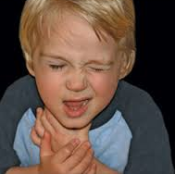

Fear of feeding
Misperceived (colic)
Younger child (anticipatory anxiety)
Older child (post choking)
Organic (e.g. GERD and Tube fed
45
Notes:
The following 7 types of feeding difficulties are commonly encountered by
pediatricians:
Poor appetite due to organic disease
Poor appetite that is a misperception on the part of the parents
Poor appetite in a child who is fundamentally vigorous
Poor appetite in a child who is apathetic and withdrawn
Highly selective intake
Colic that interferes with feeding
Fear of feeding
45

Slide 46
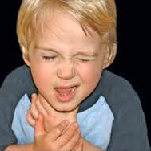
Fear of Feeding
Misperceived
Young Child
Older Child
Organic
- Inconsolable crying under age four - No pathology - Dif. Diagnosis: protein sensitivity to constipation - Fed too frequently
- Cries at sight of food or high chair
- Hungary but in pain after a few sucks
Sleep feeds
  - Sudden transition from normal to no eating - Usually post chocking - Rejects solid food
- Overt pathology - Frequently tube fed - Suppressed appetite - Visceral hyperalgesia
Calm baby and reassure parent
Avoid noxious feeding and desensitize with sleep feeding
Avoid coercion Reassure and reduce stress
Multi-disciplinary resolution
Notes:
Any severely aversive feeding related experience may cause fear of feeding
Ongoing or they have occurred in the past. Hence the termed post traumatic.

Slide 47

……but it is not all about the child
Parental pressure
to eat
Feeding resistance
Chatoor I. Diagnosis and Treatment of Feeding Disorders in Infants, Toddlers, and Young Children. Washington, DC: Zero to Three; 2009.
47
Notes:
The most likely relationship between parental pressure to eat and child body weight is a bidirectional causal relationship.
These results underscore the importance of helping parents to understand how pressuring their child to eat and feeding conflict can undermine their efforts to address and manage their child’s feeding difficulty.
47

Slide 48


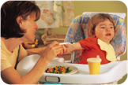

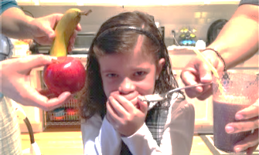


…the feeding dynamic involves a dyad
Responsive
Limited Appetite
Controlling
Caregiver
Child
Selective
Indulgent
Fearful of feeding
Neglectful
Notes:
Increase sizeThe following 7 types of feeding difficulties are commonly encountered by
pediatricians:
Poor appetite due to organic disease
Poor appetite that is a misperception on the part of the parents
Poor appetite in a child who is fundamentally vigorous
Poor appetite in a child who is apathetic and withdrawn
Highly selective intake
Colic that interferes with feeding
Fear of feeding
48

Slide 49

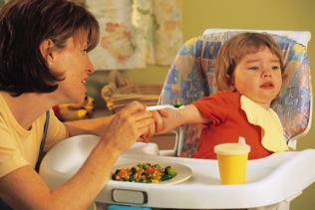
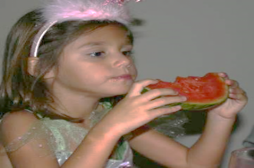

Feeding styles
Responsive
Controlling
Indulgent
Neglectful
Limits Where When and What
Models appropriately
Responds to child’s hunger signals
Guides child’s eating
Pressures child to eat
Restricts foods
Ignores hunger satiation signals
Sets no limits
Accedes to Where, When, and What
Makes special foods
Ignores satiation signals
Gives up feeding responsibilities
Sets no limits
Ignores hunger signals, emotional
and physical needs
Eats more fruit, veg. and dairy
Eats less ‘junk’ food
May protect against both under and overweight
Adjusts calories poorly
Eats fewer fruits and vegetables
More likely under or overweight
Eat diets lower in most nutrients except fat Drink less milk
More likely underweight or overweight

Slide 50
Algorithm for the management of feeding difficulties
Caregiver
Child
Feeding style
Responsive
Controlling
Indulgent
Neglectful
Limited Appetite
Misperceived
Energetic
Apathetic
Organic
Structural
Gastrointestinal
Cardiorespiratory
Neural
Metabolic
Selective Intake
Misperceived (neophobia)
Mildly selective
Highly selective
Organic
Delayed Development
Dysphagia
Fear of Feeding
Misperceived pain (colic)
Infant pattern
Older child (choking)
Organic
Causes of pain e.g. Esophagitis
Disordered motility
Visceral hyperalgesia
Tube feeding
Every child and caregiver is influenced by the feeding experience

Slide 51

In conclusion
The parent should leave the office:
Understanding the feeding problem
Confident to carry out interventions
Appreciating the dangers of controlling, indulgent and neglectful feeding styles
Notes:
51

Slide 52
Closing Video

