Slide 1
Pediatric Endocrine Board Review
Lisa Kenigsberg, MD
4.1.16
4.22.16

Slide 2
Topics to Know
Sex Differentiation
Puberty
Linear Growth
Thyroid disorders
Disorders of PTH, Calcium and Phosphate metabolism
Adrenal gland disorders
Pituitary gland disorders
Diabetes
Metabolic syndrome
Notes:
Mostly they will ask about CAH

Slide 3
Sex Differentiation
Normal development
Ambiguous genitalia
Congenital adrenal hyperplasia
Disorders of Sex Development (DSDs)

Slide 4
Normal Development

Slide 5
Question #1
You are called to the delivery room to evaluate a full term newborn. On physical exam, the baby has ambiguous genitalia and you are unable to palpate testes. The baby has good respiratory effort, color and tone, and an otherwise normal exam.
The MOST common type of congenital adrenal hyperplasia is deficiency of which of the following enzymes:
11 Hydroxylase
21 Hydroxylase
17 Hydroxylase
17, 20 Lyase
3B Hydroxysteroid Dehydrogenase
Notes:
B

Slide 6
Question #1
You are called to the delivery room to evaluate a full term newborn. On physical exam, the baby has ambiguous genitalia and you are unable to palpate testes. The baby has good respiratory effort, color and tone, and an otherwise normal exam.
The MOST common type of congenital adrenal hyperplasia is deficiency of which of the following enzymes:
11 Hydroxylase
21 Hydroxylase
17 Hydroxylase
17, 20 Lyase
3B Hydroxysteroid Dehydrogenase
Notes:
B

Slide 7
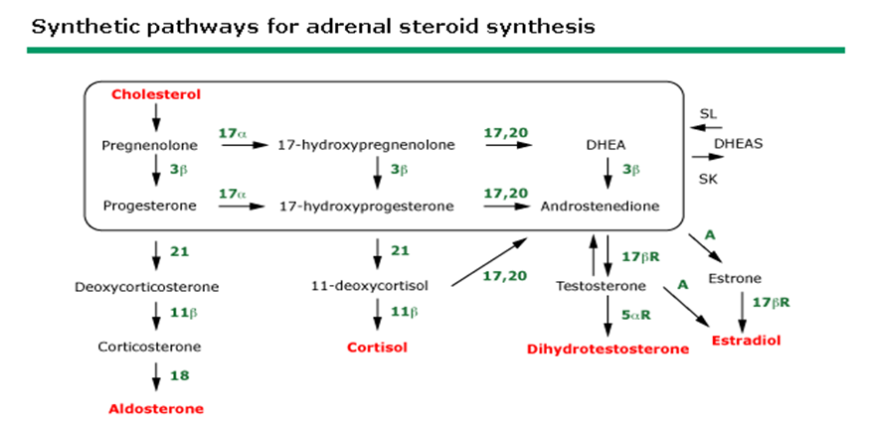
Congenital Adrenal Hyperplasia
↑ ACTH
Notes:
->95% of CAH
-Build up of 17-hydroxyprogesterone

Slide 8
Congenital Adrenal Hyperplasia
Classic: Salt Wasting
Loss of Mineralcorticoids AND Glucocorticoids
Treated with Hydrocortisone, Fludrocortisone, NaCl
Classic: Simple Virilizing
Loss of Glucocorticoids ONLY
Treated with Hydrocortisone
Virilization in girls only; boys may have hyperpigmentation
Non-classic
Presents as premature adrenarche/precocious puberty
Diagnosed with elevated 17 OHP
In infants, Newborn Screen checks for elevated 17-OHP, confirm with serum sample
Notes:
The difference between the different forms is how much of the enzyme is present

Slide 9
Question #2
A 3 yo girl who has CAH has been staying with her aunt over the weekend. The aunt calls you because her niece has a fever (101 F) and is vomiting. The girl could not tolerate the double dose of hydrocortisone and is pale and sweaty. There is no IM hydrocortisone at home. You instruct her to come to the ER. In the ER the girl is barely responsive, HR 120, BP 60/40,. You start IV D5NS and order serum electrolytes.
Of the following, the MOST definitive therapy is to administer:
Cortisone acetate IM
Dopamine IV
Hydrocortisone hemisuccinate & aldosterone IV
Hydrocortisone hemisuccinate IV
KCl 40 mEq/L & hydrocortisone hemisuccinate IV
Notes:
D

Slide 10
Question #2
A 3 yo girl who has CAH has been staying with her aunt over the weekend. The aunt calls you because her niece has a fever (101 F) and is vomiting. The girl could not tolerate the double dose of hydrocortisone and is pale and sweaty. There is no IM hydrocortisone at home. You instruct her to come to the ER. In the ER the girl is barely responsive, HR 120, BP 60/40,. You start IV D5NS and order serum electrolytes.
Of the following, the MOST definitive therapy is to administer:
Cortisone acetate IM
Dopamine IV
Hydrocortisone hemisuccinate & aldosterone IV
Hydrocortisone hemisuccinate IV
KCl 40 mEq/L & hydrocortisone hemisuccinate IV
Notes:
D

Slide 11
Salt Wasting Crisis
Presents at 7-10 days of life
Hyponatremia
Hyperkalemia
Hypotension
Metabolic Acidosis
Hypoglycemia
Treat with IV Hydrocortisone, IV fluids
Notes:
This will only happen in salt wasting form

Slide 12
Puberty
Normal Puberty
Precocious Puberty
Delayed Puberty
Turner Syndrome
Constitutional Delay of Puberty

Slide 13
Question #3
A mother brings in her 7-year-old daughter because she is worried that the little girl will go through puberty too early. The woman tells you that she reached menarche at 9 years of age, and this was a difficult experience. The child's father, on the other hand, had his growth spurt at the end of high school.
Of the following, this girl is MOST likely to have early menarche if the physical examination reveals:
A. A body mass index greater than the 85th percentile
B. Adult body odor
C. Breast tissue
D. Facial acne
E. Pubic hair

Slide 14
Question #3
A mother brings in her 7-year-old daughter because she is worried that the little girl will go through puberty too early. The woman tells you that she reached menarche at 9 years of age, and this was a difficult experience. The child's father, on the other hand, had his growth spurt at the end of high school.
Of the following, this girl is MOST likely to have early menarche if the physical examination reveals:
A. A body mass index greater than the 85th percentile
B. Adult body odor
C. Breast tissue
D. Facial acne
E. Pubic hair

Slide 15
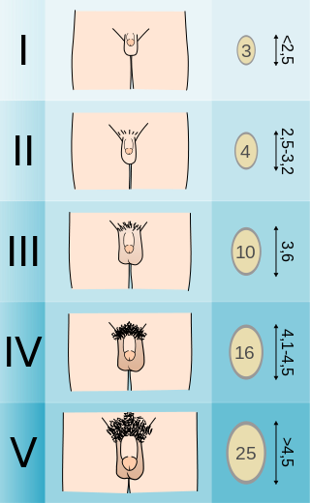
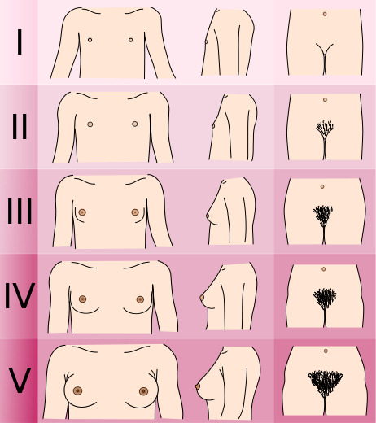
Normal Puberty
First sign of puberty in girls: Breast Tissue
First sign of puberty in boys: Increase in testicular volume

Slide 16
Question #4
There are differences in the age a growth spurt occurs. Of the following, the one that best describes the tanner stage at which boys and girls have a growth spurt is:
 | Boys | Girls
A | Tanner II | Tanner II
B | Tanner II | Tanner III
C | Tanner III | Tanner III
D | Tanner IV | Tanner III
E | Tanner IV | Tanner IV
Notes:
D

Slide 17
Question #4
There are differences in the age a growth spurt occurs. Of the following, the one that best describes the tanner stage at which boys and girls have a growth spurt is:
 | Boys | Girls
A | Tanner II | Tanner II
B | Tanner II | Tanner III
C | Tanner III | Tanner III
D | Tanner IV | Tanner III
E | Tanner IV | Tanner IV
Notes:
D

Slide 18
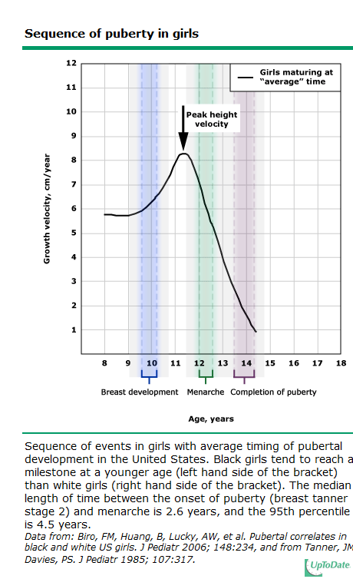

Slide 19
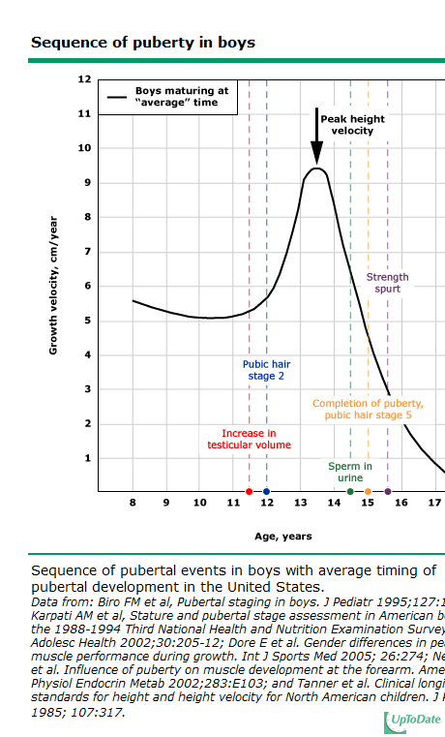

Slide 20
Question #5
A 13 year old girl comes to your office because her menstrual periods are irregular. She had menarche at 12 years of age and has had only 4 menstrual periods over the past year. The periods last for 5 -7 days and she uses four pads per day. She has never been sexually active. She plays no sports, but she swims in the summer for fun. On physical exam, weight and height are 50th percentile. She has minimal facial acne and no hirsutism or other skin lesions. Her breast and genital development is Tanner stage V.
Of the following, the MOST appropriate management strategy is to:
Measure FSH, LH, and prolactin
Measure free thyroxine and thyroid-stimulating hormone
Monitor menses and reassure the girl
Obtain a bone age by radiography
Obtain pelvic ultrasonography
Notes:
C – normal to have anovulatory cycles for 2 years post menarche

Slide 21
Question #5
A 13 year old girl comes to your office because her menstrual periods are irregular. She had menarche at 12 years of age and has had only 4 menstrual periods over the past year. The periods last for 5 -7 days and she uses four pads per day. She has never been sexually active. She plays no sports, but she swims in the summer for fun. On physical exam, weight and height are 50th percentile. She has minimal facial acne and no hirsutism or other skin lesions. Her breast and genital development is Tanner stage V.
Of the following, the MOST appropriate management strategy is to:
Measure FSH, LH, and prolactin
Measure free thyroxine and thyroid-stimulating hormone
Monitor menses and reassure the girl
Obtain a bone age by radiography
Obtain pelvic ultrasonography
Notes:
C – normal to have anovulatory cycles for 2 years post menarche

Slide 22
Question #6
The parents of a 10-year-old African-American girl think she is “developing too quickly”. The onset of her menses occurred 3 months ago. On physical examination, you note that her breasts and pubic hair are Tanner stage IV.
Of the following, the MOST appropriate next step in evaluating this patient is to:
Determine bone age
Obtain a basal LH level
Order a head CT
Order a pelvic ultrasound
Reassure the parents that this is normal development
Notes:
E

Slide 23
Question #6
The parents of a 10-year-old African-American girl think she is “developing too quickly”. The onset of her menses occurred 3 months ago. On physical examination, you note that her breasts and pubic hair are Tanner stage IV.
Of the following, the MOST appropriate next step in evaluating this patient is to:
Determine bone age
Obtain a basal LH level
Order a head CT
Order a pelvic ultrasound
Reassure the parents that this is normal development
Notes:
E

Slide 24
Question #7
A 7 year old boy is referred for precocious puberty. He has had pubic hair since age 3 and axillary hair and odor since age 4. Both are increasing. Physical exam reveals height of 95th percentile, weight 75th percentile, facial acne, axillary hair, Tanner III pubic hair, testicular volume of 8 cc.
Laboratory evaluation shows pubertal values of gonadotropins and testosterone.
His bone age is advanced at 12 years and 6 months.
Which of the following radiological studies would MOST likely reveal the underlying etiology:
Abdominal ultrasound
Testicular ultrasound
MRI of the abdomen
MRI of the brain
Notes:
D. Patient is in true puberty (i.e. central) as opposed to just adrenarche, indicated by testicular size (>3cc) and confirmed by high LH (should be undetectable in prepubertal) and supported by advanced bone age.

Slide 25
Question #7
A 7 year old boy is referred for precocious puberty. He has had pubic hair since age 3 and axillary hair and odor since age 4. Both are increasing. Physical exam reveals height of 95th percentile, weight 75th percentile, facial acne, axillary hair, Tanner III pubic hair, testicular volume of 8 cc.
Laboratory evaluation shows pubertal values of gonadotropins and testosterone.
His bone age is advanced at 12 years and 6 months.
Which of the following radiological studies would MOST likely reveal the underlying etiology:
Abdominal ultrasound
Testicular ultrasound
MRI of the abdomen
MRI of the brain
Notes:
D. Patient is in true puberty (i.e. central) as opposed to just adrenarche, indicated by testicular size (>3cc) and confirmed by high LH (should be undetectable in prepubertal) and supported by advanced bone age.

Slide 26
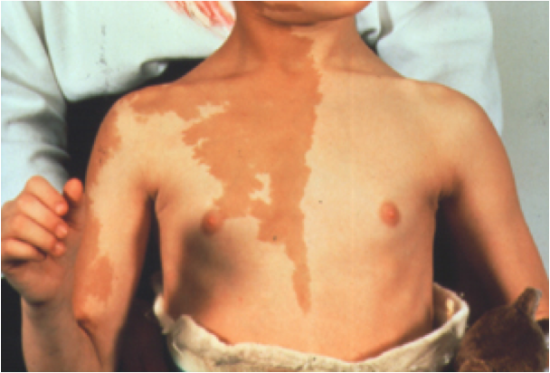
Question #8
A 3 year old girl is referred for breast development. Her mother states that she had small breast buds after birth, which slowly went away by age 2. Over the last year, she has had increasing breast size bilaterally, and last month she had some vaginal bleeding. There has not been any pubic hair, axillary hair or odor.
Physical exam is significant for multiple café-au-lait spots and bilateral Tanner III breasts with areolar hyperpigmentation and enlargement.
The MOST likely additional finding in this girl would be:
Neurofibromas
CNS hemangiomas
Fibrous dysplasia
Seizure disorder
Hyperphosphatemia
Notes:
C. McCune Albright: Triad – CALM, fibrous dysplasia (cysts on long bones, pathologic fractures), precocious puberty.
G-protein, somatic activating mutation
Skin, bone, follicular cells, thyroid, adrenal, pituitary gigantism, hypophosphatemic rickets

Slide 27
Question #8
A 3 year old girl is referred for breast development. Her mother states that she had small breast buds after birth, which slowly went away by age 2. Over the last year, she has had increasing breast size bilaterally, and last month she had some vaginal bleeding. There has not been any pubic hair, axillary hair or odor.
Physical exam is significant for multiple café-au-lait spots and bilateral Tanner III breasts with areolar hyperpigmentation and enlargement.
The MOST likely additional finding in this girl would be:
Neurofibromas
CNS hemangiomas
Fibrous dysplasia
Seizure disorder
Hyperphosphatemia
Notes:
C. McCune Albright: Triad – CALM, fibrous dysplasia (cysts on long bones, pathologic fractures), precocious puberty.
G-protein, somatic activating mutation
Skin, bone, follicular cells, thyroid, adrenal, pituitary gigantism, hypophosphatemic rickets

Slide 28
Precocious Puberty
Secondary sexual characteristics
Boys < 9 years
Girls < 8 years
Normal variants
Premature thelarche: isolated breast development
Premature adrenarche: isolated development of pubic hair
Pubertal gynecomastia in boys
Usually seen at Tanner II-III

Slide 29
Precocious Puberty
 | FSH/LH ↑ | FSH/LH ↓
Name | GnRH DEPENDENT Aka Central Precocious puberty | GnRH INDEPENDENT
Source of puberty | Premature activation of the hypothalamic-pituitary gonadal axis | Endogenous, peripheral source of sex steroids (estrogen/testosterone) OR Ongoing exposure to exogenous steroids
Etiology | -Idiopathic -CNS Tumor -Cranial Irradiation | -McCune-Albright -Exogenous sex steroids -Tumors (hCG secreting, testicular, germ cell) -Ovarian cyst

Slide 30
Question #9
A 14 year old girl presents to your practice. Her height is below the 3rd percentile, she has no breast development and a slight amount of pubic hair. She underwent repair for an aortic coarctation at 2 weeks of age. Your work up reveals a delayed bone age of 11.5 years, an estradiol of <20 pg/mL (↓), FSH of 150mIU/mL (↑) and LH of 22.6mIU/mL (↑).
What test would you order next?
Growth hormone stimulation test
Karyotype
Thyroid function
Testosterone level
Notes:
B
If they told you karyotype was done whats the next test you get

Slide 31
Question #9
A 14 year old girl presents to your practice. Her height is below the 3rd percentile, she has no breast development and a slight amount of pubic hair. She underwent repair for an aortic coarctation at 2 weeks of age. Your work up reveals a delayed bone age of 11.5 years, an estradiol of <20 pg/mL (↓), FSH of 150mIU/mL (↑) and LH of 22.6mIU/mL (↑).
What test would you order next?
Growth hormone stimulation test
Karyotype
Thyroid function
Testosterone level
Notes:
B
If they told you karyotype was done whats the next test you get

Slide 32
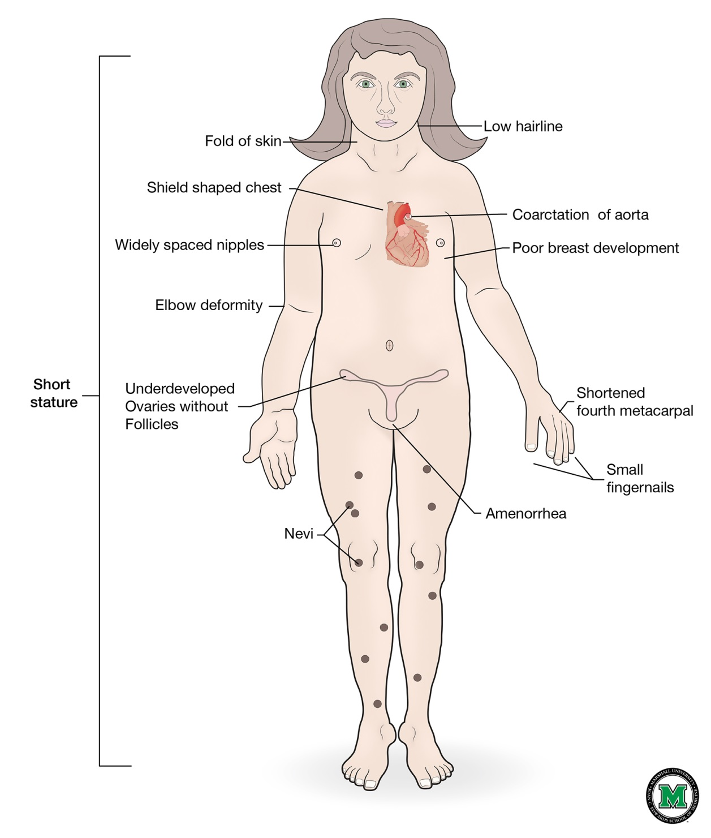
Turner Syndrome
Karotype: 45 X
Also associated with
Short stature
Coarctation of aorta
Delayed puberty/ ovarian failure
Hashimoto’s hypothyroidism

Slide 33
Delayed Puberty
No secondary sexual characteristics
Boys > 14 years
Girls > 13 years
No menarche > 16 years (Primary amenorrhea)
 | FSH/LH ↓ | FSH/LH ↑
Name | HYPOgonadotropic Hypogonadism | HYPERgonadotropic Hypogonadism
Etiology | -CNS Tumor -Cranial Irradiation -Kallman syndrome (with anosmia) -Chronic disease -Anorexia nervosa | Gonadal dysgenesis/failure Males: -Klinefelter syndrome Females: -Turner syndrome -Primary ovarian insufficiency
Notes:
Hypogonadotropic- Pituitary!!
Hypergonadotropic- ovarian/testicular failure!!!

Slide 34
Linear Growth
Short Stature
Familial Short Stature
Constitutional Growth Delay
Growth Hormone Deficiency
Tall Stature

Slide 35
Question #10
You are seeing a short 9-year-old boy. He is growing steadily in height just below the third percentile on the growth curve. His parents ask if he will be very short when he finishes growing.
Of the following, the MOST important information needed to answer this question is:
Ethnicity of family
Parent heights
Sibling heights
Upper-to-lower segment ratio
Weight-for-age curve
Notes:
B

Slide 36
Question #10
You are seeing a short 9-year-old boy. He is growing steadily in height just below the third percentile on the growth curve. His parents ask if he will be very short when he finishes growing.
Of the following, the MOST important information needed to answer this question is:
Ethnicity of family
Parent heights
Sibling heights
Upper-to-lower segment ratio
Weight-for-age curve
Notes:
B

Slide 37
Short Stature
Short stature: Height <3%ile
Familial short stature:
Low-normal growth velocity through life
Parents height essential for diagnosis
Bone age = Chronological age
Results in short adult height
Constitutional growth delay:
Growth is delayed, but prolonged
Aka late bloomer
Bone age < Chronological age
Results in normal adult height

Slide 38
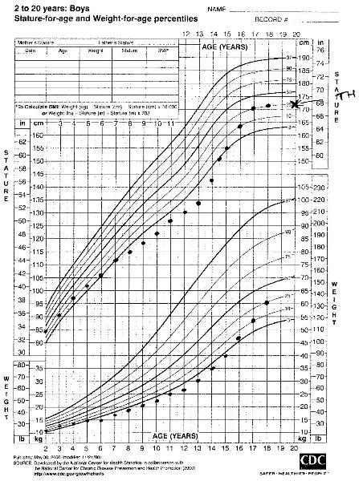
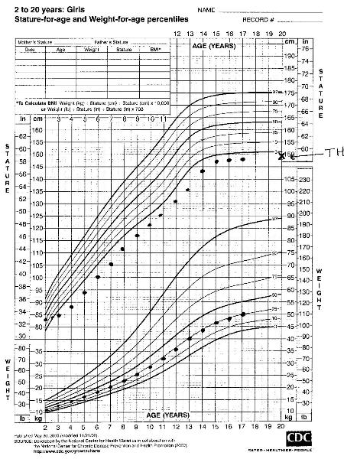
Short Stature
Constitutional growth delay Familial short stature
Notes:
38

Slide 39
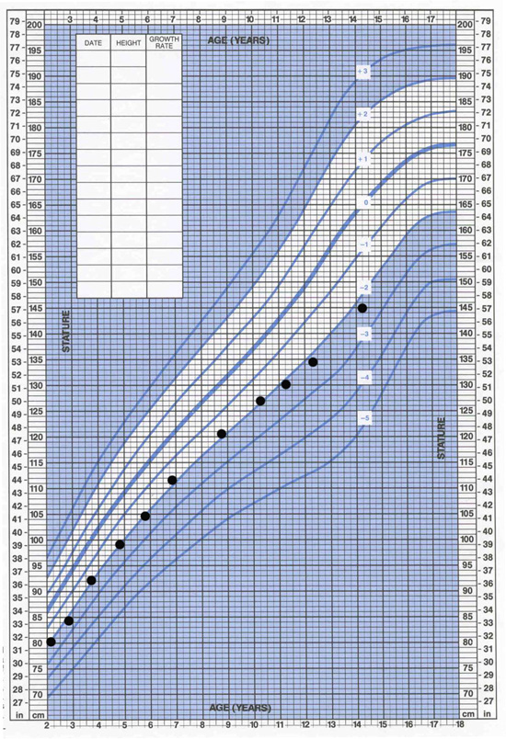
Question #11
A 14 year old boy is worried because he is so much smaller than his peers. You review his previous growth records.
Of the following, the factor that MOST strongly suggests that the boy has constitutional growth delay is that:
A. He has a normal sense of smell
B. He has Tanner III pubic hair
C. He was small for gestational age
D. His current weight is at the 50th percentile for age
E. His mother reached menarche at 15 years of age
Notes:
E
Kallman syndrome: hypothalamic hypogonadism + absence of olfaction

Slide 40
Question #11
A 14 year old boy is worried because he is so much smaller than his peers. You review his previous growth records.
Of the following, the factor that MOST strongly suggests that the boy has constitutional growth delay is that:
A. He has a normal sense of smell
B. He has Tanner III pubic hair
C. He was small for gestational age
D. His current weight is at the 50th percentile for age
E. His mother reached menarche at 15 years of age
Notes:
E
Kallman syndrome: hypothalamic hypogonadism + absence of olfaction

Slide 41
Question #12
The parents of a 7-year-old boy are concerned because he is the same size as 5-year-old children in his preschool playgroup. Both of the parents are healthy. The father is 5 ft 3 in (160.0 cm) in height and the mother is 4 ft 10 in (147.3 cm) in height. They recognize that their child may be short because they are not tall, but they want to be sure that there is no other problem.
Of the following, the BEST indicator that the boy is following his genetic growth pattern is:
A. A bone age radiograph that is normal for age
B. His height at the 3rd percentile for age
C. Normal weight for height
D. Steady linear growth at 3 cm/year
E. Steady linear growth at 5 cm/year
Notes:
E

Slide 42
Question #12
The parents of a 7-year-old boy are concerned because he is the same size as 5-year-old children in his preschool playgroup. Both of the parents are healthy. The father is 5 ft 3 in (160.0 cm) in height and the mother is 4 ft 10 in (147.3 cm) in height. They recognize that their child may be short because they are not tall, but they want to be sure that there is no other problem.
Of the following, the BEST indicator that the boy is following his genetic growth pattern is:
A. A bone age radiograph that is normal for age
B. His height at the 3rd percentile for age
C. Normal weight for height
D. Steady linear growth at 3 cm/year
E. Steady linear growth at 5 cm/year
Notes:
E

Slide 43
Normal Linear growth
First 3 months grow 3.5 cm per month
Slows over first year of life
After 1 year of age grow 1 cm per year
After 4 years of age grow 3 cm per year
Childhood 5 cm per year
Puberty 10 cm per year

Slide 44
Question #13
A 12 y/o boy has missed his health supervision visits for 2 years. He has had headaches that have caused him to miss several days of school in the past month. The headaches have awakened him at night. He has vision loss
The additional finding that is MOST contributory to your suspected diagnosis is:
Axillary hair without other signs of puberty
Decreased linear growth rate
Decreased weight gain
Gynecomastia
Unilateral testicular enlargement
Notes:
B

Slide 45
Question #13
A 12 y/o boy has missed his health supervision visits for 2 years. He has had headaches that have caused him to miss several days of school in the past month. The headaches have awakened him at night. He has vision loss
The additional finding that is MOST contributory to your suspected diagnosis is:
Axillary hair without other signs of puberty
Decreased linear growth rate
Decreased weight gain
Gynecomastia
Unilateral testicular enlargement
Notes:
B

Slide 46
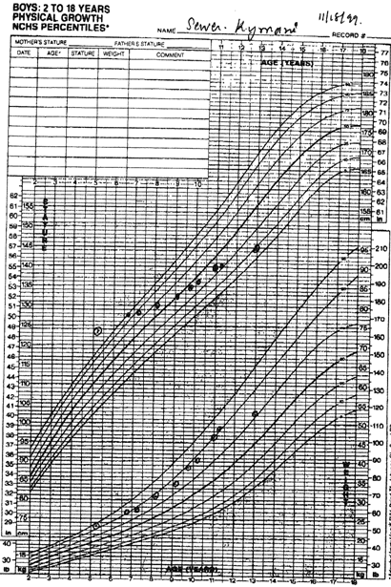
Growth Hormone Deficiency
Congenital
May present with micropenis or hypoglycemia at birth
Acquired
Can present with subnormal growth velocity OR fall in height percentile
Delayed bone age
Look for history of CNS radiation, tumors, midline defects, pituitary hormone deficiencies.

Slide 47
Tall Stature
Absolute height >2SD’s from mean for age
Etiology
Familial (most common)
Precocious puberty (final height normal)
Marfan syndrome
Klinefelter syndrome
47 XXY
Small testes/delayed puberty
Gynecomastia
May have learning disability/behavioral problems
Excess GH secretion (gigantism/acromegaly)

Slide 48
Thyroid Disorders
Hashimoto Thyroiditis
Cyst, Tumor, Nodule
Hypothyroidism
Hyperthyroidism

Slide 49
Question #14
During the health supervision visit for a 14-year-old girl, you note that her thyroid gland is symmetric, somewhat firmer than normal, and about twice normal size. Thyroid testing shows a free thyroxine (fT4) value of 1.3 ng/dL (normal, 0.9 to 1.8 ng/dL) and a thyroid-stimulating hormone (TSH) value of 2.4 mIU/L (normal, 0.5 to 5.0 mIU/L).
Of the following, the MOST likely cause of this child's thyroid enlargement is:
A. Adolescent goiter
B. Chronic lymphocytic thyroiditis
C. Graves disease
D. Iodine deficiency
E. Thyroid carcinoma
Notes:
B – many people go on to develop hypothyroidism; due to positive antibodies (usually TPO, TG), shows lymphocytic infiltrate on biopsy

Slide 50
Question #14
During the health supervision visit for a 14-year-old girl, you note that her thyroid gland is symmetric, somewhat firmer than normal, and about twice normal size. Thyroid testing shows a free thyroxine (fT4) value of 1.3 ng/dL (normal, 0.9 to 1.8 ng/dL) and a thyroid-stimulating hormone (TSH) value of 2.4 mIU/L (normal, 0.5 to 5.0 mIU/L).
Of the following, the MOST likely cause of this child's thyroid enlargement is:
A. Adolescent goiter
B. Chronic lymphocytic thyroiditis
C. Graves disease
D. Iodine deficiency
E. Thyroid carcinoma
Notes:
B – many people go on to develop hypothyroidism; due to positive antibodies (usually TPO, TG), shows lymphocytic infiltrate on biopsy

Slide 51
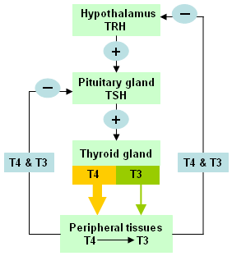
Hypothyroidism
Congenital
Most common etiology: thyroid dysgenesis or agenesis
Can also be due to dyshormonogenesis
Acquired Hypothyroidism
Most common etiology: autoimmune (Hashimoto’s)
Can also be due to post viral illness, neck radiation, iodine excess, iodine deficiency
TSH | Free T4 | Assessment
↑ | ↓ | 1° Hypothyroidism
↓ | ↑ | 1° Hyperthyroidism
↑ | ↑ | 2°/3° Hyperthyroidism
↓ | ↓ | 2°/3° Hypothyroidism

Slide 52
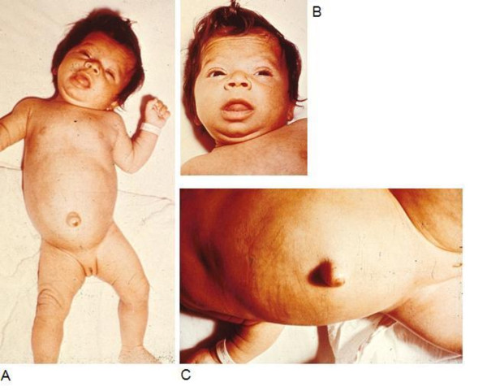
Hypothyroidism
History:
hoarse cry
hypotonia
fatigue, weakness
cold intolerance
weight gain
constipation
dry skin
depression
irregular menses
Physical Exam:
FTT
jaundice
large fontanelle
macroglossia
umbilical hernia
enlarged firm thyroid
bradycardia
weight gain
periorbital Edema
delayed relaxation of DTRs
delayed puberty
short stature
Labs:
TSH
free T4
Anti-TPO
Anti-TG
Radiology:
Thyroid scan
Ultrasound
Treatment:
Synthroid

Slide 53
Question #15
A 16 year old girl comes to your office complaining that her menstrual periods have been irregular and scanty. Her last period was 3 months ago and lasted for only 2 days. Among the findings on physical examination are fine, moist skin; firm, palpable thyroid gland; and fine tremor. Results of laboratory studies include a TSH of <0.05 mIU/L (0.5-5.0 mIU/L) and free T4 of 1.9 ng/dL (0.6-1.3 ng/dL).
Of the following, the additional physical exam finding that BEST supports the diagnosis of hyperthyroidism is:
Abdominal obesity
Atrophy of lingual papillae
Hepatomegaly
Hirsutism
Muscle weakness

Slide 54
Question #15
A 16 year old girl comes to your office complaining that her menstrual periods have been irregular and scanty. Her last period was 3 months ago and lasted for only 2 days. Among the findings on physical examination are fine, moist skin; firm, palpable thyroid gland; and fine tremor. Results of laboratory studies include a TSH of <0.05 mIU/L (0.5-5.0 mIU/L) and free T4 of 1.9 ng/dL (0.6-1.3 ng/dL).
Of the following, the additional physical exam finding that BEST supports the diagnosis of hyperthyroidism is:
Abdominal obesity
Atrophy of lingual papillae
Hepatomegaly
Hirsutism
Muscle weakness

Slide 55
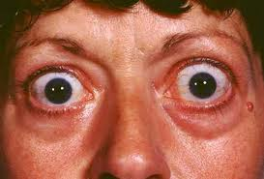
Hyperthyroidism
History:
weight loss
increased appetite
decreased strength
hyperactivity
tremors
sweating
nocturnal sleeplessness
irritability
decreased school performance
pruritus
nocturia
infrequent menses
Physical Exam:
palpable, firm thyroid gland
audible bruit
moist skin
tremor
slight skin darkening
fine scalp hair, hair loss at temples
muscle weakness
loss of muscle mass at thenar and hypothenar eminences
exopthalmos

Slide 56
Hyperthyroidism
Labs:
TSH, free T4
TSI (thyroid stimulating immunoglobins): Graves disease
Radiology: radioactive uptake scan
High uptake: Graves
Low uptake: subacute thyroiditis
Treatment:
Meds: Methimazole (Propylthiouracil rarely used)
Interfere with hormone production
Radioactive Iodine
Thyroidectomy

Slide 57
Thyroid Cysts/Nodules
Thyroglossal Duct Cyst
Midline
Anywhere from the base of the tongue down
Must be resected or can cause respiratory distress because it will grow due to TSH stimulation
Thyroid Nodules
More likely to be malignant in children than in adults
If it’s “cold” (non-active), more likely to be malignant
Work-up:
Ultrasound
FNA

Slide 58
Disorders of PTH, Calcium, and Phosphate metabolism
Hypocalcemia
Hypercalcemia
Hypophosphatemia
Rickets
Parathyroid Disorders

Slide 59
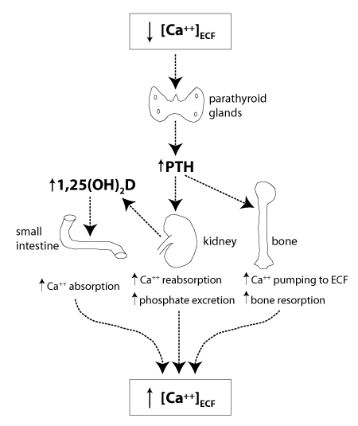
Calcium and Phosphorus

Slide 60
Calcium
Hypocalcemia
Common Etiologies: Vitamin D deficiency, hypoparathyroidism (DiGeorge syndrome)
Symptoms: muscle cramps, tetany, stridor, + Chvostek’s/Trousseau sign, prolonged QT
Hypercalcemia
Common Etiologies: immobilization, Williams syndrome, hyperparathyroidism, hypervitaminosis D
Symptoms: stones (nephrolithiasis), groans (abd pain/bone pain), psychiatric overtones (AMS), short QT

Slide 61
1. VITAMIN D DEFICIENT RICKETS 2. VITAMIN D DEPENDENT RICKETS, TYPE 1 3. VITAMIN D DEPENDENT RICKETS, TYPE 2 4. HYPOPHOSPHATEMIC RICKETS
Question #16
Match the diagnosis with the laboratory results
 | Calcium | Phosphorus | Vitamin D 25 | Vitamin D 1,25 | PTH
A | ↓/Normal | ↓ | ↓ | ↓/Normal | ↑
B | Normal | ↓ | Normal | Normal | Normal
C | ↓/Normal | ↓ | Normal | ↑ | ↑
D | ↓/Normal | ↓ | Normal | ↓ | ↑
Notes:
1 – A
2 – D. Type 1 – enzyme: 1α hydroxylase deficiency
3 – C. Type 2 – receptor defect, 1,25D inability to act
4 – B. Decreased renal resorption of phosphate and insufficient 1,25 D (unclear why) and thus also inadequate gut absorption of Ca/Phos. Low phos and osteoblast dysfunction (also present in these patients) result in poor bone mineralization and thus Rickets.

Slide 62
1. VITAMIN D DEFICIENT RICKETS 2. VITAMIN D DEPENDENT RICKETS, TYPE 1 3. VITAMIN D DEPENDENT RICKETS, TYPE 2 4. HYPOPHOSPHATEMIC RICKETS
Question #16
Match the diagnosis with the laboratory results
 | Calcium | Phosphorus | Vitamin D 25 | Vitamin D 1,25 | PTH
A | ↓/Normal | ↓ | ↓ | ↓/Normal | ↑
B | Normal | ↓ | Normal | Normal | Normal
C | ↓/Normal | ↓ | Normal | ↑ | ↑
D | ↓/Normal | ↓ | Normal | ↓ | ↑
Notes:
1 – A
2 – D. Type 1 – enzyme: 1α hydroxylase deficiency
3 – C. Type 2 – receptor defect, 1,25D inability to act
4 – B. Decreased renal resorption of phosphate and insufficient 1,25 D (unclear why) and thus also inadequate gut absorption of Ca/Phos. Low phos and osteoblast dysfunction (also present in these patients) result in poor bone mineralization and thus Rickets.

Slide 63
1. VITAMIN D DEFICIENT RICKETS 2. VITAMIN D DEPENDENT RICKETS, TYPE 1 3. VITAMIN D DEPENDENT RICKETS, TYPE 2 4. HYPOPHOSPHATEMIC RICKETS
Question #16
Match the diagnosis with the laboratory results
 | Calcium | Phosphorus | Vitamin D 25 | Vitamin D 1,25 | PTH
A | ↓/Normal | ↓ | ↓ | ↓/Normal | ↑
B | Normal | ↓ | Normal | Normal | Normal
C | ↓/Normal | ↓ | Normal | ↑ | ↑
D | ↓/Normal | ↓ | Normal | ↓ | ↑
Notes:
1 – A
2 – D. Type 1 – enzyme: 1α hydroxylase deficiency
3 – C. Type 2 – receptor defect, 1,25D inability to act
4 – B. Decreased renal resorption of phosphate and insufficient 1,25 D (unclear why) and thus also inadequate gut absorption of Ca/Phos. Low phos and osteoblast dysfunction (also present in these patients) result in poor bone mineralization and thus Rickets.

Slide 64
1. VITAMIN D DEFICIENT RICKETS 2. VITAMIN D DEPENDENT RICKETS, TYPE 1 3. VITAMIN D DEPENDENT RICKETS, TYPE 2 4. HYPOPHOSPHATEMIC RICKETS
Question #16
Match the diagnosis with the laboratory results
 | Calcium | Phosphorus | Vitamin D 25 | Vitamin D 1,25 | PTH
A | ↓/Normal | ↓ | ↓ | ↓/Normal | ↑
B | Normal | ↓ | Normal | Normal | Normal
C | ↓/Normal | ↓ | Normal | ↑ | ↑
D | ↓/Normal | ↓ | Normal | ↓ | ↑
Notes:
1 – A
2 – D. Type 1 – enzyme: 1α hydroxylase deficiency
3 – C. Type 2 – receptor defect, 1,25D inability to act
4 – B. Decreased renal resorption of phosphate and insufficient 1,25 D (unclear why) and thus also inadequate gut absorption of Ca/Phos. Low phos and osteoblast dysfunction (also present in these patients) result in poor bone mineralization and thus Rickets.

Slide 65
1. VITAMIN D DEFICIENT RICKETS 2. VITAMIN D DEPENDENT RICKETS, TYPE 1 3. VITAMIN D DEPENDENT RICKETS, TYPE 2 4. HYPOPHOSPHATEMIC RICKETS
Question #16
Match the diagnosis with the laboratory results
 | Calcium | Phosphorus | Vitamin D 25 | Vitamin D 1,25 | PTH
A | ↓/Normal | ↓ | ↓ | ↓/Normal | ↑
B | Normal | ↓ | Normal | Normal | Normal
C | ↓/Normal | ↓ | Normal | ↑ | ↑
D | ↓/Normal | ↓ | Normal | ↓ | ↑
Notes:
1 – A
2 – D. Type 1 – enzyme: 1α hydroxylase deficiency
3 – C. Type 2 – receptor defect, 1,25D inability to act
4 – B. Decreased renal resorption of phosphate and insufficient 1,25 D (unclear why) and thus also inadequate gut absorption of Ca/Phos. Low phos and osteoblast dysfunction (also present in these patients) result in poor bone mineralization and thus Rickets.

Slide 66
1. VITAMIN D DEFICIENT RICKETS 2. VITAMIN D DEPENDENT RICKETS, TYPE 1 3. VITAMIN D DEPENDENT RICKETS, TYPE 2 4. HYPOPHOSPHATEMIC RICKETS
Question #16
Match the diagnosis with the laboratory results
 | Calcium | Phosphorus | Vitamin D 25 | Vitamin D 1,25 | PTH
A | ↓/Normal | ↓ | ↓ | ↓/Normal | ↑
B | Normal | ↓ | Normal | Normal | Normal
C | ↓/Normal | ↓ | Normal | ↑ | ↑
D | ↓/Normal | ↓ | Normal | ↓ | ↑
Notes:
1 – A
2 – D. Type 1 – enzyme: 1α hydroxylase deficiency
3 – C. Type 2 – receptor defect, 1,25D inability to act
4 – B. Decreased renal resorption of phosphate and insufficient 1,25 D (unclear why) and thus also inadequate gut absorption of Ca/Phos. Low phos and osteoblast dysfunction (also present in these patients) result in poor bone mineralization and thus Rickets.

Slide 67
1. VITAMIN D DEFICIENT RICKETS 2. VITAMIN D DEPENDENT RICKETS, TYPE 1 3. VITAMIN D DEPENDENT RICKETS, TYPE 2 4. HYPOPHOSPHATEMIC RICKETS
Question #16
Match the diagnosis with the laboratory results
 | Calcium | Phosphorus | Vitamin D 25 | Vitamin D 1,25 | PTH
A | ↓/Normal | ↓ | ↓ | ↓/Normal | ↑
B | Normal | ↓ | Normal | Normal | Normal
C | ↓/Normal | ↓ | Normal | ↑ | ↑
D | ↓/Normal | ↓ | Normal | ↓ | ↑
Notes:
1 – A
2 – D. Type 1 – enzyme: 1α hydroxylase deficiency
3 – C. Type 2 – receptor defect, 1,25D inability to act
4 – B. Decreased renal resorption of phosphate and insufficient 1,25 D (unclear why) and thus also inadequate gut absorption of Ca/Phos. Low phos and osteoblast dysfunction (also present in these patients) result in poor bone mineralization and thus Rickets.

Slide 68
1. VITAMIN D DEFICIENT RICKETS 2. VITAMIN D DEPENDENT RICKETS, TYPE 1 3. VITAMIN D DEPENDENT RICKETS, TYPE 2 4. HYPOPHOSPHATEMIC RICKETS
Question #16
Match the diagnosis with the laboratory results
 | Calcium | Phosphorus | Vitamin D 25 | Vitamin D 1,25 | PTH
A | ↓/Normal | ↓ | ↓ | ↓/Normal | ↑
B | Normal | ↓ | Normal | Normal | Normal
C | ↓/Normal | ↓ | Normal | ↑ | ↑
D | ↓/Normal | ↓ | Normal | ↓ | ↑
Notes:
1 – A
2 – D. Type 1 – enzyme: 1α hydroxylase deficiency
3 – C. Type 2 – receptor defect, 1,25D inability to act
4 – B. Decreased renal resorption of phosphate and insufficient 1,25 D (unclear why) and thus also inadequate gut absorption of Ca/Phos. Low phos and osteoblast dysfunction (also present in these patients) result in poor bone mineralization and thus Rickets.

Slide 69
Rickets
↓ PO4, ↑Alk Phos
PTH
↑
Normal
Vit D 25
FAMILIAL HYPOPHOSPHATEMIC RICKETS
Phosphate wasting
↓
Normal
Vit D DEFICIENT RICKETS
Vit D 1,25
↓
↑
Vit D DEPENDENT RICKETS TYPE 1
Can’t convert 25 → 1,25
Defect in 1α-hydroxylase
Vit D DEPENDENT RICKETS TYPE 2
aka VITAMIN D RESISTANT RICKETS
Mutation in Vitamin D receptor

Slide 70
Adrenal Gland Disorders
Addison Disease and Adrenal Insufficiency
Cushing Syndrome

Slide 71
Question #17
A 12-year-old boy who has chronic lymphocytic thyroiditis presents to the emergency department with a 1-week history of nausea, vomiting, and muscle pains. On physical examination, the child is dehydrated, has a blood pressure of 80/40 mm Hg and a heart rate of 110 beats/min, and appears tanned even though it is November and he lives in Minnesota. You suspect adrenal insufficiency (Addison disease) and order laboratory tests for serum cortisol and adrenocorticotropic hormone as well as serum and urine electrolytes.

Slide 72
Question #17
Of the following, the MOST typical electrolyte pattern for primary adrenal insufficiency is:
 | SERUM |  |  |  |  | URINE
 | Sodium (mmol/L) | Potassium (mmol/L) | Chloride (mmol/L) | Bicarb (mmol/L) |  | Sodium (mmol/L) | Potassium (mmol/L)
A | 128 | 6.8 | 95 | 12 |  | 43 | 6
B | 128 | 3.2 | 85 | 20 |  | 43 | 6
C | 146 | 6.8 | 110 | 12 |  | 2 | 6
D | 128 | 6.8 | 95 | 18 |  | 3 | 36
E | 128 | 3.2 | 85 | 21 |  | 3 | 36
Notes:
A
Sodium-low; Potassium-high (NO ALDO); Bicarb low (metabolic acidosis from dehydration due to no aldo)

Slide 73
Question #17
Of the following, the MOST typical electrolyte pattern for primary adrenal insufficiency is:
 | SERUM |  |  |  |  | URINE
 | Sodium (mmol/L) | Potassium (mmol/L) | Chloride (mmol/L) | Bicarb (mmol/L) |  | Sodium (mmol/L) | Potassium (mmol/L)
A | 128 | 6.8 | 95 | 12 |  | 43 | 6
B | 128 | 3.2 | 85 | 20 |  | 43 | 6
C | 146 | 6.8 | 110 | 12 |  | 2 | 6
D | 128 | 6.8 | 95 | 18 |  | 3 | 36
E | 128 | 3.2 | 85 | 21 |  | 3 | 36
Notes:
A
Sodium-low; Potassium-high (NO ALDO); Bicarb low (metabolic acidosis from dehydration due to no aldo)

Slide 74
Pituitary Gland Disorders
Hypopituitarism
Diabetes Insipidus

Slide 75
Question #18
An 11 year old boy presents to the Pediatric ED with headaches and vomiting. A head CT is concerning for suprasellar mass, likely a craniopharyngioma. Neurosurgery is consulted. They tell you to admit the patient and send “pituitary labs”. What labs do you send?
*For bonus points: When do you send your labs?

Slide 76
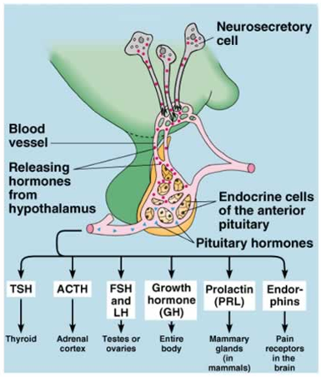
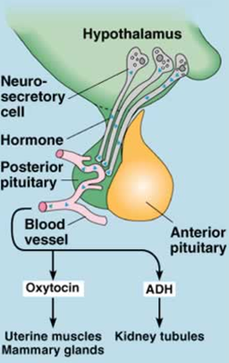
Pituitary hormones
-TSH
-fT4
-Prolactin
-BMP
-UA
-Serum osmolality
-Urine osmolality
- +/- ADH
-FSH
-LH
-Testo/Estradiol
(if pubertal only)
-IGF1
-Cortisol
- +/- ACTH

Slide 77
Multiple Pituitary Deficiencies
Congenital:
Septo-optic dysplasia
Ectopic pituitary
Midline anatomic defect
Acquired:
Usually >1 year old
Brain tumor most likely (craniopharyngioma)

Slide 78
1. SIADH 2. DIABETES INSIPIDUS 3. DIABETES KETOACIDOSIS 4. WATER INTOXICATION
Question #19
Match the diagnosis with the blood/urine results
 | Sodium | Urine Output | Serum Osmolality | Urine Osmolality
A | 155 | ⬆ | 310 | 50
B | 125 | ⬆ | 250 | 50
C | 125 | ⬆ | 280 | 300
D | 155 | ⬇ | 310 | 50
E | 125 | ⬇ | 250 | 300
Notes:
1 – E
2 – A
3 – C. Pseudohyponatremia due to hyperglycemia. Polyuria due to hyperglycemia – would only have decrease UOP in severe case with significant prerenal failure. But in this case S Osm either normal or high, never low, and U Osm high
4 – B

Slide 79
1. SIADH 2. DIABETES INSIPIDUS 3. DIABETES KETOACIDOSIS 4. WATER INTOXICATION
Question #19
Match the diagnosis with the blood/urine results
 | Sodium | Urine Output | Serum Osmolality | Urine Osmolality
A | 155 | ⬆ | 310 | 50
B | 125 | ⬆ | 250 | 50
C | 125 | ⬆ | 280 | 300
D | 155 | ⬇ | 310 | 50
E | 125 | ⬇ | 250 | 300
Notes:
1 – E
2 – A
3 – C. Pseudohyponatremia due to hyperglycemia. Polyuria due to hyperglycemia – would only have decrease UOP in severe case with significant prerenal failure. But in this case S Osm either normal or high, never low, and U Osm high
4 – B

Slide 80
1. SIADH 2. DIABETES INSIPIDUS 3. DIABETES KETOACIDOSIS 4. WATER INTOXICATION
Question #19
Match the diagnosis with the blood/urine results
 | Sodium | Urine Output | Serum Osmolality | Urine Osmolality
A | 155 | ⬆ | 310 | 50
B | 125 | ⬆ | 250 | 50
C | 125 | ⬆ | 280 | 300
D | 155 | ⬇ | 310 | 50
E | 125 | ⬇ | 250 | 300
Notes:
1 – E
2 – A
3 – C. Pseudohyponatremia due to hyperglycemia. Polyuria due to hyperglycemia – would only have decrease UOP in severe case with significant prerenal failure. But in this case S Osm either normal or high, never low, and U Osm high
4 – B

Slide 81
1. SIADH 2. DIABETES INSIPIDUS 3. DIABETES KETOACIDOSIS 4. WATER INTOXICATION
Question #19
Match the diagnosis with the blood/urine results
 | Sodium | Urine Output | Serum Osmolality | Urine Osmolality
A | 155 | ⬆ | 310 | 50
B | 125 | ⬆ | 250 | 50
C | 125 | ⬆ | 280 | 300
D | 155 | ⬇ | 310 | 50
E | 125 | ⬇ | 250 | 300
Notes:
1 – E
2 – A
3 – C. Pseudohyponatremia due to hyperglycemia. Polyuria due to hyperglycemia – would only have decrease UOP in severe case with significant prerenal failure. But in this case S Osm either normal or high, never low, and U Osm high
4 – B

Slide 82
1. SIADH 2. DIABETES INSIPIDUS 3. DIABETES KETOACIDOSIS 4. WATER INTOXICATION
Question #19
Match the diagnosis with the blood/urine results
 | Sodium | Urine Output | Serum Osmolality | Urine Osmolality
A | 155 | ⬆ | 310 | 50
B | 125 | ⬆ | 250 | 50
C | 125 | ⬆ | 280 | 300
D | 155 | ⬇ | 310 | 50
E | 125 | ⬇ | 250 | 300
Notes:
1 – E
2 – A
3 – C. Pseudohyponatremia due to hyperglycemia. Polyuria due to hyperglycemia – would only have decrease UOP in severe case with significant prerenal failure. But in this case S Osm either normal or high, never low, and U Osm high
4 – B

Slide 83
1. SIADH 2. DIABETES INSIPIDUS 3. DIABETES KETOACIDOSIS 4. WATER INTOXICATION
Question #19
Match the diagnosis with the blood/urine results
 | Sodium | Urine Output | Serum Osmolality | Urine Osmolality
A | 155 | ⬆ | 310 | 50
B | 125 | ⬆ | 250 | 50
C | 125 | ⬆ | 280 | 300
D | 155 | ⬇ | 310 | 50
E | 125 | ⬇ | 250 | 300
Notes:
1 – E
2 – A
3 – C. Pseudohyponatremia due to hyperglycemia. Polyuria due to hyperglycemia – would only have decrease UOP in severe case with significant prerenal failure. But in this case S Osm either normal or high, never low, and U Osm high
4 – B

Slide 84
1. SIADH 2. DIABETES INSIPIDUS 3. DIABETES KETOACIDOSIS 4. WATER INTOXICATION
Question #19
Match the diagnosis with the blood/urine results
 | Sodium | Urine Output | Serum Osmolality | Urine Osmolality
A | 155 | ⬆ | 310 | 50
B | 125 | ⬆ | 250 | 50
C | 125 | ⬆ | 280 | 300
D | 155 | ⬇ | 310 | 50
E | 125 | ⬇ | 250 | 300
Notes:
1 – E
2 – A
3 – C. Pseudohyponatremia due to hyperglycemia. Polyuria due to hyperglycemia – would only have decrease UOP in severe case with significant prerenal failure. But in this case S Osm either normal or high, never low, and U Osm high
4 – B

Slide 85
1. SIADH 2. DIABETES INSIPIDUS 3. DIABETES KETOACIDOSIS 4. WATER INTOXICATION
Question #19
Match the diagnosis with the blood/urine results
 | Sodium | Urine Output | Serum Osmolality | Urine Osmolality
A | 155 | ⬆ | 310 | 50
B | 125 | ⬆ | 250 | 50
C | 125 | ⬆ | 280 | 300
D | 155 | ⬇ | 310 | 50
E | 125 | ⬇ | 250 | 300
Notes:
1 – E
2 – A
3 – C. Pseudohyponatremia due to hyperglycemia. Polyuria due to hyperglycemia – would only have decrease UOP in severe case with significant prerenal failure. But in this case S Osm either normal or high, never low, and U Osm high
4 – B

Slide 86
DI, SIADH, CSW
 | Serum Sodium | Serum Osmolality | Urine Sodium | Urine Osmolality | Urine Output
DI | ↑ | ↑ | ↓ | ↓ | ↑
SIADH | ↓ | ↓ | ↑ | ↑ | ↓
CSW | ↓ | ↓ | ↑ | ↑ | ↑

Slide 87
Diabetes
Type 1 Diabetes and Associated Conditions
Diabetic Ketoacidosis (DKA)
Type 2 Diabetes

Slide 88
Question #20
A 3 year old girl presents to the ED in an almost unresponsive state. Her parents say that she has become increasingly ill over the past 5 days and has been very thirsty, with increased urination. This morning she began to vomit and could not keep down fluids. Findings on physical examination in addition to unresponsiveness include rapid, sighing respirations and flushed cheeks. You estimate that she is 10% dehydrated. Initial laboratory studies reveal a blood glucose concentration of 700.0 mg/dL, sodium of 130.0 mEq/L, potassium of 4.6 mEq/L, chloride of 96.0 mEq/L, bicarbonate of 8.0 mEq/L, and a venous pH of 7.0.
Of the following, the MOST appropriate action to decrease this child's risk for cerebral edema during treatment is to:
Avoid potassium replacement until the serum potassium value is less than 4.0 mEq/L (4.0 mmol/L)
Correct acidosis rapidly with sodium bicarbonate
Rehydrate initially with 3% saline
Rehydrate slowly using 0.45% to 0.9% saline
Replace continuing urinary fluid losses with 0.2% saline
Notes:
D

Slide 89
Question #20
A 3 year old girl presents to the ED in an almost unresponsive state. Her parents say that she has become increasingly ill over the past 5 days and has been very thirsty, with increased urination. This morning she began to vomit and could not keep down fluids. Findings on physical examination in addition to unresponsiveness include rapid, sighing respirations and flushed cheeks. You estimate that she is 10% dehydrated. Initial laboratory studies reveal a blood glucose concentration of 700.0 mg/dL, sodium of 130.0 mEq/L, potassium of 4.6 mEq/L, chloride of 96.0 mEq/L, bicarbonate of 8.0 mEq/L, and a venous pH of 7.0.
Of the following, the MOST appropriate action to decrease this child's risk for cerebral edema during treatment is to:
Avoid potassium replacement until the serum potassium value is less than 4.0 mEq/L (4.0 mmol/L)
Correct acidosis rapidly with sodium bicarbonate
Rehydrate initially with 3% saline
Rehydrate slowly using 0.45% to 0.9% saline
Replace continuing urinary fluid losses with 0.2% saline
Notes:
D

Slide 90
Question #21
The parents of a 10-year-old girl in whom you have just diagnosed type 1 diabetes mellitus and chronic lymphocytic thyroiditis (Hashimoto’s thyroiditis) tell you that many people in their family have these conditions. They wish to know if other autoimmune disorders occur with greater frequency in children who have diabetes. You tell them that additional autoimmune disorders in children who have type 1 diabetes mellitus can occur.
Of the following, the autoimmune disorders MOST likely to occur in this patient are:
A. Addison disease and premature ovarian failure
B. Celiac disease and Addison disease
C. Graves disease and alopecia areata
D. Pernicious anemia and celiac disease
E. Vitiligo and pernicious anemia

Slide 91
Question #21
The parents of a 10-year-old girl in whom you have just diagnosed type 1 diabetes mellitus and chronic lymphocytic thyroiditis (Hashimoto’s thyroiditis) tell you that many people in their family have these conditions. They wish to know if other autoimmune disorders occur with greater frequency in children who have diabetes. You tell them that additional autoimmune disorders in children who have type 1 diabetes mellitus can occur.
Of the following, the autoimmune disorders MOST likely to occur in this patient are:
A. Addison disease and premature ovarian failure
B. Celiac disease and Addison disease
C. Graves disease and alopecia areata
D. Pernicious anemia and celiac disease
E. Vitiligo and pernicious anemia

Slide 92
Type 1 diabetes and associated autoimmune disorder
Hashimoto thyroiditis:10-25%
Celiac disease: 6%
Addison’s disease: 1%
Pernicious anemia: rare
Premature ovarian failure: rare
Alopecia areata: rare

Slide 93
Question #22
A 3-year-old boy is brought to the ED by EMS after being found lethargic by his parents. His parents report that he began to have vomiting and diarrhea the day prior, which they attributed to the stomach virus that has been going around his preschool. The EMTs determined that the boy's blood glucose was 45 mg/dL on the scene and started an intravenous infusion with dextrose. When you see him in the ED, he is beginning to awaken and recognize his parents. Repeat blood glucose measures 73 mg/dL.
Of the following, the MOST useful additional laboratory test is:
Serum C-peptide assessment
Serum insulin assessment
Serum proinsulin assessment
Serum tryptophan synthetase assessment
Urine dipstick for ketones

Slide 94
Question #22
A 3-year-old boy is brought to the ED by EMS after being found lethargic by his parents. His parents report that he began to have vomiting and diarrhea the day prior, which they attributed to the stomach virus that has been going around his preschool. The EMTs determined that the boy's blood glucose was 45 mg/dL on the scene and started an intravenous infusion with dextrose. When you see him in the ED, he is beginning to awaken and recognize his parents. Repeat blood glucose measures 73 mg/dL.
Of the following, the MOST useful additional laboratory test is:
Serum C-peptide assessment
Serum insulin assessment
Serum proinsulin assessment
Serum tryptophan synthetase assessment
Urine dipstick for ketones

Slide 95
Ketotic Hypoglycemia
Most common cause of childhood hypoglycemia
Due to imbalance between glucose utilization and production
Often fasting hypoglycemia in the morning, in thin children with decreased muscle and fat
Should not occur after age 7-8 because hepatic glucose production and glycogen stores should meet needs of tissue by this time
Insulin suppresses ketogenesis, therefore if +ketones, not hyperinsulinemia
Could still be glycogen storage disease, defects in gluconeogenesis , or organic acidurias

