Slide 1
Pediatric Fractures
Jason Woods MD

Slide 2
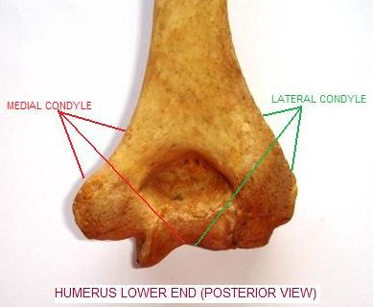
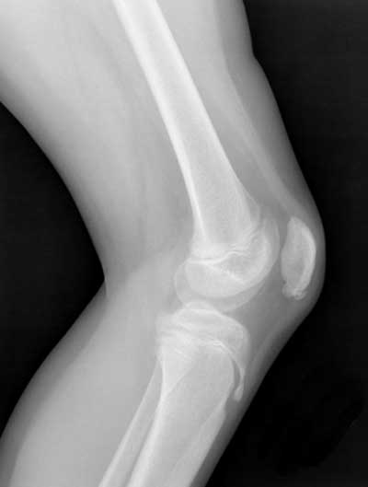
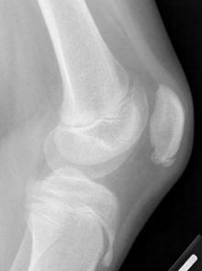
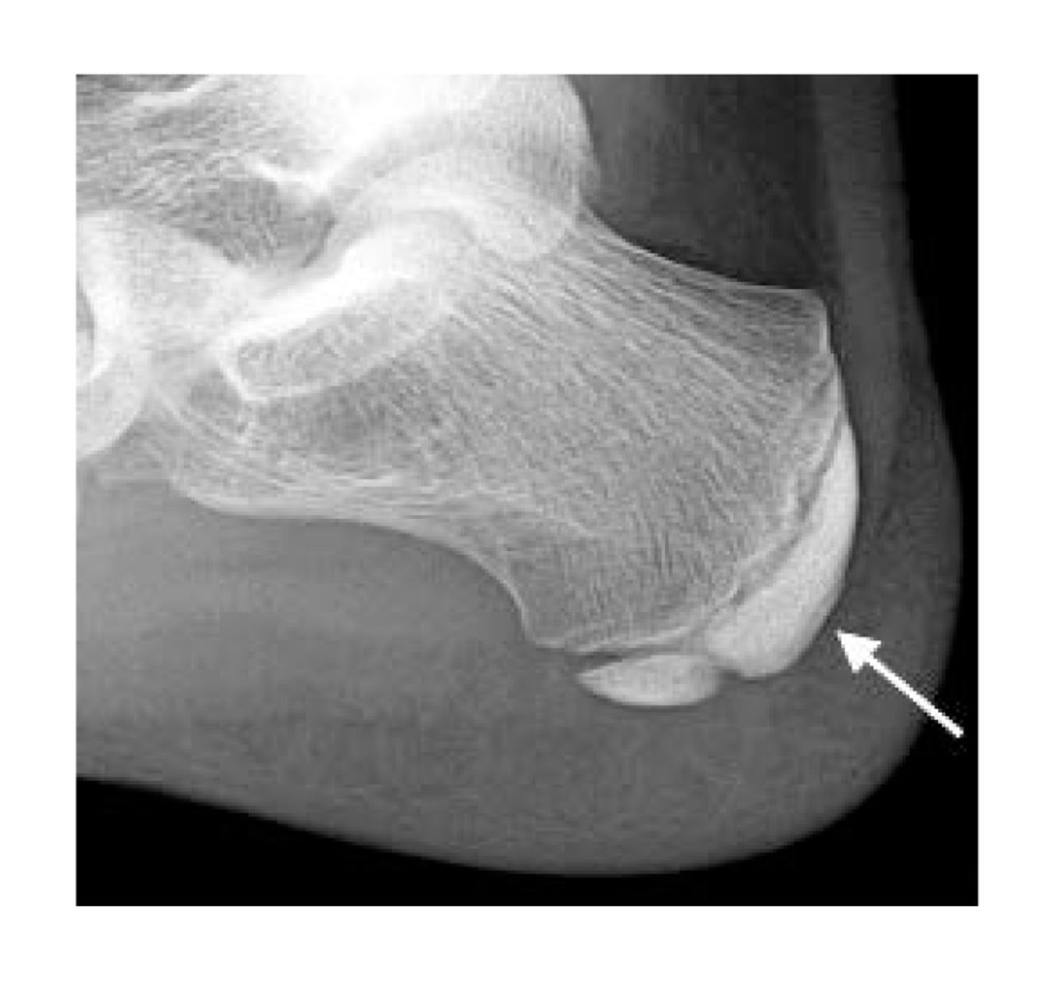
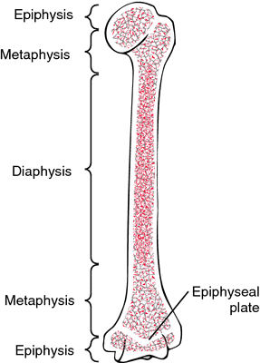
Terminology - Anatomy
Diaphysis
Metaphysis
Physis
Epiphysis
Apophysis
What’s a condyle?
Notes:
Osgood-Schlatter
Sever’s
Sinding­Larsen­Johansson
Why are the apophyseal centers so fragile?
Because…they are largely fibrocartilage which is less resistant to applied stress. Also, bones grow faster than muscle, so the unit is stressed both from growth and from traction.

Slide 3
Love the Periosteum
Pediatric periosteum has significant osteogenic potential
Guides healing, union, and remodeling
Thick and Strong
  Limits displacement
  Reduces likelihood of open fractures
Reason kids can remodel much more than adults

Slide 4
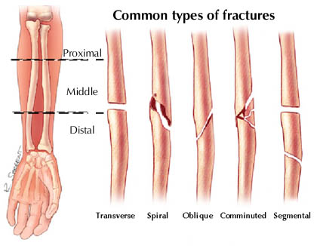
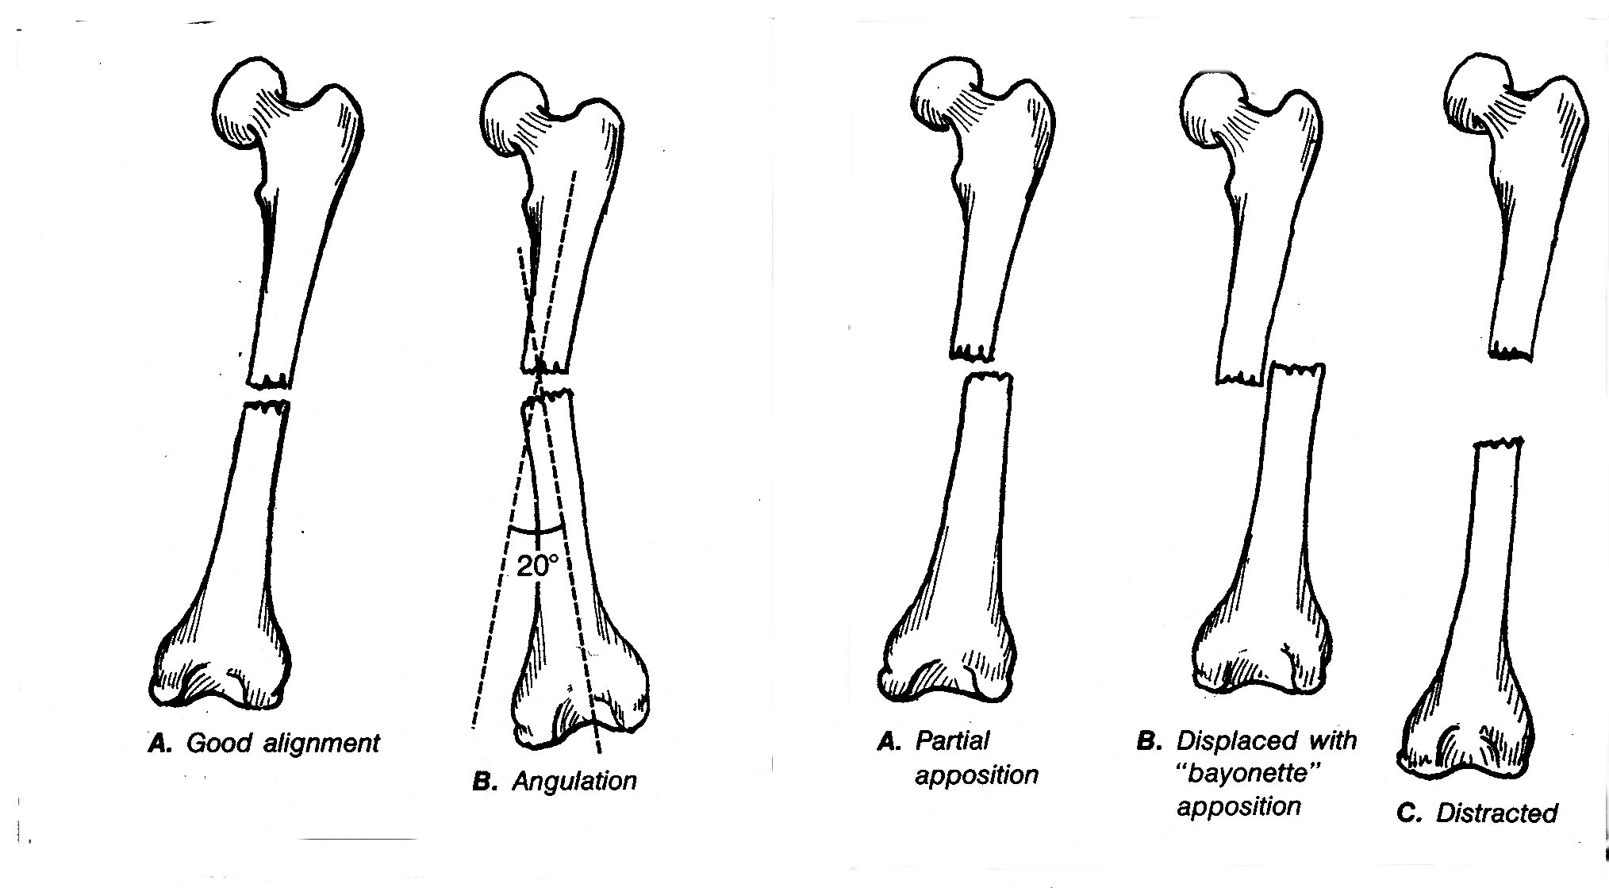
Terminology
(what ortho wants to know)
Where?
  Which bone?
  Which portion of bone?
Fracture type
Angulation
Displacement/distraction/displacement
Open or closed
Notes:
Types of fractures:
Angulation: described by apex position (or distal fragment)
Displacement: Described by distal fragment

Slide 5
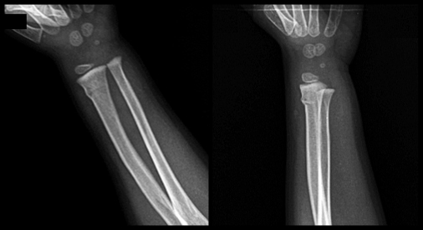
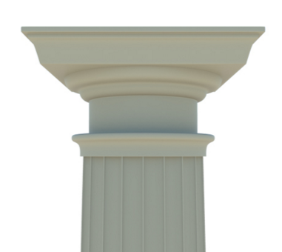
Pediatric Specific Fracture Types
Torus/Buckle Fracture
Notes:
Buckle (torus)
Bowing
Greenstick

Slide 6
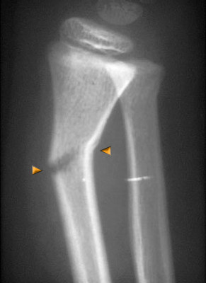
Pediatric Specific Fracture Types
Greenstick Fracture
Notes:
Buckle (torus)
Bowing
Greenstick

Slide 7
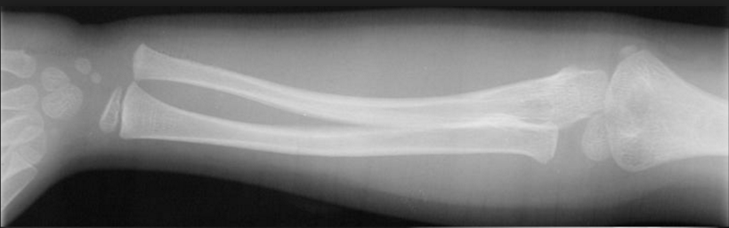
Pediatric Specific Fracture Types
Bowing deformity
Notes:
Buckle (torus)
Bowing
Greenstick

Slide 8
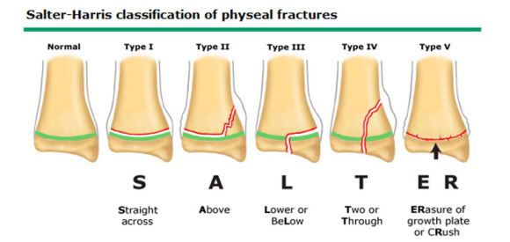
Who cares about Salter and Harris?
S - Same
A - Above
L - Lower
T - Through
ER - Eradication

Slide 9
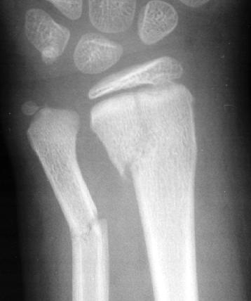
Salter-Harris ?
Notes:
2

Slide 10
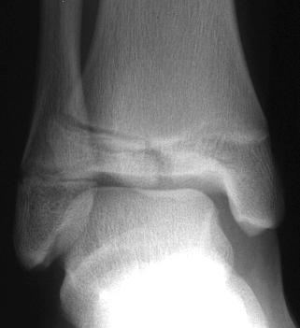
Salter-Harris ?
Notes:
3

Slide 11
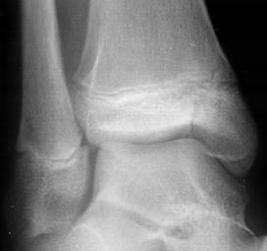
Salter-Harris ?

Slide 12
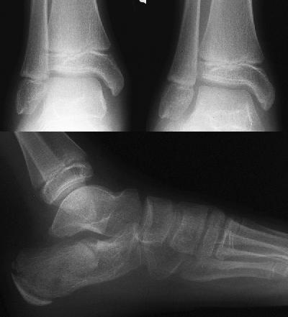
Salter-Harris ?
Notes:
Comparison views of the non-affected extremity may assist in radiographically diagnosing a SH-V type injury at initial presentation. Based on this comparison view, differences in the width of the growth plates may be evident. A complete obliteration or diminished physeal distance of the affected extremity confirms the diagnosis of a SH-V injury. This patient fell off a second story balcony onto her feet. The radiographs show several fractures within the body of the calcaneus.

Slide 13
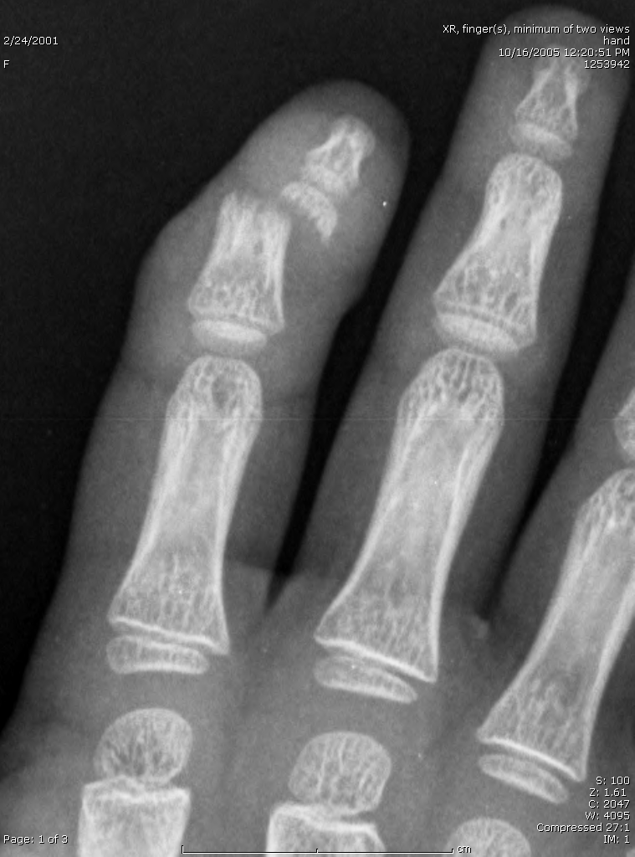
Describe Me
AP view of the right hand. Transverse fracture of the distal portion of the 2nd middle phalanx. The distal fragment is medially displaced and angulated.

Slide 14
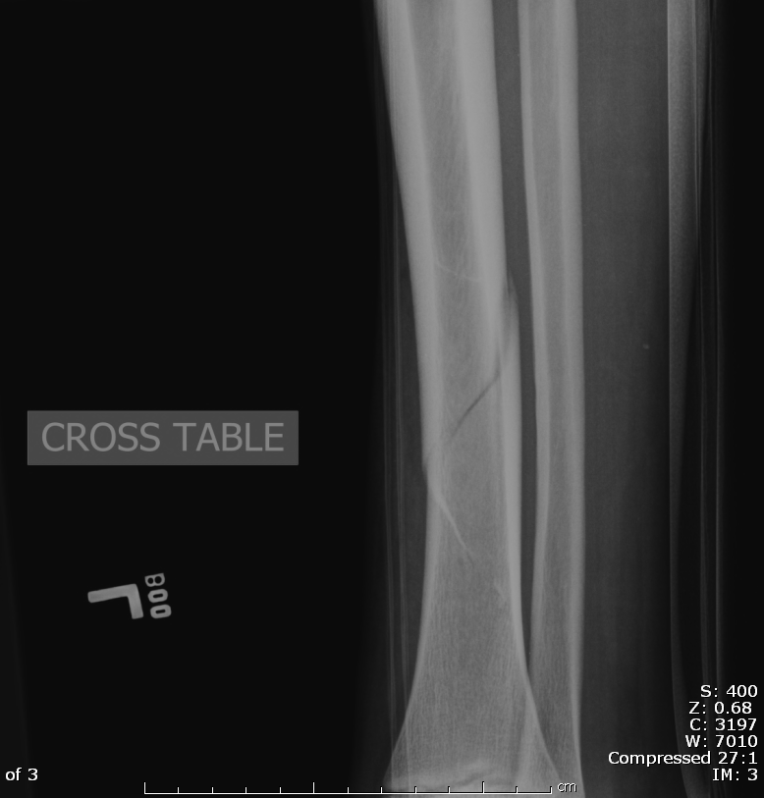
Describe Me
Cross-table lateral view of the left tibia and fibula. Spiral diaphyseal fracture of the distal tibia with minimal displacement (approximately one cortical width).

Slide 15
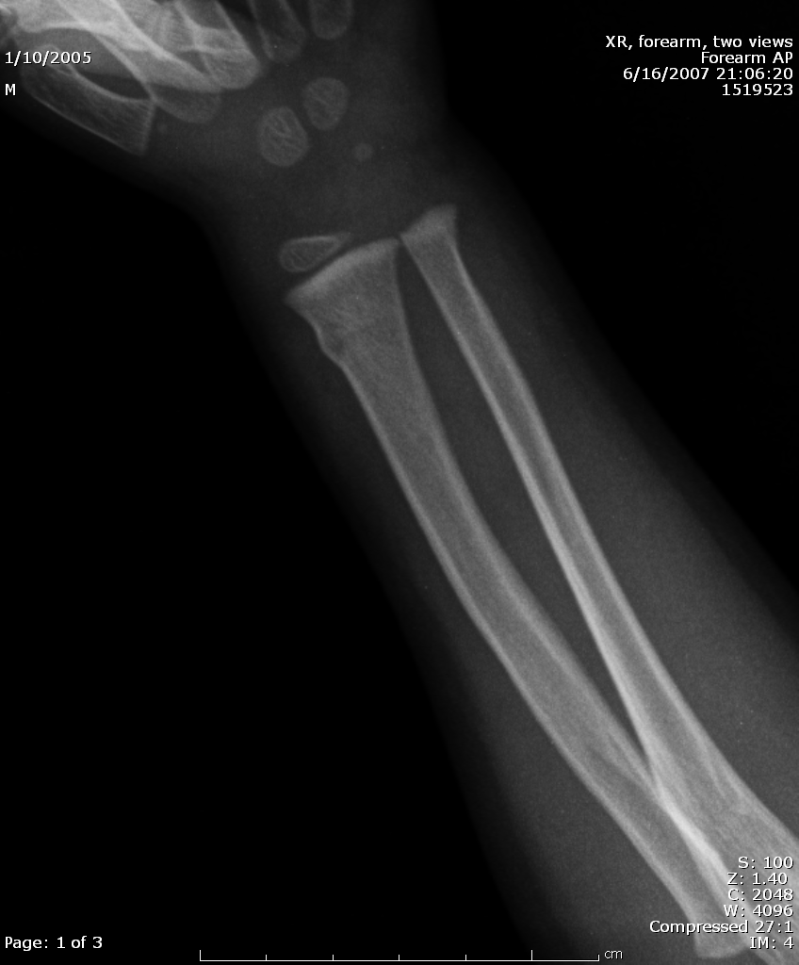
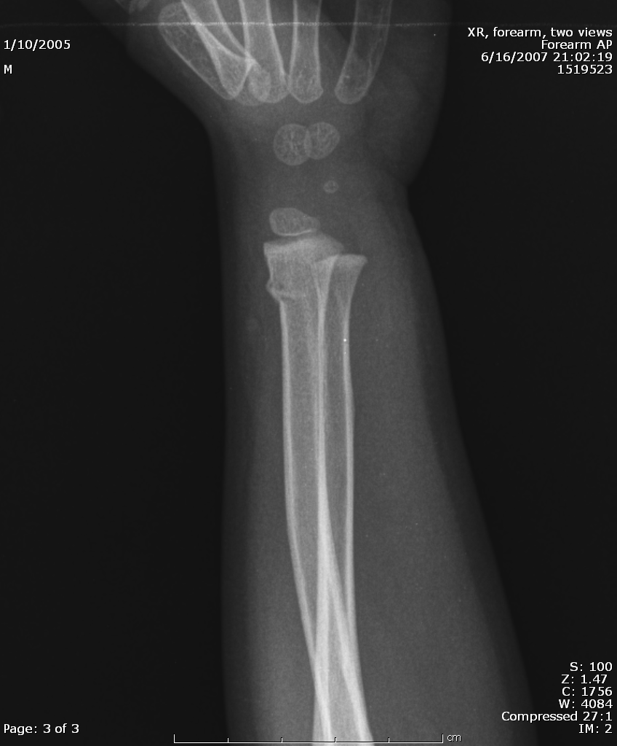
Describe Me
AP and oblique views of the left forearm. Buckle (torus) fracture of the dorsolateral cortex of the distal radial metaphysis. No displacement or angulation.

Slide 16
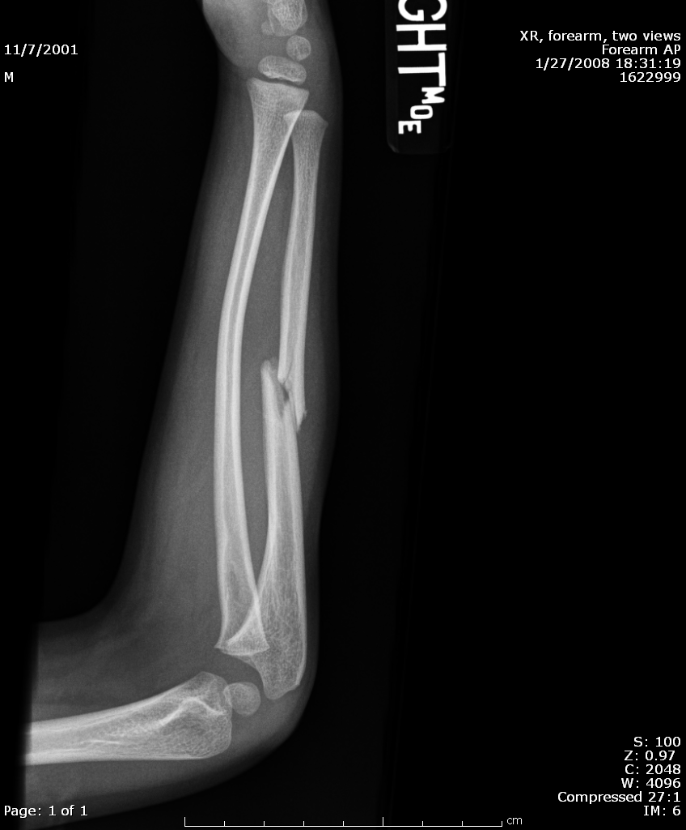
Describe Me
Plastic deformation (bowing deformity) of the right radius and an oblique mid-diaphyseal ulnar fracture with posterior displacement of the distal fragment (one-half shaft-width).

Slide 17
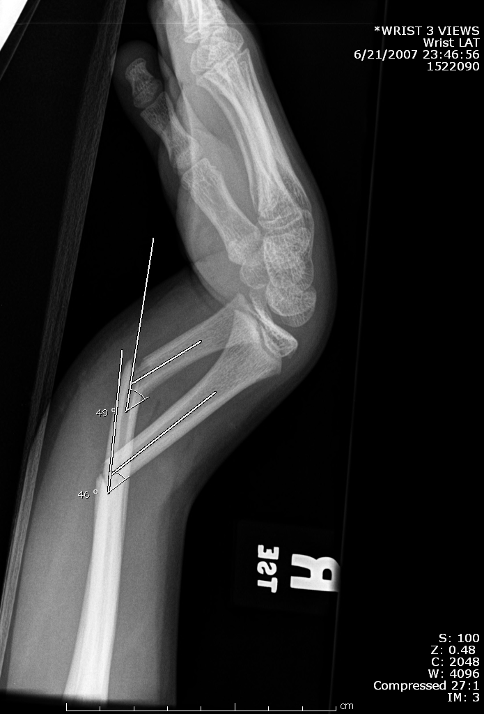
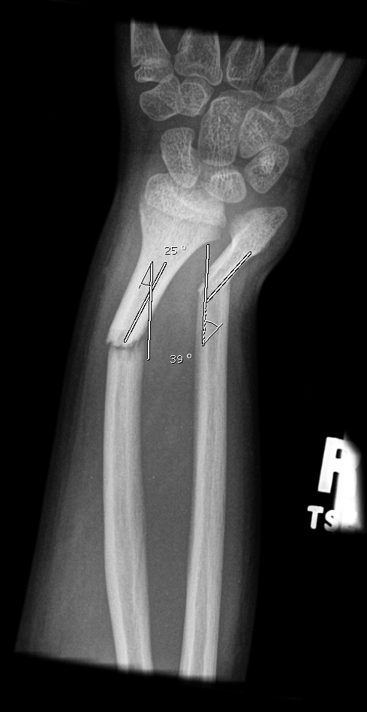
Describe Me
AP and lateral views of the right forearm. Distal radius and ulnar fractures with angulation. Fracture fragments of radius and ulna reveal approximately 45 and dorsal angulation with 30 degrees ulnar angulation

Slide 18
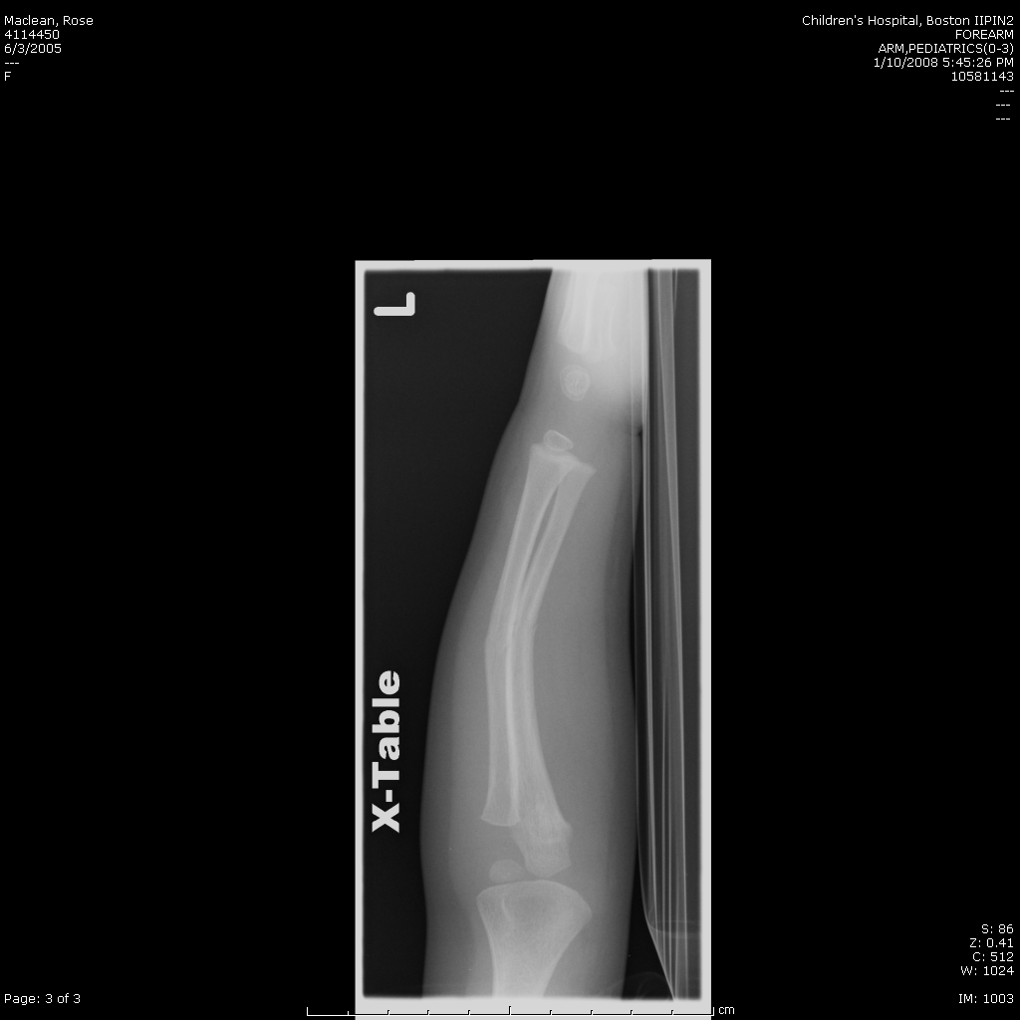
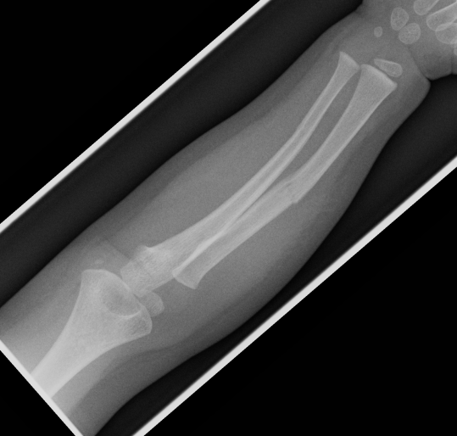
Describe ME
Greenstick fracture of the radius at the mid-diaphysis with a bowing deformity of the ulna

Slide 19

Describe Me
Salter Harris II fracture of distal radius with minimal displacement of Thurston Holland fragment. Also, a transverse fracture of the ulna with distal segment angulated 20 degrees medially.

Slide 20
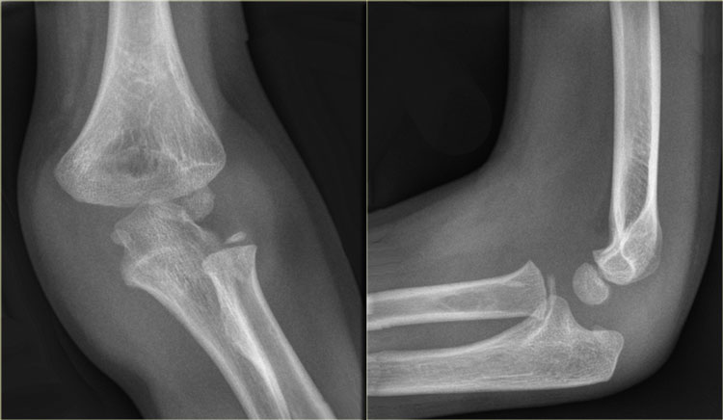
Elbow - Anatomy
Notes:
Humerus, radius, ulnar
Olecranon/fossa, coronoid fossa (the one on the anterior humerus, opposite of olecranon fossa)
Condyles - trochlea, (ulna) capitellum (radius)

Slide 21
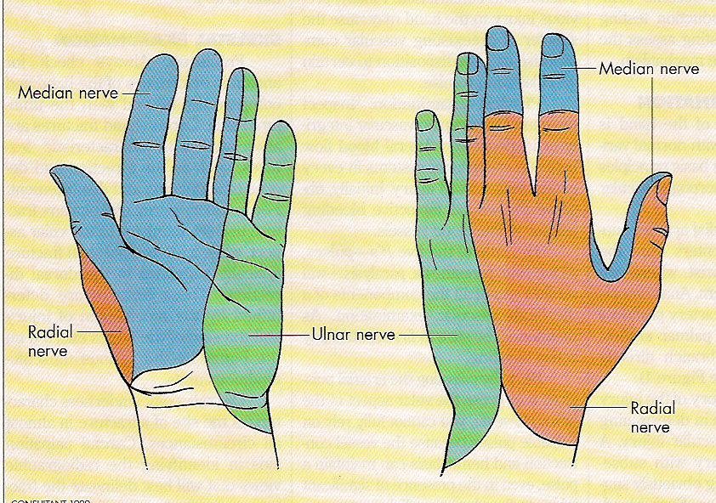
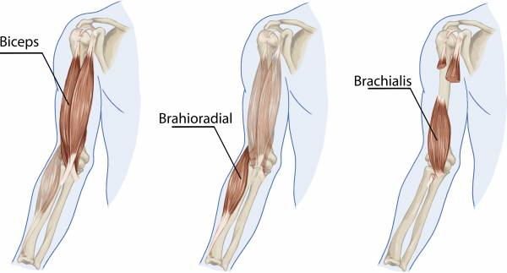
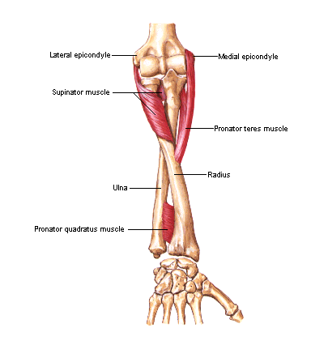
Elbow - Anatomy
Brachial artery superficial to brachialis
  Splits into radial and ulnar near antecubital fossa
Nerves
  Median: crosses elbow with the brachial artery (most common injured)
  Radial: between brachialis and brachioradialis, then penetrates supinator
  Ulnar: Posterior to medial epicondyle
Notes:
●"OK" sign (alternatively, ask the patient to pinch your hand): anterior interosseous nerve (branch of median nerve and radial nerve) (picture 1) [9,10]
●Finger spread against resistance or holding a piece of paper firmly between the middle and ring fingers: ulnar nerve (figure 9)
●Thumb's up sign: radial nerve (figure 10)
The clinician should perform testing of two point discrimination (ie, the ability to recognize two points five millimeters apart applied simultaneously to the skin as distinct from a single point) on the follow sites to evaluate peripheral nerve sensation:
●Dorsal web space – Innervated by the radial nerve
●Palmar index (pointer) finger – Innervated by the median nerve
●Pinky (or little finger) – Innervated by the ulnar nerve

Slide 22
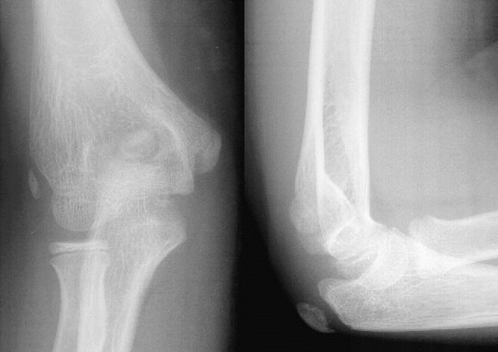
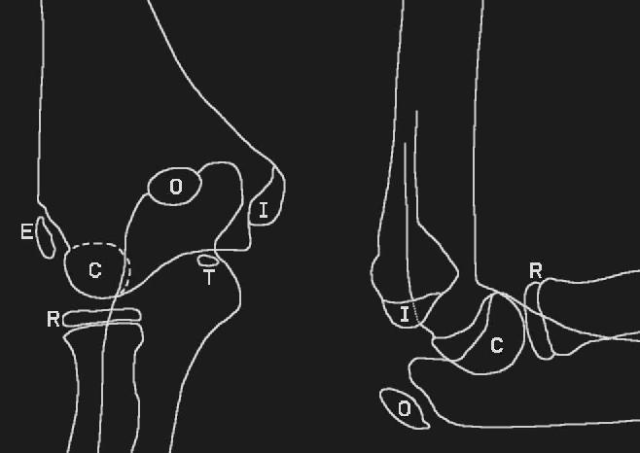
Elbow: *$!#@$ ossification Centers
C - Capitellum - 1
R - Radial head - 3
I - Internal epicondyle - 5
T - Trochlea - 7
O - Olecranon - 9
E - External epicondyle - 11
BUT fuse in different order
  Lateral epicondyle, trochlea, capitellum first fuse to each other
  Unit fuses to distal humerus
  Then medial epicondyle fuses

Slide 23
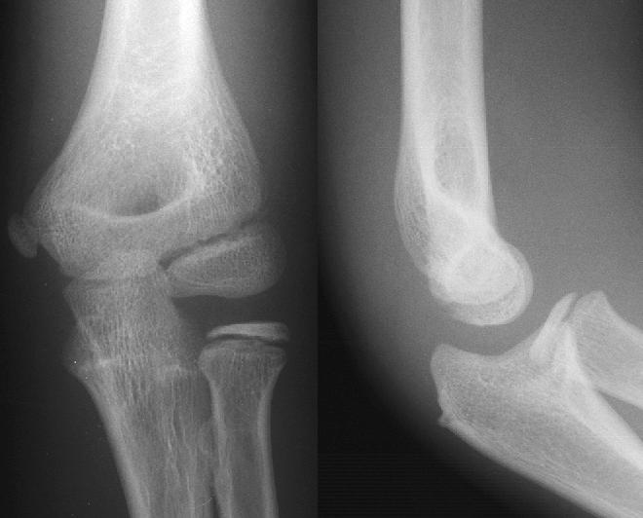
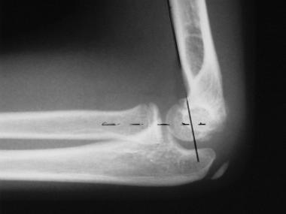
Elbow - Normal X-rays
Notes:
Anterior joint line should intersect capitellum

Slide 24
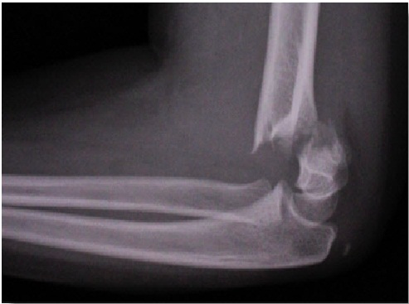
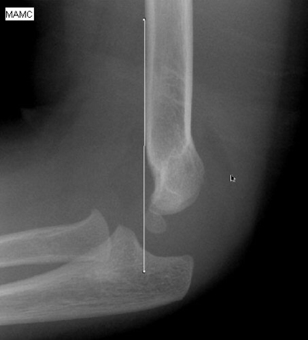
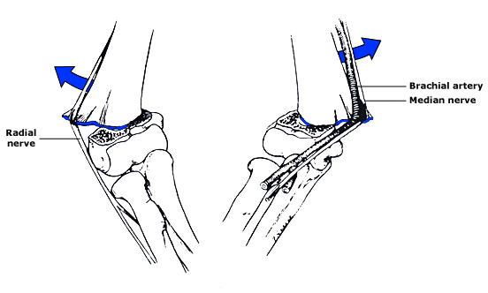
Elbow - Supracondylar
Supracondylar region weaker than surrounding areas
Types I, II, II
Complications
  Nerve injury
  Compartment syndrome
  Volkmann ischemic contracture
  Growth disturbance - distal humeral physis less active than proximal, means less remodeling and correction can occur
    58% without treatment, 3% with
Notes:
Type I - non displaced fracture with elbow effusion (atnerior and posterion periosteum remain intact, so humeral line transects the middle of capitellum)
Type II - displaced fracture with intact posterior periosteum
Type II - displaced with disrupted anterior and posterior periosteum
Neurovascular relations. Right) If the spike of the proximal fracture fragment penetrates medially (posterolateral distal fracture fragment displacement), both the median nerve and brachial artery can be tethered. This type of neurovascular injury is most common. Left) If the proximal fracture fragment spike penetrates the brachialis muscle laterally (posteromedial distal fracture fragment displacement), the radial nerve may be tethered.

Slide 25
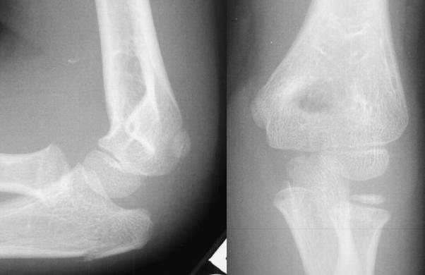
Rapid Fire
Notes:
Olecranon

Slide 26
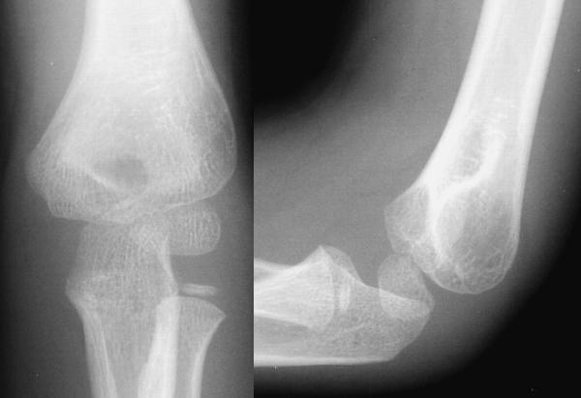
Rapid Fire
Notes:
Joint effusion, post fat pad, no fracture seen

Slide 27
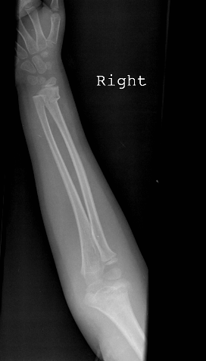
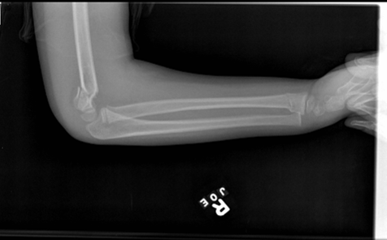
Rapid Fire
Notes:
Type 3 supracondylar

Slide 28
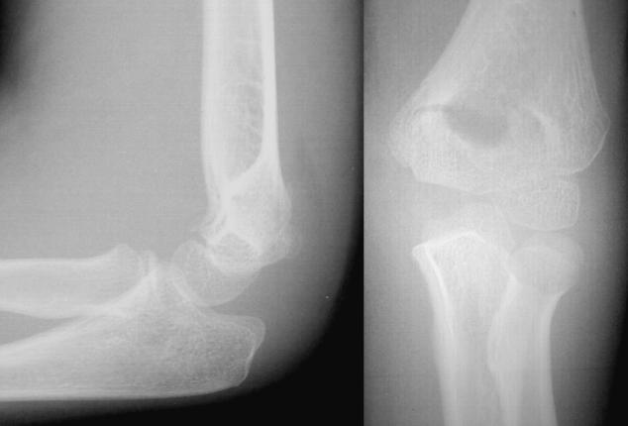
Rapid Fire
Notes:
Joint effusion and supracondylar fracture
Radial fracture (doesn’t align with capitellum)

Slide 29
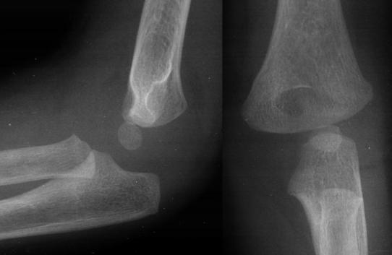
Rapid Fire
Notes:
Supracondylar fracture Type 1 - 2 with posterior fat pad

Slide 30
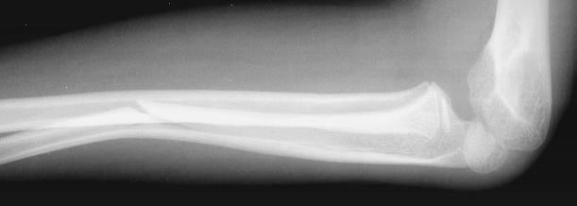
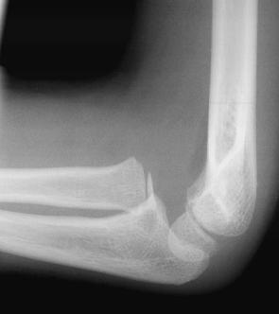
Name that Fracture
Notes:
Monteggia

Slide 31
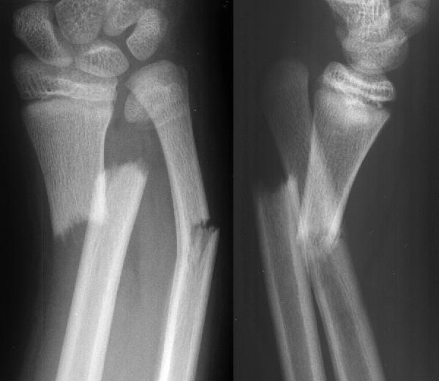
Name that Fracture
Notes:
Galeazzi

Slide 32
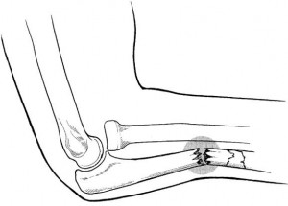
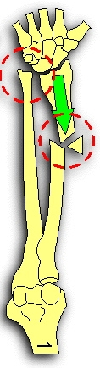
Monteggia vs Galeazzi
MUGR
Monteggia - Ulna
Galeazzi - Radius

Slide 33
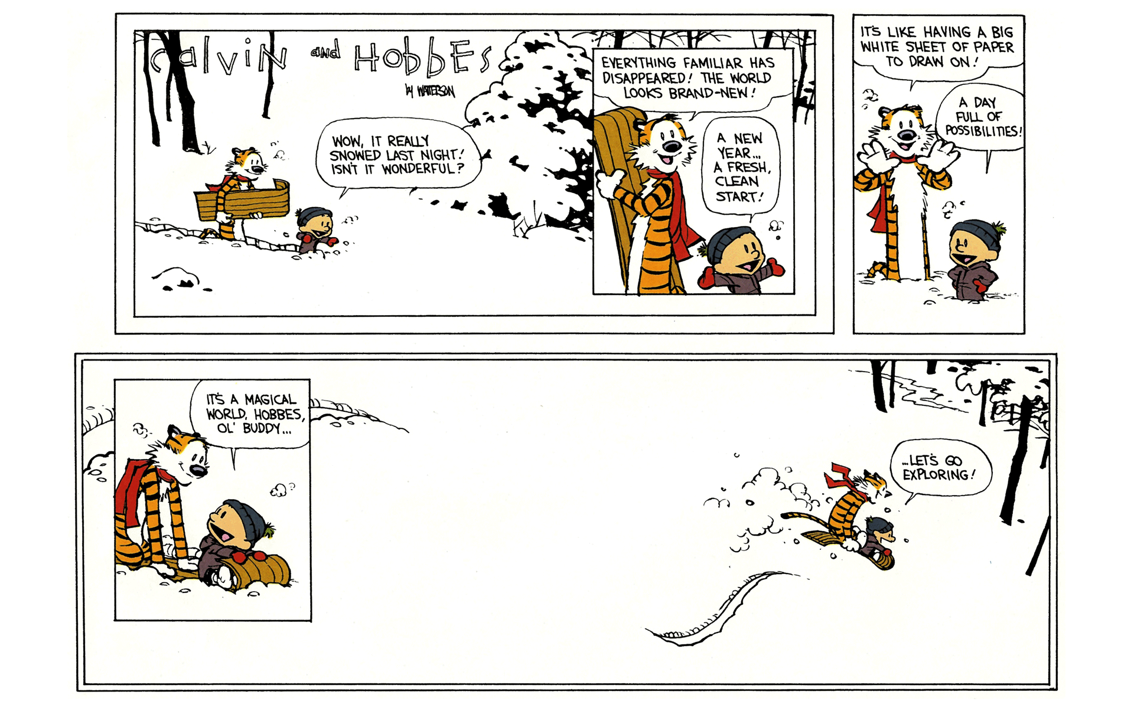
The End!

Slide 34
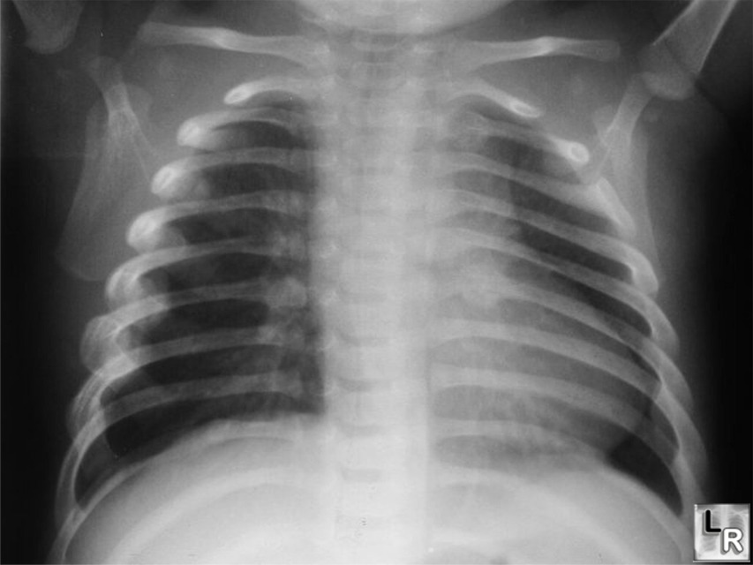
Posterior Rib Fractures

Slide 35
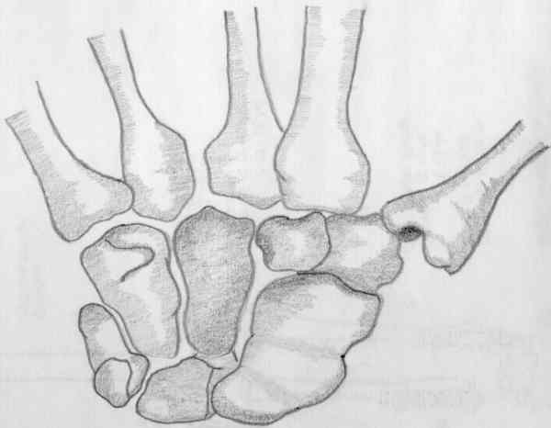
Carpal Bones
T
T
H
C
T
S
P
L

Slide 36

Scaphoid Fracture
Notes:
Dx: Scaphoid fracture (also with distal radial fracture and ulnar styloid fractures).
Case: 16 year old fell off bike onto right hand with hyperextension type injury to wrist. C/o diffuse wrist pain.
Teaching Point:
1. The scaphoid bone is the most commonly fractured carpal bone. These types of fractures are most commonly seen in patients between 15 and 35 years of age as a result of a forceful hyperextension type injury to the wrist.
2. Scaphoid fractures (even if properly diagnosed and treated) have a tendency for dreaded complications, such as avascular necrosis of the proximal fracture portion and non-union. All scaphoid fractures should be referred to Orthopedics.

Slide 37

Notes:
Dx: Hip effusion presentation. Position of comfort with hip flexed, aBducted, and externally rotated (FABER).
Case: 4 year-old previously healthy girl with fever Tmax 39.4, right leg pain, and refusal to bear weight on right LE, presents like this on a stretcher. CBC with WBC 27,000 and ESR 46.
Kocher MS, et al. “Differentiating Between Septic Arthritis and Transient Synovitis of the Hip in Children: An Evidence-Based Clinical Prediction Algorithm.” The Journal of Bone and Joint Surgery 1999: 81A(12): 1662-1670.
Identified 4 independent multivariate predictors for differentiating between septic arthritis and transient synovitis: history of fever, non-weight bearing, ESR >40, WBC >12,000.
Probability of septic arthritis increased with increasing number of predictors present: 0 – <0.2%; 1 – 3.0%, 2 – 40.0%; 3 – 93.1%, 4 – 99.6%.

Slide 38

Right Hip Effusion

Slide 39

Left Hip Effusion

Slide 40

SCFE

Slide 41

Klein’s Lines

Slide 42

Legg-Calve-Perthes

Slide 43

Bipartite Patella

Slide 44

Day 1
Day 3
Day 9
Notes:
Dx: Child Abuse (Classic Metaphyseal Lesions: occur when the extremity is pulled, twisted or shaken forcefully))
Case: 2 month-old with fussiness. On repeated questioning, father states that while he was cleaning the house he tripped over sibling and may have accidentally stepped on baby earlier today.
X-rays: Corner fracture with bucket handle appearance (days 1,3,9) of distal femur. These are SH-II fractures with metaphyseal lesions. On Day #1, corner fractures on both sides of the femur are barely visible. The middle image, taken two days later (Day #3), shows the two corner fractures more clearly. The bottom image, taken on Day #9 shows some periosteal reaction, giving rise to the classic bucket-handle appearance or pattern of healing.
Teaching Points:
1. This type of injury at the physeal-metaphyseal junction is highly suggestive of abuse. The periosteum surrounding the growing long bones is thick and tightly anchored at both ends by heavy extensions into the physeal cartilages. The resultant subperiosteal bleeding lifts the periosteum, forming layers of periosteal new bone away from the cortex to form an external shell of new bone with time.
2. This extremely strong periosteum that is tightly anchored by heavy extensions into the physeal cartilages can easily explain the dynamics of metaphyseal fractures from abuse. Axial ligament and periosteal traction or torsion forces are generated by sudden traction on the extremity, such as occurs when the arms or legs are pulled or swung violently upward or forward. This results in the typical traction "corner" fracture pathognomonic of child abuse. These are well-visualized in the cases described above.

Slide 45


Classic Metaphyseal Lesions (CML)
AKA Bucket Handle
Notes:
This diagram illustrates the phenomenon of corner fractures and bucket handle fractures.
Corner fractures and bucket handle fractures are similar in etiology despite their different names. A small bucket handle fracture may actually appear as a corner fracture on the radiograph depending on the angle of the radiograph.
If the metaphysis is tipped or simply projected obliquely to the X-ray beam, the margin of the resultant fragment is projected with a bucket-handle appearance.

Slide 46

Toddler’s Fracture
Notes:
Dx: Toddler’s fracture (close-up). The white arrows point to a thin lucency – an oblique, nondisplaced, distal tibia fracture (very subtle). The black arrows (with the white outline) point to a vascular groove (not fracture).
Pearl: This is a tough fracture to diagnose, as the physical findings are often subtle and the degree of swelling is minimal. Occasionally, gentle twisting of the lower leg will elicit pain. Even the X-ray findings may be subtle. If a Toddler’s Fracture is suspected clinically, order an internal oblique projection X-ray of the distal tibia. You may also consider a bone scan.

Slide 47

Toddler’s Fracture
Notes:
Another example of Toddler’s fracture. This one’s a bit easier to appreciate.

Slide 48


Tillaux Fracture
Notes:
Dx: Juvenile Tillaux fracture (a SH-III fracture involving avulsion of anterolateral tibial epiphysis)
Case: 13 year-old boy present with right ankle pain and swelling after twisting injury to ankle.
Teaching Points:
Occurs in older adolescents, after the posterior and medial parts of physeal plate (hump = Kump’s Bump is the first to fuse) has closed, but before the antero-lateral part closes (usually 12 to 15 yrs of age).
2. Caused by external rotation force (eversion injury) w/ stress placed on anterior tibiofibular ligament, causing avulsion of distal tibial epiphyseal plate anterolaterally; and further lateral rotation may cause displacement of fracture. The resultant fracture runs through the physeal plate and across the epiphysis and distally into the joint, creating a SH-III fracture.

Slide 49

Tillaux Fracture
Anterior
Lateral
Medial
Posterior
Notes:
Tillaux fracture CT. Posterior is down, lateral is toward the fibula.

Slide 50


Triplane Fracture
Notes:
Dx: Triplane fracture (AP+Lat) It is characterized by fracture lines that run in three planes: coronal, sagittal, and transverse. The anterior and inferior part of this fracture begins intra-articularly in the saggital plane; when the fracture reaches the physeal plate, it courses laterally in a horizontal/transverse plane; the posterior portion changes direction upward in a coronal plane.
Case: 14 year old with left ankle pain and swelling after twisting injury.
X-rays: Appears as SH type III fracture on AP view & SH type II or IV on lateral. The fracture of the antero-lateral portion of epiphysis of distal tibia is similar to Tillaux fracture. The large posterior fragment of the fracture is comprised of the posterior & medial portions of tibial epiphysis plus a metaphyseal fragment of the tibia of variable size. Remember, because the posterior and medial portions of the tibial physis have already fused, these fragments usually stay together as the posterior fracture fragment.
Teaching Points:
Note that the common triplane fracture will contain a juvenile tillaux fracture in addition to the posterior tibial metaphyseal fracture.
Like a Tillaux fracture, occurs when only the middle and medial portions of the distal tibial epiphysis is closed occurs due to external rotation forces. The mechanism of injury is usually forced external rotation (eversion type injury).

Slide 51

Triplane Fracture
Anterior
Posterior
Notes:
Triplane fracture schematic (lateral view).

Slide 52


Jones Fracture
Notes:
Dx: (True) Jones fracture of base of 5th metatarsal.
Case: 19 year-old male presents with foot pain after inversion-type injury to ankle.
Teaching Points:
1. Jones fracture involves fracture at base of fifth metatarsal at metaphyseal-diaphyseal junction.
Jones fracture is located w/in 1.5 cm distal to tuberosity of 5th metatarsal & should not be confused w/ more common avulsion fracture of 5th metatarsal styloid. This fracture is usually more proximal and occurs in younger children.
3. Insertion of the peroneus brevis tendon: can cause avulsion fractures (Jones Type Fracture) in younger kids.
4. Finally, the acute Jones fracture must be distinguished from the chronic Jones fracture (in older adults), the latter of which may represent a chronic stress fracture w/ poor prognosis for healing. Hence, strictly speaking a Jones fracture is an acute injury.
5. Jones fractures may present as an acute lesion or may be seen in chronic phase, and either presentation has a prolonged healing course in adults. Usually, there has been gradual onset of pain on outer side of foot, & only when pain interferes w/ walking does patient seek treatment.

Slide 53
Elbow - Epicondylar
Older males after FOOSH
Medial > Lateral (quite rare)
Transphyseal fractures - associated with child abuse and birth trauma
Forearm extensors - Lateral
Forearm flexors - Medial
In infants and toddlers, distal humeral physis is close to center of olecranon fossa, so more likely to fracture there than supracondylar

Slide 54
Forearm
Forearm fractures most common fracture in children
Anatomy:
  Radius
  Ulna - styloid
  Intraosseous membrane - makes it hard to fracture
  Radio-ulnar articulations
    Proximal - annular ligament
    Distal -
  Physes
Notes:
Talk about triangular fibrocartilage complex (TFCC) attaching at ulnar styloid
Pain with pronation and supination strongly suggests midshaft forearm fracture

Slide 55
Wrist/Hand
Carpal mnemonic
Scaphoid
  Most common carpal fracture
  High risk of chronic non union
  Not just snuffbox tenderness
Boxer’s fracture
Fingers
  Check for rotary displacement
Notes:
Characteristic examination findings include tenderness of the anatomic snuff box, decreased range of motion in flexion and extension, pain with radial deviation or extension of the wrist, and a positive scaphoid compression test.
The scaphoid compression test is performed by holding the thumb and gradually pushing in toward the scaphoid along the longitudinal axis of the thumb metacarpal; elicitation of pain over the palmar scaphoid tubercle constitutes a positive test. Complications of scaphoid fractures include carpal instability, osteonecrosis, and nonunion. (See "Scaphoid fractures", section on 'Symptoms and examination findings'.)

Slide 56
Proximal Humerus
Sling and swathe photo
Axillary nerve risk of injury -
Shoulder dislocation
Not pathognomonic for abuse but if no story - be suspicious
Treatment
  Sling and swath for 4-6 weeks
  Under age 12 have crazy amounts of remodeling potential
    Up to 70 degrees of angulation, 100% displacement
  >12 up to 40 degrees, 50% displacement

Slide 57
Lower Leg
Intraosseous membrane
Crural fascia - surround lower leg, makes the compartments (4)
Distal physis vulnerable to inversion and eversion (esp fibula)
Spiral - Toddlers
  Usually minimal trauma, rotating around a fixed foot
  Isolated to tibia
  Usually minor and non-displaced
  Displaced, or occurring in children not yet ambulatory - ABUSE
Bowing
~30% of tibia fractures have associated fibula fracture

Slide 58
Ankle
Hinge: talus held in place by distal tibia and fibula
Views - What to look for
Tibial physis
  Closes ~ 12 years in girls, 14 in boys
  Closes central → medial → lateral
Tillaux fracture
  SHIII of distal tibia lateral portion
  TTP anterior joint line
  X-rays sometimes normal
Triplane fracture
  SH IV of distal tibia
Notes:
Juvenile Tillaux fracture — This fracture represents a Salter­Harris III physeal injury that involves the anterolateral portion of the tibia. It typically occurs in children between 12 and 14 years of age as they approach skeletal maturity and have a partially fused tibial physis (image 1) [5]. The typical mechanism of injury is inversion of the ankle with the foot pointed away from the midline (supination with external rotation). This mechanism leads to avulsion of the lateral tibial epiphysis that is attached to the anterior inferior tibiofibular ligament (figure 8). The uninvolved medial portion of the epiphysis is closed.
Triplane fracture — Triplane fracture describes a Salter­Harris IV fracture of the tibia that occurs in the sagittal, coronal, and transverse planes and creates between two and four fracture fragments (image 2) [1,5]. Children with these fractures have an average age of 13 years. The mechanism of injury is debated but many orthopedists feel it involves inversion of the ankle with extreme turning out of the foot (supination with external rotation) [1].

Slide 59
For reference

Slide 60
Ankle Decision rules
Only 17 % of pediatric ED ankle visits have visible bony fracture
But ordered on >90% of patients
Notes:
Low Risk Ankle Rule — Use of the Low Risk Ankle Rule (LRAR) in addition to routine physical examination for children 3 to 16 years of age with acute isolated ankle injuries may be helpful in determining when plain radiographs of the ankle are not required [9,12]. Children are considered low risk by the LRAR and not in need of radiography at initial presentation if the following conditions are met:
●The injury is acute (<3 days old)
●The child is not at risk for pathological fractures (eg, osteogenesis imperfecta or known focal bone lesion such as an osteoid osteoma)
●The child has no congenital anomaly of the feet or ankles ●The child can reliably express pain or tenderness
●Physical examination demonstrates tenderness or swelling confined to the distal fibula and/or adjacent lateral ligaments distal to the anterior tibial joint line (figure 5)
●No gross deformity, neurovascular compromise, or other serious and potentially distracting injury are present
The LRAR regards distal fibular avulsion fractures and nondisplaced Salter­Harris I and II fractures as low risk injuries because they can be managed with supportive splinting, crutches as needed, and return to activities as tolerated by the patient. (See 'Distal fibula fractures' below.)
The LRAR has a reported sensitivity for the detection of clinically important ankle fractures in children of 98 to 100 percent and a negative predictive value for high risk injury of 99.7 percent when the prevalence of clinically important fractures is about 7 percent [9,12].
In a multicenter implementation study of the LRAR in six Canadian emergency departments, including community, general, and pediatric facilities evaluating 2151 children with ankle injuries, use of the LRAR reduced ankle radiography by 22 percent when compared to routine clinical practice with no significant difference in missed high risk fractures and physician or patient satisfaction [9]. Furthermore, 94 percent of the participating physicians were willing to apply a symptomatic care strategy to this group of low risk ankle injuries indicating a high physician acceptance of the rule and the related management strategy for those cases where radiography is not indicated and/or considered low risk for long­term complications. Subsequent cost analysis showed significant overall cost reductions when the LRAR was used [14]. The greatest savings were due to lower radiography costs, and fewer orthopedic or emergency department follow­up visits.
Ottawa Ankle Rules — In contrast to the experience in adults, the use of the Ottawa Ankle Rules (OAR) in children is less likely to reduce radiographic testing beyond those seen when no clinical rules are used. Thus, the clinical utility of the OAR for pediatric injuries is uncertain.
The OAR was initially derived, validated, and implemented in adults and has a reported sensitivity approaching 100 percent in this population. The rule is described in the figure (figure 6). Utilization of the OAR in adults may reduce ankle radiography by as much as 30 percent without missing significant fractures. A significant fracture as defined by the OAR is considered any fracture >3 mm. (See "Ankle sprain", section on 'Ottawa ankle rules'.)
A systematic review of 12 pediatric studies (3130 children over two years of age) found a pooled sensitivity of 98.5 percent for the OAR [7]. Specificity had a range of 8 to 47 percent among the studies and a pooled estimate was not performed because of significant heterogeneity among the studies. The missed fracture rate given a negative OAR assessment was 1.2 percent (95% CI 0.6­2.3 percent) [7]. Based upon these findings, application of the OAR in children had an estimated reduction in radiography of 25 percent.
However, in prospective validation studies of the OAR in children younger than 16 years of age with acute ankle injuries, the relative reduction in ankle radiography has only been approximately 10 percent [12,13,15]. Implementation studies of the OAR in children are lacking.
Two­Part Malleolar Zone Rule — The PMZ has not undergone validation or implementation studies. Thus, the benefits of its use in children are not known.
The Two­Part Malleolar Zone (PMZ) Rule was derived in children under 18 years of age with an acute ankle twisting injury [13]. Patients were considered to be at low risk for a significant fracture (defined as any fracture except avulsion fractures ≤3 mm) if they met the following criteria:
●No swelling or bony tenderness over any part of the medial or lateral malleolus ●No fibular tenderness proximal to the malleolus
●Able to walk at least four steps at initial presentation
During initial derivation, the PMZ had a sensitivity of 100 percent for significant fracture with an estimated reduction in radiography of 17 percent [13]. However, a subsequent prospective study of 272 children younger than 16 years with acute ankle injury found a sensitivity for any fracture, other than a Salter I fracture of 94 percent and no reduction in radiography for the PMZ when compared to examination alone [16].

Slide 61
Foot
Notes:
CLINICAL ANATOMY — From an anatomic perspective, the foot is divided into three regions (figure 1A­C): ●Forefoot – Metatarsal and phalangeal bones
●Midfoot – Navicular, cuboid, and cuneiform bones
●Hindfoot – Talus and calcaneus
The Lisfranc joint separates the forefoot from the midfoot. The Chopart joint divides the hindfoot and the midfoot.
Additional foot anatomy common to children and adults is discussed separately. (See "Metatarsal shaft fractures", section on 'Clinical anatomy' and "Toe fractures in adults", section on 'Clinical anatomy'.)
The pediatric toe and forefoot differ from the adult foot due to the presence of growth plates (figure 2). Injury to the
Jason Woods <woodsy@gmail.com>
https://mail.google.com/mail/ca/u/0/?ui=2&ik=00d3617799&view=pt&search=inbox&msg=1541b044240dc01b&siml=1541b044240dc01b 1/7
4/15/2016 Gmail - jason has sent you an UpToDate topic
growth plate may rarely lead to growth arrest and permanent deformity. (See 'Complications' below.)
These growth plates typically close around age 16 years in females and age 18 years in males. Thus, management of metatarsal and toe fractures in older adolescents is the same as for adults. (See "Toe fractures in adults".)
RADIOGRAPHIC FINDINGS — We suggest that patients with significant pain, swelling, or deformity of the forefoot or toe receive plain radiographs, including anterior­posterior, lateral, and oblique views [4]. Growth plate injuries are described using the Salter­Harris classification system (figure 3).
Radiographic findings include growth plate, cortical, and buckle fractures. Salter­Harris I through Salter­Harris III fractures are most common in the great toe (figure 3). (See "General principles of fracture management: Fracture patterns and description in children", section on 'Fracture patterns'.)
Initial radiographs are typically normal in children with Salter­Harris I fractures or metatarsal stress fractures. Repeat radiographs two weeks later show periosteal reaction and callus formation. Bone scan is helpful in doubtful cases, especially for the diagnosis of early stress fractures in adolescents.
The following normal variants may be mistaken for fractures on radiograph (figure 1A­C): ●Sesamoid bones of the first metatarsal
●Accessory ossicles (eg, os trigonum, os subfibulare)
●Bipartite epiphysis of the great toe (normal variant)
●Os vesalianum or apophyseal ossification center at the base of the fifth metatarsal. The apophyseal center appears around eight years of age. Fusion usually is complete by 12 years in girls and 15 years in boys. This is
https://mail.google.com/mail/ca/u/0/?ui=2&ik=00d3617799&view=pt&search=inbox&msg=1541b044240dc01b&siml=1541b044240dc01b 2/7
4/15/2016 Gmail - jason has sent you an UpToDate topic
typically distinguished from fracture due to the longitudinal orientation of the ossified apophysis, absence of local tenderness, swelling, or separation of this ossification center from the base of the fifth metatarsal.
Acute fractures of the proximal diaphysis (Jones fracture), first described by Jones in 1902, occur within 1.5 cm of the metatarsal tuberosity and extend towards or into the intermetatarsal joint (figure 5 and figure 6). The area where these fractures occur is referred to using different terms, including "proximal diaphysis" and "junction of the metaphysis and diaphysis." This region is at some risk for painful nonunion (image 2 and image 3). Initial care consists of immobilization with a below­knee non­weight bearing cast or splint and orthopedic consultation within one week. Symptomatic nonunion can occur in children and young adolescents with a Jones fracture [13]. However, most can be managed nonoperatively. As an example, in a retrospective observational study of 24 patients with Jones fractures, 18 healed successfully without surgery [12]. For older elite adolescent athletes, surgery may result in more rapid healing. (See "Proximal fifth metatarsal fractures", section on 'Acute fractures of the proximal diaphysis (Jones fracture)'.)
https://mail.google.com/mail/ca/u/0/?ui=2&ik=00d3617799&view=pt&search=inbox&msg=1541b044240dc01b&siml=1541b044240dc01b 4/7
4/15/2016 Gmail - jason has sent you an UpToDate topic
Stress fractures — These fractures most frequently affect young athletes (eg, long distance runners, gymnasts) and most commonly occur in the neck of the second metatarsal. They usually respond well to cessation of the causative activity for four to eight weeks. Crutches and partial weight bearing for several weeks may be helpful in patients who have mild to moderate pain with walking. A short leg cast with non­weight bearing is appropriate for patients with severe pain. Metatarsal stress fractures are discussed in more detail separately. (See "Stress fractures of the metatarsal shaft".)
Although relatively uncommon, stress fractures of the proximal diaphysis of the fifth metatarsal have high rates of nonunion. They generally occur as a result of repetitive stress. We advise early referral to an orthopedist with pediatric expertise. These injuries are discussed in greater detail separately. (See "Proximal fifth metatarsal fractures", section on 'Stress fractures of the proximal diaphysis'.)

Slide 62
Skull
Notes:
Linear — Linear fractures account for approximately 75 percent of skull fractures in children. They are single fracture lines that involve the thickness of the skull and may disrupt underlying vascular structures. They start at the point of maximum impact and spread but do not cross suture lines.
Linear fractures occur most frequently in the parietal bone but can occur in any bone of the calvarium. Of linear skull fractures, 15 to 30 percent are associated with intracranial injury [8]. Most linear skull fractures have associated physical examination findings, including overlying hematoma or soft tissue swelling; the soft­tissue swelling may not be present immediately after the injury [8].
Scalp hematomas are predictive of skull fractures in infants younger than one year of age [1,9,16]. In one prospective study of 422 asymptomatic infants with head injury, hematomas of the parietal or temporal regions increased the likelihood of underlying skull fracture, whereas hematomas of the frontal region did not (odds ratio: 38, 16, and 0.6 for parietal, temporal, and frontal hematoma, respectively) [17]. In addition, a stepwise relationship was noted between the size of the hematoma and the likelihood of skull fracture (odds ratio 27, 5.5, and 3, for large, moderate, and small hematomas, respectively). However, most children with isolated scalp hematomas and no other clinical symptoms do not have a clinically important traumatic brain injury. (See "Minor head trauma in infants and children: Evaluation", section on 'Scalp hematoma'.)
Complications — Most linear skull fractures heal without complication. Rare complications include formation of subgaleal or epidural hematoma.
●Formation of subgaleal hematoma is the most common complication of linear skull fractures. Subgaleal hematomas cause localized swelling that may be extensive enough to cause anemia. They usually absorb without
https://mail.google.com/mail/ca/u/0/?ui=2&ik=00d3617799&view=pt&search=inbox&msg=1541b09522c313e8&siml=1541b09522c313e8 2/10
4/15/2016 Gmail - jason has sent you an UpToDate topic
intervention.
●Formation of epidural hematomas is another complication of linear skull fractures. Fractures of the temporal bone that involve the middle meningeal artery may cause epidural hematomas of the temporoparietal region. Fractures of the occipital bone that involve a venous sinus may cause epidural hematomas of the posterior fossa.
Comminuted — Comminuted skull fractures consist of multiple associated linear fractures. They usually result from larger forces of impact than do single linear fractures. Stellate or comminuted fractures of the occipital bone often result from repeated blows against an object, and may suggest child abuse. (See "Physical abuse in children: Diagnostic evaluation and management".)
Depressed — Depressed skull fractures are the result of significant force and frequently are associated with underlying cerebral injury. They may result from blows over small areas (eg, from a hammer or heel of a shoe). The depressed bone can lacerate the underlying dura or penetrate the brain tissue [15]. Depressed skull fractures increase the likelihood of posttraumatic seizures and infection.
Open — Open skull fractures are skull fractures that permit communication between the skull and the scalp or mucosal surfaces of the upper respiratory tract. Open fractures increase the risk of central nervous system (CNS) infection. The two types of open skull fractures are:
●Skull fractures that have an overlying laceration, also called compound fractures.
●Skull fractures that disrupt the paranasal sinuses or middle ear and may be associated with cerebrospinal fluid (CSF) rhinorrhea or otorrhea. The evaluation of suspected cerebrospinal fluid (CSF) rhinorrhea is discussed separately. (See "Nasal trauma and fractures in children".)
Skull radiographs — Skull radiographs can be used to identify and classify skull fractures. However, computed tomography of the head, either standard or three dimensional projections, are more accurate for diagnosing pediatric skull fractures [34,35]. Furthermore, the absence of a fracture does not reliably exclude intracranial injury. This was illustrated in a meta­analysis of 16 studies to evaluate variables that predict significant intracranial injury (ICI) in children with minor head trauma [36]. Although presence of a skull fracture was a good predictor of intracranial injury, with a relative risk of 6.1 (95% CI 3.4­11.2), it was neither sensitive (59 percent) nor specific (88 percent) enough to perform well as a diagnostic test. Thus, plain radiographs should not be used as a screening test to determine whether a child with known head trauma should undergo CT to identify ICI.
Skull radiographs may be indicated when the history of trauma is uncertain (eg, skeletal survey in the evaluation of suspected abuse), or to rule out the presence of a superficial foreign body [37]. However, they should only be performed when interpretation by a pediatric radiologist or specialist with similar expertise (eg, pediatric neurosurgeon) is available. Interpretation by other physicians is likely to have poor sensitivity and specificity. As an example, when reading skull radiographs of children younger than two years of age, pediatric emergency physicians identified skull fractures with a sensitivity of 76 percent and a specificity of 84 percent [38].
Children who have any fracture on skull radiographs should undergo CT. Fractures that are depressed, open, or cross the middle meningeal artery groove are particularly concerning.

Slide 63
Signs of abuse
Notes:
Kids' Inpatient Database (discharge data on 80 percent of acute pediatric hospitalizations in the United States) for 1997, 2000, and 2003 indicate that child abuse accounts for approximately 12 percent of fracture­related hospitalizations in children younger than 36 months [12]. The proportion of fracture hospitalizations attributed to abuse decreased with increasing age (25 percent for children <12 months of age, 7 percent for children 12 to 23 months of age, and 3 percent for children 24 to 35 months of age) [12]. In a retrospective review of 258 patient visits with abusive fractures, 20 percent had at least one previous physician encounter for the fracture at which the possibility of abuse was not raised [13].
In the largest study of inflicted fractures (429 fractures in 189 children), the median age was seven months (range <1 month to 13 years); 69 percent of the patients were younger than one year of age, 17 percent were between one and two years of age, and 14 percent were older than two years of age [7]. This study also provided a description of some of the characteristic features of the fractures associated with child abuse, including the following:
●50 percent of the patients had only a single fracture; 21 percent had two fractures, 12 percent had three, and 17 percent had more than three.
●Among the patients with a single fracture, the femur was the most common location (35 percent), followed by the humerus (29 percent), and the skull (16 percent); all of the single long­bone fractures occurred in the middle one­ third of the bone.
●Among long­bone fractures, transverse fractures were most common (48 percent), followed by spiral fractures (26 percent), avulsion fractures (16 percent), and oblique fractures (10 percent).
Although there are musculoskeletal injuries or patterns of injury that are highly suggestive of child abuse, there are no pathognomonic musculoskeletal injuries.
Aspects of the history that increase the level of suspicion for inflicted injuries include [11,20]: ●Inconsistencies and/or discrepancies in caretakers' accounts of the circumstances surrounding the injury ●Unwitnessed injuries
●Injuries attributed to the patient's siblings
●Injuries inconsistent with the child's developmental stage
●Injuries inconsistent with the mechanism of injury offered
Fracture age — Clinicians may be asked to determine the age of fractures diagnosed by skeletal survey. There is a general timetable of the stages of fracture healing by which practitioners can estimate the approximate age of individual injuries (table 2).
●Soft­tissue changes (obliteration of the normal fat planes and muscle boundaries), secondary to hemorrhage or inflammation, are the first radiographically apparent signs of musculoskeletal injury [46]. These changes usually persist for several days [47,48].
●Periosteal new bone formation, which is detectable on plain radiographs only after it becomes calcified, may occur as early as four days after injury, but usually occurs between 7 and 14 days [46].
●As necrotic bone is resorbed, the margins of the fracture lines become blurred, and the fracture gap widens [46]. This process peaks between two and three weeks after injury and may be the only means of dating metaphyseal fractures [47,48].
●Soft callus, from the production and calcification of osteoid, is visible as an increase in density soon after the appearance of periosteal new bone.
●Hard callus (the lamellar bone that bridges the fracture site, filling in the fracture line) appears approximately one week after soft callus. This phase of healing is usually complete between three and six weeks after injury [48,49].
Fractures that are highly suggestive of intentional injury include [8,10,14,59,65,70,71]: ●Metaphyseal corner fractures (image 1 and image 2 and figure 1)
●Rib fractures (image 3)
●Fractures of the sternum, scapula, or spinous processes
●Multiple fractures in various stages of healing (image 4)
●Bilateral acute long­bone fractures
●Vertebral body fractures and subluxations in the absence of a history of high force trauma
●Digital fractures in children younger than 36 months of age or without a corresponding history
●Epiphyseal separations
●Complex skull fractures in children younger than 18 months of age, particularly without a corresponding history
Fractures with less specificity for abuse include [8,65]:
●Isolated long­bone fractures in ambulatory children
●Linear skull fractures
●Clavicle fractures
●Subperiosteal new bone formation
Long­bone fractures — The long bones most commonly injured in child abuse are the femur, humerus, and tibia [7,67]. Isolated fractures of the tibia and femur are common in toddlers and may result from low­energy falls [74].
Femur fractures — The peak age of incidence for femur fractures is between two and three years; boys outnumber girls by approximately 3:1 [75]. Among children younger than one year of age, child abuse accounts for 60 to 80 percent of femoral shaft fractures [67,76,77]. Among children older than one year of age who have femoral shaft fractures, there are no clinical features (eg, fracture type) that absolutely differentiate intentional from unintentional injury [78,79].

Slide 64
Signs of abuse
Notes:
Metaphyseal — Certain types of metaphyseal fractures are considered highly suggestive of child abuse [8,9,36,89], particularly when present in more than one bone. These metaphyseal fractures account for between 11 and 28 percent of nonaccidental long­bone injuries [7,66,83].
The classic metaphyseal lesion (CML) is also called a "corner" or "bucket­handle" fracture. CMLs occur when the extremity is pulled or twisted forcibly, or the child is shaken [90­92]. CML fractures that occur in infants who are not yet walking are highly associated with child abuse [93]. The resultant shearing force undercuts an isolated peripheral fragment of the metaphysis that includes the subperiosteal bone collar, resulting in a disk­shaped bone fragment that is wider at the edges than at the center (figure 3 and image 2) [54,71,94,95]. Rarely, CMLs can occur from unintentional mechanisms which result in significant twisting motion at the knee [96]. Iatrogenic CML has occurred in one infant who was subject to cephalic version and subsequent delivery by Caesarean section and in eight young infants receiving treatment for club foot [97,98].
CMLs are typically asymptomatic, causing pain only when severe or accompanied by epiphyseal displacement [71]. Plain radiographs reveal a disruption of the metaphysis with lucency [9]. The radiographic projection influences the appearance of the lesion. When viewed tangentially, the lesion appears as a triangular fragment of the metaphysis (ie, the "corner" fracture) (image 1); if an angulated view is obtained, the fragment appears as a curvilinear density adjacent to the metaphysis (ie, the "bucket handle"). Repeated injury results in widening of the radiolucent zone and traumatic cupping of the metaphysis [9].
Rib fractures — Rib fractures are produced by direct blows to the chest or compression of the chest (eg, as the torso is grasped during squeezing or shaking) [8]. Children's ribs are flexible and difficult to fracture, so a rib fracture in the absence of a history of severe trauma such as a motor vehicle crash or fall from a significant height is strongly suggestive of child abuse [8,36,99], particularly if the fractures are of the first rib [100]. The force used for chest compressions in cardiopulmonary resuscitation of infants is not great enough to cause rib fractures [101­ 103].
The predictive value of rib fractures as an indicator of child abuse was evaluated in a meta­analysis of seven cross­sectional studies [70]. When children with significant trauma (eg, motor vehicle crash) and postoperative children were excluded, the probability of abuse in children with a rib fracture was 71 percent (95% CI 42­91 percent). Six of the seven studies indicated that the number of rib fractures was greater in abused than nonabused children [70]. Inflicted rib fractures usually are nondisplaced and involve multiple sequential ribs (corresponding to the positioning of the abuser's fingers) (image 3) [8,9,102]. Two studies in the meta­analysis confirmed that anterior rib fractures were more common in abuse and that lateral fractures were more common in nonabuse [104,105]. Information regarding the predictive value of posterior rib fractures for abuse was
https://mail.google.com/mail/ca/u/0/?ui=2&ik=00d3617799&view=pt&search=inbox&msg=1541b026d5e9389b&siml=1541b026d5e9389b 7/15
4/15/2016 Gmail - jason has sent you an UpToDate topic
inconsistent [104­106].
Inflicted rib fractures are associated with a high risk of mortality from related injuries because of the degree of force that is required to produce them [8]. Nonetheless, external signs of injury may be absent. In addition, rib fractures may be difficult to detect on radiographs because of overlapping structures [71]. In one study of 31 infants who died as a result of abuse, 51 percent (84 of 165) of fractures involved the ribs [107]. Only 36 percent of the rib fractures were visible on skeletal survey; the remainder required specialized imaging or pathologic analysis.
Rib fractures are most apparent during the stage of callus formation, 10 to 14 days after the injury (table 2) [9]. Asymmetry of the rib necks from side to side or between upper and lower ribs is a radiographic sign of healing rib fractures. The asymmetry is due to widening of the neck of the rib from apposition of subperiosteal bone [71]. The addition of oblique views and/or radionuclide imaging (image 3) increases ability to detect rib fractures in children suspected to be victims of nonaccidental trauma [8,32,38,52,56].

Slide 65
Abuse: Skull
Notes:
Skull fractures — Skull fractures are frequently seen in abused children. Linear, parietal skull fractures are the most common type of skull injury following both unintentional and inflicted trauma. Complicated skull fractures (ie, complex [eg, stellate, branching], multiple, bilateral, crossing suture lines, depressed, or diastatic) are suggestive of abusive head trauma, but also occur following unintentional injury. (See "Child abuse: Epidemiology, mechanisms, and types of abusive head trauma in infants and children", section on 'Skull fractures'.)
https://mail.google.com/mail/ca/u/0/?ui=2&ik=00d3617799&view=pt&search=inbox&msg=1541b026d5e9389b&siml=1541b026d5e9389b 8/15
4/15/2016 Gmail - jason has sent you an UpToDate topic
Given the potentially similar features of accidental and inflicted skull fractures, these injuries should be evaluated in the context of the history that is provided by the child's caregiver(s). Abusive injury should be suspected if the history is inconsistent with the physical examination findings. If the mechanism of injury is a fall, it is important to determine the height of the fall and the type of surface of impact (eg, concrete, wood, carpet). In general, falls from two feet or less are unlikely to produce head injuries more serious than linear skull fractures. (See "Child abuse: Epidemiology, mechanisms, and types of abusive head trauma in infants and children", section on 'Skull fractures' and "Physical abuse in children: Diagnostic evaluation and management", section on 'Medical evaluation' and "Prevention of falls in children".)
Other fractures — Fractures of the sternum, scapula, and pelvis are suspicious for child abuse if they occur in the absence of a plausible history of high­energy injury, such as a motor vehicle accident [8,10,14,31,116,117].
In addition, fractures of the hands and feet, particularly in nonambulatory children, should raise the suspicion of child abuse [54,118]. It may be necessary to obtain oblique or high­detail, coned­down radiographs to detect these subtle lesions, which typically include torus fractures of the metacarpals and metatarsals, and buckle fractures of the proximal phalanges (from forced hyperextension) [118].

Slide 66
Compartment Syndrome

Slide 67
Clavicle
Still need article

Slide 68
Shoulder
Still need article

Slide 69
Hip
Still need article
Notes:
SCFE
Legg-Calve-Perthes

Slide 70
Knee
Still need up to date

Slide 71
Patella
Fractures incredibly rare
Need high force, direct blow
Weird normal anatomy
  Bipartite
Watch for high riding patella
“Sleeve” fractures
If injured need to evaluated the extensor mechanism
  Extend knee
  OR straight leg raise
Dislocation
  Lateral most common
  Focal bony tenderness should be absent
  Need more here

Slide 72
Femur
Still need uptodate
Signs of ACL tear etc

Slide 73
Slides from other people to put in

Slide 74
Scaphoid Fracture
Notes:
Dx: Scaphoid fracture (also with distal radial fracture and ulnar styloid fractures).
Case: 16 year old fell off bike onto right hand with hyperextension type injury to wrist. C/o diffuse wrist pain.
Teaching Point:
1. The scaphoid bone is the most commonly fractured carpal bone. These types of fractures are most commonly seen in patients between 15 and 35 years of age as a result of a forceful hyperextension type injury to the wrist.
2. Scaphoid fractures (even if properly diagnosed and treated) have a tendency for dreaded complications, such as avascular necrosis of the proximal fracture portion and non-union. All scaphoid fractures should be referred to Orthopedics.

Slide 75
Carpal Bones
T
T
H
C
T
S
P
L
Notes:
Carpal bones schematic (right wrist). “Some Lovers Try Positions That They Cannot Handle!”
Scaphoid
Lunate
Triquetral
Pisiform
Trapezium
Trapezoid
Capitate
Hamate

Slide 76


Scaphoid Fracture
Notes:
The anatomic snuffbox (between the tendons of the extensor pollicis longus and extensor pollicis brevis).
Best position of the wrist for examining the scaphoid bone is 30 degrees of wrist flexion and mild ulnar deviation: allows the scaphoid to slip out from beneath the radial styloid, making it more easily palpable in the anatomic snuffbox.
Point tenderness in the "anatomic snuff box" region should always alert one to the possibility of a scaphoid (navicular) fracture.
Another better example of scaphoid fracture.
Ulnar deviation of the wrist is key to moving the scaphoid bone out from underneath the radial styloid to allow palpation.

Slide 77
Notes:
Dx: Hip effusion presentation. Position of comfort with hip flexed, aBducted, and externally rotated (FABER).
Case: 4 year-old previously healthy girl with fever Tmax 39.4, right leg pain, and refusal to bear weight on right LE, presents like this on a stretcher. CBC with WBC 27,000 and ESR 46.
Kocher MS, et al. “Differentiating Between Septic Arthritis and Transient Synovitis of the Hip in Children: An Evidence-Based Clinical Prediction Algorithm.” The Journal of Bone and Joint Surgery 1999: 81A(12): 1662-1670.
Identified 4 independent multivariate predictors for differentiating between septic arthritis and transient synovitis: history of fever, non-weight bearing, ESR >40, WBC >12,000.
Probability of septic arthritis increased with increasing number of predictors present: 0 – <0.2%; 1 – 3.0%, 2 – 40.0%; 3 – 93.1%, 4 – 99.6%.

Slide 78
Right-sided Hip Effusion
Notes:
Yeah, OKAY, this is not a fracture! Right sided hip effusion secondary to septic arthritis.

Slide 79
Left-sided Hip Effusion
Notes:
Left-sided hip effusion (more subtle)

Slide 80
SCFE
Notes:
Dx: Slipped Capital Femoral Epiphysis – SCFE (bilateral, worse on patient’s left). Think of this as a SH-1 fracture.
Case: Obese adolescent male with c/o insidious onset of limp for weeks presents with groin and thigh pain, worse after falling last week.
Pearl: Slippage of the capital femoral epiphysis is almost always posterior and medial; thus the need for frog-leg lateral X-ray in the diagnosis. Patients presents with limited ROM of hip in flexion and medial/internal rotation.
Treatment: Surgical screws placed though the femoral neck into the physis. Reduction of the displacement is NOT performed because it may increase the likelihood of avascular necrosis of the femoral head and chondrolysis.

Slide 81
SCFE: Klein’s Line
Notes:
SCFE on left image with positive Klein’s Line.
Question: What do we call these line that are drawn on the lateral border of the proximal femur to help diagnose a SCFE?

Slide 82
Legg-Calve-Perthes Disease
Notes:
Dx: Legg-Calve-Perthes disease (avascular necrosis of the femoral head). There are some arthritis changes already in the hip joint. Yeah, I know, it’s not a fracture.
Case: 7 year old boy with c/o right thigh pain for months, now notably limping for a few weeks.

Slide 83

Notes:
Dx: Osgood-Schlatter disease.
Case: 12 year-old boy very active in athletics presents with tender lump below knee for weeks.

Slide 84


Osgood-Schlatter Disease
Notes:
Dx: Osgood-Schlatter disease. Yeah, I know this isn’t a fracture as well.
Teaching Points: This is a traction apophysitis of the tibial tubercle. Remember the tendon of the quadriceps femoris inserts here. On lateral view you see an irregular appearing tibial tubercle.

Slide 85


Apophysitis
  Osgood-Schlatter Disease Sinding-Larsen-Johanssen
Tibial tubercle
Usually running sports
Inferior pole of patella
Usually jumping sports
Notes:
These apophyseal injuries are prone to overuse traction avulsions, termed apophysitis
85

Slide 86



Apophysitis
  Sever’s Disease
  8-12 years old
  Usually soccer, bad shoes
Notes:
86

Slide 87
Bipartite Patella
Notes:
Dx: Bipartite Patella (superolateral: upper and outer)
Case: 16 year old with diffuse left knee pain after trip and fall.
Teaching Point: This a variant of normal present in about 1% of the population. Don’t confuse it with a fracture. It is a congenital synchondrosis of the patella. Most remain asymptomatic, but direct trauma may disrupt the synchondroses, causing symptoms that mimic those of fracture

Slide 88
Day 1
Day 3
Day 9
Notes:
Dx: Child Abuse (Classic Metaphyseal Lesions: occur when the extremity is pulled, twisted or shaken forcefully))
Case: 2 month-old with fussiness. On repeated questioning, father states that while he was cleaning the house he tripped over sibling and may have accidentally stepped on baby earlier today.
X-rays: Corner fracture with bucket handle appearance (days 1,3,9) of distal femur. These are SH-II fractures with metaphyseal lesions. On Day #1, corner fractures on both sides of the femur are barely visible. The middle image, taken two days later (Day #3), shows the two corner fractures more clearly. The bottom image, taken on Day #9 shows some periosteal reaction, giving rise to the classic bucket-handle appearance or pattern of healing.
Teaching Points:
1. This type of injury at the physeal-metaphyseal junction is highly suggestive of abuse. The periosteum surrounding the growing long bones is thick and tightly anchored at both ends by heavy extensions into the physeal cartilages. The resultant subperiosteal bleeding lifts the periosteum, forming layers of periosteal new bone away from the cortex to form an external shell of new bone with time.
2. This extremely strong periosteum that is tightly anchored by heavy extensions into the physeal cartilages can easily explain the dynamics of metaphyseal fractures from abuse. Axial ligament and periosteal traction or torsion forces are generated by sudden traction on the extremity, such as occurs when the arms or legs are pulled or swung violently upward or forward. This results in the typical traction "corner" fracture pathognomonic of child abuse. These are well-visualized in the cases described above.

Slide 89
Metaphyseal Corner
(Bucket Handle Fracture)
Notes:
This diagram illustrates the phenomenon of corner fractures and bucket handle fractures.
Corner fractures and bucket handle fractures are similar in etiology despite their different names. A small bucket handle fracture may actually appear as a corner fracture on the radiograph depending on the angle of the radiograph.
If the metaphysis is tipped or simply projected obliquely to the X-ray beam, the margin of the resultant fragment is projected with a bucket-handle appearance.

Slide 90


Maisonneuve Fracture
Notes:
Dx: Maisonneuve fracture
Case: 16 year-old female presents with ankle (and some proximal leg) pain after twisting her ankle while skiing. She states that she rolled her ankle out.
Teaching Point:
The mechanism of injury: injury resulting from external rotation (eversion) force to ankle with transmission of the force through the interosseous membrane, which extis through a proximal fibular fracture.
Always palpate one joint above and below to look for assoicated injuries.

Slide 91

Notes:
Dx: Toddler’s fracture of distal tibia.
Case: Toddler presents with refusal to bear weight on right leg yesterday after fall while running outside, now with limp.

Slide 92
Toddler’s Fracture
Notes:
Dx: Toddler’s fracture (close-up). The white arrows point to a thin lucency – an oblique, nondisplaced, distal tibia fracture (very subtle). The black arrows (with the white outline) point to a vascular groove (not fracture).
Pearl: This is a tough fracture to diagnose, as the physical findings are often subtle and the degree of swelling is minimal. Occasionally, gentle twisting of the lower leg will elicit pain. Even the X-ray findings may be subtle. If a Toddler’s Fracture is suspected clinically, order an internal oblique projection X-ray of the distal tibia. You may also consider a bone scan.

Slide 93
Toddler’s Fracture
Notes:
Another example of Toddler’s fracture. This one’s a bit easier to appreciate.

Slide 94
Tillaux Fracture
Notes:
Dx: Juvenile Tillaux fracture (a SH-III fracture involving avulsion of anterolateral tibial epiphysis)
Case: 13 year-old boy present with right ankle pain and swelling after twisting injury to ankle.
Teaching Points:
Occurs in older adolescents, after the posterior and medial parts of physeal plate (hump = Kump’s Bump is the first to fuse) has closed, but before the antero-lateral part closes (usually 12 to 15 yrs of age).
2. Caused by external rotation force (eversion injury) w/ stress placed on anterior tibiofibular ligament, causing avulsion of distal tibial epiphyseal plate anterolaterally; and further lateral rotation may cause displacement of fracture. The resultant fracture runs through the physeal plate and across the epiphysis and distally into the joint, creating a SH-III fracture.

Slide 95
Tillaux Fracture
Anterior
Lateral
Medial
Posterior
Notes:
Tillaux fracture CT. Posterior is down, lateral is toward the fibula.

Slide 96
Triplane Fracture
Notes:
Dx: Triplane fracture (AP+Lat) It is characterized by fracture lines that run in three planes: coronal, sagittal, and transverse. The anterior and inferior part of this fracture begins intra-articularly in the saggital plane; when the fracture reaches the physeal plate, it courses laterally in a horizontal/transverse plane; the posterior portion changes direction upward in a coronal plane.
Case: 14 year old with left ankle pain and swelling after twisting injury.
X-rays: Appears as SH type III fracture on AP view & SH type II or IV on lateral. The fracture of the antero-lateral portion of epiphysis of distal tibia is similar to Tillaux fracture. The large posterior fragment of the fracture is comprised of the posterior & medial portions of tibial epiphysis plus a metaphyseal fragment of the tibia of variable size. Remember, because the posterior and medial portions of the tibial physis have already fused, these fragments usually stay together as the posterior fracture fragment.
Teaching Points:
Note that the common triplane fracture will contain a juvenile tillaux fracture in addition to the posterior tibial metaphyseal fracture.
Like a Tillaux fracture, occurs when only the middle and medial portions of the distal tibial epiphysis is closed occurs due to external rotation forces. The mechanism of injury is usually forced external rotation (eversion type injury).

Slide 97
Triplane Fracture
Anterior
Posterior
Notes:
Triplane fracture schematic (lateral view).

Slide 98
Jones Fracture
Notes:
Dx: (True) Jones fracture of base of 5th metatarsal.
Case: 19 year-old male presents with foot pain after inversion-type injury to ankle.
Teaching Points:
1. Jones fracture involves fracture at base of fifth metatarsal at metaphyseal-diaphyseal junction.
Jones fracture is located w/in 1.5 cm distal to tuberosity of 5th metatarsal & should not be confused w/ more common avulsion fracture of 5th metatarsal styloid. This fracture is usually more proximal and occurs in younger children.
3. Insertion of the peroneus brevis tendon: can cause avulsion fractures (Jones Type Fracture) in younger kids.
4. Finally, the acute Jones fracture must be distinguished from the chronic Jones fracture (in older adults), the latter of which may represent a chronic stress fracture w/ poor prognosis for healing. Hence, strictly speaking a Jones fracture is an acute injury.
5. Jones fractures may present as an acute lesion or may be seen in chronic phase, and either presentation has a prolonged healing course in adults. Usually, there has been gradual onset of pain on outer side of foot, & only when pain interferes w/ walking does patient seek treatment.

Slide 99

Scoliosis
Spinal curvature
  Idiopathic
  Congenital
  Neuromuscular
  Syndromic
Normal spine
  Straight in frontal plane
  Kyphotic and lordotic in lateral plane

Slide 100


Idiopathic Scoliosis
Classification
  Location
    Cervical, thoracic, lumbar, combination
  Age at onset
    Infantile (0-3), Juvenile (4-10), Adolescent (11-17), adult (>18)
  Etiology

Slide 101

Idiopathic Scoliosis
Cause
  ? Genetic causes
  Idiopathic
Exam
  Forward bending
  Shoulders level?

Slide 102


Idiopathic Scoliosis
Xrays
  Cobb angle

Slide 103


Idiopathic Scoliosis
Treatment
  Nothing – 0-20 deg curves
  Brace – 20-40 deg curves
  Surgery - > 40 deg curves
Red flags
  Left side thoracic curve
  Kyphosis
  Oblique pelvic takeoff

Slide 104
Back Pain
Spondylolithesis/Spondylolysis
Infection

Slide 105

Spondylolithesis
Forward slippage of vertebral body
Usually L5
Treatment
  <50% = non-op
  >50% = possible fusion

Slide 106



Spondylolysis
Pars interarticularis disruption
  Usually stress fracture
  Repetitive motion
    Gymnasts!

Slide 107

Spondylolysis
Exam
  Pain with rotational loading
  Oblique xrays
Treatment
  Rest
  PT
  Rarely surgery

Slide 108

Hips
Developmental Dysplasia of Hip (DDH)
  Used to be called Congenital Dysplasia (dislocation) of the Hip (CDH)
  Congenital or developmental subluxation, dislocation, dysplasia of the hip

Slide 109


DDH
Risks
  First born, female, breech, family history
Findings
  Non symmetric motion
  Galeazzi sign
  Click
  Unstable hip exam
    Ortolani - reduce
    Barlow - dislocate

Slide 110




Exam
Ortolani Barlow

Slide 111



Treatment
Click
  Referral for exam
Positive Ortolani/Barlow
  ? Xray vs. ultrasound
  Pavlik harness
Can’t reduce
  Closed with cast
Unstable
  Open Reduction/Cast

Slide 112


Gait Abnormalities
Average walking age = 1 yoa
  Ok till 18 moa
Varus/Valgus
In toeing/Out toeing
Toe Walking

Slide 113


Alignment
Knock knee/bowleg (varus/valgus)

Slide 114

Alignment
Born in Varus
Valgus age 2
Normal Age 6-7
Male
Female

Slide 115

Alignment
Cause
  Trauma
  Growth issues
  Neuromuscular
  Blount’s Disease

Slide 116


Alignment
Treatment
  Nothing
  Hemi-Epiphyseodesis
  Bar excision
  Osteotomy

Slide 117

Rotation
In toeing/Out toeing
  Foot progression angle
Femur/Hip
Tibia
Foot

Slide 118
Rotation
Femur
  Anteversion
  Hip internal/external rotation

Slide 119


Rotation
Tibia
  Thigh Foot Angle
  Transmalleolar axis
Foot
  Thigh foot angle
  Foot Axis

Slide 120

Rotation
Tibia
  Remodels till age 6
Femur
  Remodels till age 8-10
Treatment
  Nothing
  Surgery
In toeing = faster runner!

Slide 121

Toe Walking
Idiopathic
Neuromuscular
Muscular Dystrophy

Slide 122

Idiopathic Toe Walking
Exam
  PROM
  AROM
  Gait
Treatment
  Nothing
    If foot flat when sitting
  Cast
  AFO
  Surgery

Slide 123


Sports Medicine
Shoulder
Knee
Elbow
Ankle
Hip

Slide 124
Sports Medicine
Shoulder
Knee
Elbow
Ankle
Hip

Slide 125

PTF Pain

Slide 126

Sinding-Larsen-Johansson Syndrome
Apophysitis of inferior patellar pole
Chronic patellar tendon contraction
10-13 years old
Running, jumping, kicking, and stairs cause pain
Tender over lower patella

Slide 127

Sinding-Larsen-Johansson Syndrome
Patellar tendon not involved
Normal xrays or calcification or ossification of patellar tendon and patella insertion
Treatment
  Stretching, conservative measures
  3-12 months usually

Slide 128
Osgood-Schlatter Disease
Apophysitis of the secondary ossification center of the tibial tubercle
Traction from patellar tendon
11-15 years old
Male most common
Usually unilateral
Worse with impact, cutting, jumping and running

Slide 129


Osgood-Schlatter Disease
Exam
  Tenderness and swelling
  Pain with resisted extension
Xray normal or calcification/ossification
Treatment
  Stretching, strengthening, patellar strap
  Activity modifications, casting if no improvement

Slide 130

Plica

Slide 131


Foot
Clubfoot
  Congenital Talipes Equinovarus
Metatarsus Adductus
Foot Pain
  Overuse sydromes
    Sever’s disease

Slide 132


Clubfoot
Equinovarus
  Congenital
  Idiopathic
  Birth - ???
Diagnosis
  No xrays at birth
Treatment
  Ponsetti casting
  Surgery

Slide 133

Metatarsus Adductus
Intoeing
Diagnosis
  Exam
  No clubfoot
Treatment
  Casting

Slide 134

Sever’s Disease
Apophysitis of secondary calcification center of calcaneus
Due to gastrocsoleus pull
9-12 years of age
More common in boys
60% bilateral
Impact sports/cleats

Slide 135
Sever’s Disease
Exam
  Pain with compression of calcaneus
  Tight heal cord
Radiographs
  Normal or sclerosis and fragmentation of apophysis

Slide 136

Sever’s Disease
Treatment
  Rest, ice, NSAIDs, PT for stretching, shoe inserts, non-weight bearing exercise
If continues
  Possibly stress fracture
  May need casting or immobilization

Slide 137
Lateral Condyle Fracture
Comprise 15% elbow fractures
More difficult to diagnose than supracondylar!
Higher incidence of decreased motion
Oblique x-rays are your friend here

Slide 138

Lateral Condyle Fracture
Mechanism
FOOSH with varus stress at elbow
Lateral condyle pulled off by lateral ligaments and extensor muscles

Slide 139

Lateral Condyle Fracture
Classification
Type I | Incomplete fx
Type II | Complete fx with minimal displacement
Type III | Completely displaced
I
II
III

Slide 140
Lateral Condyle Fracture
Treatment
Splint in posterior long arm splint
Type II or III (both intra-articular) refer acutely
Type I, referred the following day

Slide 141
Lateral Condyle Fractures
Complications
Nonunion
Loss of mobility
Valgus instability of the elbow
Valgus deformity of the arm

Slide 142

Notes:
monteggias

Slide 143

Notes:
Radial head fracture seen on AP
lateral actually oblique

Slide 144


Slide 145



Slide 146
Radial Neck Fractures
Management
Fractures <30 degrees angulated, 3 mm disp
  Splint in long arm posterior
  Refer within 1 week, early motion is RX
Fractures >30 degrees angulated, more than 3mm of translation
  Refer acutely for reduction

Slide 147


Notes:
monteggias

Slide 148


Notes:
Medial epicondyle

Slide 149
Medial Epicondyle Fracture
10% of pediatric elbow fractures
Peak age 11-12 years
Elbow dislocation associated in 50% cases

Slide 150
Medial Epicondyle Fracture
Anatomy
  Flexor mass/ UCL originates from medial epicondyle
Mechanism
  Pure avulsion – FOOSH with valgus stress
  Elbow dislocation –UCL pulls it off

Slide 151
Medial Epicondyle Fracture
Classification
Non-displaced
Minimally displaced
Significant displacement
Entrapment within joint

Slide 152

Medial Epicondyle Fracture
Non-displaced
Minimal localized swelling and tenderness
X-ray may be normal

Slide 153
Medial Epicondyle Fx
Management
Non or minimally displaced fx
  Immobilize in long posterior splint
  Refer to ortho in 2-3 days
  To be casted, followed by early motion when pain allows

Slide 154
Medial Epicondyle Fx
Management
Significant displacement
  Immobilize in long posterior splint
  Refer Acutely
  Non-operative care for <1cm displaced, and no valgus instability
  Operative treatment for incarcerated in joint, ulnar nerve dysfunction, valgus instable

Slide 155

Notes:
Joint effusion. Multiple fracture fragments.
The elbow is nearly fully ossified. The capitellum, radial head, internal epicondyle, and trochlea centers are nearly fully developed. The olecranon center is ossified. Of the two fragments on the lateral aspect (left side) of the distal humerus, one might be the external epicondyle ossification center. The other is a fracture fragment. Both may be fracture fragments. In this case, the CRITOE sequence does not help distinguish a normal external epicondyle from a fracture fragment since the external epicondyle is the last to appear.

Slide 156


Slide 157


Notes:
Oleacranon fracture
ap view really is more of an oblique so it looks like the radial neck area may have a fracture - on c-arm and a true ap, the radius was normal
this fracture required screws

Slide 158


Notes:
Misssed monteggia’s

Slide 159
Notes:
Lewis, Mathieu, 747970, 5/15/99

Slide 160

Notes:
Lateral condyle

Slide 161


Slide 162

Notes:
Lateral condyle fracture

Slide 163

Notes:
Lateral condyle – young patient

Slide 164


Slide 165

Notes:
Type 2 supracondyle fracture

Slide 166

Notes:
Type 1 SC

Slide 167


Notes:
Medial epicondyle

Slide 168



Notes:
Lateral condyle

Slide 169

Notes:
Radial neck

Slide 170
When and why to call Ortho
 | CALL NOW | REFER
Supracondylar | Type II, III | Type I, 2-3 days
Lateral condyle | Type II, III | Type I, 1-3 days
Medial epicondyle | >5-10 mm displaced, entrapment in joint | Non / minimally displaced, 2-3 days
Radial Neck | >30 degrees ang. or 3mm displaced | <30 degrees ang, within 1 week
Olecranon | > 2mm displacement | Non / minimally displaced, 2-3 days
Monteggia | ALL
Transphyseal | ALL

Slide 171


