Slide 1
Pediatric Sinusitis
Alexandra Espinel, MD
Pediatric Otolaryngology Fellow
Children’s National Medical Center

Slide 2
Objectives
Understand development and anatomy of paranasal sinuses
Distinguish between acute and chronic sinusitis
Understand indications for radiographic evaluation
Understand implications of radiographic findings
Identify surgical candidates for FESS
Recognize complications of Sinusitis

Slide 3
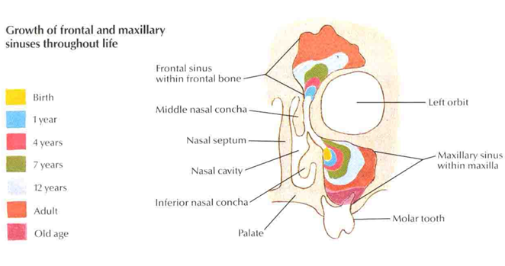
Anatomy
Maxillary Sinus
  First to develop at day 65 of gestation
  Seen on plain films at 4-5 months
  Slow expansion until 18 years
Ethmoid Sinus
  Develop in third month of gestation
  Ethmoids seen on radiographs at one year
  Reaches adult size at 12 years
Sphenoid Sinus
  Develops in the fourth month of gestation
  Pneumatization begins at age 3
  Rapid growth to reach sella at age 7, adult size at 18
Frontal Sinus
  Develops in the fourth month of gestation
  Seen radiographically at age 5-6
  Grows to adult size by adolescence

Slide 4
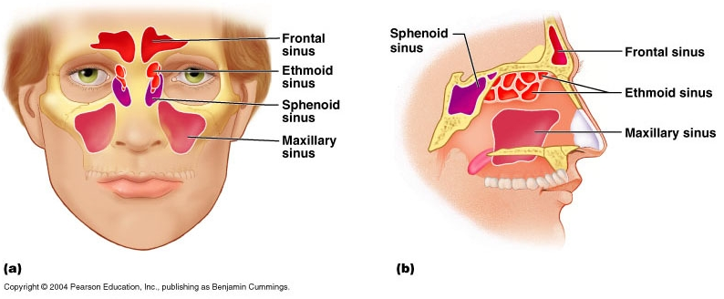
Sinus Anatomy

Slide 5
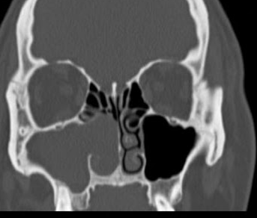
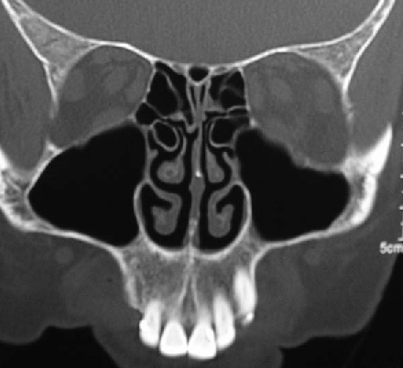
Sinus Anatomy

Slide 6
Pathophysiology and Etiology
Normal Function
  Patent ostia
  Normal cilia
  Normal mucus secretions
Primary sinus abnormality is obstruction of the osteomeatal complex by edema or mechanical obstruction
Obstruction leads to retained secretions resulting in hypoxia of sinus mucosa → causes ciliary dysfunction and increased secretions → secondarily infected
Ciliary function returns to normal as early as 6 months post FESS

Slide 7
Etiology
Edema and mechanical obstruction
  local factors
  regional factors
  systemic factors
  other
Most Common Inciting Event is Viral URI

Slide 8
Etiology

Slide 9
Sinusitis: Definitions
Common Cold
  Improves within 5-7 days
  Longer than 10 days → Acute or Chronic Sinusitis
  Longer than 3 weeks → Chronic Sinusitis

Slide 10
Sinusitis: Definitions
Rhinosinusitis – broadly defined as an inflammation and/or infection involving the nasal mucosa and at least one of the adjacent sinus cavities
  Isolated sinusitis is rare

Slide 11
Sinusitis: Definitions
Acute (AS) – the persistence and worsening of upper respiratory symptoms for greater than a 7 day course, but lasting less than 4 weeks
Sub Acute (SAS) – nasal symptoms lasting 4-13 weeks
Chronic (CRS) – persistence of mucosal inflammation for > 12 consecutive weeks despite medical therapy or occurrence of more than 4 episodes/ year with persistent radiographic findings
Chronic Recurrent (CRRS) – multiple acute episodes with complete resolution between episodes

Slide 12
Sinusitis: Definitions
Acute
  Less than 3 months
  S. Pneumo, H. Flu, M. Catarrhalis
  More Severe Symptoms
  Generally follows URI
Chronic
  Greater than 3 months
  S. Aureus, α Hemolytic Strep, M. Catarrhalis
  Milder Symptoms
  Additional Symptoms
    Chronic cough, bronchitis, fatigue, malaise, depression

Slide 13
Incidence
5-10% of children with URI develop acute sinusitis
Subset of that develop chronic sinusitis

Slide 14
Clinical Presentation
History and PE essential for proper diagnosis
Viral URI
  Unable to differential in the first 10 days
  Serous rhinorrhea, may be mucopurulent
  Nasal congestion and cough primary sx
  Low grade fever, malaise, headaches
  Night time cough may linger

Slide 15
Clinical Presentation
Acute Non Severe Rhino sinusitis
  persistent cold symptoms over 10 days
    rhinorrhea (any type)
    cough (dry or wet) worse at night
    low grade fevers
    fetid breath
    painless periorbital swelling in AM
    rarely facial pain

Slide 16
Clinical Presentation
Acute Severe Rhinosinusitis
  usually after 10 days but may be sooner
    high fever
    purulent and copious rhinorrhea
    periorbital swelling
    facial pain
    headaches
    dental pain

Slide 17
Diagnosis
Physical Exam
  Anterior rhinoscopy with otoscpe in younger children
  Flexible and rigid endoscopy in older children
  Tenderness over sinuses
  Periorbital edema and discoloration
Most Specific
  Mucopurulent secretions, facial tenderness, periorbital swelling

Slide 18
Diagnosis - CT
Not indicated for uncomplicated patients
Indications
  Failure to improve with treatment
  Concern for suppurative complications
  Pre-operative study
Ideally obtained several weeks after medical therapy
Mucosal inflammation is a common finding in children and strongly correlated with viral URI
Fluid in the sinuses ≠ Sinusitis

Slide 19
Diagnosis – Sinus Aspirate
Indications
  Severe toxic illness, Acute illness not responsive to antibiotics within 72 hours, Immunocompromised patients, Suppurative complications
Poor correlation between sinus aspirate and oro/naso pharyngeal swabs
Endoscopically guided middle meatal swab
  Requires cooperative patient

Slide 20
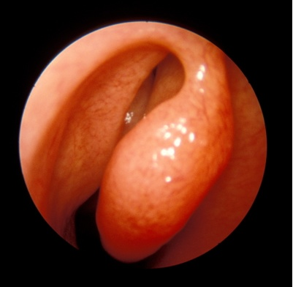
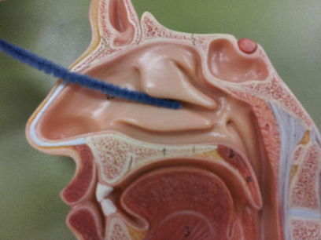
Diagnosis – Sinus Aspirate

Slide 21
Microbiology
Streptococcus pneumoniae, Moraxella catarralis, nontypeable Hemophilus influenzae
ICU/CF patient: Staphylococcus aureus, Pseudomonas aeruginosa
Resistant organisms: multiple rounds of abx, day care, abx in last 30 days
Normal flora in the sinuses – controversial

Slide 22
Medical Management
Antihistamines – dry mucosal secretions
Isotonic saline nasal drops/sprays/irrigations
  Anecdotal
Topical decongestants – inhibit cilial motion
Nasal steroids
Mucolytics – thin secretions

Slide 23
Medical Management- Antibiotics
Acute Non Severe
  Amoxicillin (10-21 days; until sx resolve + 10 days)
  PCN allergy: cephalosporin; Severe allergy: macrolide
Acute Severe / Non responders
  Augmentin
Complications
  IV Clindamycin plus Cefotaxime or Ceftriaxone
Chronic
  Beta Lactam agent for 3-6 weeks

Slide 24
Surgical Management
Adenoidectomy
  Adenoids may predispose to sinus infections
    Obstruction
    Stasis
    Reservoir (Biofilms)
  70% patients improved subjectively after adenoidectomy
  Suggests adenoidectomy as first line surgical therapy once medical therapy fails

Slide 25
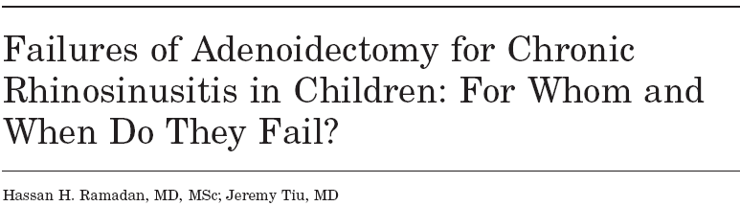
Adenoidectomy Failure
Retrospective review
  Around 50% fail to improve
  Remaining 50% required FESS
  Children with asthma required further surgical tx earlier
  Younger children had failure rate of 15 months compared with mean of 27.5 months for kids >6 y/o

Slide 26
Adenoids
Reservoir for bacteria
Interfere with mucociliary clearance
Obstruction may cause nasal stasis and increase risk for CRS
Asthmatics less likely to benefit from adenoidectomy
Older children obtain longer lasting relief than kids <6y/o

Slide 27
Functional Endoscopic Sinus Surgery
Indicated after maximal medical therapy failure and underlying conditions treated
Concern for altering developing nasal and sinus anatomy in children
  2 recent long term studies demonstrate no effect on facial skeleton

Slide 28
FESS
Indications
  Complete nasal obstruction in CF
  Antrochoanal polyp
  Intracranial or orbital complitcations
  Mucoceles
  Fungal Sinusitis
  Persistent chronic sinusitis after failing medical therapy and exclusion/treatment of systemic disease
  Asthmatic exacerbations associated with sinus disease

Slide 29
Treatment Conclusions
Medical therapy mainstay of treatment
If medical therapy fails, conservative surgery should be pursued in step-wise fashion:
  adenoidectomy, nasal endoscopy ± antral lavage/cultures
  Tonsillectomy if OSA or recurrent strep
Conservative FESS if child is miserable and failed medical and initial surgical therapy

Slide 30
Refractory Rhinosinusitis

Slide 31
Associated Conditions
Allergy
Asthma
GERD
CF
Primary Ciliary Dyskinesia
Allergic Fungal Sinusitis

Slide 32
Allergy
Major contributing factor
Similar pathogenesis as viral etiology with obstruction: mucostasis, hypoxia, colonization
History is critical
  Itching mucous membranes, clear rhinorrhea, eczema, food intolerance, nasal congestion, cough, facial pressure
PE
  Allergic shiners and salute, rash over cheeks, eczema, posterior pharyngeal lymphoid tissue, ETD

Slide 33
Allergy
Clinical diagnosis
Skin testing
Treatment
  Avoidance
  Pharmacotherapy
  Immunotherapy

Slide 34
Asthma
Frequently associated: same underlying disease process or causal relationship?
  Sinonasal /bronchial reflex
  Aspiration
Treatment of sinusitis improves pulmonary symptoms

Slide 35
GERD
GERD theorized to have direct effect on nasal mucosa, initiating inflammatory response with edema and impaired mucociliary clearance
Many pediatric patients experience improvement in chronic sinonasal symptoms after antireflux medication trial

Slide 36
Cystic Fibrosis
Most common inherited lethal disease in Caucasians
AR
CFTR gene (508delF most common)
cAMP modulated CL channel protein → decrease Cl secretion → cell water retention
Thicker mucus → inflammation and infection
  Respiratory tract, GI tract, Pancreas, Exocrine Glands
Chronic pulmonary disease, nasal polyposis, sinusiits

Slide 37
Primary Ciliary Dyskinesia
AR, 1/16000 Live Births
Dynein Defect
DNAI1, DNAH5 – most common mutation – out dynein arm
OM, rhinitis, sinusitis, pneumonia, dextrocardia
Male infertility
DX requires tracheal or biopsy of inferior turbinate

Slide 38
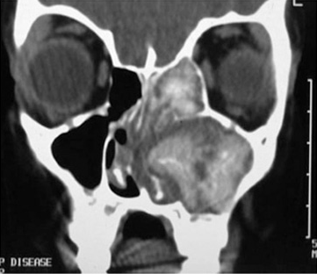
Allergic Fungal Sinusitis
Allergic reaction to aerosolized fungi, usually dematiceous species
Treatment is surgical with perioperative oral steroids post operative topical steroids
High recurrence rate
Children more likely have unilateral disease
More likely to have facial skeletal abnormalities

Slide 39
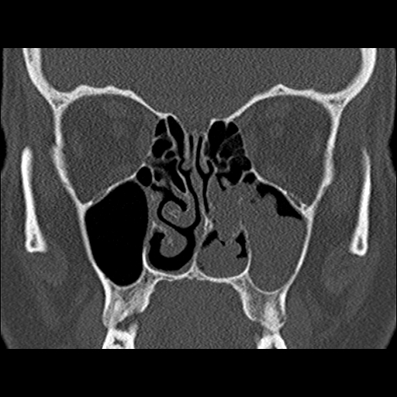
Unilateral Sinus Opacification

Slide 40
Complications of Sinusitis
Routes of spread
  Arterial
  Venous
  Lymphatic
  Direct

Slide 41
Complications
Orbital
  More common in younger children
  MC location: Medial Sub periosteal Abscess
Intracranial
  More common in adolescents
    Meningitis (MC)
    Epidural Abscess
    Subdural Abscess
    Intra cerebral Abscess
    Cavernous Sinus Thrombosis
    Pott’s Puffy Tumor

Slide 42
Orbital Complications
Chandler Classification
  Preseptal Cellulitis
  Orbital cellulitis
  Periorbital Abscess
  Orbital Abscess
  Cavernous Sinus Thrombosis
Spread by Direct extension via osseous structures or indirectly via valveless venous plexuses
CT scan with contrast if suspected orbital involvement

Slide 43
Orbital Complications
Preseptal Cellulitis
Orbital Cellulitis
Eyelid edema, erythema, normal globe movement
More likely due to cutaneous lesions or hematogenous seeding rather than sinusitis
Proptosis, chemosis, edema, pain
  Dilated pupil
  No Visual loss
  Ophthalmoplegia

Slide 44
Orbital Complications
Periorbital Abscess
Orbital Abscess
Proptosis with globe displacement inferolaterally, decreased EOM, vision decreased
IV Abx with external or endoscopic drainage of abscess and involved sinus
Severe proptosis and chemosis
Usually no globe displacement
Opthalmoplegia
Impaired visual acuity

Slide 45
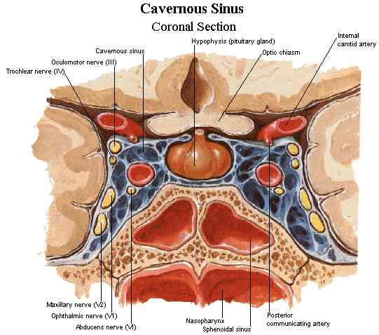
Orbital Complications
Cavernous Sinus Thrombosis
  Progressive symptoms
  Proptosis and fixation
  CN II, IV, VI
  Meningitis
  High mortality
  High fever, bilateral symptoms
  Treat with IV Abx, ± Anticoagulation

Slide 46
Intracranial Complications
High dose antibiotics, Neurosurgery involvement
Treatment involves drainage of abscess in concert with drainage of affected sinus
Frontal sinus is most implicated sinus
  venous drainage of the frontal sinus though small diploic veins extending through the sinus wall
  these communicate with the venous plexi of the dura, periorbita, and cranial periosteum

