Slide 1
Acute Mastoiditis and Retropharyngeal Infections in Children
Jane Huang, MD, MBA
Pediatric Lecture Series
November 30, 2015
Financial relationships with commercial interest: None

Slide 2
Overview
Acute Mastoiditis (AM)
Retropharyngeal Abscess (RPA)
Case presentation
Anatomy review
Diagnosis
Role of imaging
Treatment options
Algorithm

Slide 3
Case 1
DF – 5 year-old boy with 2 week history of otalgia, fever, and increased swelling behind his R ear
PMH: unremarkable
PSH: inguinal hernia repair at age 3
Social H: lives with mother and sister
Family H: unremarkable
Immunizations up to date
Notes:
Fermancanales, David

Slide 4
Case 1
Temp – 38.3; VSS
Physical Exam
Irritable but alert, oriented
Right ear proptotic, mastoid tender, erythematous and swollen
EAC filled with purulent fluid
CN VII fully intact

Slide 5
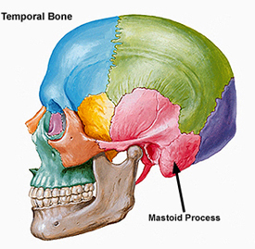
Anatomy of the Mastoid Bone

Slide 6
Anatomy of the Mastoid Bone

Slide 7
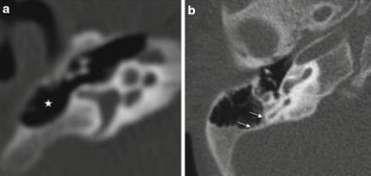
Embryology and Development
Mastoid = mastos Greek for breast
Underdeveloped at birth
Pneumatization occurs through puberty
Bone marrow → air cells

Slide 8
Diagnosis
Differential
Acute otitis media
Acute otitis externa
Soft tissue cellulitis
Chondritis
Hematoma
Lymphadenitis

Slide 9
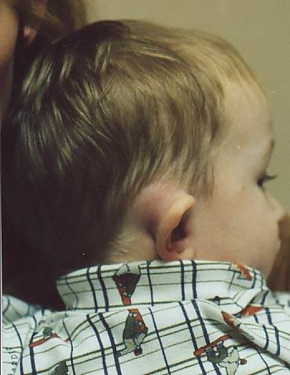
Mastoiditis
Types
Acute
Coalescent
Chronic
Masked
NOT a radiological diagnosis!!
Notes:
Acute – inflammatory changes over mastoid and signs of AOM on otoscopy
Coalescent – bony changes on CT – surgical intervention
Chronic – long standing TM perforation, cholesteatoma, infection – granulation tissue
Masked – granluation and bone erosion without otorrhea and normal appearing TM – persistent focus of infection somewhere in the mastoid not treated by antibiotics

Slide 10
Pathophysiology
Edema of mucoperiosteal lining of mastoid air cells → impaired ciliary function
Prevents normal middle ear drainage through eustachian tube
Serous fluid becomes purulent as inflammatory cells accumulate
Results in venous stasis, acidosis, and decalcification of bony septa → coalescence
Notes:
Phlebitis and periphlebitis can spread infection to meninges, sigmoid sinus, cerebellum, temporal lobe

Slide 11
Complications of Mastoiditis
Subperiosteal/Bezold’s abscess
Intracranial
Lateral sinus thrombosis
Facial nerve paralysis
Notes:
Intracranial complications – 2-17%

Slide 12
Epidemiology
Incidence 1.2-4.2/100,000 children per year
Most common bacteria:
Streptococcus pneumoniae (40.6%)
Staphylococcus coagulase negative (16.1%)
Streptococcus pyogenes (10.3%)
Hemophilus influenzae (9%)
Anaerobes (5.8%)
Staphylococcus aureus (5.2%)
No organisms (13%)
Psarommatis et al. International Journal of Pedi Oto 2012;76: 791-796.

Slide 13
Epidemiology
Tends to occur more often in those with well developed mastoid air cells and in those without previous otologic disease
More often affects boys and those younger than 4 years of age
Majority do not have symptoms of acute otitis media prior to presentation

Slide 14
Presenting symptoms
Retrospective review of 167 patients (mean age 36.7 months, median age 30 months)
Psarommatis et al. International
Journal of Pedi Oto 2012;76: 791-796.

Slide 15
Treatment Options
Rates of mastoidectomy vary greatly – between 9%-88%
Generally, conservative approach with IV antibiotics +/- myringotomy with ear tube
70% cured without additional surgical measures
Recommend combined therapy clindamycin and ceftriaxone
Psarommatis et al. International Journal of Pedi Oto 2012;76: 791-796.

Slide 16
Role of imaging
CT not necessary for diagnosis of acute mastoiditis (AM)
Postauricular edema and hyperemia very sensitive indicators (94% and 90%)
Retrospective chart review of 50 patients
92% of patients with AM did not have CT scan and treated conservatively without complications
Tamir et al. Annals of Oto, Rhino, & Laryngology 2009;118(8): 565-569.
Notes:
8% intracranial complications – 2 with sigmoid sinus thrombosis, 2 with epidural abscess;
4 patients who did have CT – CT scan did not change the medical course of disease

Slide 17
Role of imaging
Obtain CT temporal bone with contrast +/-MRI brain only if:
Neurological signs when intracranial complications suspected
History of cholesteatoma or is suspected
Patients failing to improve or worsening on conservative treatment
Tamir et al. Annals of Oto, Rhino, & Laryngology 2009;118(8): 565-569.

Slide 18
Treatment algorithm
Psarommatis et al. International Journal of Pedi Oto 2012;76: 791-796.

Slide 19
Controversy of anticoagulation
Lateral sinus thrombosis
Very rare complication
Mortality reported to be 5%
Symptoms “picket-fence” fevers, headache, nausea/vomiting
Can lead to seizures, hydrocephalus, papilledema, coma
Limited literature
Notes:
Anticoagulation for prevention of thrombus progression
Weigh risks of bleeding, drug interactions, thrombocytopenia, osteoporosis, hemorrhagic skin necrosis

Slide 20
Controversy of anticoagulation
Retrospective chart review over 12 years:
7 patients with lateral sinus thrombosis
All underwent otologic surgery
None underwent thrombectomy or VP shunt
All treated with anticoagulation (Lovenox) except one for average of 24 weeks
86% had resolution of thrombus at 3 months
Sitton, MS and Chun, R. International Journal of Pedi Oto 2012; 76:428-432.
Notes:
Surgery – mastoidectomy except for 2 who had PET placement only

Slide 21
Back to our case…
CT temporal bone with contrast obtained in ER
ENT consulted

Slide 24
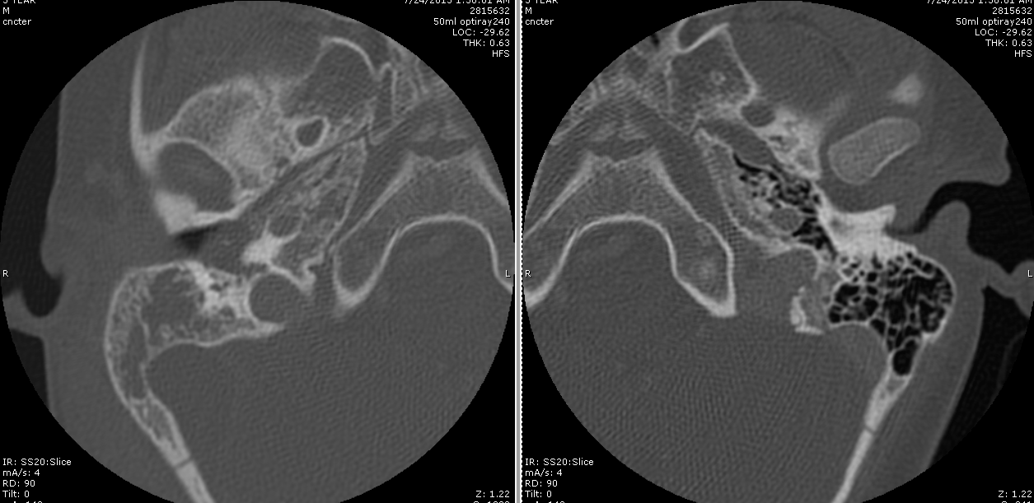

Slide 25
Hospital course
Taken to OR the following morning for cortical mastoidectomy, ear tube placement
Infectious disease consult
PICC line placed
Vancomycin, ceftriaxone, metronidazole for 6 weeks
Hematology consult
Therapeutic lovenox x 3months
Repeat MRI at 6 weeks shows resolution of sigmoid sinus thrombosis and no fluid collections

Slide 26
Case 2
SO – 16 month-old boy with 5 day history of fever, drooling, neck stiffness and pain.
PMH: unremarkable
PSH: none
Social H: lives with parents and sibling
Family H: unremarkable
Immunizations up to date
Notes:
Oliverzhang, Sage

Slide 27
Case 2
Temp – 36.8; VSS
Physical Exam
No stridor or retractions, lying supine
Tympanic membranes clear intact
Oral cavity fullness along posterior pharynx, no significant trismus
Neck decreased ROM

Slide 28
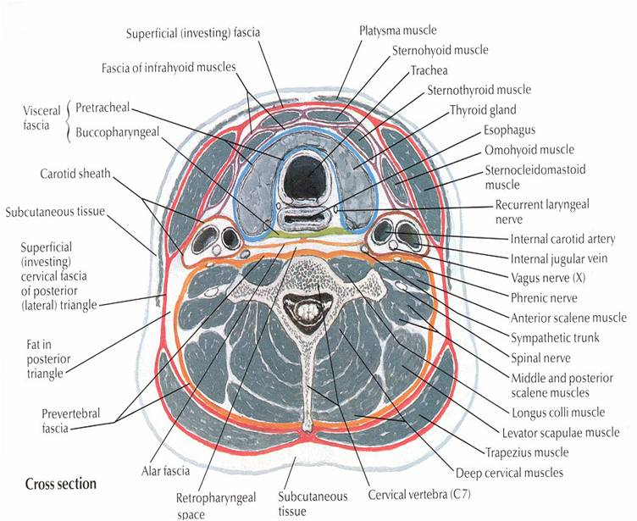
Anatomy

Slide 29
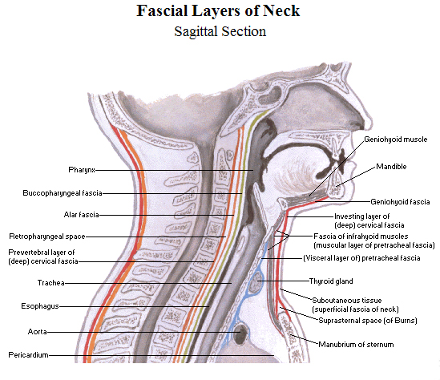
Anatomy
Notes:
Skull base to the mediastinum as far as T6
Communicates with the parapharyngeal space anteriolaterally

Slide 30
Pathophysiology Epidemiology
Paramedian chain of lymph nodes
Atrophy by puberty
Suppuration of these lead to abscess
70% of cases younger than 6 years of age
50% younger than 3
More often in boys 2:1 ratio

Slide 31
Diagnosis
Retrospective chart review 101 patients
Fever (100%)
Pain (100%)
Neck stiffness/torticollis (86%)
Neck swelling (68%)
Oropharyngeal bulging (67%)
Dysphagia (63%)
Trismus (11%)
Dyspnea (2%)
Hoffman, et al. International Journal of Pedi Oto 2011; 75:1099-1103.

Slide 32
Role of Imaging
CT scan is gold standard
But poor correlation between CT scan abnormalities and pus encountered during surgery
Sensitivity (43-89%)
Specificity (0-63%)
Lateral neck x-ray can show prevertebral thickening but not specific
Neck ultrasound not recommended
Hoffman, et al. International Journal of Pedi Oto 2011; 75:1099-1103.
Notes:
Lateral neck x ray – extended and taken on inspiration
Thickness of retropharyngeal space at C2 is double the thickness of vertebral body – sensitivity of 90%
CT needed to differentiate abscess, phlegmon, cellulitis

Slide 33
Bacteriology
Streptococcus (72%)
Staphylococcus aureus (13%)
Haemophilus influenzae (3%)
Fusobacterium (3%)
S. aureus more common in children less than one year of age
Hoffman, et al. International Journal of Pedi Oto 2011; 75:1099-1103.

Slide 34
Treatment Options
Medical treatment with IV antibiotics x 48 hours (Clindamycin and Ceftriaxone) and clinical exam
Surgical drainage – intraoral

Slide 35
Treatment Options
18% failed medical therapy alone
Higher rate of failure
Rim enhancement
Size > 2 cm
Hoffman, et al. International Journal of Pedi Oto 2011; 75:1099-1103.
Notes:
33% medical failure versus 8% if > 2cm rim enhancement on CT scan

Slide 36
Complications
Airway obstruction
Aspiration pneumonia
Mediastinitis
Sepsis
IJV thrombosis
Carotid artery erosion
Atlantoaxial dislocation
Notes:
With CT diagnosis and antibiotics, close to zero mortality

Slide 37
Back to our case…
ENT consulted
WBC 15
Lateral neck films show thickening of pre-vertebral tissue and AP view shows deviation of trachea to the right

Slide 38
Back to our case…
CT neck with contrast obtained

Slide 39
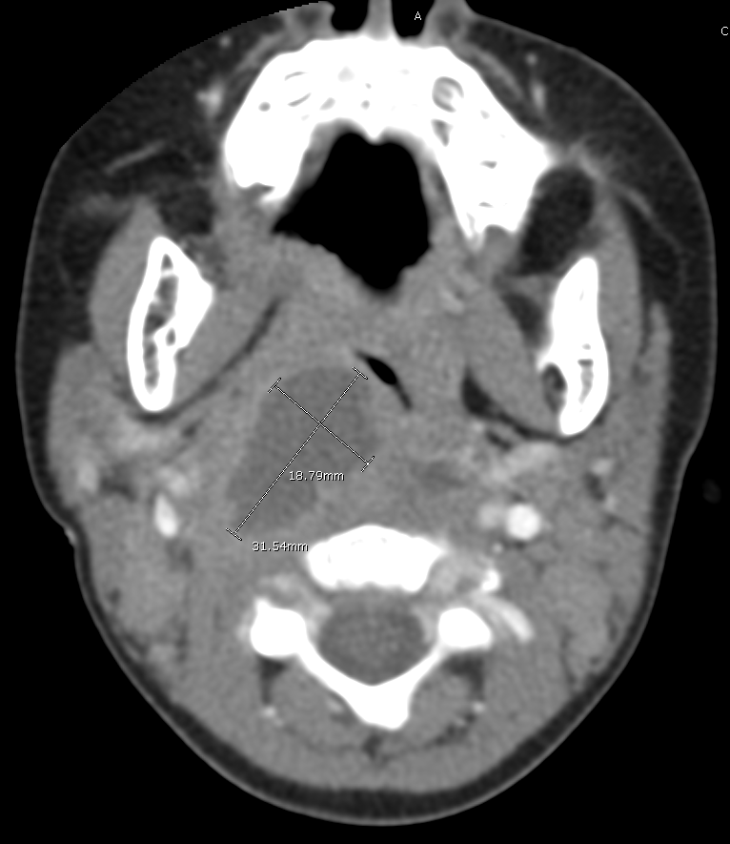
Notes:
3cm by 2cm rim enhancing abscess in right retropharyngeal space extending to contralateral side

Slide 40
Back to our case…
Patient taken to the OR after CT for intraoral incision and drainage
Discharged POD2 after tolerating PO and afebrile for >24 hours with PO clindamycin

Slide 41
Key Take Home Points Acute Mastoiditis
Acute mastoiditis is NOT a radiological diagnosis
Differential diagnosis is important
Conservative approach with IV antibiotics with myringotomy/ear tube recommended in uncomplicated cases
Otherwise, cortical mastoidectomy
Anticoagulation for sigmoid sinus thrombosis remains controversial
? PICC line necessary or not

Slide 42
Key Take Home Points Retropharyngeal Infections
Diagnosis is clinical
Initiate medical therapy first and follow clinically for 48 hours
If no improvement or febrile → CT scan
Higher medical treatment failures if CT scan shows rim enhancement > 2cm
Surgery typically is intraoral approach
Notes:
If airway compromise or toxic then surgery

Slide 43
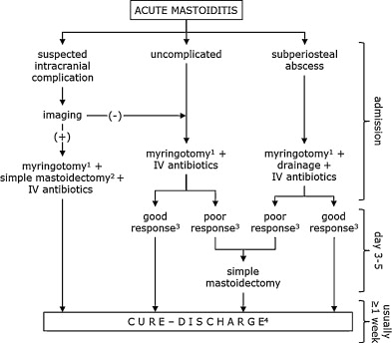
Algorithm for Treatment of AM
Psarommatis et al. International Journal of Pedi Oto 2012;76: 791-796.

Slide 44
Algorithm for Treatment of RPA

Slide 45
References
Chesney et al. What is the best practice for acute mastoiditis in children? Laryngoscope 2014;124:1057-1059.
Groth et al. Acute mastoiditis in children aged 0-16 years- A national study of 678 cases in Sweden comparing different age groups. International Journal of Pedi Oto 2012; 76:1494-1500.
Hoffman et al. Retropharyngeal infections in children. Treatment strategies and outcomes. International Journal of Pedi Oto 2011;75: 1099-1103.
Psarommatis et al. Algorithmic management of pediatric acute mastoiditis. International Journal of Pedi Oto 2012;76: 791-796.
Sitton, MS and Chun, R. Pediatric otogenic lateral sinus thrombosis: Role of anticoagulation and surgery. International Journal of Pedi Oto 2012; 76:428-432.
Tamir et al. Acute mastoiditis in children: Is computed tomography always necessary? Annals of Oto, Rhino, & Laryngology 2009;118(8): 565-569.

Slide 46
Thank you!
Questions?

