Slide 1
Shock Ashley Siems

Slide 2
By the end of this lecture, learners should be able to…
Discuss shock and it’s different etiologies
Apply treatment strategies to patients with shock
Differentiate different types of shock

Slide 3
What is shock?
Failure of the circulatory system to deliver sufficient oxygen* to meet the metabolic demands of the tissues

Slide 4
What is the supply?
Delivery of Oxygen
DO2 = CO X CaO2 =
HR X SV x [(HgbXSaO2X1.34)+(PaO2*0.003)]
Cardiac Output
Stroke Volume
Preload
Contractility
Arterial Oxygen Content
Hgb
HR
Rate
Rhythm
Afterload
Pressure
Resistance
Saturation
PaO2

Slide 5
What Determines Demand/Consumption?
ATP Use
Metabolic demand
Stress (infection, inflammation, etc)
Etiology of shock → Increased Stress state → Increased metabolic demand
Temperature
Body Weight
Activity level

Slide 6
Time line of shock
Trigger Event*
Compensated Shock
Hypotensive Shock
Irreversible Shock
Etiology:
Sepsis
Hypovolemia
Heart failure
BP is maintained
Elevated HR, contractility, SVR changes
Compensation fails, body overwhelmed
BP falls
End organ dysfunction
Damage is beyond repair

Slide 7
What does shock look like?
Let’s look at some cases
Case | Diagnosis | Physiologic Classification of Shock | Preload/Central venous pressue | Pump Function (Cardiac Output) | SVR | Tissue Perfusion | Clinical Syndromes associated with this Physiologic Classification
A | Gastroenteritis | Hypovolemic Shock | Decreased | Decreased | Increased | Low | Hemorrhage Fluid Depletion (vomiting, diarrhea, burns, diabetes, nephrotic syndrome, dehydration, septic shock)
B | Myocarditis | Cardiogenic Shock | Increased | Decreased | Increased | Low | Myocardial infarction, heart failure, low CO syndrome, dysrhythmias, myocarditis, septic shock, drugs
C | Toxic Shock Syndrome | Distributive Shock | decreased or normal | Increased | Decreased | High (Initially) | Septic Shock, TSS, anaphylaxis, neurogenic shock, endo shock, drugs
D | Tension Pneumothorax | Obstructive Shock | Increased | Decreased | Increased | Low | Tamponade, tension pneumothorax, massive PE

Slide 8
What does shock look like?
Variable based on etiology and classification
Almost always:
Elevated HR, RR
Tissue perfusion poor (depending on stage)
Warm vs. Cold Shock
Signs you are failing:
Tissue perfusion (exam)
Urine Output
Mental Status

Slide 9
Treatment of Shock

Slide 10
How do you treat decrease demand?
Factor Increasing Demand | Treatment
Stress/Trigger | Find and Treat Underlying Etiology of Shock
Temperature | Maintain Normo-thermia
Nutritional Balance | Avoid Catabolic States
Activity | Decrease activity levels: Intubation Sedation Paralysis

Slide 11
How do you improve supply?
Cardiac Output
Stroke Volume
Preload
Contractility
Arterial Oxygen Content
Hgb
HR
Rate
Rhythm
Afterload
Pressure
Resistance
Saturation
PaO2

Slide 12
Tracking your interventions
Intervention | HR | Preload | Afterload BP/SVR | Contractility | Hgb | OxygenSaturation | PaO2 | Body’s Oxygen Demand
Fluid Bolus
Catecholamines (DA, epi, NE)
Oxygen
Intubation
Transfusion
Sedation
Paralysis
Milrinone

Slide 13
Fluid Boluses
Increase Venous Return
Increase Stroke Volume = Increase Cardiac Output
Increase Preload = Increase EDP
Frank Starling Curve
Optimize Actin-Myosin Cross bridging = Optimize force of Contraction

Slide 14
Let’s take a closer look at a fluid bolus…

Slide 15
Inotropy + Cardiac Output

Slide 16
How do you know you are doing the right thing??
Physical Exam
Perfusion should improve
Pulses should improve
End organ function should normalize
Urine output, labs
Trend Values like:
CVP, lactate, MVO2

Slide 17
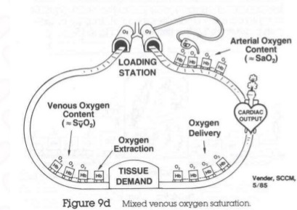
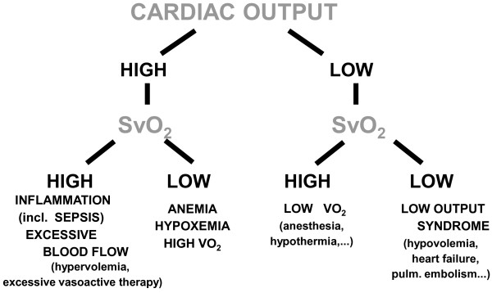
What is an MVO2?
Amount of Oxygen the body is extracting
In shock,
It could be high or low
Aim for just right

Slide 18
Summary: Key Points
Shock is inadequate supply to meet the metabolic demands of consumption (Supply does not meet demand)
In order to treat shock, you must be able to treat the underlying etiology as well improve delivery and decrease demand
There are different types of shock (but the clinical picture is often overlapping)

