Slide 1
Respiratory Distress & Respiratory Failure Ashley Siems

Slide 2
By the end of this session, you should be able to
Recognize the signs and symptoms of respiratory distress
Identify Respiratory Failure
Discuss management options for respiratory distress and failure

Slide 3
Divide into groups of four
Introduce yourselves
Elect a team spokesperson
Elect a recorder
Average your year in training
MS III = 1
MS IV = 2
Interns = 3
Second years = 4
Third Years = 5
Divide 1/average and place that on top of your scorecard

Slide 4
What Function does the lung serve? (total 4 points)
Gas Exchange
Oxygenation
Ventilation
Filtration
Defense
Metabolic

Slide 5
What is respiratory failure? (1 point, 2 points)
Failure of the lungs to oxygenate arterial blood adequately and/or fails to prevent CO2 retention
No absolute value but generally accepted to be:
PaO2 < 60 mmHg
PaCO2 > 50 or 60 (depending on where you look)

Slide 6
Why PaO2 < 60mmHg? (1 point)

Slide 7
Why PaCO2 > 60? (2 points)
Alveolar gas equation: Palv = FiO2 (P(atm) – P(H20)) – PCO2/R
At room air and sea level:
FiO2 = 0.21
Patm = 760
PH2o = 47
R = 0.8
Palv = 0.21 * (760-47) – (60/0.8) = 75
Also, before compensation….

Slide 9
Okay so you have a new admission… (1 point)
7 mo F, no PMH, admitted to the floor with 3 days of fever and URI symptoms. HR is 180 RR is 77 and Oxygen saturation is 96% on room air. She is retracting and flaring. Is she in respiratory failure?

Slide 10
MAYBE!!!! We need more information…
This child is clearly in distress but in order to say they have “failure”, then we need to have evidence of hypoxemia OR hypercarbia…

Slide 11
So what causes hypoxemia? (6 points)
Altitude
V-Q mismatch
Shunting of blood
Hypoventilation
Diffusion abnormalities
Hemoglobinopathies

Slide 12
Approach to a child in respiratory distress
Recognize Respiratory Distress
Identify and treat Underlying etiology
Upper airway disease
Lower airway disease
Offer supportive care
Oxygenation
Decrease work of breathing
Ventilation

Slide 13
Signs of Distress: What is this?
https://www.youtube.com/watch?v=1Enq2BvX9aw&feature=fvwrel

Slide 14
Stridor: List etiologies and treatments
Recognize Stridor is a sign of Upper Airway Edema
Identify and treat Underlying etiology:
Croup, Epiglotitis, anaphylaxis, foreign body aspiration
Offer supportive care
Oxygenation (Nasal Cannula, Positioning)
Decrease work of breathing (position, reduce agitation)
Venitlation: Bypass obstruction (HFNC, heliox)
Upper Airway Edema
Racemic Epi, Decadron
Antibiotics (as appropriate), epi etc, Bronch

Slide 15
Signs of Distress: What is this?
http://www.youtube.com/watch?v=5lidEPhLd48

Slide 16
Grunting
Providing positive pressure to the airway to help stent alveolar open and prevent collapse

Slide 17
Grunting: How might you treat this
Recognize Grunting is a sign of Lower Airway Disease
Identify and treat Underlying etiology:
Pneumonia, Atelecatsis, Pulmonary Edema
Offer supportive care
Oxygenation (HFNC)
Decrease work of breathing (Positive Pressure)
Antibiotics (as appropriate), chest PT, fluid management
Venitlation: Positive Pressure

Slide 18
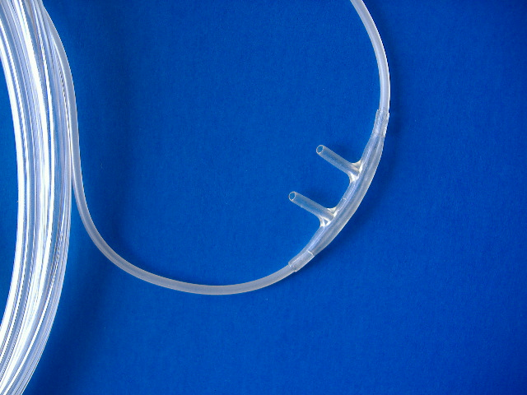
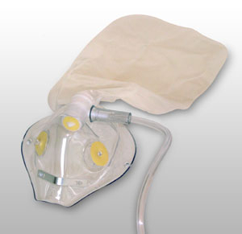
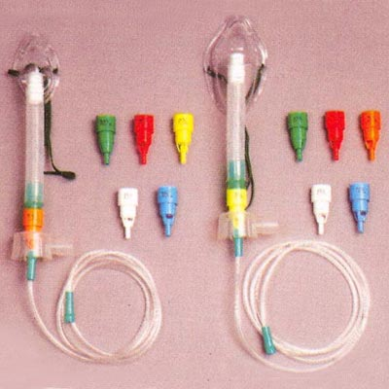
Before we get to elevated levels of support, let’s discuss common ways to deliver oxygen….

Slide 19
Nasal Cannula: What does it provide? (3 points)
Increased FiO2
How much increased FiO2?
For every 1 LPM with 100% oxygen, you have an increase in FiO2 by 4%
Is there a maximum?
Yes, 40% (or approximately 4 LPM)

Slide 20
Venturi Mask: Just for education (0 points)
Alternative delivery
Increased ability to provide FiO2
Max 60%
Titration

Slide 21
Non-rebreather (1 point)
Maximal delivery of oxygen without positive pressure
With leaks in the system, can deliver between 60 to 95% FiO2

Slide 22
What is tiring out? (1 point)
Failure of the diaphragm to contract resulting in shallow breathing and reliance on accessory muscles to maintain the work of breathing
While this can occur, it is extremely rare in pediatrics and often looks like:
Shallow breathing at a fast rate with accessory muscle use and elevated HR
Goal: Intervene prior to failure

Slide 23
But let’s say a kid stops breathing on the floor, what can you do? (2 points)
Call a code!!
Start bag mask ventilation!

Slide 24
Bag Valve Mask Ventilation
When to use: (4 points)
Apnea
Altered mental status without appropriate respiratory effort
Respiratory failure that is failing alternative therapies
Transition to intubation
As effective as intubation in MOST pediatric patients for short periods of time

Slide 25
Bag Valve Mask Ventilation
How much oxygen do you deliver?
>90%
How do you know it’s effective
Chest Rise!!!
Oxygen levels
End tidal

Slide 26
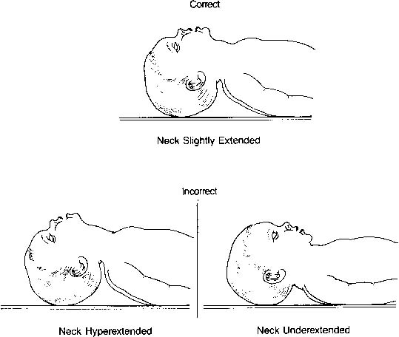
Positioning
Head midline
Flexion of the neck
Towel roll under shoulders
Sniffing position
Notes:
Sniffing = head tilt, chin lift

Slide 27
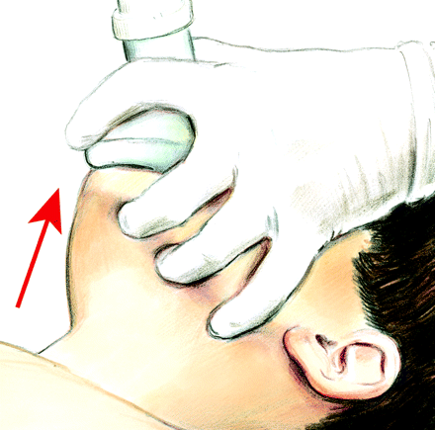
E-C positioning
Thumb + index finger = C
Middle + ring + pinkie finger = E
Jaw thrust with E
Seal with C

Slide 28
What is this? (1 point)
Flow inflating bag

Slide 29
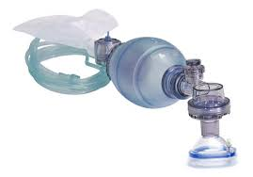
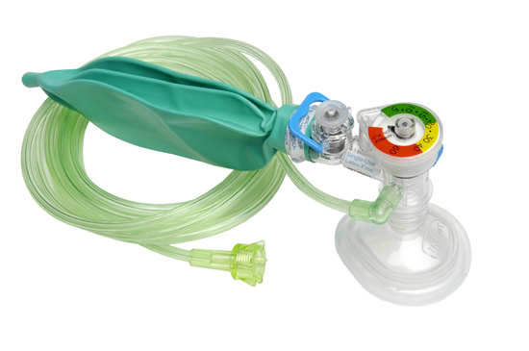
Differences
Self Inflating Bag
Flow inflating Bag
One way valve – must be bagging to provide oxygen
Can be used in spontaneously breathing patients to provide oxygen and CPAP
Technically a little more difficult to use

Slide 30
ICU Therapies: HFNC
Increases the total FiO2 non-invasively given (increase from 40% to 60%)
Humidified produces improved delivery
Creates reservoir of inspired air which reduces dead space
Effect: Improved oxygenation, reduced work of breathing

Slide 31
Positive Pressure (CPAP/BiPAP): Non invasive ventilation
Three Physiologic Benefits: (3 points)
Decreases work of breathing
Maintains patency of respiratory tract
Recruits alveoli
Increases FRC
Decreases VQ mismatch
Benefits of avoiding intubation:
Avoid airway injury
Maintenance of negative pressure breathing
Avoid complications (VAP, sedation)
Risks: Delay of intubation may make subsequent intubation more challenging

Slide 32
When to skip the non-invasive step?
Cardiopulmonary arrest
Altered mental status
High Aspiration risk
Airway protection: Epiglotitis, anaphylaxis
Hemodynamic instability: Shock
Facial injuries
Untreated pneumothorax

Slide 33
Other fun gadgets: What are these (2 points)

Slide 34
Insertion

Slide 35
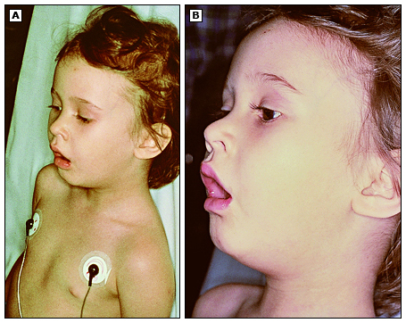
What is this position called? (1 point)
Sniffing position

Slide 36
Questions? Thank you!
Asiems@childrensnational.org

