Slide 1
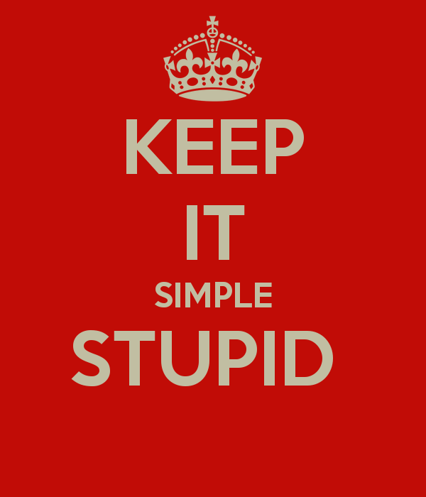
Cardiology Fellow’s Guide to ECGs
Bradley Clark, MD
3rd year Pediatric Cardiology Fellow

Slide 2
You did an ECG on a patient, so you page your “friendly” cardiology fellow for a preliminary read…

Slide 3


Slide 4
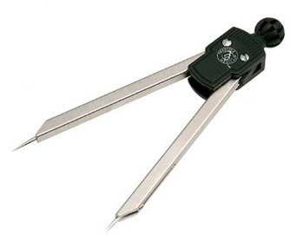
What do you see?
Please, make the effort
We will not be upset or ridicule you if you make an attempt at an ECG read
It will actually make us more willing to help
Don’t just read the computer printout, it’s often wrong
Muse access:
Username: resuser
Password: cardio$ep
Otherwise, you may need a pair of these:

Slide 5
To Start, INDICATIONS
Appropriate:
Chest pain, especially with exercise
Concern for congenital heart disease (before calling fellow)
Tachycardia of unknown etiology (after testing other theories)
Bradycardia of unknown etiology
Concern for arrhythmia on exam or telemetry

Slide 6
Less appropriate:
Tachycardia in association with beta agonist (Albuterol, Xopenex, etc)
Tachycardia with clear etiology (fever, seizures, anemia, pain, etc)
Reproducible chest pain
Even less appropriate:
My attending wanted it…

Slide 7
REMEMBER
ECG is not a great screening test
Best use is to diagnose arrhythmia
Many findings are non-specific
Myocardial ischemia/infarction are rare in pediatrics
Must be done with clinical context (clinical correlation required?)
Always need a good cardiac history to supplement ECG findings

Slide 8

Key is Repetition and Practice

Slide 9
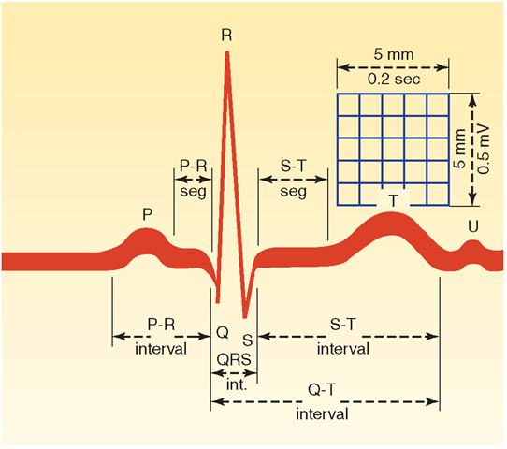
Horizontal:
Small box = 0.04 sec
Large box = 0.2 sec
Vertical:
Small box = 1.0 mV

Slide 10
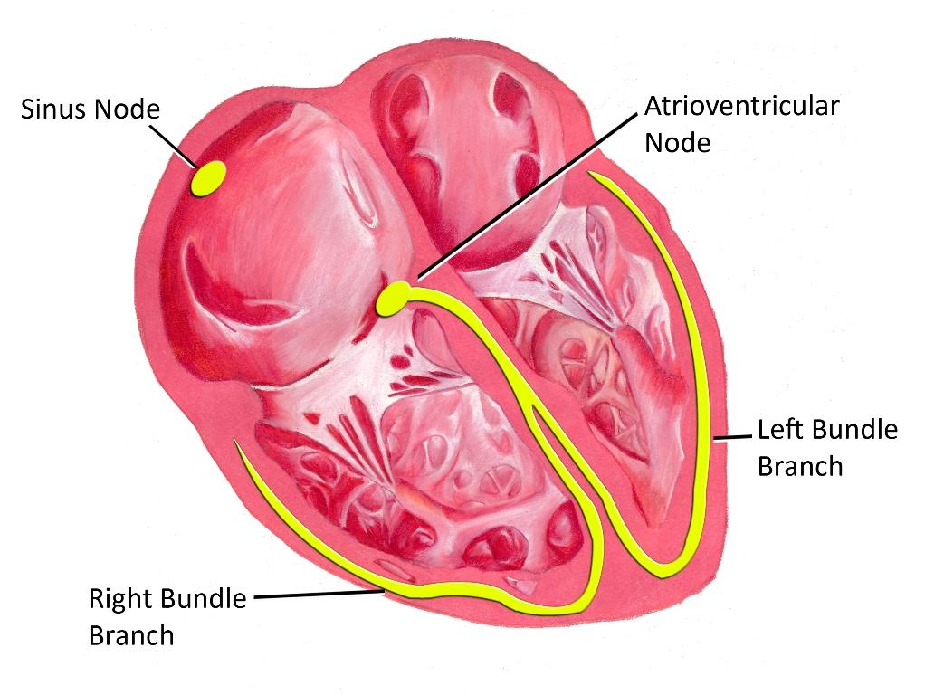
Waveform Review
P wave: atrial depolarization (SA node)
PR segment: atrial conduction continuing through AV node
QRS: ventricular depolarization (below AV node)
T wave: ventricular repolarization

Slide 11
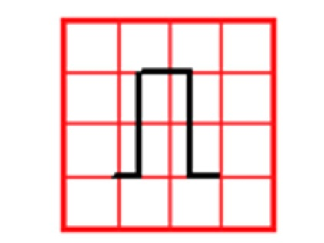
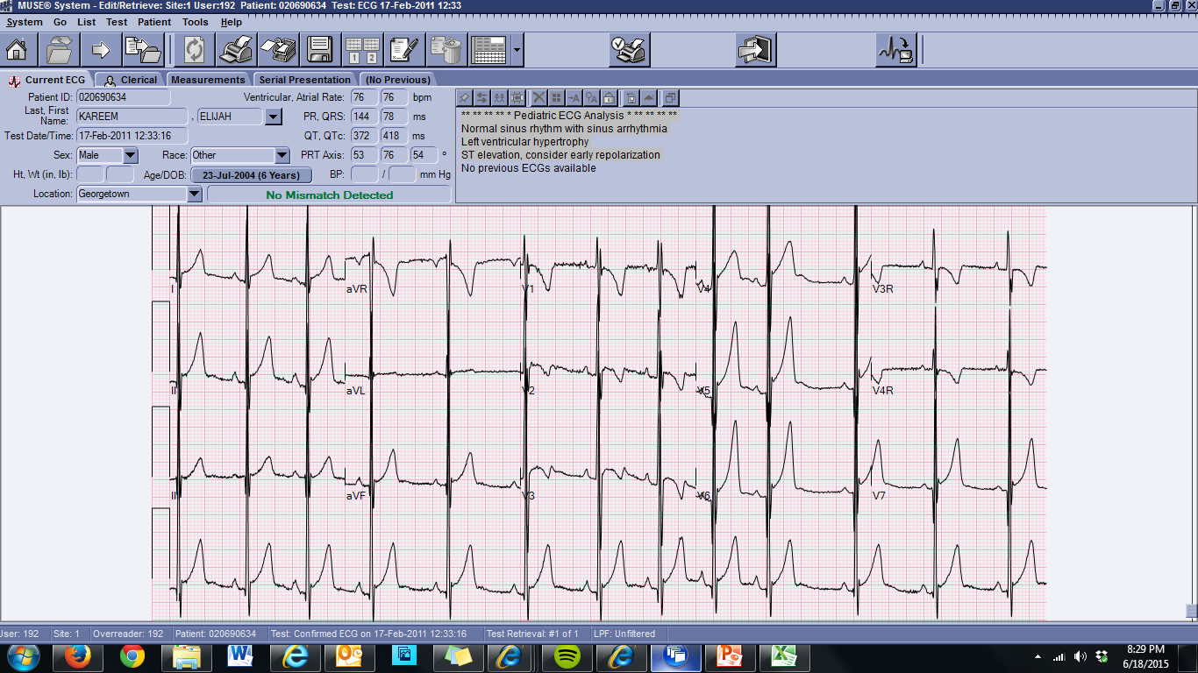
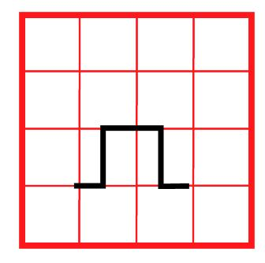
First things first
Before you start reading:
Name
Age (will affect your reading)
Look at the standard
Normal
Half
Double

Slide 12
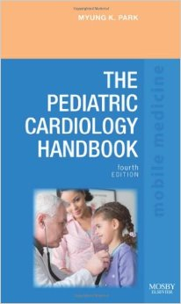
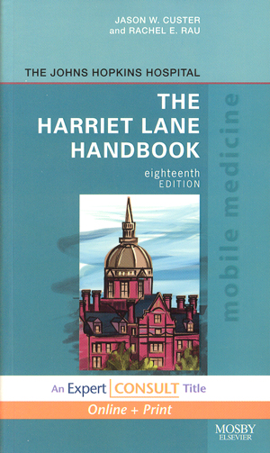
Next, use your resources
Harriet Lane!
The Pediatric Cardiology Handbook (Myung Park)

Slide 13
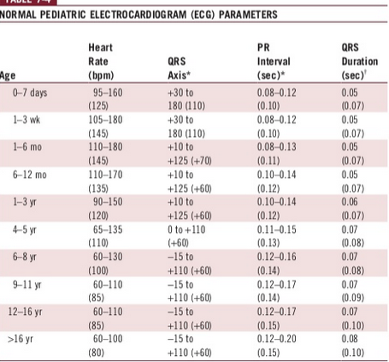
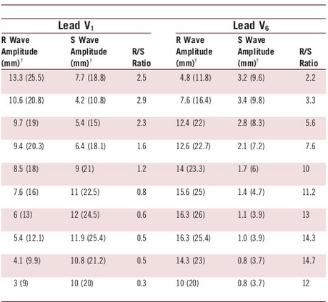

Slide 14
Let’s Start!
Rate
Rhythm
Axis

Slide 15
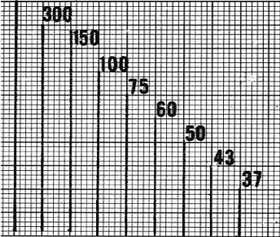
Rate
Count by large box (5 small):
300, 150, 100, 75, 60, 50
Look at the ECG, likely accurate but arrhythmia can confuse
Heart rate = 60 / RR interval
For age: normal, fast or slow?

Slide 16
Rhythm
Regular or irregular
Sinus or not-sinus
4 criteria for normal sinus rhythm
P wave before every QRS
QRS after every P wave
Normal P wave axis
All P waves have the same morphology

Slide 17
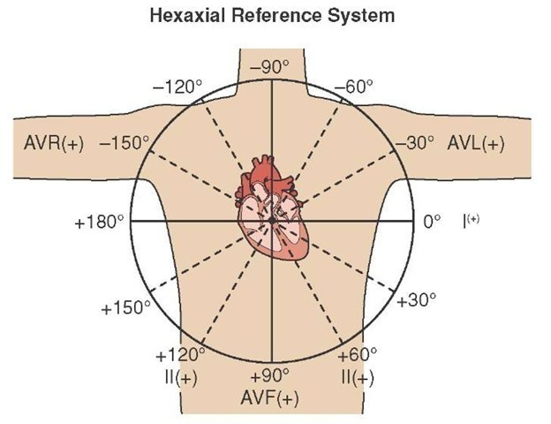
QRS Axis
Lead I
avF
Normal cardiac conduction moves:
R → L (lead I)
Superior → inferior (avF)

Slide 18
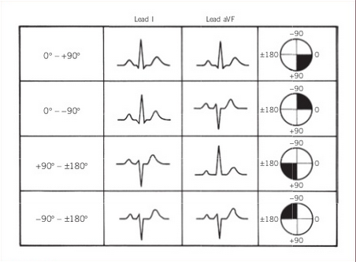
QRS Axis
Birth to 1 month: +110°
1-3 months: +70°
3 mos – 3 yrs: +60°
> 3 years: +60°
Adults: +50°

Slide 19
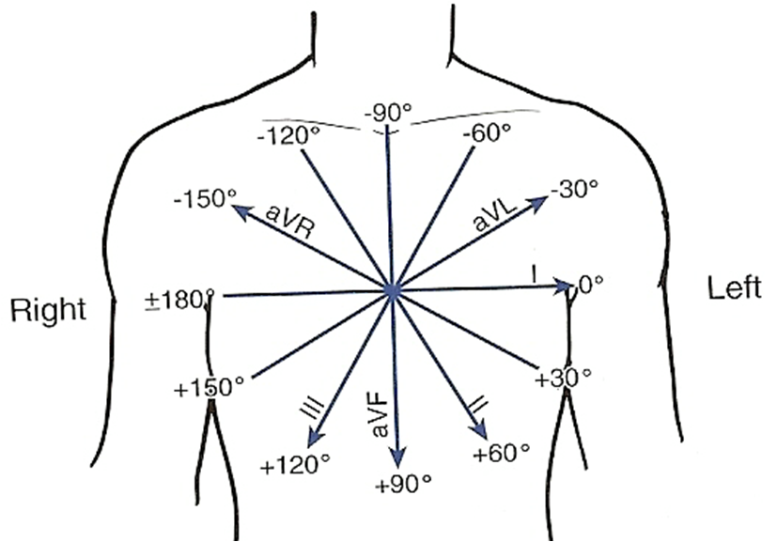
Determining Actual Axis
First determine the correct quadrant (see previous slide)
Next, find the isoelectric lead (equal R and S waves)
Axis will be perpendicular to the isoelectric lead in the correct quadrant

Slide 20
Simplify
4 choices:
Normal
Left axis
Right axis
Northwest axis
Upright in lead I (leftward lead): Normal or LAD
Down in lead I: RAD or northwest axis

Slide 21
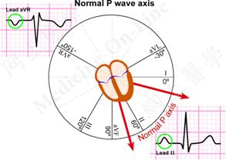
P wave axis
Need to confuse a little
Look at lead II and avF:
Lead II: +
avF: +
Low right atrial rhythm:
+ lead II, - avF
Left atrial rhythm:
- lead II, + avF

Slide 22
Clinical Utility of Axis
Right axis deviation
Normal in newborn (starts to go towards normal axis in first month)
RVH
RBBB
Left axis deviation
Tricuspid atresia
LVH
LBBB
Northwest axis (down in I and avF)
AV canal defect (and high percentage of Trisomy 21) until proven otherwise

Slide 23
Rate-Rhythm-Axis Summary
Rate: Fast, slow or normal
Rhythm:
Regular?
Sinus?
Axis: Normal, right, left or did you diagnose Trisomy 21
P wave axis: same idea, but tells you whether it is sinus

Slide 24
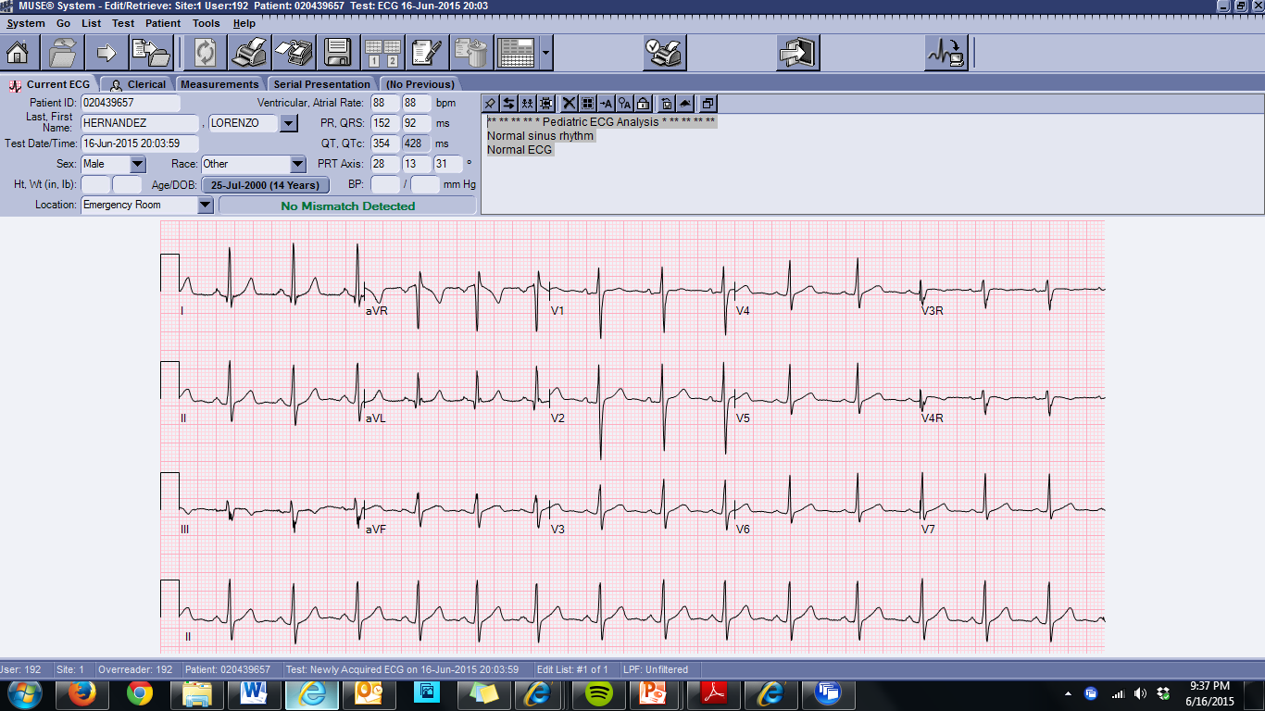
Normal sinus rhythm

Slide 25
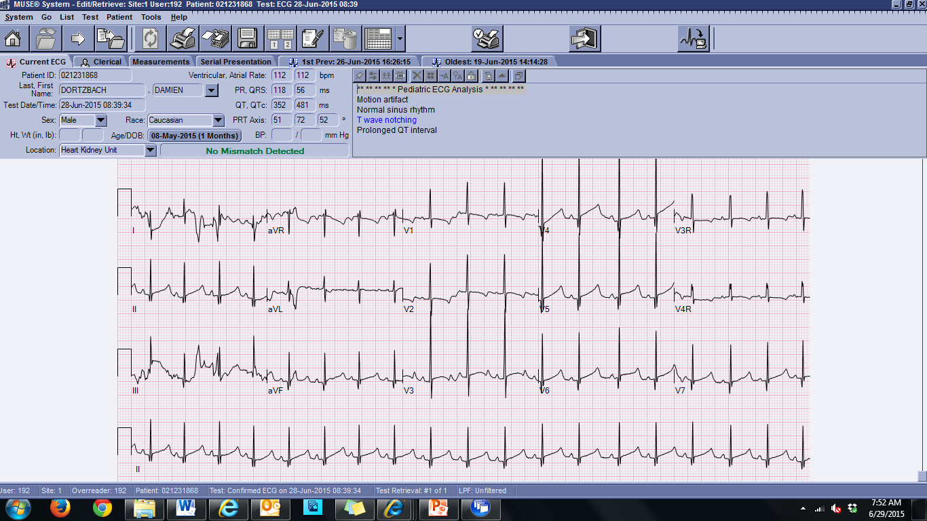
Sinus bradycardia (2 mo)

Slide 26
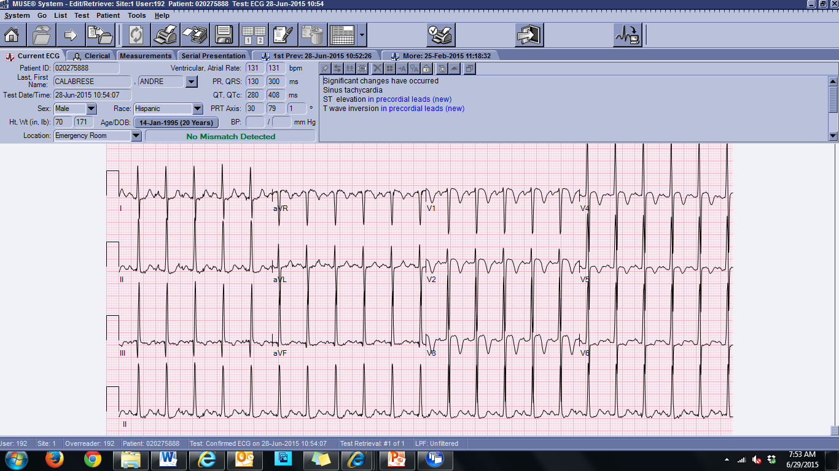
Sinus tachycardia (20 yo)

Slide 27
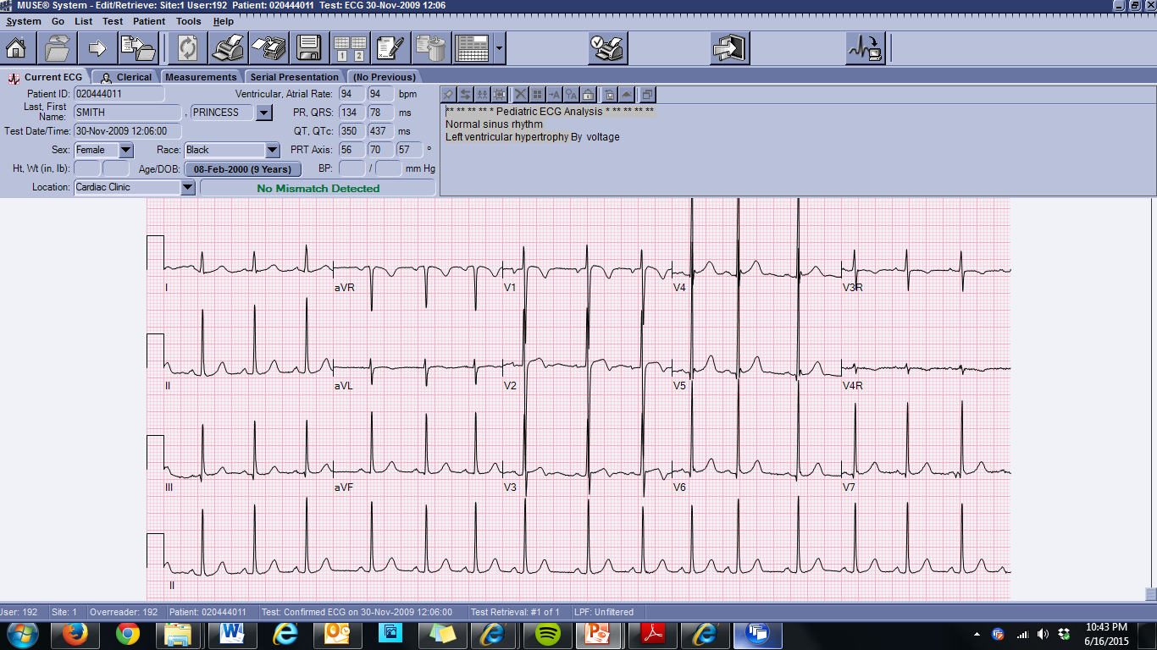
Sinus arrhythmia

Slide 28
Respiratory variation

Slide 29
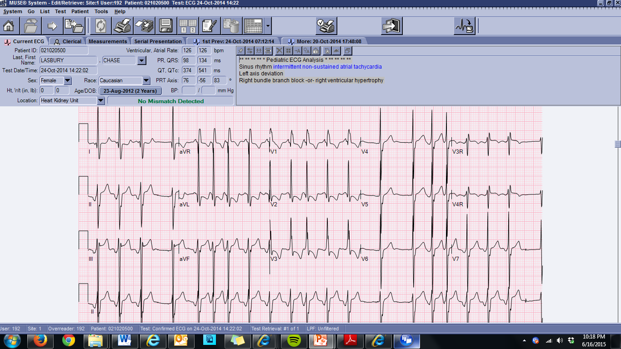
Regular??

Slide 30
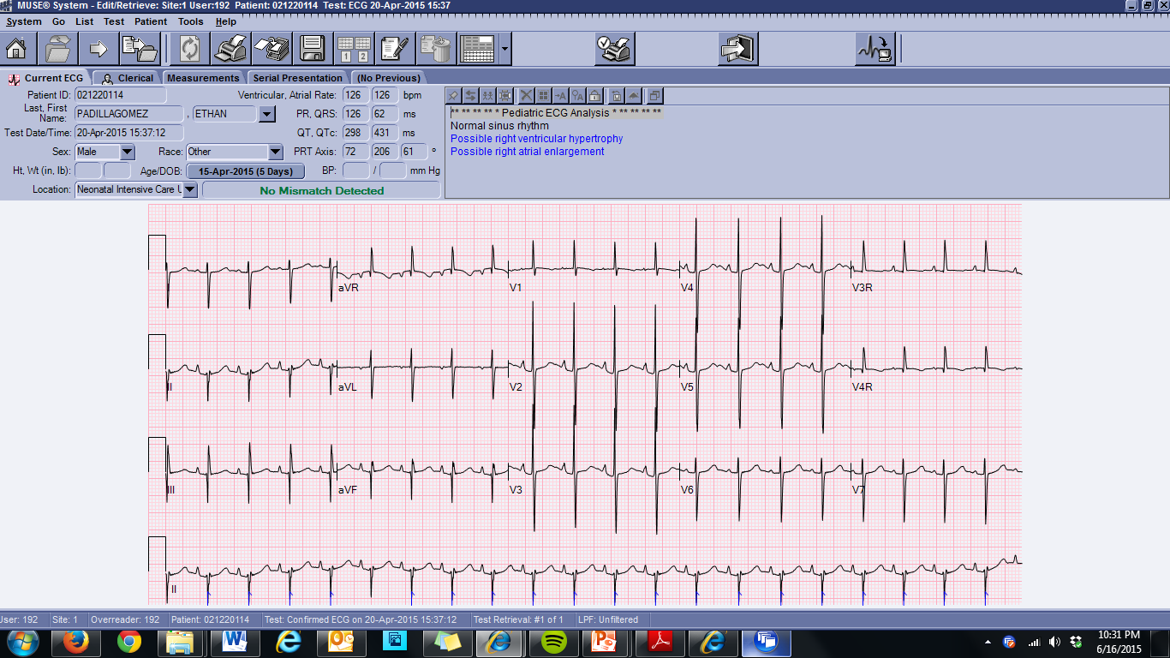
Northwest Axis

Slide 31
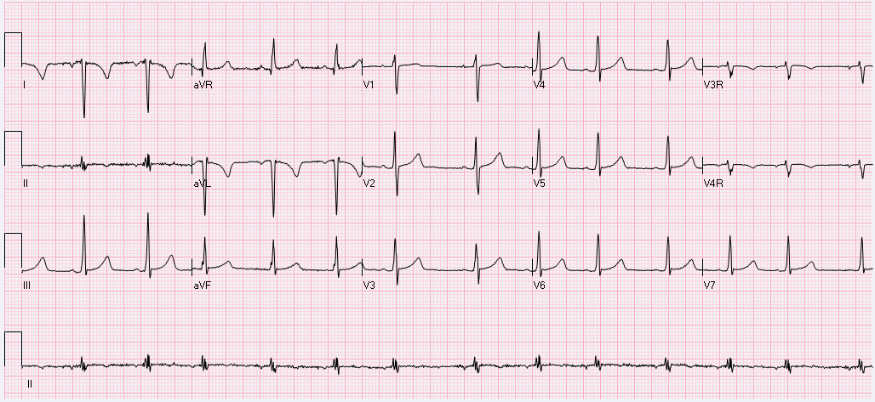
???

Slide 32
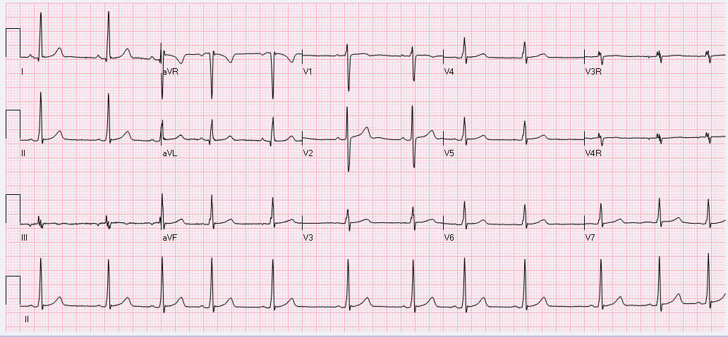
How about now?

Slide 33
ECG Stepwise interpretation
P waves
PR interval
QRS
QRS voltages
ST segment
T waves
QT interval

Slide 34
P waves
Remember P wave axis
Look at rhythm strip to evaluate for different P wave morphologies
  Atrial tachycardia, wandering atrial pacemaker

Slide 35
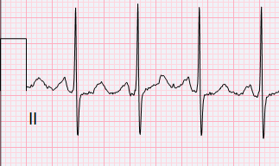
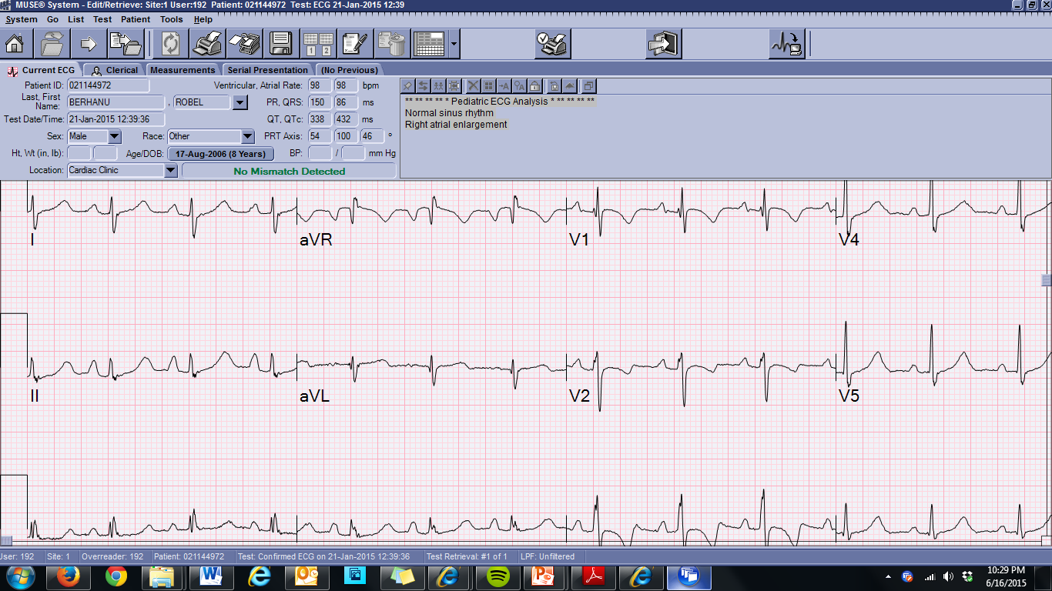
Atrial enlargement
Look at lead II
Left atrial enlargement
0.07 msec (children)
0.09 msec (adults)
> 2.5 boxes
Right atrial enlargement:
> 2.5 boxes tall

Slide 36
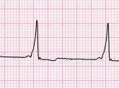
PR interval
Check your normal values!
Upper limit of normal ranges 0.12 – 0.20 (adults)
Short PR:
WPW/pre-excitation
Enhanced automaticity
Glycogen storage diseases (Pompe’s)
Long PR (1st degree AVB):
Normal hearts!
Causes: myocarditis, rheumatic heart disease, ASD, endocardial cushion defects, Ebstein’s, digitalis toxicity, hyperkalemia

Slide 37
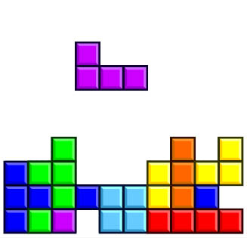
Blocks
1st degree AVB: Long PR
2nd degree AVB:
Mobitz I (Wenckebach): gradual prolongation of PR interval with dropped beat
Mobitz II: no change in PR interval with random dropped beats
3rd degree AVB:
No association between P waves and QRS

Slide 38
QRS
Duration:
Normal: < 0.08 sec (2 small boxes)
Increased: bundle branch block, ventricular arrhythmias, ventricular pacemaker
Low voltages: < 5 mm in limb leads, < 10 mm in precordial leads
Pericardial effusion
Myocarditis (with ST changes)
Generalized edema/thick chest wall
Hypothyroidism

Slide 39
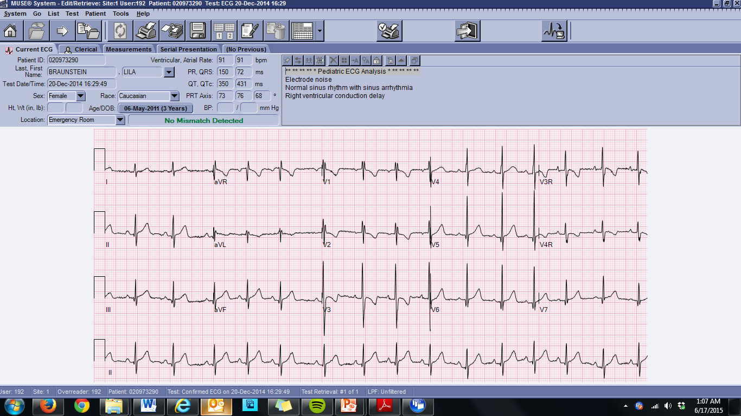
RSR’
Seen in lead V1
AKA right ventricular conduction delay
AKA incomplete bundle branch block
NORMAL VARIANT
Some literature argues that R’ > R has higher risk of ASD, though not seen in paper by Ofer Schiller (former CNMC cardiology fellow)

Slide 40
Q waves
Depolarization of the ventricular septum
Can be seen in leads II, III, avF, V5, V6
Normal: < 5 mm
Normal: < 0.02 sec
Abnormal Q waves: infarction, fibrosis
Deep Q wave in leads I and avL?

Slide 41
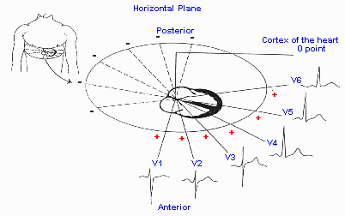
Left and Right Voltages, the Precordial Leads

Slide 42
Left ventricular hypertrophy (LVH)
More likely in the setting of left axis deviation
R wave in V6 and S wave in V1 greater than upper limits for age
R/S ratio:
Greater than upper limits of normal for age in V6
Less than lower limits of normal for age in V1
Deep Q waves (> 5 mm) in V6
LVH on ECG is most often a false positive

Slide 43
Right ventricular hypertrophy (RVH)
More likely in setting of right axis deviation
R wave in V1 and S wave in V6 greater than upper limits for age
R/S ratio:
Greater than upper limits for age in V1
Less than 1 in V6
Upright T wave in V1 (> 3 days of age)
Q wave in lead V1

Slide 44
Biventricular hypertrophy
Most specifically should concern for hypertrophic cardiomyopathy (HCM)
Fulfills criteria for both LVH and RVH
Combined mid-precordial lead (V2-V5) voltages > 50 mm

Slide 45
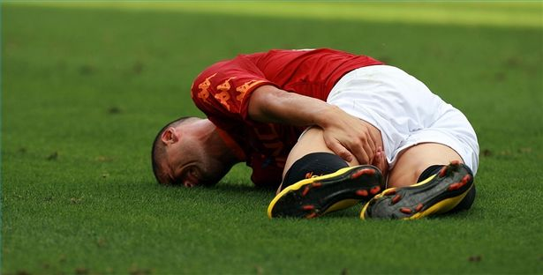
Strain
In accordance with hypertrophy
Concern for increased “strain” on a given ventricle
ST segment or T wave changes
  With LVH: changes in LV leads (I, avL, V5-V6)
  With RVH: changes in RV leads (III, avR, V1-V2)

Slide 46
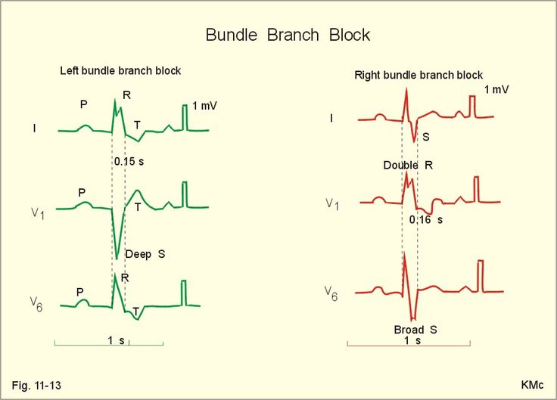
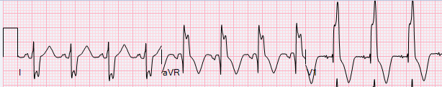
Bundles

Slide 47
P through QRS Summary
P waves: P wave axis, morphologies, size
PR: short (is it WPW?) or long (clinical context)
QRS: RSR’ is a normal variant, look at your normal values, low voltage can be ominous, LBBB is a rarity in pediatrics
Q wave: can be normal, lead I and avL can signify ALCAPA
Voltages: remember where your precordial (V1-V6) leads are:
  V1 is anterior (RV): Large R wave = increased RV voltages
  V6 is posterior (LV): Large R wave = increased LV voltages

Slide 48
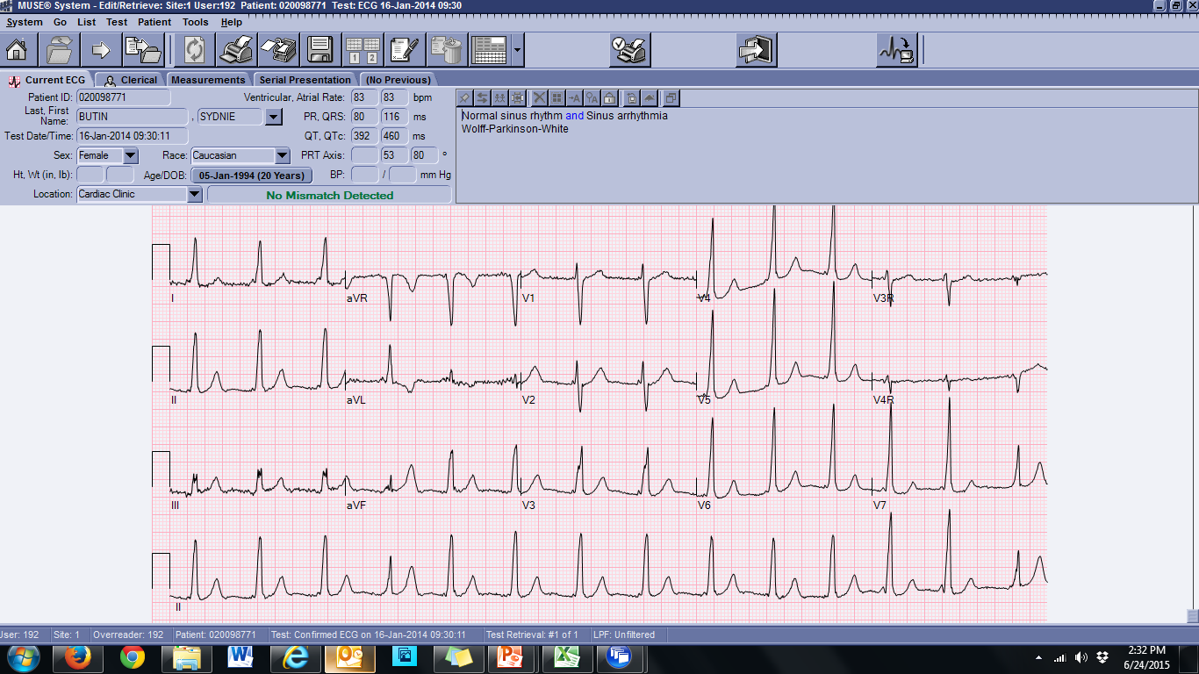
WPW

Slide 49
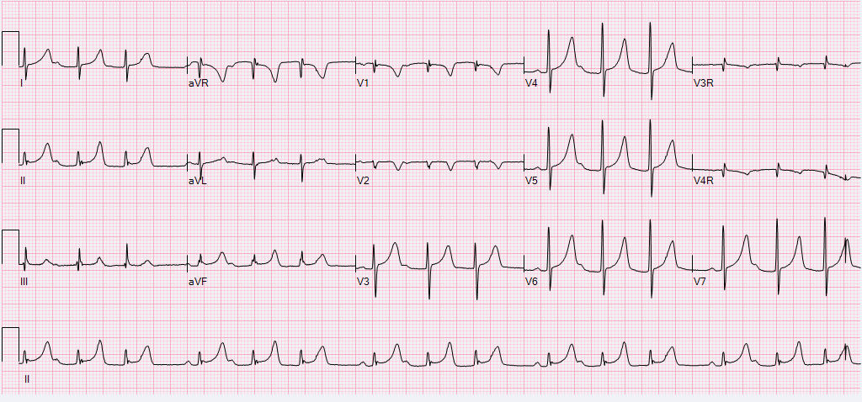
Mobitz I (Wenckebach)

Slide 50
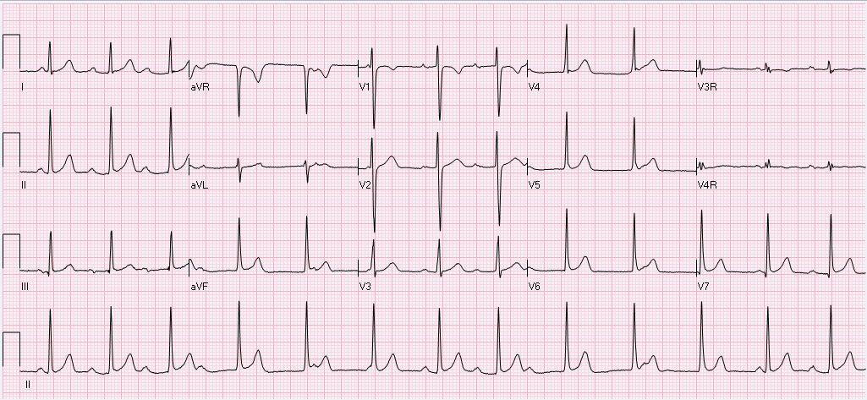
Complete HB

Slide 51
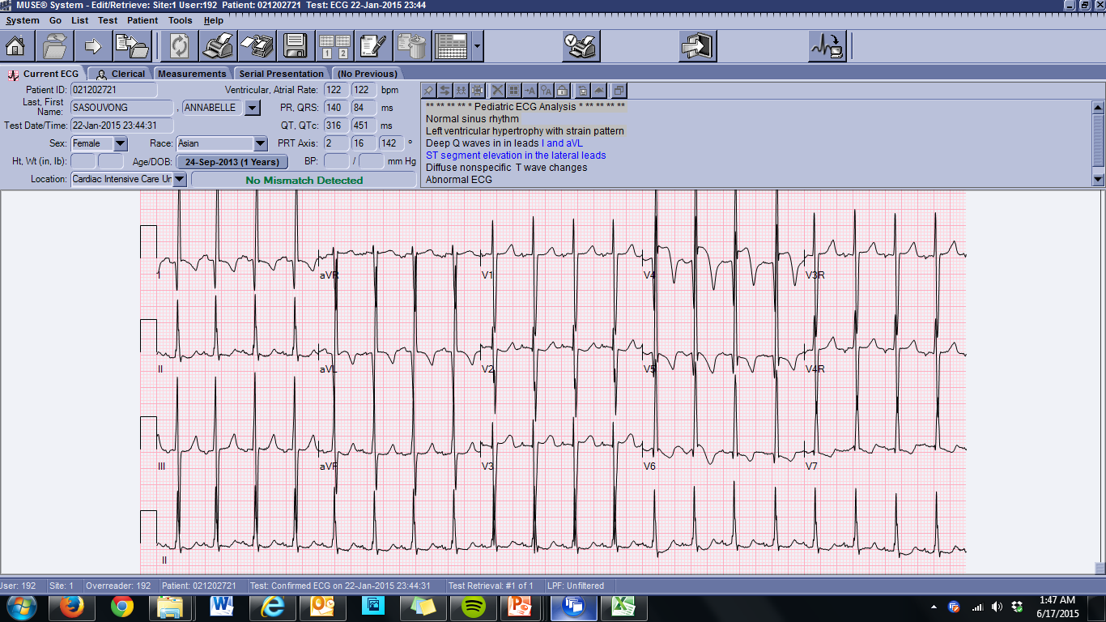
ALCAPA

Slide 52
ALCAPA

Slide 53
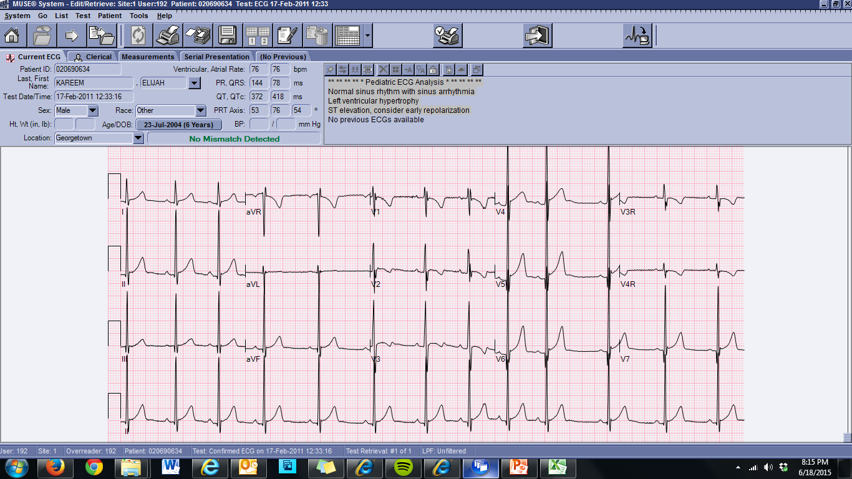
LVH

Slide 54
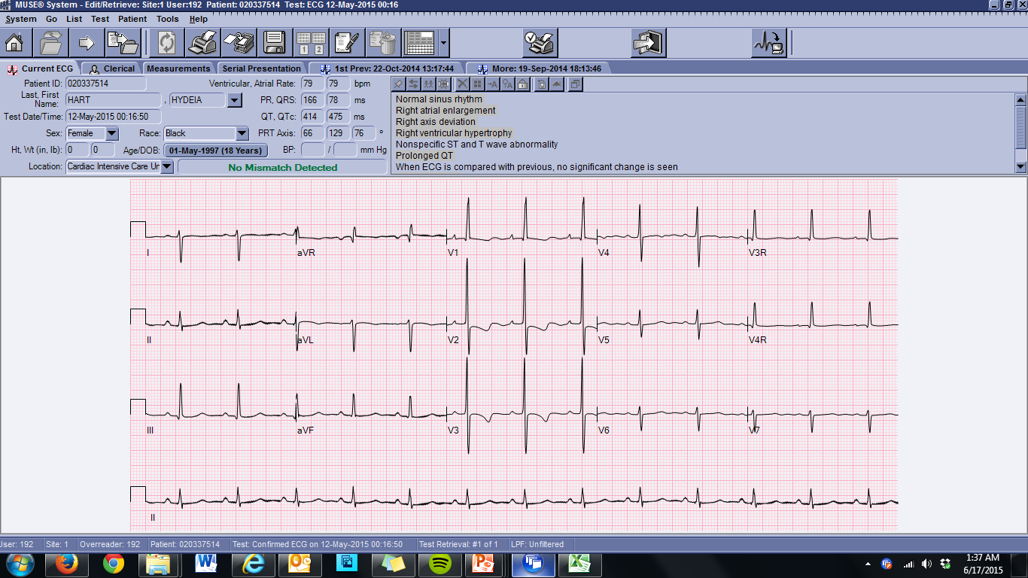
RVH

Slide 55
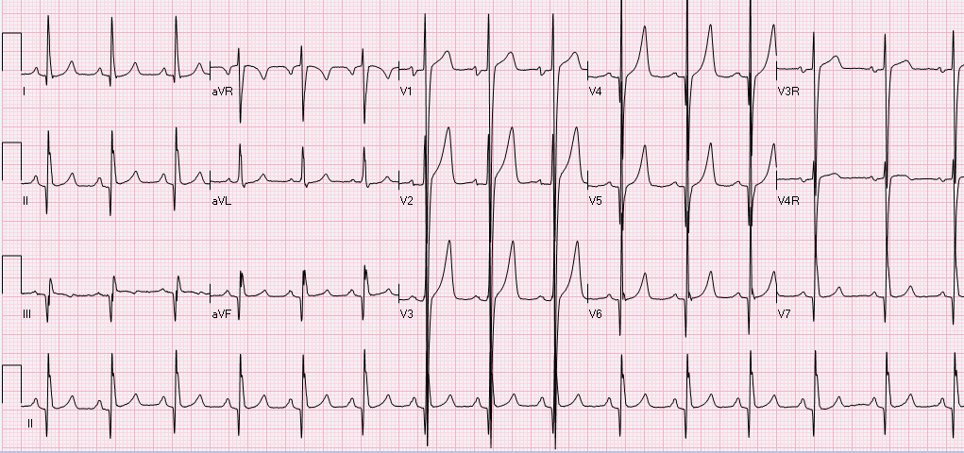
HCM

Slide 56
ST segment
Normally isoelectric
Can have some elevation:
  Limb leads: 1 mm of elevation/depression
  Left precordial leads: 2 mm of elevation/depression
  ST elevation: pericarditis, myocarditis, hypertrophy with strain pattern
  ST depression: myocarditis (usually opposite leads of those with elevation), subendocardial ischemia (more adults)

Slide 57
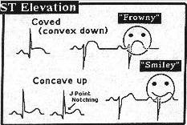
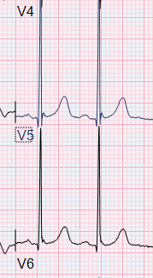
The J-point
Convex vs. concave

Slide 58
Brugada syndrome
Sodium channel (SCN5A) mutation
High incidence of sudden cardiac death (ventricular arrhythmia)
No structural heart disease
ECG findings:
ST segment elevation in V1-V3
Right bundle branch block

Slide 59
T waves
Represent ventricular repolarization
Usually mirrors the QRS (upright or downgoing)
Tall, peaked T waves: Hyperkalemia, LVH or volume overload
Flat T waves:
Non-specific
Hypokalemia
Myocarditis, pericarditis, ischemia
Hypothyroidism
LVH/pressure overload

Slide 60
T wave progression
Precordial leads (V1-V6)
Usually negative in V1
Except for birth – 5 days of life
If + starting with DOL#6 = RVH, likely with strain
T waves should go from negative → isoelectric → positive
Should be upright by V3-V4
Otherwise defined as abnormal T wave progression:
  Persistence of right sided forces
  Possible concern for ischemia (though very rare)

Slide 61
What do you mean non-specific?
Non-specific ST and T wave changes
Electrolyte abnormalities (hypoK, hypoglycemia, hyperglycemia)
Post seizure activity (can also prolong QT interval)
Sick patient, meaning anything that will cause inflammatory state leading to repolarization abnormalities
  Sepsis
  Severe acidosis (metabolic, respiratory)

Slide 62
The QTc
QT / √RR interval
Calculate QTc for every pediatric patient
QTc can be falsely prolonged in patients with conduction delay (wide QRS)

Slide 63
More QTc
Calcium is important, get an Ical!
Hypocalcemia: prolongs QT interval
Hypercalcemia: shortens QT interval
Seizures prolongs QT interval
Drugs!!!!
Short QT/Long QT syndrome

Slide 64
QT Drugs
Crediblemeds.org
Antibiotics: Azithro, Floxacin (s), Clarithromycin, Erythromycin
Anti-arrhythmics (no kidding): Amiodarone, flecainide, procainamide, sotalol
Anti-histamines
Anti-psychotics and anti-depressants
Anti-malarials
Anesthetic agents: Propofol, sevoflurane
Cocaine?

Slide 65
ST through T Summary
ST segment: 1 mm of elevation/depression can be normal, J-point elevation (early repolarization) is normal in pediatrics, watch for pericarditis/myocarditis
T waves: non-specific, normal progression in precordial leads, potassium abnormalities
QTc: always calculate, calcium, short/long QT syndrome, drugs!

Slide 66
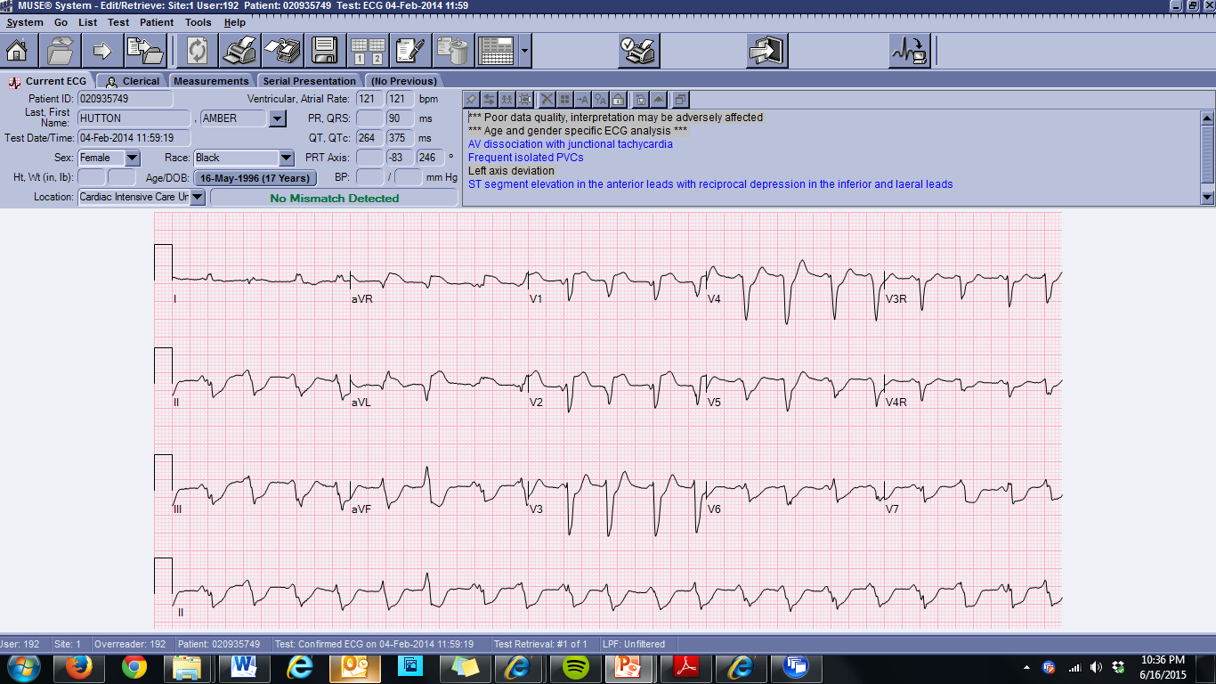
Myocarditis

Slide 67
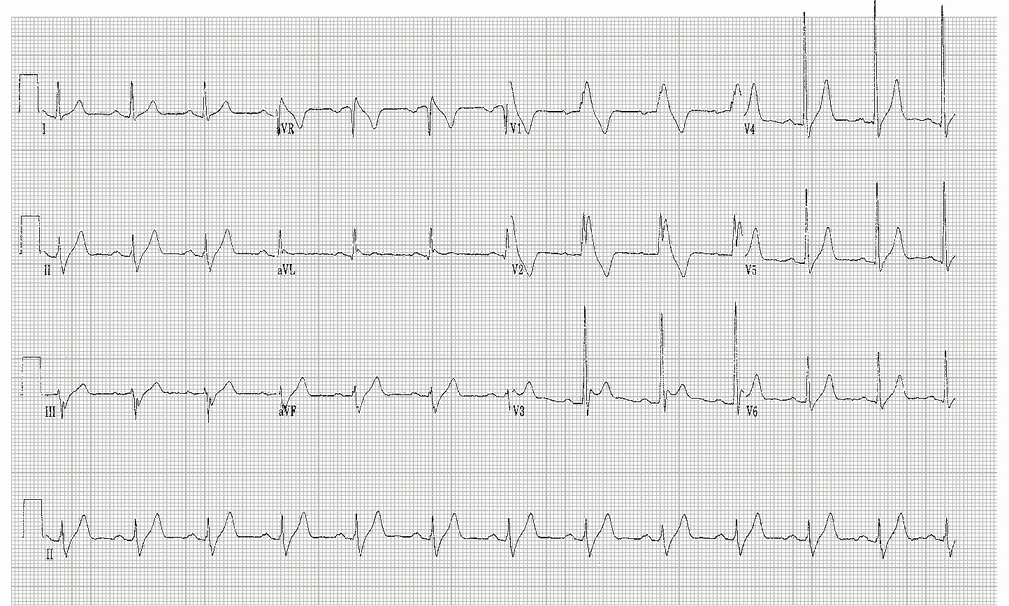
Brugada syndrome

Slide 68
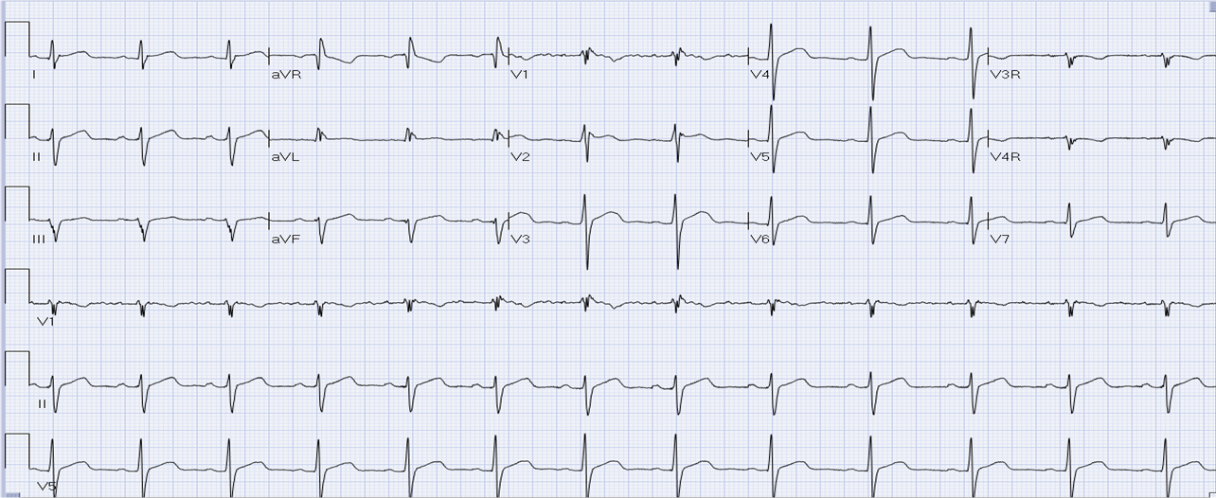
Brugada syndrome (less obvious)

Slide 69
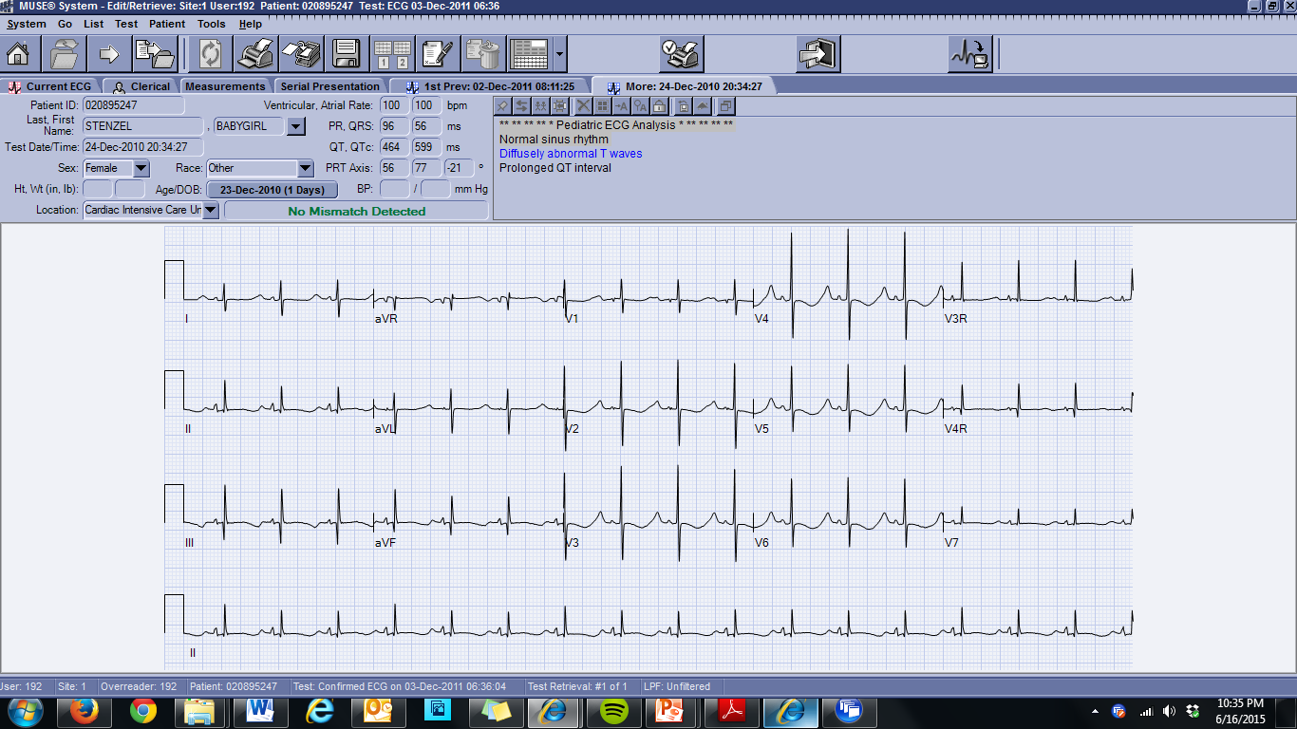
LQT

Slide 70
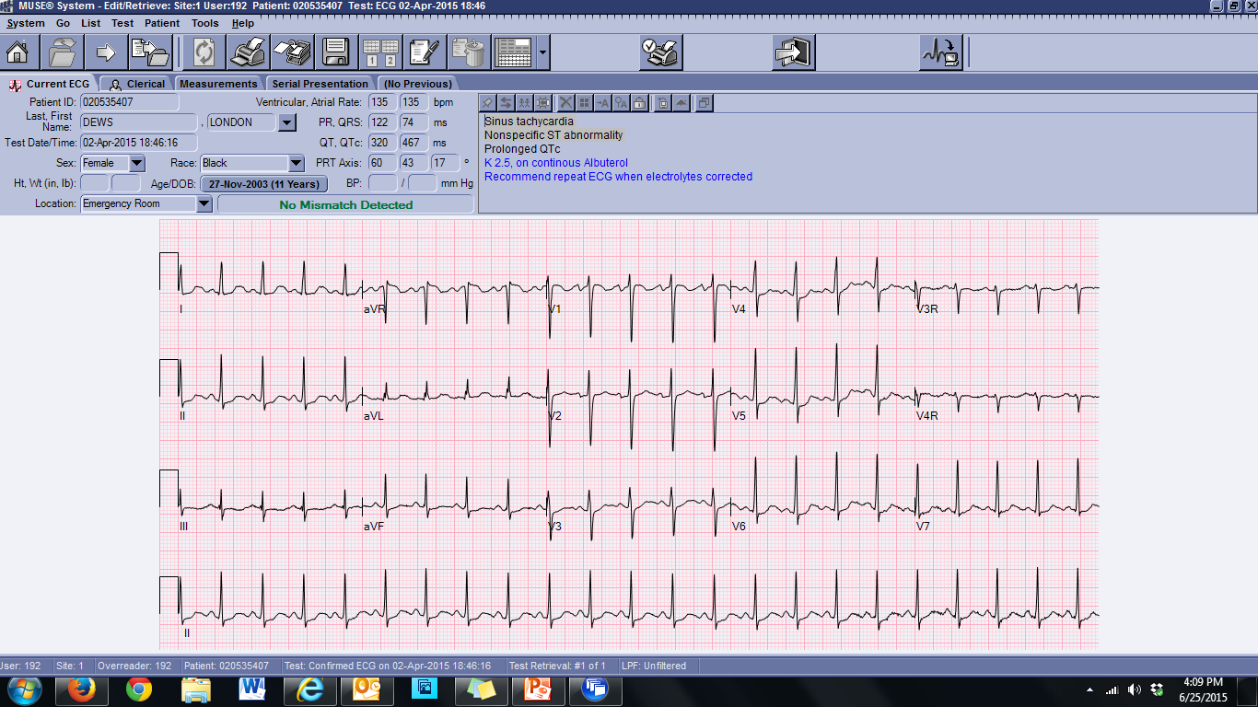
Non-specific ST/T wave changes

Slide 71
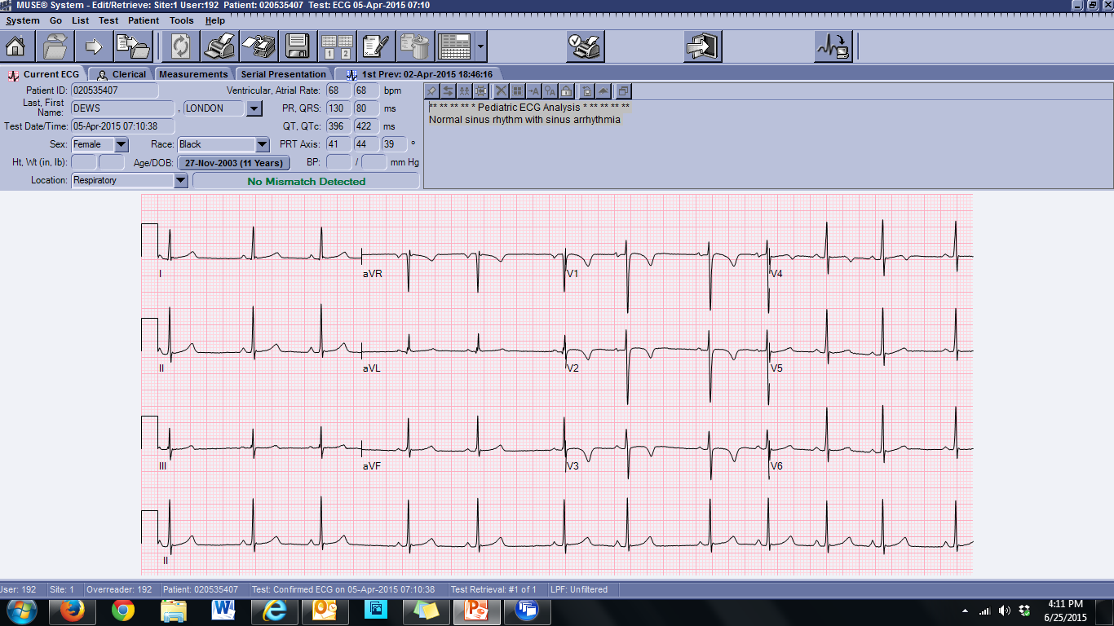
More K+, less Albuterol

Slide 72

Wake up, Summary Slide

Slide 73
Summary #1
Make the effort
Understand how ECG is useful and remember that clinical context is essential
Have a resource (Harriet Lane, Park, etc)
Always interpret in the same manner, or you will miss something
Easiest to start with rate, rhythm, and axis
Aside from rate (fast or slow), sinus vs. not-sinus is first question to answer
Simplify axis, don’t overthink
Axis doesn’t make a diagnosis, but can put you on the right path

Slide 74
Summary #2
Understand where your leads are:
  Limb leads: I is leftward
  Precordial leads: V1 (right, anterior) to V6 (left, posterior)
P wave: P waves have axis too, lead II is your friend for atrial size
PR: short PR concerning for WPW (with delta wave), long PR can be many things including isolated with a normal heart
Blocks: know ECGs for blocks, they will show up on in-service/boards
QRS: normal vs. prolonged (wide), RSR’ is a normal variant
Voltages: remember V1 and V6 and use location to guide you

Slide 75
Summary #3
ST segment: convex is bad, early repolarization is normal, Brugada is rare and requires high index of suspicion, watch for pericarditis/myocarditis in the PROPER clinical situation
T waves: usually mirrors QRS, potassium effect, normal progression in precordial leads
QTc: calculate, calcium, seizures, LQT/SQT, so many drugs
Remember, non-specific means non-specific

Slide 76
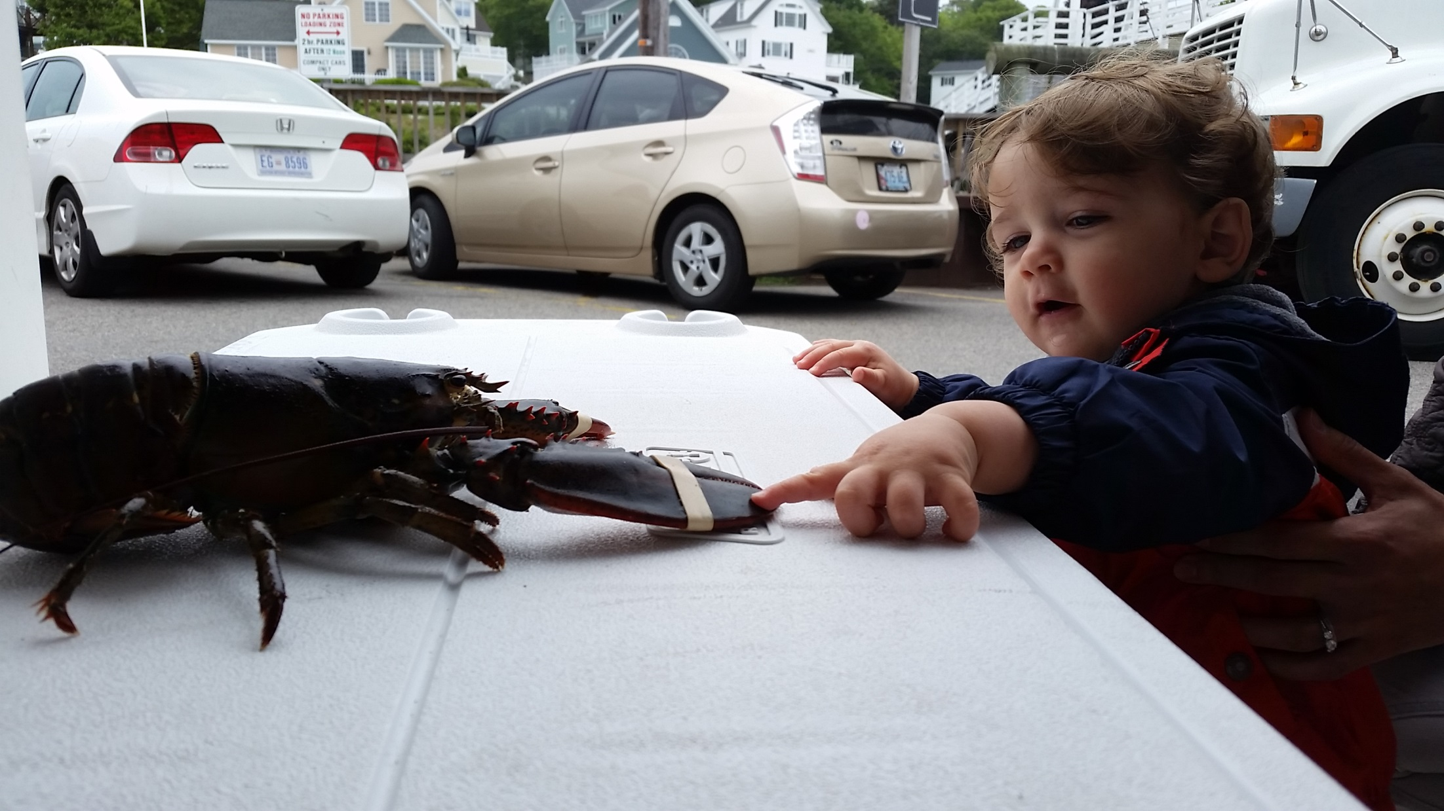
Remember, ECGs don’t bite!

Slide 77
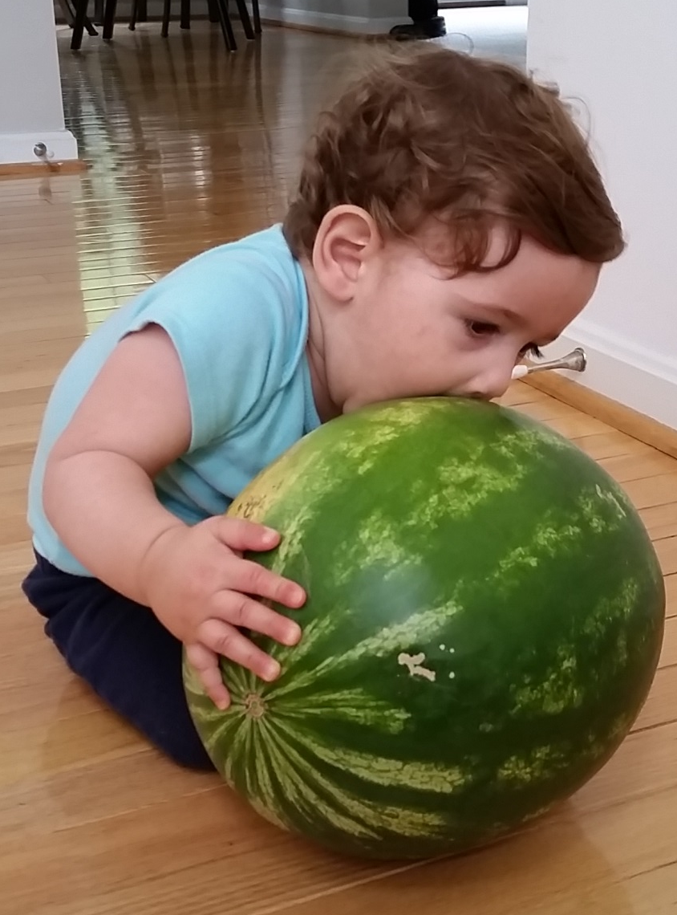
But Cardiology fellows may…..

