Slide 1
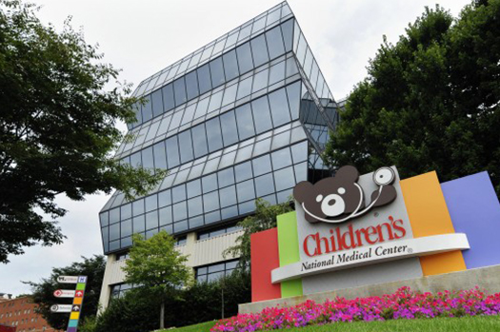
Immunodeficient hosts:
Sorting bad from not-so-bad
Michael Keller, MD
Division of Allergy & Immunology
Program for Cell Enhancement & Technologies
for Immunotherapy (CETI)
Children’s Research Institute

Slide 2
Background
Immunodeficiency is fairly common in tertiary pediatrics
Oncology / BMT
Primary Immunodeficiency
Iatrogenic immunodeficiency
Autoimmunity, solid organ transplantation
HIV
Risks & Management are quite unique depending on specifics and extent of host immunodefiency

Slide 3
Immune System Components
Immune System
Innate
Adaptive
Neutrophils
Monocytes
Complement
NK cells
T-cells
B-cells
Eosinophils
Mucosal defense

Slide 4
Immune System Components
Immune System
Innate
Adaptive
Neutrophils
Monocytes
Complement
NK cells
T-cells
B-cells
Eosinophils
Mucosal defense
Cross-talk is extremely complex

Slide 5
Host susceptibility
Absence or suppression of specific parts of the immune system can result in wide or narrow pathogen susceptibility
T-cells
B-cells
Neutrophils
TLRs
Complement
Viruses
Bacteria
Fungi
Protozoa

Slide 6
Case 1
18 month old girl is referred to the ER due to fever to 39ºC and history of neutropenia
PMH:
previously dx with autoimmune neutropenia at 1 year of age.
Otherwise thriving, no history of infections beyond two episodes of AOM.
No medications, no allergies, no notable FH.

Slide 7
Case 1
VS: T 38.5, HR 120, RR 16, BP 100/70, SpO2 100%/RA, Wt 12kg, Length 85cm
Exam: playful, moderate rhinorrhea, intermittent cough, no focal findings
Labs:
CBC: WBC 6, Hb 13, Plt 450, ANC 490, ALC 5200
CRP 1.3
Cath UA entirely normal
Blood / urine culture pending.

Slide 8
Case 1 Assessment
Degree of Risk:
Potential infections:
Plan
Low
Respiratory Viruses
UTI
Lower risk of IBI
Rocephin IM/IV
Discharge home; return to pediatrician tomorrow if fever persists

Slide 9
Case 2
6 year old boy with high-risk ALL s/p matched sib BMT, day +30, presenting with fever
PMH:
Diagnosed with ALL 1 year ago, previously well
No remission with initial chemo, now on high-risk protocol.
Medications: Tacrolimus, Atovaquone, Acyclovir, Posaconazole, GCSF.
No allergies

Slide 10
Case 2
VS: T 38.3, HR 100, RR 20, BP 120/70, SpO2 100%/RA, Wt 18kg, Length 110cm
Exam: ill appearing, laying in bed, no rhinorrhea or cough, lungs CTAB, Central line in place without erythema or drainage at site, abdomen: ND, mild TTP in LLQ, extremities: non edematous, CR ~2 secs
Labs:
CBC: WBC 1.2, Hb 7.5, Plt 50, ANC 350, ALC 50
CRP 1.5
Blood cultures, RRV panel pending.

Slide 11
Case 2 Assessment
Degree of Risk:
Potential infections:
Plan
High
CLABSI (bacterial/fungal)
GI infection (GNR)
CMV/EBV reactivation
Respiratory viruses
Other opportunists
Broad IV antibiotic coverage
Viral, fungal testing
Admit

Slide 12
Case 3
8 year old boy with X-linked agammaglobulinemia presents with cough and purulent rhinorrhea x 2 days
PMH:
XLA diagnosed at 4 years old, maintained on weekly subcutaneous immunoglobulin
Recurrent sinopulmonary infections
Previous PE tubes
Moderate persistent Asthma, seasonal allergies
Medications: Flovent, claritin, flonase, albuterol PRN.
NKDA

Slide 13
Case 3
VS: T 37.6, HR 70, RR 24, BP 110/60, SpO2 93%/RA, Wt 25kg, Length 150cm
Exam: Interactive child, mildly tachypnic and tripoding, biphasic wheezes bilaterally, absent tonsils, CV / Abd exam unremarkable, extremities WWP, CR ~1 sec.
Labs:
CBC: WBC 9, Hb 12, Plt 340, ANC 6300, ALC 1800
CRP 1.2
IgG 700 mg/dl, IgA <10, IgM 30

Slide 14
Case 3 Assessment
Degree of Risk:
Potential infections:
Plan
Moderate
Bacterial (sinopulmonary)
Respiratory /GI viruses
*Enterovirus can be life-threatening in antibody deficient patients
Imaging
Antibiotics if abnormal imaging or high suspicion of sinusitis
Discharge with close follow-up

Slide 15
Case 4
4 year old with heterotaxy syndrome presenting with fever to 39ºC
PMH:
Malrotation s/p Ladds at 4 months of age.
No known cardiac disease
Medications: Pen VK 250mg BID.
No allergies

Slide 16
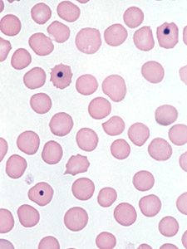
Case 4
VS: T 39, HR 100, RR 18, BP 110/66, SpO2 100%/RA, Wt 18kg, Height 95cm
Exam: timid but non-toxic, no rhinorrhea or cough, ears clear, lungs CTAB, abdominal exam unremarkable
Labs:
CBC: WBC 9, Hb 12, Plt 280,
ANC 5400, ALC 4000
CRP 2
Cath UA (CC) normal
Blood / urine culture pending.

Slide 17
Case 4 Assessment
Degree of Risk:
Potential infections:
Plan
Moderate-High
Encapsulated bacteria
Pneumococcus
H. influenzae
Meningococcus
Rochephin IV/IM
Discharge if well appearing and no psychosocial concerns;
2nd dose in pediatrician’s office tomorrow.
Discuss vaccinations

Slide 18
Case 5
11 year old with JIA who presents with persistent cough x 1 month.
Failed outpatient Augmentin course
PMH:
Diagnosed with polyarticular JIA at 7 years
No previous infections
Medications: Enbrel, Methotrexate, Nabumetone.
No allergies

Slide 19
Case 5
VS: T 37, HR 90, RR 18, BP 120/80, SpO2 98%/RA, Wt 35kg, Height 150cm
Exam: Thin, nontoxic appearing, no rhinorrhea or cough, ears clear, lungs clear with no asymmetry, abdominal exam unremarkable
Labs:
CBC: WBC 6, Hb 12, Plt 280, ANC 4100, ALC 1200
CRP 3

Slide 20
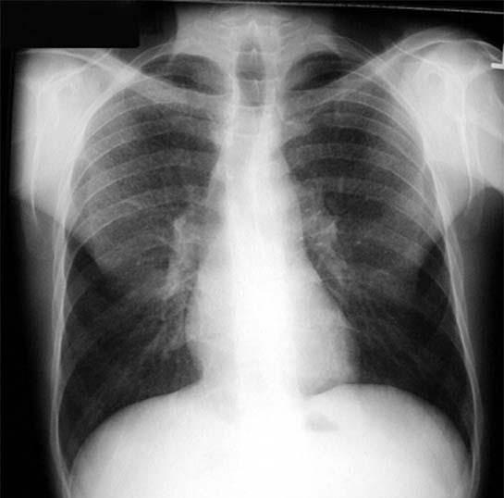

Slide 21
Case 4 Assessment
Degree of Risk:
Potential infections:
Plan
Moderate-High
Dimorphic Fungi
Mycobacteria
Invasive bacterial infections
Viral URIs
Imaging
Respiratory cultures
Fungal antigen testing
Consider admitting for workup/possible BAL

Slide 22
Take home points
There is a large spectrum of immunodeficiency
Specifics usually determine host susceptibility
When in doubt, call the specialists ☺

Slide 23
Immunity
Because your lunch wasn’t sterile ☺

