Slide 1
Allergic Rhinitis
3/14/2016
Asad Bandealy, MD MPH
Fellow - General Academic Pediatrics

Slide 2
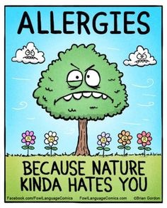

Slide 3
Learning Objectives
By the end of the session Learners will be able to:
Describe and identify typical physical findings of allergic rhinitis
Compare and contrast efficacy of treatment alternatives for allergic rhinitis
Formulate a treatment plan for children with allergic rhinitis
Evaluate response to treatment in children with allergic rhinitis

Slide 4
Outline
Review of Allergic Rhinitis
Guidelines
Application
Recent Research
Take Home Points

Slide 5
Cases
14yo female going on a camping trip with family this spring. Has sneezing and itchy nose a few days a week at the beginning of spring each year.
7yo male with snoring and frequent epistaxis. Nasal congestion and coughing when he first lays down to sleep.

Slide 6
Review of Allergic Rhinitis
Epidemiology
Up to 40% of children
Increased prevalence in past 30 years
Continues through young adulthood, improves in later adulthood
Cost > $3 billion per year + $4 billion in co-morbid conditions
School performance and quality of life

Slide 7
Review of Allergic Rhinitis
Physiology
IgE-mediated hypersensitivity
Role of Th1 vs Th2 (Hygiene Hypothesis, Old Friends Theory)
Notes:
Allergic Rhinitis is an IgE-mediated hypersensitivity reaction
Th0 (precursor-type CD4 or T-helper cell) => can differentiate into Th1 or Th2
Th1 T-cells are more commonly involved with fighting viral, bacterial, protozoans.
Th2 T-cells are more commonly involved with fighting parasites and are associated with increased IgE production
Hygiene Hypothesis stipulates that increased microbial exposure in early life can induce immune tolerance. Old Friends Theory = gut/skin micro biome, viruses/helminths that set up chronic infections/carrier state with immunomodulation — commensal organisms

Slide 9
Review of AR
Symptoms
nasal congestion + rhinorrhea
paroxysmal sneezing
itchy eyes/nose
post-nasal drip + sore throat
snoring, mouth-breathing

Slide 10
Review of AR
Physical Findings
nasal obstruction
pale (bluish), boggy turbinates
pharyngeal cobblestoning
Dennie-Morgan lines + allergic shiners
nasal crease

Slide 13
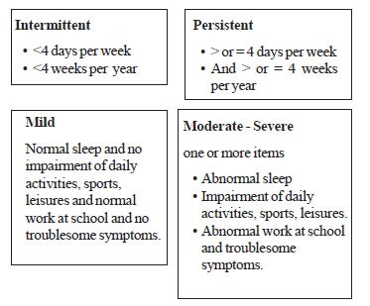
Review of AR
ARIA Classification Scheme
Notes:
Can be seasonal or perennial
Mild, moderate, or severe
Intermittent or persistent

Slide 14
Review of AR
Risk Factors
Parental AR, Eczema or Food Allergy in infancy, Male gender
Co-morbid Conditions
1/3 of AR have asthma too
Sinusitis
Snoring/Sleep disordered breathing

Slide 15
Review of AR
Differential Diagnosis
AR, sinusitis, URI, structural abn, foreign body
Diagnostic Tools
Nasal smear for eosinophils
RAST Testing
Imaging Studies
Clinical Dx
Notes:
Diagnostic Tools
1) Nasal smear for eosinophils => blow into a wax paper sheet, check for eosinophils (> 4% suggestive of AR)

Slide 16
Review of AR - Treatment Options
Allergen Avoidance
Pharmacotherapy
Anti-histamine (PO/topical)
LTRA (PO)
INS (as young as 2 yo)
Immunotherapy

Slide 18
ENT AR Guidelines
Statement 1: Hx and Exam Clinical Diagnosis Quality of Evidence = C (observational) Confidence in Recommendation = HIGH
Statement 2: Allergy Testing If no response to therapy Quality of Evidence = B (RCT, Systematic Review) Confidence in Recommendation = HIGH

Slide 19
ENT AR Guidelines
Statement 3: Imaging Avoid routine sinonasal imaging Quality of Evidence = C (observational) Confidence in Recommendation = HIGH
Statement 4: Environmental Factors Pets, A/C, pillow/mattress covers, etc. Quality of Evidence = B (RCTs with lim) Confidence in Recommendation = MODERATE

Slide 20
ENT AR Guidelines
Statement 5: Co-Morbid Conditions Assess for Asthma, Eczema, OSA, etc. Quality of Evidence = B Confidence = HIGH
Statement 6-9: Treatment Options INS, Anti-histamines, LRTAs (not 1st line) Quality of Evidence = A Confidence = HIGH
Notes:
Oral Antihistamines (2nd generation) for patients with primarily sneezing/itchy nose
Intranasal Antihistamines = 2nd line treatment
LRTAs should not be offered as first line therapy— consider for patients with AR and asthma
INS — use for patients for whom AR affects quality of life

Slide 21
ENT AR Guidelines
Statement 11: Immunotherapy For patients failing pharmacotherapy Quality of Evidence = A (RCT, SR) Confidence = HIGH
Statement 12: Inferior Turbinate Reduction Airway obstruction, failed med tx Quality of Evidence = C (Observational) Confidence = MODERATE

Slide 22
ENT AR Guidelines
Statement 13: Acupuncture Offer as alternative Quality of Evidence = B (RCTs with lim) Confidence = Low
Statement 14: Herbal Therapy No recommendation Quality of Evidence = Uncertain Confidence = Low

Slide 23
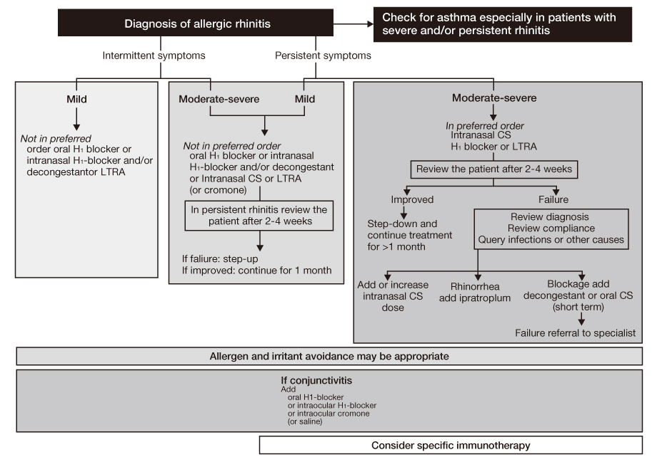
ARIA Treatment Algorithm

Slide 24
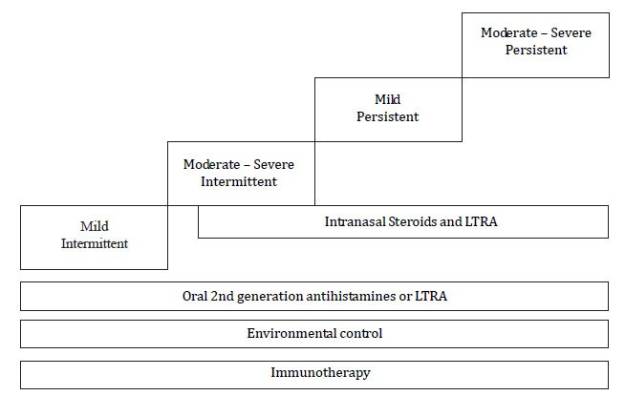
ARIA Treatment Guidelines
cx

Slide 25
Revisiting Cases
14yo female going on a camping trip with family this spring. Has sneezing and itchy nose a few days a week at the beginning of spring each year.
7yo male with snoring and frequent epistaxis for the past 6 months. He also has nasal congestion and coughing when he first lays down to sleep.

Slide 26
Recent Research
2010 - Predictors of childhood AR — Breastfeeding protective for African-American children
2013 - AR is associated with otitis media with effusion
2014 - AR associated with antibiotics in first week of life. Living on a farm helps!
2015 - Hand dishwashing = decreased risk of allergic disease (hygiene hypothesis)
Notes:
2010 study — Cincinnati Children’s found factors associated with development of Allergic Rhinitis by age 3 years => spring/summer birth, allergy to skin prick testing (SPT) for milk, egg, broth, any tree pollen. No association with traffic exhaust, tobacco smoke exposure, cat or dog exposure, pollen counts. Protective effect of prolonged breastfeeding (> 4 months) for African American children.
2013 - Denmark, Birth Cohort study — AR associate with OME. Specifically used Otoscope and tympanometry to make the diagnosis (more accurate than previous studies). Also found that cause of OME was not necessarily eustachian tube blockage, but inflammation of respiratory epithelium, including in middle ear.
2014 - Sweden, Birth Cohort (to 8 years), questionnaires at 6 months, 12 months, 4.5 years, 8 years. Found— antibiotic exposure in the 1st week of life associated with increased Odds Ratio for AR (1.75 => 95% CI = 1.03 - 2.97). Also parental AR, food allergy in 1st year, eczema in 1st year, male gender associated with AR. Living on farm as preschooler = decreased risk of AR. Findings support the hygiene hypothesis. (Theorized that antibiotic exposure in 1st week of life may be associated with changes in gut flora.)
2015 - Sweden - cross-sectional questionnaire at 7-8 years old— found that hand dishwashing associated with decreased risk of allergic disease. OR = 0.57 (0.37 - 0.85). Decreased risk also found with consumption of fermented food or buying food directly from a farm (dose-response relationship).

Slide 27
PREP Question
A 6-year-old girl presents in the spring with a 2-week history of paroxysmal sneezing associated with itching of her nose and eyes. She had similar symptoms last year that lasted for 2 months before abating. You diagnose seasonal AR. Of the following, the most effective control of her nasal symptoms would be achieved by proper use of an:
A) Intranasal corticosteroid.
B) Intranasal decongestant.
C) Oral first-generation antihistamine.
D) Oral leukotriene receptor antagonist.
E) Oral second-generation antihistamine.

Slide 28
Take Home Points
AR has significant effects on school performance and Quality of Life
Classification to guide treatment
Follow up to evaluate response
Importance of assessing and treating co-morbid conditions

Slide 29
References
Alm B, et al. Antibiotics in the first week of life is a risk factor for allergic rhinitis at school age. Pediatr Allergy Immunol. 2014;25:468-472.
Breiner-Moller E, et al. Allergic Rhinitis is Associated with Otitis Media with Effusion: A Birth Cohort Study. Clin Exp Allergy. 2012;42(11):1615-1620.
Codospoti C, et al. Predictors of Childhood Allergic Rhinitis. J Allergy Clin Immunol. 2010;125(5):1054-1060.
Hesselmar B, et al. Allergy in children in Hand Versus Machine Dishwashing. Pediatrics. Vol 135. Number 3. March 2015.
Mar T, Sheth K. Update on Allergic Rhinitis. Peds in Review. Vol 26. No 8. August 2005.
Seldman, et al. Clinical Practice Guideline: Allergic Rhinitis. Otolaryngol Head and Neck Surg. 2015 Feb;152:S1-43.

Slide 30
