Slide 1
ECW- Day 1 Survival Basics
2014

Slide 2
How to log in
Log in to the computer (if using a CHC computer)
LGAC2
password respgm
Click on the icon
Enter your ID & password and change it if prompted

Slide 3
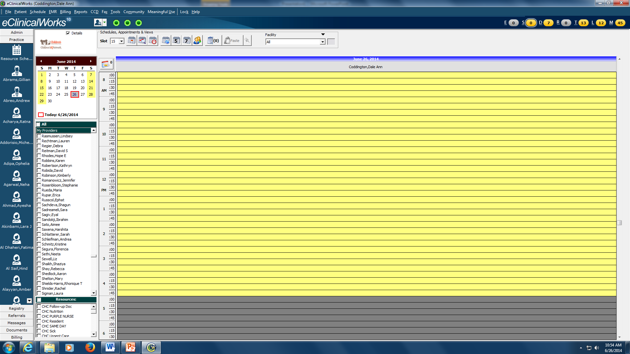
Click on Resource schedule. Now you have to add yourself (only need to do this once). Go to File, go to Settings, go to My Settings

Slide 4
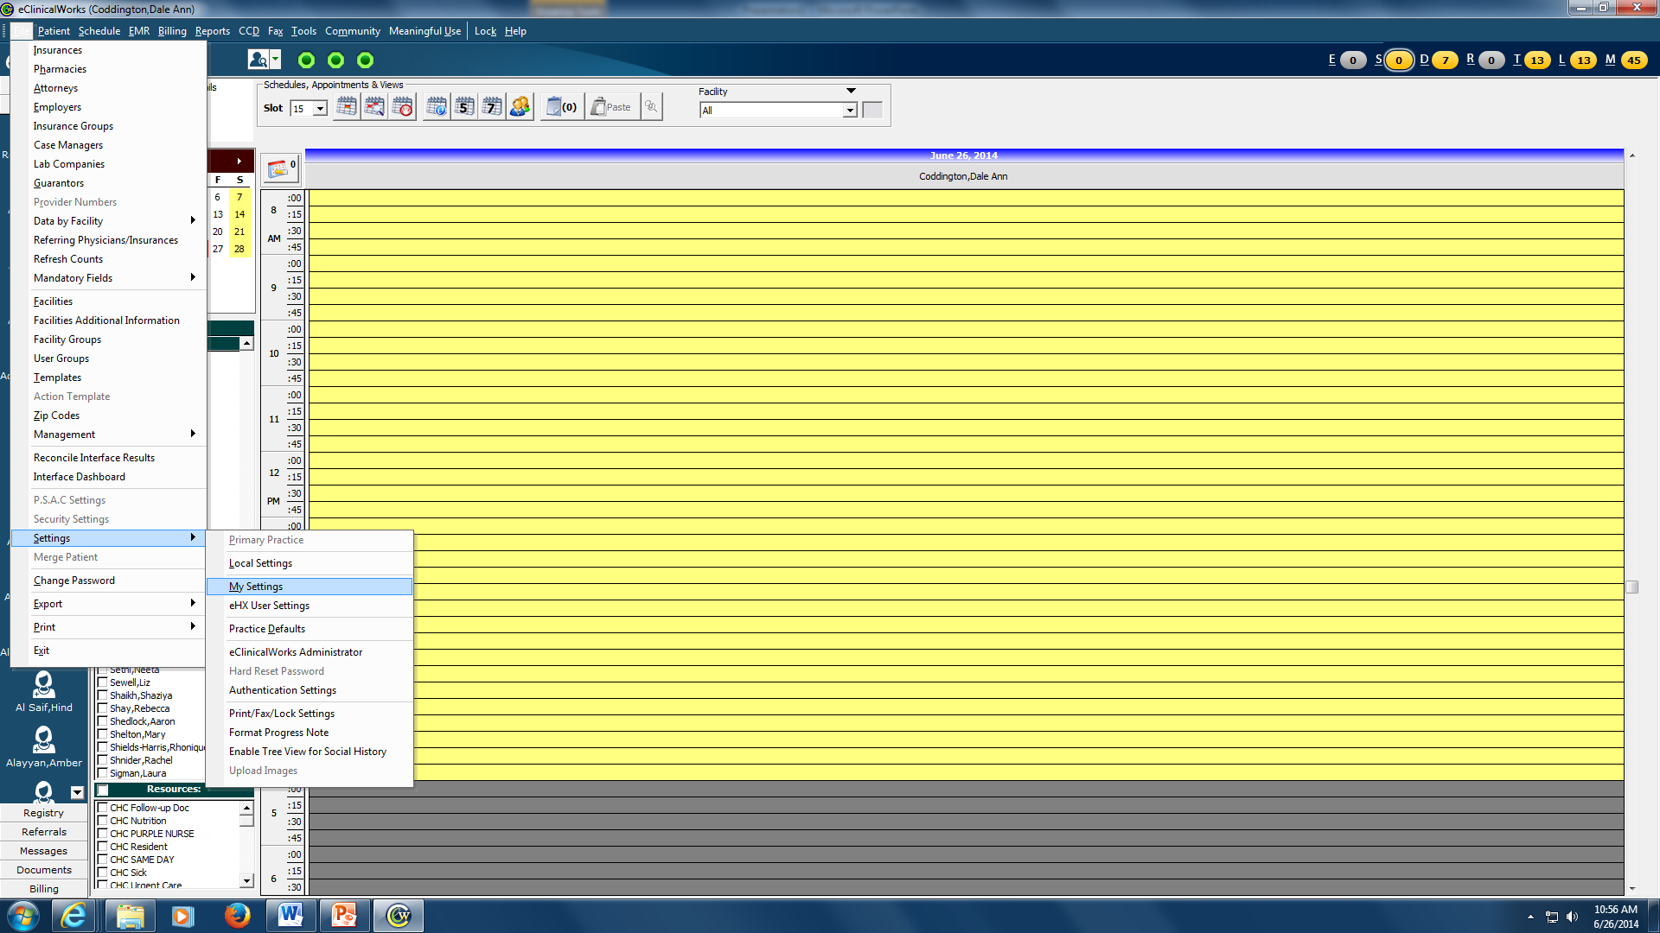
Go to File, then to settings, then to my settings

Slide 5
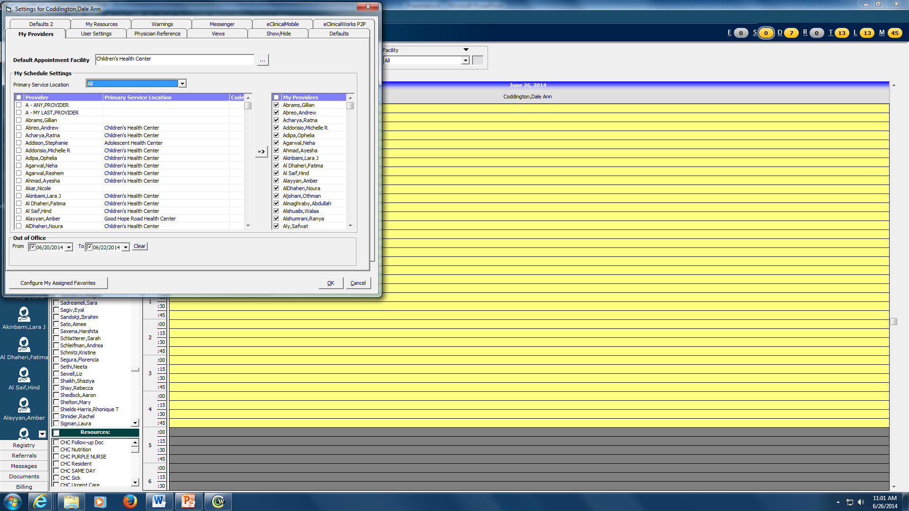
Choose Primary Service Location “All”. Check your name, click on the “Arrow” and then click OK. Now close down ECW and log in again.

Slide 6
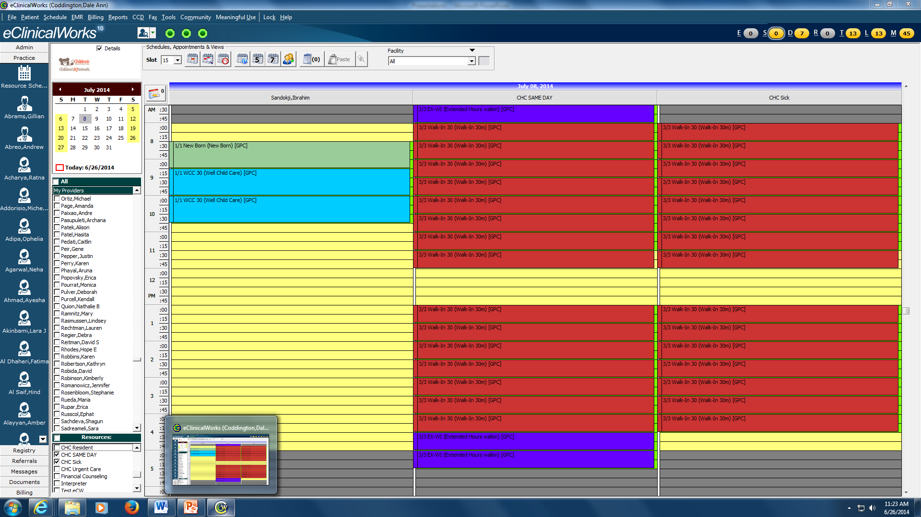
Welcome Back. Go to Resource schedule. Pick you name and then under resources pick CHC same day and CHC sick. This lets you know which patients are here in the clinic

Slide 7
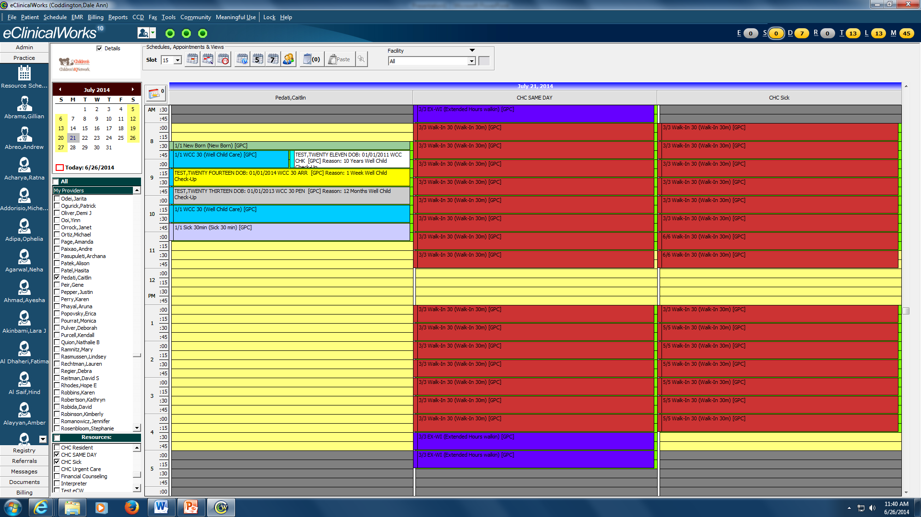
Patient appts are gray. When the patient checks in, the appointment turns yellow. When the patient is checked out, the appointment if changed to white.

Slide 8
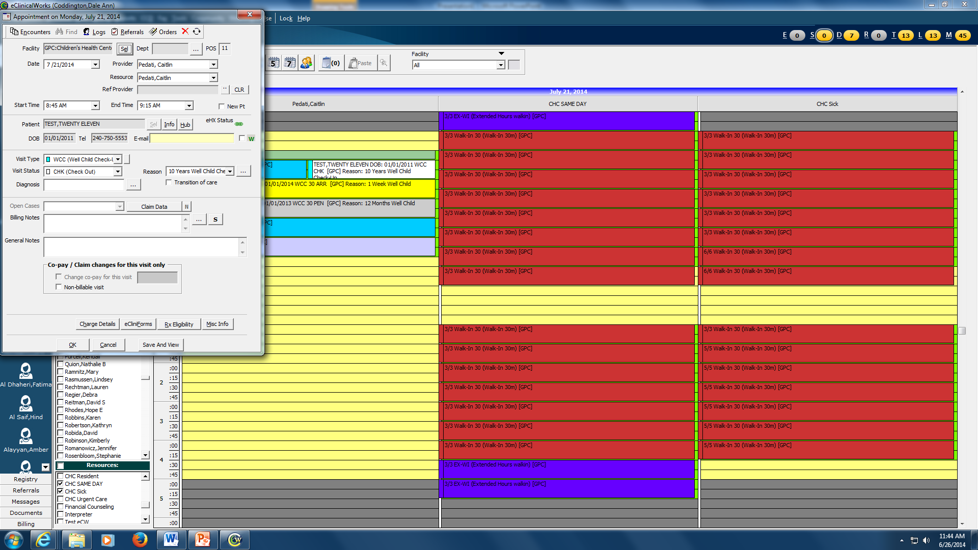
To check out a patient. Double left click on the appt and you can change “Visit Status”

Slide 9
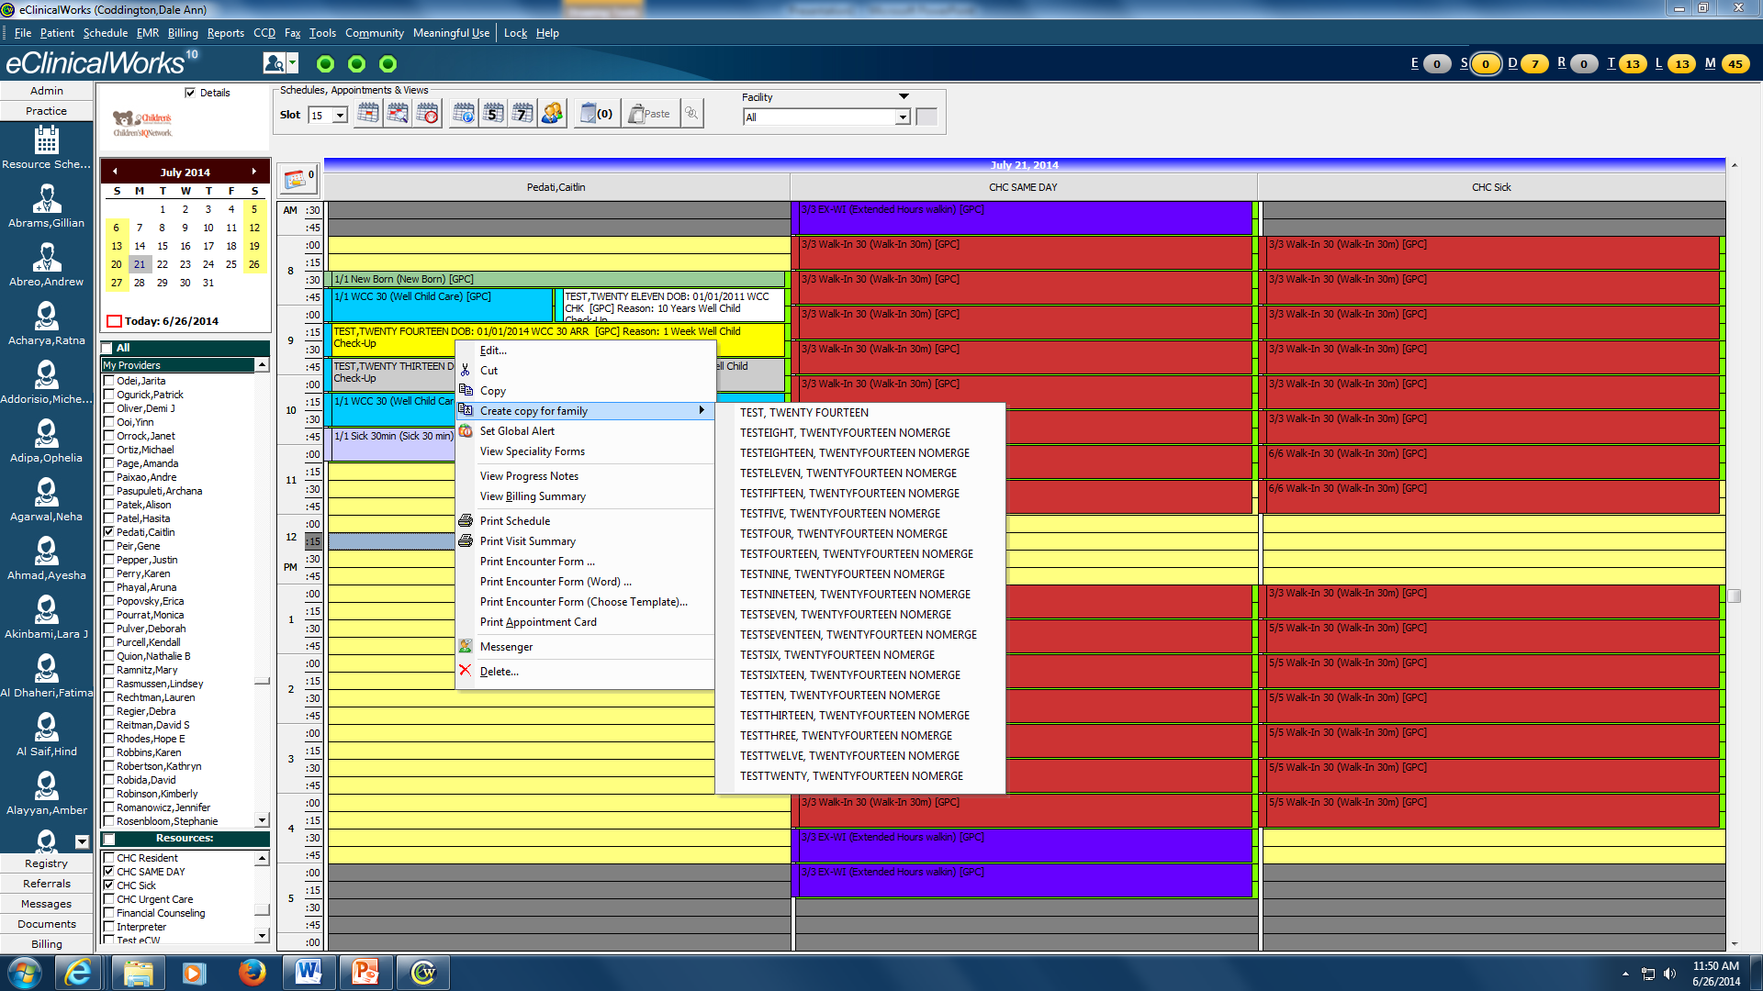
Resource screen allow you to see who is arrived and to cut and paste patients from CHC sick / CHC same day to your schedule. You can also go to the progress note or see who else is in the family by “right click”

Slide 10
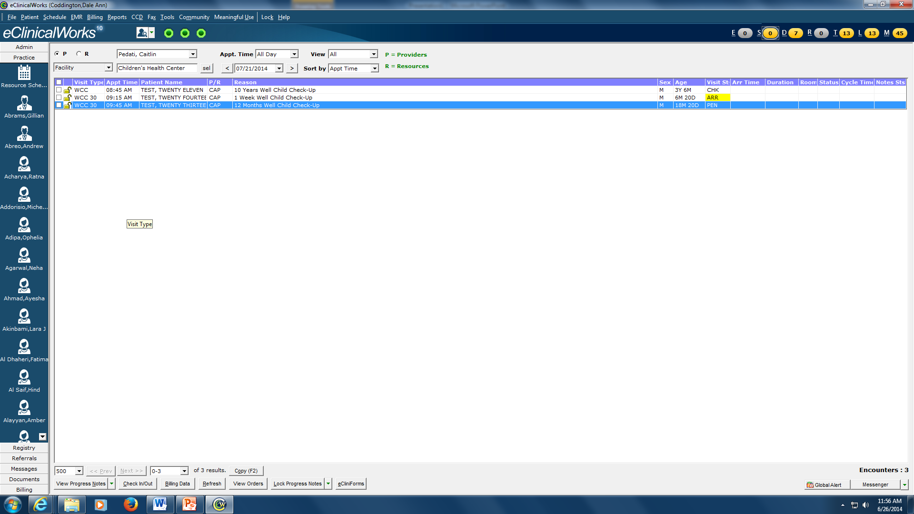
You can also see your schedule by going to the “schedule screen”. Click on the “S” Jellybean and choose your name

Slide 11
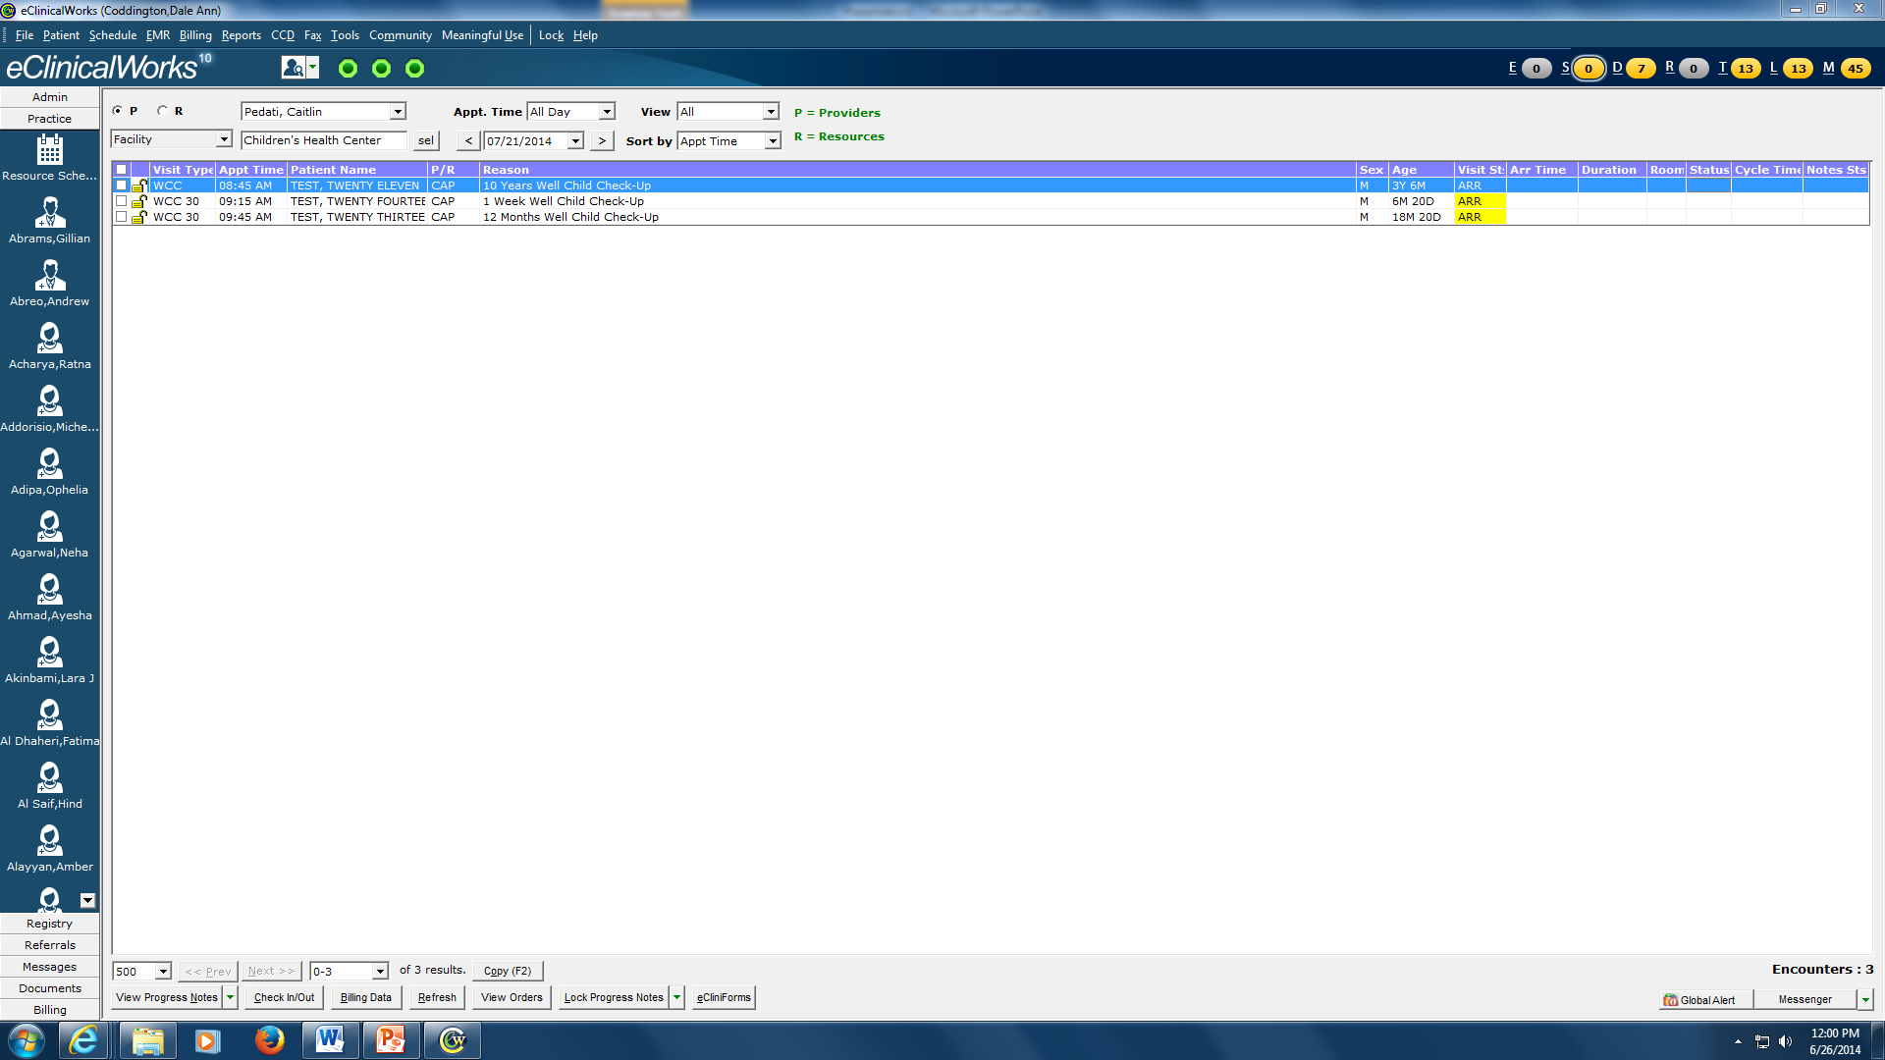
Be sure to always put the room number if you put a patient in a room. You will see if the patient is “ready”. Then you change to Provider and when order are entered, change the status “OrdHold” or “OrdGo”

Slide 12
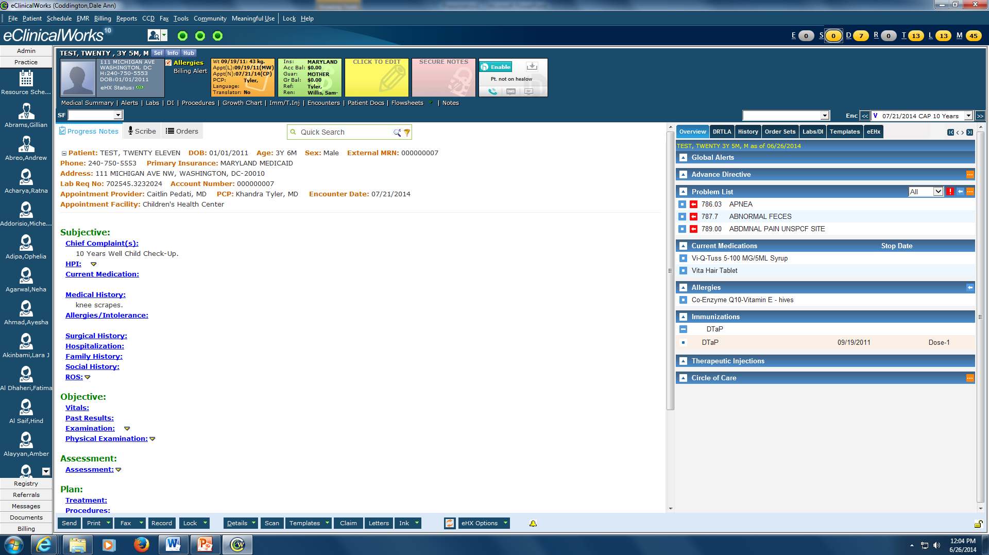
The progress note can be opened from Schedule or Resource screen.

Slide 13
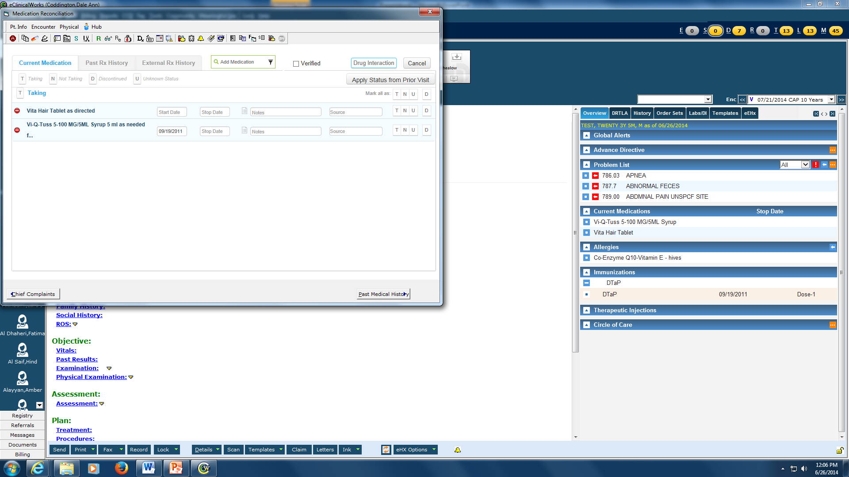
EVERY patient should have medications verified and allergies verified

Slide 14
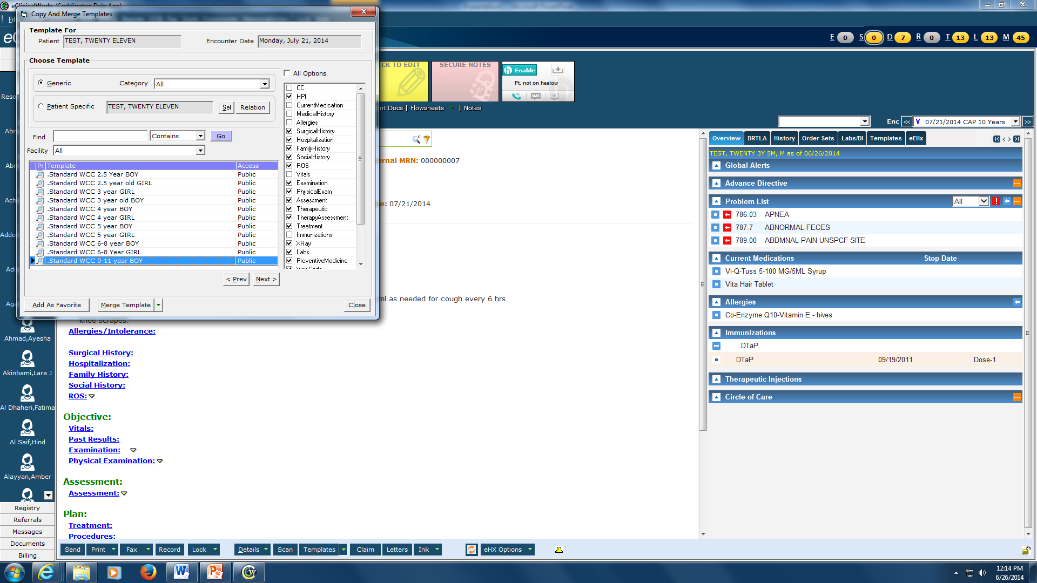
Merging a Template (WCC, asthma, obesity). Click on arrow next to Templates at Bottom, Pick merge a template. Click on Generic and Choose the template and click Merge

Slide 15
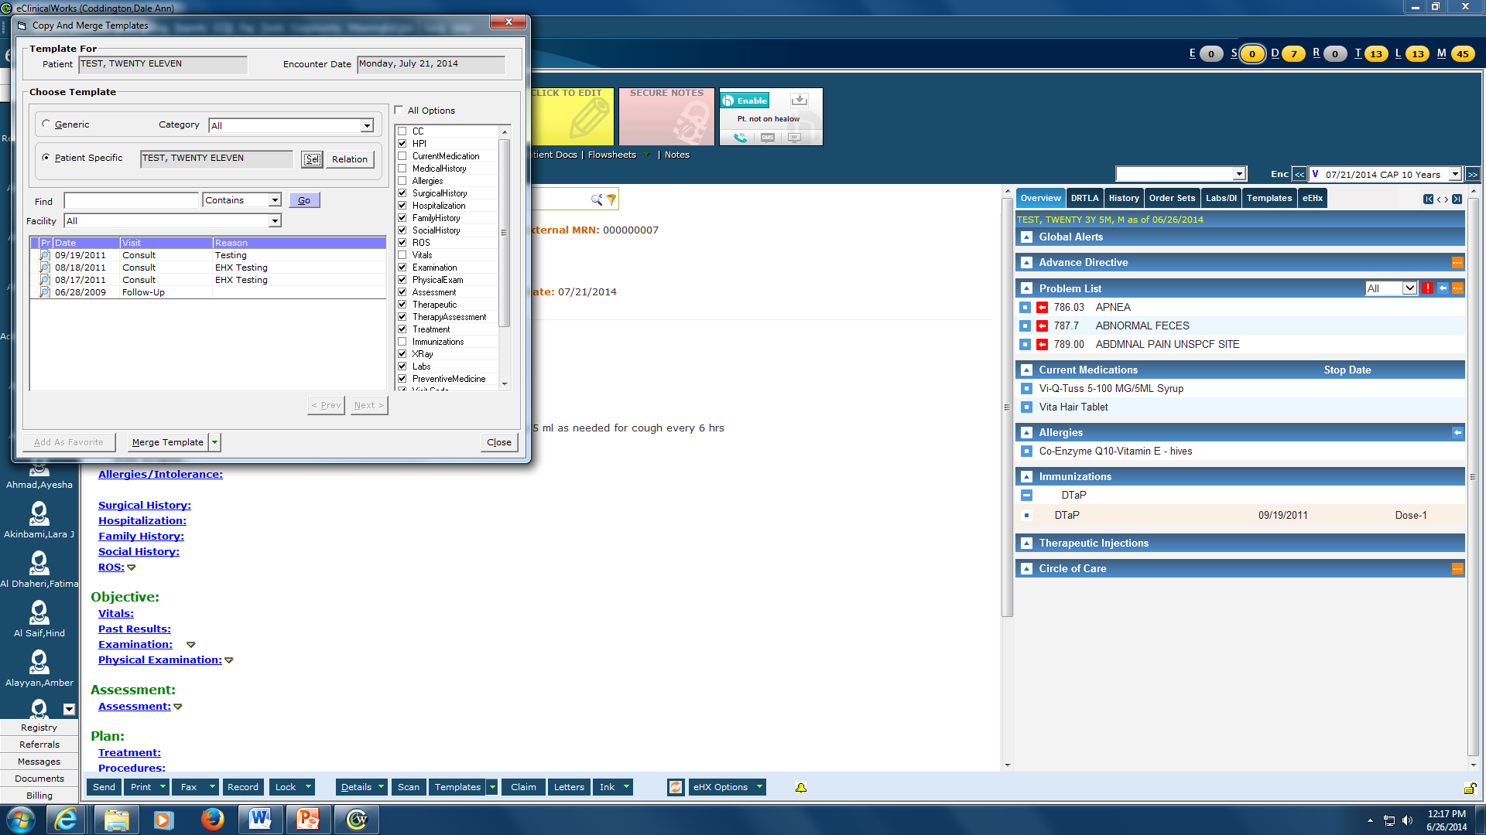
Notice that you can merge in a previous visit if you choose a patient specific template. You can also pick a different patient and merge (very useful with newborn twin visits)

Slide 16
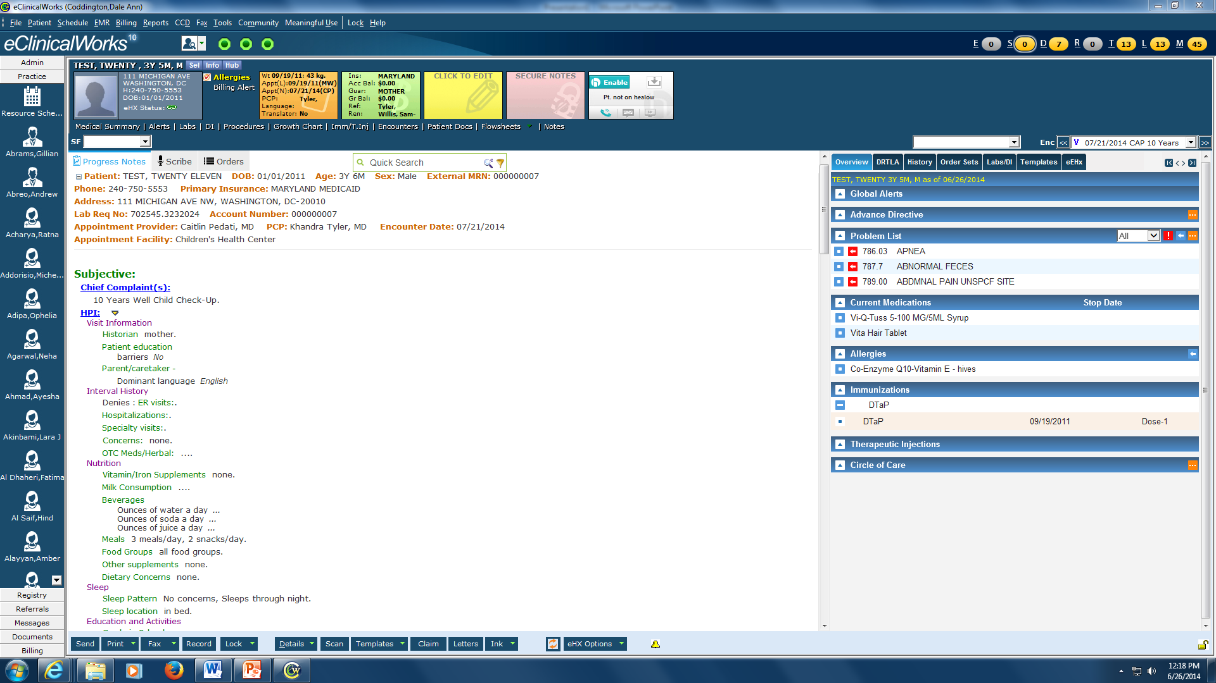
Get to know the templates. There are some fields that are filled out already and may need to be changed. Physicals are normal. What ever is in your assessment and plan- needs to be documented in the note

Slide 17
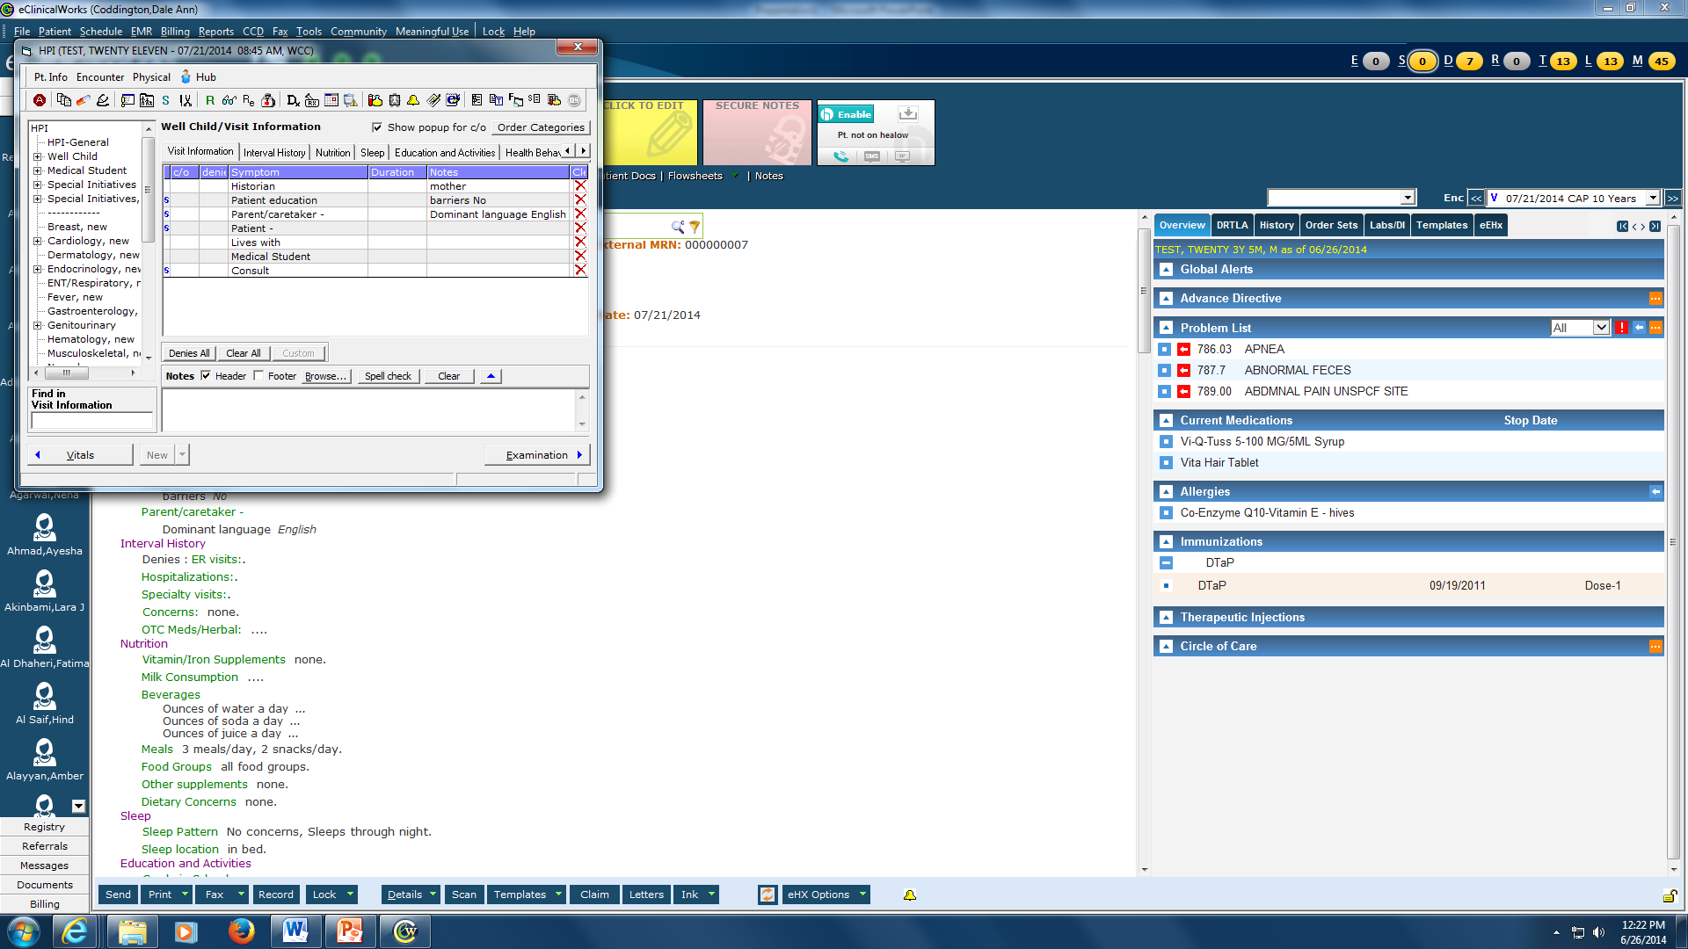
Left Click on “HPI” and you will see this view which is a faster way to go through the templates

Slide 18
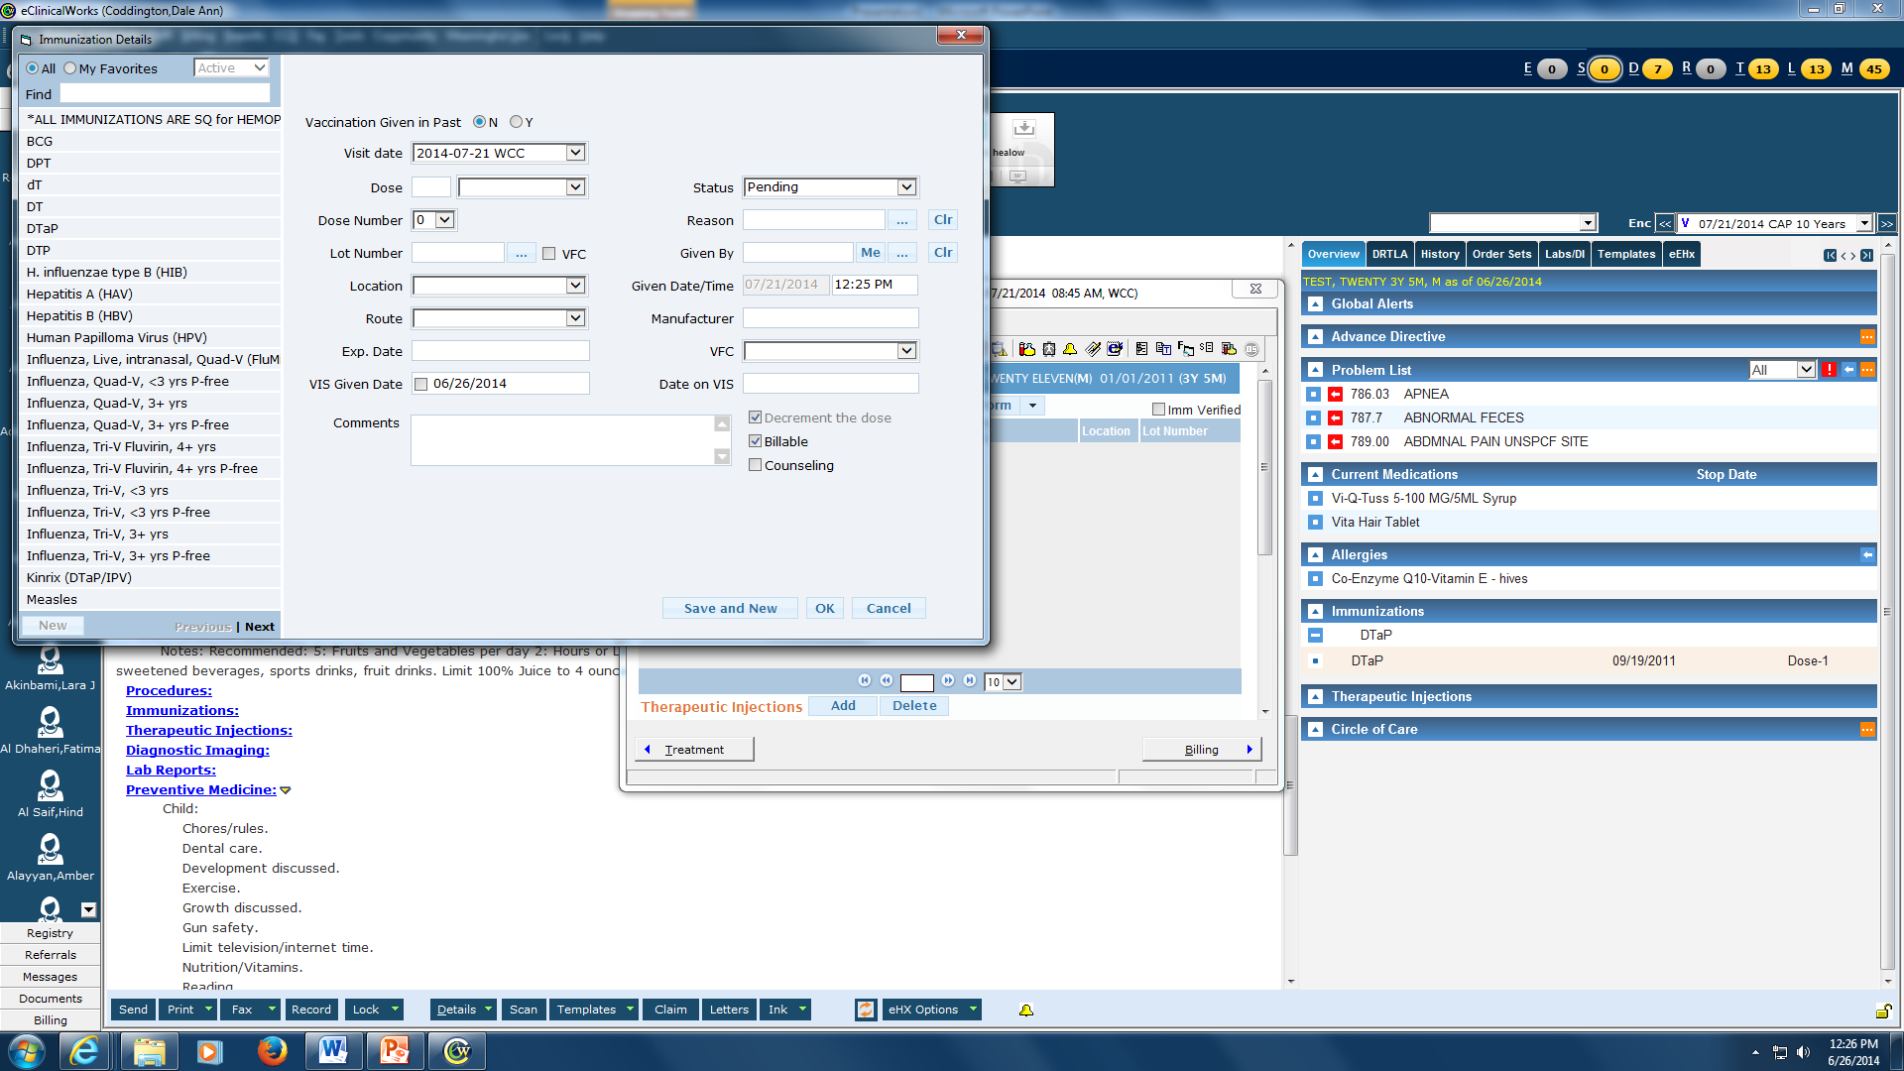
Ordering Immunizations. Click on Immunizations, then click on Add. If you have multiple immunizations to add, click on “Save and New” for each one. You can also specify given in past (useful for first Hep B)

Slide 19
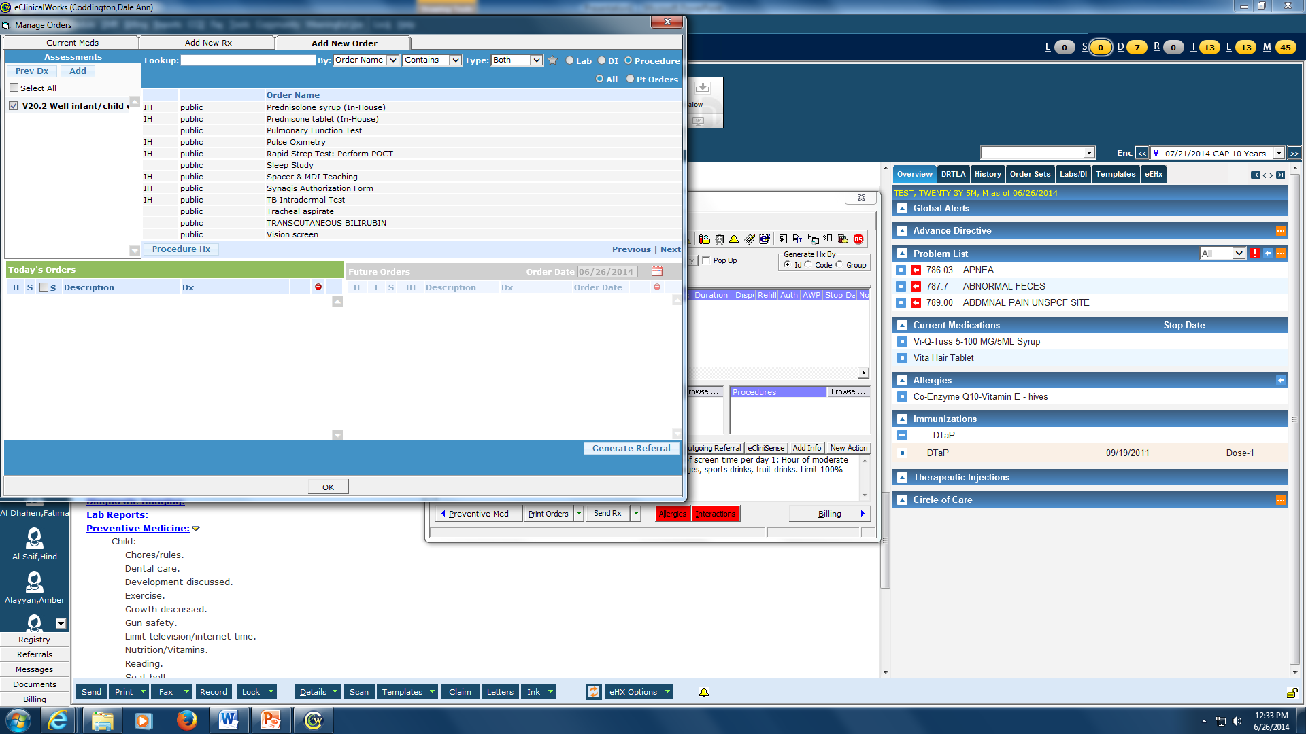
To order Albuterol Nebs, Rapid strep, Urine dip, Health forms, Asthma action plans, MDI teaching etc. Go to Plan and then Treatment and then Procedure. Change to “contains” and enter what you need

Slide 20
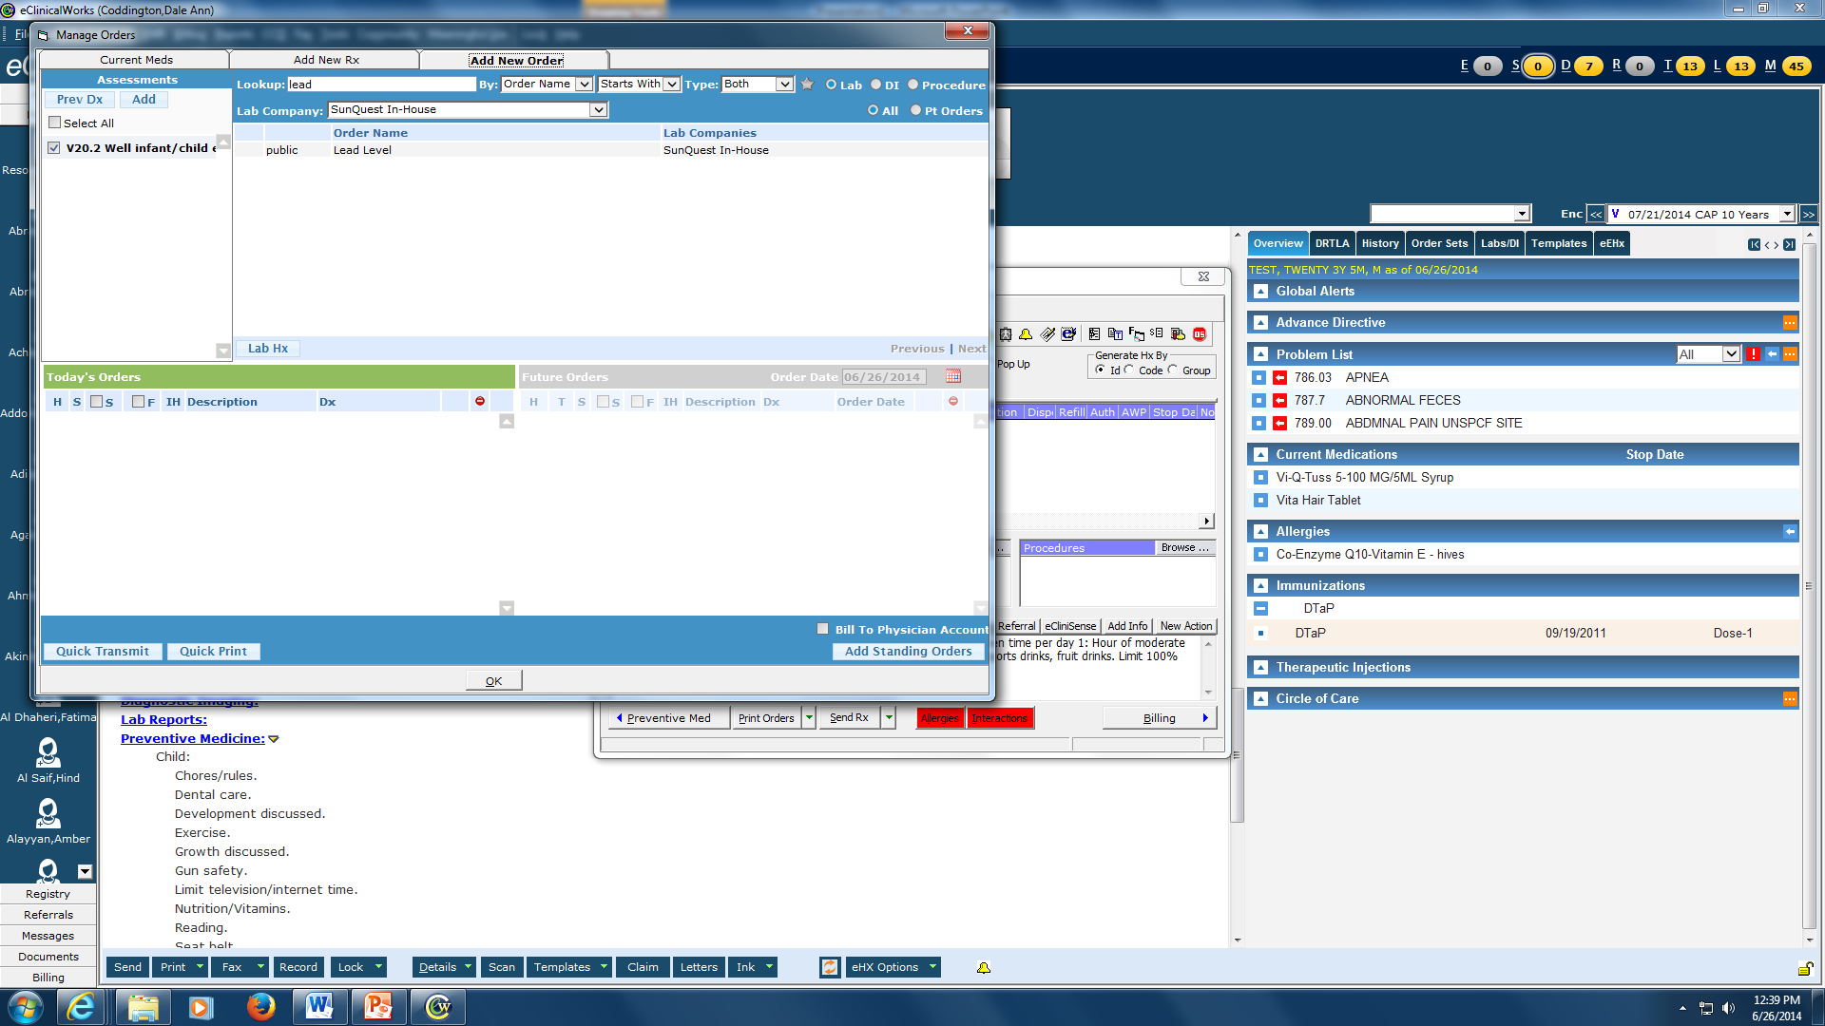
Ordering Labs: Go to Plan , then Treatment, then Lab. Click Browse (don’t change Lab company). Choose your lab. Click ok and fill out the pop-ups. Choose quick Transmit and then Transmit only. Don’t worry we’ll show you how to do this

Slide 21
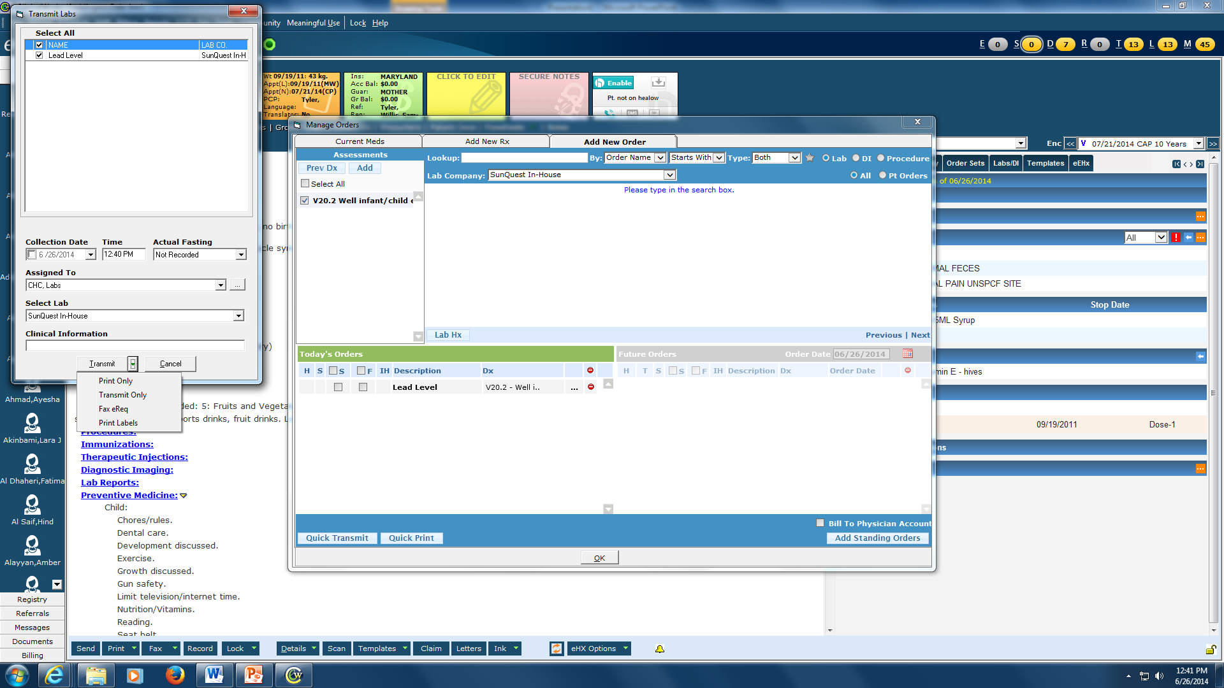

Slide 22
Always specify follow up for every patient. Every patient over 6 months should be reminded about flu vaccine in the fall and their next Well Child Visit.
We’ll teach you to do the billing but not today.

Slide 23
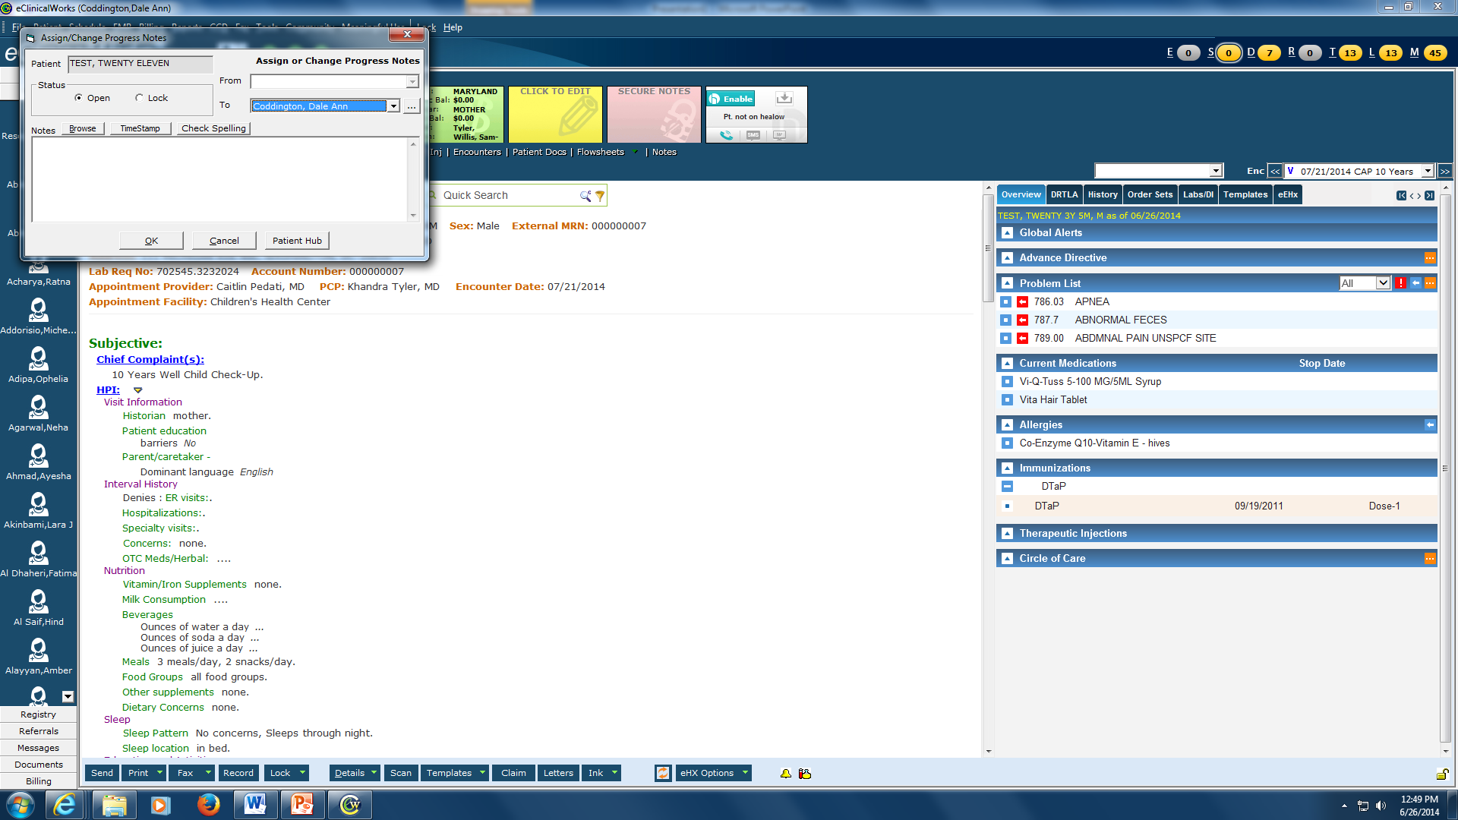
Assign your chart to the attending. Green arrow next to “Details” at the bottom of your screen and choose “change assigned to”. Enter the name. You’re done!

