Slide 1
Pediatric Public Health and Advocacy Curriculum (P-PHAC) September 25th, 2017

Slide 2
Objectives
After completion of this series, the learners will be able to:
Describe the child health effects of 5 public health topics (2017-2018 topics: health financing, immigration, socioeconomic disparities and adverse childhood experiences, education, and the opioid epidemic).
Express an interest in advocacy opportunities during training and in their future careers.
Apply strategies to communicate with lawmakers and community partners regarding child health.

Slide 3
CHAPP Pathway Credit
Attend every noon conference or, if unable to be there in person, listen to the recorded conference;
Complete one of the “continuing education” activities suggested at the end of each lecture; and
Attend the legislative advocacy day, or if unable to be there in person, discuss other options with the faculty contact.
Duration: 5 conferences and Resident Hill Day
Contact: Dr. Danielle Dooley dgdooley@childrensnational.org
Units: 0.25

Slide 4
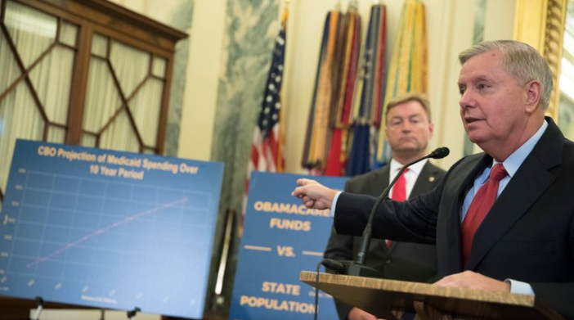
CHECK OUT THE NEWS!
“Obamacare Repeal, Thought Dead in July, May Be Revived in Senate”

Slide 5
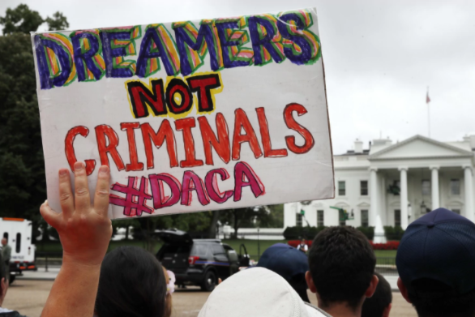
CHECK OUT THE NEWS!
“Trump Moves to End DACA and Calls on Congress to Act”

Slide 6
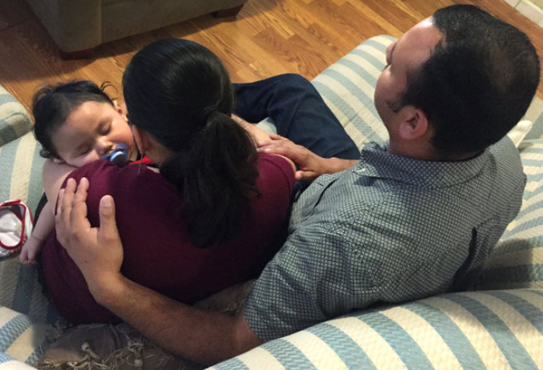
CHECK OUT THE NEWS!
“Border Patrol Arrests Parents While Infant Awaits Serious Operation”

Slide 7
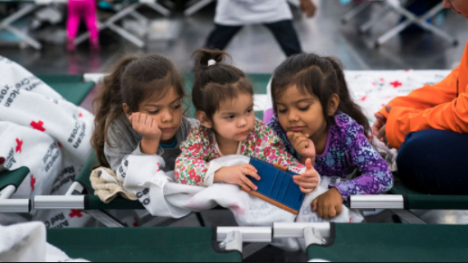
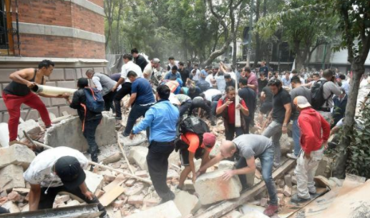
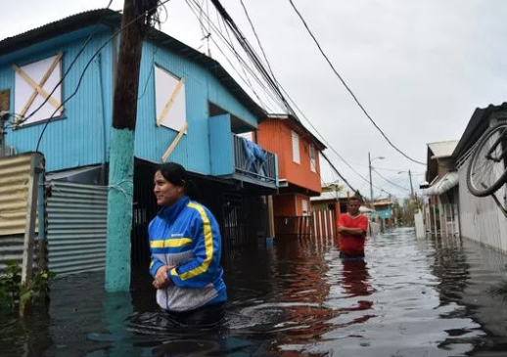
CHECK OUT THE NEWS!
Natural Disasters: Hurricane Harvey, Hurricane Maria, Earthquake in Mexico City

Slide 8
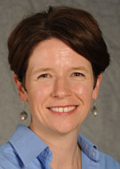
A History of Health Care in the United States: A review of the creation of our current healthcare and insurance system and the fiscal incentives that drive it
Health Care in the US Past, Present and ?Future (Or, The History of Health Care in 30 minutes or less)
Dr. Lee Beers

Slide 9
Health Care in the US Past, Present and ?Future (Or, The History of Health Care in 30 minutes or less)
Lee Savio Beers, MD, FAAP
Associate Professor of Pediatrics, Goldberg Center for Community Pediatric Health
Medical Director for Municipal and Regional Affairs, Child Health Advocacy Institute
Children’s National Health System

Slide 10
Learning Objectives
Learn the “basics” of US health care
Discuss how this system has changed over time, and is impacted by historical factors
Understand how children are impacted by the health care delivery system

Slide 11
Let’s talk!
What works in the US health care system?
What needs to get better?

Slide 12
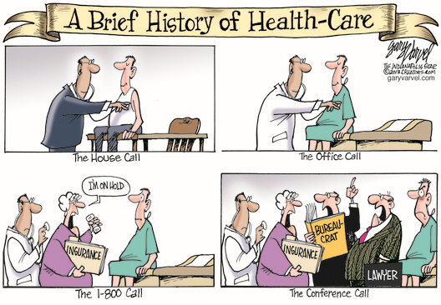

Slide 13
“We must understand backward to move forward”
Early 1900’s: Organized medicine begins. AMA is formed but legislative solutions are not under consideration
1920’s: Health care costs begin to increase, and becomes increasingly unaffordable for middle class. A few employers begin to offer health insurance
1930s: The Great Depression brings an emphasis on government benefits, but health care is not included. AMA is opposed to health insurance; despite this Blue Cross is formed and begins offering insurance

Slide 14
1940’s: Employer based insurance becomes more commonplace. A National Health Insurance plan is proposed by opposed by the AMA
1960’s: Medicare and Medicaid signed into law by President Johnson
1970’s: Health care becoming more expensive, President Nixon signs Health Maintenance Organization Act to control costs
1990’s: Health care costs continue to rise despite these efforts. CHIP enacted as bipartisan legislation President Clinton’s health care reform efforts unsuccessful
2000’s-2010’s: ACA signed into law; ACA repeal and replace efforts, which intensify after 2016 election

Slide 15
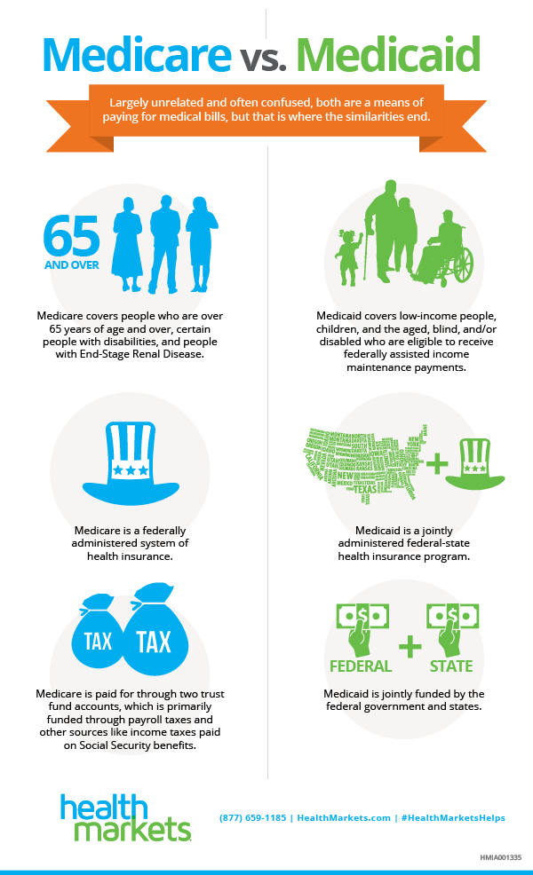

Slide 16
Children’s Health Insurance Plan (CHIP) basics
Enacted in 1997: Reauthorized in 2009 and funding extended in 2015
Financing: Block grant allotments to states
Benefits: States have greater flexibility, but most are based on EPSDT
Coverage: For children who do not qualify for Medicaid but lack access to other forms of insurance

Slide 17
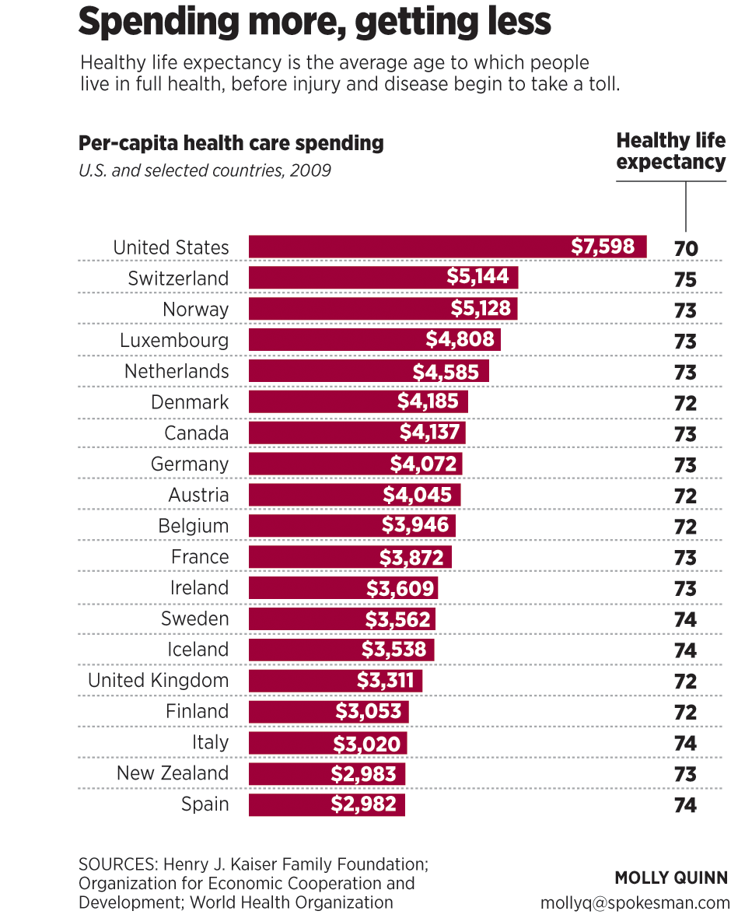

Slide 18
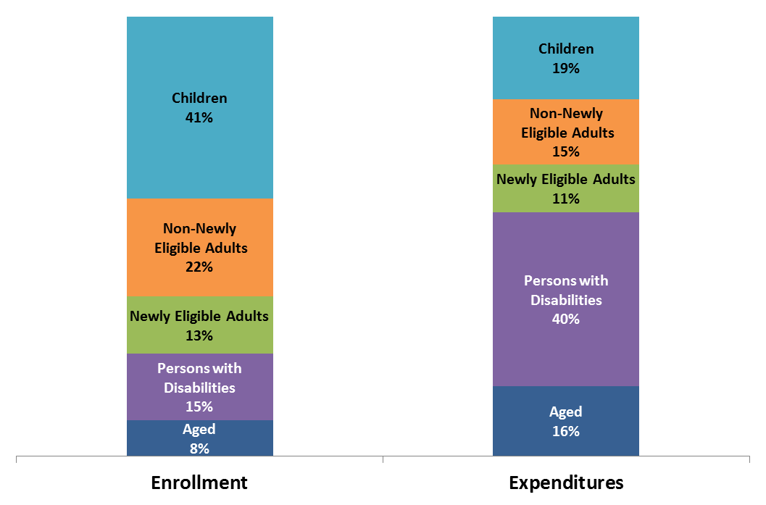
Majority of Medicaid Enrollees are Children and Adults; Most Spending is for Elderly and Disabled
Estimated Total Medicaid Enrollment and Spending by Enrollment Group, FY 2015

Slide 19
Historic Rates of Insurance for Children

Slide 20
How Children’s Coverage Works Together
ESI
Employer-Sponsored Insurance
Largest source of coverage for US kids
Medicaid
Largest public coverage program for children
Eligibility varies for age from state to state
CHIP
Builds on Medicaid, covers children whose parents earn too much for Medicaid but lack access to other options
ACA
Made changes to the individual market
46 states cover children at 200% FPL or more
Federal floor is 138% of the federal poverty level (FPL)
Provides subsidies to those at 100%-400% FPL and not eligible for Medicare, Medicaid, CHIP or other coverage

Slide 21
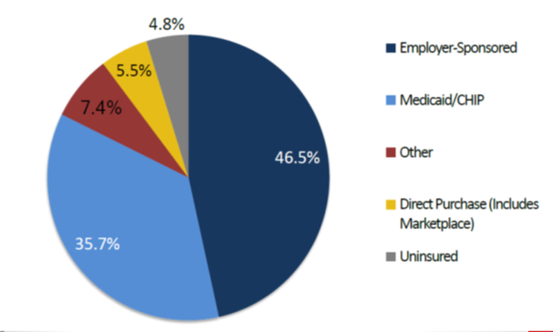
How are children covered?

Slide 22
Access to Care for Children with Complex Health Conditions
Medicaid and CHIP cover nearly half (44%) of children with special health care needs
36%: Sole source of coverage
8%: Public coverage supplements private coverage
More than 50% of children’s hospital patients are insured through Medicaid
Current health care reform proposals could have significant impact on health systems which care for Children with Special Health Care Needs

Slide 23
So what’s next?

Slide 24
CHIP reauthorization
Federal funding expires Sept. 30, 2017
Broad bipartisan support however embroiled in ACA repeal efforts
If not extended up to 37 states may run out of money in the next 6 months
SFC proposed 5 year reauthorization with decreased federal match—not yet scheduled for vote

Slide 25
How to evaluate new proposals for coverage?
AAP Endorsed Principles on Access
Every child should receive care in a medical home with a primary care pediatrician and access to pediatric subspecialists.
Quality health care is a right, regardless of income, for all children, their families, pregnant women, and ultimately all individuals.
Every child must have quality health insurance.
Plans should have a comprehensive age appropriate benefits.
Payment rates should assure that children receive all needed services.

Slide 26
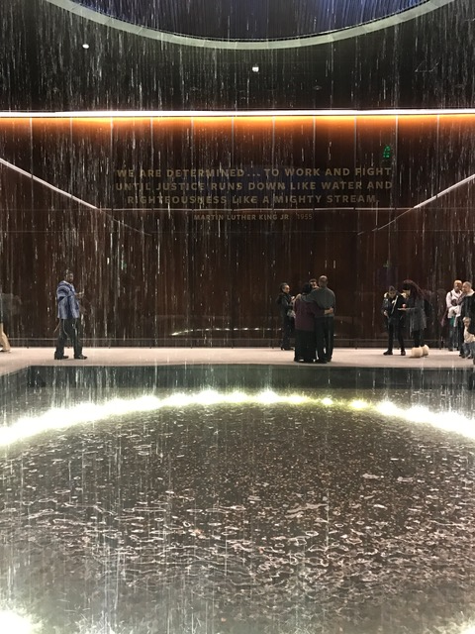
So… Two Key Questions for Every Proposal
Does every child maintain access to coverage (entitlement)?
Does every child maintain access to medically necessary care (EPSDT)?

Slide 27
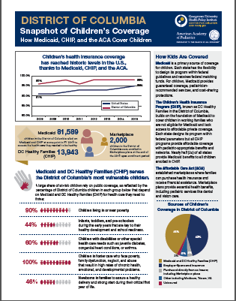
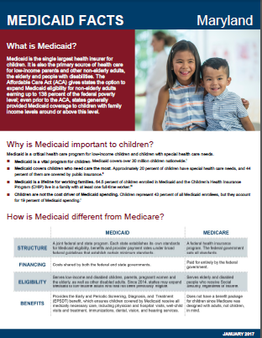
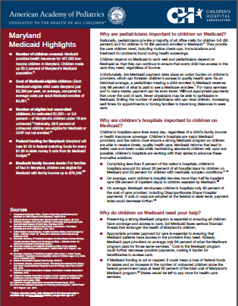
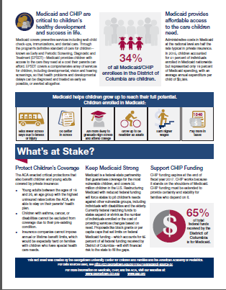
State “Snapshots”
https://www.aap.org/en-us/advocacy-and-policy/federal-advocacy/Pages/Childrens-Health-Care-Coverage-Fact-Sheets.aspx

Slide 28
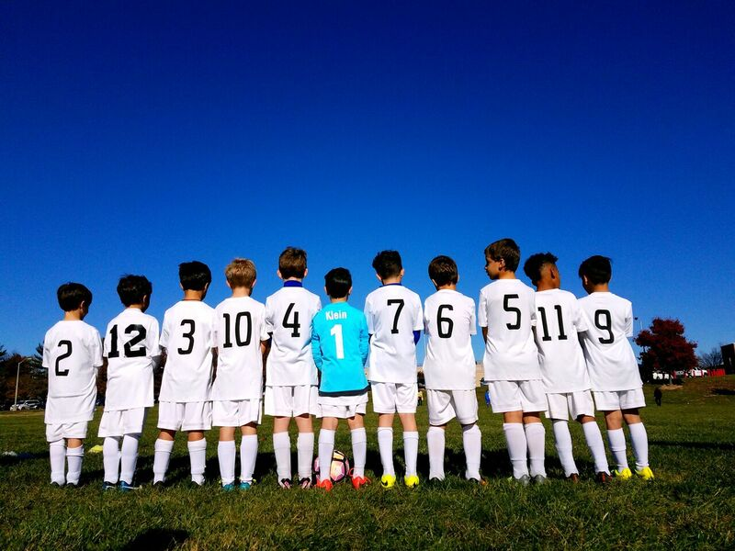
Thank you
Lee Savio Beers, MD, FAAP
lbeers@childrensnational.org
https://www.aap.org/en-us/advocacy-and-policy/Pages/Advocacy-and-Policy.aspx
https://www.childrenshospitals.org/Issues-and-Advocacy
https://ccf.georgetown.edu/

Slide 29
Get Involved in Advocacy!
Become a Key Contact → Get updates from AAP Federal Affairs Office
https://www.aap.org/en-us/advocacy-and-policy/federal-advocacy/Pages/Federal-Advocacy.aspx
Oppose the Graham-Cassidy Bill
Call your Senator: https://www.senate.gov/general/contact_information/senators_cfm.cfm

Slide 30
Get Involved in Advocacy!
“Call For Submissions” to write an OpEd
Advocacy opportunities through resolutions
Join a Section as a Resident Representative
Look out for talks, dinners, and other opportunities
Advocacy Committee: Chair is Dr. Lenore Jarvis → look out for opportunities to testify

Slide 31
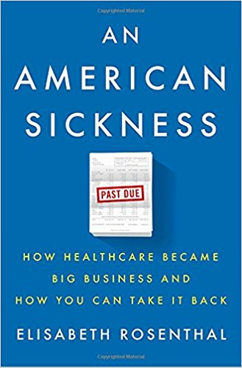
LEARN MORE

Slide 32
LEARN MORE
“Racial Disparity in NICU Care” J. Profit et al. Sep 2017.
Pediatric Perspectives: “Negative Impact on ACA Repeal at the End of Life” J. Keim-Malpass, L.C. Lindley. Sep 2017.
“Trends in Differences in US Mortality Rates Between Black and White Infants.” Sep 2017.
“No Calm After the Storm: A systemic review of human health following flood and storm disasters.” Prehospital and Disaster Medicine. Jun 2017.

Slide 33
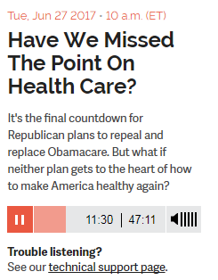
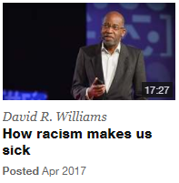
LEARN MORE
https://www.ted.com/topics/health+care

