Slide 1
Pediatric Public Health and Advocacy Curriculum (P-PHAC) March 6th, 2018

Slide 2
Objectives
After completion of this series, the learners will be able to:
Describe the child health effects of 5 public health topics (2017-2018 topics: health financing, immigration, socioeconomic disparities and adverse childhood experiences, education, and the opioid epidemic).
Express an interest in advocacy opportunities during training and in their future careers.
Apply strategies to communicate with lawmakers and community partners regarding child health.

Slide 3
CHAPP Pathway Credit
Attend every noon conference or, if unable to be there in person, listen to the recorded conference;
Complete one of the “continuing education” activities suggested at the end of each lecture; and
Attend the legislative advocacy day, or if unable to be there in person, discuss other options with the faculty contact.
Duration: 5 conferences and Resident Hill Day
Contact: Dr. Danielle Dooley dgdooley@childrensnational.org
Units: 0.25

Slide 4
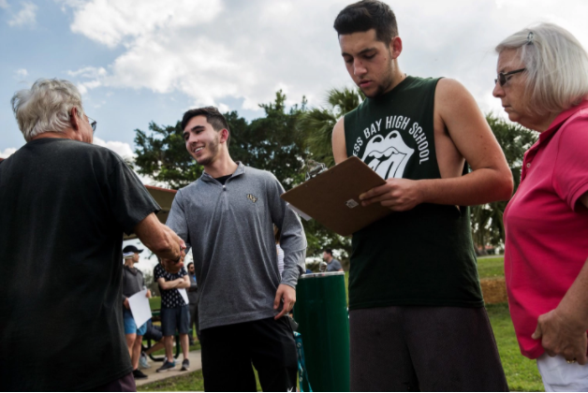
CHECK OUT THE NEWS!
Gun Control

Slide 5
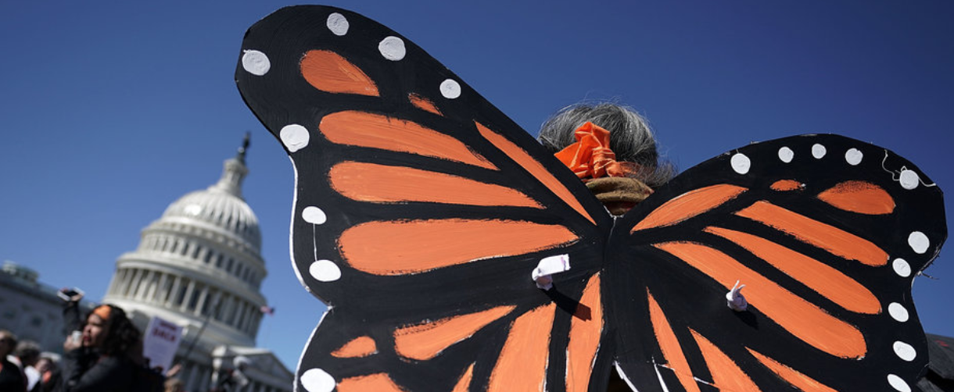
CHECK OUT THE NEWS!
Dreamers Still in Limbo

Slide 6
Pediatric Public Health & Advocacy Curriculum School Health Advocacy: From Patients to Policy
Danielle Dooley
Diana Bruce
Julia DeAngelo
Desiree de la Torre
Marcee White
March 6, 2018

Slide 7
Disclosures
No relevant financial disclosures
Notes:
Danielle

Slide 8
Agenda
Introductions
Education as a Social Determinant of Health
School Health Advocacy:
Individual Level
System Level
Community Level
Federal Level
Conclusion
Notes:
Danielle – thank TEAM for attending and special guest from DCPS

Slide 9
Learning Objectives
At the conclusion of the session participants will be able to:
Describe education as a social determinant of health
Discuss key health supports for children in school
Identify opportunities to advocate for school health at the system, community and federal levels
Notes:
Danielle

Slide 10
Why is education important for health?
Notes:
Danielle – to prompt audience discussion

Slide 11
Education as a Social Determinant of Health
Infant mortality rates are higher among children born to women who never graduated high school compared with women who have earned a college degree
On average, a college graduate is lives nine years longer than someone who has not completed high school
College graduates earn nearly twice as much as high school graduates over a lifetime
Adults with fewer years of education are more likely to die prematurely, engage in unhealthy behaviors such as smoking and have higher rates of diabetes and obesity
People with fewer years of education are more likely to have lower paying jobs that offer fewer benefits
Notes:
Danielle
https://www.rwjf.org/en/library/research/2016/09/the-relationship-between-school-attendance-and-health.html

Slide 12
Health and Educational Outcomes are Intertwined
Higher educational achievement is associated with better health throughout the lifespan
Healthier students, families & communities have higher educational achievement
Educational Outcomes
Health Outcomes
Notes:
Danielle

Slide 13
Siloed Sectors
OTHER SERVICES, JOBS
HEALTH
EDUCATION
Notes:
Danielle
Typically, the health ane education sectors are siloed – today we hope to share with you knowledge and practices that can help you break down those siloes and instead build bridges between the sectors.

Slide 14
Pop Quiz
Raise your hand if:
You know what an IEP is
You know what a 504 plan is
You have spoken to or contacted a school staff member (including school nursing) on behalf of a patient.

Slide 15
Individual Advocacy
504 plans
Caring for special populations
Notes:
Diana –

Slide 16
Advocacy Towards Equity in School Health
Diana K. Bruce
Director of Health and Wellness

Slide 17
DCPS Values
Health and Wellness Team
Our Values
Students First
Equity
Excellence
Teamwork
Courage
Joy

Slide 18
DCPS’s Health and Wellness Team
Health and Wellness Team
DCPS’s Health and Wellness Team works hard to build the capacity of schools to develop and coordinate health services and wellness strategies that empower students to stay engaged in their academics by making healthy decisions and living healthy lives.
Health Services
Expectant/Parenting Students
HIV/STI Prevention
LGBTQ Supports
Wellness Councils

Slide 19
DCPS’s LGBTQ Programming
2015 DC Youth Risk Behavior Survey
DCPS is working to make schools safe and inclusive for lesbian, gay, bisexual, transgender and questioning (LGBTQ) students, staff, and families.
LGBTQ Liaisons
GSAs
Transgender support
Leading With Pride
OUT for Safe Schools
Pride

Slide 20
WTB?
2015 DC Youth Risk Behavior Survey
Generation Z is bucking the binary. According to the Walter Thompson Innovation Group trend data, among Gen Zers:
48% identify as exclusively heterosexual
35% identify as queer
56% know someone who uses gender-neutral pronouns
44% exclusively wear clothing designed for their gender identity
70% believe public spaces should offer gender-neutral bathrooms

Slide 21
WTB?
2015 DC Youth Risk Behavior Survey
DC students, like their Generation Z peers across the U.S., are increasingly trending away from binary understandings of gender and sexuality.
From the 2015 DC YRBS, we know that:
2.6% of DC high school students identify as transgender
5.4% of DC middle school students and 10.1% of DC high school students identify as bisexual
10.5% of MS and 3.7% of HS aren’t sure
1.1% of MS and 3.8% of HS identify as gay/lesbian
30% of HS girls and 10% of boys have had same-sex sexual contact

Slide 22
DC YRBS 2017
2015 DC Youth Risk Behavior Survey
.9% of MS identify as trans
1.9% of HS identify as trans

Slide 23
DC YRBS 2017
2015 DC Youth Risk Behavior Survey

Slide 24
Voices of Transgender People
“When someone calls me by the wrong pronoun, I feel like I’m being stabbed.”
-- DC student, age 16

Slide 25
Policies and Laws
FERPA
TITLE IX
DC Human Rights Act
DCPS Bullying Prevention Policy
DC Municipal Regulations
Page 19 of policy guidance
Laws, regulations and policies together build protection for transgender and gender nonconforming people in DC.

Slide 26
DCPS’s Non-Discrimination Policy
“…DCPS does not discriminate or tolerate discrimination against employees, applicants for employment, or students on the basis of actual or perceived race, color, religion, national origin, sex (including pregnancy), age, marital status, personal appearance, sexual orientation, gender identity or expression, family status, family responsibilities, matriculation, political affiliation, genetic information, disability, source of income, status as a victim of an interfamily offense, or place of residence or business.”
(based on DC Human Rights Act)

Slide 27
We all have a right in DC to our sexual orientation, gender identity and
gender expression … free from discrimination.

Slide 28
In DC, Students Have a Right To …
Be out.
Be addressed by their preferred name and pronouns.
Use bathroom and locker room facility that matches their gender identity.
Express gender as they desire, within the constraints of school dress code.
Dress codes should be gender-neutral (school day, special events).
School dress codes can’t be enforced more strictly against transgender and gender-nonconforming students.
Participate in athletic activities, intramural sports and physical education classes that correspond with their gender identity.
GSAs can meet on campus, if other clubs are allowed.

Slide 29
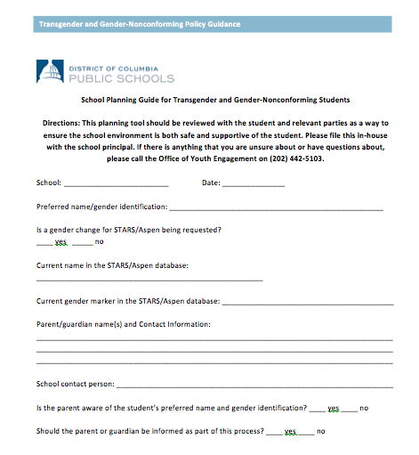
Appendix III: School Planning Guide
Page 27 of policy guidance

Slide 30
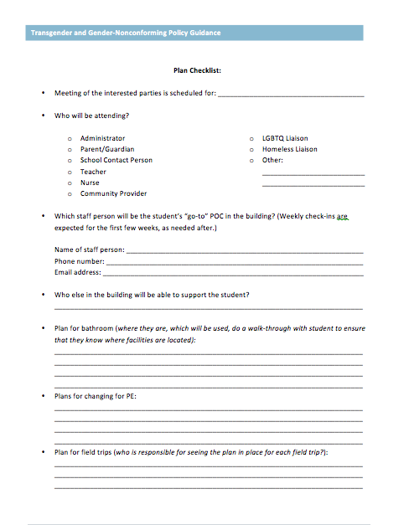
Appendix III: School Planning Guide
Page 28 of policy guidance

Slide 31
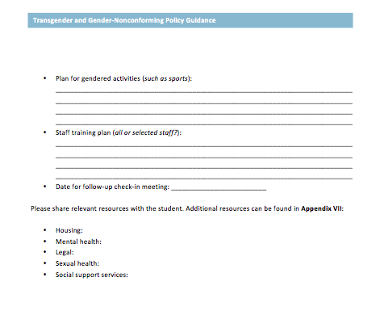
Appendix III: School Planning Guide
Page 28 of policy guidance

Slide 32
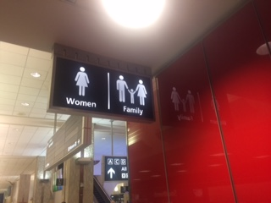
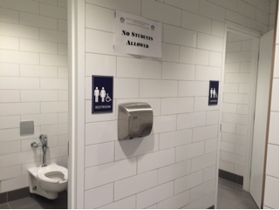
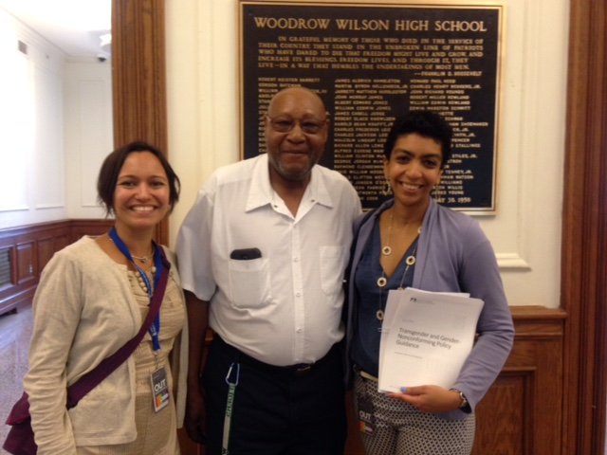
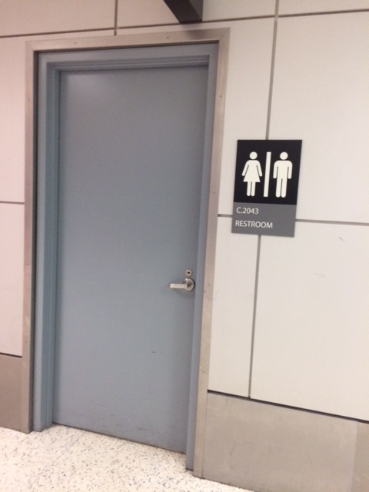
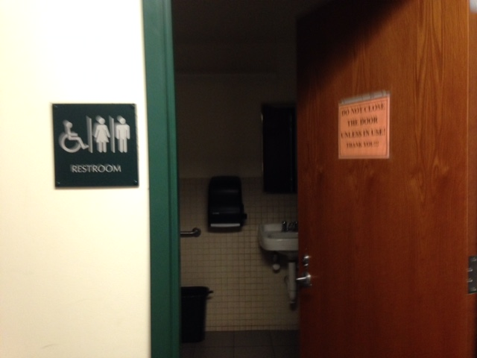

Slide 33
Bathroom Design Changes
Bathroom design became a significant initiative, Spring of 2016.
Met with architects of all with all active projects, no matter where they were in the process.
Modifications made to all projects ensuring bathrooms met latest best practices.
Addition of single-user bathrooms
All gender multi-user bathrooms
Signage changes

Slide 34
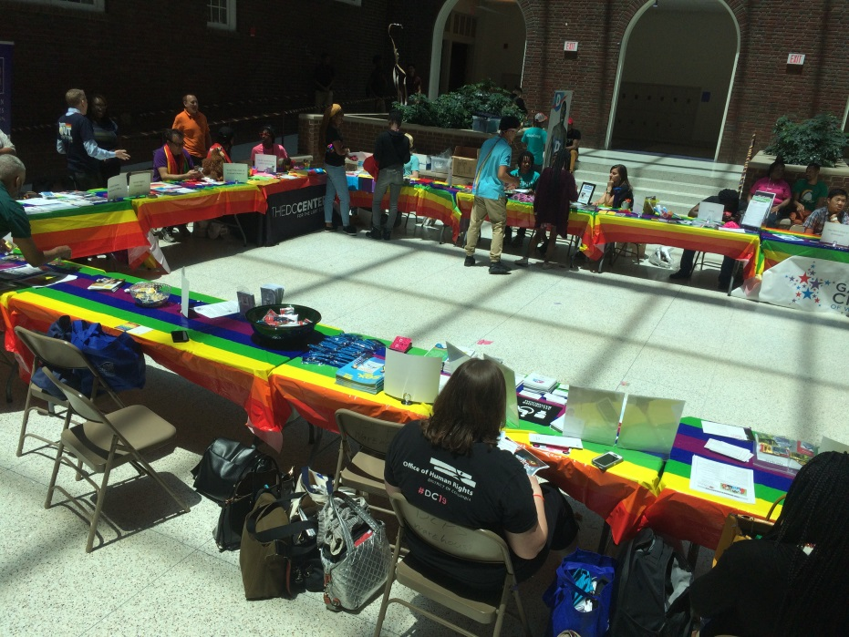
Implementation – Creating Visible Allies
DCPS builds the capacity of adults and gives them the opportunities to be visible allies.

Slide 36
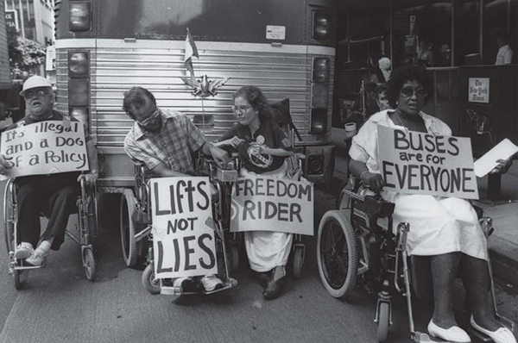
504 Federal Law
Introduction to Section 504
Section 504 is part of the federal Rehabilitation Act of 1973; it also overlaps with the Americans with Disabilities Act (ADA).
Created to prevent discrimination against individuals with disabilities in services, programs, and activities that receive federal funds.
Public Schools: protects students with disabilities so that they are able to access the curriculum and other educational opportunities provided by public schools.
Disability rights activists protesting the inaccessibility of public transit. Los Angeles, California.
Image: http://www.nxtbook.com/faircount/ADA/ADA25/index.php

Slide 37
Section 504 of the Rehabilitation Act of 1973
Introduction to Section 504
“No otherwise qualified individual with a disability in the United States . . . shall, solely by reason of his or her disability, be excluded from the participation in, be denied the benefits of, or be subjected to discrimination under any program or activity receiving Federal financial assistance.”

Slide 38
Section 504 and IDEA Comparison
 | IDEA | Section 504
Purpose | A federal statute whose purpose is to ensure FAPE for children with specific disabilities | A broad civil rights law which protects the rights of individuals with disabilities
Who is Protected | Eligible students (aged 3-21) with one of 13 specific disabilities and whose disability adversely affects the child’s educational performance | All persons with a disability that substantially limits at least one major life activity
Services | Provides an individualized educational program (IEP) which modifies the curriculum to meet the individual student’s needs | Requires schools to provide accommodations to allow students to access the existing general education curriculum, opportunities for learning, and other activities

Slide 39
Eligibility Criteria
504 Process in DCPS
Under Section 504, a student is considered an “individual with a disability” if he or she has a physical or mental impairment that substantially limits one or more major life activities.
Physical or mental impairment
Substantial limitation
Major life activities

Slide 40
Eligibility Criterion: Physical or Mental Impairment
504 Process in DCPS
Unlike the eligibility criteria for special education under IDEA, Section 504 does not list specific disabilities (“impairments”) that will make a student eligible.
Physical impairment examples:
Students who have mobility impairments, hearing impairments, visual impairments, chronic medical conditions (diabetes, juvenile arthritis, sickle cell anemia, etc.)
Mental impairment examples:
Students who have ADHD, anxiety disorders, depression, etc.

Slide 41
Eligibility Criterion: Substantial Limitation
504 Process in DCPS
A “substantial limitation” is not defined in the law or regulations for Section 504. Instead, DCPS considers multiple criteria for determining whether an impairment is substantially limiting
Consider the student’s ability to perform a major life activity to the ability of the average student of the same age in the general population.
Duration: Section 504 only covers students with disabilities, not temporary injuries.
In general, if the condition will resolve in six months or less, the student has a temporary injury, not a disability.

Slide 42
Eligibility Criterion: Major Life Activity
504 Process in DCPS
Any activity important in daily life or necessary for the student to access the education, opportunities for learning, and school activities that are accessed by other students in the school.
The most commonly considered major life activities are listed on the 504 Eligibility form, but the team may need to consider additional major life activities if applicable.

Slide 43
Eligibility Criterion: Major Life Activity
504 Process in DCPS
Any activity important in daily life or necessary for the student to access the education, opportunities for learning, and school activities that are accessed by other students in the school.

Slide 44
What goes into a Section 504 Plan?
504 Process in DCPS
Related Services
Behavior Management Plans
Instructional and Classroom Accommodations
Standardized Testing Accommodations
Assistive Technology

Slide 45
The Section 504 Process in DCPS: Timelines & Documents
504 Process in DCPS
Review Eligibility Every Three Years
Review Plan Every Year
2. Eligibility Determination
3. 504 Plan Development
1. Referral
4. Monitoring
Receipt of Referral to Eligibility Meeting: Maximum 15 School Days
Complete Eligibility Determination: Maximum 45 School Days
Write 504 Plan after Student found Eligible: Maximum 5 School Days

Slide 46
Medical Information
Medical providers can support the process by providing the following information to the school:
The diagnosis
How the disability impacts the students throughout the day
Suggested accommodations that schools may consider implementing

Slide 47
Discussion and Questions
How can I be an advocate towards equity?
How can my practice be supportive?
Where do I take it from here?

Slide 48
I get by with a little help from my friends
And don’t forget…
Diana Bruce
Director of Health and Wellness
Diana.Bruce@dc.gov
https://dcps.dc.gov/page/health-and-wellness
Section 504/Student Accommodations Team
504@dc.gov
https://dcps.dc.gov/page/section-504

Slide 49
System Advocacy
School-Based Health Centers
School Nursing
School Health Collaborative
Notes:
Marcee – now that you have heard about some steps to take in everyday practice to advocate on the individual level for school health, let’s move to the system level and learn about programs and approaches that can employ system resources to support school health. These are important components of advocacy, because there are children who may never or rarely interface with the medical system, but who are in school. Therefore, school-based health services help to meet children where they are, and reach populations that might be hard to reach otherwise.

Slide 50
School-Based Health Centers
SBHCs address acute and chronic health needs by:
providing convenient, accessible, and comprehensive health care services and preventive interventions co‐located and integrated within the school setting
serving students in grades preK‐12
forming partnerships between schools and sponsoring agencies
Funding:
sponsoring agencies include hospitals/academic medical centers, FQHCs, public health depts, community health or behavioral health centers.
funding sources include: – State (general fund, block grant, MCO arrangements); – Local (school district, city govt‐ levies/taxes); – Federal and/or private grants (esp for prevention interventions)
90% of SBHCs seek reimbursement for services from public and private health insurers, with Medicaid constituting the largest patient‐related revenue source
Notes:
Marcee

Slide 51
Benefits of School-Based Health Centers
SBHCs are associated with significant:
Improvements in access and utilization of programs and services
Enhanced health and education outcomes for students
Reductions in ER visits and health care costs
Community Preventive Services Task Force recommends implementing school‐based health services nationwide
Notes:
Marcee

Slide 52
School-Based Services at Children’s National
School-Based Health Centers
3 in high schools in Washington, DC
4 in high schools in Montgomery County, MD
4 in high schools in Prince George’s County, MD
Children’s School Services
114 public schools and 61 public charter schools in DC
school nurses provide onsite care and care coordination for 74,000 students
Notes:
Marcee

Slide 53
Children’s National School Health Collaborative
Objective: Convene school health stakeholders at Children’s National Health System to:
Learn about regional school-based efforts
Increase coordination of hospital-wide school-based efforts
Identify areas for collaboration and strategic growth
Open to all CNHS staff and trainees
Meets bi-monthly
Next meeting: Tuesday, March 20, 9-11 am
Notes:
Julia – Describe background of school-based programs report, findings, and development of collaborative to organize ourselves internally

Slide 54
Children’s National School Health Collaborative
Focus Areas
Research and Outcomes
Education
Advocacy and Policy Change
Stakeholder Engagement
Resources and Funding Opportunities
Notes:
Julia Discuss focus areas of school health collaborative and examples of efforts – ie 1 – organized panel session for School-Based Health Alliance conference; 2 – resident education and staff education; 3- testimony on local bills 4- external stakeholder meetings 5 – leveraging coordination to look for funding

Slide 55
Community Advocacy for School Health
Key Steps:
Familiarize yourself with the school system structure, governance and leadership in the jurisdiction you work in
Understand the strategic plan of your local educational system – what are their priority areas? Where might there be opportunity to work together?
Identify relationships that are key to success
Identify issues or groups where the pediatrician voice can make a difference
Notes:
Desiree - you have heard examples of how to work at the individual patient level, and at the system level, and now we will talk about working at the community level and outside your institution or practice. As a first step, it’s important to learn about the community you are working in

Slide 56
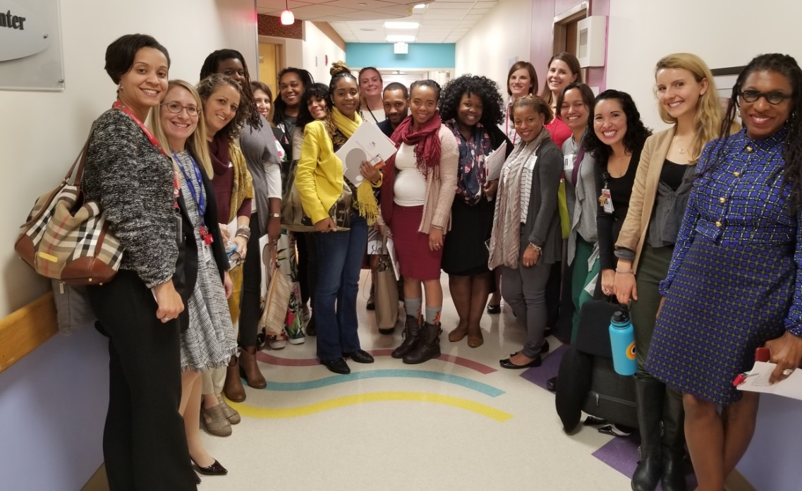
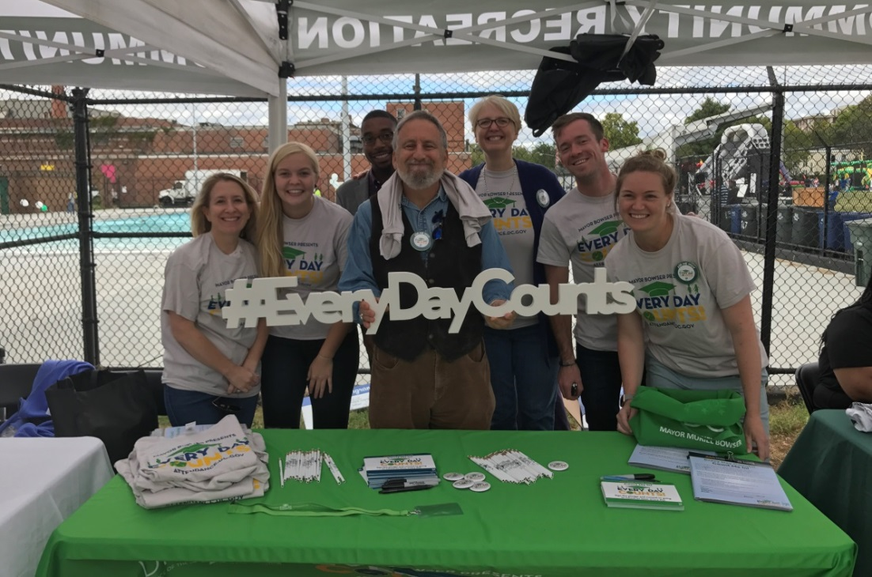
Community Advocacy – Strengthening Relationships
DCPS and OSSE Tour
Every Day Counts Task Force
Notes:
These are two examples of our work in Community Affairs to strengthen relationships with the school system. In the picture on the left, you can see that we hosted a visit from DCPS staff in the New Heights Program, which provides services to pregnant and parenting teens in school, to learn more about the services at Children’s National. On the right, we participated in a citywide back to school fair hosted by the Deputy Mayor of Education. Learn about the needs and priorities of those working in the school system, and see how your work might align.

Slide 57
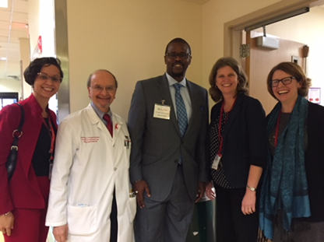
Community Advocacy – Building Relationships
Notes:
In December, Community Affairs invited the DCPS Chancellor and members of his team to visit Children’s National. Since the Chancellor was new to DC, he did not know about Children’s National and the services we provide to school-aged children. It’s important to note that we build relationships across all levels of the education sector – from the leadership at the top to the staff implementing programs and working with families.

Slide 58
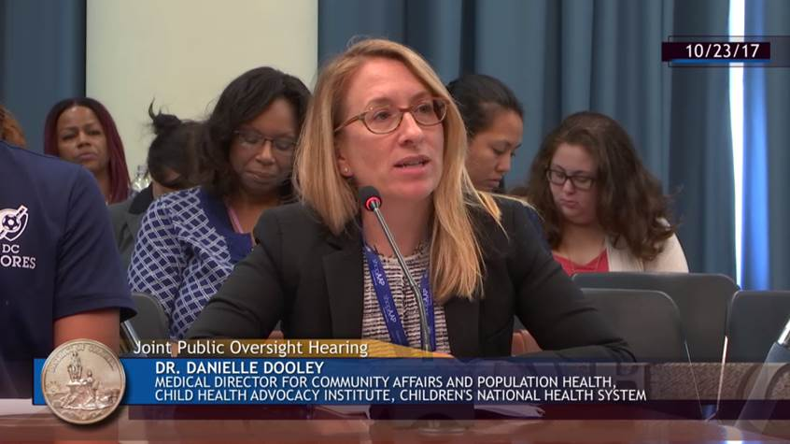
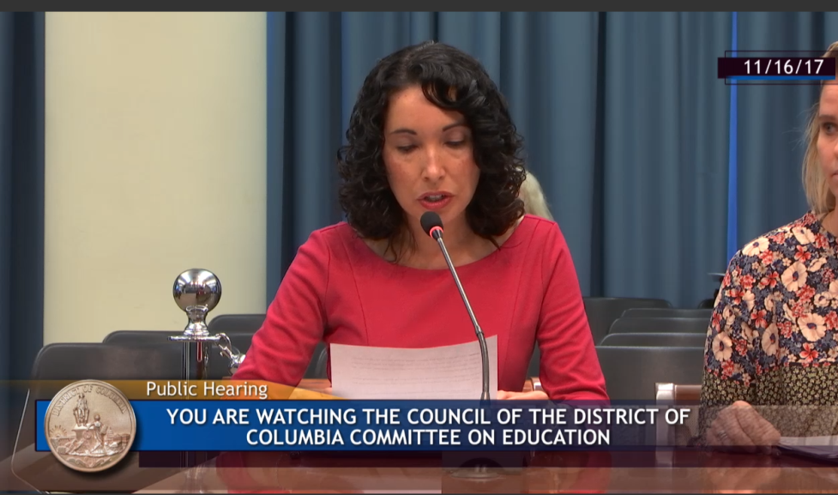
Community Advocacy – Influencing Policy
Healthy Youth and Schools Amendment Act
Hearing on School Absenteeism
Notes:
Community Affairs partners with our government affairs team at Children’s National to identify school health-related issues in DC, MD and VA and offer testimony and expertise when possible. Children’s National has resources to help you identify relevant legislation and prepare testimony. In these photos, we’re testifying at a hearing on chronic school absenteeism in DC and the Healthy Youth and Schools Act.

Slide 59
Community Advocacy – Serving on Boards or Commissions
Early Childhood Education center boards
School boards
DC has 169 Boards and Commissions
Healthy Youth and Schools Commission:
Informs the Mayor and the Council on the health, wellness, and nutritional issues concerning youth and schools in the District.
Montgomery County Commission on Health:
Advise the County Executive and the County Council on public health issues, programs, services and the allocation of funds devoted to public health needs
Notes:
Desiree – many of the educational programs or institutions in your community need board members to help guide them in their work and add a health voice/expertise. In addition, local governments have boards or commissions that are devoted to public health, and address the health needs of students in schools. In Community Affairs, we serve on two such commissions. Ways to get involved are networking with your local community based organizations and agencies, inquiring if there are vacancies that need to be filled, and being willing to step up!

Slide 60
Federal Advocacy
Medicaid and CHIP
Funding in health systems and schools
School district personnel provide critical health services in school
More than half of the nearly nine million children served by CHIP are eligible to receive services in school through their state Medicaid programs
In a 2017 survey of school districts:
Two-thirds of Medicaid dollars are used to support the work of health professionals and other support personnel (e.g., speech-language pathologists, audiologists, occupational therapists, school psychologists, school social workers, and school nurses)
Medicaid dollars used to expand the availability of a wide range of health and mental health services available to students in poverty, who are more likely to lack consistent access to healthcare professionals
Use Medicaid reimbursements to purchase and update specialized equipment (e.g., walkers, wheelchairs, exercise equipment, special playground equipment, and equipment to assist with hearing and seeing) as well as assistive technology for students with disabilities to help them learn alongside their peers
DCPS received $30.6 million in Medicaid funding in FY 16
Notes:
Danielle: While many of you were engaged in the battle to save Medicaid and CHIP this past year, you may not have realized that our colleagues in the education sector were fighting the same battle. The education sector is a critical partner for us to ensure that the children we see in our practices- from general pediatrics to subspecialties – get the care they need in school.

Slide 61
Federal Advocacy
Child Nutrition Reauthorization
Expired 2015 but programs, including National School Lunch and School Breakfast programs, continue to operate
House & Senate have own versions of bill
Rollback of 2010 Healthy Hunger Free Kids Act
Anti-Lunch Shaming Act of 2017
The School-Based Health Centers Program Reauthorization Act of 2013
Notes:
Danielle
National School lunch program - 30 million kids, School Breakfast 14 million kids; kids typically consume ½ their daily calories in school
HHKFA – increased fruit, vegetable, whole grain requirements in school meals, decr sodium content
-new secretary of agriculture released an interim rule The interim rule gives schools the option to offer flavored, low-fat milk at breakfast and lunch. Previous regulations only allowed flavored fat-free milk as well as fat-free or low-fat unflavored milk to be offered. The rule also allows state agencies to exempt schools from complying with the requirement to serve 100% whole grain-rich foods if the school can demonstrate hardship in meeting the requirement.
The rule also halts implementation of sodium reduction targets that were established in 2012. AAP responded to the rule with a letter to urge USDA to not make these changes to the standards permanent. USDA still expects to release a final rule regarding school meal standards in fall of 2018
A SFA may not permit public identification or stigmatization of the child, such as by requiring a wristband or hand stamp. The child also may not be required to: (1) perform chores or activities that are not required of students generally, or (2) dispose of food after it has been served to the child.
Any communication related to outstanding credit must be directed to the child's parent or guardian. A child may be required to deliver a letter regarding outstanding credit that is addressed to a parent or guardian if the letter is not distributed to the child in a manner that stigmatizes the child
SBHCs received 200 million in federal funding in the 2010 ACA; this bill tried to reauthorize funding for 5 years but died in committee

Slide 62
Conclusions
Know your community!
Identify ways that school services enhance child health, identify common stakeholders, form partnerships, work together to advance programs , policy or people
Join the DC AAP School Health Committee
Email Heidi Schumacher (heidi.schumacher@dc.gov) or Jaclyn Kline (jnkline@childrensnational.org)
Join the AAP Council on School Health (COSH)
Role of School Physician
School Nursing Hours
Join the Children’s National School Health Collaborative
Email Julia DeAngelo (jdeangelo@childrensnational.org)
Notes:
Danielle

Slide 63
You can't educate a child who isn't healthy, and you can't keep a child healthy who isn't educated. -Jocelyn Elders, former US Surgeon General
Notes:
Danielle

Slide 64
Thank You!
Danielle Dooley
dgdooley@childrensnational.org
Diana Bruce
diana.bruce@dc.gov
Desiree de la Torre
ddelatorre@childrensnational.org
Julia DeAngelo
jdeangelo@childrensnational.org
Marcee White
mwhite@childrensnational.org

Slide 65
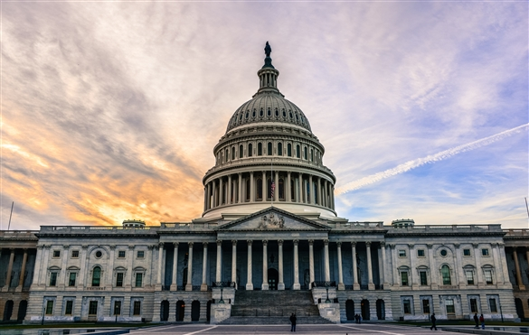
Get Involved in Advocacy!
Speak To Your Representatives With Your Fellow Residents!
April 25th, 2018!!!
Sign Up! https://docs.google.com/spreadsheets/d/12ij_8dYyYduzSvbzhA2Y3gh3dY3xS5blIUsMMSYcRfY/edit#gid=0

Slide 66
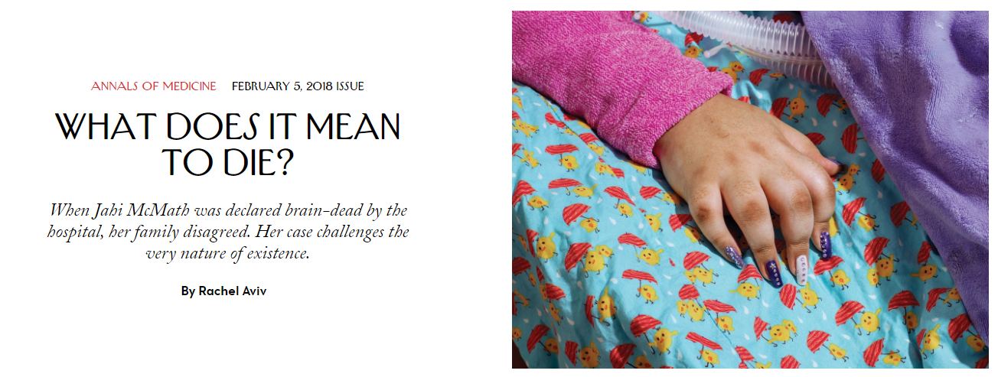
LEARN MORE

Slide 67
LEARN MORE
Unstable Housing and Caregiver and Child Health in Renter Families. Sandel et al. Feb, 2018
Online Tobacco Marketing and Subsequent Tobacco Use. Soneji et al. Feb, 2018.
Race, Preoperative Risk Factors, and Death After Surgery. Akbilgic et al. Feb, 2018
Health and Care Utilization of Trangender and Gender Nonconforming Youth: A Population-Based Study. Rider et al. Mar, 2018
Disparities in Outcomes and Resource Use After Hospitalization for Cardiac Surgery by Neighborhood Income. Anderson et al. Mar, 2018

Slide 68
LEARN MORE
School-Based Telemedicine-Enhanced Asthma Management. Hartman et al. Mar, 2018
Trends in Severe Obesity Among Children Aged 2 to 4 Years Enrolled in Special Supplemental Nutrition Program for Women, Infants, and Children from 2000 to 2014. Pan et al. Mar, 2018
A Multicomponent, Preschool to Third Grade Preventive Intervention and Educational Attainment at 35 Years of Age. Reynolds et al. Mar, 2018

Slide 69
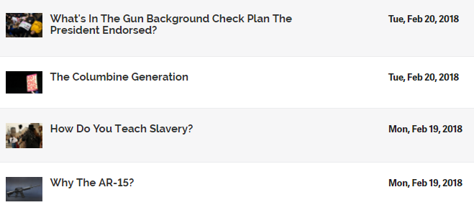
LEARN MORE

Slide 70
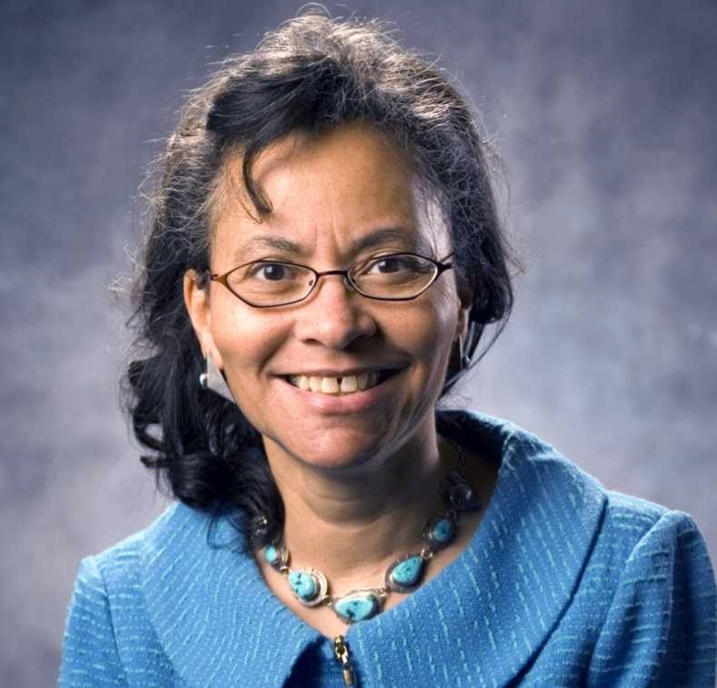
LEARN MORE
Don’t miss seeing Dr. Jones come and speak during CNMC Research Week April 18th! http://researchweek.ctsicn.org/Apps/abstractSpeaker.aspx#camara_j

