Slide 1
Pediatric Public Health and Advocacy Curriculum (P-PHAC) January 8th, 2018

Slide 2
Objectives
After completion of this series, the learners will be able to:
Describe the child health effects of 5 public health topics (2017-2018 topics: health financing, immigration, socioeconomic disparities and adverse childhood experiences, education, and the opioid epidemic).
Express an interest in advocacy opportunities during training and in their future careers.
Apply strategies to communicate with lawmakers and community partners regarding child health.

Slide 3
CHAPP Pathway Credit
Attend every noon conference or, if unable to be there in person, listen to the recorded conference;
Complete one of the “continuing education” activities suggested at the end of each lecture; and
Attend the legislative advocacy day, or if unable to be there in person, discuss other options with the faculty contact.
Duration: 5 conferences and Resident Hill Day
Contact: Dr. Danielle Dooley dgdooley@childrensnational.org
Units: 0.25

Slide 4
CHECK OUT THE NEWS!
Immigration Talks and DACA

Slide 5
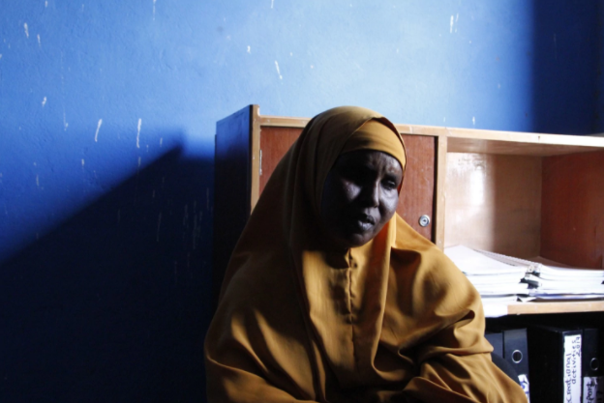
CHECK OUT THE NEWS!
“A Widening Budget Gap is Forcing the U.N. To Slash Food Aid to Refugees”

Slide 6
The significance of social determinants of health and ACEs in shaping the health of pediatric patients.
Social Determinants of Health & Adverse Childhood Experiences
Dr. Lanre Falusi
&
Dr. Cara Lichtenstein

Slide 7
PPHAC Noon Conference: Social Determinants of Health & Adverse Childhood Experiences
Cara Lichtenstein, MD, MPH
Lanre Falusi, MD
January 8, 2018
Notes:
CL & LF introduce selves

Slide 8
Objectives
By the end of the session, the learner will be able to:
Define six critical social determinants, including adverse childhood experiences (ACEs), and their impact on health.
Describe the local and federal programs that address social determinants of health (SDH).
Apply strategies to mitigate the effects of social determinants and ACEs on individual or clinic level.
Notes:
CL
We will focus on Objective #2, as we expect that most have some working knowledge of SDH, but will confirm this on the next slide…

Slide 9
How do YOU define social determinants of health? …or… What social factors do you see affecting the health of your patients (inpatient and outpatient)?
Notes:
CL

Slide 10
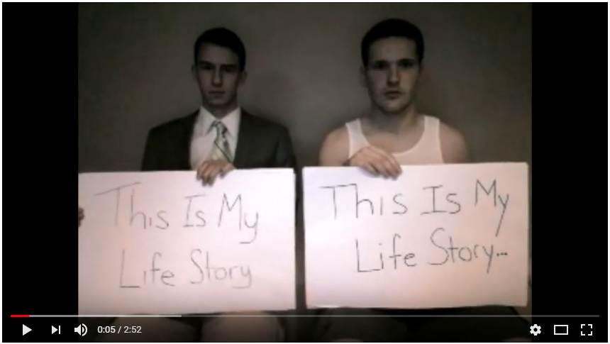
Notes:
CL
https://www.youtube.com/watch?v=_11xLlwKgWc
Reflection questions from APA Poverty Guidebook:
Do you have any friends/classmates/neighbors from childhood who had very different life trajectories from you? What factors influenced these differences?

Slide 11
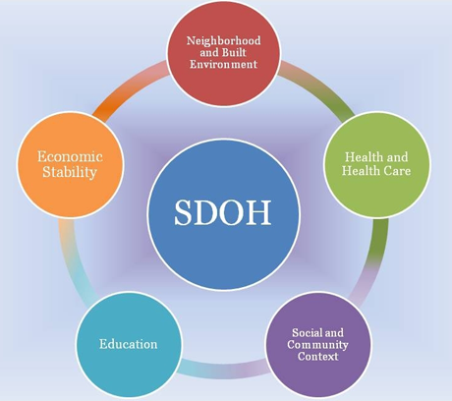
The social determinants of health (SDH, SDOH) are the conditions or circumstances in which people are born, grow up and age that affect their overall health, health risks, and quality of life.
Schematic from Healthy People 2020
Notes:
CL
The social determinants of health (SDH, SDOH) are the conditions or circumstances in which people are born, grow-up and age that affect their overall health, health risks, and quality of life. These individual circumstances are influenced by wider societal forces including economics and policy (cite WHO, HP2020). The social determinants of health can be categorized into several key domains. The schematic from Healthy People 2020, depicts 5 key domains of SDH: Economic Stability, Education, Social and Community Context, Health and Healthcare, Neighborhood and Built Environment. (Healthy People 2020).

Slide 12
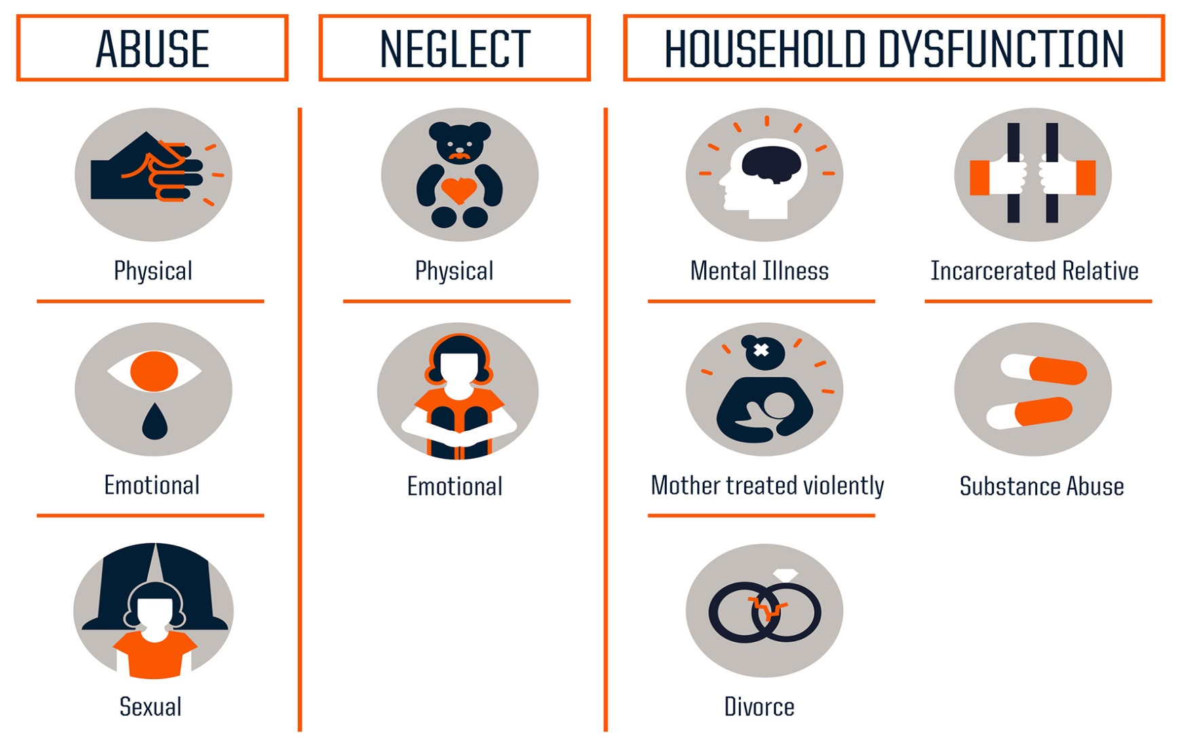
Adverse Childhood Experiences (ACEs)
Notes:
LF
For this presentation, we will talk about ACEs as a SDH. ACEs are defined as growing up (under 18yo) in a household with abuse, neglect, or household dysfunction.
Study done in California published in American Journal of Preventive Medicine in 1998 by Vincent Fellitti and CDC was 1st to define relationship between ACEs and adult health outcomes. Did a questionnaire with over 17,000 responses of adults in HMO. Findings suggest that certain experiences are major risk factors for illnesses and poor quality of life.
Notably, this study was NOT done on an impoverished population, but an upper-middle class, college educated population
More recent studies now often add: neighborhood violence, discrimination, foster care, bullying

Slide 13
Why are ACEs important?
Notes:
LF
Dose Response Relationship : cumulative ACEs score has a strong, graded relationship to numerous health, social, and behavioral problems throughout their lifespan, including substance use disorders. Furthermore, many problems related to ACEs tend to be comorbid, or co-occurring
If 3 or more ACEs: • Academic failure 3x • Attendance problems 5x • School behavior problems 6x
If 4 or more ACEs: 11.9 times more likely to attempt suicide during childhood/adolescence (Dube SR, Anda RF, Felitti VJ, Chapman DP, Williamson DF, Giles WH. Childhood Abuse, Household Dysfunction, and the Risk of Attempted Suicide Throughout the Life SpanFindings From the Adverse Childhood Experiences Study. JAMA. 2001;286(24):3089–3096. doi:10.1001/jama.286.24.3089)

Slide 14
Addressing SDH
Local Resources
Aunt Bertha (cafb.auntbertha.com)
Your medical team!
Others?
Federal Programs:
Earned Income Tax Credit (EITC)
Supplemental Nutrition Assistance Program (SNAP)
Medicaid/Children’s Health Insurance Program (CHIP)
Women, Infants, and Children Program (WIC)
Head Start
Reach Out and Read (ROR)
Temporary Assistance for Needy Families (TANF)
Notes:
LF (will quickly demo Aunt B if time and if most people say they have not used it)
EITC-The Earned Income Tax Credit (EITC) is a benefit for working people with low income who meet certain other requirements. In order to receive the credit, the parent must file a tax return and the credit will either reduce the amount they owe or provide a cash refund in the event that they do not owe any taxes. The average EITC amount for qualifying households in 2013 was around $2,000-$2,500 and varied by state (http://www.eitc.irs.gov/EITC-Central/eitcstats). When counted as income, this amount was sufficient to lift 3.2 million children above the poverty level according to an analysis by the Center on Budget and Policy Priorities (CBPP) of the 2013 US Census data. In addition to its direct effects on poverty, the EITC also promotes financial security for families by creating a system that rewards parents for working.
SNAP-The Supplemental Nutrition Assistance Program (SNAP), formerly known as food stamps, is a federally funded program that is administered by state or local agencies. To receive SNAP, households must have limited countable resources and make no more than 100% of the Federal Poverty Level in net income. The Maximum monthly SNAP award is based on family size with income taken into account. Although the amount may not be much, this additional resource has lifted many families out of poverty. According to US Census data, when SNAP benefits are counted as income, approximately 4 million households in 2012 rose above the FPL
Medicaid/ CHIP-Medicaid is an individual entitlement program that is federally regulated but state operated with joint federal and state funding. Benefits and eligibility can vary by state but are required to meet certain federal standards. The Children’s Health Insurance Program (CHIP) is a federal block grant matching funds program to allow states to cover children in families not eligible for Medicaid but who are unable to afford private health insurance. e, the benefits provided by Medicaid and CHIP can substantially decrease out of pocket spending on medical expenses and thereby impact favorably on a family’s finances. While the impact is more complex to measure than other programs, one analysis by the Association for Public Policy Analysis and Management indicated that in 2010 Medicaid (including CHIP) kept 2.6 to 3.4 million people out of poverty, making it the third largest anti-poverty program in the US
WIC- Federal assistance program for low income pregnant women (up to 185% FPL), postpartum women (up to 6mo after end of pregnancy), breastfeeding women (while breastfeeding up to 1 yr) and children under the age of 5. Program provides supplemental nutritious food, formula, nutrition education, and breastfeeding support. Currently, WIC services 53% of all infants born in the US
Head Start- Head Start is a federal program run by the Department of Health and Human Services that provides early childhood education as well as nutritional and other services to low-income children and their families. The main goal of this program is to increase school readiness. Head Start serves children ages 3-5, after which time they transition to kindergarten in the school system. Early Head start is an extension of this program that provides support to pregnant women, infants and toddlers up to age 3.
ROR- Reach Out and Read (ROR) is a not-for-profit organization that promotes literacy and school readiness particularly in children from low-income communities. The program involves book distribution and literacy promotion strategies based out of the pediatric medical provider’s office. The ROR program targets the gap that exists in the exposure to language and reading in low-income children, with a goal of improving school readiness and educational outcomes later in life.
TANF- The Temporary Assistance for Needy Families (TANF) program is funded with block grants from the federal government and operated by individual states. This program was enacted as a part of welfare reform. Program specifics vary from state to state but benefits may include: temporary cash assistance, childcare assistance, and job training/placement assistance.

Slide 15
Case Vignette:
You are seeing Ms. Jones and her 19mo old child James for a follow-up visit. After looking through the chart you see that James was in the office 1month ago for a WCC at which time he was prescribed Amoxicillin for an otitis media and referred to hearing as well as Strong Start (Early Intervention) for speech delay. You see in Cerner there is a missed appt for Audiology 2 weeks ago. When asked, Ms. Jones says she was unable to go to the appt because she didn’t have the money for the bus and that she has not been contacted from Strong Start. Ms. Jones also tells you that she started the Amoxicillin but was unable to complete the course because the domestic violence shelter where they were recently placed does not have a refrigerator and she remembers the pharmacist saying something about the medicine needing to be refrigerated. Anyway, she was unsure how helpful the medicine was because the drops kept running out of his ear.
Question:
Which Social Determinants of Health (SDH) could be playing a role in this family’s “non-compliance”?
Notes:
CL –
Resident/student reads case. CL facilitates discussion and report-outs.
Full group names SDH, then they break up into groups x 5-10 mins for worksheet activity.
Proposed SDH:
1- Transportation (no $ for the bus)
2- Housing (shelter, no fridge)
3- Health literacy (drops running out of his ear?)
Also note ACEs/Trauma (reference to DV) – but will not be a specific SDH for one of the groups
Groups complete worksheets, then each group has 2-3 mins for report out

Slide 16
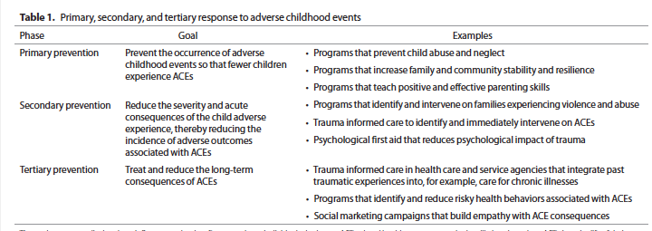
Addressing ACEs
Notes:
LF
Reference: Resmiye Oral, Marizen Ramirez, Carol Coohey, Stephanie Nakada, Amy Walz, Angela Kuntz, Jenna Benoit and
Corinne Peek-Asa. Adverse childhood experiences and trauma informed care: the future of health care. Pediatric Research. January 2016: 79:1. 227-232

Slide 17
What is trauma informed care?
A shift from wondering what is wrong with a person that would have them act the way they do…
…to asking what happened to a person that would cause them react the way they do.
Notes:
LF
Source: Oregon pediatric society
Traditionally, the health care system would point to high-risk behaviors such as poor diet, drug use, or a sedentary lifestyle as the primary causal factors. Questions for patients have focused on “What’s wrong with you?” rather than “What happened to you?”

Slide 18
Trauma informed care
1) Safety
2) Trustworthiness and transparency
3) Peer Support
4) Collaboration and mutuality
5) Empowerment, voice, and choice
6) Cultural, historical and gender issues
Notes:
LF – SKIM
**Remove this slide if too long.
Harris M, Fallot RD. Envisioning a Trauma-Informed Service System: A Vital Paradigm Shift: New Directions for Mental Health Services. San Francisco, CA: Jossey-Bass, 2001:3–2
SAMHSA principles:
1. Safety. Promoting a sense of safety involves a conscious effort to ensure that all members and clients of an organization are physically and emotionally safe.
2. Trustworthiness and transparency. Organizations must approach decisions with transparency and engender trust of staff and their clientele.
3. Peer support. Peers, which include family of traumatized children as well as individuals who have lived with histories of trauma, can be critical resources for support.
4. Collaboration and mutuality. All members of an organization can equally contribute to the healing of children impacted by adverse experiences.
5. Empowerment, voice, and choice. Developing plans of action for clients requires patient-centered approaches that empower clients.
6. Cultural, historical and gender issues. Efforts must be culturally sensitive and free of prejudices based on biases and stereotypes.
Another essential component of TIC identified by SAMHSA and other researchers is the implementation of screening, assessment, and trauma treatment services to identify children who have experienced adversity (72,74). Adoption of trauma screening procedures should be coupled with screening for
resiliency, family functional capacity, community-based resources, behavioral and neuropsychological assessments, and previous interventions for trauma (74).

Slide 19
Practical tips for the busy resident
Think: “What happened to this person?”
(Not “What is wrong with this person?”)
Ask: “Since the last time I saw your child, has anything really scary or upsetting happened to your child or anyone in your family?”
Don’t feel that you have to fix everything.
“What is speakable becomes tolerable.”
Notes:
LF

Slide 20
Addressing ACEs – Building Resilience
Close relationships with competent caregivers
Parent resilience and strengths
Caregiver knowledge and application of positive parenting skills
Identifying and cultivating a sense of purpose (faith, culture, identity)
Socioeconomic advantages and concrete support for parents and families
Communities and social systems that support health and development, and nurture human capital
Notes:
LF
Emphasize last 2 points as link to how we also address SDH

Slide 21
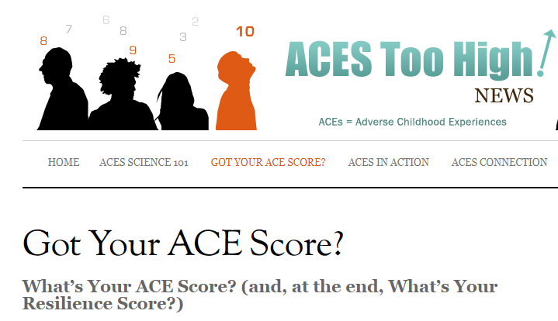
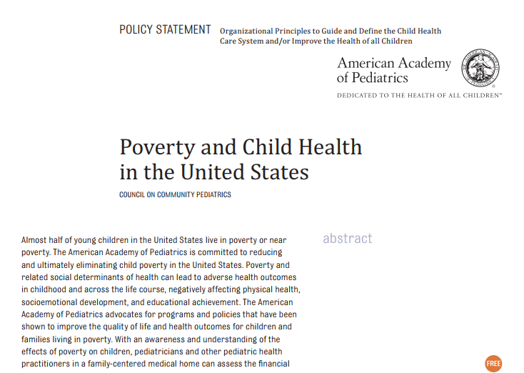
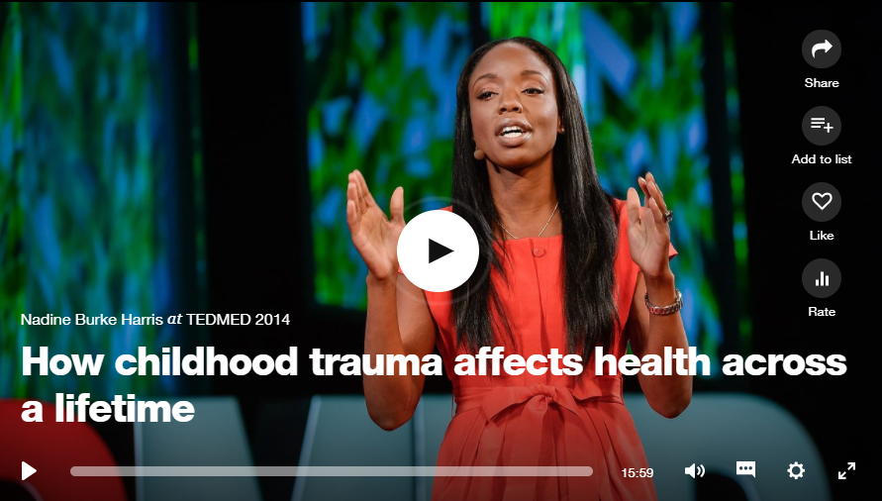
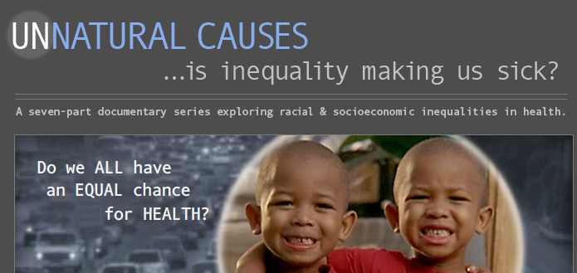
Digging Deeper
Notes:
LF
Many other available resources; these are just a few. All are hyperlinked.
1-AAP Poverty policy statement
2-Nadine Burke Harris TED Talk on ACEs and resilience
3-Calculate your ACE score (and now with a Resilience score)
4-Unnatural causes – SDH, health equity

Slide 22
Trainee Education in Advocacy and Child Health (TEACH) Curriculum
Health Disparities Curriculum
Notes:
CL & LF

Slide 23
Take Home Points
Social factors impact health twice as much as quality health care.
Childhood trauma can have insidious and lifelong effects on health and well-being.
Interdisciplinary efforts utilizing local community strengths and federal supports can mitigate the effects of SDH and ACEs.
Notes:
LF

Slide 24
Get Involved in Advocacy!
#SaveCHIP Day of Action – Wednesday Jan 10th!
CHIP Advocacy Toolkit

Slide 25
LEARN MORE

Slide 26
LEARN MORE
Trajectories of E-Cigarette and Conventional Cigarette Use Among Youth. K. Bold et al. Jan, 2018.
Preterm Birth, Poverty, and Cognitive Development. J. Beauregard et al. Jan, 2018.
Racial and Ethnic Disparities in Early Childhood Obesity. I.A. Isong et al. Jan., 2018.
The Teens Trapped Between A Gang and the Law

Slide 27
LEARN MORE
Association Between Adolescent Preventative Care and the Role of the Affordable Care Act. S. Adams, Jan, 2018.

Slide 28
LEARN MORE
https://ed.ted.com/on/emYm0MBq
Don’t miss seeing Dr. Jones come and speak during CNMC Research Week April 18th! http://researchweek.ctsicn.org/Apps/abstractSpeaker.aspx#camara_j

