Slide 1
Pediatric Public Health and Advocacy Curriculum (P-PHAC) APRIL 24th, 2018

Slide 2
Objectives
After completion of this series, the learners will be able to:
Describe the child health effects of 5 public health topics (2017-2018 topics: health financing, immigration, socioeconomic disparities and adverse childhood experiences, education, and the opioid epidemic).
Express an interest in advocacy opportunities during training and in their future careers.
Apply strategies to communicate with lawmakers and community partners regarding child health.

Slide 3
CHAPP Pathway Credit
Attend every noon conference or, if unable to be there in person, listen to the recorded conference;
Complete one of the “continuing education” activities suggested at the end of each lecture; and
Attend the legislative advocacy day, or if unable to be there in person, discuss other options with the faculty contact.
Duration: 5 conferences and Resident Hill Day
Contact: Dr. Danielle Dooley dgdooley@childrensnational.org
Units: 0.25

Slide 4
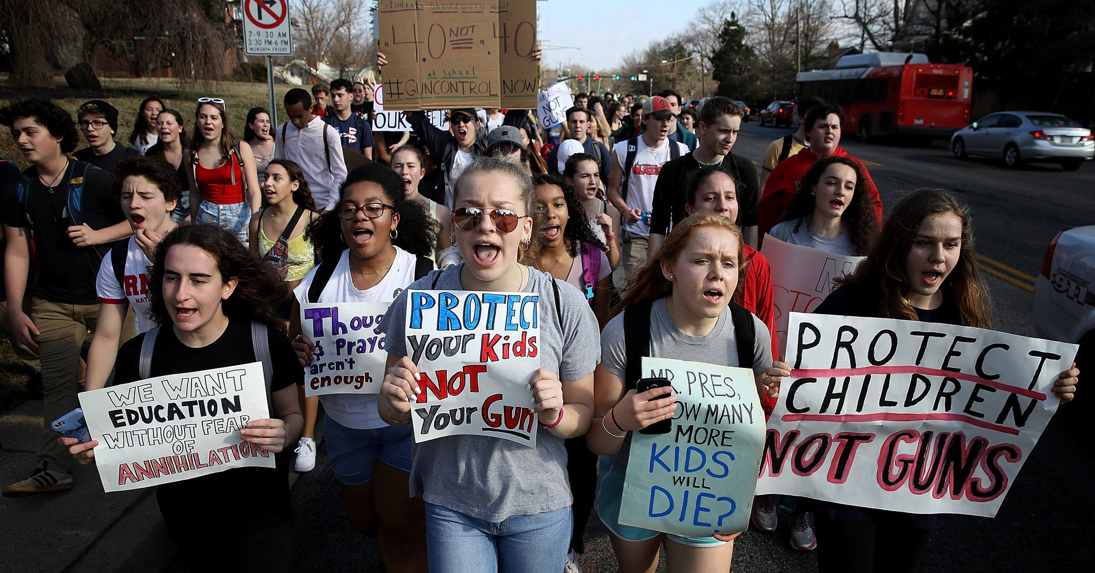
CHECK OUT THE NEWS!
Student walk-out to demand gun control

Slide 5
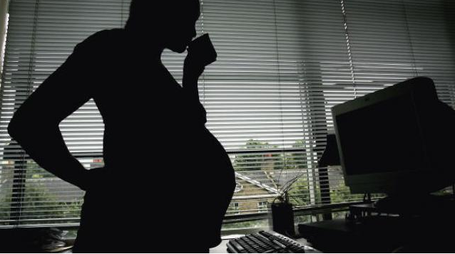
CHECK OUT THE NEWS!
Trump’s HHS will give grants to organizations that emphasize abstinence only education

Slide 6
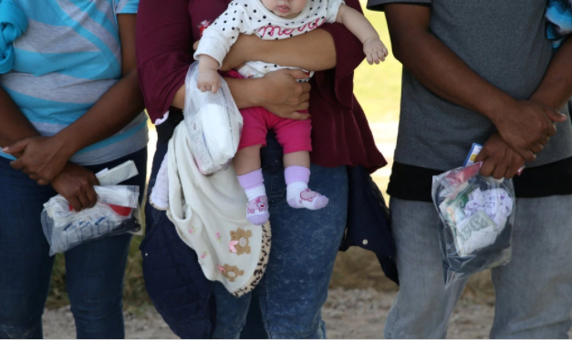
CHECK OUT THE NEWS!
Over 700 children separated from their parents at the U.S.-Mexico border

Slide 7
Important Child Health Bills
2018 Farm Bill
Passed out of the House Agriculture Committee to the House Floor Wednesday, April18th
Requires most adults 18-59 to work to receive benefits
Currently, the Bill has no support from Democrats
CBO estimates 1 million people would leave/loose SNAP benefits with the proposed changes
Current Farm Bill set to expire Oct 1, 2018
The 2018 Farm Bill be voted on in the House in May

Slide 8
A Review of the Opioid Crisis & How It Impacts Our Pediatric Patients Special Guests: Mr. Carter Batey, Dr. Brooke Bokor and Dr. Joshua Attridge

Slide 9
Learning Objectives
At the conclusion of the session participants will be able to:
Describe the impact that the opioid epidemic has had on neonates, children, adolescents, and their families
Determine individual risk factors and environmental influences that have contributed to the opioid epidemic
Identify opportunities to improve clinical practice to prevent and address opioid addiction
Identify opportunities to advocate for patients, families, and communities for better supports to address to opioid crisis.

Slide 10
General Statistics
1996-2016: 630,000 people have died from drug overdose
63,600 drug overdose deaths in 2016 involved an opioid
On average, 115 Americans die every day from an opioid overdose
Between 2000-2014, the rate of deaths from drug overdose increased 137% including a 200% increase in rate of overdose deaths from opioids
In 2016, 2.4 million Americans were estimated to have an opioid use disorder
The cost of the US opioid epidemic since 2001 is estimated to be at $1 trillion (Altarum)
Notes:
Sources:
Centers for Disease Control and Prevention. Opioid Overdose. Understanding the Epidemic. https://www.cdc.gov/drugoverdose/epidemic/index.html

Slide 11
General Statistics
~21-29% of patients prescribed opioids for chronic pain misuse them
8-12% develop an opioid use disorder
4-6% of people who misuse opioids transition heroin
80% of people who use heroin first misused prescription opioids
Notes:
Sources: National Institute of Drug Abuse. Opioid Overdose Crisis. https://www.drugabuse.gov/drugs-abuse/opioids/opioid-overdose-crisis

Slide 12
Pediatrics
In pediatric patients <19 years old, incidence of prescription opioid-related hospitalizations for ingestions/poisonings doubled between 1999 and 2012 (2nd most common exposure)
0.6% of adolescents 12 to 17 years old and 1.1% of young adults 18 to 25 years old had an opioid use disorder
Notes:
Ryan, SA. Calculating the real cost of the opioid crisis. Pediatrics. 2018; 141(4)

Slide 14
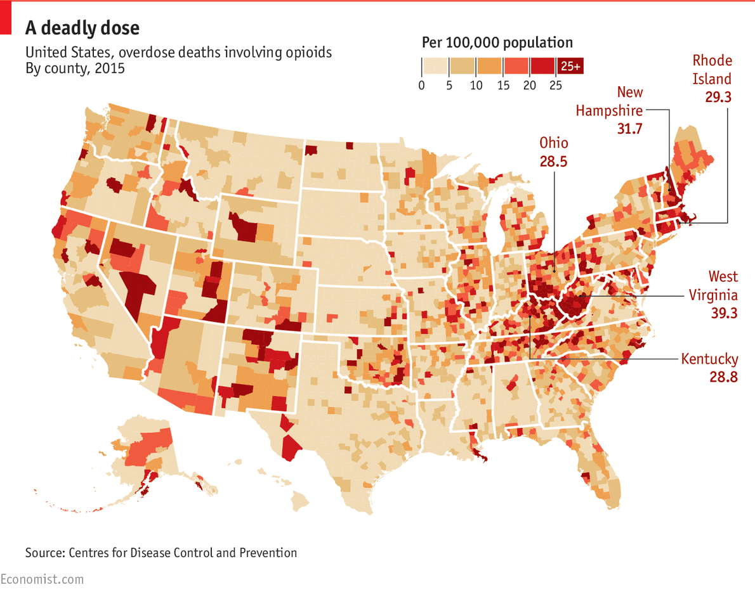

Slide 15
Questions
In what ways in which you have witnessed the impact of the opioid crisis in your work or practice?
What factors do you feel have contributed most to this epidemic?
What barriers have hampered appropriate treatment of patients and families?
What legislation has been implemented to address the opioid epidemic?
Has it helped or harmed families?
What methods do you use to help patients and families in your practice?
Do you have thoughts on the use of medication (e.g. buprenorphine) to help treat adolescents with opioid addiction?

Slide 16
Questions
Do you have suggestions for how residents can help patients and families who are struggling with opioid addiction?
Are there certain resources with which residents should be familiar?
What can residents do to become involved in advocacy efforts to address the opioid epidemic?

Slide 17
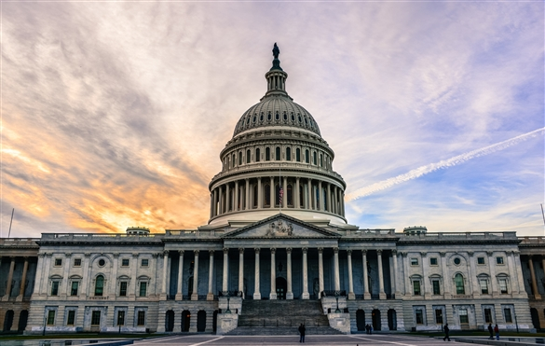
Get Involved in Advocacy!
Speak To Your Representatives With Your Fellow Residents!
TOMORROW April 25th, 2018!!!
Talk to us ASAP if you want to go but haven’t signed up.
(Like right after this.)

Slide 18
Get Involved in Advocacy!
Call Congress about the Farm Bill!
Look out for opportunities to be part of a Day of Action from the AAP over the next month!

Slide 19
DC AAP Spring Meeting and Symposium
Thursday April 26th, 2018

Slide 20
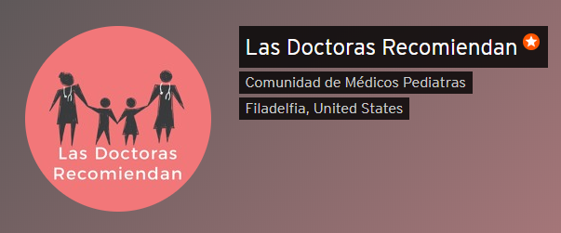
Opportunities with the AAP
SOPT Monthly Feature Annual Essay Competition– Deadline April 30, 2018 Calling all authors! The SOPT Monthly Feature in Pediatrics is now accepting submissions for our second annual essay competition .Please email SOPTpediatrics@aap.org to submit your article or with questions about the competition.
Podcasts for Spanish-Speaking Families
https://soundcloud.com/lasdoctorasrecomiendan

Slide 21
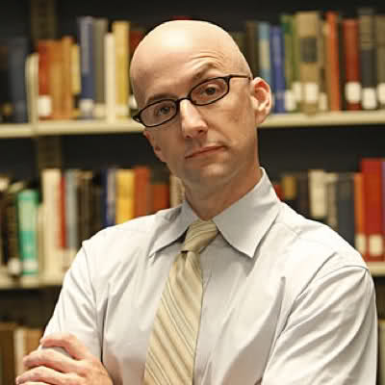
Take Over the P-PHAC Curriculum!
Enjoy teaching, public health, and advocacy? Want to ensure your co-residents continue learning about public health and become pediatric advocates?
Talk to Dr. Lanre Falusi and me (Amanda Jichlinski) about continuing the Pediatric Public Health and Advocacy Curriculum!

Slide 22
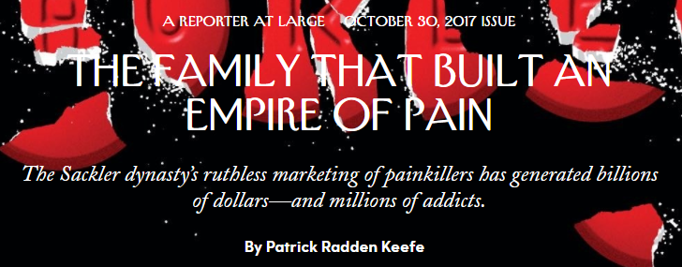
LEARN MORE

Slide 23
LEARN MORE

Slide 24
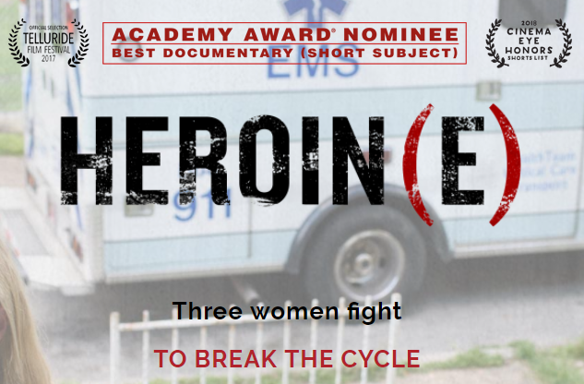

Slide 25
LEARN MORE
Kane JM et al. Opioid-related critical care resource use in US Children’s Hospitals
Collins AM et al. A summer nutrition benefit pilot program and low-income children’s food security
Racine N et al. Maternal adverse childhood experiences and infant development
Hensley C. Poverty, transportation access, and medication nonadherence
Ryan, SA. Calculating the Real Costs of the Opioid Crisis

Slide 26
“Good Night, and Good Luck” ~Edward R. Murrow

