Slide 1
Federal Advocacy & the Children’s Health Insurance Program
Children’s National Medical Center
Noon conference
February 10, 2014
Jamie Poslosky
Director, Division of Advocacy Communications
Department of Public Affairs
Bob Hall, JD, MPAff
Associate Director, Department of Federal Affairs

Slide 2
American Academy of Pediatrics
The American Academy of Pediatrics is a professional organization of 60,000 pediatricians
Dedicated to the health, safety, and well-being of infants, children, adolescents, and young adults since its founding in 1930
AAP has 66 Chapters in U.S. and Canada, at least one per state
AAP is made up of numerous organized committees, councils and sections

Slide 3
AAP & Federal Advocacy
Founded in 1970, the Department of Federal Affairs is the Academy’s voice at the federal level through lobbying, coalition-building and raising public awareness.
16 full-time employees lobby to pass and implement strong federal child health policies and engage pediatricians to advance and protect these policies
Pediatricians serve as a voice for children to our national policy leaders.
The Department provides the tools necessary to do so:
Advocacy trainings
Federal testimony, Capitol Hill briefings, amicus briefs
Guidance on using the media to advocate
Comments to rules that implement child health laws
Resources/materials/expertise on federal policy topics
Federal legislative updates & grassroots alerts

Slide 4
What is Advocacy?

Slide 5
Advocacy is Embedded in Pediatrics
“It should be our aim to discover neglected problems and,
so far as in our power, to correct evils and introduce reform.” Isaac Abt, MD, first AAP President

Slide 6
Pediatricians are Advocates
Individual Advocacy:
Work pediatricians already do every day to improve the health and well-being of individual patients.
Community and State Advocacy:
Building on and reaching beyond individual advocacy by shifting focus from children in the professional setting to children within the community.
Changing the public policies, laws, and rules at the federal level to affect broad systemic change.
Federal Advocacy:
Notes:
6

Slide 7
Advocacy in Action: How to Advocate at the Federal Level
Grasstops: Lobbying | Grassroots: Member Mobilization | External Communications: Media Advocacy
Legislative Relationship-building Hill visits & staff meetings Federal testimony | Member communications Frequent policy updates Up-to-date resources Action alerts/requests | Interviews & pitching stories Get to know reporters Undergo media training Fill a gap in coverage
Appropriations Sustained communication Understanding of process Key committee staff | Advocacy trainings Washington, DC visits Skills-building workshops CME opportunities | Op-eds, letters to the editor Local & national coverage Template op-eds/LTEs Co-sign w/gov’t, partners
Regulatory Interim, draft & final rules Targeted communication Federal agency contacts | Member advocacy Webinars & conf. calls Advocacy incentives One-click e-advocacy | Social media campaigns Twitter town halls, chats Facebook promotion Leadership/member blogs

Slide 8
Why Advocate?

Slide 10
Your Voice Makes a Difference
Goal of each member of Congress: to get re-elected
Constituent relationship-building is essential
If you don’t advocate your own cause, no one else will
Children can’t vote or speak up for themselves: they rely on you to do it for them
Staff for members of Congress are policy experts; you are the medical expert
Notes:
10

Slide 11
How do I Advocate?

Slide 12
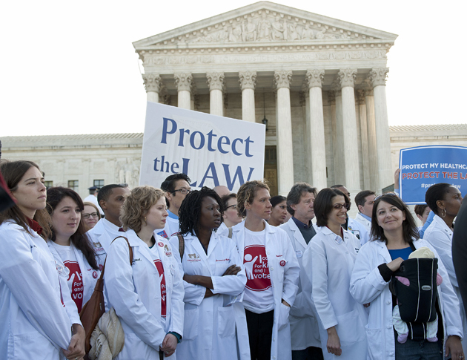
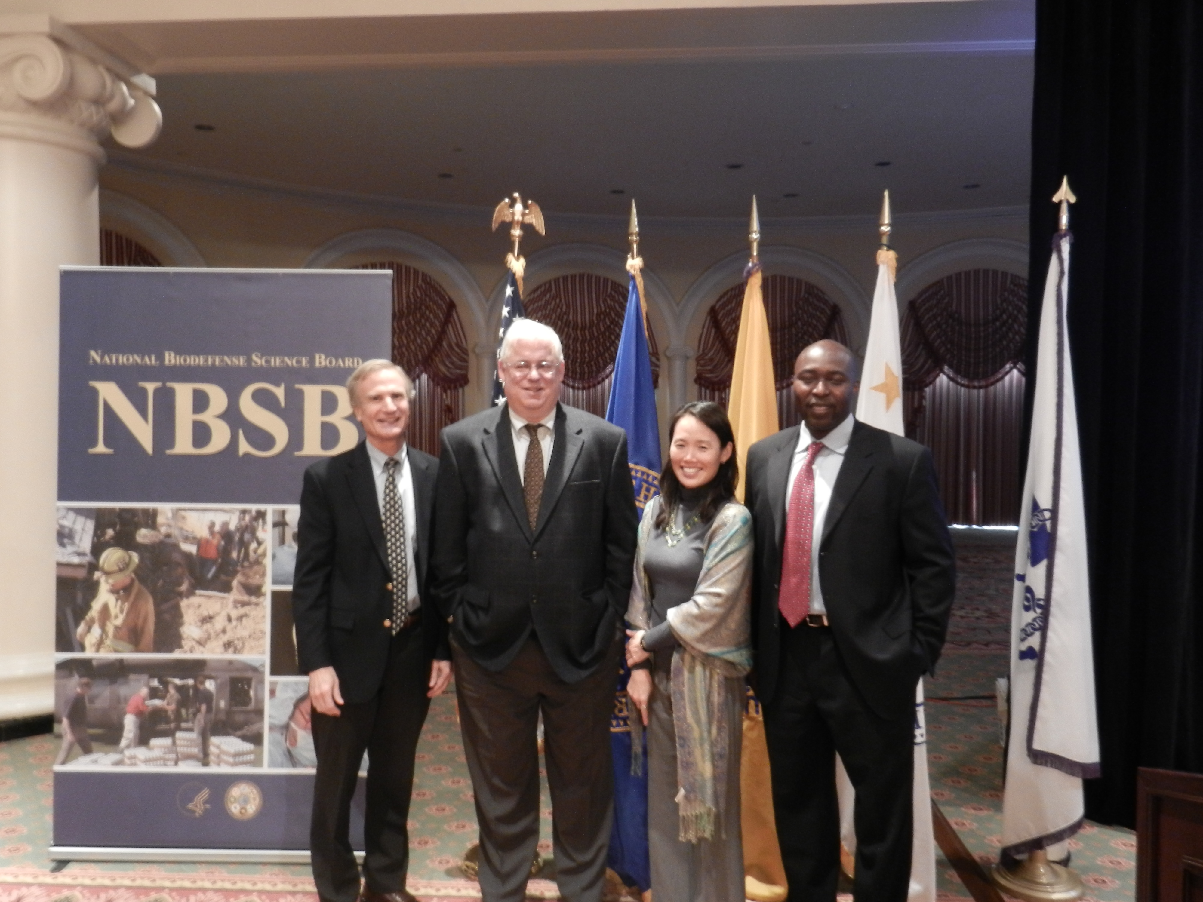
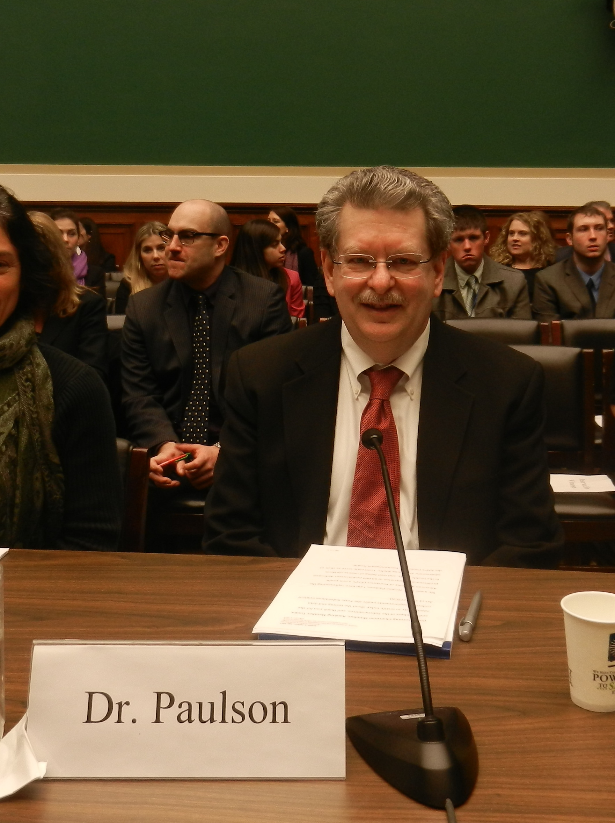
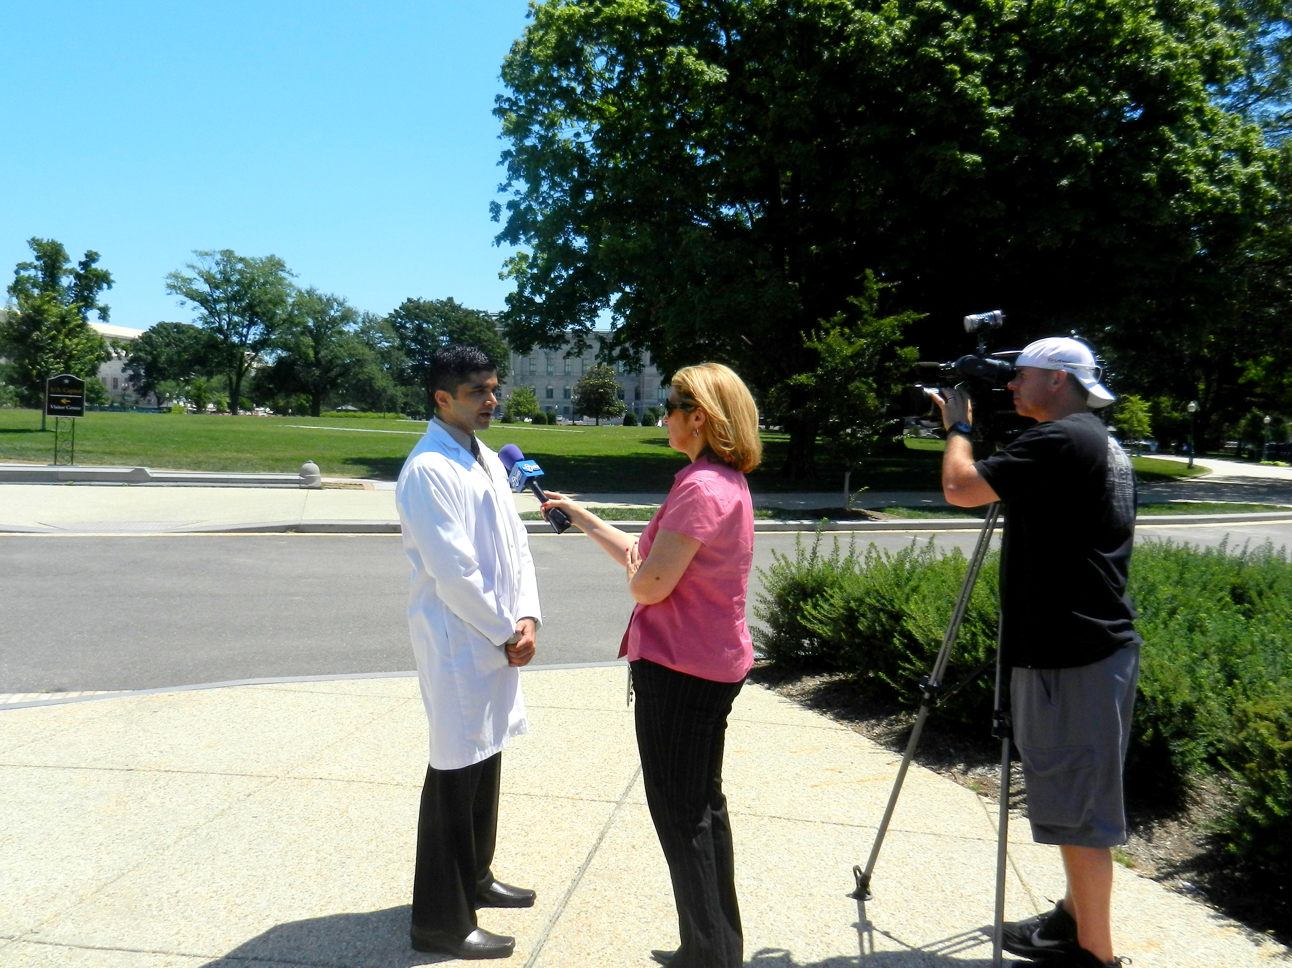
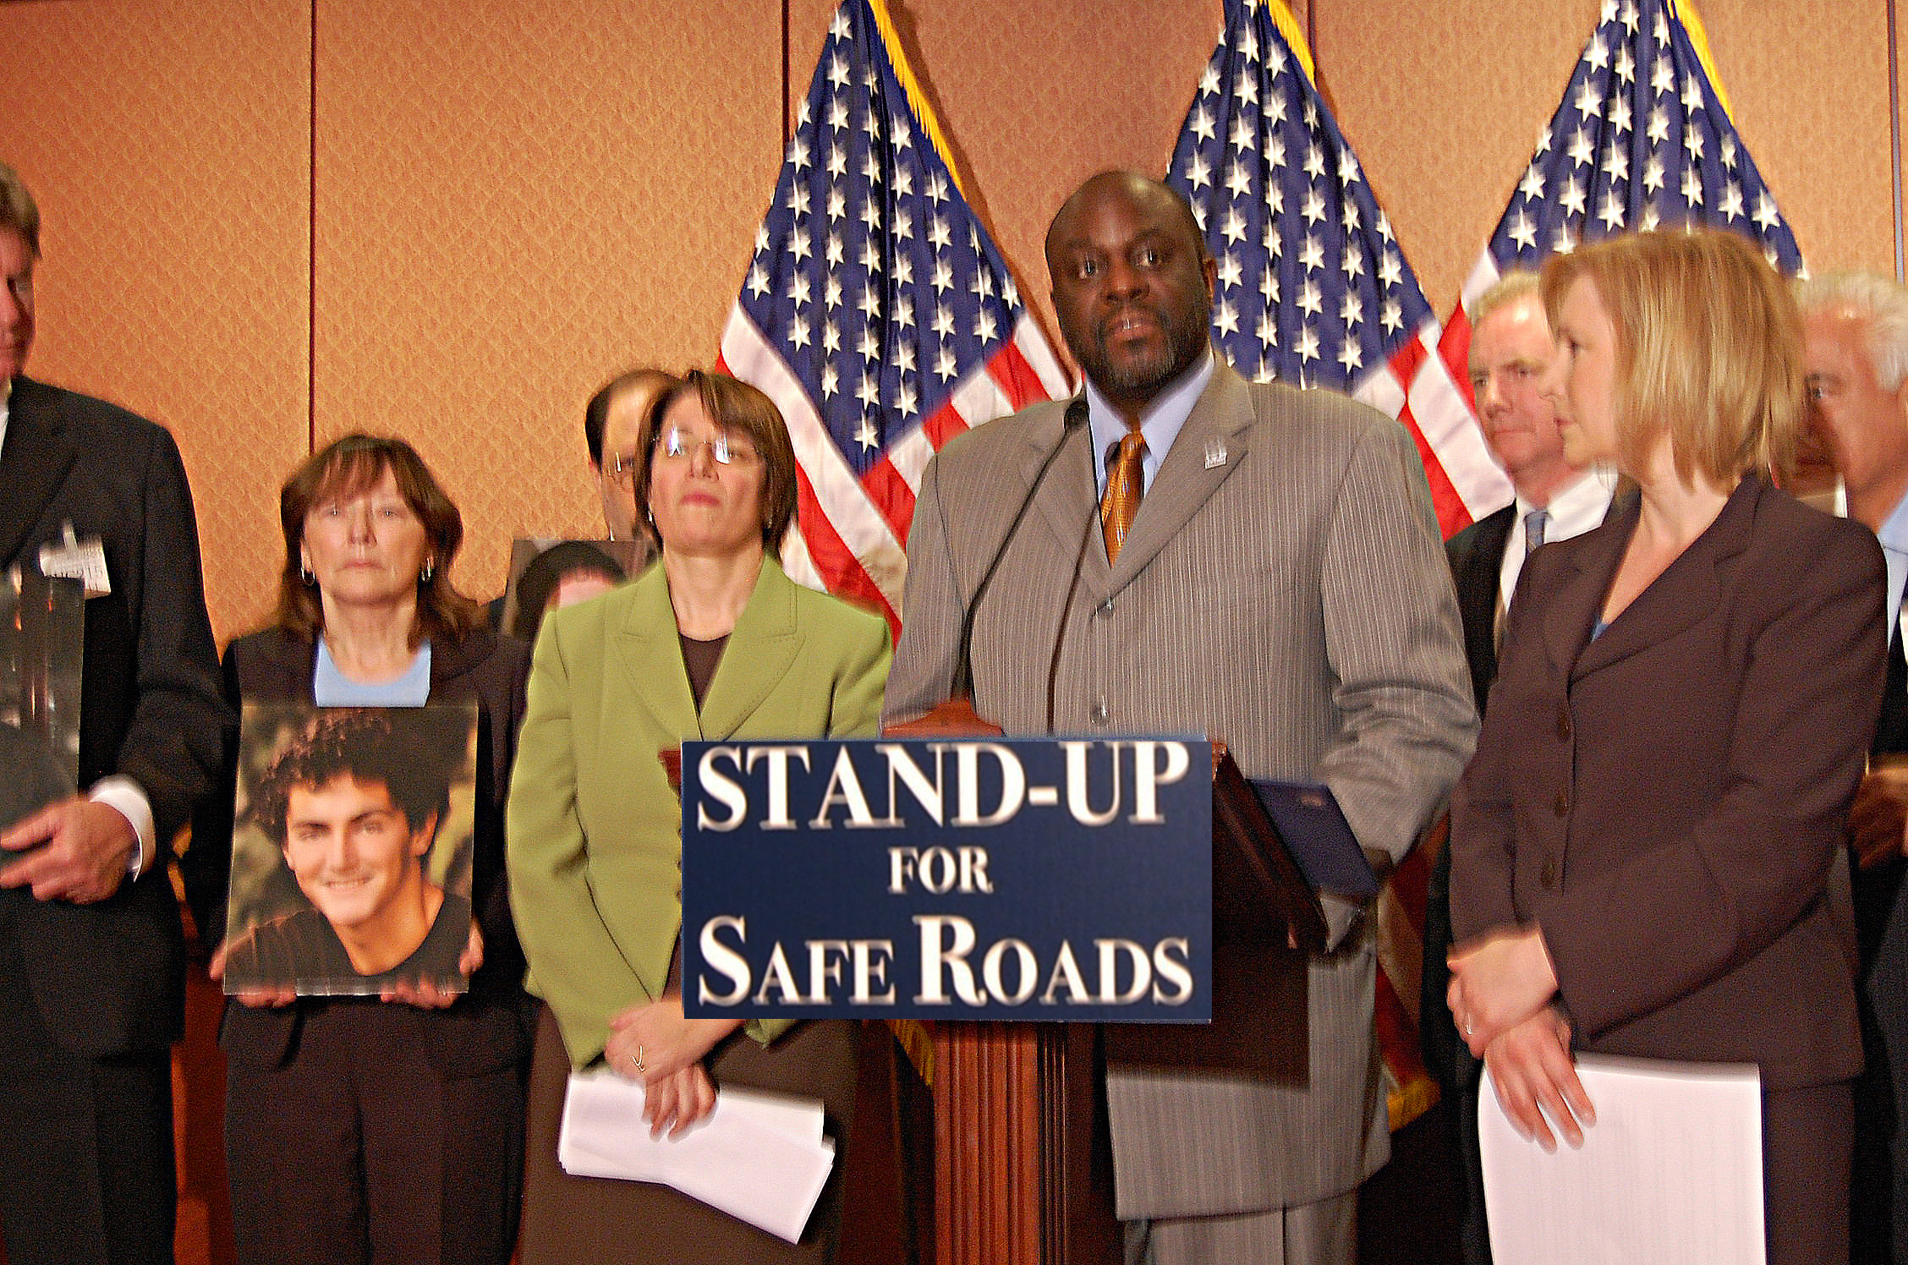
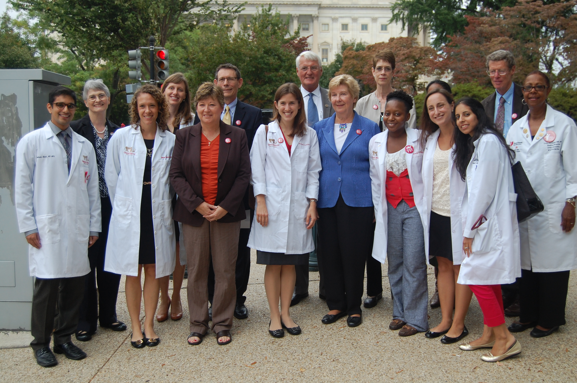
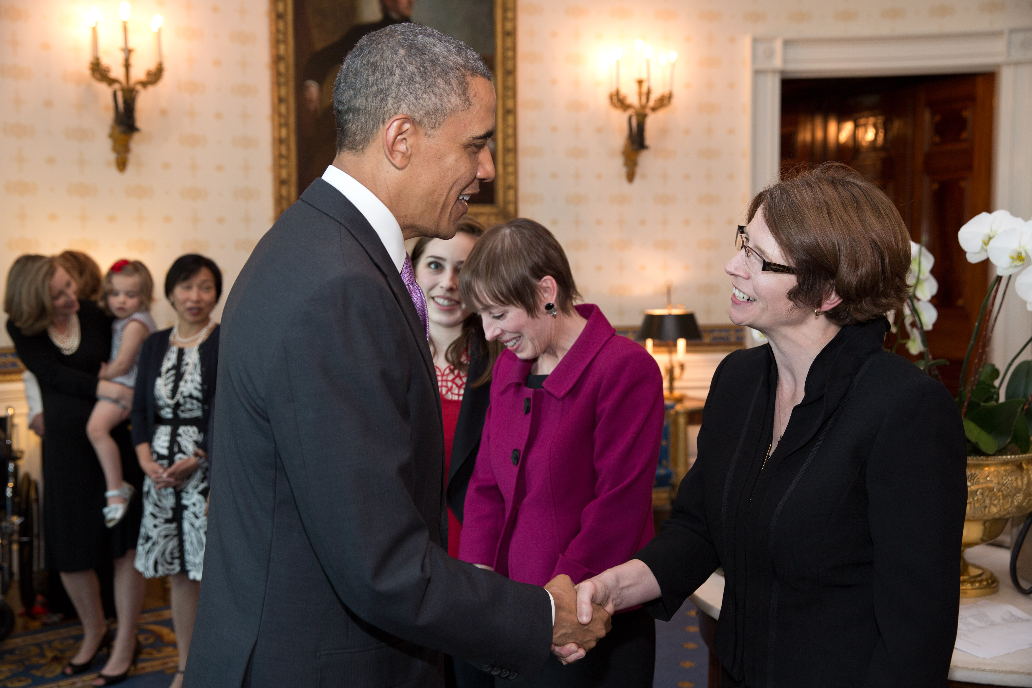
Take Advantage of Your Location
Participate in an AAP advocacy training
Go with your fellow residents to meet with staff on Capitol Hill
Attend briefings and hearings
Intern in the AAP’s DC office
Take advantage of CNMC expertise

Slide 13
Advocacy Training Opportunities
Legislative Conference: June 15-17, 2014
Three-day federal advocacy conference in Washington, DC
Guest speakers from Congress, the White House and DC media
Workshops on specific advocacy tactics and skills-building
Capitol Hill visits
Scholarships available
Visit aap.org.legcon to learn more

Slide 14
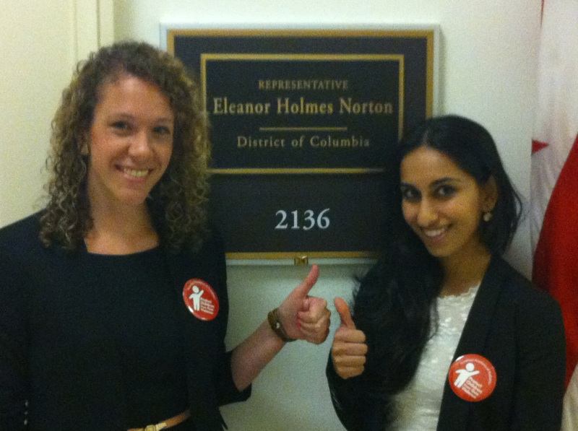
Advocate to Congress

Slide 15
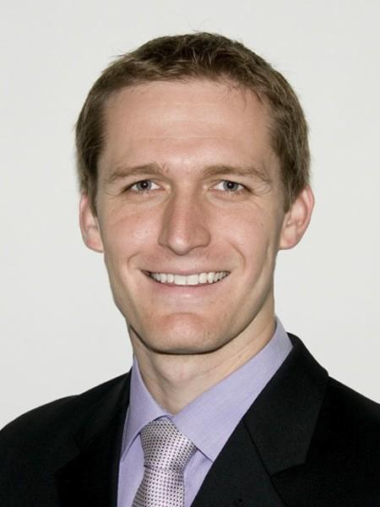
Speak Up in the Media
Media advocacy defined: Using media (newspapers, magazines, television, radio, and internet) to reach a broader audience in order to build awareness on behalf of your issue and gain more attention from decision-makers.
Keep funding kids' health insurance: My Word

Slide 16
Use Social Media to Advocate

Slide 17
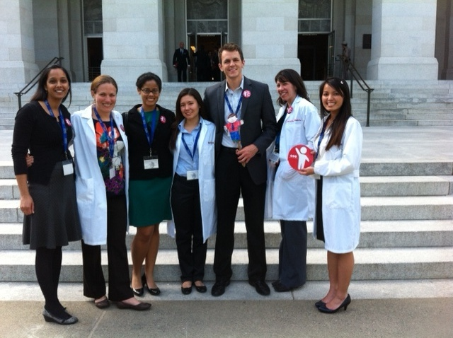
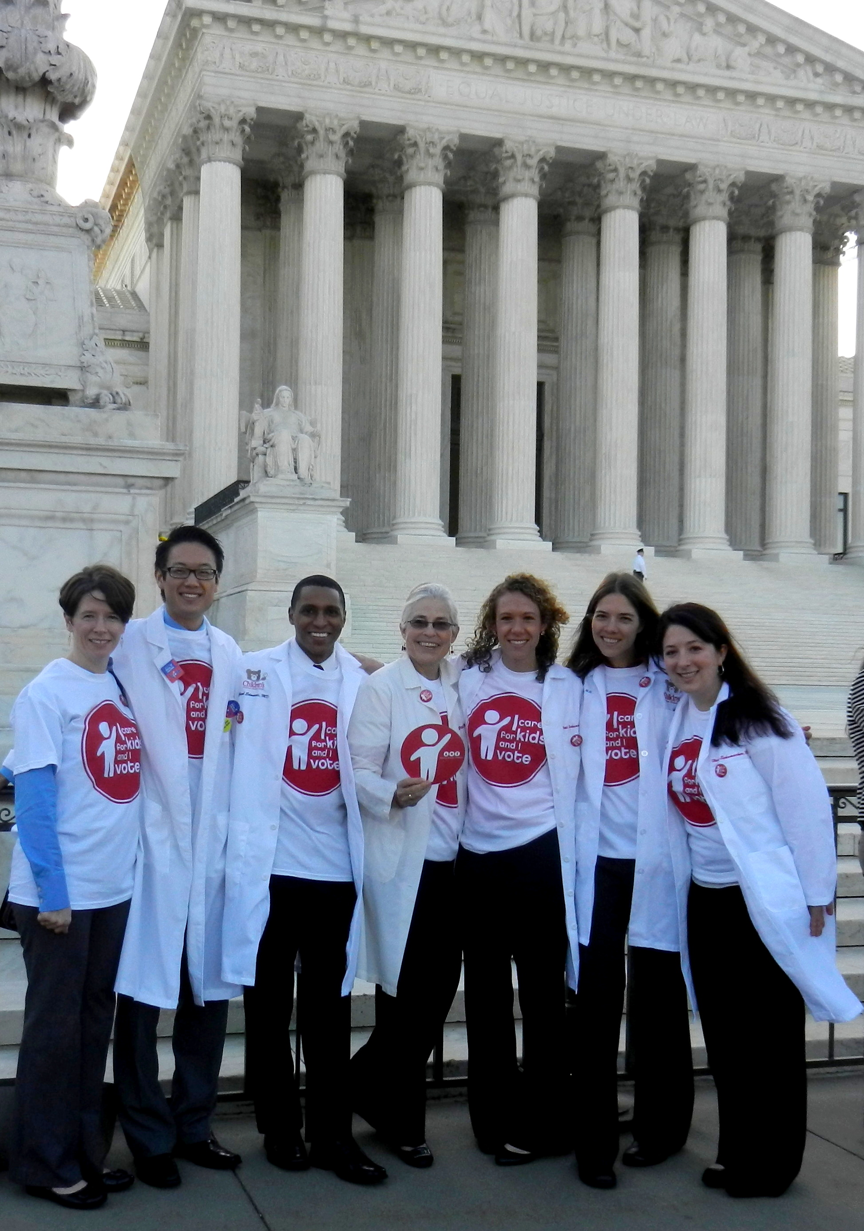
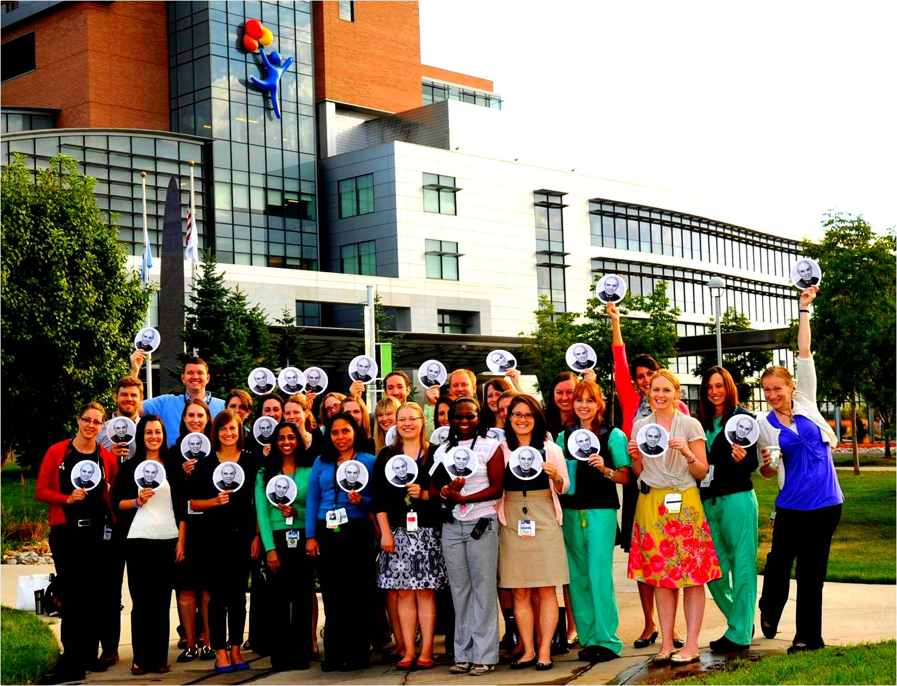
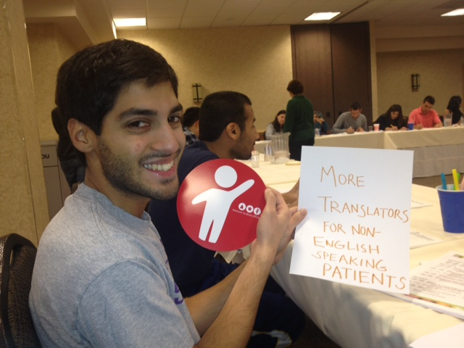
Raise Awareness: Take Part in Creative Campaigns

Slide 18
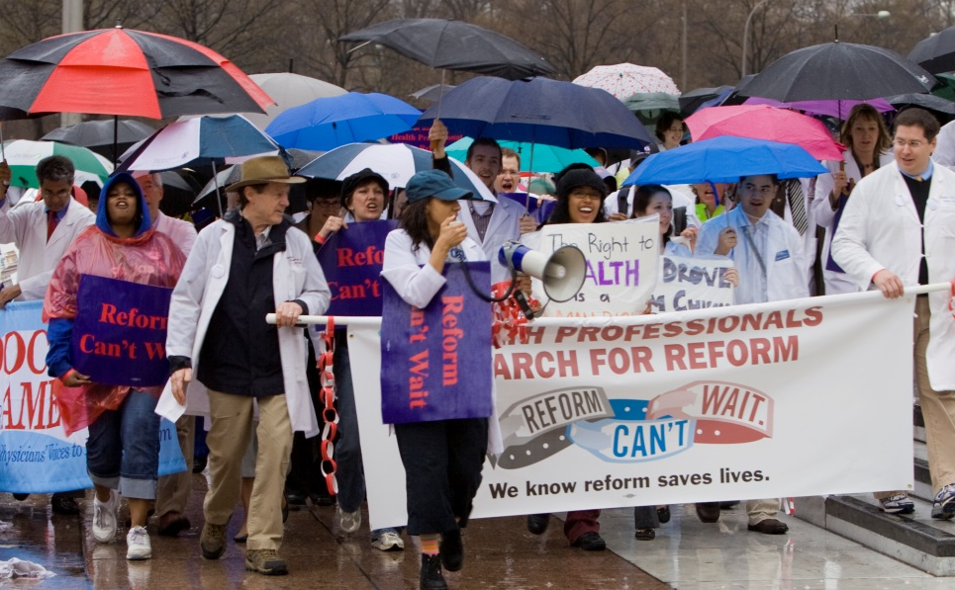
Connect: Form Coalitions
Who can you work with to amplify your message?
Fellow pediatric residents at CNMC
Children’s Hospital Association
AAP’s DC chapter
Parents and families in your communities
Other child health groups and organizations

Slide 19
The Children’s Health Insurance Program post-Obamacare
Notes:
Consumer protections include”
Summary of Benefits and Coverage and the Uniform Glossary
Premium Rate Review/Medical Loss Ratio (discloses insurer efficiency and gives rebates if insurer has high administrative costs)
Internal Claims and Appeals & External Review

Slide 20
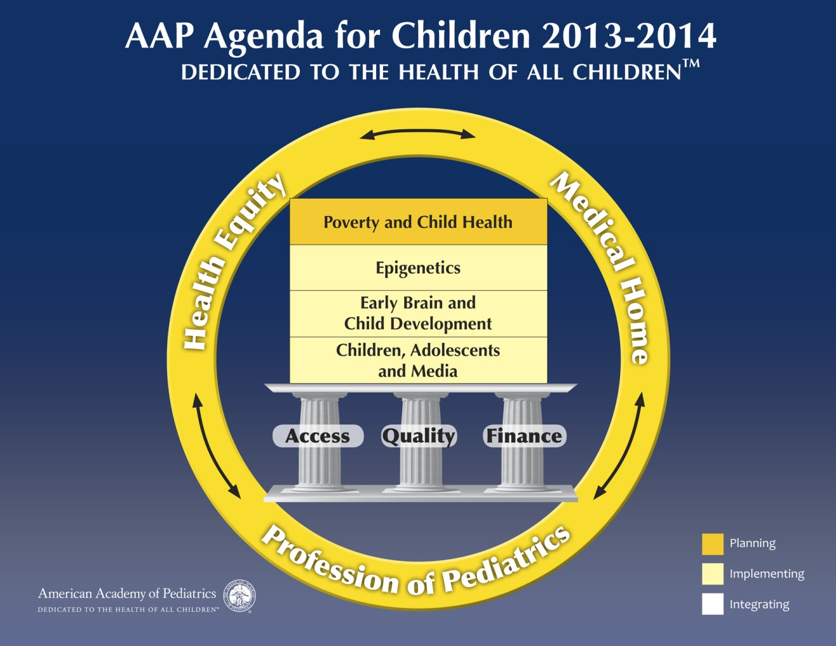
AAP Agenda for Children
Notes:
Consumer protections include”
Summary of Benefits and Coverage and the Uniform Glossary
Premium Rate Review/Medical Loss Ratio (discloses insurer efficiency and gives rebates if insurer has high administrative costs)
Internal Claims and Appeals & External Review

Slide 21
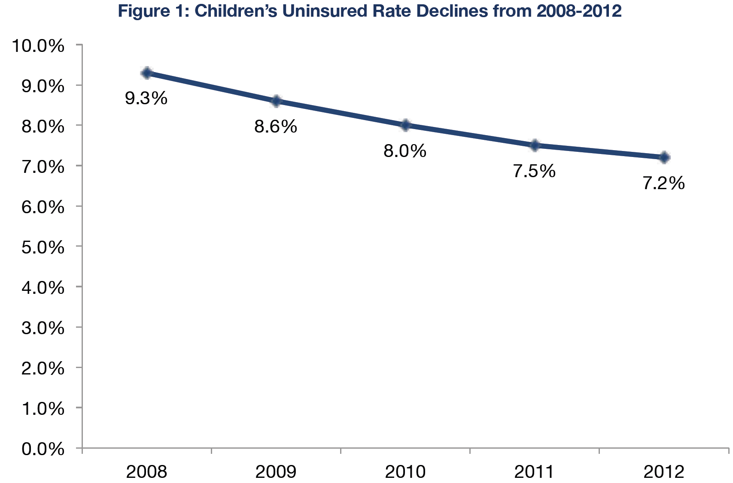
Insurance Coverage for Children in the U.S.
92.8% of children had health insurance in 2012
Only about 5.3 million children were uninsured in 2012
Lowest number and best rate ever recorded
American Community Survey data

Slide 22
Who is Left?
Highest uninsurance rates in school-age children, American Indian/Alaska Native children, children living in rural areas
Hispanic children and children living in the South and West are disproportionately uninsured
Half of uninsured children in the US live in just 6 states, which account for only 36.1% of the nation’s child population (TX, CA, FL, GA, AZ, NC)
One-quarter of uninsured children in US live in just 20 counties
Notes:
Consumer protections include”
Summary of Benefits and Coverage and the Uniform Glossary
Premium Rate Review/Medical Loss Ratio (discloses insurer efficiency and gives rebates if insurer has high administrative costs)
Internal Claims and Appeals & External Review

Slide 23
Children’s Coverage Source by Income
Fundamental problem is that insurance costs too much and employers keep shedding dependent coverage
Notes:
Consumer protections include”
Summary of Benefits and Coverage and the Uniform Glossary
Premium Rate Review/Medical Loss Ratio (discloses insurer efficiency and gives rebates if insurer has high administrative costs)
Internal Claims and Appeals & External Review

Slide 24
SCHIP History
SCHIP was enacted on August 5, 1997
Remaining effort from the end of the Clinton health reform experiment
Failed as part of initial budget debate
Block grant for 10 years passed as part of the nudget
Grew to $40 billion cost to federal government
Funded by tobacco tax (federal increase from 24 cents to 67 cents per pack) and tobacco settlement funds (state)
Academy originally opposed
States had flexibility to use private insurance benefits, not EPSDT
Not an entitlement (instead, a block grant) – resulted in funding shortfalls in several states in 2008 and waiting lists in some states
Not a federal program, but a state/federal partnership
Notes:
Consumer protections include”
Summary of Benefits and Coverage and the Uniform Glossary
Premium Rate Review/Medical Loss Ratio (discloses insurer efficiency and gives rebates if insurer has high administrative costs)
Internal Claims and Appeals & External Review

Slide 25
CHIPRA Highlights
Enacted Feb. 4th, 2009
4 million more children covered (many in Medicaid)
Contingency fund stopped penalties to states that had extra enrollment
Outreach and enrollment grants and state “bonus payments” helped boost enrollment
Express Lane eligibility – taken up by AL, IA, LA, MD, MA, NJ, OR, SC, MI, NY, OK
Coverage of legal immigrants with no waiting period
Quality improvement - $225 million for pediatric QI
state demonstrations
centers of excellence
model pediatric health IT record development
$45m diabetes demonstration grant
IOM report
annual report on pediatric quality
Notes:
Consumer protections include”
Summary of Benefits and Coverage and the Uniform Glossary
Premium Rate Review/Medical Loss Ratio (discloses insurer efficiency and gives rebates if insurer has high administrative costs)
Internal Claims and Appeals & External Review

Slide 26
CHIPRA Highlights
Benefits
Dental required
Mental health parity required
Created MACPAC
Corrected DRA ambiguity regarding EPSDT
Yearly report on children’s health
Funding
Cigarette tax increase of 62 cents to bring federal tax to $1.01 per pack
Generated $32.8 billion to fund through 2013
Notes:
Consumer protections include”
Summary of Benefits and Coverage and the Uniform Glossary
Premium Rate Review/Medical Loss Ratio (discloses insurer efficiency and gives rebates if insurer has high administrative costs)
Internal Claims and Appeals & External Review

Slide 27
ACA and CHIP
Coverage expansion
40% decrease in uninsured children projected
Mandate, marketplaces + continued funding for CHIP responsible
ACA added funding for CHIP block grant through September, 2015
Rockefeller amendment also increased the federal matching rate
CHIP FMAP was ~70%; after 9/2015, will increase by 27%
Makes CHIP funding almost fully federal, but not expected to survive
Provided ongoing funding for MACPAC
Did not provide full funding for Express lane, state bonus payments or quality funding (ELE and quality funding included in SFC-approved SGR bill)
House health reform bill would have sunset CHIP
Senate bill became base bill post-Scott Brown election
Child advocacy community had different positions about CHIP’s future
Consensus reached to study CHIP vs. Exchange coverage
Comparability study mandated by ACA: deadline April, 2015
No CMS or HHS staff have been assigned to draft report
Notes:
Consumer protections include”
Summary of Benefits and Coverage and the Uniform Glossary
Premium Rate Review/Medical Loss Ratio (discloses insurer efficiency and gives rebates if insurer has high administrative costs)
Internal Claims and Appeals & External Review

Slide 28
Likely Arguments Against
ObamaCare should solve this
ACA will help decrease pediatric uninsurance, but 70% of uninsured children are eligible for coverage in Medicaid or CHIP
Benefits, Actuarial Value, Network Adequacy, Kid Glitch show CHIP is superior
premium stacking
CBO projects CHIP enrollment in 2015 will be 13 million; 4.2 million in 2016
Health Insurance is ineffective and a waste of taxpayer dollars
Oregon study
Tobacco tax is regressive and unfair to certain ethnicities
Notes:
Consumer protections include”
Summary of Benefits and Coverage and the Uniform Glossary
Premium Rate Review/Medical Loss Ratio (discloses insurer efficiency and gives rebates if insurer has high administrative costs)
Internal Claims and Appeals & External Review

Slide 29
Older Arguments
Government take-over of health care/crowd-out
Families in NY making $88,000 qualify; NJ at 350% FPL
Makes less sense in age of subsidies to 400% of the FPL
CBO conclusion that for every 100 enrollees, 25 to 50 lose private coverage
Less compelling in an era of mandates and Obamacare
Childless adults and pregnant women
Waivers granted by the Bush Administration allowed pregnant women, parents and childless adults to be covered with SCHIP funds
Many of these populations can now get coverage elsewhere; CHIPRA phased out childless adults from the program
Immigrants
CHIPRA included components of the Immigrant Children’s Health Improvement Act
State option to lift 5-year bar
Addition of sponsor’s income to eligibility determination
How does immigration reform interact with CHIP?
Notes:
Consumer protections include”
Summary of Benefits and Coverage and the Uniform Glossary
Premium Rate Review/Medical Loss Ratio (discloses insurer efficiency and gives rebates if insurer has high administrative costs)
Internal Claims and Appeals & External Review

Slide 30
Take the Advocacy Challenge
Determine your advocacy issue
Engage with your federal legislators
Write about your issue in earned media
Amplify your message on social media
Share your earned media coverage with your federal legislator
Keep CHIP strong for kids

Slide 31
What You Can Do Today to Keep CHIP Strong for Kids
Share facts and education about CHIP on social media using #celebrateCHIP
Use our template media guidelines to write an op-ed or letter to the editor about why CHIP works for kids
Sign up to be an AAP Key Contact by emailing dmiller@aap.org to receive targeted grassroots advocacy updates

Slide 32
Questions?
Bob Hall, JD, MPAff
Associate Director, Department of Federal Affairs
American Academy of Pediatrics
Washington, DC
rhall@aap.org, 202-347-8600
Jamie Poslosky
Director, Division of Advocacy Communications
Department of Public Affairs
American Academy of Pediatrics
Washington, DC
jposlosky@aap.org, 202-347-8600

