Slide 1
Billing and Coding: Fundamentals and that Darn ICD-10 Stuff
Continuity Clinic Curriculum
September 2015

Slide 2
Learning Objectives
The learner will:
Code accurately using the fundamentals of ambulatory billing and coding
Describe the new ICD-10 coding system
Utilize new ICD-10 codes in our electronic health record

Slide 3
Every visit needs correct ICD-9 (soon ICD-10) + CPT code(s)
ICD-9 code (ICD-10 as of Oct 1 2015)
Diagnosis/Assessment Codes
Justify why you provided a service
CPT code
Describes services or procedures provided: what you did
Linked to appropriate diagnosis code (ICD9 or ICD10 code)
Includes E/M (visit) codes and procedure codes
If not done in correct & timely way:
Don’t get reimbursed
Affects population health/quality measures
At risk of fraud charges: illegal to over- and under-code

Slide 4
New vs. established patient
Two parallel sets of codes: new vs. established patients
Higher charges & reimbursement for new patient visits (more work to obtain past medical history)
New patient = no professional services from physician(s)/same specialty group practice within the past 3 years

Slide 5
Preventive Care Visit Codes (Defined by age of patient)
Age | New Pt | Established Pt
Under 1 year | 99381 | 99391
1 – 4 years | 99382 | 99392
5 – 11 years | 99383 | 99393
12 – 17 years | 99384 | 99394
18 + years | 99385 | 99395

Slide 6
The “Art” of Coding (Joel Bradley, MD, AAP Coding for Pediatrics)
E&M = EVALUATION & MANAGEMENT (Office visit)
99211 – nurse visit
99212 – easy, brief problems
(diaper rash, thrush)
99213 – average, usual problems
(fever & pharyngitis, acute otitis media)
99214 – “oh no”
(chronic or multiple problems, school-behavioral issues, complicated acute issues)
99215 –“just ran a marathon” post-visit feeling
(new ADHD evaluation, headache & vomiting)
The “art” defines coding starting point- the final code is defined by coding rules (the “science” of coding)

Slide 7
New Patient E&M: 3 of 3 (Hx, Exam, MDM)

Slide 8
Established Pt E&M: 2 of 3 (Hx, Exam &/or MDM)

Slide 9
Billing Based on Time
If > 50% visit spent face-to-face on counseling or care coordination, can use E&M code based on time
Can disregard requirements for history, PE, and medical decision-making documentation
Ex. of Care Coordination: Face-to-Face Review of Past Records
Ex. of Counseling: Test results, Prognosis, Treatment Options, Risk Factor Reduction, Patient/Family Education
Need to document either:
Spent greater than 50% of visit on counseling and care coordination (total y minutes)
Spent x of y total minutes on counseling and care coordination (Note: x/y must be greater than 50%)
Can’t include time spent by resident for billing based on time: only attending time

Slide 10
Billing Based on Time for Outpatient Services
Established pts:
99211 5 min.
99212 10 min.
99213 15 min.
99214 25 min.
99215 40 min.
Select closest level (even if you don’t reach the total number of minutes)
New patients:
99201 10 min.
99202 20 min.
99203 30 min.
99204 45 min.
99205 60 min.
Ex. Established patient – spent 22 minutes with >50% on counseling): Level 4 visit

Slide 11
CMS “Primary Care” Exemption
In approved GME programs, teaching physician can be paid for E/M services performed by the resident without direct involvement of the attending
Applies to low complexity E/M visits only (99201-3 or 99211-3)
Higher complexity resident visits (99204-99205 or 99214-99215) must be seen & documented by attending physician
Exception: All PGY1 visits during 1st 6 months must be seen by attending physician

Slide 12
What are those modifiers?
Often perform more than one service the same day
Preventive care + E/M for management of acute or chronic health issues
Vision and Hearing screens at preventive care visit
Nebulizer treatment during an asthma sick visit
Modifiers allow you to bill multiple CPT codes on same date of service
Two modifiers used in primary care:
59: apply to hearing, vision, and developmental screen codes
25: WCC and E/M; E/M with same day procedure; WCC and E/M if do vaccines same day

Slide 13
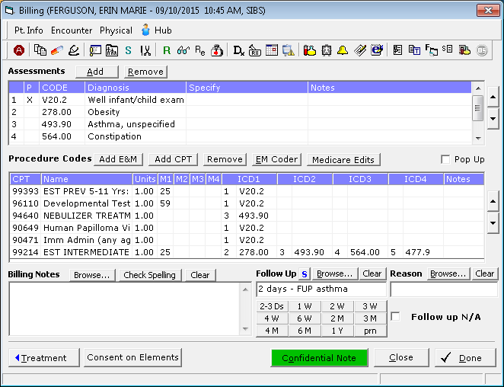
A typical WCC visit in the Children’s Health Center

Slide 14
ICD-10 begins October 1, 2015
All claims through 9/30/15 must have ICD-9 diagnosis codes
All claims beginning 10/1/15 must have ICD-10 diagnosis codes
No change in CPT codes

Slide 15
How is ICD-10 different?
Primarily, changes in ICD-10-CM are in its organization and structure, code composition and level of detail.
ICD-10 requires much greater detail on location of ailments, cause and type, and complications or manifestations compared with ICD-9.
ICD-9 expands from ~13,500 to ~68,000 codes in ICD-10.

Slide 16
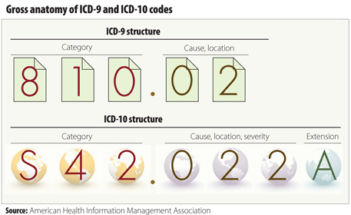
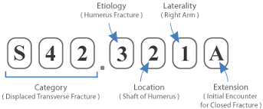

Slide 17
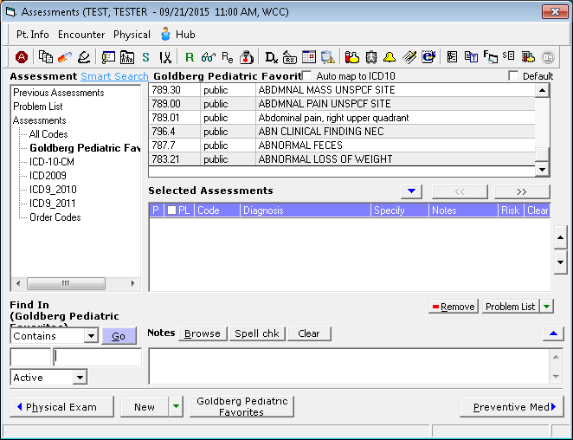
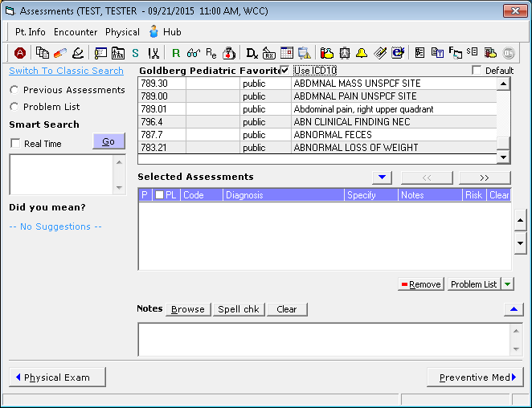
Finding ICD-10 Codes

Slide 18
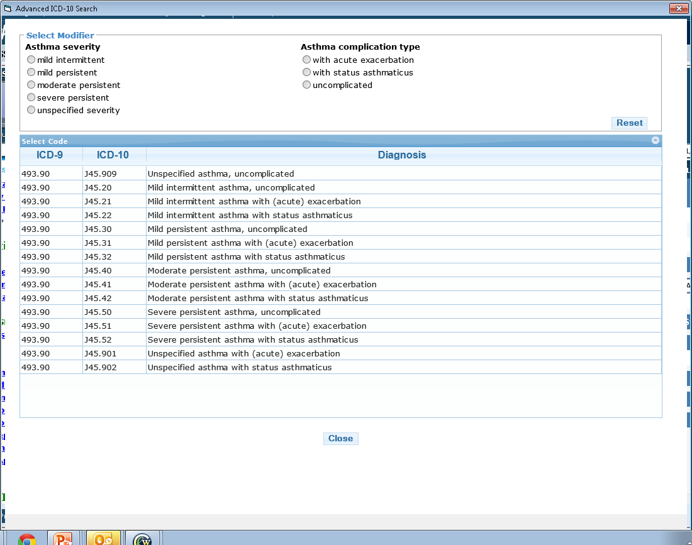
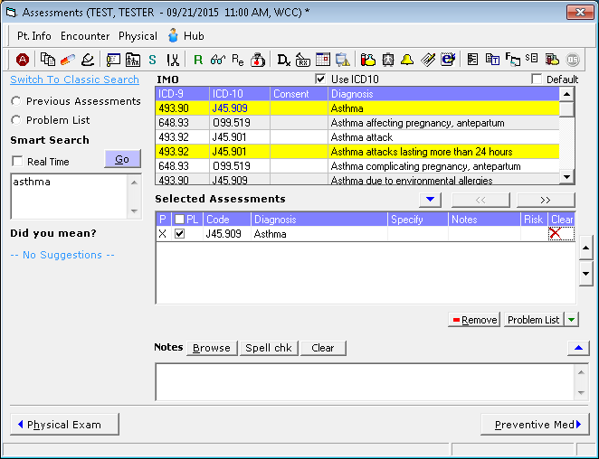
Adding Specificity to Your ICD-10 Code: Asthma Example

Slide 19
ICD-10: Primary Care Pediatrics

Slide 20
ICD-10: Routine child health examination
ICD-9 = only 1 code = V20.2
ICD-10:
Z00.129 Encounter for routine child examination without abnormal findings
Z00.121 Encounter for routine child examination with abnormal findings
Always report the abnormal finding when listing a code that indicates an abnormal finding was discovered.
Templates will have both Z-codes – need to delete the incorrect code

Slide 21
Newborn health examination (< 29 days old)
Z00.11 Newborn health examination
Z00.110 under 8 days old
Z00.111 8 to 28 days old
Use additional code(s)- not added alphanumeric- to identify any abnormal findings
Unlike Z00.12 (routine well child exam)- no added placeholder for “with abnormal finding” (Z00.121)

Slide 22
Z23: Encounter for immunization
Z23 Encounter for inoculations and immunizations
Applies to all immunizations (single antigen and combo)
Use specific product procedure code (CPT) to identify which vaccine administered (happens automatically in eCW)
Use as secondary code if part of well child exam or other visit

Slide 23
ICD-10 Coding for Preventive Care (Bright Futures)
Z00.129 Encounter for routine child examination without abnormal findings
Z00.121 Encounter for routine child examination with abnormal findings
(List additional diagnosis codes)
Z00.12x Hearing & vision SCREENING
Z13.4 Screening for certain developmental disorders in childhood
Z13.89 Screening for behavioral disorder
Z11.1 Screening for respiratory tuberculosis
OFFICE LABS:
Z13.88 Screening for disorder due to exposure to contaminants (eg lead)
Z13.0 Screening for diseases of the blood and certain disorders (Hct or Hgb)
Z13.220 Screening for lipid disorders
Z11.4 Screening for HIV

Slide 24
Other child health examinations Primary or secondary diagnosis
Z02.0 Encounter for examination for admission to education institution (preschool), including re- admission to school following illness or medical treatment
Z02.1 Encounter for pre-employment exam
Z02.2 Encounter for exam for admission to residential institution
Z02.4 Encounter for exam for driving license
Z02.5 Encounter for exam for participation in sports
Z02.6 Encounter for exam for insurance purposes
Z02.71 Encounter for disability determination
Z02.79 Encounter for issue of other medical certificate
Z02.82 Encounter for adoption services
Z02.89 Encounter for other administrative examinations Encounter for exam for admission to summer camp Encounter for immigration/naturalization examination

Slide 25
ICD-10-CM: Asthma diagnoses
Mild intermittent: J45.2x
J45.20 Mild intermittent, uncomplicated
J45.21 Mild intermittent with (acute) exacerbation
J45.22 Mild intermittent with status asthmaticus
Mild persistent: J45.3x
J45.30 Mild persistent, uncomplicated
J45.31 Mild persistent with (acute) exacerbation
J45.32 Mild persistent with status asthmaticus
Moderate persistent: J45.4x
J45.40 Moderate persistent, uncomplicated
J45.41 Moderate persistent with (acute) exacerbation
J45.42 Moderate persistent with status asthmaticus
Severe persistent: J45.5x
J45.50 Severe persistent, uncomplicated
J45.51 Severe persistent with (acute) exacerbation
J45.52 Severe persistent with status asthmaticus

Slide 26
Acute suppurative otitis media
H66.001 Acute suppurative otitis media without spontaneous rupture of ear drum, right ear
H66.002 Acute suppurative otitis media without spontaneous rupture of ear drum, left ear
H66.003 Acute suppurative otitis media without spontaneous rupture of ear drum, bilateral
H66.004 Acute suppurative otitis media without spontaneous rupture of ear drum, recurrent, right ear
H66.005 Acute suppurative otitis media without spontaneous rupture of ear drum, recurrent, left ear
H66.006 Acute suppurative otitis media without spontaneous rupture of ear drum, recurrent, bilateral
H66.007* Acute suppurative otitis media without spontaneous rupture of ear drum, recurrent, unspecified ear
H66.009* Acute suppurative otitis media without spontaneous rupture of ear drum, unspecified ear

Slide 27
A Problem … the Problem List
Needs to be repopulated with ICD-10 codes
Can’t start until October 1 2015
Will be gradual rolling process as we see patients

Slide 28
Questions & discussion…

