Slide 1
Pediatric Tuberculosis:
Diagnosis and Management in Developing Countries
Nathalie B. Quion MD MPH
Children’s National Health Systems
Children’s Health Center, Northwest
Fall 2015
Notes:
We chose this short video: to drive the main idea that Tuberculosis continues to be a disease that is a public health crises
And to show you the disaster the disease can cause
When all of these is very preventable
Good morning
I am Nathalie Quion
Thank you to the Global Health Coordinators who continue to invite me to come here and speak to you about tuberculosis.
My growing and continued interest in tuberculosis are based on coming from a country where tuberculosis continues to be a major cause for morbidity and mortality
My work sustained work in community efforts to eradicate tuberculosis in the Philippines and the community I serve here in Washington DC.

Slide 2
Goals and Objectives
Know Epidemiology of Global TB
Discuss Diagnosis and Treatment of Tuberculosis (HIV and non HIV burden countries
Public Health Approach
Notes:
Tuberculosis is such a broad topic that will fill a weeklong seminar. In the next hour, I hope to address these goals of objectives
Each of the topics I will discuss are but itself a whole day discussion which I am going to try to condense in the next 45 minutes.
I will be scratching the surface of this topics
But please do not hesitate to stop me, if there are topics you would like to spend some more time in.

Slide 3
Struggle to Live – A Fight Against TB by James Nacthwey
http://www.youtube.com/watch?v=nZZZjiqxCbY
Notes:
Extreme cases of Tuberculosis – XDR and MDR, where the morbidity and mortality is very high

Slide 4
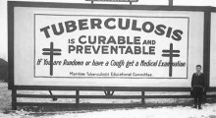
Notes:
TB is curable and preventable

Slide 5
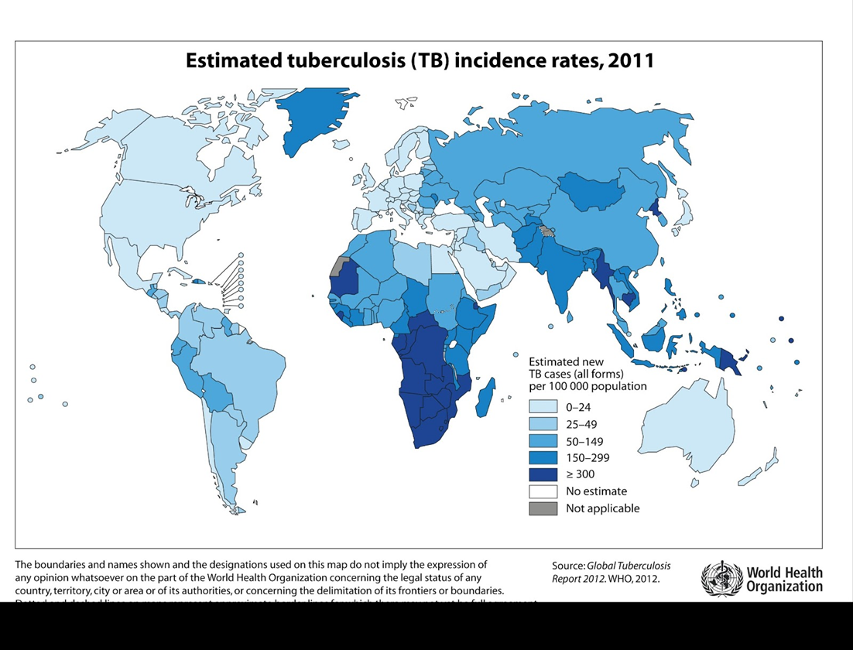
Global TB Incidence
Notes:
Greatest Incidence of TB is in the Western Pacific and South East Asia

Slide 6
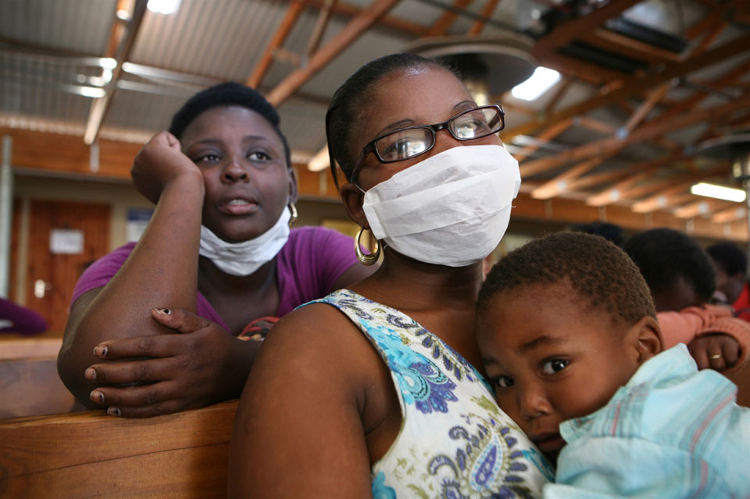
Tuberculosis Facts
Tuberculosis is more common in developing countries; about 80% of the population in many Asian and African countries test positive in tuberculin tests, while only 5–10% of the US population test positive.

Slide 7
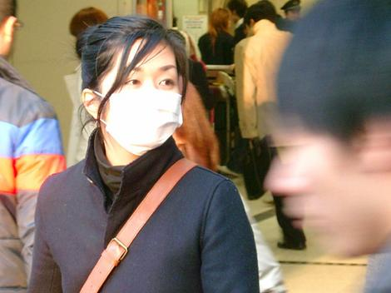
Someone in the world is newly infected with TB bacilli every second.

Slide 8
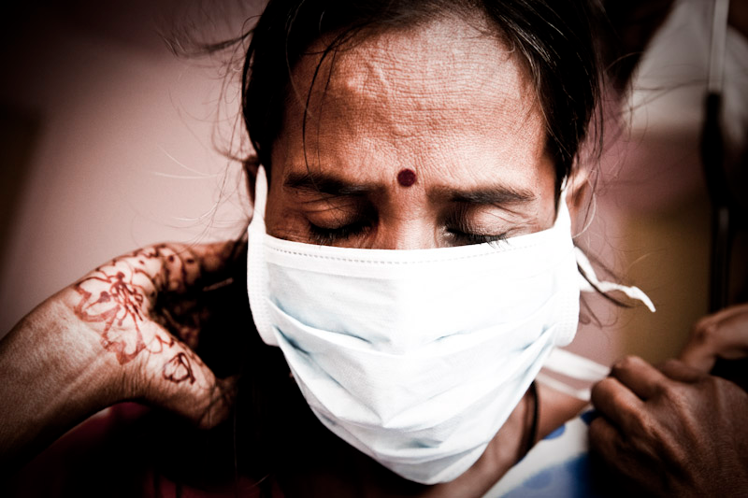
People infected with TB bacteria have a lifetime risk of falling ill with TB of 10%.
Notes:
However persons with compromised immune systems, such as people living with HIV, malnutrition or diabetes, or people who use tobacco, have a much higher risk of falling ill

Slide 9
TB
Notes:
Today’s tools in TB Control are old tools, sputum microscopy which is the gold standard in the dx of tb has been in use since 1800’s, BCG which is still currently used in the developing countries is the same vaccine used since 1920’s, the first line TB drugs we still use are the same drugs since the 1940’s

Slide 10
TB

Slide 11

TB in the United States

Slide 12
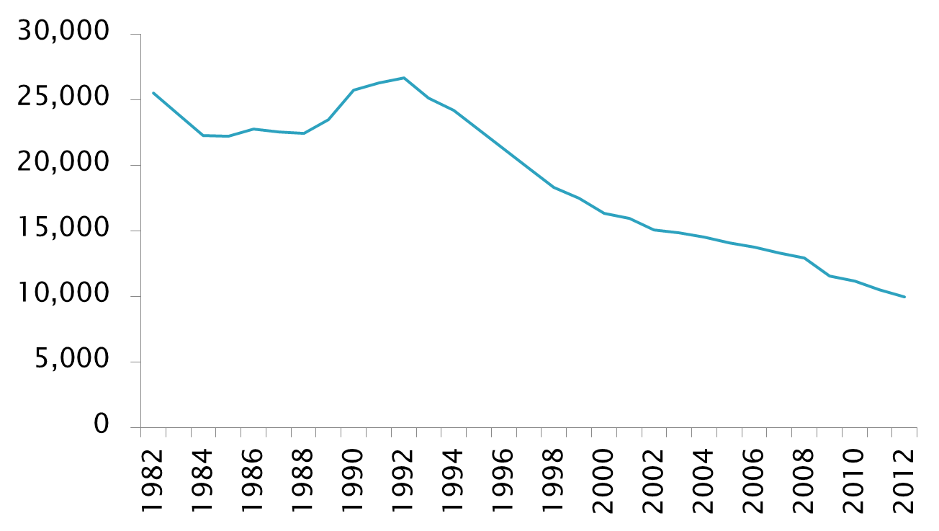
Reported TB Cases
United States, 1982–2012*
No. of Cases
Year
*Updated as of June 10, 2013.

Slide 13
TB Case Rates,* United States, 2012
D.C.
< 3.2 (2012 national average)
>3.2
*Cases per 100,000.

Slide 14
Percentage of TB Cases Among
Foreign-born Persons, United States*
2002
2012
DC
DC
>50%
25%–49%
<25%
*Updated as of June 10, 2013.

Slide 15
Countries of Birth of Foreign-born Persons Reported with TB, United States, 2012

Slide 16
TB Case Rates by Race/Ethnicity,*
United States, 2003–2012**
Cases per 100,000
*All races are non-Hispanic.
**Updated as of June 10, 2013.

Slide 17
TB Case Rates,* U.S.-Affiliated Pacific Islands, 2013
*Cases per 100,000

Slide 18
TB Cases by Residence in Correctional Facilities, Age ≥15, United States, 1993-2012*
*Updated as of June 10, 2013
Note: Resident of correctional facility at time of TB diagnosis

Slide 19
TB Cases Reported as Homeless in the
12 Months Prior to Diagnosis,
Age ≥15, United States, 1993-2012*
*Updated as of June 10, 2013
Note: Homeless within past 12 months of TB diagnosis

Slide 20
Pediatric Tuberculosis

Slide 21
Pediatric Tuberculosis
At least half a million children become ill with tuberculosis (TB) each year.
Up to 74 000 HIV-uninfected children die of TB every year*.
-WHO 2013

Slide 22
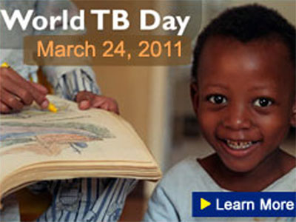
Pediatric Tuberculosis
70–80% of children with TB, have the disease in their lungs (pulmonary TB). The rest are affected by TB disease in other parts of the body (extrapulmonary TB).
WHO 2013

Slide 23
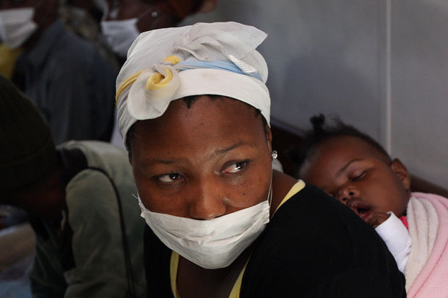
There were over ten million orphans due to parental TB deaths in 2010.

Slide 24
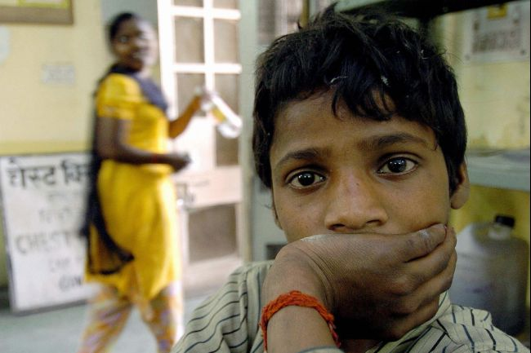
Every day, more than 200 children under the age of 15 die needlessly from TB - a disease that is preventable and curable. –

Slide 25
TB Exposure
Notes:
This study in South Africa, shows that as much 50% of pts diagnosed with TB had a hx of a close contact with an adult of PTB.
Children with TB younger than 3 years old had a known source
Only less than 20% of the children diagnosed with TB despit national recommendations

Slide 26
PediatricTuberculosis
Infants and post pubertal adolescents are at increased risk of progression of LTBI to TB disease

Slide 27
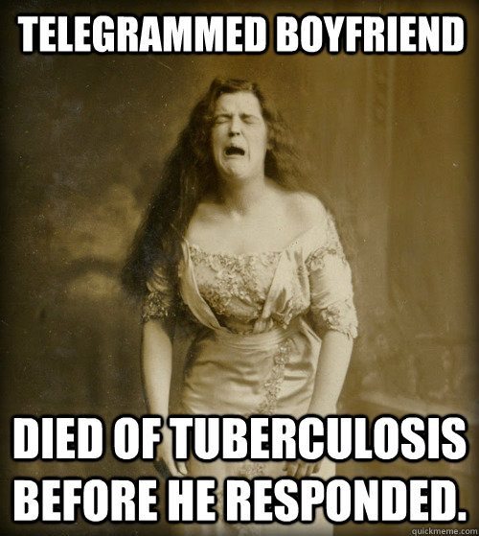
Incubation Period:
2-12 weeks
Risk of developing tuberculosis disease is highest during the 6 months after infection and remains high for 2 years

Slide 28
Risk of TB Progression Based on Age
Notes:
TB disease is more common in children less than a year old and greater than 10 years old

Slide 29
Pediatric Tuberculosis: Diagnosis
Contact with a smear-positive PTB case
Respiratory symptoms for more than 2-3 weeks
not responding to broad- spectrum antibiotics

Slide 30
PPD
(Purified Protein Derivative)
5 TU intradermal, wait 48-72 hours for T-cell response (type IV hypersensitivity) and inflammation, measure induration
Requires 2 visits (low return rate)
Cheap: ~$5 per dose
Reader variability
False Positives
  Read incorrectly; read too early (type I reaction), measured incorrectly
  BCG vaccine
  Cross-reactive with other non-mycobacterium species
False Negatives
  Given incorrectly (wrong dose, given IM)
  Read incorrectly
  Live virus vaccines (MMR studied, others presumed…ie. Influenza)
  Anything affecting T-cell response (chronic steroids, HIV, measles, mumps, mono)

Slide 31
Who to Screen? Targeted TB Screening
  Four validated screening questions from CDC
    Has a family member or contact had TB disease?
    Has a family member had a positive PPD?
    Was your child born in a high-risk county (countries other than the US, Australia, New Zealand, or Western and Northern European countries)?
    Has your child traveled (or had contact with resident populations) to a high risk country for more than 1 week?
    Targeted Tuberculin Skin Testing and Treatment of Latent Tuberculosis Infection in Children and Adolescents; Pediatrics 2004; 114; 1175

Slide 32
Risk-assessment can also include…
Does your child spend time with anyone who has been in jail or a shelter, uses illegal drugs, or has HIV?
Has your child drank raw milk or eaten unpasteurized cheese?
Does your child have a household member who was born outside of the US?
Does your child have a household member who has traveled outside of the US?
Targeted Tuberculin Skin Testing and Treatment of Latent Tuberculosis Infection in Children and Adolescents; Pediatrics 2004; 114; 1175

Slide 33
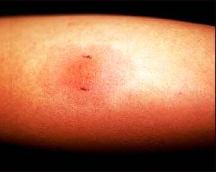
PPD Reading
The PPD is read 48 to 72 hours after placement of the test. Reading should be based on palpating the skin for induration borders. The reading should not be based on the extent of erythema on the arm. Many providers use a pen to facilitate measurement of induration. A single measurement of the induration diameter transverse to the long axis of the forearm should be recorded

Slide 34
Positive PPD
> 5mm induration:
Household or close contacts of an active case, persons with a clinical suspicion of TB, and patients with HIV infection.
> 10 mm of induration:
foreign-born persons from high prevalence countries; those from medically underserved, low-income populations including high risk ethnic minorities; intravenous drug users; the homeless; residents of facilities for long term care (nursing homes, institutions for the developmentally disabled, and correctional institutions); and persons with medical conditions associated with a higher risk of TB.
> 15 mm induration:
Low risk patient with no risk factors

Slide 35
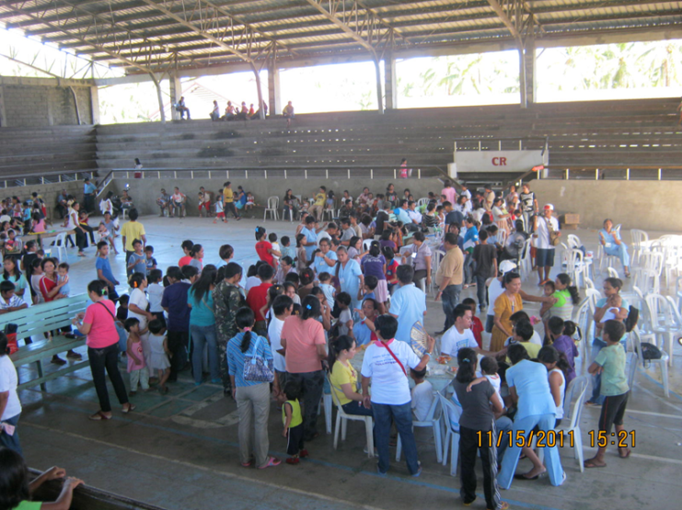
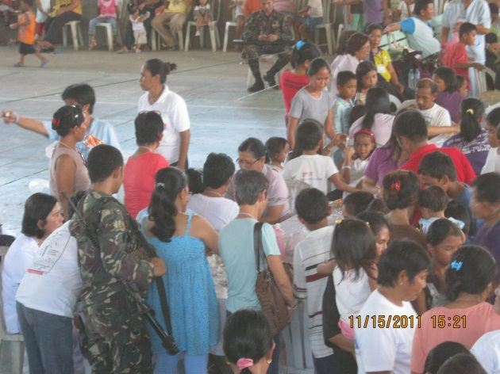
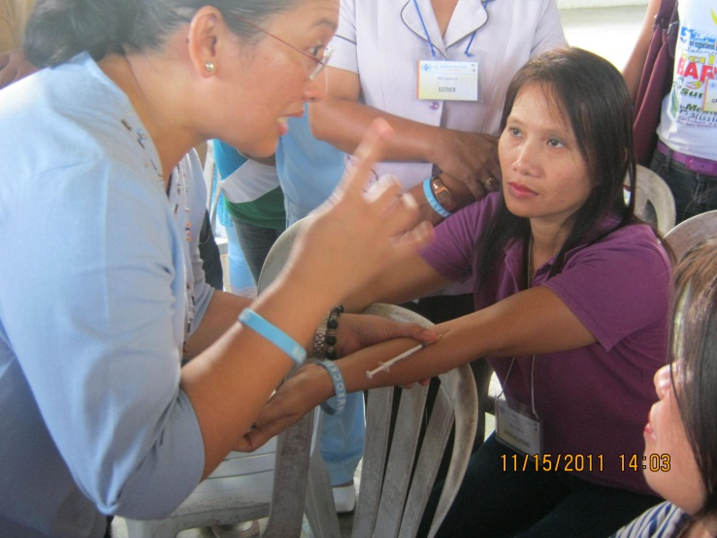
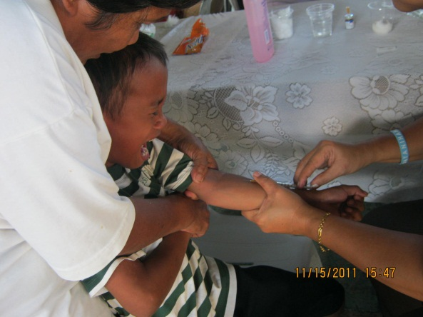
Community TB Screening

Slide 36
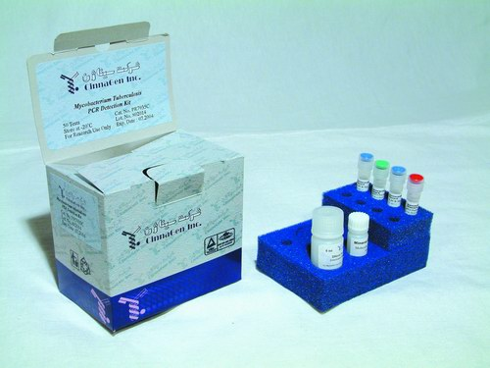
PCR

Slide 37
Quantiferon TB Gold
The Quantiferon-TB Gold In-Tube test is a specific test for M tuberculosis exposure in children, with performance characteristics similar to those for adults residing in regions with low levels of endemic disease.
Concerns about test sensitivity, especially for children <2 years of age, will require additional prospective long-term evaluation.
Latent Tuberculosis Diagnosis inChildren by Using theQuantiFERON-TB Gold In-Tube Test Jennifer Lighter, MD, Mona Rigaud, MD, MPH,Roger Eduardo, BS, Chia-Hui Peng MPH,Henry Pollack, MD PEDIATRICS Vol. 123 No. 1 January 2009, pp. 30-37

Slide 38
IGRA vs. PPD testing
Only one visit, do not need to return for reading
Sensitivity: ~75-90%, similar to PPD
Specificity: high 90’s%, slightly better than PPD
  Fewer false positives, no cross-reactivity with BCG vaccine or other non-tuberculous mycobacteria
Not validated for age < 5 years old
Cost at CNMC: $157 (vs. $5 PPD vs. $178 CBC w/ diff)
Needs to be collected in special tube and received by CNMC lab by 2PM on day of collection
Send-out to Quest, turn-around-time of 2 days
Covered fully by AmeriHealth

Slide 39
BCG

Slide 40
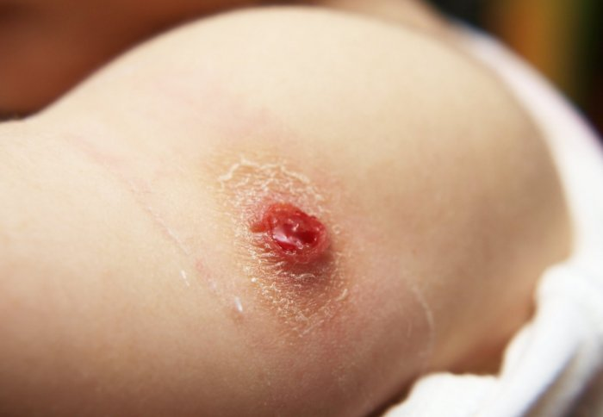
BCG
Live Attenuated Vaccine against tuberculosis , Mycobacterium bovis
Notes:
is avaccine against tuberculosis that is prepared from a strain of the attenuated (weakened) live bovine tuberculosis bacillus, intradermal injection on the deltoid area which can cause a scar, used also in vaccinating against leprosy

Slide 41
EFFICACY: BCG IS EFFECTIVE IN PREVENTING SEVERE TB IN CHIDREN
Protection
  Consistent 60-80% protection against disseminated tuberculosis (TBM, miliary TB) in HIV-negative and unexposed young children
  Variable protection: pulmonary TB, limited impact transmission
  Revaccination: no benefit
  Cost-effective
Limited efficacy data in HIV-infected infants
  High TB incidence HIV-infected infants (small subpopulation): 25 fold higher in HIV-infected infants
  HAART: reduces risk of TB in HIV-infected infants
Trunz, Fine, Dye. The Lancet 2006; 367:1173-1180,
Rodrigues, Int J Epi 2002

Slide 42
What to do with patient who had BCG vaccine?
Age > 5 years
  CDC recommends IGRA
  If positive, get CXR
  CXR w/out evidence of active TB→ treat for LTBI
Age < 5 years
  Place PPD
  Disregard BCG vaccination when reading PPD

Slide 43
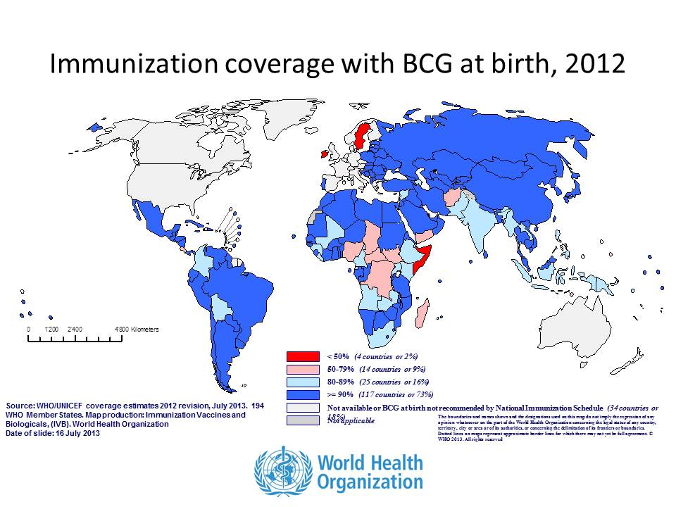
Countries where BCG is given

Slide 44
TB Diseases

Slide 45
2 year old from El Salvador presents with a month long cough. No fever, parents are concerned that he is not gaining weight
Physical exam: Weight 5%, not respiratory distress, lungs with some crackles on the bases

Slide 46
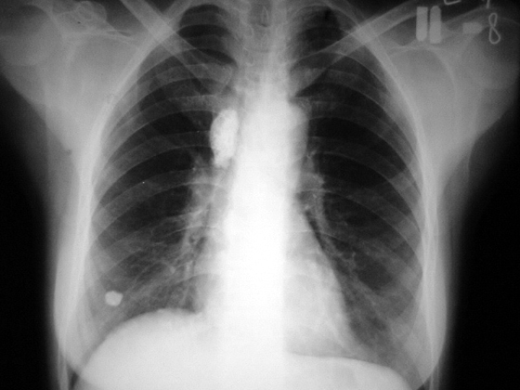

Slide 47
Primary Complex
Primary complex:
Hilar/Mediastinal lymphadenopathy
and a small opacity in the lung, 3-10 mm in
diameter (primary lesion).
20%, usually in children aged under 5 years).

Slide 48
9 month old from South Africa presenting with cough, respiratory distress and listlessness, denies fever
Parents are concerned that he has been losing weight for the past month
Physical Exam: Infant is in the 5 percentile for weight, RR:40, lethargic
Chest: intercostal retractions, diffuse crackles
Hepatosplenomegaly
PPD negative

Slide 49
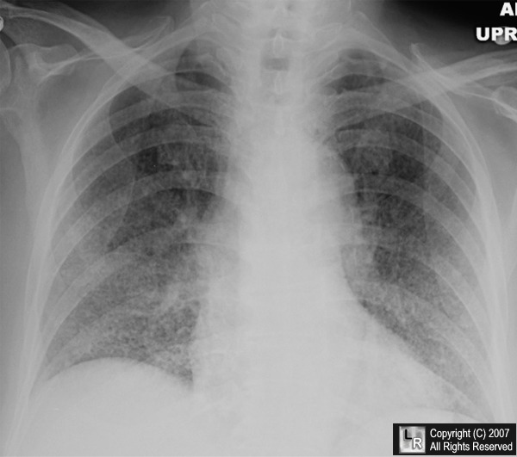
Notes:
2-4 mm nodular opacities

Slide 50
Miliary tuberculosis
Less than 5 years old
Multiorgan involvement
Early empirical treatment for possible but not yet definitive miliary TB increases the likelihood of survival and should never be withheld while test results are pending.

Slide 51
17 year old male, originally from El Salvador with a history of Tricuspid Atresia and Transposition of the Great Vessels s/p surgery, and intermittent asthma,
Presents with a 2 week history of cough, not improved with a albuterol and inhaled steroids

Slide 52
Previous history shows that 4 years ago he had a positive PPD, negative CXR which was treated with INH for 3 months. Treatment of INH stopped because of increasing liver function tests

Slide 53
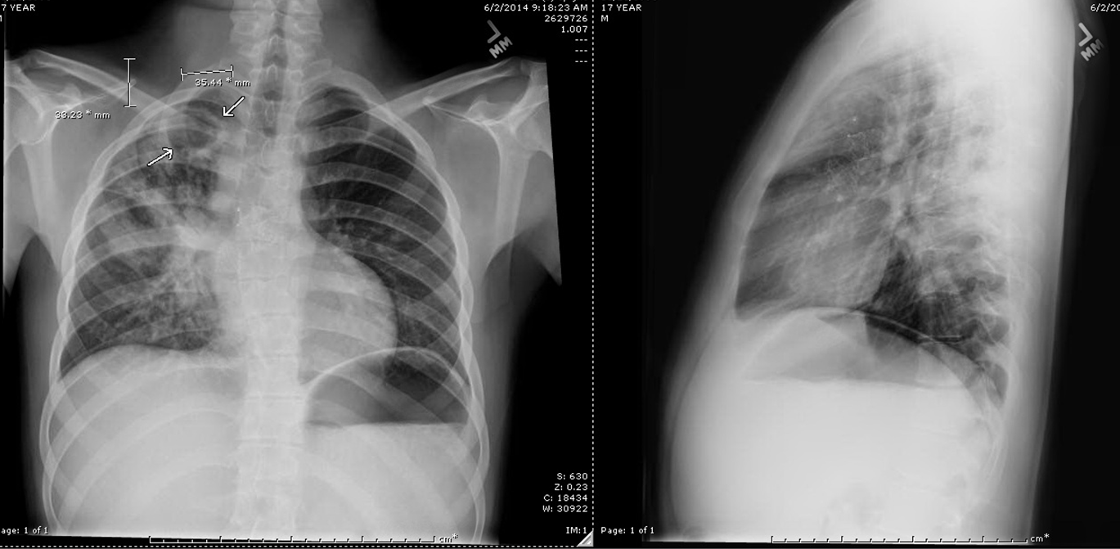
Notes:
Consolidation in the right upper and lower lob with a cavitary lesion

Slide 54
Treated with RIPE Therapy
Rifampin, Isoniazid, Pyrazinamid, and Ethambutol for 2 months
Then 4 month sof Rifampin and Isoniazin for 4 months
Under DOT by the DC DOH (daily or twice weekly)

Slide 55
3 year old from Mexico with fever and lethargy
Physical Examination:
Normal weight, Temp: 101 rest WNL
Neck rigidity
CTA

Slide 56
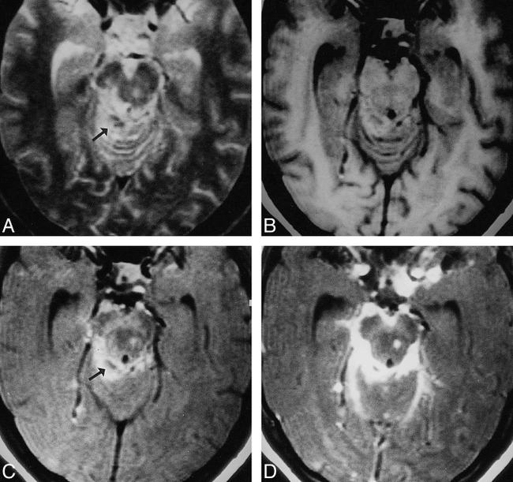
TB MENINGITIS
Fever
Listlessness
Loss of appetite
Loss of consciousness
Nausea and vomiting
Seizures
Sensitivity to light (photophobia)
Severe headache
Stiff neck

Slide 57
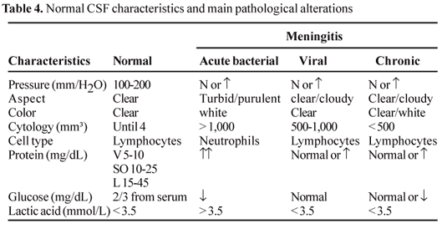
TB MENINGITIS

Slide 58
8 year old from India presents with focal seizures. Previous history of chronic headache and had an episode of vomiting yesterday

Slide 59
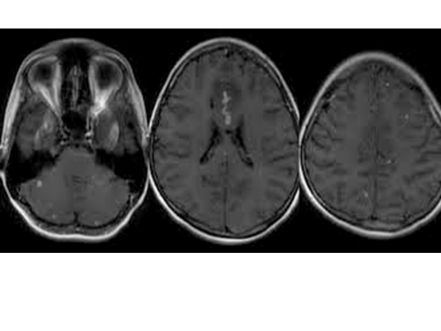
Tuberculoma
Notes:
Child presenting with focal seizures

Slide 60
17 year old from Vietnam presents with a history of chronic back pain which sometimes radiates to his lower right leg
Physical Examination: Well Developed, well nourished, afebrile
L3 and L4 with swelling and tenderness, rigidity of the paralumbar muscles

Slide 61
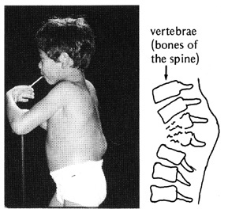
Notes:
lower thoracic and upper lumbar vertebrae are the areas of the spine most often affected.

Slide 62
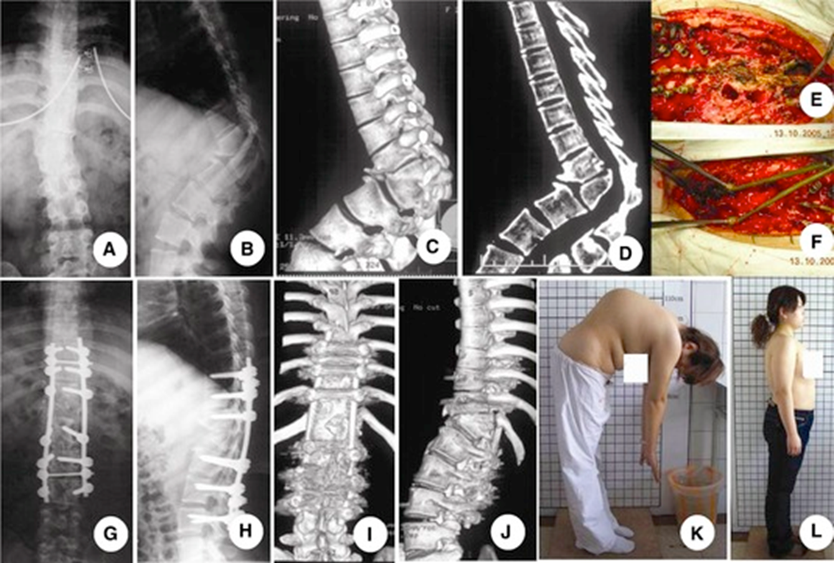
Pott’s

Slide 63
POTT’S DISEASE
Tuberculous spondylitis
lower thoracic and upper lumbar vertebrae are the areas of the spine most often affected.
hematogenous spread of tuberculosis from other sites, often pulmonary. The infection then spreads from two adjacent vertebrae into the adjoining intervertebral disc space.

Slide 64
16 year old from the Philippines with a 2 month history of swelling on the right neck. She was seen by her PCP and was given a course of antibiotics which did not help.
Physical Exam: Afebrile, Normal weight and height
4 cm mass on the right anterior cervical chain nontender, not warm, not red, hard mass

Slide 65
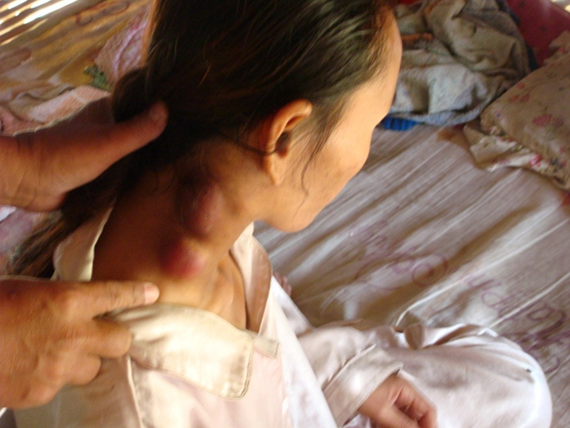

Slide 66
Scrofula
Tuberculous cervical lymphadenitis but not a local disease
"cold abscess", because there is no accompanying local color or warmth and the overlying skin acquires a violaceous (bluish-purple) color.
Diagnosis is by needle biopsy
Therapy: RIPE not excision (recurrence and fistula formation

Slide 67
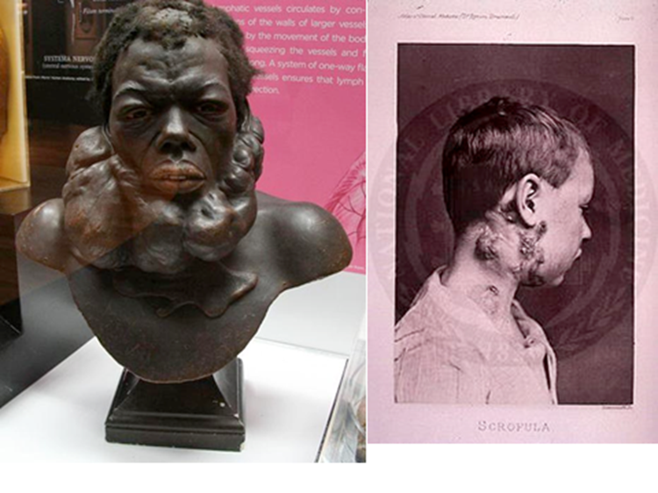
Scrofula
Notes:
Skin lesions result from direct extension of underlying TB infection of lymph nodes, bone or joints
Often associated with TB of the lungs
Firm, painless lesions that eventually ulcerate with a granular base
May heal even without treatment but this takes years and leaves unsightly scars

Slide 68
8 year old who recently migrated from Ethiopia with a 10 day history of vomiting, abdominal pain and abdominal distention after eating. Pt also reports that she had eaten paper
PE: consistent with constipation

Slide 69
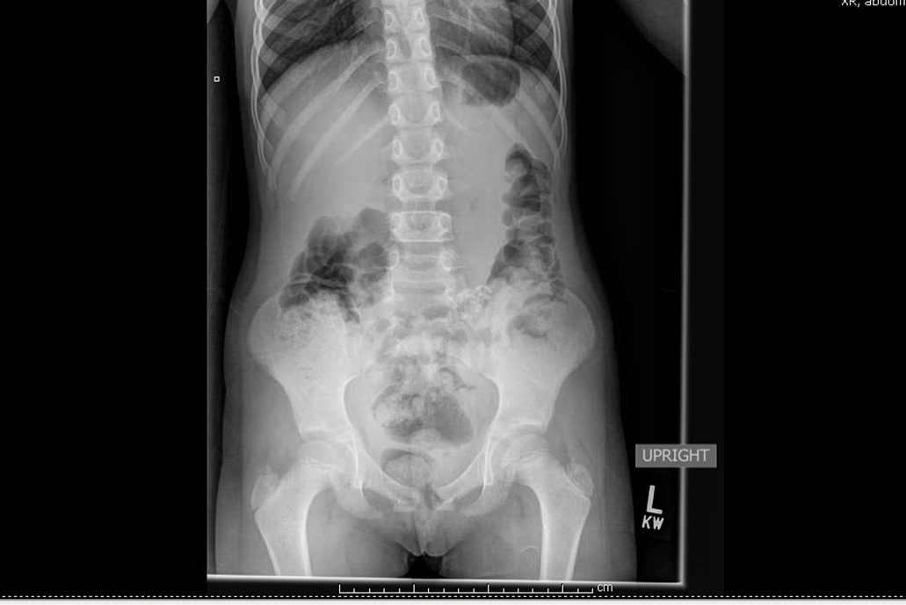
Notes:
Popcorn calcification

Slide 70
She was treated with Miralax for a month
Pt was seen a week after
Repeat abdominal xray showed clearance of stool with the persistence of the calcified lesion
CT Scan of the abdomen: 3 mesenteric calcified lesions
PPD positive
Treated with RIPE under DOT

Slide 71
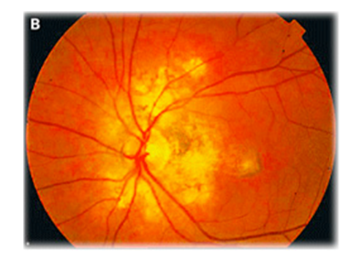
25 year old presenting with diminishing vision – tuberculous choroiditis

Slide 72
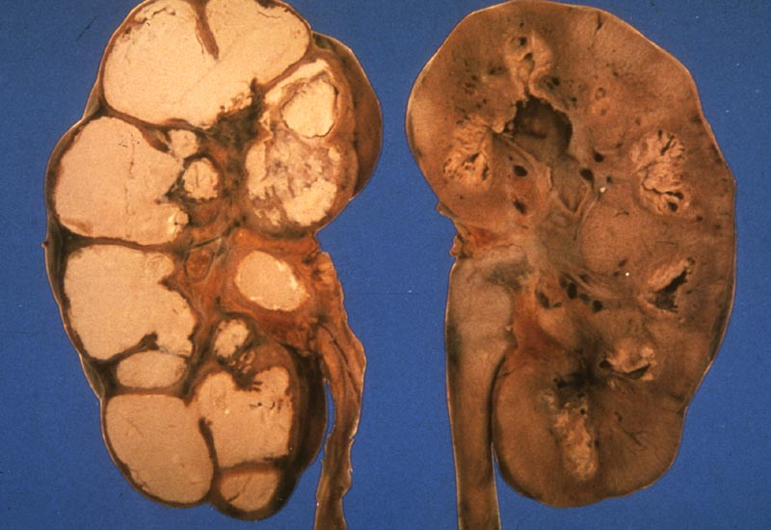
TB OF THE KIDNEYS: presenting with sterile pyuria or hematuria

Slide 73
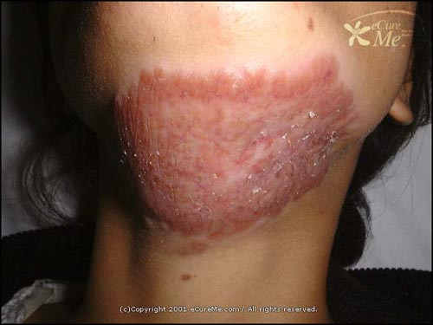
TB OF THE SKIN

Slide 74
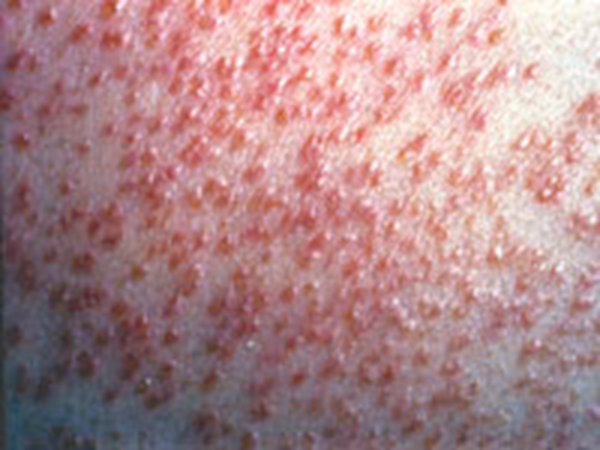
Miliary TB of the Skin
Notes:
Miliary TB (disseminated TB) is characterized by a wide dissemination of Mycobacterium tuberculosisinto the body and shows a distinctive pattern on chest x-ray of multiple, tiny lesions (millet-sized) distributed throughout the lung fields. Miliary TB may hematogenously infect any number of organs, including the lungs, liver, and spleen, in patients with advanced TB disease. There is a systemic failure of the cell-mediated immune system that allows and facilitates the spread of infection resulting in rapid deterioration and death.³ Certain events, infections, and medications that suppress the body’s cell-mediated immune system can precipitate this infection. Although miliary TB has historically been extremely rare and well known for its occurrence in children, it is an increasingly serious infection in immunosuppressed patients, such as those infected with HIV, on long-term oral corticosteroid therapy, or on other immunosuppressive therapies for organ transplant or inflammatory or autoimmune conditions. Cutaneous skin lesions consist of small, erythematous to violaceous papules or pustules with hemorrhagic necrosis and umbilication affecting a substantial portion of the body (Figure 7). If healing occurs, lesions leave atrophic, depressed scars surrounded by a brownish, hyperpigmented halo. TST is typically negative because of anergy. Skin biopsy with histological examination reveals numerous microabscesses containing neutrophils and numerous mycobacterial organisms.³ Confirmation of the diagnosis requires cultures of sputum, blood, and skin lesions, as well as diagnostic tests, such as bronchoscopy, chest x-ray, or computed tomography of the chest. Prognosis is poor, as affected individuals tend to be very ill at initial presentation (i.e., they have HIV, cancer, and/or are immunosuppressed).

Slide 75
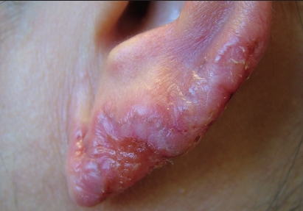
TB of the Skin: Lupus Vulgaris
Notes:
painful cutaneous tuberculosis skin lesions with nodular appearance, most often on the face around the nose, eyelids, lips, cheeks, ears^{[2]} and neck. It is the most common M. tuberculosis skin infection.^{[3]} The lesions may ultimately develop into disfiguring skin ulcers if left untreated.

Slide 76
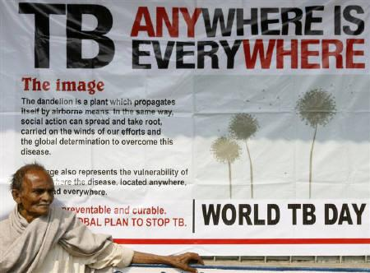
Will always be in your differential diagnosis
TUBERCULOSIS

Slide 77


Slide 78
TREATMENT OF TB

Slide 79
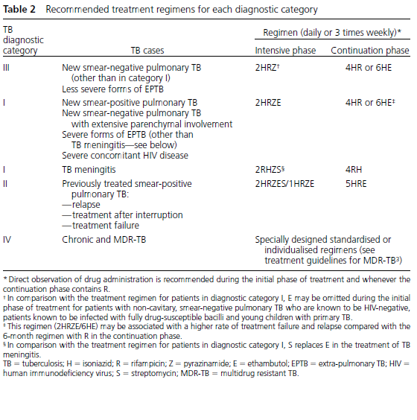
TREATMENT

Slide 80
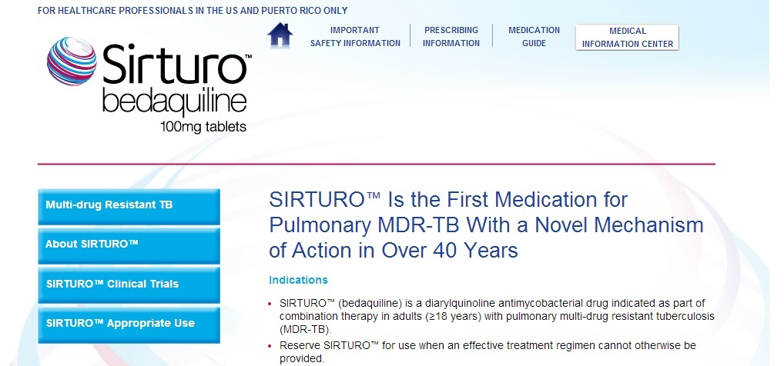
New TB Drug

Slide 81
Latent TBI

Slide 82
Latent TB
Antigen-specific T cell response without clinical symptoms

Slide 83
Latent TB Infection
INH given to adults who have LTBI provides protection 54-88% against the development of the disease for at least 20 years
In children efficacy approaches 100%
9 month treatment with INH is the standard regimen
Preferred treatment in HIV infected
Children between 2-11

Slide 84
LTBI
Before therapy, rule out TB disease
Get a list of other meds:
INH increase levels of Dilantin, Disulfiram
RIF and RPT decreases blood levels of oral contraceptives, warfarin, methadone, and sulfonureas
RIF and RPT are contraindicated in HIV patients on protease inhibitors and nonnucleoside transcriptase inhibitors

Slide 87

Latent TB
“Today, we have tuberculosis drugs that we have to take for 9 months. Why can’t we find one that works in 3 days?” -Bill Gates World Health Assembly, 2005

Slide 88
Direct Observation Therapy Strategy

Slide 89
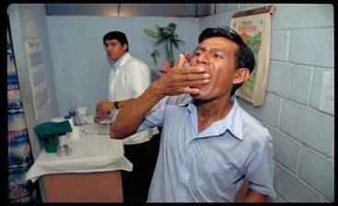
Direct Observed Treatment Strategy
Directly observed treatment means that an observer
watches the patient swallowing their tablets,
in a way that is sensitive and
supportive to the patient's needs.

Slide 90

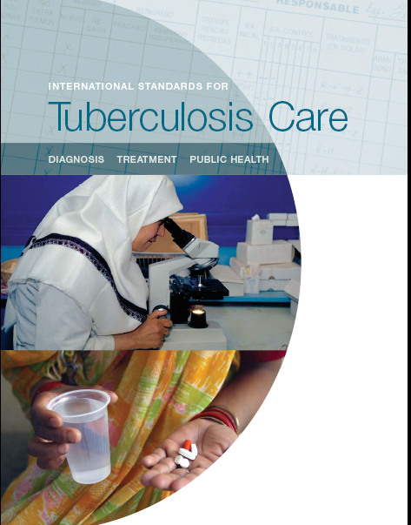
DOTS is the overarching framework…

Slide 91
Dynamics of pulmonary TB in
Peru 1980-2000
220
DOTS 1990
200
case finding
180
Pulmonary TB cases/100,000
160
140
120
PTB falling at 6%/yr
100
1980
1985
1990
1995
2000

Slide 92
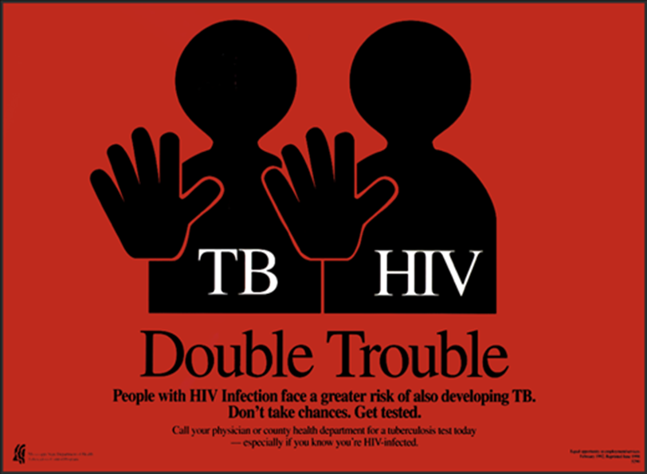
TB and HIV

Slide 93
TB and HIV

Slide 94
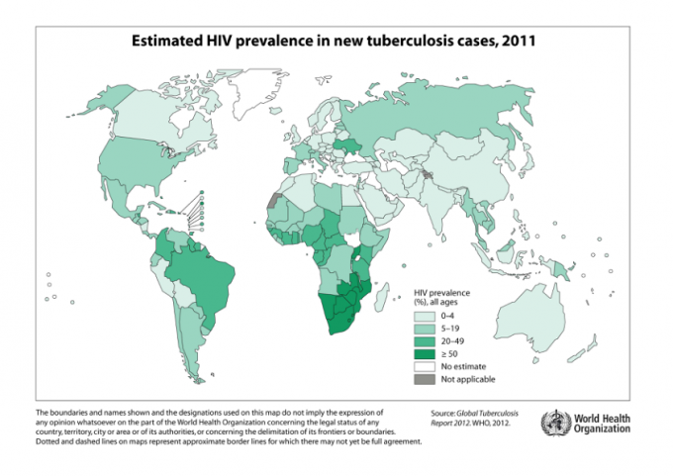

Slide 95
TB in Infants
Notes:
Infants with HIV can present with Disseminated TB, In this particular case, this 6 month old Pakistani infantwith AIDs presented with involvement of the liver, spleen, bone marrow. The infant presented with recurrent infections, bilateral axillary lymphadenitis, hepatomegaly, splenomegaly and FTT

Slide 96
BCG in HIV infected Infants
Notes:
BCG while effective and cost effective in HIV negative infants. In HIV infants, data is lacking of benefit and does not have a protective effect

Slide 97
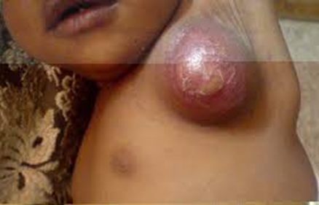
BCG IRIS
Notes:
Immune reconstitution inflammatory syndrome due BCG in an HIV positive child, ipsilateral suppurative and nonsuppurative regional adenitis, low mortality but considerable morbidity. Will self resolve in 4-6 months, may benefit from needle aspiration with INH instillation, unclear if tx with anti TB drugs help

Slide 101
MDR and XDR TB

Slide 102
Multi Drug Resistant TB
Multidrug-resistant TB (MDR-TB) is defined as the disease caused by TB bacilli resistant to at least isoniazid and rifampicin, the two most powerful anti-TB drugs.
While drug-resistant TB is generally treatable, it requires extensive chemotherapy (up to two years of treatment) with second-line anti-TB drugs which are more costly than first-line drugs, and which produce adverse drug reactions that are more severe, though manageable.

Slide 103
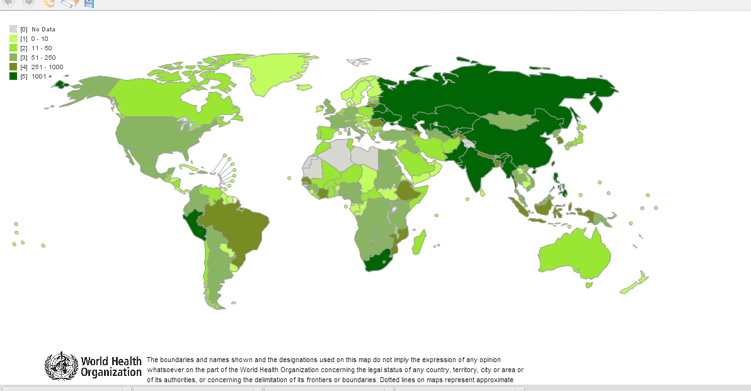
MDR TB

Slide 104
MDR TB
The highly accurate and reliable TruArray MDR-TB test is the first portable, bench-top test to identify resistance to rifampin and isoniazid,TruArray MDR-TB delivers results in a few hours.
Bedaquiline fumarate (Sirturo™) is approved by the U.S. Food and Drug Administration (FDA) for use as part of a combination therapy in adults with pulmonary multidrug-resistant tuberculosis (MDR TB) when an effective treatment regimen cannot otherwise be provided.

Slide 105
XDR tuberculosis
resistant to isoniazid and rifampin
(which defines MDR tuberculosis)
in addition to any fluoroquinolone
and at least one of the three following
injectable drugs: capreomycin, kanamycin, and amikacin.

Slide 106
Number of patients with laboratory-confirmed XDR-TB started on treatment in 2013

Slide 107
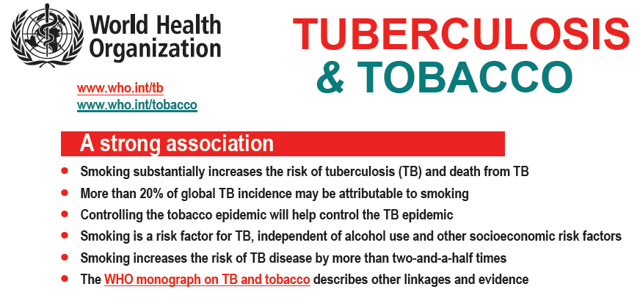

Slide 109
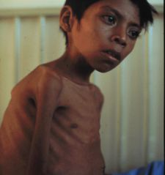
Malnutrition and TB
Malnutrition profoundly affects cell-mediated immunity (CMI), and CMI is the principle host defense against TB.
Synergistic interactions of malnutrition and tuberculosis
The results point out the importance of better nutritional status of the child in preventing the severe forms of the disease.

Slide 110
TB AND VITAMIN D
TB progression was significantly associated with relatively lower plasma vitamin D levels
use of vitamin D as a supplement for persons undergoing treatment for TB and those with latent TB infection
vitamin D plays a key role in the production of a molecule called cathelicidin, which kills the tuberculosis bacteria.

Slide 111
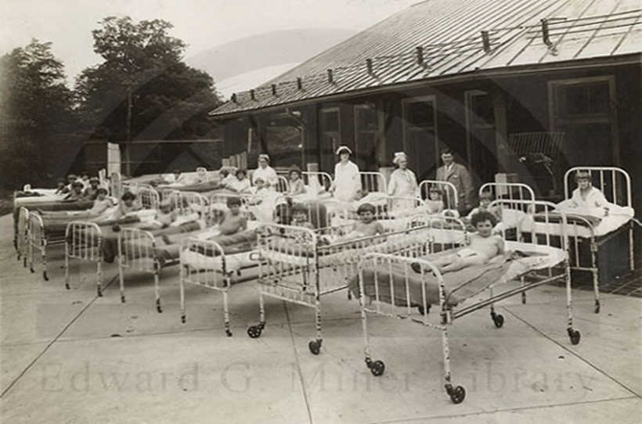
TB Sanitorium

Slide 112
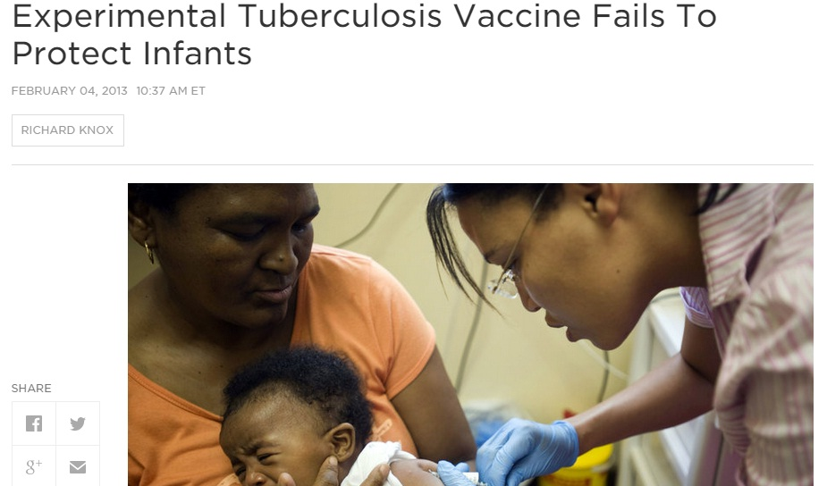
Experimental TB vaccine in Infants

Slide 113
TB in the Philippines

Slide 114
Current Status: Philippines
9th among the 22 high burdened countries (HBCs) worldwide
                – Global TB Control Report 2009
4th in Case Notification Rate (TB all forms) amongst the WPRO countries
    – TB Control in the Western Pacific Region, 2009 Report
8th among 27 priority countries worldwide with highest number of MDR-TB cases
TB is 6th in mortality and morbidity
                – FHSIS Report 2007

Slide 115
Community TB Programs
Partnering with local physicians or local physician groups
Education of Rural Health Units: physician,nurses and rural health workers
Partnering with the Adult TB program
Community Wide anti TB education:
“TB rallies”
Forming partnerships with specialists in the cities

Slide 116
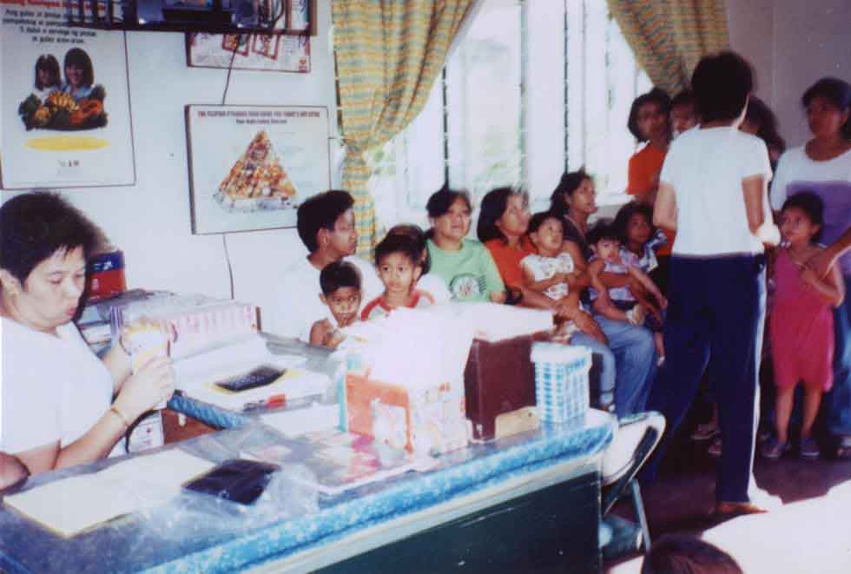
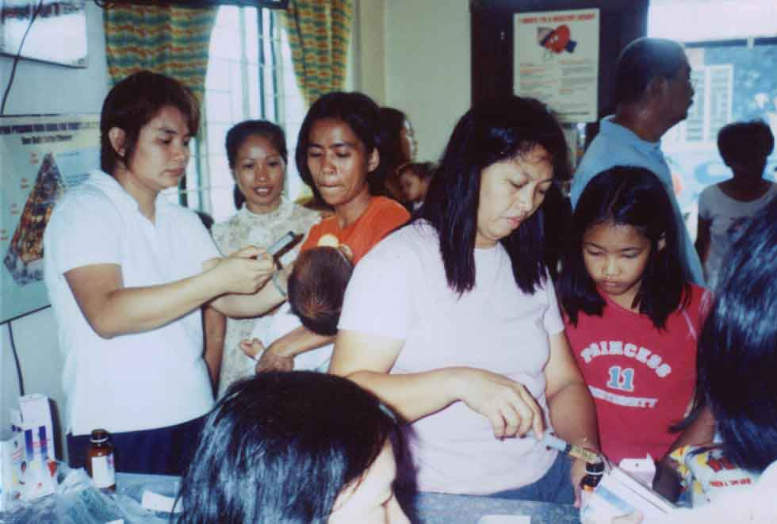
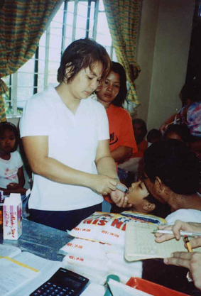

Slide 117



Slide 118


Slide 119
Summary
Tuberculosis continues to be a public health concern globally, the problem is worse in developing countries where access to health care is a problem
We are still using very old tools for diagnosis and treatment
TB is a preventable disease and curable: IPT works
Tuberculosis should always be part of your differential diagnosis
To be able to make an impact, we need a public health response, case identification and DOTS

Slide 120

Think outside the box

Slide 121


Slide 122

Thank you

