Slide 1
Emergency Triage Assessment & Treatment
April 5, 2013
Global Pediatric Emergency Medicine Group
Eiman Abdulrahman, MD | Kristen Breslin, MD
Rasha Sawaya, MD

Slide 2
Objectives
Describe the variations in triage seen in the developing world
Organize children into priority categories in low-resource and tropical settings
Manage emergency signs according to ETAT guidelines
Discuss current evidence on the impact of triage, patient flow, and emergency treatment on early and total hospital mortality rates

Slide 3
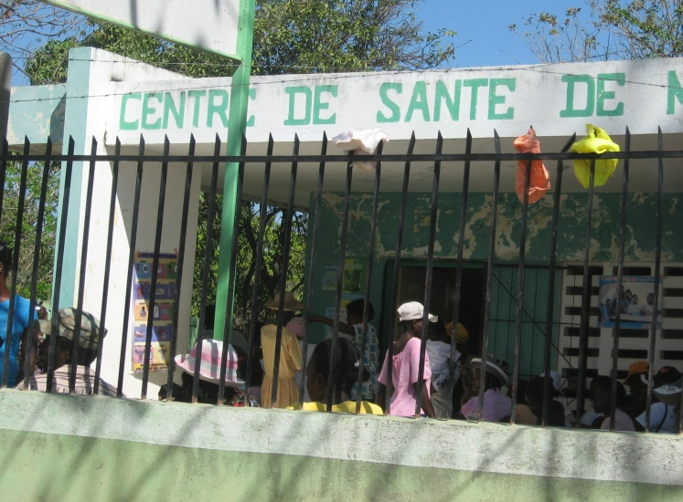
Your international elective
Hospital rounds from 7am – 8am
Outpatient clinic from 8am until finished (2-3p)
Patients arrive starting at 6am and are given a number
When the numbers run out, patients are turned away
Families may present to the ED instead, but are turned away if staff feel there is no true emergency
Notes:
Tabletop exercise

Slide 4
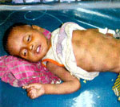
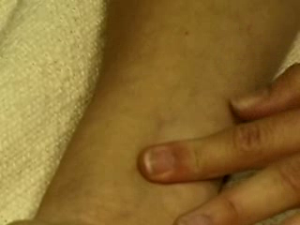
Tuesday, 11am, 12th patient
18mo girl with fever & diarrhea x 2 days
Not really drinking much since last night
  T 40, P 190, R 50
  Good bilateral BS, no retractions
  Capillary refill 4 seconds, cool extremities
  Drowsy, awakens to voice but restless
Notes:
http://www.childhealthfoundation.org/enews/2011-1/index.html

Slide 5
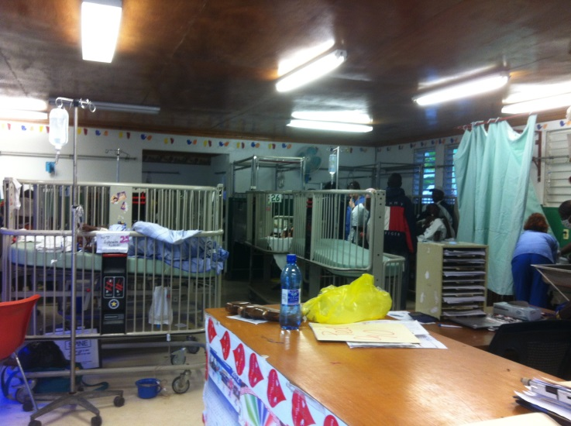
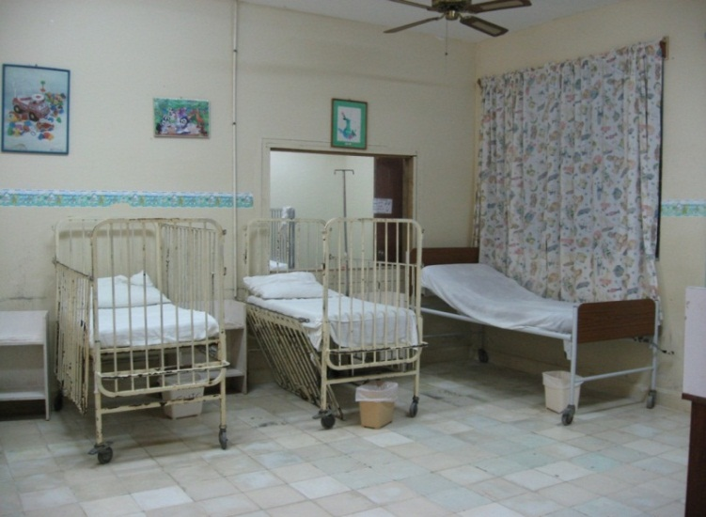
Follow Up
You walk the patient down to the inpatient ward for labs, IV, and admission
On-call providers promise fluids and antibiotics
Child has a cardiac arrest and dies later that afternoon

Slide 6
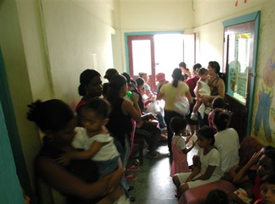
Wednesday
You arrive at 8am and start seeing patients
You ask the second year med student volunteer to check on the next 10 patients waiting to be seen and report back
He brings you a list of chief complaints and asks what you want him to check for each patient

Slide 7
Waiting Room
3 yo with diarrhea
1 yo with febrile seizure
1 mo with noisy breathing
20 mo with fever
9 mo with cough
3 yo hurt by a bicycle
16 mo with rash
14 mo with sleepiness
4 yo with trouble breathing
2 yo with vomiting
Notes:
What information would you want to quickly check to prioritize these children? What signs would make you want to see a child immediately?

Slide 8
Waiting Room
3 yo with diarrhea
  Active, P 90, good cap refill
1 yo with febrile seizure
  Not seizing now, awake, no breathing problems
1 mo with noisy breathing
  R 40, P 120, feeding well
20 mo with fever
  P 140, no distress, pale
9 mo with cough
  R 45, no distress
3 yo hurt by a bicycle
  Alert, P 110, R 30, no bleeding
16 mo with rash
  Pruritic, red welts, blanching
2 yo with sleepiness
  Drank allergy medicine
  Sleepy, P 140, CR 2s
4 yo with trouble breathing
  R 45, mild subcostal rtxns
2 yo with vomiting
  Irritable, P 160, CR 2s
Notes:
Are you worried about any of these children?

Slide 9
Under-Fives Clinic, Malawi
Initial contact with nurse who weighs fully clothed child
Retrospective review of 50 severely ill children who were admitted (45), died before admission (2), or treated in ED (3)
  13 of 50 children identified by nurse
  5 identified by caregiver who alerted staff
  32 waited in line
Notes:
Kristen
Some of the major contributions to the development of the WHO triage and treatment guidelines came from a group in Malawi. They did a review of severely ill children presenting to their outpatient under-fives clinic.

Slide 10







Nolan, 2001
Observational study of 21 district & teaching hospitals in Bangladesh, Dominican, Ethiopia, Indonesia, Philippines, Tanzania, and Uganda
7 hospitals had good or excellent triage
  One had a formal algorithm
14 had poor triage, including 4 with no triage
No association between type of staff and quality of triage
Nolan T, et al. Lancet 2001;357:106‐110.
Notes:
Kristen
How common is this problem? In 2001, as IMCI was being rolled out, a group funded by the WHO developed a standardized assessment to look at the quality of triage in hospitals in the developing world.

Slide 11
Nolan, 2001
Out of 131 children
  8% had inappropriate/delayed triage
  41% had inadequate initial assessment
  61% had inappropriate use/nonuse of antibiotics, fluids, feeding or oxygen
  18% had delays in appropriate treatment
Management of dehydration, pneumonia, malnutrition, hypoglycemia, sepsis
  73% of 43 doctors and 91% of 23 nurses inadequate in at least one area
Notes:
Kristen

Slide 12
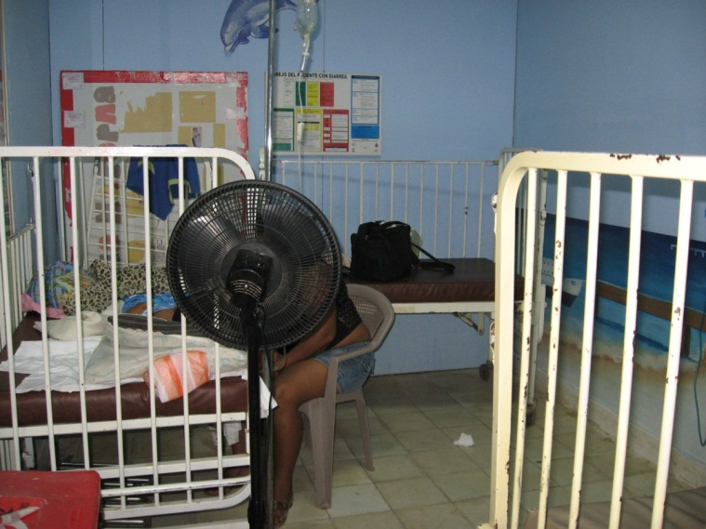
Problems
Staff not trained in triage or not assigned to triage
Facilities not organized
No standard assessment or treatment
Emergency drugs and supplies not available
Delays
Notes:
Kristen

Slide 13
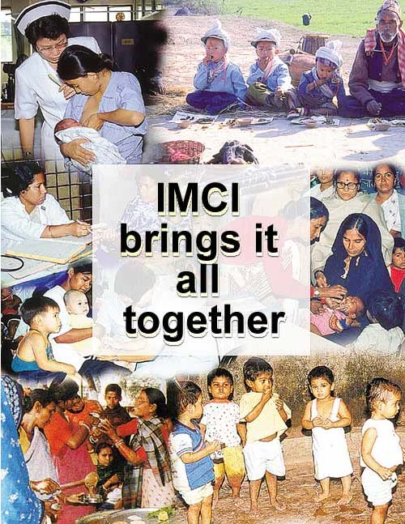
Development of ETAT
Emergency Triage Assessment & Treatment
Developed by WHO as part of IMCI
APLS adapted for low-resource settings
  No CPR or intubation
Addresses preventable mortality
  Diarrhea/dehydration, malaria,
  malnutrition, bacterial pneumonia
  Special attention to infants < 2 mo
Simplified guidelines
Gove S. et. al. Arch Dis Child 1999;81:473‐7.
Notes:
Kristen
Idea is to adapt PALS for low resource settings – not to focus on resuscitation but to focus on preventable mortality, children who need to be identified early in order to start early treatment
Specifically designed to address causes of preventable mortality in the developing world and to use simplified guidelines

Slide 14
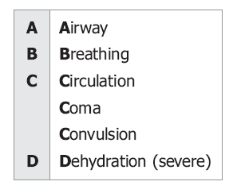
Emergency Signs
Airway & Breathing
  Obstructed breathing, central cyanosis, severe respiratory distress
Circulation
  Cold hands with prolonged cap refill and weak/fast pulse
Consciousness/Disability (Coma/convulsions)
Diarrhea with severe dehydration
  Two of: lethargy, sunken eyes, skin pinch
Notes:
ETAT has 2 parts, triage and treatment. The first priority in triage is to recognize children with emergency signs. In ETAT, these are the signs that are considered absolute emergencies – stop everything else and treat now.

Slide 15
Emergency Treatments
Airway & breathing
  Relieve obstruction, position airway, give oxygen
Circulation
  IV or IO fluids
  Oxygen, hypothermia prevention
  IV or NG glucose if malnourished
Disability
  Positioning, PR diazepam and IV glucose
Diarrhea
  Plan C
  Recognition of malnutrition
Notes:
These are the ETAT treatments. The focus is on treatments that need to be started immediately, not on definitive care. Why separate out these treatments? First, in an emergency, you want everyone to be clear that these are the first steps, so there is no delay. Also, the goal in ETAT is that these treatments can be started by any clinician – not just the doctor, but the nurse or the clinical officer. For many places, initiating treatment without a doctor’s order can be a new concept. Finally, this also serves as a starting point for the minimum emergency supplies that an outpatient area should have on hand.

Slide 16
ETAT Training
Manual based on ETAT Guidelines in Pocketbook of Hospital Care for Children
  Spanish: Clasificación, Evaluación y Tratamiento de Emergencias Pediátricas (CETEP)
7 modules
  Triage, Airway & Breathing, Circulation, Coma & Convulsions, Dehydration
  Also case scenarios & implementation module
3.5 day training course
Drills, practical skills sessions, clinical practice
Notes:
The WHO provides training materials online for ETAT. The official course is designed to take 3.5 days, with 7 modules and clinical scenarios. We’re going to go over the highlights in about an hour and a half, but you also have the link to the WHO materials in your reading. Having the ETAT charts available will be helpful to follow along.

Slide 17
Triage
The “ABCD” Concept
Notes:
Eiman

Slide 18
Triage
Sorting of patients into priority groups according to their need and the resources available
Quickly identify very sick children and start treatment
Notes:
Eiman

Slide 19
Triage
When?
  On arrival, before registration
Who?
  Everyone should know emergency signs
  Clinical staff should know assessment
  Ideally all clinical staff can initiate treatment
How long?
  15-20 seconds for emergency signs
  Less than 1 minute for non-urgent child
Notes:
Eiman

Slide 20
Categories
Emergency Cases
  Start to give appropriate treatment
  Call a senior health worker & other help
  Get blood for emergency labwork
Priority Cases
  Need to be given priority in line
  Need rapid assessment and treatment without delay
Non-urgent Cases
  Can wait their turn
Notes:
Eiman

Slide 21
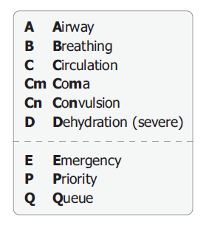
Emergency Signs ABCD
Is the child breathing?
Is the airway obstructed?
Is the child blue?
Is there severe respiratory distress?
Does the child have warm hands?
  If no, is cap refill > 3 seconds?
  And is the pulse weak & fast?
Is there coma (AVPU) or convulsions?
Is there diarrhea?
  If yes, are there two of these signs: lethargy, sunken eyes, or tenting?
Notes:
Eiman

Slide 22
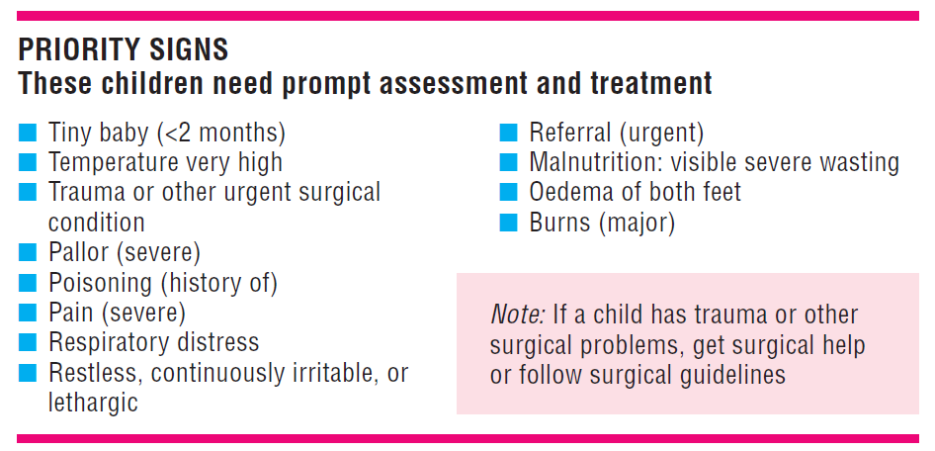
Priority Signs
Notes:
Eiman

Slide 23
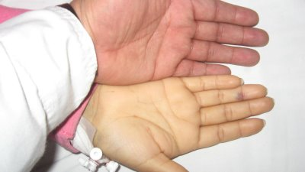
Palmar Pallor
Screening for severe anemia
May require urgent transfusion
Important in malaria-endemic areas
Compare your palm with child’s palm
Notes:
Eiman

Slide 24
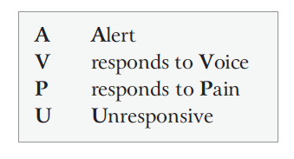
Restless, irritable, or lethargic
ETAT uses AVPU scale
Defines lethargy as responsive to voice, but drowsy and uninterested (V in AVPU) - priority
Defines coma as responsive to pain only or unresponsive - emergent
Continuously irritable or restless is inconsolable crying
Notes:
Eiman

Slide 25
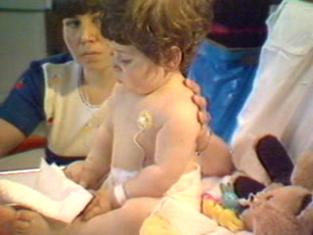

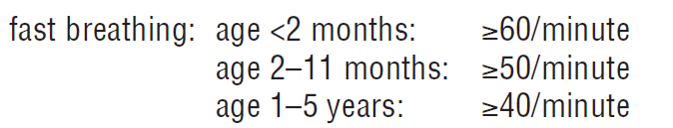
Respiratory Distress
Severe distress is emergent
  Difficult to talk, eat or breastfeed?
  Breathing fast and getting tired?
  Severe chest indrawing or auxiliary respiratory muscles?
  Abnormal sounds like stridor or grunting
Any respiratory distress is priority
  Chest indrawing that is not severe
When in doubt, triage as emergent
Notes:
Eiman

Slide 26
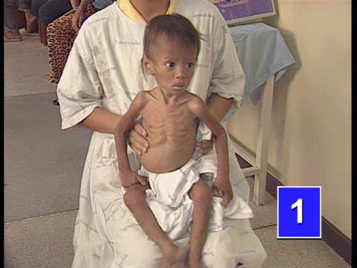
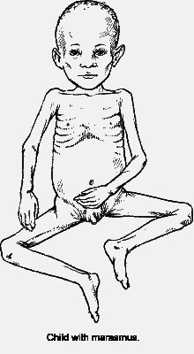
Severe Malnutrition - Wasting
Marasmus or severe wasting
  Look at arms, legs, chest
  “Skin & bones”
  No fat, muscle wasting, visible ribs
Notes:
Eiman
Video – Sue Torrey ETAT teaching (E. Molyneaux, Malawi)

Slide 27
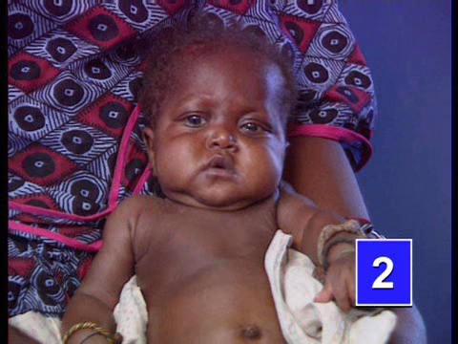
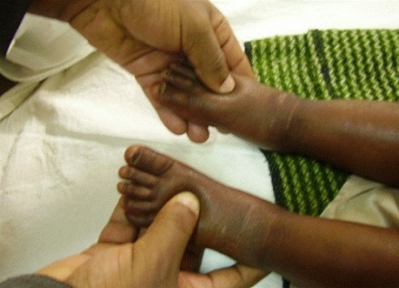
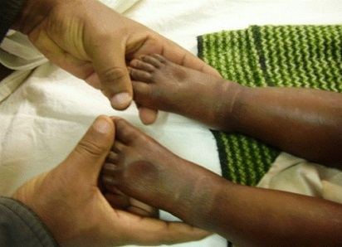
Severe Malnutrition - Edema
Kwashiorkor or edema of both feet
  Press top of the foot gently with your thumb
Notes:
Eiman
Video – Sue Torrey ETAT teaching (E. Molyneaux, Malawi)

Slide 28
Emergency Treatment
Treatment begins as soon as any emergency sign is identified
  Call for a senior health worker
  Draw blood for glucose, malaria smear, Hb
  Ask about head or neck trauma
  Note severe malnourishment
Teamwork
  Team leader
  Simultaneous treatments
  Time is critical
Notes:
Eiman

Slide 29
Emergent & Priority
Priority Treatment
  Local guidelines may provide for pain management, temperature measurement, or antipyretics
Reassessment
  Reassessment should use the complete ABCD process
Notes:
Eiman

Slide 30
Triage Drill
Mom runs in with baby
No obstruction, cyanosis, or severe distress
Warm hands
Alert child
No diarrhea
Child is very hot
Assess Airway & Breathing
Assess Circulation
Assess Consciousness
Ask about diarrhea
Assess priority signs
Triage as priority

Slide 31
Triage Drill
Mom runs in with baby
No obstruction, cyanosis, or severe distress
Cold hands
Cap refill fast
Convulsing
Assess Airway & Breathing
Assess Circulation
Assess cap refill
Assess consciousness
Go to Emergency

Slide 32
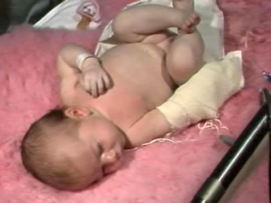
Triage Drill
Notes:
Video from WHO Pocketbook Course

Slide 33
Triage Drill
Mom runs in with baby
Rapid breathing and facial cyanosis
Assess Airway & Breathing
Triage as emergency

Slide 34
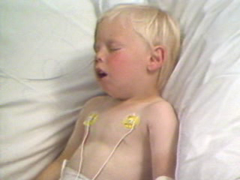
Triage Drill
Notes:
Video from WHO Pocketbook Course - epiglottitis

Slide 35
Triage Drill
Mom runs in with baby
No obstruction, cyanosis, or severe distress
Warm hands
Responsive only to pain
Assess Airway & Breathing
Assess Circulation
Assess Consciousness
Triage as Emergency

Slide 36
Triage Drill
Mom runs in with baby
No obstruction, cyanosis, or severe distress
Warm hands
Alert child
Diarrhea
Skin pinch 4 secs & sunken eyes
Assess Airway & Breathing
Assess Circulation
Assess Consciousness
Ask about diarrhea
Assess dehydration
Triage as emergency

Slide 37
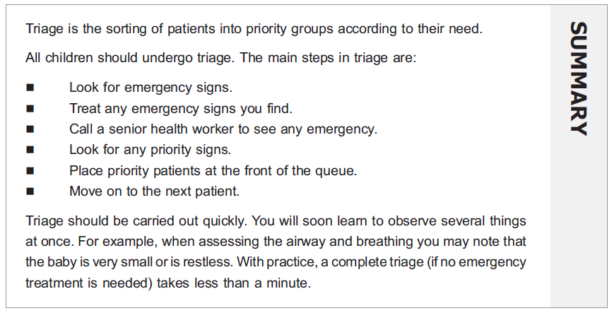

Triage Summary
Notes:
Eiman – Summarize then break

Slide 38
Emergency Treatment
Airway/Breathing, Circulation, Coma/Convulsions, Diarrhea with dehydration
Notes:
Return from break - Jennifer

Slide 39
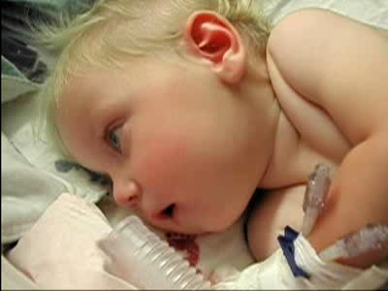
Notes:
Jennifer
How would you use ETAT to assess this child and what treatments can you offer?
Video from Status Epilepticus module

Slide 40
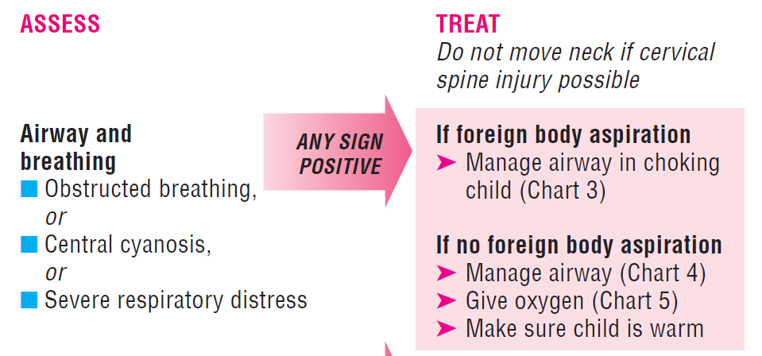
Airway & Breathing
Or, Not Breathing
Notes:
Review charts 3-6 in handout: Clear the AW (backblows, chest thrusts), head tilt/chin lift & jaw thrust, C spine immobilization, Bag-valve-mask, Oropharyngeal AW, giving oxygen

Slide 41
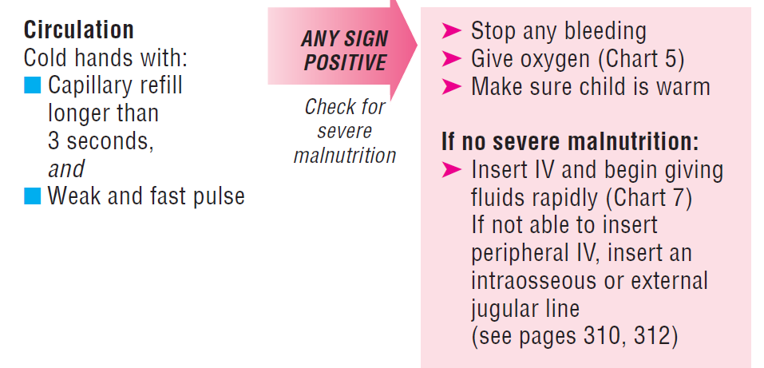
Shock without Severe Malnutrition
Notes:
Review chart 7

Slide 42
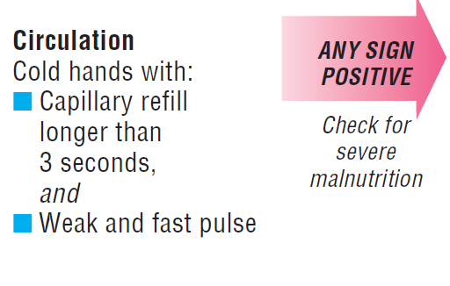
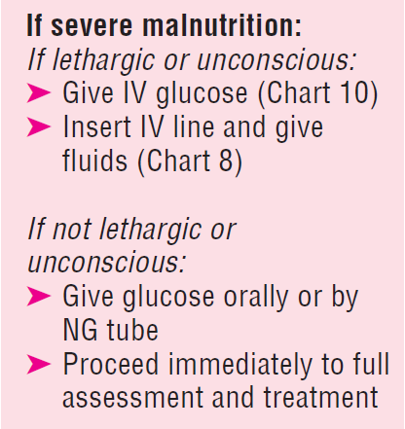
Shock with Severe Malnutrition
Notes:
Review chart 8: assessment of severe malnutrition, difficulty assessing dehydration in the setting of severe malnutrition, risks of IVF in severe malnutrition

Slide 43
Severe Malnutrition
Easy to overestimate dehydration in malnourished children
Rapid IVF may cause congestive heart failure
Increased risk of sepsis as cause of shock
Avoid IV if possible – give NG or PO fluids
If fluid is necessary, give less & monitor frequently
Notes:
Jennifer

Slide 44
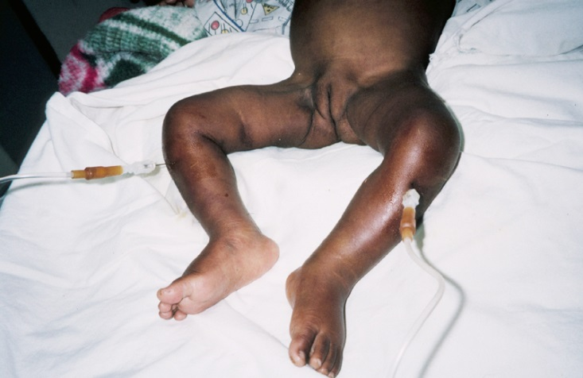
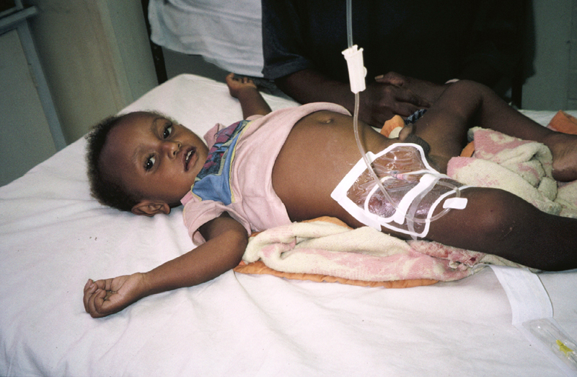
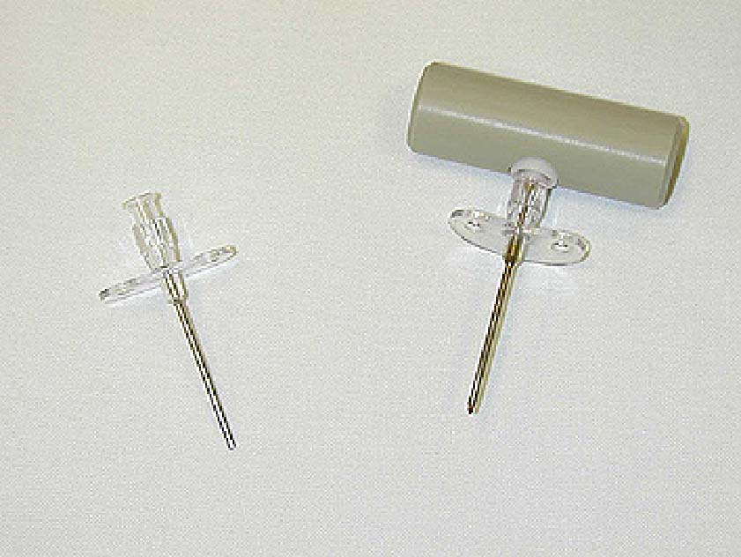

If peripheral vein access can’t be obtained
Intraosseus using spinal needle (Ref p. 310)
Femoral venous access (Ref. p. 313)
Intraosseus needle

Slide 45
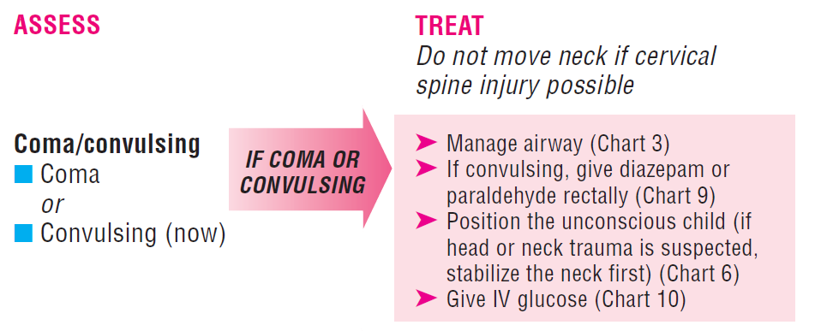
Coma/Convulsions
Notes:
Review chart 6, 9, 10: rectal valium, checking bedside glucose, giving IV glucose, diluting D50 to D10

Slide 46
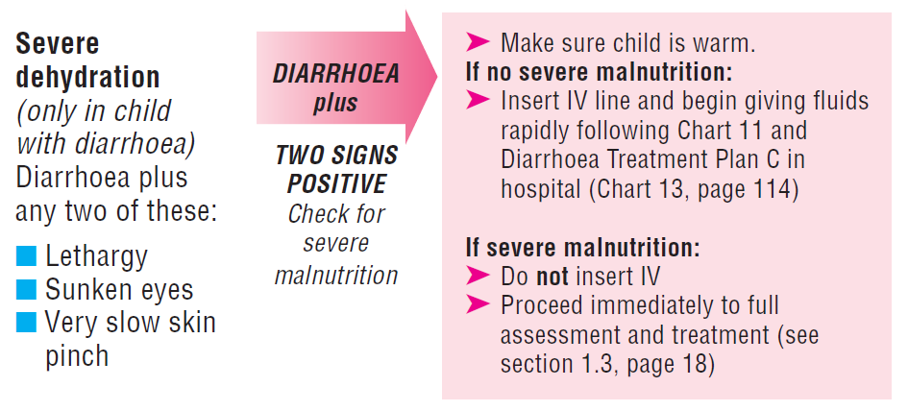
Dehydration with Diarrhea
Notes:
Review chart 11 and 13: Plan C

Slide 47
Cases
Notes:
Break into groups
Treatment drills

Slide 48
3yo wrapped in a blanket
Breathing OK
Cool hands
Normal cap refill
Alert
Diarrhea x 2 days
Skin pinch 3 seconds, eyes sunken
Visible severe wasting
Assess Airway & Breathing
Assess Circulation
Check cap refill
Assess Consciousness
Ask about diarrhea
Assess dehydration
Triage as emergency
Check for malnutrition
Refer for immediate evaluation
Check glucose
ReSoMal

Slide 49
2yo boy brought in after a seizure
Breathing fast, no cyanosis, no distress, no obstruction
Warm hands
Drowsy, responds to voice
Diarrhea x 2 days
Skin pinch 2 seconds, eyes not sunken, crying tears
Priority signs?
Assess Airway & Breathing
Assess Circulation
Assess Consciousness
Ask about diarrhea
Assess dehydration
Assess for priority signs
Triage as priority (fever, lethargy)

Slide 50
1yo who had two seizures
Breathing noisy, blue
Breathing more easily, no cyanosis
Warm hand
Responsive to pain
Blood glucose 20
Assess Airway & Breathing
Triage as emergency
Position airway, give O2
Consider OP airway
Reassess breathing
Assess Circulation
Assess Consciousness
Position child
Check glucose
D10W 60mL
Reassess

Slide 51
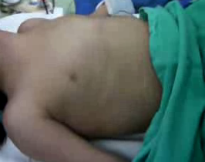
Notes:
Video from http://www.youtube.com/watch?v=Hv68EQ3tCBI&feature=related

Slide 52
14mo sleeping too much
Mild tachypnea, no distress
Warm hand
Responsive to voice
Diarrhea x 2 days
Sunken eyes, no tenting
No visible wasting or edema
Assess Airway & Breathing
Assess Circulation
Assess Consciousness
Ask about diarrhea
Assess dehydration
Assess nutrition
Plan C

Slide 53
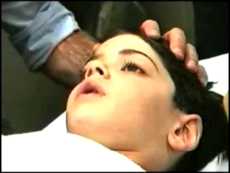
Notes:
Video from WHO Pocketbook Course - Coma

Slide 54
4 yo hit by bicycle
Breathing noisy, gurgling
Responds only to pain
Breathing sounds clear
Cold hands
Cap refill 4s, weak pulse
Bleeding from leg
HR improving
More responsive
Assess Airway & Breathing
Stabilize neck
Jaw thrust, clear secretions
Reassess airway/breathing
Assess Circulation
Check pulse, cap refill
IV/IO, give fluid
Check for bleeding
Apply pressure
Reassess circulation
Assess consciousness
Triage as emergency

Slide 55
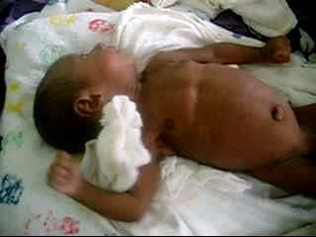
Notes:
Video from WHO Pocketbook course - neonate

Slide 56
Evidence
Notes:
Kristen

Slide 57
Is this worthwhile?
Why do we need this?
Emergency care is variable and often poor
Is it too simple?
How does it compare to PALS?
Data from Brazil & Malawi
Does it have an impact?
Appropriate triage & emergency treatment reduce early in-hospital mortality

Slide 58
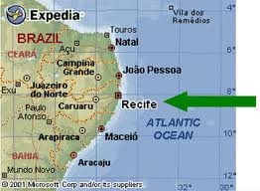
Recife, Brazil
Population:
  3837 patients, age 7 days to 5 years
  Tropical climate, malaria is uncommon
Intervention: Assessment by ETAT-trained nurse
Outcome:
  Sensitivity 86%, specificity 85% to detect admission
  Sensitivity 97%, specificity 91% to detect patients with pediatric advanced life support signs
Tamburlini, G. et. al. Arch Dis Child 1999;81:478‐82.
Notes:
180 children seen in ED/day, 600 bed maternal-infant hospital
Measuring two things simultaneously: how well do nurses do ETAT, and how does ETAT compare to physician assessment?

Slide 59
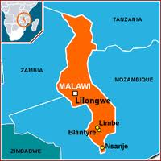
Blantyre, Malawi
Population:
  2281 children < 5 years
  10% inpatient mortality
  1/3 within 24 hours
Multiple changes in under-five clinic:
  ETAT training & triage implementation
  Change in physical space
  Increased staffing
  Monitoring of workload & mortality review

Slide 60
Blantyre, Malawi
Inpatient mortality fell from 10-18% to 6-8%
Proportion of inpatient deaths in first 24 hours decreased 36% → 12.6%
Number of admissions increased
Criteria for admission unchanged
Molyneux, E. et. al. Bull World Health Organ 2006;84(4): 314‐9.

Slide 61
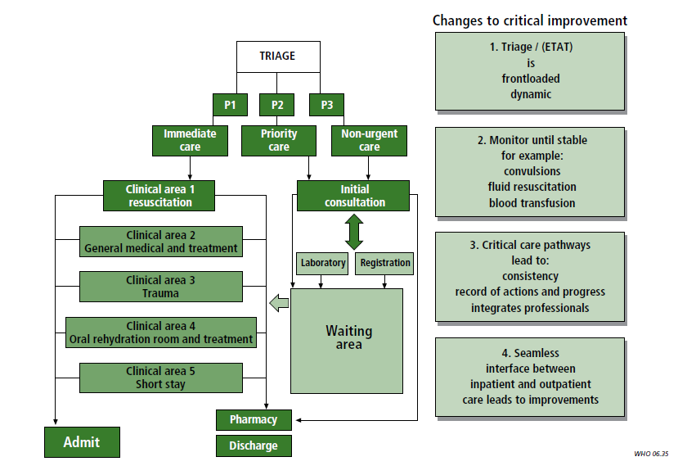

Slide 62
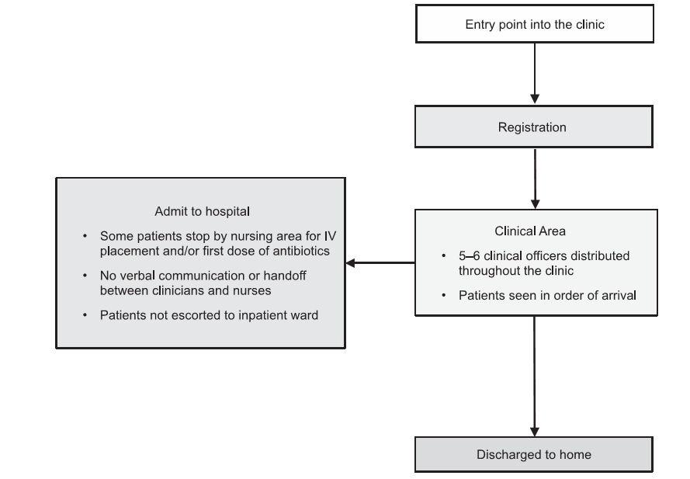
Lilongwe, Malawi
Intervention in under-five clinic
  Institution of formal triage process
  Treatment & stabilization
  Reallocation of senior-level clinical support to clinic to supervise emergency care
Robison, J. et. al. Pediatrics 2012.
Notes:
Under-5 clinic in referring hospital
No formal triage or goal-directed care; sick patients referred to overcrowded inpatient ward
Care provided by clinical officers with no responsible MD

Slide 63
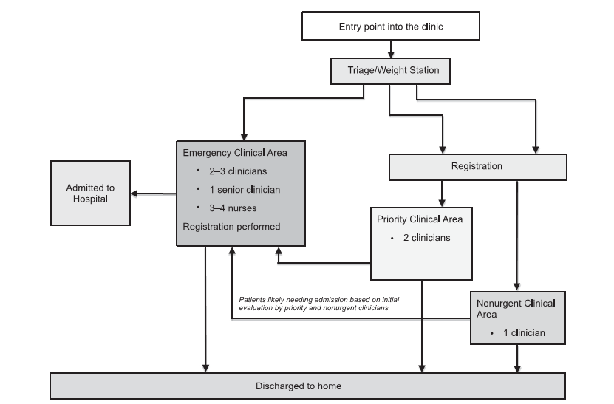
Post-Intervention
Notes:
Added one staff – a senior clinician in the Emergency tx area
Also worked with lab and radiology to prioritize patients

Slide 64
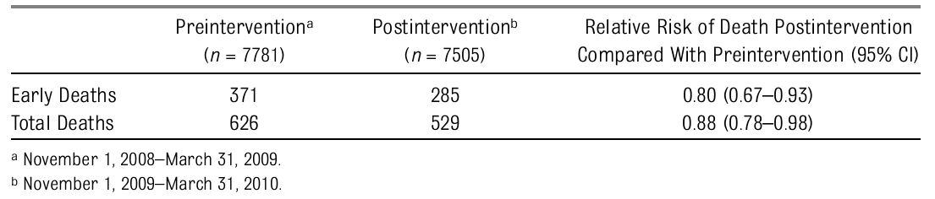
Lilongwe, Malawi
Early mortality decreased
  47.6 per 1000 admissions to 37.9 per 1000
  72 fewer early deaths over 5 mo (95% CI 22-120)
Total mortality decreased
  80.5 per 1000 to 70.5 per 1000
  75 fewer deaths over 5 mo (95% CI 14-142)
Notes:
72 fewer early deaths – from 357 to 285 over 5 months
75 fewer total deaths – from 604 to 529 over 5 months

Slide 65
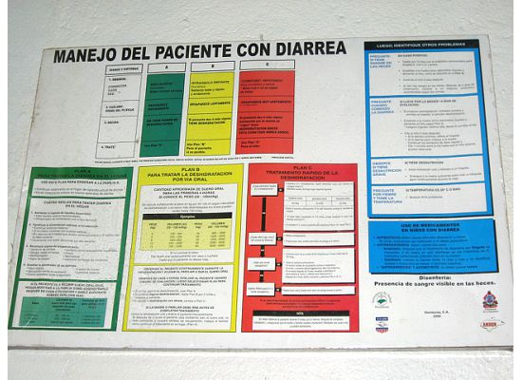
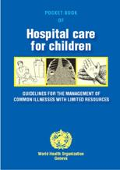
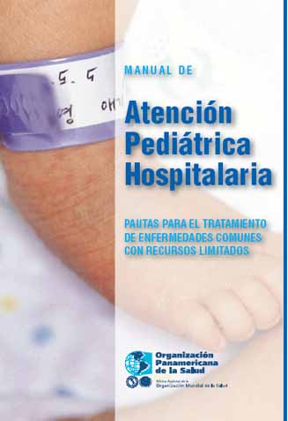
Where does ETAT fit?
Pocketbook
  ETAT Charts
  Differential diagnosis
  Hospital-level treatment in resource-limited settings
IMCI
  Outpatient tx & referral guidelines for difficulty breathing, fever, diarrhea, ear problems

Slide 66
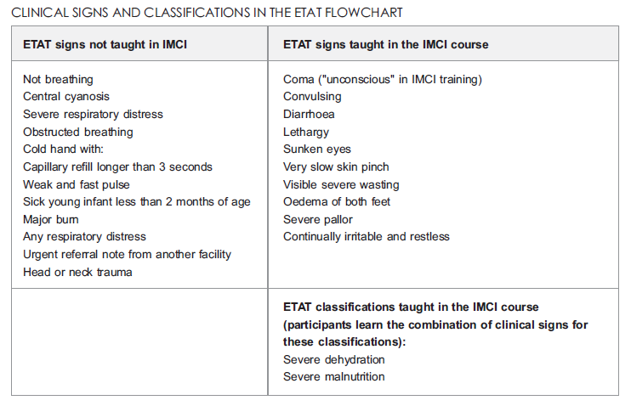
ETAT & IMCI

Slide 67
Summary
Triage should identify children at high risk of preventable mortality
Emergency care requires systematic assessment and an organized response
Implementing ETAT may require changes in staffing, patient flow, and emergency supplies
Effective triage and emergency care can reduce in-hospital mortality

Slide 68
References
Gove S, Tamburlini G, Molyneux E, Whitesell P, Campbell H. Development and technical basis of simplified treatment guidelinesfor emergency triage assessment and treatment in developing countries. Arch Dis Child 1999;81:473‐7
Nolan T, et al. Quality of hospital care for seriously ill children in less‐developed countries. Lancet 2001;357:106‐110.
Tamburlini G, Di Mario S, Maggi RS, Vilarim JN, Gove S. Evaluation of guidelines for emergency assessment and treatment in developing countries. Arch Dis Child 1999;81:478‐82
Molyneux E, Ahmad S, Robertson A. Improved triage and emergency care for children reduces inpatient mortality in a resourceconstrained setting. Bull World Health Organ 2006;84(4): 314‐9
Robison, J., et. al. Decreased Pediatric Hospital Mortality After an Intervention to Improve Emergency Care in Lilongwe, Malawi. Pediatrics August 13,2012.

