Slide 1
Human Trafficking:
What health care professionals need to know
Clydette Powell, MD, MPH
April 2013

Slide 2
Learning Objectives
To characterize the epidemic of human trafficking (TIP) – magnitude, geography, demographics
Identify risk factors, health consequences, and impact of TIP
Define the role and response of health care professionals
Identify next steps and resources

Slide 3
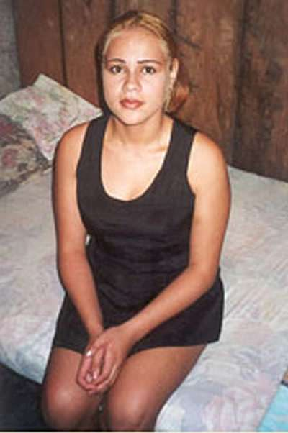
Jill’s Story
Runaway teen at age 14, escaping sexual and physical abuse
Homeless until approached in a suburban mall by a man named Bruce
Promised to help and provide work

Slide 4
Jill’s Story
What are some signs that might have tipped you off that Jill was a TIP victim?
What could have been done to look further into this possibility?

Slide 5
Two Broad Categories of Human Trafficking
Labor Trafficking:
Domestic Service
Sweat Shops/Factories
Begging
Agricultural Work
Mining
Brick Kilns
Military Conscription
Sexual Trafficking:
Prostitution
Pornography
Stripping
Lap Dancing
Live-Sex Shows
Mail-order Brides
Child Brides
(Sex is Not Labor/Work!)

Slide 6
Types of Trafficking in Persons:
(Federal Definition)
  Sex trafficking: a commercial sex act is induced by force, fraud, or coercion, OR in which the person induced to perform such act has not attained 18 years of age

Slide 7
Trafficking is …
“The recruitment, harboring, transportation, provision, or obtaining a person for labor or services, through the use of force, fraud, or coercion for the purpose of subjection to involuntary servitude, peonage, debt bondage, or slavery”

Slide 8
Trafficking in Persons is Not
Not exclusively movement of persons
(Remember: recruitment, harboring, transportation, provisioning, and obtaining)
Not carried out by exclusively violent means of force
Not the same as smuggling of migrants

Slide 9
International Scope of TIP
21 million in forced labor, bonded labor, forced child labor, and sex servitude at any given time
Domestic servitude – 50 – 100 million
Women and children – 55%
One million kids are sex trafficked each year
Billions of dollars – no tax, no regulation

Slide 10
Government
Policies
New
Technologies
Cultural Attitudes
And Values
Orphaned
War
Gender
Prior Sexual
Abuse
Sexual Trafficking
Demand for
Commercial Sex
Poverty
Abandonment/
Runaways
Ethnic
Minority
Legal and Tolerated
Sex Industries
Corruption

Slide 11
Myths….
Trafficking happens somewhere else in the world
Mostly it is a problem for women
Most trafficking is sex trafficking
You can tell who is a trafficker, pimp, or john
Legalization of prostitution helps to control the problem
Health care professionals have a small role to play

Slide 12
Teenage Prostitution…
The most common form of human trafficking in the US today

Slide 13
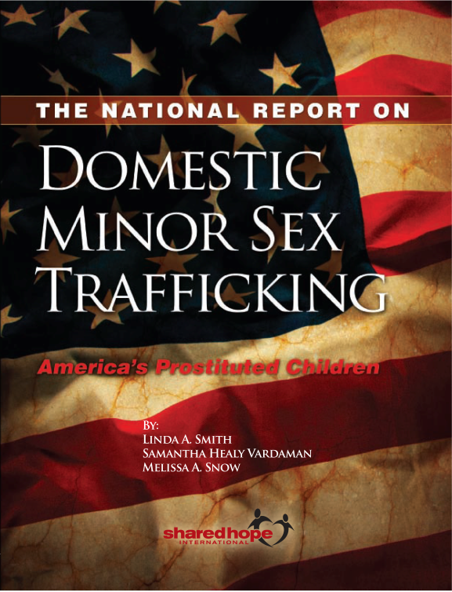
The National Report on
Domestic Minor Sex Trafficking
100,000 to 300,000 children are used in prostitution every year in the United States.
The average age of entry into prostitution is 13 years old.
easy targets– pre-teen and adolescent girls are especially susceptible to the deception of traffickers.

Slide 14

Methods of
Recruitment and Trafficking
Kidnapping
Deception/Fraud
  Newspaper ads
  Recruitment by other victims
  Falsified travel document
  Visa overstays
Debt bondage
Parents, family, boyfriends, husbands selling children/wives/relatives

Slide 15
Mobile technology, the internet and TIP
Child porn: fastest growing online industry
Predators - on cutting edge of technology
Home – the “virtual brothel”
“Sexting”
Apps

Slide 16

Grooming and cyber seduction
Predators’ risk assessment
  easy target?
  introduce a sexually explicit conversation
  teen willing to engage?
  send photo?

Slide 17
Who Are the Traffickers?
Pimp = Trafficker
Can be a boyfriend, father, mother, brother, uncle, a coach, a teacher or anyone exerting control over a minor, even a peer
Not always organized criminals
Men and women of varying ages
Any ethnicity or race
Anyone who benefits from the commercial sexual exploitation of a minor or facilitates the commercial sexual exploitation of a minor

Slide 18
Pimp Control
“You'll start to dress her, think for her, own her. If you and your victim are sexually active, slow it down. After sex, take her shopping for one item. Hair and/or nails is fine. She'll develop a feeling of accomplishment. The shopping after a month will be replaced with cash. The love making turns into raw sex. She'll start to crave the intimacy and be willing to get back into your good graces. After you have broken her spirit, she has no sense of self value. Now pimp, put a price tag on the item you have manufactured.”
The Pimp Game; An Instructional Manual (Royal, 1998),

Slide 19
Why don’t victims seek help?
Captivity, confinement and isolation
Use and threat of violence
Fear, shame, self-blame and hopelessness
Dependency
Often do not view themselves as a victim
Distrust of service providers & law enforcement

Slide 20
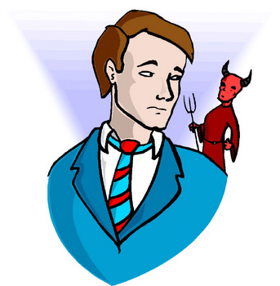
Who are the buyers?
Men who purchase sex acts are all ages and come from all socioeconomic levels, all occupation categories, and ethnic/racial groups. Their behavior to buy a sex act is a choice.
Donna Hughes. Best Practices to End Demand. 2004.

Slide 21

What are the settings for the health problems of trafficked victims ?
Victims suffer from host of physical and psychological problems stemming from:
  Inhumane living conditions
  Poor sanitation
  Inadequate nutrition
  Poor personal hygiene
  Brutal physical and emotional abuse
  Dangerous workplace conditions
  General lack of quality medical care
Notes:
Trafficking victims suffer from a host of physical and psychological problems because they are often forced to live in inhuman conditions, work in dangerous conditions, and subjected to brutal physical and emotional attacks. Often they lack access to quality medical care.

Slide 22
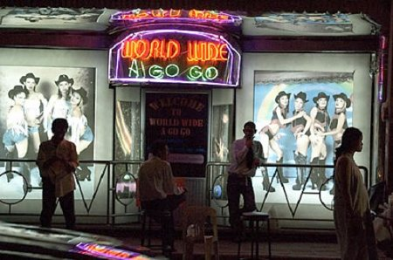
Health Issues Associated with Victims of Human Trafficking
  Drug/alcohol addiction
  Bodily injuries, burns
  Traumatic brain injury
  STIs; comm disease
  Reproductive health
  Forced abortions
  Sleep disorders Malnutrition
  Dental trauma
  Occupational hazards
Silverman, JG, Decker MR, Gupta J, Dharmadhkari A, Seage GR, and Raj J. “Syphilis and Hepatitis B co-infection among HIV infected sex trafficked women and girls, Nepal”. (2008) Emerg Inf Dis 14(6):932-934).

Slide 23
HIV and Victims of Human Trafficking
  Rates of HIV range from 6 to 20 times normal population
    Rates as high as 80% have been reported
  Girls < 15 recruited into sex trafficking in Nepal have a higher risk of HIV than older prostitutes- 61%
    Limited ability to negotiate condom use
    Low levels of awareness of HIV/STI’s
    Subjected to greater violence in sex

Slide 24
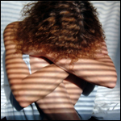
Mental Health Issues Associated with Victims of Human Trafficking
Substance abuse or addictions
Psychological trauma
  Daily mental abuse
  Torture
Psychological problems
  Depression
  Stress-related disorders; PTSD
  Phobias
  Panic attacks
  Suicide

Slide 25
PTSD Among Prostituted Women
In a study of prostituted women from 9 countries, PTSD was 68%, which is in the same range as that of treatment-seeking combat veterans.
(Farley et al. (2003). Prostitution and Trafficking in Nine Countries: An Update on Violence and Posttraumatic Stress Disorder. Prostitution, Trafficking, and Traumatic Stress.)

Slide 26
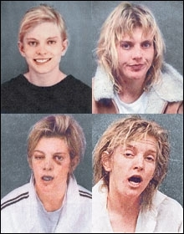
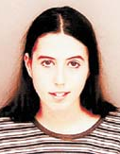
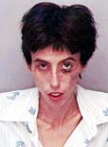
The Faces of Prostitution
Courtney. The Denver Post. 2005.
Melissa. Photos -Pinellas County Police Dept, Florida.

Slide 27
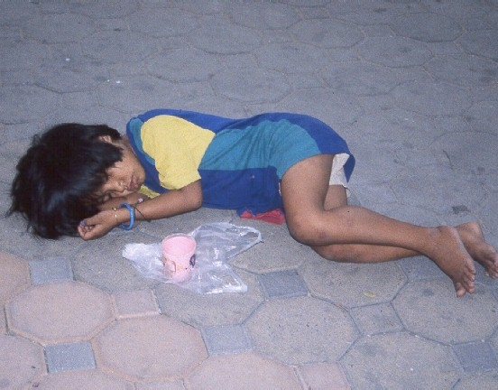
Indirect health effects: the children of trafficked persons
Single parent issues
Sleep disorders
Schooling
Health care access
Witness to sexual violence
Left behind in “raids”
Potential target of reprisals
Ultimately vulnerable to being groomed and trafficked

Slide 28

Understanding the Impact
“Sexual trauma is unique from other forms of trauma. It is a violation of the most intimate and personal aspects of the self. One’s own body becomes the setting in which the atrocities are perpetrated . . . .”

Slide 29
The crime scene is… the body

Slide 30
How do I know if this is a trafficked minor?

Slide 31

First, observe….
General identifiers of DMST
Your initial assessment of patient and accompanying person

Slide 32
Communicating with Victims of Human Trafficking
Before questioning potential trafficking victim:
  Isolate individual
  Remember their training and bonding
Give control
Inform and inquire
  Establish trust
  Be patient
  Ask key questions…

Slide 33
Ask the patient...
Where do you eat and sleep?
Do you have to ask permission to eat, sleep, go to the bathroom?
Are there locks on your doors and windows?
Has your family been threatened?
Are you known by other names?
Is any one hurting you? Do you feel unsafe?

Slide 34
What do I do if I discover someone who may be a victim of trafficking?

Slide 35
Hotline (USA)
1-888-3737-888

Slide 36
So, what else can I do??

Slide 37

Easy first steps
Reflect
  Slaveryfootprint.org
Learn
  SAFE; VoT; R and R
Know your community resources
  Law enforcement
Address demand
Serve/Give
Report

Slide 38
So, how many slaves are working for you?
Slaveryfootprint.org

Slide 39
Community referrals
Know your local resources
Make a list of name and phone numbers to call.
Shelters and safe houses
Hotlines
Local clergy and other organizations

Slide 40
Ideas for Action
Get training
Give/support
Know the internet and mobile technology –yours and theirs
Reach out through survivor programs
Address demand

Slide 41
Fight demand
Fight internet pornography
Advocate laws that criminalize demand
  Billboards with pictures of men arrested for soliciting
  Impounding cars of men arrested for soliciting
  Johns schools
Sex addiction treatment programs
Oppose legalization of prostitution
Street outreach to potential “johns” passing out literature

Slide 42
Where can I learn more?

Slide 43
Where to go for more information…(US govt and UN)
US Health and Human Services
  www.acf.hhs.gov/trafficking
US Department of State – J/TIP Office
US Department of Justice
  Office on Victims and Crime
US Agency for International Development
  Bureau for Democracy, Conflict, Hum’tn Assistance
International Organization for Migration (UN)
UN Office on Drugs and Crime
Local area Human Trafficking Task Force

Slide 44
Where to go for more information
(non-govt)
National Center for Missing and Exploited Children
International Justice Mission
Polaris (NHTRC)
Academic researchers – e.g., Melissa Farley
The Coalition to Abolish Slavery and Trafficking
ECPAT (End Child Prostitution and Trafficking)
GEMS (NYC)
Shared Hope International
Salvation Army
Enough is Enough

Slide 45
Some films on TIP
Not My Life (2012) - global
Trade of Innocents ( 2012) - Cambodia
Playground (2010 ) USA
Precious (2009) USA
Very Young Girls (2007) USA
Taken (2007) USA

Slide 46
Books
Prostitution, Trafficking, and Traumatic Stress – (Farley)
Not for Sale (Batson)
Disposable People (Bales)
Terrify No More (Haugen)
The Johns: Sex for sale and the men who buy it (Malarek)
Girls Like Us (Lloyd)

Slide 47
Human Trafficking is Modern day Slavery
Abolition!!

