Slide 1


Parasitic Infections in Children
David Diemert, MD, FRCP(C)
Associate Professor
Dept. of Microbiology, Immunology & Tropical Medicine
George Washington University
&
Director of Clinical Trials
Albert B. Sabin Vaccine Institute
12 October 2015

Slide 2
Objectives
Describe the parasitic infections that most commonly cause disease in children.
Recognize the clinical manifestations of these diseases and know how to diagnosis them.
Identify treatment and management strategies for parasitic infections, especially intestinal helminths.
Develop awareness of international policies/strategies toward control of parasitic infections.

Slide 3
Case Presentation
10-year old girl living in small village in Mali
Presenting complaint: “urine is red”
HPI: longstanding history x yrs of episodic lower abdominal pain
  Episodic red urine x 2 years + mild dysuria
  Denies frequency, fevers, diarrhea, bloody stool
Exam: stunted, conjunctival pallor
  Abdomen: non-tender, no masses or HSM

Slide 4
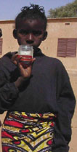
Labs
Hgb 10.7 g/dl
Platelets 179 x 10⁶/mm³
WBC 5.37 x 10³/mm³
  N 39.5%, L 38.2%, E 16.9%, M 4.8%
ALT, bilirubin, creatinine: normal
Tests?
Diagnosis?

Slide 5
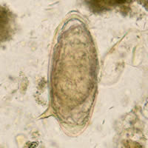
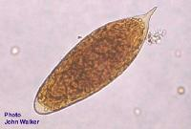

Slide 6
Classification of Parasites
Worms (helminths)
  Multicellular
  Large
  Nematodes, cestodes & trematodes
Protozoa
  Unicellular eukaryotes
  Small
  Intestinal, tissue & blood protozoa

Slide 7

Worms (Helminths)
Nematodes
  Intestinal nematodes:
      Ascaris (roundworm)
      Hookworm
      Trichuris (whipworm)
      Enterobius (pinworm)
      Strongyloides
      Toxocara
      Trichinella
      Anisakis
Ascaris lumbricoides

Slide 8
Worms (Helminths)
Nematodes:
  Non-intestinal:
      Filaria: lymphatic, Onchocerca, Loa Loa
      Dracunculiasis (Guinea worm)

Slide 9
Worms
Tapeworms (Cestodes):
  Adult worms:
      Taenia (pork = solium, beef = saginata)
      Diphyllobothrium (fish)
  Larvae:
      Taenia solium – neurocysticercosis (SEIZURES)
      Echinococcus – hydatid cysts in liver and/or lung

Slide 10
Worms
Flukes (Trematodes): think snails!
  Liver flukes:
      Fasciola hepatica
      Clonorchis
      Opisthorchis
  Lung fluke: Paragonimus
  Blood fluke: Schistosoma
      S. mansoni & S. japonicum: venules of intestine
        Chronic infection – liver disease
      S. haematobium: venules of bladder
        Chronic infection – bladder disease/cancer

Slide 11
Protozoa
Intestinal protozoa:
    Giardia (chronic diarrhea)
    Entamoeba histolytica (dysentery, liver abscess)
    Cryptosporidium (diarrhea in AIDS)
    Cyclospora
    Cystoisopora (Isospora)
    Dientamoeba fragilis

Slide 12
Protozoa
Tissue protozoa:
  Trypanosomiasis
    African: T. b. rhodesiense, T. b. gambiense
        Rhodesian: East Africa (cattle reservoir)
        Gambian: West Africa (no animal reservoir)
        Both: CNS disease
    South American: T. cruzi (Chagas Disease)
        Chagoma (acute), heart & GI disease (chronic)
  Leishmaniasis
    Visceral vs. cutaneous
  Toxoplasmosis

Slide 13
Protozoa
Blood protozoa:
  Plasmodium (malaria)
    P. falciparum, P. vivax, P. ovale, P. malariae, P. knowlesi
  Babesia
        Transmitted by ticks

Slide 14
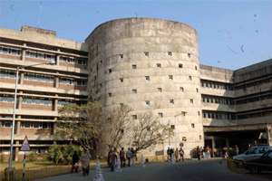
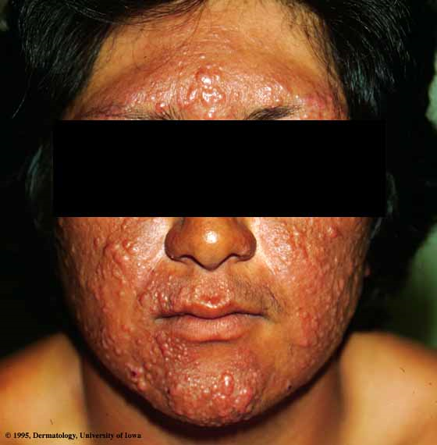

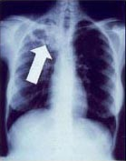

Postgraduate Medical Institute,
Chandigarh, India

Slide 15
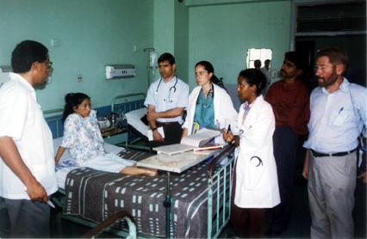
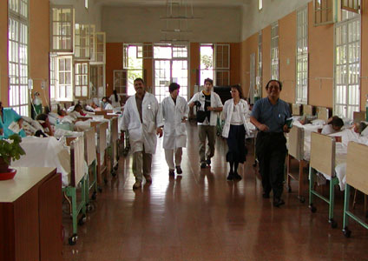

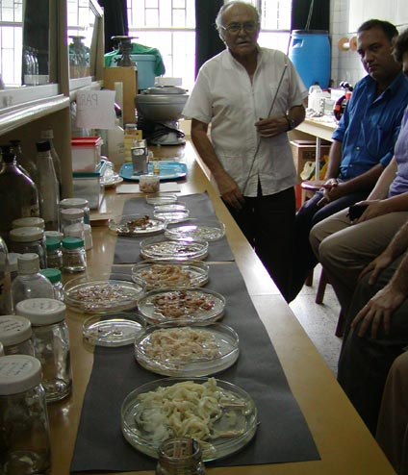
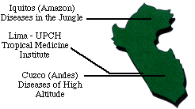
Gorgas Course in Clinical Tropical Medicine

Slide 16
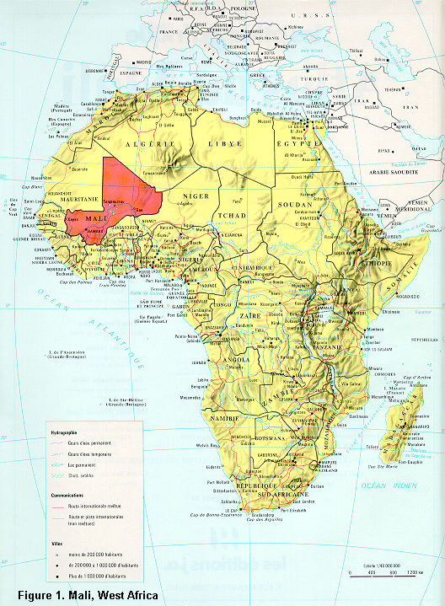
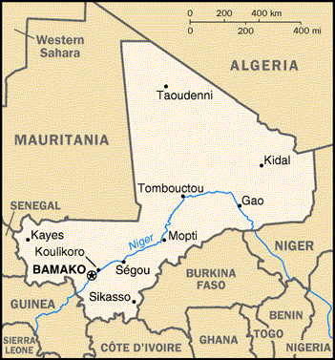
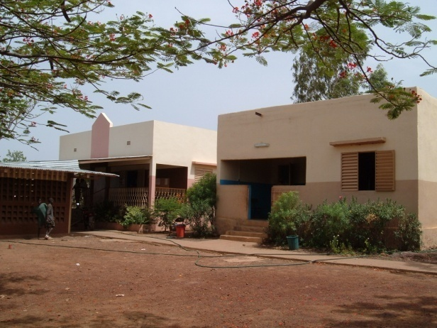
Donéguébougou

Slide 17
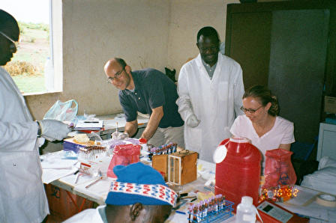
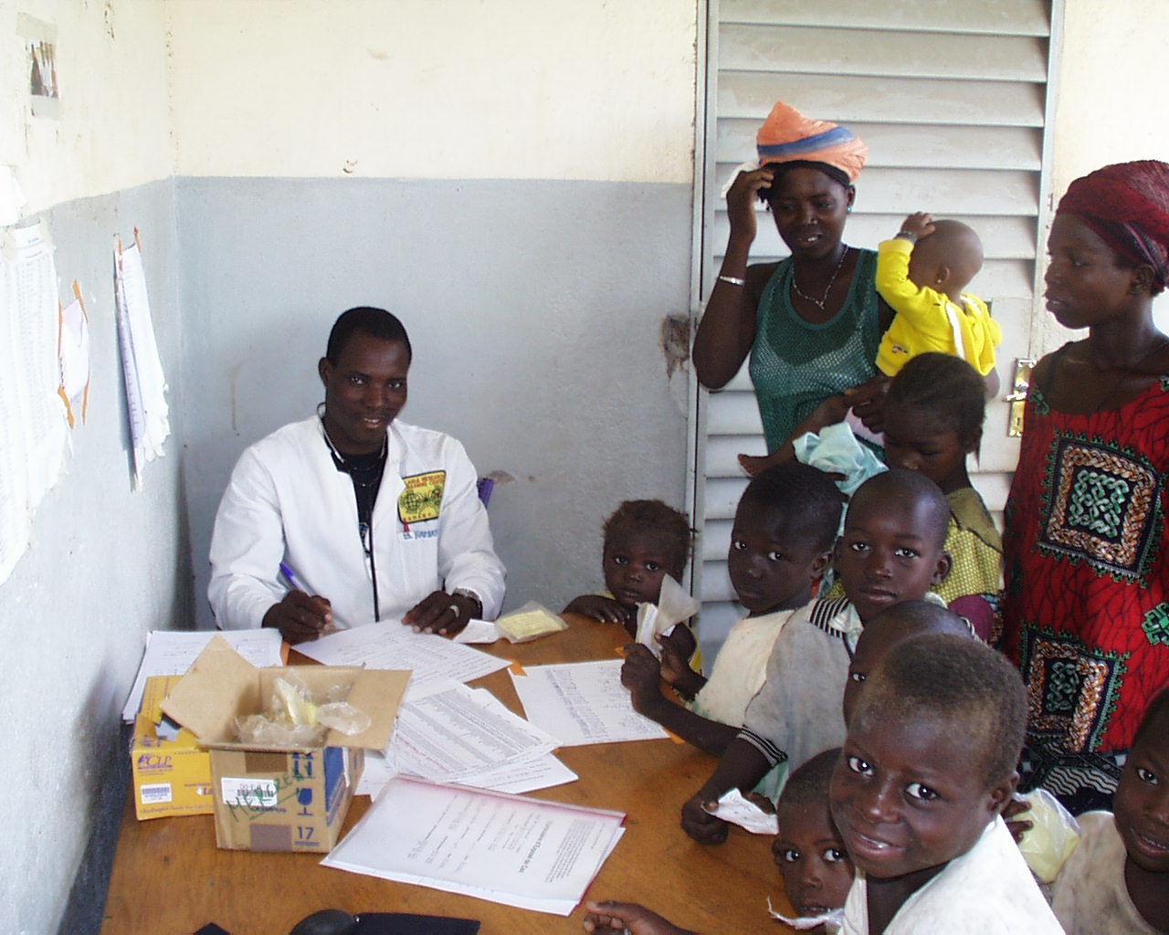
Donéguébougou, Mali

Slide 18
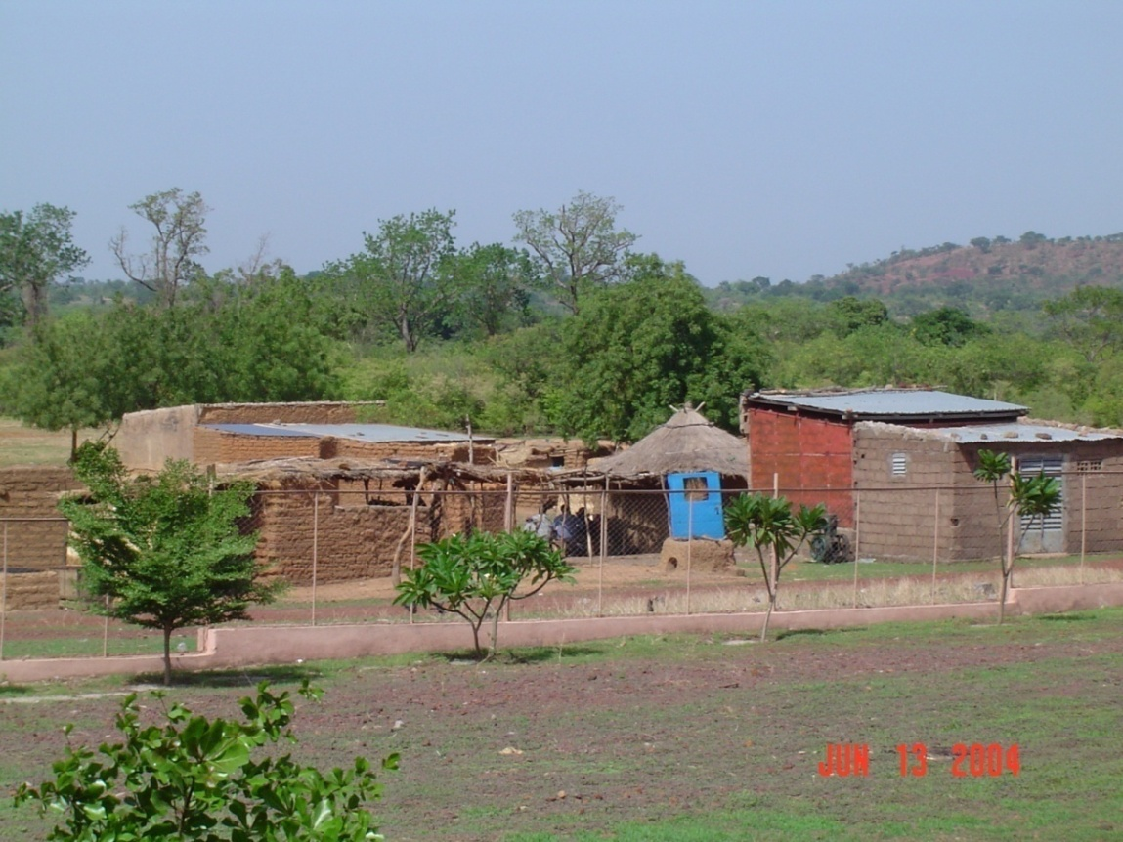
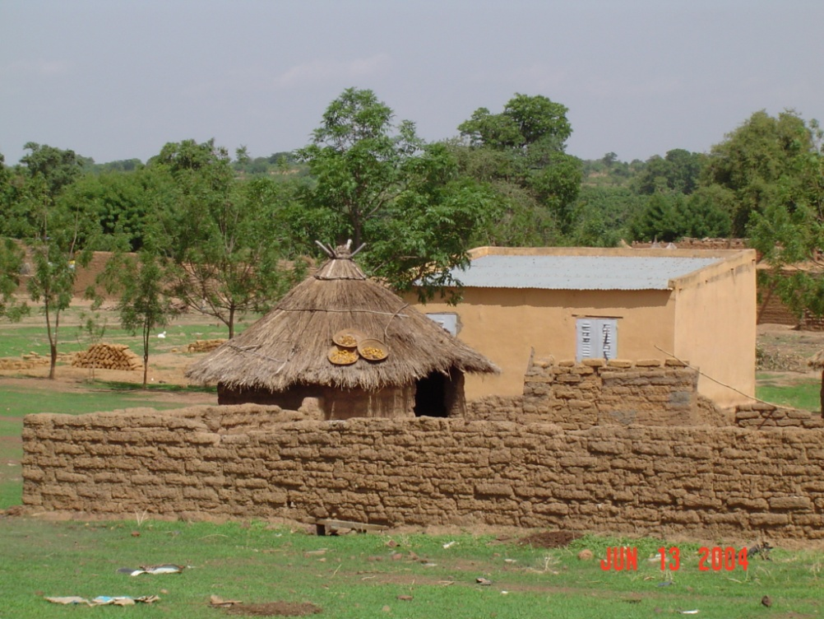
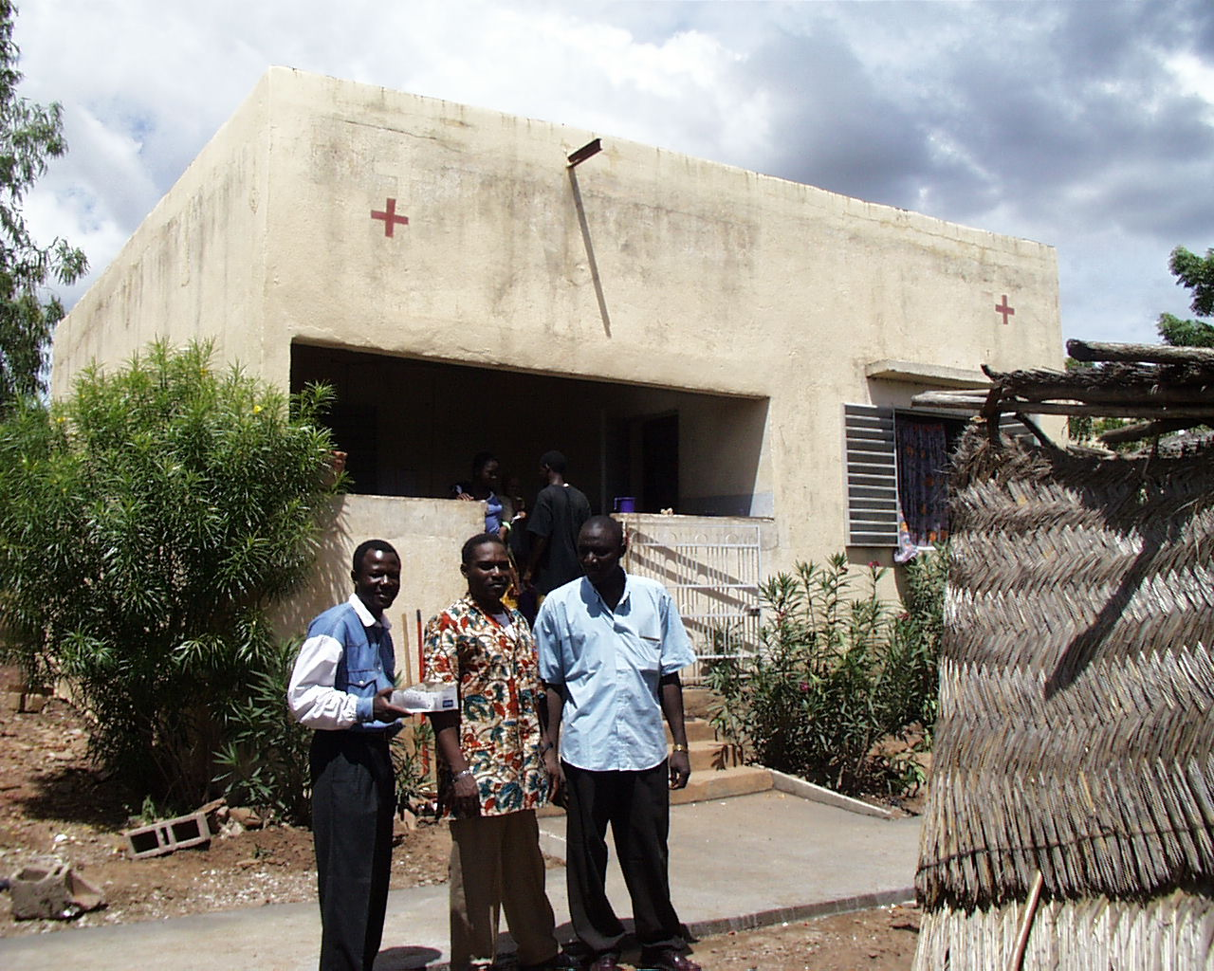
Donéguébougou, Mali

Slide 19
Malaria is a Parasitic but
“Un”- Neglected Tropical Disease

Slide 20
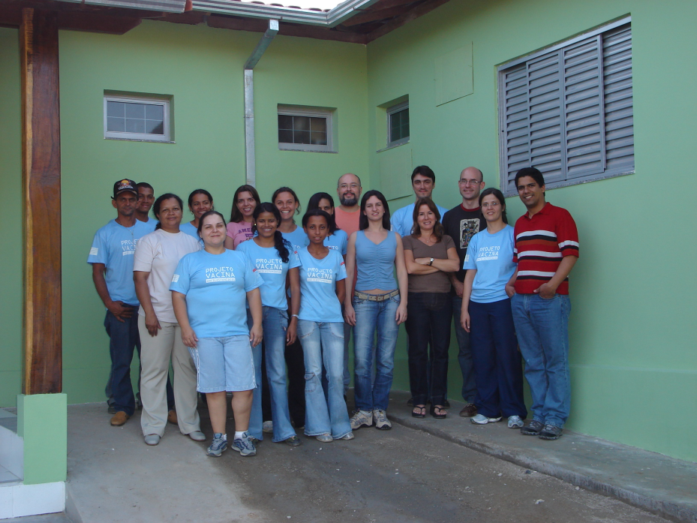
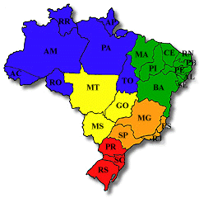
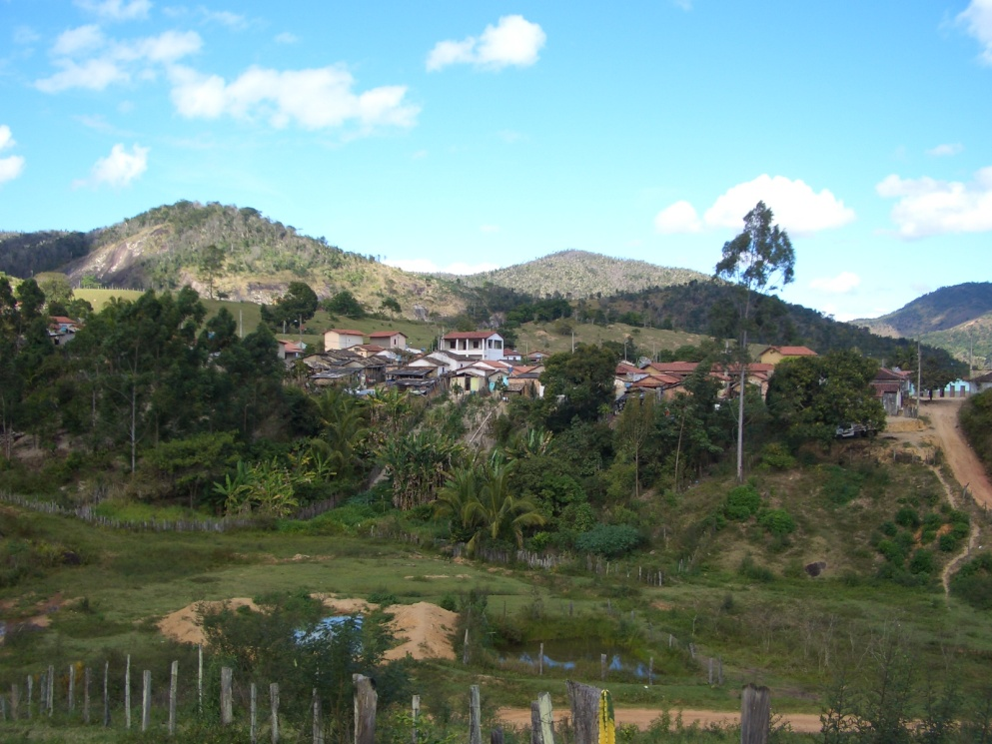

Slide 21
The Neglected Tropical Diseases
Group of tropical infectious diseases that afflict the poor and powerless
Rural areas of low-income countries
  Transmission of many NTDs related to contact with contaminated soil or water
Cause immense suffering, life-long disabilities
  Morbidity related to parasite burden
Promote poverty and impair education and economic development
Do not receive attention and funding of high-mortality diseases (HIV/AIDS, TB, malaria)

Slide 22
Disease burden of the NTDs in Deaths and DALYs
Disease Deaths/yr DALYs/yr
Schistosomiasis 11,700 3.3 million
Hookworm - 3.2 million
Ascariasis 2,700 1.3 million
Leishmaniasis - 3.3 million
African Trypanosomiasis (HAT) 9,100 0.6 million
Chagas disease 10,300 0.5 million
Trichuriasis - 0.6 million
Dengue 14,700 0.8 million
Lymphatic Filariasis 0 2.8 million
Cysticercosis 1,200 0.5 million
Echinococcosis 1,200 0.1 million
Trachoma 0 0.3 million
Onchocerciasis 0 0.5 million
Rabies 26,400 1.5 million
Other NTDs 23,700 4.7 million
Total 152,000 25.0 million
Wilson C et al. Lancet 2012
Notes:
TB = 50 million DALYS
HIV = 80 million

Slide 23
The Neglected Tropical Diseases & Children
Peak prevalence/intensity of many NTDs is in childhood, particularly ages 5-15 years
Result in chronic morbidity:
  Iron-deficiency anemia
  Malnutrition
  Deformity
Impair childhood growth and development
Lasting impact through adulthood

Slide 24
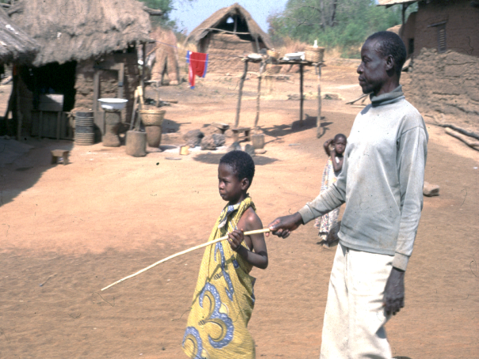
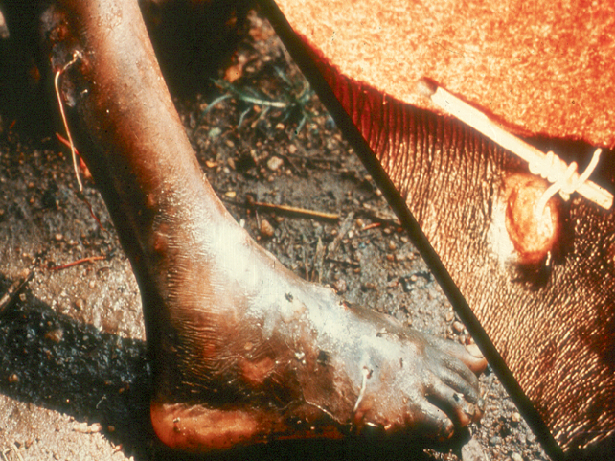
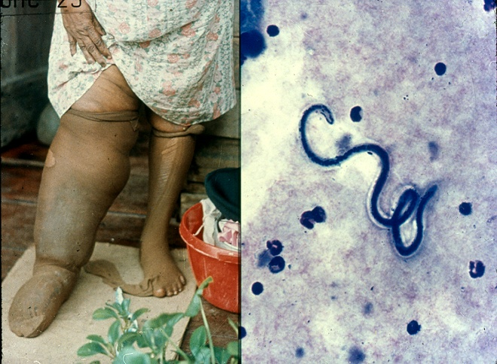
The NTDs: Humanity’s Ancient Diseases of Stigma
Have existed for centuries
Deforming and disabling diseases
Associated with intense stigma
River Blindness
Guinea Worm
Lymphatic Filariasis

Slide 25
The Neglected Tropical Diseases
Protozoan Infections
  Leishmaniasis (Kala-azar)
  African Trypanosomiasis (Sleeping Sickness)
  Chagas Disease
Helminth Infections
  Soil-transmitted Helminth Infections:
    Ascariasis, Trichuriasis, Hookworm
  Lymphatic Filariasis (Elephantiasis)
  Onchocerciasis (River Blindness)
  Schistosomiasis
  Dracunculiasis (Guinea Worm)
  Echinococcosis
  Foodborne trematodiases
  Taeniasis/Cysticercosis
Bacterial Infections
  Leprosy
  Trachoma
  Buruli Ulcer
  Yaws
Viral Infections
  Dengue/Severe dengue
  Rabies

Slide 26
Neglected Tropical Diseases
4.2 Billion People at risk in 142 Countries
High rates of “Polyparasitism”

Slide 27
Soil-Transmitted Helminths (STHs)

Slide 28
The Major Soil-Transmitted Helminths
Rank Disease Worldwide Prevalence
1. Ascariasis 807,000,000
2. Trichuriasis 604,000,000
3. Hookworm 576,000,000
“The Unholy Trinity”
[Strongyloides stercoralis: prevalence much lower]

Slide 29
STHs: Typical Age/Intensity Relationships
100
90
80
Trichuris
70
60
Hookworm
PRevalence (%)
50
Ascaris
40
30
20
10
0
0
10
20
30
40
Mean Age (y)

Slide 30
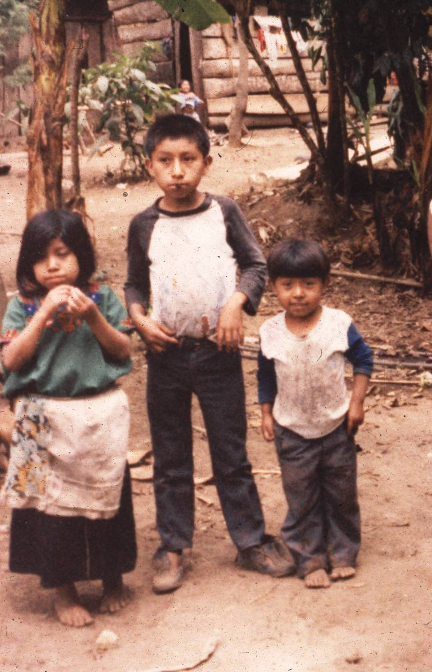
STHs & Polyparasitism: Guatemala
100
80
60
Prevalence (%)
40
20
0
0 – 3
4 – 7
8 – 12
Age Class (y)
Ascaris
Trichuris
Hookworm
Strongyloides

Slide 31
Intestinal Helminths
Long-lived: often survive for years in host
In general, do not reproduce within human host
  Exceptions: Strongyloides & Echinococcus
Morbidity related to worm burden
  Light infections usually asymptomatic
Eosinophilia: tissue migration phases of helminths

Slide 32
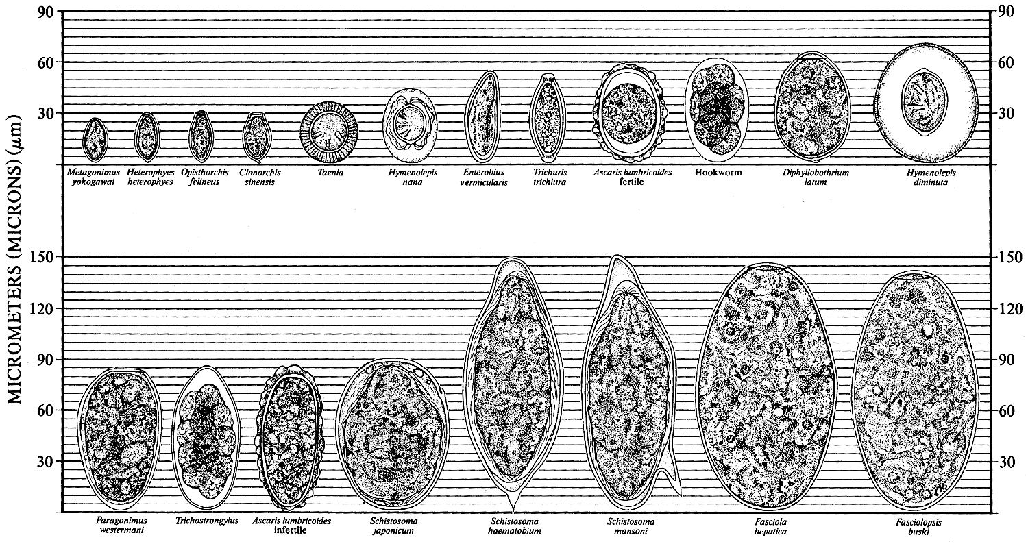
Intestinal Helminths: Diagnosis
www.dpd.cdc.gov/dpdx

Slide 33
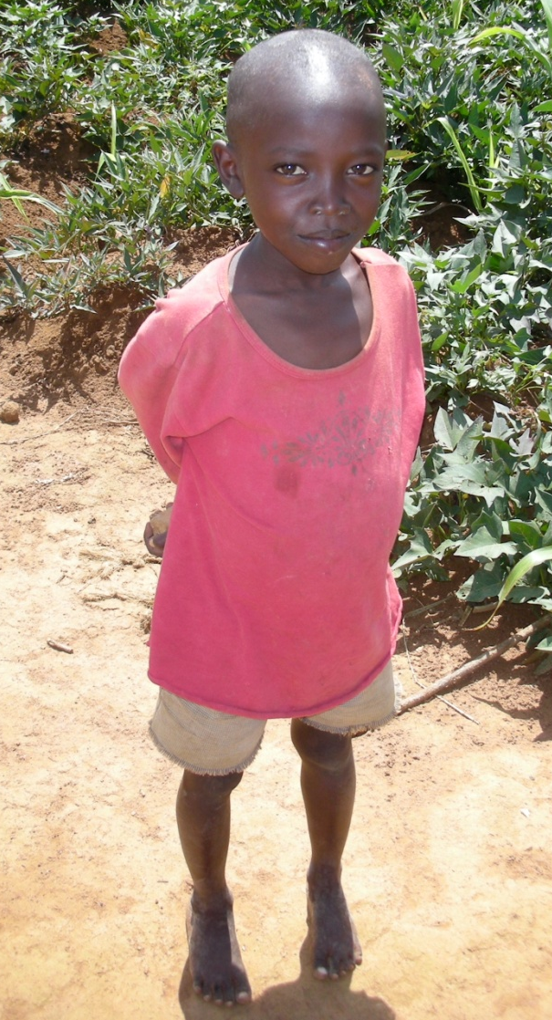
Soil-transmitted Helminth Infections
Stunting, Impaired Memory
Decreased School Performance
Hookworm leads to 40% reduction in future wage earnings
6
5
Notes:
-big head, out of proportion with the rest of his body

Slide 34
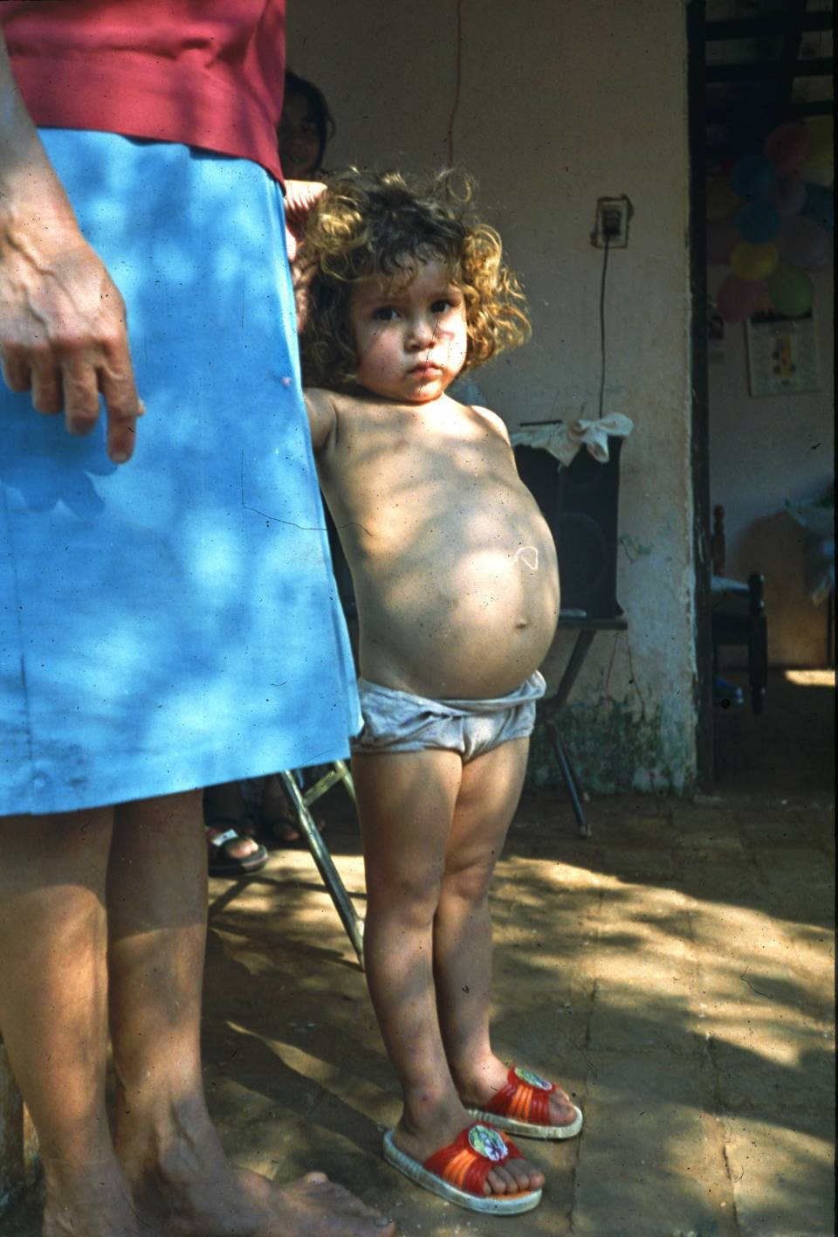
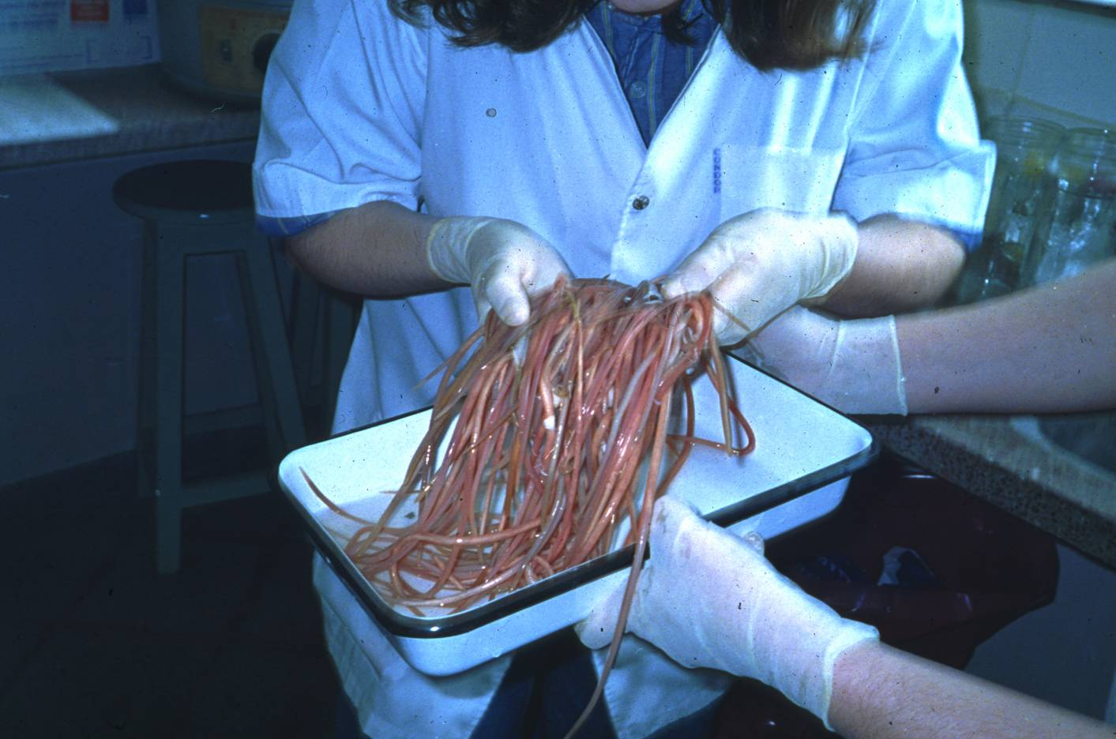
Ascaris lumbricoides: Roundworm
From: Despommier DD, Gwadz RW, Hotez PJ, Knirsch CA. Parasitic Diseases, 5th Ed., 2005

Slide 35
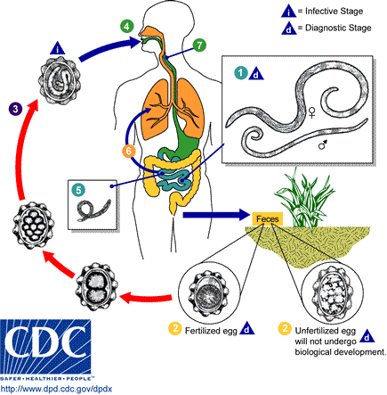
Ascaris lumbricoides – Life Cycle
Adult worms:
small intestine
20-40 cm

Slide 36
Ascaris lumbricoides
Symptoms:
  Usually asymptomatic
  Pulmonary phase: eosinophilic pneumonitis
    “Loeffler’s pneumonitis”
    Asthma-like symptoms
  High worm burdens: abdominal pain and intestinal obstruction
    Major cause of “surgical abdomen” worldwide, esp. young children
  Worm migration: biliary obstruction & oral expulsion
    Pancreatitis & cholangitis
  Chronic infection: impaired nutrition & growth

Slide 37
10-year old Kenyan Girl
NEJM 2013
Notes:
Emergency laparotomy for acute intestinal obstruction

Slide 38
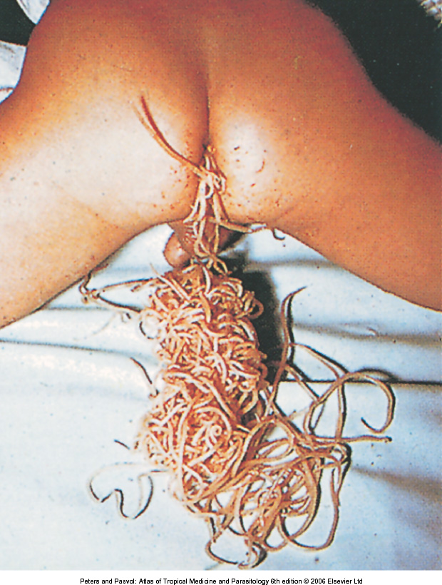

Slide 39
Ascaris lumbricoides
Diagnosis:
  Microscopic demonstration of ova in fecal sample
  Adult worms (post-treatment or migration)
Treatment:
  Albendazole, mebendazole, ivermectin, pyrantel pamoate, levamisole
  Single-dose recommended by WHO

Slide 40
Fecal Microscopy Techniques
Wet mount: saline or iodine solution
Kato-Katz: semi-quantitative
Concentration techniques:
  Sedimentation (formalin-ethyl alcohol)
  Flotation (saturated salt)
Stains: malachite green, iron-hematoxylin, trichrome

Slide 41
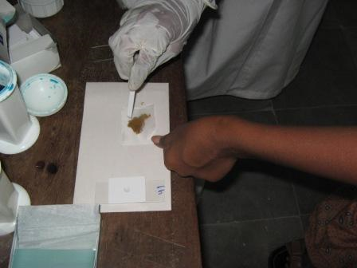
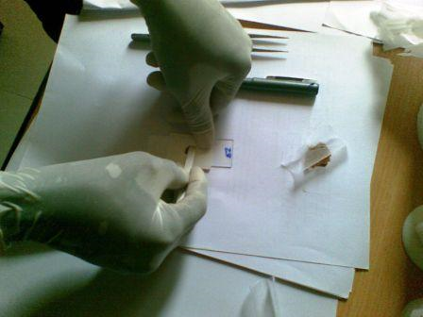
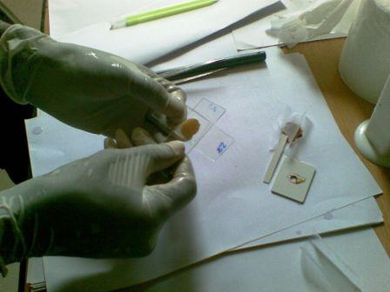
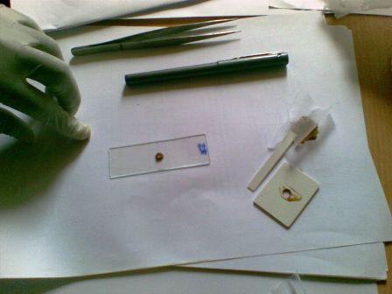
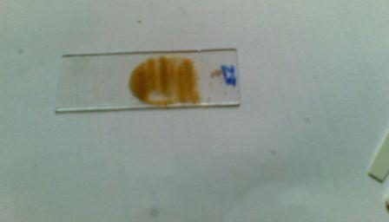
Kato-Katz Fecal Smear Technique

Slide 42
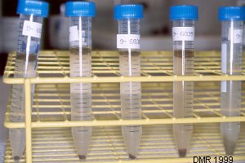
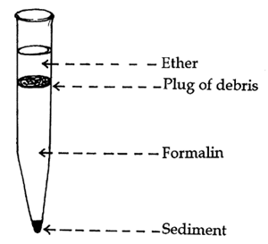
Formalin Ether Sedimentation Technique

Slide 43
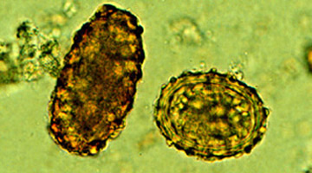
Ascaris lumbricoides
Eggs extremely hardy
Female: 200,000 eggs/day
www.dpd.cdc.gov/dpdx

Slide 44
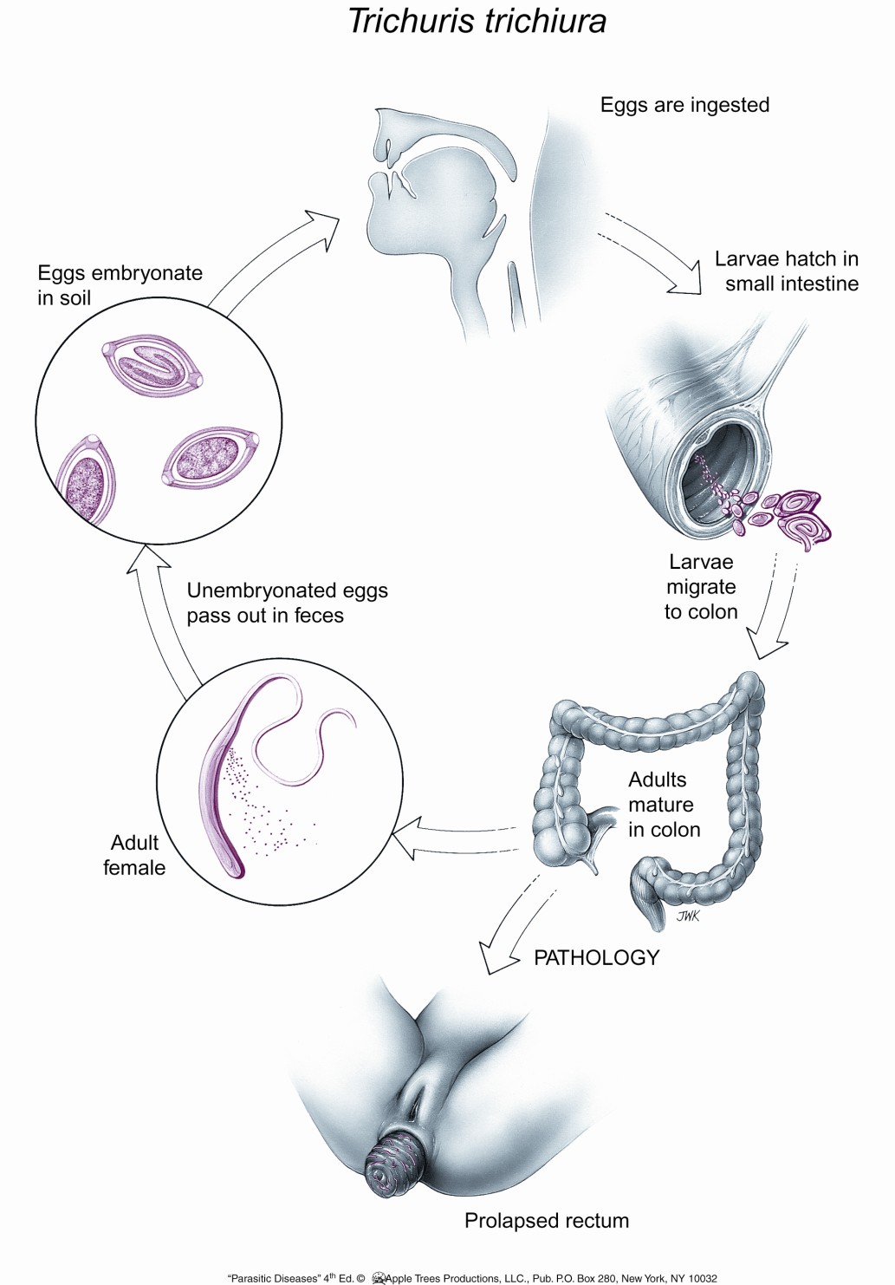
Life Cycle of Trichuris trichiura:
“Whipworm”
Adult worms:
Colon
Up to 4 cm long
Females lay 4-20K eggs/day

Slide 45
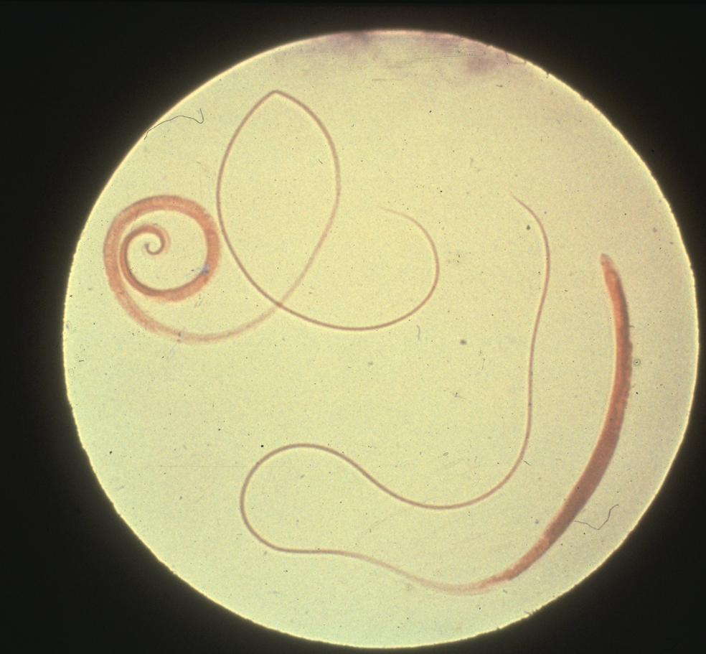
Adult Male/Female Trichuris Trichiura

Slide 46
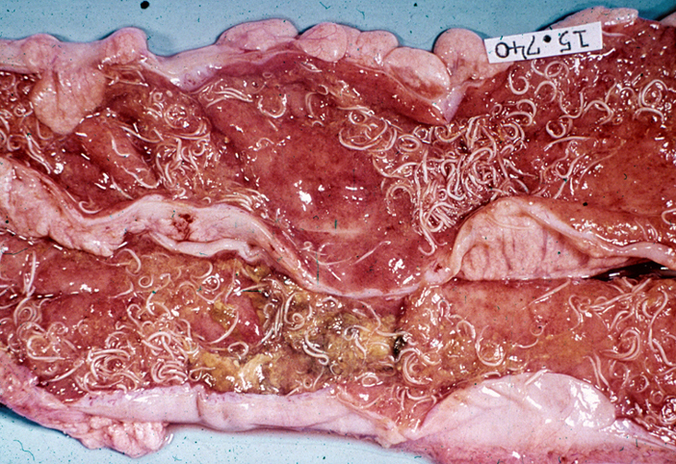
Trichuris trichiura
Courtesy of R. Pearson

Slide 47
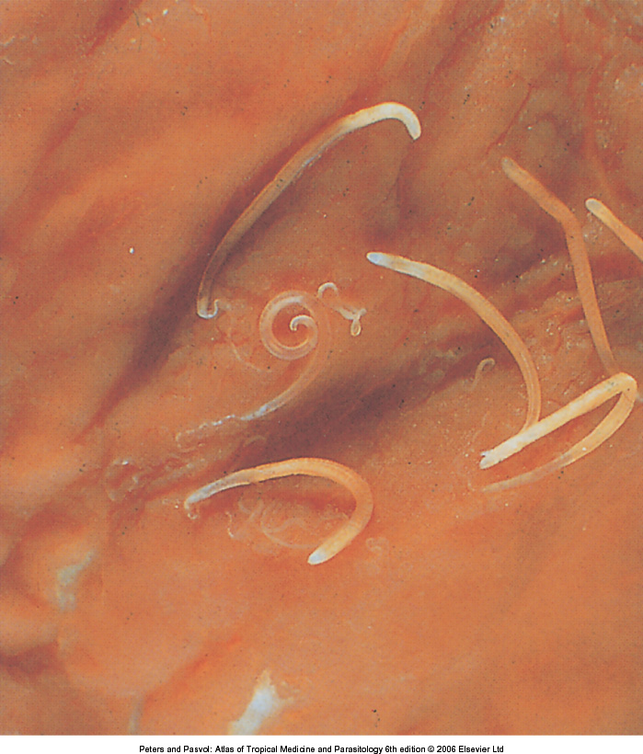
Whipworm: Trichuris trichiuria

Slide 48
Clinical Sequelae of Trichuriasis
Trichuris Dysentery Syndrome
Trichuris colitis
Rectal prolapse
Usually only seen with heavy infections
Light infections asymptomatic

Slide 49
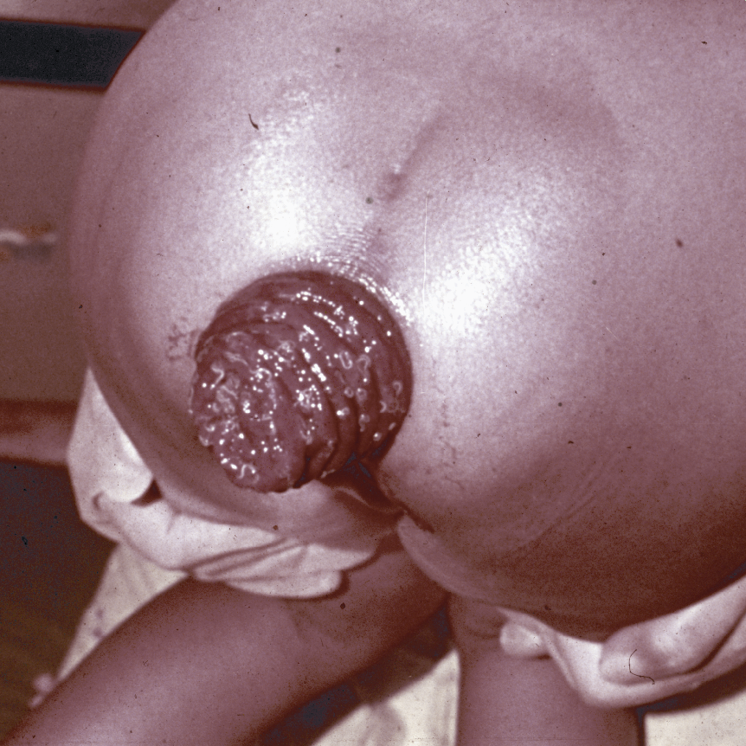
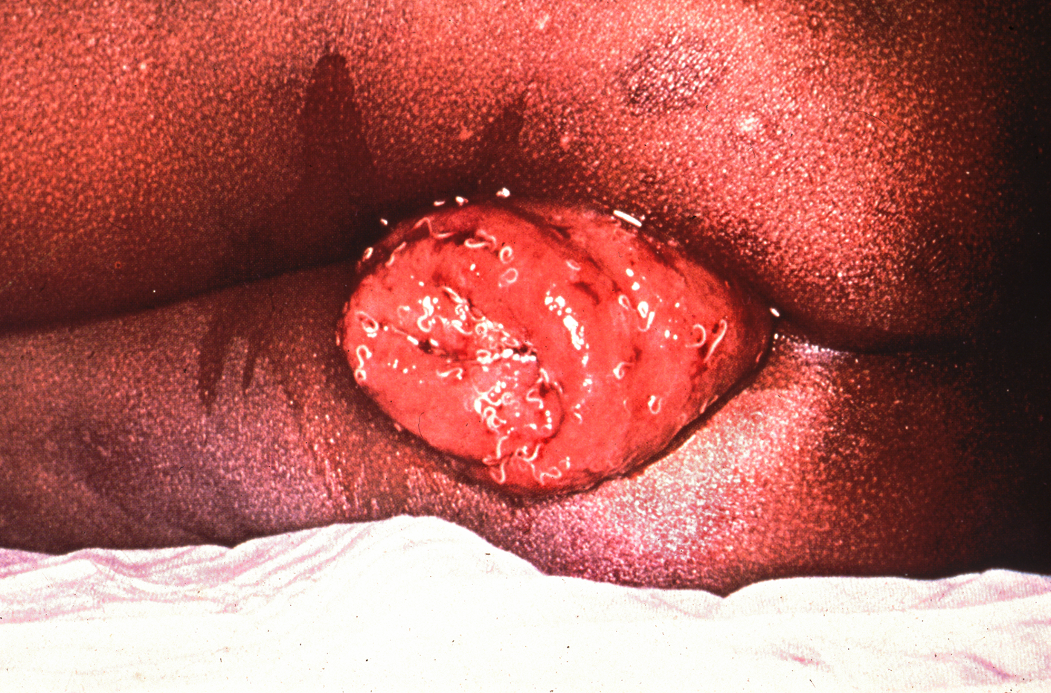
Rectal Prolapse from Trichuriasis

Slide 50
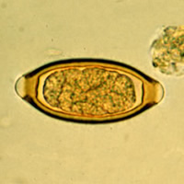
Trichuris trichiura
Diagnosis: eggs in feces
Treatment:
  Albendazole, mebendazole, ivermectin
    3 days for heavy infections

Slide 51
Case Presentation
4-year old girl in rural Brazil
Brought to clinic because of months of increasing listlessness and fatigue
On exam: conjunctival and palmar pallor
  Abdominal exam normal, no masses
  Cardiac exam normal
Portable hemoglobinometer: Hgb 6.4 g/dl
Tests?
Differential?

Slide 52
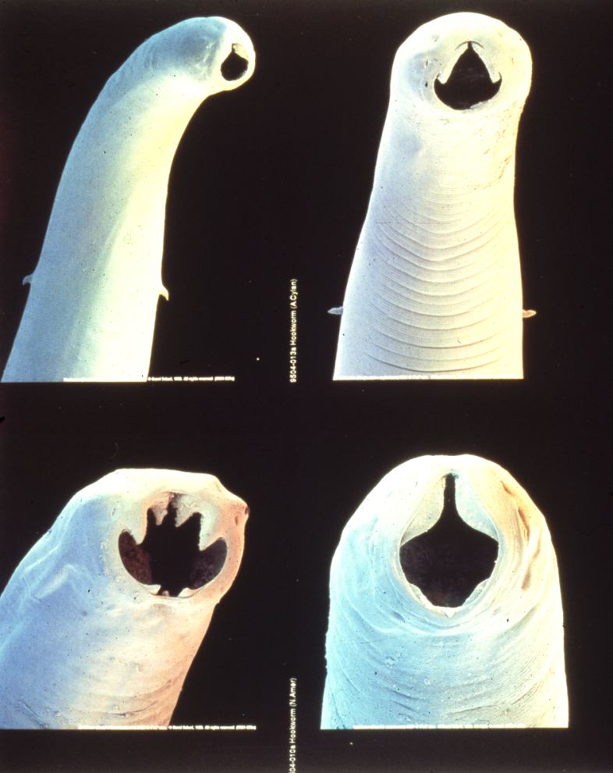
Hookworm
Intestinal nematode
Soil-transmitted helminth
2 human hookworms:
  Necator americanus
  Ancylostoma duodenale
Infection is chronic:
  A. duodenale: 1 year
  N. americanus: 3-5 years

Slide 53
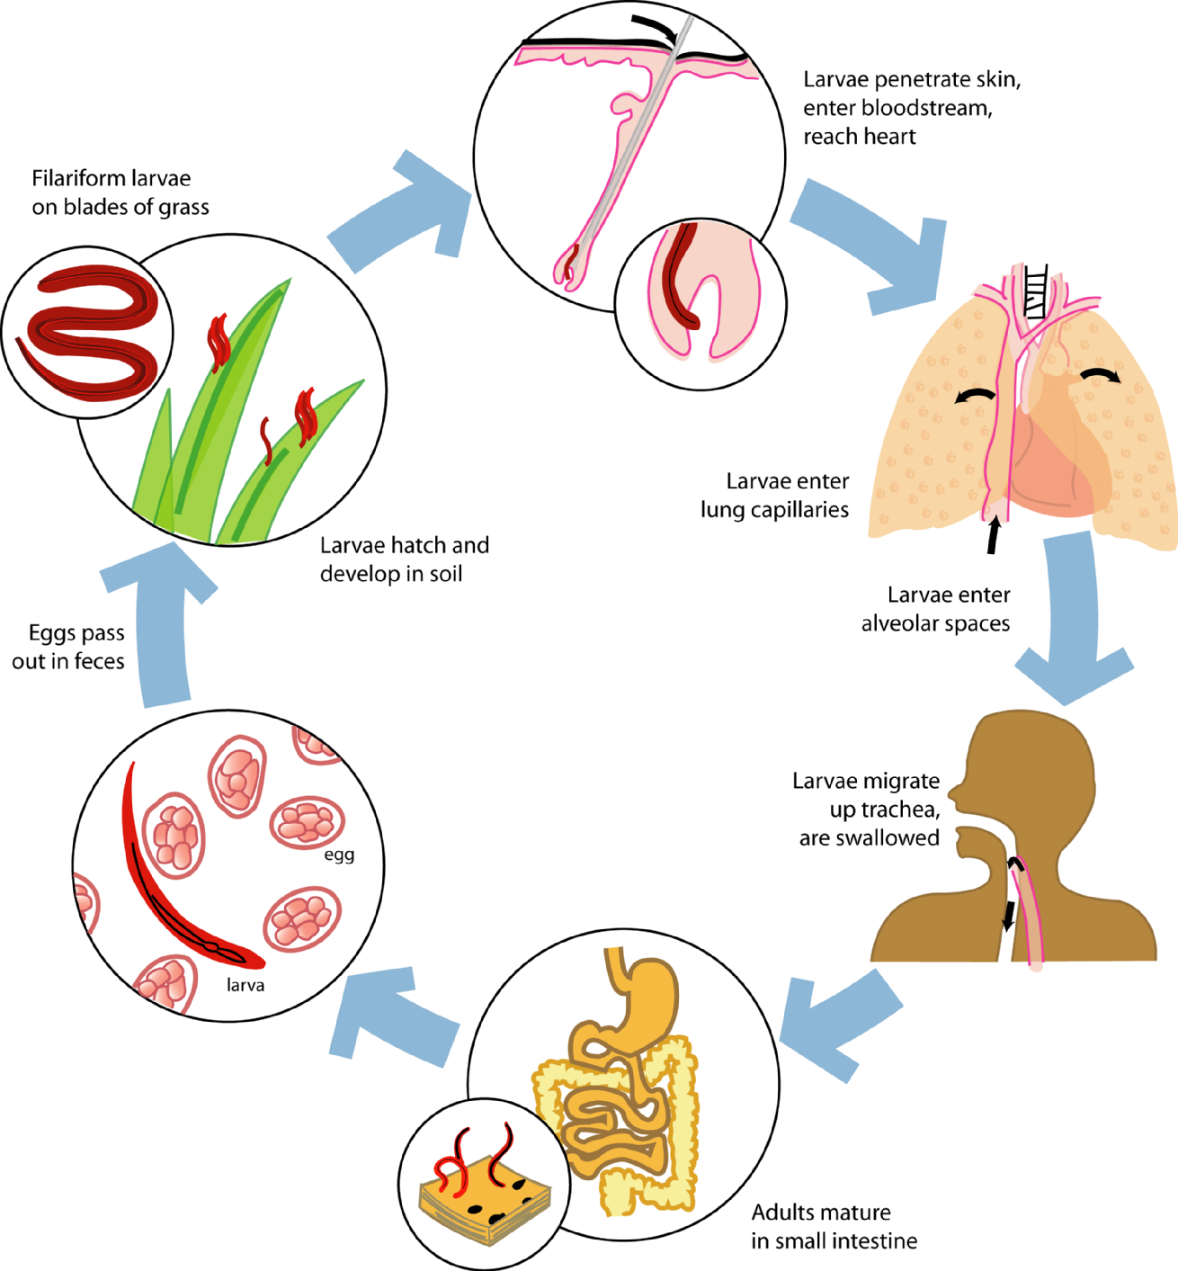
L3

Slide 54
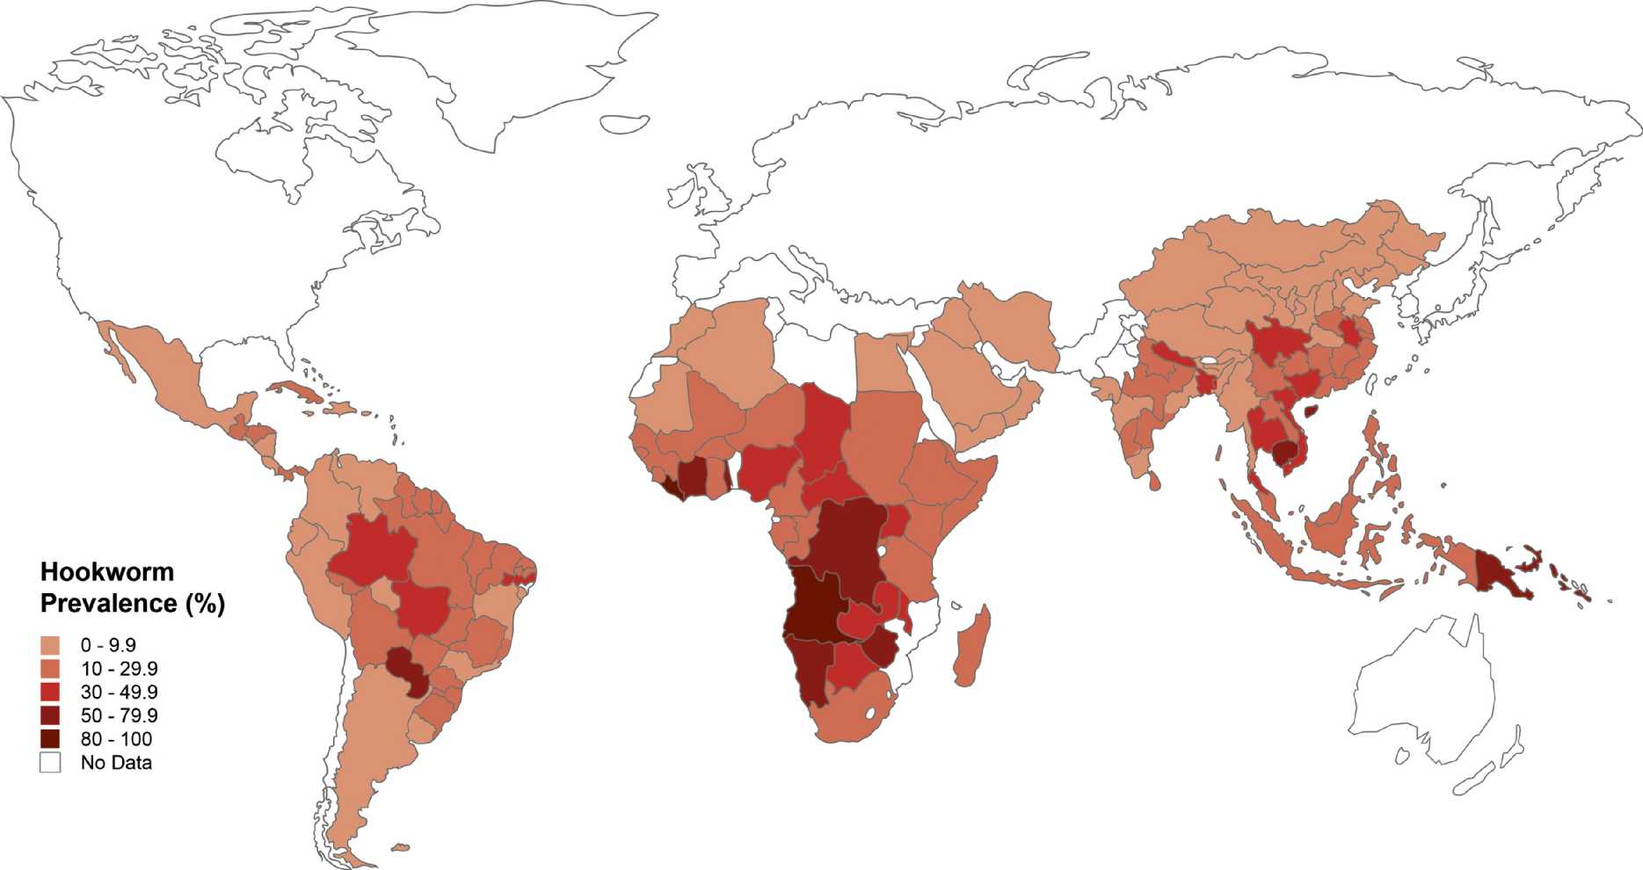
Hookworm Infection
>576 million cases (25% of the world’s poor)
22 million DALYs lost annually
Overlap between Rural Poverty and Adequate Climate
M. Shear, Public Library of Medicine

Slide 55
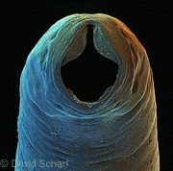


Hookworm Infection = Blood Loss
Adult worms injure their host by causing intestinal blood loss:
Intestinal blood loss: 25 Necator worms = 1 ml blood loss/day
= 0.55 mg Fe = pediatric daily iron requirement
Result: Iron Deficiency Anemia and protein malnutrition

Slide 56
Hookworm-related Blood Loss is Proportional to Worm Burden
From: Stoltzfus RJ et al. 1997. Hookworm control as a strategy to prevent iron deficiency. Nutr. Rev. 55: 223-32.

Slide 57
Impact of Treatment on Hemoglobin: Schoolchildren
Albendazole: mean 1.9-2.6 g/dl increase in hemoglobin
Source: Brooker & Smith

Slide 58


Pediatric Hookworm Disease
Iron deficiency anemia
Protein malnutrition
Growth stunting
Impaired intellectual development
Impairment in memory/cognition
Reduction in school attendance
Reduction in school performance
Impact on health, education
and economic development

Slide 59

Hookworm & IQ:
Jeca Tatú in Brazil

Slide 60

Effect of STHs on Cognitive Development
Americaninhas, Brazil
Jardim-Botelho et al, 2008 (Trop Med Int Health;13:994-1004)

Slide 61

Adult Hookworms in Situ (1 cm)
Notes:
430 Adult hookworms in situ The worms are about 1 cm long and characteristically curved. They are attached by their buccal capsules to the villi of the small intestine. (Natural size)

Slide 62

Hookworm
Diagnosis: fecal examination
  Can’t speciate based on eggs
Treatment: albendazole, mebendazole, pyrantel pamoate

Slide 63


Cutaneous Larva Migrans
“Creeping Eruption”
Ancylostoma caninum/braziliense
  Dog/cat hookworm
Caribbean
Florida
Gulf Coast
Travelers from tropical resorts
Military personnel
Diagnosis: clinical
Treatment: oral ivermectin or
albendazole

Slide 64


Slide 65
Schistosomiasis

Slide 66
Schistosomiasis
Blood fluke (trematode)
Africa, South America & Asia
Human disease caused by 3 main species:
  S. mansoni
  S. hematobium
  S. japonicum
  Less common: S. mekongi & S. intercalatum
Contact with contaminated fresh water

Slide 67


Slide 68

Schistosomiasis
www.stanford.edu

Slide 70
Schistosomiasis: Clinical Manifestations
“Swimmers’ itch” with cercarial penetration
  12-24 hours post-infection
  Intensely pruritic, urticarial or papulovesicular eruption
  Lasts for a few days
Katayama fever: 4-8 weeks post-infection
  Coincides with start of egg deposition by adult worms
  Can be severe
  Eosinophilia universal & proportional to severity
  Rx = praziquantel +/- steroids

Slide 71
Schistosomiasis: Clinical Manifestations
Chronic disease: after years of infection
  High worm burdens with egg deposition over many years
  Disease due to granuloma formation in intestinal wall, liver or bladder/genital tract (females)
    S. mansoni/japonicum: periportal fibrosis, portal hypertension, abdominal pain, GI blood loss
    S. haematobium: eggs deposit in wall of bladder
      Fibrosis – obstructive uropathy
      Hematuria, dysuria
      Associated with bladder carcinoma
      Females: genital tract involvement → inc. HIV risk
Rare: CNS schistosomiasis

Slide 72



www.stanford.edu

Slide 73

Durães & Araujo 2009 Tortuous varicosities in chronic schistosomiasis N Eng J Med 361:e9

Slide 74



NTDs and Girls & Women
Female Genitourinary Schistosomiasis
100 million girls & women
Africa’s most common
gynecologic condition?
Notes:
xxx00.#####.ppt 10/11/15 10:19 PM
P.74
Text
Text
Text
Text
Hotez - UTSPH Middle East

Slide 75
Schistosoma haematobium in the genital tract
Pathophysiology:
  Granulomas, mucosal erosions and ulcerations, bleeding
Diagnosis:
  Ova in cervical smear/biopsy
Physical Effects:
  Infertility, post-coital bleeding, pelvic pain
  Depression
Increased risk of HIV acquisition
Poggensee and Feldmeier, Acta Tropica 2001; 79(3): 193-210.
Photo: Kjetland EF et al., Trends Parasitol 2012; 28(2): 58-65.

Slide 76

Schistosomiasis: Diagnosis
CBC: eosinophilia
Urine/stool exam for eggs
Urinalysis (S. haematobium)
Rectal/bladder biopsies
Serology:
  ELISA screen followed by immunoblot

Slide 77


Slide 78

Schistosomiasis: Treatment
Praziquantel: single or divided dose, 60 mg/kg
Oxamniquine in South America
  Only S. mansoni

Slide 79

World Health Assembly Resolution 54.19
Aim: reduce mortality and morbidity and improving health and development in infected communities
Regular treatment of high-risk groups:
  Particularly school-aged children
  Single-dose drugs against schistosomiasis and STH infections
  Improved basic sanitation and safe water supplies
Goal: regular administration of chemotherapy to at least 75% and up to 100% of all school-age children at risk of morbidity by 2010 (extended to 2020)
Benzimidazoles
Mebendazole
Albendazole

Slide 80
MDA Coverage – STHs
WHO WER, March 2015

Slide 81
MDA Coverage – STHs
WHO WER, March 2015

Slide 82
Re-Infection Following Anthelmintic Treatment
Côte d’Ivoire
Village A
Zanzibar, Tanzania
Village B
Hookworm Intensity
20 40 60 80 100 120
20 40 60 80 100 120
140 160 180
140 160 180
Days Since Treatment
Days Since Treatment
N’Goran et al, TMIH 2001
Albonico et al, Trans R Soc Trop Med Hyg, 1995

Slide 83

Drug Failure: Mebendazole for Hookworm

Slide 84






Human Hookworm Vaccine Initiative
An Orphan Product for a Neglected Tropical Disease
HHVI
Human Hookworm Vaccine Initiative
Institute of Parasitic Diseases, Chinese Centers for Disease Control and Prevention

Slide 85


Americaninhas, Brazil

Slide 86
Human Filariases
Lymphatic filariasis (LF)
Onchocerciasis (“River Blindness”)
Loiasis (African eye worm disease)
Dracunculiasis (Guinea worm infection)

Slide 87
Lymphatic Filariasis
120 million cases
6 million DALYs
>$2 billion in lost productivity
1 billion at risk in 83 countries
Hopkins, NEJM 2013

Slide 88

Lymphatic Filariasis (LF)
Causative agents of LF:
Wuchereria bancrofti
Brugia malayi; Brugia timori
Mosquito-transmitted
120 million people infected, 90% with W. bancrofti
  43 million with swelling of limbs or breasts (lymphoedema) and genitals (hydrocoele) and the more chronic state – elephantiasis – skin enormously thickened, rough, hard and fissured
Children acquire disease early, blighted for life

Slide 89



Slide 90
Lymphatic filariasis – Pathology
Asymptomatic to irreversible lymphedema
Often asymptomatic microfilaremia
Acute lymphangitis and lymphadenitis:
  Especially in young
Tropical Pulmonary Eosinophilia
  Young men
Chronic lymphatic dysfunction
  Lymphedema and elephantiasis –lower extremities, breast, genitalia, other locations
Hydrocoele and scrotal elephantiasis

Slide 91


Late Stage Elephantiasis

Slide 92


“It’s quite a problem for me when I have to stand at work for long periods.”

Slide 93

“People make fun of me. “

Slide 94

Lymphatic filariasis: Diagnosis
Clinical suspicion: endemic region, > 10 yrs old, with lymphedema of the extremities/genitalia
Microfilariae on thick blood smear
  Blood collection at night – W. bancrofti and B. malayi release mf at night
Antigen detection in blood – rapid test (ICT TEST)
  W. bancrofti only
Serology: cross-reactivity with other helminths
Ultrasound imaging of lymph nodes
  Adult worm “nests” – Filaria Dance Sign (FDS)

Slide 95

Microfilaria – Wuchereria bancrofti
anterior
posterior

Slide 96
LF: Treatment
In returned traveler/immigrant: prolonged & repeated treatment
  Attempt to kill adult worm(s)

Slide 97
LF: Management in Endemic Countries
Interrupt transmission
  Mass treatment of “at risk” population:
    Single-dose, once-yearly 2-drug regimen for 4-6 yrs
    DEC-fortified salt for 1 year
  Vector control
  Insecticide-treated bednets
Control morbidity (relief of suffering)
  Community-level care of those with disease
    Lymphedema: prevent 2º bacterial infection
    Acute inflammatory attacks
    Hydrocoele repair

Slide 98
Case Presentation
4-year old boy in Bihar, India
Presents with 2 months of:
  Listlessness
  Fever
  Abdominal distention
  Yellow eyes
  Bruising

Slide 99
Exam: scleral icterus, listless
  Skin: jaundice, purpura
  Abdo: hepatosplenomegaly
Labs:
  Hgb: 8.1 g/dl
  Platelets: 75 x 10⁶/mm³
  WBC: 2.9 x 10³/mm³
  ALT: 122 IU/L
  Creatinine: 1.0 mg/dl
Differential diagnosis?
Other tests?

Slide 100
Leishmaniasis
Visceral leishmaniasis (VL)
  Kala-azar
  Major cause of morbidity & mortality
  Opportunistic infection in HIV/AIDS
Cutaneous leishmaniasis (CL)
Mucocutaneous leishmaniasis

Slide 101

Sandfly Vector of Leishmania spp.

Slide 102
Visceral Leishmaniasis: Kala Azar
L. donovani (Asia-Africa), L. infantum (southern Europe), L. chagasi (Brazil)
~500,000 new cases/year:
  90% in India and Sudan
Opportunistic infection in AIDS patients

Slide 103

Global Distribution of VL
Desjeux, Nat Rev Micro, 2004

Slide 104


Slide 105
Clinical Features of Kala-Azar (“Black Fever”)
Majority of infections self-resolving
Full-blown Kala-azar
  Fever
  Weight Loss
  Hepatosplenomegaly
  Neutropenia
  Hypergammaglobulinemia
  Hyperpigmentation (“Black Fever”)
Children <5 years are the most susceptible age groups

Slide 106

Child with Visceral Leishmaniasis

Slide 107


Diagnosis of Kala-Azar
PCR of blood or biopsy material
  Lymph node, bone marrow, spleen aspirate
Microscopic visualization of amastigotes
  Bone marrow, spleen aspirate
Serology (anti-rK39 Ab: sensitive and specific)

Slide 108


Canine Reservoir and Leishmaniasis

Slide 109
Treatment of VL
Pentavalent Antimony (SbV): 28 days
  Many side effects:
    Nausea, vomiting, abdominal pain, chemical pancreatitis, ECG changes
  Increasing resistance (esp. India)
Liposomal amphotericin B: 1st line in US
  3 mg/kg days 1-5, 14 & 21
Oral miltefosine x 28 days
  Approved by FDA (March 2014)

Slide 110

Cutaneous Leishmaniasis:
Baghdad boil, Delhi boil, Chiclero’s ulcer, Uta

Slide 111
Cutaneous Leishmaniasis
New World CL
  L. mexicana
  L. amazonensis
  L. braziliensis
Old World CL
  L. major (Iran, Middle East, Subsaharan W. Africa)
  L. tropica (Middle East, India, Pakistan, Central Asia)

Slide 112

Cutaneous Manifestations of CL
Ulcer develops at site where parasites are inoculated
Diagnosis: biopsy (serology not useful)
  Pathology & PCR

Slide 113
Mucocutaneous Leishmaniasis
L. braziliensis (Central/South America)
Destructive mucosal lesions can develop at same time as cutaneous lesion:
  More commonly, mucosal lesions develop months to years after cutaneous lesion has resolved
  Nose, oropharynx most commonly involved
  Treatment of cutaneous lesion may not prevent future mucosal lesion

Slide 114
Mucocutaneous Leishmaniasis

Slide 115
Treatment of CL
Mild disease:
  Topical paromomycin
  Heat therapy
  Intralesional antimony x 8-10 weeks
Moderate disease:
  Pentavalent antimony
    Sodium stibogluconate (Pentostam)
    Meglumin antimonate (Glucantime)
    20 mg/kg/d for 20 d
  Fluconazole/ketoconazole x 4-6 weeks
  Oral miltefosine

Slide 116
Integrated Control of NTDs

Slide 117

Proven Treatment Strategies
Lymphatic filariasis - Zanzibar
Trachoma - Morocco
Guinea Worm - Global
Schistosomiasis - Egypt

Slide 118
The Solution: The “Rapid Impact Package”
BIG SEVEN NTDs
Ascariasis
Trichuriasis
Hookworm
Lymphatic Filariasis
Onchocerciasis
Schistosomiasis
Trachoma
The Rapid
Impact
Package
  Albendazole (GSK) or Mebendazole (J&J)
  Diethylcarbamazine or Ivermectin (Merck)
  Praziquantel
  Azithromycin (Pfizer)
Bonuses:
Strongyloidiasis
Trematodiases
Taeniasis
Scabies
Notes:
118

Slide 119
NTD INTEGRATED CONTROL
SEVEN NTDS: Ascariasis, Trichuriasis, Hookworm,
Schistosomiasis, LF, Onchocerciasis, and Trachoma
FOUR Donated DRUGS: Albendazole, Ivermectin,
Azithromycin & Praziquantel

Slide 120
Low Cost of Interventions
~$0.40 for combined drug intervention
Source: Global Network for NTD Control
Notes:
$0.03 to $0.50 for each individual disease intervention…

Slide 121








Partners of
The Global Network for NTDs

Slide 122
London Declaration on NTDs – 2012
Governments, industry, NGOs, foundations
Targets 10 NTDs for control, elimination or eradication by 2020
Drug donations major component

Slide 124
Resources
Gorgas Course: http://gorgas.dom.uab.edu/
Tropical Medicine Central Resource: http://tmcr.usuhs.mil/tmcr/toc.htm
  Imaging of Tropical Diseases
CDC Parasite Diagnosis Aid:
  http://www.dpd.cdc.gov/dpdx/

